Slide 1
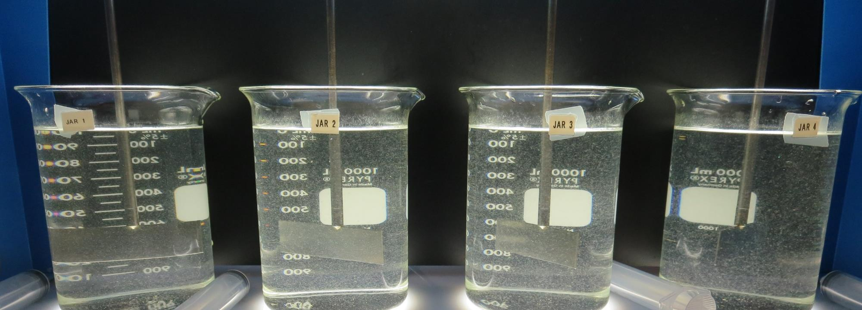
Kids Camp
Lake County
Inline Filtration
Jar Test
by Guy Schott, P.E.
February 19, 2020

Slide 2
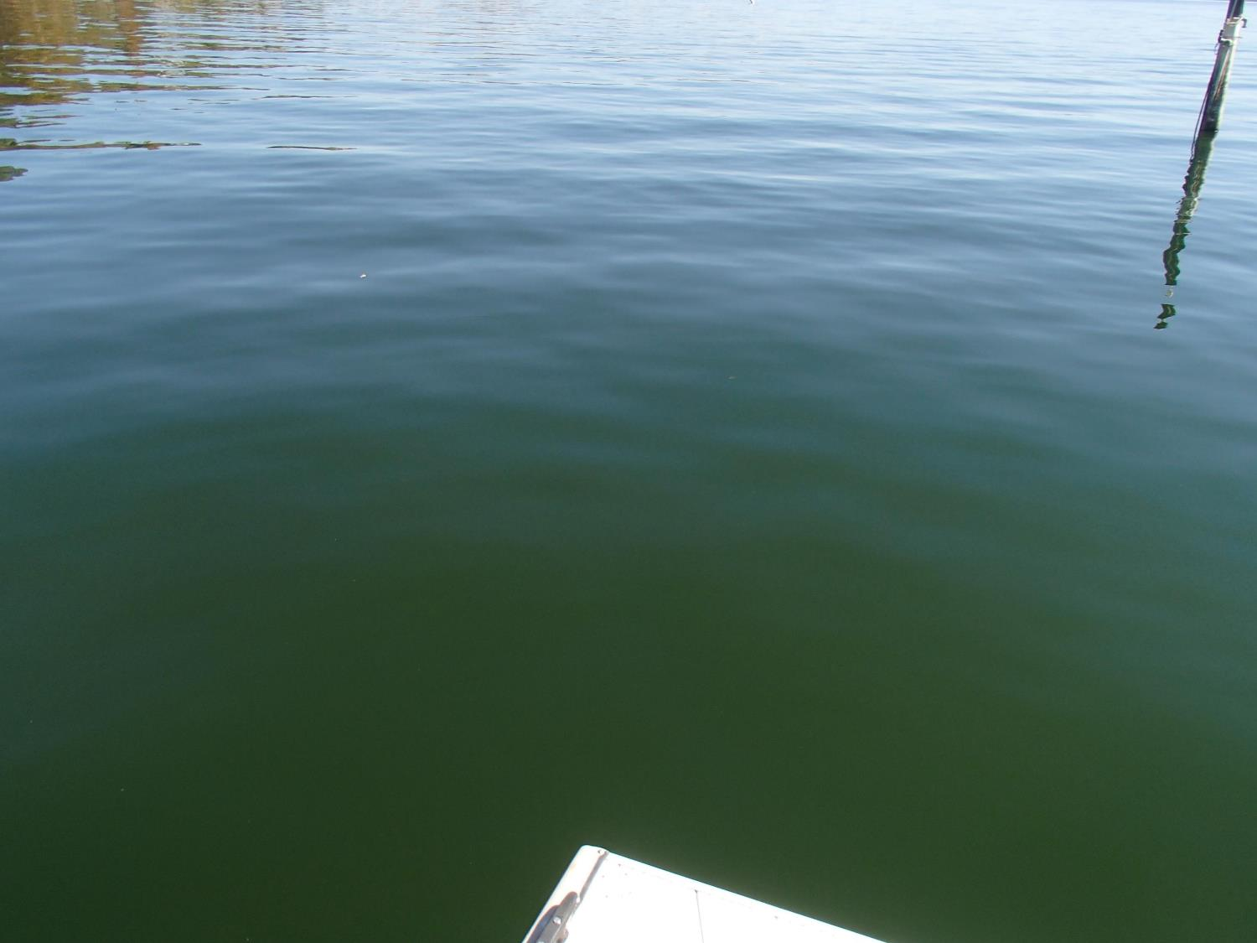
Source: Clear Lake
February 19, 2020
Source
Turbidity: 5.7 NTU
pH: 8.03
UVT: 82.3%, UVA: 0.084/cm
0.4 um Filtered
Turbidity: 0.20 NTU
UVT: 87.4%, UVA: 0.058/cm

Slide 3
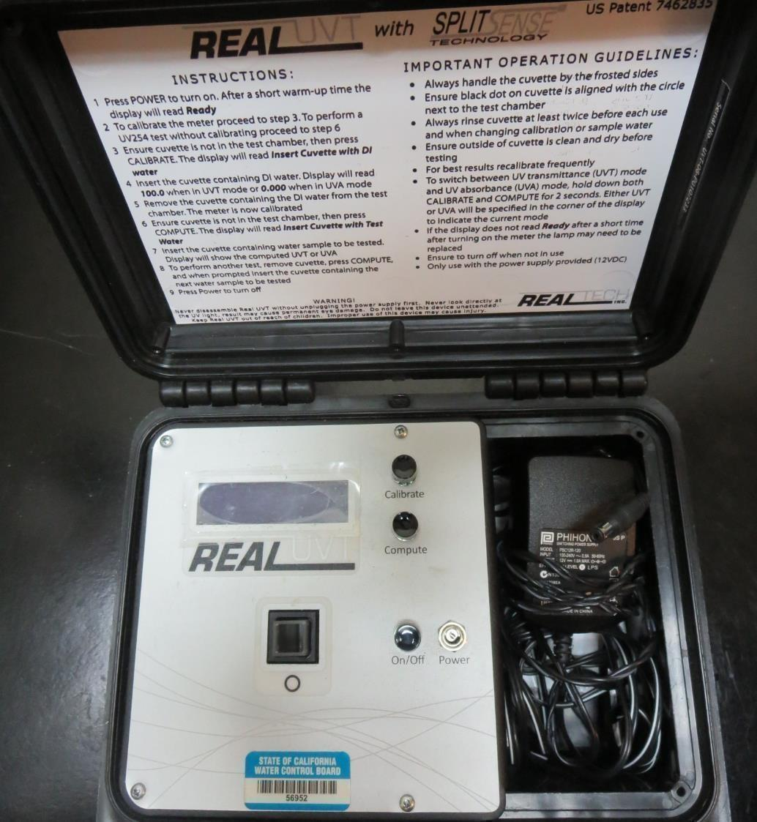
UVT/UVA
UV transmittance (UVT) is a measurement of the amount of ultraviolet light (commonly at 254 nm due to its germicidal effect) that passes through a water sample compared to the amount of light that passes through a pure water sample. The measurement is expressed as a percentage, % UVT.
%UVT = 10^{(-UVA)} x 100%
UV absorbance (UVA) is calculated as a relative measure of the amount of light absorbed by a water sample compared with the amount of light absorbed by a pure water sample.
UVA = -log(%UVT/100)

Slide 4
Coagulant Used for Jar Testing
Pro Pac 9810 (NTU Technologies)
45-50% Aluminum Chlorohydrate (ACH)
35-45% Water
5% Proprietary
SG = 1.25 – 1.34
Pro Pac 9890 (NTU Technologies)
35-45% Aluminum Chlorohydrate (ACH)
35-45% Water
20% Proprietary
SG = 1.25 – 1.34

Slide 5
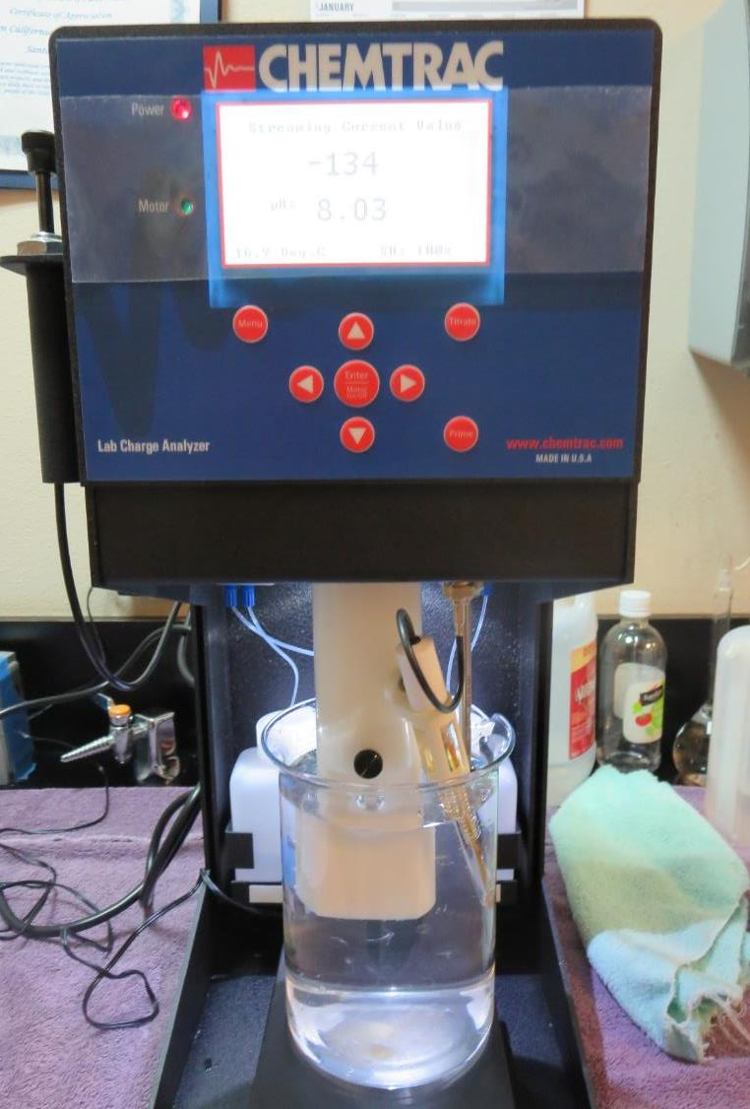
Laboratory Charge Analyzer
LCA: Used to determine coagulant demand of a source water entering the treatment plant.
Source pH: 8.03
LCA #1:
9810: 14.5 mg/L as product
pH adjusted to 7.5 with Acetic Acid
LCA #2:
7066: 120 mg/L as product
pH adjusted to 7.5 with Acetic Acid

Slide 6
Coagulant Information
Unless stated otherwise, all coagulant doses are reported as Product (100% strength).
Preparation of coagulant stock solutions are generally 1.0 or 0.1 percent strength using 100 and/or 200 mL volumetric flasks.
Finnpipette F2 variable volume pipette, capacity 100-1000 micro liters is used for stock solution preparation and coagulant aid jar test dosing.
Finnpipette F2 variable volume pipette, capacity 0.5-5 mL is used for primary coagulant jar test dosing.

Slide 7
Kids Camp– Clear Lake, Inline Filtration
Jar Test 1-4 Results
Jar | 200 RPM Flash Mix Seconds | 10 RPM Floc Mix Seconds | 9810 mg/L | Filtrate NTU | Filtrate %UVT | Filtrate UVA/cm
J1 | 30 | 120 | 14 | 0.09 | 90.4 | 0.043
J2 | 30 | 120 | 16 | 0.10 | 90.3 | 0.044
J3 | 30 | 120 | 18 | 0.08 | 90.5 | 0.043
J4 | 30 | 120 | 20 | 0.08 | 90.5 | 0.043

Slide 8
Kids Camp– Clear Lake, Inline Filtration
Jar Test 5-12 Results
Jar | 200 RPM Flash Mix Seconds | 10 RPM Floc Mix Seconds | 9810 mg/L | Filtrate NTU | Filtrate %UVT | Filtrate UVA/cm
J5 | 30 | 120 | 10.0 | 0.10 | 89.8 | 0.046
J6 | 30 | 120 | 11.5 | 0.17 | 89.7 | 0.046
J7 | 30 | 120 | 13.0 | 0.11 | 90.1 | 0.045
J8 | 30 | 120 | 14.5 | 0.07 | 90.5 | 0.043
J9 | 0 | 120 | 14.5 | 0.08 | 90.1 | 0.045
J10 | 10 | 120 | 14.5 | 0.09 | 90.2 | 0.044
J11 | 30 | 120 | 14.5 | 0.12 | 90.2 | 0.044
J12 | 30 | 120 | 14.5 | 0.09 | 90.3 | 0.044

Slide 9
Kids Camp– Clear Lake, Inline Filtration
Jar Test 13-20 Results
Jar | 200 RPM Flash Mix Seconds | 10 RPM Floc Mix Seconds | 9890 mg/L | Filtrate NTU | Filtrate %UVT | Filtrate UVA/cm
J13 | 30 | 120 | 11 | 0.09 | 90.7 | 0.042
J14 | 30 | 120 | 12 | 0.09 | 90.6 | 0.042
J15 | 30 | 120 | 13 | 0.13 | 90.7 | 0.042
J16 | 30 | 120 | 14 | 0.08 | 90.8 | 0.041
J17 | 0 | 120 | 11 | 0.11 | 90.7 | 0.042
J18 | 10 | 120 | 11 | 0.08 | 90.5 | 0.043
J19 | 30 | 120 | 11 | 0.11 | 90.4 | 0.043
J20 | 30 | 120 | 11 | 0.12 | 90.4 | 0.043

Slide 10
Jars 1-4 Test
Flash Mix 30 Sec (200 RPM)
Floc Mix 2 min (10 RPM)
Applied Coagulant
9810

Slide 11
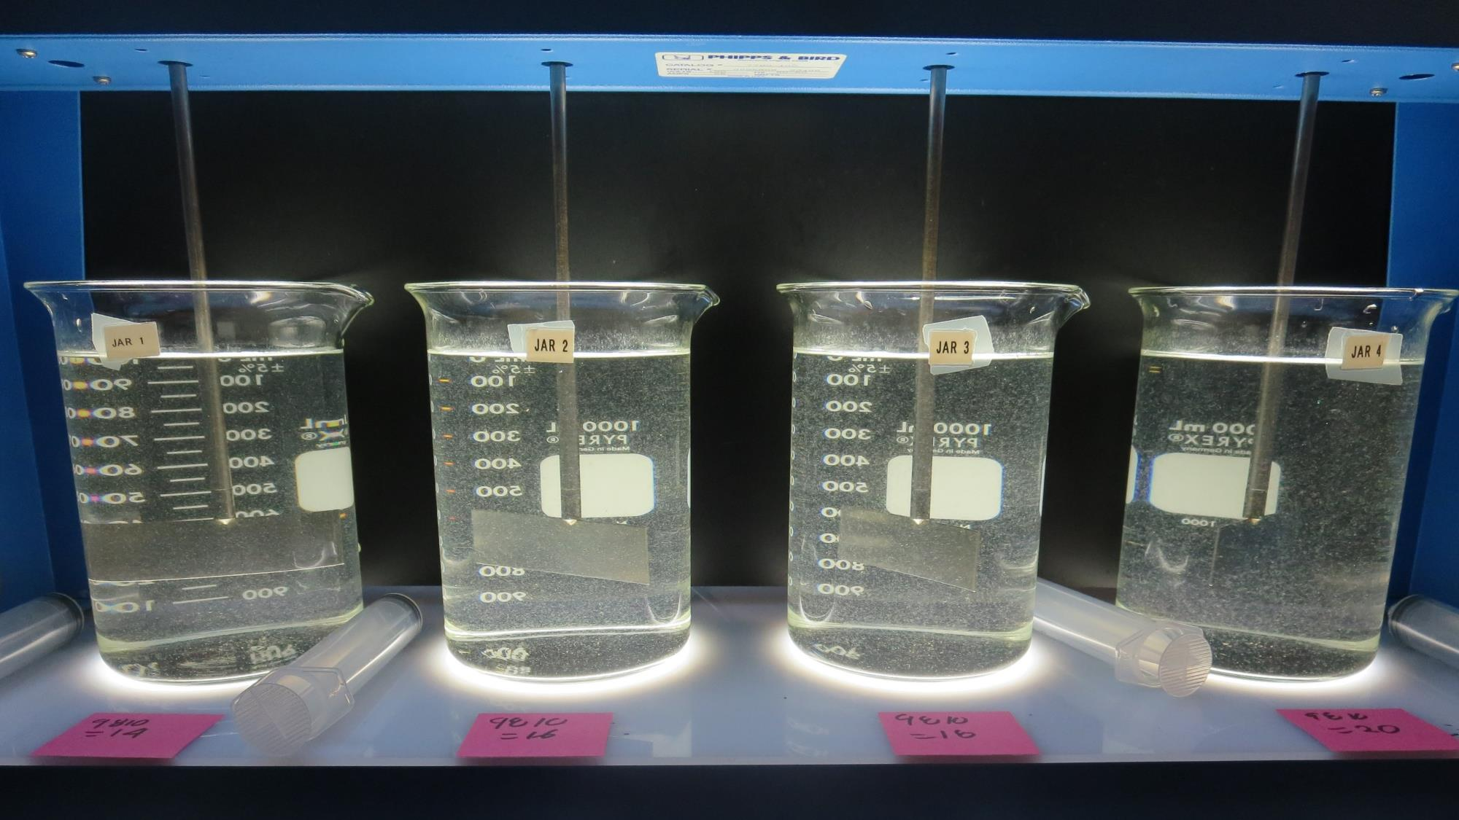
Jars 1-4: End of 2-minute flocculation (10 RPM) duration. 25 mL is syringed for filterability and %UVT/UVA Analysis.
14 mg/L 9810
Filtrate 0.09 NTU
UVT: 90.4%
UVA: 0.043/cm
16 mg/L 9810
Filtrate 0.10 NTU
UVT: 90.3%
UVA: 0.044/cm
18 mg/L 9810
Filtrate 0.08 NTU
UVT: 90.5%
UVA: 0.043/cm
20 mg/L 9810
Filtrate 0.08 NTU
UVT: 90.5%
UVA: 0.043/cm

Slide 12
Jars 5-8 Test
Flash Mix 30 Sec (200 RPM)
Floc Mix 2 min (10 RPM)
Applied Coagulant
9810

Slide 13
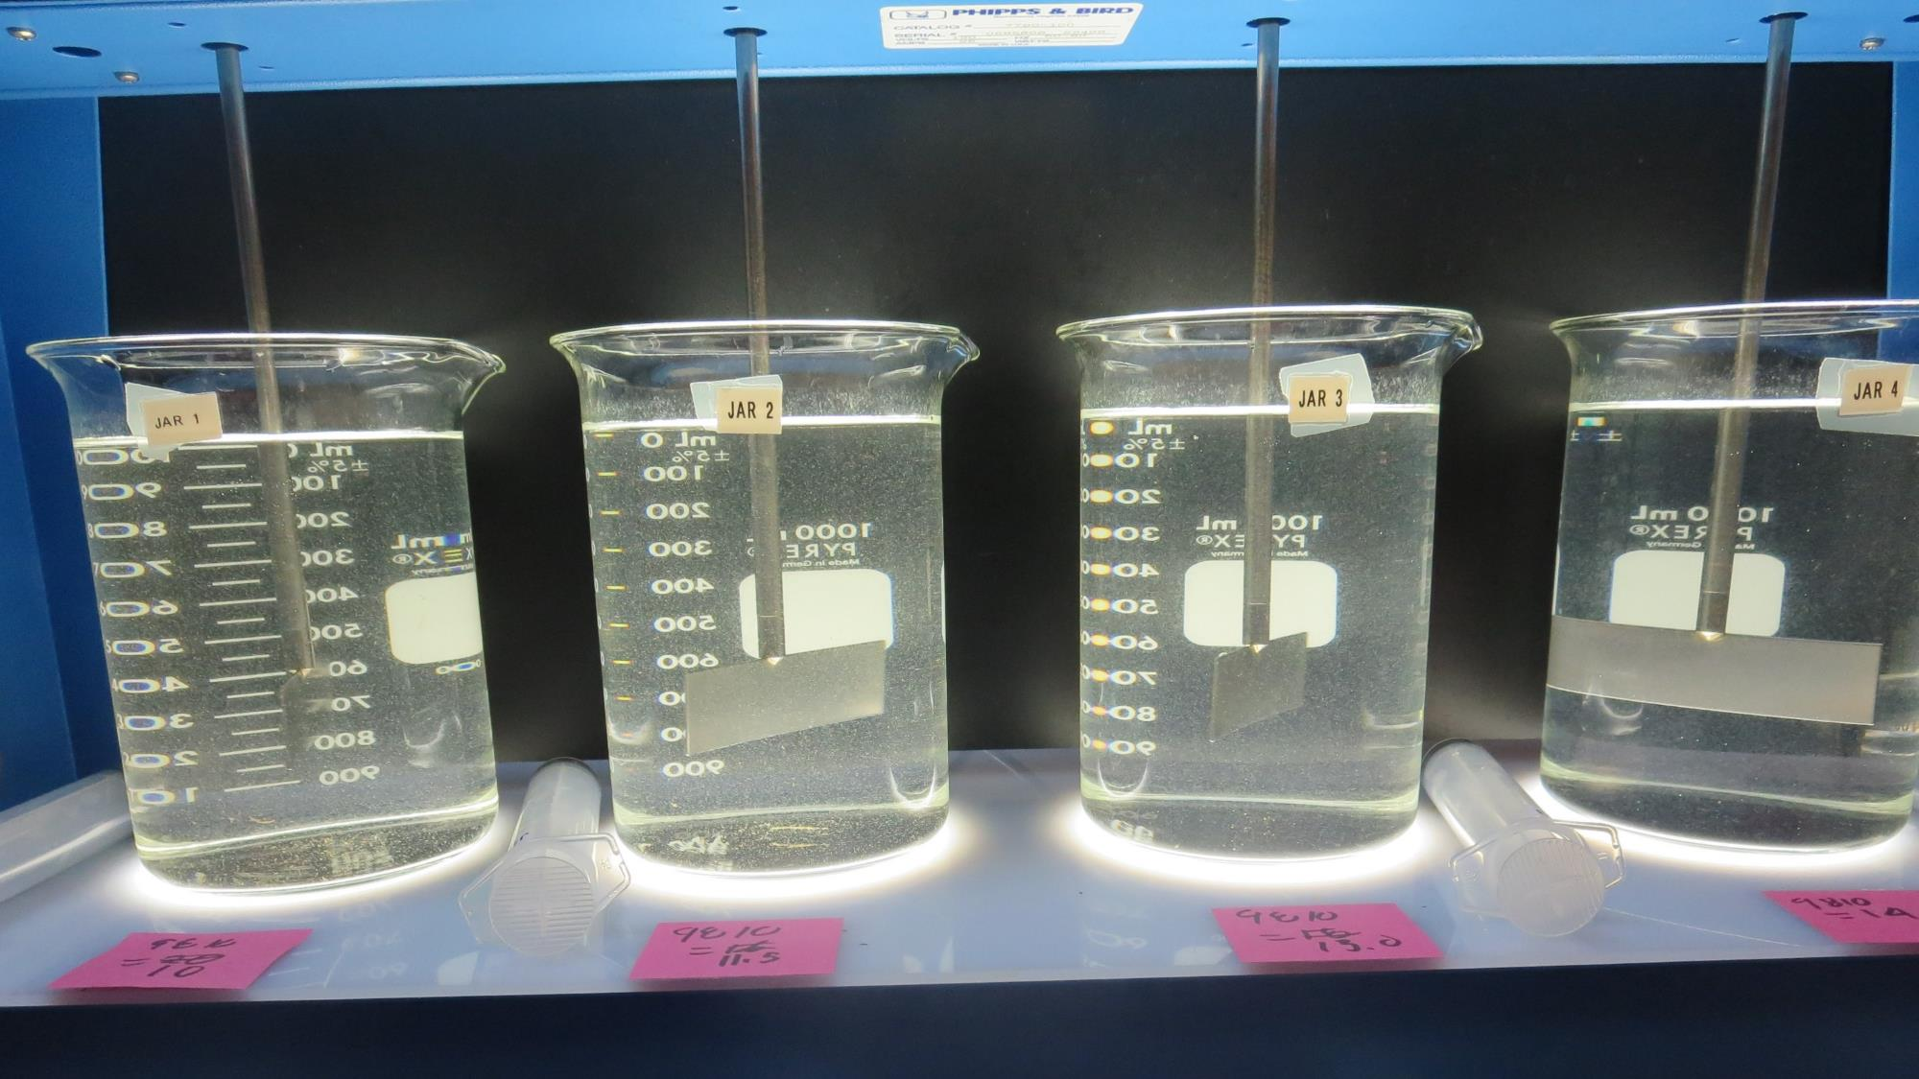
Jars 5-8: End of 2-minute flocculation (10 RPM) duration. 25 mL is syringed for filterability and %UVT/UVA Analysis.
10 mg/L 9810
Filtrate 0.10 NTU
UVT: 89.7%
UVA: 0.046/cm
11.5 mg/L 9810
Filtrate 0.17 NTU
UVT: 89.7%
UVA: 0.046/cm
13 mg/L 9810
Filtrate 0.11 NTU
UVT: 90.1%
UVA: 0.045/cm
14.5 mg/L 9810
Filtrate 0.07 NTU
UVT: 90.5%
UVA: 0.043/cm

Slide 14
Jars 9-12 Test
Flash Mix 0-30 Sec (200 RPM)
Floc Mix 2 min (10 RPM)
Applied Coagulant
9810

Slide 15
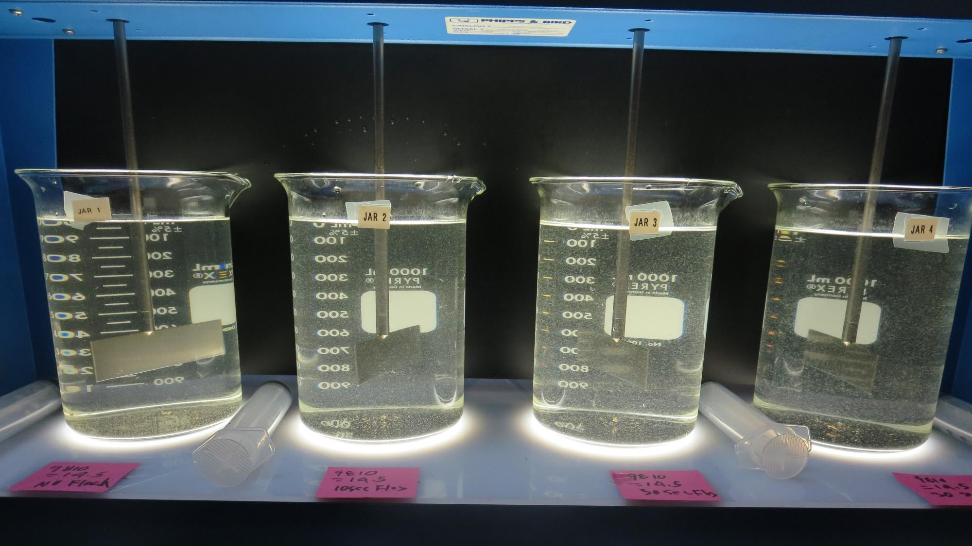
Jars 9-12: End of 2-minute flocculation (10 RPM) duration. 25 mL is syringed for filterability and %UVT/UVA Analysis.
14.5 mg/L 9810
Filtrate 0.08 NTU
UVT: 90.1%
UVA: 0.045/cm
No Flash Mix
14.5 mg/L 9810
Filtrate 0.09 NTU
UVT: 90.2%
UVA: 0.044/cm
10 Sec Flash Mix
14.5 mg/L 9810
Filtrate 0.12 NTU
UVT: 90.2%
UVA: 0.044/cm
30 Sec Flash Mix
14.5 mg/L 9810
Filtrate 0.09 NTU
UVT: 90.3%
UVA: 0.044/cm
30 Sec Flash Mix

Slide 16
Jars 13-16 Test
Flash Mix 30 Sec (200 RPM)
Floc Mix 2 min (10 RPM)
Applied Coagulant
9890

Slide 17
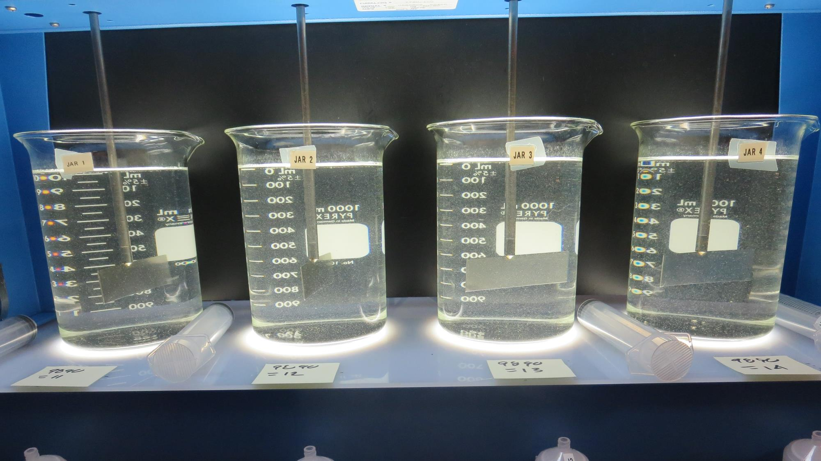
Jars 13-16: End of 2-minute flocculation (10 RPM) duration. 25 mL is syringed for filterability and %UVT/UVA Analysis.
11 mg/L 9890
Filtrate 0.09 NTU
UVT: 90.7%
UVA: 0.042/cm
12 mg/L 9890
Filtrate 0.09 NTU
UVT: 90.6%
UVA: 0.042/cm
13 mg/L 9890
Filtrate 0.13 NTU
UVT: 90.7%
UVA: 0.042/cm
14 mg/L 9890
Filtrate 0.08 NTU
UVT: 90.8%
UVA: 0.041/cm

Slide 18
Jars 17-20 Test
Flash Mix 0-30 Sec (200 RPM)
Floc Mix 2 min (10 RPM)
Applied Coagulant
9890

Slide 19
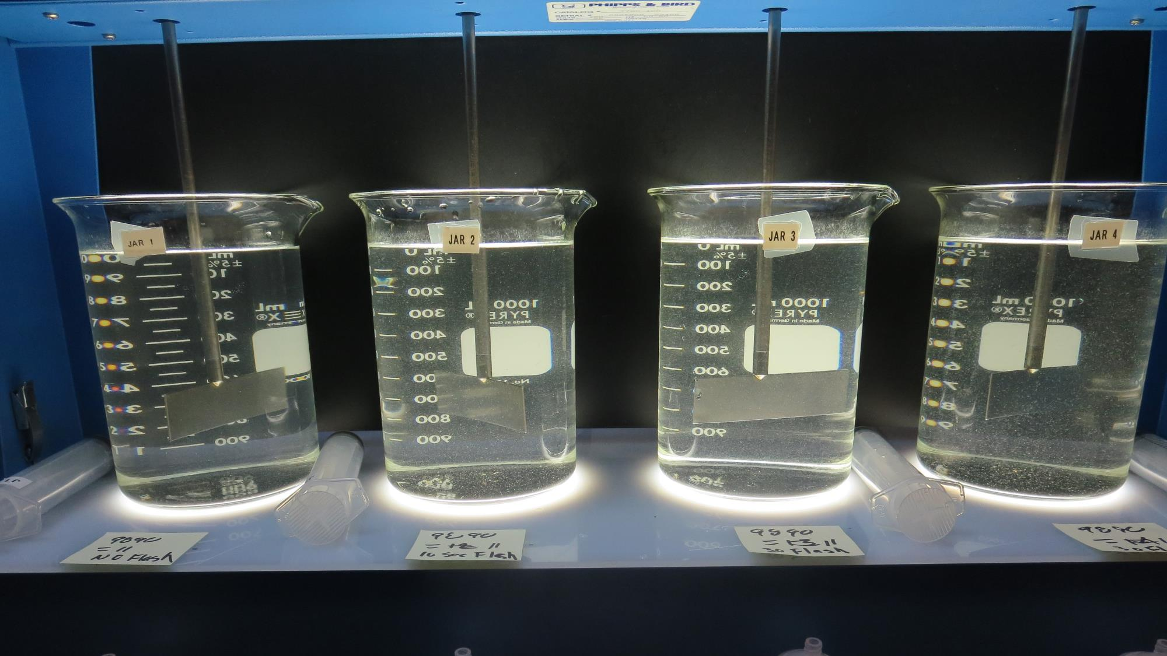
Jars 17-20: End of 2-minute flocculation (10 RPM) duration. 25 mL is syringed for filterability and %UVT/UVA Analysis.
11 mg/L 9890
Filtrate 0.11NTU
UVT: 90.7%
UVA: 0.042/cm
No Flash Mix
11 mg/L 9890
Filtrate 0.08 NTU
UVT: 90.5%
UVA: 0.043/cm
10 Sec Flash Mix
11 mg/L 9890
Filtrate 0.11 NTU
UVT: 90.4%
UVA: 0.043/cm
30 Sec Flash Mix
11 mg/L 9890
Filtrate 0.12 NTU
UVT: 90.4%
UVA: 0.043/cm
30 Sec Flash Mix

Slide 20
Jar Testing –
Procedures for Inline Filtration
Fill jars with source water prior to coagulant injection.
Add chemicals (i.e., NaOCl, primary coagulant, coagulant aid) to each jar.
Flash mix for 30 seconds (200 rpm for 1-liter jars; up to 300 rpm for 2-liter jars).
Slow mix for 2 minutes (10 rpm for 1-liter jars, up to 15 rpm for 2-liter jars).
End of 2 minutes quickly Syringe 25 mL from each jar taken 1-inch below surface.
Filtered through 1.2 um isopore membrane into cuvette drip rate, 15 mL/(50-90 sec).
Measure filtrate turbidity, chlorine residual and %UVT or UVA.
Record all data.

Slide 21

Jar Test
Filterability Test Equipment
Turbidity Instrument
Syringe w/Luer-Lock Tip, 30 cc
(part#: 2225800, by Hach)
Swinnex Filter Holder, 25 mm (part#: SX0002500)
Isopore Membrane Filter, 1.2 um absolute
pore size,
Φ= 25 mm , thickness: 24 um,
hydrophilic polycarbonate membrane
(part #: RTTP02500)
Go to Sigma-Aldrich for laboratory supplies http://www.sigmaaldrich.com/united-states.html

Slide 22
Isopore Membrane Information
Categories | Information
trade name | Isopore
filter color | White
chemistry | Polycarbonate (PC)
water flow rate | Avg. 175 mL/min x cm² (typical results @ 10 psi)
media | Isopore®
wettability | Hydrophilic
porosity | 14.7%
pore size | 1.2 µm
bubble point at 23 °C | 1.0 bar, air with water
thickness | 24 µm
filter diameter (ø) | 25 mm
material size | polycarbonate, Hydrophilic, 1.2 µm, 25 mm, white, plain, 100

Slide 23
Isopore Membrane Background Information
The Isopore membrane is a polycarbonate, track-etched screen filter recommended for all analyses in which the sample is viewed on the surface of the membrane. The Isopore membrane is composed of polycarbonate film, which has a smooth, glass-like surface for clearer sample observation. The unique manufacturing process of the membrane ensures a precise pore diameter and a consistent pore size for accurate separation of samples by size. Matched-weight filters are not usually required because of low, constant tar and ash weights.
Features & Benefits:
Membrane structure retains particles on the surface, simplifying counting and analysis

Slide 24
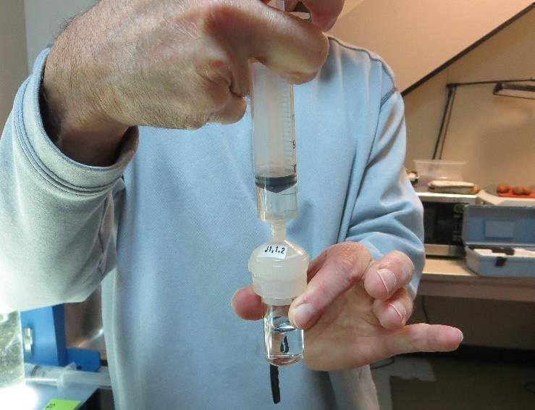

Jar Test - Filterability Test
Syringe ~ 25 mL from jar (after 5-minutes of settling)
Filter-to-waste 3-5 mL
Filter directly into clean cuvette
Measure turbidity
Note: Take several readings before recording final NTU results. Micro bubbles can adhere to glass causing false NTU readings. To remove bubbles, tilt cuvette up to 90 degrees.

Slide 25

Contact
Guy Schott, P.E.
State Water Resources Control Board
Division of Drinking Water
Santa Rosa, CA
Go to Stock Solution/Dose calculations/Jar Test Results for tools to download
www.waterboards.ca.gov/drinking_water/programs/districts/mendocino_district.html
Email: Guy Schott - Guy.Schott@waterboards.ca.gov
Office Number: 707-576-2732

