Slide 1
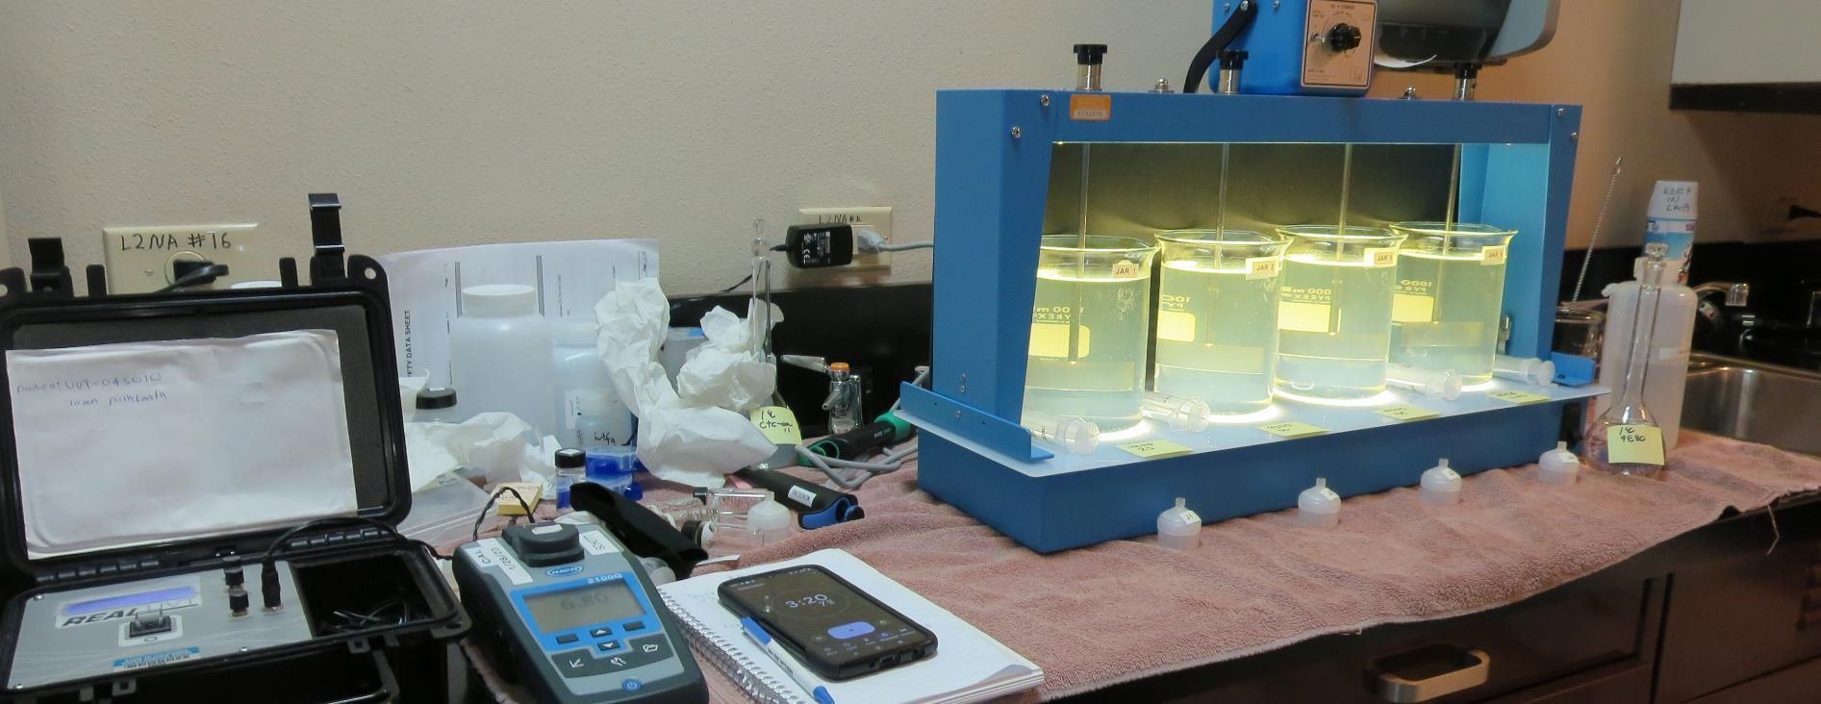
Surfwood Mutual Water Corporation
CA2300590
Mendocino County
Jar Test
by Guy Schott, P.E
March 2, 2023

Slide 2
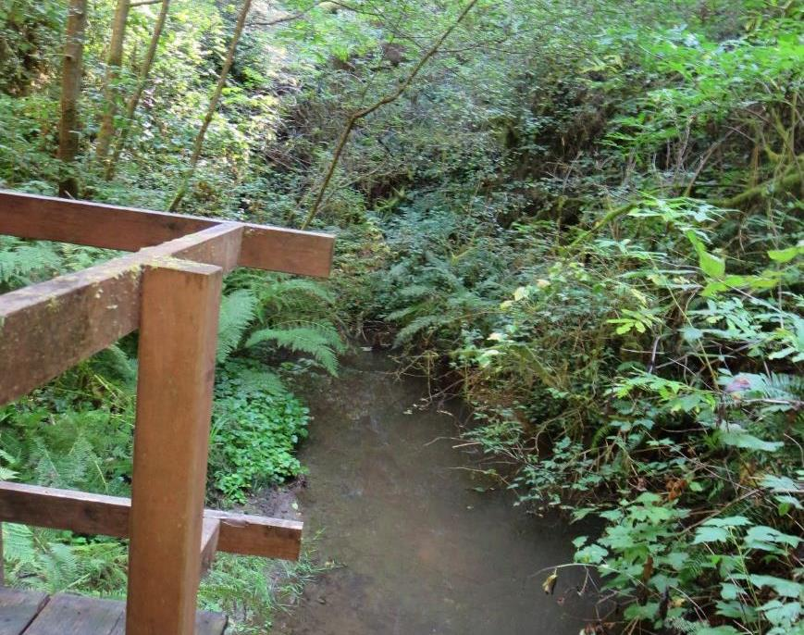
Source Water: Jack Peter’s Creek
Roughing Filter followed by Multi-Media Filtration
Source Water Characteristics
Turbidity: 6.8 NTU
pH: 7.10 – 7.17
UVT: 37.3%
UVA: 0.427/cm
0.4 um Filtered
Turbidity: 0.97 NTU
UVT: 41.9%
UVA: 0.377/cm

Slide 3
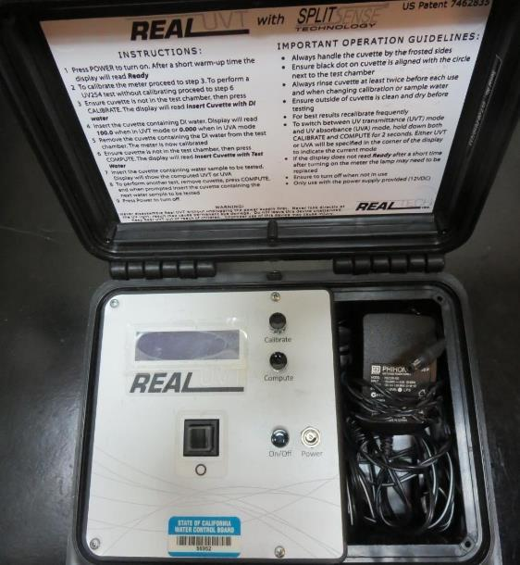
UVT/UVA, pathlength 10 mm
UV transmittance (UVT) is a measurement of the amount of ultraviolet light (commonly at 254 nm due to its germicidal effect) that passes through a water sample compared to the amount of light that passes through a pure water sample. The measurement is expressed as a percentage, % UVT.
%UVT = 10^{(-UVA)} x 100%
UV absorbance (UVA) is calculated as a relative measure of the amount of light absorbed by a water sample compared with the amount of light absorbed by a pure water sample.
UVA = -log(%UVT/100)

Slide 4
Applied Coagulants for Jar Testing (1)
Pro Pac 926 (NTU Technologies)
35% Aluminum Chlorohydrate
35% Water
23.62% Al₂O₃
30% pDADMAC solution
83% Basicity
SG = 1.25-1.34
NSF limit: 83 mg/L as Product
Pro Pac 9890 (NTU Technologies)
35-45% Aluminum Chlorohydrate
35-45% Water
~18.9% Al₂O₃
~10.5% Al
83% Basicity
20% polyamine (50% water, 50% active polyamines)
SG = 1.25-1.34
NSF limit: 50 mg/L as Product;
Product dose 10 mg/L = 1 mg/L polyamines active

Slide 5
Applied Coagulants for Jar Testing (2)
960 (NTU Technologies)
33% Polyaluminum Hydroxychlorosulfate
67% Water
SG = 1.29
NSF limit: 250 mg/L as Product
BWS, Inc.
Greg Nieckarz, Ph.D.
Greg.niekarz@bws.works
541-953-5112
AdvFloc-CTC-00011
Polyaluminum Hydroxy Chlorosulfate
12.55% Al₂O₃
6.64% Al
64.9% Basicity
SG = 1.299
NSF limit: 250 mg/L as Product

Slide 6
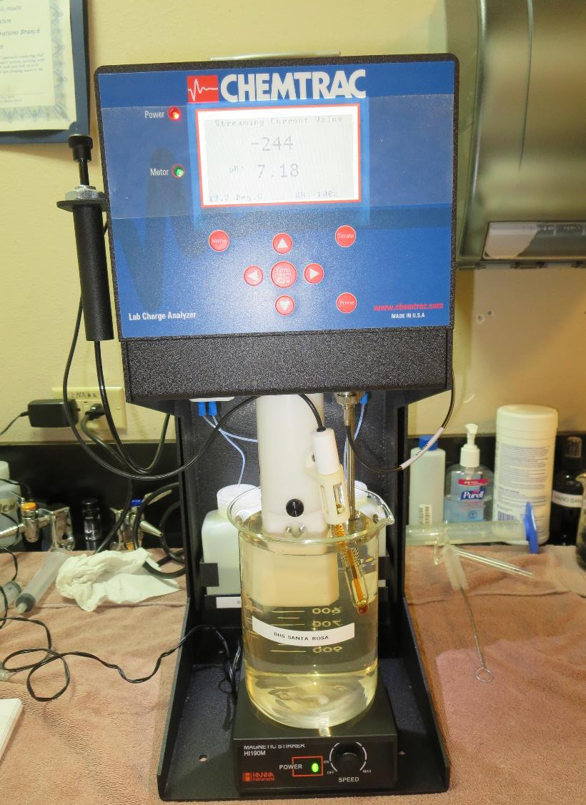
Laboratory Charge Analyzer
LCA: Used to determine coagulant demand of a source water entering the treatment plant.
Source pH: 7.10-7.17
LCA #1:
CTC-00011: 118 mg/L as product (no pH adjustment)
Final pH: 7:09
LCA #2:
960: 90 mg/L as product (no pH adjustment)
Final pH: 6.30
LCA #3:
9890: 36 mg/L as product (no pH adjustment)
Final pH: 6.91

Slide 7
Coagulant Information
Unless stated otherwise, all coagulant doses are reported as Product (100% strength).
Preparation of coagulant stock solutions are generally 1.0 or 0.1 percent strength using 100 and/or 200 mL volumetric flasks.
Finnpipette F2 variable volume pipette, capacity 100-1000 micro liters is used for stock solution preparation and coagulant aid jar test dosing.
Finnpipette F2 variable volume pipette, capacity 0.5-5 mL is used for primary coagulant jar test dosing.

Slide 8
Filtrate and %UVT/UVA Analysis
For this study, all jars were samples for Filtrate and %UVT/UVA analysis immediately at the end of the flocculation period.

Slide 9
Surfwood MWC; Jar Test 1 - 4 Results
Flash Mix 200 RPM (20 sec); Floc Mix 20 RPM (5 min)
Jar# | 9890 (ACH/PY) mg/L | Filtrate NTU | Filtrate %UVT | Filtrate UVA/cm | %UVA Reduction | Settle NTU 25 min
J1 | 25 | 3.86 | 61.0 | 0.214 | 43.2 | 10.8
J2 | 30 | 0.26 | 85.8 | 0.066 | 71.9 | 5.22
J3 | 35 | 0.18 | 85.3 | 0.068 | 71.4 | 8.16
J4 | 40 | 0.17 | 86.5 | 0.062 | 72.9 | 3.35

Slide 10
Surfwood MWC; Jar Test 5 - 12 Results
Flash Mix 200 RPM (20 sec); Floc Mix 20 RPM (5 min)
Jar# | CTC-00011 mg/L | Filtrate NTU | Filtrate %UVT | Filtrate UVA/cm | %UVA Reduction | Settle NTU 25 min
J5 | 50 | 5.83 | 42.5 | 0.370 | 1.9 | 10.2
J6 | 55 | 8.06 | 42.4 | 0.371 | 1.6 | 13.6
J7 | 60 | 9.30 | 43.0 | 0.365 | 3.2 | 14.7
J8 | 65 | 6.58 | 52.5 | 0.279 | 26.0 | 14.9
J9 | 100 | 0.12 | 81.8 | 0.086 | 77.2 | 20.2
J10 | 110 | 0.37 | 83.0 | 0.080 | 78.8 | 29.7
J11 | 120 | 0.28 | 85.8 | 0.066 | 82.5 | 37.3
J12 | 130 | 0.25 | 87.5 | 0.057 | 84.9 | 46.0

Slide 11
Surfwood MWC; Jar Test 13 - 16 Results
Flash Mix 200 RPM (20 sec); Floc Mix 20 RPM (5 min)
Jar# | 926 (ACH/pDADMAC) mg/L | Filtrate NTU | Filtrate %UVT | Filtrate UVA/cm | %UVA Reduction | Settle NTU 25 min
J13 | 30 | 4.45 | 40.7 | 0.389 | 0 | 7.88
J14 | 35 | 4.44 | 40.6 | 0.390 | 0 | 8.07
J15 | 40 | 4.41 | 42.9 | 0.366 | 2.9 | 8.16
J16 | 45 | 4.60 | 39.1 | 0.407 | 0 | -

Slide 12
Surfwood MWC; Jar Test 17 - 23 Results
Flash Mix 200 RPM (20 sec); Floc Mix 20 RPM (5 min)
Jar# | 960 mg/L | Filtrate NTU | Filtrate %UVT | Filtrate UVA/cm | %UVA Reduction | Settle NTU 25 min
J17 | 70 | 3.78 | 69.2 | 0.159 | 57.8 | 11.1
J18 | 80 | 0.35 | 89.3 | 0.049 | 87.0 | 6.2
J19 | 90 | 0.10 | 92.7 | 0.032 | 91.5 | 2.54
J20 | 100 | 0.07 | 94.0 | 0.026 | 93.1 | 2.09
J21 | 100 | 0.18 | 91.5 | 0.038 | 88.7 | 1.98
J22 | 110 | 0.07 | 94.3 | 0.025 | 93.4 | 2.48
J23 | 120 | 0.13 | 94.4 | 0.024 | 93.6 | 3.11

Slide 13
Jars 1-4 Test
Flash Mix 20 Sec (200 RPM)
Floc Mix 5 min (20 RPM)
25 mL sampled end of Floc
Applied Coagulant
9890

Slide 14
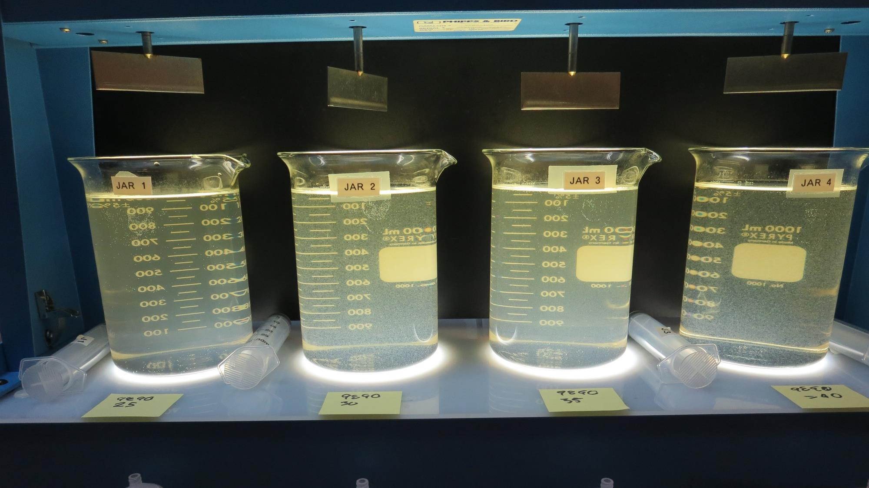
Jars 1-4: End of Floc Duration, 25 mL is syringed for filterability and %UVT/UVA.
25 mg/L 9890
Filtrate 3.86 NTU
UVT: 61.0%
UVA: 0.214/cm
UVA Reduction: 43.2%
Settled: 10.8 NTU
30 mg/L 9890
Filtrate 0.26NTU
UVT: 85.8%
UVA: 0.066/cm
UVA Reduction: 71.9%
Settled: 5.22 NTU
35 mg/L 9890
Filtrate 0.18 NTU
UVT: 85.3%
UVA: 0.068/cm
UVA Reduction: 71.4%
Settled: 8.16 NTU
40 mg/L 9890
Filtrate 0.17 NTU
UVT: 86.5%
UVA: 0.062/cm
UVA Reduction: 72.9%
Settled: 3.35 NTU

Slide 15
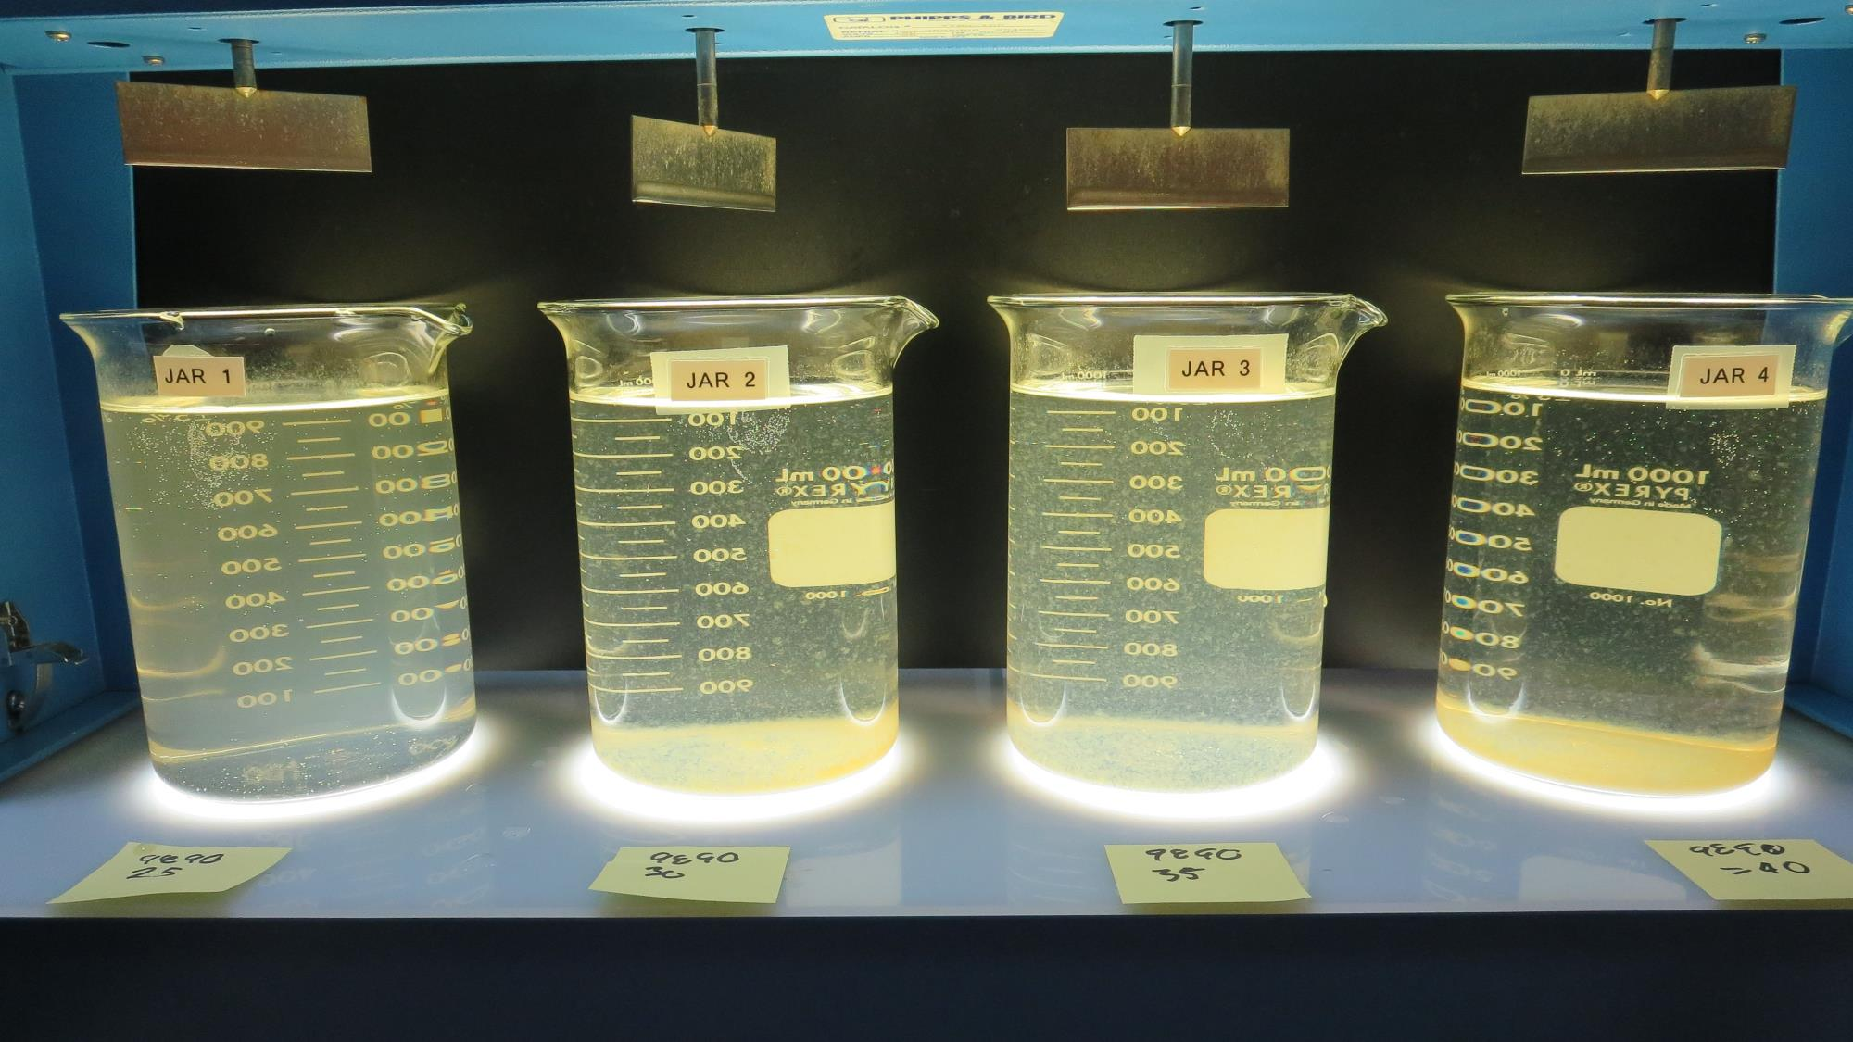
Jars 1-4: After 25-minutes of settling, settled water turbidity is taken.

Slide 16
Jars 5-8 Test
Flash Mix 20 Sec (200 RPM)
Floc Mix 5 min (20 RPM)
25 mL sampled end of Floc
Applied Coagulant
CTC-00011

Slide 17
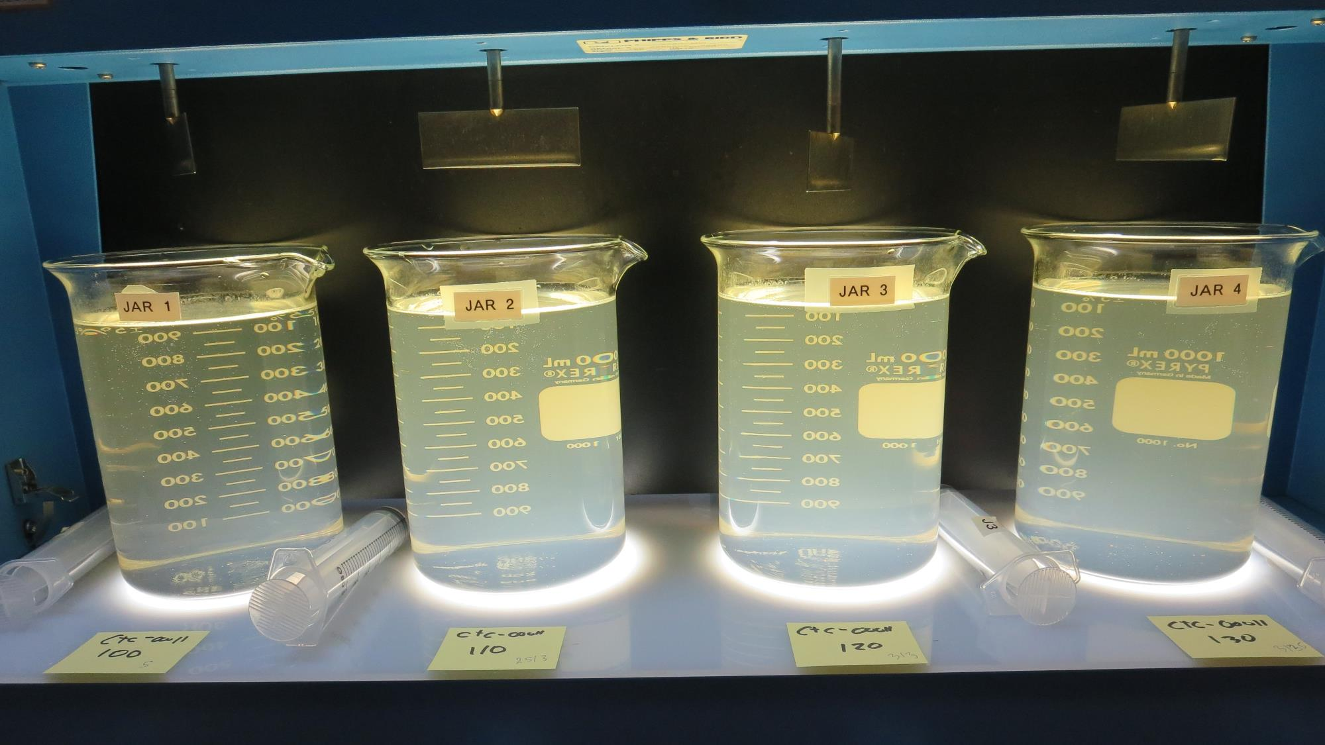
Jars 5-8: End of Floc Duration, 25 mL is syringed for filterability and %UVT/UVA.
50 mg/L CTC-00011
Filtrate 5.83 NTU
UVT: 42.5%
UVA: 0.378/cm
UVA Reduction: 1.9%
Settled: 10.2 NTU
55 mg/L CTC-00011
Filtrate 8.06 NTU
UVT: 42.4%
UVA: 0.371/cm
UVA Reduction: 1.6%
Settled: 13.6 NTU
60 mg/L CTC-00011
Filtrate 9.30 NTU
UVT: 43.0%
UVA: 0.365/cm
UVA Reduction: 3.2%
Settled: 14.7 NTU
65 mg/L CTC-00011
Filtrate 6.58 NTU
UVT: 52.5%
UVA: 0.279/cm
UVA Reduction: 26.0%
Settled: 14.9 NTU

Slide 18
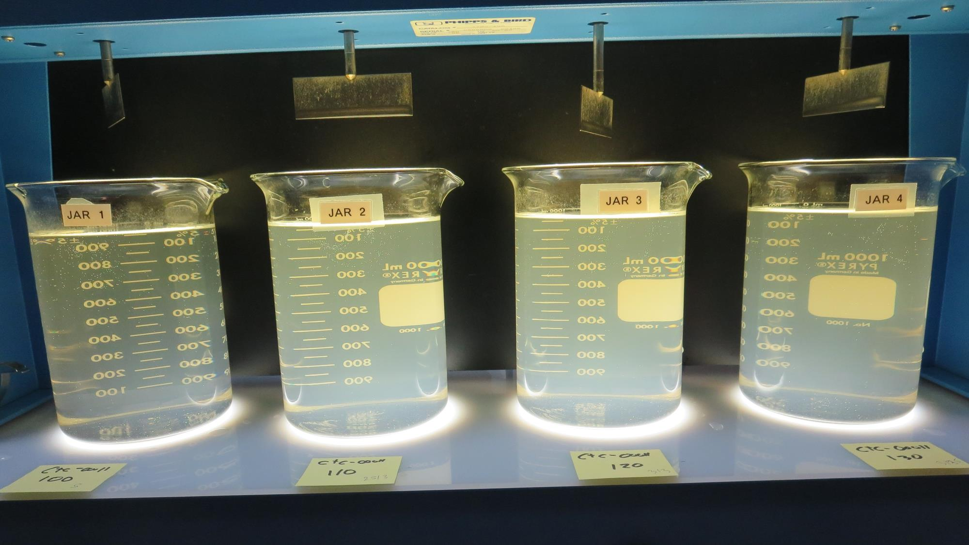
Jars 5-8: After 25-minutes of settling, settled water turbidity is taken.

Slide 19
Jars 9-12 Test
Flash Mix 20 Sec (200 RPM)
Floc Mix 5 min (20 RPM)
25 mL sampled end of Floc
Applied Coagulant
CTC-00011

Slide 20
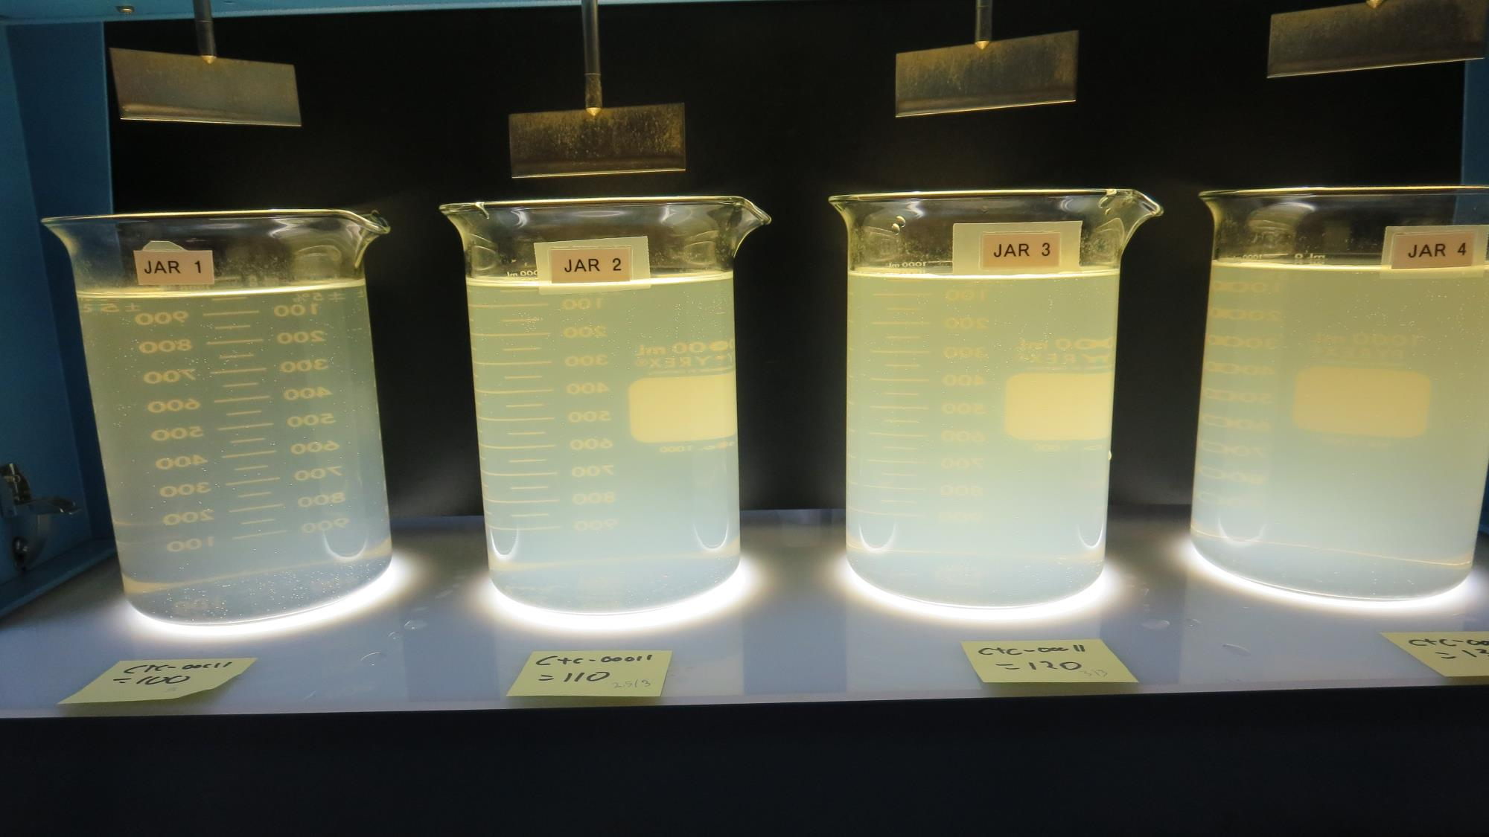
Jars 9-12: End of Floc Duration, 25 mL is syringed for filterability and %UVT/UVA.
100 mg/L CTC-00011
Filtrate 0.12 NTU
UVT: 81.8%
UVA: 0.086/cm
UVA Reduction: 77.2%
Settled: 20.2 NTU
110 mg/L CTC-00011
Filtrate 0.37 NTU
UVT: 83.0%
UVA: 0.080/cm
UVA Reduction: 78.8%
Settled: 29.7 NTU
120 mg/L CTC-00011
Filtrate 0.28 NTU
UVT: 85.8%
UVA: 0.066/cm
UVA Reduction: 82.5%
Settled: 37.3 NTU
130 mg/L CTC-00011
Filtrate 0.25 NTU
UVT: 87.5%
UVA: 0.057/cm
UVA Reduction: 84.9%
Settled: 46.0 NTU

Slide 21
Jars 9-12: After 25-minutes of settling, settled water turbidity is taken.

Slide 22
Jars 13-16 Test
Flash Mix 20 Sec (200 RPM)
Floc Mix 5 min (20 RPM)
25 mL sampled end of Floc
Applied Coagulant
960

Slide 23
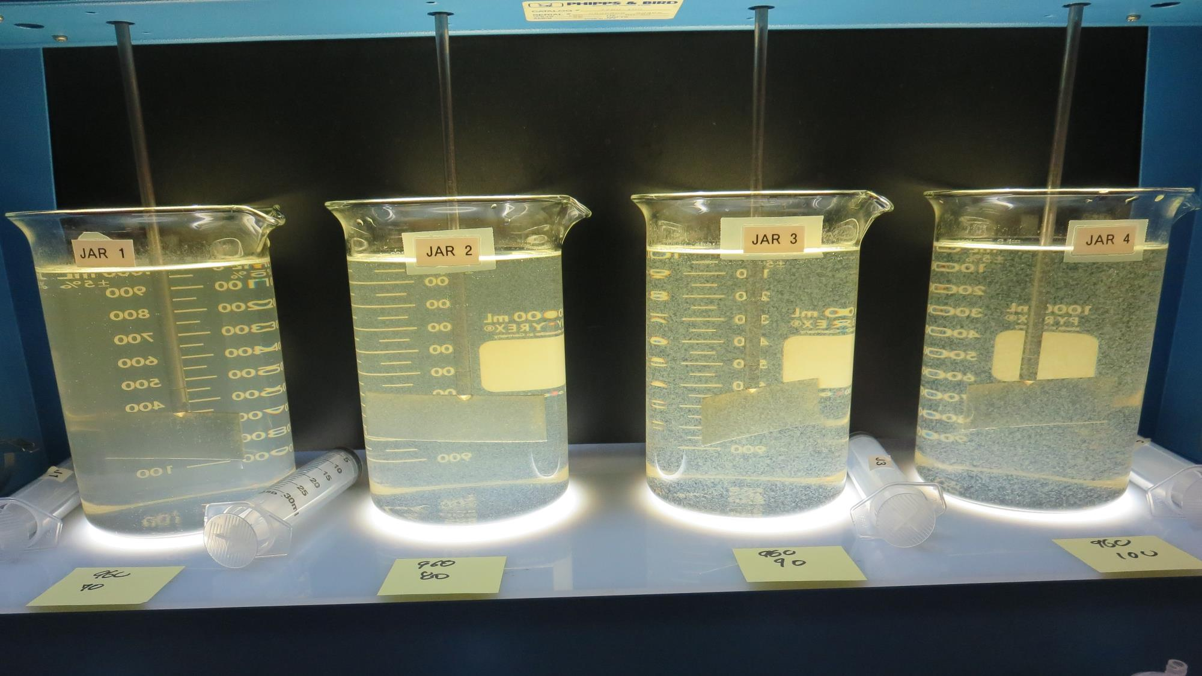
Jars 13-16: End of Floc Duration, 25 mL is syringed for filterability and %UVT/UVA.
70 mg/L 960
Filtrate 2.78 NTU
UVT: 69.2%
UVA: 0.159/cm
UVA Reduction: 57.8%
Settled: 11.1 NTU
80 mg/L 960
Filtrate 0.35 NTU
UVT: 89.3%
UVA: 0.049/cm
UVA Reduction: 87.0%
Settled: 6.2 NTU
90 mg/L 960
Filtrate 0.10 NTU
UVT: 92.7%
UVA: 0.032/cm
UVA Reduction: 91.5%
Settled: 2.54 NTU
100 mg/L 960
Filtrate 0.07 NTU
UVT: 94.0%
UVA: 0.026/cm
UVA Reduction: 93.1%
Settled: 2.09 NTU

Slide 24
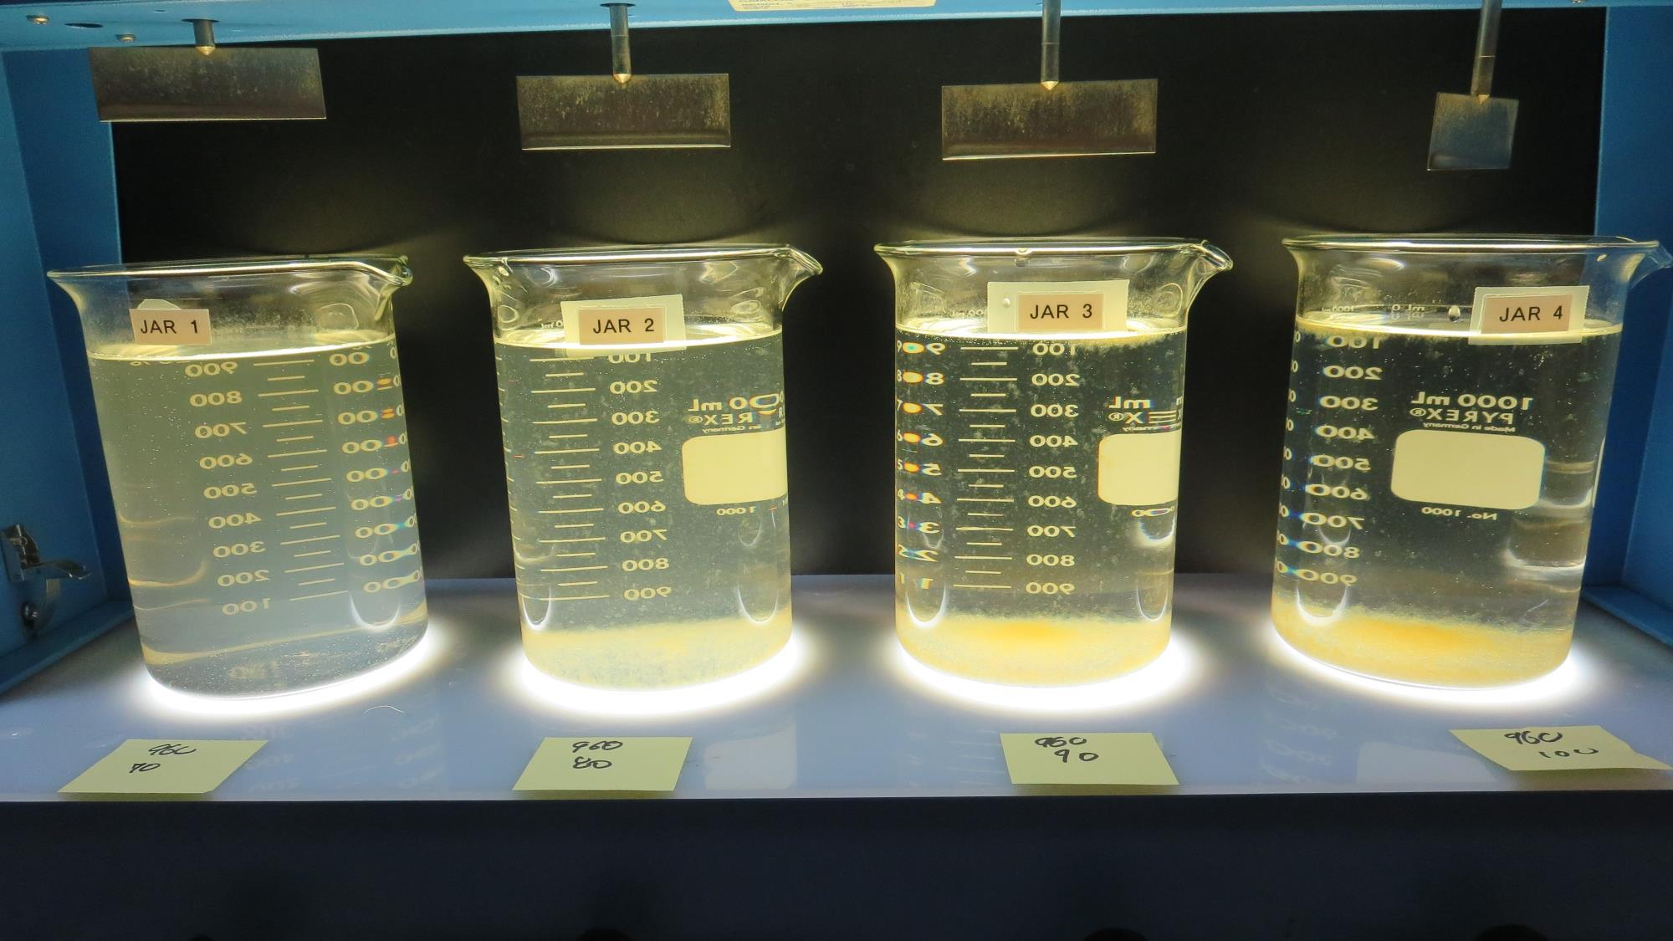
Jars 13-16: After 25-minutes of settling, settled water turbidity is taken.

Slide 25
Jars 17-19 Test
Flash Mix 20 Sec (200 RPM)
Floc Mix 5 min (20 RPM)
25 mL sampled end of Floc
Applied Coagulant
960

Slide 26
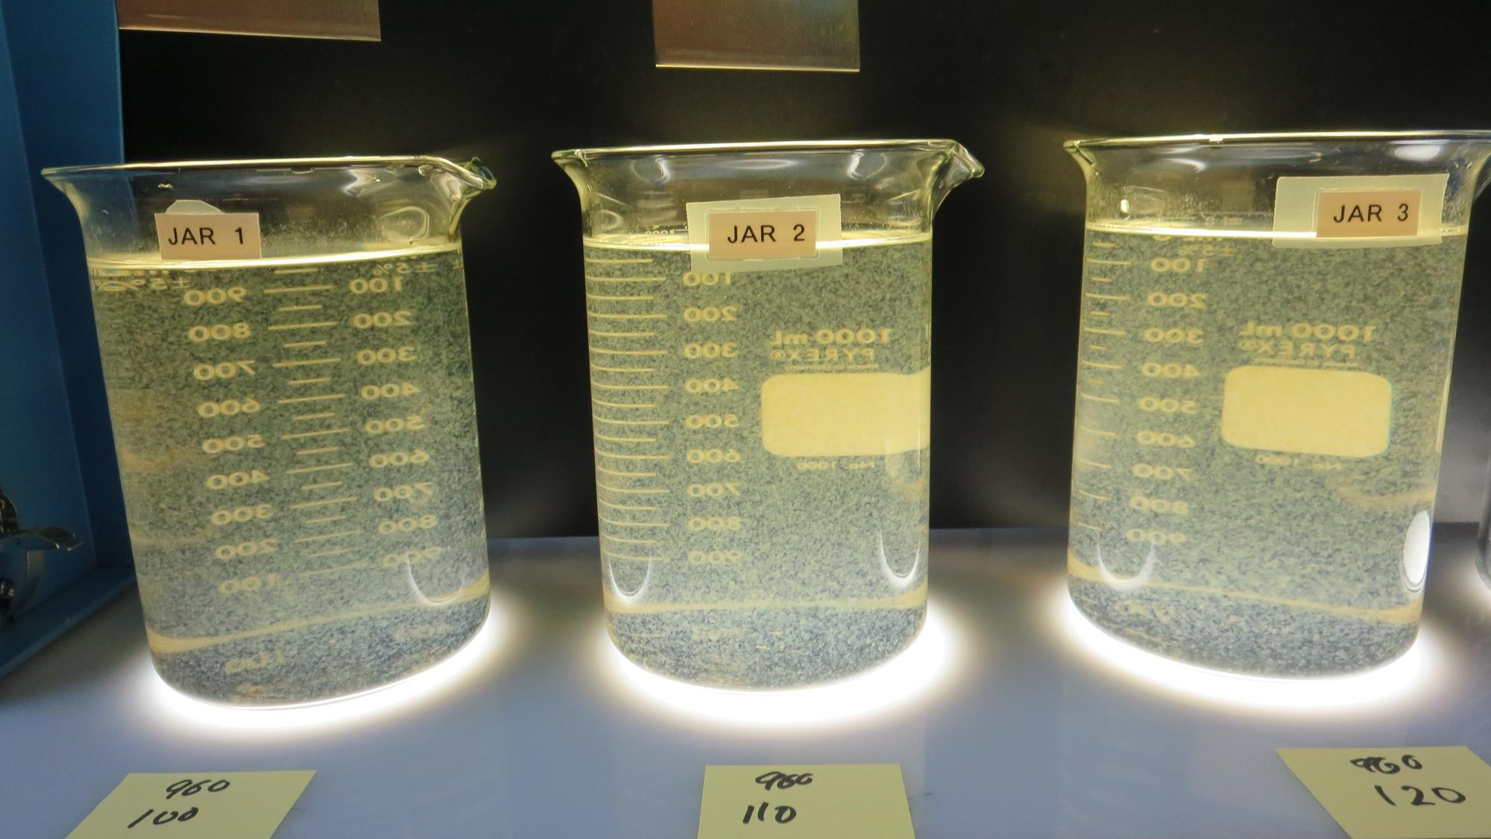
Jars 17-19: End of Floc Duration, 25 mL is syringed for filterability and %UVT/UVA.
100 mg/L 960
Filtrate 0.18 NTU
UVT: 91.5%
UVA: 0.038/cm
UVA Reduction: 88.7%
Settled: 1.98 NTU
110 mg/L 960
Filtrate 0.07 NTU
UVT: 94.3%
UVA: 0.025/cm
UVA Reduction: 93.4%
Settled: 2.48 NTU
120 mg/L 960
Filtrate 0.13 NTU
UVT: 94.4%
UVA: 0.025/cm
UVA Reduction: 93.6%
Settled: 3.11 NTU

Slide 27
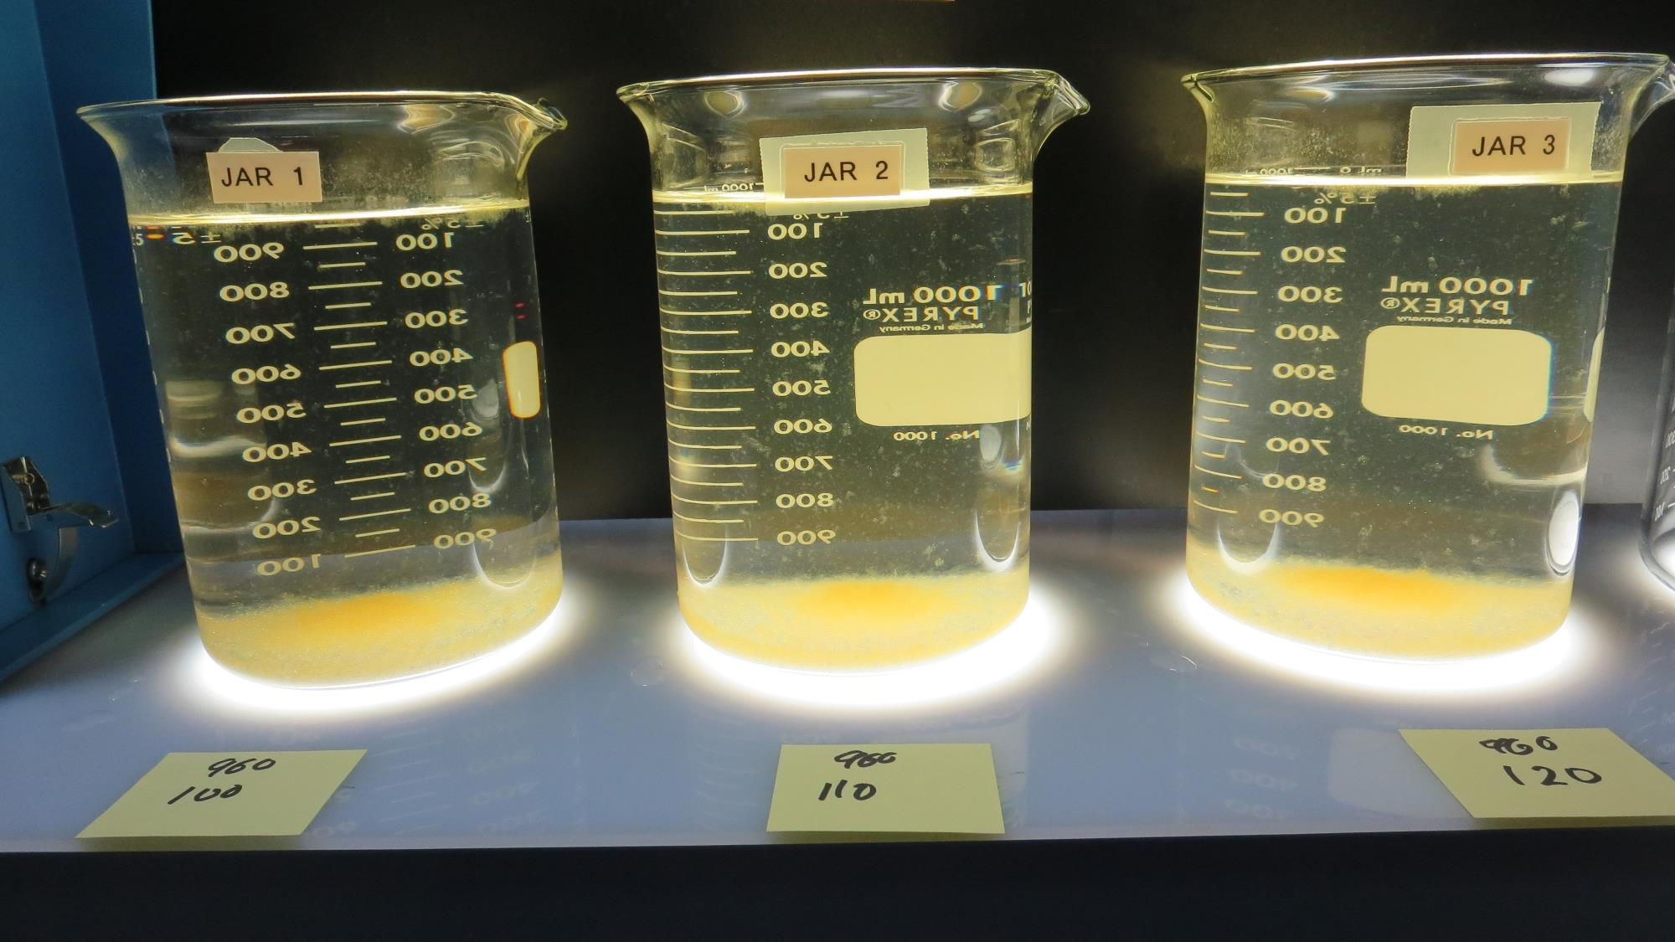
Jars 17-19: After 25-minutes of settling, settled water turbidity is taken.

Slide 28
Jars 20-23 Test
Flash Mix 20 Sec (200 RPM)
Floc Mix 5 min (20 RPM)
25 mL sampled end of Floc
Applied Coagulant
926

Slide 29
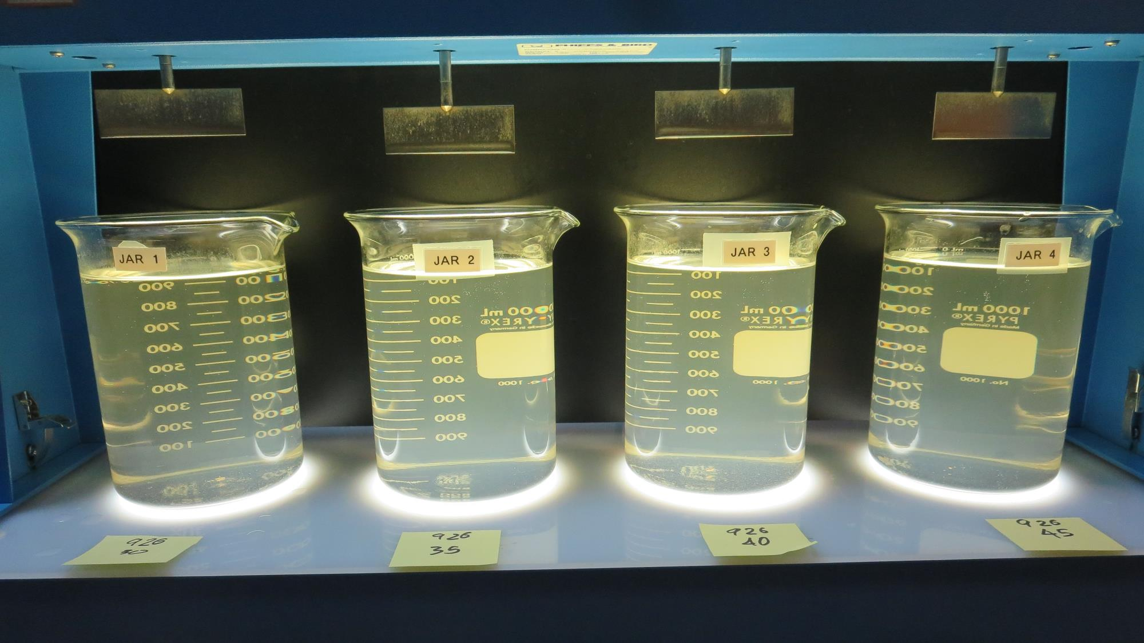
Jars 20-23: End of Floc Duration, 25 mL is syringed for filterability and %UVT/UVA.
30 mg/L 926
Filtrate 4.45 NTU
UVT: 40.7%
UVA: 0.389/cm
UVA Reduction: 0%
Settled: 7.88 NTU
35 mg/L 926
Filtrate 4.44 NTU
UVT: 40.6%
UVA: 0.390/cm
UVA Reduction: 0%
Settled: 8.07 NTU
40 mg/L 926
Filtrate 4.41 NTU
UVT: 42.9%
UVA: 0.366/cm
UVA Reduction: 0%
Settled: 8.16 NTU
45 mg/L 926
Filtrate 4.60 NTU
UVT: 39.1%
UVA: 0.407/cm
UVA Reduction: 0%
Settled: - NTU

Slide 30
Jar Testing for 1-Liter Jars:
Procedures for Most Treatment Plants
Fill jars with source water prior to coagulant injection and set paddle speed at 20-30 rpm
Add chemicals (i.e., NaOCl, primary coagulant, coagulant aid) to each jar
Flash mix for 15-30 seconds (200 rpm)
Slow mix for 5 minutes (20-30 rpm)
Settled for 5 minutes. Syringe 25 mL from each jar taken 1-inch below surface (25 mL/12 sec rate). For this study, sample was taken immediately at the end of flocculation process.
Filtered through 1.2 um isopore membrane into cuvette drip rate, 15 mL/(50-90 sec)
Measure filtrate turbidity, chlorine residual and %UVT/UVA
Measure settled water turbidity after 25 minutes of total setting
Record all data

Slide 31

Jar Test
Filterability Test Equipment
Turbidity Instrument
Syringe w/Luer-Lock Tip, 30 cc
(part#: 2225800, by Hach)
Swinnex Filter Holder, 25 mm (part#: SX0002500)
Isopore Membrane Filter, 1.2 um absolute
pore size,
Φ= 25 mm , thickness: 24 um,
hydrophilic polycarbonate membrane
(part #: RTTP02500)
Go to Sigma-Aldrich for laboratory supplies http://www.sigmaaldrich.com/united-states.html

Slide 32
Isopore Membrane Information
Categories | Information
trade name | Isopore
filter color | White
chemistry | Polycarbonate (PC)
water flow rate | Avg. 175 mL/min x cm² (typical results @ 10 psi)
media | Isopore®
wettability | Hydrophilic
porosity | 14.7%
pore size | 1.2 µm
bubble point at 23 °C | 1.0 bar, air with water
thickness | 24 µm
filter diameter (ø) | 25 mm
material size | polycarbonate, Hydrophilic, 1.2 µm, 25 mm, white, plain, 100

Slide 33
Isopore Membrane Background Information
The Isopore membrane is a polycarbonate, track-etched screen filter recommended for all analyses in which the sample is viewed on the surface of the membrane. The Isopore membrane is composed of polycarbonate film, which has a smooth, glass-like surface for clearer sample observation. The unique manufacturing process of the membrane ensures a precise pore diameter and a consistent pore size for accurate separation of samples by size. Matched-weight filters are not usually required because of low, constant tar and ash weights.
Features & Benefits:
Membrane structure retains particles on the surface, simplifying counting and analysis

Slide 34
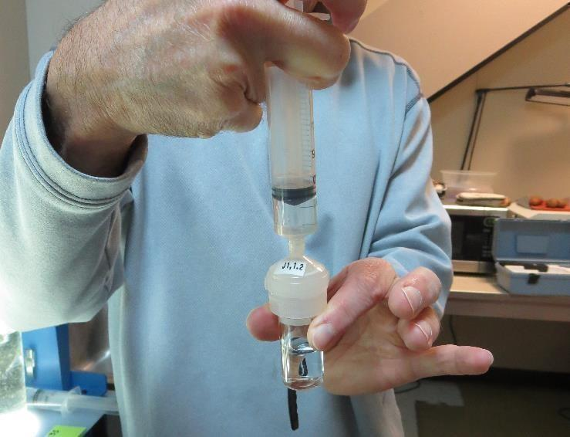

Jar Test - Filterability Test
Syringe ~ 25 mL from jar (after 5-minutes of settling)
Filter-to-waste 3-5 mL
Filter directly into clean cuvette
Measure turbidity
Note: Take several readings before recording final NTU results. Micro bubbles can adhere to glass causing false NTU readings. To remove bubbles, tilt cuvette up to 90 degrees.

Slide 35

Contact
Guy Schott, P.E.
State Water Resources Control Board
Division of Drinking Water
Santa Rosa, CA
Go to Jar Test Results/Procedures for tools to download
www.waterboards.ca.gov/drinking_water/programs/districts/mendocino_district.html
Jar Testing Done Right video training https://youtu.be/aGByyxhelkI
Email: Guy Schott - Guy.Schott@waterboards.ca.gov
Office Number: 707-576-2732

