Slide 1
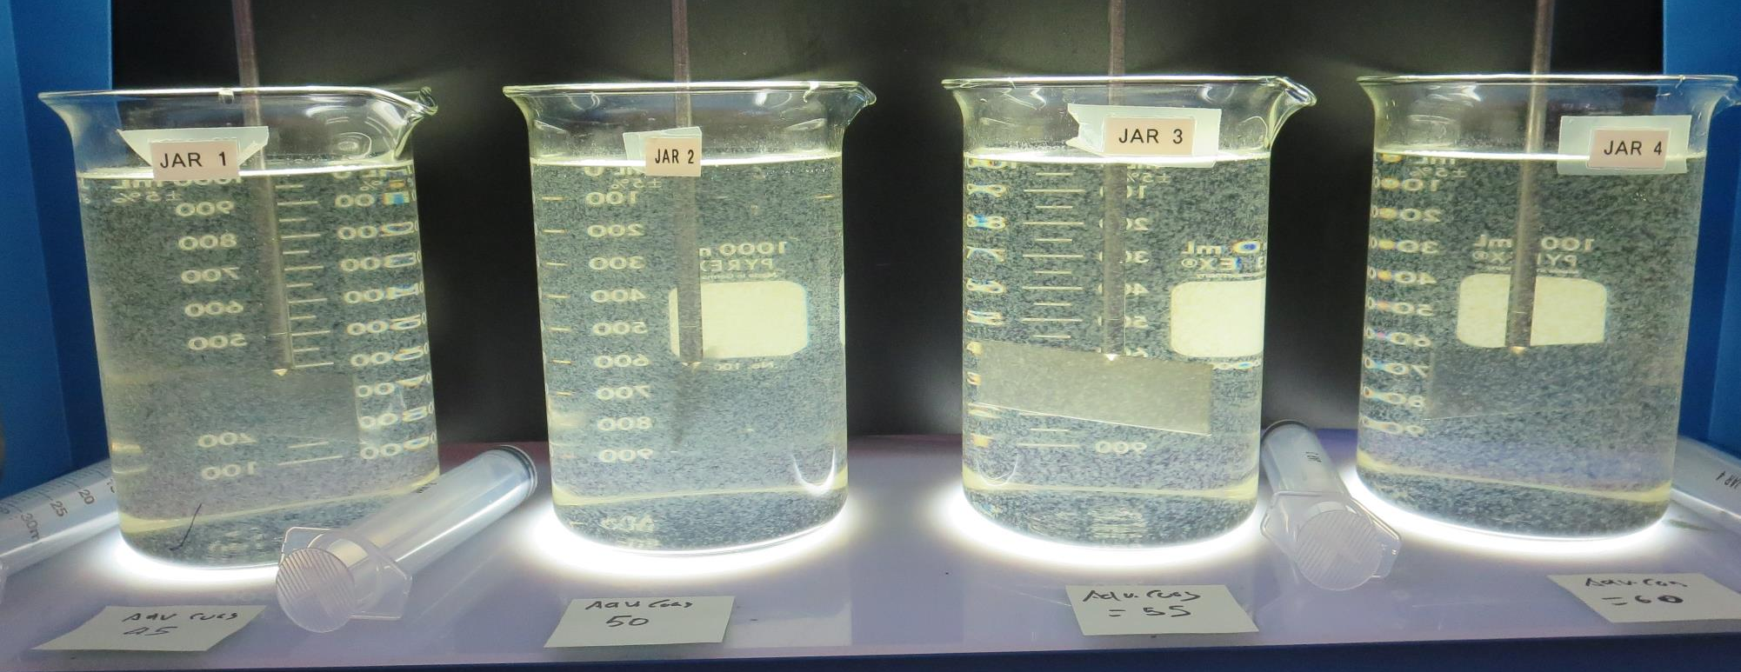
Surfwood Mutual Water Corporation
CA2300590, Mendocino County
Jar Test
by Guy Schott, P.E. August 13, 2020

Slide 2
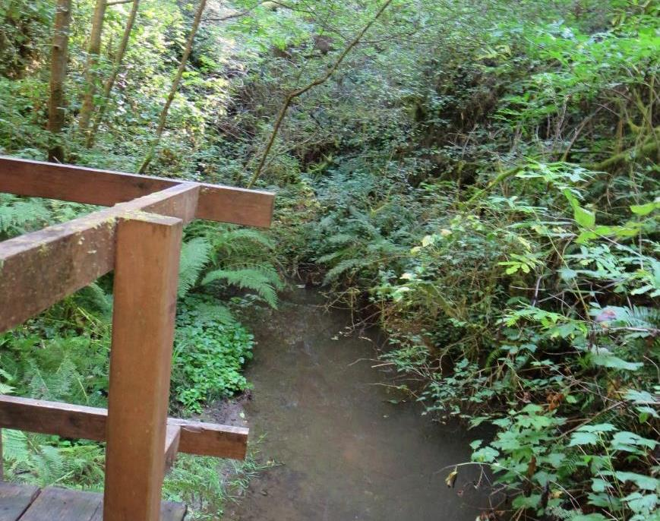
Source Water: Jack Peter’s Creek
Roughing Filter followed by Multi-Media Filtration

Slide 3
Surfwood MWC, August 13, 2020
Water Characteristics
Source (morning)
pH: 7.28
Turbidity: 5.26 NTU
UVT: 55.5%
UVA: 0.255/cm
0.4 um Filtered
Turbidity: 0.30 NTU
UVT: 77.0%
UVA: 0.113/cm
Plant Train 1
Flow: 17.5 gpm
Dose: 35.5 mg/l Adv Coag
Dose: 1.25 mg/L polyDADMAC
Turbidity: 0.06 NTU
UVT: 96.9%
UVA: 0.013/cm
UVA Reduction: 88.5%
Aluminum: 0.014 mg/L as Al
Plant Train 2
Flow: 27 gpm
Dose: 40 mg/l Adv Coag
Dose: 0 mg/L polyDADMAC
Turbidity: 0.06 NTU
UVT: 97.9%
UVA: 0.008/cm
UVA Reduction: 92.9%

Slide 4
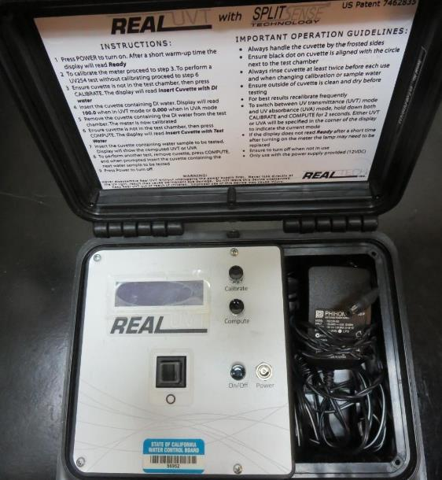
UVT/UVA, pathlength 10 mm
UV transmittance (UVT) is a measurement of the amount of ultraviolet light (commonly at 254 nm due to its germicidal effect) that passes through a water sample compared to the amount of light that passes through a pure water sample. The measurement is expressed as a percentage, % UVT.
%UVT = 10^{(-UVA)} x 100%
UV absorbance (UVA) is calculated as a relative measure of the amount of light absorbed by a water sample compared with the amount of light absorbed by a pure water sample.
UVA = -log(%UVT/100)

Slide 5
Coagulant Used for Jar Testing
Advanced Coagulant
12.55% Al₂O₃
64.9% Basicity
SG = 1.299

Slide 6
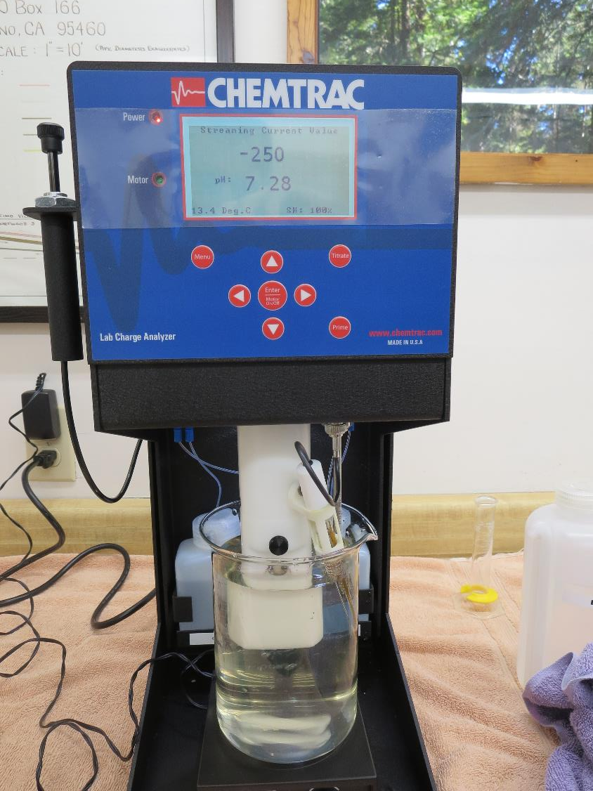
Laboratory Charge Analyzer
LCA: Used to determine coagulant demand of a source water entering the treatment plant.
Source pH: 7.28
LCA #1:
Advanced Coagulant:
49.5 mg/L as product (no pH adjustment)
Dose: 10.4 mg/L, pH: 7.21
Dose: 20.3 mg/L, pH: 7.14
Dose: 35.4 mg/L, pH: 7.03
Dose: 44.6 mg/L, pH: 6.96
Dose: 48.1 mg/L, pH: 6.91
Dose: 49.9 mg/L, pH: 6.87

Slide 7
Coagulant Information
Unless stated otherwise, all coagulant doses are reported as Product (100% strength).
Preparation of coagulant stock solutions are generally 1.0 or 0.1 percent strength using 100 and/or 200 mL volumetric flasks.
Finnpipette F2 variable volume pipette, capacity 100-1000 micro liters is used for stock solution preparation and coagulant aid jar test dosing.
Finnpipette F2 variable volume pipette, capacity 0.5-5 mL is used for primary coagulant jar test dosing.

Slide 8
Filtrate and %UVT/UVA Analysis
For this study, all jars were samples for Filtrate and %UVT/UVA analysis immediately at the end of the flocculation period.

Slide 9
Surfwood MWC: Jar Test 1-8 Results
Flash Mix 200 RPM (30 sec), Floc 30 RPM (5 min)
Jar # | Adv Coag mg/L | Poly- DADMAC mg/L | Filtrate NTU | Filtrate %UVT | Filtrate UVA/cm | %UVA Reduction
J1 | 45 | 0 | 0.35 | 93.5 | 0.029 | 74.3
J2 | 50 | 0 | 0.13 | 96.6 | 0.014 | 87.6
J3 | 55 | 0 | 0.21 | 95.1 | 0.021 | 81.4
J4 | 60 | 0 | 0.18 | 95.5 | 0.020 | 82.3
J5 | 45 | 1.0 | 0.13 | 95.8 | 0.018 | 84.1
J6 | 50 | 1.0 | 0.06 | 96.7 | 0.014 | 87.6
J7 | 55 | 1.0 | 0.09 | 96.6 | 0.015 | 86.7
J8 | 60 | 1.0 | 0.10 | 96.3 | 0.016 | 85.8

Slide 10
Jars 1-4 Test
Flash Mix 30 Sec (200 RPM)
Floc Mix 5 min (30 RPM)
25 mL sampled end of Floc
Applied Coagulant
Advanced Coagulant

Slide 11
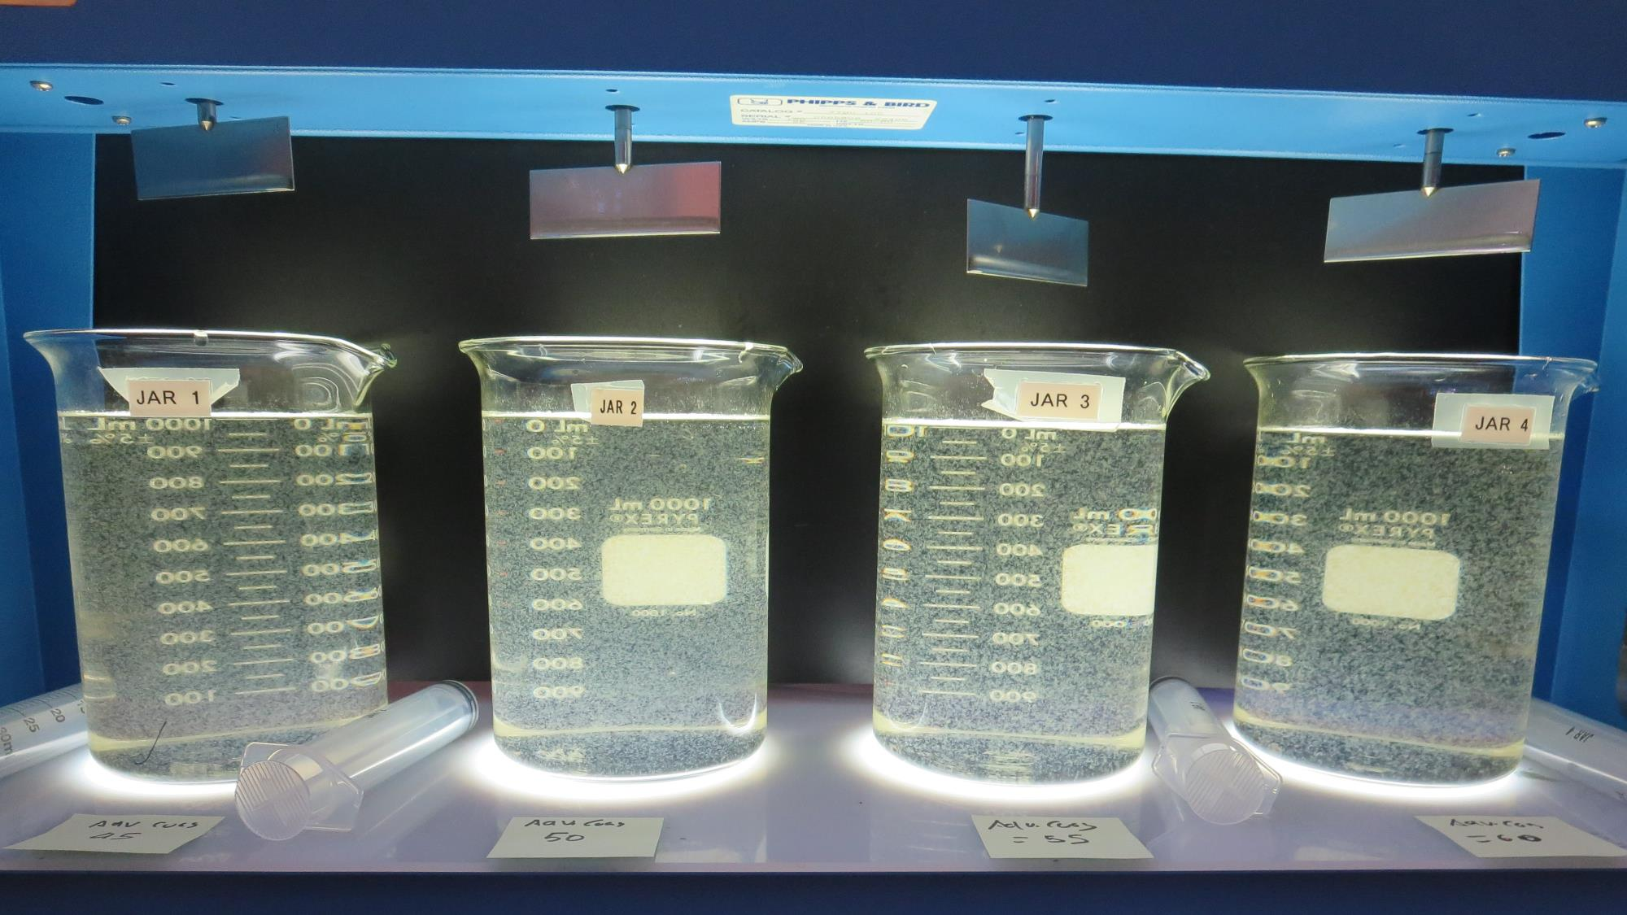
Jars 1-4: End of Floc Duration, 25 mL is syringed for filterability and %UVT/UVA.
45 mg/L Adv Coag.
Filtrate 0.35 NTU
UVT: 93.5%
UVA: 0.029/cm
UVA Reduction 74.3%
50 mg/L Adv Coag.
Filtrate 0.13 NTU
UVT: 96.6%
UVA: 0.014/cm
UVA Reduction 87.6%
55 mg/L Adv Coag.
Filtrate 0.21 NTU
UVT: 95.1%
UVA: 0.021/cm
UVA Reduction 81.4%
60 mg/L Adv Coag.
Filtrate 0.18 NTU
UVT: 95.5%
UVA: 0.020/cm
UVA Reduction 82.3%

Slide 12
Jars 5-8 Test
Flash Mix 30 Sec (200 RPM)
Floc Mix 5 min (30 RPM)
25 mL sampled end of Floc
Applied Coagulant
Advanced Coagulant

Slide 13
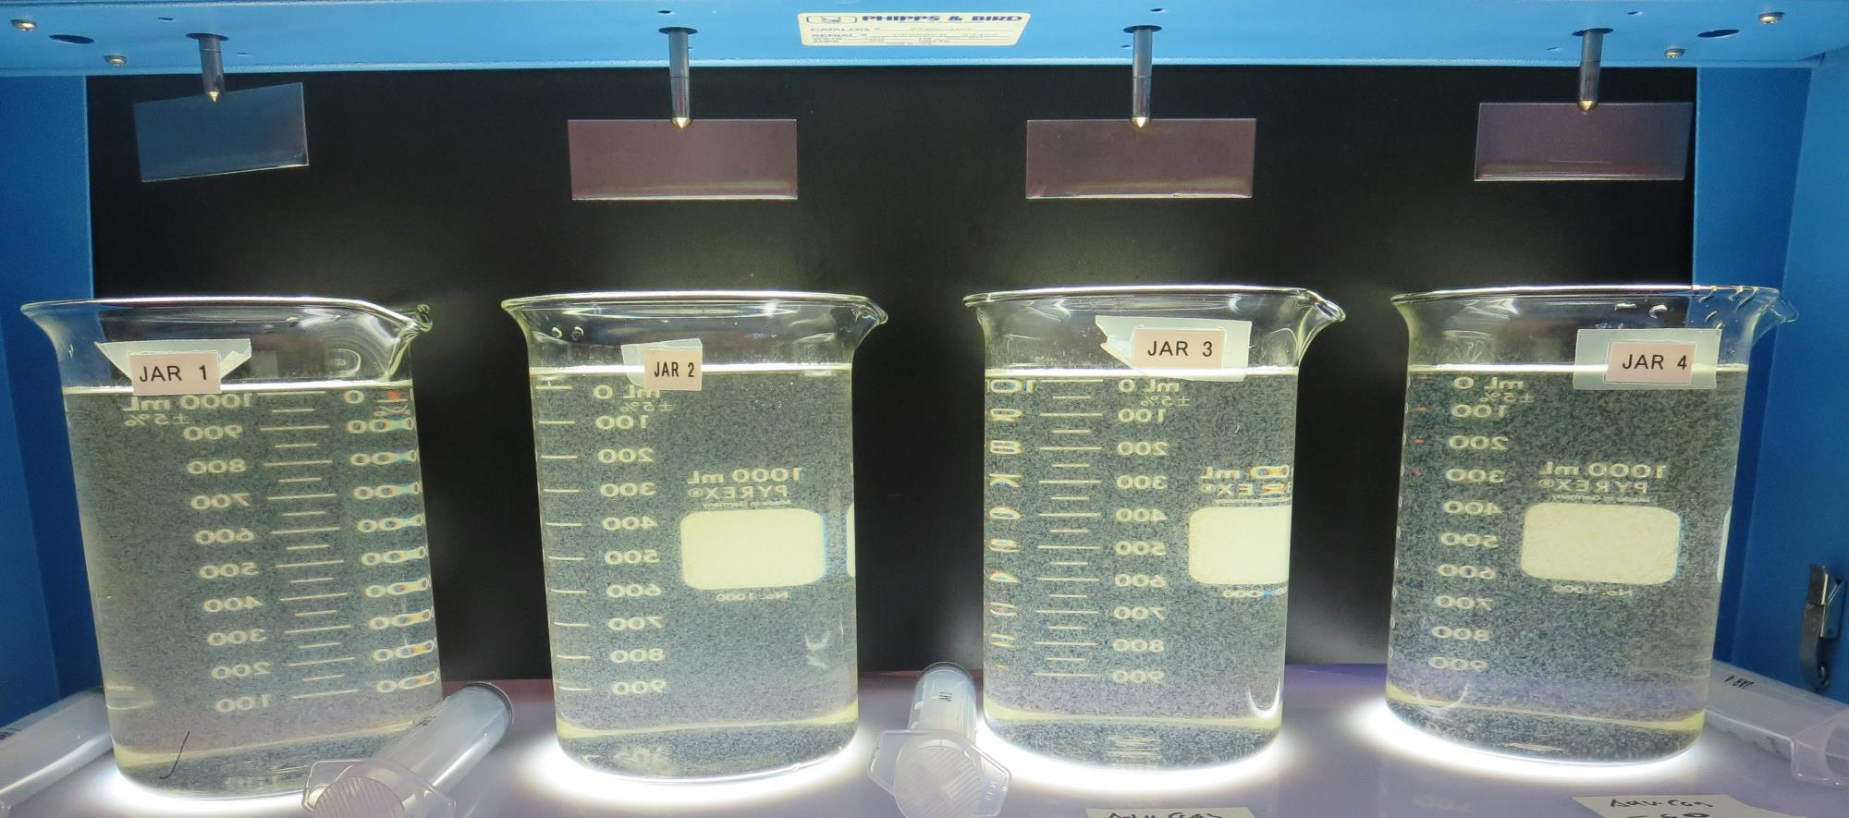
Jars 5-8: End of Floc Duration, 25 mL is syringed for filterability and %UVT/UVA.
45 mg/L Adv Coag.
1.0 mg/L PolyDADMAC
Filtrate 0.13 NTU
UVT: 95.8%
UVA: 0.018/cm
UVA Reduction 84.1%
50 mg/L Adv Coag.
1.0 mg/L PolyDADMAC
Filtrate 0.06 NTU
UVT: 96.7%
UVA: 0.014/cm
UVA Reduction 87.6%
Al: 0.030 mg/L as Al
55 mg/L Adv Coag.
1.0 mg/L PolyDADMAC
Filtrate 0.09 NTU
UVT: 96.6%
UVA: 0.015/cm
UVA Reduction 86.7%
60 mg/L Adv Coag.
1.0 mg/L PolyDADMAC
Filtrate 0.10 NTU
UVT: 96.3%
UVA: 0.016/cm
UVA Reduction 85.8%

Slide 14
Jar Testing for 1-Liter Jars:
Procedures for Most Treatment Plants
Fill jars with source water prior to coagulant injection and set paddle speed at 30 rpm
Add chemicals (i.e., NaOCl, primary coagulant, coagulant aid) to each jar
Flash mix for 15-60 seconds (200 rpm)
Slow mix for 5 minutes (20-30 rpm)
Settled for 5 minutes. Syringe 25 mL from each jar taken 1-inch below surface (25 mL/12 sec rate). For this study, sample was taken immediately at the end of flocculation process.
Filtered through 1.2 um isopore membrane into cuvette drip rate, 15 mL/(50-90 sec)
Measure filtrate turbidity, chlorine residual and %UVT/UVA
Measure settled water turbidity after 25 minutes of total setting
Record all data

Slide 15

Jar Test
Filterability Test Equipment
Turbidity Instrument
Syringe w/Luer-Lock Tip, 30 cc
(part#: 2225800, by Hach)
Swinnex Filter Holder, 25 mm (part#: SX0002500)
Isopore Membrane Filter, 1.2 um absolute
pore size,
Φ= 25 mm , thickness: 24 um,
hydrophilic polycarbonate membrane
(part #: RTTP02500)
Go to Sigma-Aldrich for laboratory supplies http://www.sigmaaldrich.com/united-states.html

Slide 16
Isopore Membrane Information
Categories | Information
trade name | Isopore
filter color | White
chemistry | Polycarbonate (PC)
water flow rate | Avg. 175 mL/min x cm² (typical results @ 10 psi)
media | Isopore®
wettability | Hydrophilic
porosity | 14.7%
pore size | 1.2 µm
bubble point at 23 °C | 1.0 bar, air with water
thickness | 24 µm
filter diameter (ø) | 25 mm
material size | polycarbonate, Hydrophilic, 1.2 µm, 25 mm, white, plain, 100

Slide 17
Isopore Membrane Background Information
The Isopore membrane is a polycarbonate, track-etched screen filter recommended for all analyses in which the sample is viewed on the surface of the membrane. The Isopore membrane is composed of polycarbonate film, which has a smooth, glass-like surface for clearer sample observation. The unique manufacturing process of the membrane ensures a precise pore diameter and a consistent pore size for accurate separation of samples by size. Matched-weight filters are not usually required because of low, constant tar and ash weights.
Features & Benefits:
Membrane structure retains particles on the surface, simplifying counting and analysis

Slide 18
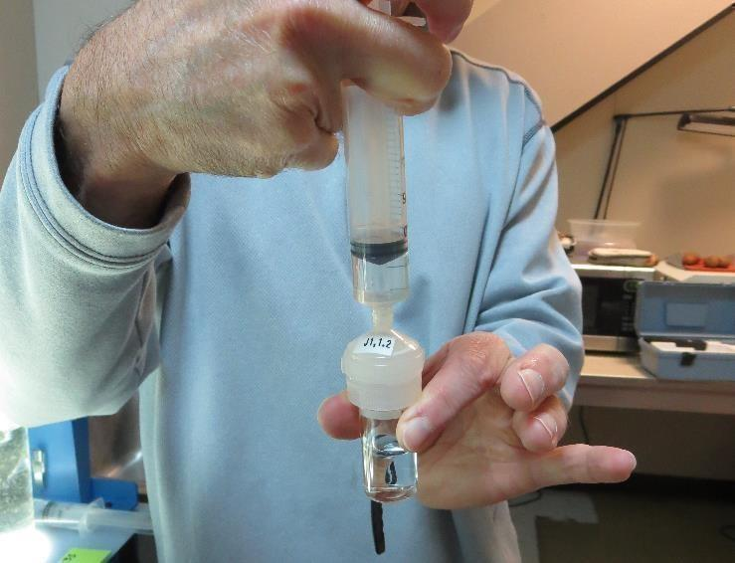

Jar Test - Filterability Test
Syringe ~ 25 mL from jar (after 5-minutes of settling)
Filter-to-waste 3-5 mL
Filter directly into clean cuvette
Measure turbidity
Note: Take several readings before recording final NTU results. Micro bubbles can adhere to glass causing false NTU readings. To remove bubbles, tilt cuvette up to 90 degrees.

Slide 19

Contact
Guy Schott, P.E.
State Water Resources Control Board
Division of Drinking Water
Santa Rosa, CA
Go to Stock Solution/Dose calculations/Jar Test Results for tools to download
www.waterboards.ca.gov/drinking_water/programs/districts/mendocino_district.html
Email: Guy Schott - Guy.Schott@waterboards.ca.gov
Office Number: 707-576-2732

