Slide 1
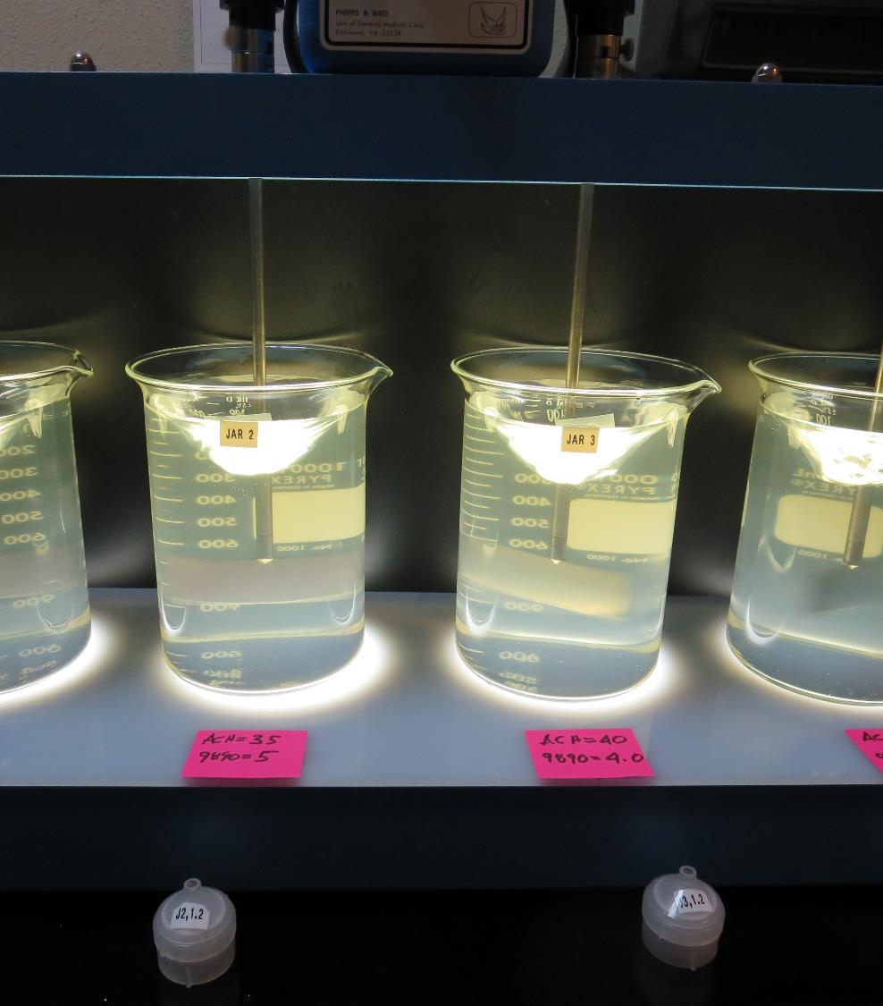
Surfwood Mutual Water Corporation CA2300590 Mendocino County Jar Test
by Guy Schott, P.E.
January 31, 2019

Slide 2
Source Water: Jack Peter’s Creek Roughing Filter followed by Multi-Media Filtration
Source Water Characteristics
Turbidity: 4.8 NTU
pH: 7.12
UVT: 32.1%
UVA: 0.493
0.4 um Filtered
UVT: 42%
UVA: 0.377

Slide 3
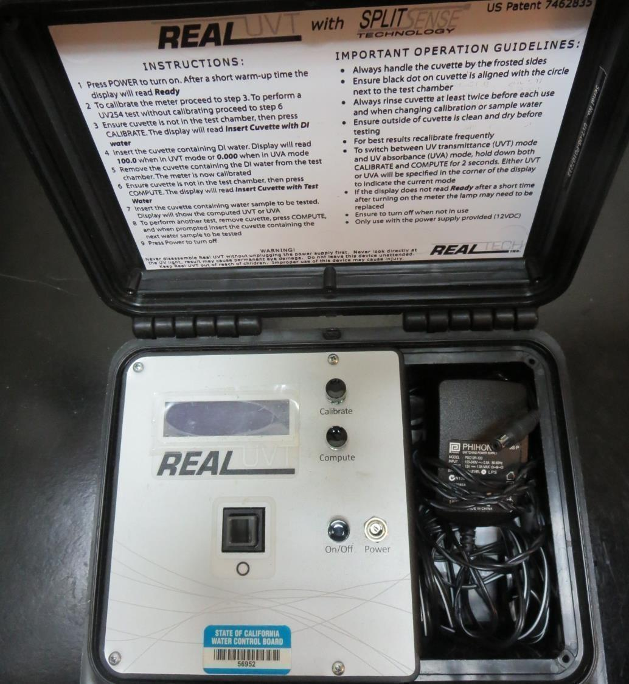
UVT/UVA
UV transmittance (UVT) is a measurement of the amount of ultraviolet light (commonly at 254 nm due to its germicidal effect) that passes through a water sample compared to the amount of light that passes through a pure water sample. The measurement is expressed as a percentage, % UVT.
%UVT = 10^{(-UVA)} x 100%
UV absorbance (UVA) is calculated as a relative measure of the amount of light absorbed by a water sample compared with the amount of light absorbed by a pure water sample.
UVA = -log(%UVT/100)

Slide 4
Applied Coagulants for Jar Testing
Pro Pac 9800 (NTU Technologies)
50% Aluminum Chlorohydrate (ACH)
50% Water
SG = 1.34
48.2% Aluminum Sulfate
SG = 1.34
Pro Pac 9890 (NTU Technologies)
35-45% Aluminum Chlorohydrate (ACH)
35-45% Water
20% Trade Secret
SG = 1.25-1.34
Zeta Floc PA 40 (NTU Technologies)
Cat-Organic Polymer
SG = 1.0 - 1.2

Slide 5
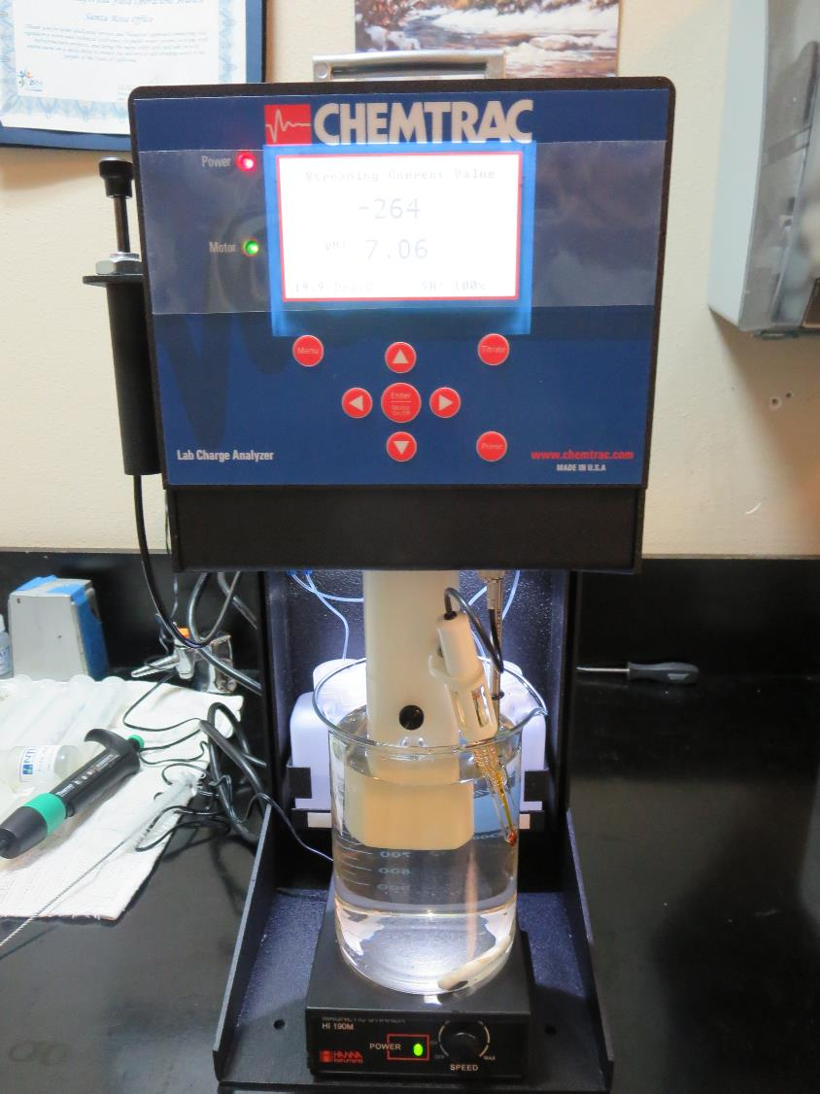
Laboratory Charge Analyzer
LCA: Used to determine coagulant demand of a source water entering the treatment plant.
Source pH: 7.06-7.12
LCA #1 & 2:
ACH (9800): 40-41 mg/L as product
LCA #3:
9890: 6 mg/L as product (manually added)
+ ACH (9800) = 34 mg/L

Slide 6
Coagulant Information
Unless stated otherwise, all coagulant doses are reported as Product (100% strength).
Preparation of coagulant stock solutions are generally 1.0 or 0.1 percent strength using 100 and/or 200 mL volumetric flasks.
Finnpipette F2 variable volume pipette, capacity 100-1000 micro liters is used for stock solution preparation and coagulant aid jar test dosing.
Finnpipette F2 variable volume pipette, capacity 0.5-5 mL is used for primary coagulant jar test dosing.

Slide 7
Surfwood MWC: Jar Test 1-8 Results Water Temperature (11ºC)
Jar # | 200 RPM Flash Mix Seconds | 30 RPM Floc Duration minutes | 9800 mg/L | 9890 mg/L | Filtrate NTU | Filtrate %UVT | Filtrate UVA/cm | Settle NTU 25 min
J1 | 60 | 5 | 25 | 0 | 1.5 | 73.0 | 0.137 | 7.4
J2 | 60 | 5 | 30 | 0 | 2.8 | 67.5 | 0.171 | 2.3
J3 | 60 | 5 | 35 | 0 | 1.0 | 82.1 | 0.086 | 1.2
J4 | 60 | 5 | 40 | 0 | 2.0 | 77.3 | 0.112 | 4.4
J5 | 60 | 5 | 30 | 4.5 | 0.22 | 88.6 | 0.053 | 2.2
J6 | 60 | 5 | 35 | 5.0 | 0.10 | 91.2 | 0.040 | 0.9
J7 | 60 | 5 | 40 | 6.0 | 0.08 | 92.4 | 0.034 | 1.5
J8 | 60 | 5 | 50 | 7.5 | 1.37 | 86.8 | 0.061 | 1.4

Slide 8
Surfwood MWC: Jar Test 9-12 Results Water Temperature (11ºC)
Jar # | 200 RPM Flash Mix Seconds | 30 RPM Floc Duration minutes | 9800 mg/L | 9890 mg/L | Filtrate NTU | Filtrate %UVT | Filtrate UVA/cm | Settle NTU 25 min
J9 | 60 | 5 | 50 | 7.5 | 1.37 | 86.8 | 0.061 | 1.4
J10 | 60 | 5 | 0 | 25 | 2.6 | 71.0 | 0.149 | 4.3
J11 | 60 | 5 | 0 | 30 | 1.7 | 76.9 | 0.114 | 1.1
J12 | 60 | 5 | 0 | 35 | 0.42 | 87.8 | 0.057 | 0.8

Slide 9
Surfwood MWC: Jar Test 13-20 Results Water Temperature (20ºC)
Jar # | 200 RPM Flash Mix Seconds | 30 RPM Floc Duration minutes | 9800 mg/L | 9890 mg/L | Filtrate NTU | Filtrate %UVT | Filtrate UVA/cm | Settle NTU 25 min
J13 | 60 | 5 | 34 | 6.0 | 0.11 | 90.9 | 0.041 | 3.7
J14 | 60 | 5 | 37 | 6.5 | 0.47 | 90.9 | 0.041 | 4.1
J15 | 60 | 5 | 40 | 7.0 | 0.8 | 89.0 | 0.051 | 3.3
J16 | 60 | 5 | 42.6 | 7.5 | 1.1 | 86.5 | 0.063 | 3.4
J17 | 60 | 5 | 35 | 3.5 | 1.1 | 82.2 | 0.085 | 2.9
J18 | 60 | 5 | 35 | 5.0 | 0.9 | 84.9 | 0.071 | 2.3
J19 | 60 | 5 | 40 | 4.0 | 1.1 | 84.1 | 0.075 | 1.9
J20 | 60 | 5 | 40 | 6.0 | 1.1 | 84.6 | 0.073 | 1.9

Slide 10
Surfwood MWC: Jar Test 21-24 Results Water Temperature (20ºC)
Jar # | 200 RPM Flash Mix Seconds | 30 RPM Floc Duration minutes | 9800 mg/L | 9890 mg/L | Filtrate NTU | Filtrate %UVT | Filtrate UVA/cm | Settle NTU 25 min
J21 | 60 | 5 | 25 | 3.8 | 0.55 | 81.0 | 0.092 | 7.2
J22 | 60 | 5 | 30 | 4.5 | 1.6 | 76.9 | 0.114 | 3.0
J23 | 60 | 5 | 34 | 5 | 0.19 | 89.7 | 0.047 | 2.8
J24 | 60 | 5 | 34 | 6 | 0.75 | 85.8 | 0.067 | 2.0

Slide 11
Surfwood MWC: Jar Test 25-32 Results Flash Mix 60 sec (200 RPM)
Jar # | 30 RPM Floc minutes | NaOCl mg/L | 9800 mg/L | 9890 mg/L | Filtrate NTU | Filtrate %UVT | Filtrate UVA/cm | Settle NTU 25 min
J25 | 5 | 2 | 34 | 3.0 | 0.08 | 88.9 | 0.051 | 2.7
J26 | 5 | 2 | 34 | 4.0 | 0.8 | 84.2 | 0.075 | 2.7
J27 | 5 | 2 | 34 | 5.0 | 0.13 | 89.0 | 0.051 | 2.6
J28 | 5 | 2 | 34 | 6.0 | 0.09 | 89.7 | 0.047 | 3.3
J29 | 5 | 3 | 34 | 3 | 0.20 | 86.0 | 0.066 | 3.6
J30 | 5 | 3 | 34 | 6 | 1.5 | 76.2 | 0.118 | 3.5
J31 | 5 | 0 | 34 | 3 | 0.26 | 86.1 | 0.065 | 3.3
J32 | 5 | 0 | 34 | 6 | 0.55 | 83.0 | 0.081 | 3.6

Slide 12
Surfwood MWC: Jar Test 33-35 Results Water Temperature (20ºC)
Jar # | 200 RPM Flash Mix Seconds | 30 RPM Floc Duration minutes | Alum mg/L | Filtrate NTU | Filtrate %UVT | Filtrate UVA/cm | Settle NTU 25 min
J33 | 60 | 5 | 19 | 2.6 | 61.4 | 0.209 | 9
J34 | 60 | 5 | 24 | 1.6 | 74.9 | 0.126 | 11.8
J35 | 60 | 5 | 29 | 0.18 | 88.0 | 0.056 | 9.6

Slide 13
Jars 1-4 Test Flash Mix 60 Sec (200 RPM) Floc Mix 5 min (30 RPM) Water Temperature, 11ºC Applied Coagulant 9800

Slide 14
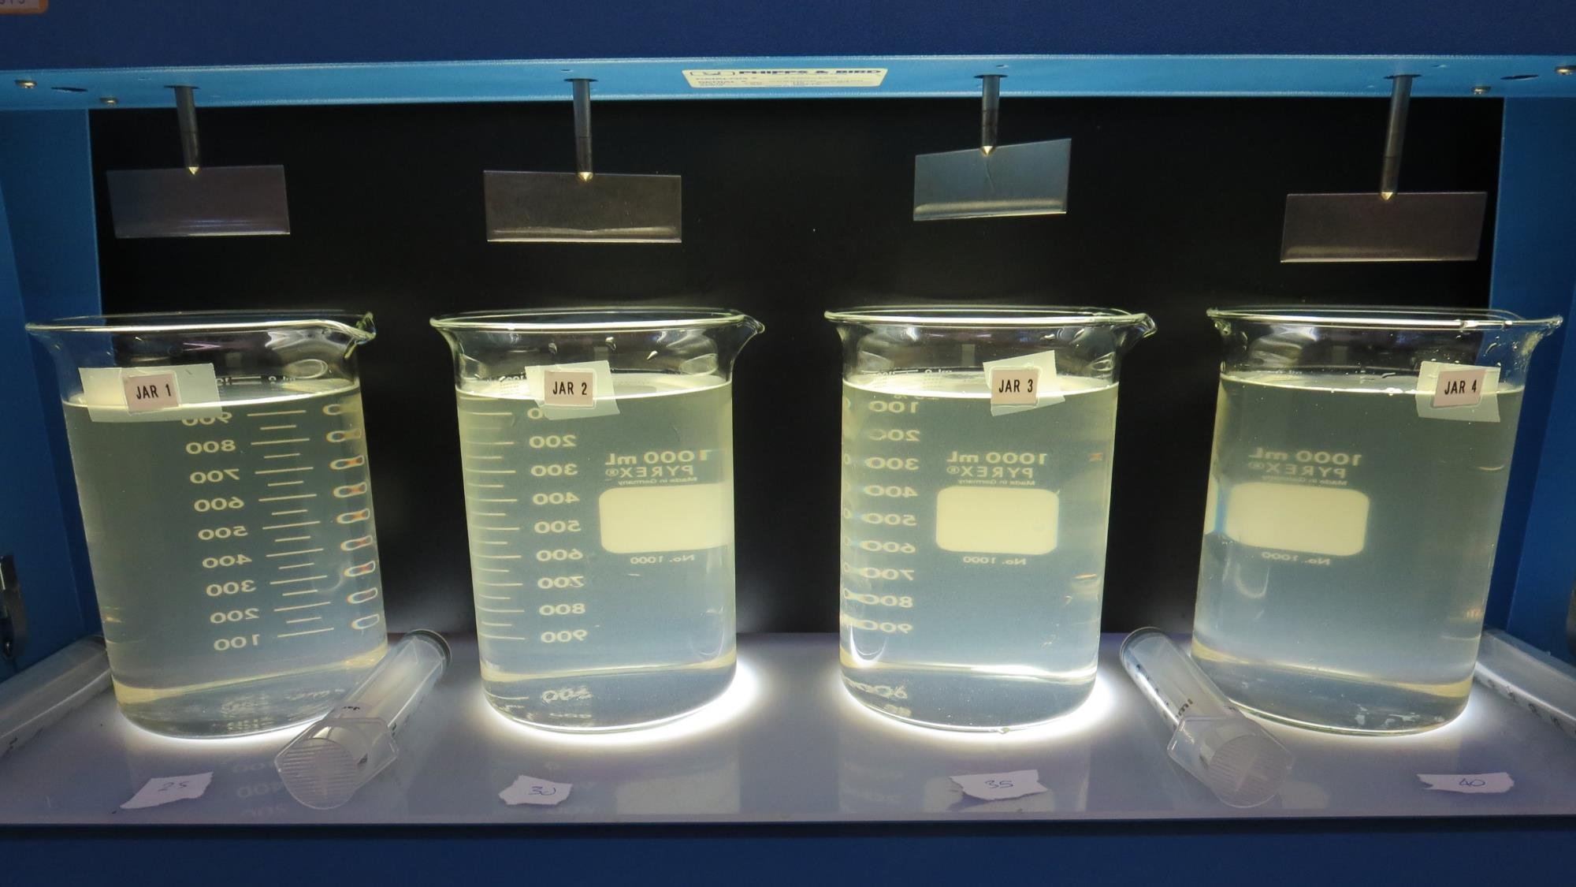
Jars 1-4: End of 5-minute flocculation (30 RPM) duration.
25 mg/L 9800
Filtrate 1.5 NTU
UVT: 73%
UVA: 0.137/cm
Settled: 7.4 NTU
30 mg/L 9800
Filtrate 2.8 NTU
UVT: 67.5%
UVA: 0.171/cm
Settled: 1.2 NTU
35 mg/L 9800
Filtrate 1.0 NTU
UVT: 82.1%
UVA: 0.086/cm
Settled: 1.2 NTU
40 mg/L 9800
Filtrate 2.0 NTU
UVT: 77.3%
UVA: 0.112/cm
Settled: 4.4 NTU

Slide 15
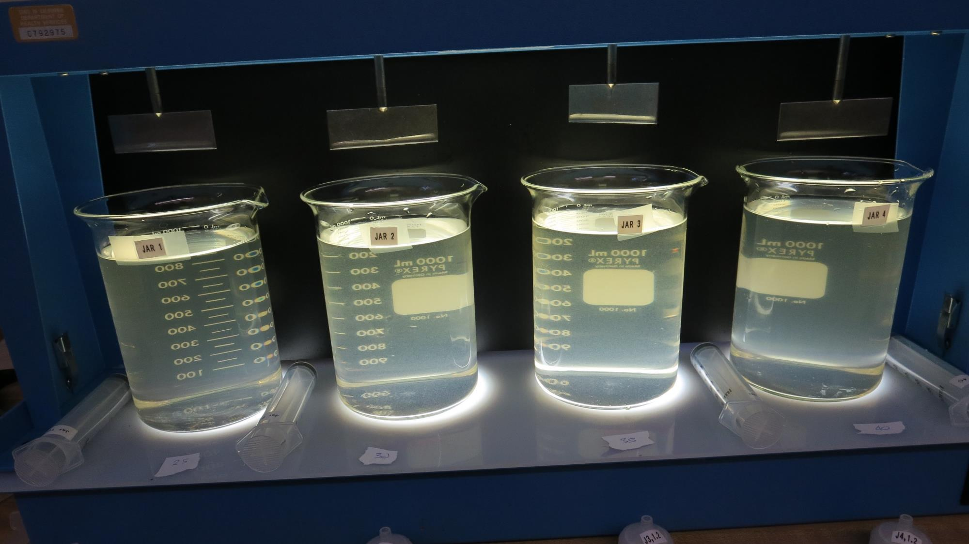
Jars 1-4: After 5 min of settling, 25 mL is syringed for filterability and %UVT/UVA.

Slide 16
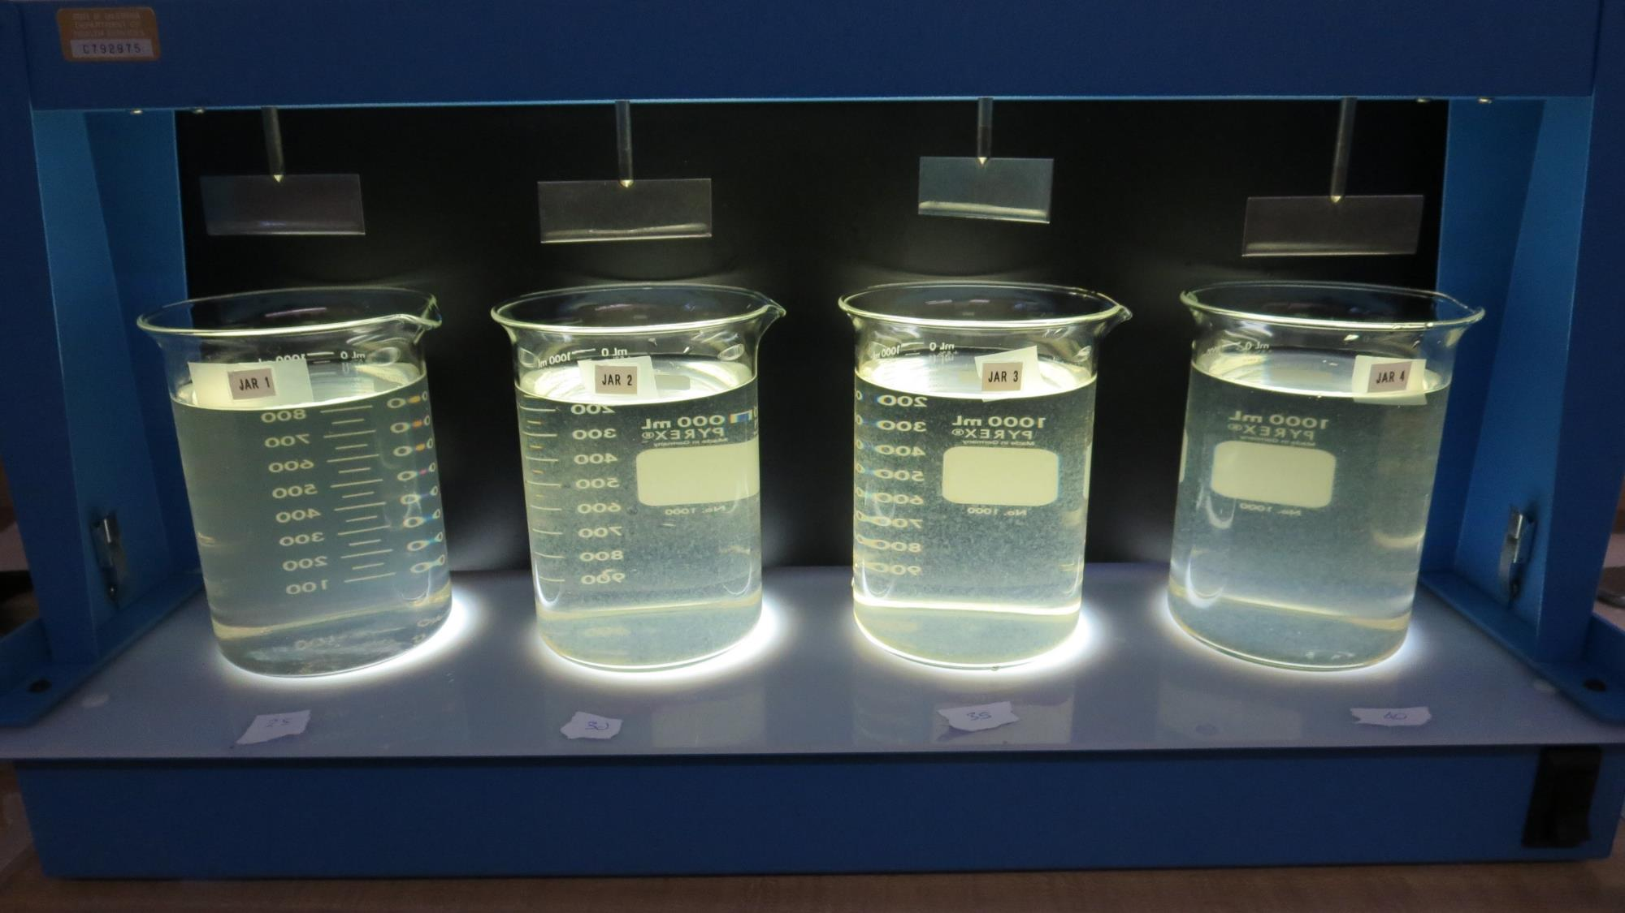
Jars 1-4: After 25-minutes of settling, settled water turbidity is taken.
25 mg/L 9800
Filtrate 1.5 NTU
UVT: 73%
UVA: 0.137/cm
Settled: 7.4 NTU
30 mg/L 9800
Filtrate 2.8 NTU
UVT: 67.5%
UVA: 0.171/cm
Settled: 1.2 NTU
35 mg/L 9800
Filtrate 1.0 NTU
UVT: 82.1%
UVA: 0.086/cm
Settled: 1.2 NTU
40 mg/L 9800
Filtrate 2.0 NTU
UVT: 77.3%
UVA: 0.112/cm
Settled: 4.4 NTU

Slide 17
Jars 5-8 Test Flash Mix 60 Sec (200 RPM) Floc Mix 5 min (30 RPM) Water Temperature, 11ºC Applied Coagulants 9800/9890

Slide 18
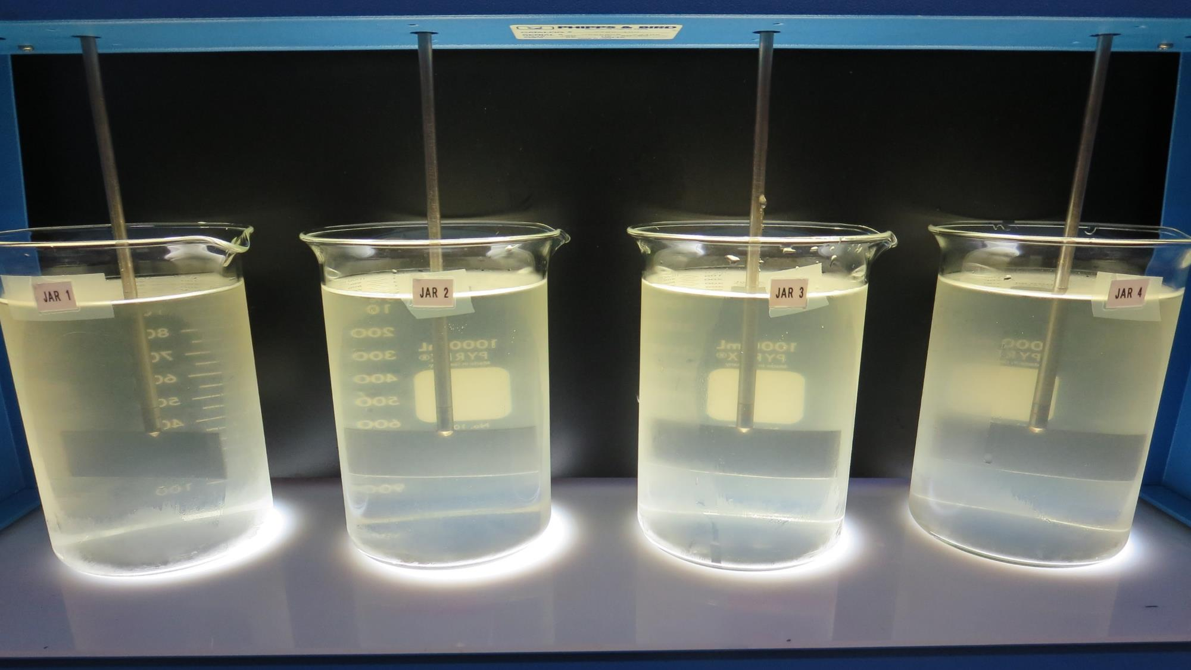
Jars 5-8: End of 5-minute flocculation (30 RPM) duration.
4.5 mg/L 9890
30 mg/L 9800
Filtrate 0.22 NTU
UVT: 88.6%
UVA: 0.053/cm
Settled: 2.2 NTU
5 mg/L 9890
35 mg/L 9800
Filtrate 0.10 NTU
UVT: 91.2%
UVA: 0.040/cm
Settled: 0.9 NTU
6 mg/L 9890
40 mg/L 9800
Filtrate 0.08 NTU
UVT: 92.4%
UVA: 0.034/cm
Settled: 1.5 NTU
7.5 mg/L 9890
50 mg/L 9800
Filtrate 1.37 NTU
UVT: 86.8%
UVA: 0.061/cm
Settled: 3.0 NTU

Slide 19
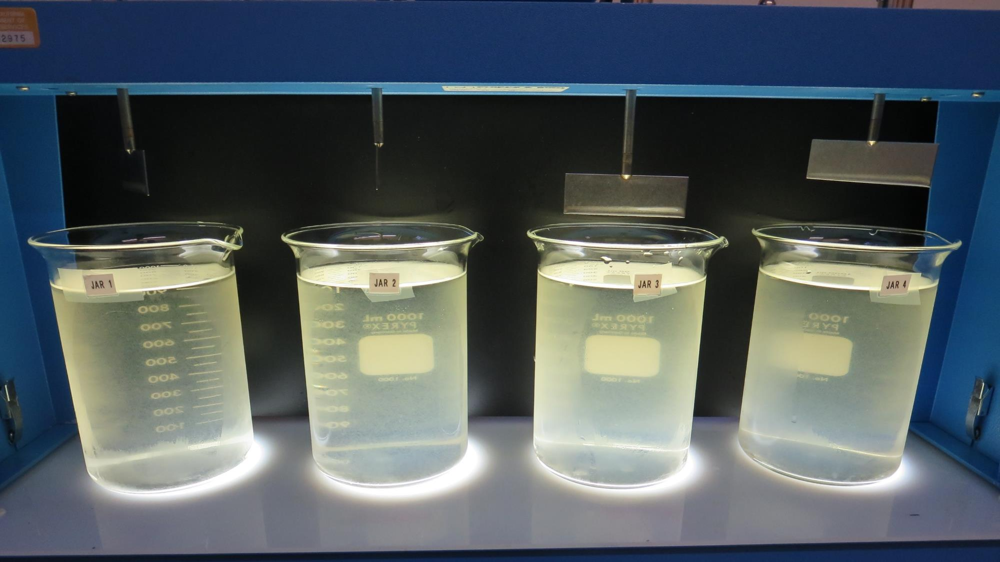
Jars 5-8: After 5 min of settling, 25 mL is syringed for filterability and %UVT/UVA.

Slide 20
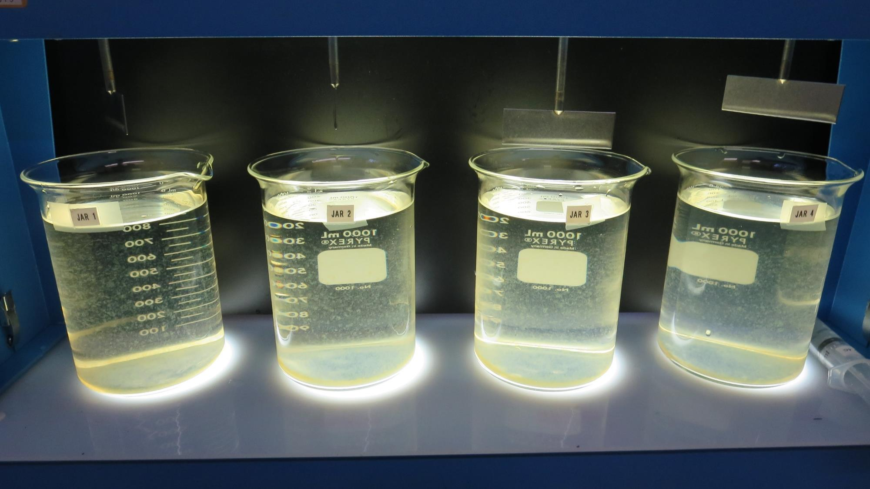
Jars 5-8: After 25-minutes of settling, settled water turbidity is taken.
4.5 mg/L 9890
30 mg/L 9800
Filtrate 0.22 NTU
UVT: 88.6%
UVA: 0.053/cm
Settled: 2.2 NTU
5 mg/L 9890
35 mg/L 9800
Filtrate 0.10 NTU
UVT: 91.2%
UVA: 0.040/cm
Settled: 0.9 NTU
6 mg/L 9890
40 mg/L 9800
Filtrate 0.08 NTU
UVT: 92.4%
UVA: 0.034/cm
Settled: 1.5 NTU
7.5 mg/L 9890
50 mg/L 9800
Filtrate 1.37 NTU
UVT: 86.8%
UVA: 0.061/cm
Settled: 3.0 NTU

Slide 21
Jars 9-12 Test Flash Mix 60 Sec (200 RPM) Floc Mix 5 min (30 RPM) Water Temperature, 11ºC Applied Coagulant 9890

Slide 22
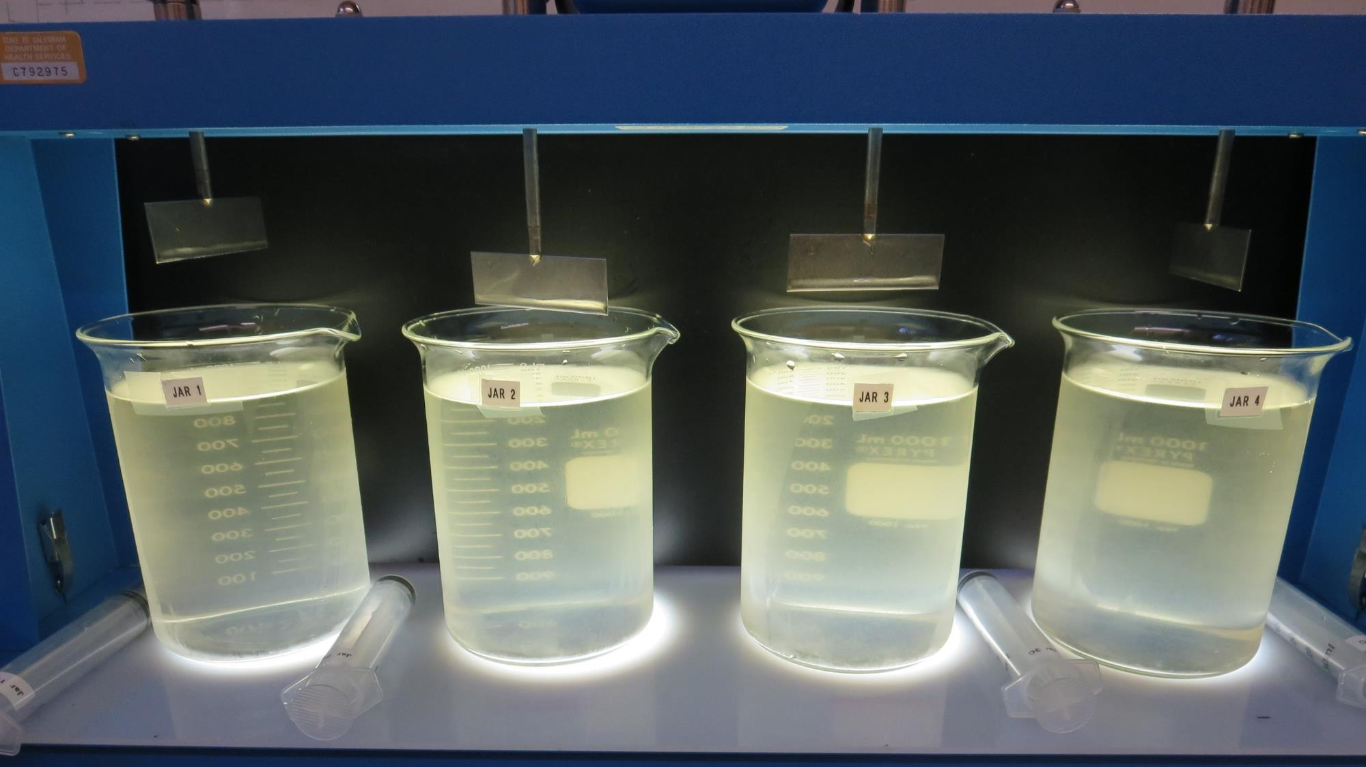
Jars 9-12: End of 5-minute flocculation (30 RPM) duration.
25 mg/L 9890
Filtrate 2.6 NTU
UVT: 71%
UVA: 0.149/cm
Settled:4.3 NTU
30 mg/L 9890
Filtrate 1.7 NTU
UVT: 76.9%
UVA: 0.114/cm
Settled:1.1 NTU
35 mg/L 9890
Filtrate 0.42 NTU
UVT: 87.8%
UVA: 0.057/cm
Settled:0.8 NTU
40 mg/L 9890
Filtrate 0.61 NTU
UVT: 88.2%
UVA: 0.055/cm
Settled:1.1 NTU

Slide 23
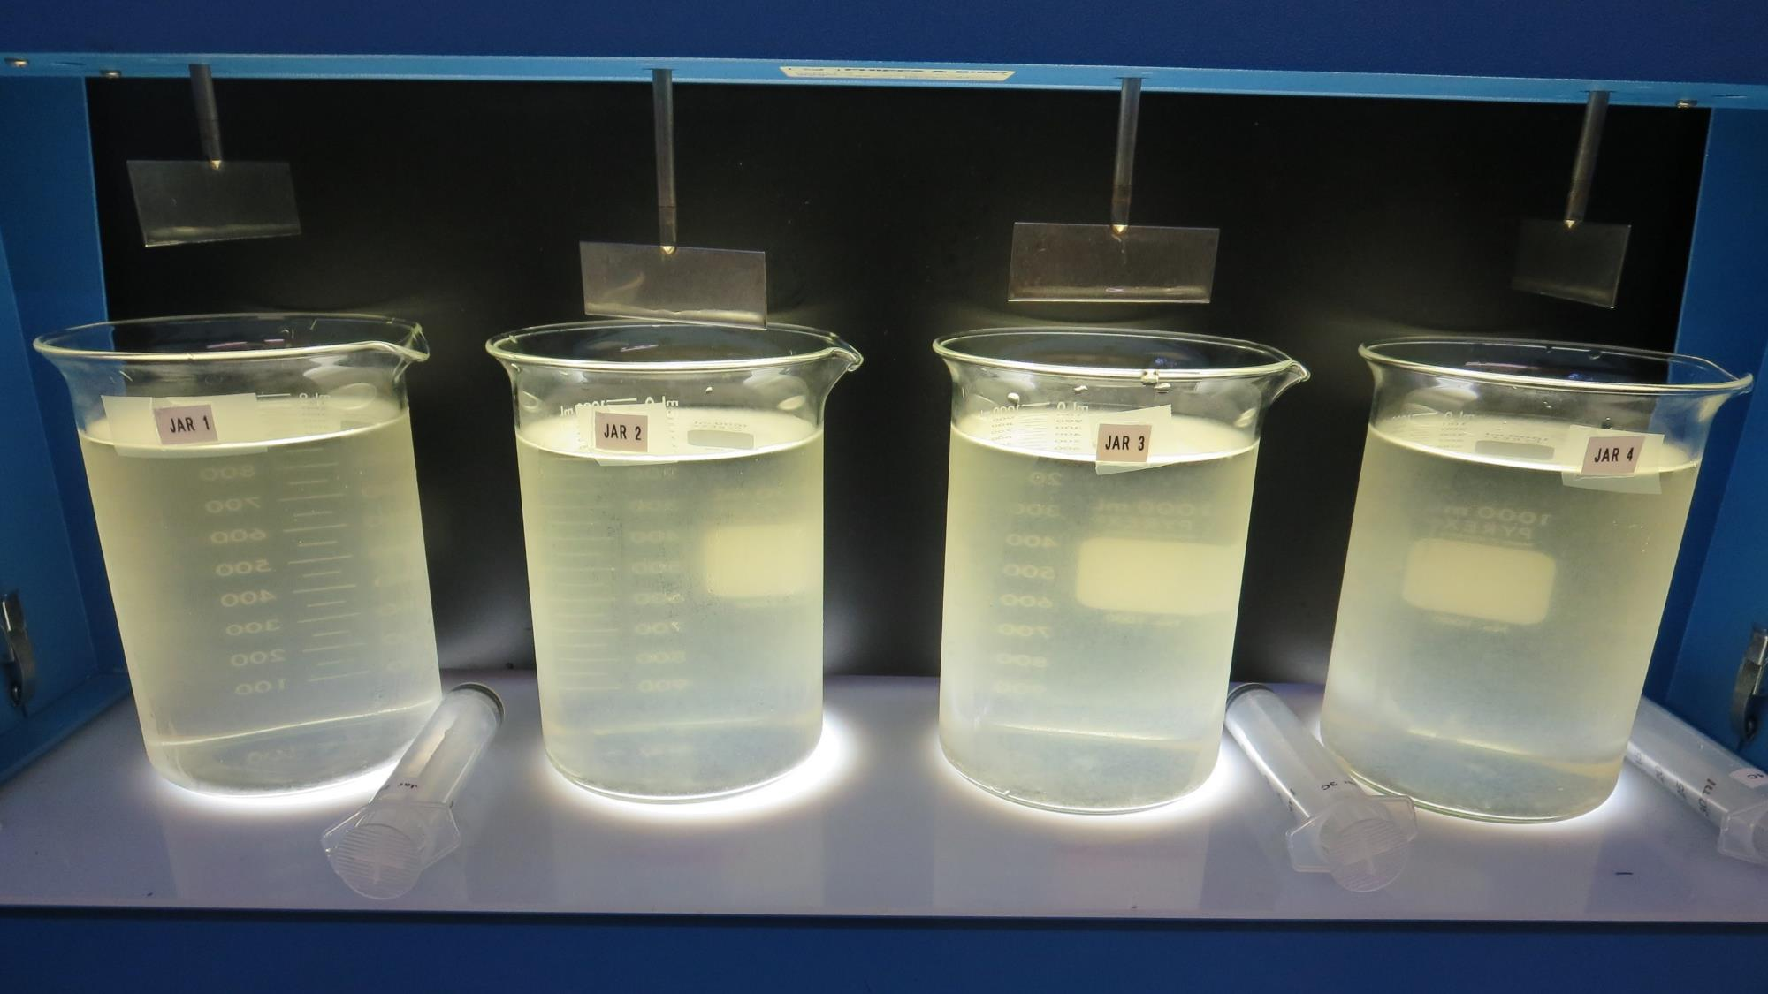
Jars 9-12: After 5 min of settling, 25 mL is syringed for filterability and %UVT/UVA.

Slide 24
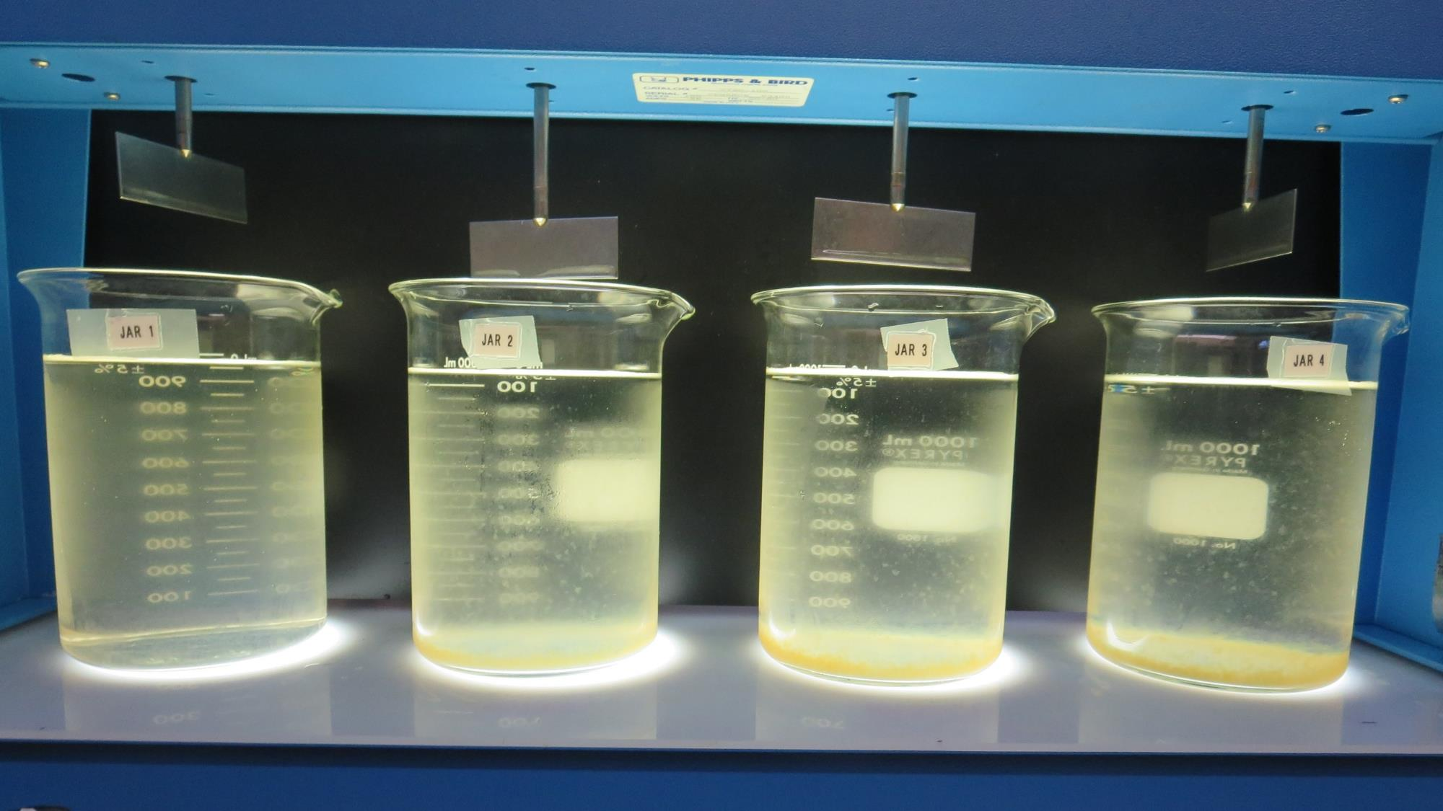
Jars 9-12: After 25-minutes of settling, settled water turbidity is taken.
25 mg/L 9890
Filtrate 2.6 NTU
UVT: 71%
UVA: 0.149/cm
Settled:4.3 NTU
25 mg/L 9890
Filtrate 2.6 NTU
UVT: 71%
UVA: 0.114/cm
Settled:4.3 NTU
35 mg/L 9890
Filtrate 0.42 NTU
UVT: 87.8%
UVA: 0.057/cm
Settled:0.8 NTU
40 mg/L 9890
Filtrate 0.61 NTU
UVT: 88.2%
UVA: 0.055/cm
Settled:1.1 NTU

Slide 25
Jars 13-16 Test Flash Mix 60 Sec (200 RPM) Floc Mix 5 min (30 RPM) Applied Coagulants 9800/9890

Slide 26
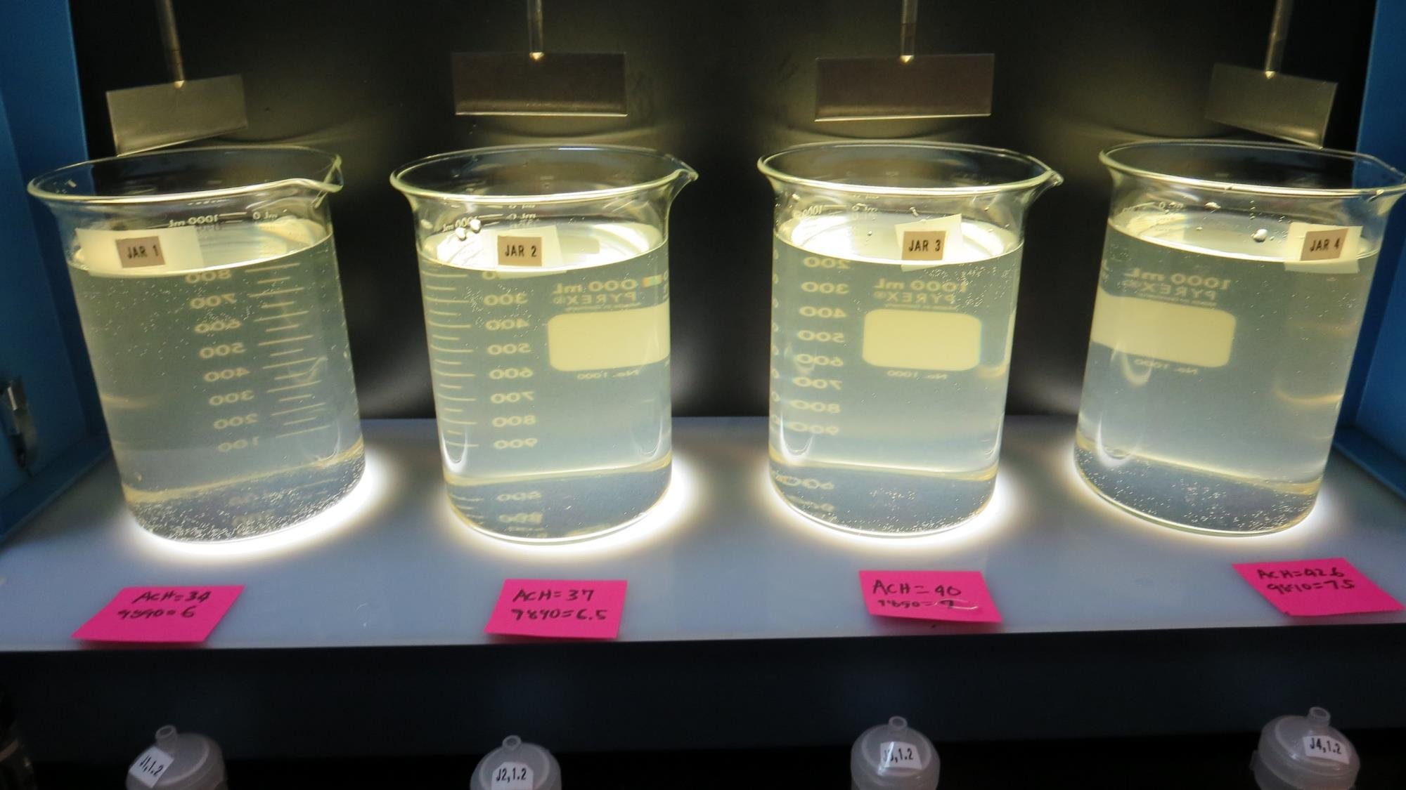
Jars 13-16: End of 5-minute flocculation (30 RPM) duration.
6 mg/L 9890
34 mg/L 9800
Filtrate 0.12 NTU
UVT: 90.9%
UVA: 0.041/cm
Settled: 3.7 NTU
6.5 mg/L 9890
37 mg/L 9800
Filtrate 0.47 NTU
UVT: 90.9%
UVA: 0.041/cm
Settled: 4.1 NTU
7 mg/L 9890
40 mg/L 9800
Filtrate 0.8 NTU
UVT: 89%
UVA: 0.051/cm
Settled: 3.3 NTU
7.5 mg/L 9890
42.6 mg/L 9800
Filtrate 1.1 NTU
UVT: 86.5%
UVA: 0.063/cm
Settled: 3.4 NTU

Slide 27
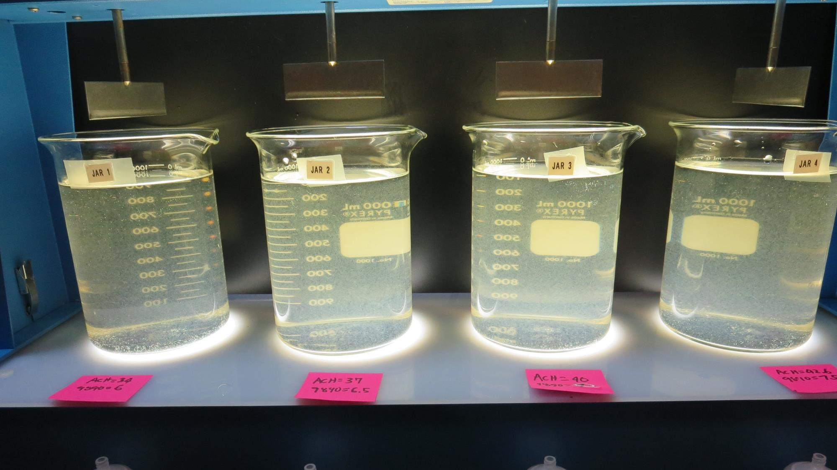
Jars 13-16: After 5 min of settling, 25 mL is syringed for filterability and %UVT/UVA.

Slide 28
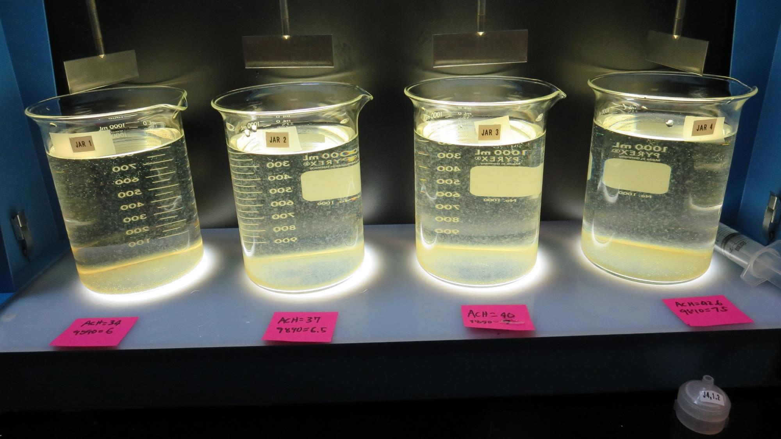
Jars 13-16: After 25-minutes of settling, settled water turbidity is taken.
6 mg/L 9890
34 mg/L 9800
Filtrate 0.12 NTU
UVT: 90.9%
UVA: 0.041/cm
Settled: 3.7 NTU
6.5 mg/L 9890
37 mg/L 9800
Filtrate 0.47 NTU
UVT: 90.9%
UVA: 0.041/cm
Settled: 4.1 NTU
7 mg/L 9890
40 mg/L 9800
Filtrate 0.8 NTU
UVT: 89%
UVA: 0.051/cm
Settled: 3.3 NTU
7.5 mg/L 9890
42.6 mg/L 9800
Filtrate 1.1 NTU
UVT: 86.5%
UVA: 0.063/cm
Settled: 3.4 NTU

Slide 29
Jars 17-20 Test Flash Mix 60 Sec (200 RPM) Floc Mix 5 min (30 RPM) Applied Coagulants 9800/9890

Slide 30
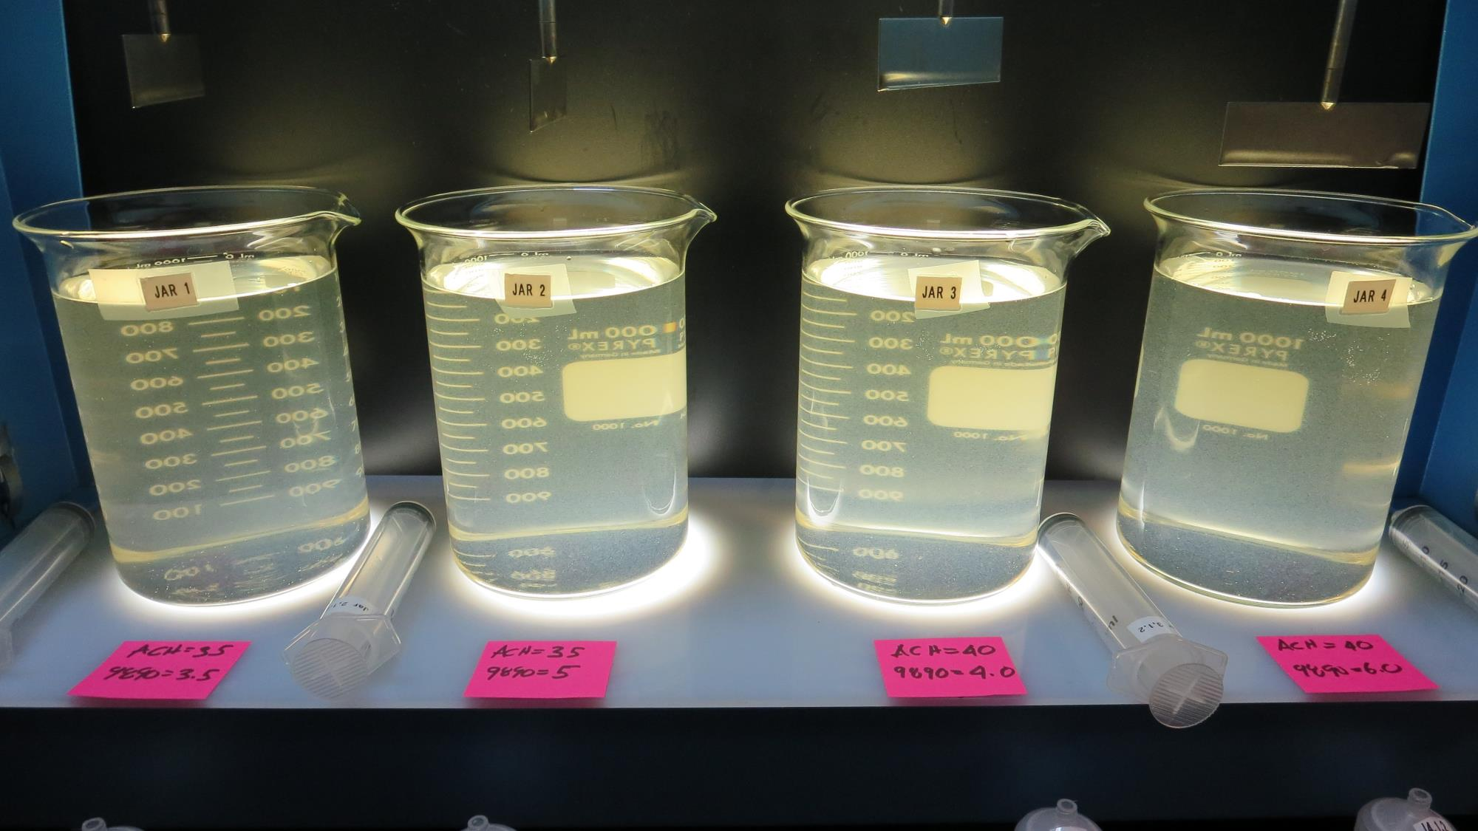
Jars 17-20: End of 5-minute flocculation (30 RPM) duration.
3.5 mg/L 9890
35 mg/L 9800
Filtrate 1.1 NTU
UVT: 82.2%
UVA: 0.085/cm
Settled: 2.9 NTU
5 mg/L 9890
35 mg/L 9800
Filtrate 0.9 NTU
UVT: 84.9%
UVA: 0.071/cm
Settled: 2.3 NTU
4 mg/L 9890
40 mg/L 9800
Filtrate 1.1 NTU
UVT: 84.1%
UVA: 0.075/cm
Settled: 1.9 NTU
6 mg/L 9890
40 mg/L 9800
Filtrate 1.1 NTU
UVT: 84.6%
UVA: 0.073/cm
Settled: 1.9 NTU

Slide 31
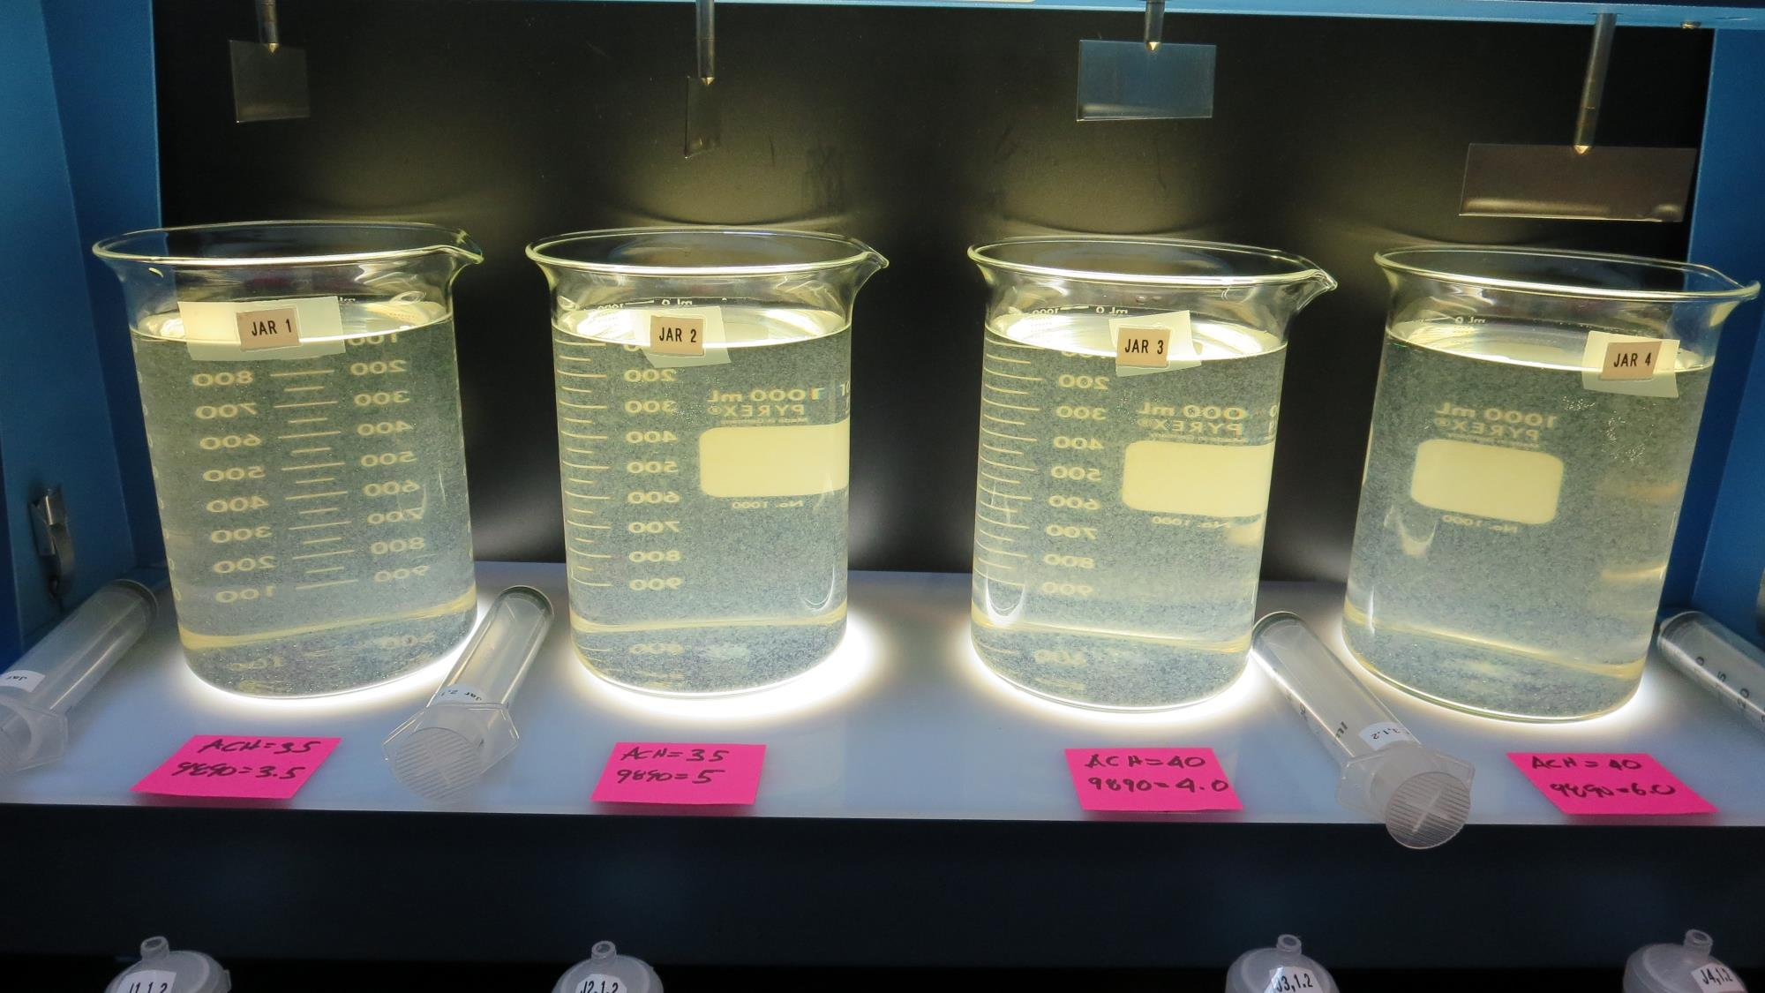
Jars 17-20: After 5 min of settling, 25 mL is syringed for filterability and %UVT/UVA.

Slide 32
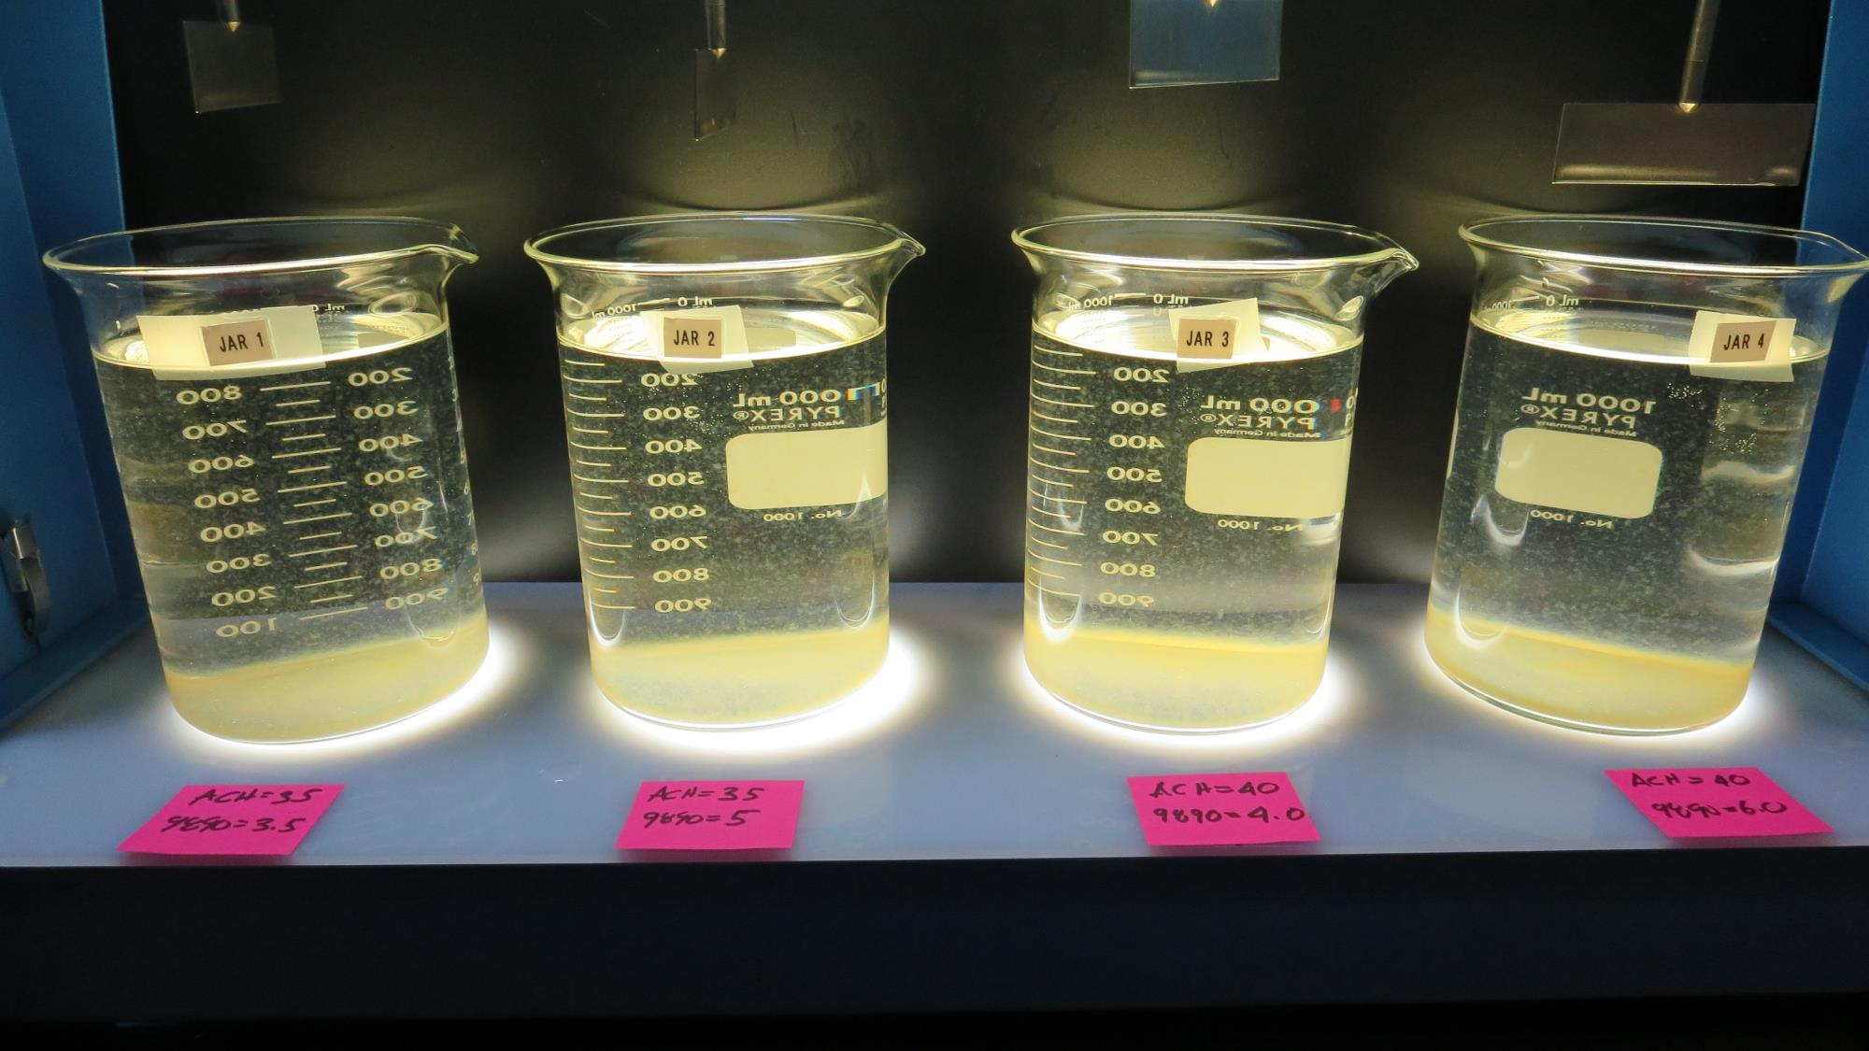
Jars 17-20: After 25-minutes of settling, settled water turbidity is taken.
3.5 mg/L 9890
35 mg/L 9800
Filtrate 1.1 NTU
UVT: 82.2%
UVA: 0.085/cm
Settled: 2.9 NTU
5 mg/L 9890
35 mg/L 9800
Filtrate 0.9 NTU
UVT: 84.9%
UVA: 0.071/cm
Settled: 2.3 NTU
4 mg/L 9890
40 mg/L 9800
Filtrate 1.1 NTU
UVT: 84.1%
UVA: 0.075/cm
Settled: 1.9 NTU
6 mg/L 9890
40 mg/L 9800
Filtrate 1.1 NTU
UVT: 84.6%
UVA: 0.073/cm
Settled: 1.9 NTU

Slide 33
Jars 21-24 Test Flash Mix 60 Sec (200 RPM) Floc Mix 5 min (30 RPM) Applied Coagulants 9800/9890

Slide 34
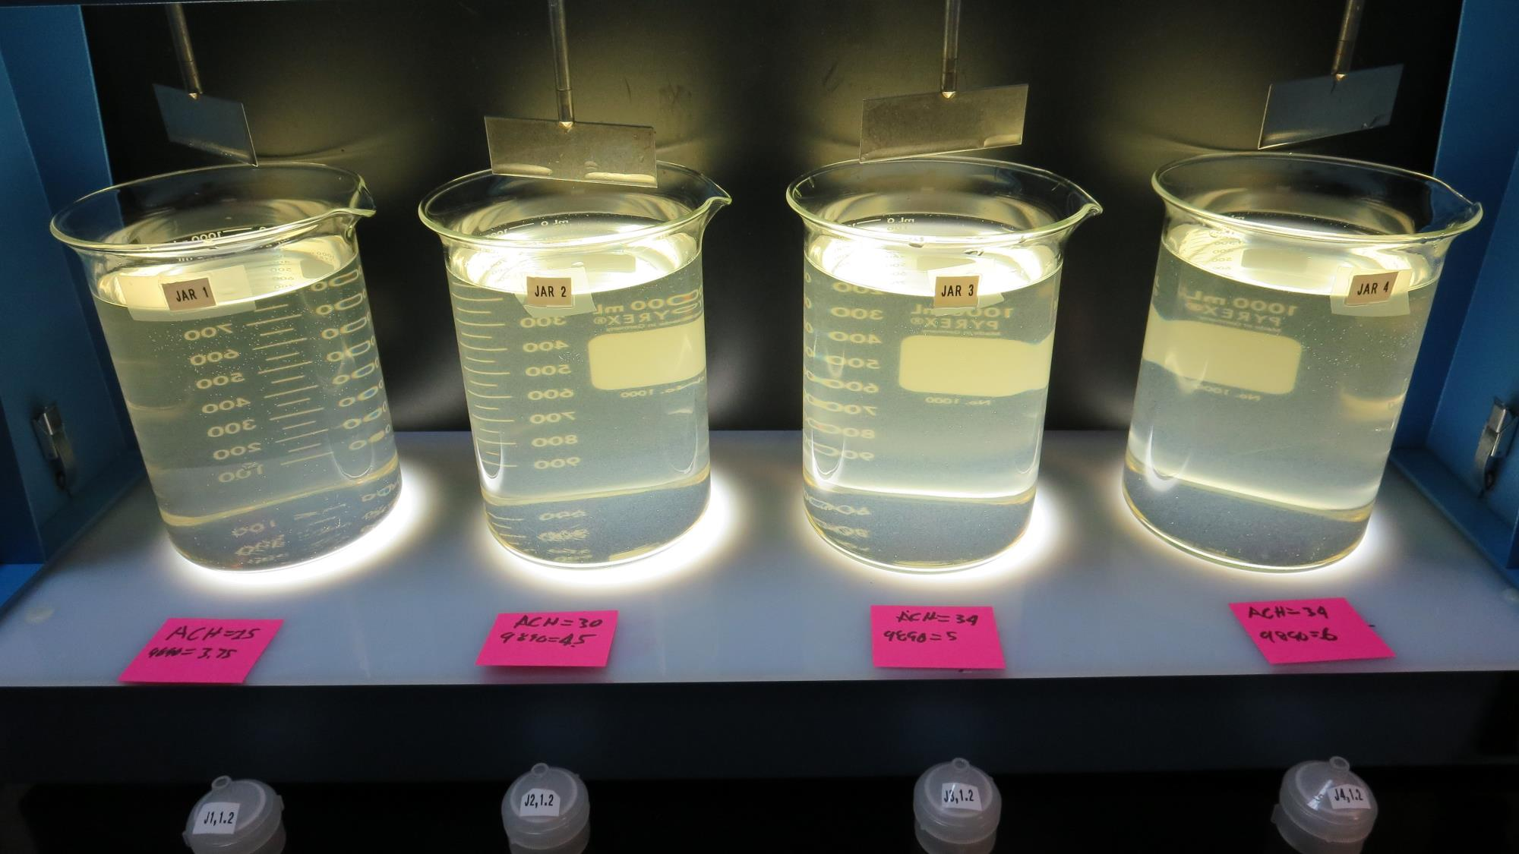
Jars 21-24: End of 5-minute flocculation (30 RPM) duration.
3.75 mg/L 9890
25 mg/L 9800
Filtrate 0.55 NTU
UVT: 81.0%
UVA: 0.092/cm
Settled: 7.2 NTU
4.5 mg/L 9890
30 mg/L 9800
Filtrate 1.6 NTU
UVT: 76.9%
UVA: 0.114/cm
Settled: 3 NTU
5 mg/L 9890
34 mg/L 9800
Filtrate 0.19 NTU
UVT: 89.7%
UVA: 0.047/cm
Settled: 2.8 NTU
6 mg/L 9890
34 mg/L 9800
Filtrate 0.75 NTU
UVT: 85.8%
UVA: 0.067/cm
Settled: 2 NTU

Slide 35
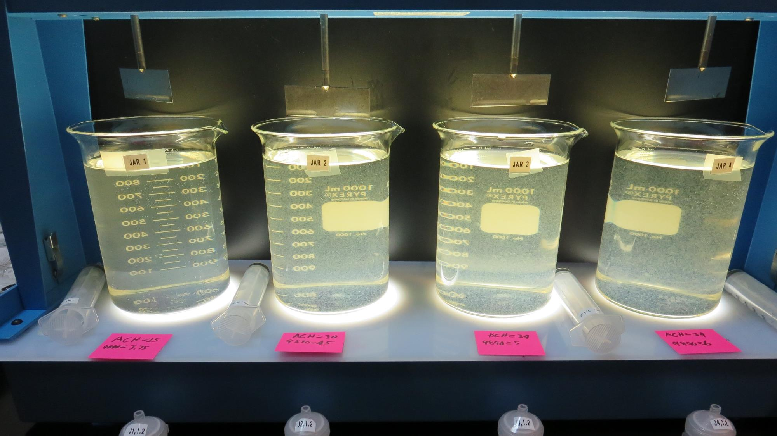
Jars 21-24: After 5 min of settling, 25 mL is syringed for filterability and %UVT/UVA.

Slide 36
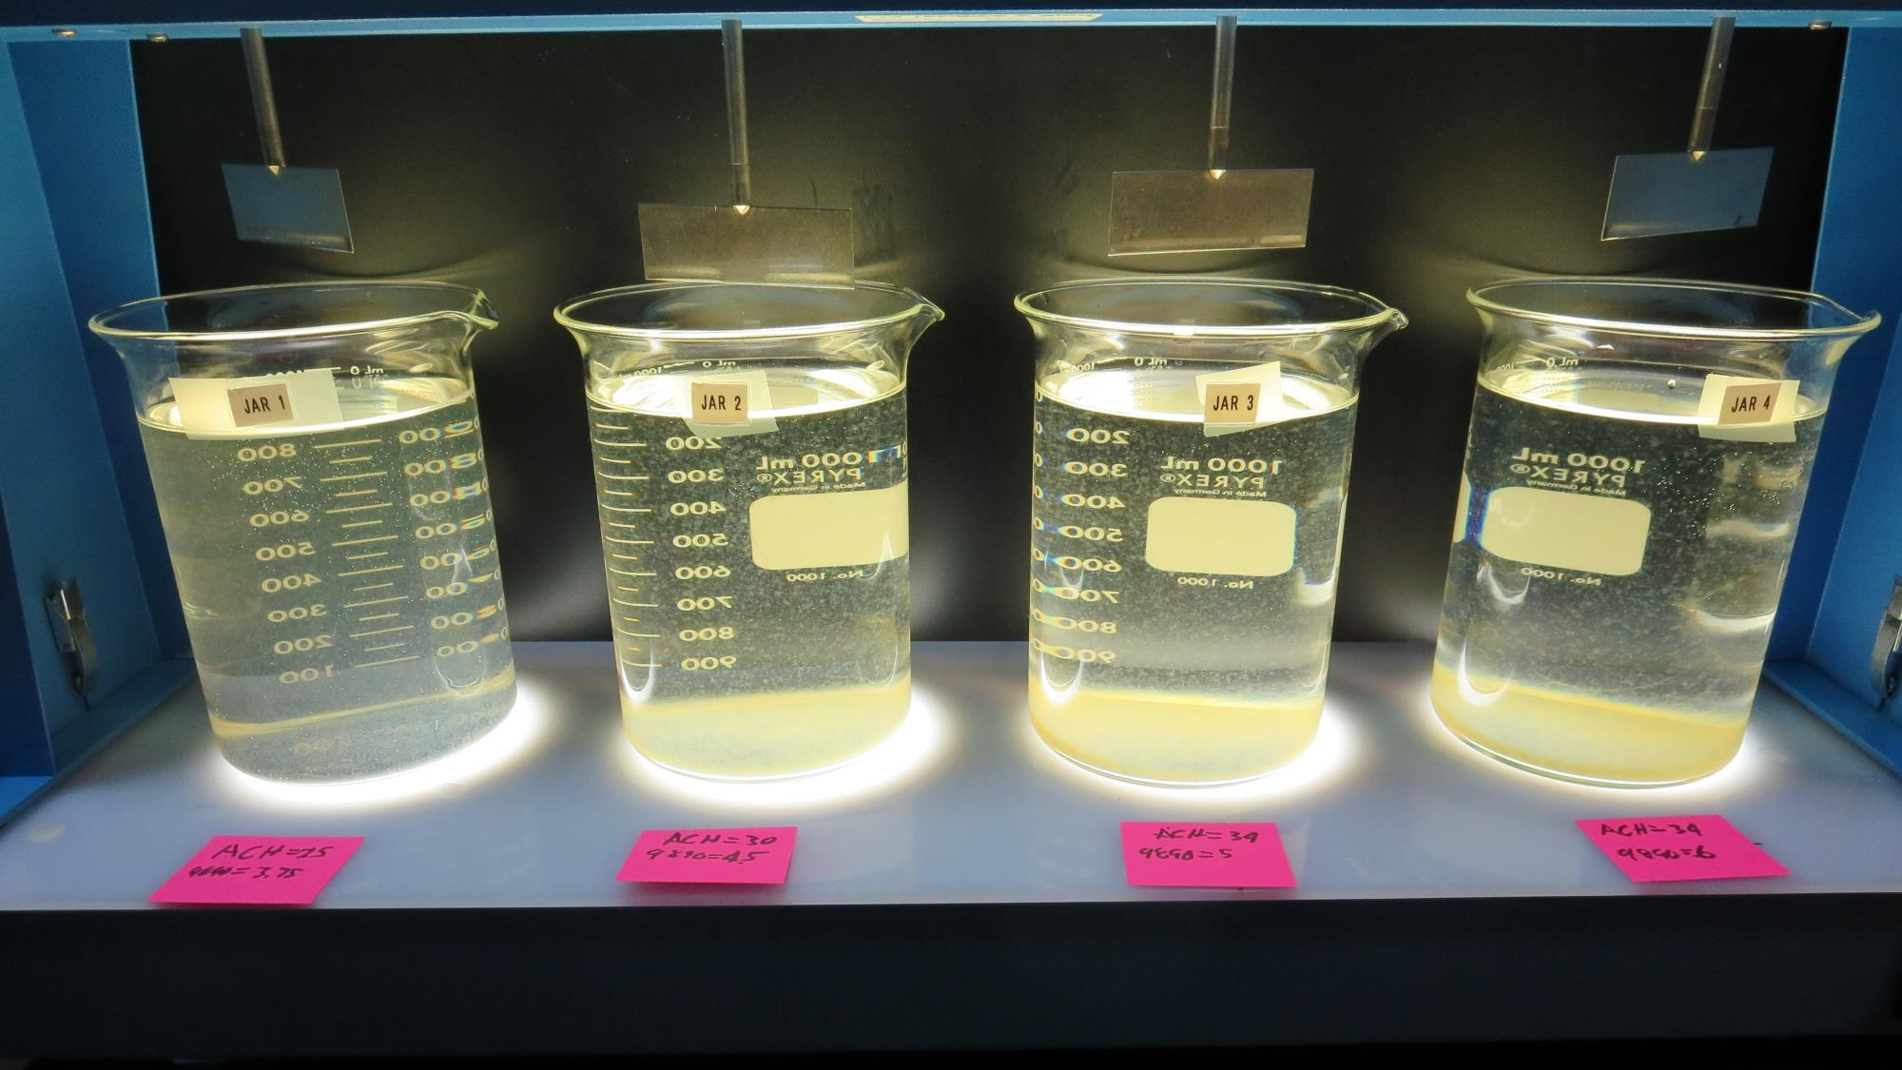
Jars 21-24: After 25-minutes of settling, settled water turbidity is taken.
3.75 mg/L 9890
25 mg/L 9800
Filtrate 0.55 NTU
UVT: 81.0%
UVA: 0.092/cm
Settled: 7.2 NTU
4.5 mg/L 9890
30 mg/L 9800
Filtrate 1.6 NTU
UVT: 76.9%
UVA: 0.114/cm
Settled: 3 NTU
5 mg/L 9890
34 mg/L 9800
Filtrate 0.19 NTU
UVT: 89.7%
UVA: 0.047/cm
Settled: 2.8 NTU
6 mg/L 9890
34 mg/L 9800
Filtrate 0.75 NTU
UVT: 85.8%
UVA: 0.067/cm
Settled: 2 NTU

Slide 37
Jars 25-28 Test Flash Mix 60 Sec (200 RPM) Floc Mix 5 min (30 RPM) Applied Coagulants 9800/9890 w/NaOCl

Slide 38
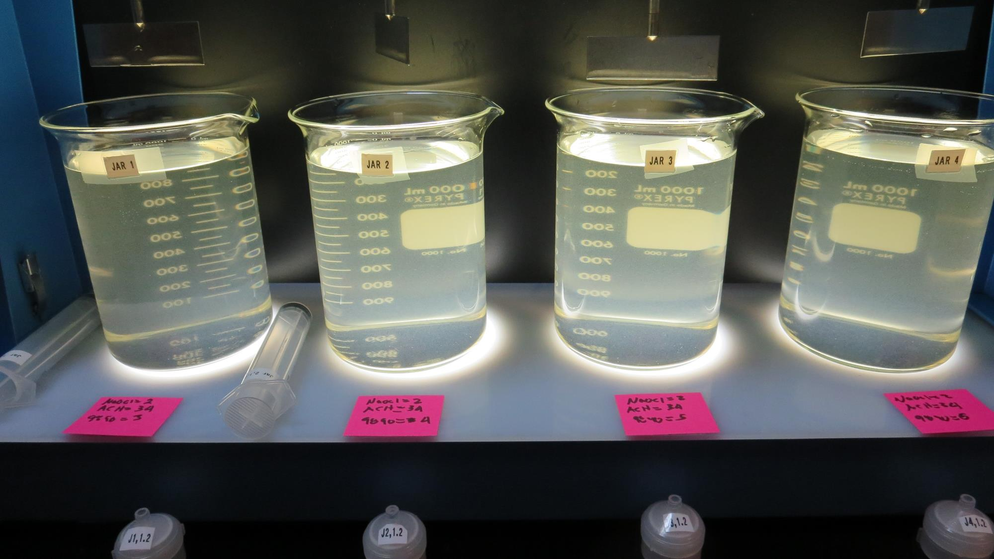
Jars 25-28: End of 5-minute flocculation (30 RPM) duration.
2 mg/L NaOCl
3 mg/L 9890
34 mg/L 9800
Filtrate 0.08 NTU
UVT: 88.9%
UVA: 0.051/cm
Settled: 2.7 NTU
2 mg/L NaOCl
4 mg/L 9890
34 mg/L 9800
Filtrate 0.8 NTU
UVT: 84.2%
UVA: 0.075/cm
Settled: 2.7 NTU
2 mg/L NaOCl
5 mg/L 9890
34 mg/L 9800
Filtrate 0.13 NTU
UVT: 89%
UVA: 0.051/cm
Settled: 2.6 NTU
2 mg/L NaOCl
6 mg/L 9890
34 mg/L 9800
Filtrate 0.09 NTU
UVT: 89.7%
UVA: 0.047/cm
Settled: 3.3 NTU

Slide 39
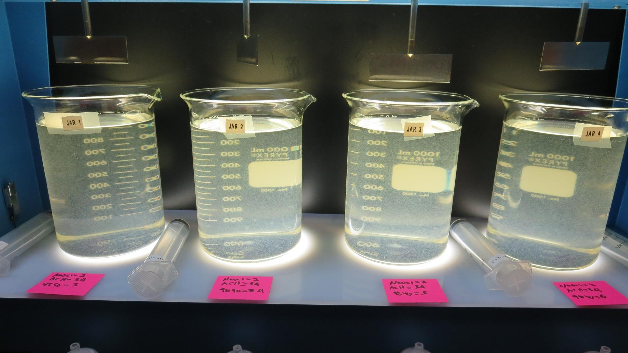
Jars 25-28: After 5 min of settling, 25 mL is syringed for filterability and %UVT/UVA.

Slide 40
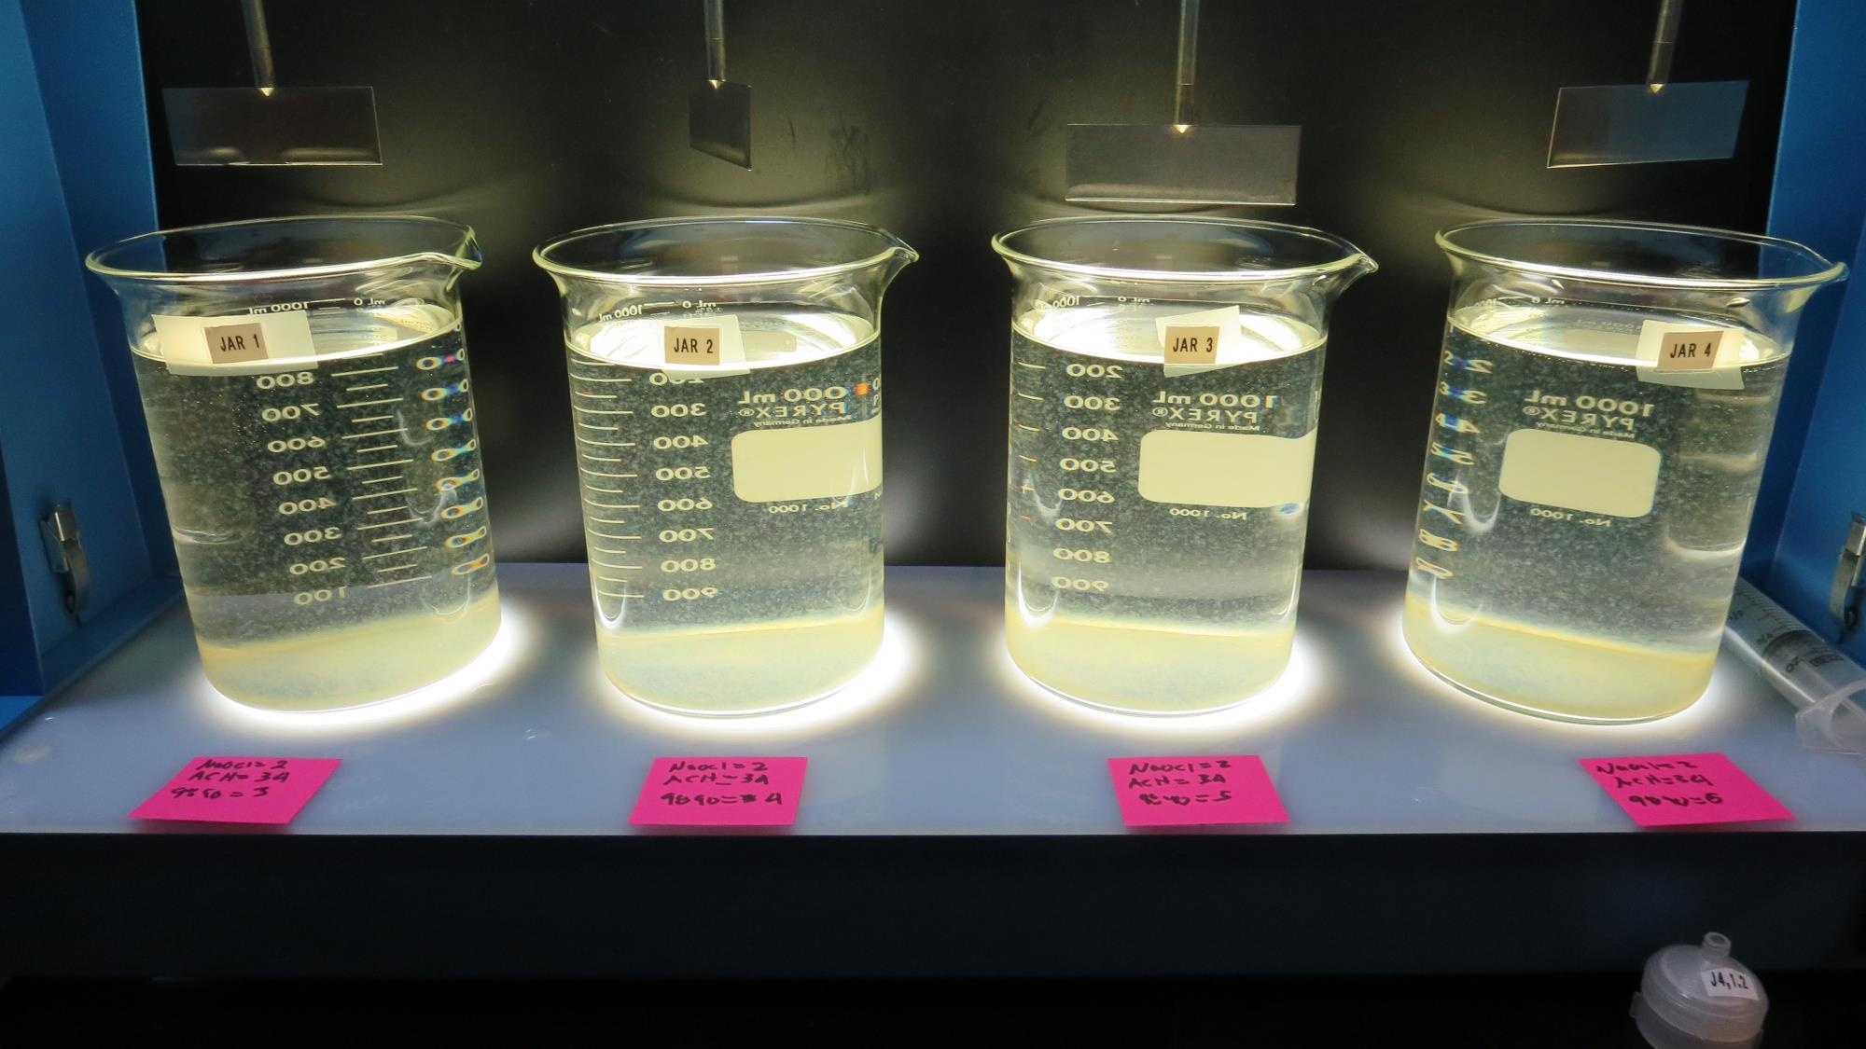
Jars 25-28: After 25-minutes of settling, settled water turbidity is taken.
2 mg/L NaOCl
3 mg/L 9890
34 mg/L 9800
Filtrate 0.08 NTU
UVT: 88.9%
UVA: 0.051/cm
Settled: 2.7 NTU
2 mg/L NaOCl
4 mg/L 9890
34 mg/L 9800
Filtrate 0.8 NTU
UVT: 84.2%
UVA: 0.075/cm
Settled: 2.7 NTU
2 mg/L NaOCl
5 mg/L 9890
34 mg/L 9800
Filtrate 0.13 NTU
UVT: 89%
UVA: 0.051/cm
Settled: 2.6 NTU
2 mg/L NaOCl
6 mg/L 9890
34 mg/L 9800
Filtrate 0.09 NTU
UVT: 89.7%
UVA: 0.047/cm
Settled: 3.3 NTU

Slide 41
Jars 29-32 Test Flash Mix 60 Sec (200 RPM) Floc Mix 5 min (30 RPM) Applied Coagulants 9800/9890 w/NaOCl

Slide 42
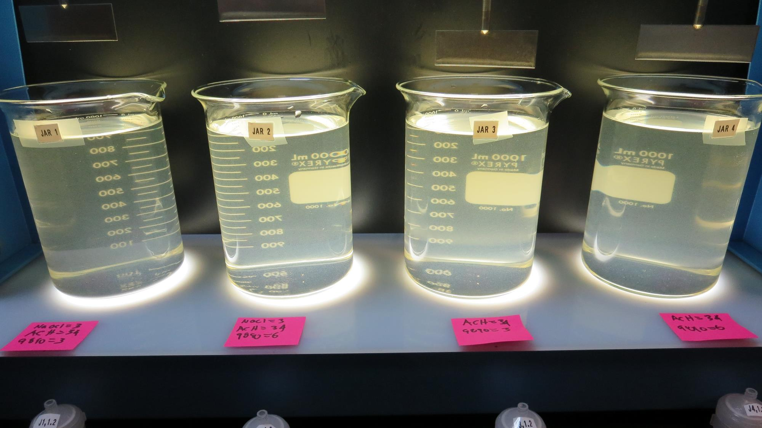
Jars 29-32: End of 5-minute flocculation (30 RPM) duration.
3 mg/L NaOCl
3 mg/L 9890
34 mg/L ACH
Filtrate 0.20 NTU
UVT: 86%
UVA: 0.066/cm
Settled: 3.6 NTU
3 mg/L NaOCl
6 mg/L 9890
34 mg/L ACH
Filtrate 1.5 NTU
UVT: 76.2%
UVA: 0.118/cm
Settled: 3.5 NTU
3 mg/L 9890
34 mg/L ACH
Filtrate 0.26 NTU
UVT: 86.1%
UVA: 0.065/cm
Settled: 3.3 NTU
6 mg/L 9890
34 mg/L ACH
Filtrate 0.55 NTU
UVT: 83%
UVA: 0.081/cm
Settled: 3.6 NTU

Slide 43
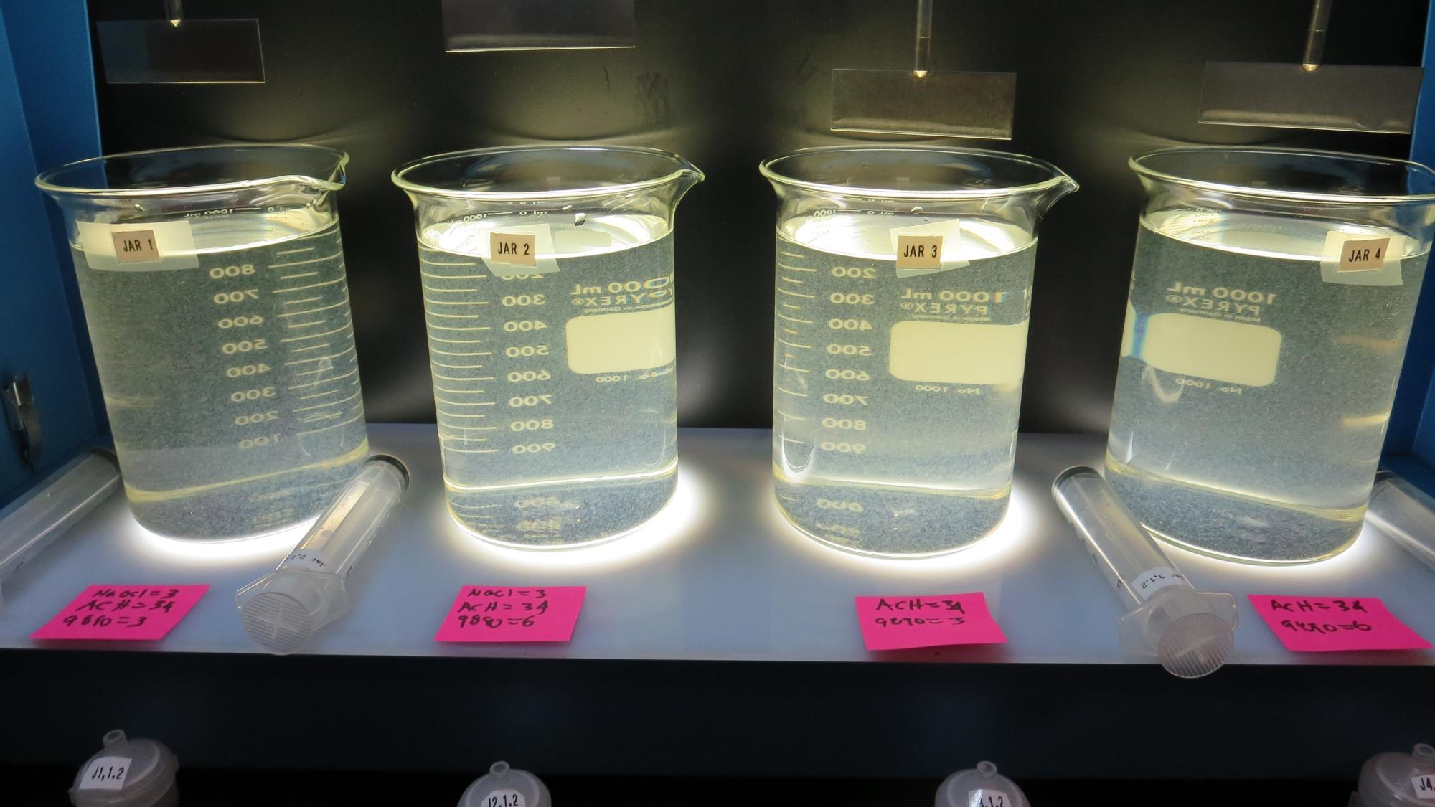
Jars 29-32: After 5 min of settling, 25 mL is syringed for filterability and %UVT/UVA.

Slide 44
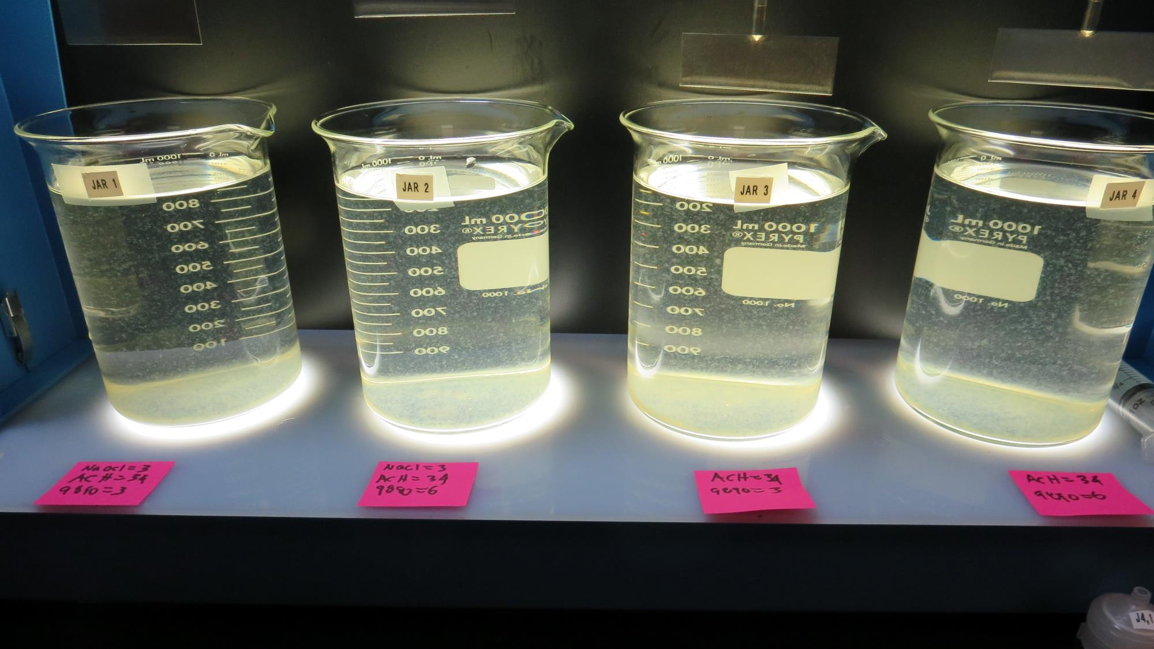
Jars 29-32: After 25-minutes of settling, settled water turbidity is taken.
3 mg/L NaOCl
3 mg/L 9890
34 mg/L 9800
Filtrate 0.20 NTU
UVT: 86%
UVA: 0.066/cm
Settled: 3.6 NTU
3 mg/L NaOCl
6 mg/L 9890
34 mg/L 9800
Filtrate 1.5 NTU
UVT: 76.2%
UVA: 0.118/cm
Settled: 3.5 NTU
3 mg/L 9890
34 mg/L 9800
Filtrate 0.26 NTU
UVT: 86.1%
UVA: 0.065/cm
Settled: 3.3 NTU
6 mg/L 9890
34 mg/L 9800
Filtrate 0.55 NTU
UVT: 83%
UVA: 0.081/cm
Settled: 3.6 NTU

Slide 45
Jars 33-35 Test Flash Mix 60 Sec (200 RPM) Floc Mix 5 min (30 RPM) Applied Coagulant Aluminum Sulfate

Slide 46
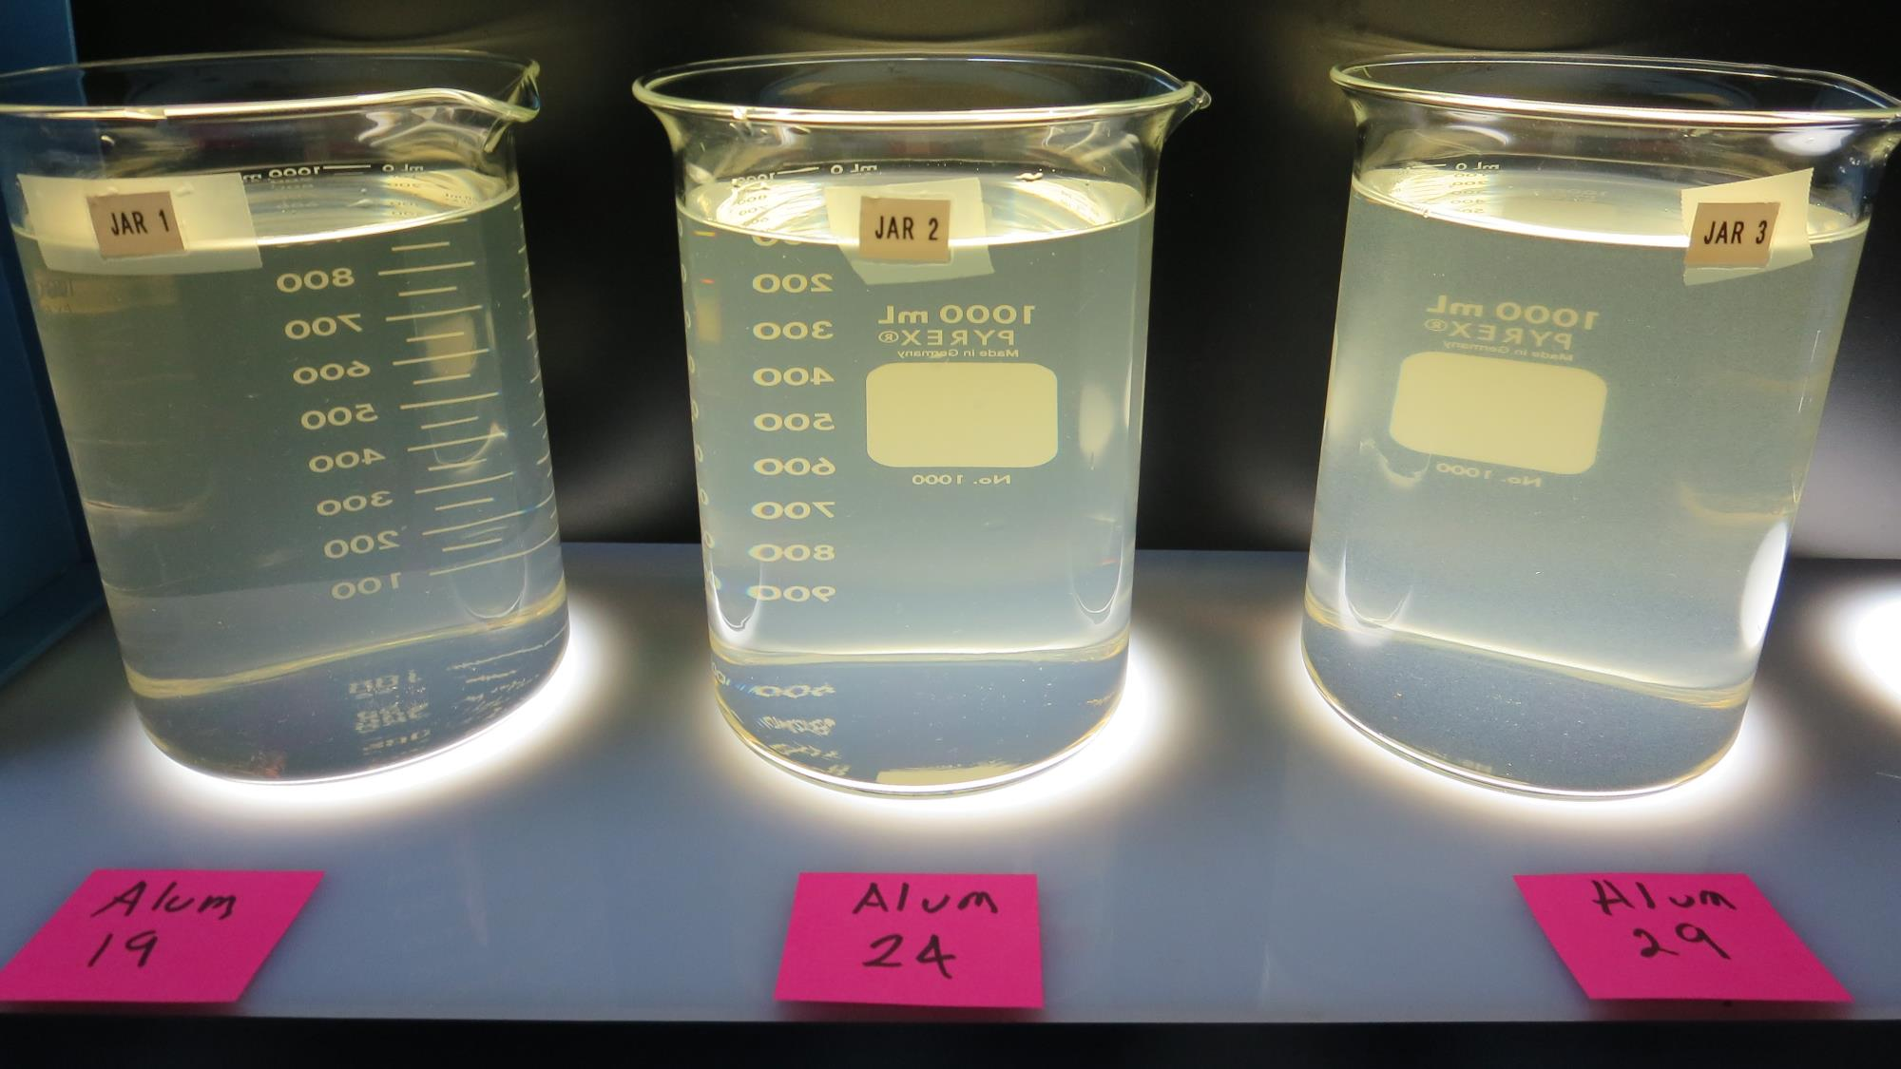
Jars 33-35: End of 5-minute flocculation (30 RPM) duration.
19 mg/L Alum
Filtrate 2.6 NTU
UVT: 61.4%
UVA: 0.209/cm
Settled: 9 NTU
24 mg/L Alum
Filtrate 1.6 NTU
UVT: 74.9%
UVA: 0.126/cm
Settled: 11.8 NTU
29 mg/L Alum
Filtrate 0.18 NTU
UVT: 88%
UVA: 0.056/cm
Settled: 9.6 NTU

Slide 47
Jars 33-35: After 5 min of settling, 25 mL is syringed for filterability and %UVT/UVA.

Slide 48
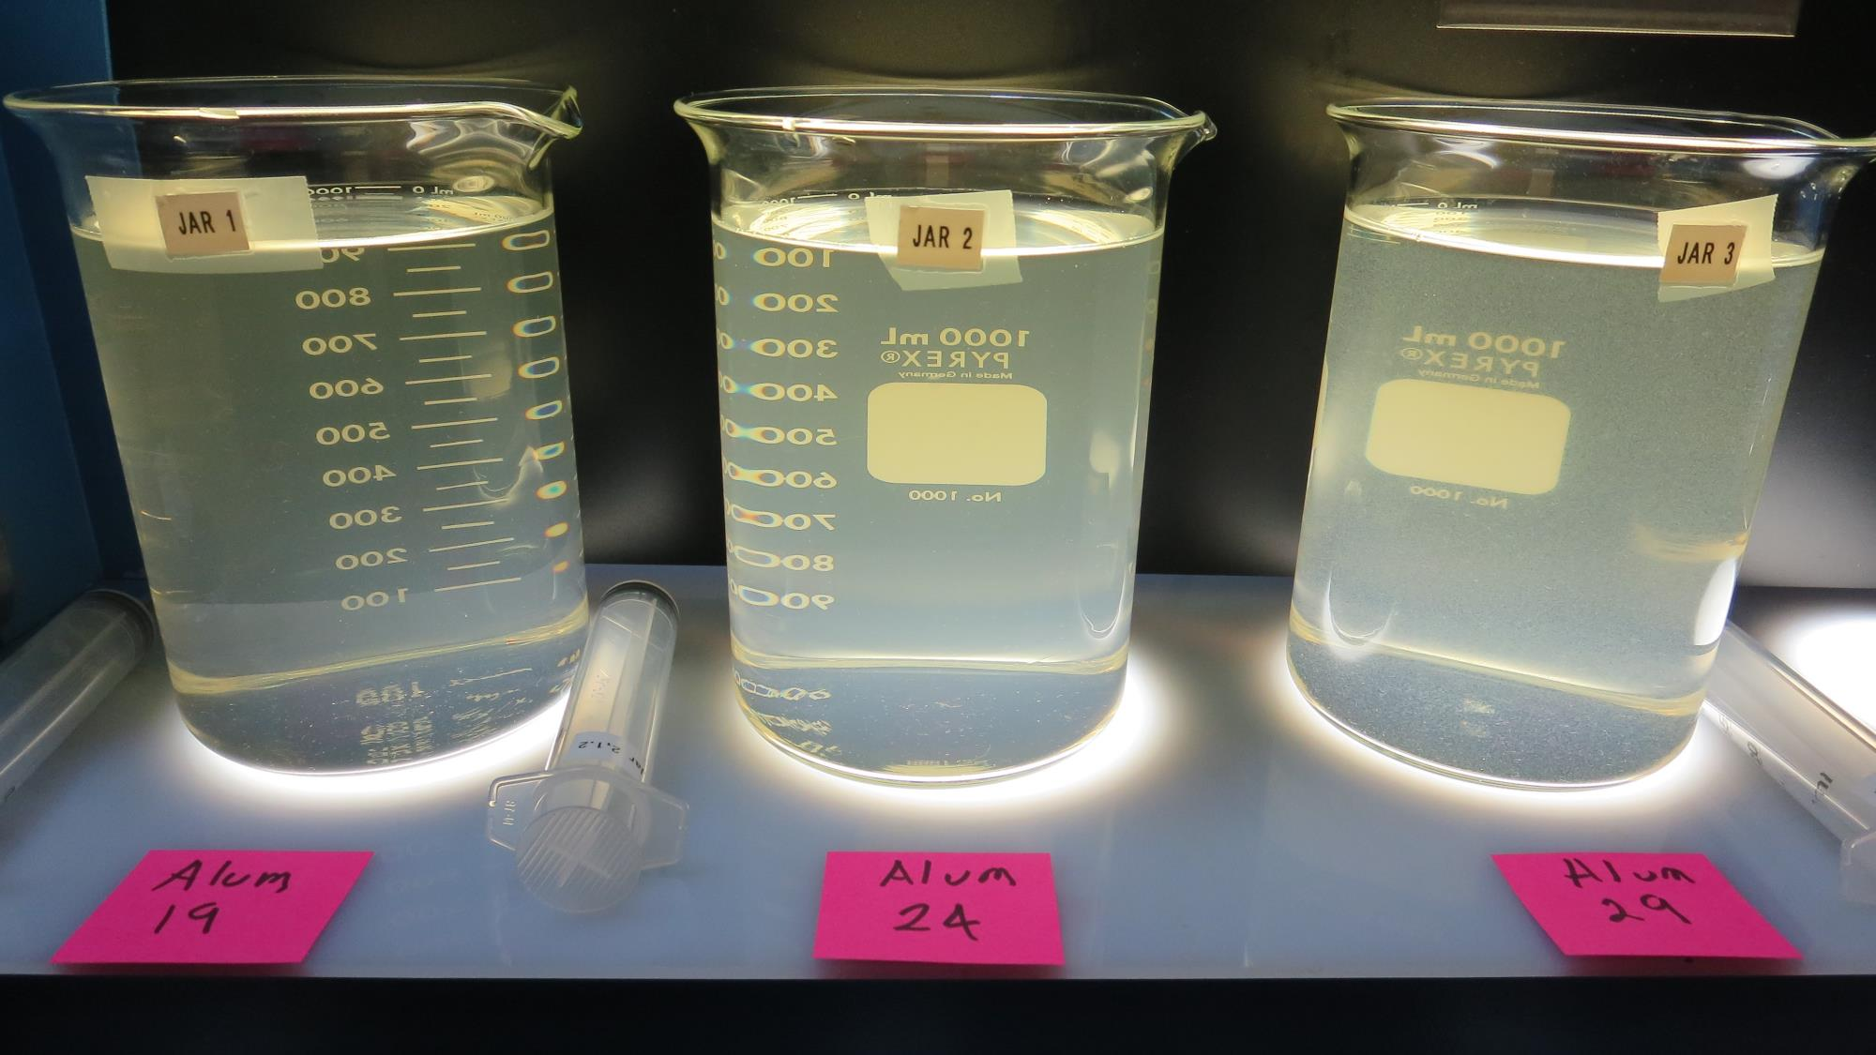
Jars 33-35: After 25-minutes of settling, settled water turbidity is taken.
19 mg/L Alum
Filtrate 2.6 NTU
UVT: 61.4%
UVA: 0.209/cm
Settled: 9 NTU
24 mg/L Alum
Filtrate 1.6 NTU
UVT: 74.9%
UVA: 0.126/cm
Settled: 11.8 NTU
29 mg/L Alum
Filtrate 0.18 NTU
UVT: 88%
UVA: 0.056/cm
Settled: 9.6 NTU

Slide 49
Jar Testing for 1-Liter Jars: Procedures for Most Treatment Plants
Fill jars with source water prior to coagulant injection and set paddle speed at 30 rpm
Add chemicals (i.e., NaOCl, primary coagulant, coagulant aid) to each jar
Flash mix for 15-60 seconds (200 rpm)
Slow mix for 5 minutes (20-30 rpm)
Settled for 5 minutes. Syringe 25 mL from each jar taken 1-inch below surface (25 mL/12 sec rate)
Filtered through 1.2 um isopore membrane into cuvette drip rate, 15 mL/(50-90 sec)
Measure filtrate turbidity, chlorine residual and %UVT/UVA
Measure settled water turbidity after 25 minutes of total setting
Record all data

Slide 50
Jar Test Filterability Test Equipment
Turbidity Instrument
Syringe w/Luer-Lock Tip, 30 cc
(part#: 2225800, by Hach)
Swinnex Filter Holder, 25 mm (part#: SX0002500)
Isopore Membrane Filter, 1.2 um absolute
pore size,
Φ= 25 mm , thickness: 24 um,
hydrophilic polycarbonate membrane
(part #: RTTP02500)
Go to Sigma-Aldrich for laboratory supplies http://www.sigmaaldrich.com/united-states.html

Slide 51
Isopore Membrane Information
Categories | Information
trade name | Isopore
filter color | White
chemistry | Polycarbonate (PC)
water flow rate | Avg. 175 mL/min x cm² (typical results @ 10 psi)
media | Isopore®
wettability | Hydrophilic
porosity | 14.7%
pore size | 1.2 µm
bubble point at 23 °C | 1.0 bar, air with water
thickness | 24 µm
filter diameter (ø) | 25 mm
material size | polycarbonate, Hydrophilic, 1.2 µm, 25 mm, white, plain, 100

Slide 52
Isopore Membrane Background Information
The Isopore membrane is a polycarbonate, track-etched screen filter recommended for all analyses in which the sample is viewed on the surface of the membrane. The Isopore membrane is composed of polycarbonate film, which has a smooth, glass-like surface for clearer sample observation. The unique manufacturing process of the membrane ensures a precise pore diameter and a consistent pore size for accurate separation of samples by size. Matched-weight filters are not usually required because of low, constant tar and ash weights. Features & Benefits: Membrane structure retains particles on the surface, simplifying counting and analysis

Slide 53
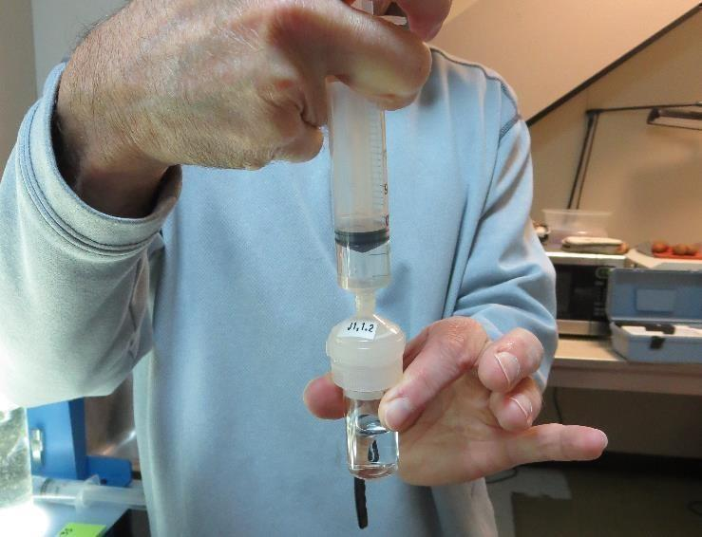
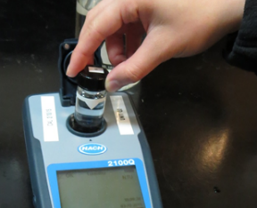
Jar Test - Filterability Test
Syringe ~ 25 mL from jar (after 5-minutes of settling)
Filter-to-waste 3-5 mL
Filter directly into clean cuvette
Measure turbidity
Note: Take several readings before recording final NTU results. Micro bubbles can adhere to glass causing false NTU readings. To remove bubbles, tilt cuvette up to 90 degrees.

Slide 54
Contact
Guy Schott, P.E.
State Water Resources Control Board
Division of Drinking Water
Santa Rosa, CA
Go to Stock Solution/Dose calculations/Jar Test Results for tools to download
www.waterboards.ca.gov/drinking_water/programs/districts/mendocino_district.html
Email: Guy Schott - Guy.Schott@waterboards.ca.gov
Office Number: 707-576-2732

