Slide 1
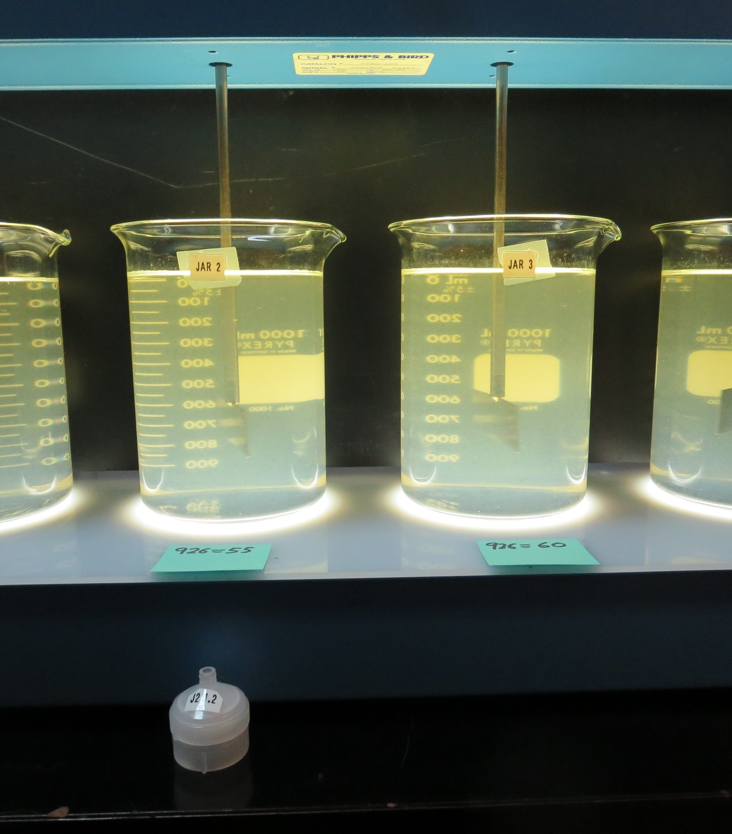
Surfwood Mutual Water Corporation CA2300590 Mendocino County Jar Test
by Guy Schott, P.E.
March 20, 2019

Slide 2
Source Water: Jack Peter’s Creek Roughing Filter followed by Multi-Media Filtration
Source Water Characteristics
Turbidity: 5.8 NTU
pH: 7.05
UVT: 32.1%
UVA: 0.493
0.4 um Filtered
UVT: 38.1%
UVA: 0.419

Slide 3
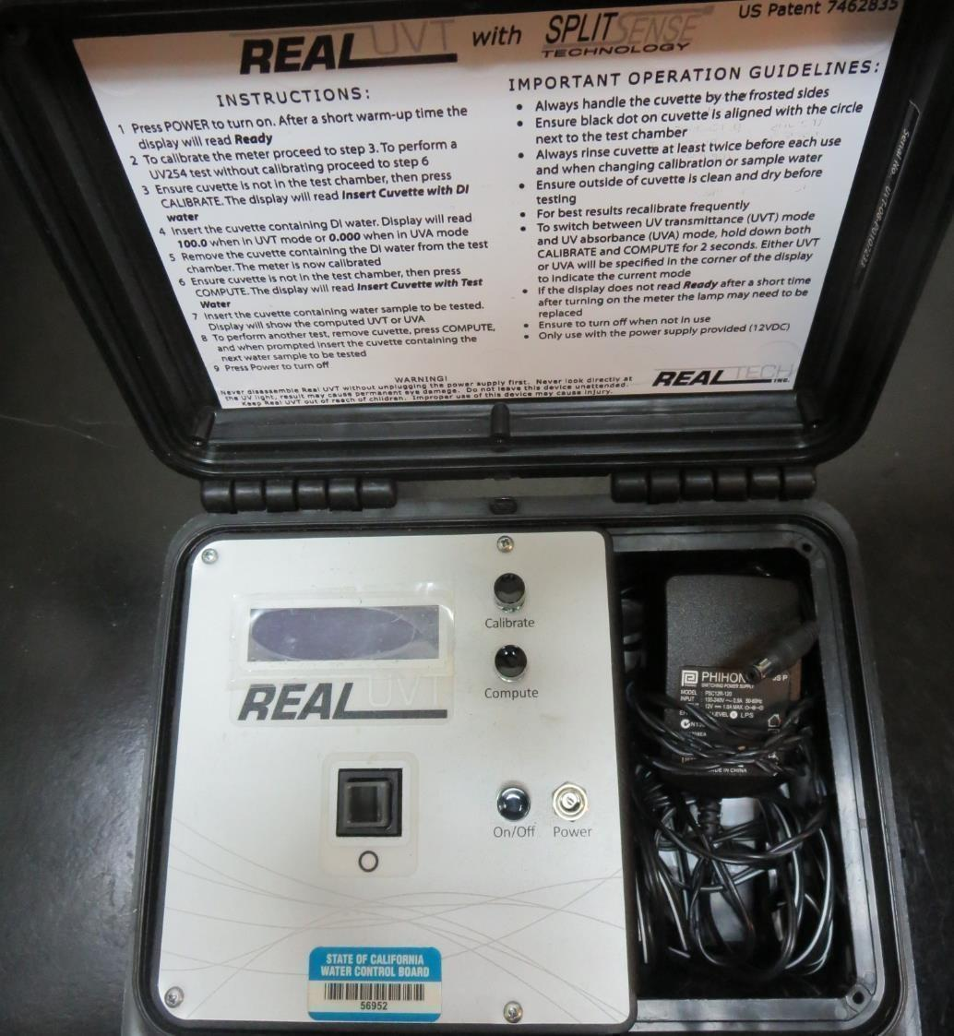
UVT/UVA
UV transmittance (UVT) is a measurement of the amount of ultraviolet light (commonly at 254 nm due to its germicidal effect) that passes through a water sample compared to the amount of light that passes through a pure water sample. The measurement is expressed as a percentage, % UVT.
%UVT = 10^{(-UVA)} x 100%
UV absorbance (UVA) is calculated as a relative measure of the amount of light absorbed by a water sample compared with the amount of light absorbed by a pure water sample.
UVA = -log(%UVT/100)

Slide 4
Applied Coagulants for Jar Testing
Pro Pac 9800 (NTU Technologies)
50% Aluminum Chlorohydrate (ACH)
50% Water
SG = 1.34
926 (NTU Technologies)
30-40% ACH
30% Trade Secret
30-40% Water
SG = 1.2 - 1.34
Pro Pac 9890 (NTU Technologies)
35-45% Aluminum Chlorohydrate (ACH)
35-45% Water
20% Trade Secret
SG = 1.25-1.34
Zeta Floc PA 40 (NTU Technologies)
Cat-Organic Polymer
SG = 1.0 - 1.2

Slide 5
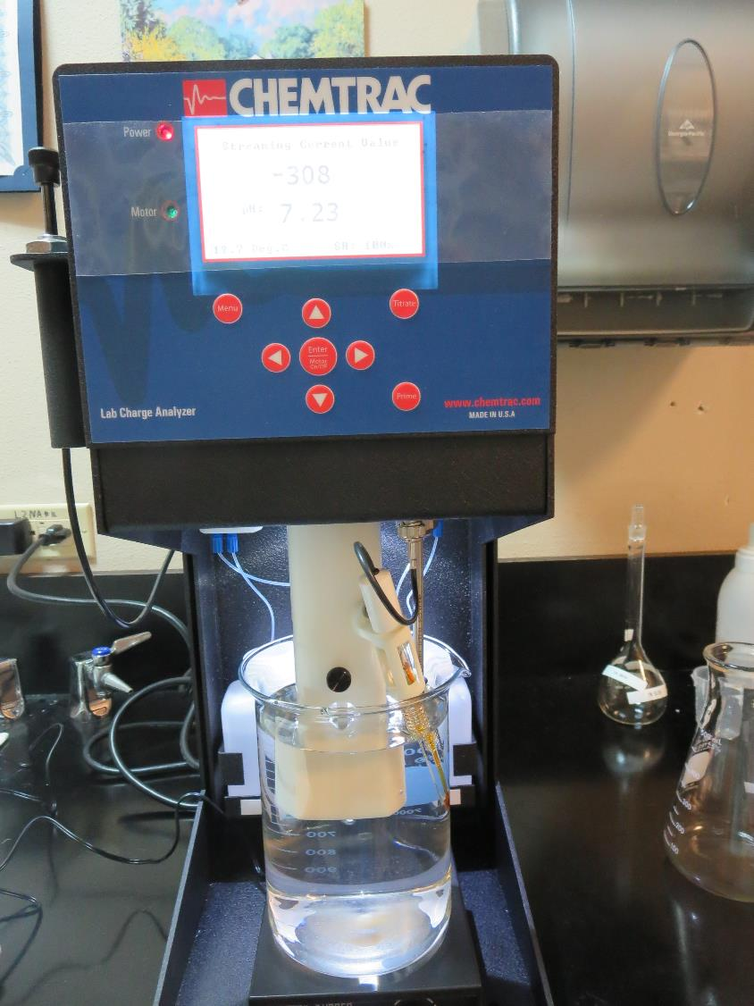
Laboratory Charge Analyzer
LCA: Used to determine coagulant demand of a source water entering the treatment plant.
Source pH: 7.05
LCA #1:
9800: 51 mg/L as product
LCA #2:
926: 55.7 mg/L as product
LCA #3:
ULTRION 8157: 132 mg/L as product

Slide 6
Coagulant Information
Unless stated otherwise, all coagulant doses are reported as Product (100% strength).
Preparation of coagulant stock solutions are generally 1.0 or 0.1 percent strength using 100 and/or 200 mL volumetric flasks.
Finnpipette F2 variable volume pipette, capacity 100-1000 micro liters is used for stock solution preparation and coagulant aid jar test dosing.
Finnpipette F2 variable volume pipette, capacity 0.5-5 mL is used for primary coagulant jar test dosing.

Slide 7
Surfwood MWC: Jar Test 1-8 Results Flash Mix 60 sec (200 RPM)
Jar # | 30 RPM Floc minutes | KMnO₄ mg/L | 926 mg/L | 9800 mg/L | Filtrate NTU | Filtrate %UVT | Filtrate UVA/cm | Settle NTU 25 min
J1 | 5 | 0 | 50 | 0 | 0.65 | 82.7 | 0.082 | 2.0
J2 | 5 | 0 | 55 | 0 | 0.16 | 88.0 | 0.056 | 1.7
J3 | 5 | 0 | 60 | 0 | 0.76 | 84.9 | 0.071 | 1.7
J4 | 5 | 0 | 65 | 0 | 0.53 | 88.0 | 0.056 | 2.2
J5 | 5 | 2 | 55 | 0 | 0.12 | 87.9 | 0.056 | 2.3
J6 | 5 | 2 | 56 | 0 | 0.59 | 85.5 | 0.068 | 2.0
J7 | 5 | 2 | 0 | 51 | 1.0 | 80.7 | 0.093 | 2.9
J8 | 5 | 2 | 0 | 54 | 1.6 | 76.9 | 0.114 | 2.8

Slide 8
Surfwood MWC: Jar Test 9-16 Results
Jar # | 200 RPM Flash Mix Seconds | 30 RPM Floc Duration minutes | 9800 mg/L | 9890 mg/L | Filtrate NTU | Filtrate %UVT | Filtrate UVA/cm | Settle NTU 25 min
J9 | 60 | 5 | 40 | 6.5 | 0.20 | 85.9 | 0.066 | 1.9
J10 | 60 | 5 | 45 | 6.8 | 0.12 | 88.6 | 0.053 | 1.9
J11 | 60 | 5 | 50 | 7.5 | 0.47 | 87.8 | 0.057 | 2.0
J12 | 60 | 5 | 55 | 8.3 | 0.62 | 88.3 | 0.054 | 2.6
J13 | 60 | 5 | 40 | 8.0 | 0.75 | 82.8 | 0.082 | 2.3
J14 | 60 | 5 | 40 | 10 | 0.70 | 85.0 | 0.071 | 2.1
J15 | 60 | 5 | 45 | 6.8 | 1.07 | 82.1 | 0.086 | 2.2
J16 | 60 | 5 | 45 | 9.0 | 1.1 | 83.2 | 0.080 | 2.1

Slide 9
Surfwood MWC: Jar Test 17-24 Results
Jar # | 200 RPM Flash Mix Seconds | 30 RPM Floc Duration minutes | 926 mg/L | Zeta Floc 40 mg/L | Filtrate NTU | Filtrate %UVT | Filtrate UVA/cm | Settle NTU 25 min
J17 | 60 | 5 | 50 | 10 | 0.13 | 91.5 | 0.039 | 6.5
J18 | 60 | 5 | 55 | 11 | 0.60 | 88.3 | 0.054 | 6.1
J19 | 60 | 5 | 60 | 12 | 0.74 | 86.7 | 0.062 | 5.5
J20 | 60 | 5 | 65 | 13 | 2.1 | 77.0 | 0.114 | 6.3
J21 | 60 | 5 | 45 | 9 | 0.34 | 88.6 | 0.053 | 6.0
J22 | 60 | 5 | 47.5 | 9.5 | 0.40 | 89.0 | 0.051 | 5.3
J23 | 60 | 5 | 50 | 5 | 0.31 | 88.5 | 0.053 | 3.4
J24 | 60 | 5 | 50 | 10 | 0.61 | 87.3 | 0.059 | 4.4

Slide 10
Surfwood MWC: Jar Test 25-32 Results Flash Mix 60 sec (200 RPM)
Jar # | 30 RPM Floc minutes | KMnO₄ mg/L | NaOCl mg/L | 9800 mg/L | Filtrate NTU | Filtrate %UVT | Filtrate UVA/cm | Settle NTU 25 min
J25 | 5 | 2.5 | 0 | 54 | 0.15 | 87.5 | 0.058 | 1.8
J26 | 5 | 3.0 | 0 | 54 | 0.18 | 87.4 | 0.058 | 1.8
J27 | 5 | 0 | 2.5 | 54 | 0.84 | 81.1 | 0.091 | 2.2
J28 | 5 | 0 | 0 | 54 | 0.28 | 86.8 | 0.061 | 1.5
J29 | 5 | 1.0 | 0 | 55 | 1.2 | 80.2 | 0.096 | 1.9
J30 | 5 | 1.5 | 0 | 55 | 0.09 | 88.4 | 0.054 | 1.9
J31 | 5 | 2.0 | 0 | 55 | 0.41 | 85.6 | 0.068 | 1.6
J32 | 5 | 0 | 0 | 55 | 0.09 | 89.2 | 0.050 | 2.0

Slide 11
Jars 1-4 Test Flash Mix 60 Sec (200 RPM) Floc Mix 5 min (30 RPM) Applied Coagulant 926

Slide 12
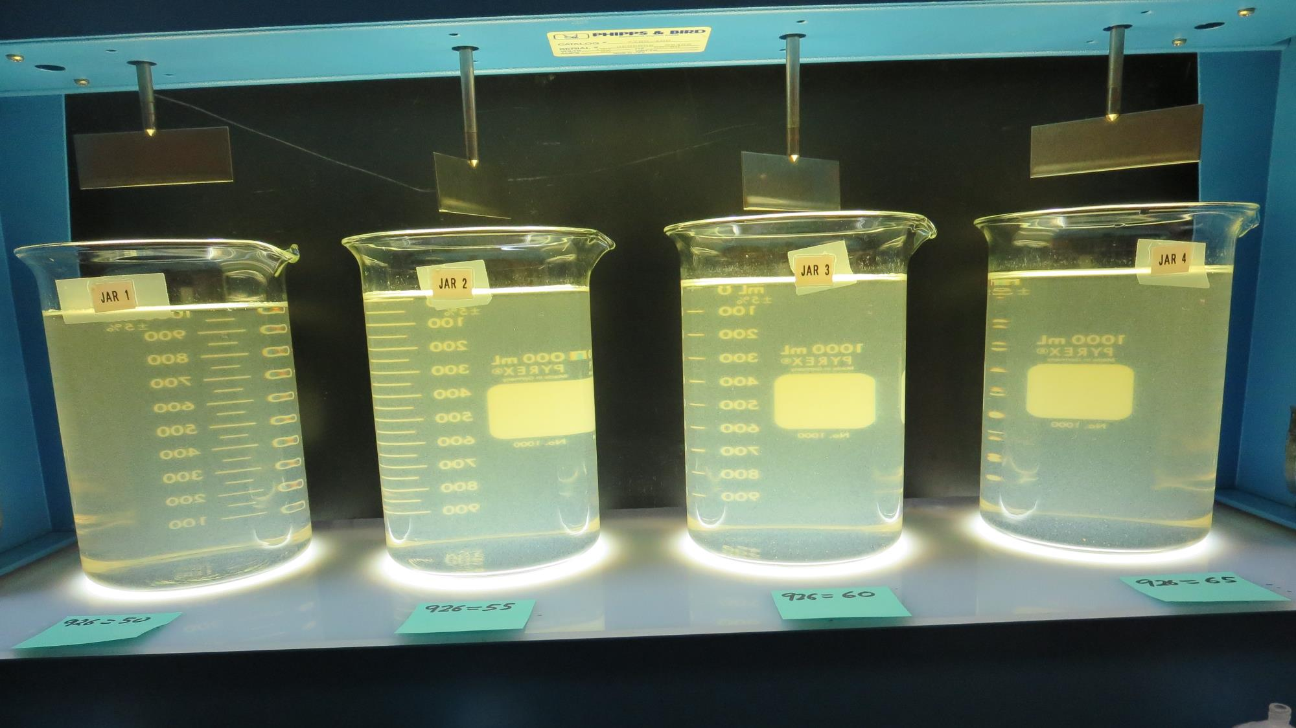
Jars 1-4: End of 5-minute flocculation (30 RPM) duration.
50 mg/L 926
Filtrate 0.65 NTU
UVT: 82.7%
UVA: 0.082/cm
Settled: 2.0 NTU
55 mg/L 926
Filtrate 0.16 NTU
UVT: 88.0%
UVA: 0.056/cm
Settled: 1.7 NTU
60 mg/L 926
Filtrate 0.76 NTU
UVT: 84.9%
UVA: 0.071/cm
Settled: 1.7 NTU
65 mg/L 926
Filtrate 0.56 NTU
UVT: 88.0%
UVA: 0.056/cm
Settled: 2.2 NTU

Slide 13
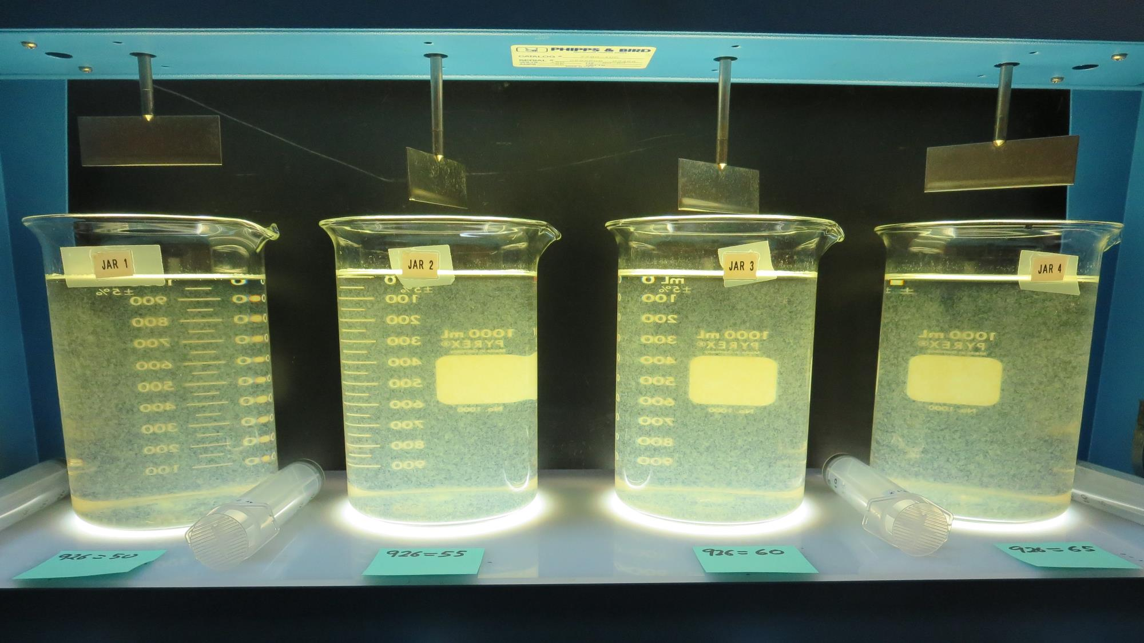
Jars 1-4: After 5 min of settling, 25 mL is syringed for filterability and %UVT/UVA.

Slide 14
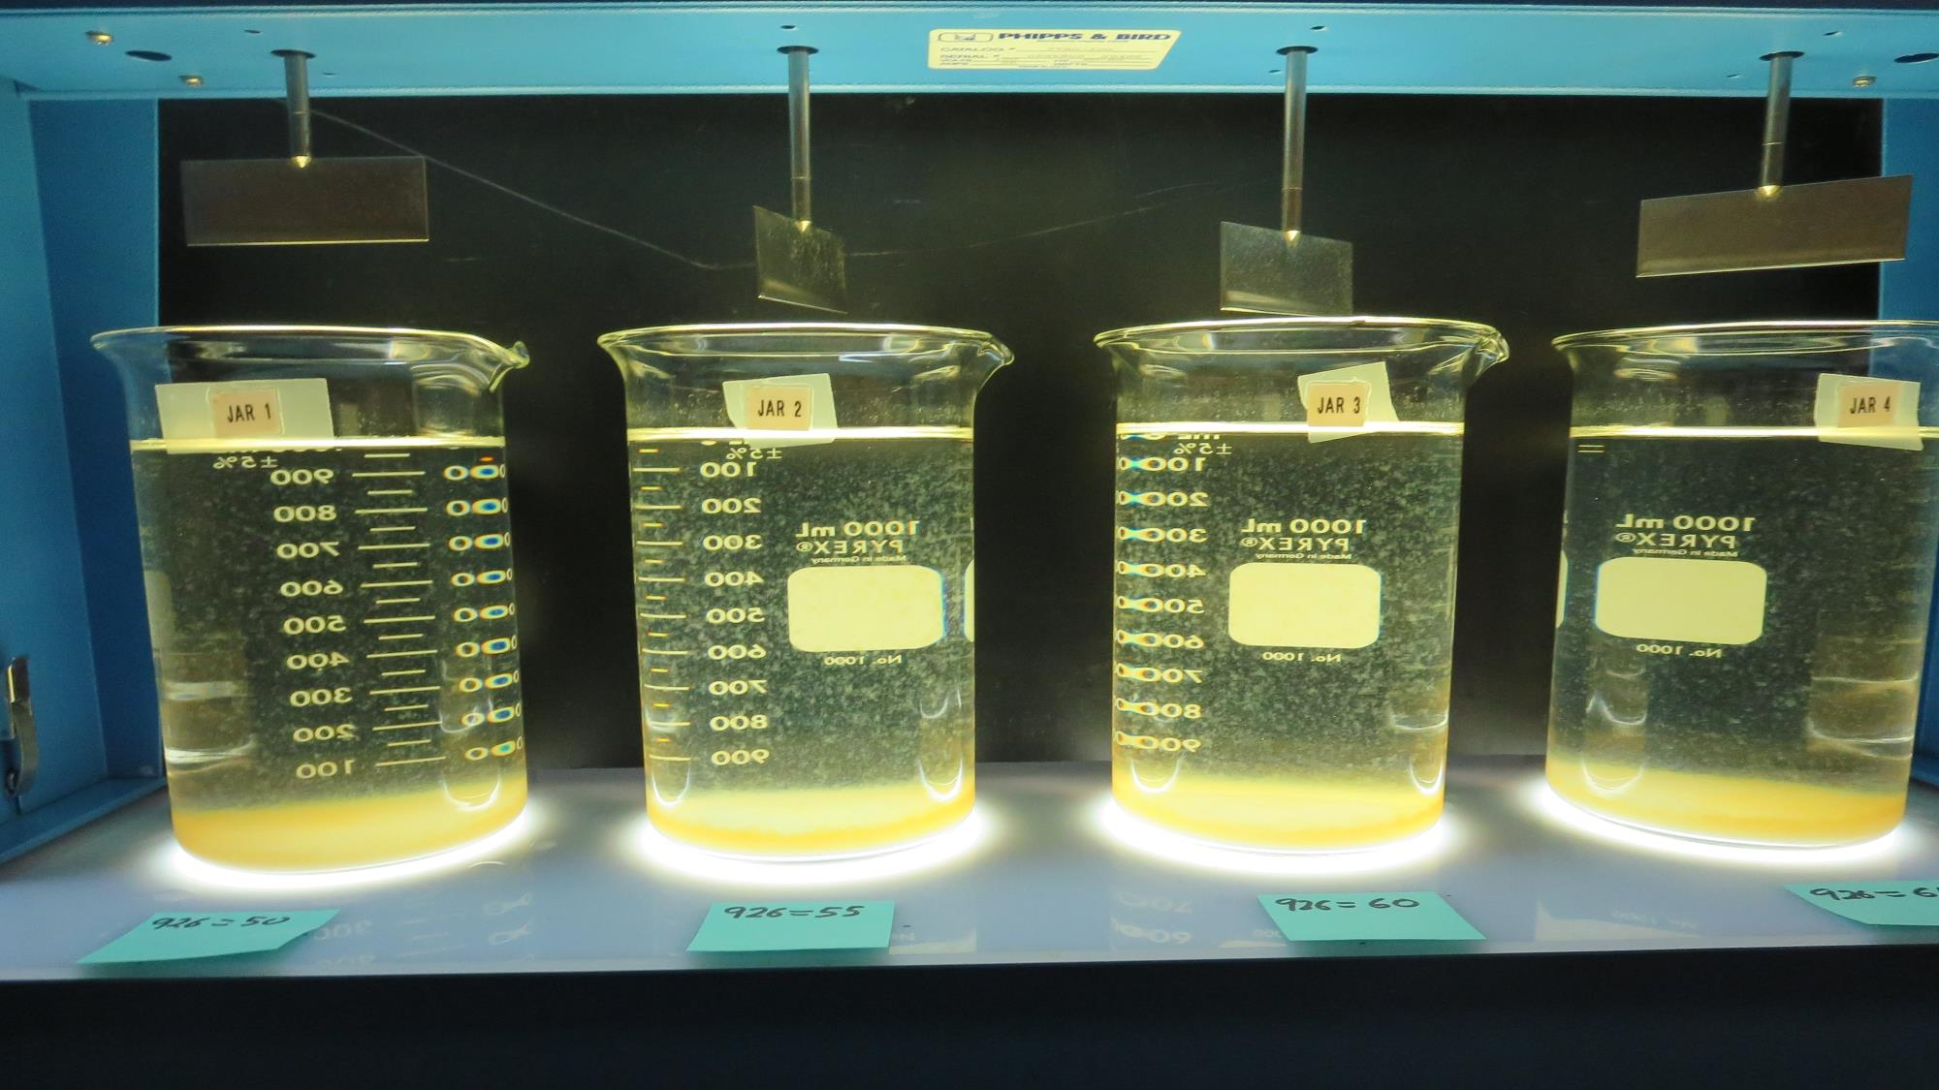
Jars 1-4: After 25-minutes of settling, settled water turbidity is taken.
50 mg/L 926
Filtrate 0.65 NTU
UVT: 82.7%
UVA: 0.082/cm
Settled: 2.0 NTU
55 mg/L 926
Filtrate 0.16 NTU
UVT: 88.0%
UVA: 0.056/cm
Settled: 1.7 NTU
60 mg/L 926
Filtrate 0.76 NTU
UVT: 84.9%
UVA: 0.071/cm
Settled: 1.7 NTU
65 mg/L 926
Filtrate 0.56 NTU
UVT: 88.0%
UVA: 0.056/cm
Settled: 2.2 NTU

Slide 15
Jars 5-8 Test KMnO₄ Floc 70 min (30 RPM) Flash Mix 60 Sec (200 RPM) Floc Mix 5 min (30 RPM) Applied Coagulants 926/9800

Slide 16
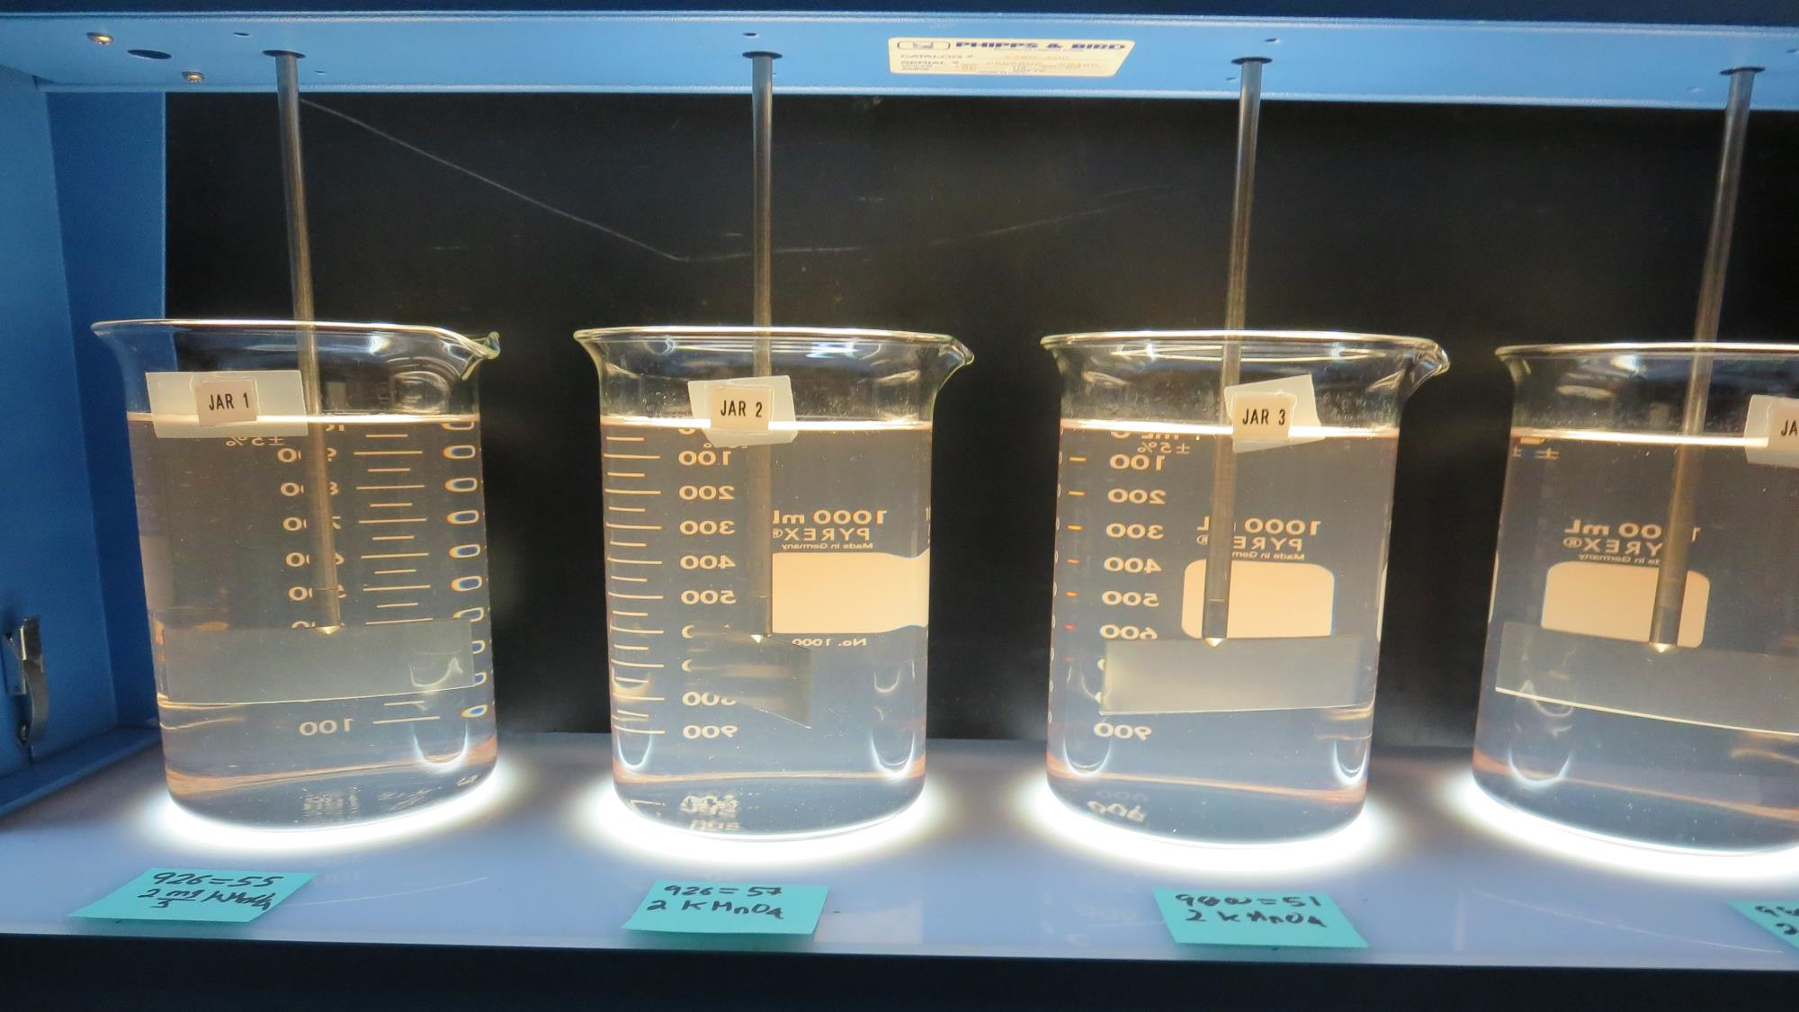
Jars 1-5: After injection of 2 mg/L KMnO4 to each jar. Floc for 70 minutes at 30 RPM.

Slide 17
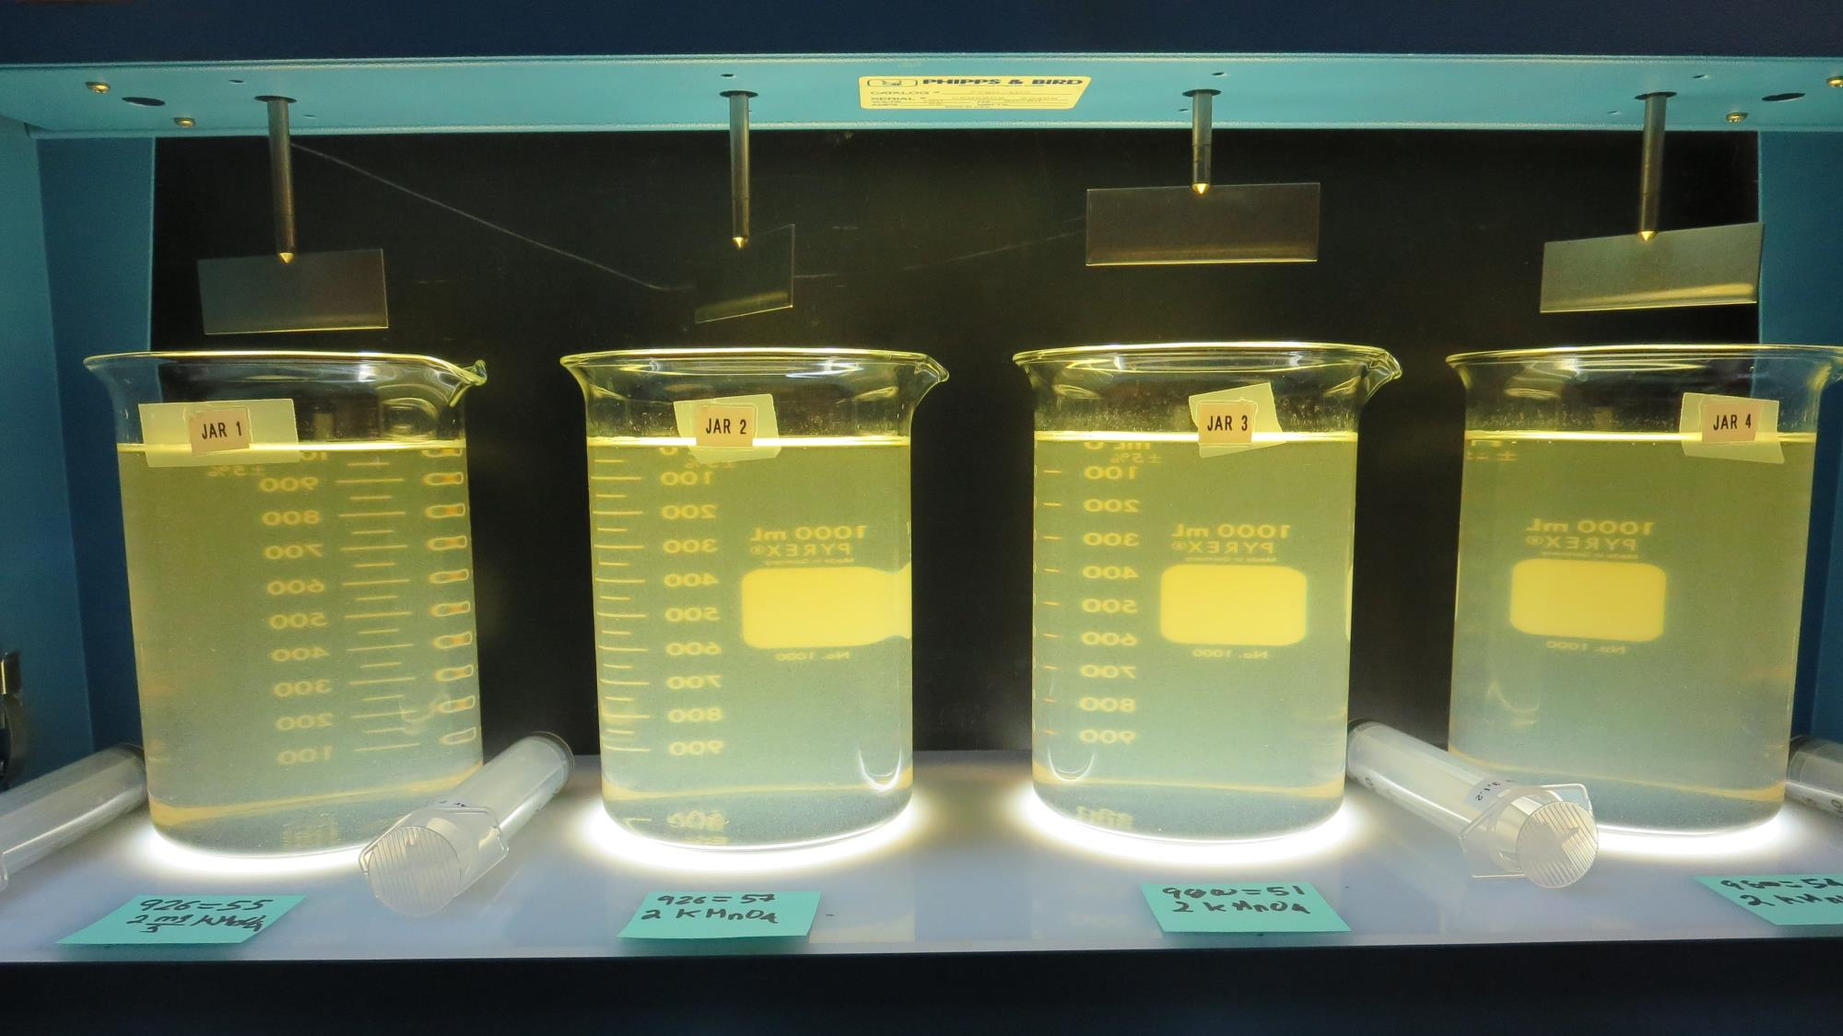
Jars 5-8: End of 5-minute flocculation (30 RPM) duration.
2 mg/L KMnO₄
55 mg/L 926
Filtrate 0.12 NTU
UVT: 87.9%
UVA: 0.056/cm
Settled: 2.3 NTU
2 mg/L KMnO₄
56 mg/L 926
Filtrate 0.59 NTU
UVT: 85.5%
UVA: 0.068/cm
Settled: 2.0 NTU
2 mg/L KMnO₄
51 mg/L 9800
Filtrate 1.0 NTU
UVT: 80.7%
UVA: 0.093/cm
Settled: 2.9 NTU
2 mg/L KMnO₄
54 mg/L 9800
Filtrate 1.6 NTU
UVT: 76.9%
UVA: 0.114/cm
Settled: 2.8 NTU

Slide 18
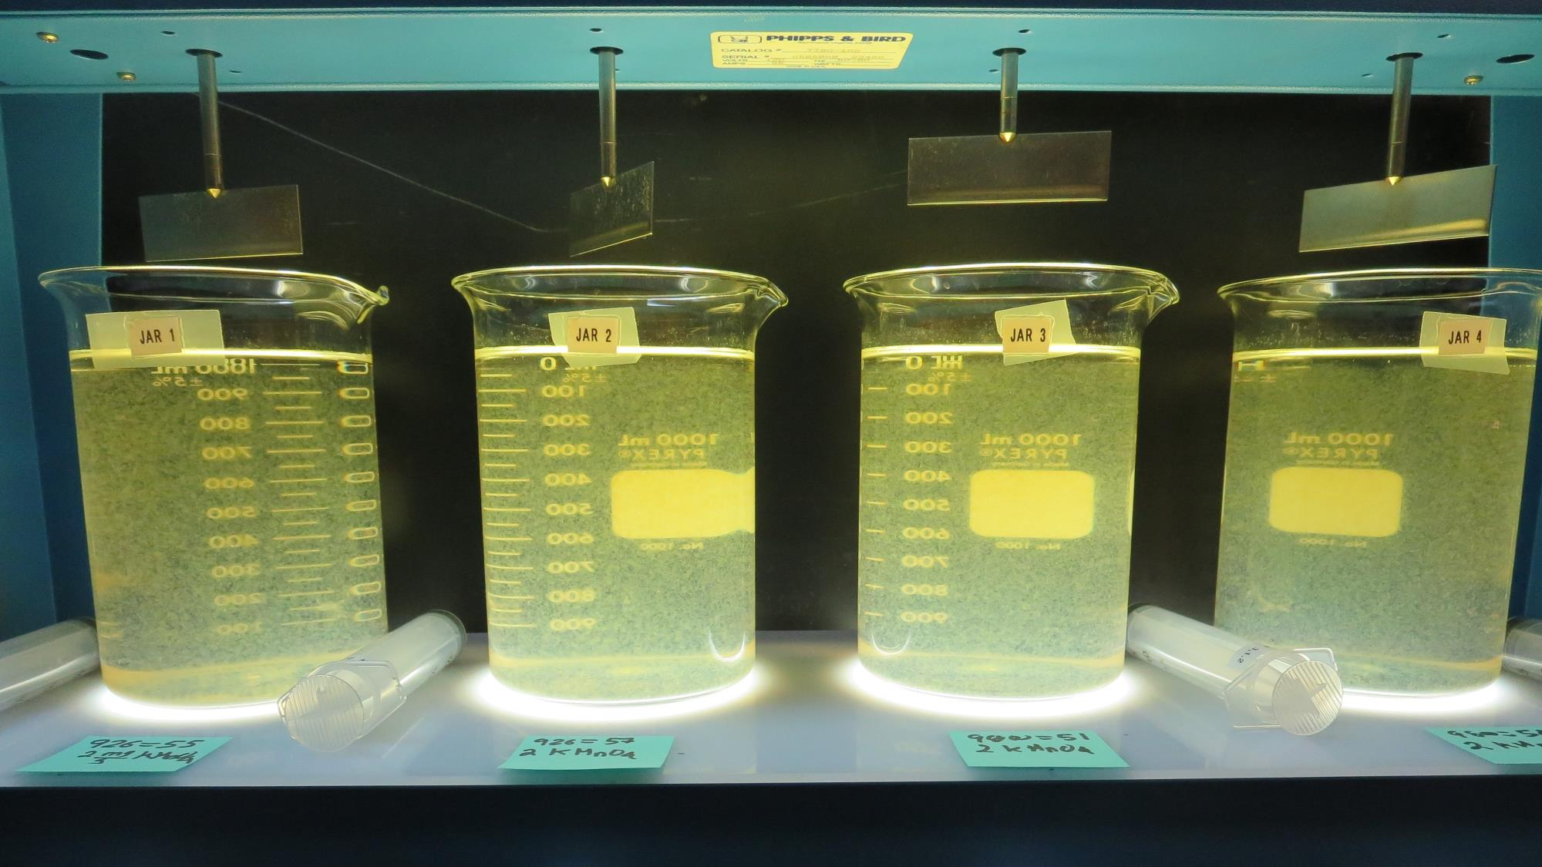
Jars 5-8: After 5 min of settling, 25 mL is syringed for filterability and %UVT/UVA.

Slide 19
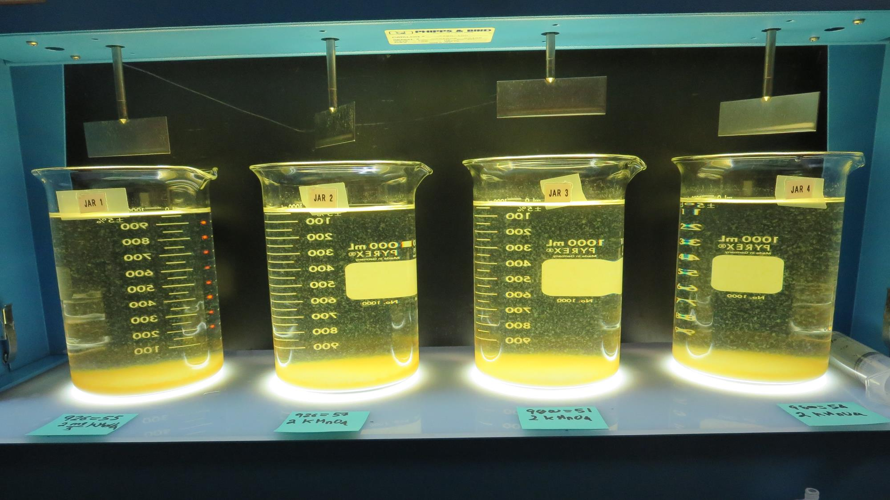
Jars 5-8: After 25-minutes of settling, settled water turbidity is taken.
2 mg/L KMnO₄
55 mg/L 926
Filtrate 0.12 NTU
UVT: 87.9%
UVA: 0.056/cm
Settled: 2.3 NTU
2 mg/L KMnO₄
56 mg/L 926
Filtrate 0.59 NTU
UVT: 85.5%
UVA: 0.068/cm
Settled: 2.0 NTU
2 mg/L KMnO₄
51 mg/L 9800
Filtrate 1.0 NTU
UVT: 80.7%
UVA: 0.093/cm
Settled: 2.9 NTU
2 mg/L KMnO₄
54 mg/L 9800
Filtrate 1.6 NTU
UVT: 76.9%
UVA: 0.114/cm
Settled: 2.8 NTU

Slide 20
Jars 9-12 Test Flash Mix 60 Sec (200 RPM) Floc Mix 5 min (30 RPM) Applied Coagulants 9800/9890

Slide 21
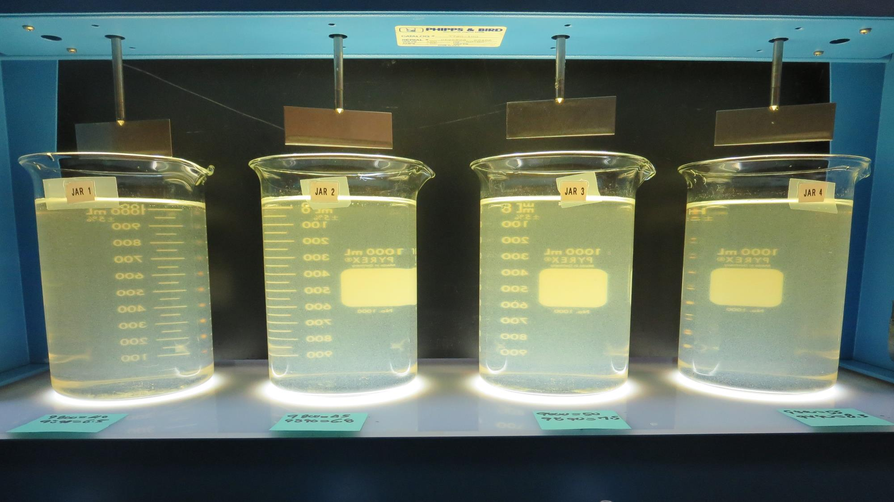
Jars 9-12: End of 5-minute flocculation (30 RPM) duration.
40 mg/L 9800
6.5 mg/L 9890
Filtrate 0.20 NTU
UVT: 85.9%
UVA: 0.066/cm
Settled: 1.9 NTU
45 mg/L 9800
6.8 mg/L 9890
Filtrate 0.12 NTU
UVT: 88.6%
UVA: 0.053/cm
Settled: 1.9 NTU
50 mg/L 9800
7.5 mg/L 9890
Filtrate 0.47 NTU
UVT: 87.8%
UVA: 0.057/cm
Settled: 2.0 NTU
55 mg/L 9800
8.3 mg/L 9890
Filtrate 0.62 NTU
UVT: 88.3%
UVA: 0.054/cm
Settled: 2.6 NTU

Slide 22
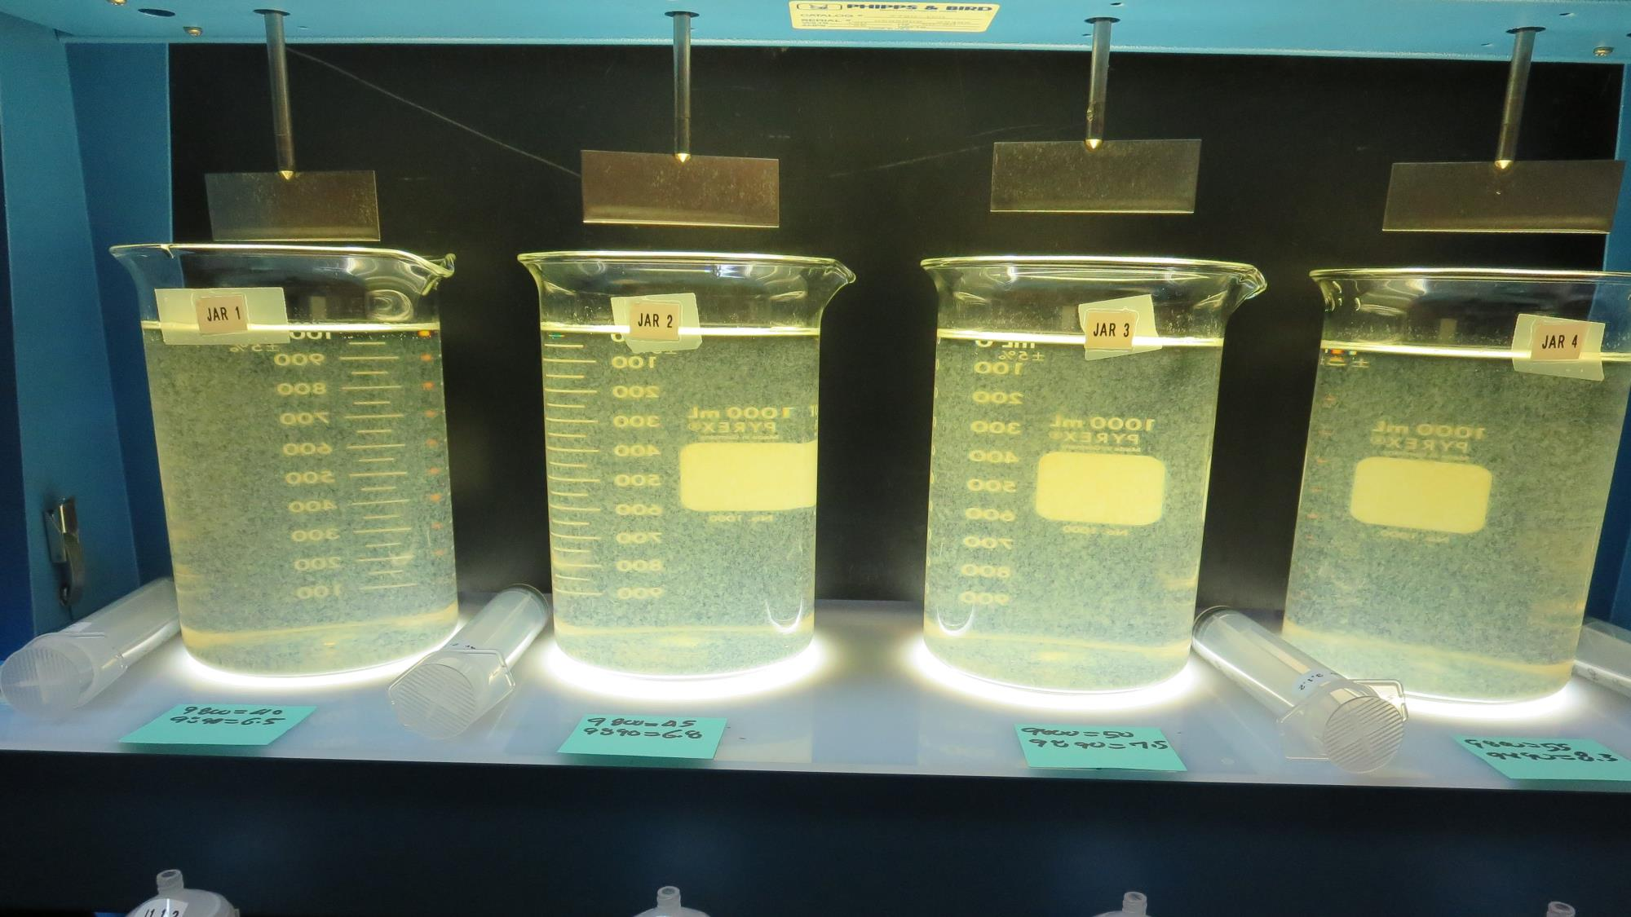
Jars 9-12: After 5 min of settling, 25 mL is syringed for filterability and %UVT/UVA.

Slide 23
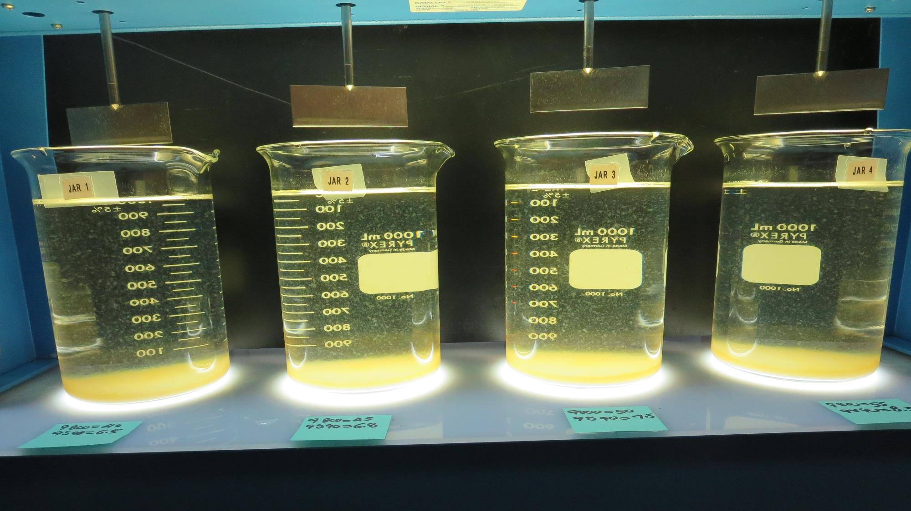
Jars 9-12: After 25-minutes of settling, settled water turbidity is taken.
40 mg/L 9800
6.5 mg/L 9890
Filtrate 0.20 NTU
UVT: 85.9%
UVA: 0.066/cm
Settled: 1.9 NTU
45 mg/L 9800
6.8 mg/L 9890
Filtrate 0.12 NTU
UVT: 88.6%
UVA: 0.053/cm
Settled: 1.9 NTU
50 mg/L 9800
7.5 mg/L 9890
Filtrate 0.47 NTU
UVT: 87.8%
UVA: 0.057/cm
Settled: 2.0 NTU
55 mg/L 9800
8.3 mg/L 9890
Filtrate 0.62 NTU
UVT: 88.3%
UVA: 0.054/cm
Settled: 2.6 NTU

Slide 24
Jars 13-16 Test Flash Mix 60 Sec (200 RPM) Floc Mix 5 min (30 RPM) Applied Coagulants 9800/9890

Slide 25
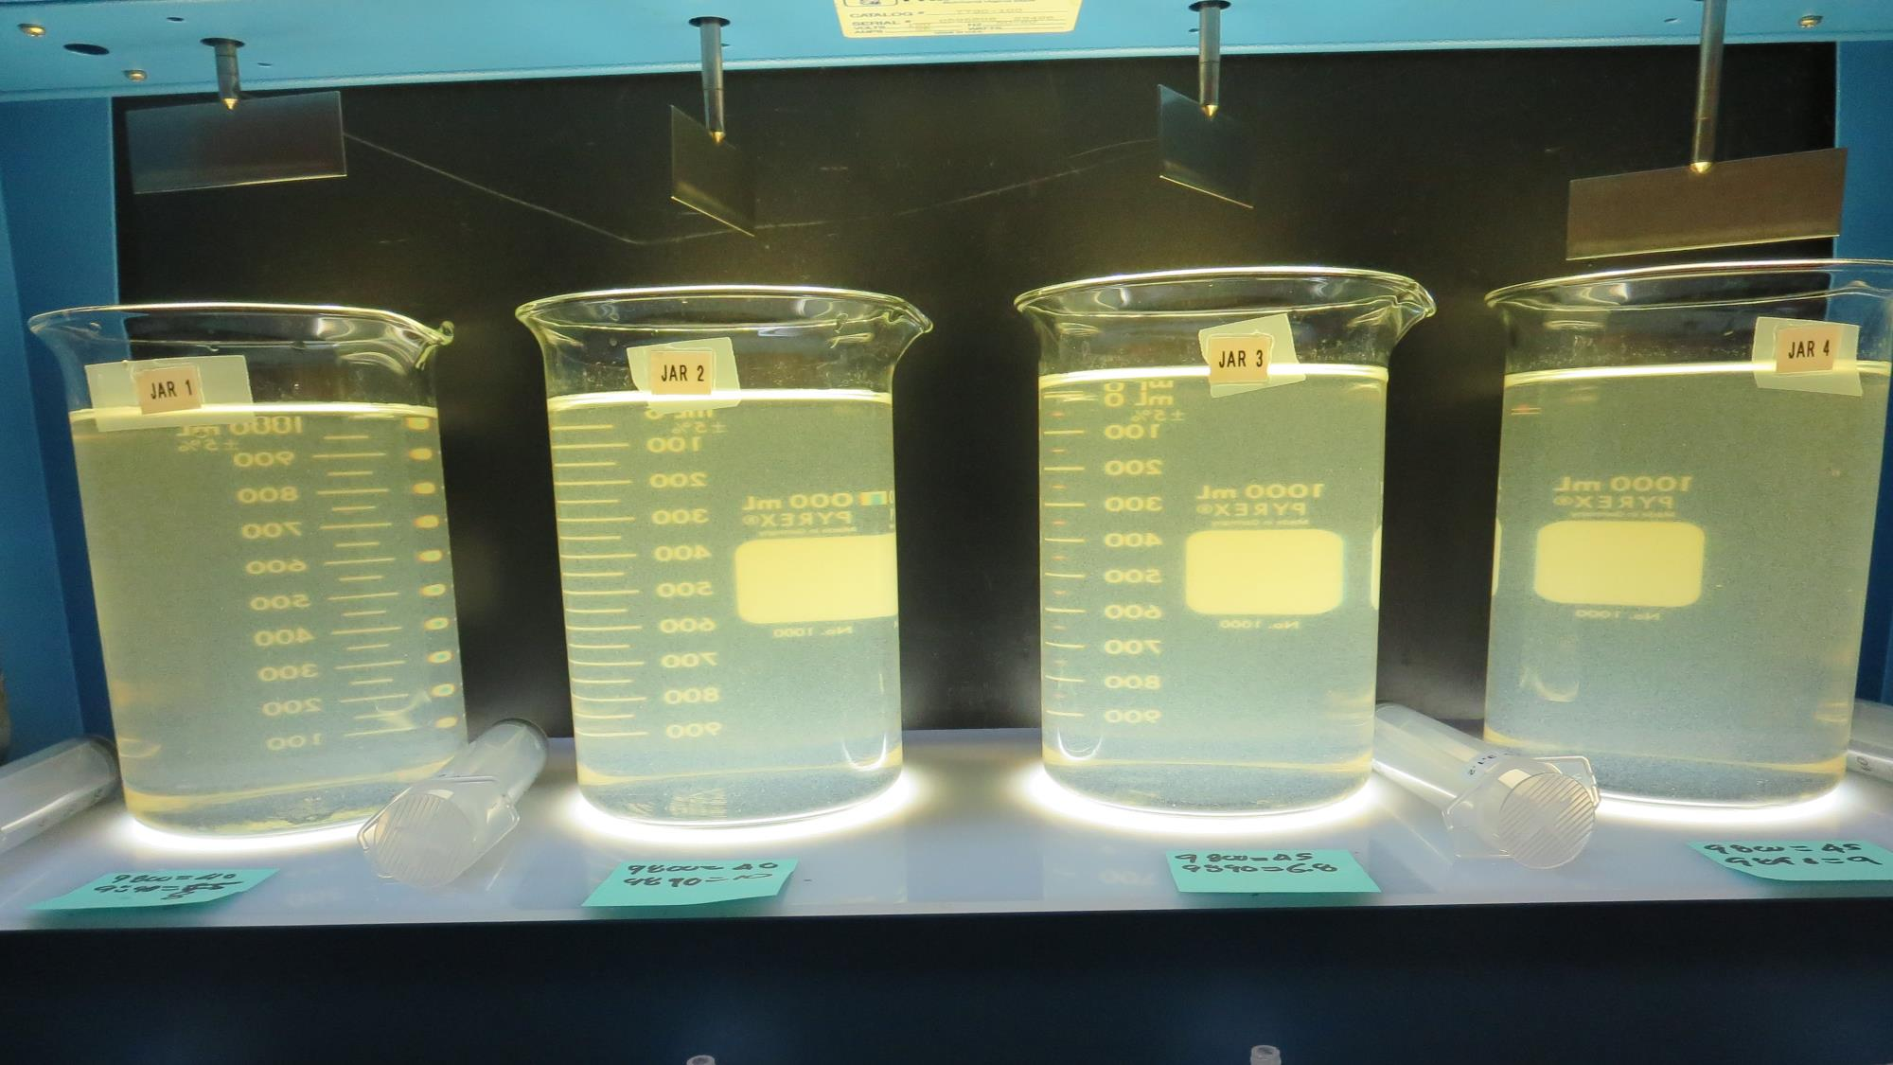
Jars 13-16: End of 5-minute flocculation (30 RPM) duration.
40 mg/L 9800
8 mg/L 9890
Filtrate 0.75 NTU
UVT: 82.8%
UVA: 0.082/cm
Settled: 2.3 NTU
40 mg/L 9800
10 mg/L 9890
Filtrate 0.70 NTU
UVT: 85.0%
UVA: 0.071/cm
Settled: 2.1 NTU
45 mg/L 9800
6.8 mg/L 9890
Filtrate 1.07 NTU
UVT: 82.1%
UVA: 0.086/cm
Settled: 2.2 NTU
45 mg/L 9800
9 mg/L 9890
Filtrate 1.1 NTU
UVT: 83.2%
UVA: 0.080/cm
Settled: 2.1 NTU

Slide 26
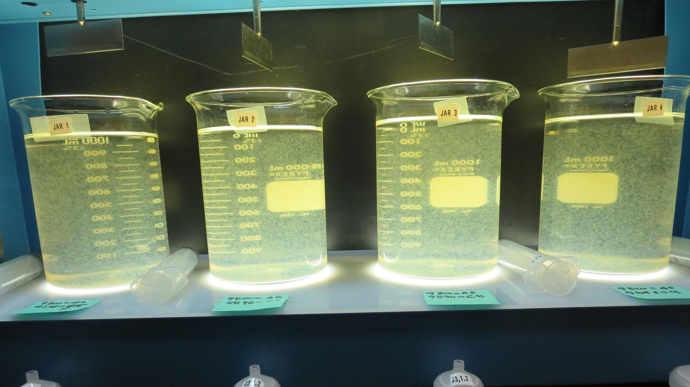
Jars 13-16: After 5 min of settling, 25 mL is syringed for filterability and %UVT/UVA.

Slide 27
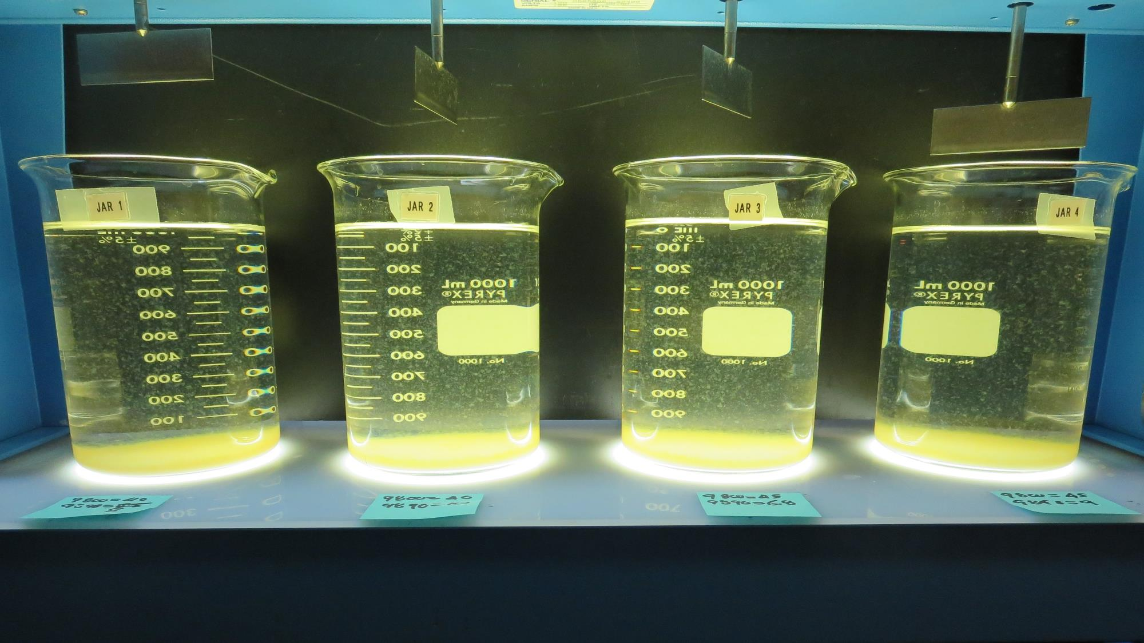
Jars 13-16: After 25-minutes of settling, settled water turbidity is taken.
40 mg/L 9800
8 mg/L 9890
Filtrate 0.75 NTU
UVT: 82.8%
UVA: 0.082/cm
Settled: 2.3 NTU
40 mg/L 9800
10 mg/L 9890
Filtrate 0.70 NTU
UVT: 85.0%
UVA: 0.071/cm
Settled: 2.1 NTU
45 mg/L 9800
6.8 mg/L 9890
Filtrate 1.07 NTU
UVT: 82.1%
UVA: 0.086/cm
Settled: 2.2 NTU
45 mg/L 9800
9 mg/L 9890
Filtrate 1.1 NTU
UVT: 83.2%
UVA: 0.080/cm
Settled: 2.1 NTU

Slide 28
Jars 17-20 Test Flash Mix 60 Sec (200 RPM) Floc Mix 5 min (30 RPM) Applied Coagulants 926/Zeta Floc 40

Slide 29
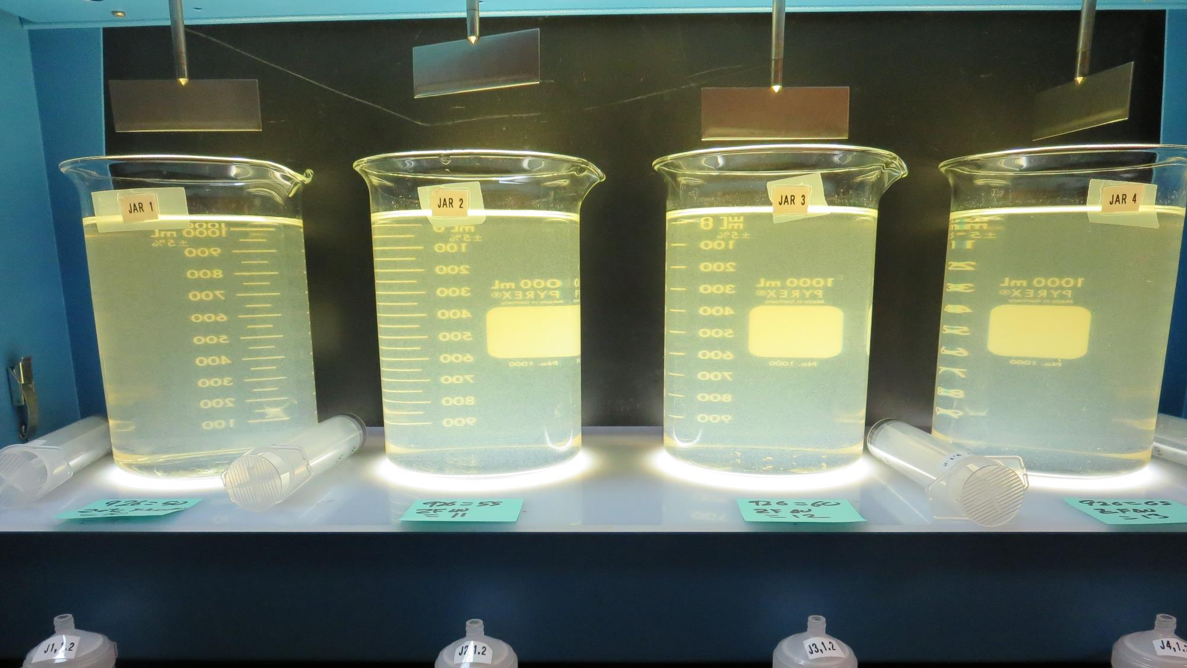
Jars 17-20: End of 5-minute flocculation (30 RPM) duration.
50 mg/L 926
10 mg/L Zeta Floc 40
Filtrate 0.13 NTU
UVT: 91.5%
UVA: 0.039/cm
Settled: 6.5 NTU
55 mg/L 926
11 mg/L Zeta Floc 40
Filtrate 0.60 NTU
UVT: 88.3%
UVA: 0.054/cm
Settled: 6.1 NTU
60 mg/L 926
12 mg/L Zeta Floc 40
Filtrate 0.74 NTU
UVT: 86.7%
UVA: 0.062/cm
Settled: 5.5 NTU
65 mg/L 926
13 mg/L Zeta Floc 40
Filtrate 2.1 NTU
UVT: 77.0%
UVA: 0.114/cm
Settled: 6.3 NTU

Slide 30
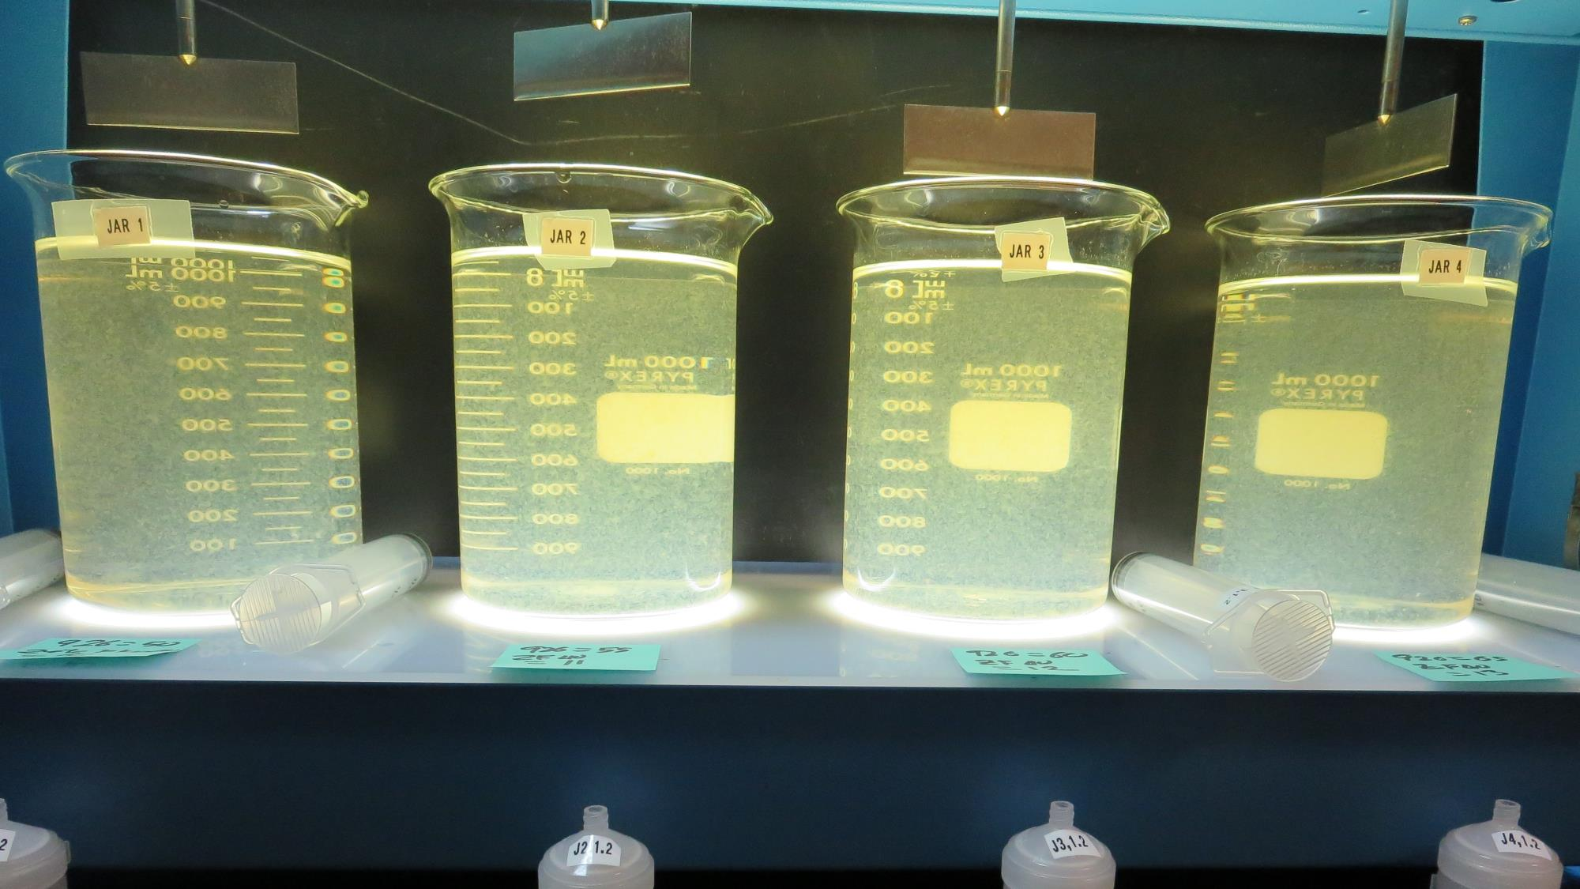
Jars 17-20: After 5 min of settling, 25 mL is syringed for filterability and %UVT/UVA.

Slide 31
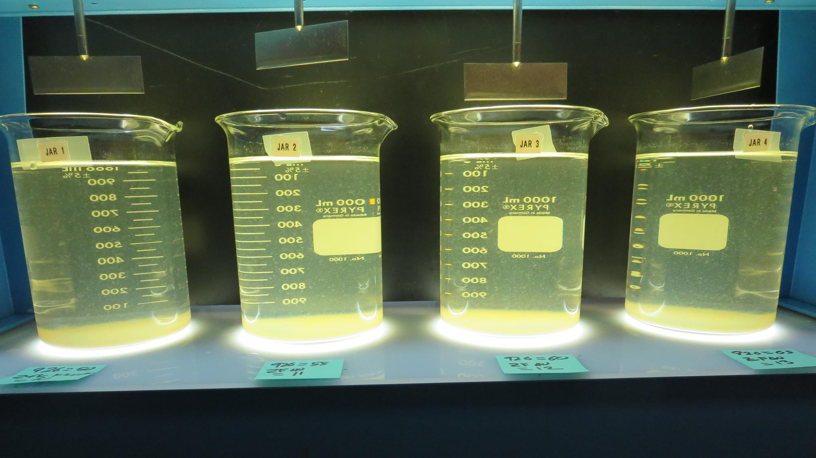
Jars 17-20: After 25-minutes of settling, settled water turbidity is taken.
50 mg/L 926
10 mg/L Zeta Floc 40
Filtrate 0.13 NTU
UVT: 91.5%
UVA: 0.039/cm
Settled: 6.5 NTU
55 mg/L 926
11 mg/L Zeta Floc 40
Filtrate 0.60 NTU
UVT: 88.3%
UVA: 0.054/cm
Settled: 6.1 NTU
60 mg/L 926
12 mg/L Zeta Floc 40
Filtrate 0.74 NTU
UVT: 86.7%
UVA: 0.062/cm
Settled: 5.5 NTU
65 mg/L 926
13 mg/L Zeta Floc 40
Filtrate 2.1 NTU
UVT: 77.0%
UVA: 0.114/cm
Settled: 6.3 NTU

Slide 32
Jars 21-24 Test Flash Mix 60 Sec (200 RPM) Floc Mix 5 min (30 RPM) Applied Coagulants 926/Zeta Floc 40

Slide 33
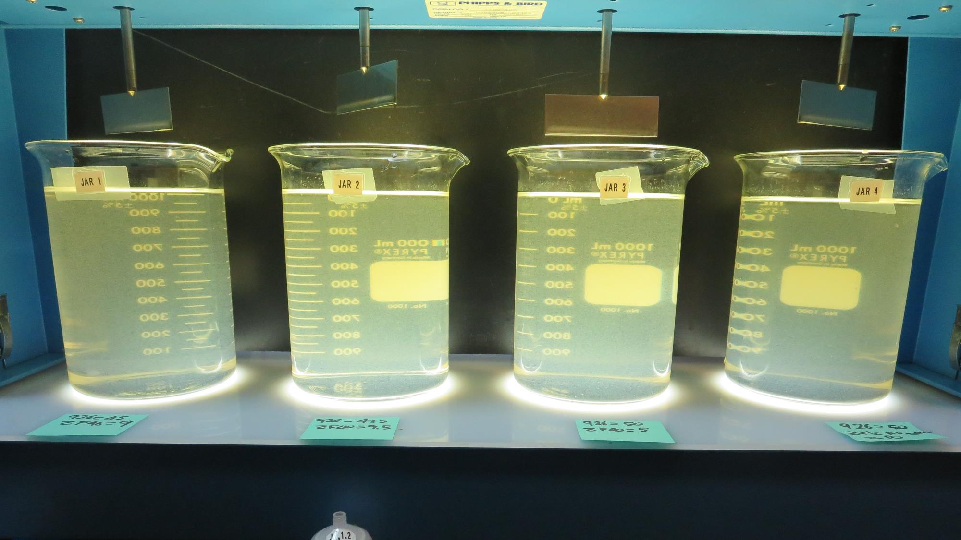
Jars 21-24: End of 5-minute flocculation (30 RPM) duration.
45 mg/L 926
9 mg/L Zeta Floc 40
Filtrate 0.34 NTU
UVT: 88.6%
UVA: 0.053/cm
Settled: 6 NTU
47.5 mg/L 926
9.5 mg/L Zeta Floc 40
Filtrate 0.40 NTU
UVT: 89.0%
UVA: 0.051/cm
Settled: 5.3 NTU
50 mg/L 926
5 mg/L Zeta Floc 40
Filtrate 0.31 NTU
UVT: 88.5%
UVA: 0.053/cm
Settled: 3.4 NTU
50 mg/L 926
10 mg/L Zeta Floc 40
Filtrate 0.61 NTU
UVT: 87.3%
UVA: 0.059/cm
Settled: 4.4 NTU

Slide 34
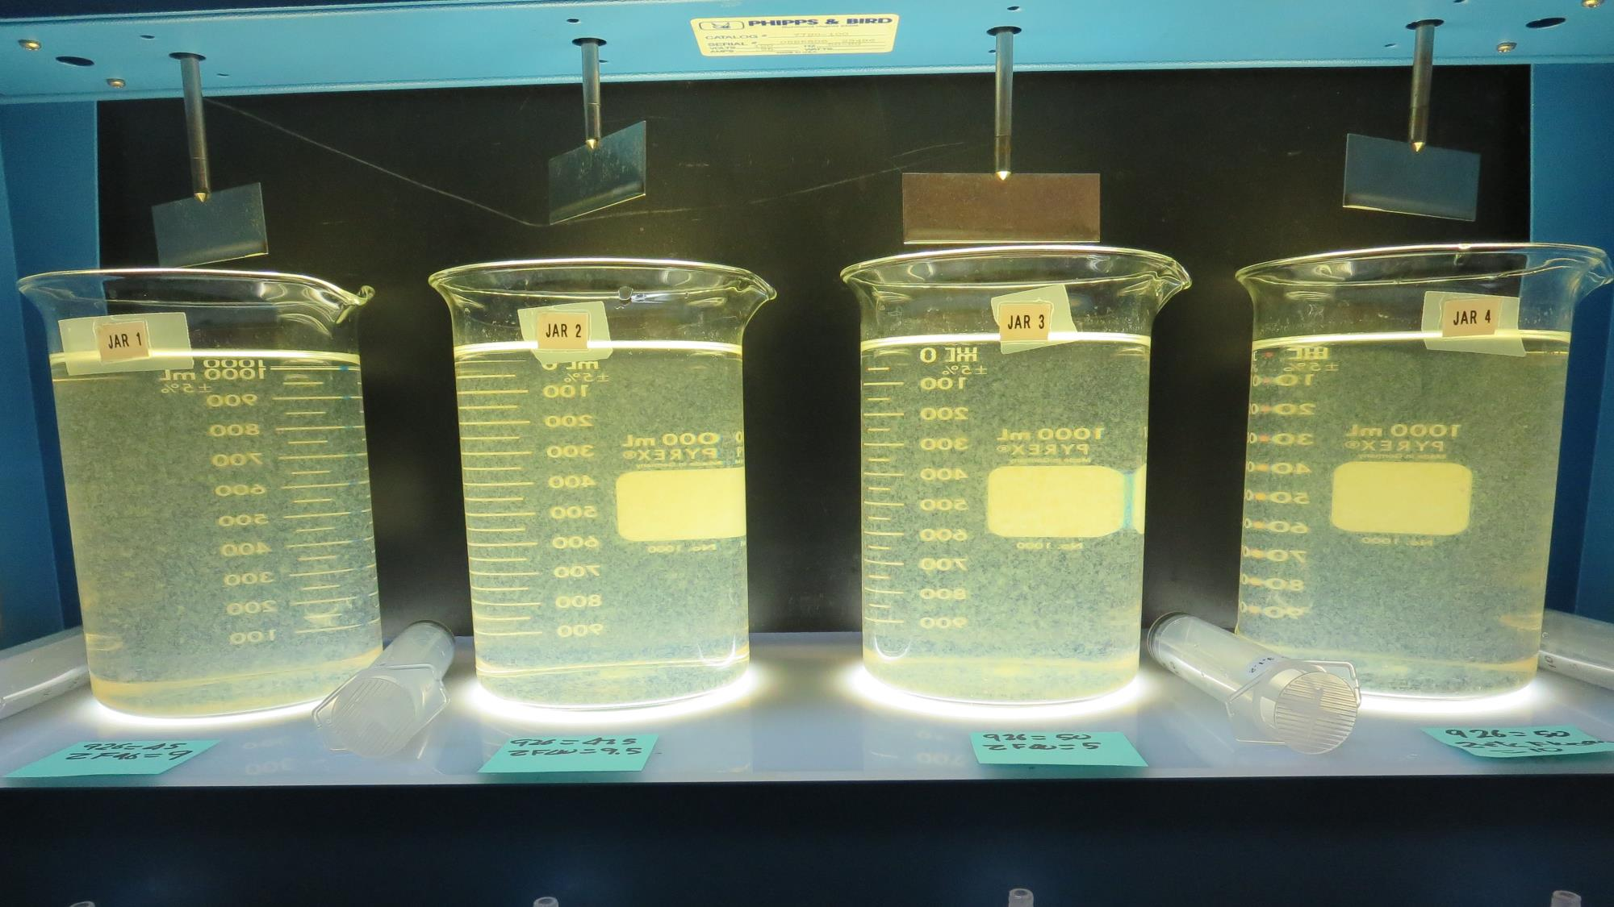
Jars 21-24: After 5 min of settling, 25 mL is syringed for filterability and %UVT/UVA.

Slide 35
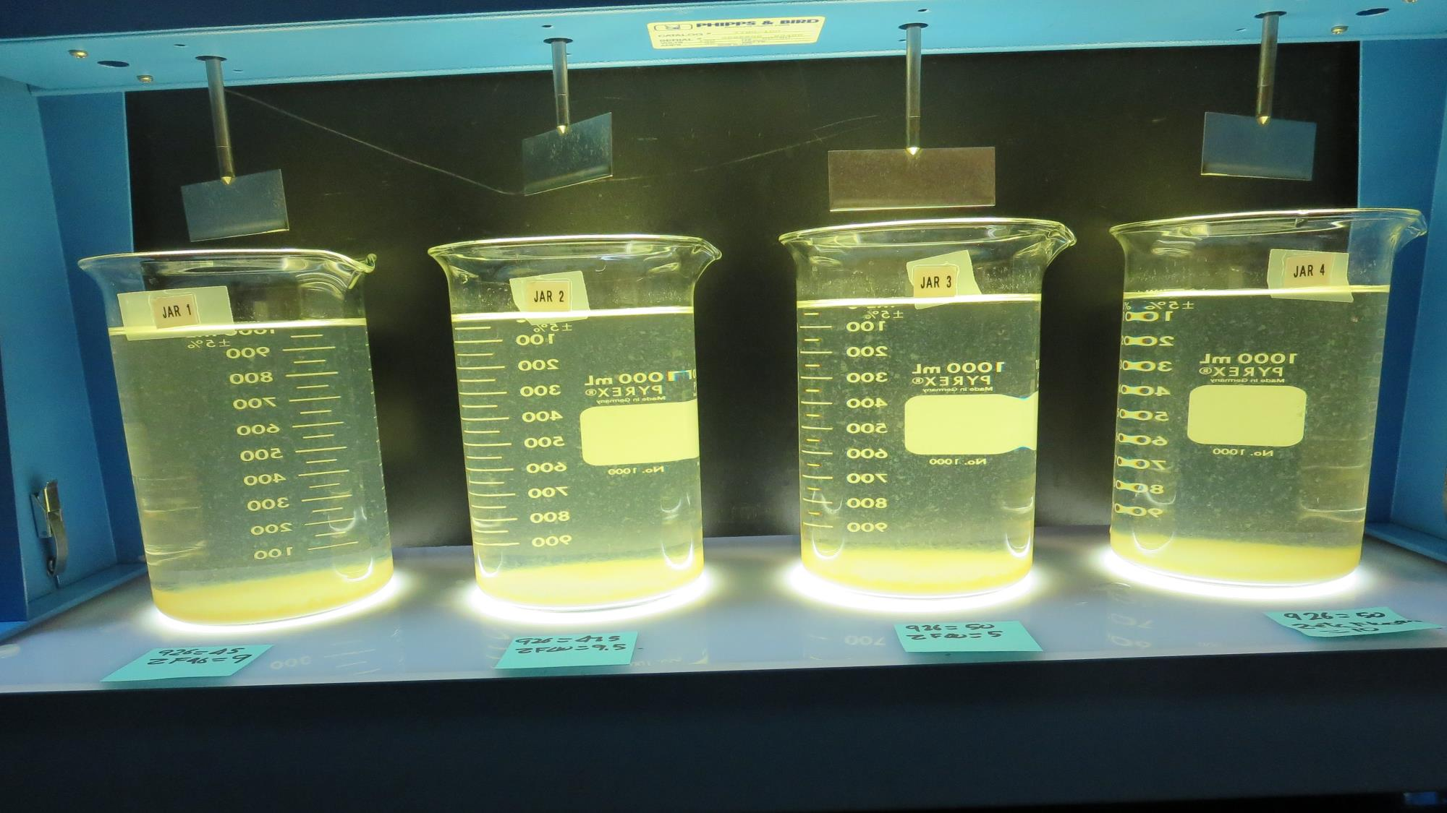
Jars 21-24: After 25-minutes of settling, settled water turbidity is taken.
45 mg/L 926
9 mg/L Zeta Floc 40
Filtrate 0.34 NTU
UVT: 88.6%
UVA: 0.053/cm
Settled: 6 NTU
47.5 mg/L 926
9.5 mg/L Zeta Floc 40
Filtrate 0.40 NTU
UVT: 89.0%
UVA: 0.051/cm
Settled: 5.3 NTU
50 mg/L 926
5 mg/L Zeta Floc 40
Filtrate 0.31 NTU
UVT: 88.5%
UVA: 0.053/cm
Settled: 3.4 NTU
50 mg/L 926
10 mg/L Zeta Floc 40
Filtrate 0.61 NTU
UVT: 87.3%
UVA: 0.059/cm
Settled: 4.4 NTU

Slide 36
Jars 25-28 Test KMnO₄ Floc 70 min (30 RPM) Flash Mix 60 Sec (200 RPM) Floc Mix 5 min (30 RPM) Applied Coagulant 926

Slide 37
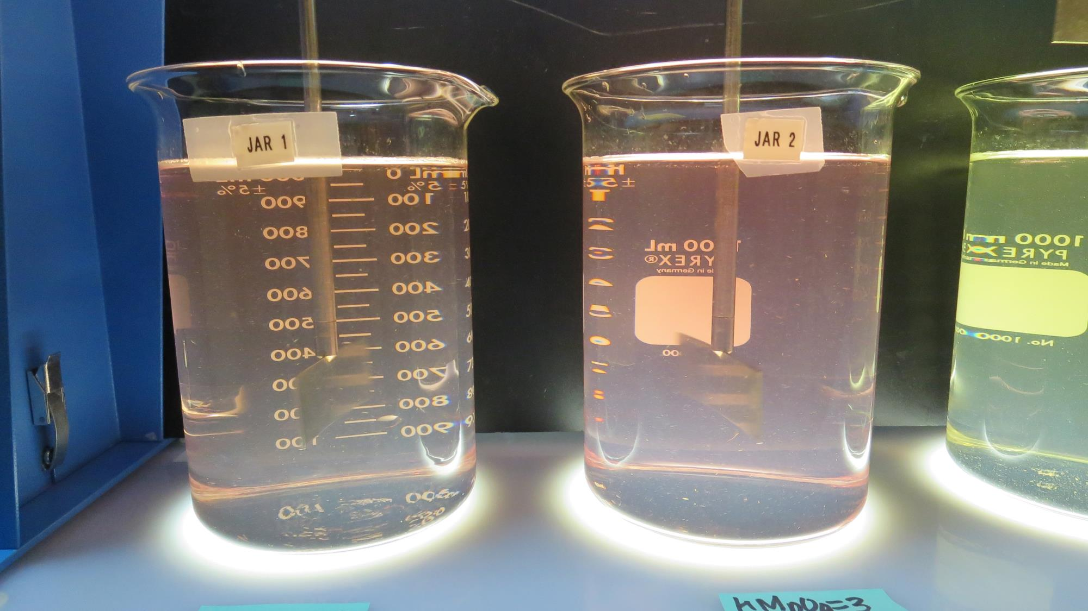
Jars 25-26: After injection of 2 mg/L KMnO4 to each jar. Floc for 70 minutes at 30 RPM.

Slide 38
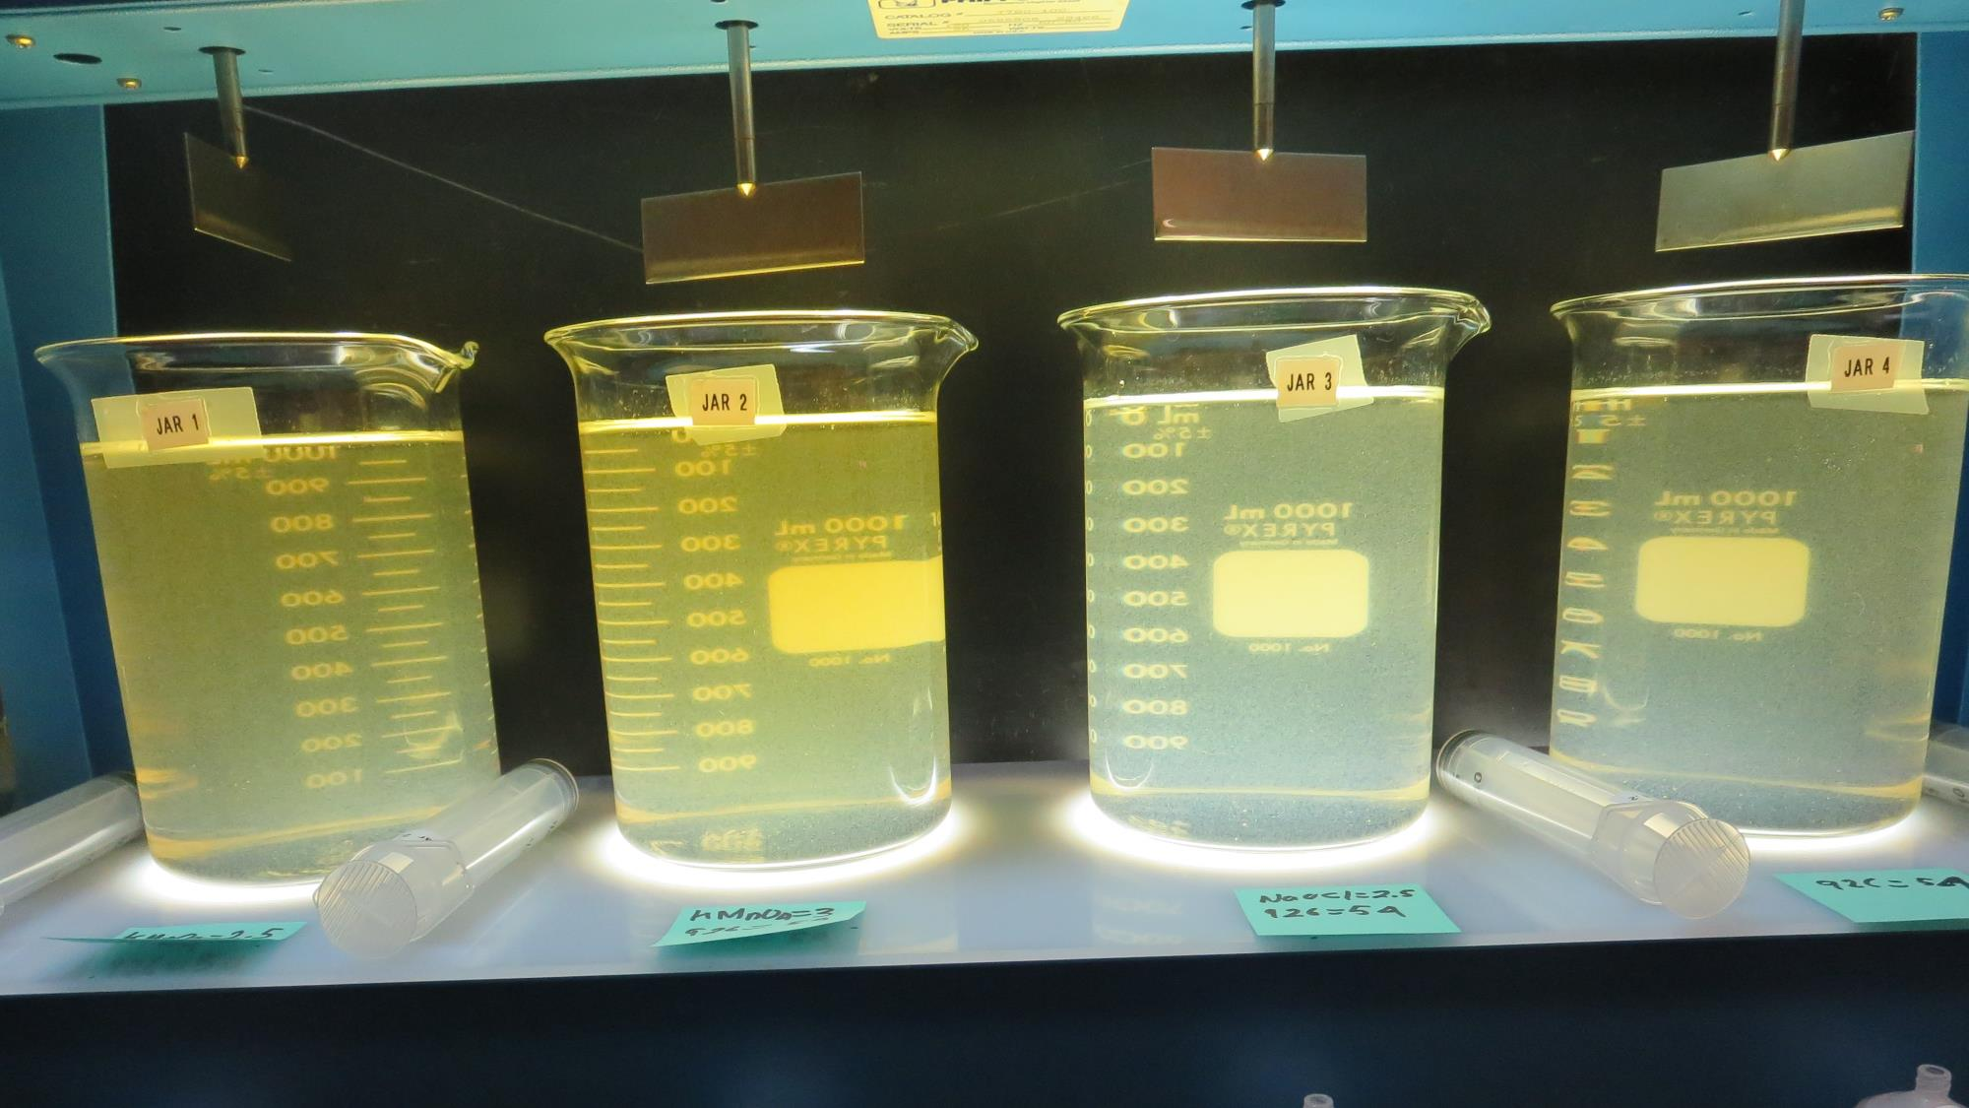
Jars 25-28: End of 5-minute flocculation (30 RPM) duration.
2.5 mg/L KMnO₄
54 mg/L 926
Filtrate 0.15 NTU
UVT: 87.5%
UVA: 0.058/cm
Settled: 1.8 NTU
3 mg/L KMnO₄
54 mg/L 926
Filtrate 0.18 NTU
UVT: 87.4%
UVA: 0.058/cm
Settled: 1.8 NTU
2.5 mg/L NaOCl
54 mg/L 926
Filtrate 0.84 NTU
UVT: 81.1%
UVA: 0.091/cm
Settled: 2.2 NTU
54 mg/L 926
Filtrate 0.28 NTU
UVT: 86.8%
UVA: 0.061/cm
Settled: 1.5 NTU

Slide 39
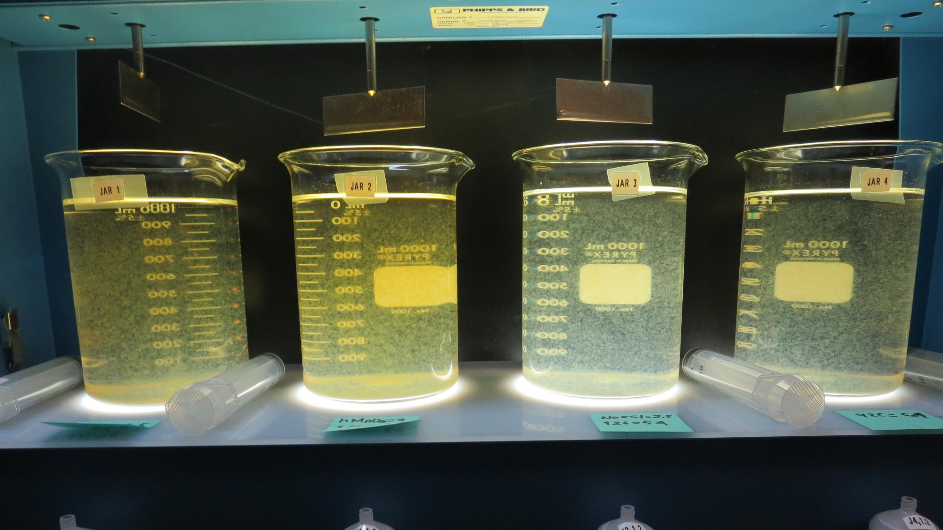
Jars 25-28: After 5 min of settling, 25 mL is syringed for filterability and %UVT/UVA.

Slide 40
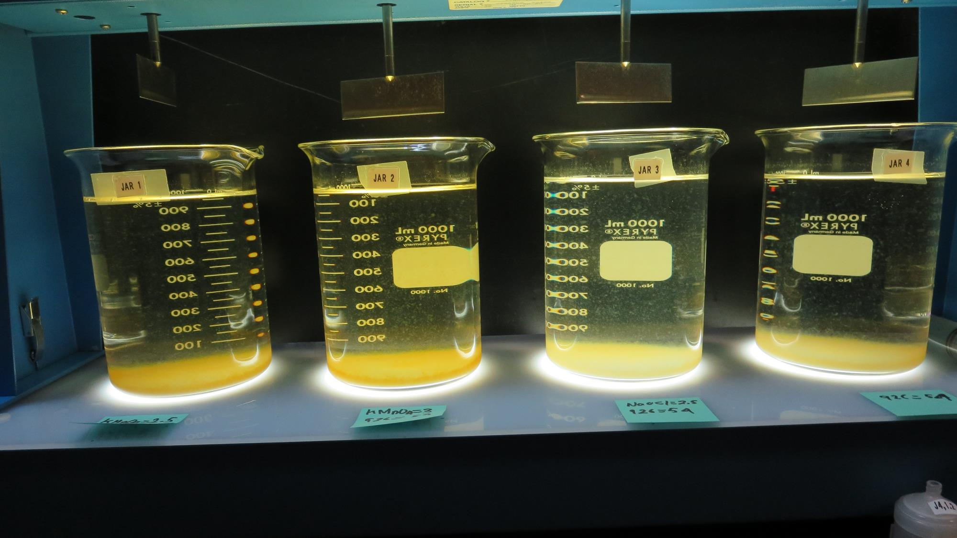
Jars 25-28: After 25-minutes of settling, settled water turbidity is taken.
2.5 mg/L KMnO₄
54 mg/L 926
Filtrate 0.15 NTU
UVT: 87.5%
UVA: 0.058/cm
Settled: 1.8 NTU
3 mg/L KMnO₄
54 mg/L 926
Filtrate 0.18 NTU
UVT: 87.4%
UVA: 0.058/cm
Settled: 1.8 NTU
2.5 mg/L NaOCl
54 mg/L 926
Filtrate 0.84 NTU
UVT: 81.1%
UVA: 0.091/cm
Settled: 2.2 NTU
54 mg/L 926
Filtrate 0.28 NTU
UVT: 86.8%
UVA: 0.061/cm
Settled: 1.5 NTU

Slide 41
Jars 29-32 Test KMnO₄ Floc 70 min (30 RPM) Flash Mix 60 Sec (200 RPM) Floc Mix 5 min (30 RPM) Applied Coagulant 9890

Slide 42
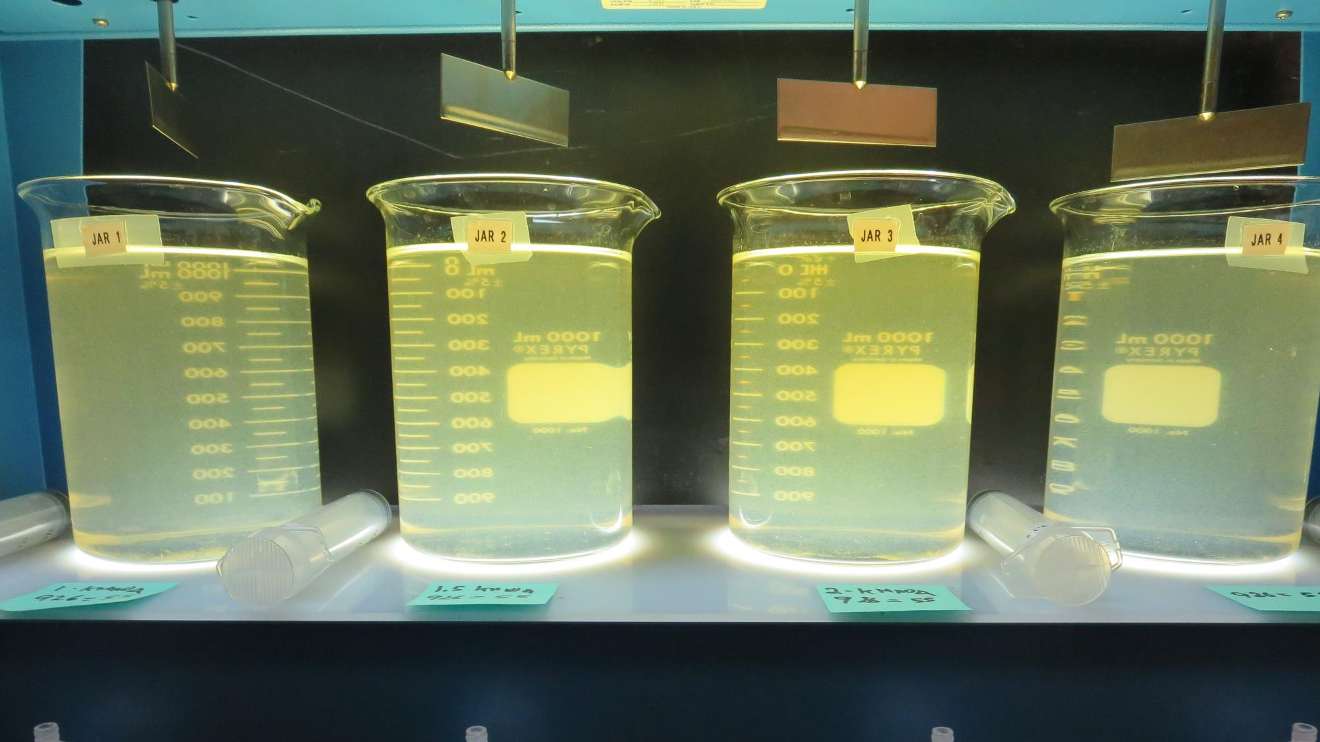
Jars 29-32: End of 5-minute flocculation (30 RPM) duration.
1 mg/L KMnO₄
55 mg/L 926
Filtrate 1.2 NTU
UVT: 80.2%
UVA: 0.096/cm
Settled: 1.9 NTU
1.5 mg/L KMnO₄
55 mg/L 926
Filtrate 0.09 NTU
UVT: 88.4%
UVA: 0.054/cm
Settled: 1.9 NTU
2 mg/L KMnO₄
55 mg/L 926
Filtrate 0.41 NTU
UVT: 85.6%
UVA: 0.068/cm
Settled: 1.6 NTU
55 mg/L 926
Filtrate 0.09 NTU
UVT: 89.2%
UVA: 0.050/cm
Settled: 2.0 NTU

Slide 43
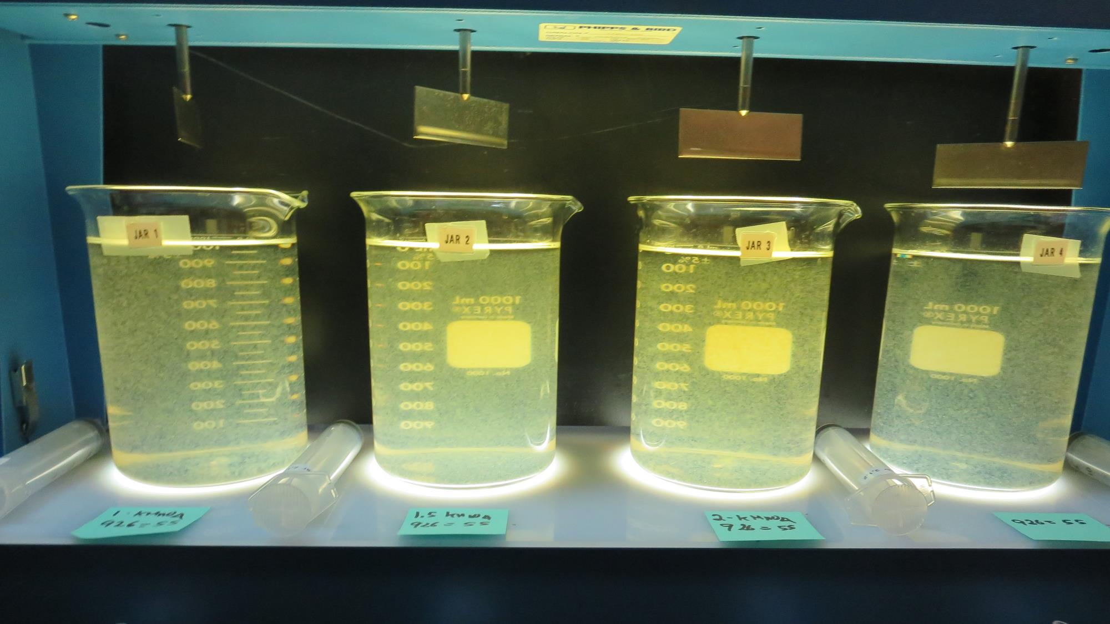
Jars 29-32: After 5 min of settling, 25 mL is syringed for filterability and %UVT/UVA.

Slide 44
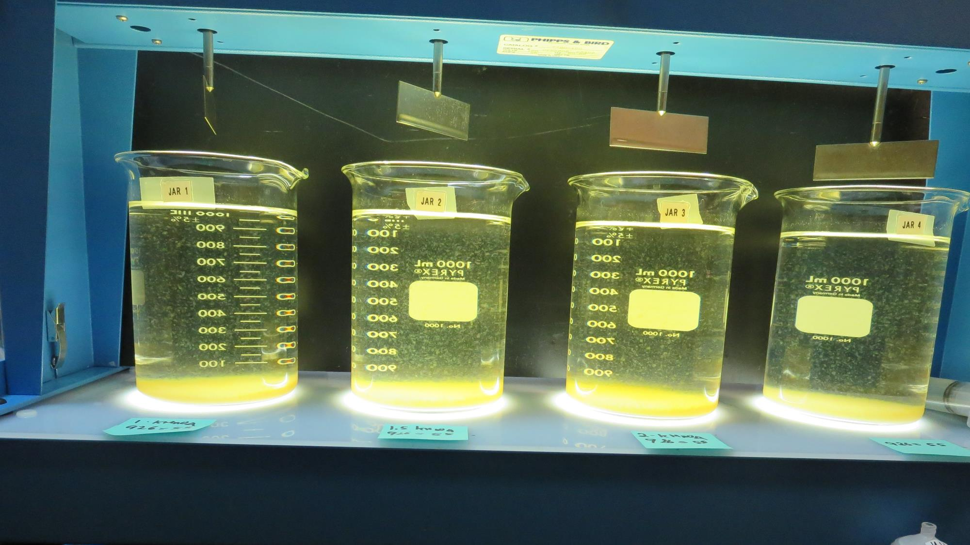
Jars 29-32: After 25-minutes of settling, settled water turbidity is taken.
1 mg/L KMnO₄
55 mg/L 926
Filtrate 1.2 NTU
UVT: 80.2%
UVA: 0.096/cm
Settled: 1.9 NTU
1.5 mg/L KMnO₄
55 mg/L 926
Filtrate 0.09 NTU
UVT: 88.4%
UVA: 0.054/cm
Settled: 1.9 NTU
2 mg/L KMnO₄
55 mg/L 926
Filtrate 0.41 NTU
UVT: 85.6%
UVA: 0.068/cm
Settled: 1.6 NTU
55 mg/L 926
Filtrate 0.09 NTU
UVT: 89.2%
UVA: 0.050/cm
Settled: 2.0 NTU

Slide 45
Jar Testing for 1-Liter Jars: Procedures for Most Treatment Plants
Fill jars with source water prior to coagulant injection and set paddle speed at 30 rpm
Add chemicals (i.e., NaOCl, primary coagulant, coagulant aid) to each jar
Flash mix for 15-60 seconds (200 rpm)
Slow mix for 5 minutes (20-30 rpm)
Settled for 5 minutes. Syringe 25 mL from each jar taken 1-inch below surface (25 mL/12 sec rate)
Filtered through 1.2 um isopore membrane into cuvette drip rate, 15 mL/(50-90 sec)
Measure filtrate turbidity, chlorine residual and %UVT/UVA
Measure settled water turbidity after 25 minutes of total setting
Record all data

Slide 46
Jar Test Filterability Test Equipment
Turbidity Instrument
Syringe w/Luer-Lock Tip, 30 cc
(part#: 2225800, by Hach)
Swinnex Filter Holder, 25 mm (part#: SX0002500)
Isopore Membrane Filter, 1.2 um absolute
pore size,
Φ= 25 mm , thickness: 24 um,
hydrophilic polycarbonate membrane
(part #: RTTP02500)
Go to Sigma-Aldrich for laboratory supplies http://www.sigmaaldrich.com/united-states.html

Slide 47
Isopore Membrane Information
Categories | Information
trade name | Isopore
filter color | White
chemistry | Polycarbonate (PC)
water flow rate | Avg. 175 mL/min x cm² (typical results @ 10 psi)
media | Isopore®
wettability | Hydrophilic
porosity | 14.7%
pore size | 1.2 µm
bubble point at 23 °C | 1.0 bar, air with water
thickness | 24 µm
filter diameter (ø) | 25 mm
material size | polycarbonate, Hydrophilic, 1.2 µm, 25 mm, white, plain, 100

Slide 48
Isopore Membrane Background Information
The Isopore membrane is a polycarbonate, track-etched screen filter recommended for all analyses in which the sample is viewed on the surface of the membrane. The Isopore membrane is composed of polycarbonate film, which has a smooth, glass-like surface for clearer sample observation. The unique manufacturing process of the membrane ensures a precise pore diameter and a consistent pore size for accurate separation of samples by size. Matched-weight filters are not usually required because of low, constant tar and ash weights. Features & Benefits: Membrane structure retains particles on the surface, simplifying counting and analysis

Slide 49
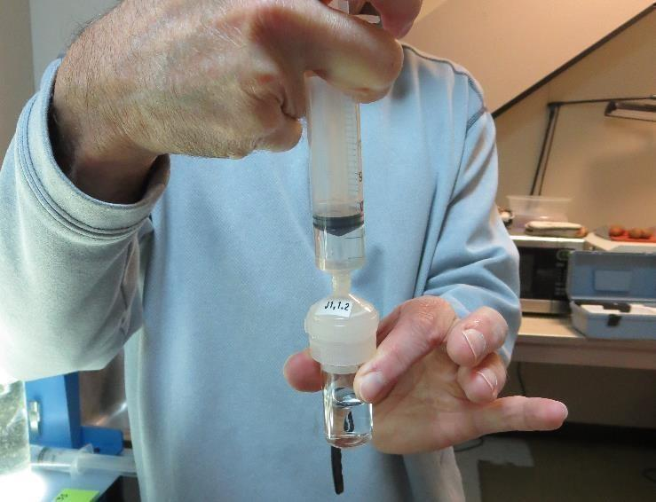
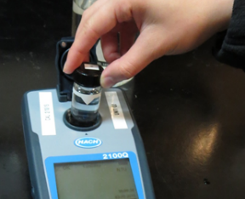
Jar Test - Filterability Test
Syringe ~ 25 mL from jar (after 5-minutes of settling)
Filter-to-waste 3-5 mL
Filter directly into clean cuvette
Measure turbidity
Note: Take several readings before recording final NTU results. Micro bubbles can adhere to glass causing false NTU readings. To remove bubbles, tilt cuvette up to 90 degrees.

Slide 50
Contact
Guy Schott, P.E.
State Water Resources Control Board
Division of Drinking Water
Santa Rosa, CA
Go to Stock Solution/Dose calculations/Jar Test Results for tools to download
www.waterboards.ca.gov/drinking_water/programs/districts/mendocino_district.html
Email: Guy Schott - Guy.Schott@waterboards.ca.gov
Office Number: 707-576-2732

