Slide 1
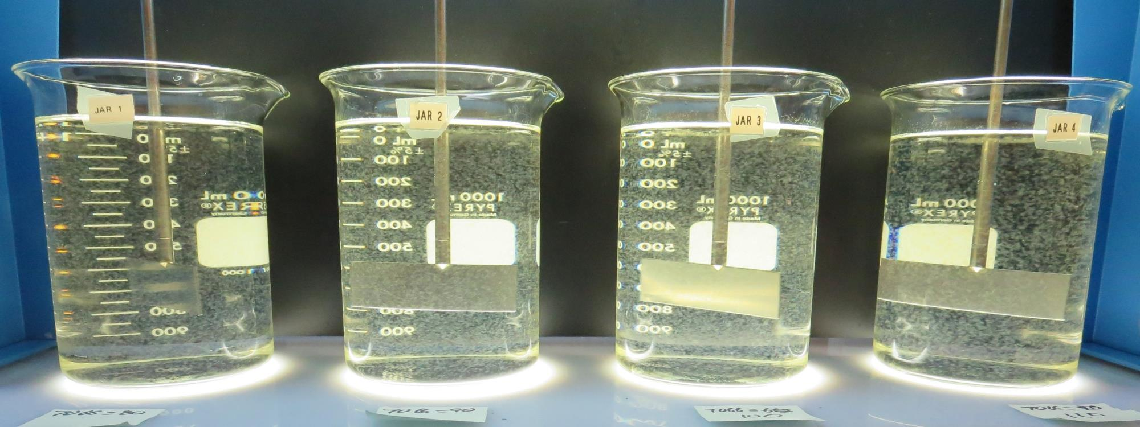
Surfwood Mutual Water Corporation
CA2300590
Mendocino County
Jar Test
by Guy Schott, P.E.
May 14, 2019

Slide 2
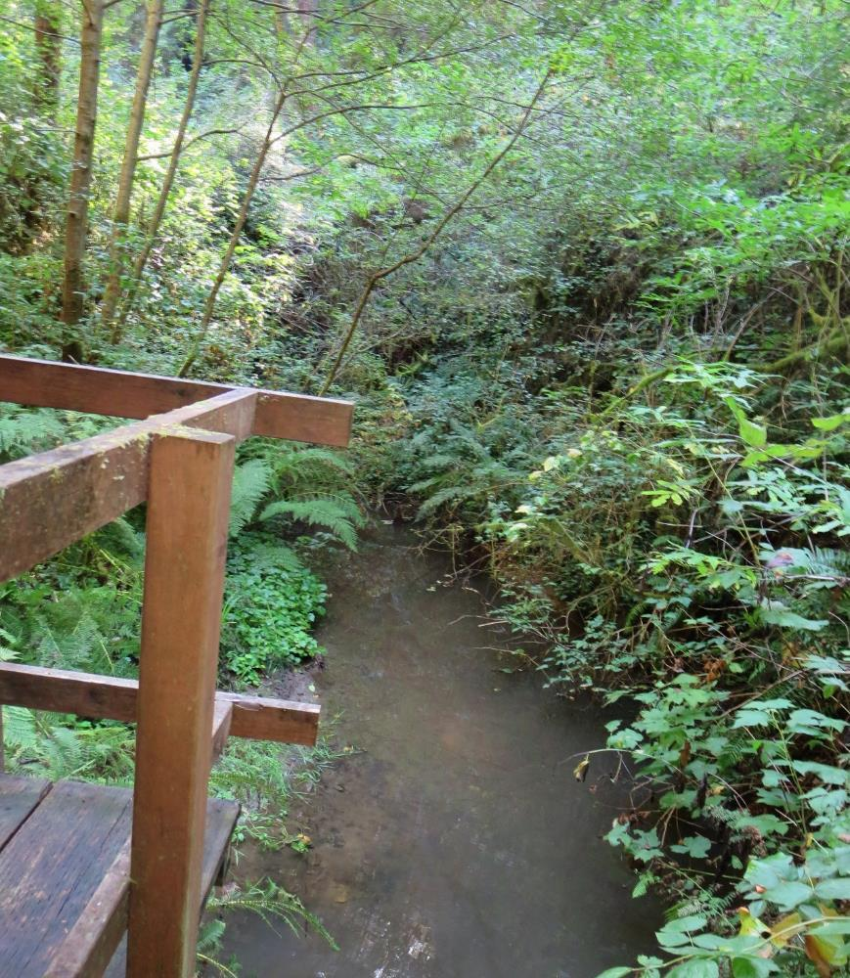
Source Water: Jack Peter’s Creek
Roughing Filter followed by Multi-Media Filtration
Source Water Characteristics
Turbidity: 1.7 NTU
pH: 7.74
UVT: 64.4%
UVA: 0.191
0.4 um Filtered
UVT: 64.3%
UVA: 0.192

Slide 3
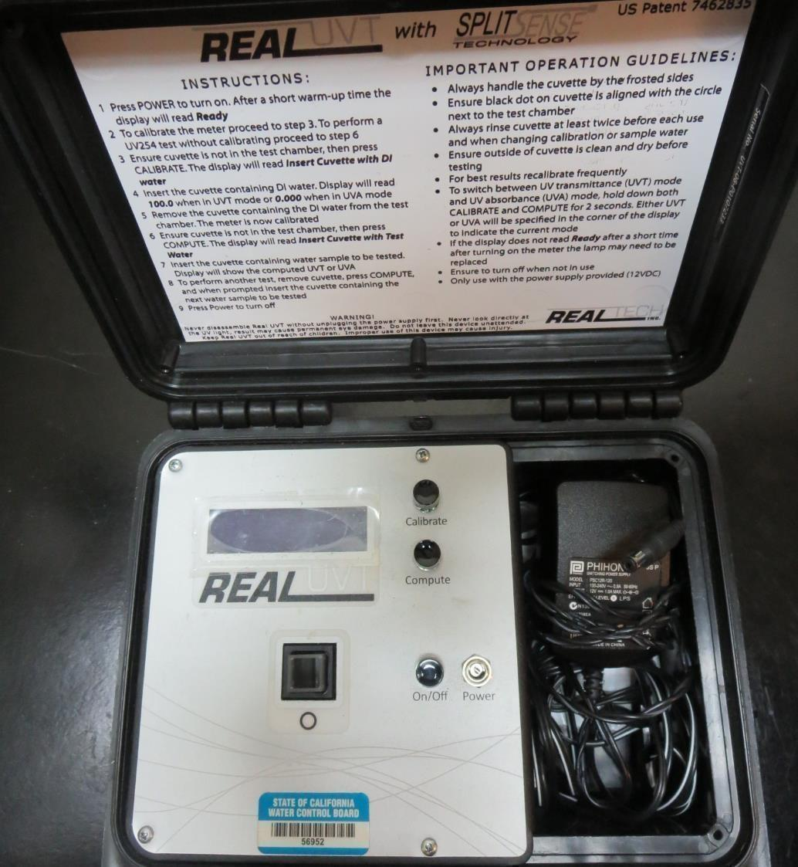
UVT/UVA
UV transmittance (UVT) is a measurement of the amount of ultraviolet light (commonly at 254 nm due to its germicidal effect) that passes through a water sample compared to the amount of light that passes through a pure water sample. The measurement is expressed as a percentage, % UVT.
%UVT = 10^{(-UVA)} x 100%
UV absorbance (UVA) is calculated as a relative measure of the amount of light absorbed by a water sample compared with the amount of light absorbed by a pure water sample.
UVA = -log(%UVT/100)

Slide 4
Coagulant Used for Jar Testing
Pro Pac 9890 (NTU Technologies)
35-45% Aluminum Chlorohydrate
35-45% Water
20% Proprietary
SG = 1.25-1.34
Pro Pac 9890 (NTU Technologies)
50% Aluminum Chlorohydrate
50% Water
SG = 1.34
7066 (Garratt Callahan)
10 – 30% Poly Aluminum Hydroxychloride Sulfate
SG = 1.2

Slide 5
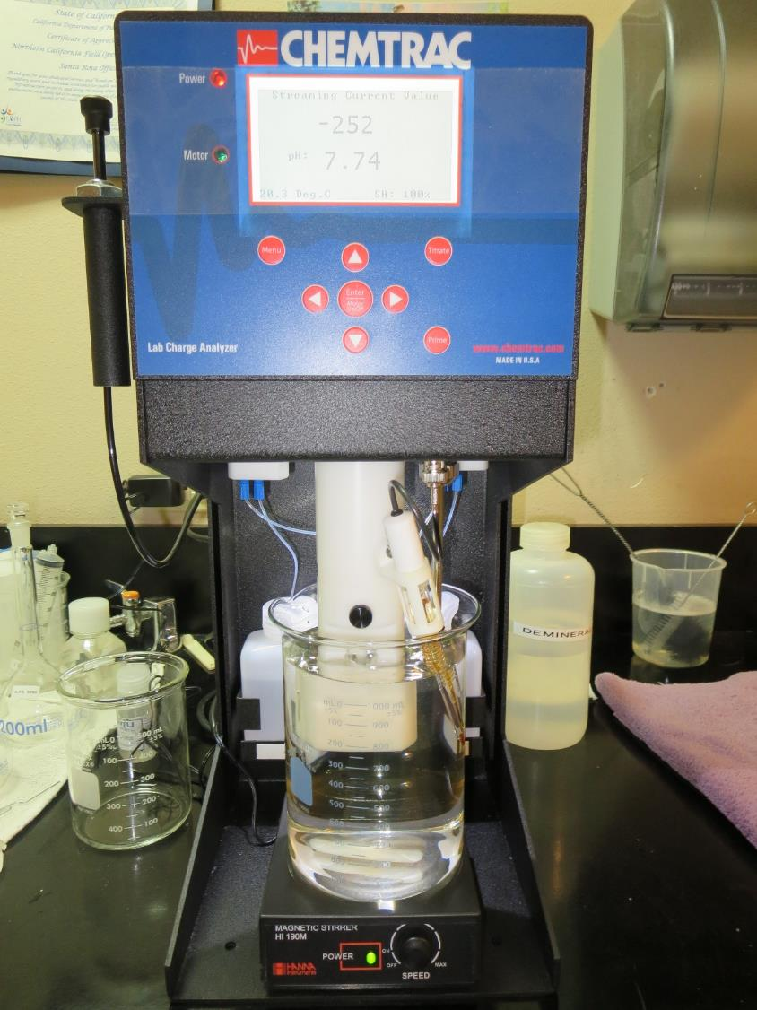
Laboratory Charge Analyzer
LCA: Used to determine coagulant demand of a source water entering the treatment plant.
Source pH: 7.74
LCA #1:
7066: 118 mg/L as product
(no pH adjustment)
LCA #2:
9800: 38 mg/L as product
(no pH adjustment)

Slide 6
Coagulant Information
Unless stated otherwise, all coagulant doses are reported as Product (100% strength).
Preparation of coagulant stock solutions are generally 1.0 or 0.1 percent strength using 100 and/or 200 mL volumetric flasks.
Finnpipette F2 variable volume pipette, capacity 100-1000 micro liters is used for stock solution preparation and coagulant aid jar test dosing.
Finnpipette F2 variable volume pipette, capacity 0.5-5 mL is used for primary coagulant jar test dosing.

Slide 7
Surfwood MWC: Jar Test 1-8 Results
Jar | 200 RPM Flash Mix seconds | 30 RPM Floc Duration minutes | 7066 mg/L | Filtrate NTU | Filtrate %UVT | Filtrate UVA/cm | Settle NTU 25 min
J1 | 60 | 5 | 60 | 0.22 | 85.0 | 0.071 | 0.57
J2 | 60 | 5 | 70 | 0.09 | 89.1 | 0.050 | 0.40
J3 | 60 | 5 | 80 | 0.07 | 90.4 | 0.044 | 0.40
J4 | 60 | 5 | 90 | 0.07 | 91.6 | 0.038 | 0.31
J5 | 60 | 5 | 80 | 0.11 | 89.8 | 0.047 | 0.24
J6 | 60 | 5 | 90 | 0.07 | 91.5 | 0.039 | 0.21
J7 | 60 | 5 | 100 | 0.07 | 92.3 | 0.035 | 0.26
J8 | 60 | 5 | 110 | 0.08 | 93.0 | 0.032 | 0.38

Slide 8
Surfwood MWC: Jar Test 1-8 Results:
Membrane Filter, 1.2 um nominal, 25 mm, polypropylene hydrophobic membrane, thickness 180-250 um
Jar | 200 RPM Flash Mix seconds | 30 RPM Floc Duration minutes | 7066 mg/L | Filtrate NTU | Filtrate %UVT | Filtrate UVA/cm | Settle NTU 25 min
J1 | 60 | 5 | 60 | 0.34 | 81.9 | 0.087 | 0.57
J2 | 60 | 5 | 70 | 0.16 | 87.6 | 0.057 | 0.40
J3 | 60 | 5 | 80 | 0.13 | 89.3 | 0.049 | 0.40
J4 | 60 | 5 | 90 | 0.07 | 91.9 | 0.037 | 0.31
J5 | 60 | 5 | 80 | 0.16 | 88.7 | 0.052 | 0.24
J6 | 60 | 5 | 90 | 0.12 | 91.1 | 0.040 | 0.21
J7 | 60 | 5 | 100 | 0.07 | 92.3 | 0.035 | 0.26
J8 | 60 | 5 | 110 | 0.07 | 93.2 | 0.031 | 0.38

Slide 9
Surfwood MWC: Jar Test 9-12 Results
Flash Mix 60 sec (200 RPM), Floc 5 min (30 RPM)
Jar | 9800 mg/L | 9890 mg/L | Filtrate NTU | Filtrate %UVT | Filtrate UVA/cm | Settle NTU 15 min | Settle NTU 25 min | Settle NTU 35 min
J9 | 38 | 0 | 0.09 | 91.4 | 0.039 | 2.30 | 1.36 | 1.04
J10 | 40 | 0 | 0.39 | 88.6 | 0.053 | 1.82 | 1.38 | 1.10
J11 | 36 | 1.8 | 0.50 | 86.7 | 0.062 | 2.43 | 1.40 | 1.0
J12 | 38 | 1.9 | 0.40 | 88.3 | 0.054 | 1.55 | 1.36 | 1.08

Slide 10
Surfwood MWC: Jar Test 9-12 Results
Flash Mix 60 sec (200 RPM), Floc 5 min (30 RPM)
Membrane Filter, 1.2 um nominal, 25 mm, polypropylene hydrophobic membrane, thickness 180-250 um
Jar | 9800 mg/L | 9890 mg/L | Filtrate NTU | Filtrate %UVT | Filtrate UVA/cm | Settle NTU 15 min | Settle NTU 25 min | Settle NTU 35 min
J9 | 38 | 0 | 1.17 | 76.9 | 0.114 | 2.30 | 1.36 | 1.04
J10 | 40 | 0 | 1.36 | 75.4 | 0.123 | 1.82 | 1.38 | 1.10
J11 | 36 | 1.8 | 1.07 | 79.5 | 0.100 | 2.43 | 1.40 | 1.0
J12 | 38 | 1.9 | 1.27 | 76.8 | 0.115 | 1.55 | 1.36 | 1.08

Slide 11
Jars 1-4 Test
Flash Mix 60 Sec (200 RPM)
Floc Mix 5 min (30 RPM)
Applied Coagulant
7066

Slide 12
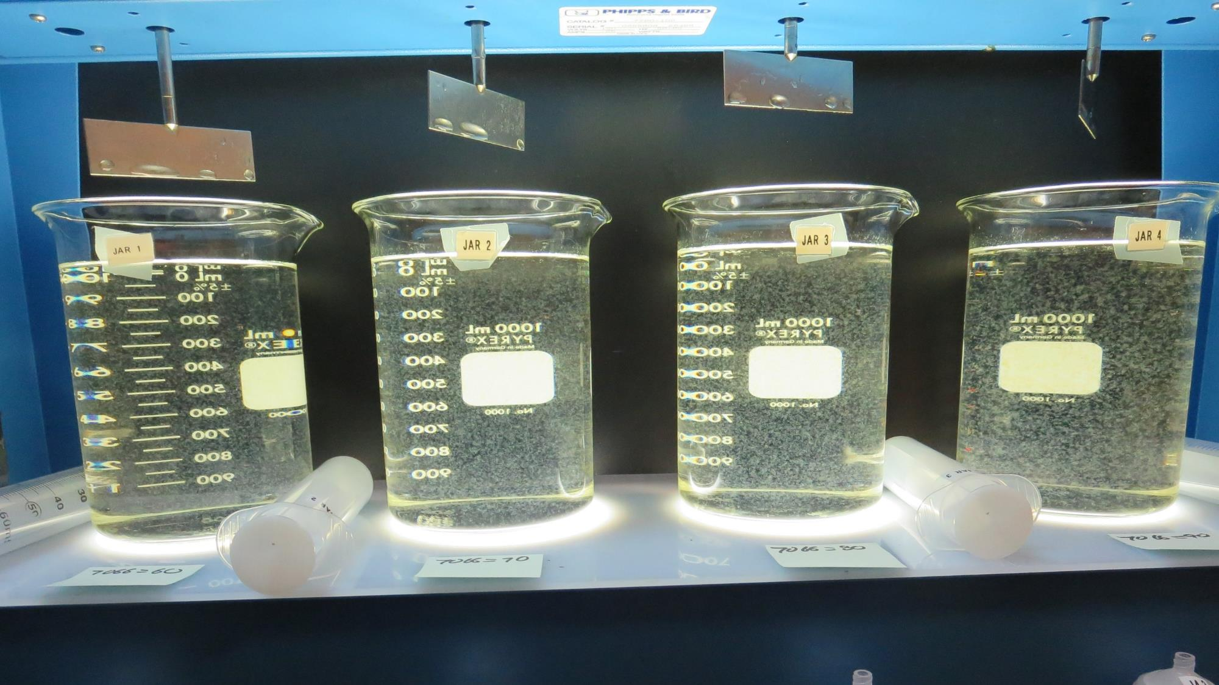
Jars 1-4: End of 5-minute flocculation (30 RPM) duration.
60 mg/L 7066
Filtrate 0.22 NTU
UVT: 85.0%
UVA: 0.071/cm
Settled: 0.57 NTU
70 mg/L 7066
Filtrate 0.09 NTU
UVT: 89.1%
UVA: 0.050/cm
Settled: 0.40 NTU
80 mg/L 7066
Filtrate 0.07 NTU
UVT: 90.4%
UVA: 0.044/cm
Settled: 0.40 NTU
90 mg/L 7066
Filtrate 0.07 NTU
UVT: 91.6%
UVA: 0.038/cm
Settled: 0.31 NTU

Slide 13
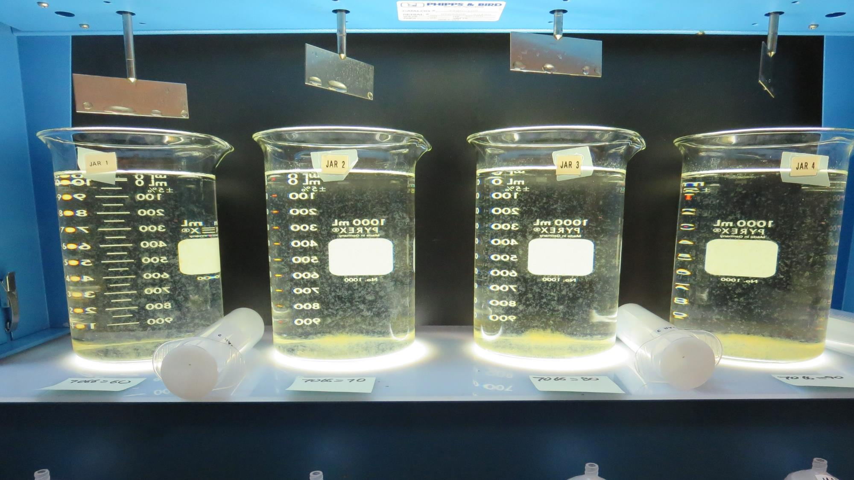
Jars 1-4: After 5 min of settling, 25 mL is decanted for filterability and %UVT/UVA.

Slide 14
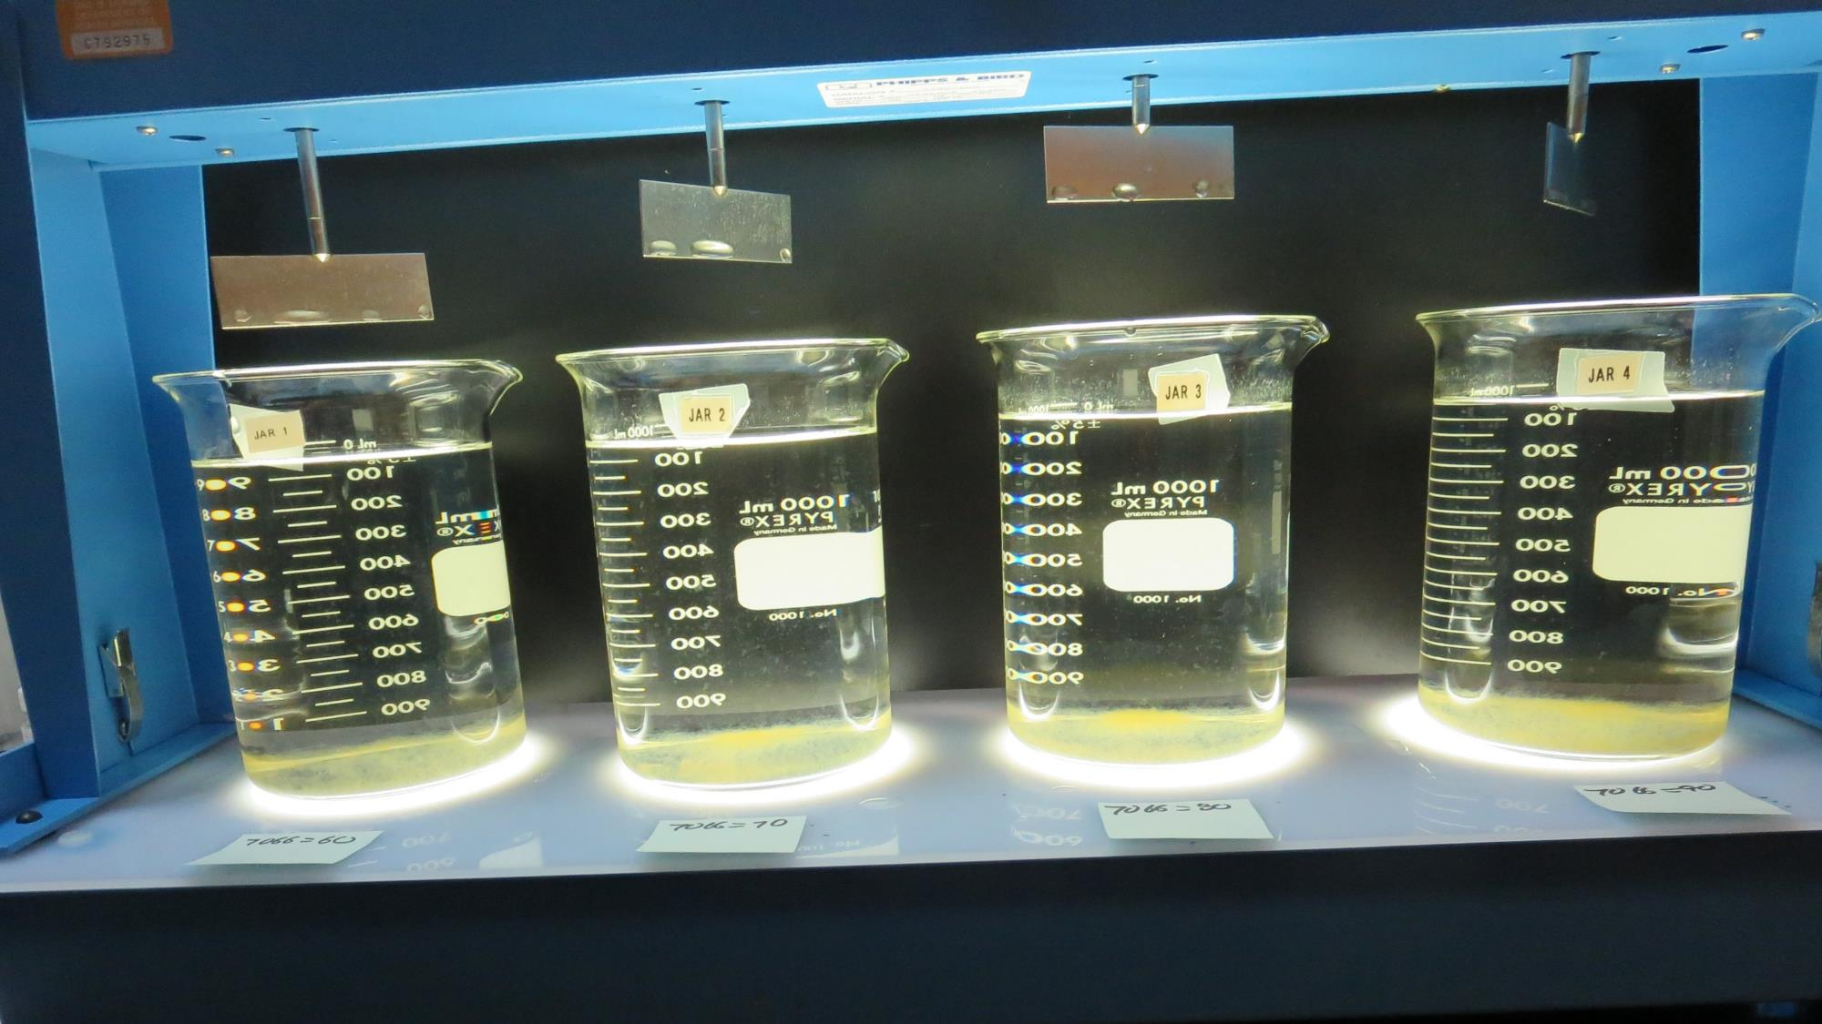
Jars 1-4: After 25-minutes of settling, settled water turbidity is taken.
60 mg/L 7066
Filtrate 0.22 NTU
UVT: 85.0%
UVA: 0.071/cm
Settled: 0.57 NTU
70 mg/L 7066
Filtrate 0.09 NTU
UVT: 89.1%
UVA: 0.050/cm
Settled: 0.40 NTU
80 mg/L 7066
Filtrate 0.07 NTU
UVT: 90.4%
UVA: 0.044/cm
Settled: 0.40 NTU
90 mg/L 7066
Filtrate 0.07 NTU
UVT: 91.6%
UVA: 0.038/cm
Settled: 0.31 NTU

Slide 15
Jars 5-8 Test
Flash Mix 60 Sec (200 RPM)
Floc Mix 5 min (30 RPM)
Applied Coagulant
7066

Slide 16
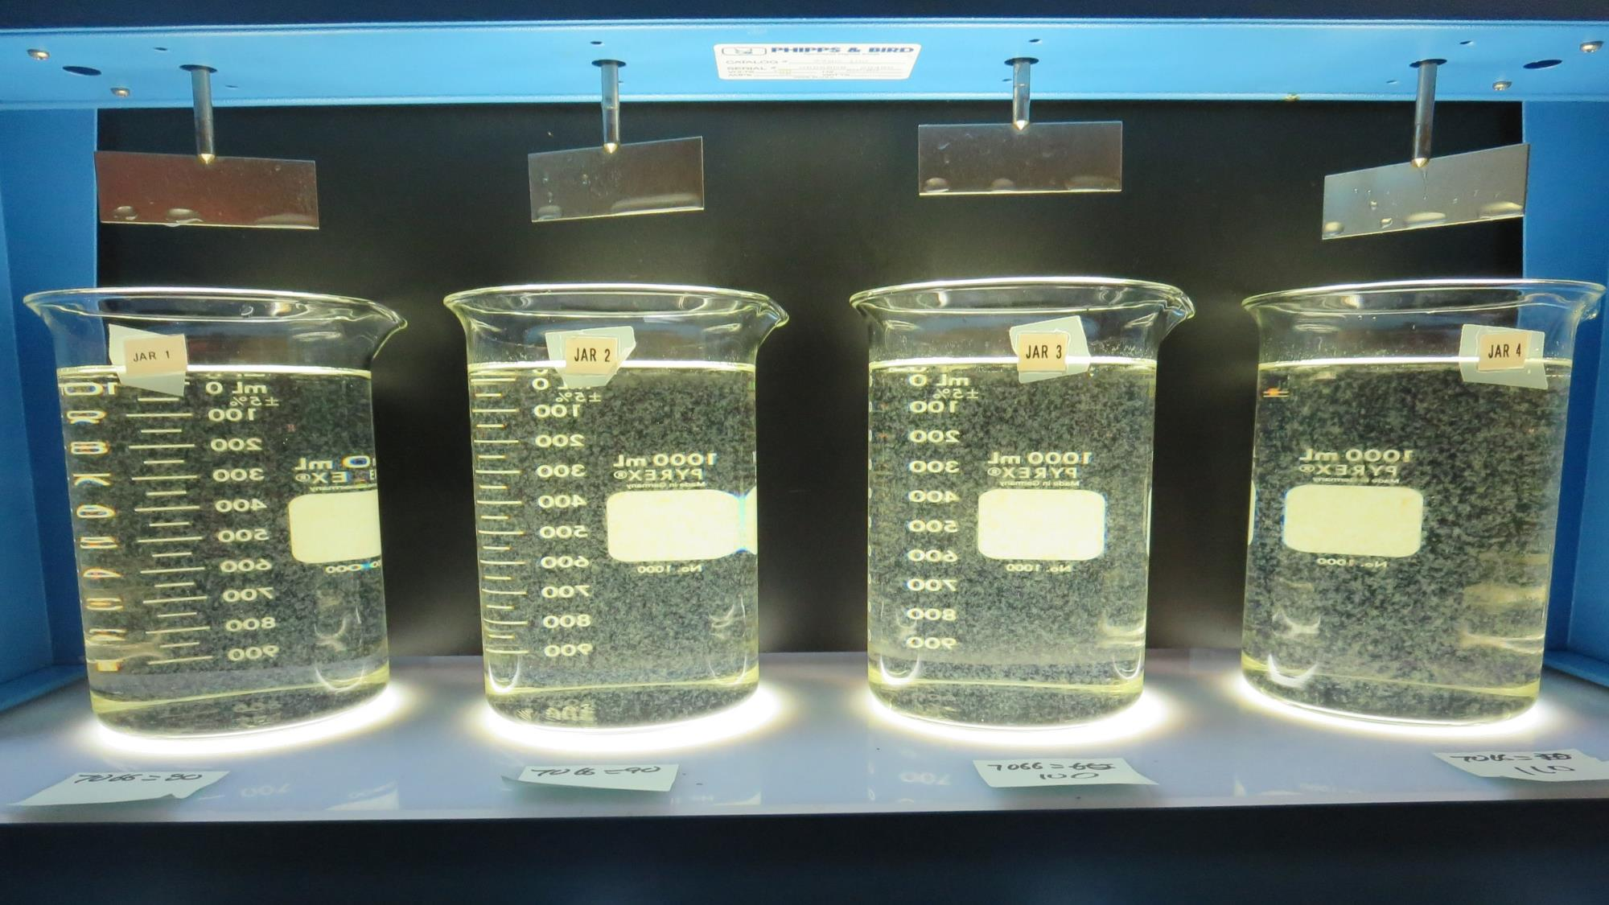
Jars 5-8: End of 5-minute flocculation (30 RPM) duration.
80 mg/L 7066
Filtrate 0.11 NTU
UVT: 89.8%
UVA: 0.047/cm
Settled: 0.24 NTU
90 mg/L 7066
Filtrate 0.07 NTU
UVT: 91.5%
UVA: 0.039/cm
Settled: 0.21 NTU
100 mg/L 7066
Filtrate 0.07 NTU
UVT: 92.3%
UVA: 0.035/cm
Settled: 0.26 NTU
110 mg/L 7066
Filtrate 0.08 NTU
UVT: 93.0%
UVA: 0.032/cm
Settled: 0.38 NTU

Slide 17
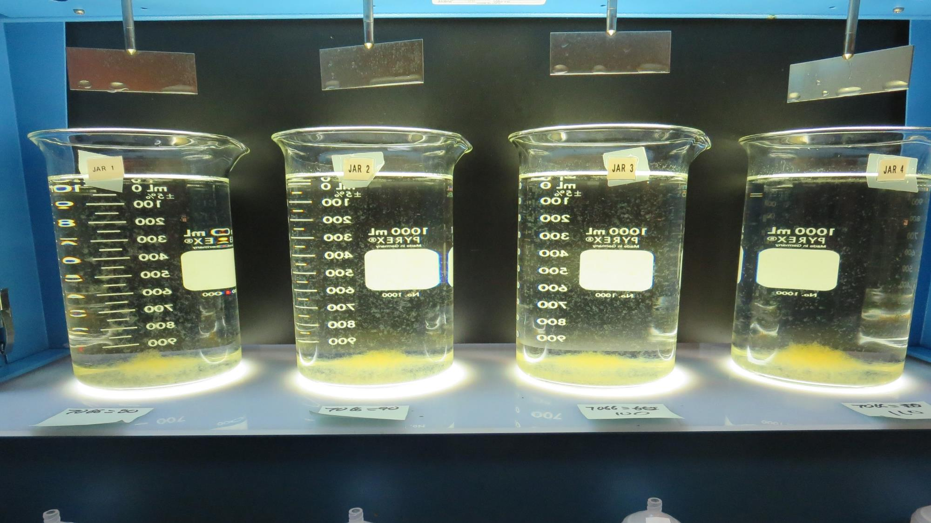
Jars 5-8: After 5 min of settling, 25 mL is decanted for filterability and %UVT/UVA.

Slide 18
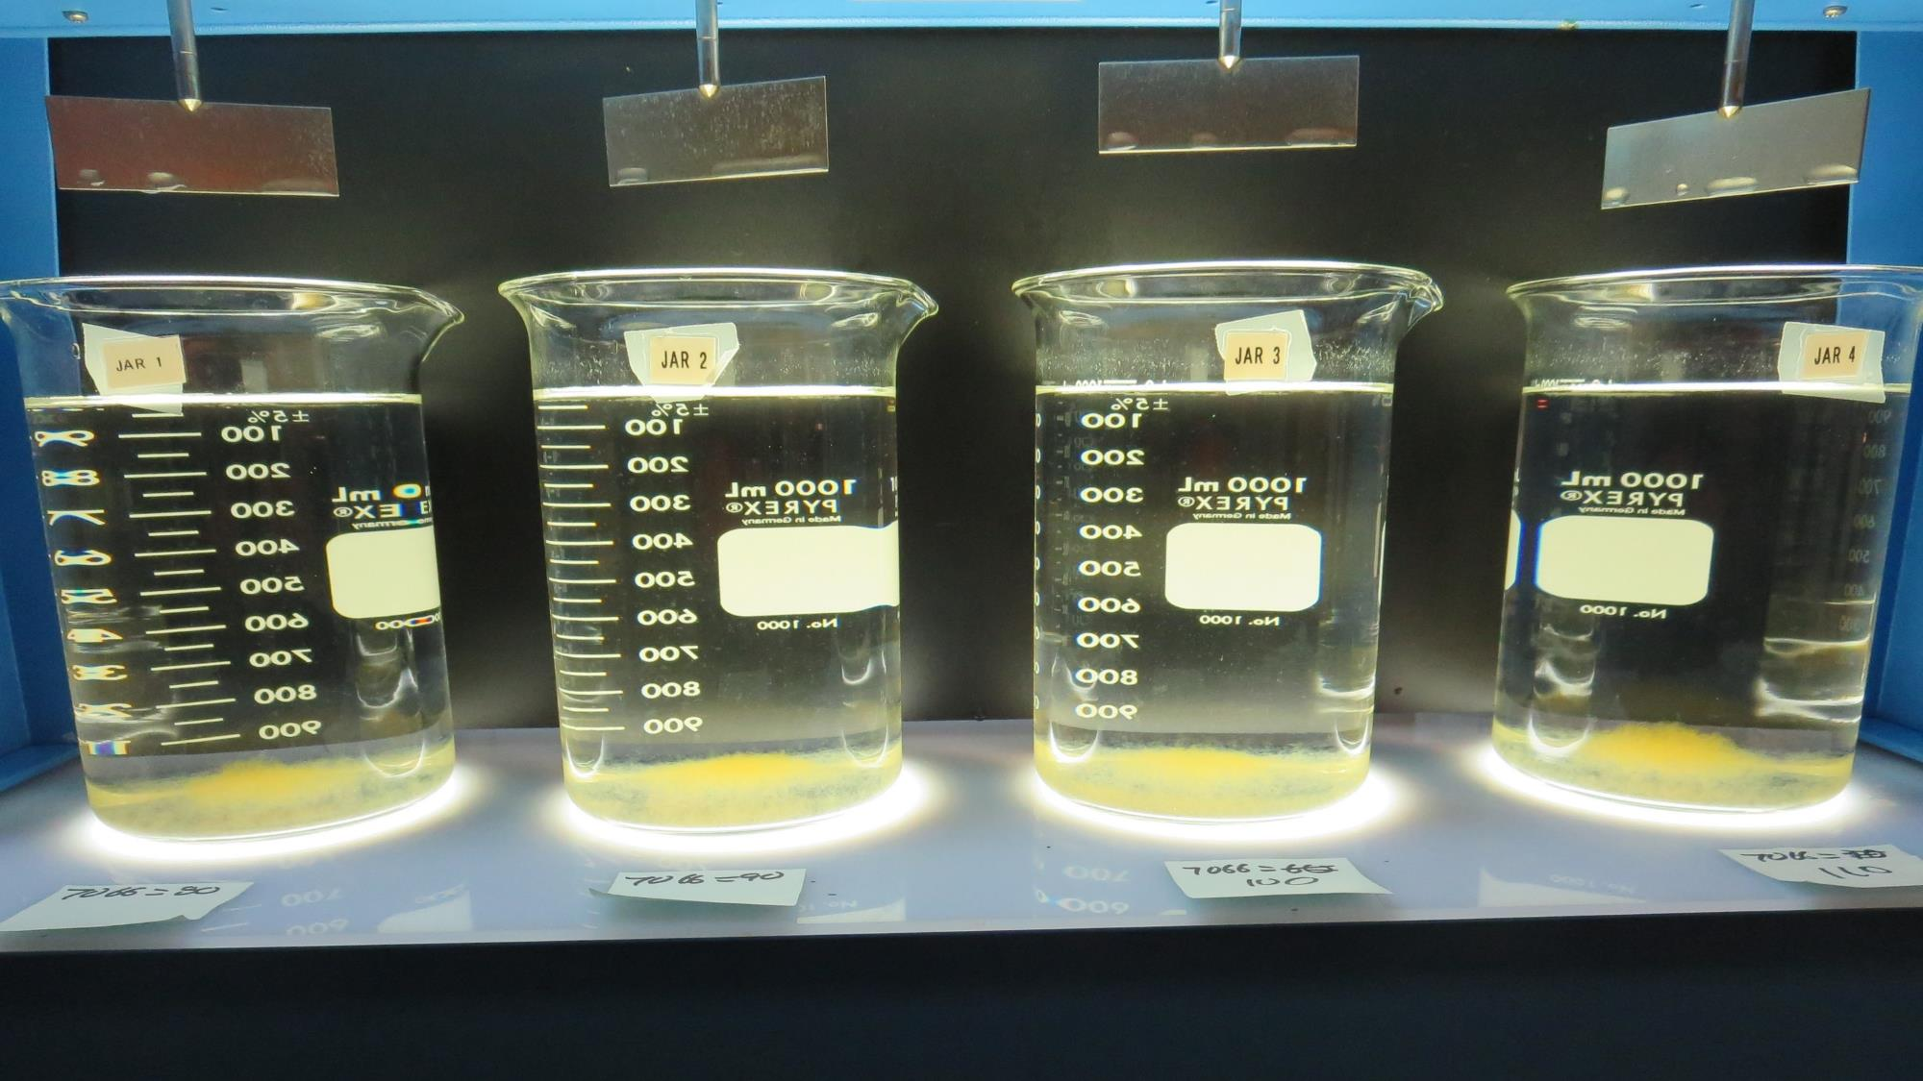
Jars 5-8: After 25-minutes of settling, settled water turbidity is taken.
80 mg/L 7066
Filtrate 0.11 NTU
UVT: 89.8%
UVA: 0.047/cm
Settled: 0.24 NTU
90 mg/L 7066
Filtrate 0.07 NTU
UVT: 91.5%
UVA: 0.039/cm
Settled: 0.21 NTU
100 mg/L 7066
Filtrate 0.07 NTU
UVT: 92.3%
UVA: 0.035/cm
Settled: 0.26 NTU
110 mg/L 7066
Filtrate 0.08 NTU
UVT: 93.0%
UVA: 0.032/cm
Settled: 0.38 NTU

Slide 19
Jars 9-12 Test
Flash Mix 60 Sec (200 RPM)
Floc Mix 5 min (30 RPM)
Applied Coagulants
9800/9890

Slide 20
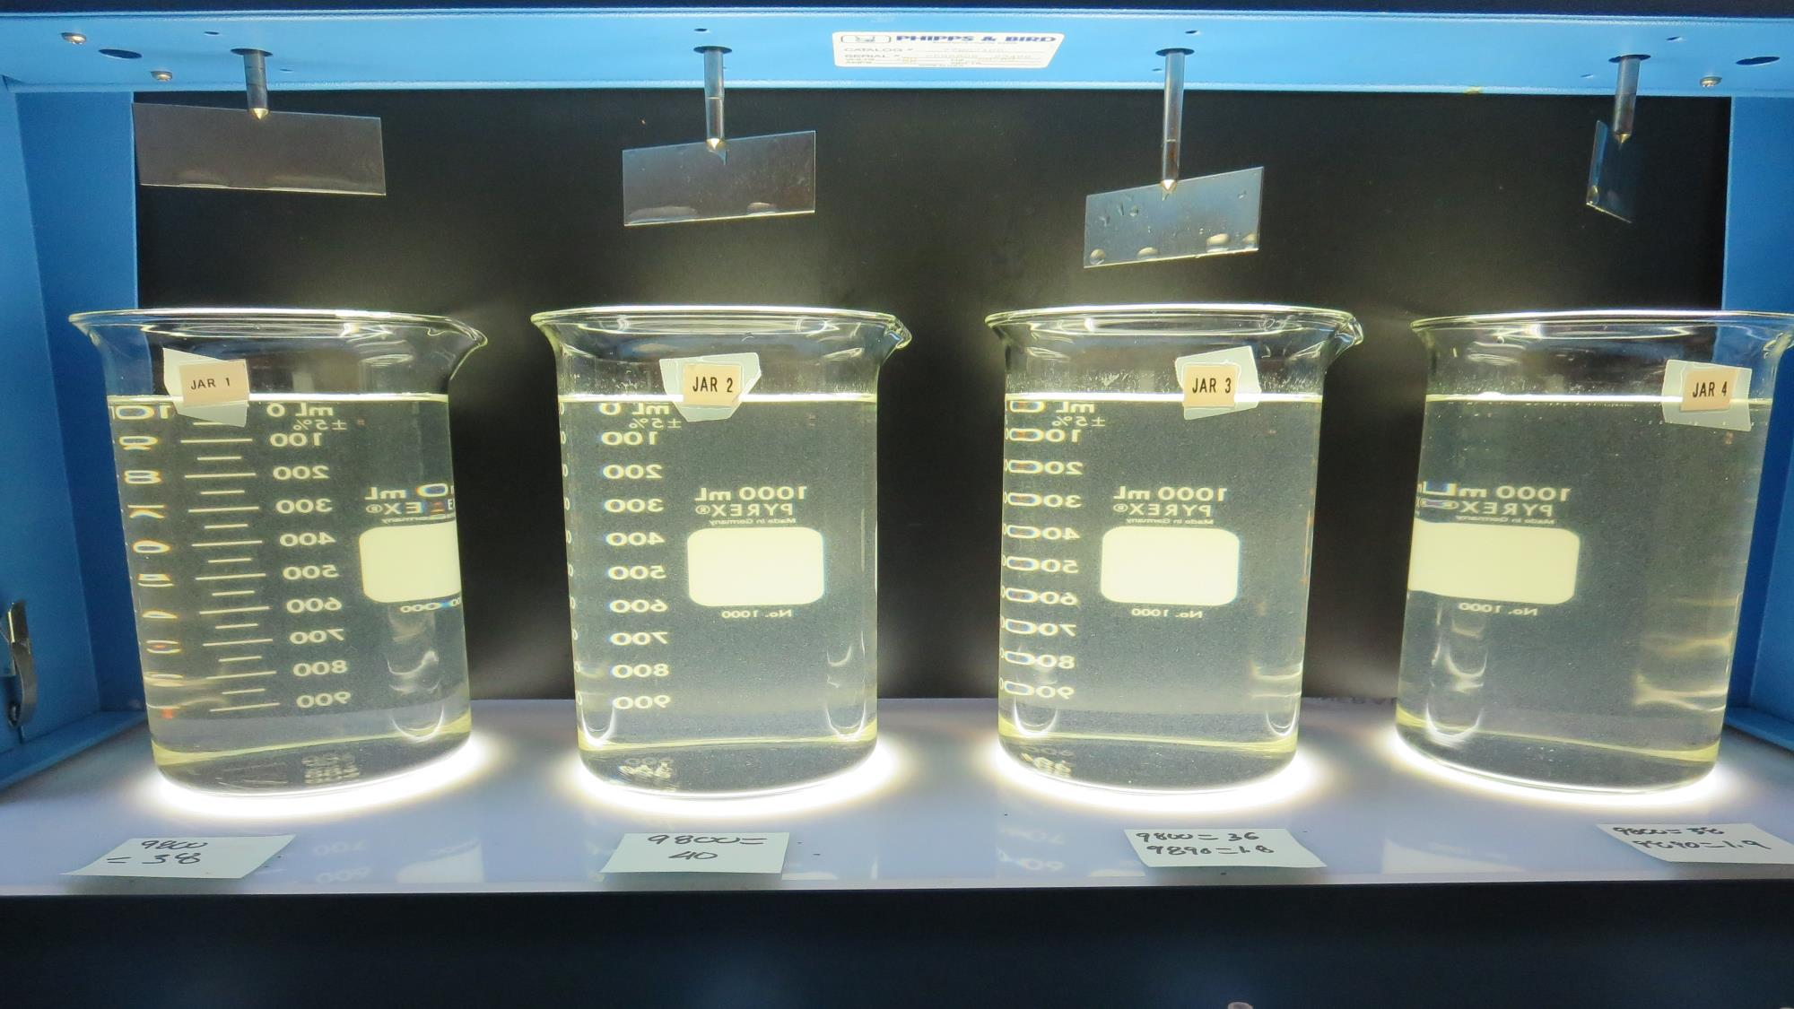
Jars 9-12: End of 5-minute flocculation (30 RPM) duration.
38 mg/L 9800
Filtrate 0.09 NTU
UVT: 91.4%
UVA: 0.039/cm
Settled: 1.36 NTU
40 mg/L 9800
Filtrate 0.39 NTU
UVT: 88.9%
UVA: 0.053/cm
Settled: 1.38 NTU
36 mg/L 9800
1.8 mg/L 9890
Filtrate 0.50 NTU
UVT: 86.7%
UVA: 0.062/cm
Settled: 1.40 NTU
38 mg/L 9800
1.9 mg/L 9890
Filtrate 0.40 NTU
UVT: 88.3%
UVA: 0.054/cm
Settled: 1.36 NTU

Slide 21
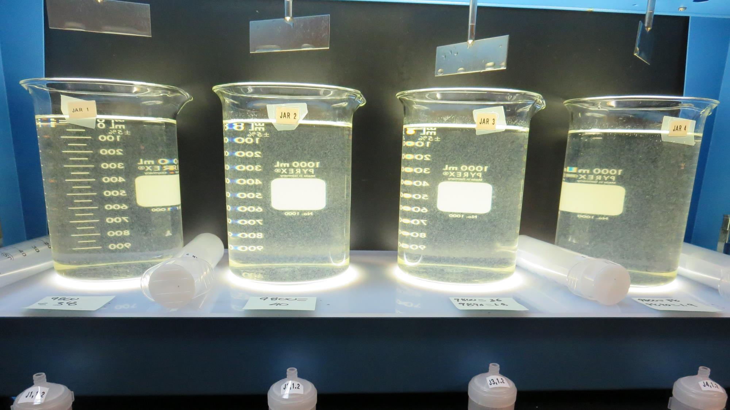
Jars 9-12: After 5 min of settling, 25 mL is decanted for filterability and %UVT/UVA.

Slide 22
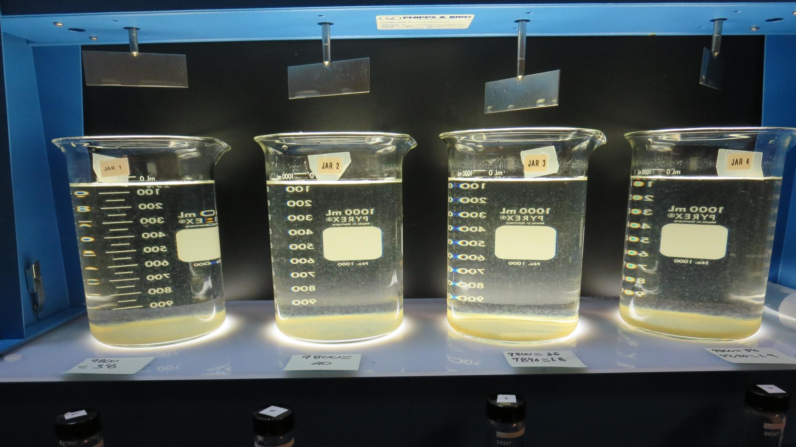
Jars 9-12: After 25-minutes of settling, settled water turbidity is taken.
38 mg/L 9800
Filtrate 0.09 NTU
UVT: 91.4%
UVA: 0.039/cm
Settled: 1.36 NTU
40 mg/L 9800
Filtrate 0.39 NTU
UVT: 88.9%
UVA: 0.053/cm
Settled: 1.38 NTU
36 mg/L 9800
1.8 mg/L 9890
Filtrate 0.50 NTU
UVT: 86.7%
UVA: 0.062/cm
Settled: 1.40 NTU
38 mg/L 9800
1.9 mg/L 9890
Filtrate 0.40 NTU
UVT: 88.3%
UVA: 0.054/cm
Settled: 1.36 NTU

Slide 23
Jar Testing for 1-Liter Jars:
Procedures for Most Treatment Plants
Fill jars with source water prior to coagulant injection and set paddle speed at 30 rpm
Add chemicals (i.e., NaOCl, primary coagulant, coagulant aid) to each jar
Flash mix for 15-60 seconds (200 rpm)
Slow mix for 5 minutes (20-30 rpm)
Settled for 5 minutes. Syringe 25 mL from each jar taken 1-inch below surface (25 mL/12 sec rate)
Filtered through 1.2 um isopore membrane into cuvette drip rate, 15 mL/(50-90 sec)
Measure filtrate turbidity, chlorine residual and %UVT/UVA
Measure settled water turbidity after 25 minutes of total setting
Record all data

Slide 24

Jar Test
Filterability Test Equipment
Turbidity Instrument
Syringe w/Luer-Lock Tip, 30 cc
(part#: 2225800, by Hach)
Swinnex Filter Holder, 25 mm (part#: SX0002500)
Isopore Membrane Filter, 1.2 um absolute
pore size,
Φ= 25 mm , thickness: 24 um,
hydrophilic polycarbonate membrane
(part #: RTTP02500)
Go to Sigma-Aldrich for laboratory supplies http://www.sigmaaldrich.com/united-states.html

Slide 25
Isopore Membrane Information
Categories | Information
trade name | Isopore
filter color | White
chemistry | Polycarbonate (PC)
water flow rate | Avg. 175 mL/min x cm² (typical results @ 10 psi)
media | Isopore®
wettability | Hydrophilic
porosity | 14.7%
pore size | 1.2 µm
bubble point at 23 °C | 1.0 bar, air with water
thickness | 24 µm
filter diameter (ø) | 25 mm
material size | polycarbonate, Hydrophilic, 1.2 µm, 25 mm, white, plain, 100

Slide 26
Isopore Membrane Background Information
The Isopore membrane is a polycarbonate, track-etched screen filter recommended for all analyses in which the sample is viewed on the surface of the membrane. The Isopore membrane is composed of polycarbonate film, which has a smooth, glass-like surface for clearer sample observation. The unique manufacturing process of the membrane ensures a precise pore diameter and a consistent pore size for accurate separation of samples by size. Matched-weight filters are not usually required because of low, constant tar and ash weights.
Features & Benefits:
Membrane structure retains particles on the surface, simplifying counting and analysis

Slide 27
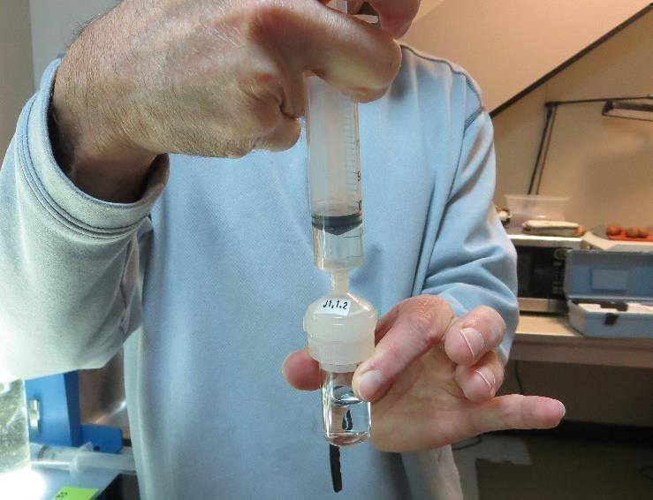

Jar Test - Filterability Test
Syringe ~ 25 mL from jar (after 5-minutes of settling)
Filter-to-waste 3-5 mL
Filter directly into clean cuvette
Measure turbidity
Note: Take several readings before recording final NTU results. Micro bubbles can adhere to glass causing false NTU readings. To remove bubbles, tilt cuvette up to 90 degrees.

Slide 28

Contact
Guy Schott, P.E.
State Water Resources Control Board
Division of Drinking Water
Santa Rosa, CA
Go to Stock Solution/Dose calculations/Jar Test Results for tools to download
www.waterboards.ca.gov/drinking_water/programs/districts/mendocino_district.html
Email: Guy Schott - Guy.Schott@waterboards.ca.gov
Office Number: 707-576-2732

