Slide 1
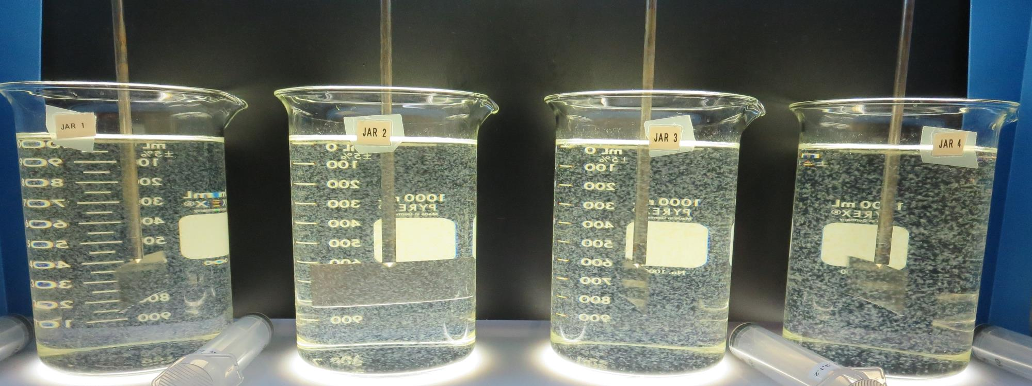
Surfwood Mutual Water Corporation
CA2300590
Mendocino County
Jar Test
by Guy Schott, P.E.
May 3, 2019

Slide 2
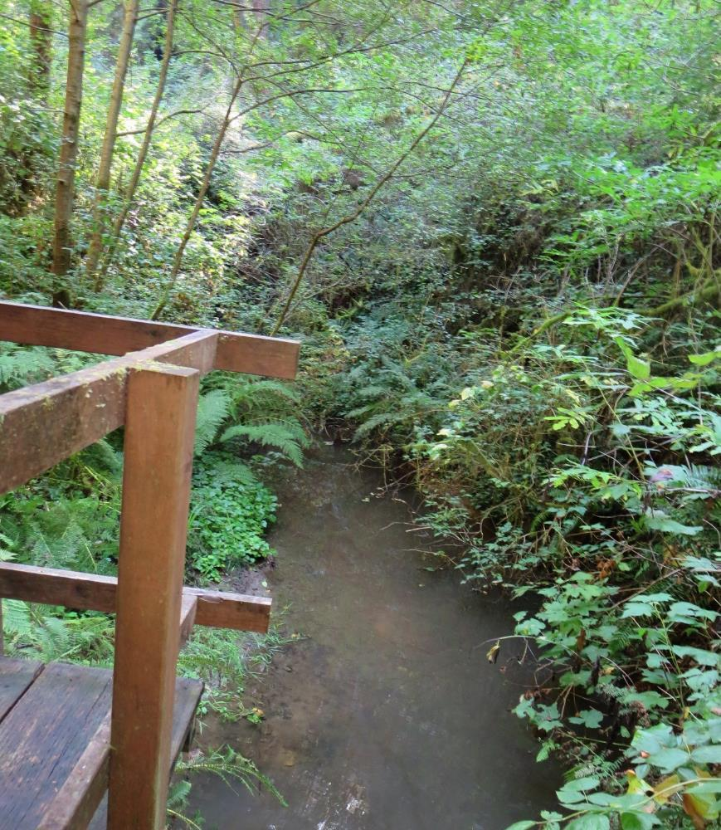
Source Water: Jack Peter’s Creek
Roughing Filter followed by Multi-Media Filtration
Source Water Characteristics
Turbidity: 3.4 NTU
pH: 7.23
UVT: 64.3%
UVA: 0.192
0.4 um Filtered
UVT: 67.1%
UVA: 0.173

Slide 3
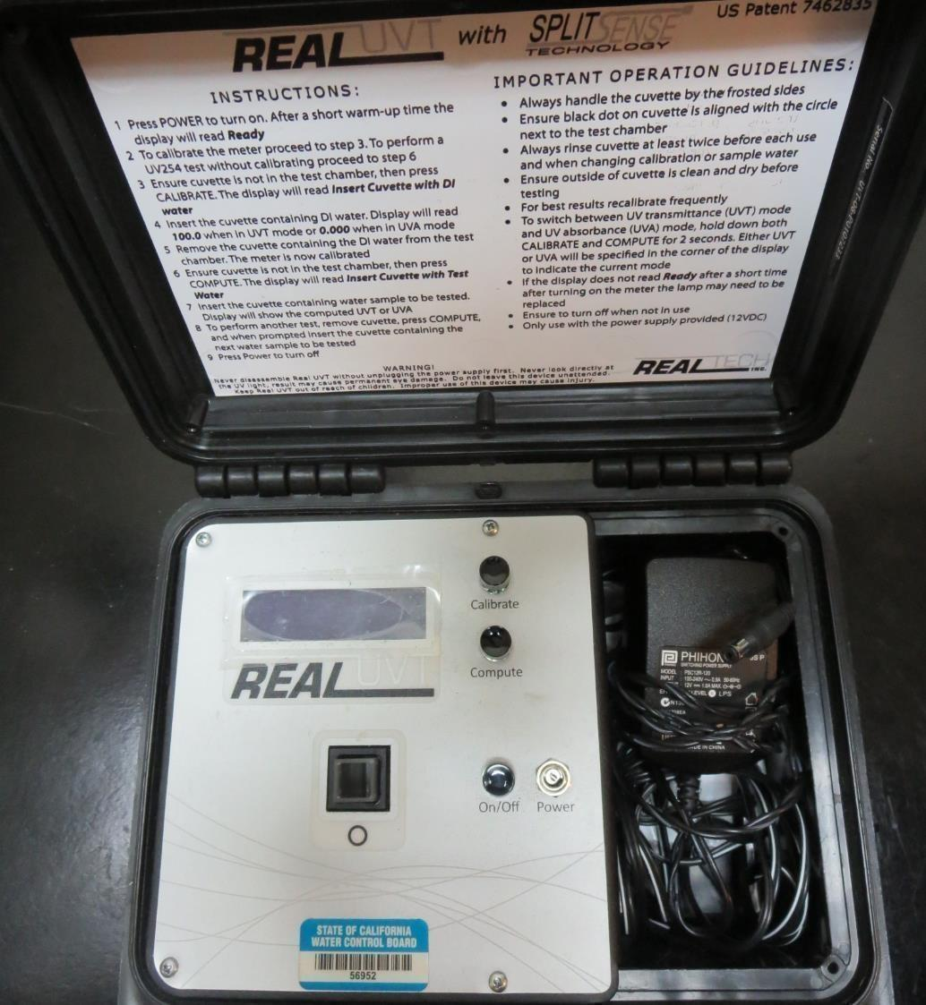
UVT/UVA
UV transmittance (UVT) is a measurement of the amount of ultraviolet light (commonly at 254 nm due to its germicidal effect) that passes through a water sample compared to the amount of light that passes through a pure water sample. The measurement is expressed as a percentage, % UVT.
%UVT = 10^{(-UVA)} x 100%
UV absorbance (UVA) is calculated as a relative measure of the amount of light absorbed by a water sample compared with the amount of light absorbed by a pure water sample.
UVA = -log(%UVT/100)

Slide 4
Coagulant Used for Jar Testing
7066 (Garratt Callahan)
10 – 30% Poly Aluminum Hydroxychloride Sulfate
SG = 1.2
7045 (Garratt Callahan)
10 – 30% Poly Aluminum Chloride Hexahydrate
0.1 – 1% Hydrogen Chloride
SG = 1.14

Slide 5
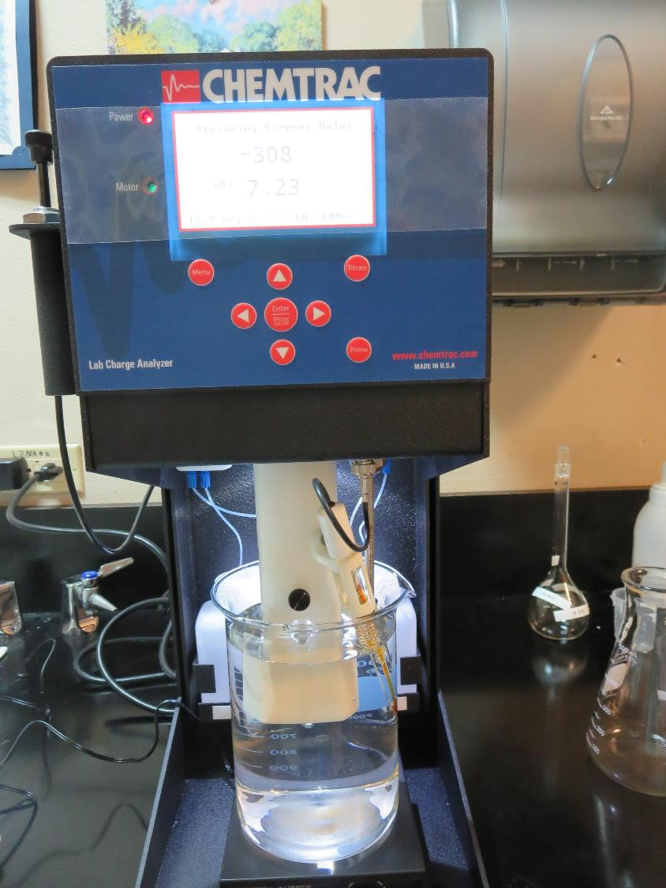
Laboratory Charge Analyzer
LCA: Used to determine coagulant demand of a source water entering the treatment plant.
Source pH: 7.23
LCA #1:
7066: 59 mg/L as product
(no pH adjustment)
LCA #2:
7066: 44 mg/L as product
pH adjusted to 6.6 w/acetic acid

Slide 6
Coagulant Information
Unless stated otherwise, all coagulant doses are reported as Product (100% strength).
Preparation of coagulant stock solutions are generally 1.0 or 0.1 percent strength using 100 and/or 200 mL volumetric flasks.
Finnpipette F2 variable volume pipette, capacity 100-1000 micro liters is used for stock solution preparation and coagulant aid jar test dosing.
Finnpipette F2 variable volume pipette, capacity 0.5-5 mL is used for primary coagulant jar test dosing.

Slide 7
Surfwood MWC: Jar Test 1-8 Results
Jar | 200 RPM Flash Mix seconds | 30 RPM Floc Duration minutes | 7066 mg/L | Filtrate NTU | Filtrate %UVT | Filtrate UVA/cm | Settle NTU 25 min
J1 | 60 | 10 | 35 | 2.1 | 73.6 | 0.133 | 4.6
J2 | 60 | 10 | 40 | 1.7 | 78.4 | 0.106 | 4.6
J3 | 60 | 10 | 45 | 0.52 | 90.4 | 0.044 | 2.7
J4 | 60 | 10 | 50 | 0.12 | 94.8 | 0.023 | 0.7
J5 | 60 | 10 | 50 | 0.24 | 92.8 | 0.032 | 1.25
J6 | 60 | 10 | 54 | 0.16 | 94.2 | 0.026 | 0.73
J7 | 60 | 10 | 58 | 0.10 | 95.0 | 0.022 | 0.67
J8 | 60 | 10 | 62 | 0.06 | 95.8 | 0.019 | 0.44

Slide 8
Surfwood MWC: Jar Test 9-12 Results
Jar | 200 RPM Flash Mix seconds | 30 RPM Floc Duration minutes | 7066 mg/L | Filtrate NTU | Filtrate %UVT | Filtrate UVA/cm | Settle NTU 25 min
J9 | 60 | 10 | 58 | 0.17 | 94.6 | 0.024 | 0.62
J10 | 60 | 10 | 62 | 0.06 | 95.7 | 0.019 | 0.51
J11 | 60 | 10 | 66 | 0.12 | 95.2 | 0.021 | 0.45
J12 | 60 | 10 | 70 | 0.06 | 96.3 | 0.016 | 0.53

Slide 9
Surfwood MWC: Jar Test 13-20 Results
Jar | 200 RPM Flash Mix seconds | 30 RPM Floc Duration minutes | 7066 mg/L | Filtrate NTU | Filtrate %UVT | Filtrate UVA/cm | Settle NTU 25 min
J13 | 60 | 10 | 60 | 0.15 | 95.4 | 0.020 | 0.53
J14 | 60 | 10 | 65 | 0.14 | 95.7 | 0.019 | 0.63
J15 | 60 | 10 | 70 | 0.07 | 96.5 | 0.015 | 0.64
J16 | 60 | 10 | 75 | 0.05 | 97.3 | 0.012 | 0.66
J17 | 60 | 10 | 70 | 0.14 | 96.3 | 0.016 | 0.41
J18 | 60 | 10 | 75 | 0.11 | 96.8 | 0.014 | 0.46
J19 | 60 | 10 | 80 | 0.07 | 97.3 | 0.012 | 0.79
J20 | 60 | 10 | 85 | 0.06 | 97.4 | 0.011 | 0.72

Slide 10
Surfwood MWC: Jar Test 21-28 Results
Jar | 200 RPM Flash Mix seconds | 30 RPM Floc Duration minutes | 7045 mg/L | Filtrate NTU | Filtrate %UVT | Filtrate UVA/cm | Settle NTU 25 min
J21 | 60 | 10 | 60 | 0.09 | 96.0 | 0.018 | 2.3
J22 | 60 | 10 | 65 | 0.07 | 96.7 | 0.015 | 2.8
J23 | 60 | 10 | 70 | 0.22 | 95.6 | 0.020 | 3.2
J24 | 60 | 10 | 75 | 0.14 | 96.3 | 0.016 | 5.5
J25 | 60 | 10 | 50 | 0.14 | 94.8 | 0.023 | 3.2
J26 | 60 | 10 | 55 | 0.16 | 95.3 | 0.021 | 3.2
J27 | 60 | 10 | 60 | 0.16 | 95.5 | 0.020 | 3.6
J28 | 60 | 10 | 65 | 0.83 | 91.2 | 0.040 | 5.1

Slide 11
Jars 1-4 Test
Flash Mix 60 Sec (200 RPM)
Floc Mix 10 min (30 RPM)
Applied Coagulant
7066

Slide 12
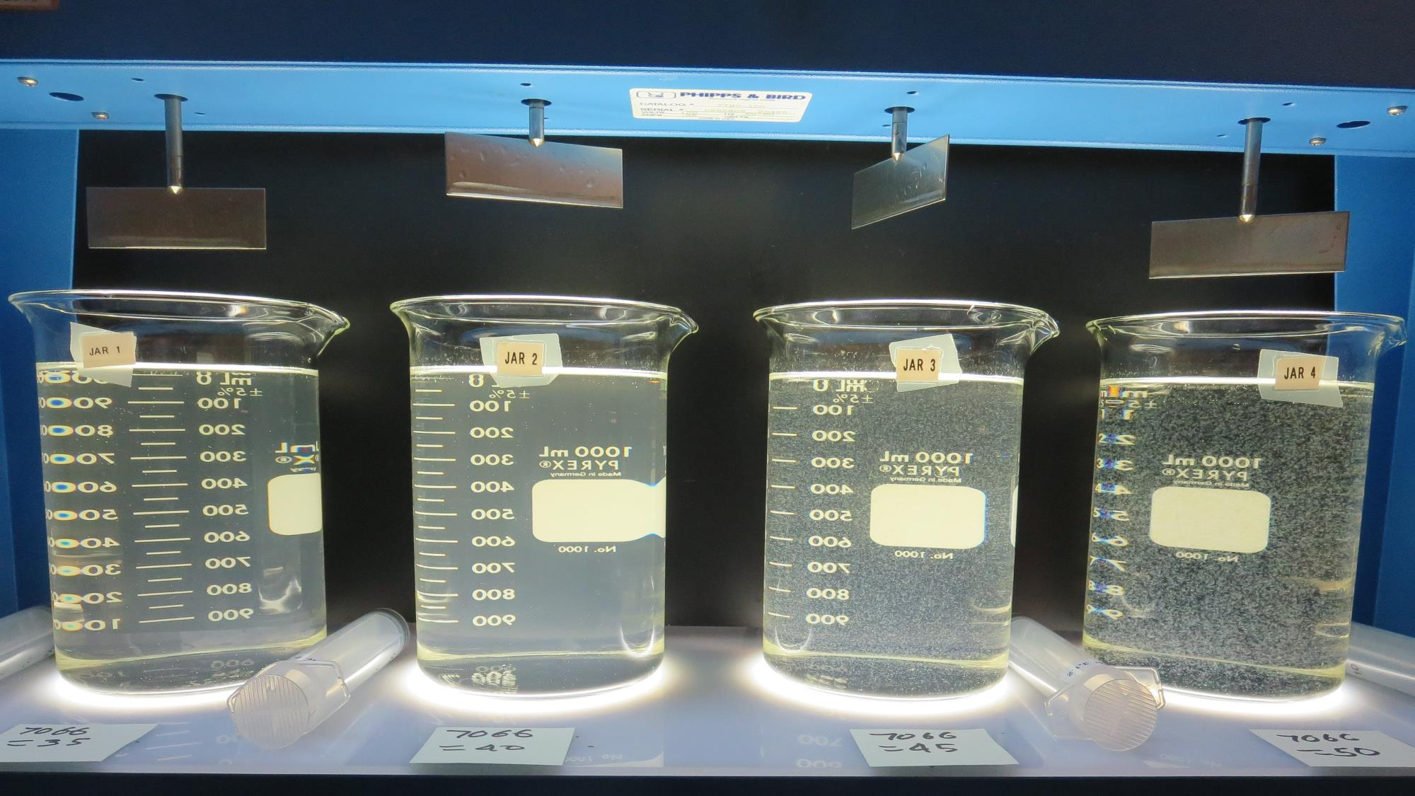
Jars 1-4: End of 10-minute flocculation (30 RPM) duration.
35 mg/L 7066
Filtrate 2.1 NTU
UVT: 73.6%
UVA: 0.133/cm
Settled: 4.6 NTU
40 mg/L 7066
Filtrate 1.7 NTU
UVT: 78.4%
UVA: 0.106/cm
Settled: 4.6 NTU
45 mg/L 7066
Filtrate 0.52 NTU
UVT: 90.4%
UVA: 0.044/cm
Settled: 2.7 NTU
50 mg/L 7066
Filtrate 0.12 NTU
UVT: 94.8%
UVA: 0.023/cm
Settled: 0.7 NTU

Slide 13
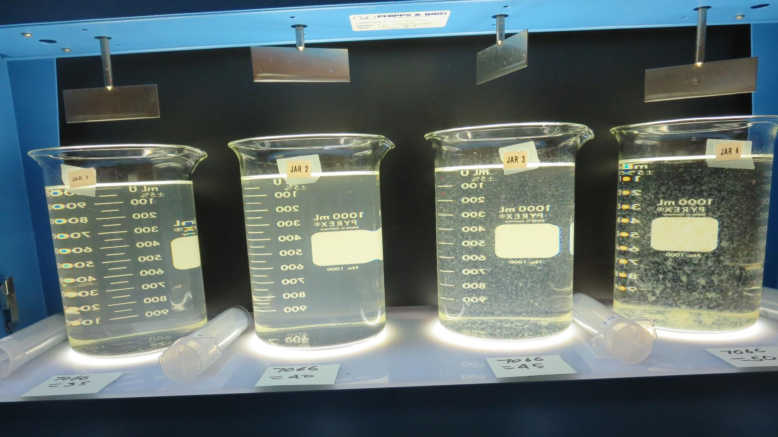
Jars 1-4: After 5 min of settling, 25 mL is decanted for filterability and %UVT/UVA.

Slide 14
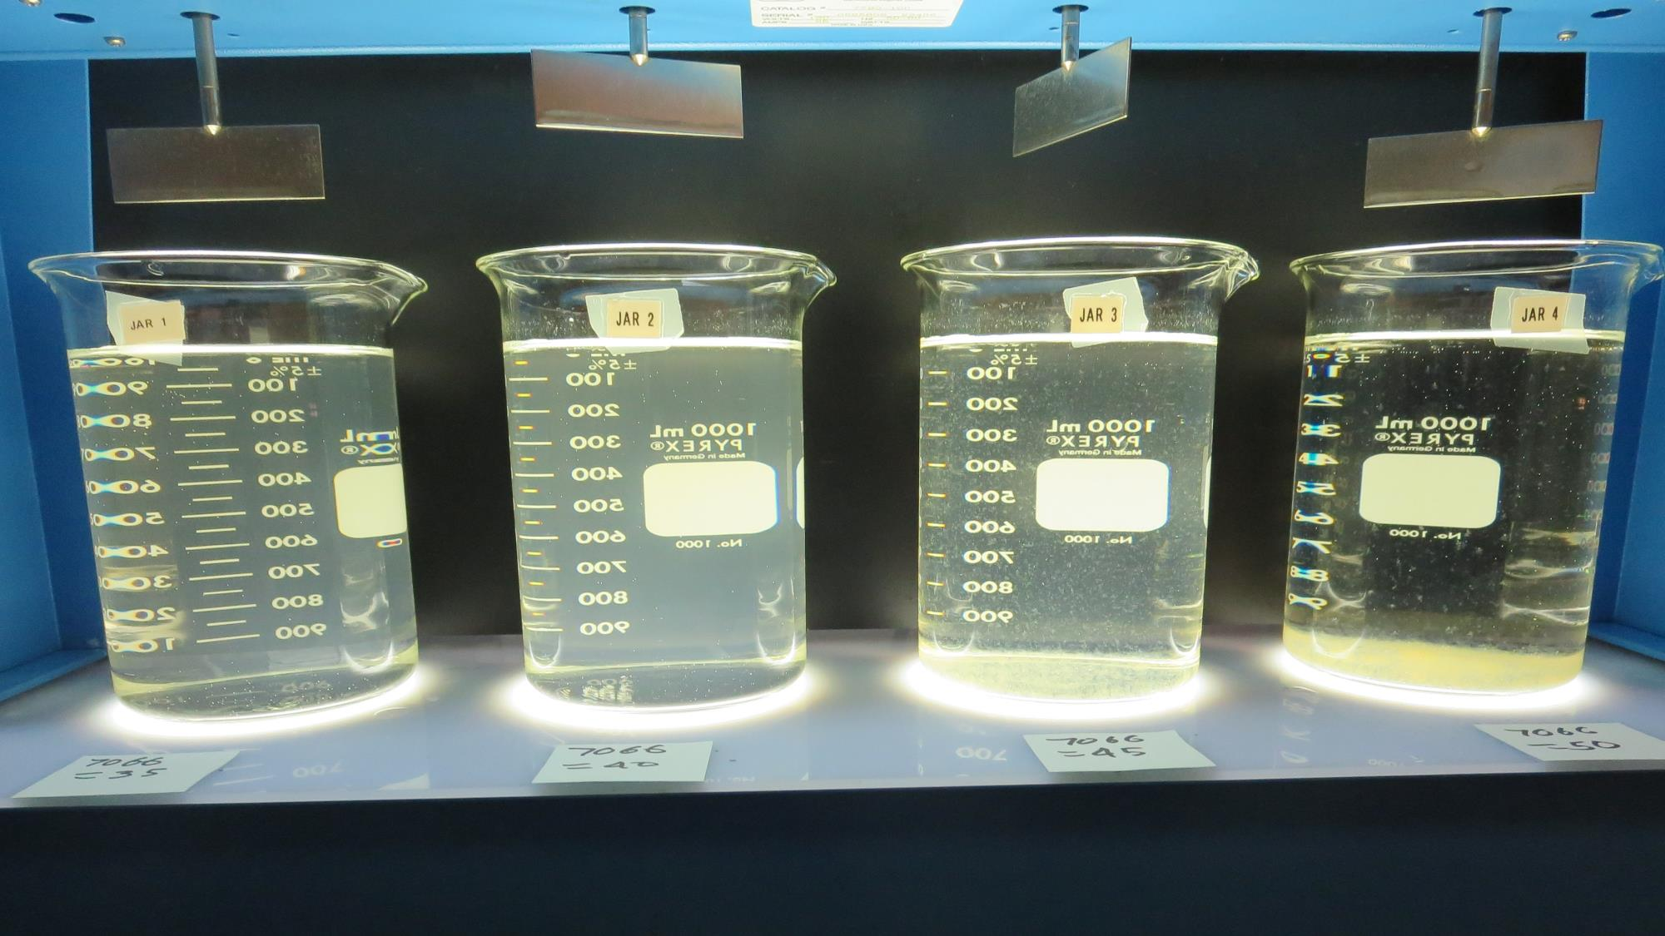
Jars 1-4: After 25-minutes of settling, settled water turbidity is taken.
35 mg/L 7066
Filtrate 2.1 NTU
UVT: 73.6%
UVA: 0.133/cm
Settled: 4.6 NTU
40 mg/L 7066
Filtrate 1.7 NTU
UVT: 78.4%
UVA: 0.106/cm
Settled: 4.6 NTU
45 mg/L 7066
Filtrate 0.52 NTU
UVT: 90.4%
UVA: 0.044/cm
Settled: 2.7 NTU
50 mg/L 7066
Filtrate 0.12 NTU
UVT: 94.8%
UVA: 0.023/cm
Settled: 0.7 NTU

Slide 15
Jars 5-8 Test
Flash Mix 60 Sec (200 RPM)
Floc Mix 10 min (30 RPM)
Applied Coagulant
7066

Slide 16
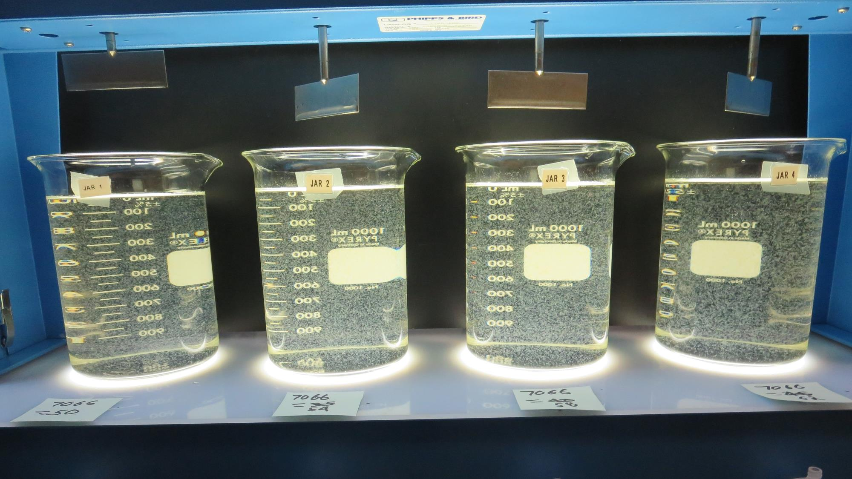
Jars 5-8: End of 10-minute flocculation (30 RPM) duration.
50 mg/L 7066
Filtrate 0.24 NTU
UVT: 92.8%
UVA: 0.032/cm
Settled: 1.25 NTU
54 mg/L 7066
Filtrate 0.16 NTU
UVT: 94.2%
UVA: 0.026/cm
Settled: 0.73 NTU
58 mg/L 7066
Filtrate 0.10 NTU
UVT: 95.0%
UVA: 0.022/cm
Settled: 0.67 NTU
62 mg/L 7066
Filtrate 0.06 NTU
UVT: 95.8%
UVA: 0.019/cm
Settled: 0.44 NTU

Slide 17
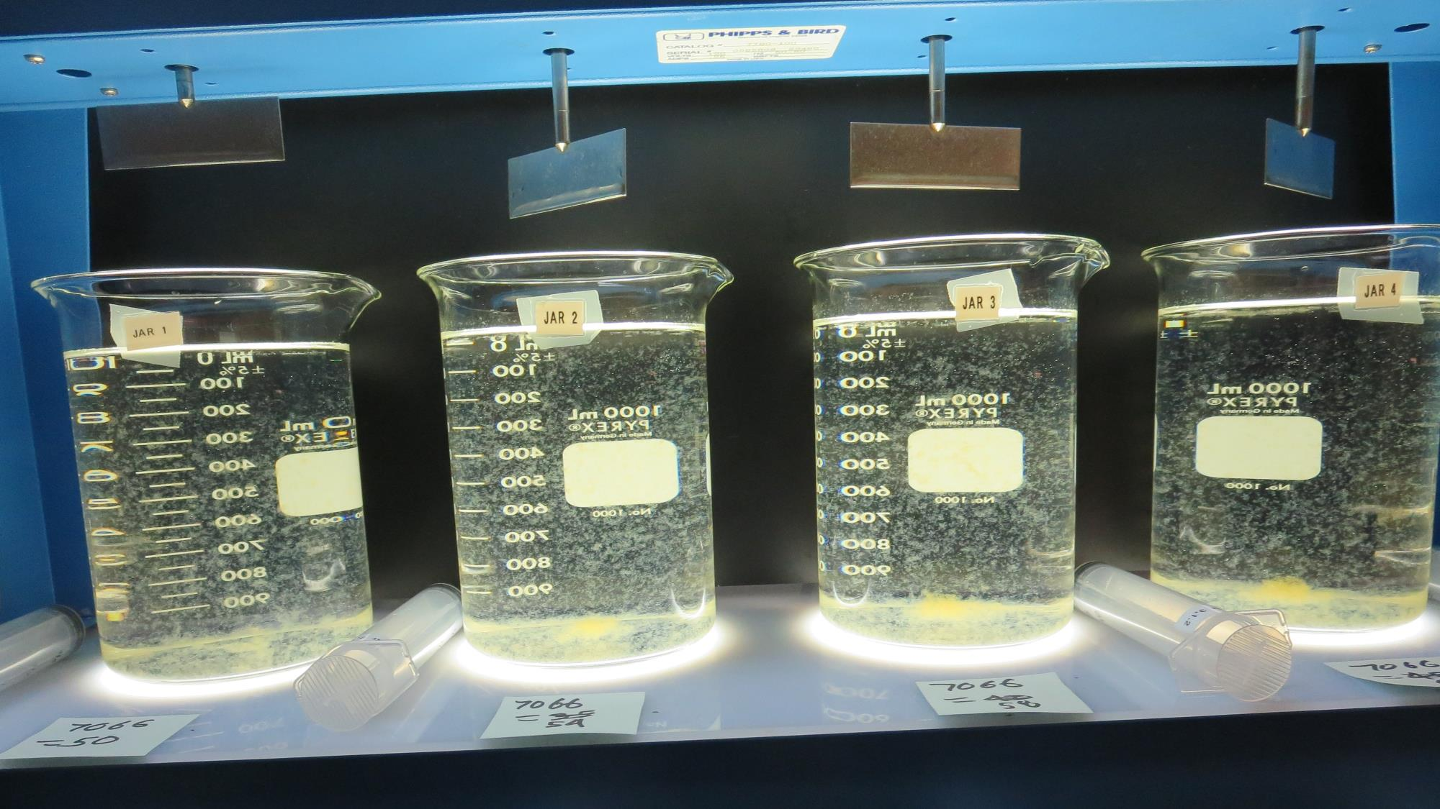
Jars 5-8: After 5 min of settling, 25 mL is decanted for filterability and %UVT/UVA.

Slide 18
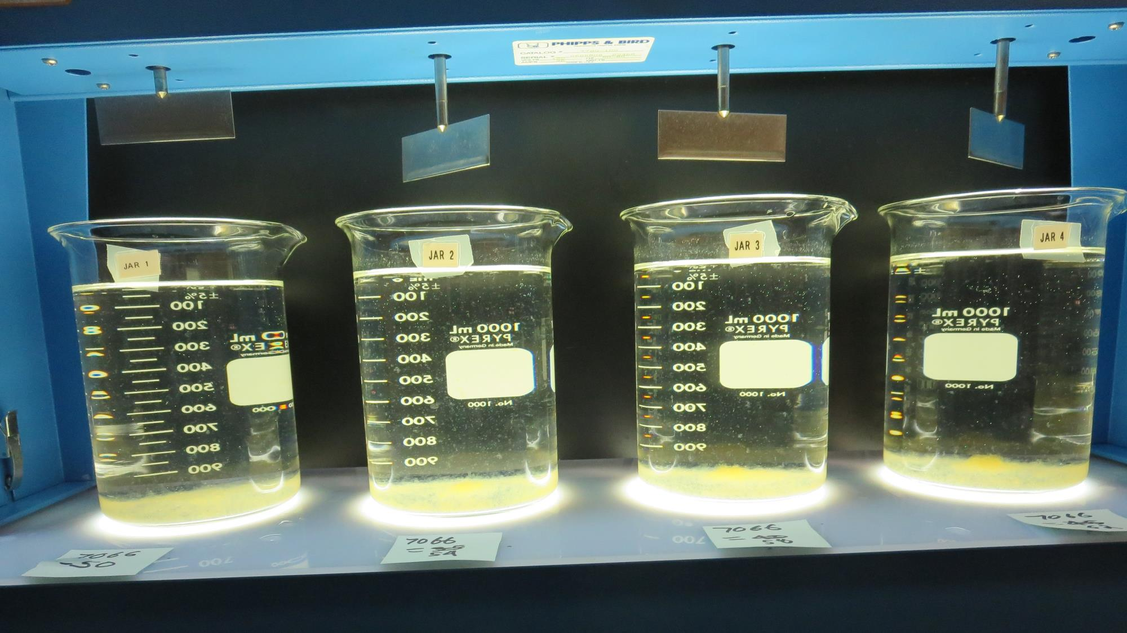
Jars 5-8: After 25-minutes of settling, settled water turbidity is taken.
50 mg/L 7066
Filtrate 0.24 NTU
UVT: 92.8%
UVA: 0.032/cm
Settled: 1.25 NTU
54 mg/L 7066
Filtrate 0.16 NTU
UVT: 94.2%
UVA: 0.026/cm
Settled: 0.73 NTU
58 mg/L 7066
Filtrate 0.10 NTU
UVT: 95.0%
UVA: 0.022/cm
Settled: 0.67 NTU
62 mg/L 7066
Filtrate 0.06 NTU
UVT: 95.8%
UVA: 0.019/cm
Settled: 0.44 NTU

Slide 19
Jars 9-12 Test
Flash Mix 60 Sec (200 RPM)
Floc Mix 10 min (30 RPM)
Applied Coagulant
7066

Slide 20
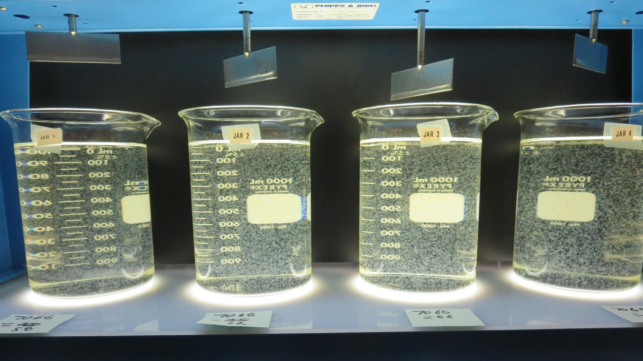
Jars 9-12: End of 10-minute flocculation (30 RPM) duration.
58 mg/L 7066
Filtrate 0.17 NTU
UVT: 94.6%
UVA: 0.024/cm
Settled: 0.62 NTU
62 mg/L 7066
Filtrate 0.06 NTU
UVT: 95.7%
UVA: 0.019/cm
Settled: 0.51 NTU
66 mg/L 7066
Filtrate 0.12 NTU
UVT: 95.2%
UVA: 0.021/cm
Settled: 0.45 NTU
70 mg/L 7066
Filtrate 0.06 NTU
UVT: 96.3%
UVA: 0.016/cm
Settled: 0.53 NTU

Slide 21
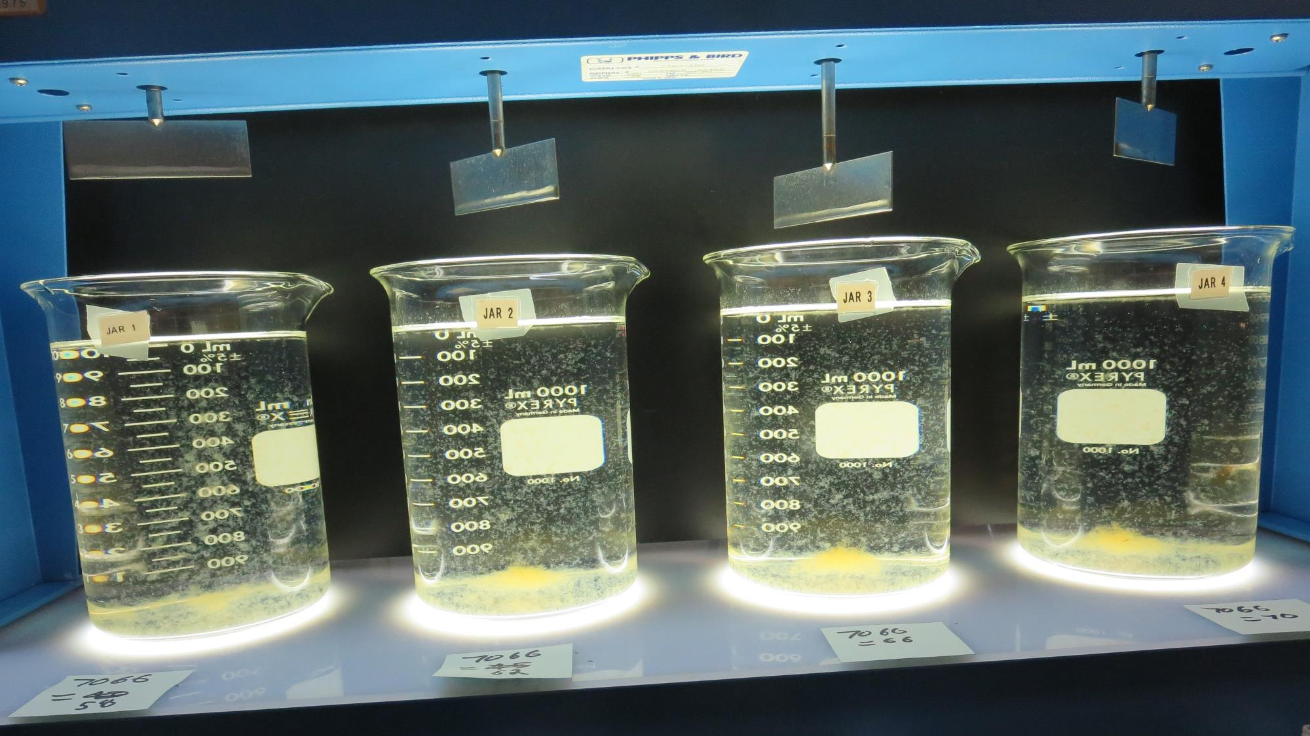
Jars 9-12: After 5 min of settling, 25 mL is decanted for filterability and %UVT/UVA.

Slide 22
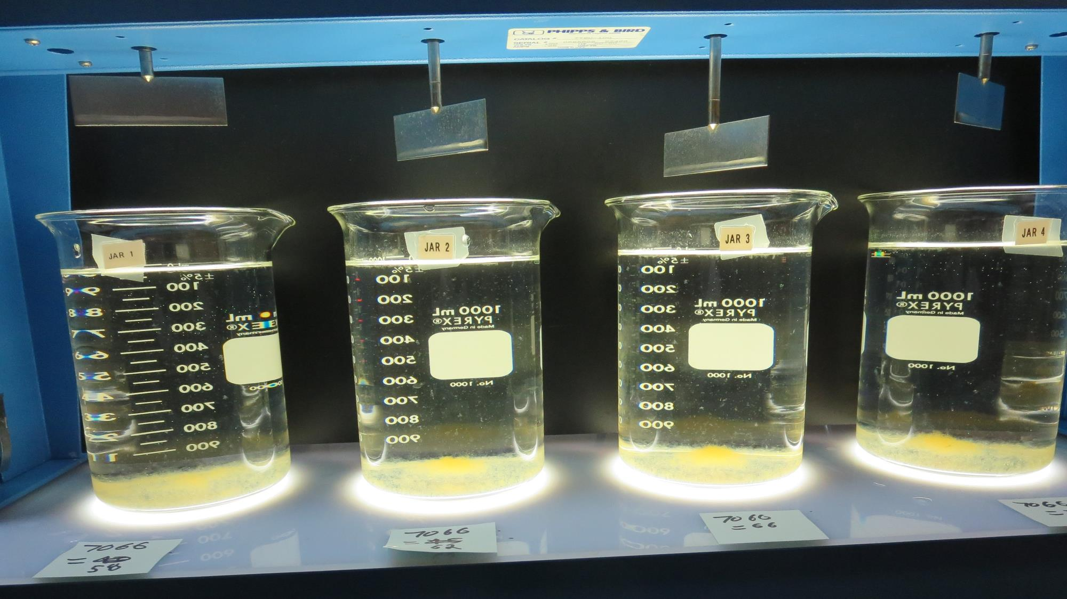
Jars 9-12: After 25-minutes of settling, settled water turbidity is taken.
58 mg/L 7066
Filtrate 0.17 NTU
UVT: 94.6%
UVA: 0.024/cm
Settled: 0.62 NTU
62 mg/L 7066
Filtrate 0.06 NTU
UVT: 95.7%
UVA: 0.019/cm
Settled: 0.51 NTU
66 mg/L 7066
Filtrate 0.12 NTU
UVT: 95.2%
UVA: 0.021/cm
Settled: 0.45 NTU
70 mg/L 7066
Filtrate 0.06 NTU
UVT: 96.3%
UVA: 0.016/cm
Settled: 0.53 NTU

Slide 23
Jars 13-16 Test
Flash Mix 60 Sec (200 RPM)
Floc Mix 10 min (30 RPM)
Applied Coagulant
7066

Slide 24
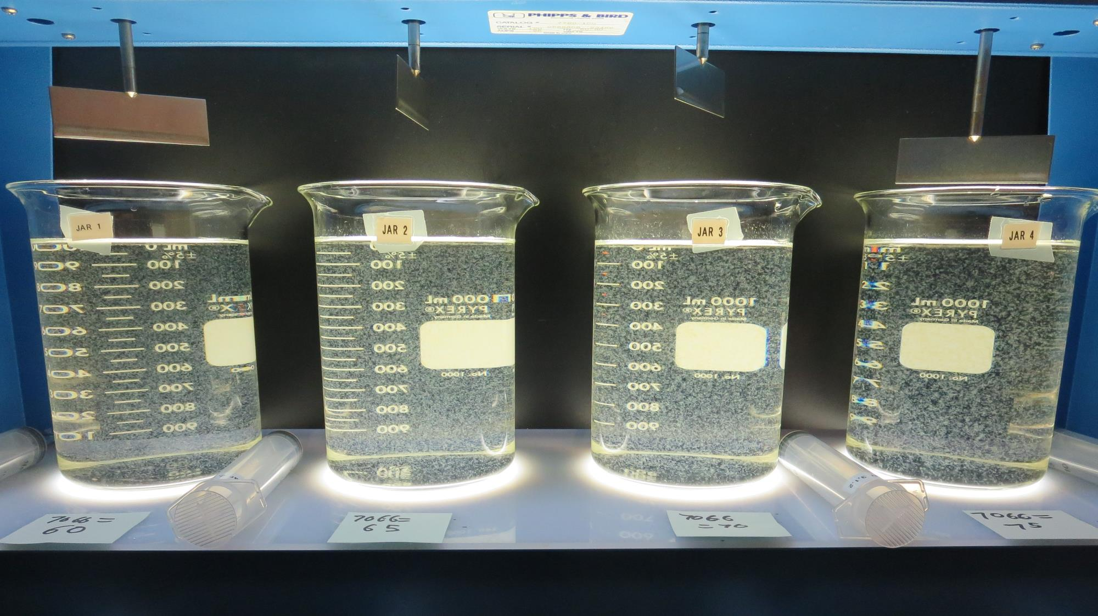
Jars 13-16: End of 10-minute flocculation (30 RPM) duration.
60 mg/L 7066
Filtrate 0.15 NTU
UVT: 95.4%
UVA: 0.020/cm
Settled: 0.53 NTU
65 mg/L 7066
Filtrate 0.14 NTU
UVT: 95.7%
UVA: 0.019/cm
Settled: 0.63 NTU
70 mg/L 7066
Filtrate 0.07 NTU
UVT: 96.5%
UVA: 0.015/cm
Settled: 0.64 NTU
75 mg/L 7066
Filtrate 0.05 NTU
UVT: 97.3%
UVA: 0.012/cm
Settled: 0.66 NTU

Slide 25
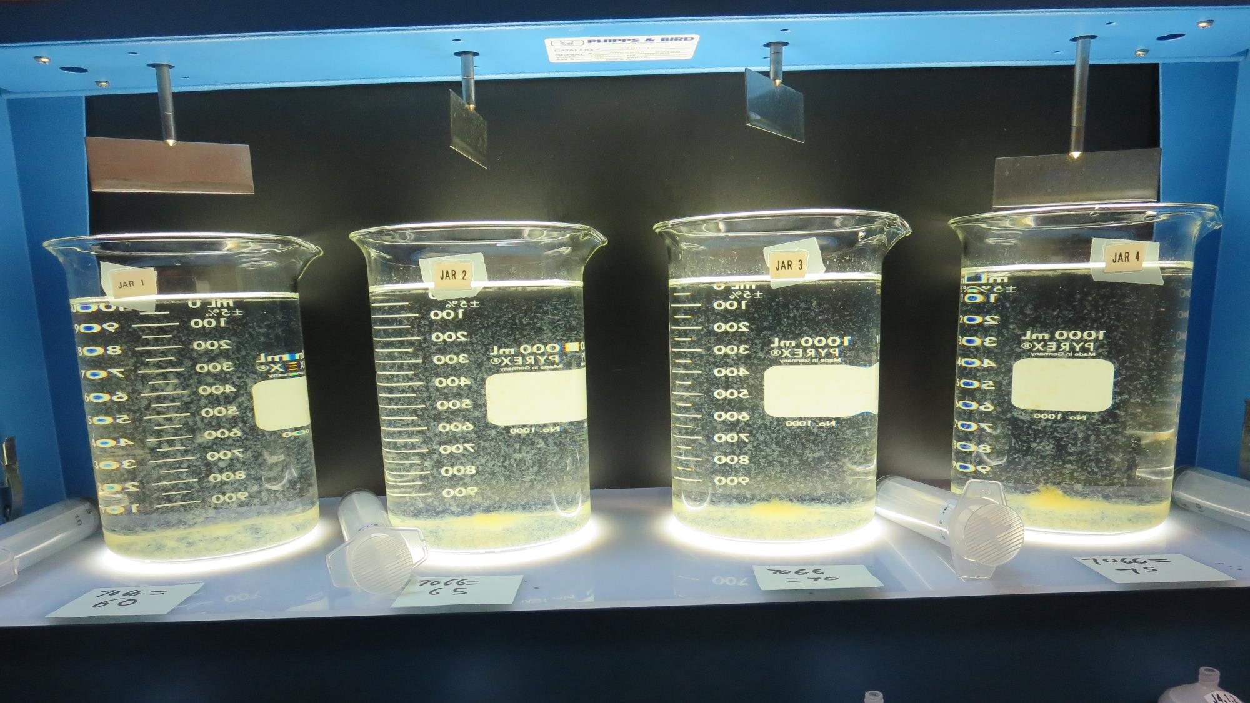
Jars 13-16: After 5 min of settling, 25 mL is decanted for filterability and %UVT/UVA.

Slide 26
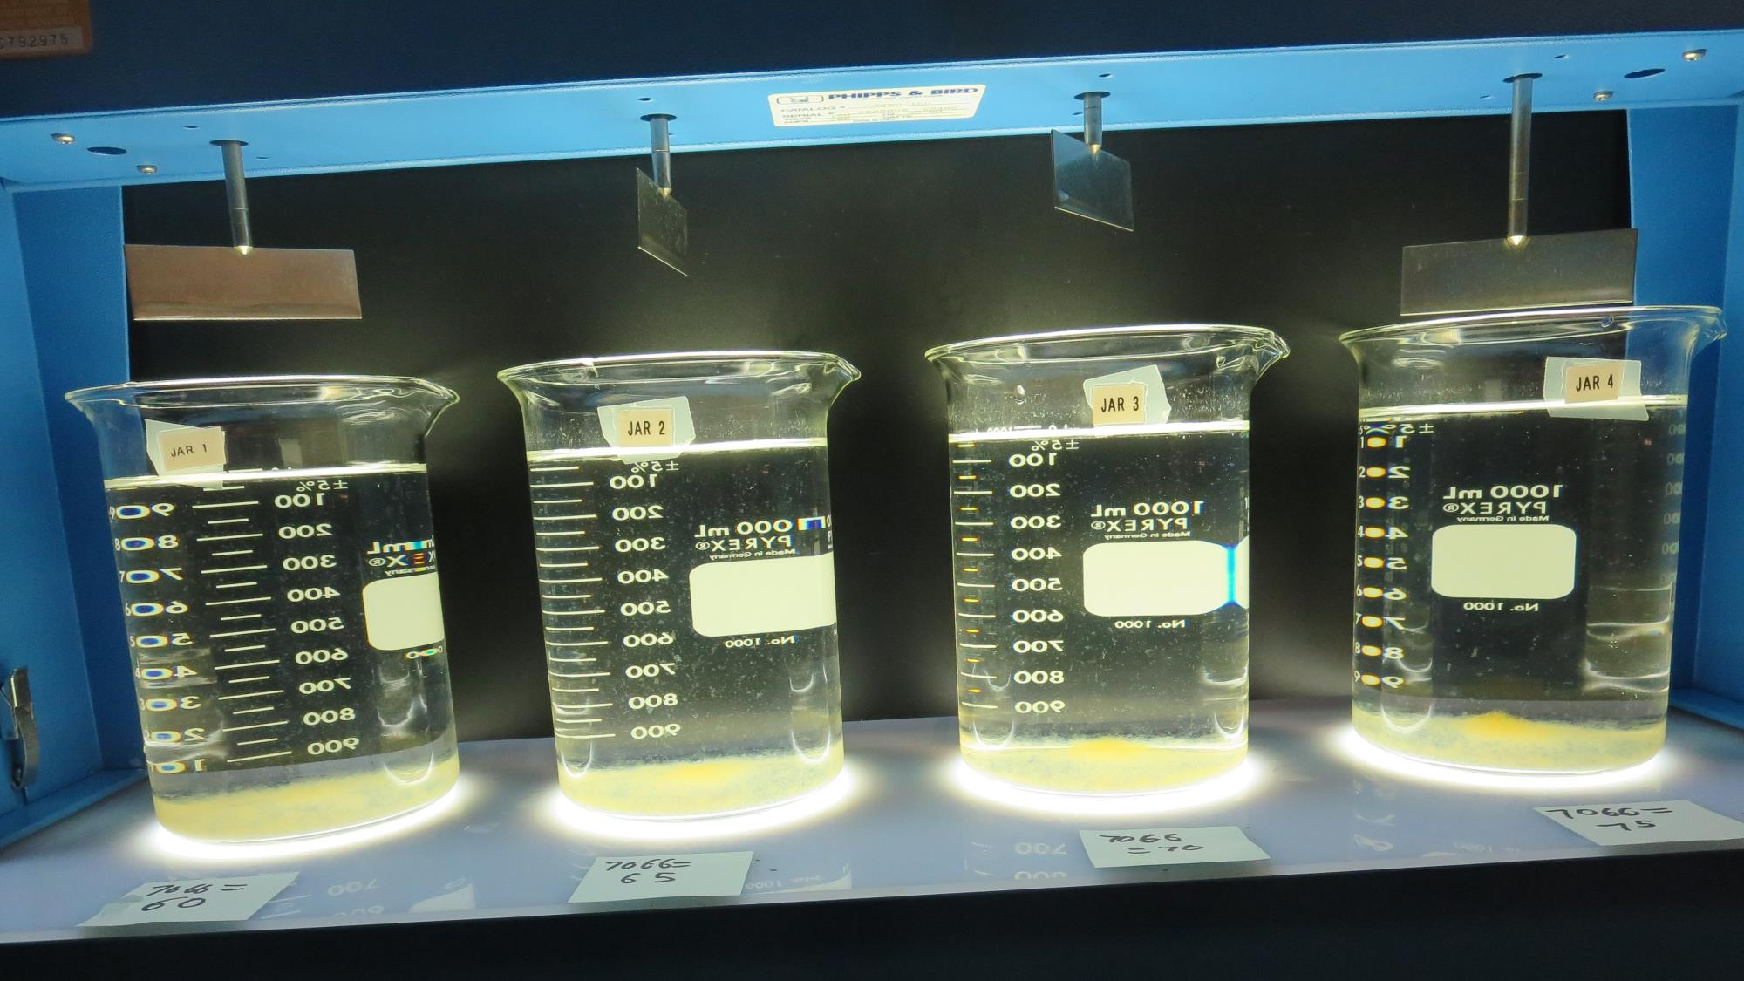
Jars 13-16: After 25-minutes of settling, settled water turbidity is taken.
60 mg/L 7066
Filtrate 0.15 NTU
UVT: 95.4%
UVA: 0.020/cm
Settled: 0.53 NTU
65 mg/L 7066
Filtrate 0.14 NTU
UVT: 95.7%
UVA: 0.019/cm
Settled: 0.63 NTU
70 mg/L 7066
Filtrate 0.07 NTU
UVT: 96.5%
UVA: 0.015/cm
Settled: 0.64 NTU
75 mg/L 7066
Filtrate 0.05 NTU
UVT: 97.3%
UVA: 0.012/cm
Settled: 0.66 NTU

Slide 27
Jars 17-20 Test
Flash Mix 60 Sec (200 RPM)
Floc Mix 10 min (30 RPM)
Applied Coagulant
7066

Slide 28
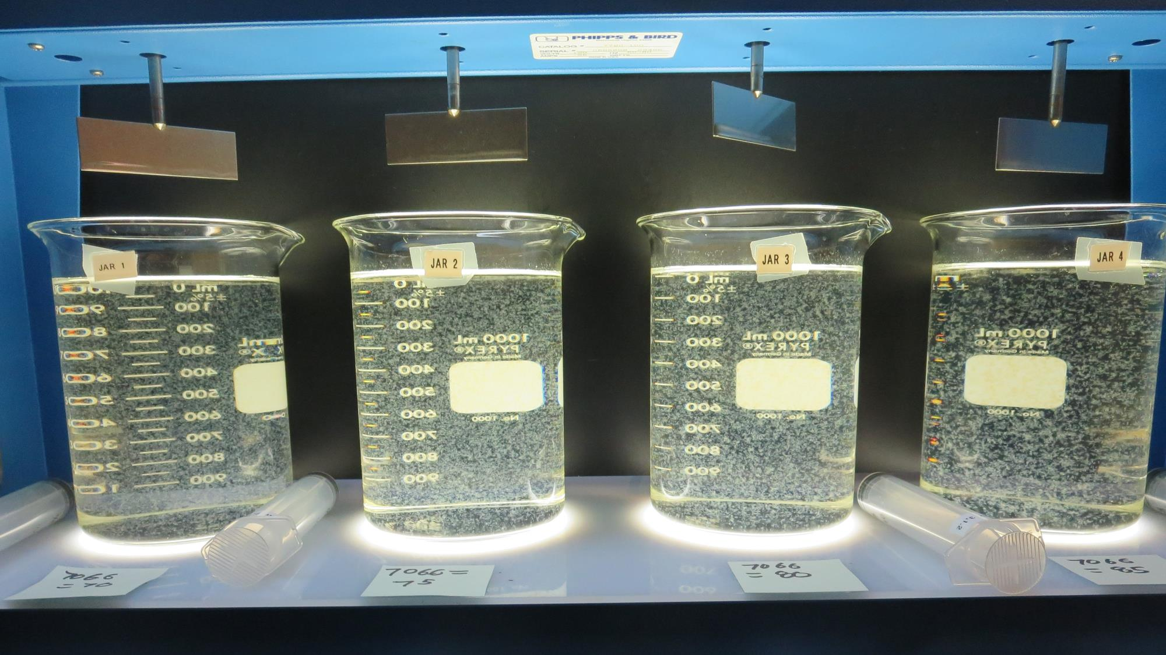
Jars 17-20: End of 10-minute flocculation (30 RPM) duration.
70 mg/L 7066
Filtrate 0.14 NTU
UVT: 96.3%
UVA: 0.016/cm
Settled: 0.41 NTU
75 mg/L 7066
Filtrate 0.11 NTU
UVT: 96.8%
UVA: 0.014/cm
Settled: 0.46 NTU
80 mg/L 7066
Filtrate 0.07 NTU
UVT: 97.3%
UVA: 0.012/cm
Settled: 0.79 NTU
85 mg/L 7066
Filtrate 0.06 NTU
UVT: 97.4%
UVA: 0.011/cm
Settled: 0.72 NTU

Slide 29
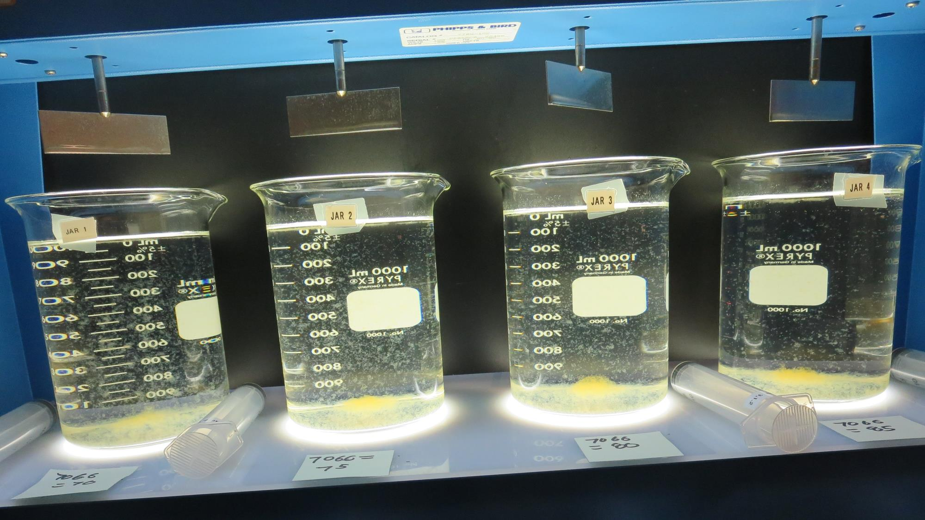
Jars 17-20: After 5 min of settling, 25 mL is decanted for filterability and %UVT/UVA.

Slide 30
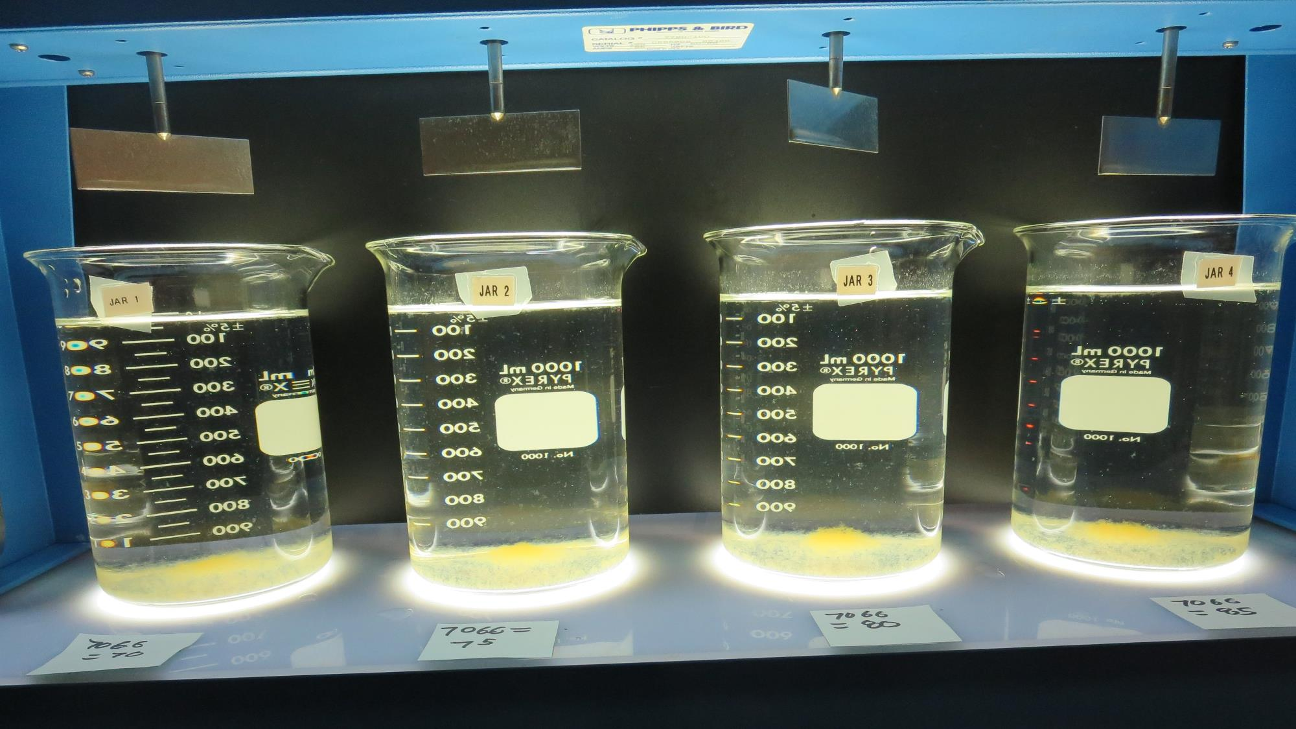
Jars 17-20: After 25-minutes of settling, settled water turbidity is taken.
70 mg/L 7066
Filtrate 0.14 NTU
UVT: 96.3%
UVA: 0.016/cm
Settled: 0.41 NTU
75 mg/L 7066
Filtrate 0.11 NTU
UVT: 96.8%
UVA: 0.014/cm
Settled: 0.46 NTU
80 mg/L 7066
Filtrate 0.07 NTU
UVT: 97.3%
UVA: 0.012/cm
Settled: 0.79 NTU
85 mg/L 7066
Filtrate 0.06 NTU
UVT: 97.4%
UVA: 0.011/cm
Settled: 0.72 NTU

Slide 31
Jars 21-24 Test
Flash Mix 60 Sec (200 RPM)
Floc Mix 10 min (30 RPM)
Applied Coagulant
7045

Slide 32
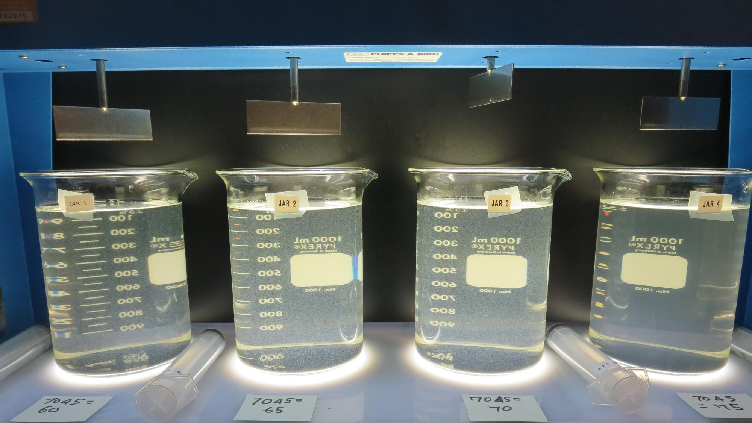
Jars 21-24: End of 10-minute flocculation (30 RPM) duration.
60 mg/L 7045
Filtrate 0.09 NTU
UVT: 96.0%
UVA: 0.018/cm
Settled: 2.3 NTU
65 mg/L 7045
Filtrate 0.07 NTU
UVT: 96.7%
UVA: 0.015/cm
Settled: 2.8 NTU
70 mg/L 7045
Filtrate 0.22 NTU
UVT: 95.6%
UVA: 0.020/cm
Settled: 3.2 NTU
75 mg/L 7045
Filtrate 0.14 NTU
UVT: 96.3%
UVA: 0.016/cm
Settled: 5.5 NTU

Slide 33
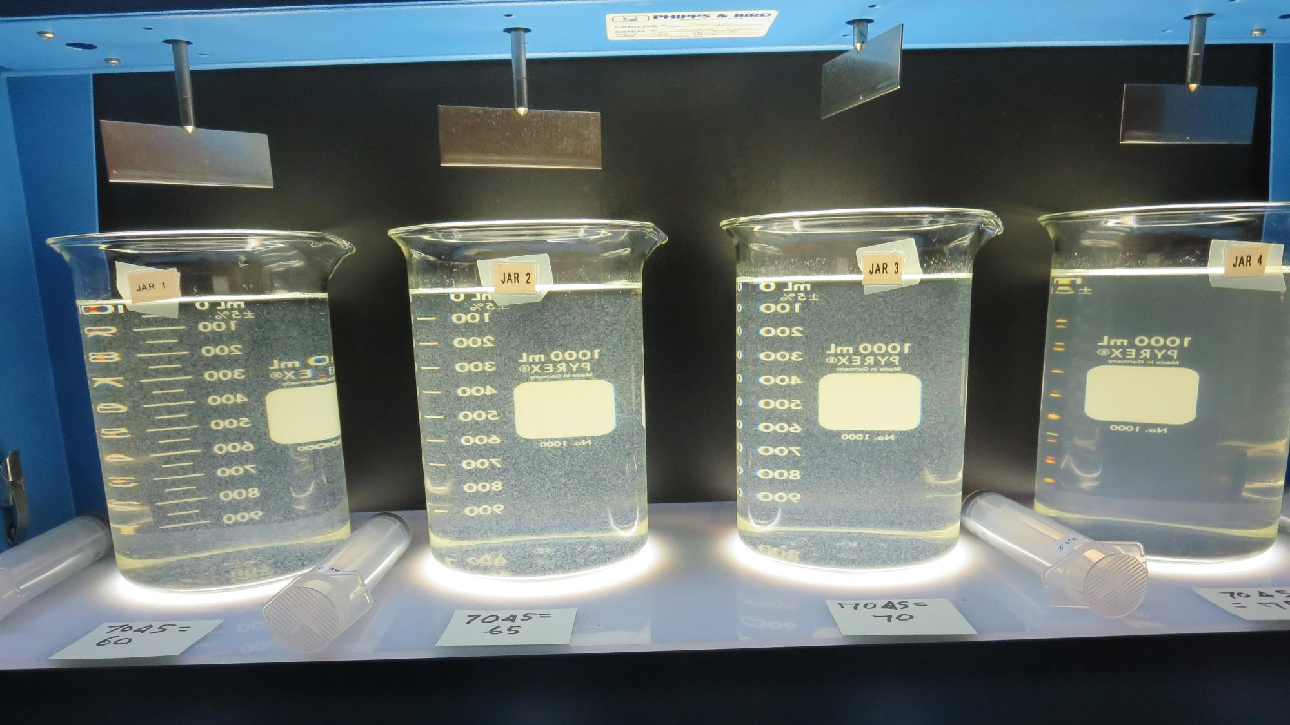
Jars 21-24: After 5 min of settling, 25 mL is decanted for filterability and %UVT/UVA.

Slide 34
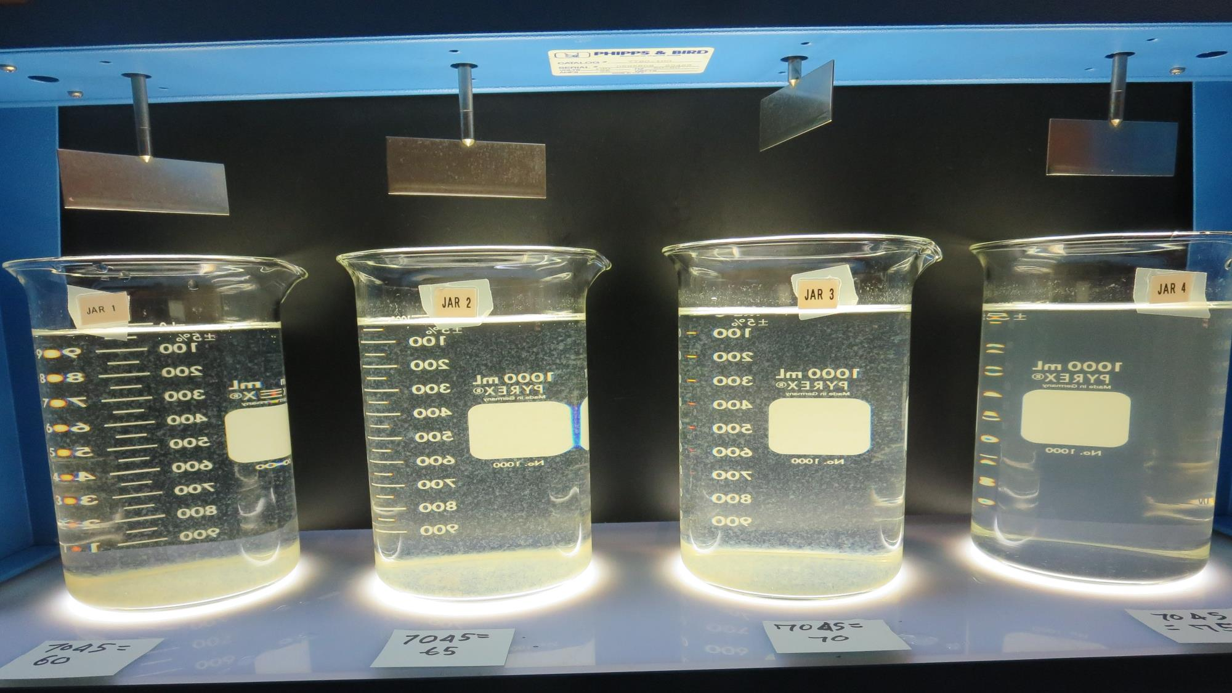
Jars 21-24: After 25-minutes of settling, settled water turbidity is taken.
60 mg/L 7045
Filtrate 0.09 NTU
UVT: 96.0%
UVA: 0.018/cm
Settled: 2.3 NTU
65 mg/L 7045
Filtrate 0.07 NTU
UVT: 96.7%
UVA: 0.015/cm
Settled: 2.8 NTU
70 mg/L 7045
Filtrate 0.22 NTU
UVT: 95.6%
UVA: 0.020/cm
Settled: 3.2 NTU
75 mg/L 7045
Filtrate 0.14 NTU
UVT: 96.3%
UVA: 0.016/cm
Settled: 5.5 NTU

Slide 35
Jars 25-28 Test
Flash Mix 60 Sec (200 RPM)
Floc Mix 10 min (30 RPM)
Applied Coagulant
7045

Slide 36
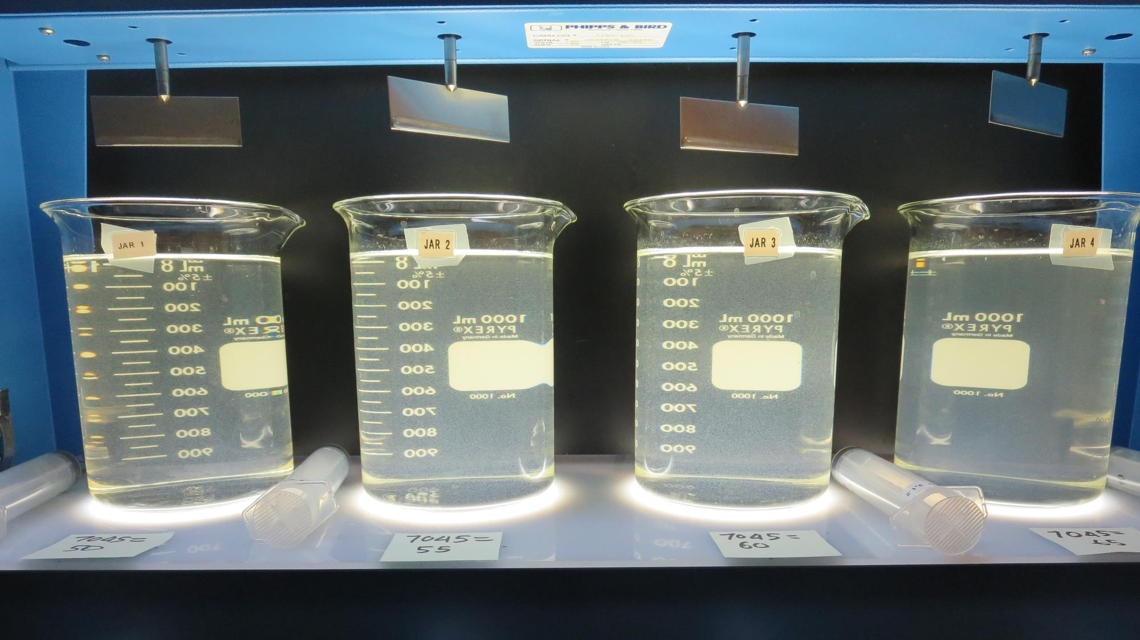
Jars 25-28: End of 10-minute flocculation (30 RPM) duration.
50 mg/L 7045
Filtrate 0.14 NTU
UVT: 94.8%
UVA: 0.023/cm
Settled: 3.2 NTU
55 mg/L 7045
Filtrate 0.16 NTU
UVT: 95.3%
UVA: 0.021/cm
Settled: 3.2 NTU
60 mg/L 7045
Filtrate 0.16 NTU
UVT: 95.5%
UVA: 0.020/cm
Settled: 3.6 NTU
65 mg/L 7045
Filtrate 0.83 NTU
UVT: 91.2%
UVA: 0.040/cm
Settled: 5.1 NTU

Slide 37
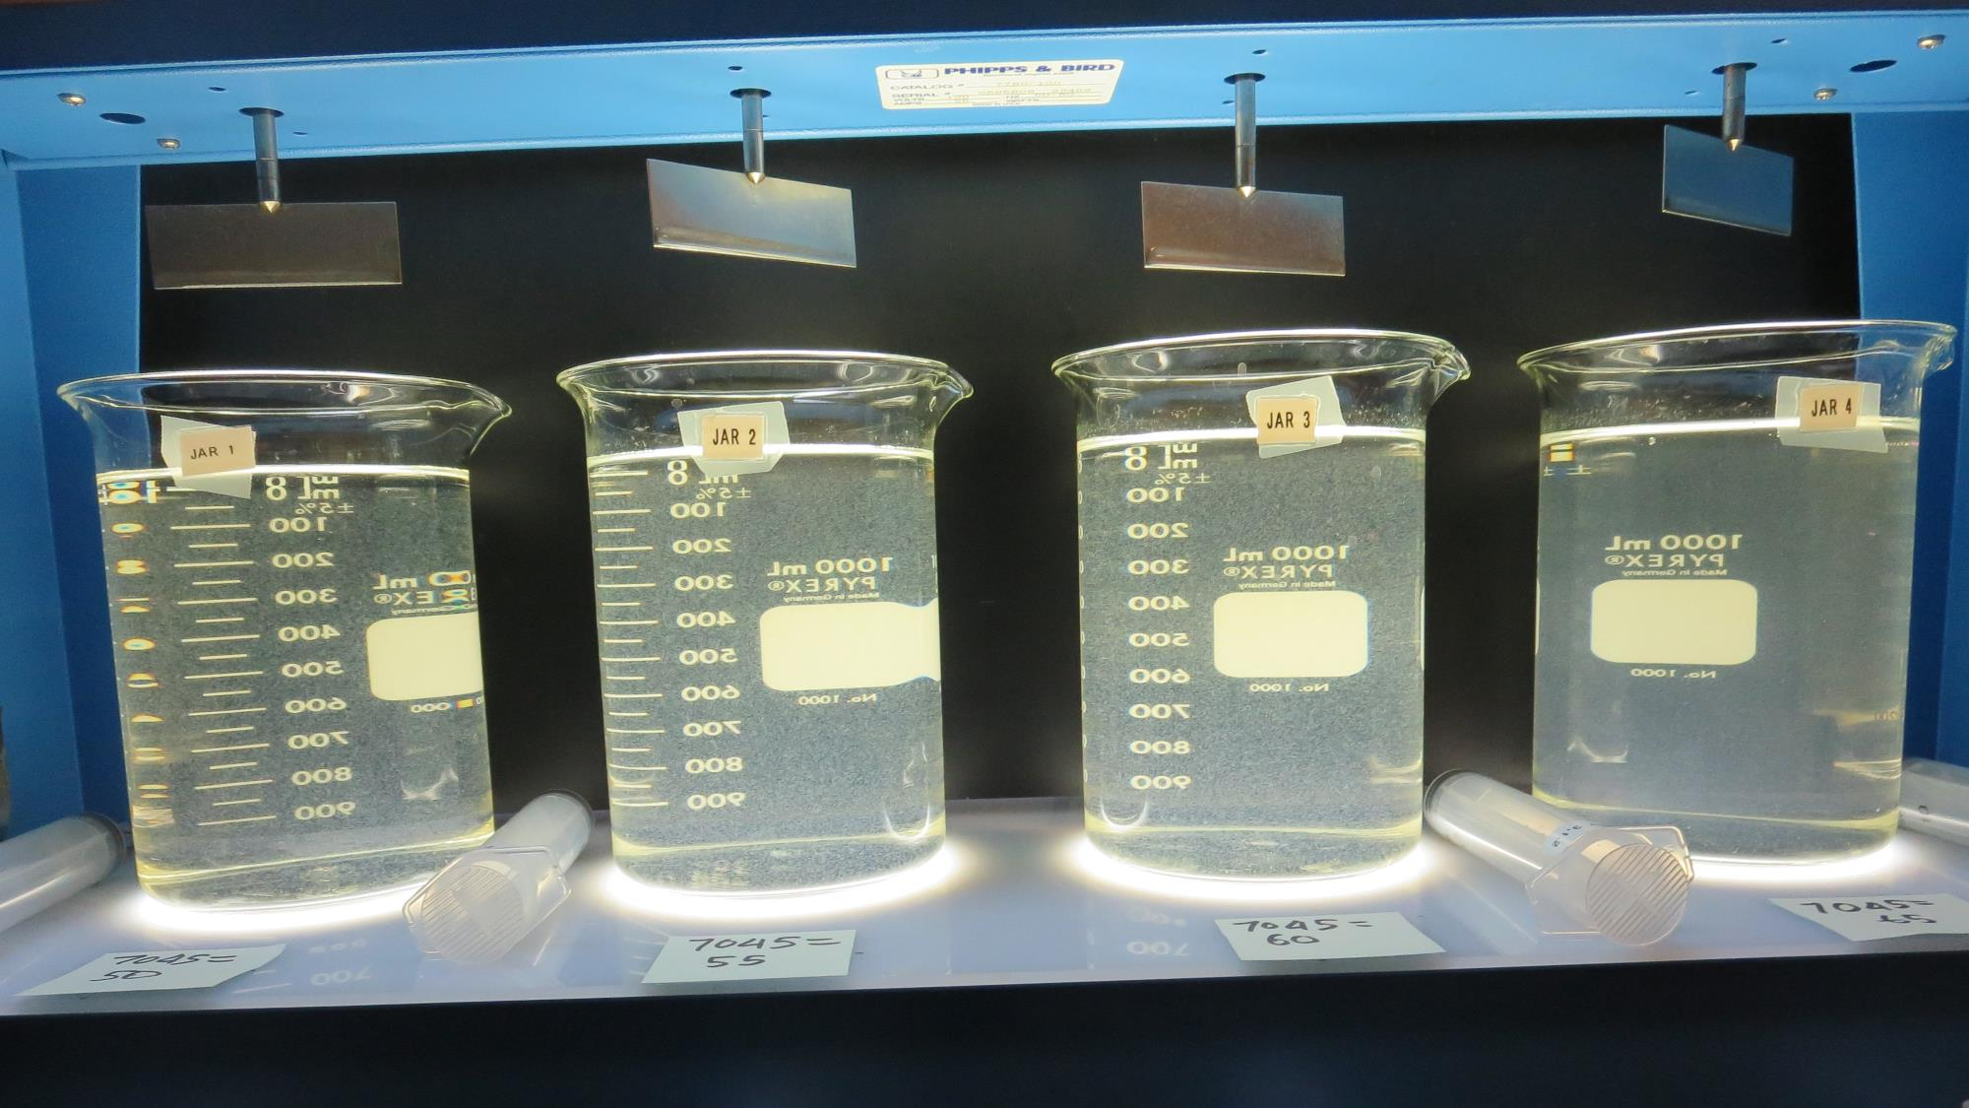
Jars 25-28: After 5 min of settling, 25 mL is decanted for filterability and %UVT/UVA.

Slide 38
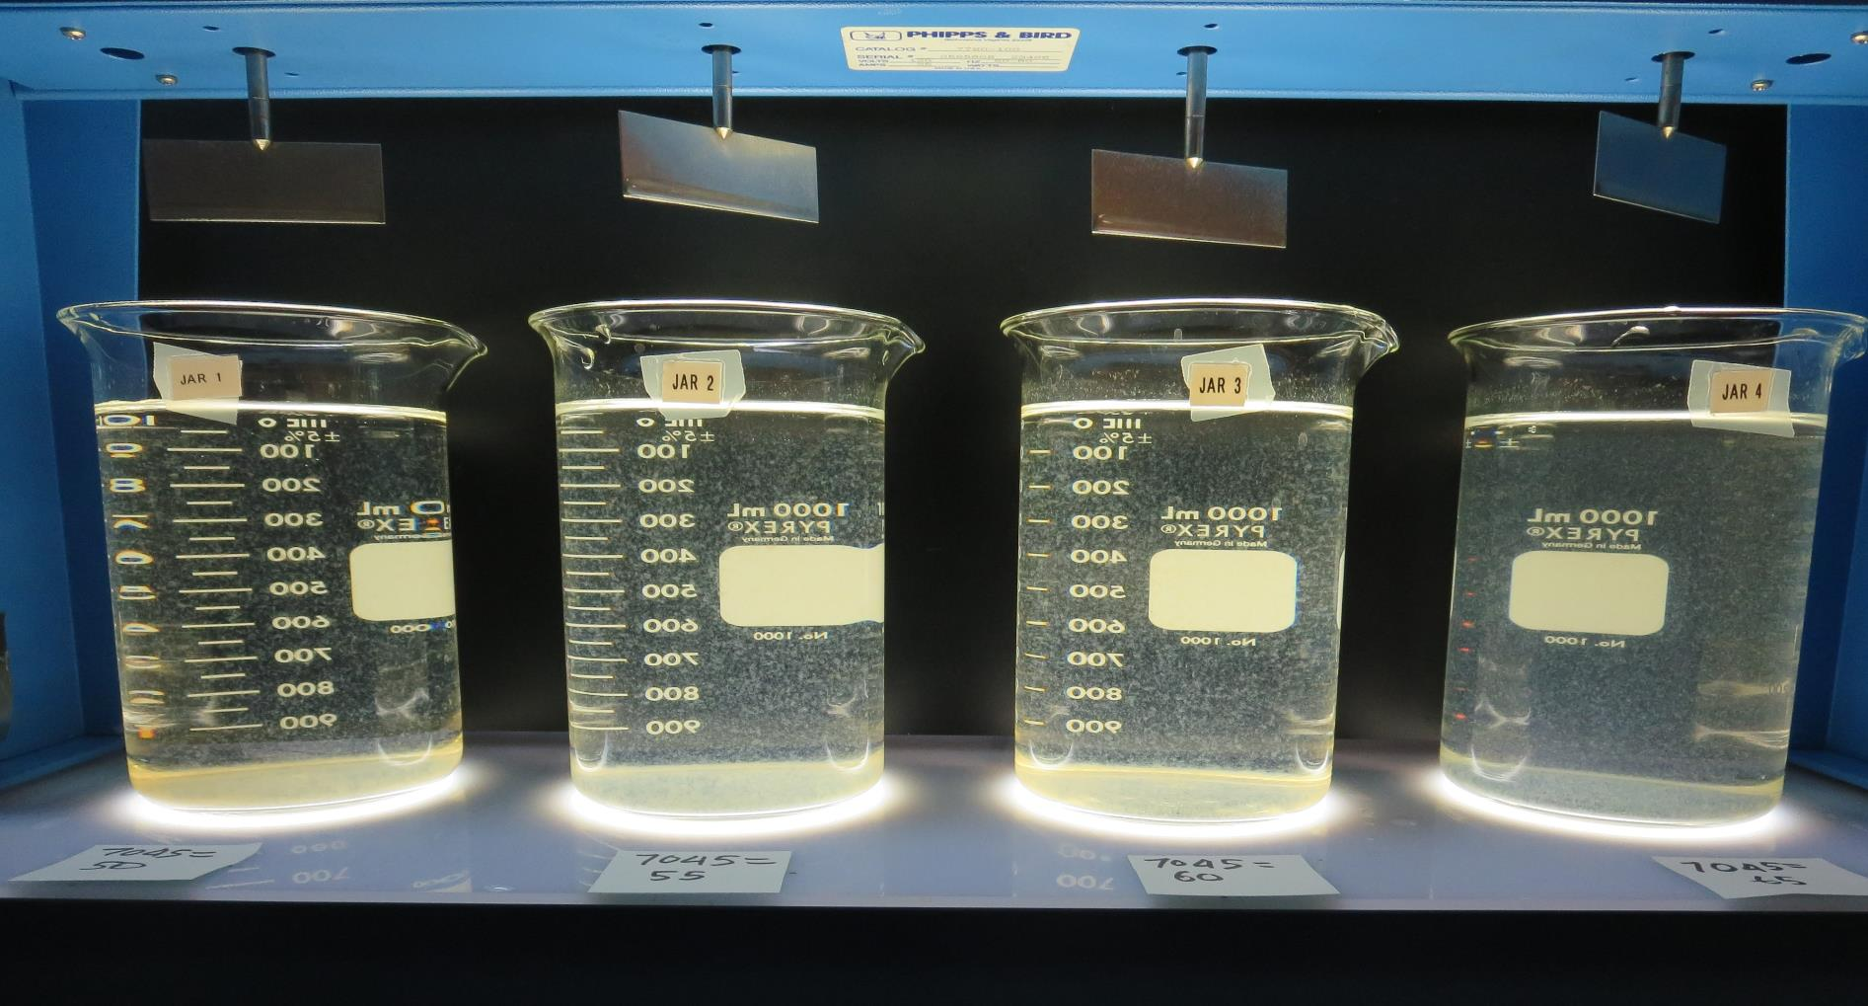
Jars 25-28: After 25-minutes of settling, settled water turbidity is taken.
50 mg/L 7045
Filtrate 0.14 NTU
UVT: 94.8%
UVA: 0.023/cm
Settled: 3.2 NTU
55 mg/L 7045
Filtrate 0.16 NTU
UVT: 95.3%
UVA: 0.021/cm
Settled: 3.2 NTU
60 mg/L 7045
Filtrate 0.16 NTU
UVT: 95.5%
UVA: 0.020/cm
Settled: 3.6 NTU
65 mg/L 7045
Filtrate 0.83 NTU
UVT: 91.2%
UVA: 0.040/cm
Settled: 5.1 NTU

Slide 39
Jar Testing for 1-Liter Jars:
General Procedures for Most Treatment Plants
Fill jars with source water prior to coagulant injection and set paddle speed at 30 rpm
Add chemicals (i.e., NaOCl, primary coagulant, coagulant aid) to each jar
Flash mix for 15-60 seconds (200 rpm)
Slow mix for 5 minutes (20-30 rpm)
Settled for 5 minutes. Syringe 25 mL from each jar taken 1-inch below surface (25 mL/12 sec rate)
Filtered through 1.2 um isopore membrane into cuvette drip rate, 15 mL/(50-90 sec)
Measure filtrate turbidity, chlorine residual and %UVT/UVA
Measure settled water turbidity after 25 minutes of total setting
Record all data

Slide 40

Jar Test
Filterability Test Equipment
Turbidity Instrument
Syringe w/Luer-Lock Tip, 30 cc
(part#: 2225800, by Hach)
Swinnex Filter Holder, 25 mm (part#: SX0002500)
Isopore Membrane Filter, 1.2 um absolute
pore size,
Φ= 25 mm , thickness: 24 um,
hydrophilic polycarbonate membrane
(part #: RTTP02500)
Go to Sigma-Aldrich for laboratory supplies http://www.sigmaaldrich.com/united-states.html

Slide 41
Isopore Membrane Information
Categories | Information
trade name | Isopore
filter color | White
chemistry | Polycarbonate (PC)
water flow rate | Avg. 175 mL/min x cm² (typical results @ 10 psi)
media | Isopore®
wettability | Hydrophilic
porosity | 14.7%
pore size | 1.2 µm
bubble point at 23 °C | 1.0 bar, air with water
thickness | 24 µm
filter diameter (ø) | 25 mm
material size | polycarbonate, Hydrophilic, 1.2 µm, 25 mm, white, plain, 100

Slide 42
Isopore Membrane Background Information
The Isopore membrane is a polycarbonate, track-etched screen filter recommended for all analyses in which the sample is viewed on the surface of the membrane. The Isopore membrane is composed of polycarbonate film, which has a smooth, glass-like surface for clearer sample observation. The unique manufacturing process of the membrane ensures a precise pore diameter and a consistent pore size for accurate separation of samples by size. Matched-weight filters are not usually required because of low, constant tar and ash weights.
Features & Benefits:
Membrane structure retains particles on the surface, simplifying counting and analysis

Slide 43
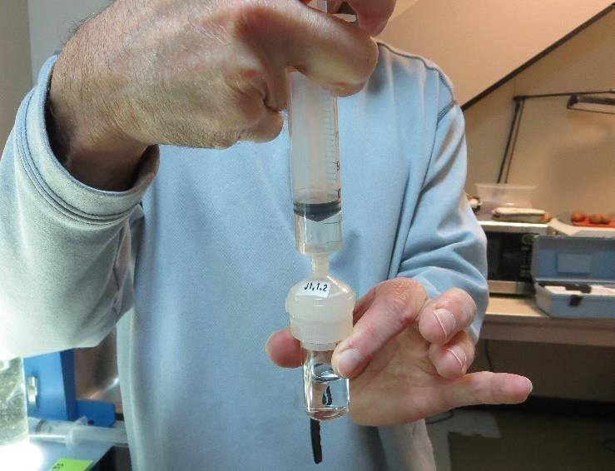

Jar Test - Filterability Test
Syringe ~ 25 mL from jar (after 5-minutes of settling)
Filter-to-waste 3-5 mL
Filter directly into clean cuvette
Measure turbidity
Note: Take several readings before recording final NTU results. Micro bubbles can adhere to glass causing false NTU readings. To remove bubbles, tilt cuvette up to 90 degrees.

Slide 44

Contact
Guy Schott, P.E.
State Water Resources Control Board
Division of Drinking Water
Santa Rosa, CA
Go to Stock Solution/Dose calculations/Jar Test Results for tools to download
www.waterboards.ca.gov/drinking_water/programs/districts/mendocino_district.html
Email: Guy Schott - Guy.Schott@waterboards.ca.gov
Office Number: 707-576-2732

