Slide 1
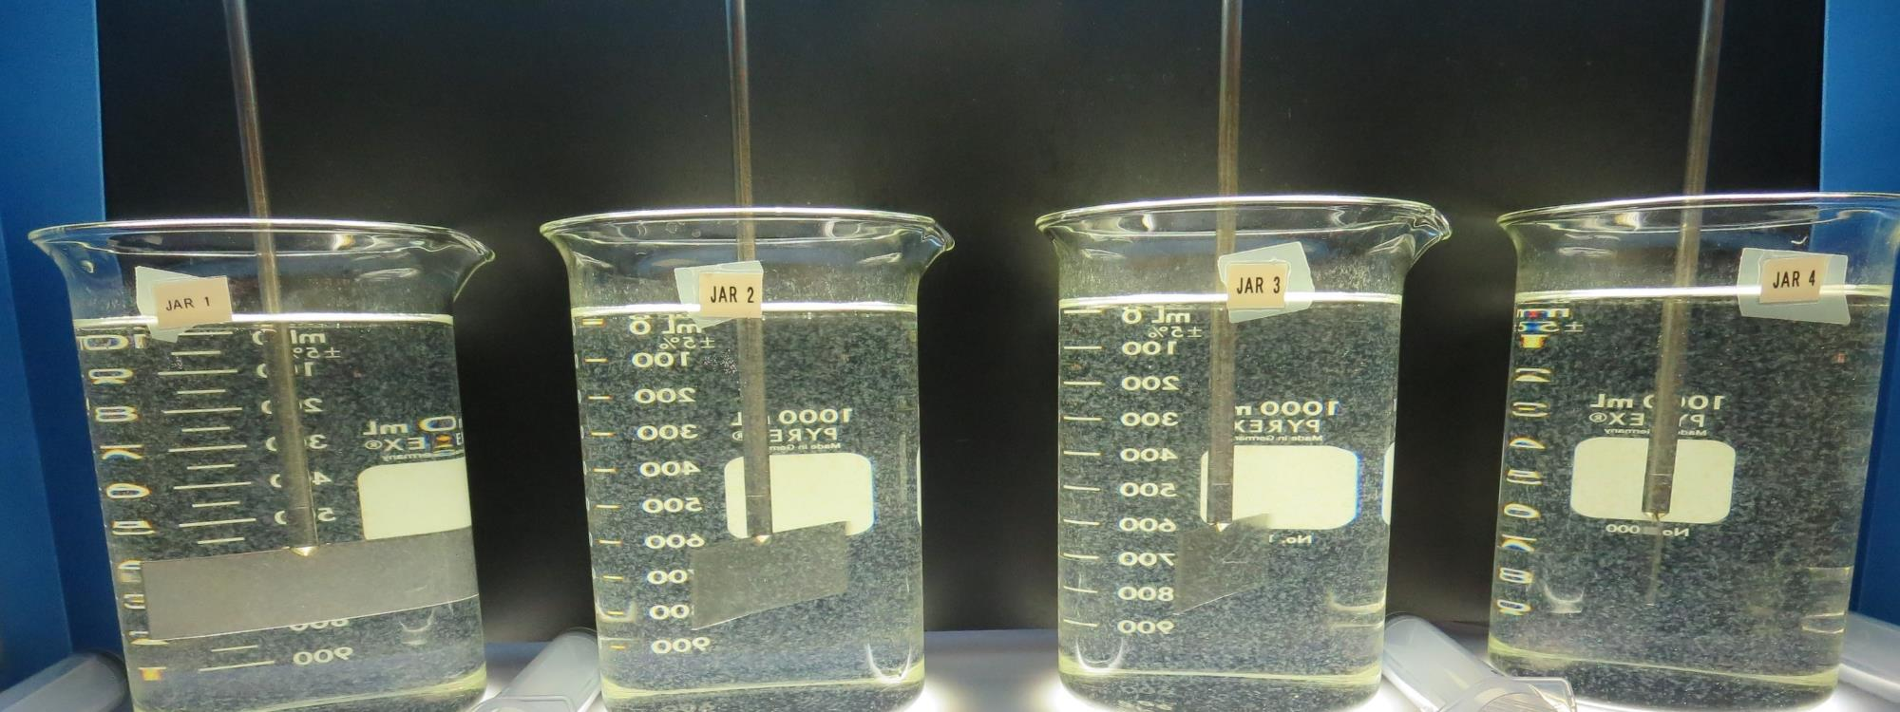
Surfwood MWC CA2300590 Mendocino County Jar Test
by Guy Schott, P.E
October 18, 2019

Slide 2
Source Water: Jack Peter’s Creek Roughing Filter followed by Multi-Media Filtration
Source Water Characteristics
Turbidity: 2.14 NTU
pH: 7.24
UVT: 70.8%, UVA: 0.150/cm
0.4 um Filtered
UVT: 73.3%, UVA: 0.135/cm
Treated Water Train 1 (7066 coagulant 46 mg/L)
Turbidity: 0.06 NTU
UVT: 97.2%, UVA: 0.012/cm
Treated Water Train 2 (pDADMAC)
Turbidity: 0.07 NTU
UVT: 90.7%, UVA: 0.042/cm

Slide 3
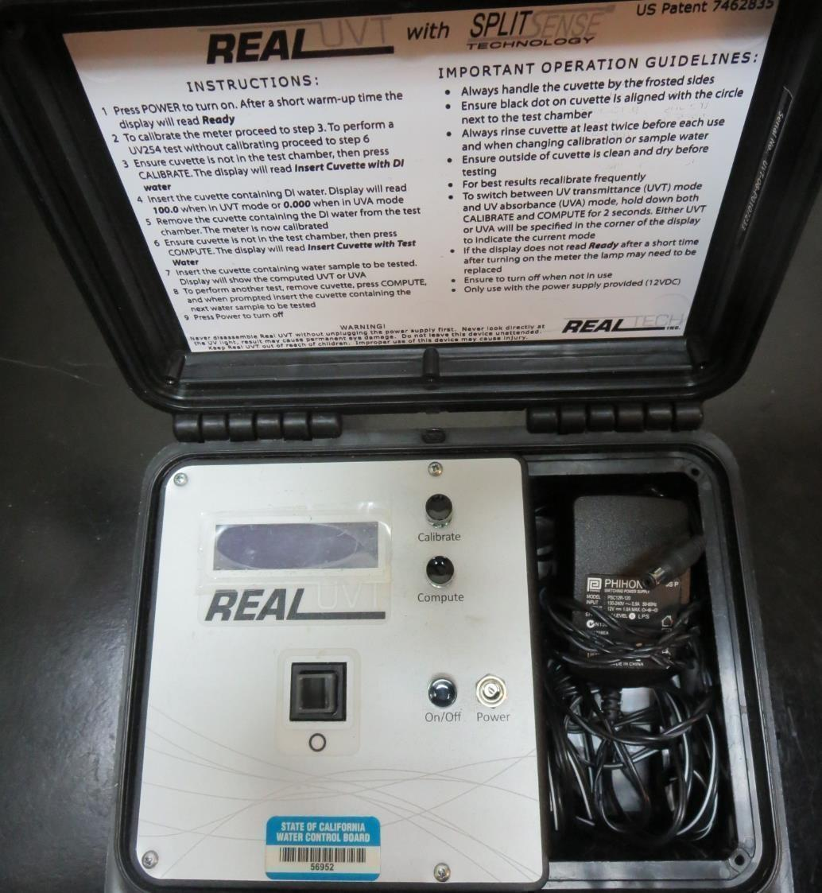
UVT/UVA
UV transmittance (UVT) is a measurement of the amount of ultraviolet light (commonly at 254 nm due to its germicidal effect) that passes through a water sample compared to the amount of light that passes through a pure water sample. The measurement is expressed as a percentage, % UVT.
%UVT = 10^{(-UVA)} x 100%
UV absorbance (UVA) is calculated as a relative measure of the amount of light absorbed by a water sample compared with the amount of light absorbed by a pure water sample.
UVA = -log(%UVT/100)

Slide 4
Coagulant Used for Jar Testing
Pro Pac 9890 (NTU Technologies)
35-45% Aluminum Chlorohydrate
35-45% Water
20% Proprietary
SG = 1.25-1.34
7066 (Garratt Callahan)
10 – 30% Poly Aluminum Hydroxychloride Sulfate
SG = 1.2

Slide 5
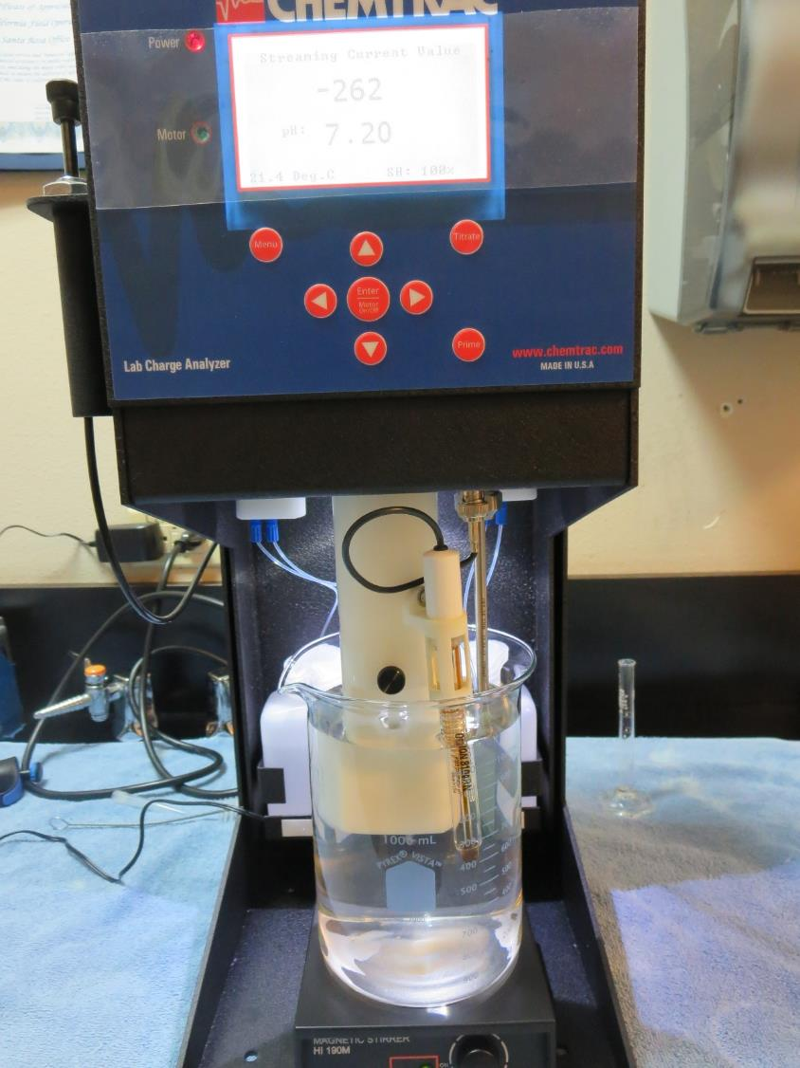
Laboratory Charge Analyzer
LCA: Used to determine coagulant demand of a source water entering the treatment plant.
Source pH: 7.22
LCA #1:
7066: 54 mg/L as product (no pH adjustment)
Final pH: 6.60
LCA #2:
9890: 16 mg/L as product (no pH adjustment)
Final pH: 7.12

Slide 6
Coagulant Information
Unless stated otherwise, all coagulant doses are reported as Product (100% strength).
Preparation of coagulant stock solutions are generally 1.0 or 0.1 percent strength using 100 and/or 200 mL volumetric flasks.
Finnpipette F2 variable volume pipette, capacity 100-1000 micro liters is used for stock solution preparation and coagulant aid jar test dosing.
Finnpipette F2 variable volume pipette, capacity 0.5-5 mL is used for primary coagulant jar test dosing.

Slide 7
Filtrate and %UVT/UVA Analysis
For this study, all jars except for jars 10 & 12 were samples for Filtrate and %UVT/UVA analysis immediately at the end of the flocculation period. Jars 10 & 12 were allowed to settled for 5 minutes before sampling.

Slide 8
Surfwood MWC: Jar Test 1-8 Results
Jar # | 200 RPM Flash Mix Seconds | 30 RPM Floc Duration Minutes | 7066 mg/L | Filtrate NTU | Filtrate %UVT | Filtrate UVA/cm | Settle NTU 25 min
J1 | 15 | 5 | 40 | 0.28 | 90.7 | 0.042 | 2.65
J2 | 15 | 5 | 45 | 0.16 | 93.3 | 0.030 | 1.25
J3 | 15 | 5 | 50 | 0.08 | 94.6 | 0.024 | 1.32
J4 | 15 | 5 | 55 | 0.12 | 94.3 | 0.025 | 1.11
J5 | 15 | 5 | 50 | 0.10 | 94.8 | 0.023 | 0.89
J6 | 15 | 5 | 50 | 0.08 | 95.2 | 0.021 | 0.93
J7 | 15 | 5 | 50 | 0.12 | 94.1 | 0.026 | 1.01
J8 | 15 | 5 | 50 | 0.08 | 95.0 | 0.022 | 0.96

Slide 9
Surfwood MWC: Jar Test 9-16 Results
Jar # | 200 RPM Flash Mix Seconds | 30 RPM Floc Duration Minutes | 7066 mg/L | Filtrate NTU | Filtrate %UVT | Filtrate UVA/cm | Settle NTU 25 min
J9 | 15 | 5 | 48 | 0.18 | 94.4 | 0.025 | 1.06
J10 | 15 | 5 | 48 | 0.17 | 94.6 | 0.024 | 1.19
J11 | 15 | 5 | 48 | 0.20 | 94.8 | 0.023 | 1.08
J12 | 15 | 5 | 48 | 0.17 | 95.3 | 0.021 | 0.88
J13 | 30 | 5 | 50 | 0.09 | 95.8 | 0.019 | 0.62
J14 | 30 | 5 | 52 | 0.14 | 95.2 | 0.021 | 0.78
J15 | 30 | 5 | 54 | 0.06 | 96.2 | 0.017 | 0.65
J16 | 30 | 5 | 56 | 0.09 | 96.1 | 0.017 | 0.68

Slide 10
Surfwood MWC: Jar Test 17-20 Results
Jar # | 200 RPM Flash Mix Seconds | 30 RPM Floc Duration Minutes | 9800 mg/L | Filtrate NTU | Filtrate %UVT | Filtrate UVA/cm | Settle NTU 25 min
J17 | 30 | 5 | 15 | 0.11 | 94.0 | 0.027 | 2.41
J18 | 30 | 5 | 16 | 0.29 | 92.5 | 0.034 | 2.40
J19 | 30 | 5 | 17 | 0.08 | 95.2 | 0.021 | 2.49
J20 | 30 | 5 | 18 | 0.15 | 95.1 | 0.022 | 2.66

Slide 11
Surfwood MWC: Jar Test 21-28 Results
Jar # | 200 RPM Flash Mix Seconds | 30 RPM Floc Duration Minutes | 7066 mg/L | Filtrate NTU | Filtrate %UVT | Filtrate UVA/cm | Settle NTU 25 min | Water Temp. ºC
J21 | 30 | 5 | 54 | 0.06 | 96.8 | 0.014 | n/a | 22
J22 | 30 | 5 | 54 | 0.09 | 96.2 | 0.017 | 0.61 | 22
J23 | 30 | 5 | 54 | 0.08 | 97.2 | 0.012 | 1.12 | 6
J24 | 30 | 5 | 54 | 0.11 | 96.7 | 0.015 | 0.98 | 6
J25 | 0 | 5 | 54 | 0.09 | 95.5 | 0.020 | 0.84 | 22
J26 | 0 | 5 | 54 | 0.09 | 95.4 | 0.020 | 0.90 | 22
J27 | 30 | 5 | 54 | 0.08 | 95.8 | 0.019 | 0.53 | 22
J28 | 30 | 5 | 54 | 0.07 | 95.9 | 0.018 | 0.63 | 22

Slide 12
Jars 1-4 Test Flash Mix 15 Sec (200 RPM) Floc Mix 5 min (30 RPM) 25 mL sampled end of Floc Applied Coagulant 7066

Slide 13
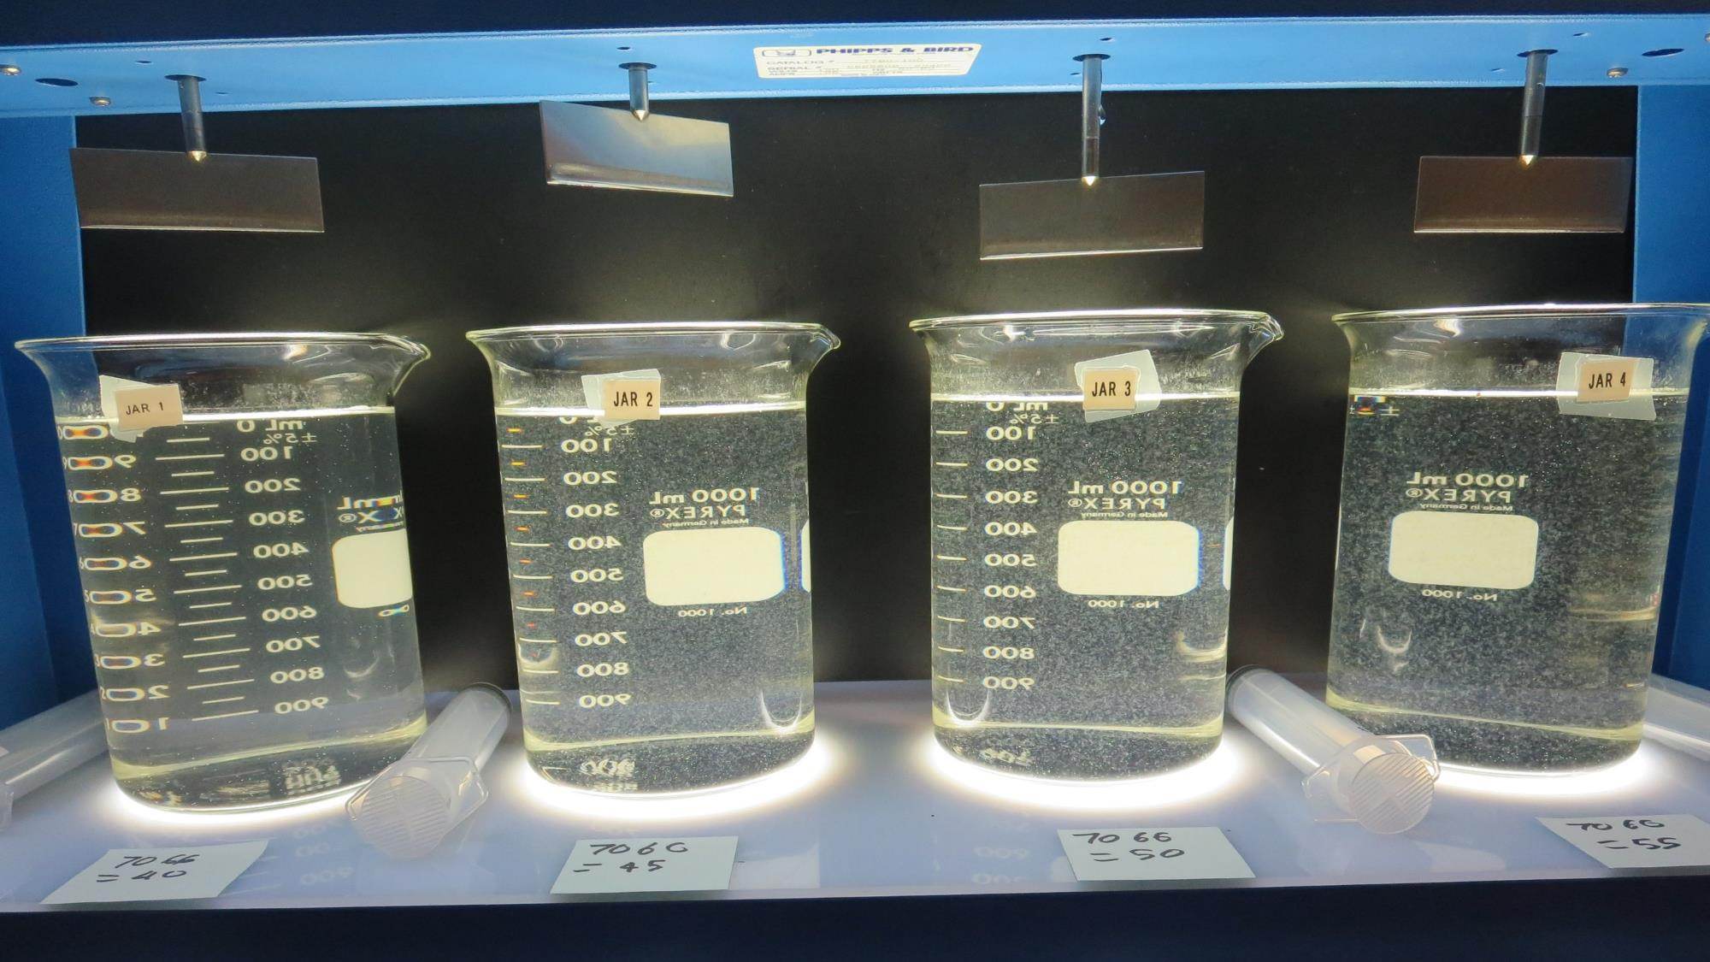
Jars 1-4: End of Floc Duration, 25 mL is syringed for filterability and %UVT/UVA.
40 mg/L 7066
Filtrate 0.28 NTU
UVT: 90.7%
UVA: 0.042/cm
Settled: 2.65 NTU
45 mg/L 7066
Filtrate 0.16 NTU
UVT: 93.3%
UVA: 0.030/cm
Settled: 1.25 NTU
50 mg/L 7066
Filtrate 0.08 NTU
UVT: 94.6%
UVA: 0.024/cm
Settled: 1.32 NTU
55 mg/L 7066
Filtrate 0.12 NTU
UVT: 94.3%
UVA: 0.025/cm
Settled: 1.11 NTU

Slide 14
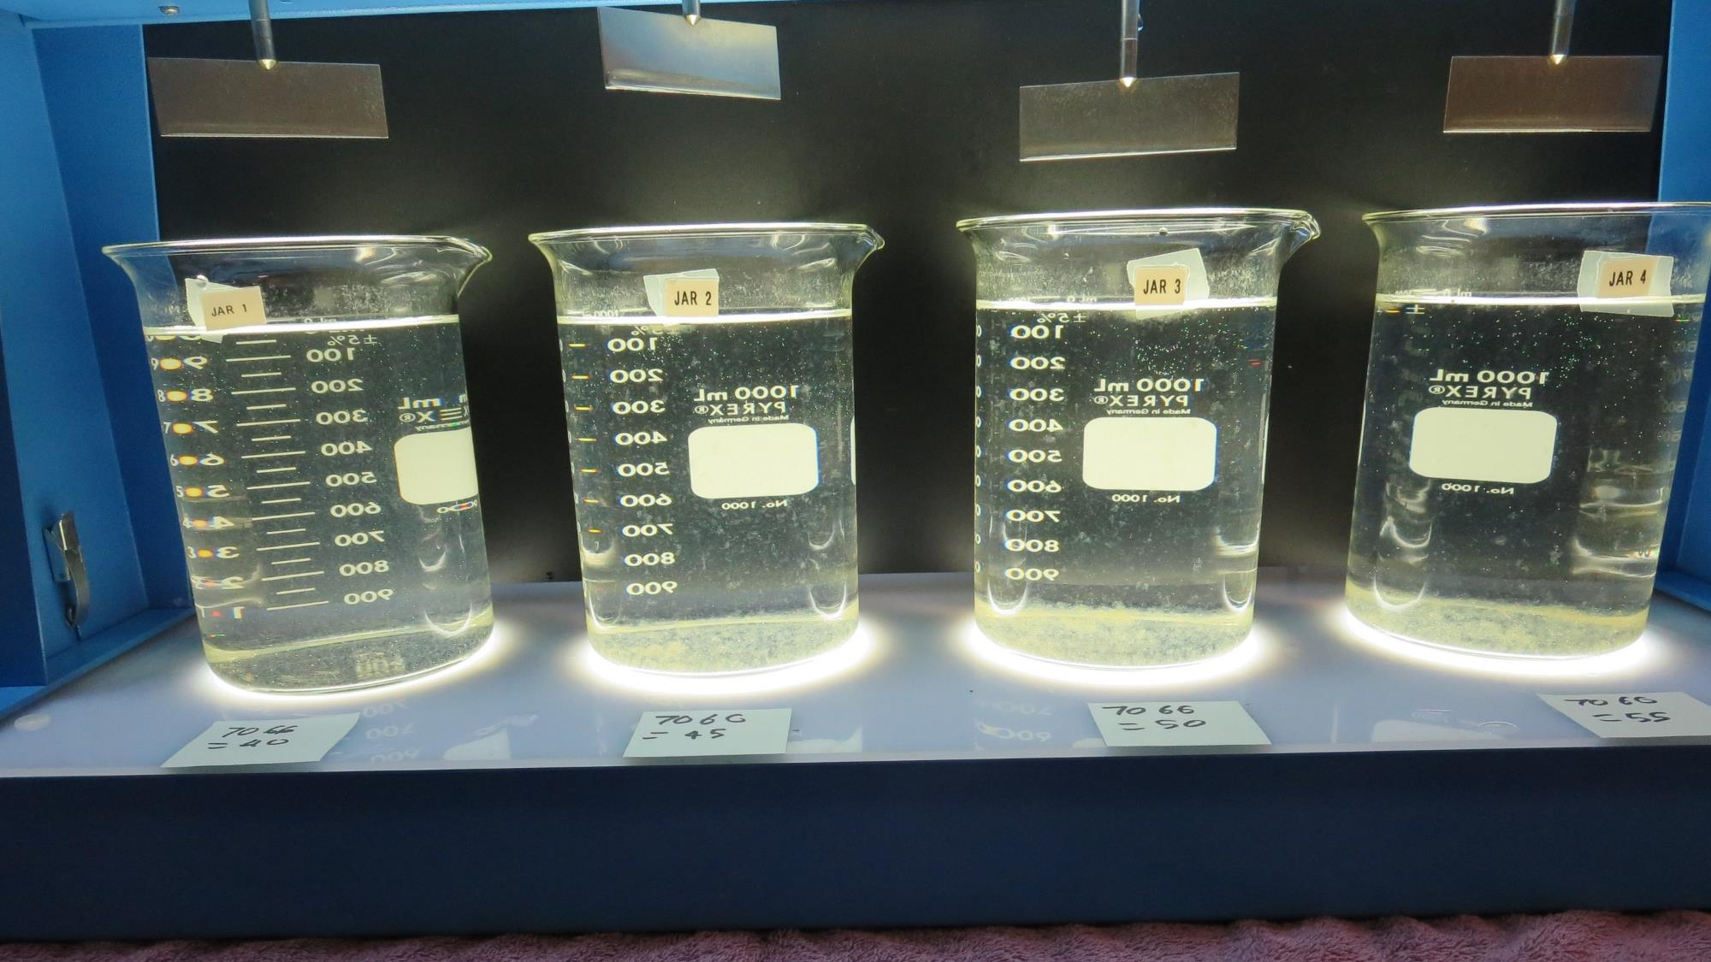
Jars 1-4: After 25-minutes of settling, settled water turbidity is taken.

Slide 15
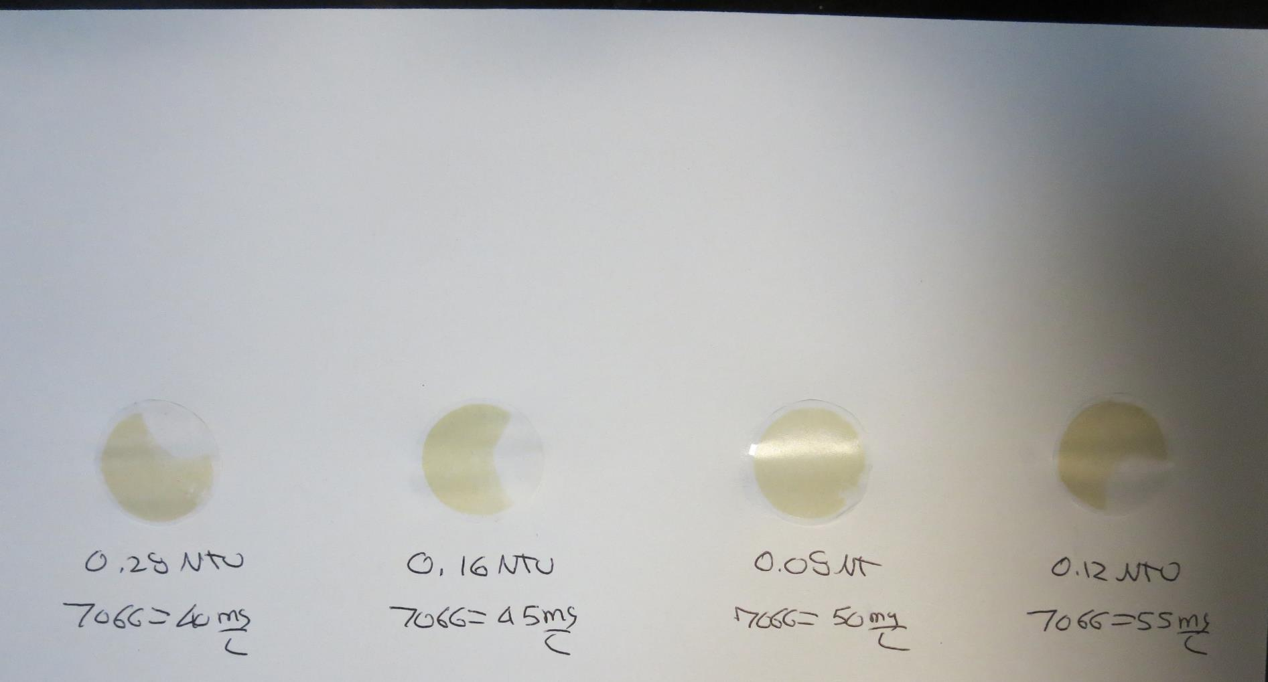
Visual of Filterability of Jars 1-4
40 mg/L 7066
Filtrate 0.28 NTU
UVT: 90.7%
UVA: 0.042/cm
Settled: 2.65 NTU
45 mg/L 7066
Filtrate 0.16 NTU
UVT: 93.3%
UVA: 0.030/cm
Settled: 1.25 NTU
50 mg/L 7066
Filtrate 0.08 NTU
UVT: 94.6%
UVA: 0.024/cm
Settled: 1.32 NTU
55 mg/L 7066
Filtrate 0.12 NTU
UVT: 94.3%
UVA: 0.025/cm
Settled: 1.11 NTU

Slide 16
Jars 5-8 Test Flash Mix 15 Sec (200 RPM) Floc Mix 5 min (30 RPM) 25 mL sampled end of Floc Applied Coagulant 7066

Slide 17
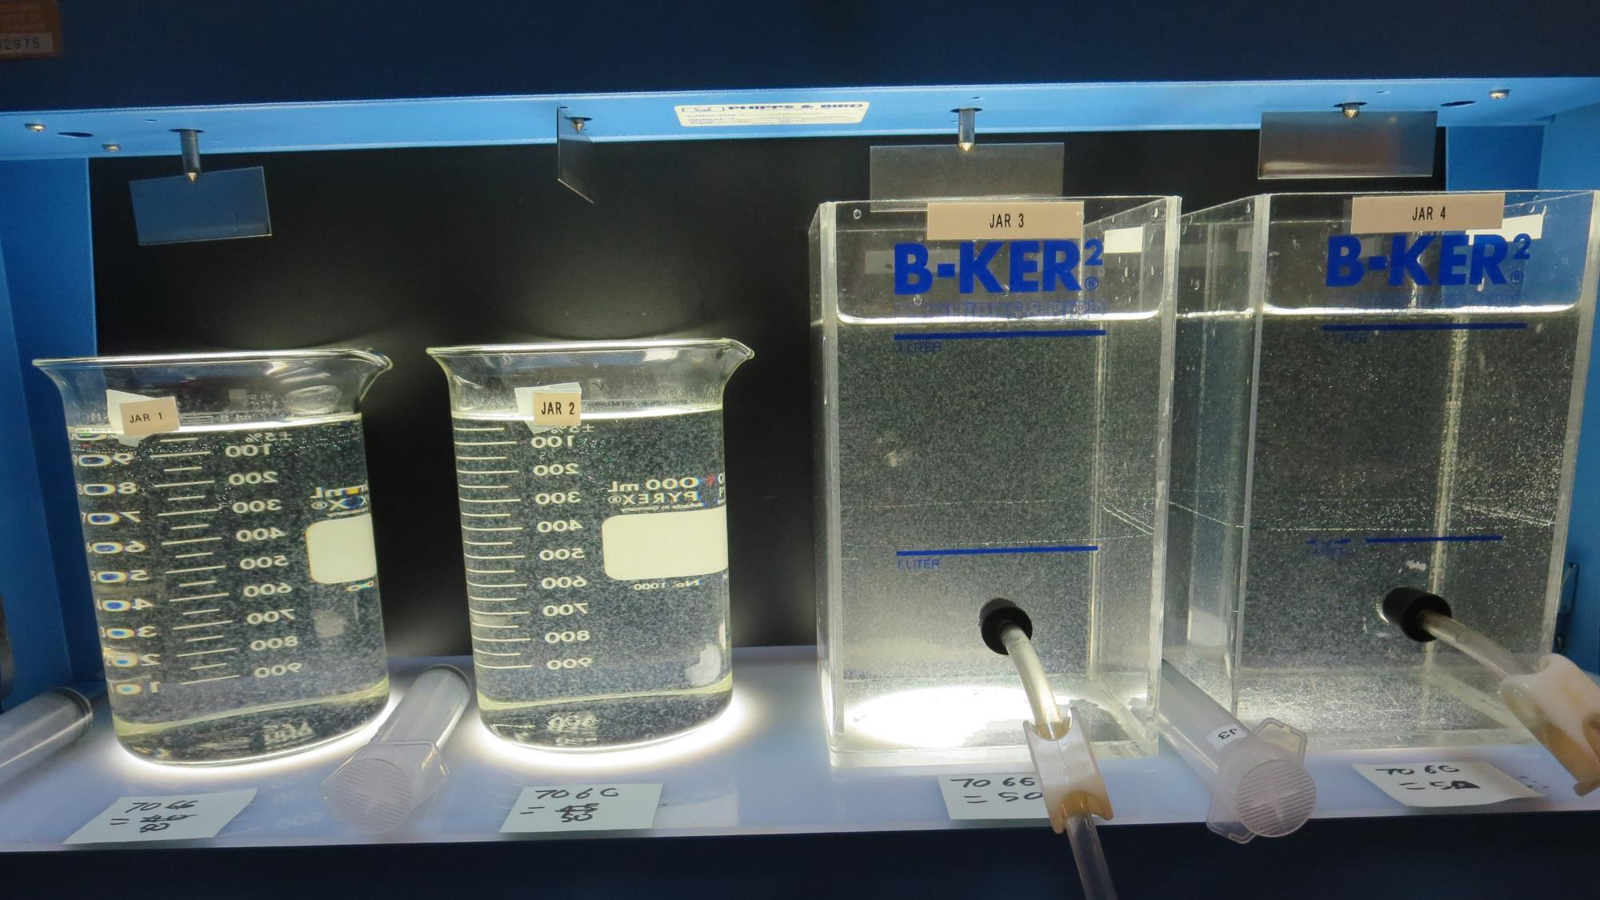
Jars 5-8: End of Floc Duration, 25 mL is syringed for filterability and %UVT/UVA.
50 mg/L 7066
Filtrate 0.10 NTU
UVT: 94.8%
UVA: 0.023/cm
Settled: 0.89 NTU
50 mg/L 7066
Filtrate 0.08 NTU
UVT: 95.2%
UVA: 0.021/cm
Settled: 0.93 NTU
50 mg/L 7066
Filtrate 0.12 NTU
UVT: 94.1%
UVA: 0.026/cm
Settled: 1.01 NTU
50 mg/L 7066
Filtrate 0.08 NTU
UVT: 95.0%
UVA: 0.022/cm
Settled: 0.96 NTU

Slide 18
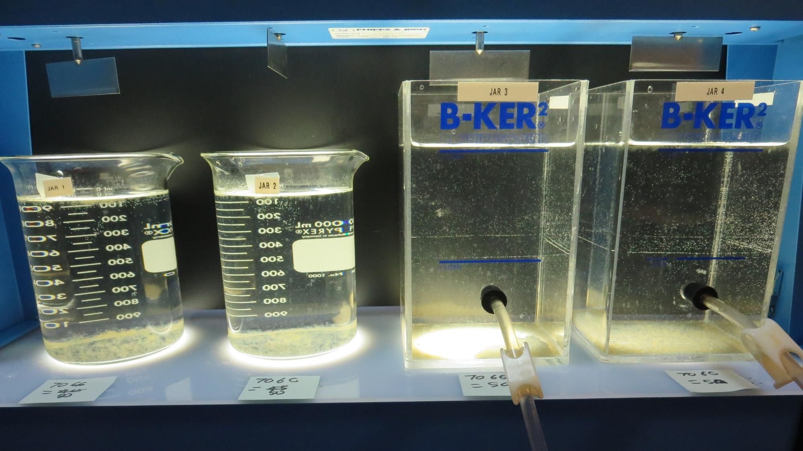
Jars 5-8: After 25-minutes of settling, settled water turbidity is taken.

Slide 19
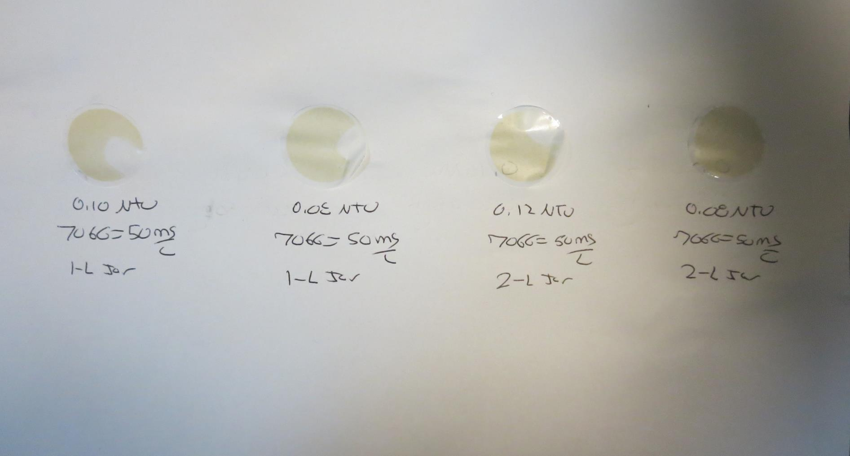
Visual of Filterability of Jars 5-8
50 mg/L 7066
Filtrate 0.10 NTU
UVT: 94.8%
UVA: 0.023/cm
Settled: 0.89 NTU
50 mg/L 7066
Filtrate 0.08 NTU
UVT: 95.2%
UVA: 0.021/cm
Settled: 0.93 NTU
50 mg/L 7066
Filtrate 0.12 NTU
UVT: 94.1%
UVA: 0.026/cm
Settled: 1.01 NTU
50 mg/L 7066
Filtrate 0.08 NTU
UVT: 95.0%
UVA: 0.022/cm
Settled: 0.96 NTU

Slide 20
Jars 9-12 Test Flash Mix 15 Sec (200 RPM) Floc Mix 5 min (30 RPM) 25 mL sampled end of Floc (Jars 9 & 11) 25 mL sampled 5 minutes after end of Floc (Jars 10 & 12) Applied Coagulant 7066

Slide 21
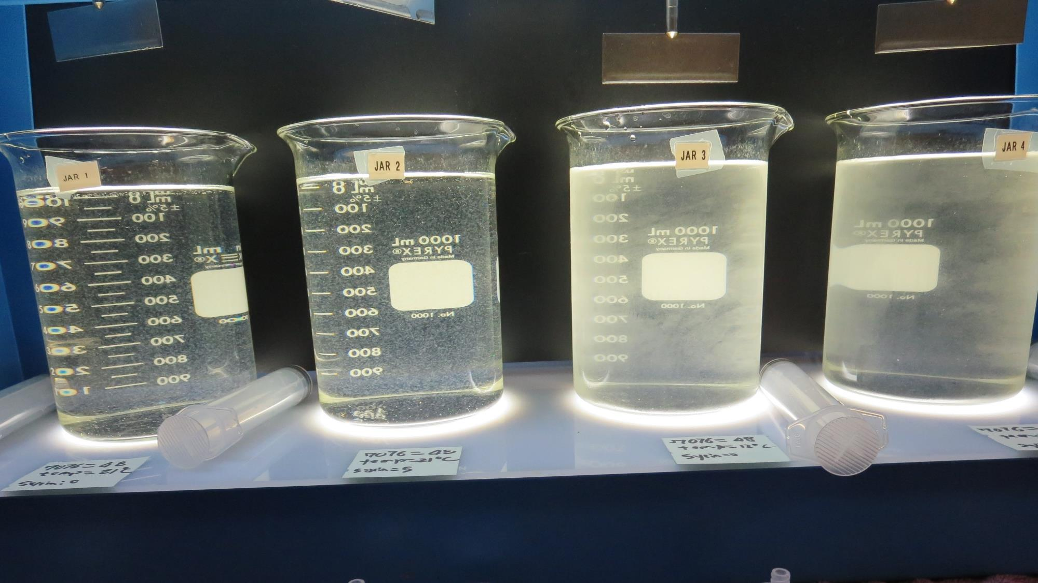
Jars 9-12: End of Floc Duration, 25 mL is syringed for filterability and %UVT/UVA. Jars 10 & 12 sampled after 5 minutes of settling.
48 mg/L 7066
Filtrate 0.18 NTU
UVT: 94.4%
UVA: 0.025/cm
Settled: 1.06 NTU
Temp: 21ºC
48 mg/L 7066
Filtrate 0.17 NTU
UVT: 94.6%
UVA: 0.024/cm
Settled: 1.19 NTU
Temp: 21ºC
48 mg/L 7066
Filtrate 0.20 NTU
UVT: 94.8%
UVA: 0.023/cm
Settled: 1.08 NTU
Temp: 12ºC
48 mg/L 7066
Filtrate 0.17 NTU
UVT: 95.3%
UVA: 0.021/cm
Settled: 0.88 NTU
Temp: 12ºC

Slide 22
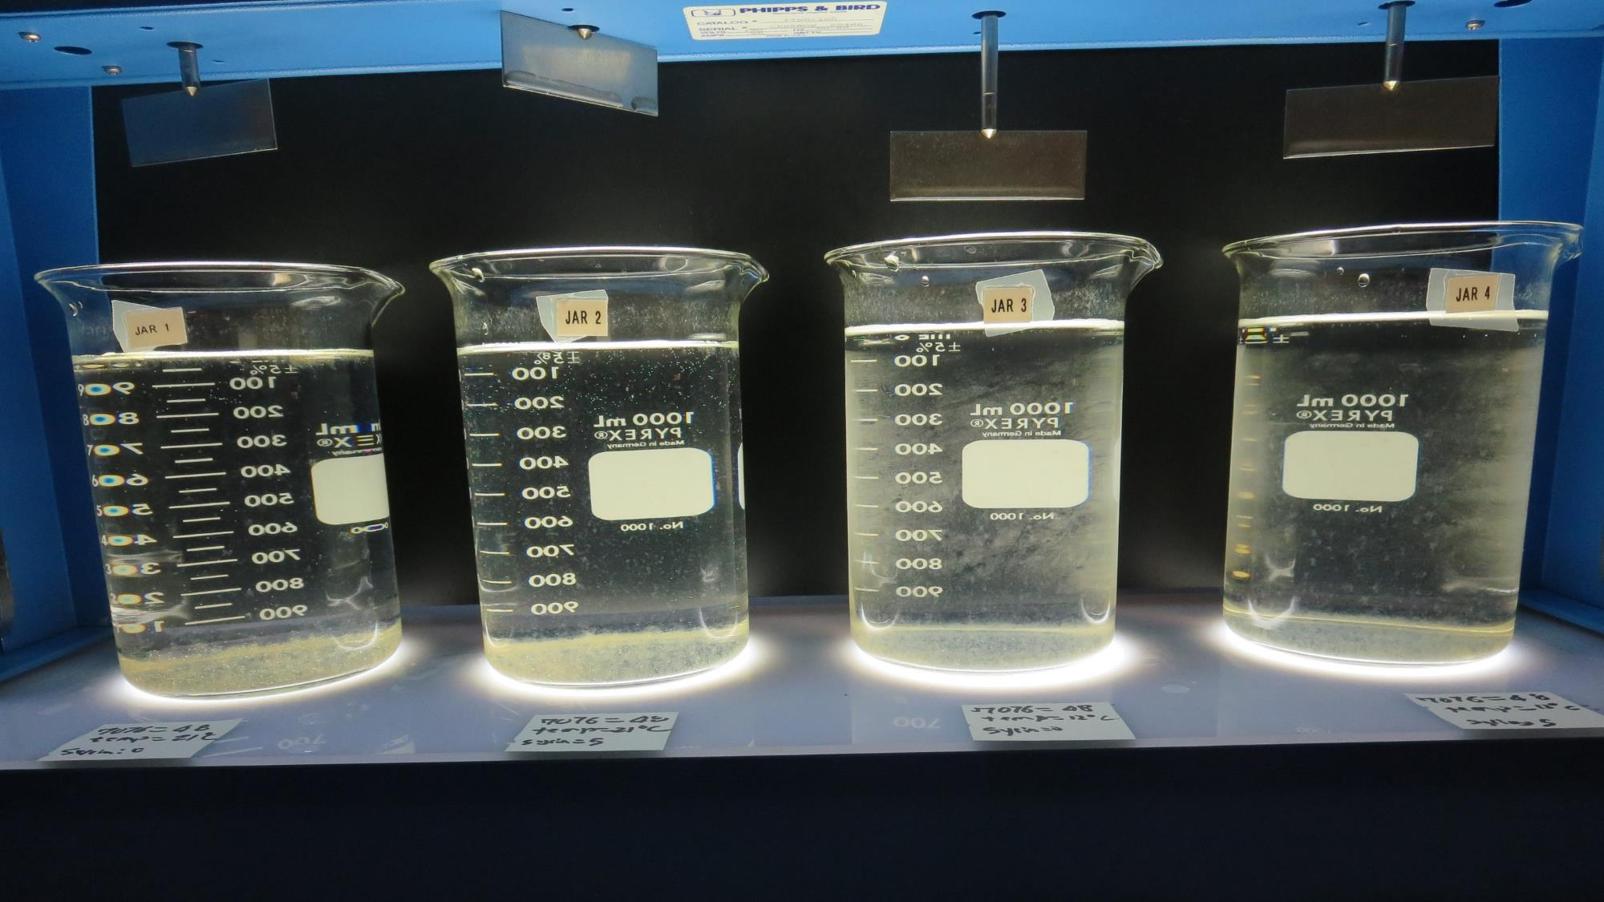
Jars 9-12: After 25-minutes of settling, settled water turbidity is taken.

Slide 23
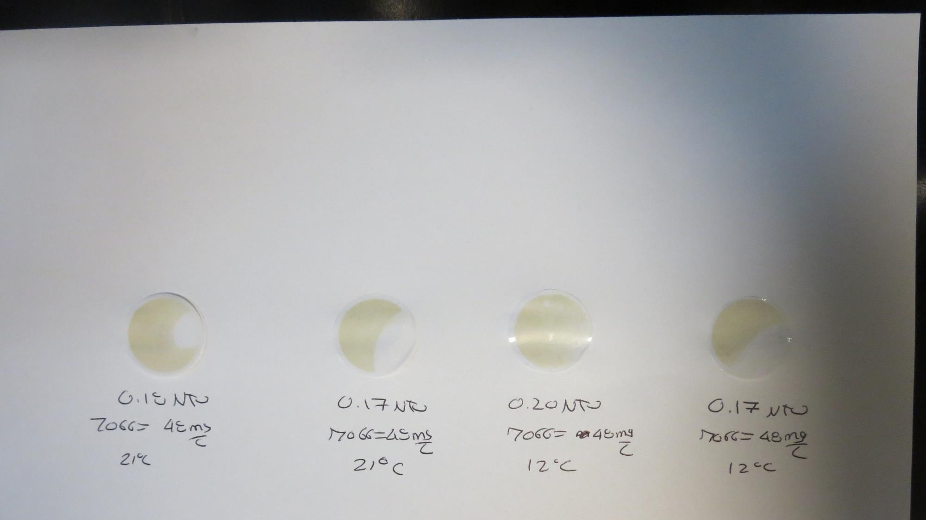
Visual of Filterability of Jars 9-12
48 mg/L 7066
Filtrate 0.18 NTU
UVT: 94.4%
UVA: 0.025/cm
Settled: 1.06 NTU
48 mg/L 7066
Filtrate 0.17 NTU
UVT: 94.6%
UVA: 0.024/cm
Settled: 1.19 NTU
48 mg/L 7066
Filtrate 0.20 NTU
UVT: 94.8%
UVA: 0.023/cm
Settled: 1.08 NTU
48 mg/L 7066
Filtrate 0.17 NTU
UVT: 95.3%
UVA: 0.021/cm
Settled: 0.88 NTU

Slide 24
Jars 13-16 Test Flash Mix 30 Sec (200 RPM) Floc Mix 5 min (30 RPM) 25 mL sampled end of Floc Applied Coagulant 7066

Slide 25
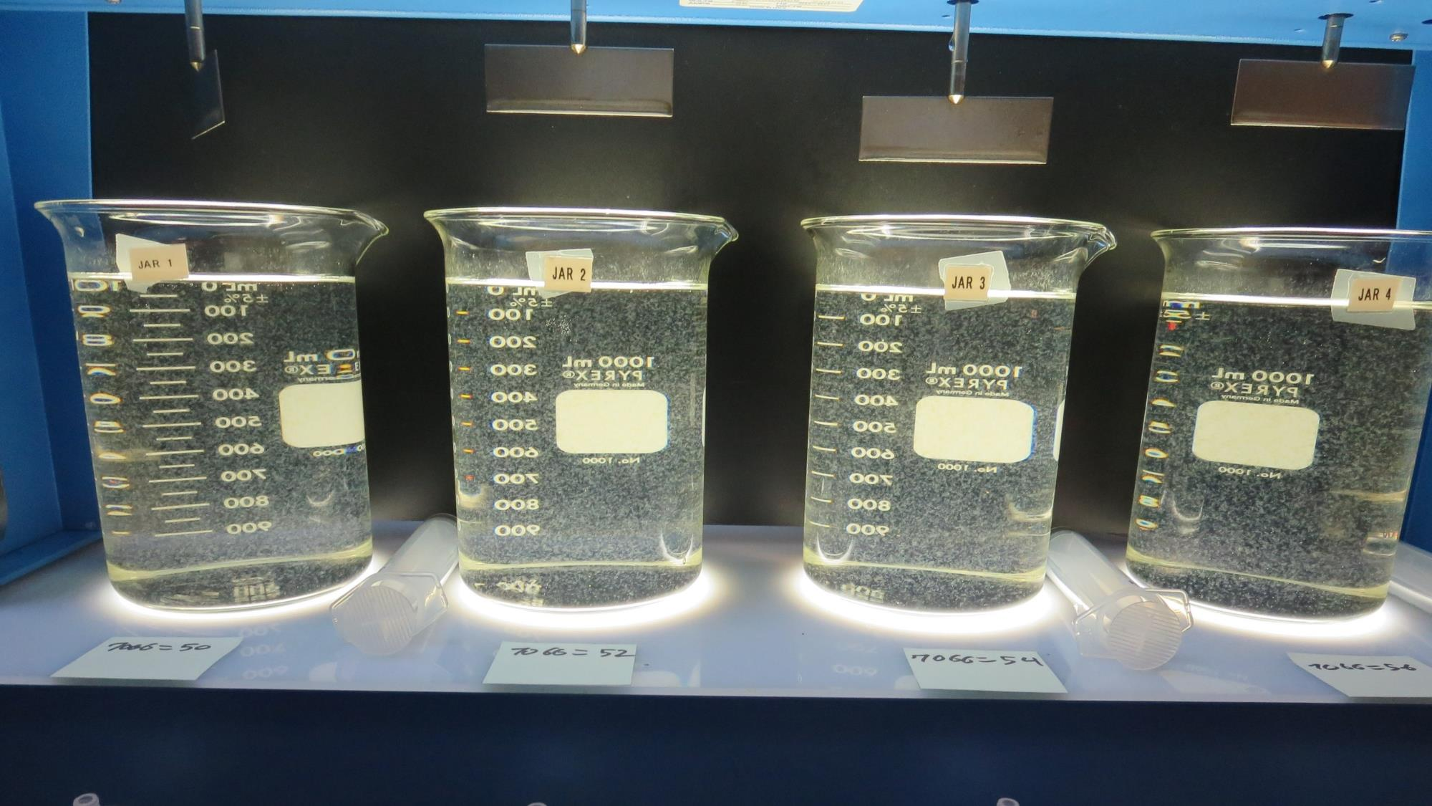
Jars 13-16: End of Floc Duration, 25 mL is syringed for filterability and %UVT/UVA.
50 mg/L 7066
Filtrate 0.09 NTU
UVT: 95.8%
UVA: 0.019/cm
Settled: 0.62 NTU
52 mg/L 7066
Filtrate 0.14 NTU
UVT: 95.2%
UVA: 0.021/cm
Settled: 0.78 NTU
54 mg/L 7066
Filtrate 0.06 NTU
UVT: 96.2%
UVA: 0.017/cm
Settled: 0.65 NTU
56 mg/L 7066
Filtrate 0.09 NTU
UVT: 96.1%
UVA: 0.017/cm
Settled: 0.68 NTU

Slide 26
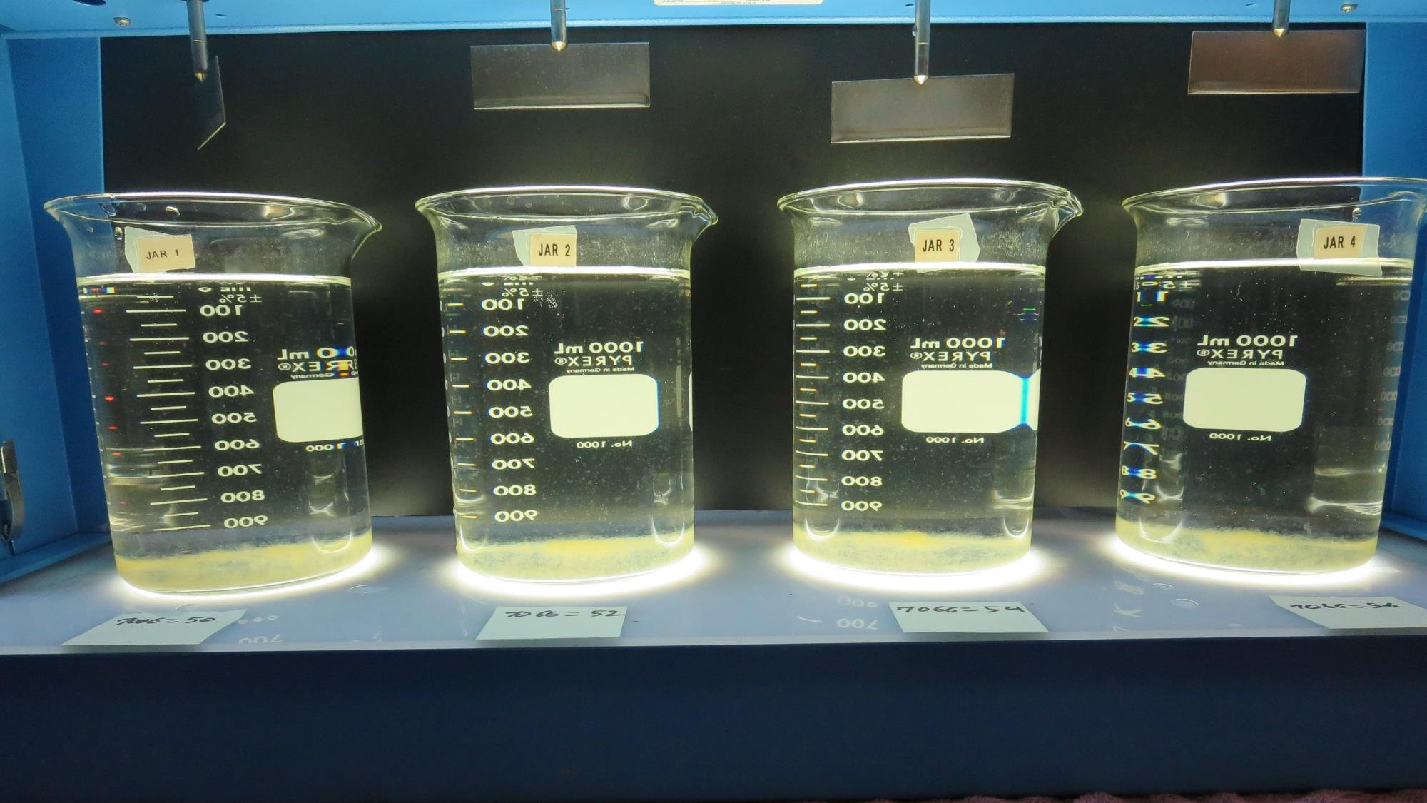
Jars 13-16: After 25-minutes of settling, settled water turbidity is taken.

Slide 27
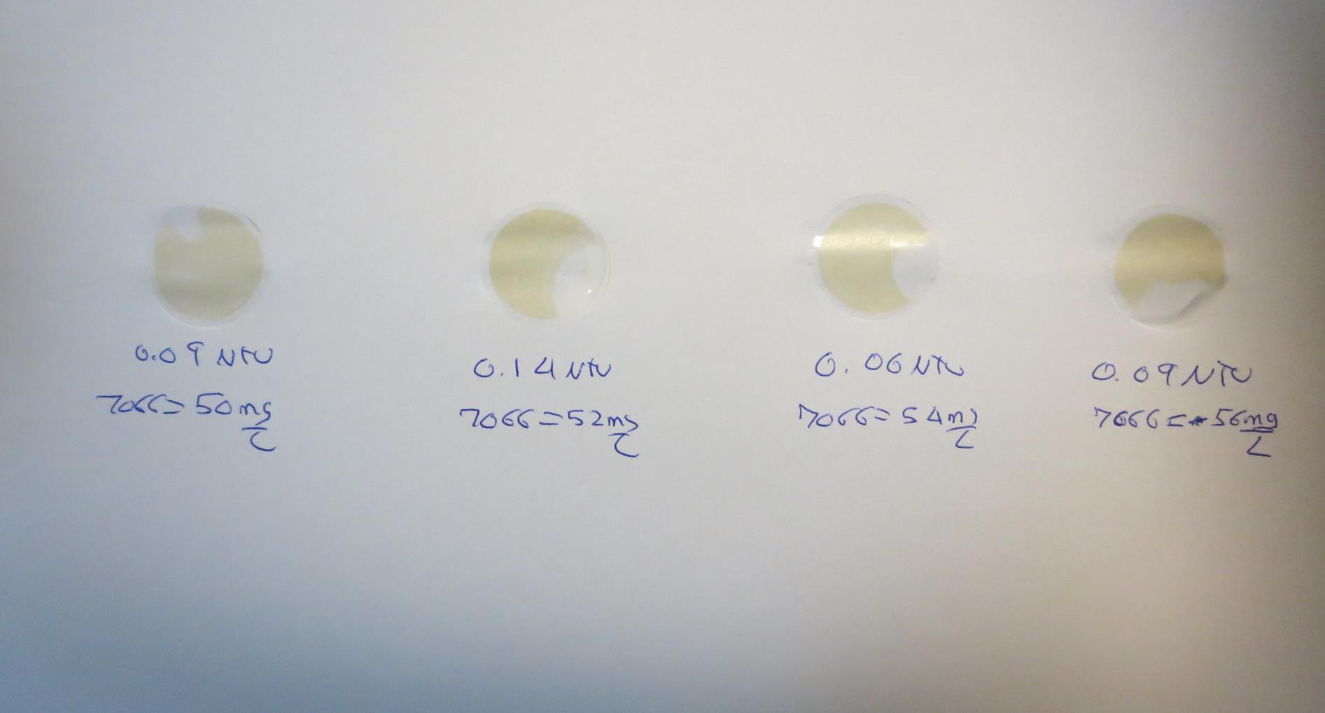
Visual of Filterability of Jars 13-16
50 mg/L 7066
Filtrate 0.09 NTU
UVT: 95.8%
UVA: 0.019/cm
Settled: 0.62 NTU
52 mg/L 7066
Filtrate 0.14 NTU
UVT: 95.2%
UVA: 0.021/cm
Settled: 0.78 NTU
54 mg/L 7066
Filtrate 0.06 NTU
UVT: 96.2%
UVA: 0.017/cm
Settled: 0.65 NTU
56 mg/L 7066
Filtrate 0.09 NTU
UVT: 96.1%
UVA: 0.017/cm
Settled: 0.68 NTU

Slide 28
Jars 17-20 Test Flash Mix 30 Sec (200 RPM) Floc Mix 5 min (30 RPM) 25 mL sampled end of Floc Applied Coagulant 9890

Slide 29
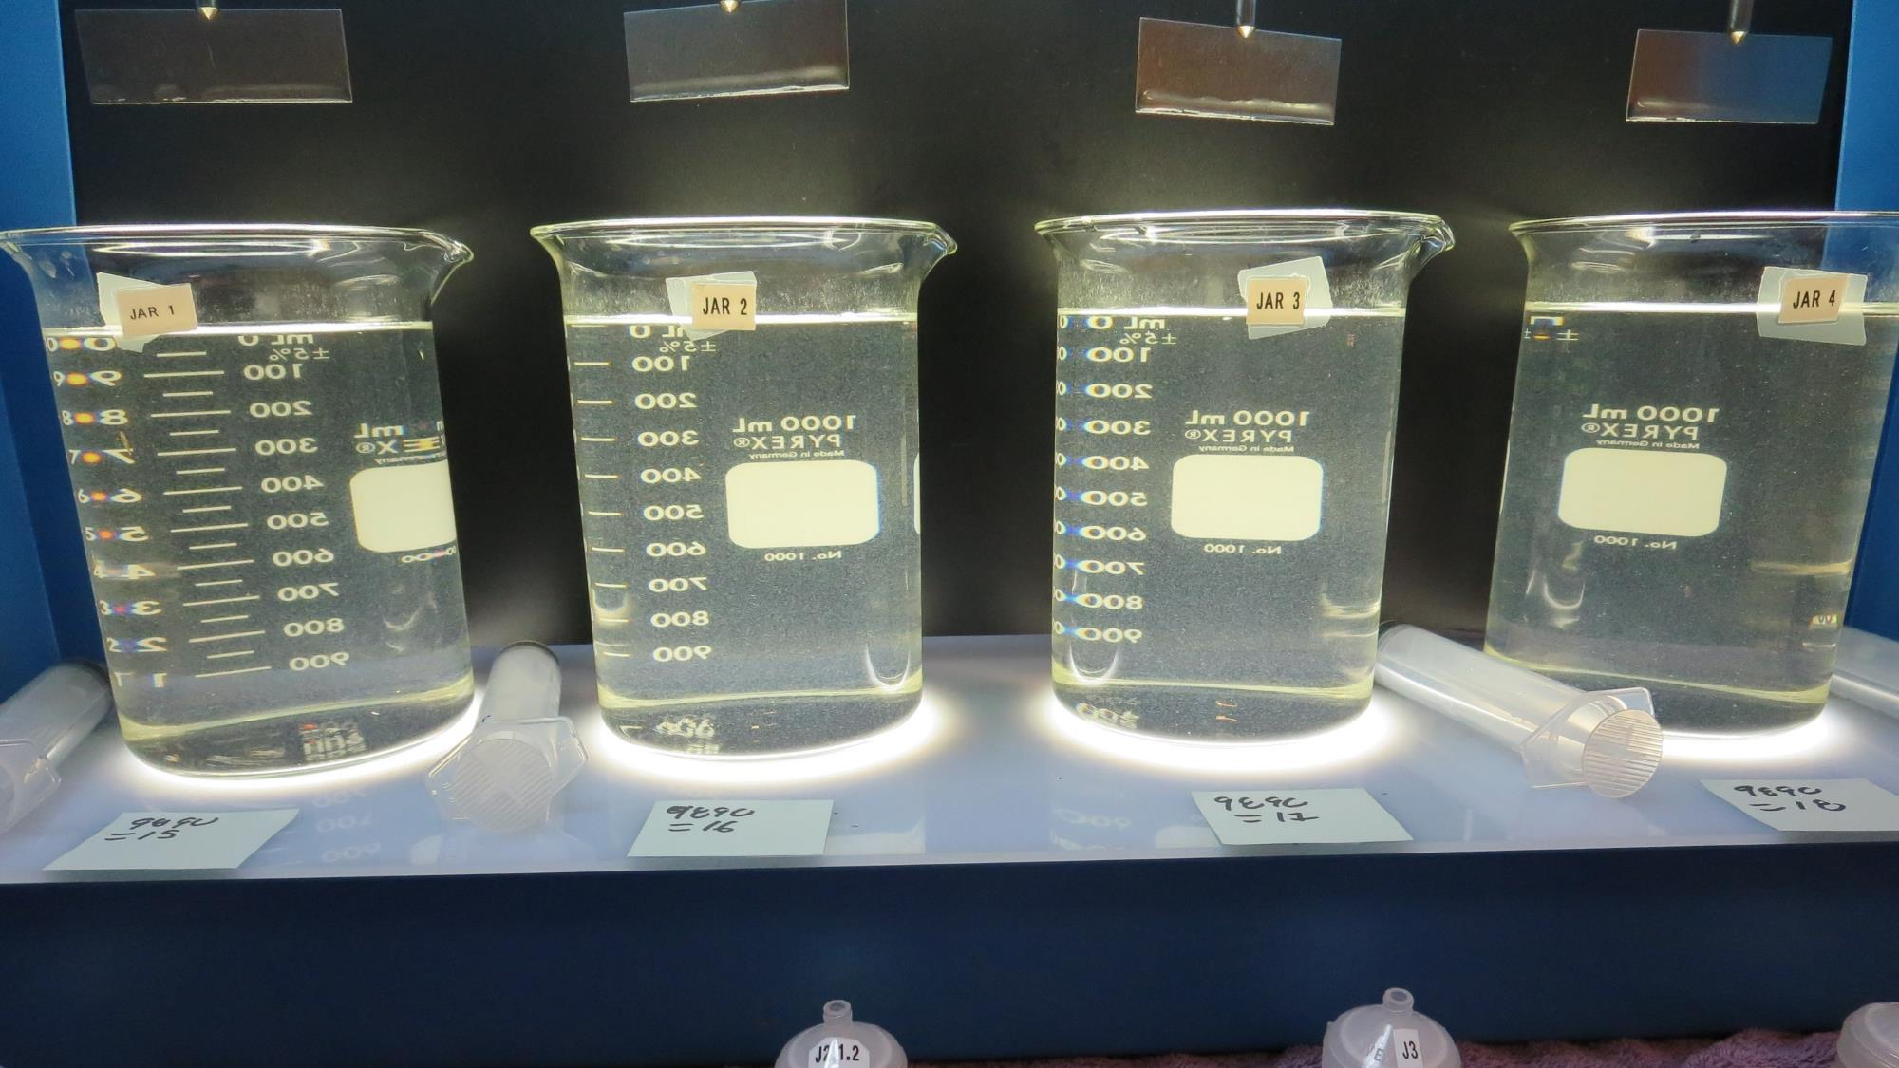
Jars 17-20: End of Floc Duration, 25 mL is syringed for filterability and %UVT/UVA.
15 mg/L 9890
Filtrate 0.11 NTU
UVT: 94.0%
UVA: 0.027/cm
Settled: 2.41 NTU
16 mg/L 9890
Filtrate 0.29 NTU
UVT: 92.5%
UVA: 0.034/cm
Settled: 2.40 NTU
17 mg/L 9890
Filtrate 0.08 NTU
UVT: 95.2%
UVA: 0.021/cm
Settled: 2.49 NTU
18 mg/L 9890
Filtrate 0.15 NTU
UVT: 95.2%
UVA: 0.022/cm
Settled: 2.66 NTU

Slide 30
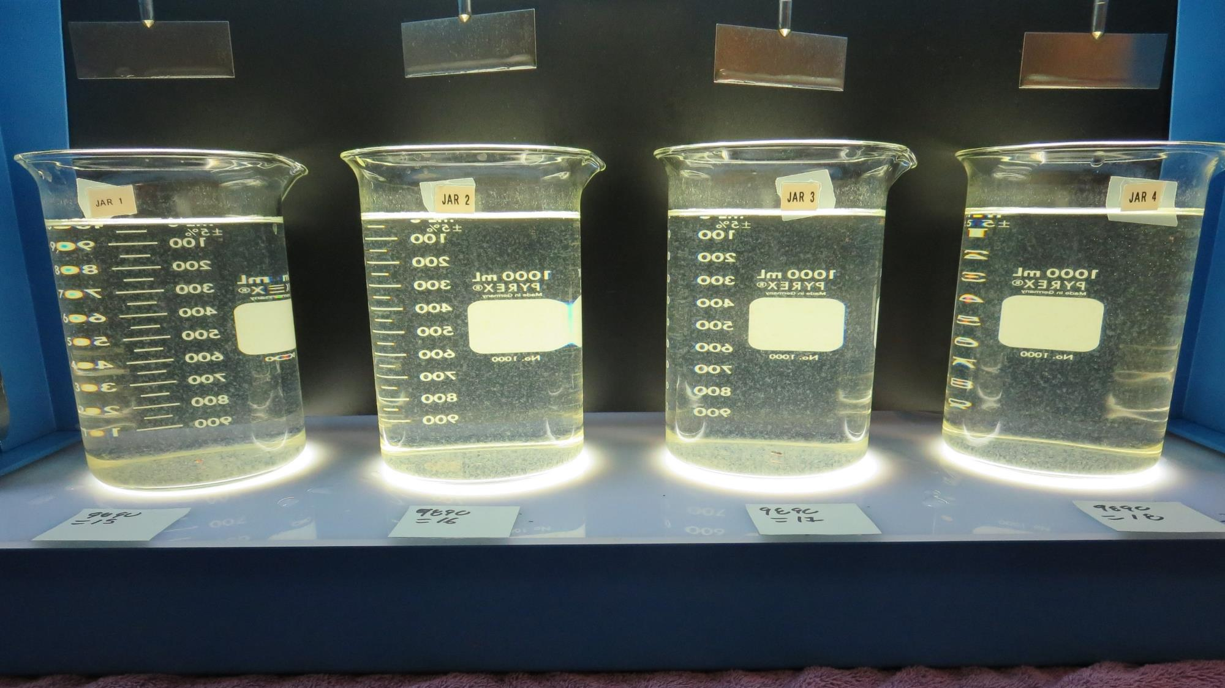
Jars 17-20: After 25-minutes of settling, settled water turbidity is taken.

Slide 31
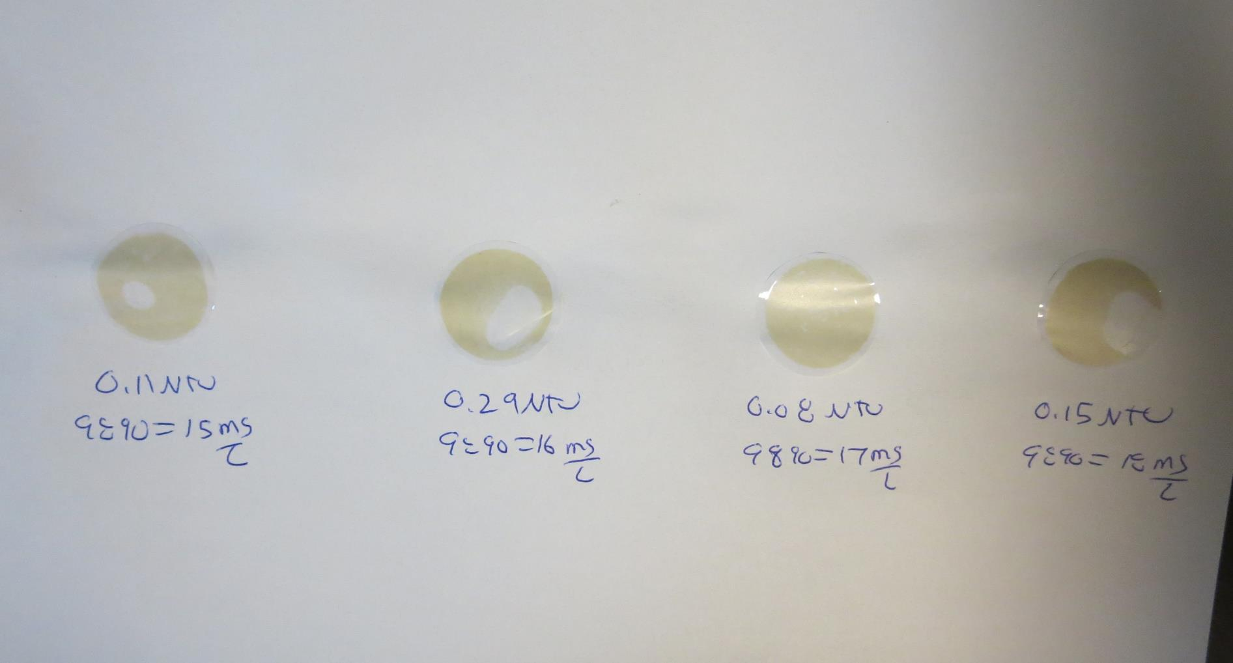
Visual of Filterability of Jars 17-20
15 mg/L 9890
Filtrate 0.11 NTU
UVT: 94.0%
UVA: 0.027/cm
Settled: 2.41 NTU
16 mg/L 9890
Filtrate 0.29 NTU
UVT: 92.5%
UVA: 0.034/cm
Settled: 2.40 NTU
17 mg/L 9890
Filtrate 0.08 NTU
UVT: 95.2%
UVA: 0.021/cm
Settled: 2.49 NTU
18 mg/L 9890
Filtrate 0.15 NTU
UVT: 95.2%
UVA: 0.022/cm
Settled: 2.66 NTU

Slide 32
Jars 21-24 Test Flash Mix 30 Sec (200 RPM) Floc Mix 5 min (30 RPM) 25 mL sampled end of Floc Applied Coagulant 7066

Slide 33
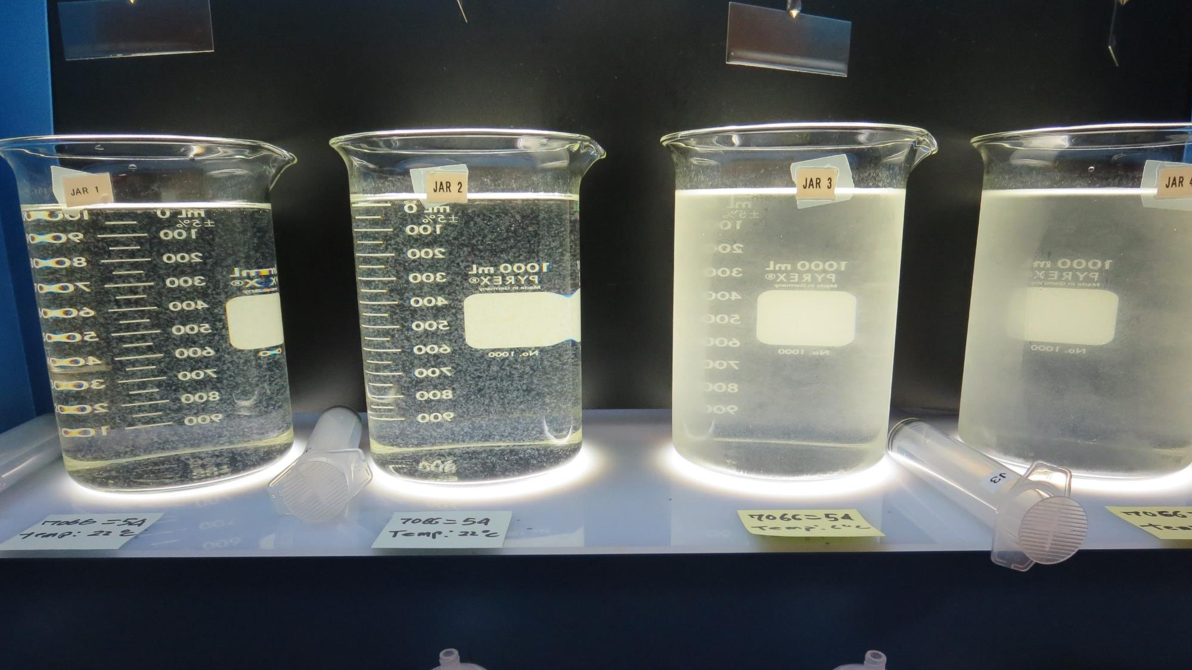
Jars 21-24: End of Floc Duration, 25 mL is syringed for filterability and %UVT/UVA.
54 mg/L 7066
Filtrate 0.06 NTU
UVT: 96.8%
UVA: 0.014/cm
Settled: 0.65 NTU
Temp: 22ºC
54 mg/L 7066
Filtrate 0.09 NTU
UVT: 96.2%
UVA: 0.017/cm
Settled: 0.61 NTU
Temp: 22ºC
54 mg/L 7066
Filtrate 0.08 NTU
UVT: 97.2%
UVA: 0.012/cm
Settled: 1.12 NTU
Temp: 6ºC
54 mg/L 7066
Filtrate 0.11 NTU
UVT: 96.7%
UVA: 0.015/cm
Settled: 0.98NTU
Temp: 6ºC

Slide 34
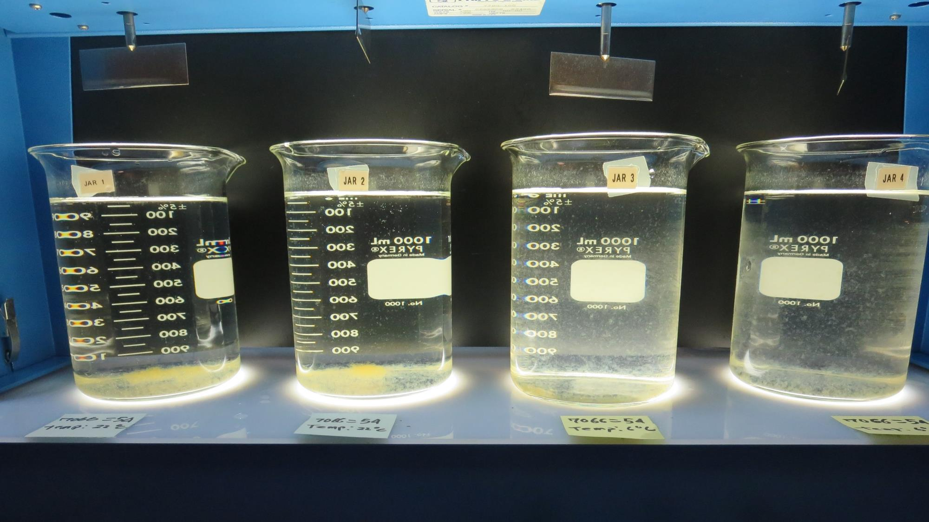
Jars 21-24: After 25-minutes of settling, settled water turbidity is taken.

Slide 35
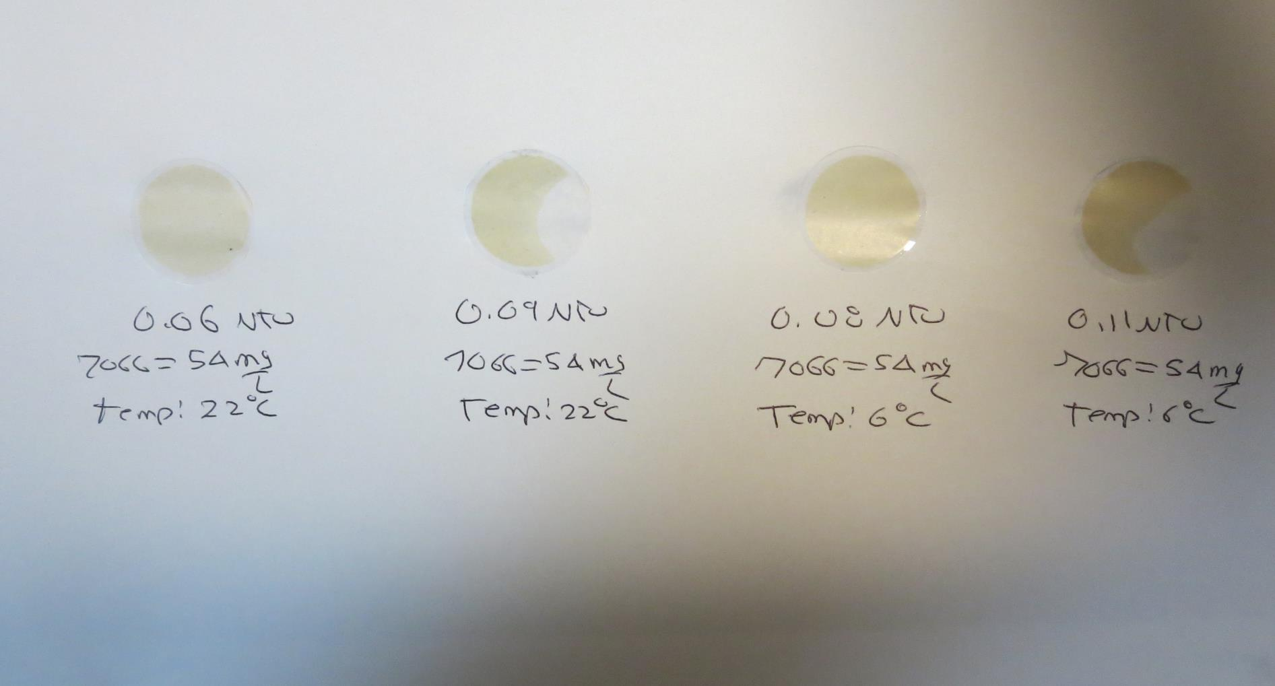
Visual of Filterability of Jars 21-24
54 mg/L 7066
Filtrate 0.06 NTU
UVT: 96.8%
UVA: 0.014/cm
Settled: 0.65 NTU
Temp: 22ºC
54 mg/L 7066
Filtrate 0.09 NTU
UVT: 96.2%
UVA: 0.017/cm
Settled: 0.61 NTU
Temp: 22ºC
54 mg/L 7066
Filtrate 0.08 NTU
UVT: 97.2%
UVA: 0.012/cm
Settled: 1.12 NTU
Temp: 6ºC
54 mg/L 7066
Filtrate 0.11 NTU
UVT: 96.7%
UVA: 0.015/cm
Settled: 0.98NTU
Temp: 6ºC

Slide 36
Jars 25-28 Test Flash Mix 30 Sec (200 RPM) and No Flash Mix (Jars 25 & 26) Floc Mix 5 min (30 RPM) 25 mL sampled end of Floc Applied Coagulant 7066

Slide 37
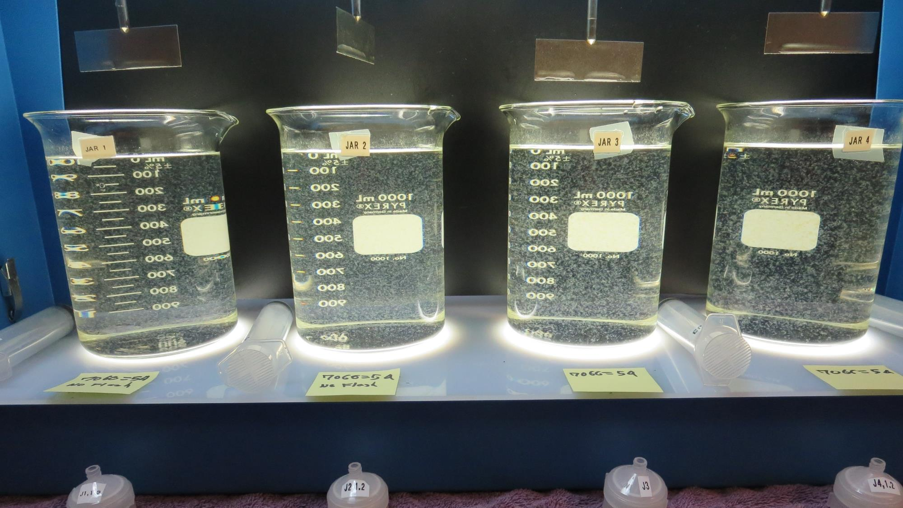
Jars 25-28: End of Floc Duration, 25 mL is syringed for filterability and %UVT/UVA.
54 mg/L 7066
Filtrate 0.09 NTU
UVT: 95.5%
UVA: 0.020/cm
Settled: 0.84 NTU
No Flash Mixing
54 mg/L 7066
Filtrate 0.09 NTU
UVT: 95.4%
UVA: 0.020/cm
Settled: 0.90 NTU
No Flash Mixing
54 mg/L 7066
Filtrate 0.08 NTU
UVT: 95.8%
UVA: 0.019/cm
Settled: 0.53 NTU
W/Flash Mixing
54 mg/L 7066
Filtrate 0.07 NTU
UVT: 95.9%
UVA: 0.018/cm
Settled: 0.63 NTU
W/Flash Mixing

Slide 38
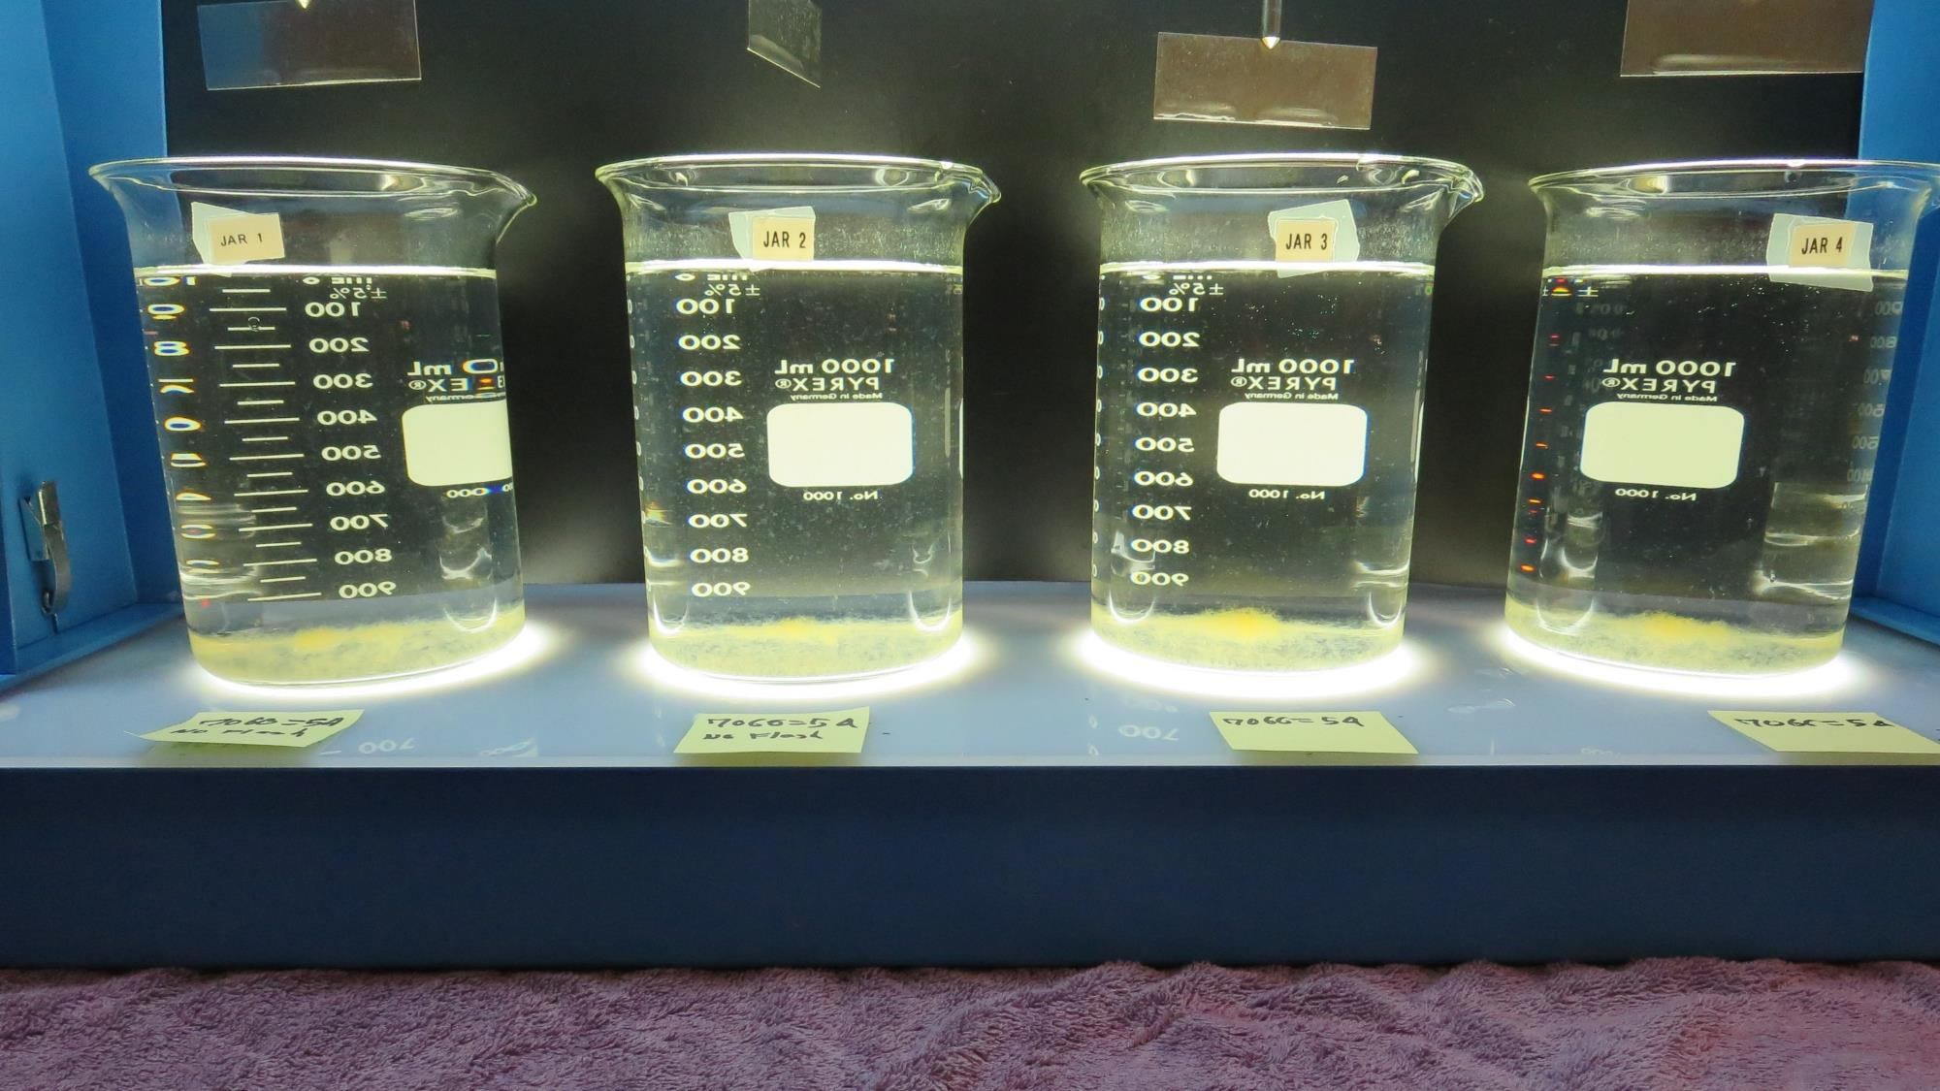
Jars 25-28: After 25-minutes of settling, settled water turbidity is taken.

Slide 39
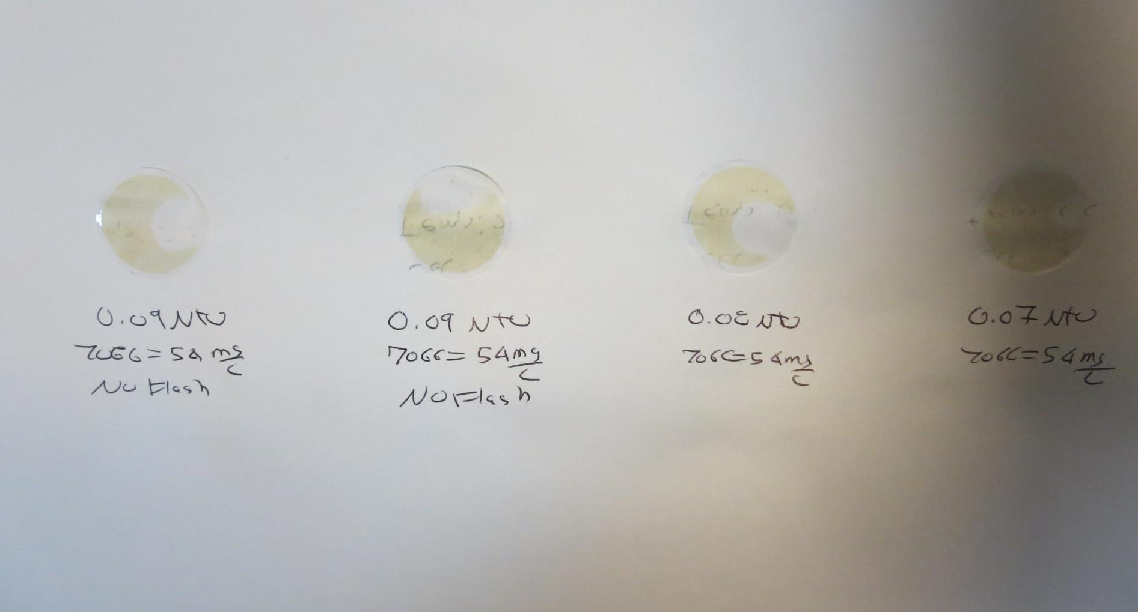
Visual of Filterability of Jars 25-28
54 mg/L 7066
Filtrate 0.09 NTU
UVT: 95.5%
UVA: 0.020/cm
Settled: 0.84 NTU
No Flash Mixing
54 mg/L 7066
Filtrate 0.09 NTU
UVT: 95.4%
UVA: 0.020/cm
Settled: 0.90 NTU
No Flash Mixing
54 mg/L 7066
Filtrate 0.08 NTU
UVT: 95.8%
UVA: 0.019/cm
Settled: 0.53 NTU
W/Flash Mixing
54 mg/L 7066
Filtrate 0.07 NTU
UVT: 95.9%
UVA: 0.018/cm
Settled: 0.63 NTU
W/Flash Mixing

Slide 40
Jar Testing for 1-Liter Jars: Procedures for Most Treatment Plants
Fill jars with source water prior to coagulant injection and set paddle speed at 30 rpm
Add chemicals (i.e., NaOCl, primary coagulant, coagulant aid) to each jar
Flash mix for 15-60 seconds (200 rpm)
Slow mix for 5 minutes (20-30 rpm)
Settled for 5 minutes. Syringe 25 mL from each jar taken 1-inch below surface (25 mL/12 sec rate). For this study, sample was taken immediately at the end of flocculation process.
Filtered through 1.2 um isopore membrane into cuvette drip rate, 15 mL/(50-90 sec)
Measure filtrate turbidity, chlorine residual and %UVT/UVA
Measure settled water turbidity after 25 minutes of total setting
Record all data

Slide 41
Jar Test Filterability Test Equipment
Turbidity Instrument
Syringe w/Luer-Lock Tip, 30 cc
(part#: 2225800, by Hach)
Swinnex Filter Holder, 25 mm (part#: SX0002500)
Isopore Membrane Filter, 1.2 um absolute
pore size,
Φ= 25 mm , thickness: 24 um,
hydrophilic polycarbonate membrane
(part #: RTTP02500)
Go to Sigma-Aldrich for laboratory supplies http://www.sigmaaldrich.com/united-states.html

Slide 42
Isopore Membrane Information
Categories | Information
trade name | Isopore
filter color | White
chemistry | Polycarbonate (PC)
water flow rate | Avg. 175 mL/min x cm² (typical results @ 10 psi)
media | Isopore®
wettability | Hydrophilic
porosity | 14.7%
pore size | 1.2 µm
bubble point at 23 °C | 1.0 bar, air with water
thickness | 24 µm
filter diameter (ø) | 25 mm
material size | polycarbonate, Hydrophilic, 1.2 µm, 25 mm, white, plain, 100

Slide 43
Isopore Membrane Background Information
The Isopore membrane is a polycarbonate, track-etched screen filter recommended for all analyses in which the sample is viewed on the surface of the membrane. The Isopore membrane is composed of polycarbonate film, which has a smooth, glass-like surface for clearer sample observation. The unique manufacturing process of the membrane ensures a precise pore diameter and a consistent pore size for accurate separation of samples by size. Matched-weight filters are not usually required because of low, constant tar and ash weights. Features & Benefits: Membrane structure retains particles on the surface, simplifying counting and analysis

Slide 44
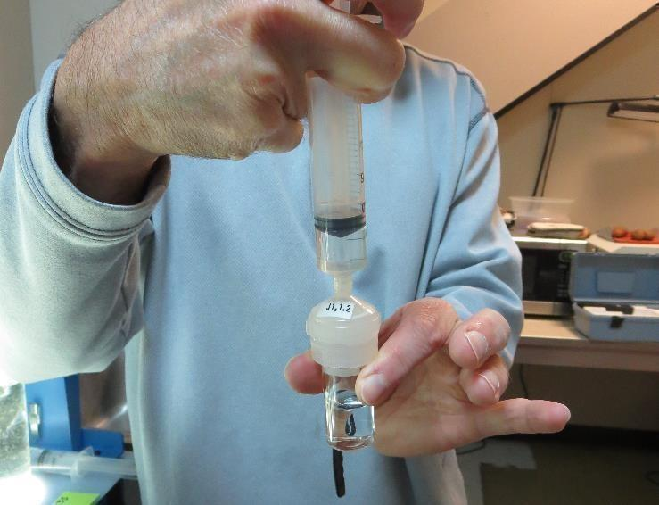
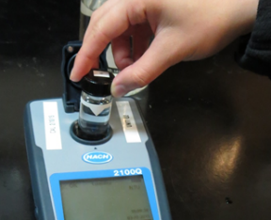
Jar Test - Filterability Test
Syringe ~ 25 mL from jar (after 5-minutes of settling)
Filter-to-waste 3-5 mL
Filter directly into clean cuvette
Measure turbidity
Note: Take several readings before recording final NTU results. Micro bubbles can adhere to glass causing false NTU readings. To remove bubbles, tilt cuvette up to 90 degrees.

Slide 45
Contact
Guy Schott, P.E.
State Water Resources Control Board
Division of Drinking Water
Santa Rosa, CA
Go to Stock Solution/Dose calculations/Jar Test Results for tools to download
www.waterboards.ca.gov/drinking_water/programs/districts/mendocino_district.html
Email: Guy Schott - Guy.Schott@waterboards.ca.gov
Office Number: 707-576-2732

