Slide 1
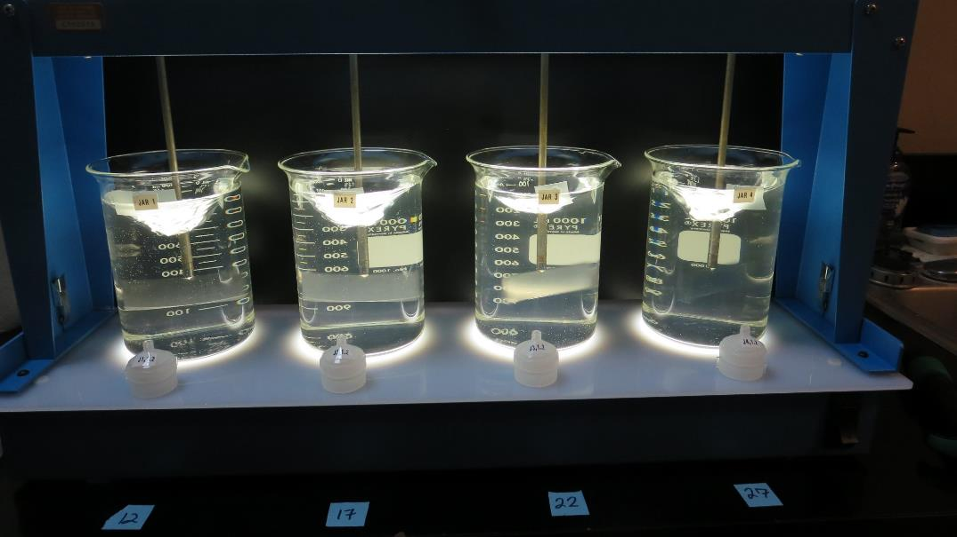
Surfwood MWC
CA2300590
Mendocino County
Jar Test
by Guy Schott, P.E
October 20, 2018

Slide 2
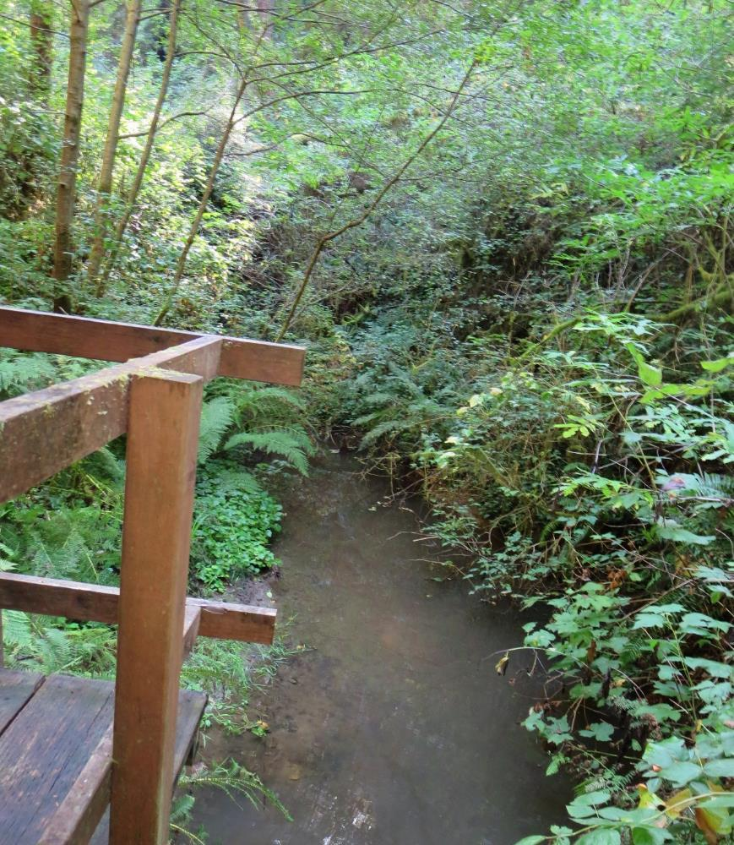
Source Water: Jack Peter’s Creek
Roughing Filter followed by Multi-Media Filtration
Source Water Characteristics
Turbidity: 1.24 NTU
pH: 7.3
Particles > 2.0 um: 2,096/mL
pH: 7.3
UVT: 72.2%
UVA: 0.141
Treated Water Train 1
Filter 1: 0.05 NTU
Particles > 2.0 um: 2/mL
UVT: 88.9%
UVA: 0.051/cm

Slide 3
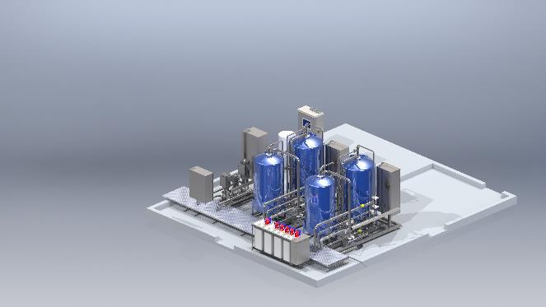
Treatment Trains: Roughing Filter followed by Multi-Media Filtration

Slide 4
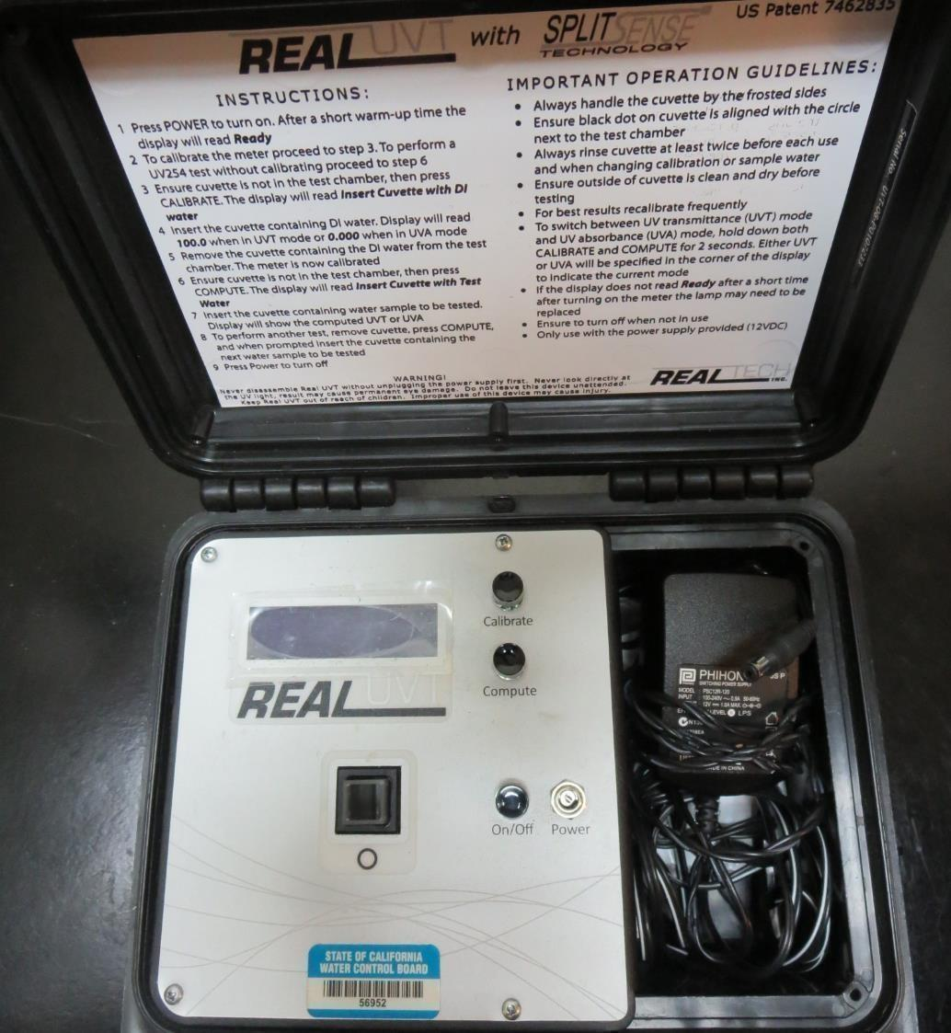
UVT/UVA
UV transmittance (UVT) is a measurement of the amount of ultraviolet light (commonly at 254 nm due to its germicidal effect) that passes through a water sample compared to the amount of light that passes through a pure water sample. The measurement is expressed as a percentage, % UVT.
%UVT = 10^{(-UVA)} x 100%
UV absorbance (UVA) is calculated as a relative measure of the amount of light absorbed by a water sample compared with the amount of light absorbed by a pure water sample.
UVA = -log(%UVT/100)

Slide 5
Coagulant Used for Jar Testing
Pro Pac 9800 (NTU Technologies)
50% Aluminum Chlorohydrate
50% Water
SG = 1.25-1.34
Pro Pac 9890 (NTU Technologies)
35-45% Aluminum Chlorohydrate
35-45% Water
20% Proprietary
SG = 1.25-1.34
Carillon C-308 Polymer
(PolyDADMAC)
Low molecular weight, homopolymer of diallyldimethylammonium chloride
% Active 19-21%
SG = 1.03 – 1.05

Slide 6
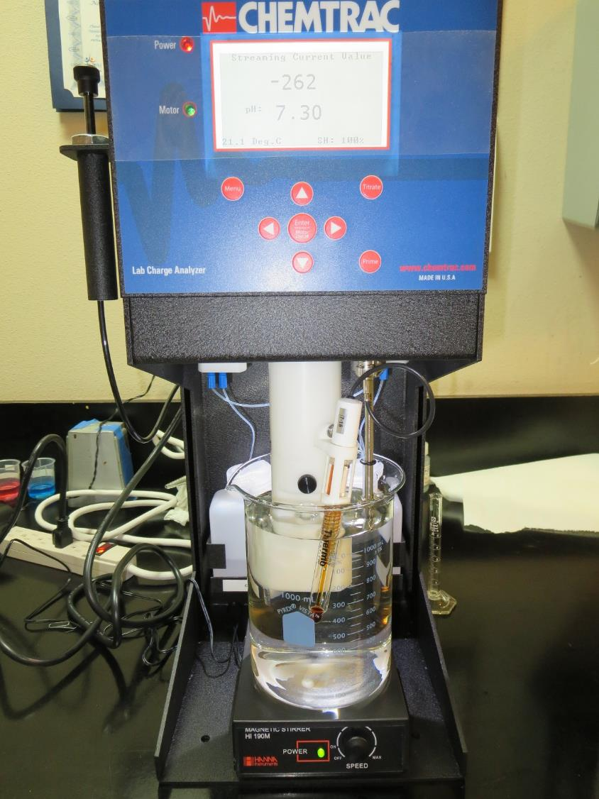
Laboratory Charge Analyzer
LCA: Used to determine coagulant demand of a source water entering the treatment plant.
Source pH: 7.30
LCA #1:
9800: 22 mg/L as product

Slide 7
Coagulant Information
Unless stated otherwise, all coagulant doses are reported as Product (100% strength).
Preparation of coagulant stock solutions are generally 1.0 or 0.1 percent strength using 100 and/or 200 mL volumetric flasks.
Finnpipette F2 variable volume pipette, capacity 100-1000 micro liters is used for stock solution preparation and coagulant aid jar test dosing.
Finnpipette F2 variable volume pipette, capacity 0.5-5 mL is used for primary coagulant jar test dosing.

Slide 8
Surfwood MWC: Jar Test 1-8 Results
Jar # | 200 RPM Flash Mix Seconds | 30 RPM Floc Mix minutes | 9800 mg/L | 9890 mg/L | Filtrate NTU | Filtrate %UVT | Filtrate UVA/cm | Water Temp. ºC
J1 | 60 | 5 | 22 | 6 | 0.05 | 97.5 | 0.011 | 13
J2 | 60 | 5 | 32 | 0 | 0.07 | 97.5 | 0.011 | 13
J3 | 60 | 5 | 27 | 4.05 | 0.06 | 97.4 | 0.011 | 13
J4 | 60 | 5 | 27 | 4.05 | 0.04 | 97.2 | 0.012 | 21
J5 | 60 | 5 | 32 | 0 | 0.06 | 97.1 | 0.013 | 21
J6 | 60 | 5 | 27 | 4.05 | 0.05 | 96.9 | 0.014 | 21
J7 | 60 | 5 | 22 | 3.3 | 0.07 | 96.6 | 0.015 | 21
J8 | 60 | 5 | 32 | 4.8 | 0.19 | 96.1 | 0.017 | 21

Slide 9
Surfwood MWC: Jar Test 9-16 Results
Flash Mix 60 sec (200 RPM)
Jar # | 30 RPM Floc Mix minutes | Clarifloc mg/L | 9800 mg/L | 9890 mg/L | Filtrate NTU | Filtrate %UVT | Filtrate UVA/cm | Water Temp. ºC
J9 | 5 | 0 | 27 | 0 | 0.14 | 95.9 | 0.018 | 21
J10 | 5 | 0 | 37 | 0 | 0.19 | 95.9 | 0.018 | 21
J11 | 5 | 7 | 1 | 0 | 0.13 | 95.9 | 0.018 | 21
J12 | 5 | 0 | 31 | 0 | 0.16 | 95.7 | 0.019 | 21
J13 | 5 | 0 | 27 | 0 | 0.19 | 95.4 | 0.020 | 21
J14 | 5 | 0 | 15 | 15 | 0.23 | 95.6 | 0.020 | 21
J15 | 5 | 0 | 22 | 0 | 0.2 | 94.3 | 0.025 | 21
J16 | 5 | 0 | 22 | 0 | 0.25 | 94 | 0.027 | 21

Slide 10
Surfwood MWC: Jar Test 17-24 Results
Flash Mix 60 sec (200 RPM)
Jar # | 30 RPM Floc Mix minutes | Clarifloc mg/L | 9800 mg/L | 9890 mg/L | Filtrate NTU | Filtrate %UVT | Filtrate UVA/cm | Water Temp. ºC
J17 | 5 | 0 | 17 | 2.55 | 0.45 | 90.5 | 0.043 | 21
J18 | 5 | 0 | 17 | 0 | 0.41 | 89.8 | 0.047 | 21
J19 | 5 | 10 | 2 | 0 | 0.23 | 88.3 | 0.054 | 21
J20 | 5 | 0 | 12 | 0 | 0.7 | 83.2 | 0.08 | 21
J21 | 5 | 7 | 2 | 0 | 0.67 | 82.4 | 0.084 | 21
J22 | 5 | 7 | 1 | 0 | 0.70 | 82.0 | 0.086 | 21
J23 | 5 | 0 | 0 | 8 | 0.9 | 78.0 | 0.108 | 21
J24 | 5 | 5 | 1 | 0 | 1.0 | 77.7 | 0.110 | 21

Slide 11
Surfwood MWC: Jar Test 25-27 Results
Flash Mix 60 sec (200 RPM)
Jar # | 200 RPM Flash Mix seconds | 30 RPM Floc Mix minutes | Clarifloc mg/L | 9800 mg/L | Filtrate NTU | Filtrate %UVT | Filtrate UVA/cm | Water Temp. ºC
J25 | 60 | 5 | 4 | 1 | 0.78 | 76.6 | 0.116 | 21
J26 | 60 | 5 | 3 | 1 | 0.9 | 73.4 | 0.134 | 21
J27 | 60 | 5 | 6 | 1 | 0.62 | n/a | n/a | 21

Slide 12
Jars 1-4 Test
Flash Mix 60 Sec (200 RPM)
Floc Mix 5 min (30 RPM)
Water Temperature 21ºC
Applied Coagulant
9800

Slide 13
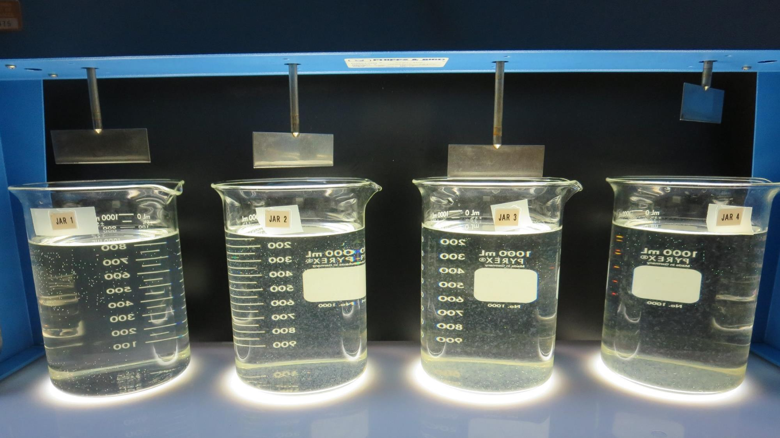
Jars 1-4: After 5 min of settling, 25 mL is syringed for filterability and %UVT/UVA.
12 mg/L 9800
Filtrate 0.70 NTU
UVT: 83.2%
UVA: 0.080/cm
17 mg/L 9800
Filtrate 0.41 NTU
UVT: 89.8%
UVA: 0.047/cm
22 mg/L 9800
Filtrate 0.20 NTU
UVT: 94.3%
UVA: 0.025/cm
27 mg/L 9800
Filtrate 0.14 NTU
UVT: 95.9%
UVA: 0.018/cm

Slide 14
Jars 5-8 Test
Flash Mix 60 Sec (200 RPM)
Floc Mix 5 min (30 RPM)
Water Temperature 21ºC
Applied Coagulant
9800

Slide 15
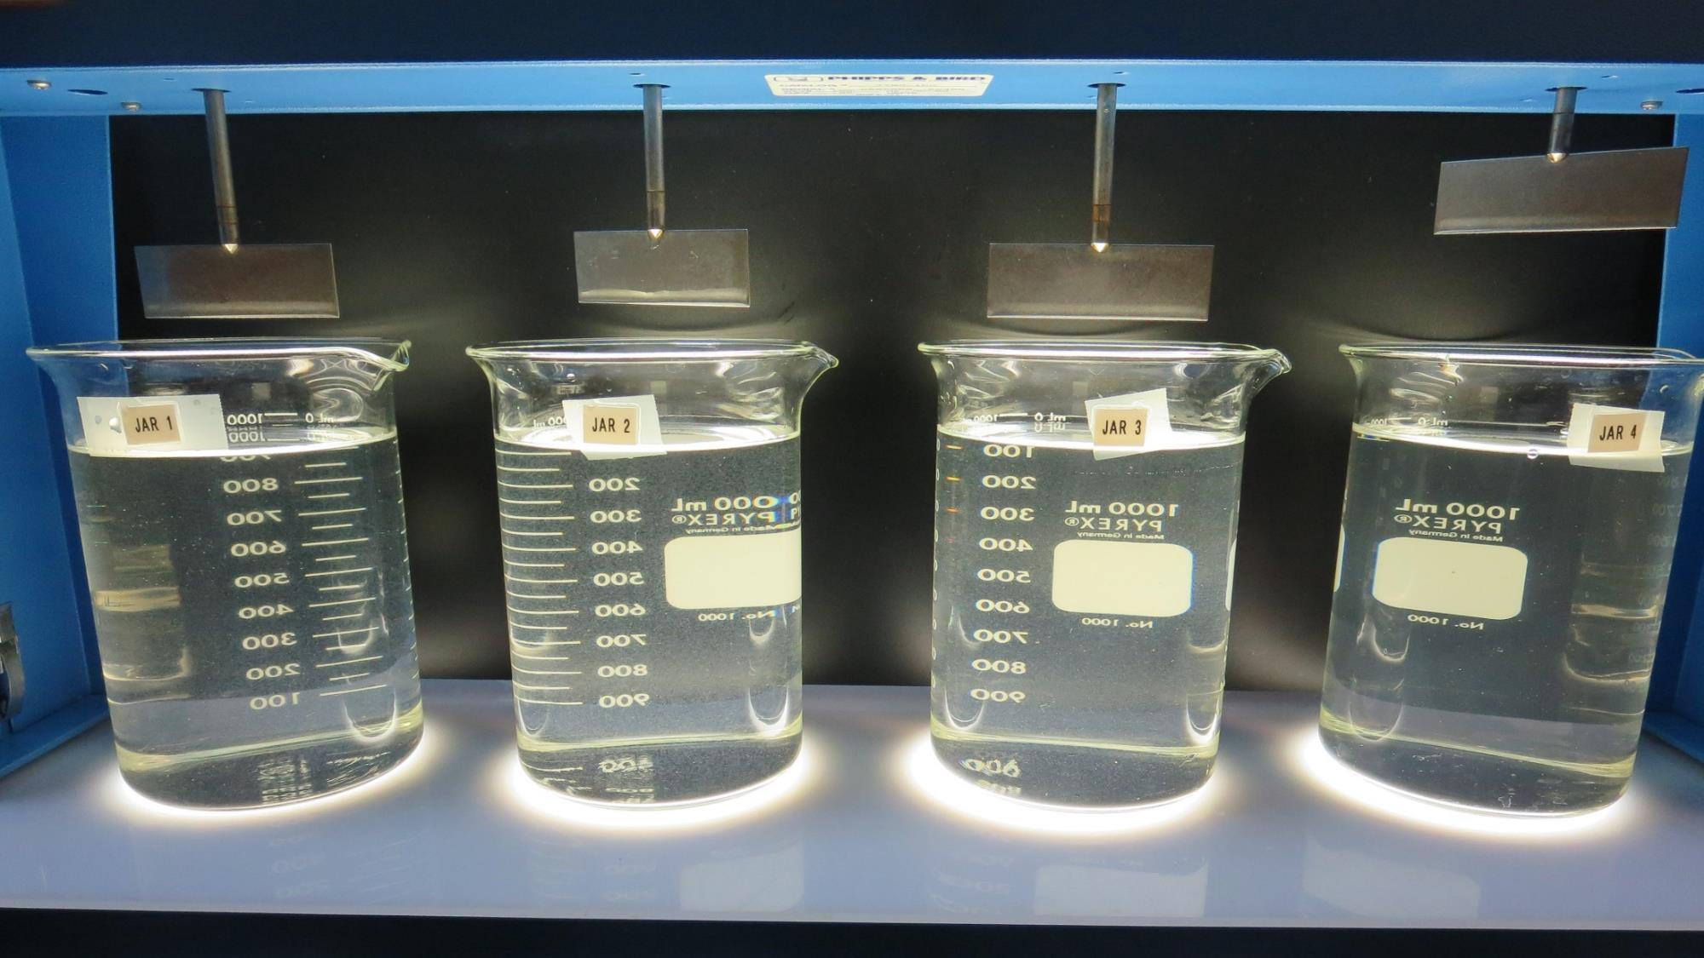
Jars 5-8: After 5 min of settling, 25 mL is syringed for filterability and %UVT/UVA.
22 mg/L 9800
Filtrate 0.25 NTU
UVT: 94%
UVA: 0.027/cm
27 mg/L 9800
Filtrate 0.19 NTU
UVT: 95.4%
UVA: 0.020/cm
32 mg/L 9800
Filtrate 0.06 NTU
UVT: 97.1%
UVA: 0.013/cm
37 mg/L 9800
Filtrate 0.19 NTU
UVT: 95.9%
UVA: 0.018/cm

Slide 16
Jars 9-12 Test
Flash Mix 60 Sec (200 RPM)
Floc Mix 5 min (30 RPM)
Water Temperature 21ºC
Applied Coagulants
9800/9890

Slide 17
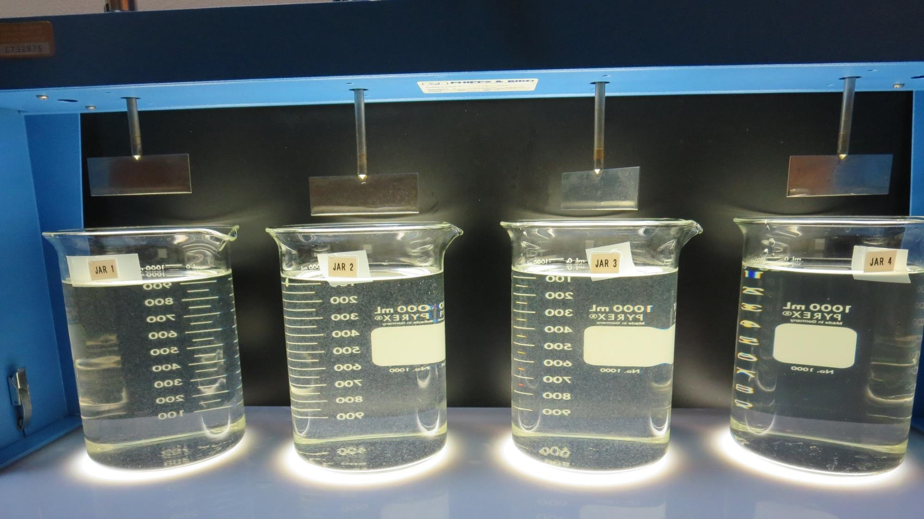
Jars 9-12: After 5 min of settling, 25 mL is syringed for filterability and %UVT/UVA.
17 mg/L 9800
2.55 mg/L 9890
Filtrate 0.45 NTU
UVT: 90.5%
UVA: 0.043/cm
22 mg/L 9800
3.3 mg/L 9890
Filtrate 0.07 NTU
UVT: 96.6%
UVA: 0.015/cm
27 mg/L 9800
4.05 mg/L 9890
Filtrate 0.04 NTU
UVT: 97.2%
UVA: 0.012/cm
0 mg/L 9800
8 mg/L 9890
Filtrate 0.9 NTU
UVT: 78%
UVA: 0.108/cm

Slide 18
Jars 13-16 Test
Flash Mix 60 Sec (200 RPM)
Floc Mix 5 min (30 RPM)
Water Temperature 21ºC
Applied Coagulants
9800/9890/Clarifloc

Slide 19
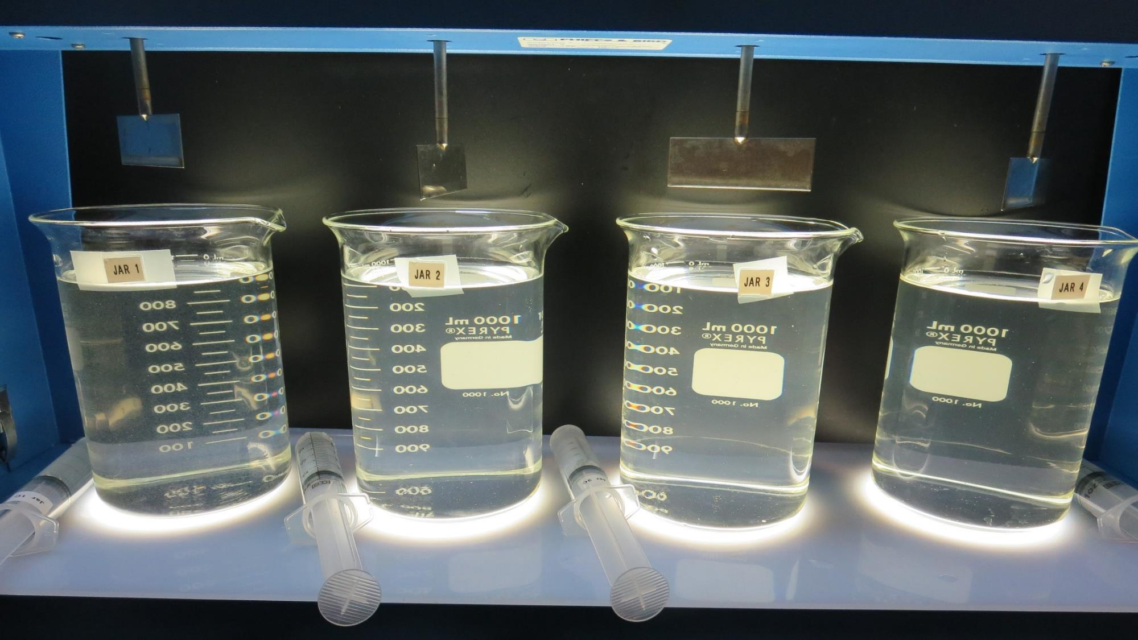
Jars 13-16: After 5 min of settling, 25 mL is syringed for filterability and %UVT/UVA.
1 mg/L 9800
7 mg/L Clarifloc
Filtrate 0.13 NTU
UVT: 95.9%
UVA: 0.018/cm
2 mg/L 9800
10 mg/L Clarifloc
Filtrate 0.23 NTU
UVT: 88.3%
UVA: 0.054/cm
15 mg/L 9800
15 mg/L 9890
Filtrate 0.23 NTU
UVT: 95.6%
UVA: 0.020/cm
32 mg/L 9800
4.8 mg/L 9890
Filtrate 0.19 NTU
UVT: 96.1%
UVA: 0.017/cm

Slide 20
Jars 17-20 Test
Flash Mix 60 Sec (200 RPM)
Floc Mix 5 min (30 RPM)
Water Temperature 21ºC
Applied Coagulants
9800/Clarifloc

Slide 21
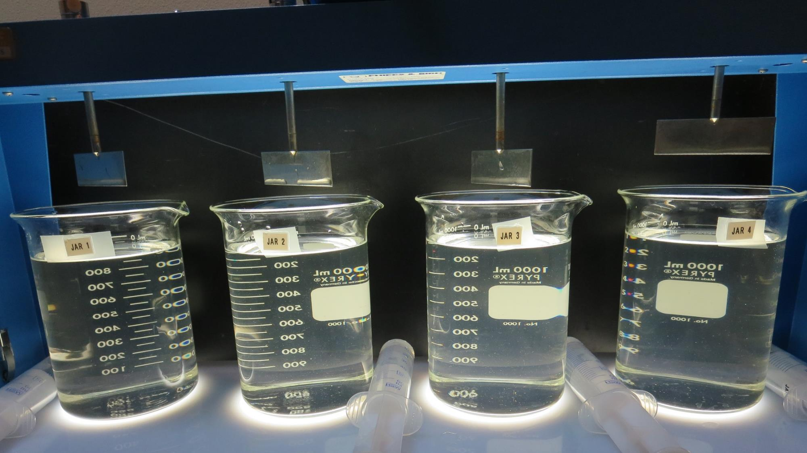
Jars 17-20: After 5 min of settling, 25 mL is syringed for filterability and %UVT/UVA.
1 mg/L 9800
4 mg/L Clarifloc
Filtrate 0.78 NTU
UVT: 76.6%
UVA: 0.116/cm
1 mg/L 9800
3 mg/L Clarifloc
Filtrate 0.9 NTU
UVT: 73.4%
UVA: 0.134/cm
1 mg/L 9800
5 mg/L Clarifloc
Filtrate 1.0 NTU
UVT: 77.7%
UVA: 0.110/cm
1 mg/L 9800
6 mg/L Clarifloc
Filtrate 0.62 NTU
UVT: -
UVA: -/cm

Slide 22
Jars 21-24 Test
Flash Mix 60 Sec (200 RPM)
Floc Mix 5 min (30 RPM)
Water Temperature 21ºC
Applied Coagulants
9800/9890/Clarifloc

Slide 23
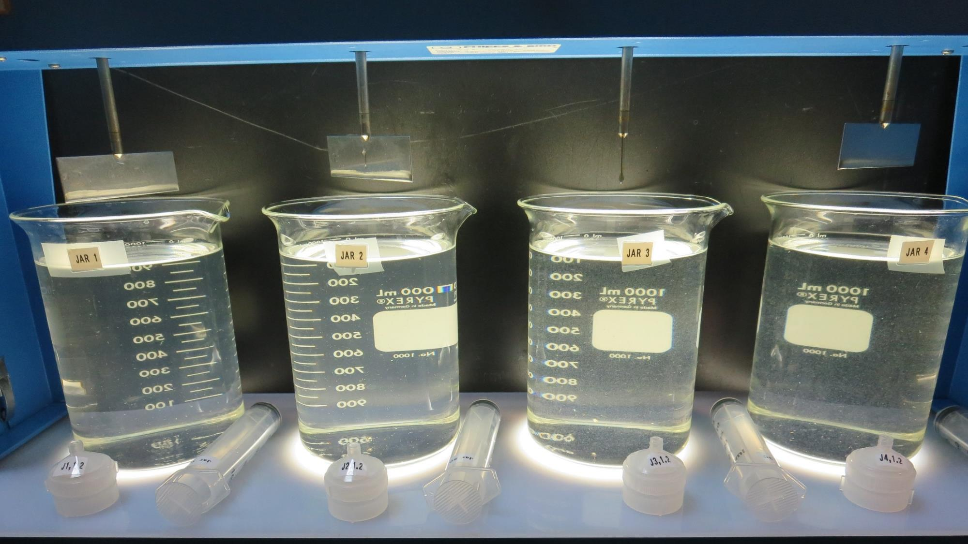
Jars 21-24: After 5 min of settling, 25 mL is syringed for filterability and %UVT/UVA.
1 mg/L 9800
7 mg/L Clarifloc
Filtrate 0.70 NTU
UVT: 82%
UVA: 0.086/cm
2 mg/L 9800
7 mg/L Clarifloc
Filtrate 0.67 NTU
UVT: 82.4%
UVA: 0.084/cm
31 mg/L 9800
Filtrate 0.16 NTU
UVT: 95.7%
UVA: 0.019/cm
27 mg/L 9800
4.05 mg/L 9890
Filtrate 0.05 NTU
UVT: 96.9%
UVA: 0.014/cm

Slide 24
Jars 25-27 Test
Flash Mix 60 Sec (200 RPM)
Floc Mix 5 min (30 RPM)
Water Temperature 13ºC
Applied Coagulants
9800/9890

Slide 25
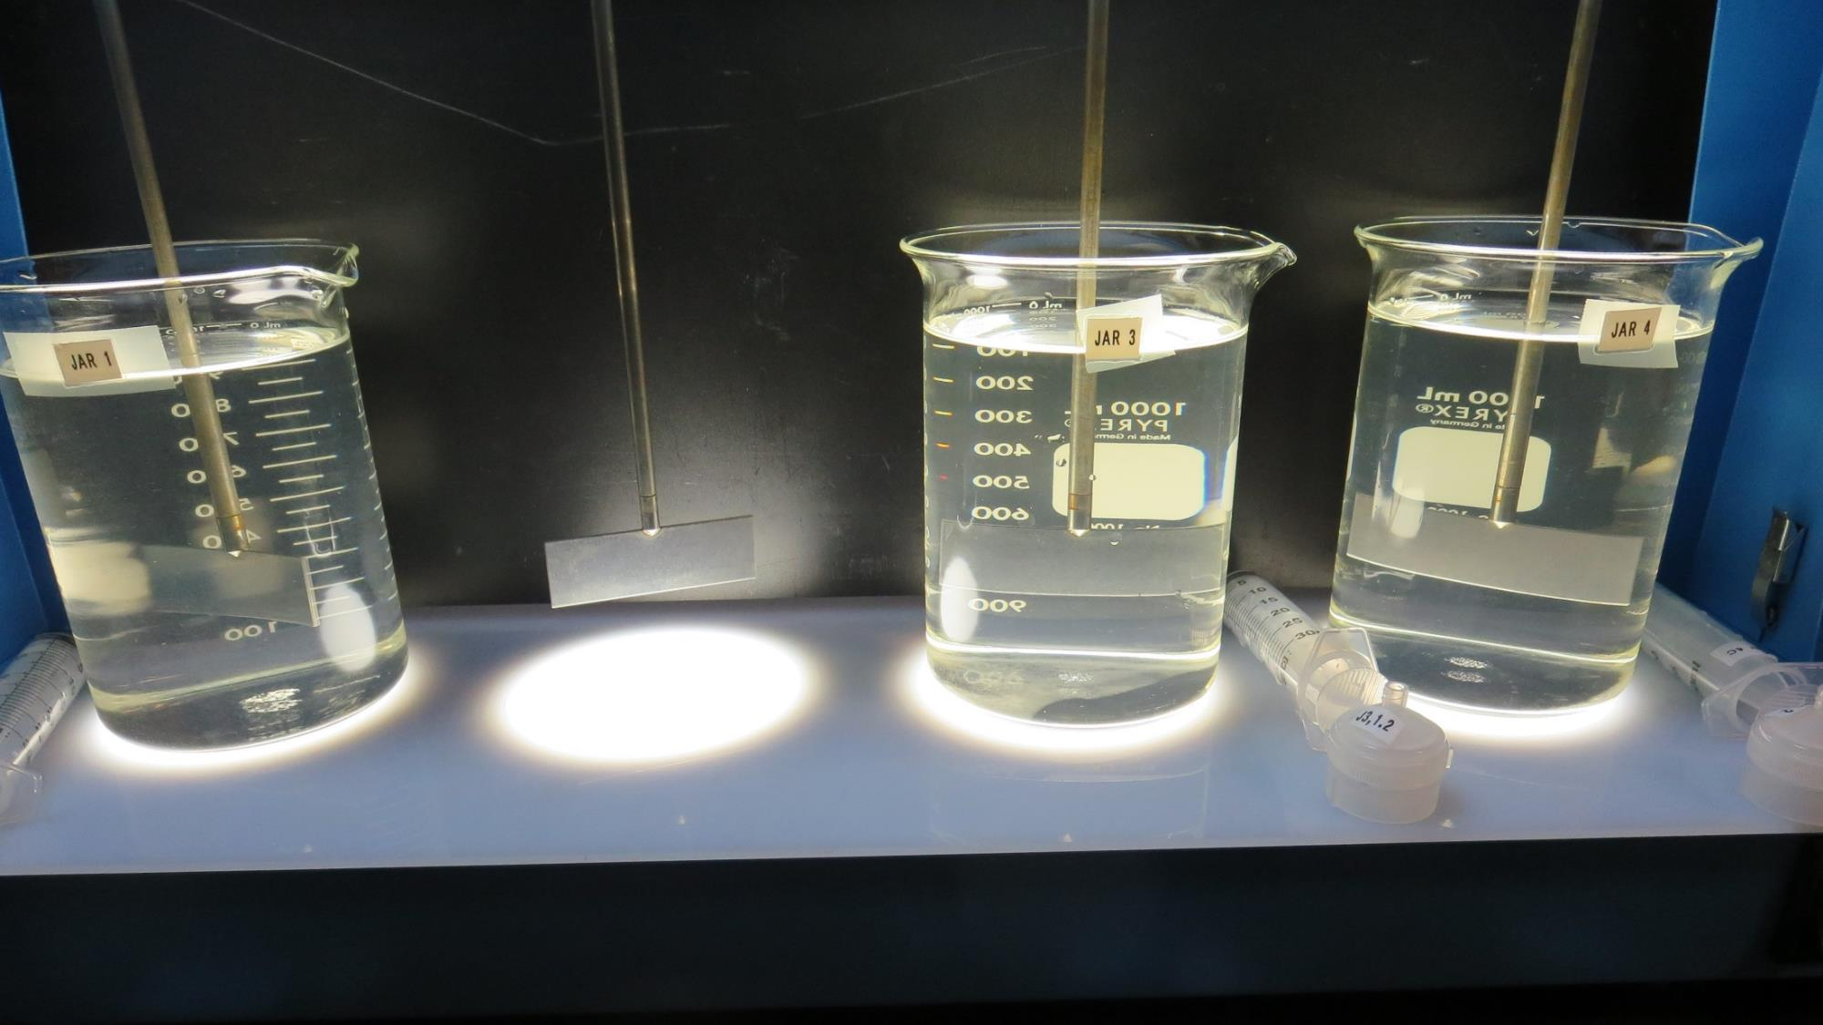
Jars 25-27: After 5 min of settling, 25 mL is syringed for filterability and %UVT/UVA.
22 mg/L 9800
6 mg/L 9890
Filtrate 0.05 NTU
UVT: 97.5%
UVA: 0.011/cm
32 mg/L 9800
Filtrate 0.07 NTU
UVT: 97.5%
UVA: 0.011/cm
27 mg/L 9800
4.05 mg/L 9890
Filtrate 0.06 NTU
UVT: 97.4%
UVA: 0.011/cm

Slide 26
Jar Testing for 1-Liter Jars:
Procedures for Most Treatment Plants
Fill jars with source water prior to coagulant injection and set paddle speed at 30 rpm
Add chemicals (i.e., NaOCl, primary coagulant, coagulant aid) to each jar
Flash mix for 15-60 seconds (200 rpm)
Slow mix for 5 minutes (20-30 rpm)
Settled for 5 minutes. Syringe 25 mL from each jar taken 1-inch below surface (25 mL/12 sec rate). For this study, sample was taken immediately at the end of flocculation process.
Filtered through 1.2 um isopore membrane into cuvette drip rate, 15 mL/(50-90 sec)
Measure filtrate turbidity, chlorine residual and %UVT/UVA
Measure settled water turbidity after 25 minutes of total setting
Record all data

Slide 27

Jar Test
Filterability Test Equipment
Turbidity Instrument
Syringe w/Luer-Lock Tip, 30 cc
(part#: 2225800, by Hach)
Swinnex Filter Holder, 25 mm (part#: SX0002500)
Isopore Membrane Filter, 1.2 um absolute
pore size,
Φ= 25 mm , thickness: 24 um,
hydrophilic polycarbonate membrane
(part #: RTTP02500)
Go to Sigma-Aldrich for laboratory supplies http://www.sigmaaldrich.com/united-states.html

Slide 28
Isopore Membrane Information
Categories | Information
trade name | Isopore
filter color | White
chemistry | Polycarbonate (PC)
water flow rate | Avg. 175 mL/min x cm² (typical results @ 10 psi)
media | Isopore®
wettability | Hydrophilic
porosity | 14.7%
pore size | 1.2 µm
bubble point at 23 °C | 1.0 bar, air with water
thickness | 24 µm
filter diameter (ø) | 25 mm
material size | polycarbonate, Hydrophilic, 1.2 µm, 25 mm, white, plain, 100

Slide 29
Isopore Membrane Background Information
The Isopore membrane is a polycarbonate, track-etched screen filter recommended for all analyses in which the sample is viewed on the surface of the membrane. The Isopore membrane is composed of polycarbonate film, which has a smooth, glass-like surface for clearer sample observation. The unique manufacturing process of the membrane ensures a precise pore diameter and a consistent pore size for accurate separation of samples by size. Matched-weight filters are not usually required because of low, constant tar and ash weights.
Features & Benefits:
Membrane structure retains particles on the surface, simplifying counting and analysis

Slide 30
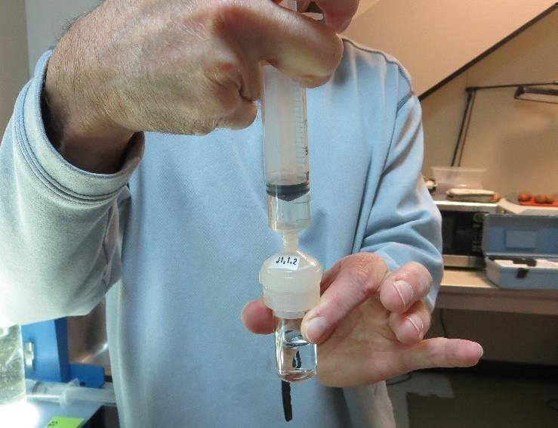

Jar Test - Filterability Test
Syringe ~ 25 mL from jar (after 5-minutes of settling)
Filter-to-waste 3-5 mL
Filter directly into clean cuvette
Measure turbidity
Note: Take several readings before recording final NTU results. Micro bubbles can adhere to glass causing false NTU readings. To remove bubbles, tilt cuvette up to 90 degrees.

Slide 31

Contact
Guy Schott, P.E.
State Water Resources Control Board
Division of Drinking Water
Santa Rosa, CA
Go to Stock Solution/Dose calculations/Jar Test Results for tools to download
www.waterboards.ca.gov/drinking_water/programs/districts/mendocino_district.html
Email: Guy Schott - Guy.Schott@waterboards.ca.gov
Office Number: 707-576-2732

