Slide 1
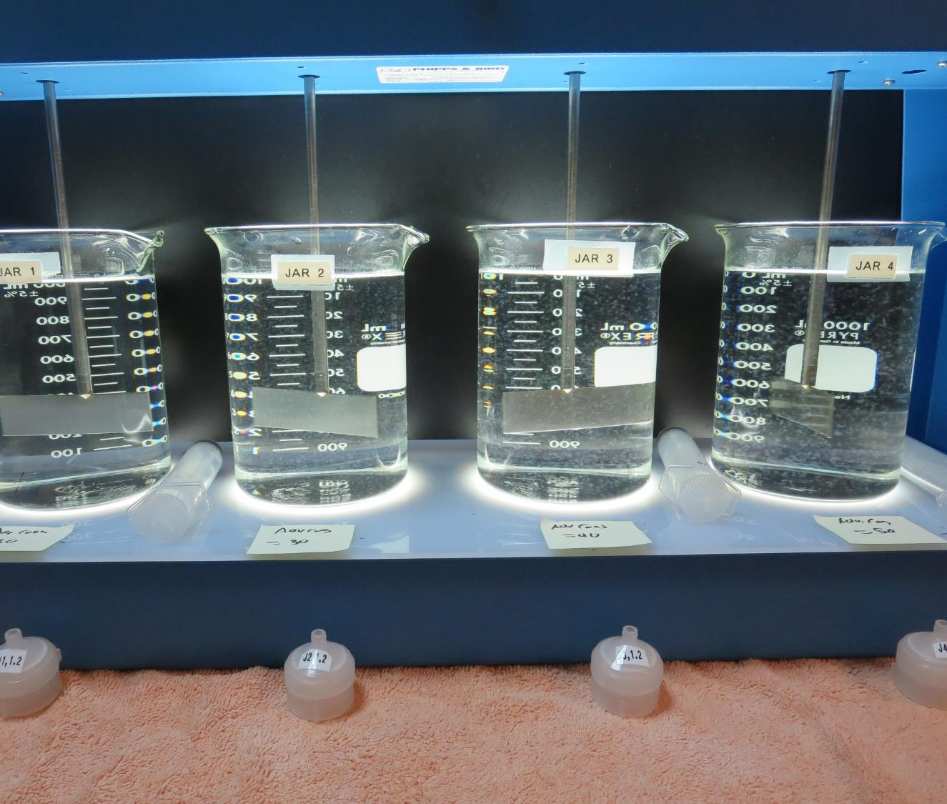
North Gualala Water Company
CA2300007
Mendocino County
Jar Test
by Guy Schott, P.E.
July 9, 2020

Slide 2
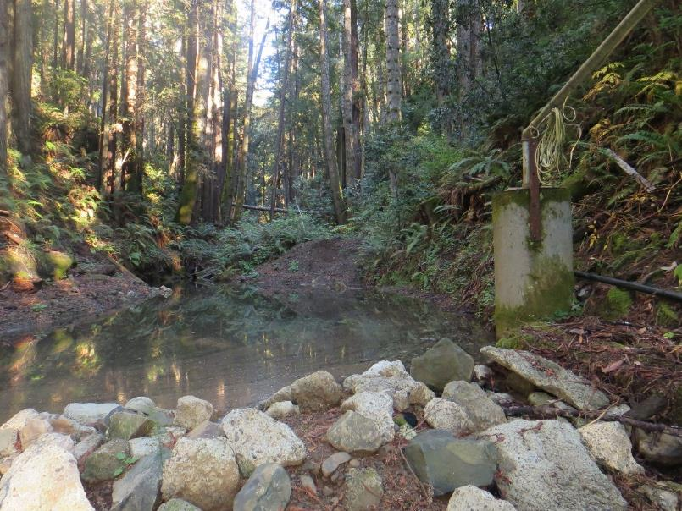
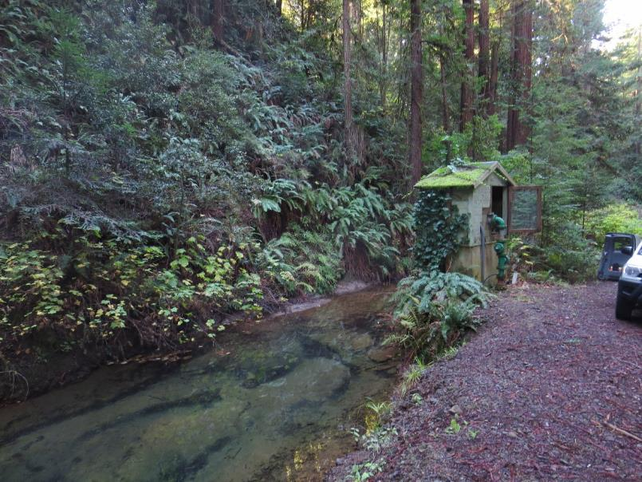
Source Water Intakes
Big Gulch and Intake
Robinson Gulch and Intake

Slide 3
Treatment Processes
Pre-Treatment: NaOCl
Vertical pressure roughing filter
Waterboy Filtration (tube settler/sedimentation/multi-media filtration)
Chlorine disinfection

Slide 4
North Gualala Water Company, July 9, 2020
Source Water Characteristics
Source
pH: 7.81
Turbidity: 0.85 NTU
UVT: 93.6%
UVA: 0.028/cm
0.4 um Filtered
Turbidity: 0.09 NTU
UVT: 95.3%
UVA: 0.020/cm
Chemicals
Pre-NaOCl: 5 mg/L
Coagulant Dose: 1 mg/L 9810
Plant Filtrate
Turbidity: 0.06 NTU
UVT: 98.1%
UVA: 0.008/cm
UVA Reduction: 60%

Slide 5
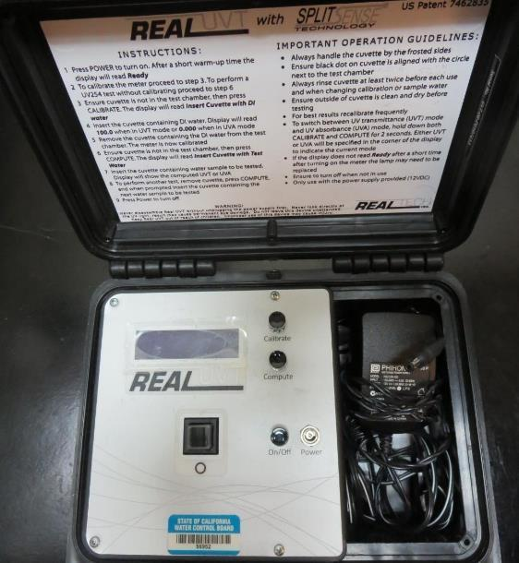
UVT/UVA, pathlength 10 mm
UV transmittance (UVT) is a measurement of the amount of ultraviolet light (commonly at 254 nm due to its germicidal effect) that passes through a water sample compared to the amount of light that passes through a pure water sample. The measurement is expressed as a percentage, % UVT.
%UVT = 10^{(-UVA)} x 100%
UV absorbance (UVA) is calculated as a relative measure of the amount of light absorbed by a water sample compared with the amount of light absorbed by a pure water sample.
UVA = -log(%UVT/100)

Slide 6
Applied Coagulants for Jar Testing
Pro Pac 9810 (NTU Technologies)
45% Aluminum Chlorohydrate
5% Trade Secret
45% Water
SG = 1.25-1.34
Advanced Coagulant
12.55% Al₂O₃
6.64% Al
66.4% Basicity
SG = 1.3

Slide 7
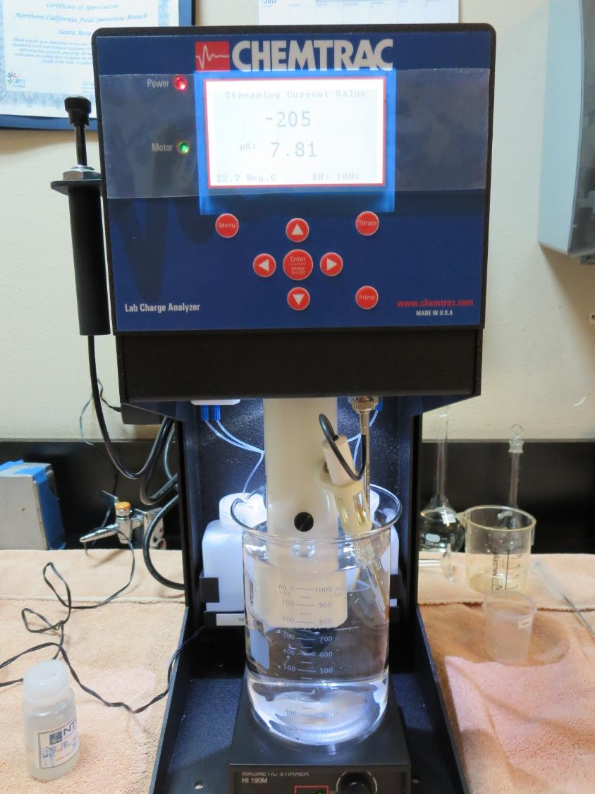
Laboratory Charge Analyzer
LCA: Used to determine coagulant demand of a source water entering the treatment plant.
Source pH: 7.81
LCA #1:
9810: 5.3 mg/L as product (0.01% stock)
pH adjusted to 7.5 w/acetic acid solution
LCA #2:
9810: 7.13 mg/L as product (0.1% stock)
pH adjusted to 7.5 w/acetic acid solution
LCA #3:
Advance Coagulant: >60 mg/L as product
pH adjusted to 7.5 w/acetic acid solution

Slide 8
Coagulant Information
Unless stated otherwise, all coagulant doses are reported as Product (100% strength).
Preparation of coagulant stock solutions are generally 1.0 and/or 0.1 percent strength using 100 and/or 200 mL volumetric flasks.
Finnpipette F2 variable volume pipette, capacity 100-1000 micro liters is used for stock solution preparation and coagulant aid jar test dosing.
Finnpipette F2 variable volume pipette, capacity 0.5-5 mL is used for primary coagulant jar test dosing.

Slide 9
Filterability and %UVT/UVA Analysis
For each set of jar testing, 25 mL was syringed at the end of the flocculation period. Settleability was not tested as this facility has a roughing filter in front of the Waterboy treatment plant.

Slide 10
North Gualala WC: Jar Test 1-8 Results
Big Gulch/Robinson Gulch Source Water
Jar # | 200 RPM Flash Mix Seconds | 30 RPM Floc Duration minutes | 9810 mg/L | Filtrate NTU | Filtrate %UVT | Filtrate UVA/cm | %UVA Reduction
J1 | 30 | 5 | 1.0 | 0.23 | 95.6 | 0.019 | 5
J2 | 30 | 5 | 2.0 | 0.25 | 95.4 | 0.020 | 0
J3 | 30 | 5 | 3.0 | 0.22 | 95.7 | 0.019 | 5
J4 | 30 | 5 | 4.0 | 0.26 | 95.8 | 0.018 | 10
J5 | 30 | 5 | 5.0 | 0.15 | 96.8 | 0.013 | 35
J6 | 30 | 5 | 6.0 | 0.25 | 96.4 | 0.015 | 25
J7 | 30 | 5 | 7.0 | 0.13 | 97.1 | 0.012 | 40
J8 | 30 | 5 | 8.0 | 0.30 | 96.5 | 0.015 | 25

Slide 11
North Gualala WC: Jar Test 9-16 Results
Flash Mix 30 RPM (30 sec)
Jar | 30 RPM Floc Duration minutes | NaOCl mg/L | 9810 mg/L | Filtrate NTU | Filtrate %UVT | Filtrate UVA/cm | %UVA Reduction
J9 | 5 | 0 | 9.0 | 0.08 | 97.7 | 0.009 | 55
J10 | 5 | 0 | 10 | 0.15 | 97.4 | 0.011 | 45
J11 | 5 | 0 | 11 | 0.07 | 97.6 | 0.010 | 50
J12 | 5 | 0 | 12 | 0.20 | 97.3 | 0.011 | 45
J13 | 5 | 1.0 | 5.0 | 0.22 | 96.9 | 0.013 | 35
J14 | 5 | 1.0 | 6.0 | 0.20 | 97.2 | 0.012 | 40
J15 | 5 | 1.0 | 7.0 | 0.08 | 97.5 | 0.011 | 45
J16 | 5 | 1.0 | 8.0 | 0.24 | 97.1 | 0.012 | 40

Slide 12
North Gualala WC: Jar Test 17-24 Results
Big Gulch/Robinson Gulch Source Water
Jar # | 200 RPM Flash Mix Seconds | 30 RPM Floc Duration minutes | Adv Coag. mg/L | Filtrate NTU | Filtrate %UVT | Filtrate UVA/cm | %UVA Reduction
J17 | 30 | 5 | 20 | 0.08 | 97.1 | 0.012 | 40
J18 | 30 | 5 | 30 | 0.07 | 97.2 | 0.012 | 40
J19 | 30 | 5 | 40 | 0.07 | 97.5 | 0.011 | 45
J20 | 30 | 5 | 50 | 0.07 | 97.7 | 0.009 | 55
J21 | 30 | 5 | 10 | 0.08 | 96.6 | 0.014 | 30
J22 | 30 | 5 | 50 | 0.06 | 97.7 | 0.010 | 50
J23 | 30 | 5 | 60 | 0.06 | 97.6 | 0.010 | 50
J24 | 30 | 5 | 70 | 0.08 | 97.7 | 0.010 | 50

Slide 13
North Gualala WC: Jar Test 24-32 Results
Flash Mix 200 RPM (30 sec)
Jar # | 30 RPM Floc Duration min | NaOCl mg/L | 9810 mg/L | Adv Coag. mg/L | Filtrate NTU | Filtrate %UVT | Filtrate UVA/cm | %UVA Reduction
J25 | 5 | 0 | 13 | 0 | 0.12 | 97.8 | 0.009 | 55
J26 | 5 | 0 | 14 | 0 | 0.09 | 97.9 | 0.009 | 55
J27 | 5 | 0 | 15 | 0 | 0.07 | 98.1 | 0.008 | 60
J28 | 5 | 0 | 16 | 0 | 0.08 | 98.3 | 0.007 | 65
J29 | 5 | 0 | 15 | 0 | 0.11 | 97.9 | 0.008 | 60
J30 | 5 | 1.0 | 15 | 0 | 0.11 | 97.6 | 0.010 | 50
J31 | 5 | 0 | 0 | 50 | 0.07 | 97.6 | 0.010 | 50
J32 | 5 | 1.0 | 0 | 50 | 0.06 | 97.6 | 0.010 | 50

Slide 14
Jars 1-4 Test
Flash Mix 30 Sec (200 RPM)
Floc Mix 5 min (30 RPM)
Applied Coagulant
9810

Slide 15
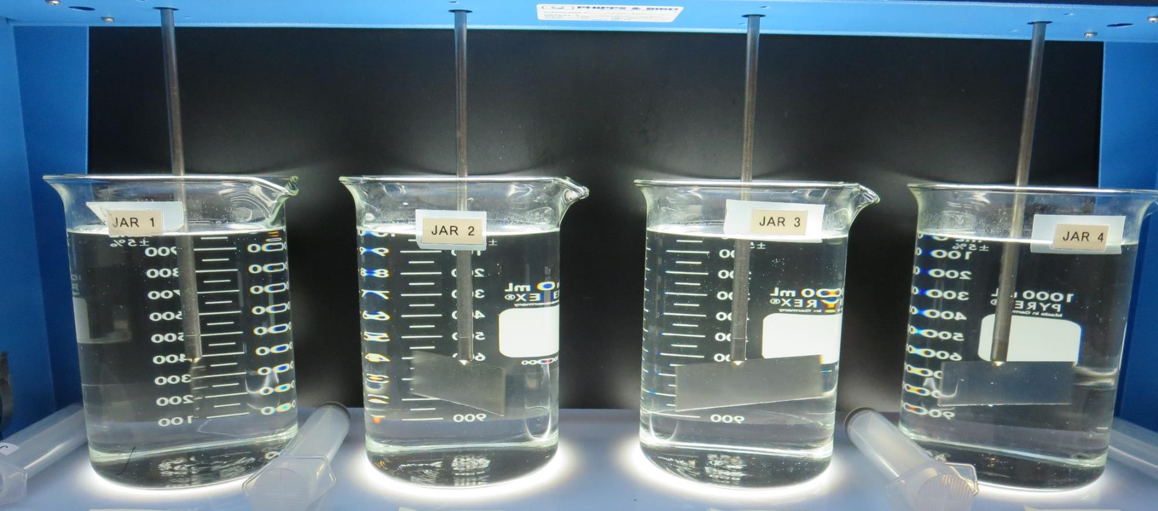
Jars 1-4: End of 5-minute flocculation (30 RPM) duration.
1.0 mg/L 9810
Filtrate 0.23 NTU
UVT: 95.6%
UVA: 0.019/cm
UVA Reduction 5%
2.0 mg/L 9810
Filtrate 0.25 NTU
UVT: 95.4%
UVA: 0.020/cm
UVA Reduction 0%
3.0 mg/L 9810
Filtrate 0.22 NTU
UVT: 95.7%
UVA: 0.019/cm
UVA Reduction 5%
4.0 mg/L 9810
Filtrate 0.26 NTU
UVT: 95.8%
UVA: 0.018/cm
UVA Reduction 10%

Slide 16
Jars 5-8 Test
Flash Mix 30 Sec (200 RPM)
Floc Mix 5 min (30 RPM)
Applied Coagulant
9810

Slide 17
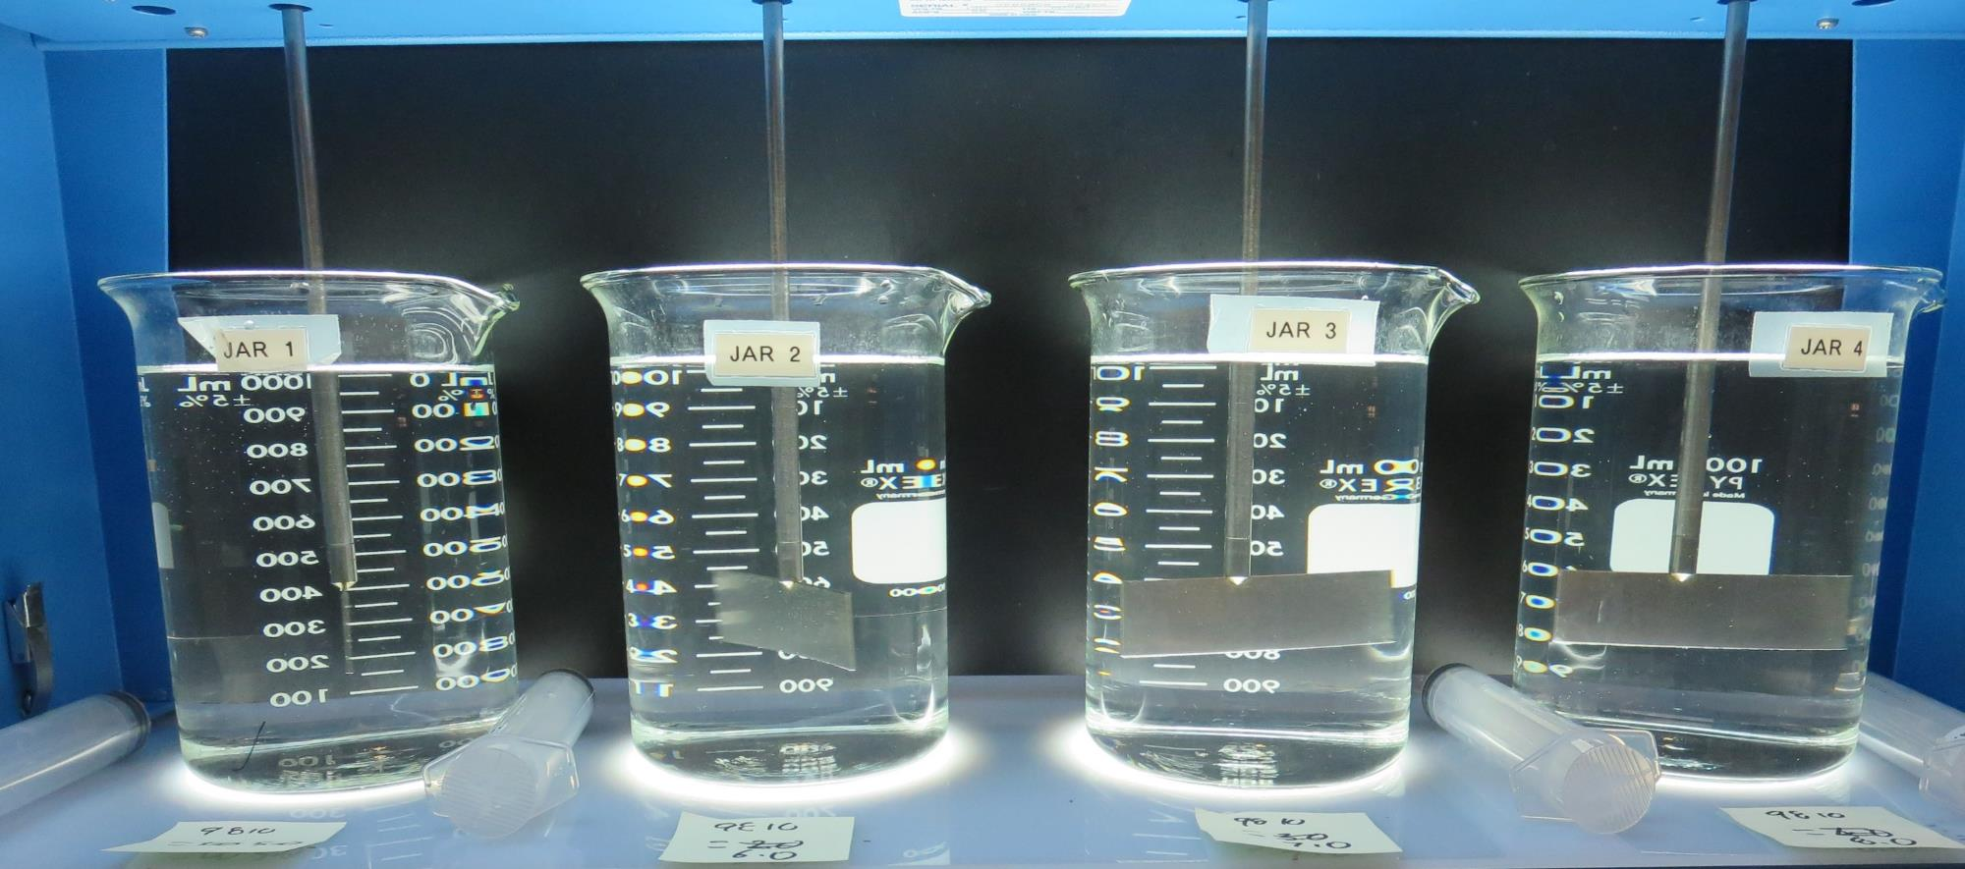
Jars 5-8: End of 5-minute flocculation (30 RPM) duration.
5.0 mg/L 9810
Filtrate 0.15 NTU
UVT: 96.8%
UVA: 0.013/cm
UVA Reduction 35%
6.0 mg/L 9810
Filtrate 0.25 NTU
UVT: 96.4%
UVA: 0.015/cm
UVA Reduction 25%
7.0 mg/L 9810
Filtrate 0.13 NTU
UVT: 97.1%
UVA: 0.012/cm
UVA Reduction 40%
8.0 mg/L 9810
Filtrate 0.13 NTU
UVT: 97.1%
UVA: 0.012/cm
UVA Reduction 25%

Slide 18
Jars 9-12 Test
Flash Mix 30 Sec (200 RPM)
Floc Mix 5 min (30 RPM)
Applied Coagulant
9810

Slide 19
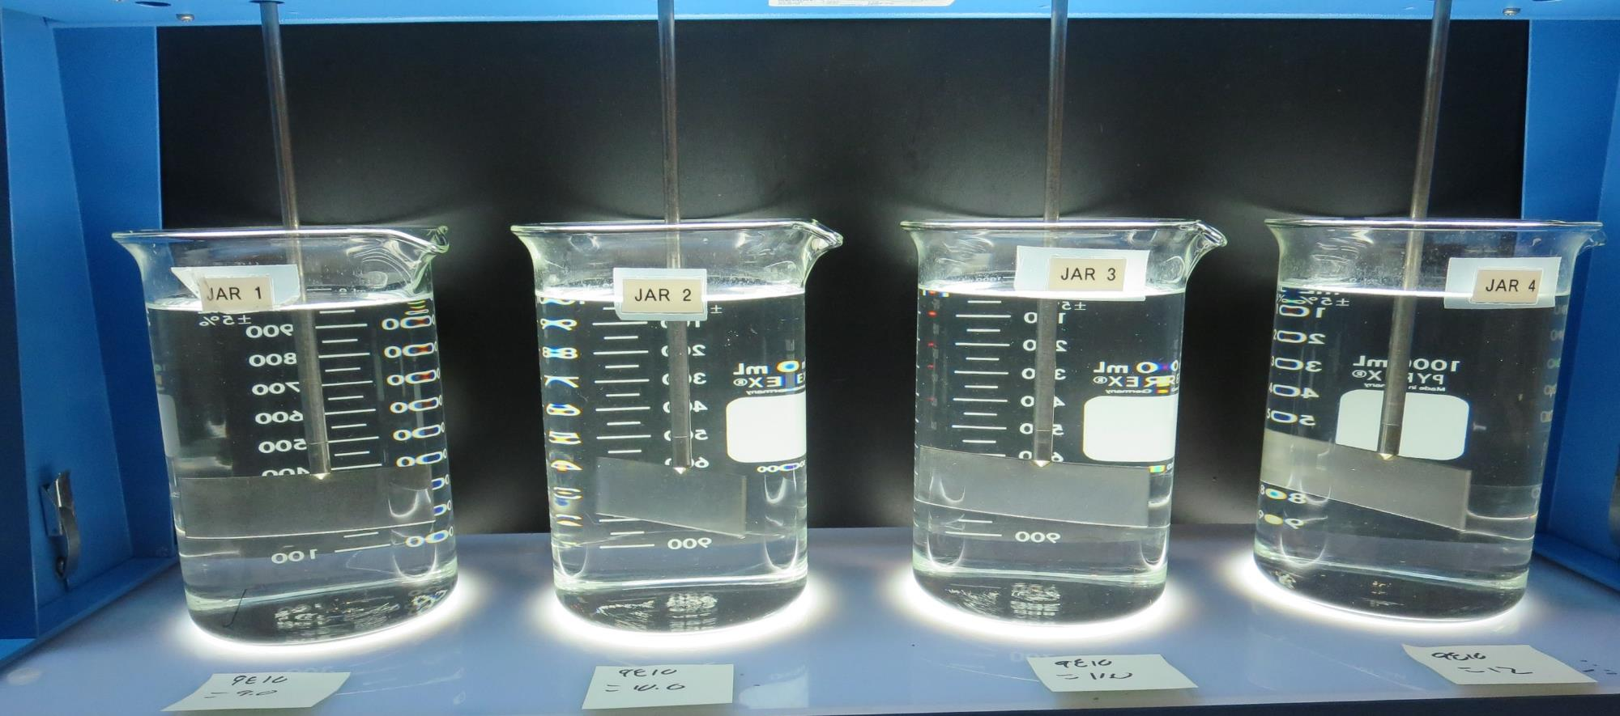
Jars 9-12: End of 5-minute flocculation (30 RPM) duration.
9.0 mg/L 9810
Filtrate 0.08 NTU
UVT: 97.7%
UVA: 0.009/cm
UVA Reduction 55%
10 mg/L 9810
Filtrate 0.15 NTU
UVT: 97.4%
UVA: 0.011/cm
UVA Reduction 45%
11 mg/L 9810
Filtrate 0.07 NTU
UVT: 97.6%
UVA: 0.010/cm
UVA Reduction 50%
12 mg/L 9810
Filtrate 0.20 NTU
UVT: 97.3%
UVA: 0.011/cm
UVA Reduction 45%

Slide 20
Jars 13-16 Test
Flash Mix 30 Sec (200 RPM)
Floc Mix 5 min (30 RPM) w/NaOCl
Applied Coagulant
9810

Slide 21
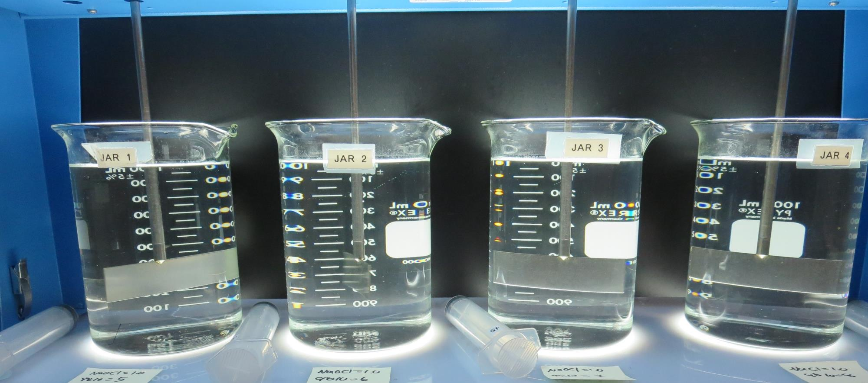
Jars 13-16: End of 5-minute flocculation (30 RPM) duration.
1.0 mg/L NaOCl
5.0 mg/L 9810
Filtrate 0.22 NTU
UVT: 96.9%
UVA: 0.013/cm
UVA Reduction 35%
1.0 mg/L NaOCl
6.0 mg/L 9810
Filtrate 0.20 NTU
UVT: 97.2%
UVA: 0.012/cm
UVA Reduction 40%
1.0 mg/L NaOCl
7.0 mg/L 9810
Filtrate 0.08 NTU
UVT: 97.5%
UVA: 0.011/cm
UVA Reduction 45%
1.0 mg/L NaOCl
8.0 mg/L 9810
Filtrate 0.24 NTU
UVT: 97.1%
UVA: 0.012/cm
UVA Reduction 40%

Slide 22
Jars 17-20 Test
Flash Mix 30 Sec (200 RPM)
Floc Mix 5 min (30 RPM)
Applied Coagulant
Advanced Coagulant

Slide 23
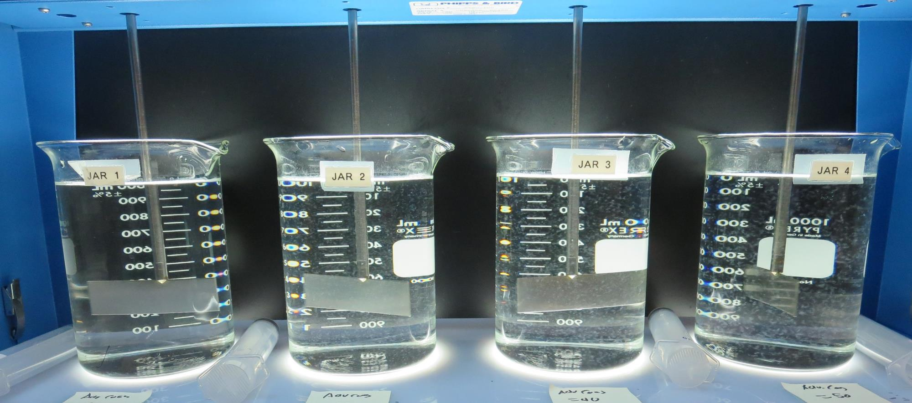
Jars 17-20: End of 5-minute flocculation (30 RPM) duration.
20 mg/L Adv Coag
Filtrate 0.08 NTU
UVT: 97.1%
UVA: 0.012/cm
UVA Reduction 40%
30 mg/L Adv Coag
Filtrate 0.07 NTU
UVT: 97.2%
UVA: 0.012/cm
UVA Reduction 40%
40 mg/L Adv Coag
Filtrate 0.07 NTU
UVT: 97.5%
UVA: 0.011/cm
UVA Reduction 45%
50 mg/L Adv Coag
Filtrate 0.07 NTU
UVT: 97.7%
UVA: 0.009/cm
UVA Reduction 55%

Slide 24
Jars 21-24 Test
Flash Mix 30 Sec (200 RPM)
Floc Mix 5 min (30 RPM)
Applied Coagulant
Advanced Coagulant

Slide 25
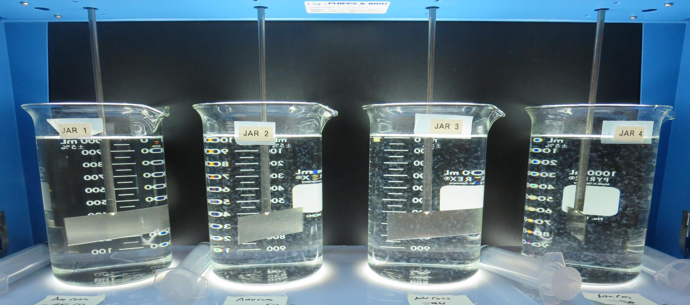
Jars 21-24: End of 5-minute flocculation (30 RPM) duration.
10 mg/L Adv Coag
Filtrate 0.08 NTU
UVT: 96.6%
UVA: 0.014/cm
UVA Reduction 30%
50 mg/L Adv Coag
Filtrate 0.06 NTU
UVT: 97.7%
UVA: 0.010/cm
UVA Reduction 50%
60 mg/L Adv Coag
Filtrate 0.06 NTU
UVT: 97.6%
UVA: 0.010/cm
UVA Reduction 50%
70 mg/L Adv Coag
Filtrate 0.08 NTU
UVT: 97.7%
UVA: 0.010/cm
UVA Reduction 50%

Slide 26
Jars 25-28 Test
Flash Mix 30 Sec (200 RPM)
Floc Mix 5 min (30 RPM)
Applied Coagulant
9810

Slide 27
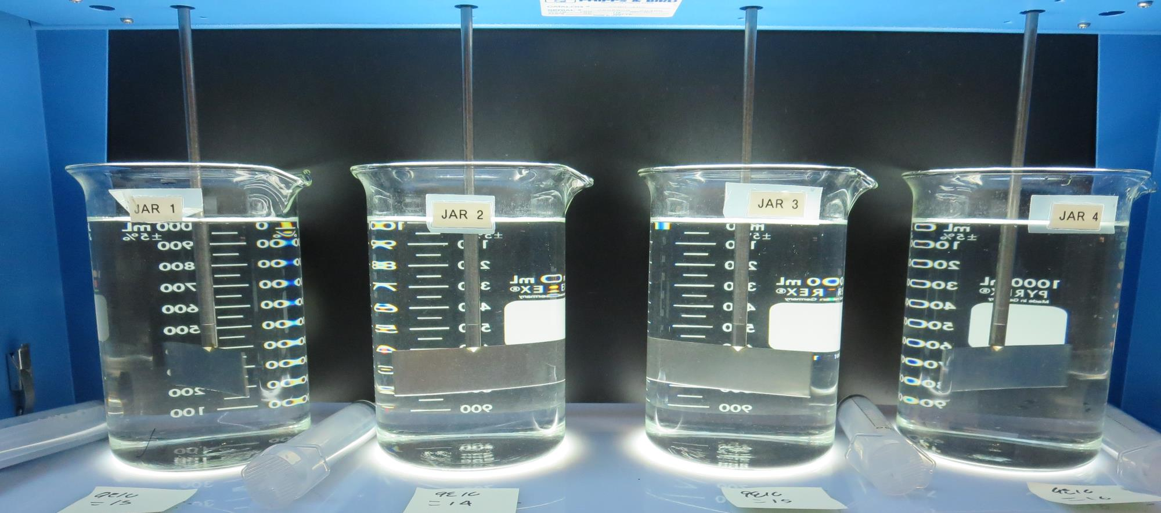
Jars 25-28: End of 5-minute flocculation (30 RPM) duration.
13 mg/L 9810
Filtrate 0.12 NTU
UVT: 97.8%
UVA: 0.009/cm
UVA Reduction 55%
14 mg/L 9810
Filtrate 0.09 NTU
UVT: 97.9%
UVA: 0.009/cm
UVA Reduction 55%
15 mg/L 9810
Filtrate 0.07 NTU
UVT: 98.1%
UVA: 0.008/cm
UVA Reduction 60%
16 mg/L 9810
Filtrate 0.08 NTU
UVT: 98.3%
UVA: 0.007/cm
UVA Reduction 65%

Slide 28
Jars 29-32 Test
Flash Mix 30 Sec (200 RPM)
Floc Mix 5 min (30 RPM) w/NaOCl
Applied Coagulants
9810/Adv Coagulant

Slide 29
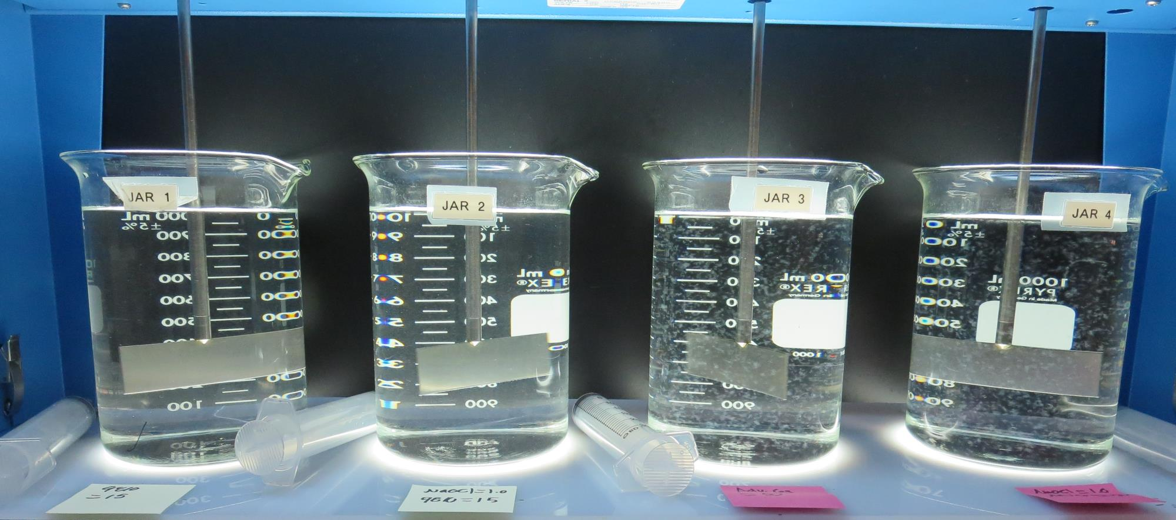
Jars 29-32: End of 5-minute flocculation (30 RPM) duration.
1.0 mg/L NaOCl
15 mg/L 9810
Filtrate 0.09 NTU
UVT: 97.6%
UVA: 0.010/cm
UVA Reduction 50%
1.0 mg/L NaOCl
50 mg/L Adv Coag
Filtrate 0.06 NTU
UVT: 97.6%
UVA: 0.010/cm
UVA Reduction 50%
15 mg/L 9810
Filtrate 0.11 NTU
UVT: 97.9%
UVA: 0.008/cm
UVA Reduction 60%
50 mg/L Adv Coag
Filtrate 0.07 NTU
UVT: 97.6%
UVA: 0.010/cm
UVA Reduction 50%

Slide 30
Jar Testing for 1-Liter Jars:
Procedures for Most Treatment Plants
Fill jars with source water prior to coagulant injection and set paddle speed at 30 rpm
Add chemicals (i.e., NaOCl, primary coagulant, coagulant aid) to each jar
Flash mix for 15-30 seconds (200 rpm)
Slow mix for 5 minutes (20-30 rpm)
Settled for 5 minutes. Syringe 25 mL from each jar taken 1-inch below surface (25 mL/12 sec rate).
Filtered through 1.2 um isopore membrane into cuvette drip rate, 15 mL/(50-90 sec)
Measure filtrate turbidity, chlorine residual and %UVT/UVA
Measure settled water turbidity after 25 minutes of total setting
Record all data

Slide 31

Jar Test
Filterability Test Equipment
Turbidity Instrument
Syringe w/Luer-Lock Tip, 30 cc
(part#: 2225800, by Hach)
Swinnex Filter Holder, 25 mm (part#: SX0002500)
Isopore Membrane Filter, 1.2 um absolute
pore size,
Φ= 25 mm , thickness: 24 um,
hydrophilic polycarbonate membrane
(part #: RTTP02500)
Go to Sigma-Aldrich for laboratory supplies http://www.sigmaaldrich.com/united-states.html

Slide 32
Isopore Membrane Information
Categories | Information
trade name | Isopore
filter color | White
chemistry | Polycarbonate (PC)
water flow rate | Avg. 175 mL/min x cm² (typical results @ 10 psi)
media | Isopore®
wettability | Hydrophilic
porosity | 14.7%
pore size | 1.2 µm
bubble point at 23 °C | 1.0 bar, air with water
thickness | 24 µm
filter diameter (ø) | 25 mm
material size | polycarbonate, Hydrophilic, 1.2 µm, 25 mm, white, plain, 100

Slide 33
Isopore Membrane Background Information
The Isopore membrane is a polycarbonate, track-etched screen filter recommended for all analyses in which the sample is viewed on the surface of the membrane. The Isopore membrane is composed of polycarbonate film, which has a smooth, glass-like surface for clearer sample observation. The unique manufacturing process of the membrane ensures a precise pore diameter and a consistent pore size for accurate separation of samples by size. Matched-weight filters are not usually required because of low, constant tar and ash weights.
Features & Benefits:
Membrane structure retains particles on the surface, simplifying counting and analysis

Slide 34
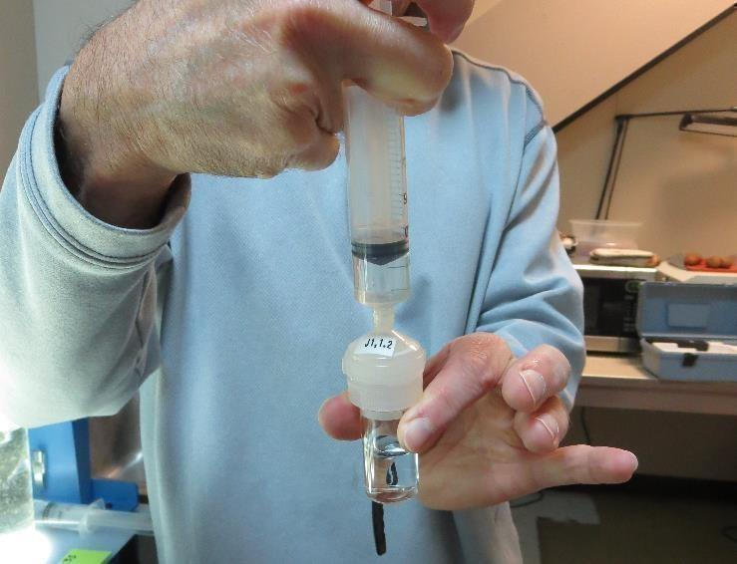

Jar Test - Filterability Test
Syringe ~ 25 mL from jar (after 5-minutes of settling)
Filter-to-waste 3-5 mL
Filter directly into clean cuvette
Measure turbidity
Note: Take several readings before recording final NTU results. Micro bubbles can adhere to glass causing false NTU readings. To remove bubbles, tilt cuvette up to 90 degrees.

Slide 35

Contact
Guy Schott, P.E.
State Water Resources Control Board
Division of Drinking Water
Santa Rosa, CA
Go to Stock Solution/Dose calculations/Jar Test Results for tools to download
www.waterboards.ca.gov/drinking_water/programs/districts/mendocino_district.html
Email: Guy Schott - Guy.Schott@waterboards.ca.gov
Office Number: 707-576-2732

