Slide 1
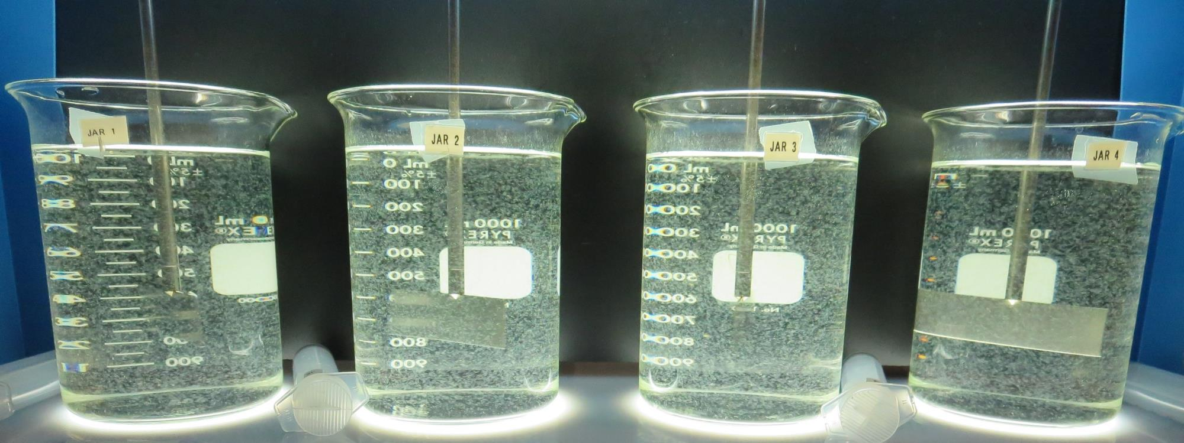
Redwood Valley County Water District
CA2310008
Mendocino County
Jar Test
by Guy Schott, P.E
April 30, 2020

Slide 2
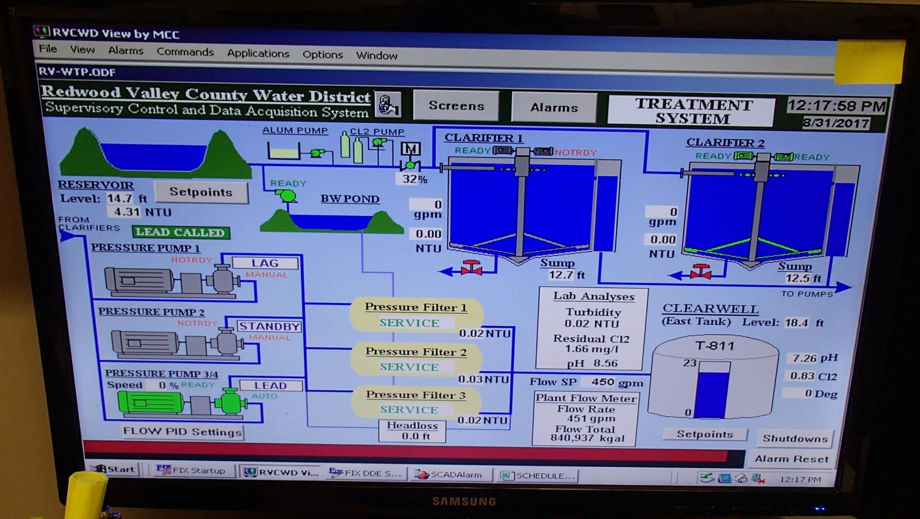
Conventional Water Treatment Plant

Slide 3
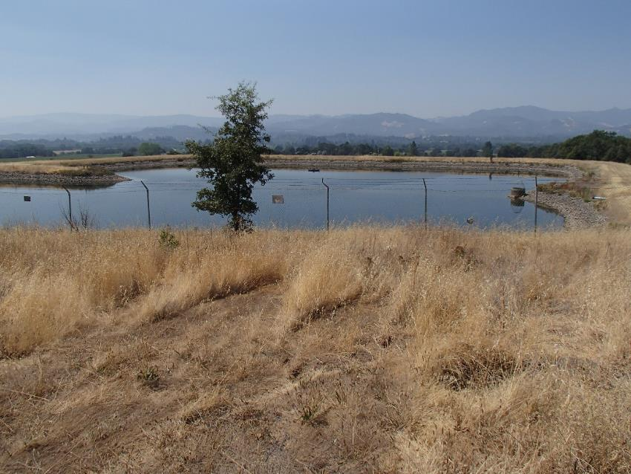
Redwood Valley CWD
Water Characteristics, April 29, 2020
Source
Turbidity: 0.40 NTU
pH: 8.9
UVT: 90.3%, UVA: 0.044/cm
Filter 1
Turbidity: 0.09 NTU
UVT: 94.9%, UVA: 0.022/cm
UVA Reduction: 50%
Filter 2
Turbidity: 0.09 NTU
UVT: 95.4%, UVA: 0.020/cm
UVA Reduction: 54.5%
Filter 3
Turbidity: 0.08 NTU
UVT: 95.6%, UVA: 0.019/cm
UVA Reduction: 56.8%

Slide 4
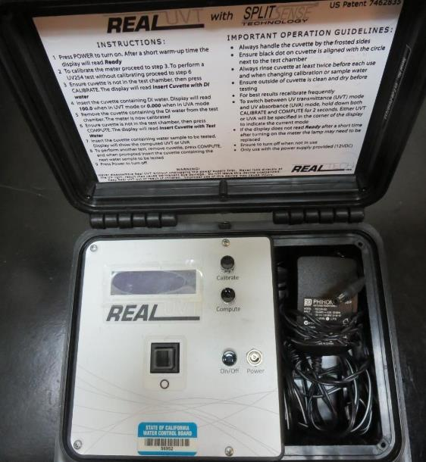
UVT/UVA, pathlength 10 mm
UV transmittance (UVT) is a measurement of the amount of ultraviolet light (commonly at 254 nm due to its germicidal effect) that passes through a water sample compared to the amount of light that passes through a pure water sample. The measurement is expressed as a percentage, % UVT.
%UVT = 10^{(-UVA)} x 100%
UV absorbance (UVA) is calculated as a relative measure of the amount of light absorbed by a water sample compared with the amount of light absorbed by a pure water sample.
UVA = -log(%UVT/100)

Slide 5
Applied Coagulants for Jar Testing, Set 1
Pro Pac 9800 (NTU Technologies)
50% Aluminum Chlorohydrate (ACH)
50% Water
SG = 1.34
7066 (Garratt Callahan)
10 – 30% Poly Aluminum Hydroxychloride Sulfate
50% Basicity
SG = 1.2

Slide 6
Applied Coagulants for Jar Testing, Set 2
Pro Pac 9810 (NTU Technologies)
45-50% Aluminum Chlorohydrate (ACH)
45-50% Water
5% Proprietary
SG = 1.25 - 1.34
Aluminum Sulfate
48.25% Alum
SG = 1.34
Advanced Coagulant
SG = 1.3

Slide 7
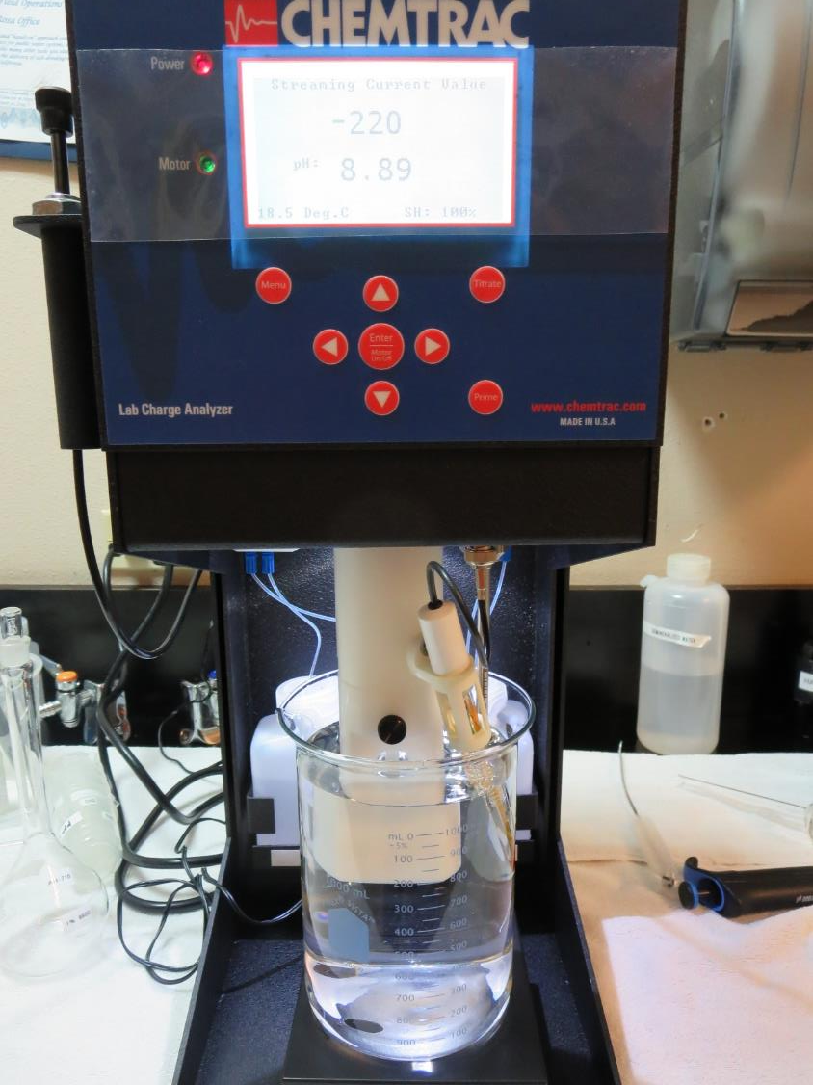
Laboratory Charge Analyzer
LCA: Used to determine coagulant demand of a source water entering the treatment plant.
Source pH: 8.9
LCA #1: 9800: 13.7 mg/L as product
pH adjusted to 7.5 with acidic acid
LCA #2: 7066: 44.5 mg/L as product
pH adjusted to 7.5 with acidic acid
LCA #3: Alum: 19.7 mg/L as product
pH adjusted to 6.6 with acidic acid
LCA #4: Advance Coag: 40 mg/L as product
pH adjusted to 7.5 with acidic acid

Slide 8
Laboratory Charge Analyzer - Continue
LCA #3:
Added 1.0 mg/L NaOCl
7032 (ACH): 26.6 mg/L as product
pH adjusted to 7.5 with acidic acid
LCA #4:
917: 19 mg/L as product
pH adjusted to 7.5 with acidic acid

Slide 9
Coagulant Information
Unless stated otherwise, all coagulant doses are reported as Product (100% strength). Aluminum sulfate is reported as Alum.
Preparation of coagulant stock solutions are generally 1.0 and/or 0.1 percent strength using 100 and/or 200 mL volumetric flasks.
Finnpipette F2 variable volume pipette, capacity 100-1000 micro liters is used for stock solution preparation and coagulant aid jar test dosing.
Finnpipette F2 variable volume pipette, capacity 0.5-5 mL is used for primary coagulant jar test dosing.

Slide 10
Redwood Valley CWD: Jar Test 1-6 Results
Floc Mix 30 RPM (5 minutes)
Jar # | 100 RPM Flash Mix seconds | 9800 mg/L | Alum mg/L | Filtrate NTU | Filtrate %UVT | Filtrate UVA/cm | %UVA Reduction | Settle NTU 25 min
J1 | 0 | 11.2 | 14.6 | 0.10 | 92.2 | 0.035 | 20.5 | 0.70
J2 | 0 | 11.2 | 14.6 | 0.10 | 91.9 | 0.036 | 18.2 | 0.64
J3 | 20 | 11.2 | 14.6 | 0.11 | 92.2 | 0.035 | 20.5 | 0.47
J4 | 20 | 11.2 | 14.6 | 0.11 | 92.2 | 0.035 | 22.7 | 0.46
J5 | 0 | 36.6 | 14.6 | 0.13 | 94.6 | 0.024 | 45.5 | 0.33
J6 | 20 | 36.6 | 14.6 | 0.07 | 94.7 | 0.023 | 47.7 | 0.33

Slide 11
Redwood Valley CWD: Jar Test 7-14 Results
Floc Mix 30 RPM (5 minutes)
Jar # | 200 RPM Flash Mix sec | 7066 mg/L | Adv/ Coag mg/L | Filtrate NTU | Filtrate %UVT | Filtrate UVA/cm | %UVA Reduction | Settle NTU 25 min
J7 | 0 | 45 | 0 | 0.13 | 91.9 | 0.036 | 18.2 | 0.46
J8 | 0 | 60 | 0 | 0.15 | 92.5 | 0.033 | 25.0 | 0.54
J9 | 20 | 45 | 0 | 0.10 | 91.8 | 0.037 | 15.9 | 0.42
J10 | 20 | 60 | 0 | 0.14 | 92.6 | 0.033 | 25.0 | 0.32
J11 | 0 | 0 | 40 | 0.09 | 92.2 | 0.035 | 20.5 | 0.42
J12 | 0 | 0 | 50 | 0.10 | 92.7 | 0.032 | 27.3 | 0.35
J13 | 20 | 0 | 40 | 0.13 | 92.1 | 0.035 | 20.5 | 0.39
J14 | 20 | 0 | 50 | 0.16 | 92.5 | 0.033 | 25.0 | 0.30

Slide 12
Redwood Valley CWD: Jar Test 15-22 Results
Jar # | 200 RPM Flash Mix sec | 30 RPM Floc Duration minutes | 9800 mg/L | Filtrate NTU | Filtrate %UVT | Filtrate UVA/cm | %UVA Reduction | Settle NTU 25 min
J15 | 0 | 5 | 13.5 | 0.09 | 92.5 | 0.034 | 22.7 | 0.85
J16 | 0 | 5 | 16 | 0.11 | 92.4 | 0.034 | 22.7 | 0.61
J17 | 0 | 5 | 18.5 | 0.10 | 92.6 | 0.033 | 25.0 | 0.51
J18 | 0 | 5 | 21 | 0.11 | 92.9 | 0.032 | 27.3 | 0.48
J19 | 0 | 5 | 23.5 | 0.08 | 93.3 | 0.030 | 31.8 | 0.41
J20 | 0 | 5 | 26 | 0.15 | 93.2 | 0.030 | 31.8 | 0.45
J21 | 0 | 5 | 28.5 | 0.10 | 93.4 | 0.029 | 34.1 | 0.38
J22 | 0 | 5 | 31 | 0.11 | 93.6 | 0.028 | 36.4 | 0.34

Slide 13
Redwood Valley CWD: Jar Test 23-26 Results
Jar # | 200 RPM Flash Mix sec | 30 RPM Floc Duration minutes | Alum mg/L | Filtrate NTU | Filtrate %UVT | Filtrate UVA/cm | %UVA Reduction | Settle NTU 25 min
J23 | 0 | 5 | 20 | 0.18 | 91.3 | 0.039 | 11.4 | 1.11
J24 | 0 | 5 | 23 | 0.20 | 91.5 | 0.038 | 13.6 | 1.05
J25 | 0 | 5 | 26 | 0.20 | 91.6 | 0.037 | 15.9 | 0.89
J26 | 0 | 5 | 29 | 0.12 | 92.5 | 0.033 | 25.0 | 0.68

Slide 14
Redwood Valley CWD: Jar Test 27-34 Results
Jar # | 200 RPM Flash Mix sec | 30 RPM Floc Duration minutes | 9810 mg/L | Filtrate NTU | Filtrate %UVT | Filtrate UVA/cm | %UVA Reduction | Settle NTU 25 min
J27 | 0 | 5 | 14 | 0.08 | 93.1 | 0.030 | 31.8 | 0.47
J28 | 0 | 5 | 17 | 0.09 | 93.2 | 0.030 | 31.8 | 0.40
J29 | 0 | 5 | 20 | 0.10 | 93.3 | 0.029 | 34.1 | 0.38
J30 | 0 | 5 | 23 | 0.08 | 93.7 | 0.026 | 40.9 | 0.35
J31 | 0 | 5 | 26 | 0.10 | 93.7 | 0.028 | 36.4 | 0.27
J32 | 0 | 5 | 29 | 0.08 | 93.9 | 0.027 | 38.6 | 0.29
J33 | 0 | 5 | 33 | 0.10 | 94.0 | 0.026 | 40.9 | 0.31
J34 | 0 | 5 | 36 | 0.10 | 94.0 | 0.026 | 40.9 | 0.28

Slide 15
Redwood Valley CWD: Jar Test 35-37 Results
No Initial Flash Mixing Applied, Floc 30 RPM (5 min)
Jar # | 9800 mg/L | 9810 mg/L | Alum mg/L | Filtrate NTU | Filtrate %UVT | Filtrate UVA/cm | %UVA Reduction | Settle NTU 25 min
J35 | 36 | 0 | 0 | 0.14 | 93.8 | 0.027 | 38.6 | 0.35
J36 | 36 | 0 | 15 | 0.12 | 94.5 | 0.024 | 45.5 | 0.37
J37 | 0 | 36 | 15 | 0.08 | 94.5 | 0.024 | 45.5 | 0.47

Slide 16
Jars 1-6 Test
Flash Mix 0-20 Sec (100 RPM)
Floc Mix 5 min (30 RPM)
Applied Coagulants
9800/Alum
No Pictures to View

Slide 17
Jars 7-10 Test
Flash Mix 0-20 Sec (200 RPM)
Floc Mix 5 min (30 RPM)
Applied Coagulant
7066

Slide 18
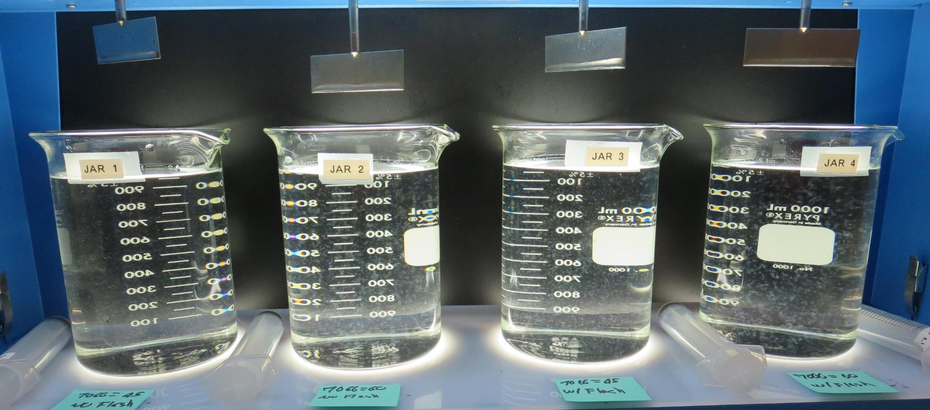
Jars 7-10: End of 5-minute flocculation (30 RPM) duration.
45 mg/L 7066
Filtrate 0.13 NTU
UVT: 91.9%
UVA: 0.036/cm
UVA Reduction 18.2%
Settled: 0.46 NTU
No Flash Mix
60 mg/L 7066
Filtrate 0.15 NTU
UVT: 92.5%
UVA: 0.033/cm
UVA Reduction 25%
Settled: 0.54 NTU
No Flash Mix
45 mg/L 7066
Filtrate 0.10 NTU
UVT: 91.8%
UVA: 0.037/cm
UVA Reduction 15.9%
Settled: 0.42 NTU
Flash Mix,
20 sec (200 RPM)
60 mg/L 7066
Filtrate 0.14 NTU
UVT: 92.6%
UVA: 0.033/cm
UVA Reduction 25%
Settled: 0.32 NTU
Flash Mix,
20 sec (200 RPM)

Slide 19
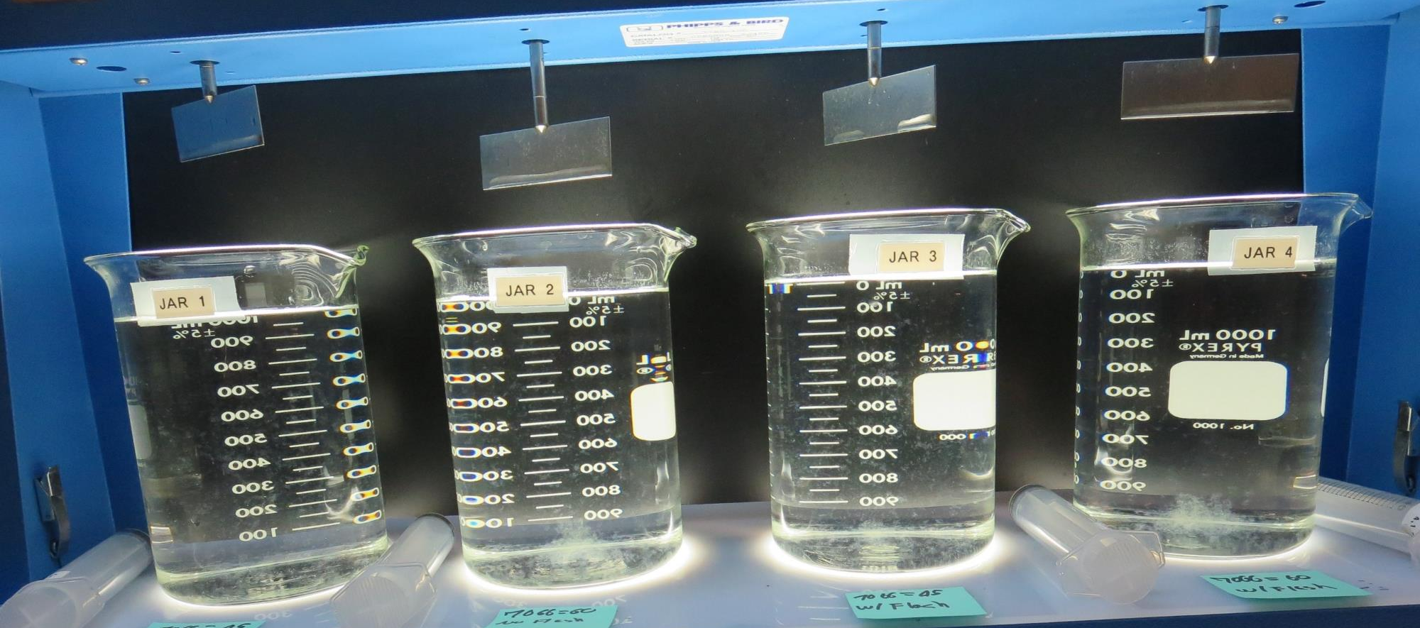
Jars 7-10: After 5 min of settling, 25 mL is syringed for filterability and %UVT/UVA.

Slide 20
Jars 7-10: After 25-minutes of settling, settled water turbidity is taken.
45 mg/L 7066
Filtrate 0.10 NTU
UVT: 91.8%
UVA: 0.037/cm
UVA Reduction 15.9%
Settled: 0.42 NTU
Flash Mix,
20 sec (200 RPM)
60 mg/L 7066
Filtrate 0.14 NTU
UVT: 92.6%
UVA: 0.033/cm
UVA Reduction 25%
Settled: 0.32 NTU
Flash Mix,
20 sec (200 RPM)
45 mg/L 7066
Filtrate 0.13 NTU
UVT: 91.9%
UVA: 0.036/cm
UVA Reduction 18.2%
Settled: 0.46 NTU
No Flash Mix
60 mg/L 7066
Filtrate 0.15 NTU
UVT: 92.5%
UVA: 0.033/cm
UVA Reduction 25%
Settled: 0.54 NTU
No Flash Mix

Slide 21
Jars 11-14 Test
Flash Mix 0-20 Sec (200 RPM)
Floc Mix 5 min (30 RPM)
Applied Coagulant
Adv Coag

Slide 22
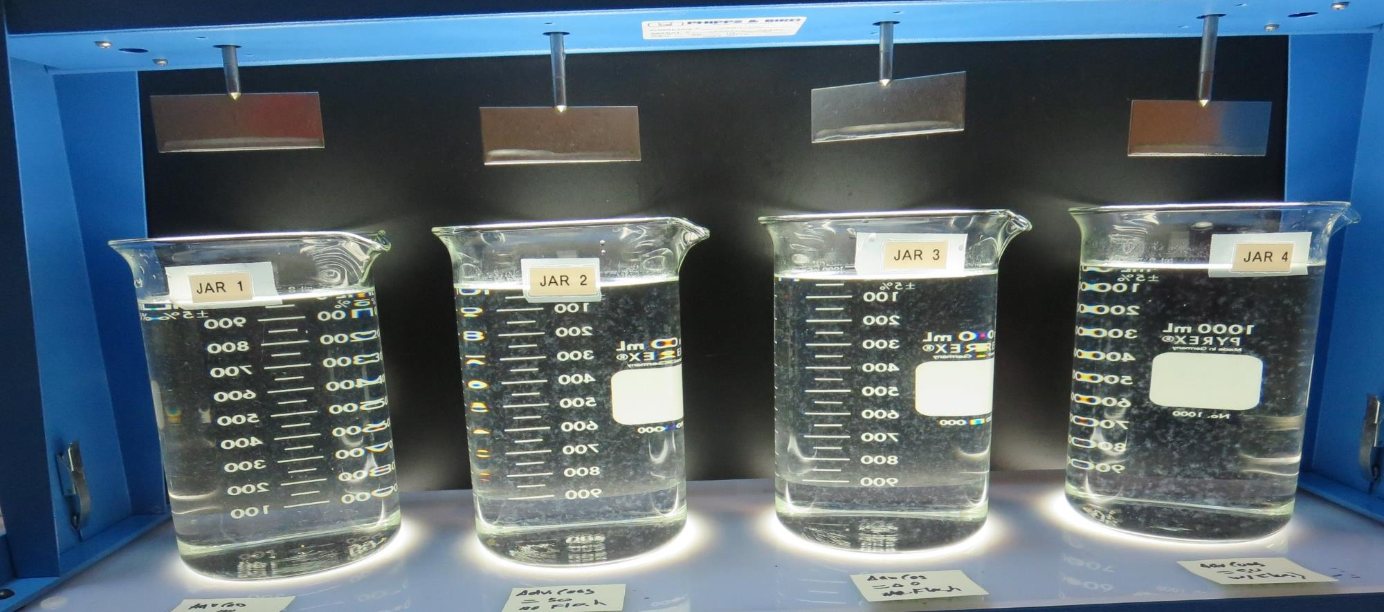
Jars 11-14: End of 5-minute flocculation (30 RPM) duration.
40 mg/L Adv Coag
Filtrate 0.09 NTU
UVT: 92.9%
UVA: 0.035/cm
UVA Reduction 20.5%
Settled: 0.42 NTU
No Flash Mix
50 mg/L Adv Coag
Filtrate 0.10 NTU
UVT: 92.7%
UVA: 0.032/cm
UVA Reduction 27.3%
Settled: 0.35 NTU
No Flash Mix
40 mg/L Adv Coag
Filtrate 0.13 NTU
UVT: 92.1%
UVA: 0.035/cm
UVA Reduction 20.5%
Settled: 0.39 NTU
Flash Mix,
20 sec (200 RPM)
50 mg/L Adv Coag
Filtrate 0.16 NTU
UVT: 92.5%
UVA: 0.033/cm
UVA Reduction 25%
Settled: 0.30 NTU
Flash Mix,
20 sec (200 RPM)

Slide 23
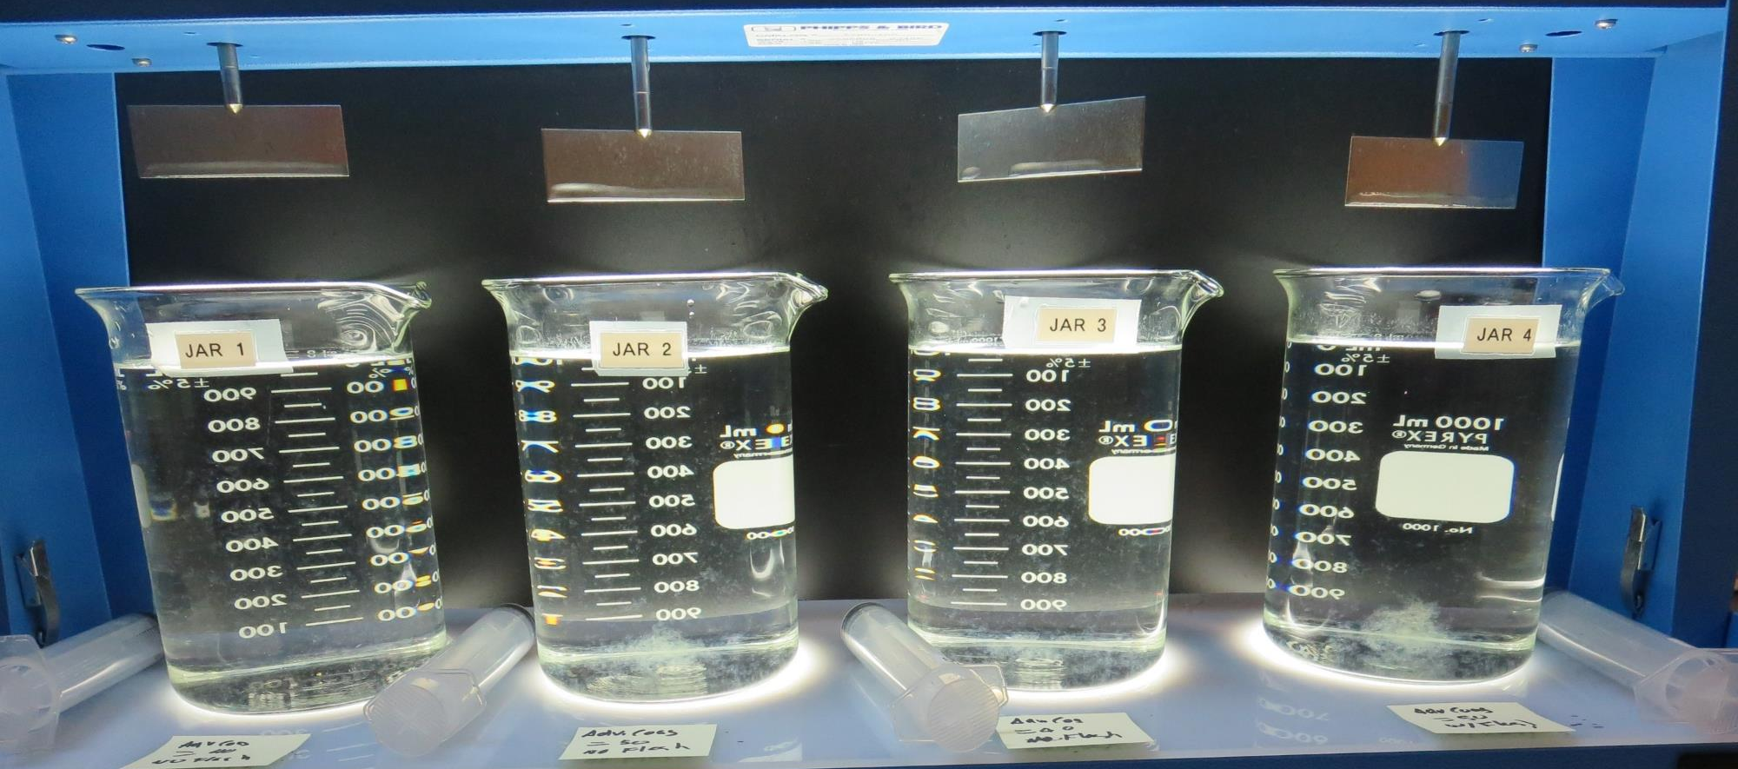
Jars 11-14: After 5 min of settling, 25 mL is syringed for filterability and %UVT/UVA.

Slide 24
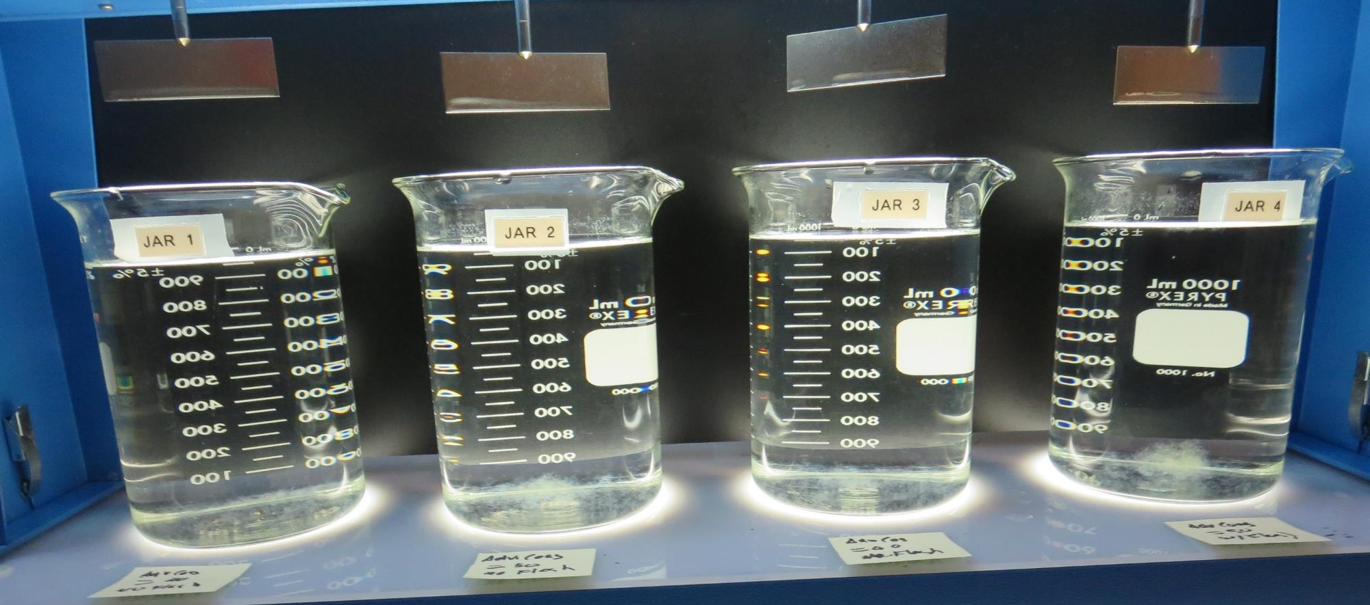
Jars 11-14: After 25-minutes of settling, settled water turbidity is taken.
40 mg/L Adv Coag
Filtrate 0.09 NTU
UVT: 92.9%
UVA: 0.035/cm
UVA Reduction 20.5%
Settled: 0.42 NTU
No Flash Mix
50 mg/L Adv Coag
Filtrate 0.10 NTU
UVT: 92.7%
UVA: 0.032/cm
UVA Reduction 27.3%
Settled: 0.35 NTU
No Flash Mix
40 mg/L Adv Coag
Filtrate 0.13 NTU
UVT: 92.1%
UVA: 0.035/cm
UVA Reduction 20.5%
Settled: 0.39 NTU
Flash Mix,
20 sec (200 RPM)
50 mg/L Adv Coag
Filtrate 0.16 NTU
UVT: 92.5%
UVA: 0.033/cm
UVA Reduction 25%
Settled: 0.30 NTU
Flash Mix,
20 sec (200 RPM)

Slide 25
Jars 15-18 Test
No Flash Mix
Floc Mix 5 min (30 RPM)
Applied Coagulant
9800

Slide 26
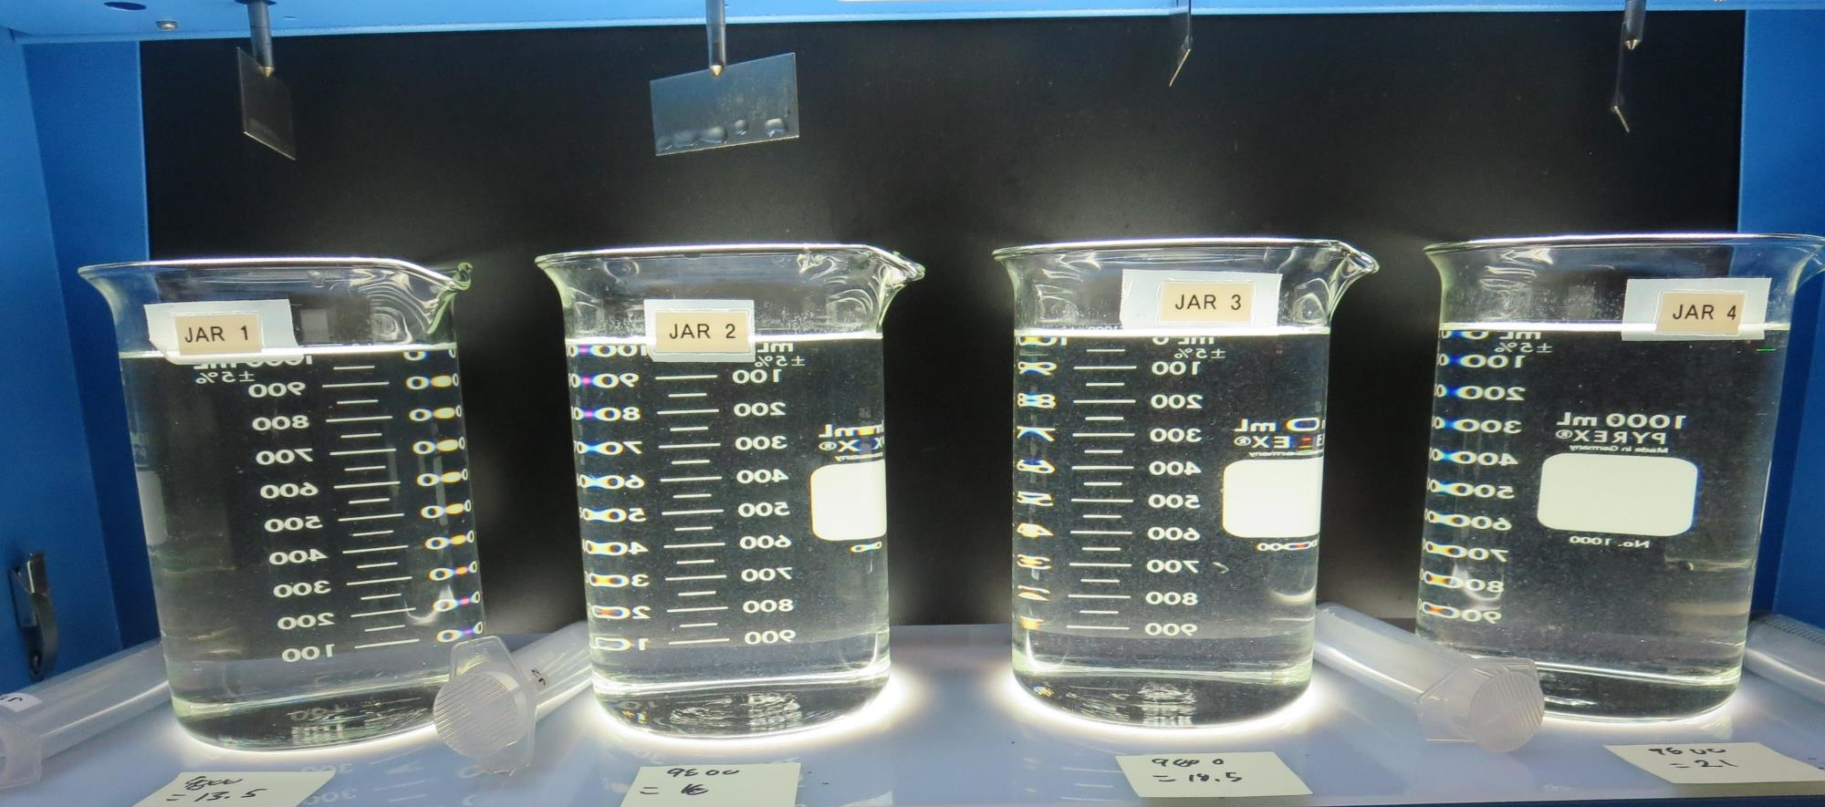
Jars 15-18: End of 5-minute flocculation (30 RPM) duration.
13.5 mg/L 9800
Filtrate 0.09 NTU
UVT: 92.5%
UVA: 0.034/cm
UVA Reduction 22.7%
Settled: 0.85 NTU
16 mg/L 9800
Filtrate 0.11 NTU
UVT: 92.4%
UVA: 0.034/cm
UVA Reduction 22.7%
Settled: 0.61 NTU
18.5 mg/L 9800
Filtrate 0.10 NTU
UVT: 92.6%
UVA: 0.033/cm
UVA Reduction 25%
Settled: 0.51 NTU
21 mg/L 9800
Filtrate 0.11 NTU
UVT: 92.9%
UVA: 0.032/cm
UVA Reduction 27.3%
Settled: 0.48 NTU

Slide 27
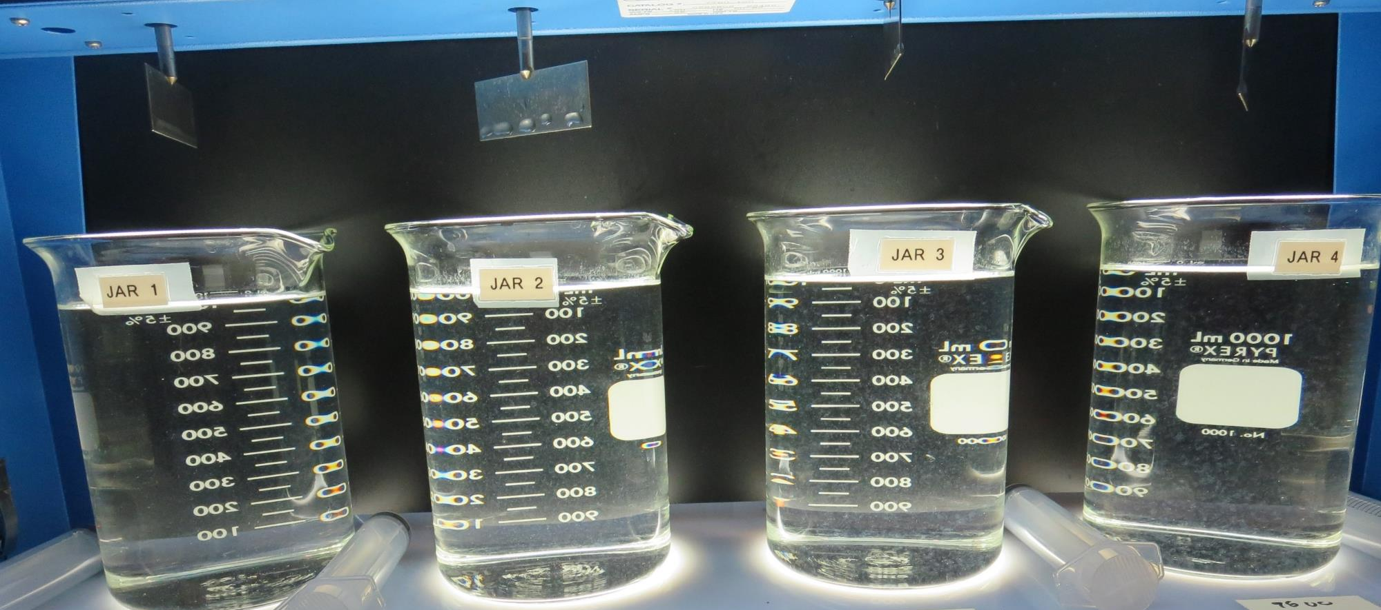
Jars 15-18: After 5 min of settling, 25 mL is syringed for filterability and %UVT/UVA.

Slide 28
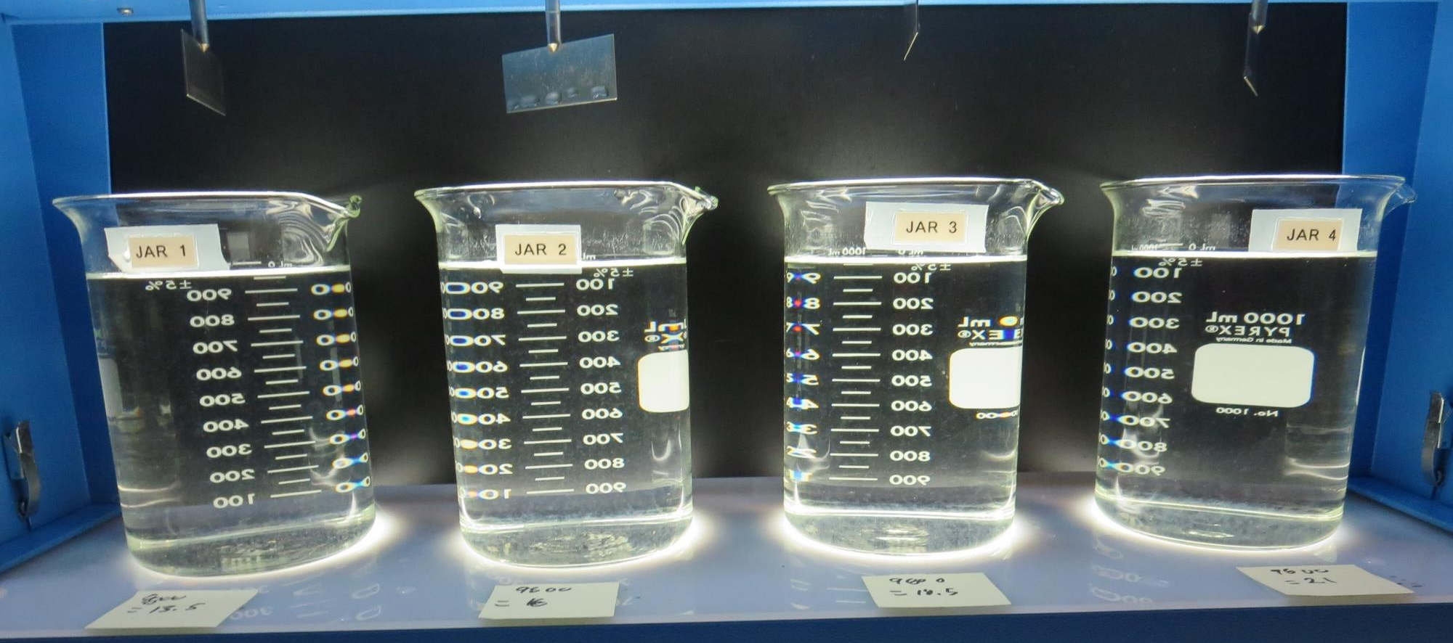
Jars 15-18: After 25-minutes of settling, settled water turbidity is taken.
13.5 mg/L 9800
Filtrate 0.09 NTU
UVT: 92.5%
UVA: 0.034/cm
UVA Reduction 22.7%
Settled: 0.85 NTU
16 mg/L 9800
Filtrate 0.11 NTU
UVT: 92.4%
UVA: 0.034/cm
UVA Reduction 22.7%
Settled: 0.61 NTU
18.5 mg/L 9800
Filtrate 0.10 NTU
UVT: 92.6%
UVA: 0.033/cm
UVA Reduction 25%
Settled: 0.51 NTU
21 mg/L 9800
Filtrate 0.11 NTU
UVT: 92.9%
UVA: 0.032/cm
UVA Reduction 27.3%
Settled: 0.48 NTU

Slide 29
Jars 19-22 Test
No Flash Mix
Floc Mix 5 min (30 RPM)
Applied Coagulant
9800

Slide 30
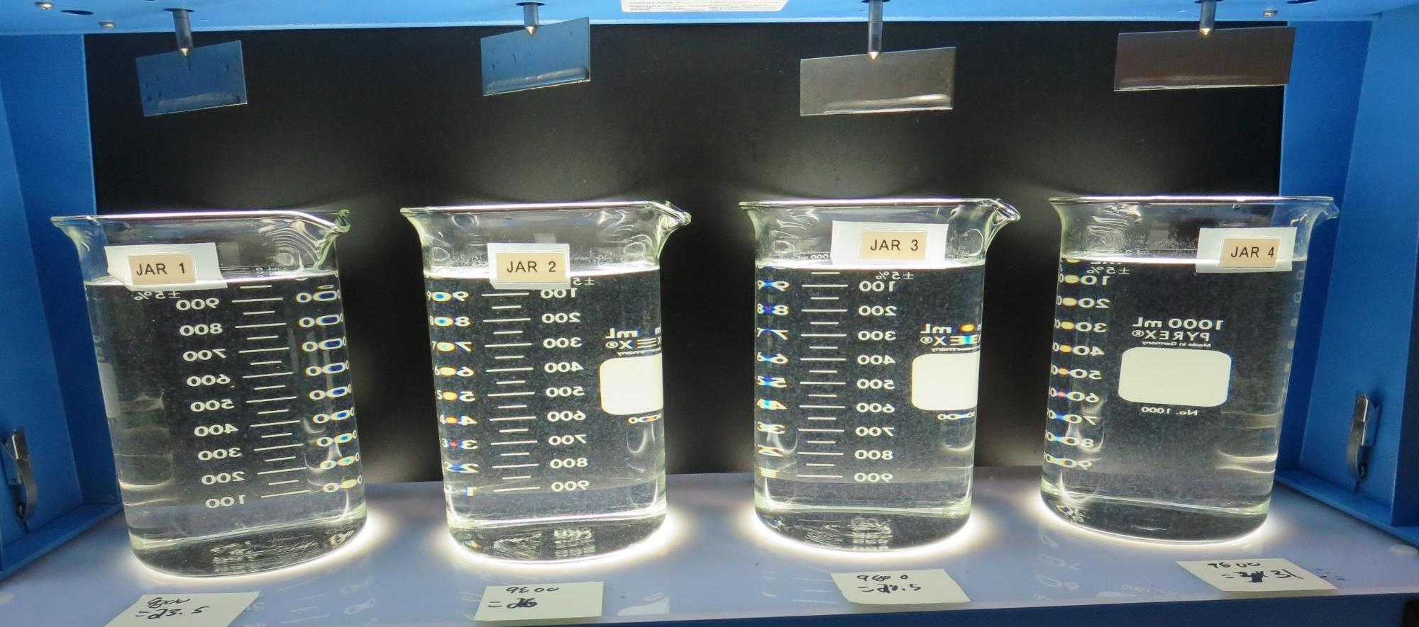
Jars 19-22: End of 5-minute flocculation (30 RPM) duration.
23.5 mg/L 9800
Filtrate 0.08 NTU
UVT: 93.3%
UVA: 0.030/cm
UVA Reduction 31.8%
Settled: 0.41 NTU
26 mg/L 9800
Filtrate 0.15 NTU
UVT: 93.2%
UVA: 0.030/cm
UVA Reduction 31.8%
Settled: 0.45 NTU
28.5 mg/L 9800
Filtrate 0.10 NTU
UVT: 93.4%
UVA: 0.029/cm
UVA Reduction 34.1%
Settled: 0.38 NTU
31 mg/L 9800
Filtrate 0.11 NTU
UVT: 93.6%
UVA: 0.028/cm
UVA Reduction 36.4%
Settled: 0.34 NTU

Slide 31
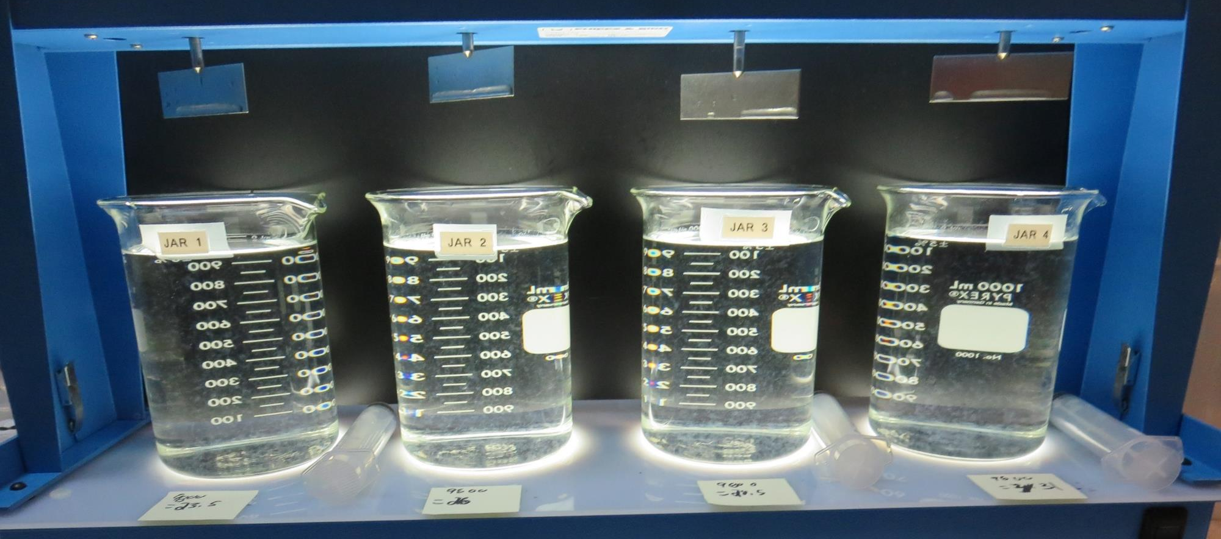
Jars 19-22: After 5 min of settling, 25 mL is syringed for filterability and %UVT/UVA.

Slide 32
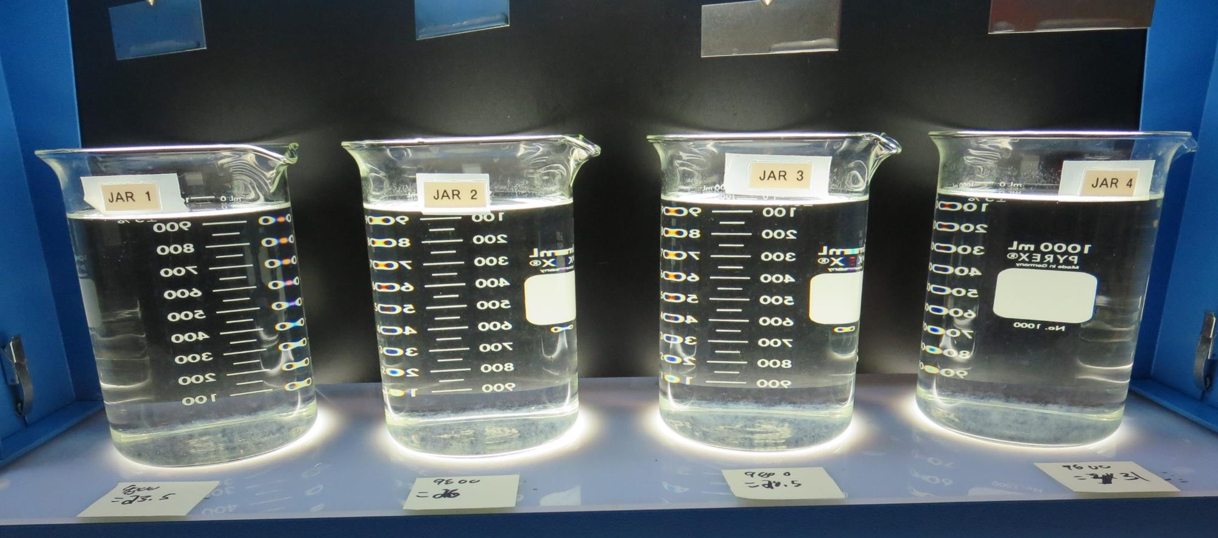
Jars 19-22: After 25-minutes of settling, settled water turbidity is taken.
23.5 mg/L 9800
Filtrate 0.08 NTU
UVT: 93.3%
UVA: 0.030/cm
UVA Reduction 31.8%
Settled: 0.41 NTU
26 mg/L 9800
Filtrate 0.15 NTU
UVT: 93.2%
UVA: 0.030/cm
UVA Reduction 31.8%
Settled: 0.45 NTU
28.5 mg/L 9800
Filtrate 0.10 NTU
UVT: 93.4%
UVA: 0.029/cm
UVA Reduction 34.1%
Settled: 0.38 NTU
31 mg/L 9800
Filtrate 0.11 NTU
UVT: 93.6%
UVA: 0.028/cm
UVA Reduction 36.4%
Settled: 0.34 NTU

Slide 33
Jars 23-26 Test
No Flash Mix
Floc Mix 5 min (30 RPM)
Applied Coagulant
Alum

Slide 34
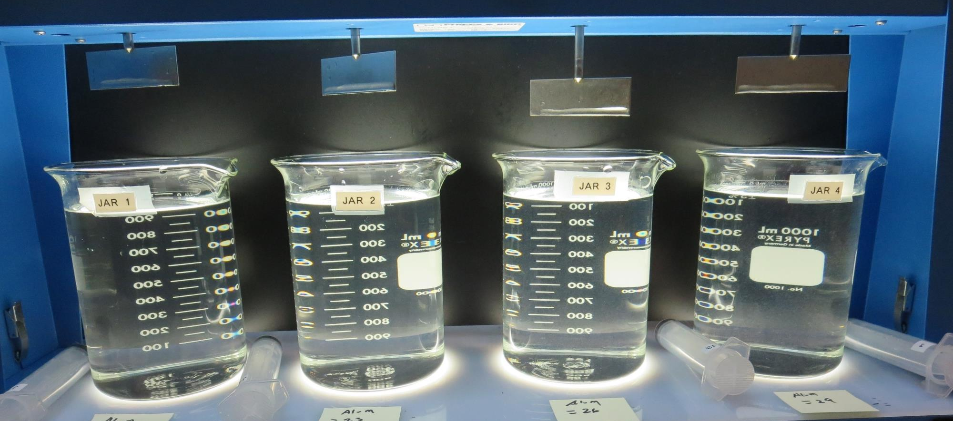
Jars 23-26: End of 5-minute flocculation (30 RPM) duration.
20 mg/L Alum
Filtrate 0.18 NTU
UVT: 91.3%
UVA: 0.039/cm
UVA Reduction 11.4%
Settled: 1.11 NTU
23 mg/L Alum
Filtrate 0.20 NTU
UVT: 91.5%
UVA: 0.038/cm
UVA Reduction 13.6%
Settled: 1.05 NTU
26 mg/L Alum
Filtrate 0.20 NTU
UVT: 91.6%
UVA: 0.037/cm
UVA Reduction 15.9%
Settled: 0.89 NTU
29 mg/L Alum
Filtrate 0.12 NTU
UVT: 92.5%
UVA: 0.033/cm
UVA Reduction 25%
Settled: 0.68 NTU

Slide 35
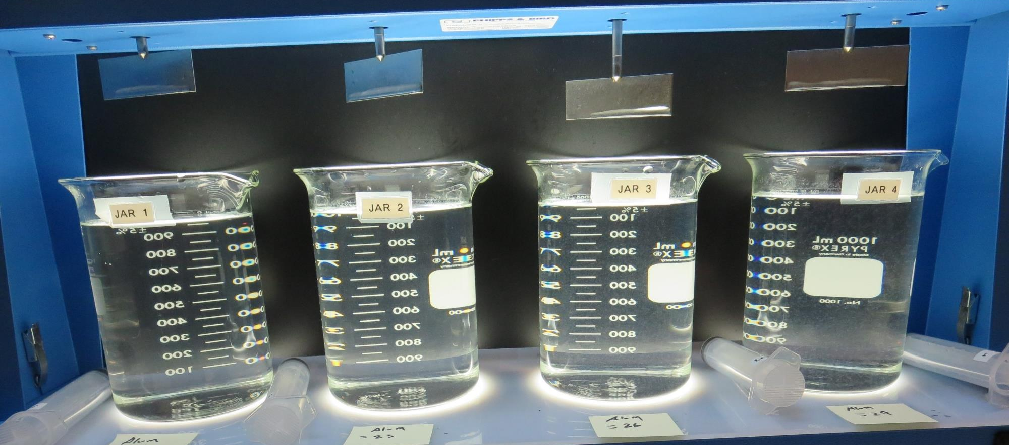
Jars 23-26: After 5 min of settling, 25 mL is syringed for filterability and %UVT/UVA.

Slide 36
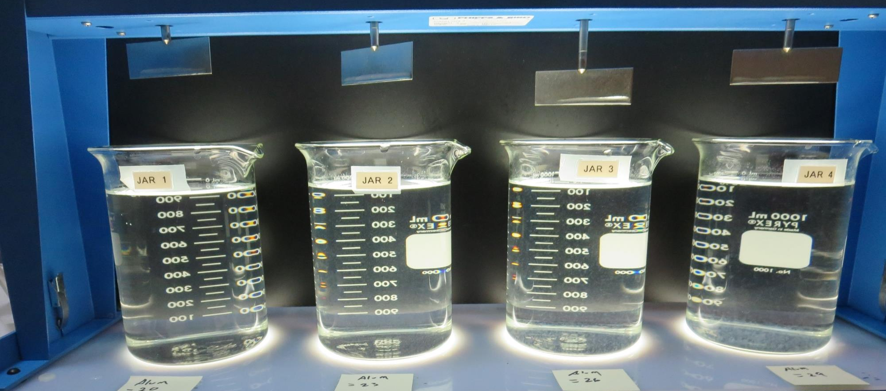
Jars 23-26: After 25-minutes of settling, settled water turbidity is taken.
20 mg/L Alum
Filtrate 0.18 NTU
UVT: 91.3%
UVA: 0.039/cm
UVA Reduction 11.4%
Settled: 1.11 NTU
23 mg/L Alum
Filtrate 0.20 NTU
UVT: 91.5%
UVA: 0.038/cm
UVA Reduction 13.6%
Settled: 1.05 NTU
26 mg/L Alum
Filtrate 0.20 NTU
UVT: 91.6%
UVA: 0.037/cm
UVA Reduction 15.9%
Settled: 0.89 NTU
29 mg/L Alum
Filtrate 0.12 NTU
UVT: 92.5%
UVA: 0.033/cm
UVA Reduction 25%
Settled: 0.68 NTU

Slide 37
Jars 27-30 Test
No Flash Mix
Floc Mix 5 min (30 RPM)
Applied Coagulant
9810

Slide 38
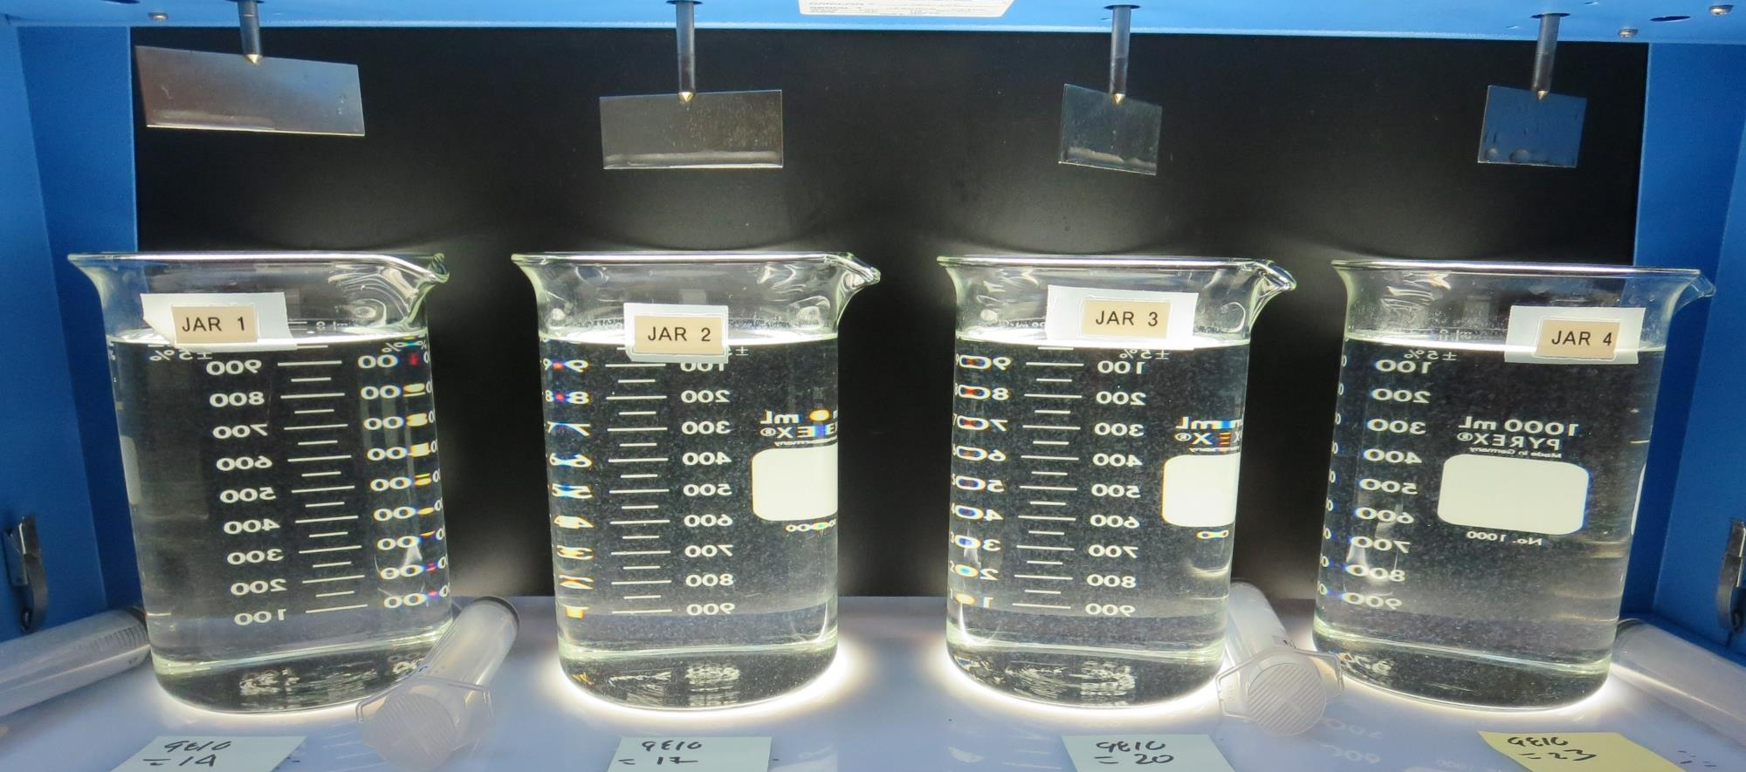
Jars 27-30: End of 5-minute flocculation (30 RPM) duration.
14 mg/L 9810
Filtrate 0.08 NTU
UVT: 93.1%
UVA: 0.030/cm
UVA Reduction 31.8%
Settled: 0.47 NTU
17 mg/L 9810
Filtrate 0.09 NTU
UVT: 93.2%
UVA: 0.030/cm
UVA Reduction 31.8%
Settled: 0.40 NTU
20 mg/L 9810
Filtrate 0.10 NTU
UVT: 93.3%
UVA: 0.029/cm
UVA Reduction 34.1%
Settled: 0.38 NTU
23 mg/L 9810
Filtrate 0.08 NTU
UVT: 93.7%
UVA: 0.026/cm
UVA Reduction 40.9%
Settled: 0.35 NTU

Slide 39
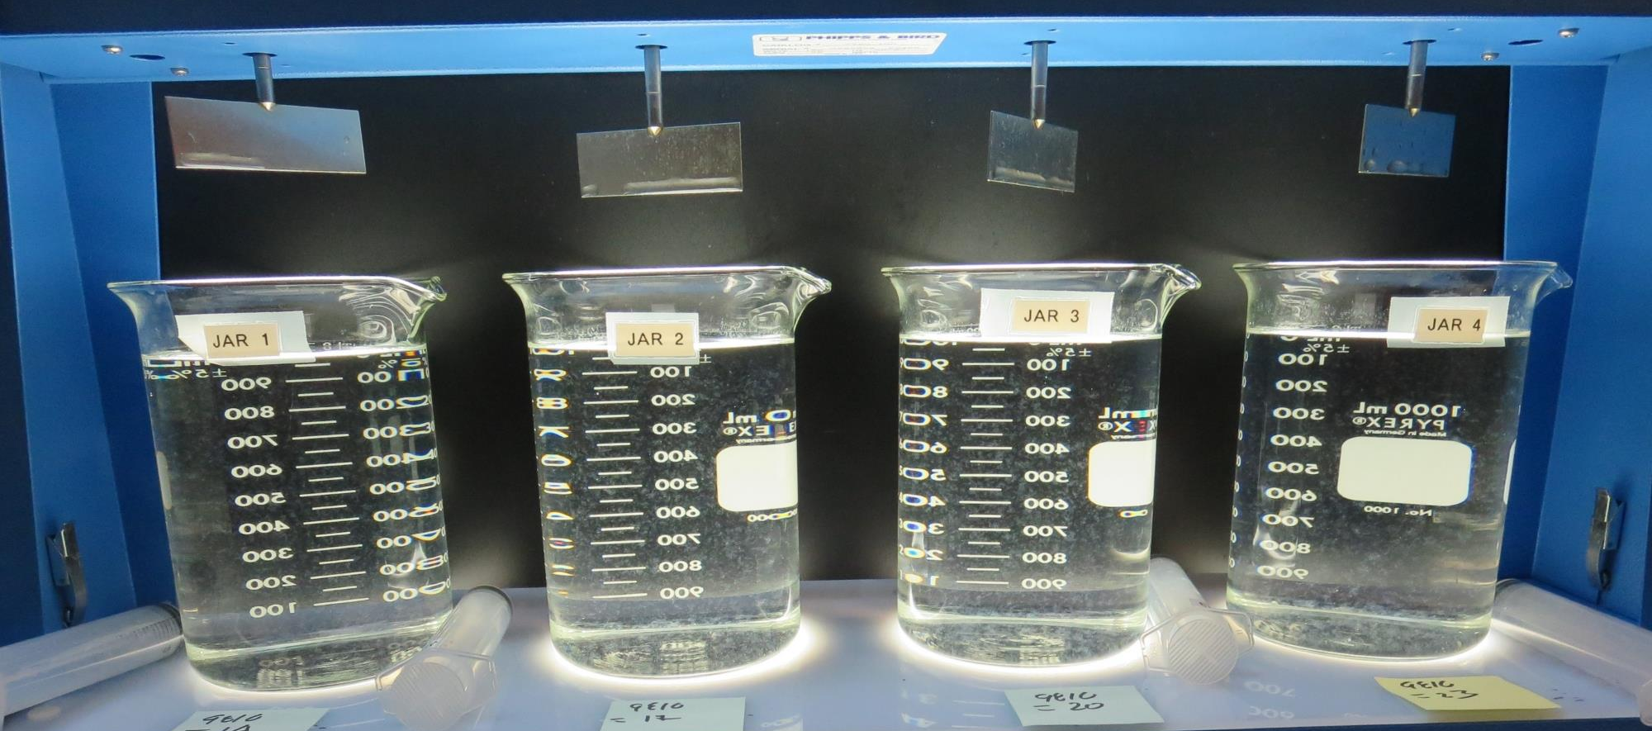
Jars 27-30: After 5 min of settling, 25 mL is syringed for filterability and %UVT/UVA.

Slide 40
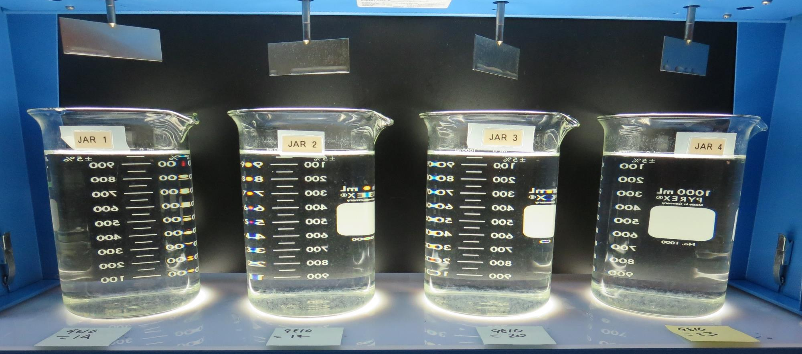
Jars 27-30: After 25-minutes of settling, settled water turbidity is taken.
14 mg/L 9810
Filtrate 0.08 NTU
UVT: 93.1%
UVA: 0.030/cm
UVA Reduction 31.8%
Settled: 0.47 NTU
17 mg/L 9810
Filtrate 0.09 NTU
UVT: 93.2%
UVA: 0.030/cm
UVA Reduction 31.8%
Settled: 0.40 NTU
20 mg/L 9810
Filtrate 0.10 NTU
UVT: 93.3%
UVA: 0.029/cm
UVA Reduction 34.1%
Settled: 0.38 NTU
23 mg/L 9810
Filtrate 0.08 NTU
UVT: 93.7%
UVA: 0.026/cm
UVA Reduction 40.9%
Settled: 0.35 NTU

Slide 41
Jars 31-34 Test
No Flash Mix
Floc Mix 5 min (30 RPM)
Applied Coagulant
9810

Slide 42
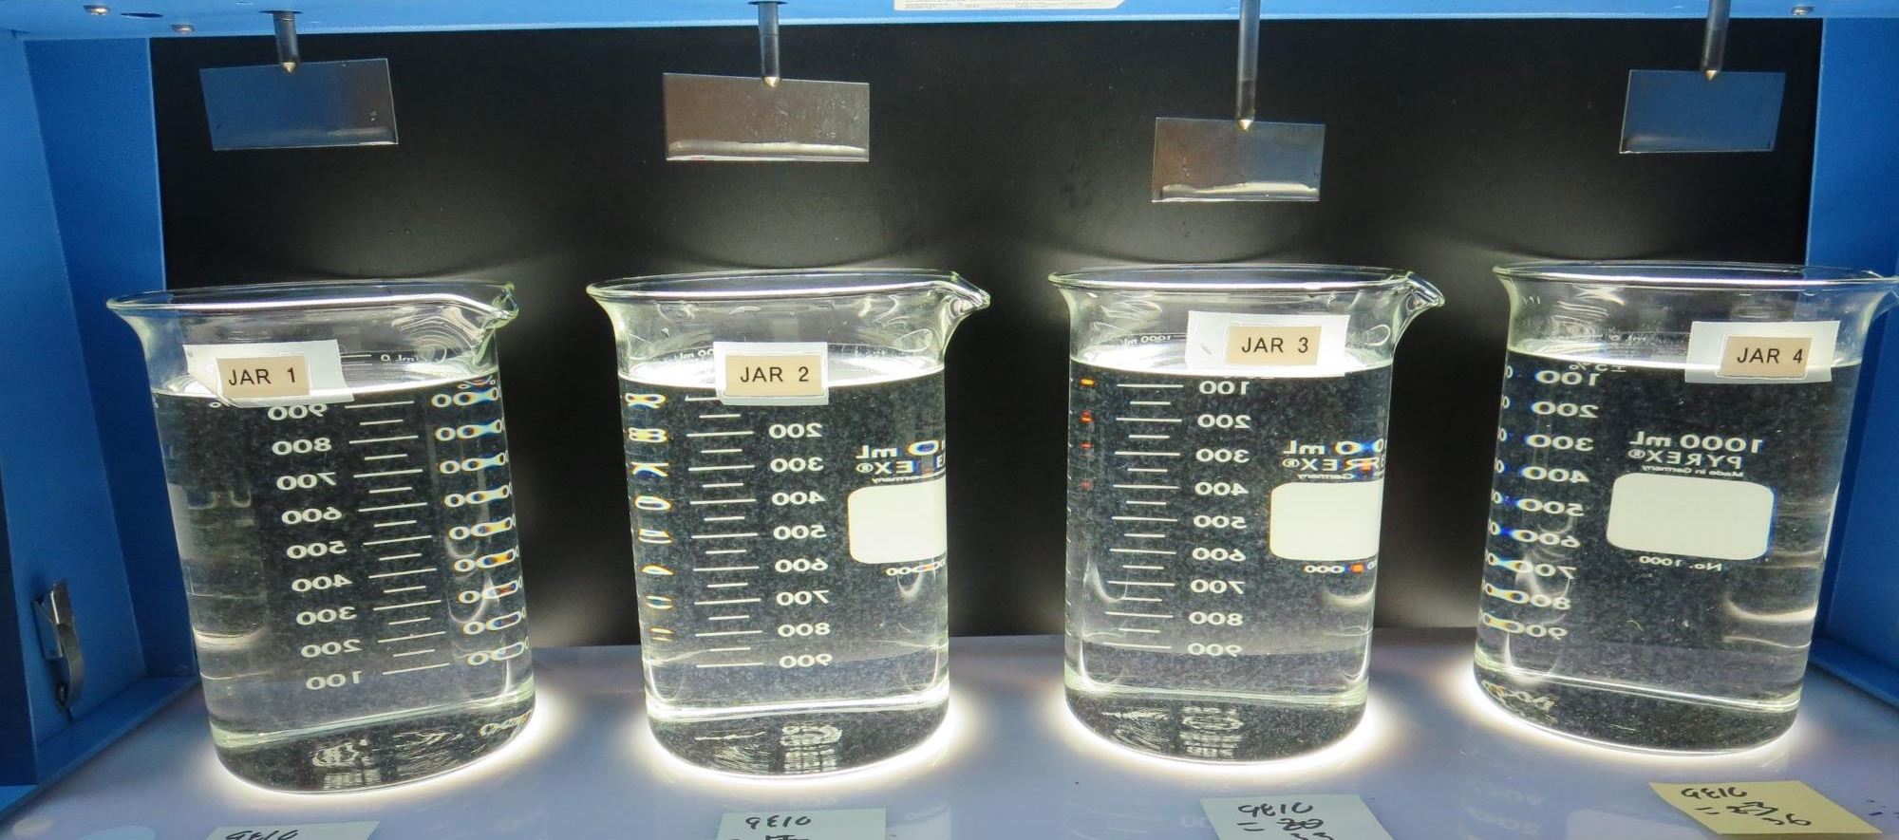
Jars 31-34: End of 5-minute flocculation (30 RPM) duration.
26 mg/L 9810
Filtrate 0.10 NTU
UVT: 93.7%
UVA: 0.028/cm
UVA Reduction 36.4%
Settled: 0.27 NTU
29 mg/L 9810
Filtrate 0.08 NTU
UVT: 93.9%
UVA: 0.027/cm
UVA Reduction 38.6%
Settled: 0.29 NTU
33 mg/L 9810
Filtrate 0.10 NTU
UVT: 94.0%
UVA: 0.026/cm
UVA Reduction 40.9%
Settled: 0.31 NTU
36 mg/L 9810
Filtrate 0.10 NTU
UVT: 94.0%
UVA: 0.026/cm
UVA Reduction 40.9%
Settled: 0.28 NTU

Slide 43
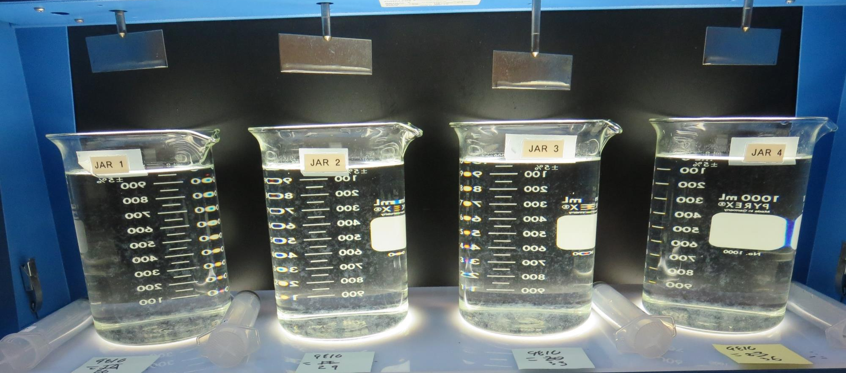
Jars 31-34: After 5 min of settling, 25 mL is syringed for filterability and %UVT/UVA.

Slide 44
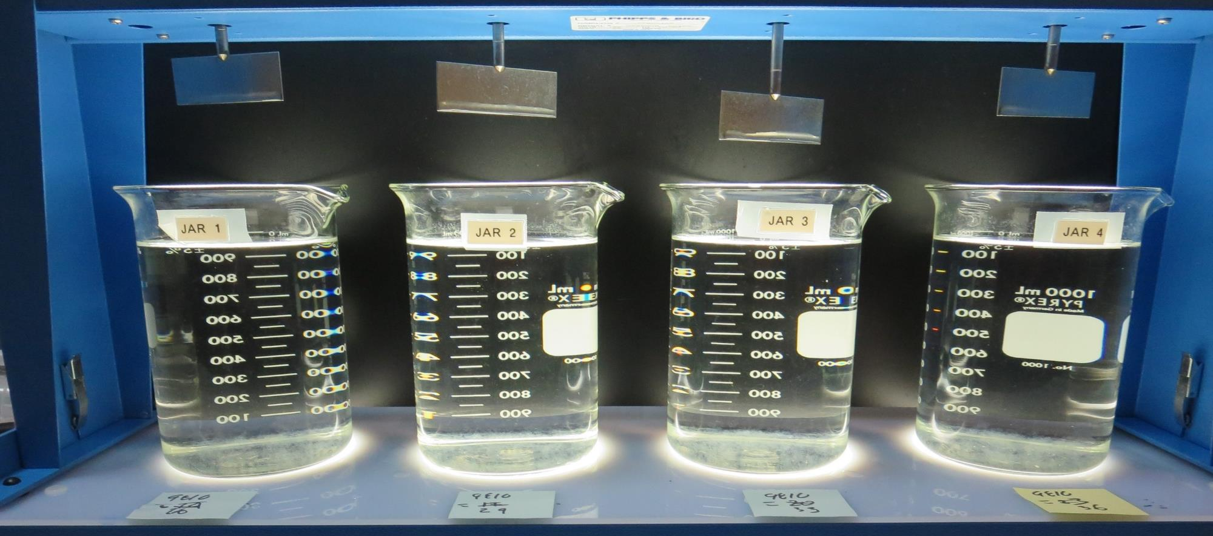
Jars 31-34: After 25-minutes of settling, settled water turbidity is taken.
26 mg/L 9810
Filtrate 0.10 NTU
UVT: 93.7%
UVA: 0.028/cm
UVA Reduction 36.4%
Settled: 0.27 NTU
29 mg/L 9810
Filtrate 0.08 NTU
UVT: 93.9%
UVA: 0.027/cm
UVA Reduction 38.6%
Settled: 0.29 NTU
33 mg/L 9810
Filtrate 0.10 NTU
UVT: 94.0%
UVA: 0.026/cm
UVA Reduction 40.9%
Settled: 0.31 NTU
36 mg/L 9810
Filtrate 0.10 NTU
UVT: 94.0%
UVA: 0.026/cm
UVA Reduction 40.9%
Settled: 0.28 NTU

Slide 45
Jars 35-37 Test
No Flash Mix
Floc Mix 5 min (30 RPM)
Applied Coagulant
9800/9810/Alum

Slide 46
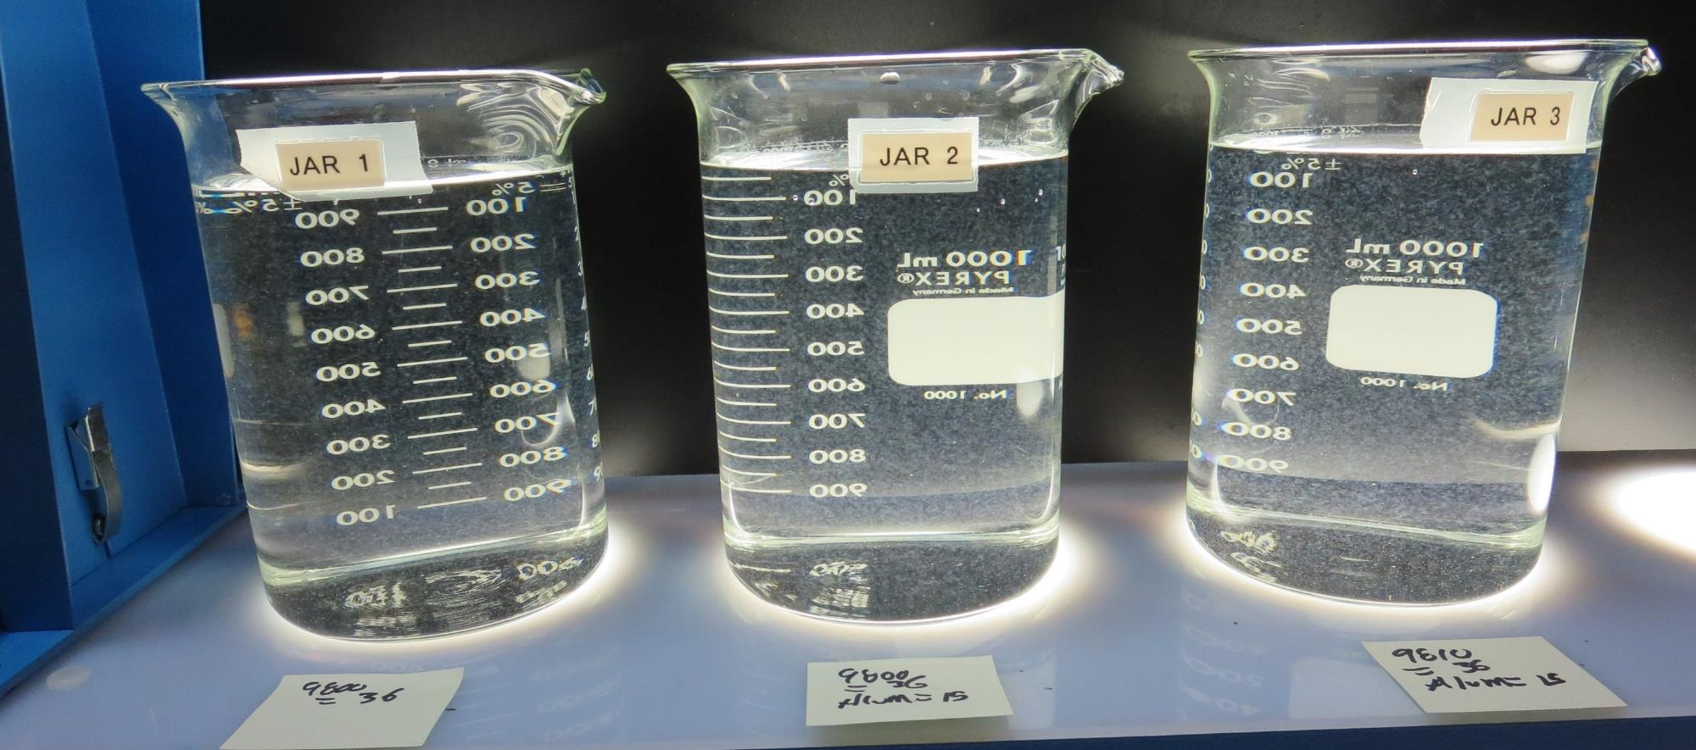
Jars 35-37: End of 5-minute flocculation (30 RPM) duration.
36 mg/L 9800
15 mg/L Alum
Filtrate 0.12 NTU
UVT: 94.5%
UVA: 0.024/cm
UVA Reduction 45.5%
Settled: 0.37 NTU
36 mg/L 9810
15 mg/L Alum
Filtrate 0.08 NTU
UVT: 94.5%
UVA: 0.024/cm
UVA Reduction 45.5%
Settled: 0.77 NTU
36 mg/L 9800
0 mg/L Alum
Filtrate 0.14 NTU
UVT: 93.8%
UVA: 0.027/cm
UVA Reduction 38.6%
Settled: 0.35 NTU

Slide 47
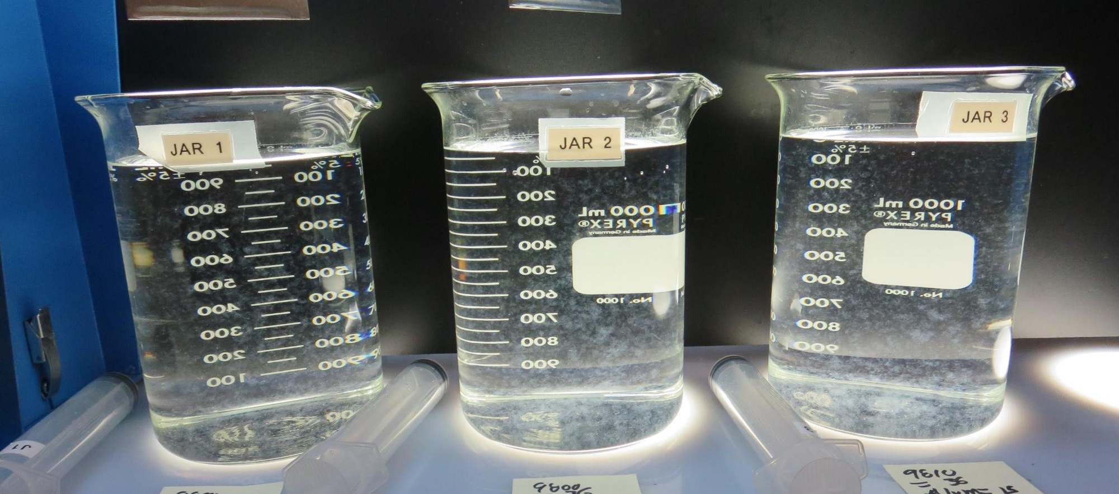
Jars 35-37: After 5 min of settling, 25 mL is syringed for filterability and %UVT/UVA.

Slide 48
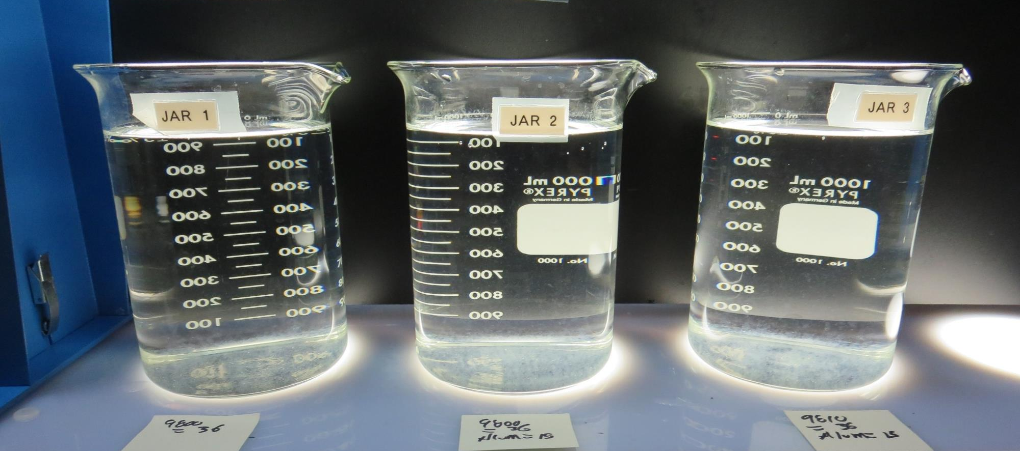
Jars 35-37: After 25-minutes of settling, settled water turbidity is taken.
36 mg/L 9800
15 mg/L Alum
Filtrate 0.12 NTU
UVT: 94.5%
UVA: 0.024/cm
UVA Reduction 45.5%
Settled: 0.37 NTU
36 mg/L 9810
15 mg/L Alum
Filtrate 0.08 NTU
UVT: 94.5%
UVA: 0.024/cm
UVA Reduction 45.5%
Settled: 0.77 NTU
36 mg/L 9800
0 mg/L Alum
Filtrate 0.14 NTU
UVT: 93.8%
UVA: 0.027/cm
UVA Reduction 38.6%
Settled: 0.35 NTU

Slide 49
Jar Testing for 1-Liter Jars:
Procedures for Most Treatment Plants
Fill jars with source water prior to coagulant injection and set paddle speed at 30 rpm
Add chemicals (i.e., NaOCl, primary coagulant, coagulant aid) to each jar
Flash mix for 15-60 seconds (200 rpm)
Slow mix for 5 minutes (20-30 rpm)
Settled for 5 minutes. Syringe 25 mL from each jar taken 1-inch below surface (25 mL/12 sec rate)
Filtered through 1.2 um isopore membrane into cuvette drip rate, 15 mL/(50-90 sec)
Measure filtrate turbidity, chlorine residual and %UVT/UVA
Measure settled water turbidity after 25 minutes of total setting
Record all data

Slide 50

Jar Test
Filterability Test Equipment
Turbidity Instrument
Syringe w/Luer-Lock Tip, 30 cc
(part#: 2225800, by Hach)
Swinnex Filter Holder, 25 mm (part#: SX0002500)
Isopore Membrane Filter, 1.2 um absolute
pore size,
Φ= 25 mm , thickness: 24 um,
hydrophilic polycarbonate membrane
(part #: RTTP02500)
Go to Sigma-Aldrich for laboratory supplies http://www.sigmaaldrich.com/united-states.html

Slide 51
Isopore Membrane Information
Categories | Information
trade name | Isopore
filter color | White
chemistry | Polycarbonate (PC)
water flow rate | Avg. 175 mL/min x cm² (typical results @ 10 psi)
media | Isopore®
wettability | Hydrophilic
porosity | 14.7%
pore size | 1.2 µm
bubble point at 23 °C | 1.0 bar, air with water
thickness | 24 µm
filter diameter (ø) | 25 mm
material size | polycarbonate, Hydrophilic, 1.2 µm, 25 mm, white, plain, 100

Slide 52
Isopore Membrane Background Information
The Isopore membrane is a polycarbonate, track-etched screen filter recommended for all analyses in which the sample is viewed on the surface of the membrane. The Isopore membrane is composed of polycarbonate film, which has a smooth, glass-like surface for clearer sample observation. The unique manufacturing process of the membrane ensures a precise pore diameter and a consistent pore size for accurate separation of samples by size. Matched-weight filters are not usually required because of low, constant tar and ash weights.
Features & Benefits:
Membrane structure retains particles on the surface, simplifying counting and analysis

Slide 53
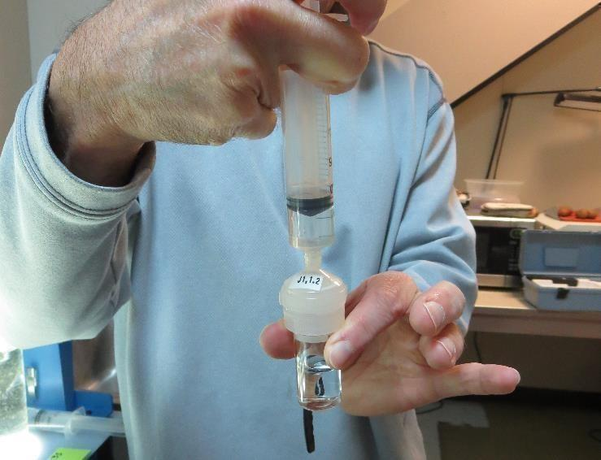

Jar Test - Filterability Test
Syringe ~ 25 mL from jar (after 5-minutes of settling)
Filter-to-waste 3-5 mL
Filter directly into clean cuvette
Measure turbidity
Note: Take several readings before recording final NTU results. Micro bubbles can adhere to glass causing false NTU readings. To remove bubbles, tilt cuvette up to 90 degrees.

Slide 54

Contact
Guy Schott, P.E.
State Water Resources Control Board
Division of Drinking Water
Santa Rosa, CA
Go to Stock Solution/Dose calculations/Jar Test Results for tools to download
www.waterboards.ca.gov/drinking_water/programs/districts/mendocino_district.html
Email: Guy Schott - Guy.Schott@waterboards.ca.gov
Office Number: 707-576-2732

