Slide 1
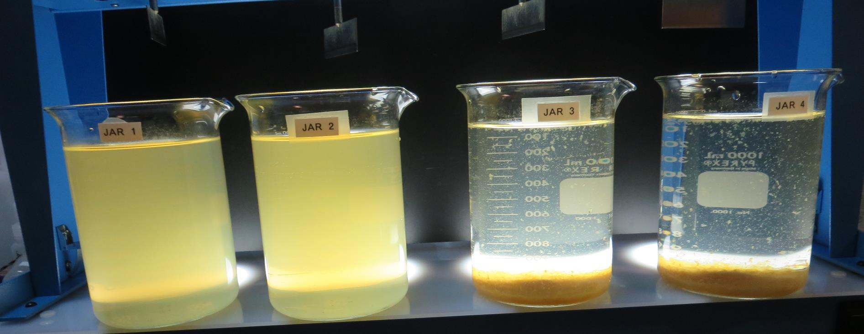
CSP-MacKerricher State Park
CA2310301, Mendocino County
Jar Test
by Guy Schott, P.E.
February 28, 2023

Slide 2
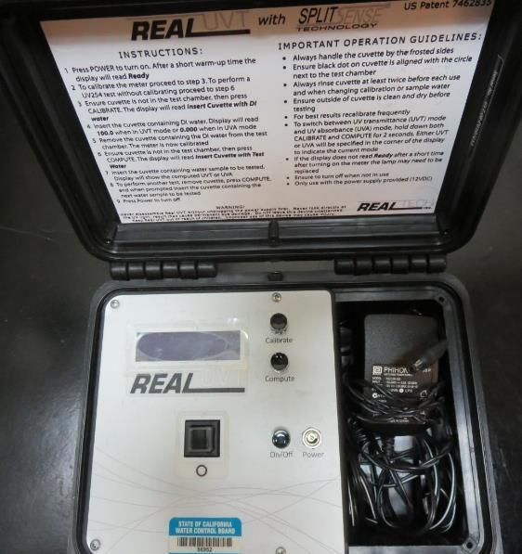
UVT/UVA, pathlength 10 mm
UV transmittance (UVT) is a measurement of the amount of ultraviolet light (254 nm) that passes through a water sample compared to the amount of light that passes through a pure water sample. The measurement is expressed as % UVT.
%UVT = 10^{(-UVA)} x 100%
UV absorbance (UVA) is calculated as a relative measure of the amount of light absorbed by a water sample compared with the amount of light absorbed by a pure water sample.
UVA = -log(%UVT/100)

Slide 3
CSP-MacKerricher State Park Source & Treated Water Characteristics, January 27, 2023
Source – Mill Creek
pH: 6.8 – 7.16
Alkalinity: x mg/L as CaCO₃
Turbidity: 43 NTU
UVT: 23.3%,
UVA: 0.632/cm
0.4 um Filtered
Turbidity: 1.12 NTU
UVT: 60.2%,
UVA: 0.220/cm
Source – Iron Concentration
Fe: 11.7 mg/L

Slide 4
Applied Coagulants for Jar Testing ()
BWS, Inc.
Greg Nieckarz, Ph.D.
Greg.niekarz@bws.works
541-953-5112
AdvFloc-CTC-00011
Polyaluminum Hydroxy Chlorosulfate
12.55% Al₂O₃
6.64% Al
64.9% Basicity
SG = 1.299
NSF limit: 250 mg/L as Product
960 (NTU Technologies)
33% Polyaluminum Hydroxychlorosulfate
67% Water
SG = 1.29
NSF limit: 250 mg/L as Product

Slide 5
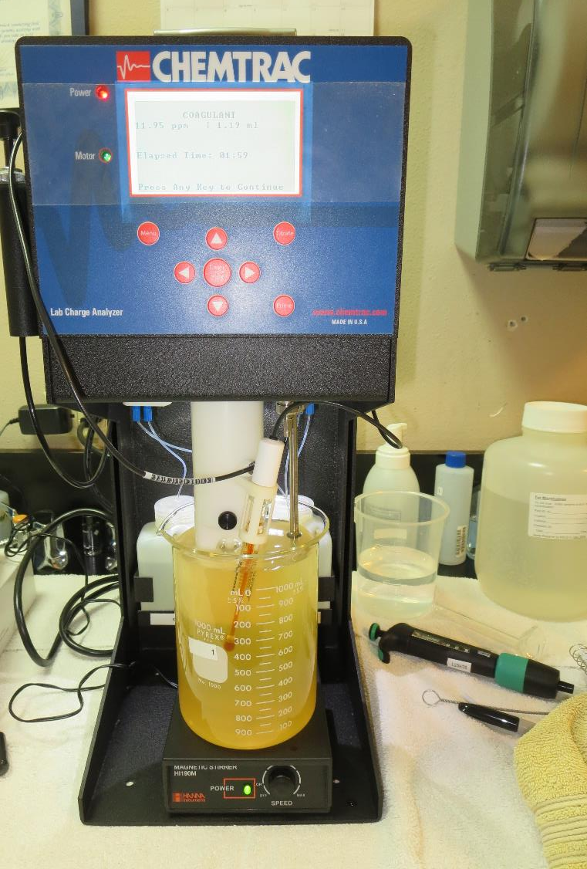
Laboratory Charge Analyzer
LCA: Used to determine coagulant demand of a source water entering the treatment plant.
Source pH: 6.8-7.16
LCA #1: CTC-00011: 51 mg/L
LCA #: 960: 78 mg/L

Slide 6
Coagulant Information
Unless stated otherwise, all coagulant doses are reported as Product (100% strength).
Aluminum Sulfate doses are reported as hydrated Al₂(SO₄)₃*14.3H₂0.
Ferric Chloride doses are reported as FeCl₃.
Preparation of coagulant stock solutions are generally 1.0 and/or 0.1 percent strength using 100 and/or 200 mL volumetric flasks.
Finnpipette F2 variable volume pipette, capacity 100-1000 micro liters is used for stock solution preparation and coagulant aid jar test dosing.
Finnpipette F2 variable volume pipette, capacity 0.5-5 mL is used for primary coagulant jar test dosing.

Slide 7
CSP-MacKerricher State Park; Jar Test 1 - 8 Results
Flash Mix 200 RPM (20 sec); Floc Mix 30 RPM (5 min)
Jar# | 960 mg/L | CTC-00011 mg/L | Filtrate NTU | Filtrate %UVT | Filtrate UVA/cm | Settle NTU 25 min | %UVA Reduction | Filtrate Fe, mg/L
J1 | 40 | - | 0.07 | 79.7 | 0.098 | 32.1 | 55.5 | -
J2 | 50 | - | 0.24 | 89.0 | 0.050 | 20.6 | 77.3 | -
J3 | - | 40 | 0.70 | 81.6 | 0.087 | 12.2 | 60.5 | -
J4 | - | 50 | 0.71 | 82.9 | 0.081 | 9.97 | 63.2 | -
J5 | 60 | - | 0.28 | 83.7 | 0.076 | 59.4 | 65.5 | -
J6 | 70 | - | 0.08 | 85.1 | 0.069 | 65.4 | 68.6 | -
J7 |  | 60 | 0.92 | 82.7 | 0.082 | 8.54 | 62.7 | -
J8 |  | 70 | 0.08 | 86.3 | 0.063 | 10.1 | 71.4 | 6.8
J9 | 80 | - | 0.09 | 87.6 | 0.057 | 8.66 | 74.1 | -

Slide 8
Jars 1-4 Test
Flash Mix 200 RPM, 20 Sec
Floc Mix 30 RPM, 5 min
25 mL sampled 5 minutes at end of Floc period
Applied Coagulants
960 & CTC-00011

Slide 9
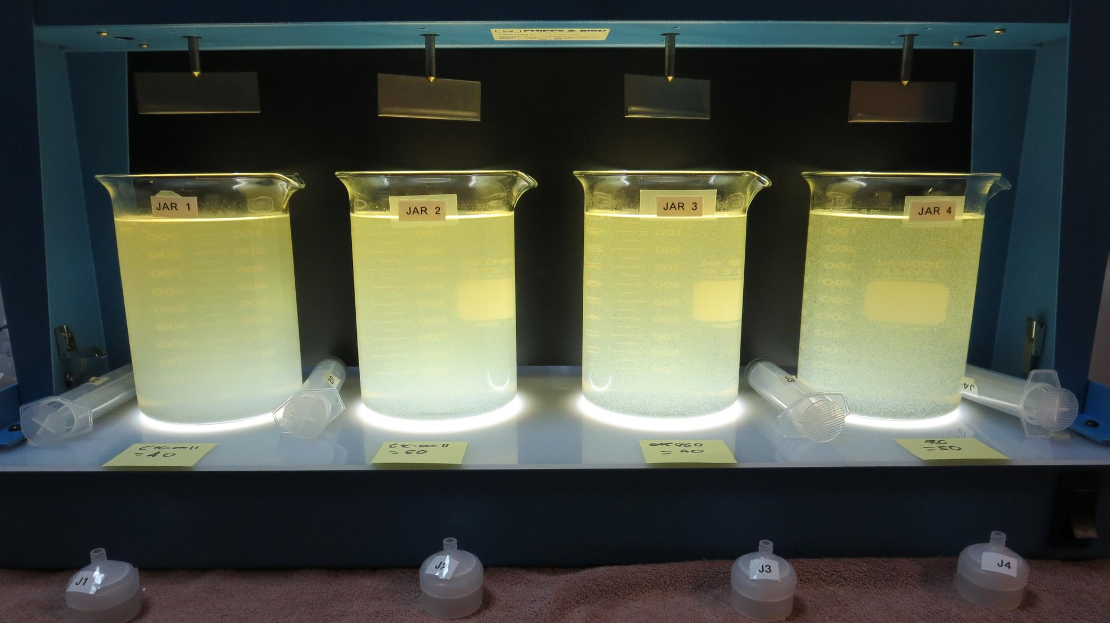
Jars 1-4: End of Floc Duration, 25 mL is syringed for filterability and %UVT/UVA.
40 mg/L CTC-00011
Filtrate: 0.07 NTU
UVT: 79.7%
UVA: 0.098/cm
UVA Reduction: 55.5%
Settled: 32.1 NTU
50 mg/L CTC-00011
Filtrate: 0.24 NTU
UVT: 89.0%
UVA: 0.050/cm
UVA Reduction: 77.3%
Settled: 20.6 NTU
40 mg/L 960
Filtrate: 0.70 NTU
UVT: 81.6%
UVA: 0.087/cm
UVA Reduction: 60.5%
Settled: 12.2 NTU
50 mg/L 960
Filtrate: 0.71 NTU
UVT: 82.9%
UVA: 0.081/cm
UVA Reduction: 63.2%
Settled: 9.97 NTU

Slide 10
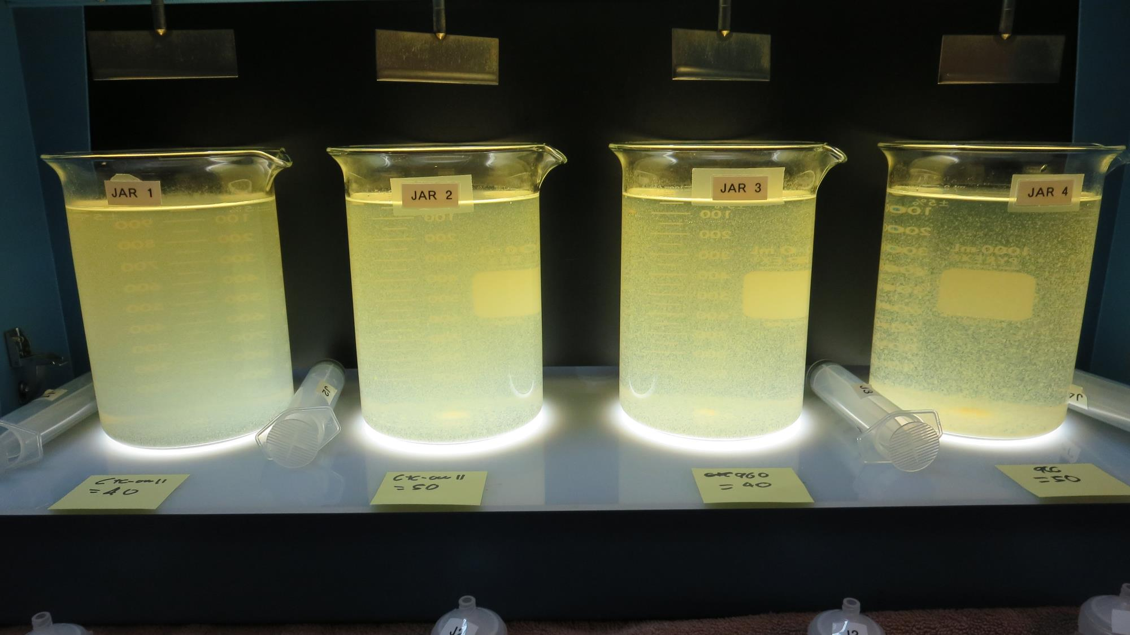
Jars 1-4: After 5 min of settling, 25 mL is syringed for filterability and %UVT/UVA.

Slide 11
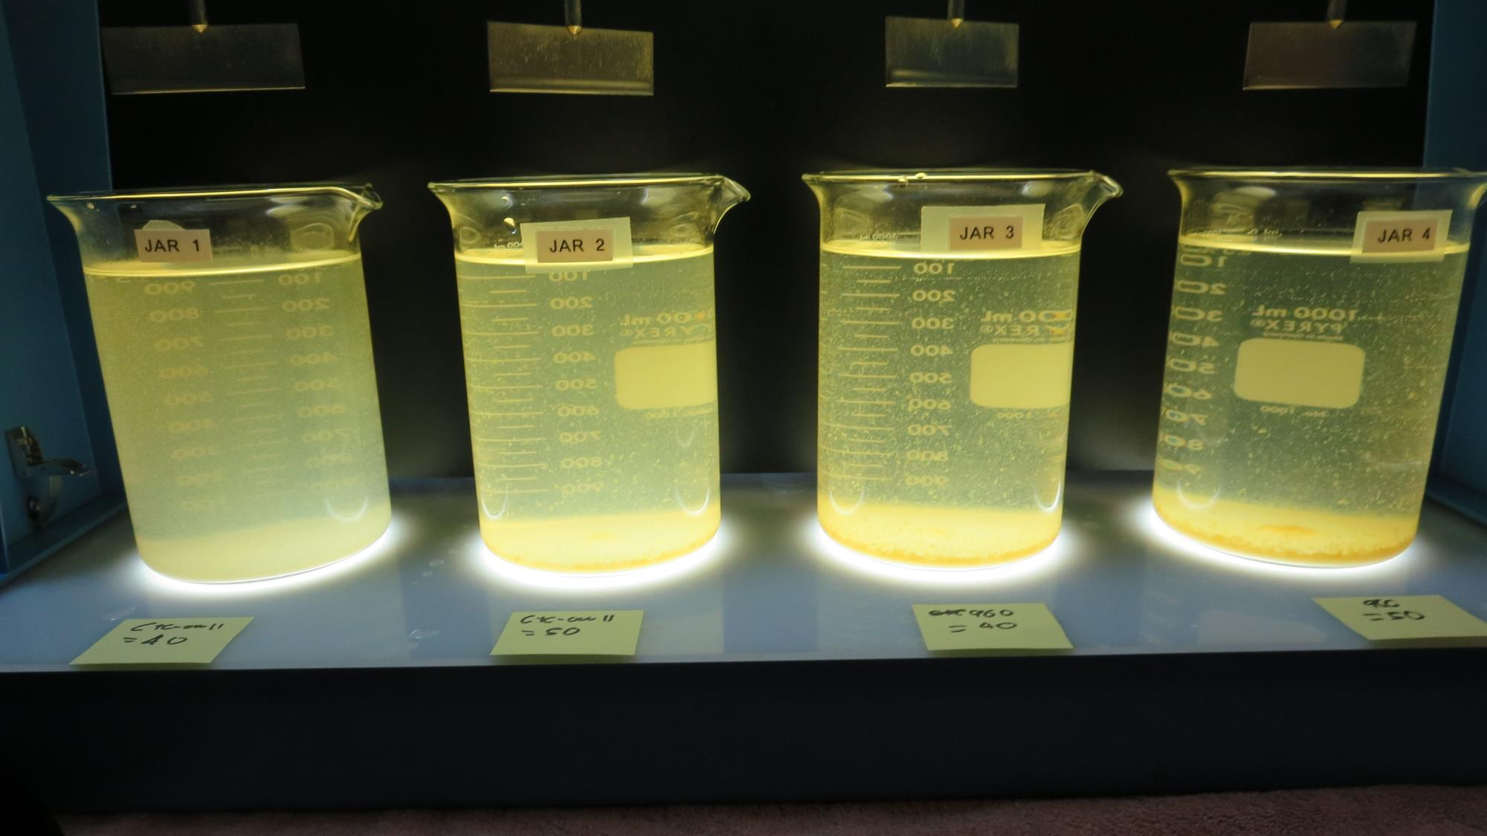
Jars 1-4: After 25-minutes of settling, settled water turbidity is taken.
40 mg/L CTC-00011
Filtrate: 0.07 NTU
UVT: 79.7%
UVA: 0.098/cm
UVA Reduction: 55.5%
Settled: 32.1 NTU
50 mg/L CTC-00011
Filtrate: 0.24 NTU
UVT: 89.0%
UVA: 0.050/cm
UVA Reduction: 77.3%
Settled: 20.6 NTU
40 mg/L 960
Filtrate: 0.70 NTU
UVT: 81.6%
UVA: 0.087/cm
UVA Reduction: 60.5%
Settled: 12.2 NTU
50 mg/L 960
Filtrate: 0.71 NTU
UVT: 82.9%
UVA: 0.081/cm
UVA Reduction: 63.2%
Settled: 9.97 NTU

Slide 12
Jars 5-8 Test
Flash Mix 200 RPM, 20 Sec
Floc Mix 30 RPM, 5 min
25 mL sampled 5 minutes at end of Floc period
Applied Coagulants
960 & CTC-00011

Slide 13
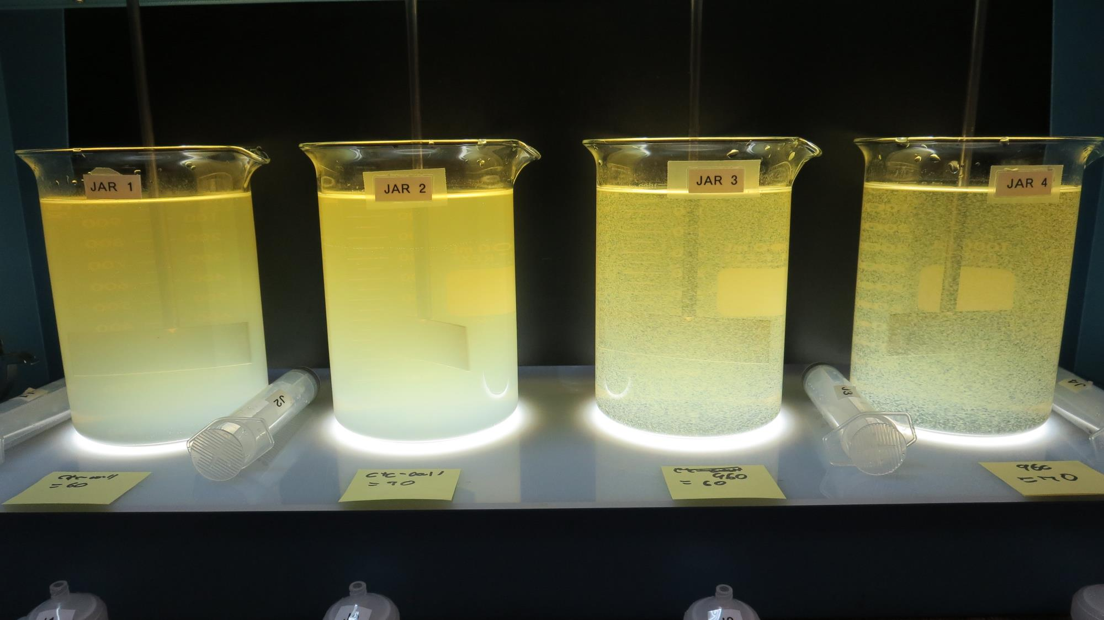
Jars 5-8: End of Floc Duration, 25 mL is syringed for filterability and %UVT/UVA.
60 mg/L CTC-00011
Filtrate: 0.28 NTU
UVT: 83.7%
UVA: 0.076/cm
UVA Reduction: 65.5%
Settled: 59.4 NTU
70 mg/L CTC-00011
Filtrate: 0.08 NTU
UVT: 85.1%
UVA: 0.069/cm
UVA Reduction: 68.6%
Settled: 65.4 NTU
60 mg/L 960
Filtrate: 0.92 NTU
UVT: 82.7%
UVA: 0.082/cm
UVA Reduction: 62.7%
Settled: 8.54 NTU
70 mg/L 960
Filtrate: 0.08 NTU
UVT: 86.3%
UVA: 0.063/cm
UVA Reduction: 71.4%
Settled: 10.1 NTU

Slide 14
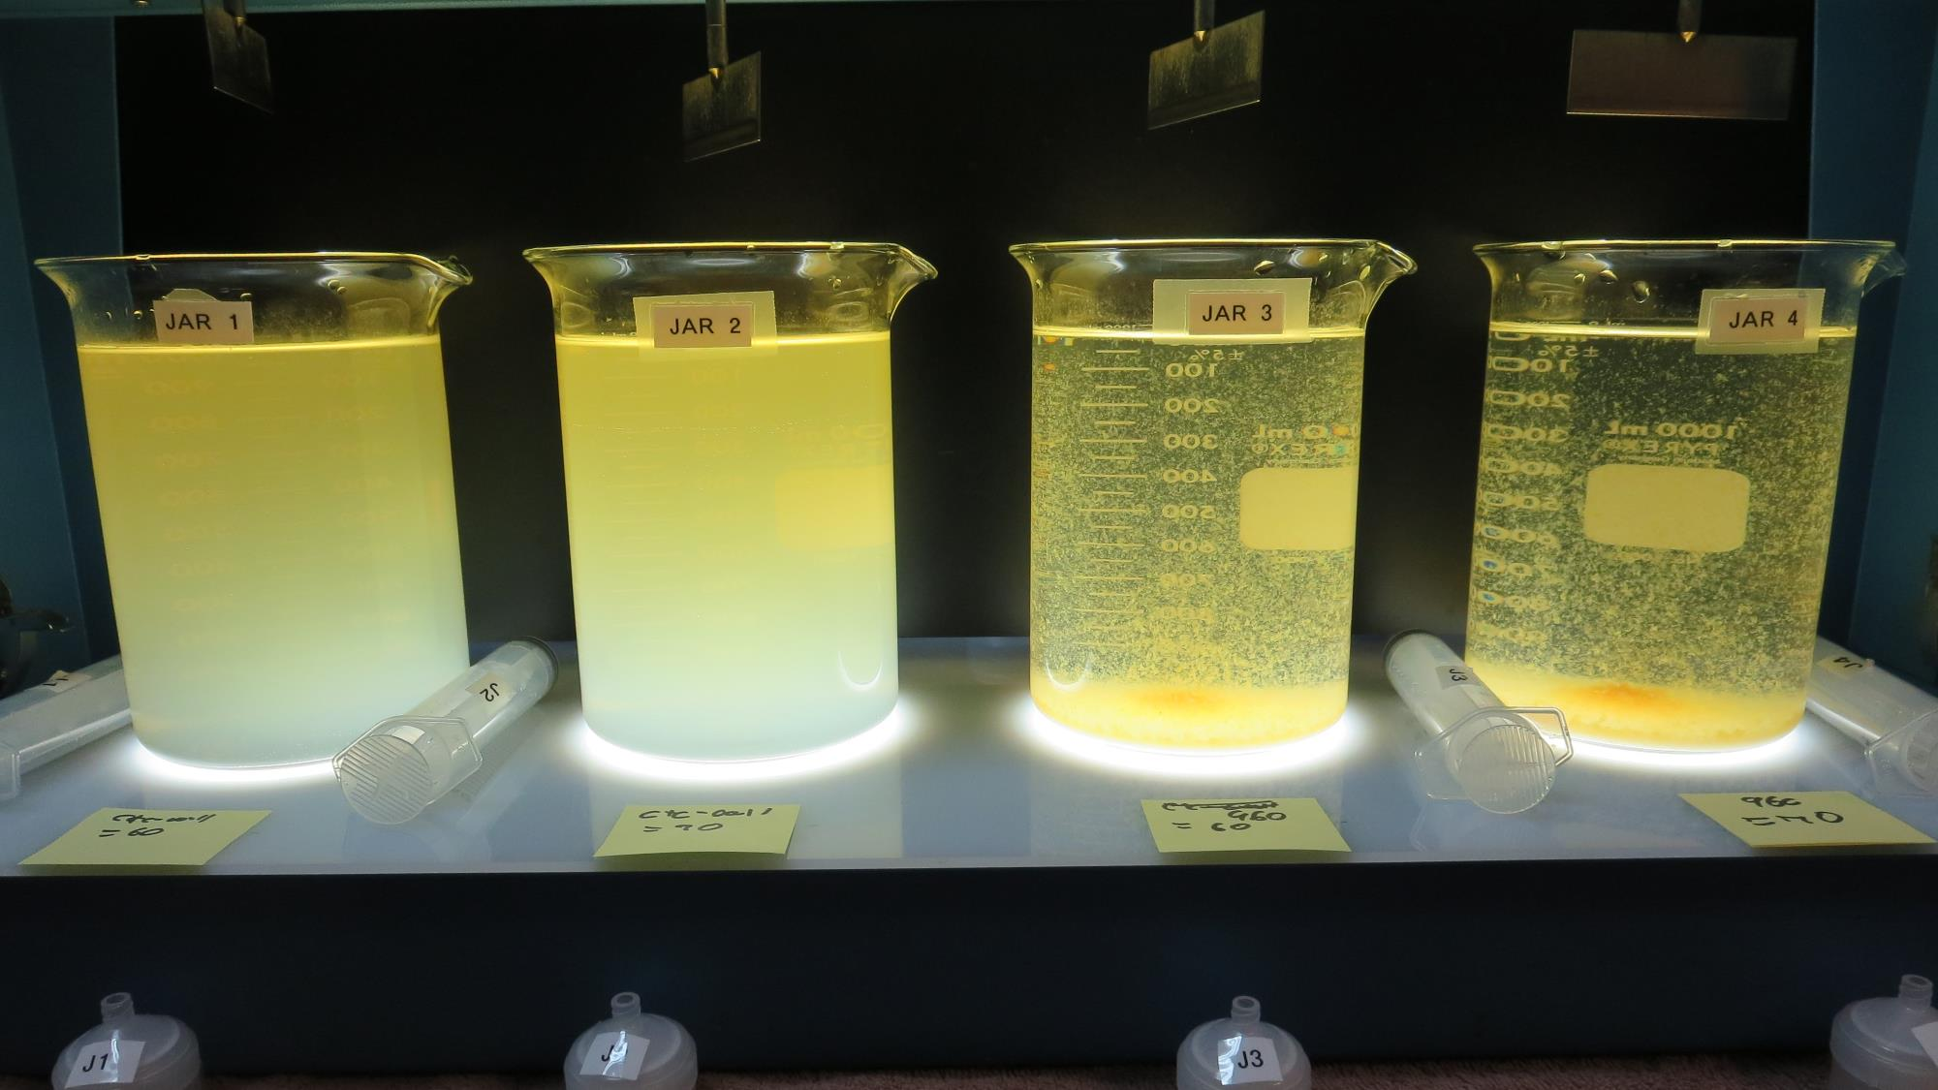
Jars 5-8: After 5 min of settling, 25 mL is syringed for filterability and %UVT/UVA.

Slide 15
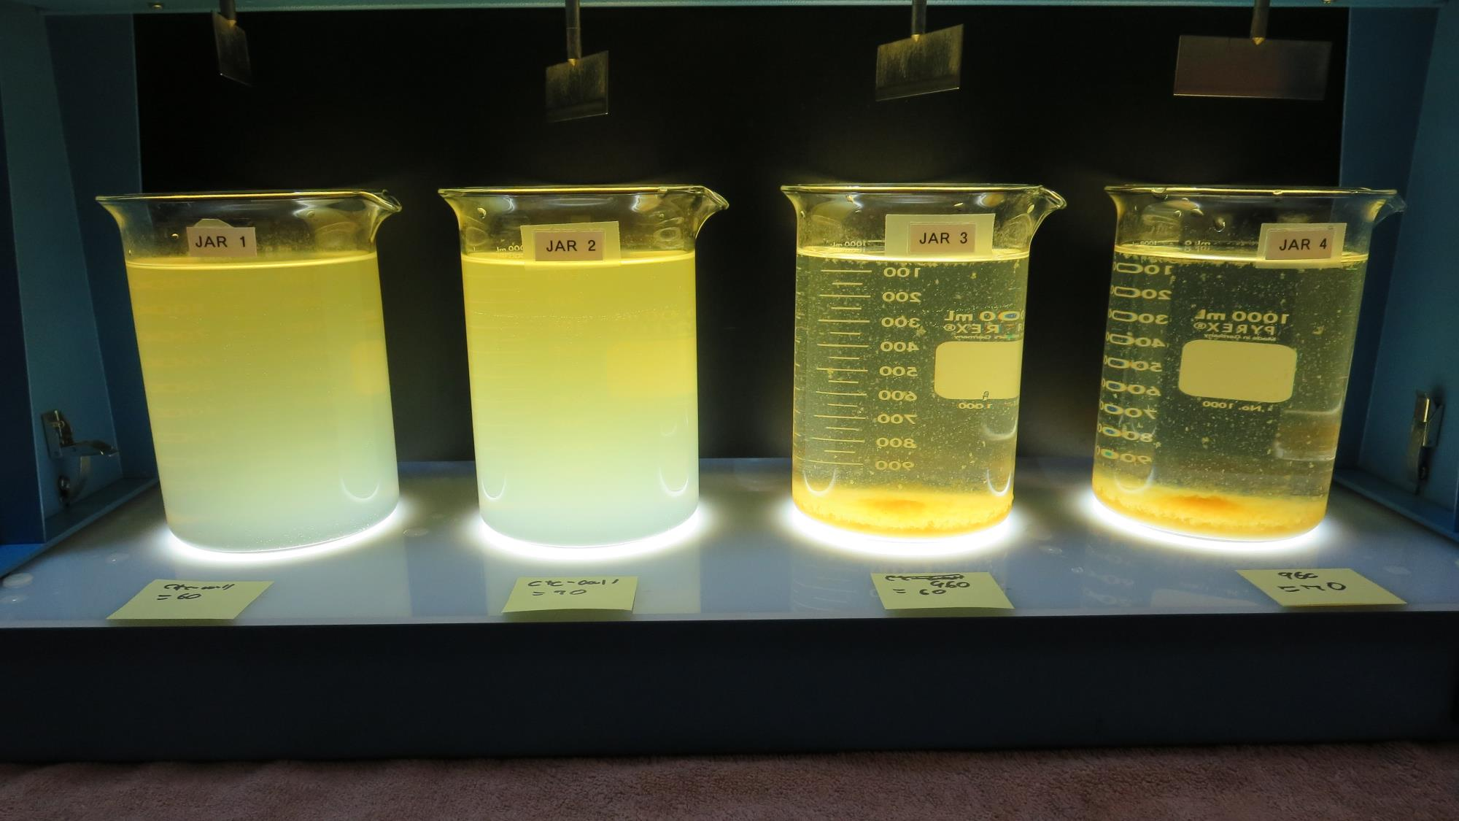
Jars 5-8: After 25-minutes of settling, settled water turbidity is taken.
60 mg/L CTC-00011
Filtrate: 0.28 NTU
UVT: 83.7%
UVA: 0.076/cm
UVA Reduction: 65.5%
Settled: 59.4 NTU
70 mg/L CTC-00011
Filtrate: 0.08 NTU
UVT: 85.1%
UVA: 0.069/cm
UVA Reduction: 68.6%
Settled: 65.4 NTU
60 mg/L 960
Filtrate: 0.92 NTU
UVT: 82.7%
UVA: 0.082/cm
UVA Reduction: 62.7%
Settled: 8.54 NTU
70 mg/L 960
Filtrate: 0.08 NTU
UVT: 86.3%
UVA: 0.063/cm
UVA Reduction: 71.4%
Settled: 10.1 NTU
Fe: 6.8 mg/L

Slide 16
Jar 9 Test
Flash Mix 200 RPM, 20 Sec
Floc Mix 30 RPM, 5 min
25 mL sampled 5 minutes at end of Floc period
Applied Coagulant
960

Slide 17
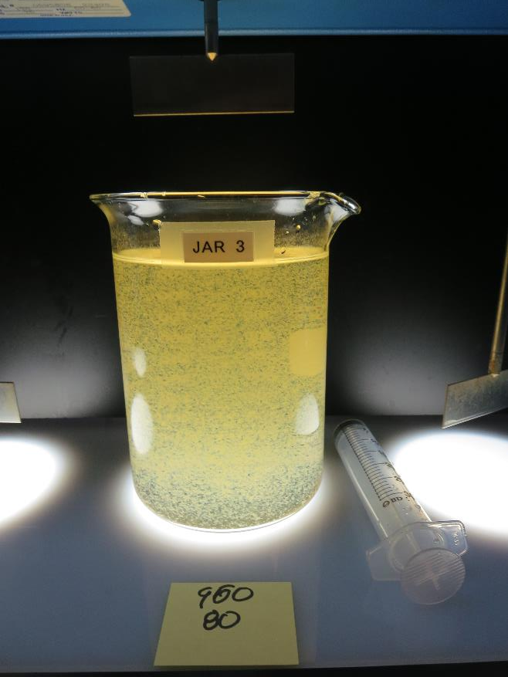
Jar 9: End of Floc Duration, 25 mL is syringed for filterability and %UVT/UVA.
80 mg/L 960
Filtrate: 0.09 NTU
UVT: 87.6%
UVA: 0.057/cm
UVA Reduction: 74.1%
Settled: 8.66 NTU

Slide 18
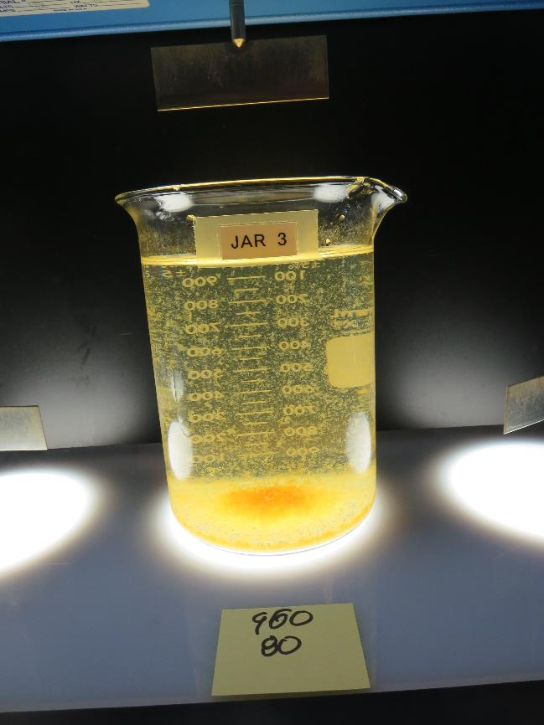
Jar 9: After 5 min of settling, 25 mL is syringed for filterability and %UVT/UVA.

Slide 19
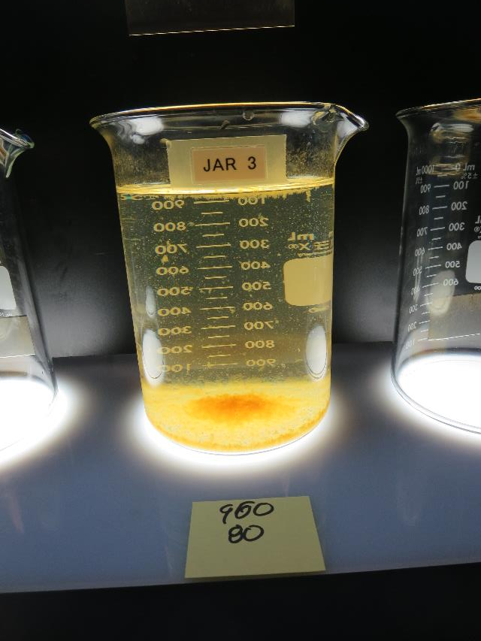
Jar 9: After 25-minutes of settling, settled water turbidity is taken.
80 mg/L 960
Filtrate: 0.09 NTU
UVT: 87.6%
UVA: 0.057/cm
UVA Reduction: 74.1%
Settled: 8.66 NTU

Slide 20
Jar Testing for 1-Liter Jars:
Procedures for Most Treatment Plants
Fill jars with source water prior to coagulant injection and set paddle speed at 30 rpm
Add chemicals (i.e., NaOCl, primary coagulant, coagulant aid) to each jar
Flash mix for 15-30 seconds (200 rpm)
Slow mix for 5 minutes (20-30 rpm)
Settled for 5 minutes. Syringe 25 mL from each jar taken 1-inch below surface (25 mL/12 sec rate)
Filtered through 1.2 um isopore membrane into cuvette drip rate, 15 mL/(50-90 sec)
Measure filtrate turbidity, chlorine residual and %UVT/UVA
Measure settled water turbidity after 25 minutes of total setting
Record all data

Slide 21

Jar Test
Filterability Test Equipment
Turbidity Instrument
Syringe w/Luer-Lock Tip, 30 cc
(part#: 2225800, by Hach)
Swinnex Filter Holder, 25 mm (part#: SX0002500)
Isopore Membrane Filter, 1.2 um absolute
pore size,
Φ= 25 mm , thickness: 24 um,
hydrophilic polycarbonate membrane
(part #: RTTP02500)
Go to Sigma-Aldrich for laboratory supplies http://www.sigmaaldrich.com/united-states.html

Slide 22
Isopore Membrane Information
Categories | Information
trade name | Isopore
filter color | White
chemistry | Polycarbonate (PC)
water flow rate | Avg. 175 mL/min x cm² (typical results @ 10 psi)
media | Isopore®
wettability | Hydrophilic
porosity | 14.7%
pore size | 1.2 µm
bubble point at 23 °C | 1.0 bar, air with water
thickness | 24 µm
filter diameter (ø) | 25 mm
material size | polycarbonate, Hydrophilic, 1.2 µm, 25 mm, white, plain, 100

Slide 23
Isopore Membrane Background Information
The Isopore membrane is a polycarbonate, track-etched screen filter recommended for all analyses in which the sample is viewed on the surface of the membrane. The Isopore membrane is composed of polycarbonate film, which has a smooth, glass-like surface for clearer sample observation. The unique manufacturing process of the membrane ensures a precise pore diameter and a consistent pore size for accurate separation of samples by size. Matched-weight filters are not usually required because of low, constant tar and ash weights.
Features & Benefits:
Membrane structure retains particles on the surface, simplifying counting and analysis

Slide 24
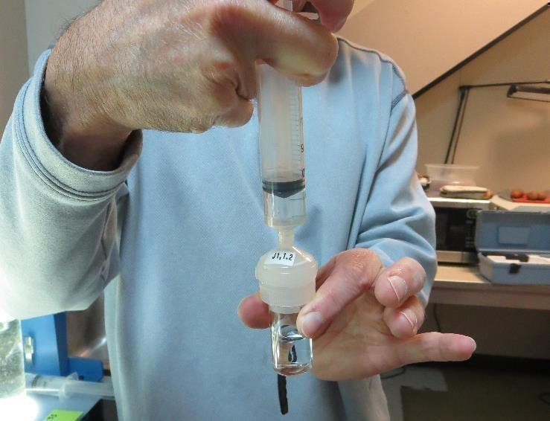

Jar Test - Filterability Test
Syringe ~ 25 mL from jar (after 5-minutes of settling)
Filter-to-waste 3-5 mL
Filter directly into clean cuvette
Measure turbidity
Note: Take several readings before recording final NTU results. Micro bubbles can adhere to glass causing false NTU readings. To remove bubbles, tilt cuvette up to 90 degrees.

Slide 25

Contact
Guy Schott, P.E.
State Water Resources Control Board
Division of Drinking Water
Santa Rosa, CA
Go to Stock Solution/Dose calculations/Jar Test Results for tools to download
www.waterboards.ca.gov/drinking_water/programs/districts/mendocino_district.html
Jar Testing Done Right training video: https://www.youtube.com/watch?v=aGByyxhelkI
Email: Guy Schott - Guy.Schott@waterboards.ca.gov
Office Number: 707-576-2732

