Slide 1
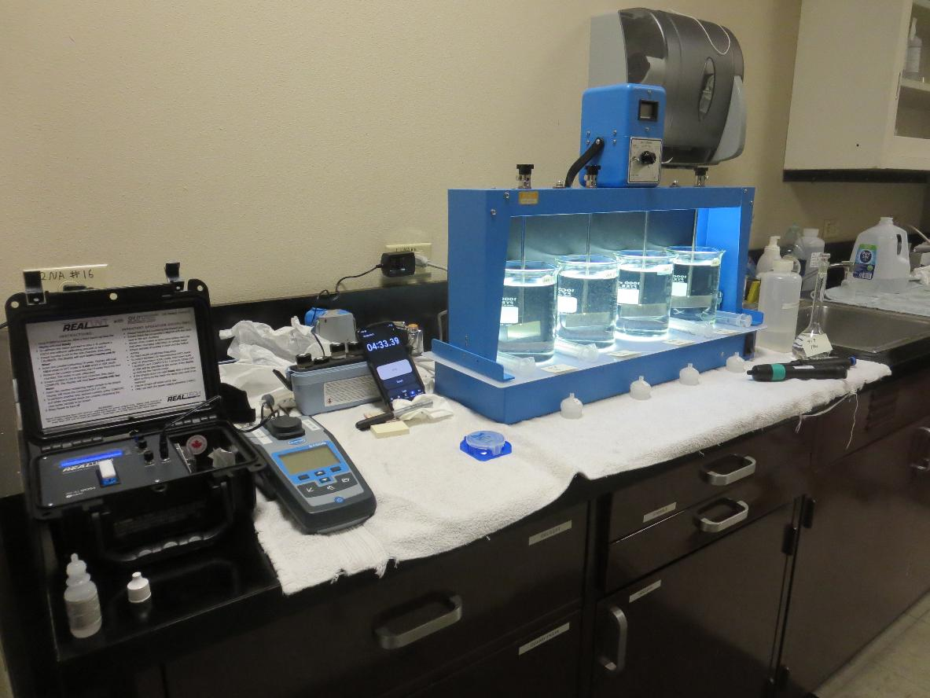
Howell Mountain MWC
CA2810001, Napa County, Jar Test
by Guy Schott, P.E. October 29, 2025

Slide 2
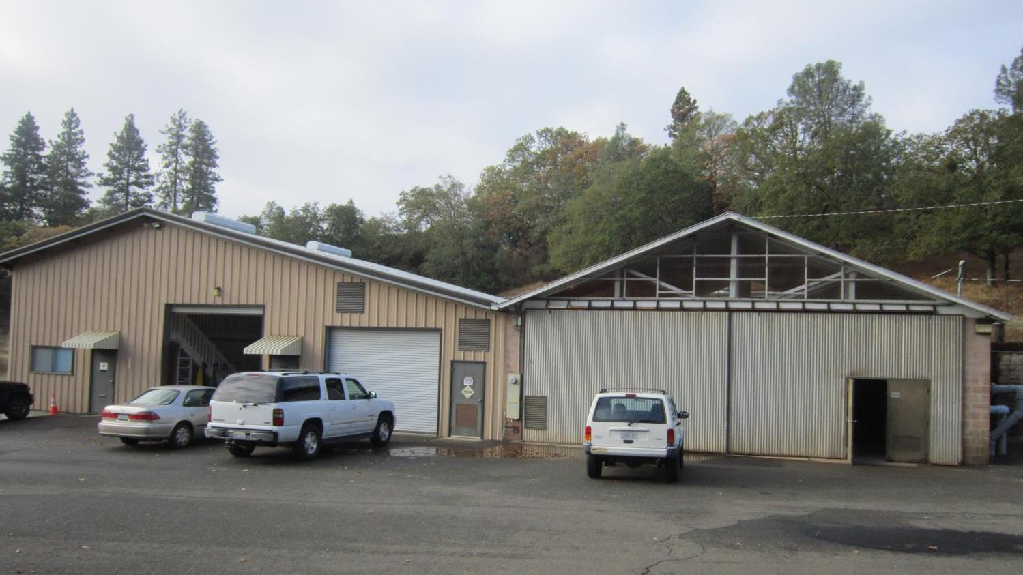
Treatment Plant
Office Building
Treatment Plant Building

Slide 3
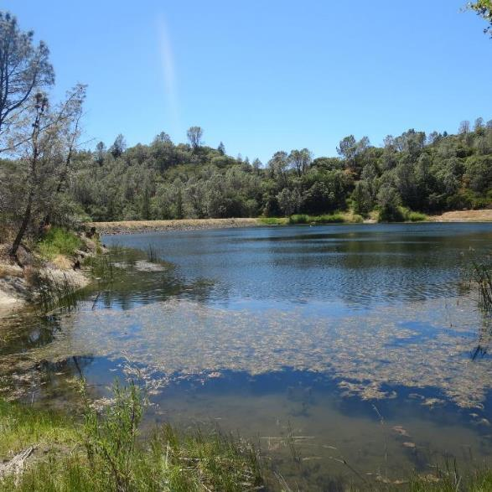
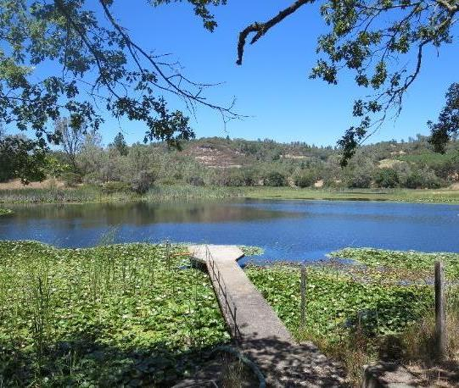
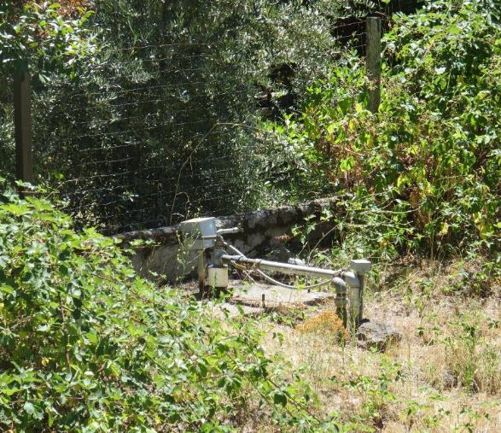
Source Waters (blend):
Lake Dear/
Lake Henne
Source Water Characteristics
Turbidity: 0.60 NTU
UVT: 79.37%, UVA: 0.1004/cm
0.4 um Filtered
Turbidity: 24 NTU
UVT: 80.51%, UVA: 0.0942/cm

Slide 4
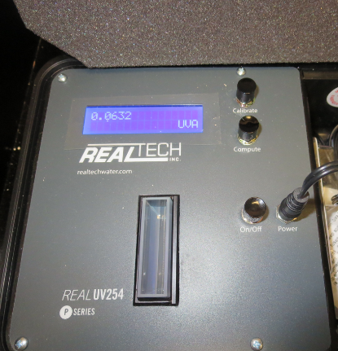
UVT/UVA, pathlength 40 mm
UV transmittance (UVT) is a measurement of the amount of ultraviolet light (commonly at 254 nm due to its germicidal effect) that passes through a water sample compared to the amount of light that passes through a pure water sample. The measurement is expressed as a percentage, % UVT.
%UVT = 10^{(-UVA)} x 100%
UV absorbance (UVA) is calculated as a relative measure of the amount of light absorbed by a water sample compared with the amount of light absorbed by a pure water sample.
UVA = -log(%UVT/100)

Slide 5
Howell Mountain MWC Treated Water Characteristics, October 29, 2025
Plant Dose 917: 15 mg/L
Plant Filtrate Water (before NaOCl injection)
Turbidity: 0.04 NTU
UVT: 91.33%,
UVA: 0.0394/cm

Slide 6
Applied Coagulants for Jar Testing (1)
Pro Pac 917 (NTU Technologies, Inc.)
10% polyamine (50% water, 50% active polyamines)
45% Aluminum Chlorohydrate (ACH)
~21.3% Al₂O₃
~11.3% Al
45% Water
83% Basicity
SG = 1.25-1.34
NSF limit: 100 mg/L as Product

Slide 7
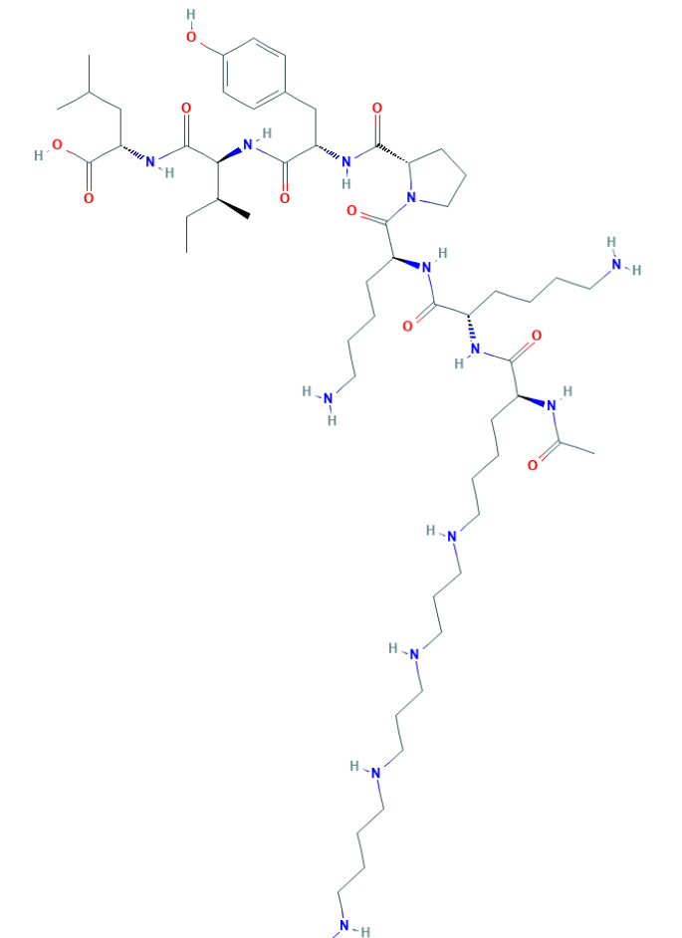
Polyamine
C₅₉H₁₀₈N₁₄O₁₀
MW: 1,173.6 g/mol

Slide 8
Coagulant Information
Unless stated otherwise, all coagulant doses are reported as Product (100% strength).
Aluminum Sulfate doses are reported as hydrated Al₂(SO₄)₃*14.3H₂0.
Preparation of coagulant stock solutions are generally 1.0 and/or 0.1 percent strength using 100 and/or 200 mL volumetric flasks.
Finnpipette F2 variable volume pipette, capacity 100-1000 micro liters is used for stock solution preparation and coagulant aid jar test dosing.
Finnpipette F2 variable volume pipette, capacity 0.5-5 mL is used for primary coagulant jar test dosing.

Slide 9
Howell Mountain; Jar Test 1 - 8 Results
Flash Mix 200 RPM (20 sec); Floc Mix 30 RPM (5 min)
Jar# | 917 mg/L | Filtrate NTU | Filtrate %UVT | Filtrate UVA/cm | %UVA Reduction | Settle NTU 25 min
J1 | 15 | 0.05 | 89.04 | 0.0504 | 46.5 | 0.38
J2 | 20 | 0.04 | 90.20 | 0.0448 | 52.4 | 0.45
J3 | 25 | 0.04 | 90.77 | 0.0421 | 55.3 | 0.79
J4 | 30 | 0.04 | 91.34 | 0.0394 | 58.2 | 1.27
J5 | 16 | 0.04 | 89.22 | 0.0496 | 47.3 | 0.49
J6 | 18 | 0.04 | 89.56 | 0.0479 | 49.2 | 0.38
J7 | 20 | 0.05 | 89.89 | 0.0463 | 50.8 | 0.46
J8 | 22 | 0.04 | 90.23 | 0.0447 | 52.5 | 0.53

Slide 10
Jars 1-4 Test
Flash Mix 20 Sec (200 RPM)
Floc Mix 5 min (30 RPM)
Applied Coagulant
917

Slide 11
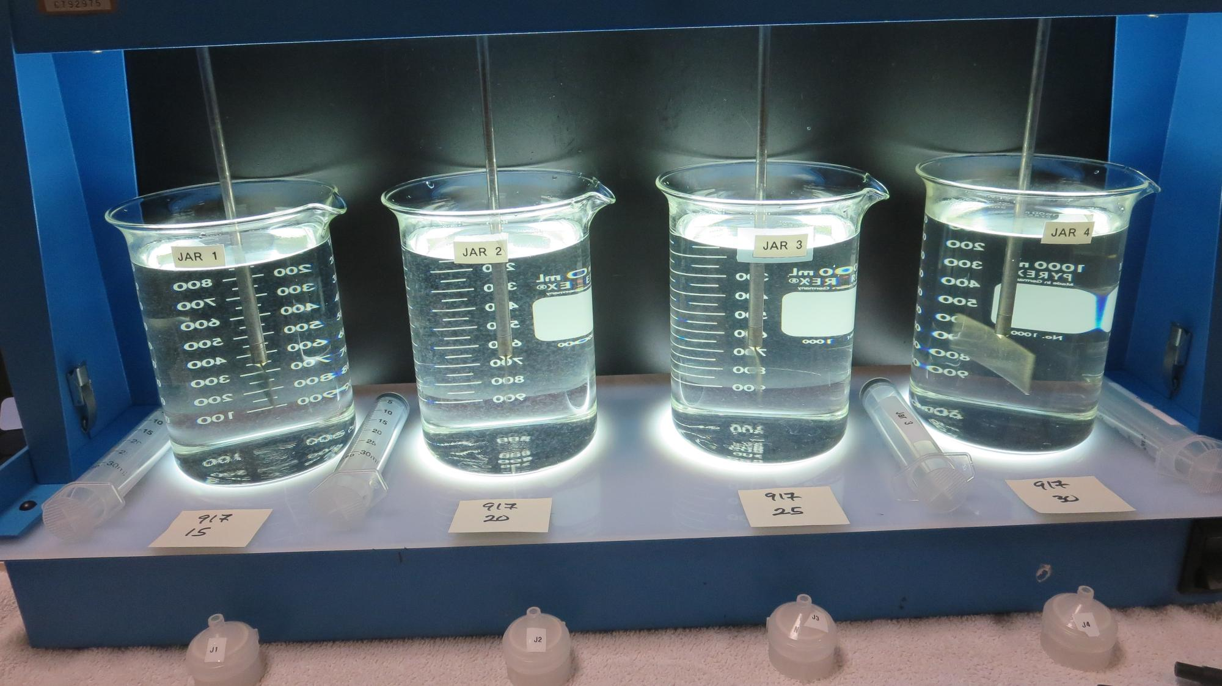
Jars 1-4: End of 5-minute flocculation (25 RPM) duration.
917: 15 mg/L
Filtrate: 0.05 NTU
UVT: 89.04%
UVA: 0.0504/cm
UVA Reduction: 46.5%
Settled: 0.38 NTU
917: 20 mg/L
Filtrate: 0.04 NTU
UVT: 90.20%
UVA: 0.0448/cm
UVA Reduction: 52.4%
Settled: 0.45 NTU
917: 25 mg/L
Filtrate: 0.04 NTU
UVT: 90.77%
UVA: 0.0421/cm
UVA Reduction: 55.3%
Settled: 0.79 NTU
917: 30 mg/L
Filtrate: 0.04 NTU
UVT: 91.34%
UVA: 0.0394/cm
UVA Reduction: 58.2%
Settled: 1.27 NTU

Slide 12
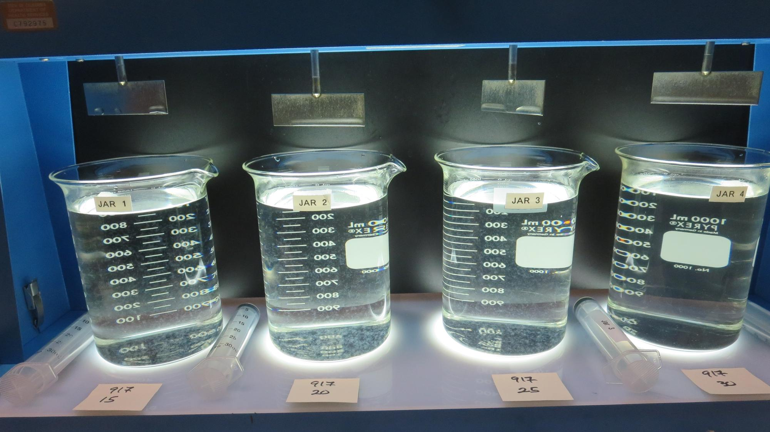
Jars 1-4: After 5 min of settling, 25 mL is syringed for filterability and %UVT/UVA.

Slide 13
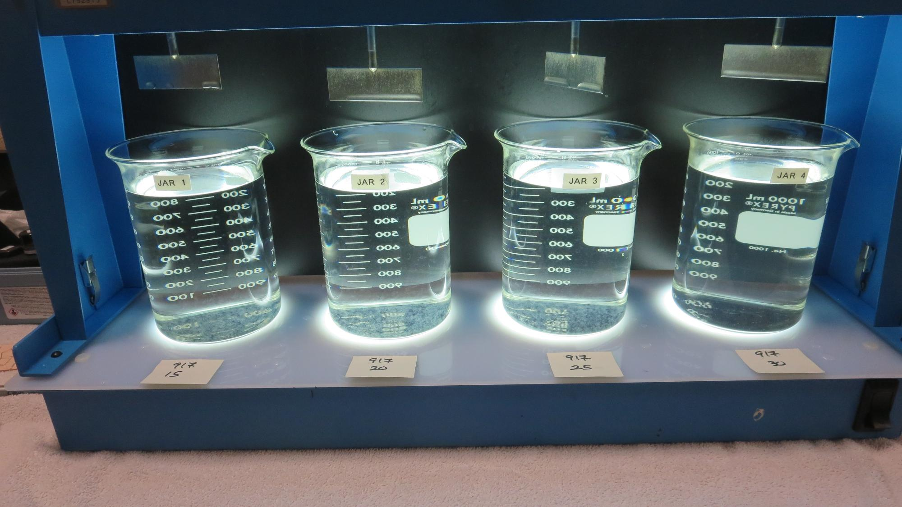
Jars 1-4: After 25-minutes of settling, settled water turbidity is taken.
917: 15 mg/L
Filtrate: 0.05 NTU
UVT: 89.04%
UVA: 0.0504/cm
UVA Reduction: 46.5%
Settled: 0.38 NTU
917: 20 mg/L
Filtrate: 0.04 NTU
UVT: 90.20%
UVA: 0.0448/cm
UVA Reduction: 52.4%
Settled: 0.45 NTU
917: 25 mg/L
Filtrate: 0.04 NTU
UVT: 90.77%
UVA: 0.0421/cm
UVA Reduction: 55.3%
Settled: 0.79 NTU
917: 30 mg/L
Filtrate: 0.04 NTU
UVT: 91.34%
UVA: 0.0394/cm
UVA Reduction: 58.2%
Settled: 1.27 NTU

Slide 14
Jars 5-8 Test
Flash Mix 20 Sec (200 RPM)
Floc Mix 5 min (30 RPM)
Applied Coagulant
917

Slide 15
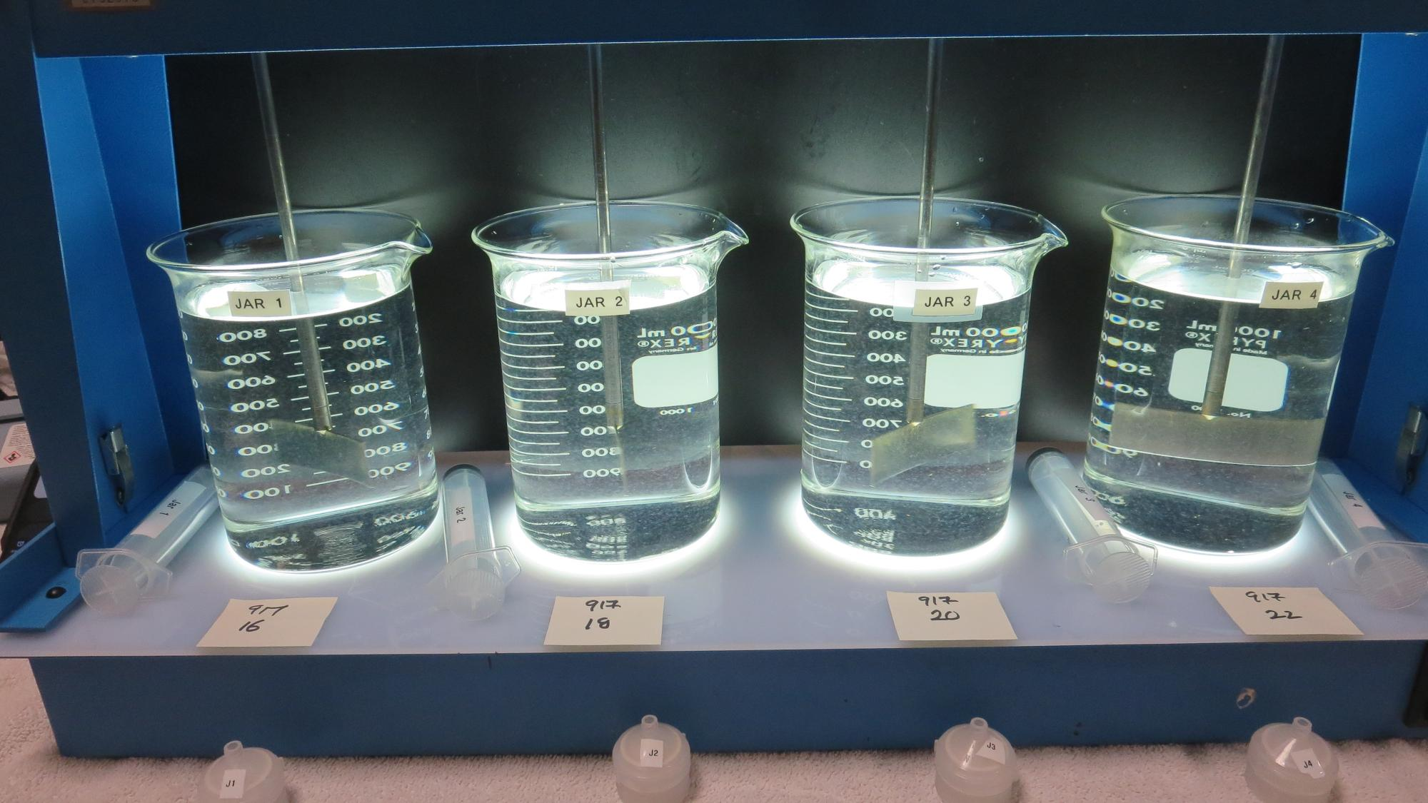
Jars 5-8: End of 5-minute flocculation (25 RPM) duration.
917: 16 mg/L
Filtrate: 0.04 NTU
UVT: 89.22%
UVA: 0.0496/cm
UVA Reduction: 47.3%
Settled: 0.49 NTU
917: 18 mg/L
Filtrate: 0.04 NTU
UVT: 89.56%
UVA: 0.0479/cm
UVA Reduction: 49.2%
Settled: 0.38 NTU
917: 20 mg/L
Filtrate: 0.05 NTU
UVT: 89.56%
UVA: 0.0463/cm
UVA Reduction: 50.8%
Settled: 0.46 NTU
917: 22 mg/L
Filtrate: 0.04 NTU
UVT: 90.23%
UVA: 0.0447/cm
UVA Reduction: 52.5%
Settled: 0.53 NTU

Slide 16
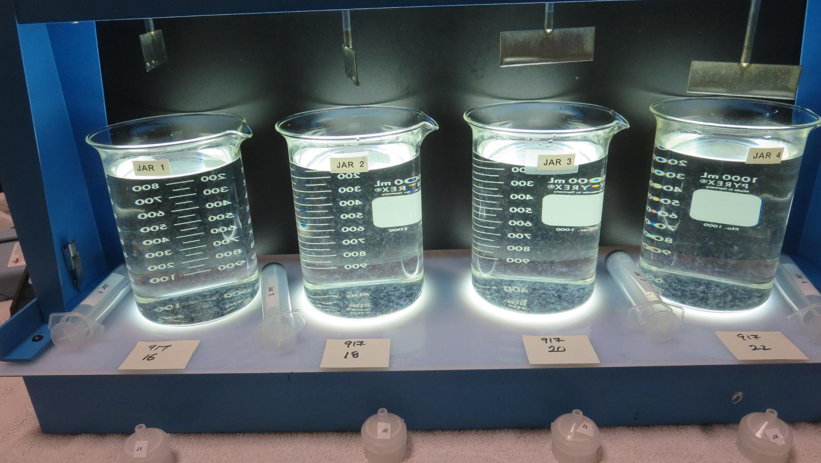
Jars 5-8: After 5 min of settling, 25 mL is syringed for filterability and %UVT/UVA.

Slide 17
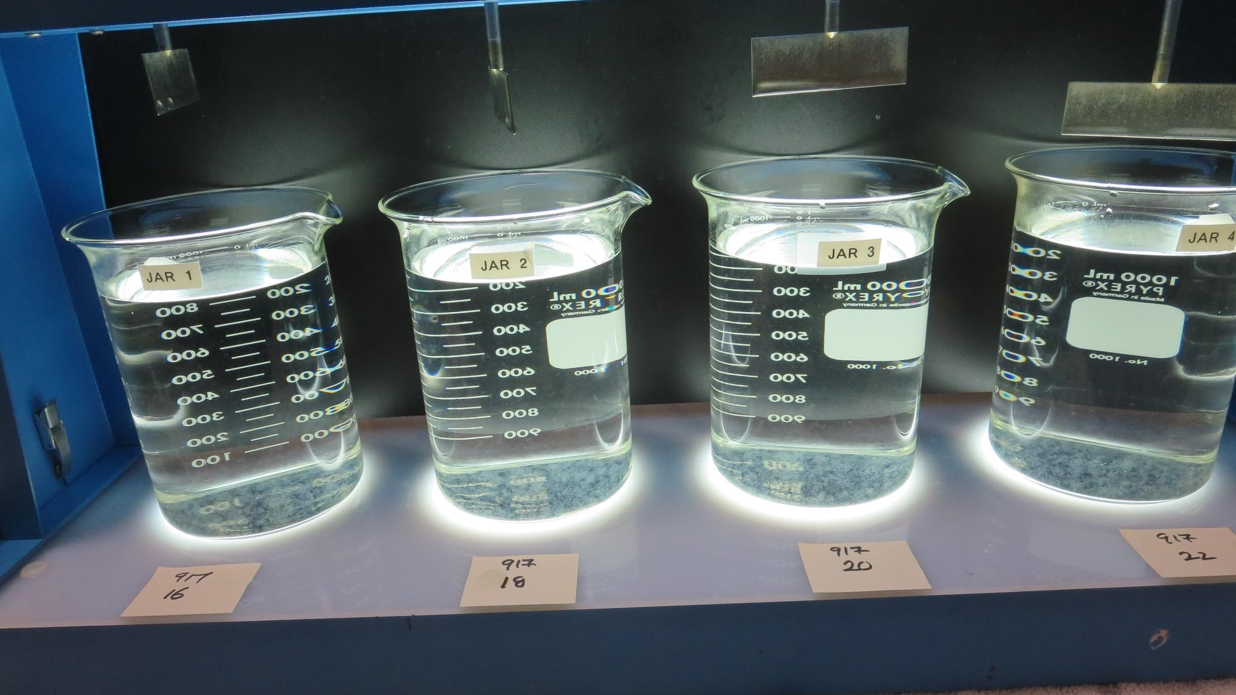
Jars 5-8: After 25-minutes of settling, settled water turbidity is taken.
917: 16 mg/L
Filtrate: 0.04 NTU
UVT: 89.22%
UVA: 0.0496/cm
UVA Reduction: 47.3%
Settled: 0.49 NTU
917: 18 mg/L
Filtrate: 0.04 NTU
UVT: 89.56%
UVA: 0.0479/cm
UVA Reduction: 49.2%
Settled: 0.38 NTU
917: 20 mg/L
Filtrate: 0.05 NTU
UVT: 89.56%
UVA: 0.0463/cm
UVA Reduction: 50.8%
Settled: 0.46 NTU
917: 22 mg/L
Filtrate: 0.04 NTU
UVT: 90.23%
UVA: 0.0447/cm
UVA Reduction: 52.5%
Settled: 0.53 NTU

Slide 18
Jar Testing for 1-Liter Jars:
Procedures for Most Treatment Plants
Fill jars with source water prior to coagulant injection and set paddle speed at 30 rpm
Add chemicals (i.e., NaOCl, primary coagulant, coagulant aid) to each jar
Flash mix for 15-30 seconds (200 rpm)
Slow mix for 5 minutes (20-30 rpm)
Settled for 5 minutes. Syringe 25 mL from each jar taken 1-inch below surface (25 mL/12 sec rate)
Filtered through 1.2 um isopore membrane into cuvette drip rate, 15 mL/(50-90 sec)
Measure filtrate turbidity, chlorine residual and %UVT/UVA
Measure settled water turbidity after 25 minutes of total setting
Record all data

Slide 19
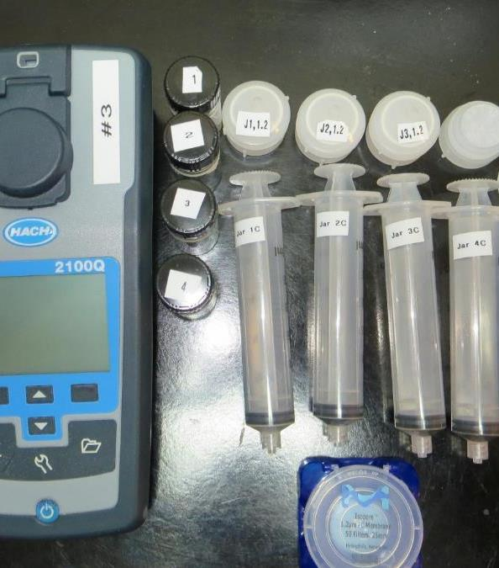
Jar Test
Filterability Test Equipment
Turbidity Instrument
Syringe w/Luer-Lock Tip, 30 cc
(part#: 2225800, by Hach)
Swinnex Filter Holder, 25 mm (part#: SX0002500)
Isopore Membrane Filter, 1.2 um absolute
pore size,
Φ= 25 mm , thickness: 24 um,
hydrophilic polycarbonate membrane
(part #: RTTP02500)
Go to Sigma-Aldrich for laboratory supplies http://www.sigmaaldrich.com/united-states.html

Slide 20
Isopore Membrane Information
Categories | Information
trade name | Isopore
filter color | White
chemistry | Polycarbonate (PC)
water flow rate | Avg. 175 mL/min x cm² (typical results @ 10 psi)
media | Isopore®
wettability | Hydrophilic
porosity | 14.7%
pore size | 1.2 µm
bubble point at 23 °C | 1.0 bar, air with water
thickness | 24 µm
filter diameter (ø) | 25 mm
material size | polycarbonate, Hydrophilic, 1.2 µm, 25 mm, white, plain, 100

Slide 21
Isopore Membrane Background Information
The Isopore membrane is a polycarbonate, track-etched screen filter recommended for all analyses in which the sample is viewed on the surface of the membrane. The Isopore membrane is composed of polycarbonate film, which has a smooth, glass-like surface for clearer sample observation. The unique manufacturing process of the membrane ensures a precise pore diameter and a consistent pore size for accurate separation of samples by size. Matched-weight filters are not usually required because of low, constant tar and ash weights.
Features & Benefits:
Membrane structure retains particles on the surface, simplifying counting and analysis

Slide 22
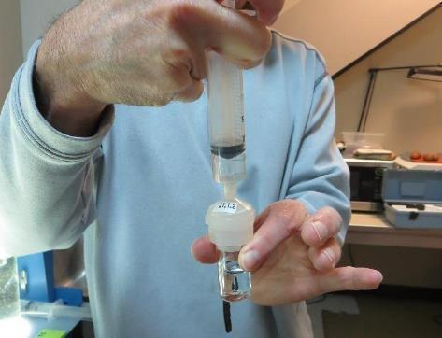
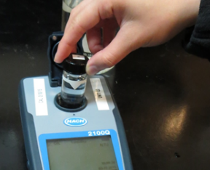
Jar Test - Filterability Test
Syringe ~ 25 mL from jar (after 5-minutes of settling)
Filter-to-waste 3-5 mL
Filter directly into clean cuvette
Measure turbidity
Note: Take several readings before recording final NTU results. Micro bubbles can adhere to glass causing false NTU readings. To remove bubbles, tilt cuvette up to 90 degrees.

Slide 23

Contact
Guy Schott, P.E.
State Water Resources Control Board
Division of Drinking Water
Santa Rosa, CA
Go to Stock Solution/Dose calculations/Jar Test Results for tools to download
www.waterboards.ca.gov/drinking_water/programs/districts/mendocino_district.html
Jar Testing Done Right training video: https://www.youtube.com/watch?v=aGByyxhelkI
Email: Guy Schott - Guy.Schott@waterboards.ca.gov
Office Number: 707-576-2732

