Slide 1
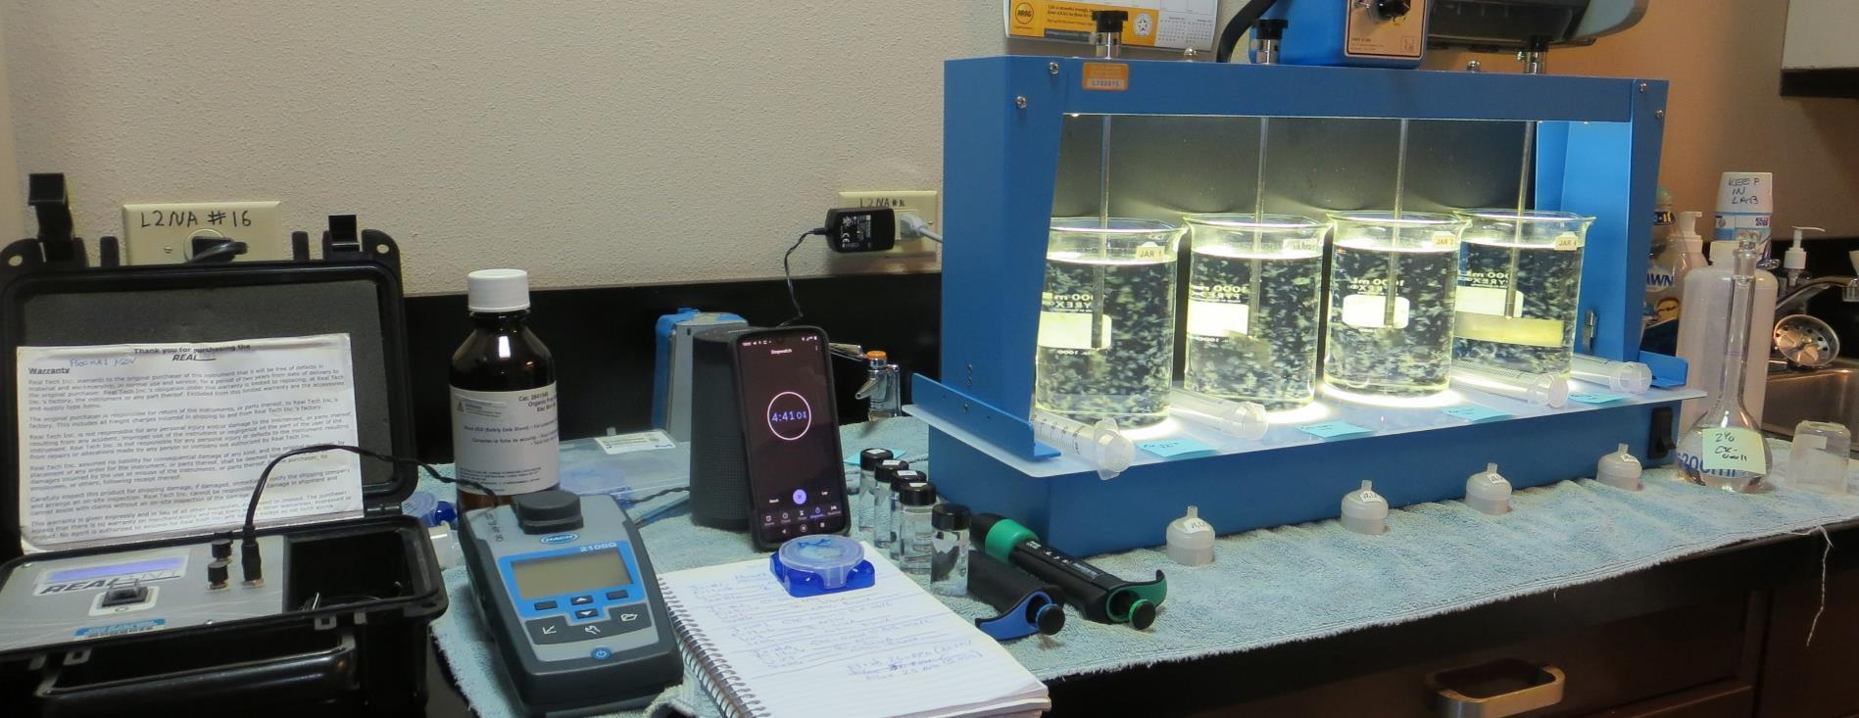
Howell Mountain MWC CA2810001, Napa County, Jar Test
by Guy Schott, P.E. September 30, 2021

Slide 2
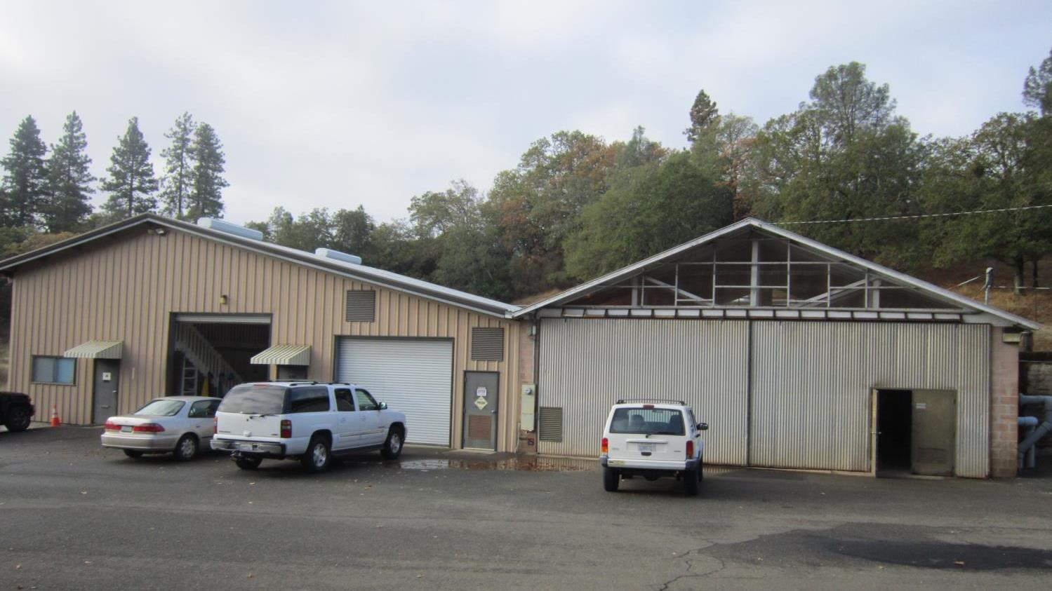
Treatment Plant
Office Building
Treatment Plant Building

Slide 3
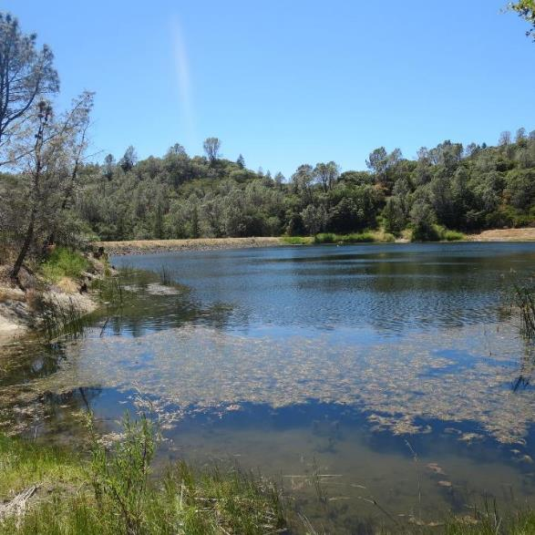
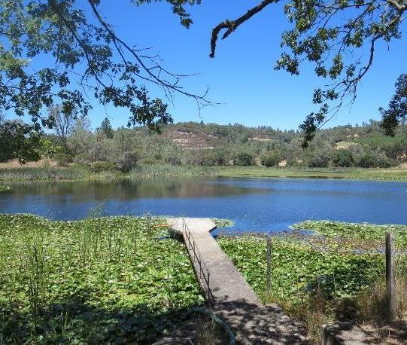
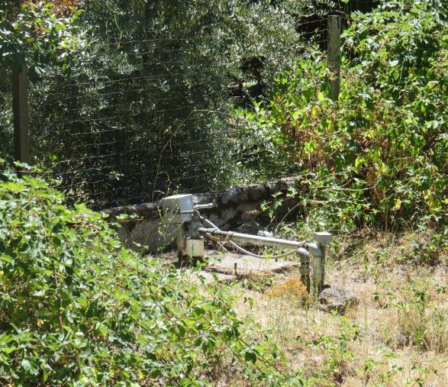
Source Waters (blend): Lake Dear/Lake Henne/Well 01
Source Water Characteristics
September 30, 2021
Turbidity: 1.69 NTU
Alkalinity: 30 mg/L as CaCO₃
pH: 7.02
UVT: 73.7%, UVA: 0.133/cm
0.4 um Filtered
Turbidity: 0.56 NTU
UVT: 76.0%, UVA: 0.118/cm

Slide 4
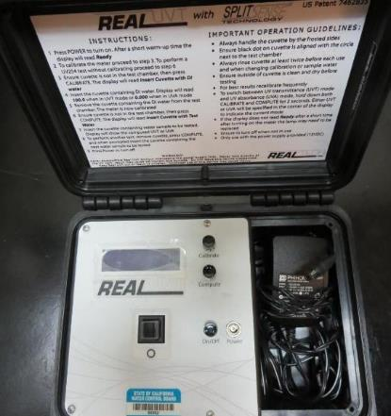
UVT/UVA, pathlength 10 mm
UV transmittance (UVT) is a measurement of the amount of ultraviolet light (254 nm) that passes through a water sample compared to the amount of light that passes through a pure water sample. The measurement is expressed as % UVT.
%UVT = 10^{(-UVA)} x 100%
UV absorbance (UVA) is calculated as a relative measure of the amount of light absorbed by a water sample compared with the amount of light absorbed by a pure water sample.
UVA = -log(%UVT/100)

Slide 5
Howell Mountain MWC Treated Water Characteristics, September 30, 2021
Plant Dose 917: 27 mg/L
Settled water turbidites: 089 – 0.93 NTU
Plant Filtrate Water (before NaOCl injection)
Turbidity: 0.12 NTU
UVT: 91.1%,
UVA: 0.040/cm
Plant Filtrate Water (after NaOCl injection)
Turbidity: 0.13 NTU
UVT: 93.5%,
UVA: 0.029/cm

Slide 6
Applied Coagulants for Jar Testing (1)
AdvFloc-CTC-00011
Polyaluminum Hydroxy Chlorosulfate
12.55% Al₂O₃
6.64% Al
64.9% Basicity
SG = 1.299
NSF limit: 450 mg/L as Product
BWS, Inc.
Greg Nieckarz, Ph.D.
Greg.niekarz@bws.works
541-953-5112
Pro Pac 917 (NTU Technologies, Inc.)
10% polyamine (50% water, 50% active polyamines)
45% Aluminum Chlorohydrate (ACH)
~21.3% Al₂O₃
~11.3% Al
45% Water
83% Basicity
SG = 1.25-1.34
NSF limit: 100 mg/L as Product

Slide 7
Applied Coagulants for Jar Testing (2)
Brenntag (559-485-4150)
Solenis
Praestol 186K
SG = 1.0 – 1.2
Viscosity: 60-180 centipoise
MW: 150,00 g/moles
pDADMAC (20% active, 80% H₂O)
NSF limit: 50 mg/L (product)
Product dose 5 mg/L = 1 mg/L pDADMAC active

Slide 8
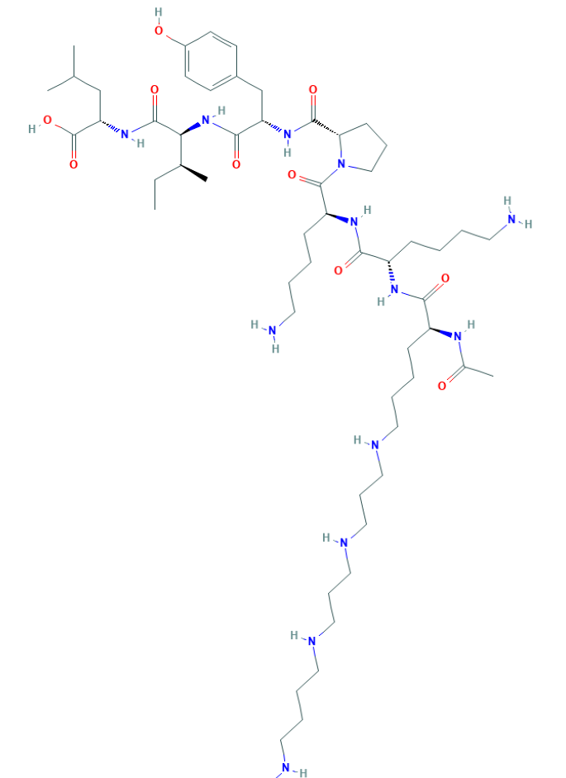
Polyamine C₅₉H₁₀₈N₁₄O₁₀ MW: 1,173.6 g/mol

Slide 9
Diallyldimethylammonium chloride or N-allyl-N,N-dimethylprop-2-en-1-aminium chloride pDADMAC C₈H₁₆ClN MW: 161.67 g/mol
CH₃
CH₂
CH₂
CH
N
+
CH
CH₂
CH₂
CH₃
Cl⁻

Slide 10
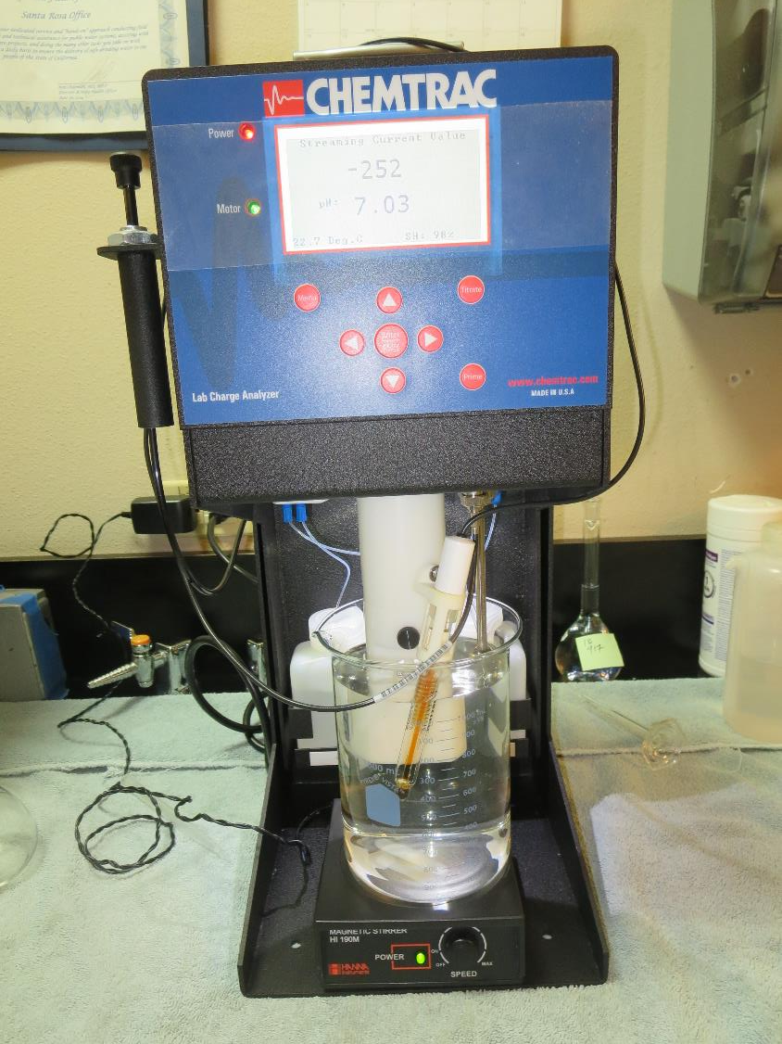
Laboratory Charge Analyzer
LCA: Used to determine coagulant demand of a source water entering the treatment plant.
No pH adjustment
Source pH: 7.02
LCA #1:
CTC-00011: 75 mg/L as product
Final pH: 6.51

Slide 11
Coagulant Information
Unless stated otherwise, all coagulant doses are reported as Product (100% strength).
Aluminum Sulfate doses are reported as hydrated Al₂(SO₄)₃*14.3H₂0.
Preparation of coagulant stock solutions are generally 1.0 and/or 0.1 percent strength using 100 and/or 200 mL volumetric flasks.
Finnpipette F2 variable volume pipette, capacity 100-1000 micro liters is used for stock solution preparation and coagulant aid jar test dosing.
Finnpipette F2 variable volume pipette, capacity 0.5-5 mL is used for primary coagulant jar test dosing.

Slide 12
Howell Mountain; Jar Test 1 - 8 Results Flash Mix 200 RPM (20 sec); Floc Mix 25 RPM (5 min)
Jar# | CTC-00011 mg/L | Filtrate NTU | Filtrate %UVT | Filtrate UVA/cm | %UVA Reduction | Settle NTU 25 min
J1 | 70 | 0.07 | 89.1 | 0.049 | 58.5 | 0.34
J2 | 75 | 0.08 | 89.4 | 0.048 | 59.3 | 0.38
J3 | 80 | 0.05 | 89.5 | 0.047 | 60.2 | 0.40
J4 | 85 | 0.06 | 89.5 | 0.047 | 60.2 | 0.40
J5 | 85 | 0.06 | 89.7 | 0.047 | 60.2 | 0.46
J6 | 90 | 0.04 | 90.0 | 0.045 | 61.9 | 0.41
J7 | 95 | 0.06 | 89.9 | 0.045 | 61.9 | 0.40
J8 | 100 | 0.05 | 90.1 | 0.045 | 61.9 | 0.41

Slide 13
Howell Mountain; Jar Test 9 - 16 Results Flash Mix 200 RPM (20 sec); Floc Mix 25 RPM (5 min)
Jar# | 917 mg/L | Filtrate NTU | Filtrate %UVT | Filtrate UVA/cm | %UVA Reduction | Settle NTU 25 min
J9 | 27 | 0.08 | 89.6 | 0.047 | 60.2 | 0.99
J10 | 40 | 0.10 | 89.8 | 0.046 | 61.0 | 2.95
J11 | 45 | 0.06 | 90.3 | 0.044 | 62.7 | 2.79
J12 | 50 | 0.17 | 88.6 | 0.052 | 55.9 | 2.57
J13 | 21 | 0.09 | 89.3 | 0.049 | 58.5 | 0.78
J14 | 24 | 0.08 | 89.4 | 0.048 | 59.3 | 0.90
J15 | 27 | 0.09 | 89.4 | 0.048 | 59.3 | 1.19
J16 | 30 | 0.13 | 89.3 | 0.049 | 58.5 | 1.52

Slide 14
Howell Mountain; Jar Test 17 - 24 Results Flash Mix 200 RPM (20 sec); Floc Mix 25 RPM (5 min)
Jar# | PAC mg/L | CTC-00011 mg/L | 917 mg/L | Filtrate NTU | Filtrate %UVT | Filtrate UVA/cm | %UVA Reduction | Settle NTU 25 min
J17 | 0 | 0 | 25 | 0.07 | 90.3 | 0.044 | 62.7 | 0.80
J18 | 10 | 0 | 25 | 0.24 | 91.3 | 0.039 | 66.9 | 4.93
J19 | 15 | 0 | 25 | 0.17 | 91.4 | 0.038 | 67.8 | 7.67
J20 | 20 | 0 | 25 | 0.20 | 91.8 | 0.036 | 69.5 | 10.5
J21 | 0 | 80 | 0 | 0.05 | 91.2 | 0.039 | 66.9 | 0.77
J22 | 10 | 80 | 0 | 0.05 | 92.0 | 0.035 | 70.3 | 4.09
J23 | 15 | 80 | 0 | 0.05 | 92.5 | 0.033 | 72.0 | 6.54
J24 | 20 | 80 | 0 | 0.05 | 93.1 | 0.030 | 74.6 | 8.97

Slide 15
Howell Mountain; Jar Test 25 - 32 Results Flash Mix 200 RPM (20 sec); Floc Mix 25 RPM (5 min)
Jar# | PAC mg/L | CTC-00011 mg/L | 186K mg/L | Filtrate NTU | Filtrate %UVT | Filtrate UVA/cm | %UVA Reduction | Settle NTU 25 min
J25 | 0 | 70 | 0 | 0.04 | 90.5 | 0.042 | 64.4 | 0.54
J26 | 0 | 70 | 1 | 0.04 | 90.7 | 0.042 | 64.4 | 0.58
J27 | 0 | 70 | 2 | 0.05 | 90.7 | 0.042 | 64.4 | 0.97
J28 | 0 | 70 | 3 | 0.04 | 90.8 | 0.041 | 65.3 | 0.80
J29 | 0 | 50 | 0 | 0.04 | 90.1 | 0.044 | 62.7 | 0.26
J30 | 20 | 50 | 0 | 0.05 | 90.7 | 0.037 | 68.6 | 3.76
J31 | 0 | 60 | 0 | 0.04 | 90.3 | 0.044 | 62.7 | 0.48
J32 | 20 | 60 | 0 | 0.04 | 91.9 | 0.036 | 69.5 | 2.62

Slide 16
Jars 1-4 Test Flash Mix 20 Sec (200 RPM) Floc Mix 5 min (25 RPM) Applied Coagulant CTC-00011

Slide 17
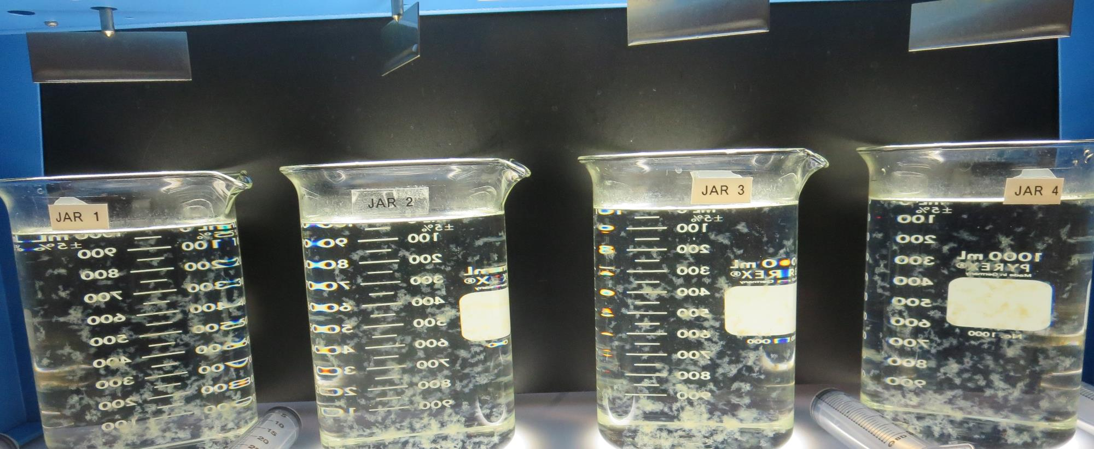
Jars 1-4: End of 5-minute flocculation (25 RPM) duration.
70 mg/L CTC-00011
Filtrate: 0.07 NTU
UVT: 89.1%
UVA: 0.049/cm
UVA Reduction: 58.5%
Settled: 0.34 NTU
75 mg/L CTC-00011
Filtrate: 0.08 NTU
UVT: 89.4%
UVA: 0.048/cm
UVA Reduction: 59.3%
Settled: 0.38 NTU
80 mg/L CTC-00011
Filtrate: 0.05 NTU
UVT: 89.4%
UVA: 0.047/cm
UVA Reduction: 60.2%
Settled: 0.40 NTU
85 mg/L CTC-00011
Filtrate: 0.06 NTU
UVT: 89.5%
UVA: 0.047/cm
UVA Reduction: 60.2%
Settled: 0.40 NTU

Slide 18
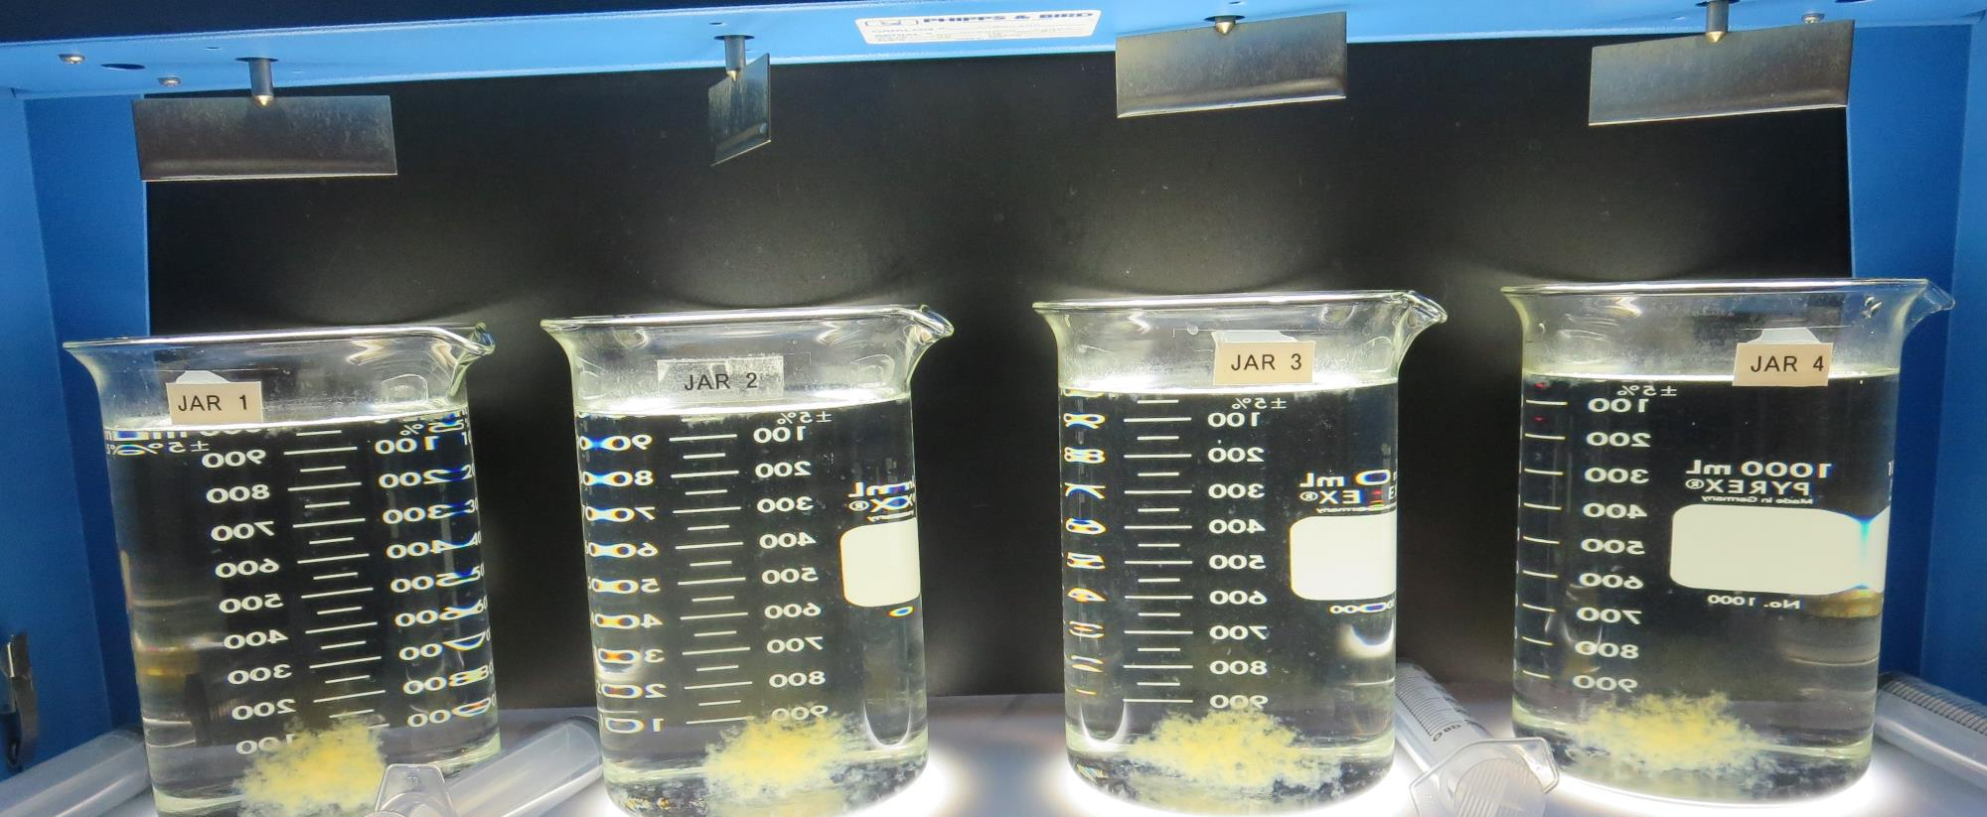
Jars 1-4: After 5 min of settling, 25 mL is syringed for filterability and %UVT/UVA.

Slide 19
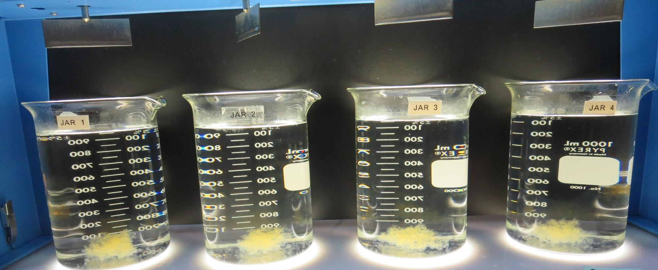
Jars 1-4: After 25-minutes of settling, settled water turbidity is taken.
70 mg/L CTC-00011
Filtrate: 0.07 NTU
UVT: 89.1%
UVA: 0.049/cm
UVA Reduction: 58.5%
Settled: 0.34 NTU
75 mg/L CTC-00011
Filtrate: 0.08 NTU
UVT: 89.4%
UVA: 0.048/cm
UVA Reduction: 59.3%
Settled: 0.38 NTU
80 mg/L CTC-00011
Filtrate: 0.05 NTU
UVT: 89.4%
UVA: 0.047/cm
UVA Reduction: 60.2%
Settled: 0.40 NTU
85 mg/L CTC-00011
Filtrate: 0.06 NTU
UVT: 89.5%
UVA: 0.047/cm
UVA Reduction: 60.2%
Settled: 0.40 NTU

Slide 20
Jars 5-8 Test Flash Mix 20 Sec (200 RPM) Floc Mix 5 min (25 RPM) Applied Coagulant CTC-00011

Slide 21
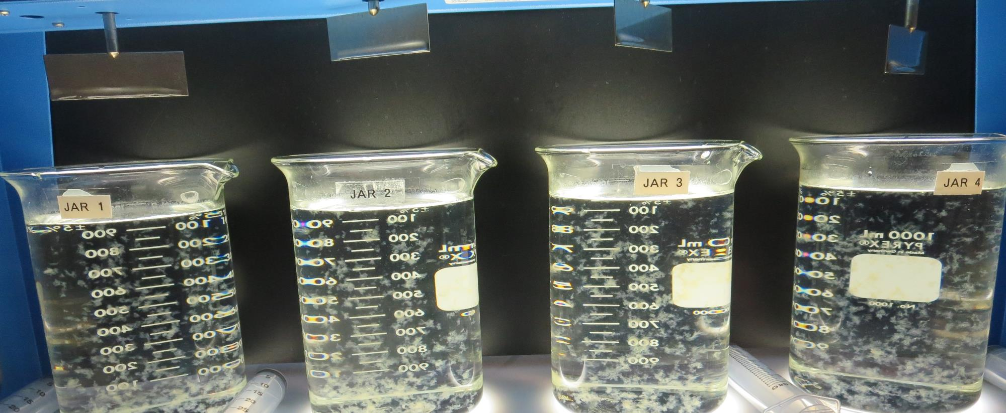
Jars 5-8: End of 5-minute flocculation (25 RPM) duration.
85 mg/L CTC-00011
Filtrate: 0.06 NTU
UVT: 89.7%
UVA: 0.047/cm
UVA Reduction: 60.2%
Settled: 0.46 NTU
90 mg/L CTC-00011
Filtrate: 0.04 NTU
UVT: 90.0%
UVA: 0.045/cm
UVA Reduction: 61.9%
Settled: 0.41 NTU
95 mg/L CTC-00011
Filtrate: 0.06 NTU
UVT: 89.9%
UVA: 0.045/cm
UVA Reduction: 61.9%
Settled: 0.40 NTU
100 mg/L CTC-00011
Filtrate: 0.05 NTU
UVT: 90.1%
UVA: 0.045/cm
UVA Reduction: 61.9%
Settled: 0.41 NTU

Slide 22
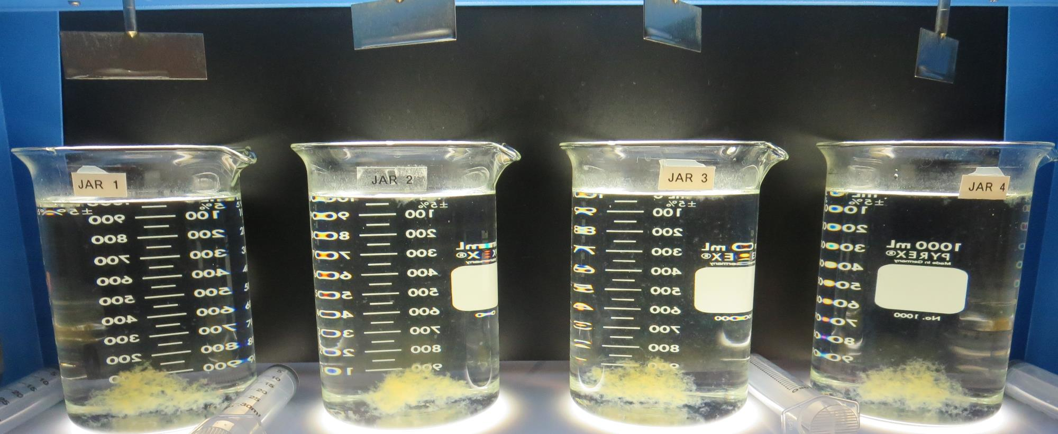
Jars 5-8: After 5 min of settling, 25 mL is syringed for filterability and %UVT/UVA.

Slide 23
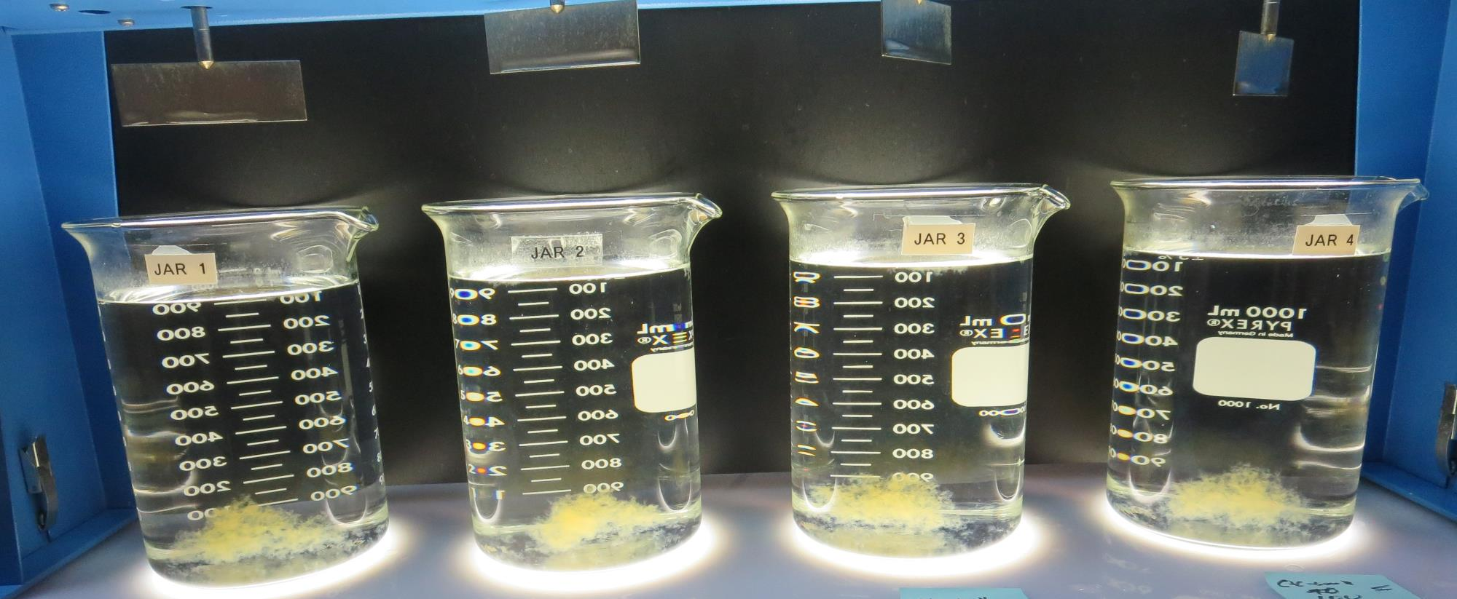
Jars 5-8: After 25-minutes of settling, settled water turbidity is taken.
85 mg/L CTC-00011
Filtrate: 0.06 NTU
UVT: 89.7%
UVA: 0.047/cm
UVA Reduction: 60.2%
Settled: 0.46 NTU
90 mg/L CTC-00011
Filtrate: 0.04 NTU
UVT: 90.0%
UVA: 0.045/cm
UVA Reduction: 61.9%
Settled: 0.41 NTU
95 mg/L CTC-00011
Filtrate: 0.06 NTU
UVT: 89.9%
UVA: 0.045/cm
UVA Reduction: 61.9%
Settled: 0.40 NTU
100 mg/L CTC-00011
Filtrate: 0.05 NTU
UVT: 90.1%
UVA: 0.045/cm
UVA Reduction: 61.9%
Settled: 0.41 NTU

Slide 24
Jars 9-12 Test Flash Mix 20 Sec (200 RPM) Floc Mix 5 min (25 RPM) Applied Coagulant 917

Slide 25
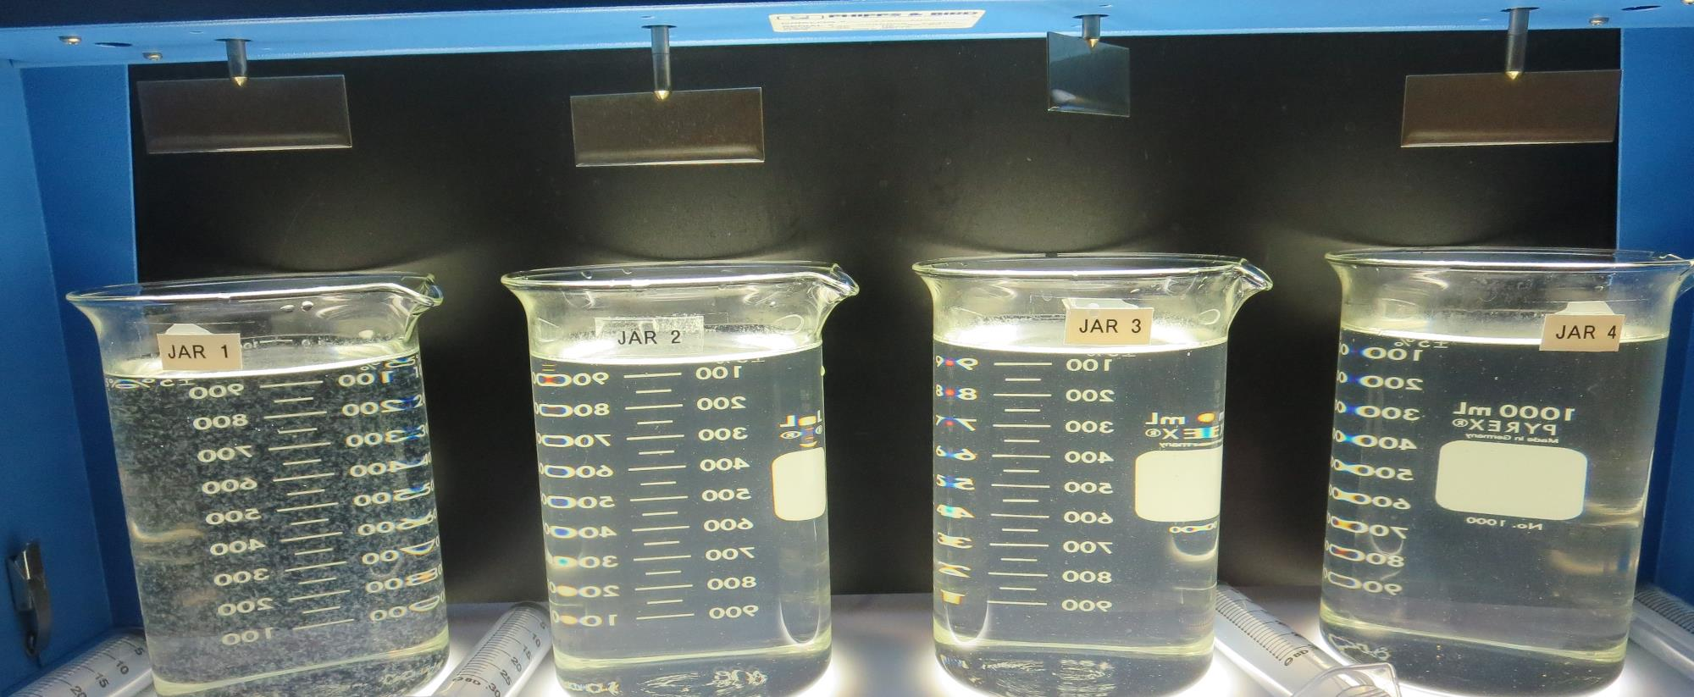
Jars 9-12: End of 5-minute flocculation (25 RPM) duration.
27 mg/L 917
Filtrate: 0.08 NTU
UVT: 89.6%
UVA: 0.047/cm
UVA Reduction: 60.2%
Settled: 0.99 NTU
40 mg/L 917
Filtrate: 0.10 NTU
UVT: 89.8%
UVA: 0.046/cm
UVA Reduction: 61.0%
Settled: 2.95 NTU
45 mg/L 917
Filtrate: 0.06 NTU
UVT: 90.3%
UVA: 0.044/cm
UVA Reduction: 62.7%
Settled: 2.79 NTU
50 mg/L 917
Filtrate: 0.17 NTU
UVT: 88.6%
UVA: 0.052/cm
UVA Reduction: 55.9%
Settled: 2.57 NTU

Slide 26
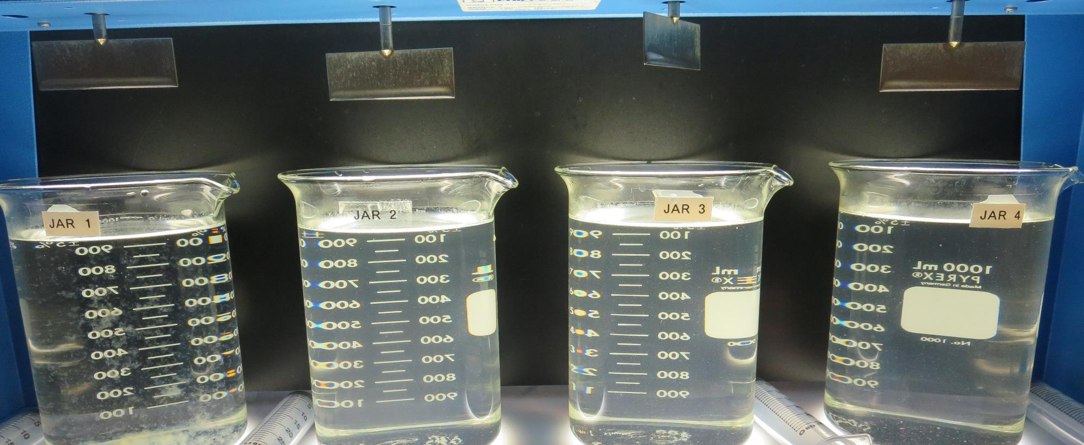
Jars 9-12: After 5 min of settling, 25 mL is syringed for filterability and %UVT/UVA.

Slide 27
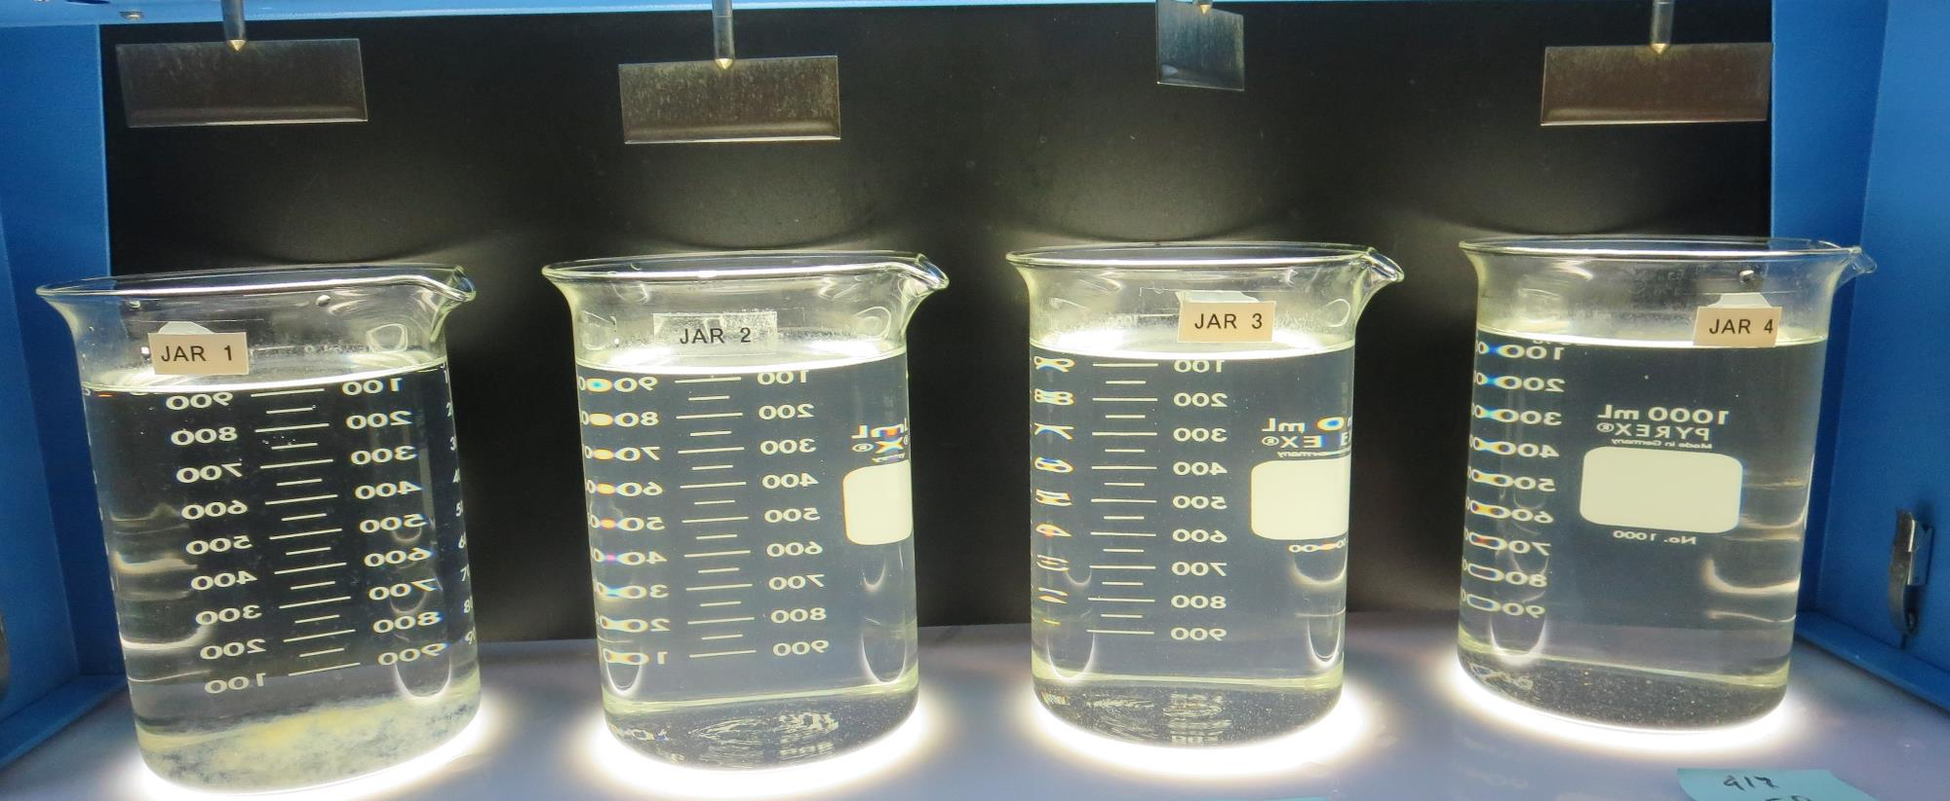
Jars 9-12: After 25-minutes of settling, settled water turbidity is taken.
27 mg/L 917
Filtrate: 0.08 NTU
UVT: 89.6%
UVA: 0.047/cm
UVA Reduction: 60.2%
Settled: 0.99 NTU
40 mg/L 917
Filtrate: 0.10 NTU
UVT: 89.8%
UVA: 0.046/cm
UVA Reduction: 61.0%
Settled: 2.95 NTU
45 mg/L 917
Filtrate: 0.06 NTU
UVT: 90.3%
UVA: 0.044/cm
UVA Reduction: 62.7%
Settled: 2.79 NTU
50 mg/L 917
Filtrate: 0.17 NTU
UVT: 88.6%
UVA: 0.052/cm
UVA Reduction: 55.9%
Settled: 2.57 NTU

Slide 28
Jars 13-16 Test Flash Mix 20 Sec (200 RPM) Floc Mix 5 min (25 RPM) Applied Coagulant 917

Slide 29
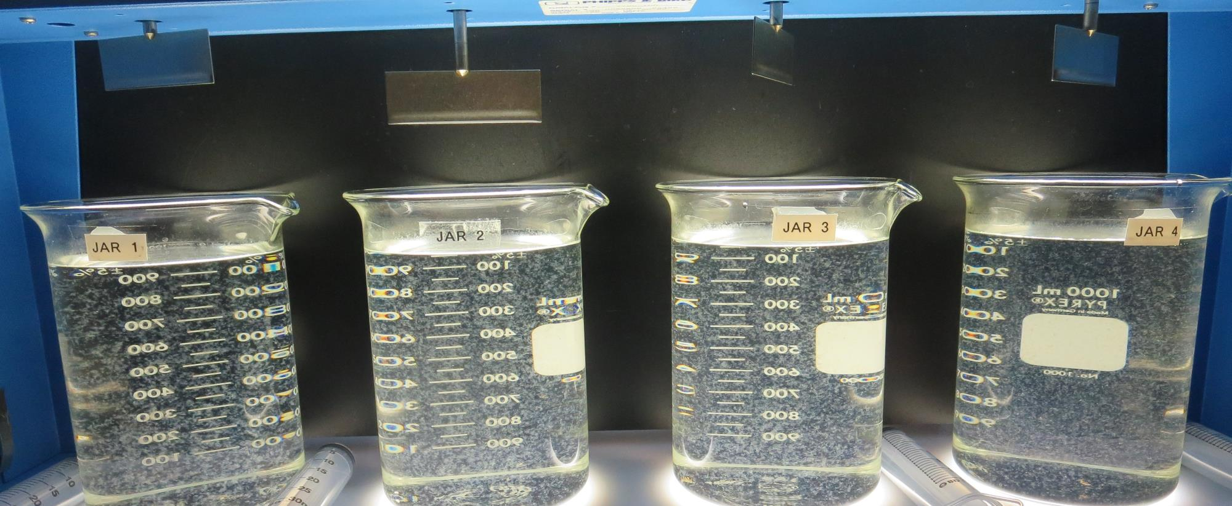
Jars 13-16: End of 5-minute flocculation (25 RPM) duration.
21 mg/L 917
Filtrate: 0.09 NTU
UVT: 89.3%
UVA: 0.049/cm
UVA Reduction: 58.5%
Settled: 0.78 NTU
24 mg/L 917
Filtrate: 0.08 NTU
UVT: 89.4%
UVA: 0.048/cm
UVA Reduction: 59.3%
Settled: 0.90 NTU
27 mg/L 917
Filtrate: 0.09 NTU
UVT: 89.4%
UVA: 0.048/cm
UVA Reduction: 59.3%
Settled: 1.19 NTU
30 mg/L 917
Filtrate: 0.13 NTU
UVT: 89.3%
UVA: 0.049/cm
UVA Reduction: 58.5%
Settled: 1.52 NTU

Slide 30
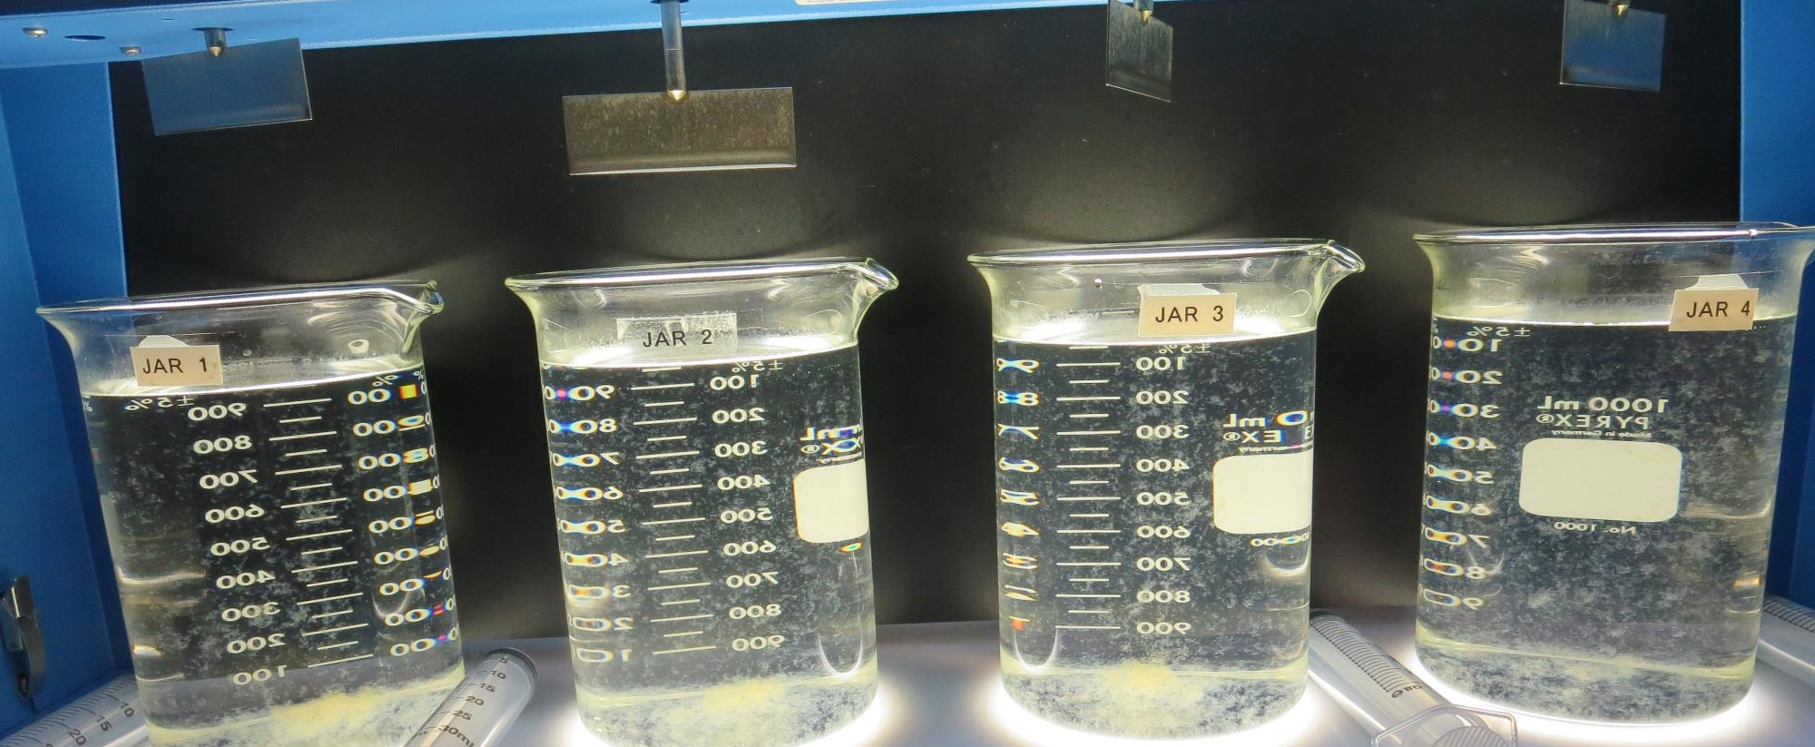
Jars 13-16: After 5 min of settling, 25 mL is syringed for filterability and %UVT/UVA.

Slide 31
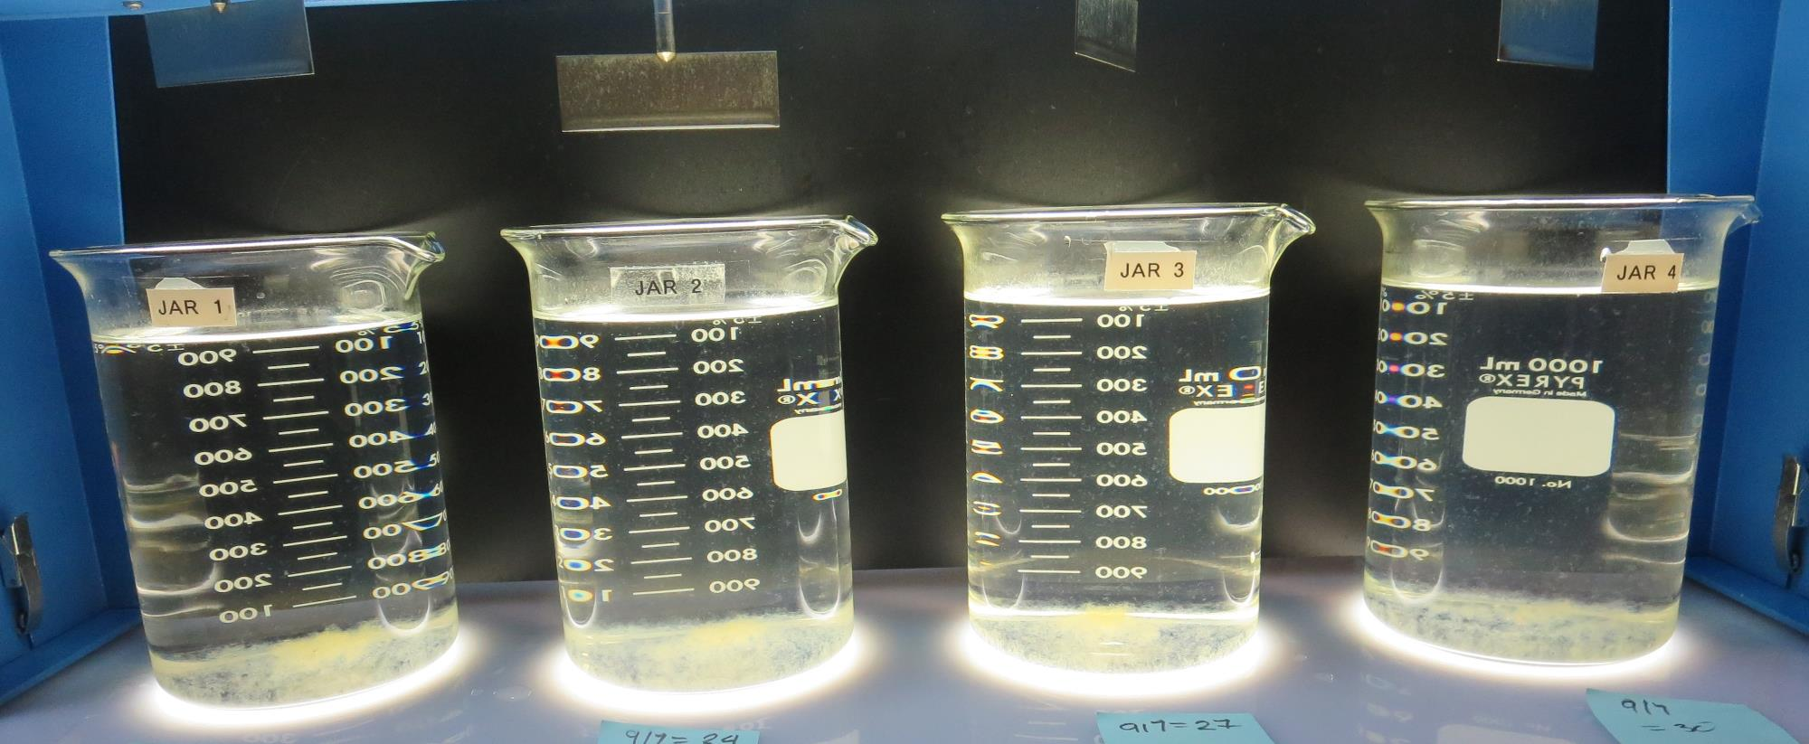
Jars 13-16: After 25-minutes of settling, settled water turbidity is taken.
21 mg/L 917
Filtrate: 0.09 NTU
UVT: 89.3%
UVA: 0.049/cm
UVA Reduction: 58.5%
Settled: 0.78 NTU
24 mg/L 917
Filtrate: 0.08 NTU
UVT: 89.4%
UVA: 0.048/cm
UVA Reduction: 59.3%
Settled: 0.90 NTU
27 mg/L 917
Filtrate: 0.09 NTU
UVT: 89.4%
UVA: 0.048/cm
UVA Reduction: 59.3%
Settled: 1.19 NTU
30 mg/L 917
Filtrate: 0.13 NTU
UVT: 89.3%
UVA: 0.049/cm
UVA Reduction: 58.5%
Settled: 1.52 NTU

Slide 32
Jars 17-20 Test Flash Mix 20 Sec (200 RPM) Floc Mix 5 min (30 RPM) PAC with Applied Coagulant 917

Slide 33
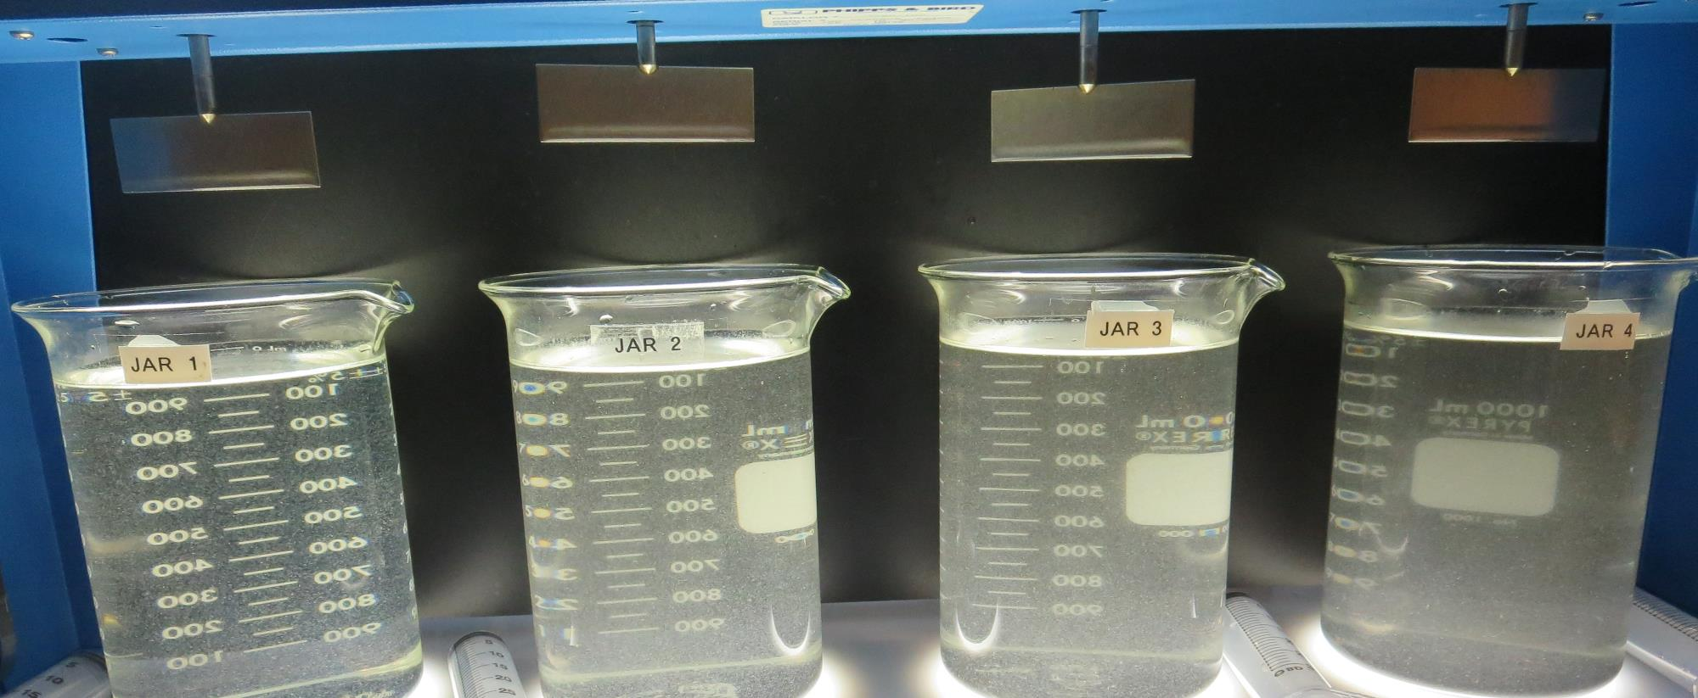
Jars 17-20: End of 5-minute flocculation (25 RPM) duration.
0 mg/L PAC
25 mg/L 917
Filtrate: 0.07 NTU
UVT: 90.3%
UVA: 0.044/cm
UVA Reduction: 62.7%
Settled: 0.80 NTU
10 mg/L PAC
25 mg/L 917
Filtrate: 0.24 NTU
UVT: 91.3%
UVA: 0.039/cm
UVA Reduction: 66.9%
Settled: 4.93 NTU
15 mg/L PAC
25 mg/L 917
Filtrate: 0.17 NTU
UVT: 91.4%
UVA: 0.038/cm
UVA Reduction: 67.8%
Settled: 7.67 NTU
20 mg/L PAC
25 mg/L 917
Filtrate: 0.20 NTU
UVT: 91.8%
UVA: 0.036/cm
UVA Reduction: 69.5%
Settled: 10.5 NTU

Slide 34
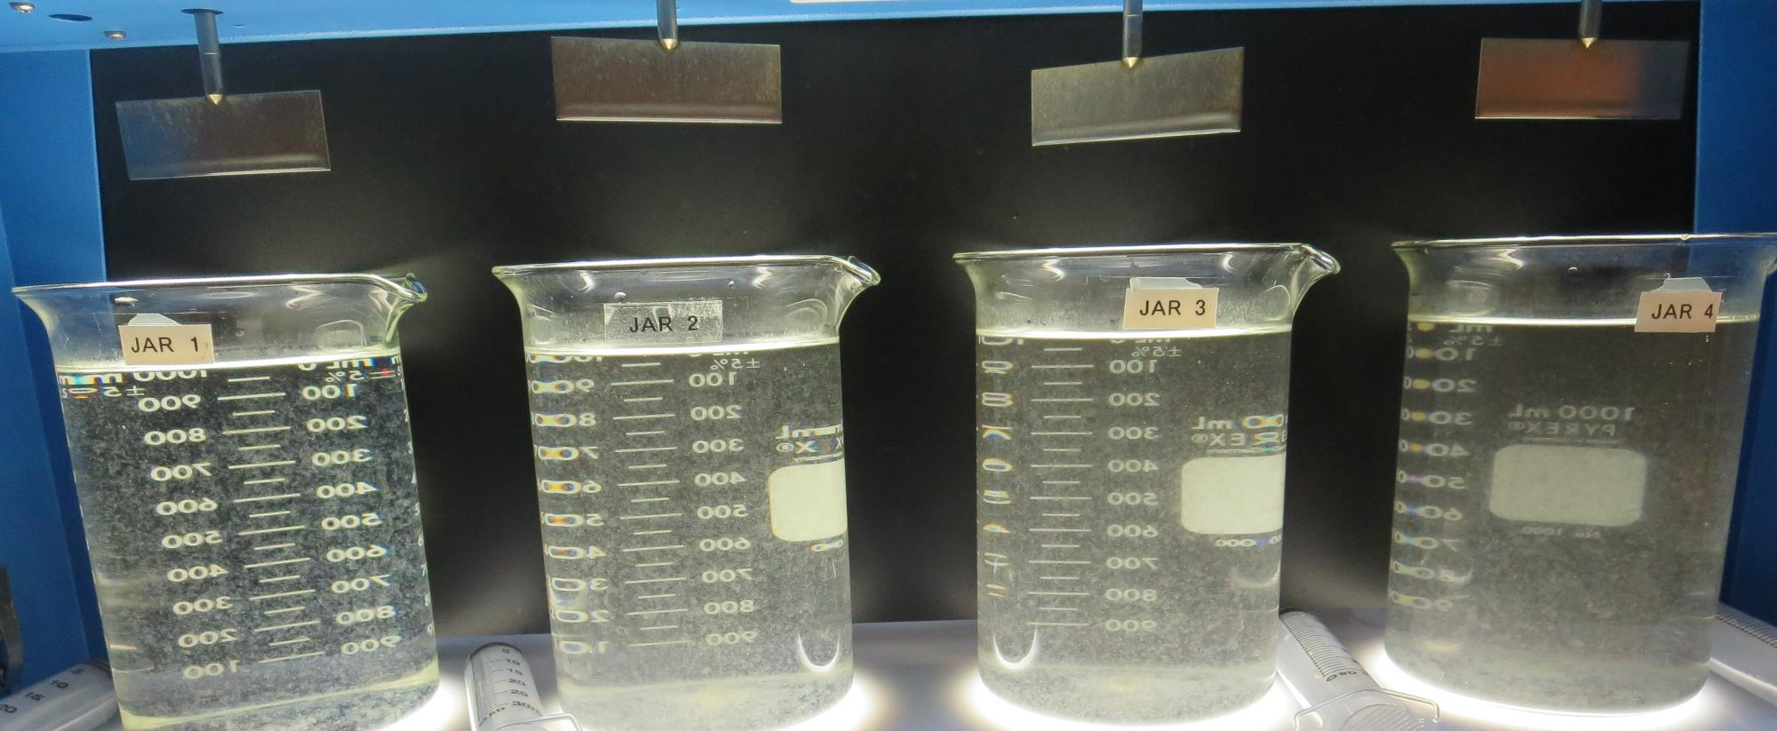
Jars 17-20: After 5 min of settling, 25 mL is syringed for filterability and %UVT/UVA.

Slide 35
Jars 17-20: After 25-minutes of settling, settled water turbidity is taken.
0 mg/L PAC
25 mg/L 917
Filtrate: 0.07 NTU
UVT: 90.3%
UVA: 0.044/cm
UVA Reduction: 62.7%
Settled: 0.80 NTU
10 mg/L PAC
25 mg/L 917
Filtrate: 0.24 NTU
UVT: 91.3%
UVA: 0.039/cm
UVA Reduction: 66.9%
Settled: 4.93 NTU
15 mg/L PAC
25 mg/L 917
Filtrate: 0.17 NTU
UVT: 91.4%
UVA: 0.038/cm
UVA Reduction: 67.8%
Settled: 7.67 NTU
20 mg/L PAC
25 mg/L 917
Filtrate: 0.20 NTU
UVT: 91.8%
UVA: 0.036/cm
UVA Reduction: 69.5%
Settled: 10.5 NTU

Slide 36
Jars 21-24 Test Flash Mix 20 Sec (200 RPM) Floc Mix 5 min (30 RPM) PAC with Applied Coagulants CTC-00011

Slide 37
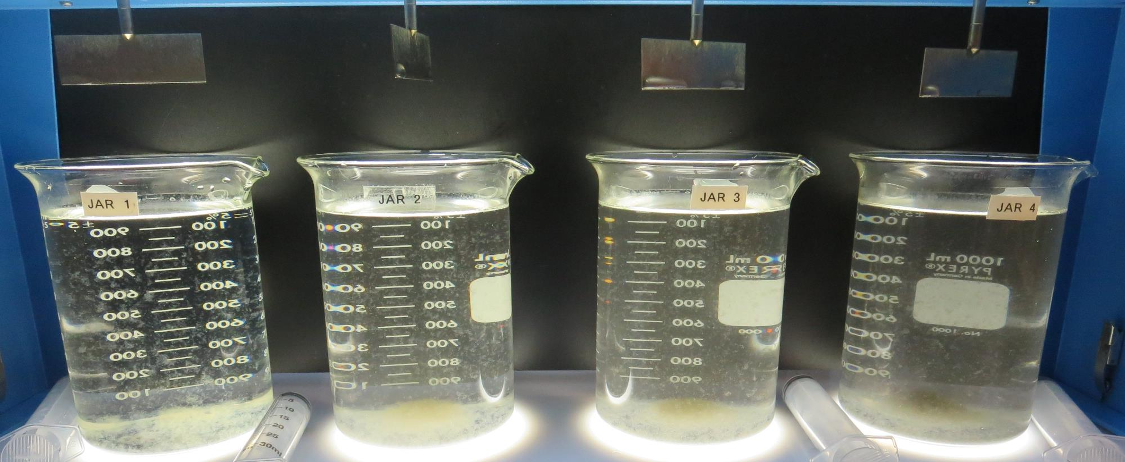
Jars 21-24: End of 5-minute flocculation (25 RPM) duration.
0 mg/L PAC
80 mg/L CTC-00011
Filtrate: 0.05 NTU
UVT: 91.2%
UVA: 0.039/cm
UVA Reduction: 66.9%
Settled: 0.77 NTU
10 mg/L PAC
80 mg/L CTC-00011
Filtrate: 0.05 NTU
UVT: 92.0%
UVA: 0.035/cm
UVA Reduction: 70.3%
Settled: 4.09 NTU
15 mg/L PAC
80 mg/L CTC-00011
Filtrate: 0.05 NTU
UVT: 92.5%
UVA: 0.033/cm
UVA Reduction: 72.0%
Settled: 6.54 NTU
20 mg/L PAC
80 mg/L CTC-00011
Filtrate: 0.05 NTU
UVT: 93.1%
UVA: 0.030/cm
UVA Reduction: 74.6%
Settled: 8.97 NTU

Slide 38
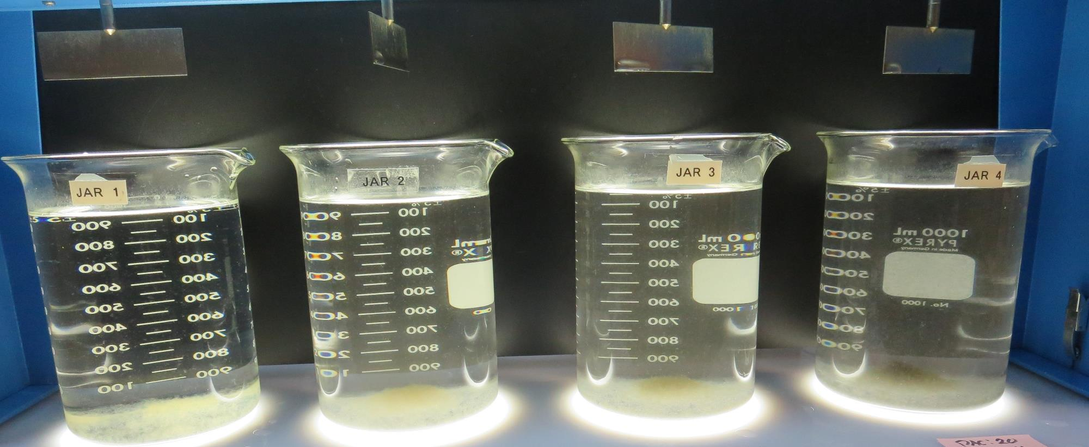
Jars 21-24: After 25-minutes of settling, settled water turbidity is taken.
0 mg/L PAC
80 mg/L CTC-00011
Filtrate: 0.05 NTU
UVT: 91.2%
UVA: 0.039/cm
UVA Reduction: 66.9%
Settled: 0.77 NTU
10 mg/L PAC
80 mg/L CTC-00011
Filtrate: 0.05 NTU
UVT: 92.0%
UVA: 0.035/cm
UVA Reduction: 70.3%
Settled: 4.09 NTU
15 mg/L PAC
80 mg/L CTC-00011
Filtrate: 0.05 NTU
UVT: 92.5%
UVA: 0.033/cm
UVA Reduction: 72.0%
Settled: 6.54 NTU
20 mg/L PAC
80 mg/L CTC-00011
Filtrate: 0.05 NTU
UVT: 93.1%
UVA: 0.030/cm
UVA Reduction: 74.6%
Settled: 8.97 NTU

Slide 39
Jars 25-28 Test Flash Mix 20 Sec (200 RPM) Floc Mix 5 min (25 RPM) Applied Coagulants CTC-00011/186K

Slide 40
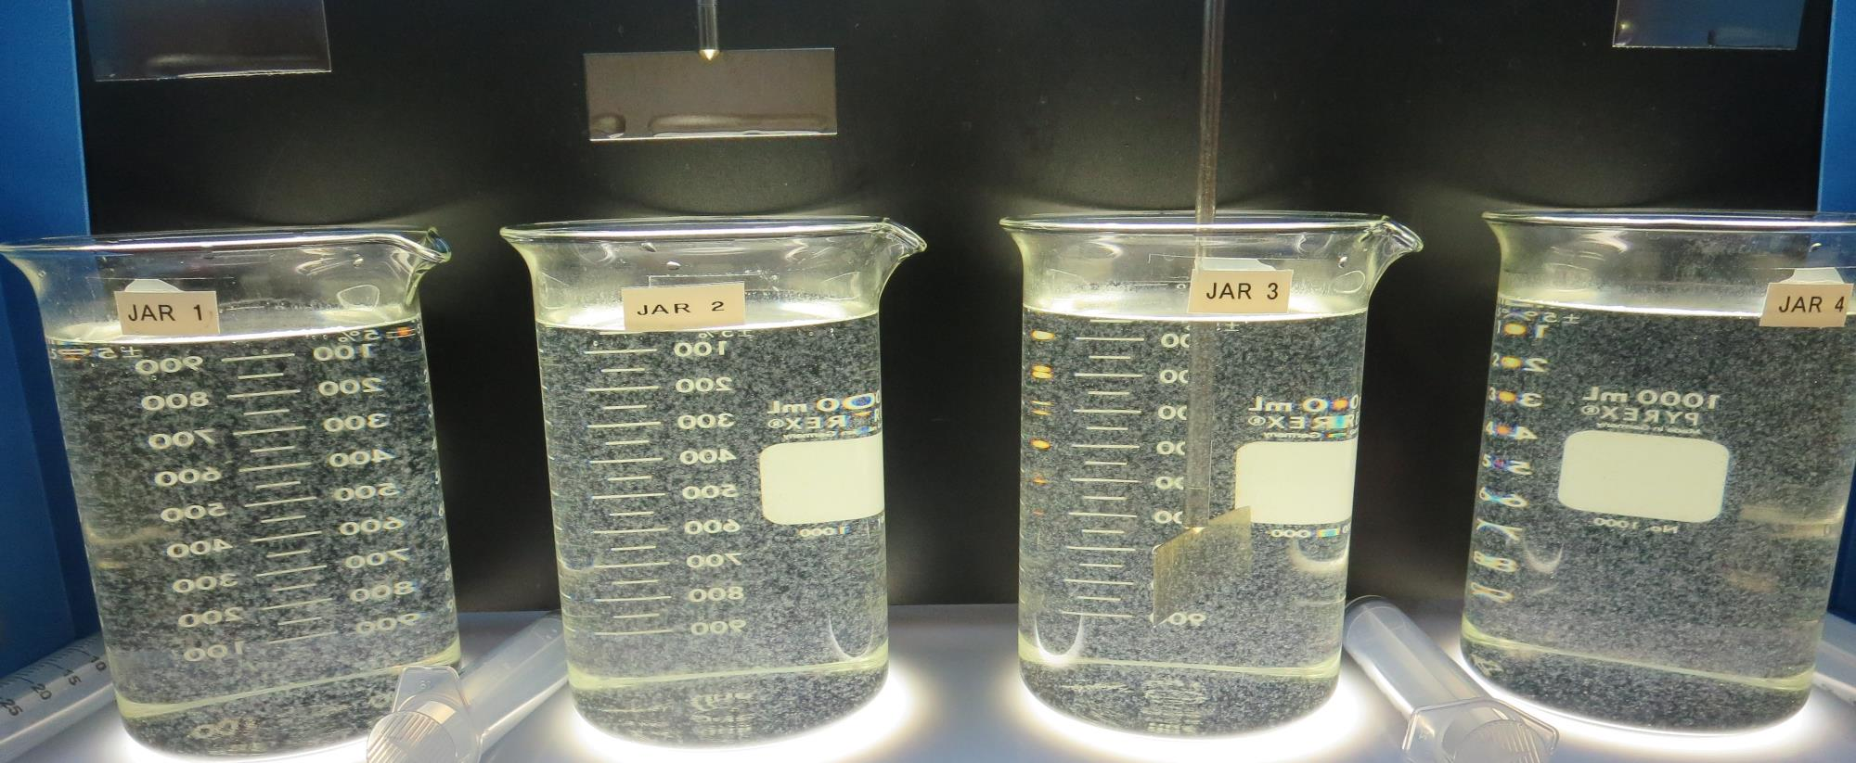
Jars 25-28: End of 5-minute flocculation (25 RPM) duration.
70 mg/L CTC-00011
0 mg/L 186K
Filtrate: 0.04 NTU
UVT: 90.5%
UVA: 0.042/cm
UVA Reduction: 64.4%
Settled: 0.54 NTU
70 mg/L CTC-00011
1 mg/L 186K
Filtrate: 0.04 NTU
UVT: 90.7%
UVA: 0.042/cm
UVA Reduction: 64.4%
Settled: 0.58 NTU
70 mg/L CTC-00011
2 mg/L 186K
Filtrate: 0.05 NTU
UVT: 90.7%
UVA: 0.042/cm
UVA Reduction: 64.4%
Settled: 0.97 NTU
70 mg/L CTC-00011
3 mg/L 186K
Filtrate: 0.04 NTU
UVT: 90.8%
UVA: 0.041/cm
UVA Reduction: 65.3%
Settled: 0.80 NTU

Slide 41
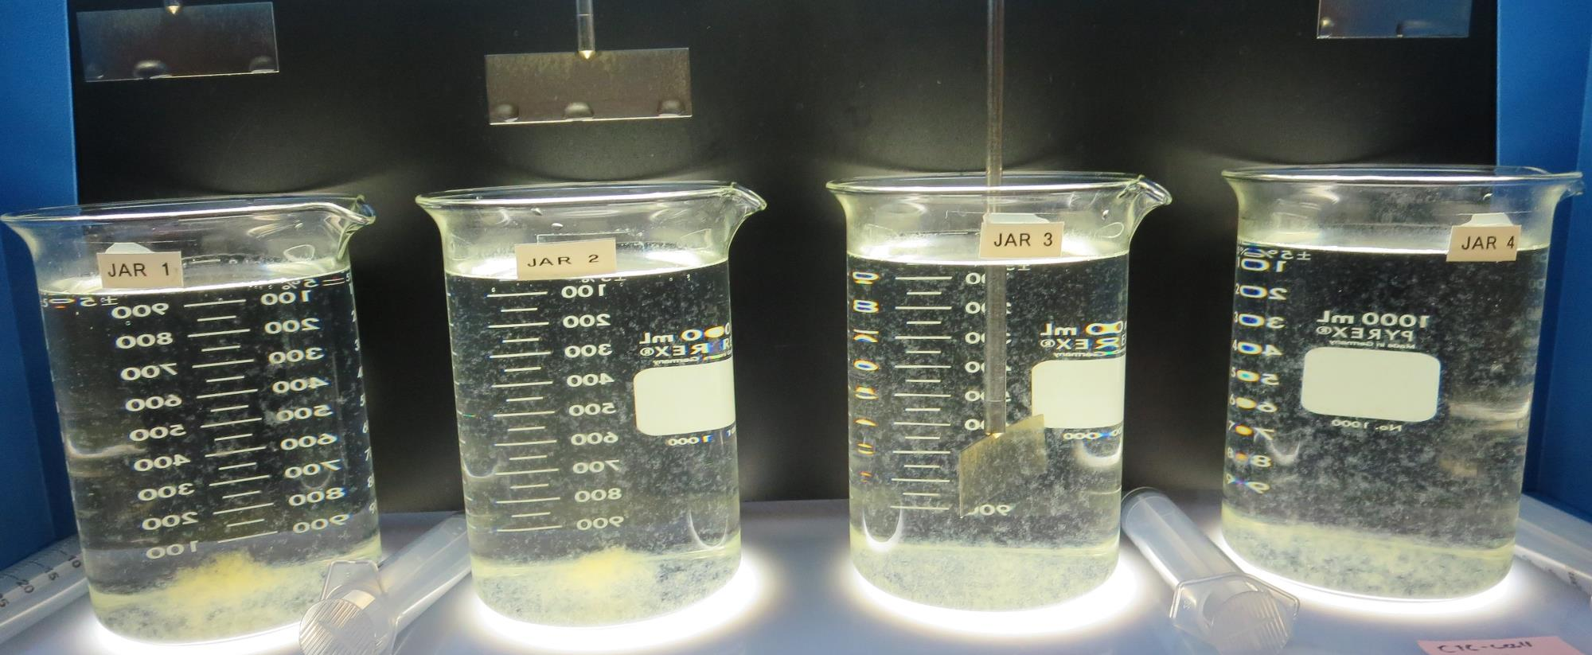
Jars 25-28: After 5 min of settling, 25 mL is syringed for filterability and %UVT/UVA.

Slide 42
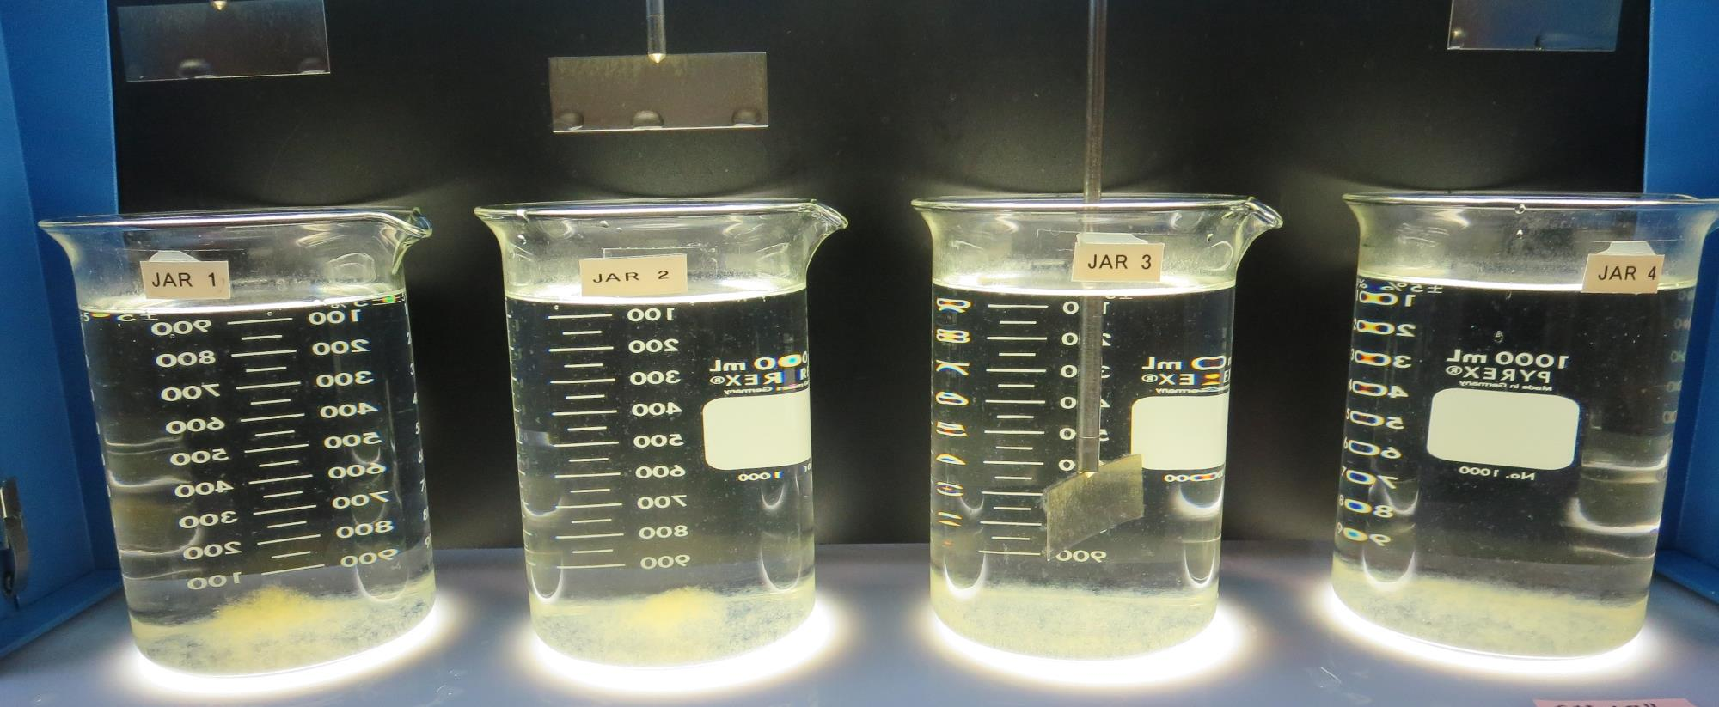
Jars 25-28: After 25-minutes of settling, settled water turbidity is taken.
70 mg/L CTC-00011
0 mg/L 186K
Filtrate: 0.04 NTU
UVT: 90.5%
UVA: 0.042/cm
UVA Reduction: 64.4%
Settled: 0.54 NTU
70 mg/L CTC-00011
1 mg/L 186K
Filtrate: 0.04 NTU
UVT: 90.7%
UVA: 0.042/cm
UVA Reduction: 64.4%
Settled: 0.58 NTU
70 mg/L CTC-00011
2 mg/L 186K
Filtrate: 0.05 NTU
UVT: 90.7%
UVA: 0.042/cm
UVA Reduction: 64.4%
Settled: 0.97 NTU
70 mg/L CTC-00011
3 mg/L 186K
Filtrate: 0.04 NTU
UVT: 90.8%
UVA: 0.041/cm
UVA Reduction: 65.3%
Settled: 0.80 NTU

Slide 43
Jars 28-32 Test Flash Mix 20 Sec (200 RPM) Floc Mix 5 min (25 RPM) PAC with Applied Coagulant CTC-00011

Slide 44
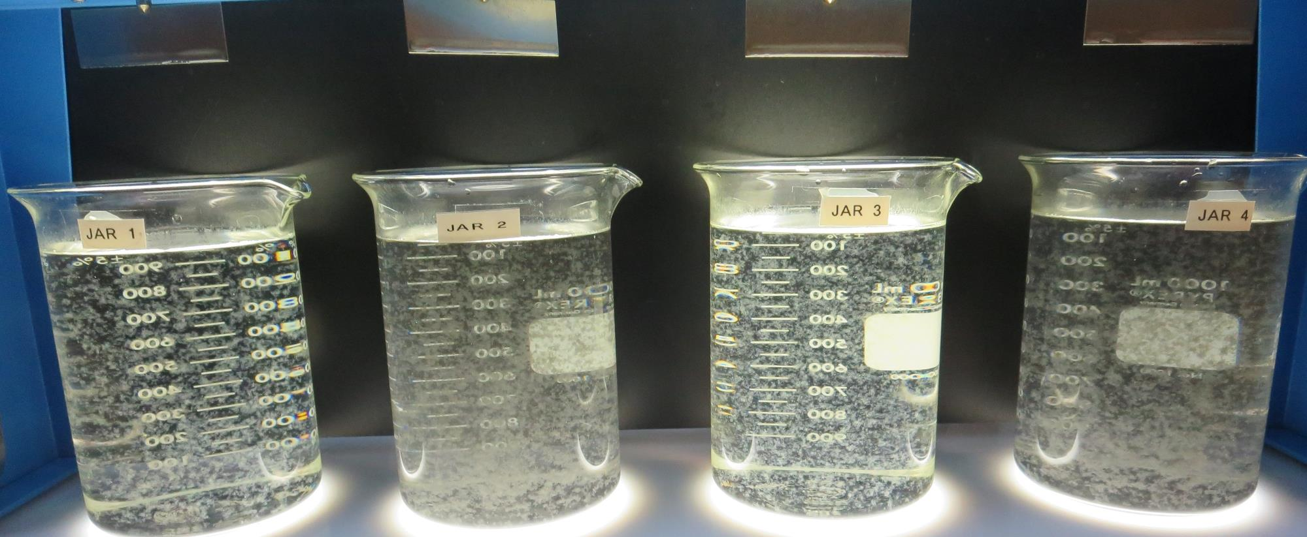
Jars 29-32: End of 5-minute flocculation (25 RPM) duration.
0 mg/L PAC
50 mg/L CTC-00011
Filtrate: 0.04 NTU
UVT: 90.1%
UVA: 0.044/cm
UVA Reduction: 62.7%
Settled: 0.26 NTU
20 mg/L PAC
50 mg/L CTC-00011
Filtrate: 0.05 NTU
UVT: 91.7%
UVA: 0.037/cm
UVA Reduction: 68.6%
Settled: 3.76 NTU
0 mg/L PAC
60 mg/L CTC-00011
Filtrate: 0.04 NTU
UVT: 90.3%
UVA: 0.044/cm
UVA Reduction: 62.7%
Settled: 0.48 NTU
20 mg/L PAC
60 mg/L CTC-00011
Filtrate: 0.04 NTU
UVT: 91.9%
UVA: 0.036/cm
UVA Reduction: 69.5%
Settled: 2.62 NTU

Slide 45
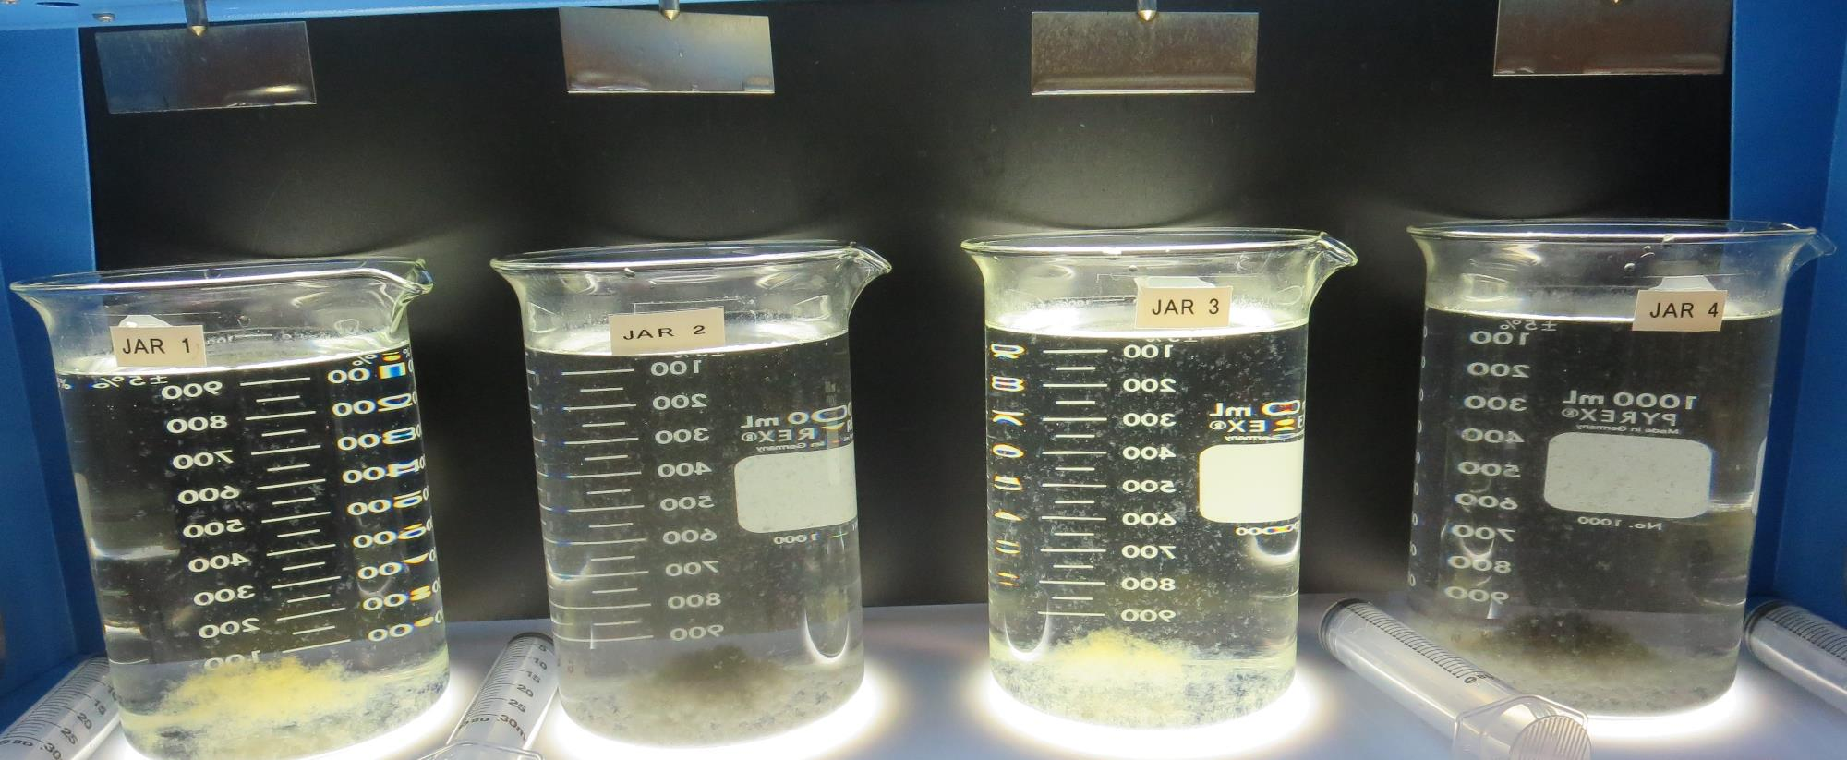
Jars 29-32: After 5 min of settling, 25 mL is syringed for filterability and %UVT/UVA.

Slide 46
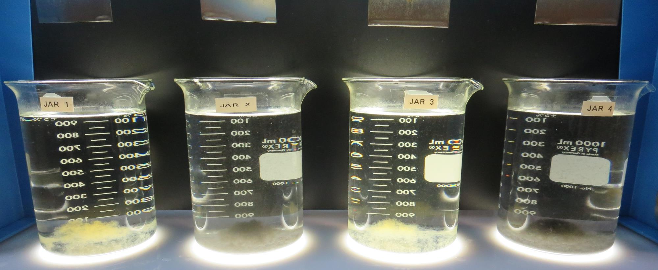
Jars 29-32: After 25-minutes of settling, settled water turbidity is taken.
0 mg/L PAC
50 mg/L CTC-00011
Filtrate: 0.04 NTU
UVT: 90.1%
UVA: 0.044/cm
UVA Reduction: 62.7%
Settled: 0.26 NTU
20 mg/L PAC
50 mg/L CTC-00011
Filtrate: 0.05 NTU
UVT: 91.7%
UVA: 0.037/cm
UVA Reduction: 68.6%
Settled: 3.76 NTU
0 mg/L PAC
60 mg/L CTC-00011
Filtrate: 0.04 NTU
UVT: 90.3%
UVA: 0.044/cm
UVA Reduction: 62.7%
Settled: 0.48 NTU
20 mg/L PAC
60 mg/L CTC-00011
Filtrate: 0.04 NTU
UVT: 91.9%
UVA: 0.036/cm
UVA Reduction: 69.5%
Settled: 2.62 NTU

Slide 47
Jar Testing for 1-Liter Jars: Procedures for Most Treatment Plants
Fill jars with source water prior to coagulant injection and set paddle speed at 30 rpm
Add chemicals (i.e., NaOCl, primary coagulant, coagulant aid) to each jar
Flash mix for 15-30 seconds (200 rpm)
Slow mix for 5 minutes (20-30 rpm)
Settled for 5 minutes. Syringe 25 mL from each jar taken 1-inch below surface (25 mL/12 sec rate)
Filtered through 1.2 um isopore membrane into cuvette drip rate, 15 mL/(50-90 sec)
Measure filtrate turbidity, chlorine residual and %UVT/UVA
Measure settled water turbidity after 25 minutes of total setting
Record all data

Slide 48
Jar Test Filterability Test Equipment
Turbidity Instrument
Syringe w/Luer-Lock Tip, 30 cc
(part#: 2225800, by Hach)
Swinnex Filter Holder, 25 mm (part#: SX0002500)
Isopore Membrane Filter, 1.2 um absolute
pore size,
Φ= 25 mm , thickness: 24 um,
hydrophilic polycarbonate membrane
(part #: RTTP02500)
Go to Sigma-Aldrich for laboratory supplies http://www.sigmaaldrich.com/united-states.html

Slide 49
Isopore Membrane Information
Categories | Information
trade name | Isopore
filter color | White
chemistry | Polycarbonate (PC)
water flow rate | Avg. 175 mL/min x cm² (typical results @ 10 psi)
media | Isopore®
wettability | Hydrophilic
porosity | 14.7%
pore size | 1.2 µm
bubble point at 23 °C | 1.0 bar, air with water
thickness | 24 µm
filter diameter (ø) | 25 mm
material size | polycarbonate, Hydrophilic, 1.2 µm, 25 mm, white, plain, 100

Slide 50
Isopore Membrane Background Information
The Isopore membrane is a polycarbonate, track-etched screen filter recommended for all analyses in which the sample is viewed on the surface of the membrane. The Isopore membrane is composed of polycarbonate film, which has a smooth, glass-like surface for clearer sample observation. The unique manufacturing process of the membrane ensures a precise pore diameter and a consistent pore size for accurate separation of samples by size. Matched-weight filters are not usually required because of low, constant tar and ash weights. Features & Benefits: Membrane structure retains particles on the surface, simplifying counting and analysis

Slide 51
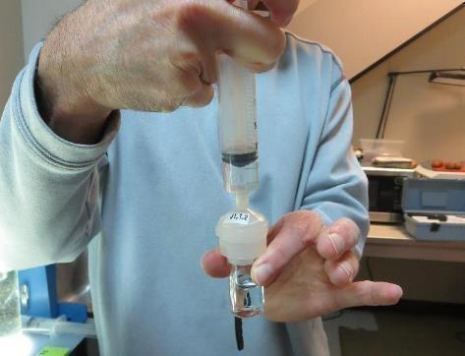
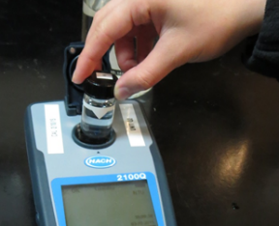
Jar Test - Filterability Test
Syringe ~ 25 mL from jar (after 5-minutes of settling)
Filter-to-waste 3-5 mL
Filter directly into clean cuvette
Measure turbidity
Note: Take several readings before recording final NTU results. Micro bubbles can adhere to glass causing false NTU readings. To remove bubbles, tilt cuvette up to 90 degrees.

Slide 52
Contact
Guy Schott, P.E.
State Water Resources Control Board
Division of Drinking Water
Santa Rosa, CA
Go to Stock Solution/Dose calculations/Jar Test Results for tools to download
www.waterboards.ca.gov/drinking_water/programs/districts/mendocino_district.html
Email: Guy Schott - Guy.Schott@waterboards.ca.gov
Office Number: 707-576-2732

