Slide 1
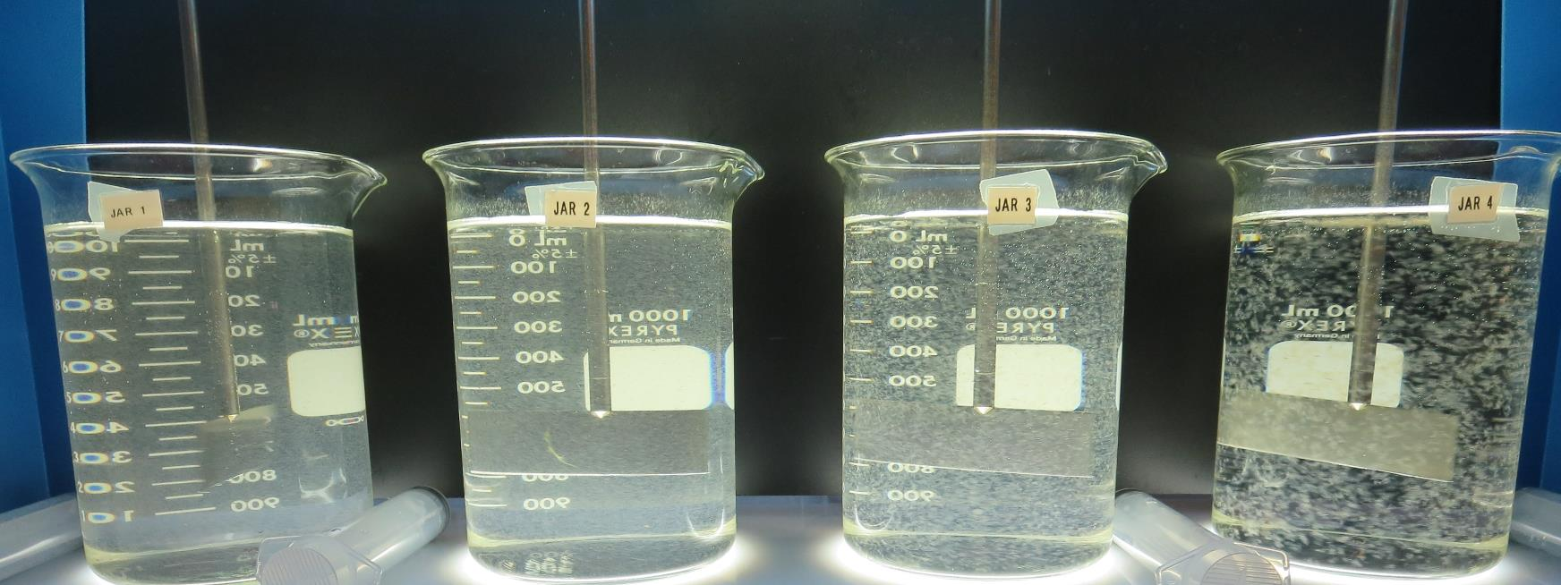
City of Calistoga
CA2810002
Napa County
Jar Test
by Guy Schott, P.E.
February 3, 2020

Slide 2
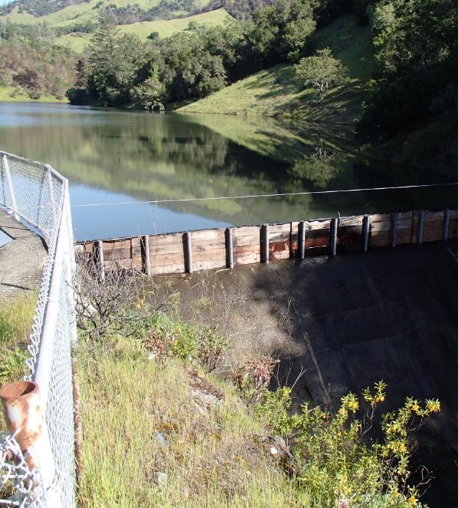
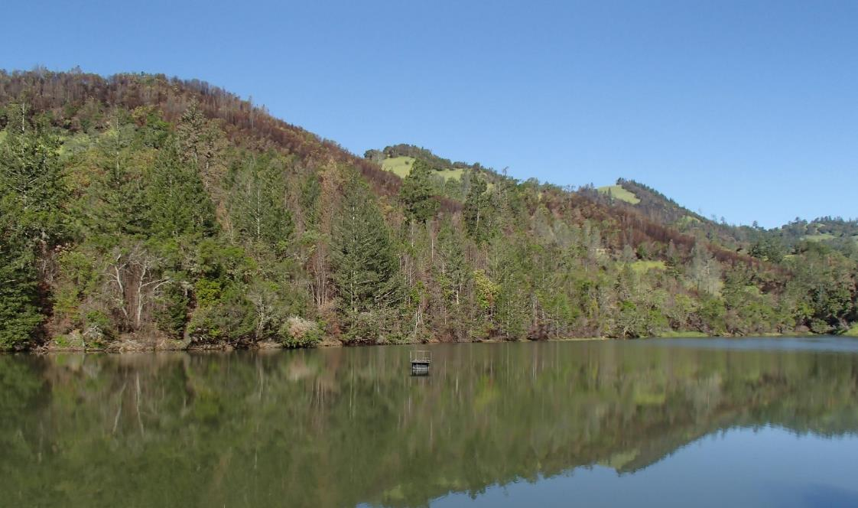
City of Calistoga
Source Water: Kimball Reservoir

Slide 3
City of Calistoga, February 3, 2020
Kimball Reservoir and Treated Water Characteristics
Source
Turbidity: 5.4 NTU
pH: 7.52
UVT: 75.1%, UVA: 0.124/cm
0.4 um Filtered
Turbidity: 0.3 NTU
UVT: 80.3%, UVA: 0.095/cm
Media Filter
Turbidity: 0.07 NTU
UVT: 95.6%, UVA: 0.019/cm
UVA Reduction: 80%
Post Cl2:
Turbidity: 0.09 NTU
UVT: 95.6%, UVA: 0.019/cm
UVA Reduction: 80%

Slide 4
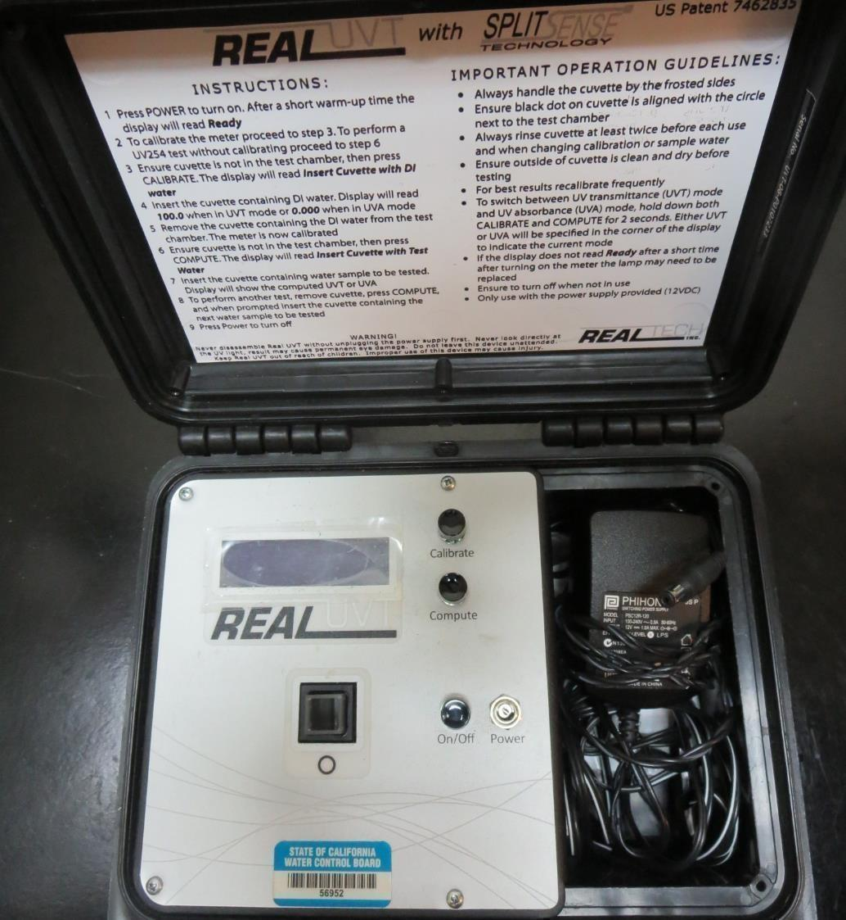
UVT/UVA
UV transmittance (UVT) is a measurement of the amount of ultraviolet light (commonly at 254 nm due to its germicidal effect) that passes through a water sample compared to the amount of light that passes through a pure water sample. The measurement is expressed as a percentage, % UVT.
%UVT = 10^{(-UVA)} x 100%
UV absorbance (UVA) is calculated as a relative measure of the amount of light absorbed by a water sample compared with the amount of light absorbed by a pure water sample.
UVA = -log(%UVT/100)

Slide 5
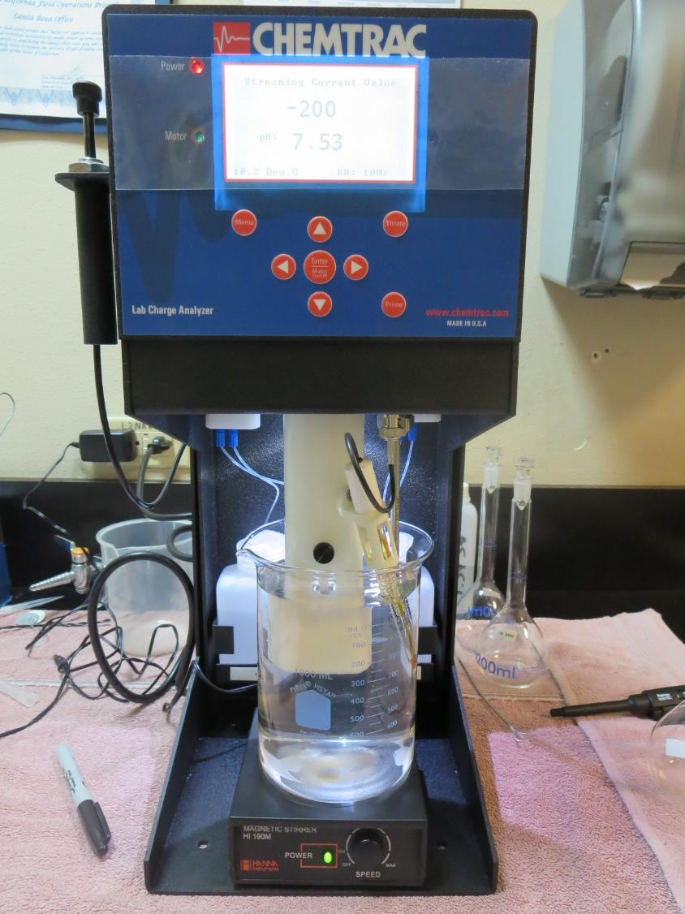
Laboratory Charge Analyzer
LCA: Used to determine coagulant demand of a source water entering the treatment plant.
Source pH: 7.52
LCA #1:
JC 1600: 28.4 mg/L as product (no pH adjustment)
Final pH: 7.42
LCA #2:
JC 1720: 36 mg/L as product (no pH adjustment)
Final pH: 7.34
LCA #3:
7066: 134.6 mg/L as product (no pH adjustment)
Final pH: 6.95

Slide 6
Coagulants Used for Jar Testing
JC 1600 (Jenfitch, LLC)
45-50% Aluminum Chlorohydrate
50% Water
SG = 1.34
JC 1720 (Jenfitch, LLC)
Polyaluminum Hydroxychlorosulfate
SG = 1.29
Basicity (70%)
JC 9450 (Jenfitch, LLC)
Has advanced reactive oxygen species (ROS)
SG = 1.14-1.22
7066 (Garratt Callahan)
10 – 30% Poly Aluminum Hydroxychloride Sulfate
50% Basicity
SG = 1.2
AH-423 (Garratt Callahan)
2.5 – 50% Aluminum Chlorohydrate
2.5-50% Polydimethyldiallylammonium Chloride
SG = 1.14 – 1.35

Slide 7
Coagulant Information
Unless stated otherwise, all coagulant doses are reported as Product (100% strength).
Preparation of coagulant stock solutions are generally 1.0 and/or 0.1 percent strength using 100 and/or 200 mL volumetric flasks.
Finnpipette F2 variable volume pipette, capacity 100-1000 micro liters is used for stock solution preparation and coagulant aid jar test dosing.
Finnpipette F2 variable volume pipette, capacity 0.5-5 mL is used for primary coagulant jar test dosing.

Slide 8
City of Calistoga, Jar Test 1-8 Results
Flash Mix 200 RPM (30 sec)
Jar # | 30 RPM Floc Mix Minutes | JC 1600 mg/L | Filtrate NTU | Filtrate %UVT | Filtrate UVA/cm | %UVA Reduction | Settle NTU 25 min
J1 | 5 | 28 | 0.28 | 91.8 | 0.037 | 61.2 | 2.04
J2 | 5 | 31 | 0.11 | 92.5 | 0.033 | 65.4 | 2.39
J3 | 5 | 34 | 0.17 | 92.2 | 0.035 | 63.3 | 2.39
J4 | 5 | 37 | 0.11 | 92.9 | 0.032 | 66.4 | 2.21
J5 | 5 | 37 | 0.32 | 91.7 | 0.037 | 61.2 | 2.26
J6 | 5 | 40 | 0.40 | 91.6 | 0.038 | 60.1 | 2.46
J7 | 5 | 43 | 0.41 | 91.6 | 0.038 | 60.1 | 2.61
J8 | 5 | 47 | 0.44 | 91.3 | 0.039 | 59.1 | 2.51

Slide 9
City of Calistoga, Jar Test 9-12 Results
Flash Mix 200 RPM (30 sec), Floc Mix 30 RPM (5 min)
Jar # | JC 1600 mg/L | JC 1720 mg/L | 7066 mg/L | Filtrate NTU | Filtrate %UVT | Filtrate UVA/cm | %UVA Reduction | Settle NTU 25 min
J9 | 31 | 3.1 | 0 | 0.13 | 92.3 | 0.034 | 64.3 | 1.33
J10 | 31 | 6.2 | 0 | 0.25 | 91.8 | 0.037 | 61.2 | 1.26
J11 | 37.7 | 36.6 | 0 | 0.13 | 93.4 | 0.030 | 68.5 | 1.07
J12 | 37 | 0 | 140 | 0.07 | 93.2 | 0.030 | 68.5 | 0.39

Slide 10
City of Calistoga, Jar Test 13-16 Results
Flash Mix 200 RPM (30 sec), Floc Mix 30 RPM (5 min)
Jar # | JC 1600 mg/L | JC 1720 mg/L | 7066 mg/L | JC 9450 mg/L | Filtrate NTU | Filtrate %UVT | Filtrate UVA/cm | %UVA Reduction | Settle NTU 25 min
J13 | 37.7 | 36.6 | 0 | 0 | 0.06 | 94.7 | 0.023 | 75.9 | 0.60
J14 | 37.7 | 36.6 | 0 | 19.2 | 0.06 | 94.7 | 0.023 | 75.9 | 0.62
J15 | 0 | 0 | 140 | 0 | 0.06 | 93.7 | 0.028 | 70.6 | 0.35
J16 | 46 | 0 | 140 | 19.2 | 0.06 | 93.9 | 0.027 | 71.7 | 0.33

Slide 11
City of Calistoga, Jar Test 17-20 Results
Flash Mix 200 RPM (30 sec)
Jar # | 30 RPM Floc Mix min | JC 1600 mg/L | JC 1720 mg/L | Filtrate NTU | Filtrate %UVT | Filtrate UVA/cm | %UVA Reduction | Settle NTU 25 min
J17 | 3 | 37.7 | 36.6 | 0.06 | 94.5 | 0.024 | 74.8 | 1.87
J18 | 5 | 37.7 | 36.6 | 0.07 | 94.3 | 0.025 | 73.8 | 1.07
J19 | 10 | 37.7 | 36.6 | 0.06 | 94.4 | 0.024 | 74.8 | 0.82
J20 | 15 | 37.7 | 36.6 | 0.09 | 94.3 | 0.025 | 73.8 | 0.39

Slide 12
City of Calistoga, Jar Test 21-24 Results
Flash Mix 200 RPM (30 sec)
Jar # | 30 RPM Floc Mix Minutes | JC 1720 mg/L | Filtrate NTU | Filtrate %UVT | Filtrate UVA/cm | %UVA Reduction | Settle NTU 25 min
J21 | 5 | 36 | 0.07 | 92.5 | 0.033 | 65.4 | 1.08
J22 | 5 | 39 | 0.07 | 92.3 | 0.034 | 64.3 | 1.15
J23 | 5 | 42 | 0.10 | 92.4 | 0.034 | 64.3 | 1.07
J24 | 5 | 45 | 0.07 | 92.5 | 0.033 | 65.4 | 1.03

Slide 13
City of Calistoga, Jar Test 25-28 Results
No Flash Mix for Jars 25-28
Jar # | 30 RPM Floc Mix Minutes | JC 1600 mg/L | JC 1720 mg/L | Filtrate NTU | Filtrate %UVT | Filtrate UVA/cm | %UVA Reduction | Settle NTU 25 min
J25 | 3 | 37.7 | 36.6 | 0.07 | 94.3 | 0.025 | 73.8 | 2.51
J26 | 5 | 37.7 | 36.6 | 0.12 | 94.0 | 0.026 | 72.7 | 1.53
J27 | 10 | 37.7 | 36.6 | 0.15 | 93.9 | 0.027 | 71.7 | 0.75
J28 | 15 | 37.7 | 36.6 | 0.10 | 94.0 | 0.026 | 72.7 | 0.43

Slide 14
City of Calistoga, Jar Test 29-32 Results
Flash Mix 200 RPM (30 Sec)
Jar # | 30 RPM Floc Mix Minutes | AH 423 mg/L | Filtrate NTU | Filtrate %UVT | Filtrate UVA/cm | %UVA Reduction | Settle NTU 25 min
J29 | 5 | 35 | 0.23 | 92.6 | 0.033 | 65.3 | 1.04
J30 | 5 | 38 | 0.09 | 93.1 | 0.030 | 68.4 | 1.50
J31 | 5 | 41 | 0.24 | 92.5 | 0.033 | 65.3 | 1.31
J32 | 5 | 44 | 0.28 | n/a | n/a | n/a | 1.11

Slide 15
Jars 1-4 Test
Flash Mix 30 Sec (200 RPM)
Floc Mix 5 min (30 RPM)
Applied Coagulant
JC 1600

Slide 16
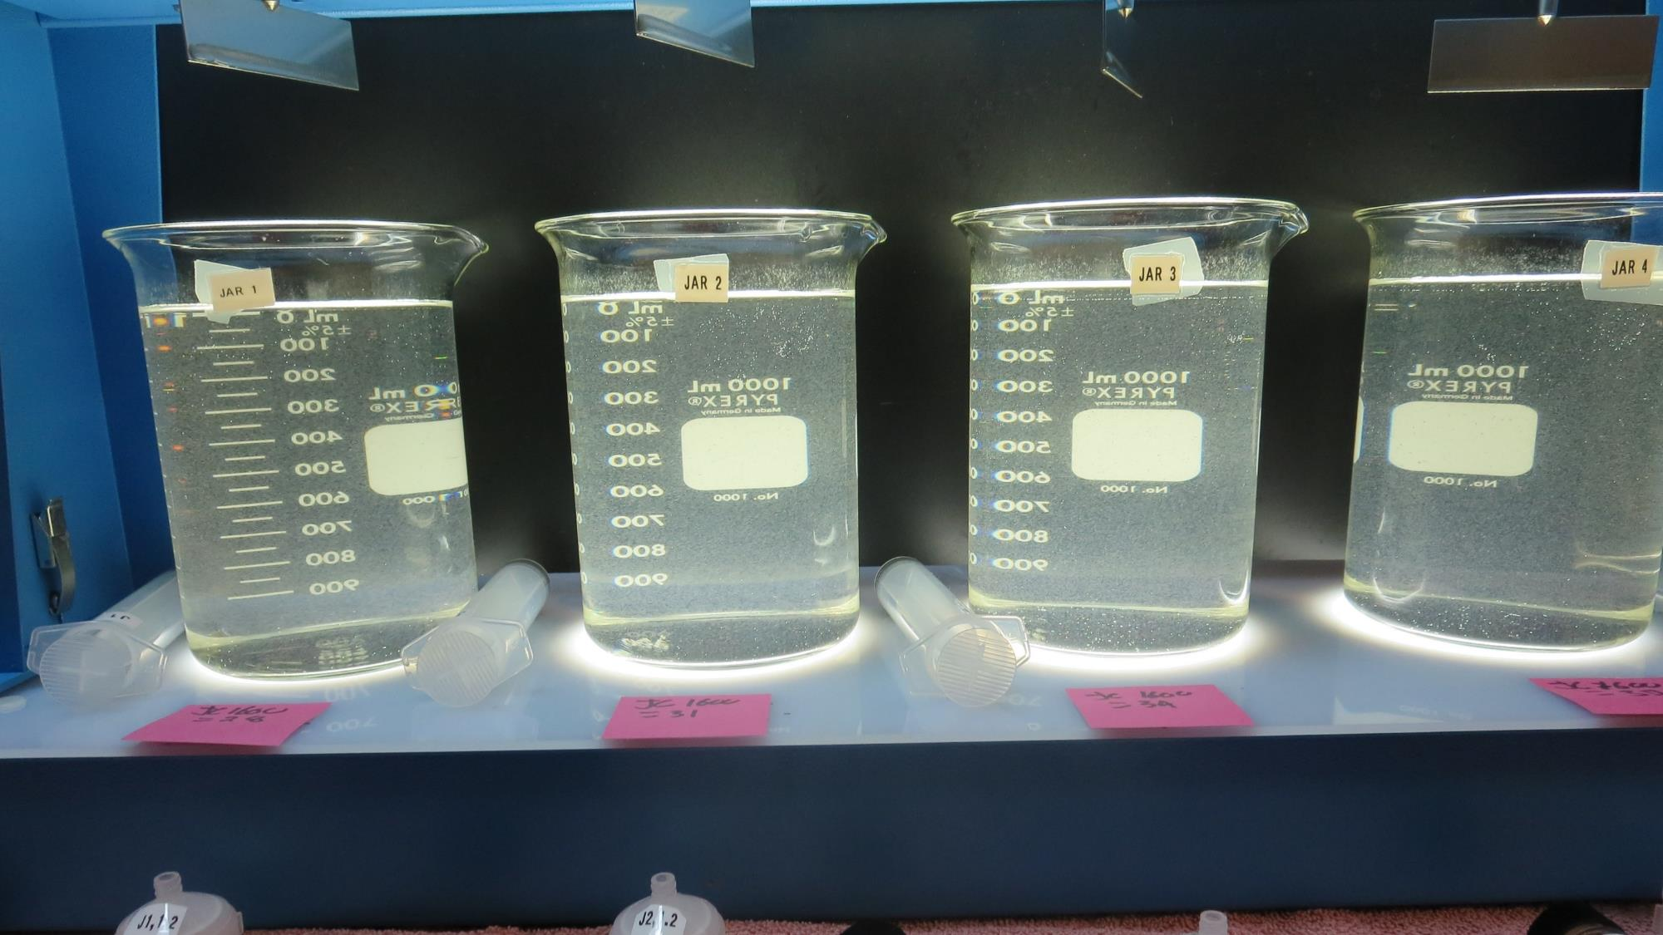
Jars 1-4: End of 5-minute flocculation (30 RPM) duration.
28 mg/L JC 1600
Filtrate 0.28 NTU
UVT: 91.8%
UVA: 0.037/cm
UVA Reduction: 61.2%
Settled: 2.04 NTU
31 mg/L JC 1600
Filtrate 0.11 NTU
UVT: 92.5%
UVA: 0.033/cm
UVA Reduction: 65.4%
Settled: 2.39 NTU
34 mg/L JC 1600
Filtrate 0.17 NTU
UVT: 92.2%
UVA: 0.035/cm
UVA Reduction: 63.3%
Settled: 2.39 NTU
37 mg/L JC 1600
Filtrate 0.11 NTU
UVT: 92.9%
UVA: 0.032/cm
UVA Reduction: 66.4%
Settled: 2.21 NTU

Slide 17
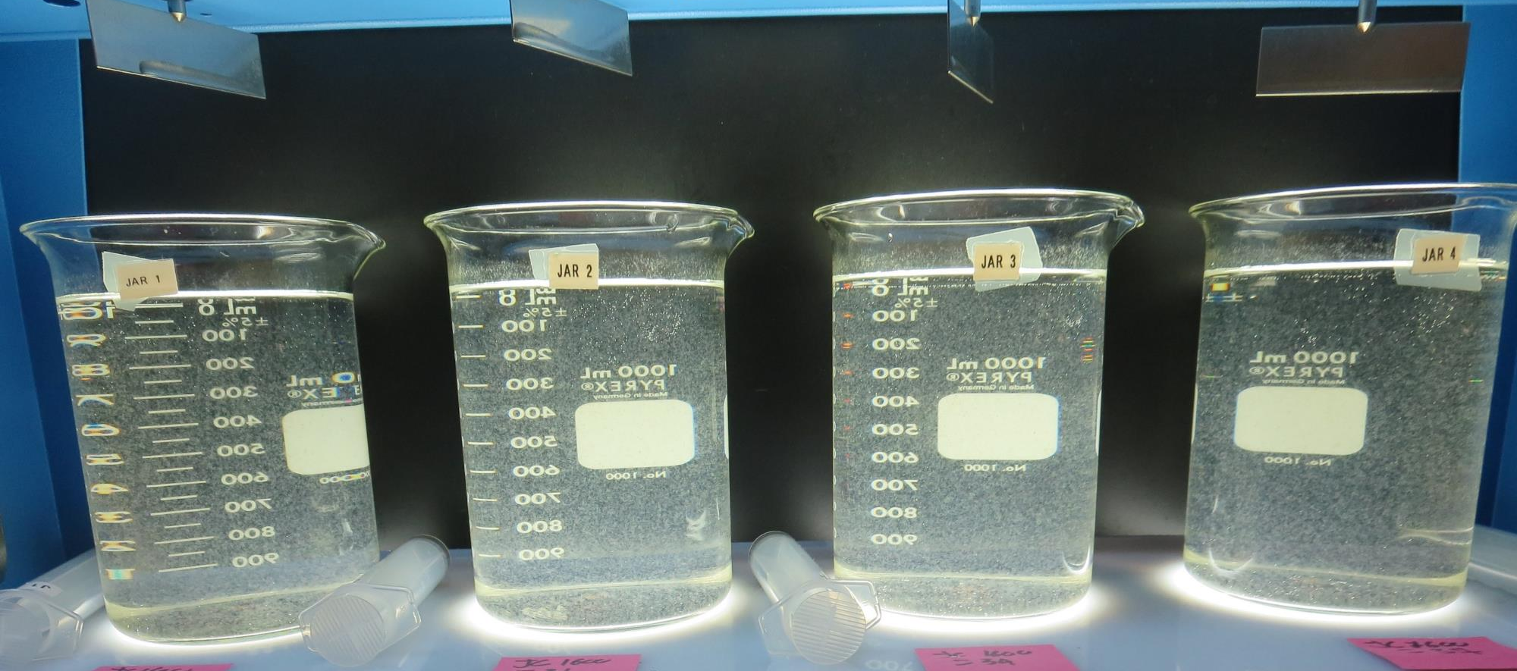
Jars 1-4: After 5 min of settling, 25 mL is decanted for filterability and %UVT/UVA.

Slide 18
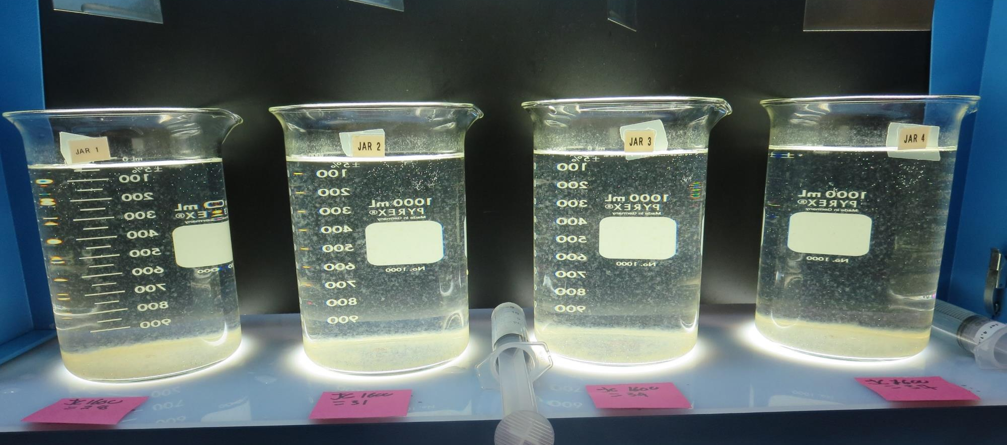
Jars 1-4: After 25-minutes of settling, settled water turbidity is taken.
28 mg/L JC 1600
Filtrate 0.28 NTU
UVT: 91.8%
UVA: 0.037/cm
UVA Reduction: 61.2%
Settled: 2.04 NTU
31 mg/L JC 1600
Filtrate 0.11 NTU
UVT: 92.5%
UVA: 0.033/cm
UVA Reduction: 65.4%
Settled: 2.39 NTU
34 mg/L JC 1600
Filtrate 0.17 NTU
UVT: 92.2%
UVA: 0.035/cm
UVA Reduction: 63.3%
Settled: 2.39 NTU
37 mg/L JC 1600
Filtrate 0.11 NTU
UVT: 92.9%
UVA: 0.032/cm
UVA Reduction: 66.4%
Settled: 2.21 NTU

Slide 19
Jars 5-8 Test
Flash Mix 30 Sec (200 RPM)
Floc Mix 5 min (30 RPM)
Applied Coagulant
JC 1600

Slide 20
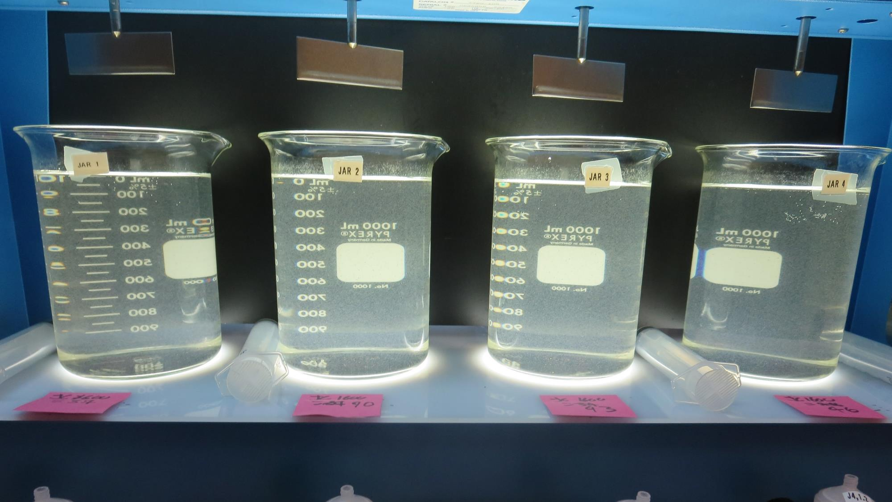
Jars 5-8: End of 5-minute flocculation (30 RPM) duration.
37 mg/L JC 1600
Filtrate 0.32 NTU
UVT: 91.7%
UVA: 0.037/cm
UVA Reduction: 61.2%
Settled: 2.26 NTU
40 mg/L JC 1600
Filtrate 0.40 NTU
UVT: 91.6%
UVA: 0.038/cm
UVA Reduction: 60.1%
Settled: 2.46 NTU
43 mg/L JC 1600
Filtrate 0.41 NTU
UVT: 91.6%
UVA: 0.038/cm
UVA Reduction: 60.1%
Settled: 2.61 NTU
47 mg/L JC 1600
Filtrate 0.44 NTU
UVT: 91.3%
UVA: 0.039/cm
UVA Reduction: 59.1%
Settled: 2.51 NTU

Slide 21
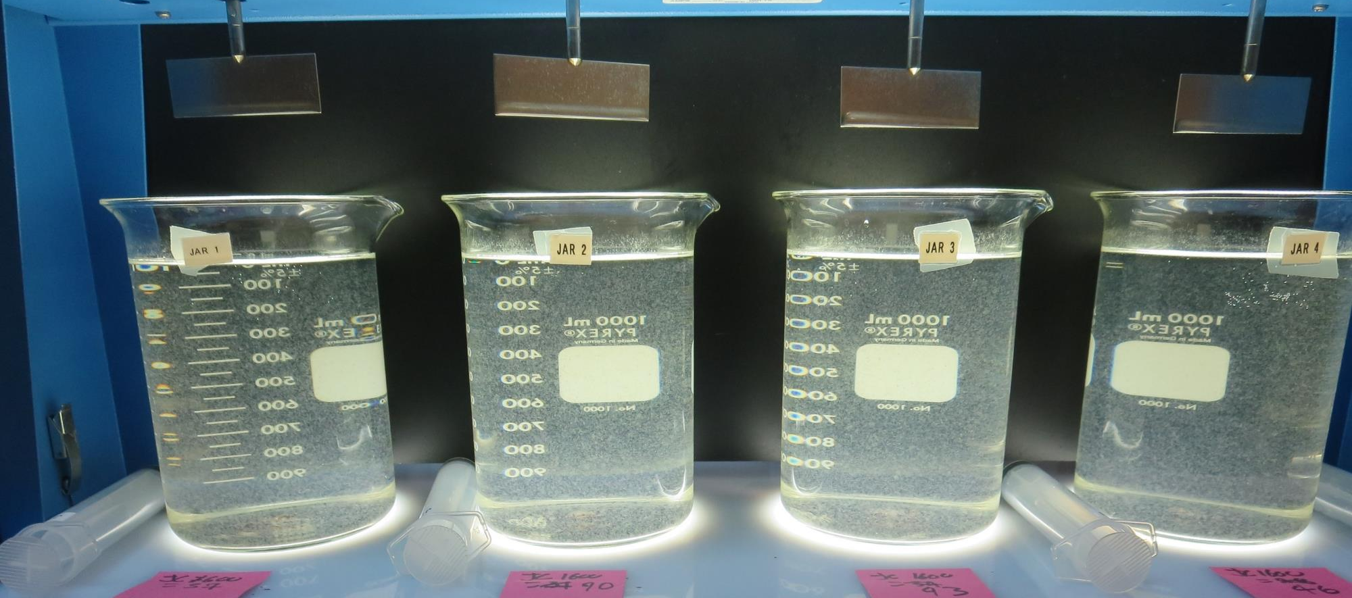
Jars 5-8: After 5 min of settling, 25 mL is decanted for filterability and %UVT/UVA.

Slide 22
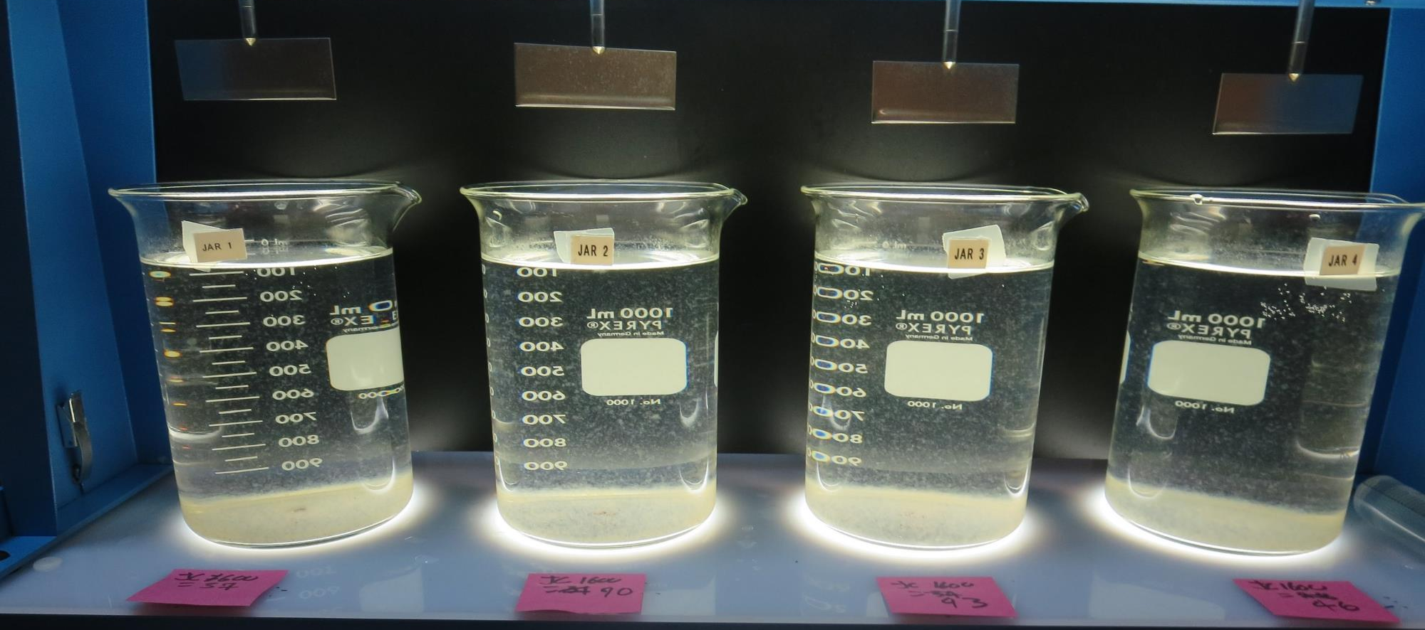
Jars 5-8: After 25-minutes of settling, settled water turbidity is taken.
37 mg/L JC 1600
Filtrate 0.32 NTU
UVT: 91.7%
UVA: 0.037/cm
UVA Reduction: 61.2%
Settled: 2.26 NTU
40 mg/L JC 1600
Filtrate 0.40 NTU
UVT: 91.6%
UVA: 0.038/cm
UVA Reduction: 60.1%
Settled: 2.46 NTU
43 mg/L JC 1600
Filtrate 0.41 NTU
UVT: 91.6%
UVA: 0.038/cm
UVA Reduction: 60.1%
Settled: 2.61 NTU
47 mg/L JC 1600
Filtrate 0.44 NTU
UVT: 91.3%
UVA: 0.039/cm
UVA Reduction: 59.1%
Settled: 2.51 NTU

Slide 23
Jars 9-12 Test
Flash Mix 30 Sec (200 RPM)
Floc Mix 5 min (30 RPM)
Applied Coagulants
JC 1600
JC 1720
7066

Slide 24
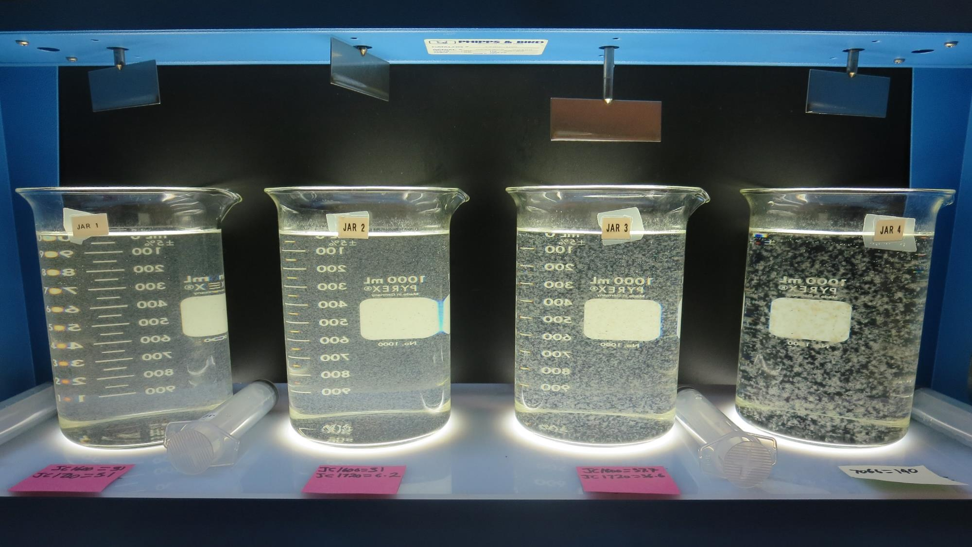
Jars 9-12 Test: End of 5-minute flocculation (30 RPM) duration.
31 mg/L JC 1600
3.1 mg/L JC 1720
Filtrate 0.13 NTU
UVT: 92.3%
UVA: 0.034/cm
UVA Reduction: 64.3%
Settled: 1.33 NTU
31 mg/L JC 1600
6.2 mg/L JC 1720
Filtrate 0.25 NTU
UVT: 91.8%
UVA: 0.037/cm
UVA Reduction: 61.2%
Settled: 1.26 NTU
37.7 mg/L JC 1600
36.6 mg/L JC 1720
Filtrate 0.13 NTU
UVT: 93.4%
UVA: 0.030/cm
UVA Reduction: 68.5%
Settled: 1.07 NTU
140 mg/L 7066
Filtrate 0.07 NTU
UVT: 93.2%
UVA: 0.031/cm
UVA Reduction: 68.5%
Settled: 0.39 NTU

Slide 25
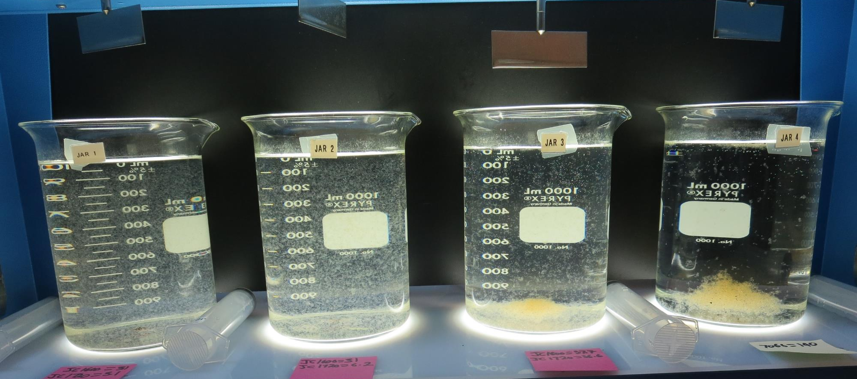
Jars 9-12: After 5 min of settling, 25 mL is decanted for filterability and %UVT/UVA.

Slide 26
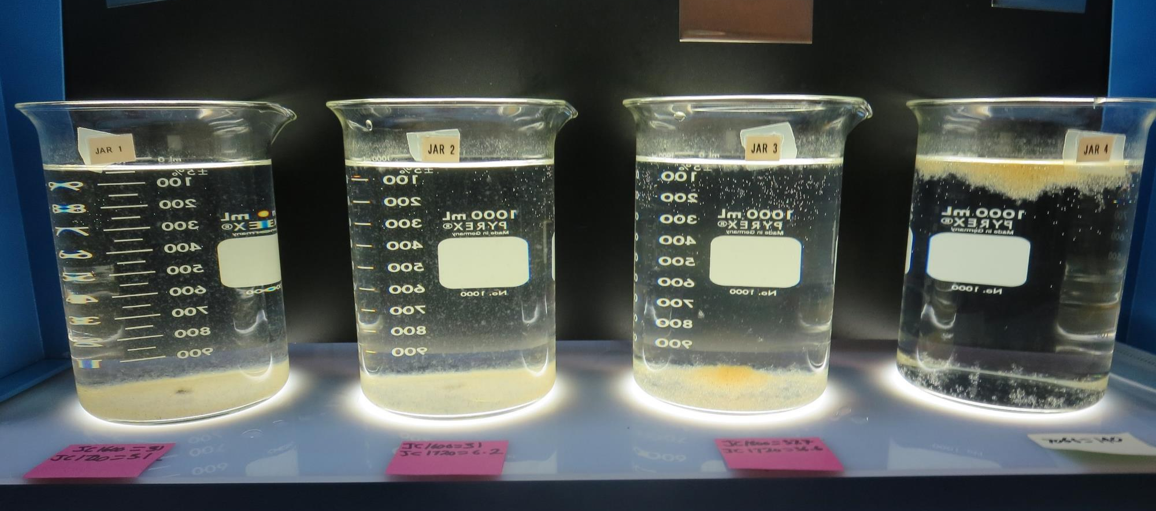
Jars 9-12: After 25-minutes of settling, settled water turbidity is taken.
31 mg/L JC 1600
3.1 mg/L JC 1720
Filtrate 0.13 NTU
UVT: 92.3%
UVA: 0.034/cm
UVA Reduction: 64.3%
Settled: 1.33 NTU
31 mg/L JC 1600
6.2 mg/L JC 1720
Filtrate 0.25 NTU
UVT: 91.8%
UVA: 0.037/cm
UVA Reduction: 61.2%
Settled: 1.26 NTU
37.7 mg/L JC 1600
36.6 mg/L JC 1720
Filtrate 0.13 NTU
UVT: 93.4%
UVA: 0.030/cm
UVA Reduction: 68.5%
Settled: 1.07 NTU
140 mg/L 7066
Filtrate 0.07 NTU
UVT: 93.2%
UVA: 0.031/cm
UVA Reduction: 68.5%
Settled: 0.39 NTU

Slide 27
Jars 13-16 Test
Flash Mix 30 Sec (200 RPM)
Floc Mix 5 min (30 RPM)
Applied Coagulants
JC 1600
JC 1720
JC 9450
7066

Slide 28
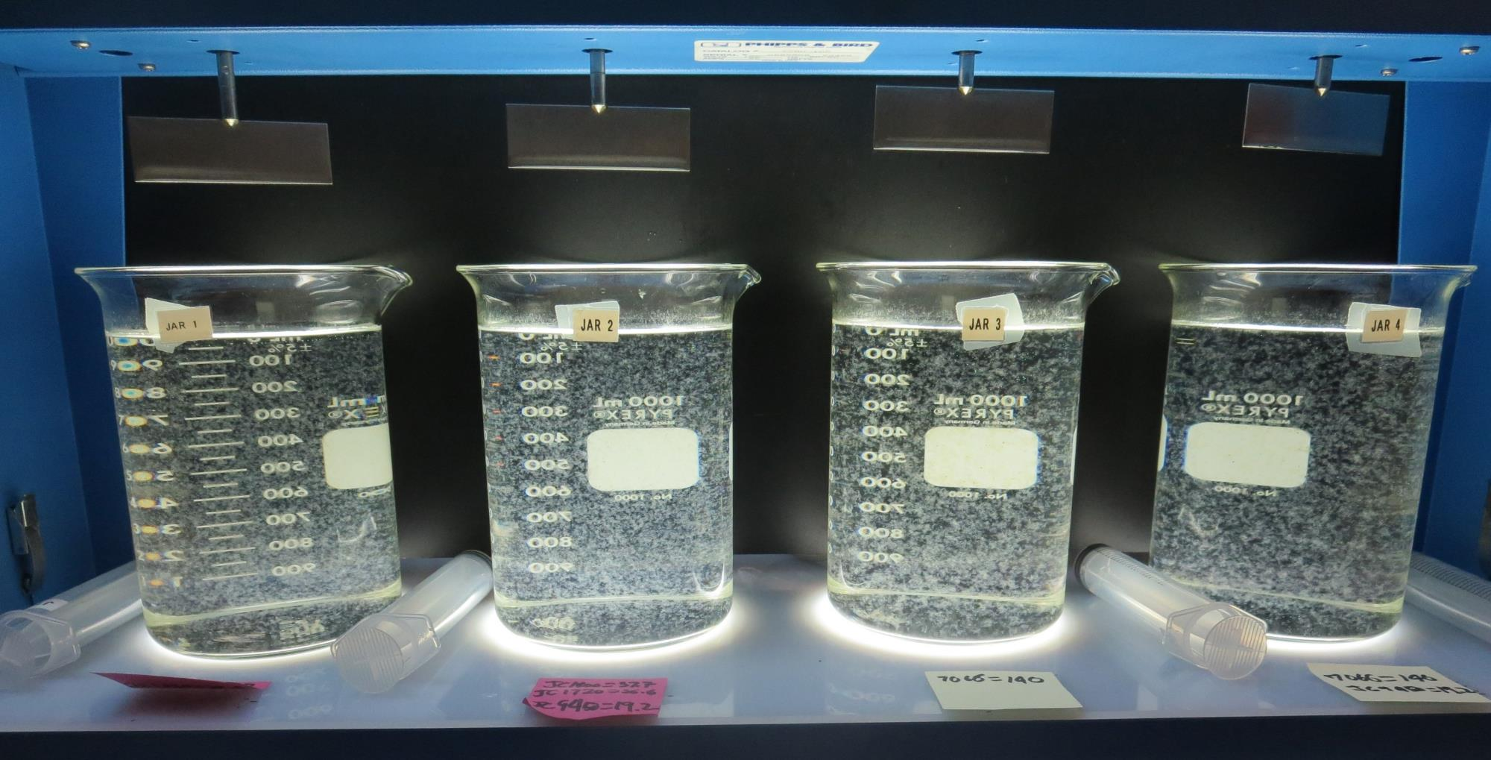
Jars 13-16: End of 5-minute flocculation (30 RPM) duration.
37.7 mg/L JC 1600
36.6 mg/L JC 1720
0 mg/L JC 9450
Filtrate 0.06 NTU
UVT: 94.7%
UVA: 0.023/cm
UVA Reduction: 75.9%
Settled: 0.60 NTU
37.7 mg/L JC 1600
36.6 mg/L JC 1720
19.2 mg/L JC 9450
Filtrate 0.06 NTU
UVT: 94.7%
UVA: 0.023/cm
UVA Reduction: 75.9%
Settled: 0.62 NTU
140 mg/L 7066
0 mg/L JC 9450
Filtrate 0.06 NTU
UVT: 93.7%
UVA: 0.028/cm
UVA Reduction: 70.6%
Settled: 0.35 NTU
140 mg/L 7066
19.2 mg/L JC 9450
Filtrate 0.06 NTU
UVT: 93.9%
UVA: 0.027/cm
UVA Reduction: 71.7%
Settled: 0.33 NTU

Slide 29
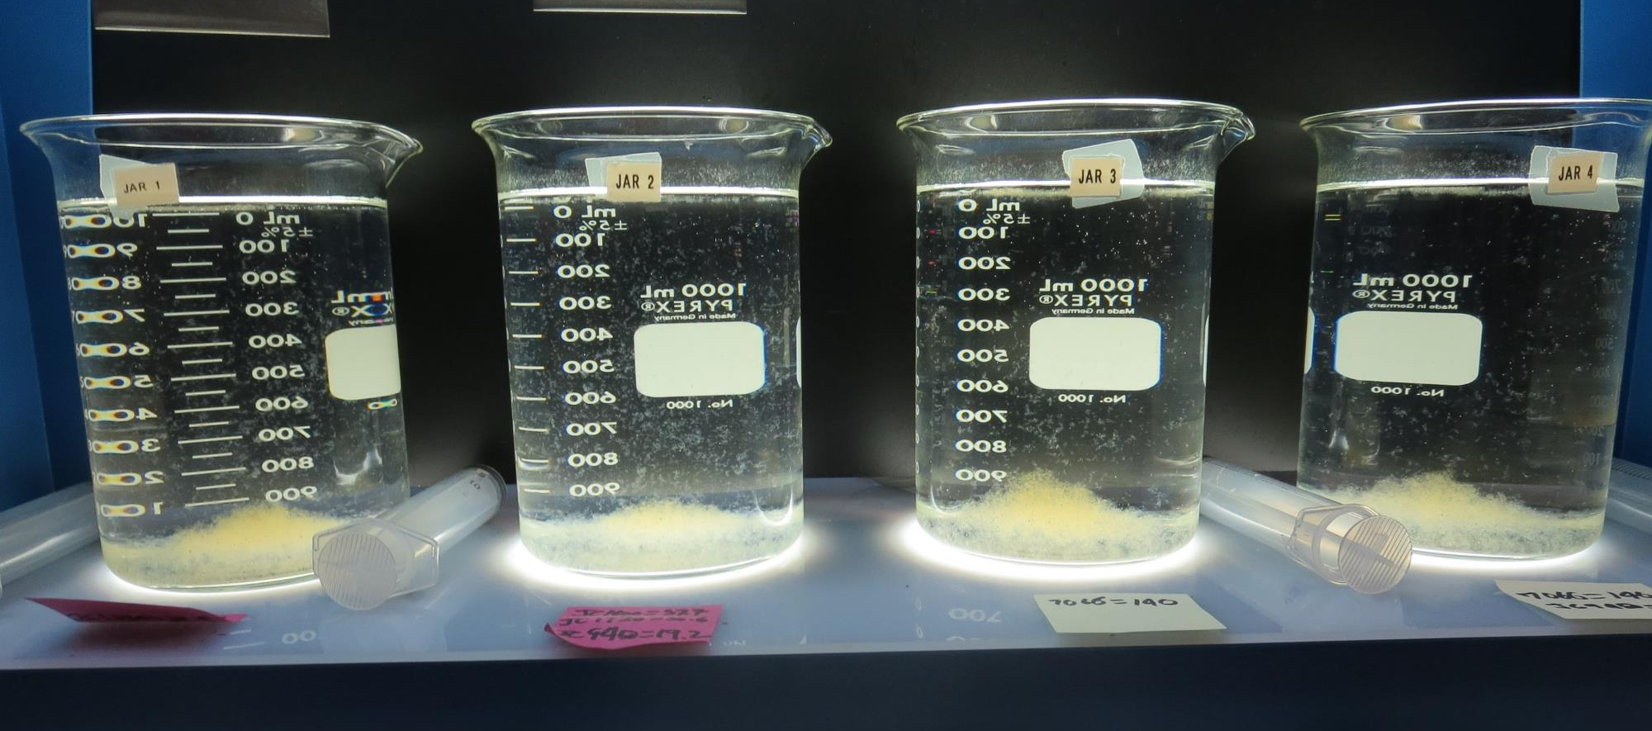
Jars 13-16: After 5 min of settling, 25 mL is decanted for filterability and %UVT/UVA.

Slide 30
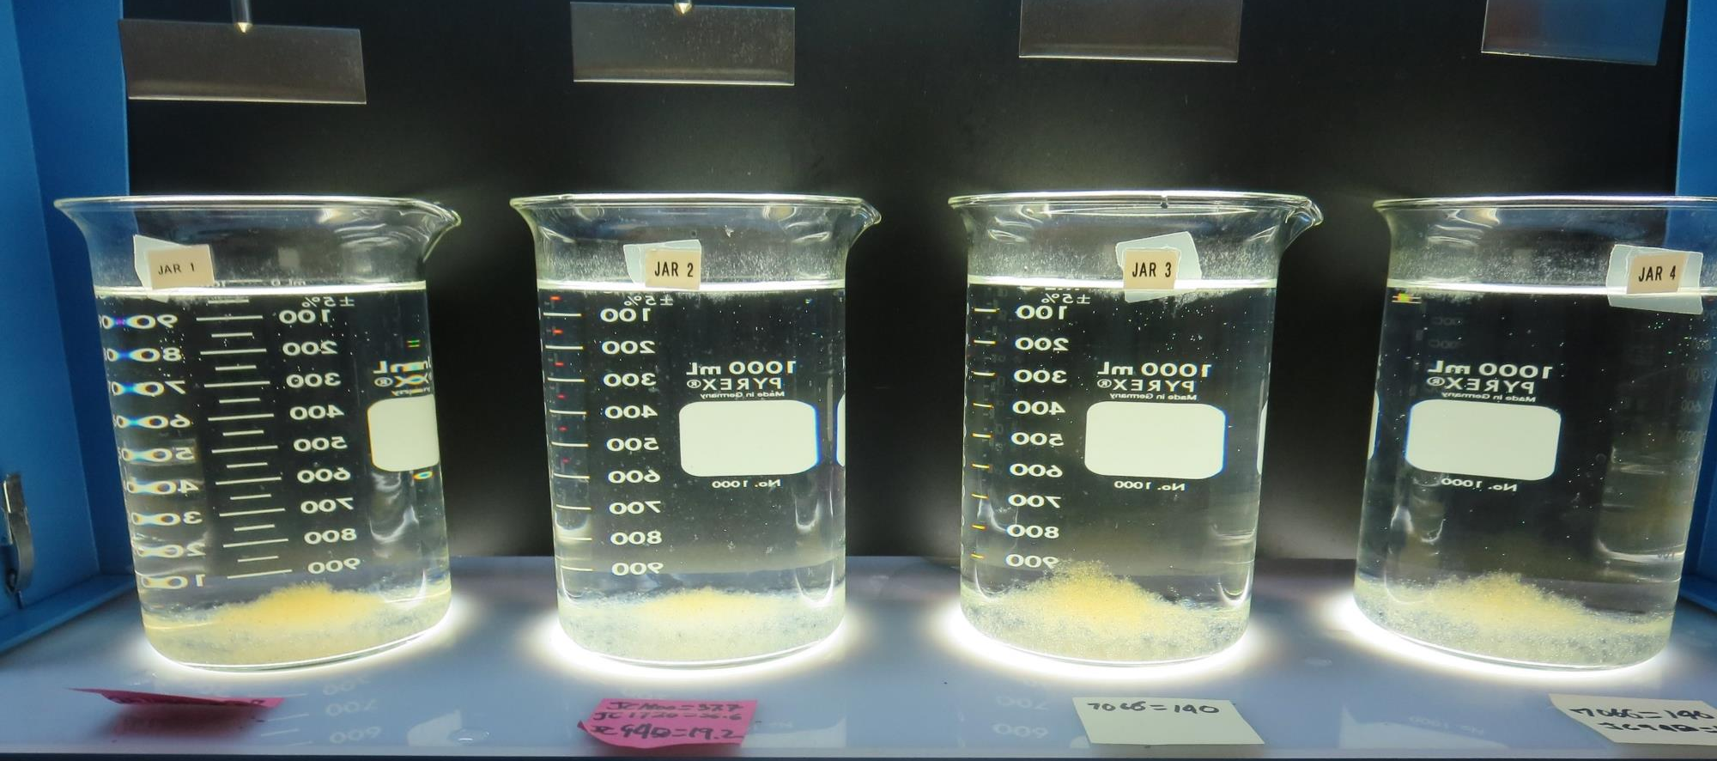
Jars 13-16: After 25-minutes of settling, settled water turbidity is taken.
37.7 mg/L JC 1600
36.6 mg/L JC 1720
0 mg/L JC 9450
Filtrate 0.06 NTU
UVT: 94.7%
UVA: 0.023/cm
UVA Reduction: 75.9%
Settled: 0.60 NTU
37.7 mg/L JC 1600
36.6 mg/L JC 1720
19.2 mg/L JC 9450
Filtrate 0.06 NTU
UVT: 94.7%
UVA: 0.023/cm
UVA Reduction: 75.9%
Settled: 0.62 NTU
140 mg/L 7066
0 mg/L JC 9450
Filtrate 0.06 NTU
UVT: 93.7%
UVA: 0.028/cm
UVA Reduction: 70.6%
Settled: 0.35 NTU
140 mg/L 7066
19.2 mg/L JC 9450
Filtrate 0.06 NTU
UVT: 93.9%
UVA: 0.027/cm
UVA Reduction: 71.7%
Settled: 0.33 NTU

Slide 31
Jars 17-20 Test
Flash Mix 30 Sec (200 RPM)
Floc Mix 3/5/10/15 min (30 RPM)
No Pictures
Applied Coagulants
JC 1600
JC 1720

Slide 32
Jars 21-24 Test
Flash Mix 30 Sec (200 RPM)
Floc Mix 5 min (30 RPM)
Applied Coagulant
JC 1720

Slide 33
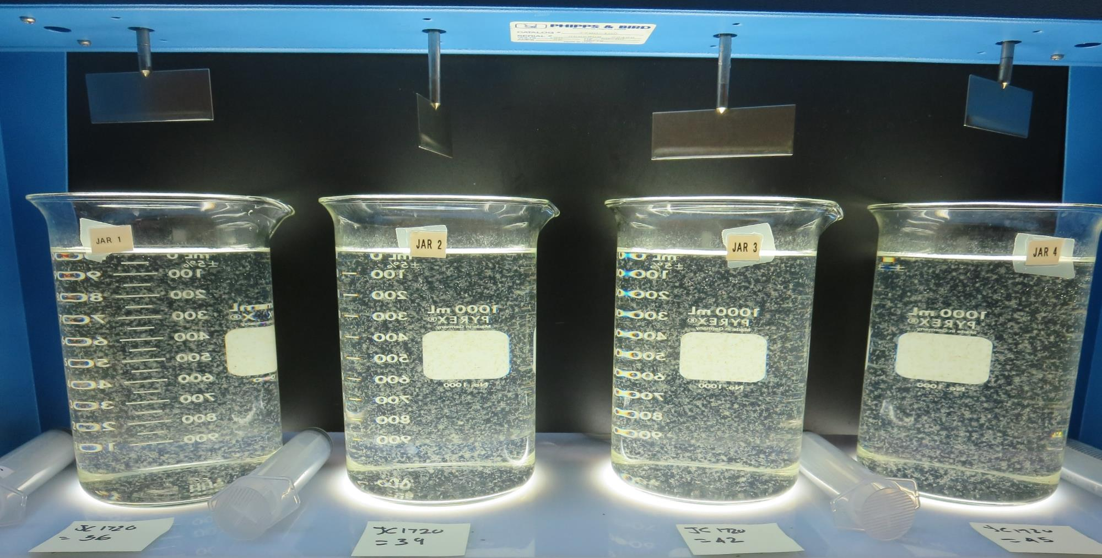
Jars 21-24: End of 5-minute flocculation (30 RPM) duration.
36 mg/L JC 1720
Filtrate 0.07 NTU
UVT: 92.5%
UVA: 0.033/cm
UVA Reduction: 65.4%
Settled: 1.08 NTU
39 mg/L JC 1720
Filtrate 0.07 NTU
UVT: 92.3%
UVA: 0.034/cm
UVA Reduction: 65.4%
Settled: 1.15 NTU
42 mg/L JC 1720
Filtrate 0.10 NTU
UVT: 92.4%
UVA: 0.034/cm
UVA Reduction: 64.3%
Settled: 1.07 NTU
45 mg/L JC 1720
Filtrate 0.07 NTU
UVT: 92.5%
UVA: 0.033/cm
UVA Reduction: 65.4%
Settled: 1.03 NTU

Slide 34
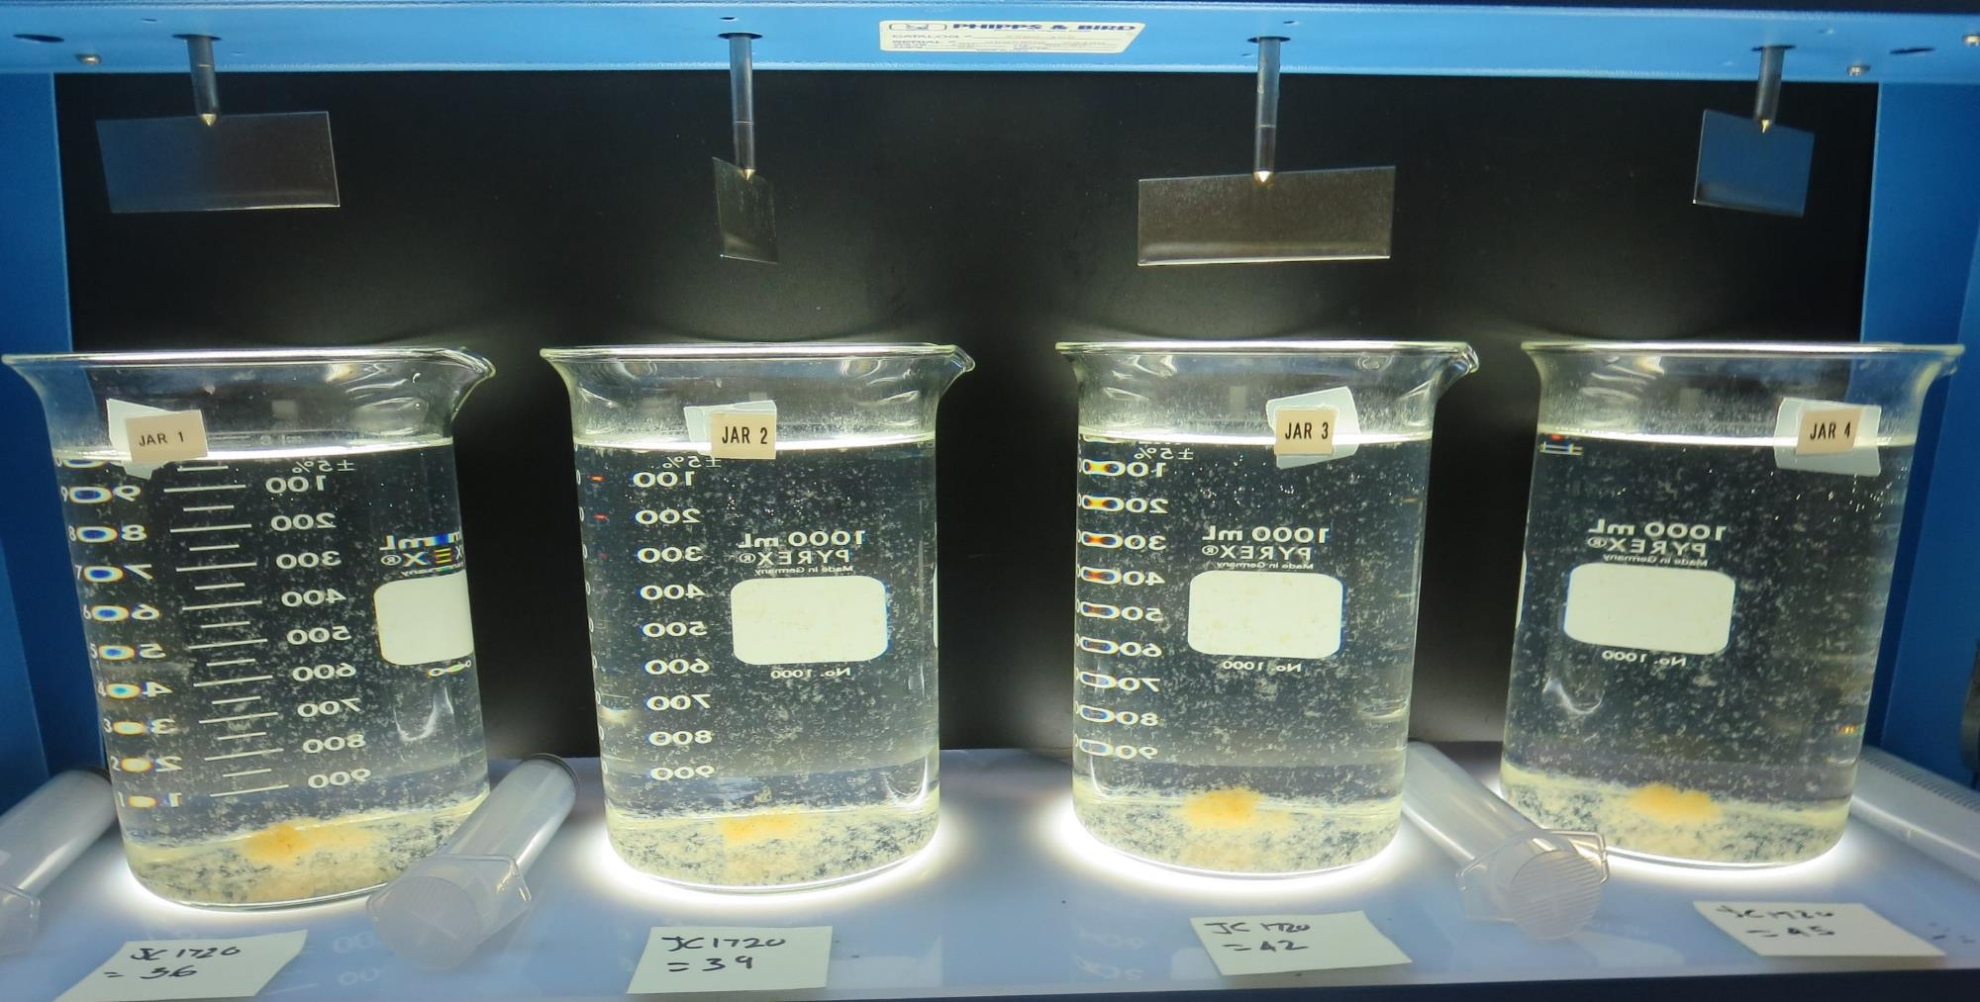
Jars 21-24: After 5 min of settling, 25 mL is decanted for filterability and %UVT/UVA.

Slide 35
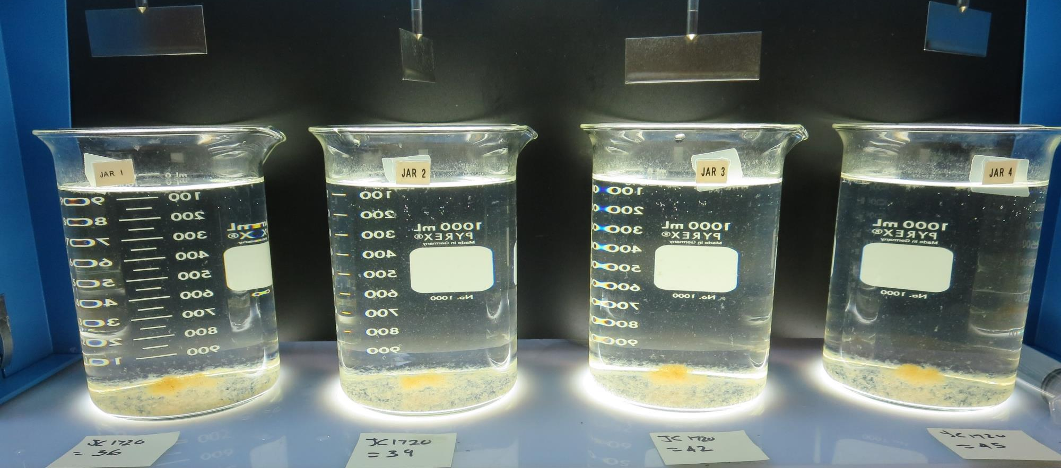
Jars 21-24: After 25-minutes of settling, settled water turbidity is taken.
36 mg/L JC 1720
Filtrate 0.07 NTU
UVT: 92.5%
UVA: 0.033/cm
UVA Reduction: 65.4%
Settled: 1.08 NTU
39 mg/L JC 1720
Filtrate 0.07 NTU
UVT: 92.3%
UVA: 0.034/cm
UVA Reduction: 65.4%
Settled: 1.15 NTU
42 mg/L JC 1720
Filtrate 0.10 NTU
UVT: 92.4%
UVA: 0.034/cm
UVA Reduction: 64.3%
Settled: 1.07 NTU
45 mg/L JC 1720
Filtrate 0.07 NTU
UVT: 92.5%
UVA: 0.033/cm
UVA Reduction: 65.4%
Settled: 1.03 NTU

Slide 36
Jars 25-28 Test
No Flash Mixing
Floc Mix 3/5/10/15 min (30 RPM)
Applied Coagulants
JC 1600
JC 1720

Slide 37
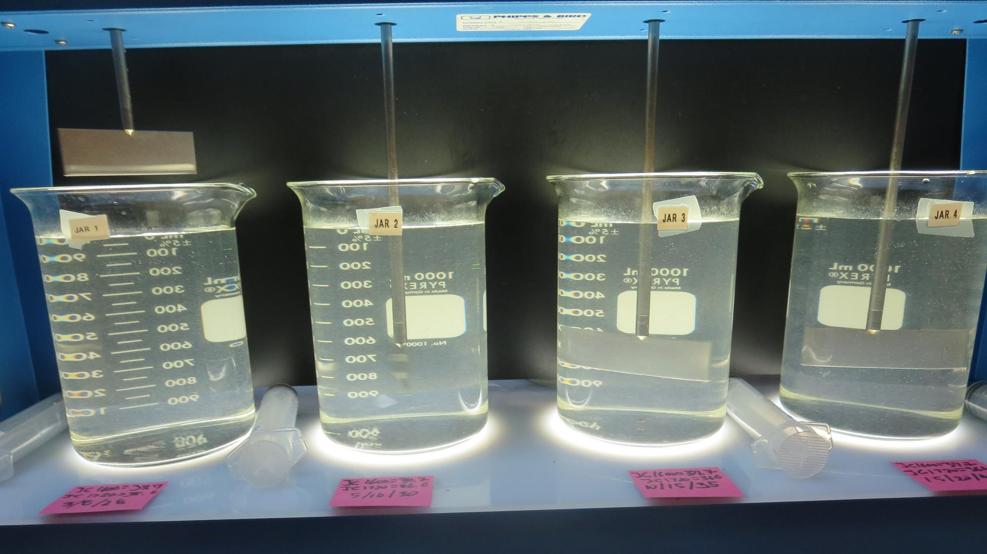
Jars 25-28 Test: End of 3-minute flocculation (30 RPM) duration for Jar 1.
37.7 mg/L JC 1600
36.6 mg/L JC 1720
Filtrate 0.07 NTU
UVT: 94.3%
UVA: 0.025/cm
UVA Reduction: 73.8%
Settled: 2.51 NTU
Floc: 3 minutes
37.7 mg/L JC 1600
36.6 mg/L JC 1720
Filtrate 0.12 NTU
UVT: 94.0%
UVA: 0.026/cm
UVA Reduction: 72.7%
Settled: 1.53 NTU
Floc: 5 minutes
37.7 mg/L JC 1600
36.6 mg/L JC 1720
Filtrate 0.15 NTU
UVT: 93.9%
UVA: 0.027/cm
UVA Reduction: 71.7%
Settled: 0.75 NTU
Floc: 10 minutes
37.7 mg/L JC 1600
36.6 mg/L JC 1720
Filtrate 0.10 NTU
UVT: 94.0%
UVA: 0.026/cm
UVA Reduction: 72.7%
Settled: 0.43 NTU
Floc: 15 minutes

Slide 38
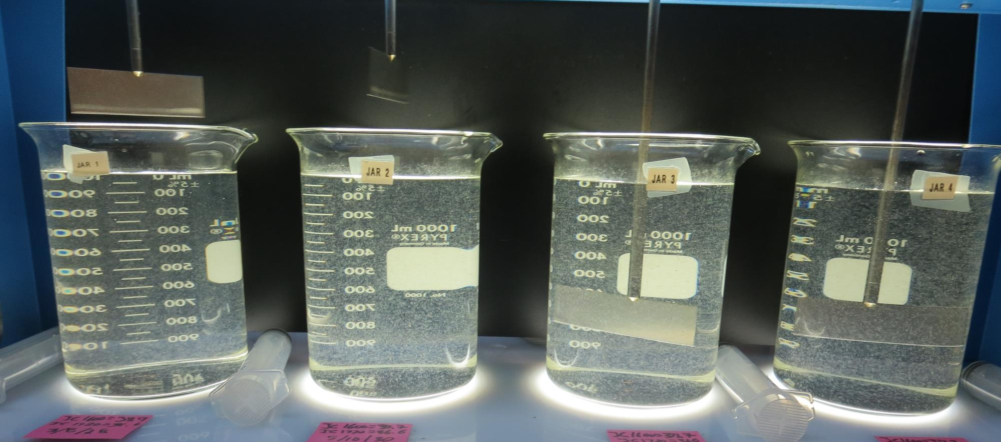
Jars 25-28 Test: End of 5-minute flocculation (30 RPM) duration for Jar 2.
37.7 mg/L JC 1600
36.6 mg/L JC 1720
Filtrate 0.07 NTU
UVT: 94.3%
UVA: 0.025/cm
UVA Reduction: 73.8%
Settled: 2.51 NTU
Floc: 3 minutes
37.7 mg/L JC 1600
36.6 mg/L JC 1720
Filtrate 0.12 NTU
UVT: 94.0%
UVA: 0.026/cm
UVA Reduction: 72.7%
Settled: 1.53 NTU
Floc: 5 minutes
37.7 mg/L JC 1600
36.6 mg/L JC 1720
Filtrate 0.15 NTU
UVT: 93.9%
UVA: 0.027/cm
UVA Reduction: 71.7%
Settled: 0.75 NTU
Floc: 10 minutes
37.7 mg/L JC 1600
36.6 mg/L JC 1720
Filtrate 0.10 NTU
UVT: 94.0%
UVA: 0.026/cm
UVA Reduction: 72.7%
Settled: 0.43 NTU
Floc: 15 minutes

Slide 39
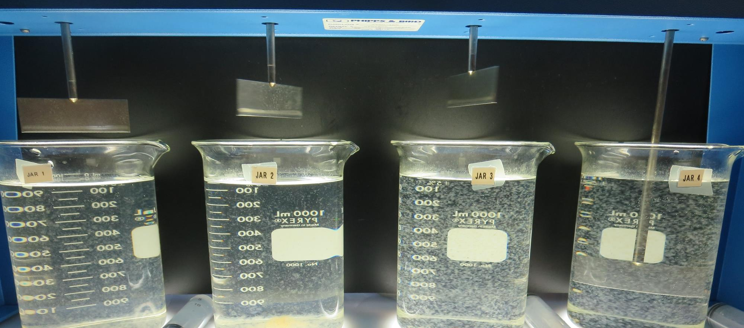
Jars 25-28 Test: End of 10-minute flocculation (30 RPM) duration for Jar 3.
37.7 mg/L JC 1600
36.6 mg/L JC 1720
Filtrate 0.07 NTU
UVT: 94.3%
UVA: 0.025/cm
UVA Reduction: 73.8%
Settled: 2.51 NTU
Floc: 3 minutes
37.7 mg/L JC 1600
36.6 mg/L JC 1720
Filtrate 0.12 NTU
UVT: 94.0%
UVA: 0.026/cm
UVA Reduction: 72.7%
Settled: 1.53 NTU
Floc: 5 minutes
37.7 mg/L JC 1600
36.6 mg/L JC 1720
Filtrate 0.15 NTU
UVT: 93.9%
UVA: 0.027/cm
UVA Reduction: 71.7%
Settled: 0.75 NTU
Floc: 10 minutes
37.7 mg/L JC 1600
36.6 mg/L JC 1720
Filtrate 0.10 NTU
UVT: 94.0%
UVA: 0.026/cm
UVA Reduction: 72.7%
Settled: 0.43 NTU
Floc: 15 minutes

Slide 40
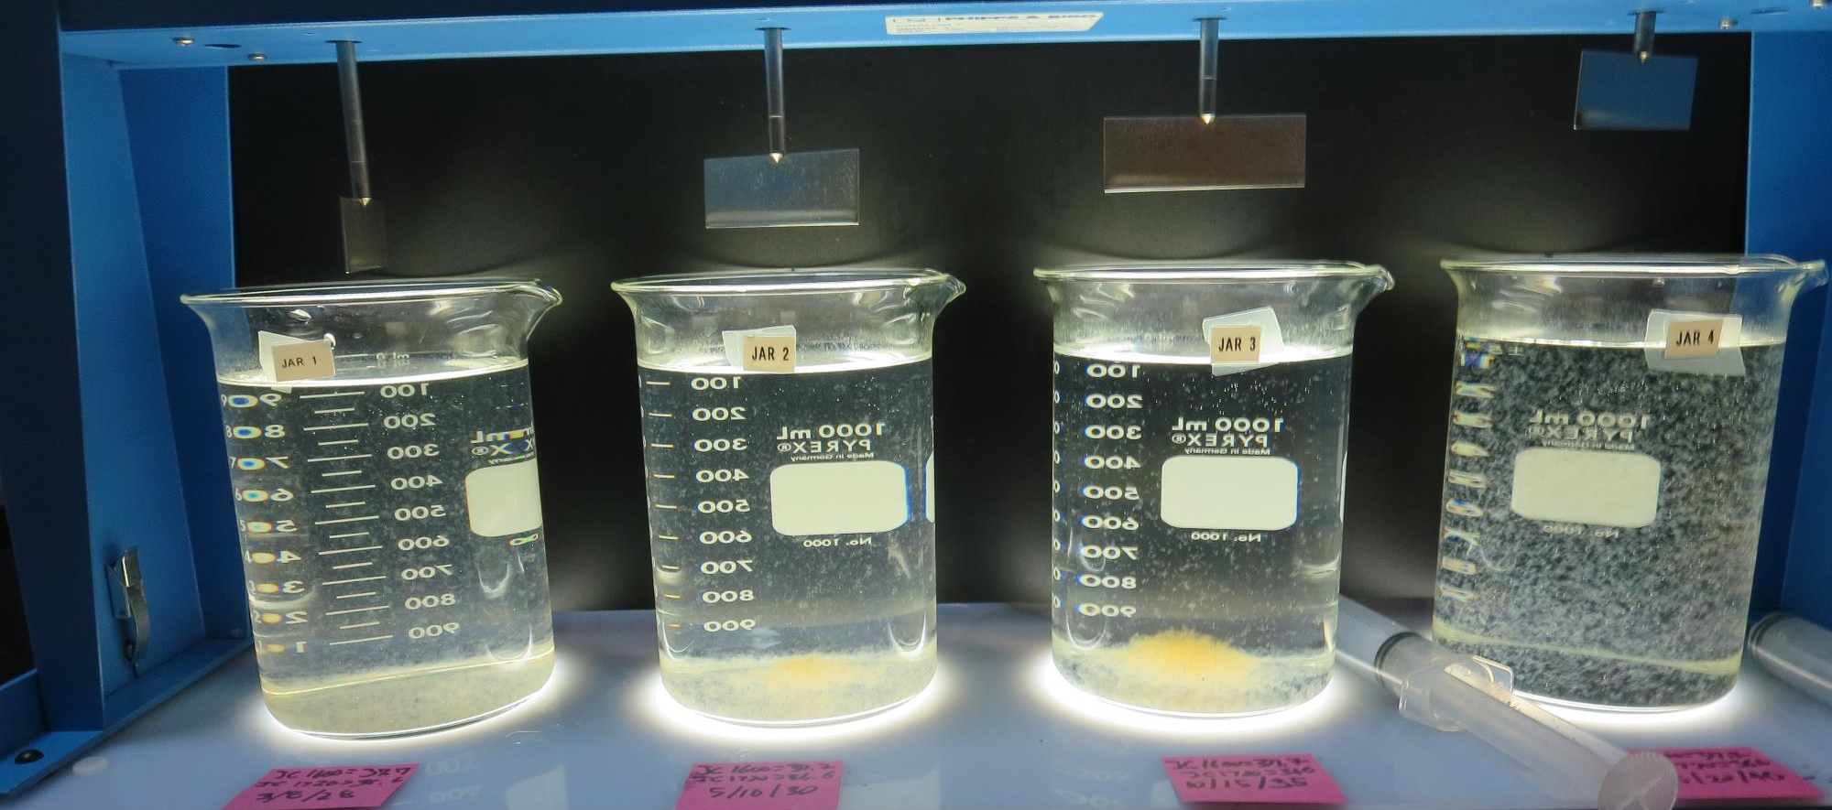
Jars 25-28: End of 15-minute flocculation (30 RPM) duration for Jar 4.
37.7 mg/L JC 1600
36.6 mg/L JC 1720
Filtrate 0.07 NTU
UVT: 94.3%
UVA: 0.025/cm
UVA Reduction: 73.8%
Settled: 2.51 NTU
Floc: 3 minutes
37.7 mg/L JC 1600
36.6 mg/L JC 1720
Filtrate 0.12 NTU
UVT: 94.0%
UVA: 0.026/cm
UVA Reduction: 72.7%
Settled: 1.53 NTU
Floc: 5 minutes
37.7 mg/L JC 1600
36.6 mg/L JC 1720
Filtrate 0.15 NTU
UVT: 93.9%
UVA: 0.027/cm
UVA Reduction: 71.7%
Settled: 0.75 NTU
Floc: 10 minutes
37.7 mg/L JC 1600
36.6 mg/L JC 1720
Filtrate 0.10 NTU
UVT: 94.0%
UVA: 0.026/cm
UVA Reduction: 72.7%
Settled: 0.43 NTU
Floc: 15 minutes

Slide 41
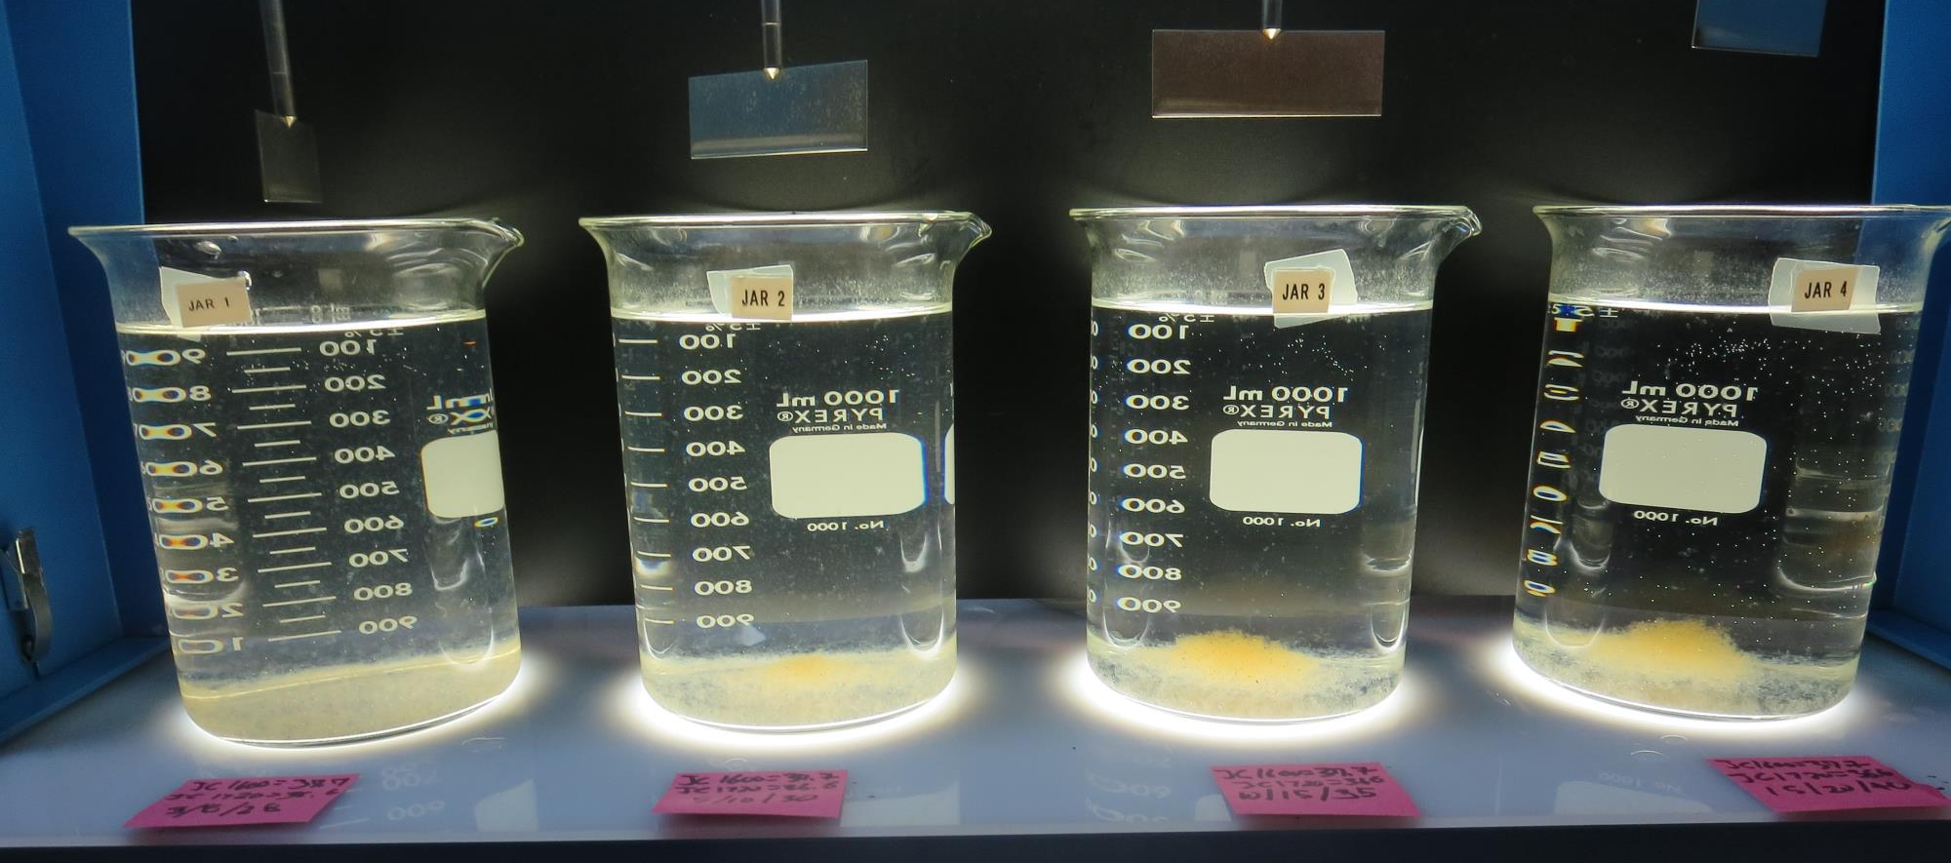
Jars 21-24 Test: After 25-minutes of settling for Jar 4, settled water turbidity is taken.
37.7 mg/L JC 1600
36.6 mg/L JC 1720
Filtrate 0.07 NTU
UVT: 94.3%
UVA: 0.025/cm
UVA Reduction: 73.8%
Settled: 2.51 NTU
Floc: 3 minutes
37.7 mg/L JC 1600
36.6 mg/L JC 1720
Filtrate 0.12 NTU
UVT: 94.0%
UVA: 0.026/cm
UVA Reduction: 72.7%
Settled: 1.53 NTU
Floc: 5 minutes
37.7 mg/L JC 1600
36.6 mg/L JC 1720
Filtrate 0.15 NTU
UVT: 93.9%
UVA: 0.027/cm
UVA Reduction: 71.7%
Settled: 0.75 NTU
Floc: 10 minutes
37.7 mg/L JC 1600
36.6 mg/L JC 1720
Filtrate 0.10 NTU
UVT: 94.0%
UVA: 0.026/cm
UVA Reduction: 72.7%
Settled: 0.43 NTU
Floc: 15 minutes

Slide 42
Jars 28-32 Test
Flash Mix 30 Sec (200 RPM)
Floc Mix 5 min (30 RPM)
Applied Coagulant
AH-423

Slide 43
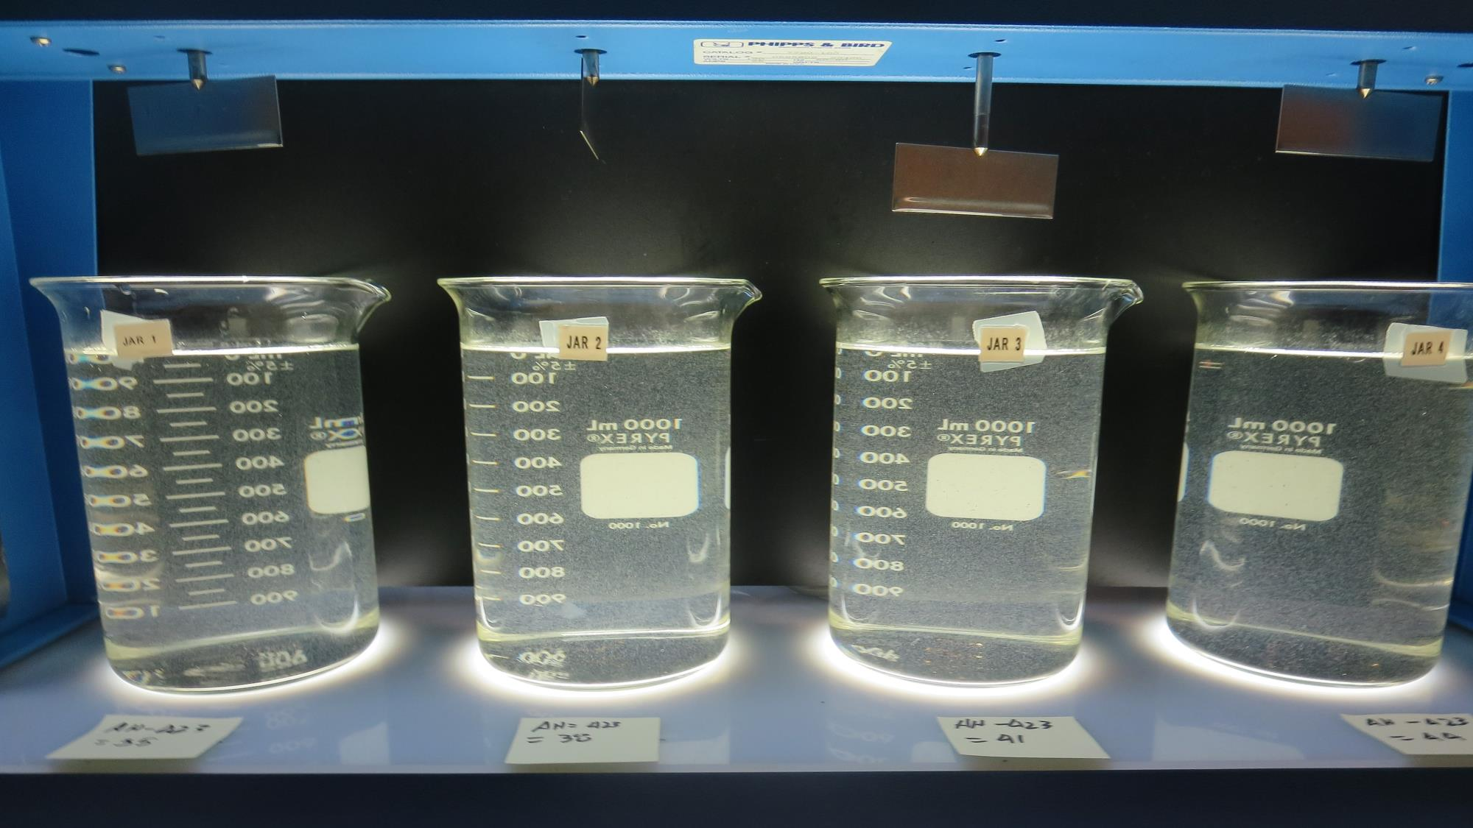
Jars 28-32: End of 5-minute flocculation (30 RPM) duration.
35 mg/L AH-423
Filtrate 0.23 NTU
UVT: 92.6%
UVA: 0.033/cm
UVA Reduction: 65.3%
Settled: 1.04 NTU
38 mg/L AH-423
Filtrate 0.09 NTU
UVT: 93.1%
UVA: 0.030/cm
UVA Reduction: 68.4%
Settled: 1.50 NTU
41 mg/L AH-423
Filtrate 0.24 NTU
UVT: 92.5%
UVA: 0.033/cm
UVA Reduction: 65.3%
Settled: 1.31 NTU
44 mg/L AH-423
Filtrate 0.28 NTU
UVT: -%
UVA: -/cm
Settled: 1.11 NTU

Slide 44
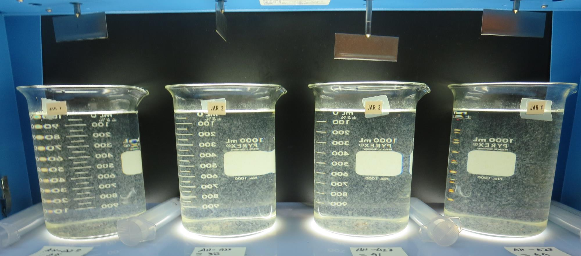
Jars 28-32: After 5 min of settling, 25 mL is decanted for filterability and %UVT/UVA.

Slide 45
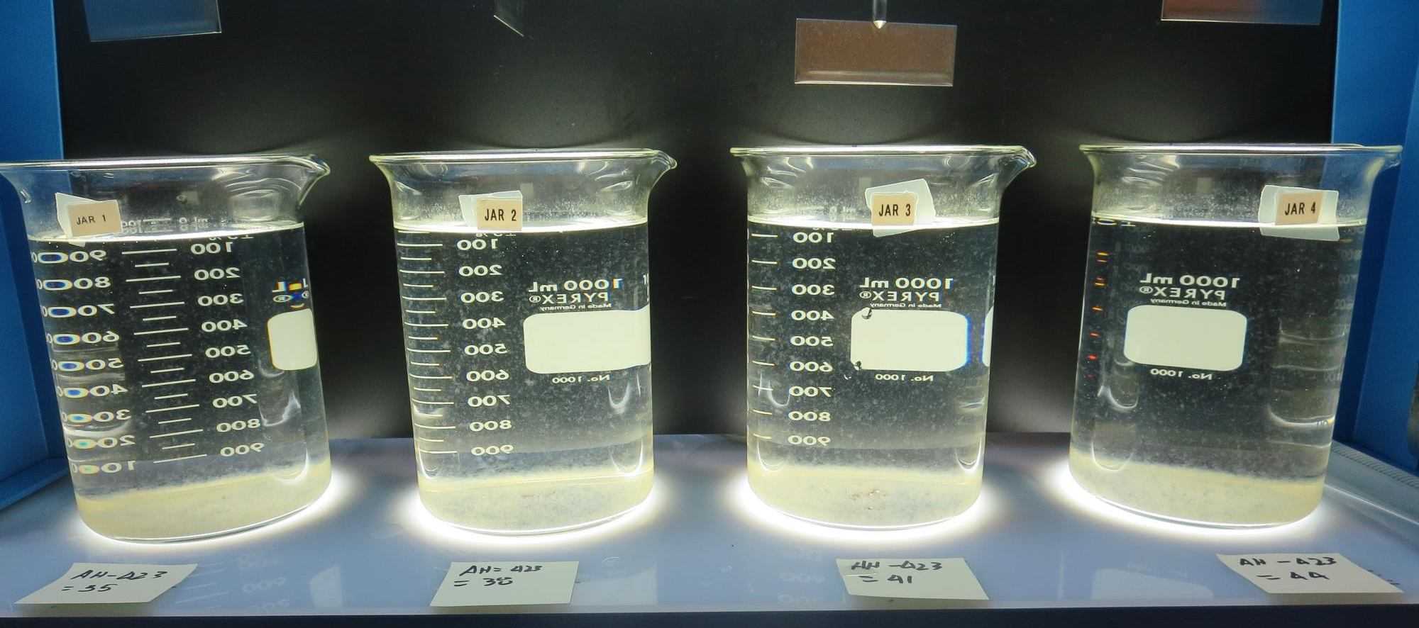
Jars 28-32 Test: After 25-minutes of settling, settled water turbidity is taken.
35 mg/L AH-423
Filtrate 0.23 NTU
UVT: 92.6%
UVA: 0.033/cm
UVA Reduction: 65.3%
Settled: 1.04 NTU
38 mg/L AH-423
Filtrate 0.09 NTU
UVT: 93.1%
UVA: 0.030/cm
UVA Reduction: 68.4%
Settled: 1.50 NTU
41 mg/L AH-423
Filtrate 0.24 NTU
UVT: 92.5%
UVA: 0.033/cm
UVA Reduction: 65.3%
Settled: 1.31 NTU
44 mg/L AH-423
Filtrate 0.28 NTU
UVT: -%
UVA: -/cm
Settled: 1.11 NTU

Slide 46
Jar Testing for 1-Liter Jars:
Procedures for Most Treatment Plants
Fill jars with source water prior to coagulant injection and set paddle speed at 30 rpm
Add chemicals (i.e., NaOCl, primary coagulant, coagulant aid) to each jar
Flash mix for 15-60 seconds (200 rpm)
Slow mix for 5 minutes (20-30 rpm)
Settled for 5 minutes. Syringe 25 mL from each jar taken 1-inch below surface (25 mL/12 sec rate)
Filtered through 1.2 um isopore membrane into cuvette drip rate, 15 mL/(50-90 sec)
Measure filtrate turbidity, chlorine residual and %UVT/UVA
Measure settled water turbidity after 25 minutes of total setting
Record all data

Slide 47

Jar Test
Filterability Test Equipment
Turbidity Instrument
Syringe w/Luer-Lock Tip, 30 cc
(part#: 2225800, by Hach)
Swinnex Filter Holder, 25 mm (part#: SX0002500)
Isopore Membrane Filter, 1.2 um absolute
pore size,
Φ= 25 mm , thickness: 24 um,
hydrophilic polycarbonate membrane
(part #: RTTP02500)
Go to Sigma-Aldrich for laboratory supplies http://www.sigmaaldrich.com/united-states.html

Slide 48
Isopore Membrane Information
Categories | Information
trade name | Isopore
filter color | White
chemistry | Polycarbonate (PC)
water flow rate | Avg. 175 mL/min x cm² (typical results @ 10 psi)
media | Isopore®
wettability | Hydrophilic
porosity | 14.7%
pore size | 1.2 µm
bubble point at 23 °C | 1.0 bar, air with water
thickness | 24 µm
filter diameter (ø) | 25 mm
material size | polycarbonate, Hydrophilic, 1.2 µm, 25 mm, white, plain, 100

Slide 49
Isopore Membrane Background Information
The Isopore membrane is a polycarbonate, track-etched screen filter recommended for all analyses in which the sample is viewed on the surface of the membrane. The Isopore membrane is composed of polycarbonate film, which has a smooth, glass-like surface for clearer sample observation. The unique manufacturing process of the membrane ensures a precise pore diameter and a consistent pore size for accurate separation of samples by size. Matched-weight filters are not usually required because of low, constant tar and ash weights.
Features & Benefits:
Membrane structure retains particles on the surface, simplifying counting and analysis

Slide 50
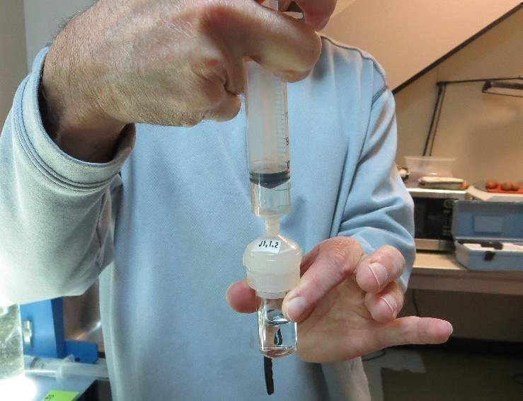

Jar Test - Filterability Test
Syringe ~ 25 mL from jar (after 5-minutes of settling)
Filter-to-waste 3-5 mL
Filter directly into clean cuvette
Measure turbidity
Note: Take several readings before recording final NTU results. Micro bubbles can adhere to glass causing false NTU readings. To remove bubbles, tilt cuvette up to 90 degrees.

Slide 51

Contact
Guy Schott, P.E.
State Water Resources Control Board
Division of Drinking Water
Santa Rosa, CA
Go to Stock Solution/Dose calculations/Jar Test Results for tools to download
www.waterboards.ca.gov/drinking_water/programs/districts/mendocino_district.html
Email: Guy Schott - Guy.Schott@waterboards.ca.gov
Office Number: 707-576-2732

