Slide 1
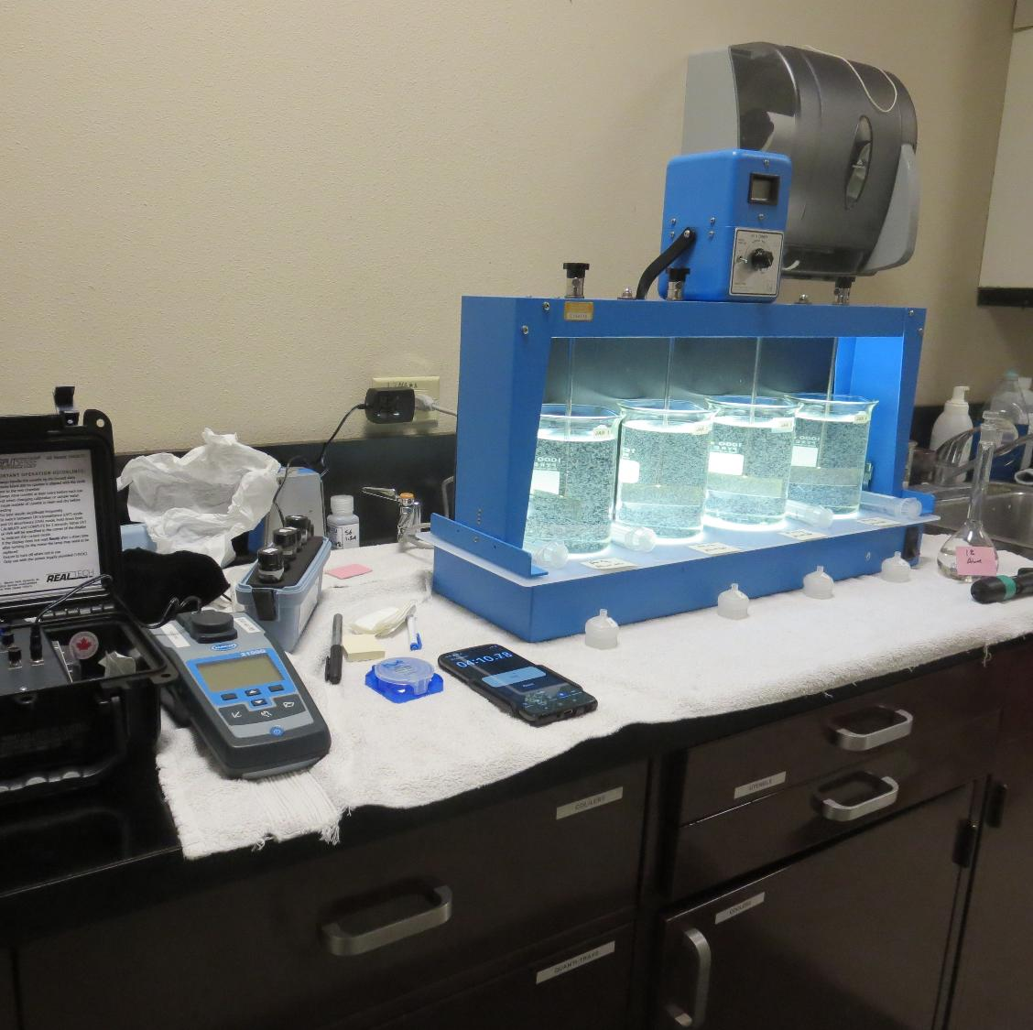
City of St. Helena CA2810004 Napa County Jar Test
by Guy Schott, P.E.
October 29, 2025

Slide 2
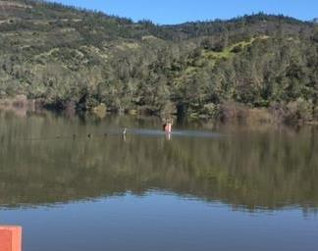
Source Water: Bell Canyon Reservoir
Source Water Characteristics
Turbidity: 10.7 NTU
UVT: 70.37%
UVA: 0.1529/cm
0.4 um Filtered
UVT: 75.19%
UVA: 0.1238/cm

Slide 3
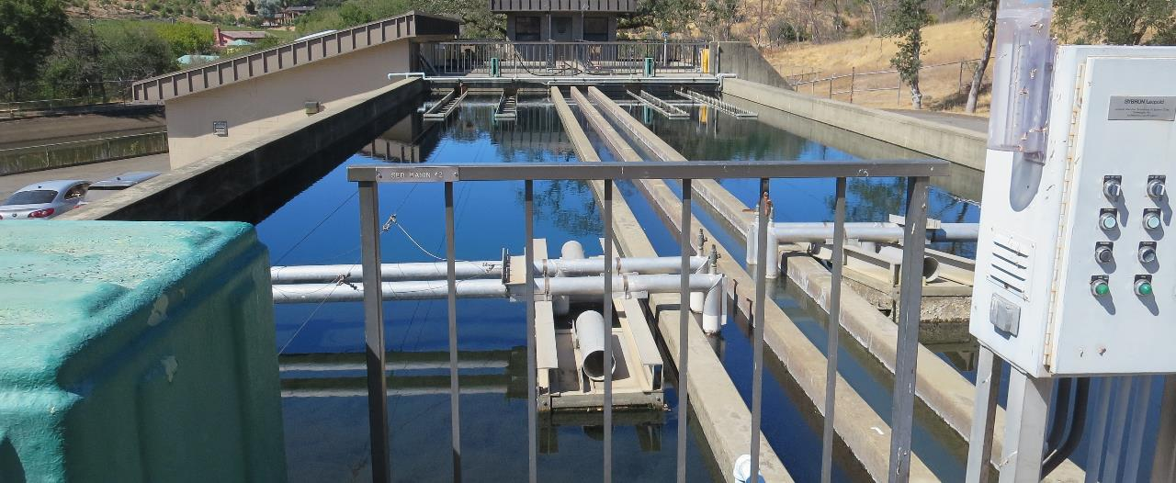
Flocculation/Sedimentation Basins

Slide 4
Bell Canyon Reservoir Source & Treated Water Characteristics, October 29, 2025
Source – Bell Canyon Reservoir
Turbidity: 10.7 NTU
UVT: 70.37%,
UVA: 0.1529/cm
0.4 um Filtered
Turbidity: 0.5 NTU
UVT: 75.19%,
UVA: 0.1238/cm
Clearwell Water
0.08 NTU
UVT: 92.68%
UVA: 0.0331/cm

Slide 5
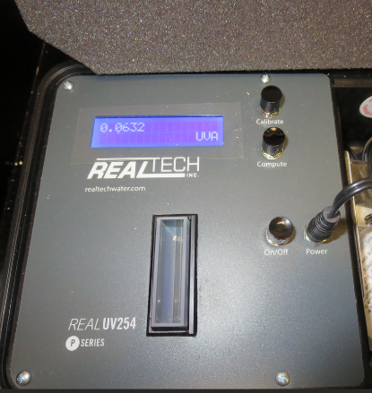
UVT/UVA, pathlength 40 mm
UV transmittance (UVT) is a measurement of the amount of ultraviolet light (commonly at 254 nm due to its germicidal effect) that passes through a water sample compared to the amount of light that passes through a pure water sample. The measurement is expressed as a percentage, % UVT.
%UVT = 10^{(-UVA)} x 100%
UV absorbance (UVA) is calculated as a relative measure of the amount of light absorbed by a water sample compared with the amount of light absorbed by a pure water sample.
UVA = -log(%UVT/100)

Slide 6
Applied Coagulant for Jar Testing
Aluminum Sulfate (Product)
Al₂(SO₄)₃*14.3H₂0 (Liquid)
47.47% Aluminum Sulfate
52% Water
8.08% Al₂O₃
0% Basicity
SG = 1.325
NSF max use: 400 mg/L (product)
As hydrated Al₂(SO₄)₃*14.3H₂0
17% Al₂O₃

Slide 7
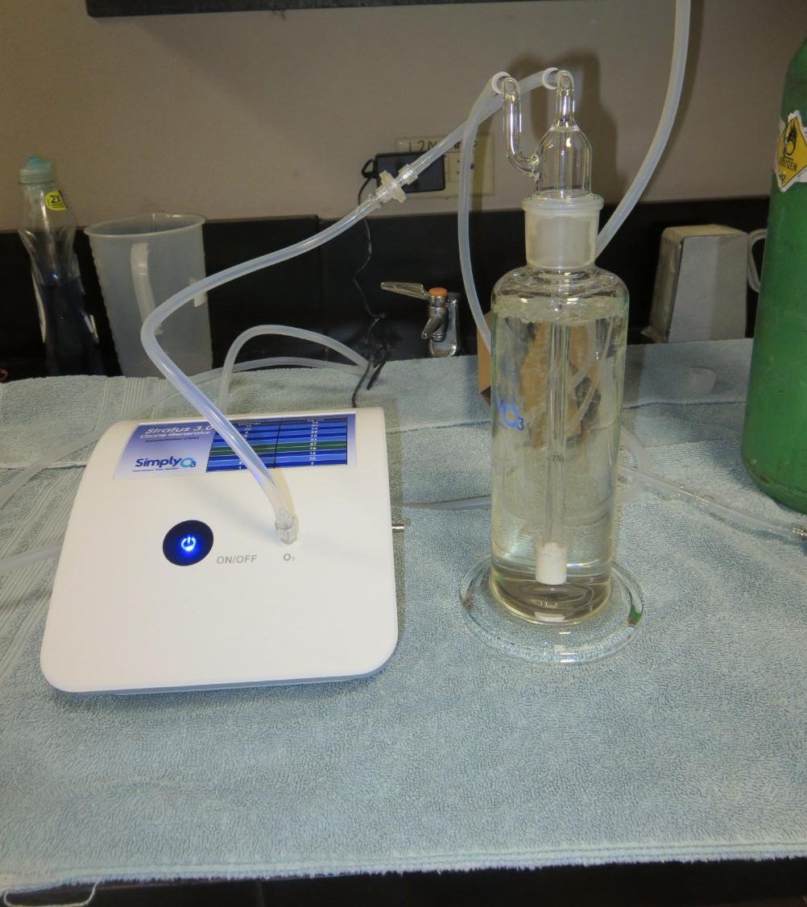
Ozone Generator
O₂ Regulator setting: 5
O₃ contact times (0.5 – 2 minutes)
27 ug/mL
Oxygen flow rate: 0.25 LPM
Batch volume: 500 mL

Slide 8
Coagulant Information
Unless stated otherwise, all coagulant doses are reported as Product (100% strength). Aluminum sulfate is reported as Alum.
Preparation of coagulant stock solutions are generally 1.0 and/or 0.1 percent strength using 100 and/or 200 mL volumetric flasks.
Finnpipette F2 variable volume pipette, capacity 100-1000 micro liters is used for stock solution preparation and coagulant aid jar test dosing.
Finnpipette F2 variable volume pipette, capacity 0.5-5 mL is used for primary coagulant jar test dosing.

Slide 9
City of St. Helena : Jar Test 1-8 Results Flash Mix 200 RPM (20 sec); Floc Mix 30 RPM (5 min)
Jar # | Pre-Ozone Contact Time, min | Alum mg/L | Filtrate NTU | Filtrate %UVT | Filtrate UVA/cm | %UVA Reduction | Settle NTU 25 min
J1 | 1.5 | 60 | 0.04 | 96.16 | 0.0171 | 85.8 | 1.38
J2 | 0 | 60 | 0.05 | 90.47 | 0.0435 | 64.9 | 0.59
J3 | 0 | 65 | 0.05 | 90.71 | 0.0424 | 65.8 | 0.56
J4 | 0 | 70 | 0.05 | 90.87 | 0.0416 | 66.4 | 0.60
J5 | 1.0 | 45 | 0.04 | 94.11 | 0.0264 | 78.7 | 0.26
J6 | 1.0 | 50 | 0.04 | 94.49 | 0.0240 | 80.6 | 0.48
J7 | 1.0 | 55 | 0.04 | 94.71 | 0.0236 | 80.9 | 0.53
J8 | 1.0 | 60 | 0.04 | 95.03 | 0.0221 | 82.1 | 0.44

Slide 10
City of St. Helena : Jar Test 9-16 Results Flash Mix 200 RPM (20 sec); Floc Mix 30 RPM (5 min)
Jar # | Pre-Ozone Contact Time, min | Alum mg/L | Filtrate NTU | Filtrate %UVT | Filtrate UVA/cm | %UVA Reduction | Settle NTU 25 min
J9 | 0.5 | 35 | 0.04 | 91.48 | 0.0387 | 69.5 | 0.33
J10 | 0.5 | 40 | 0.04 | 91.56 | 0.0383 | 69.1 | 0.54
J11 | 0.5 | 45 | 0.04 | 92.71 | 0.0329 | 73.4 | 0.31
J12 | 0.5 | 50 | 0.04 | 92.83 | 0.0323 | 73.9 | 0.56
J13 | 0 | 35 | 0.07 | 87.31 | 0.0590 | 52.3 | 0.43
J14 | 1.0 | 35 | 0.04 | 93.26 | 0.0300 | 75.8 | 0.39
J15 | 1.5 | 35 | 0.04 | 94.56 | 0.0243 | 80.4 | 0.39
J16 | 2.0 | 35 | 0.04 | 95.44 | 0.0200 | 83.6 | 0.34

Slide 11
Jars 1-4 Test Flash Mix 20 Sec (200 RPM) Floc Mix 5 min (30 RPM) Post NaMnO₄ Applied Coagulant Alum

Slide 12
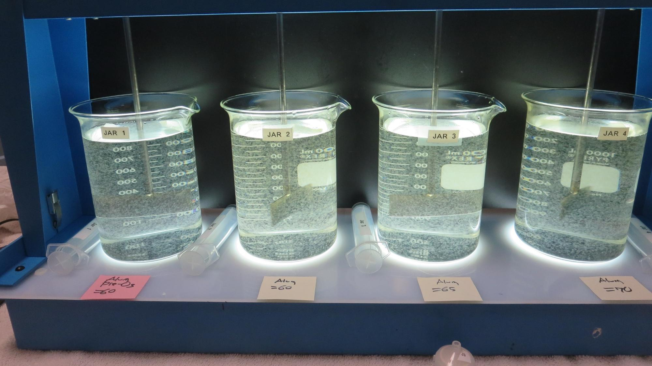
Jars 1-4: End of 5-minute flocculation (30 RPM) duration.
Pre-O₃: 1.5 min contact time
Alum: 60 mg/L
Filtrate: 0.04 NTU
UVT: 96.16%
UVA: 0.0171/cm
UVA Reduction: 85.8%
Settled: 1.38 NTU
Alum: 60 mg/L
Filtrate: 0.05 NTU
UVT: 90.47%
UVA: 0.0435/cm
UVA Reduction: 64.9%
Settled: 0.59 NTU
Alum: 65 mg/L
Filtrate: 0.05 NTU
UVT: 90.71%
UVA: 0.0424/cm
UVA Reduction: 65.8%
Settled: 0.56 NTU
Alum: 70 mg/L
Filtrate: 0.05 NTU
UVT: 90.87%
UVA: 0.0416/cm
UVA Reduction: 66.4%
Settled: 0.60 NTU

Slide 13
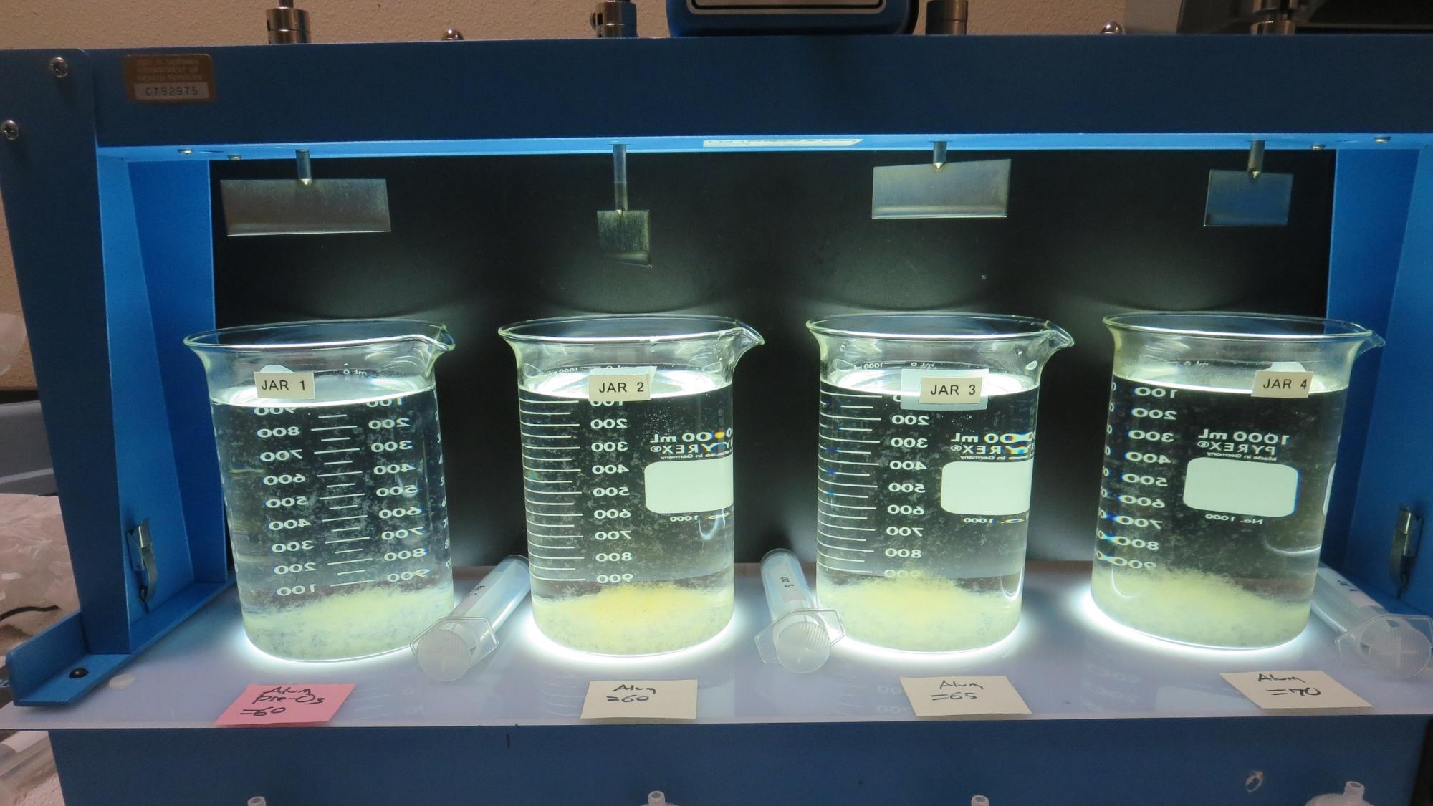
Jars 1-4: After 5 min of settling, 25 mL is syringed for filterability and %UVT/UVA

Slide 14
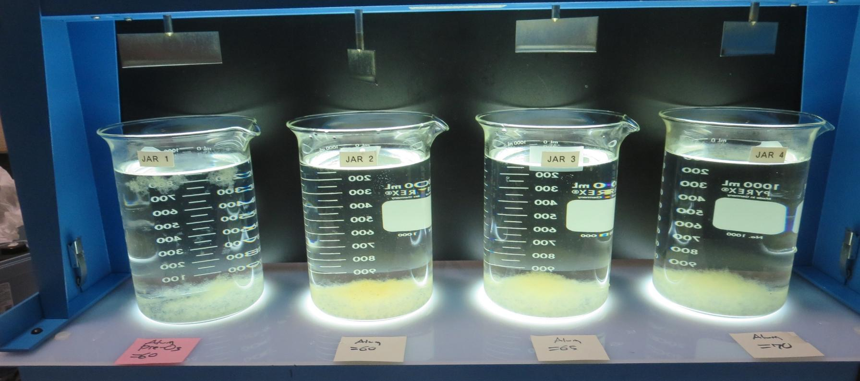
Jars 1-4: After 25-minutes of settling, settled water turbidity is taken.
Pre-O₃: 1.5 min contact time
Alum: 60 mg/L
Filtrate: 0.04 NTU
UVT: 96.16%
UVA: 0.0171/cm
UVA Reduction: 85.8%
Settled: 1.38 NTU
Alum: 60 mg/L
Filtrate: 0.05 NTU
UVT: 90.47%
UVA: 0.0435/cm
UVA Reduction: 64.9%
Settled: 0.59 NTU
Alum: 65 mg/L
Filtrate: 0.05 NTU
UVT: 90.71%
UVA: 0.0424/cm
UVA Reduction: 65.8%
Settled: 0.56 NTU
Alum: 70 mg/L
Filtrate: 0.05 NTU
UVT: 90.87%
UVA: 0.0416/cm
UVA Reduction: 66.4%
Settled: 0.60 NTU

Slide 15
Jars 5-8 Test Flash Mix 20 Sec (200 RPM) Floc Mix 5 min (30 RPM) Applied Coagulant Alum

Slide 16
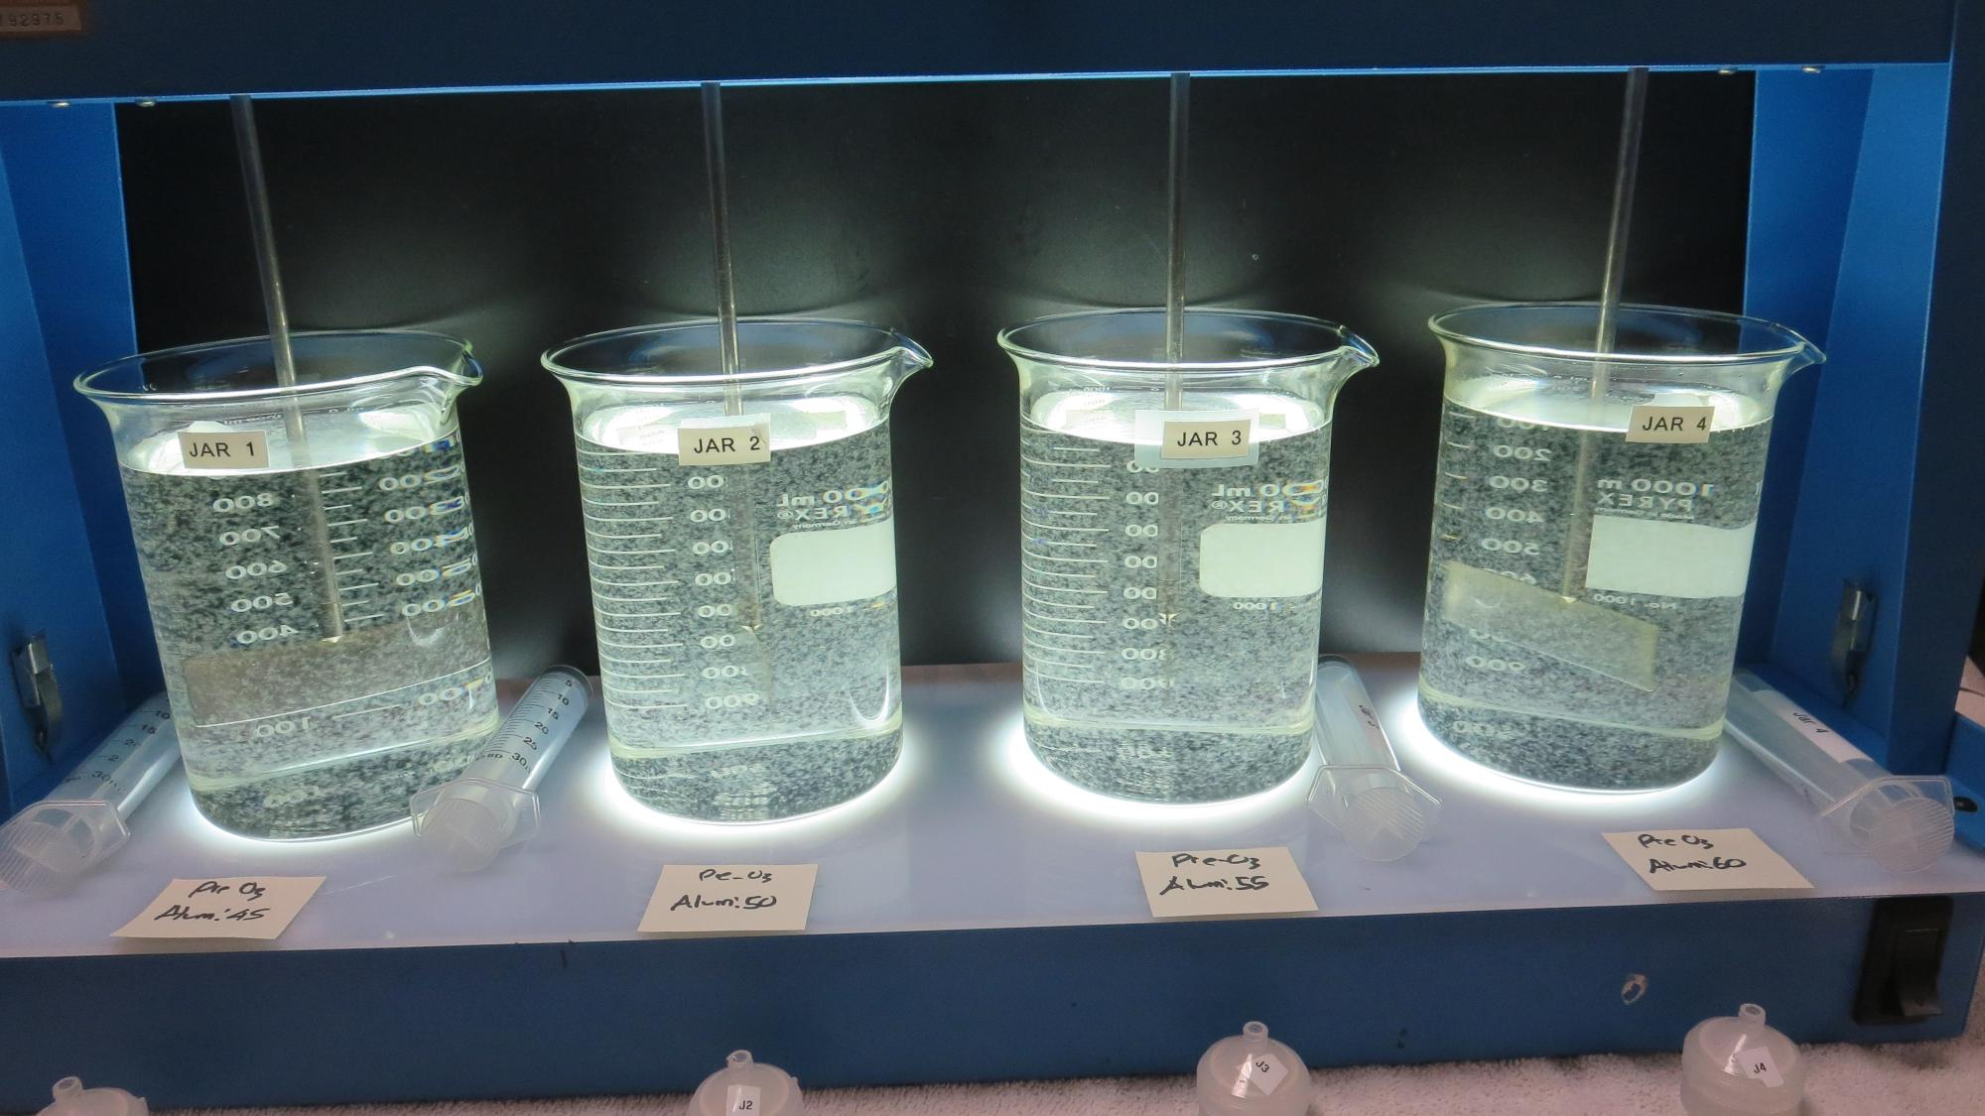
Jars 5-8: End of 5-minute flocculation (30 RPM) duration.
Pre-O₃: 1.0 min contact time
Alum: 45 mg/L
Filtrate: 0.04 NTU
UVT: 94.11%
UVA: 0.0264/cm
UVA Reduction: 78.7%
Settled: 0.26 NTU
Pre-O₃: 1.0 min contact time
Alum: 50 mg/L
Filtrate: 0.04 NTU
UVT: 94.64%
UVA: 0.0240/cm
UVA Reduction: 80.6%
Settled: 0.48 NTU
Pre-O₃: 1.0 min contact time
Alum: 55 mg/L
Filtrate: 0.04 NTU
UVT: 94.71%
UVA: 0.0236/cm
UVA Reduction: 80.9%
Settled: 0.53 NTU
Pre-O₃: 1.0 min contact time
Alum: 60 mg/L
Filtrate: 0.04 NTU
UVT: 95.03%
UVA: 0.0221/cm
UVA Reduction: 82.1%
Settled: 0.44 NTU

Slide 17
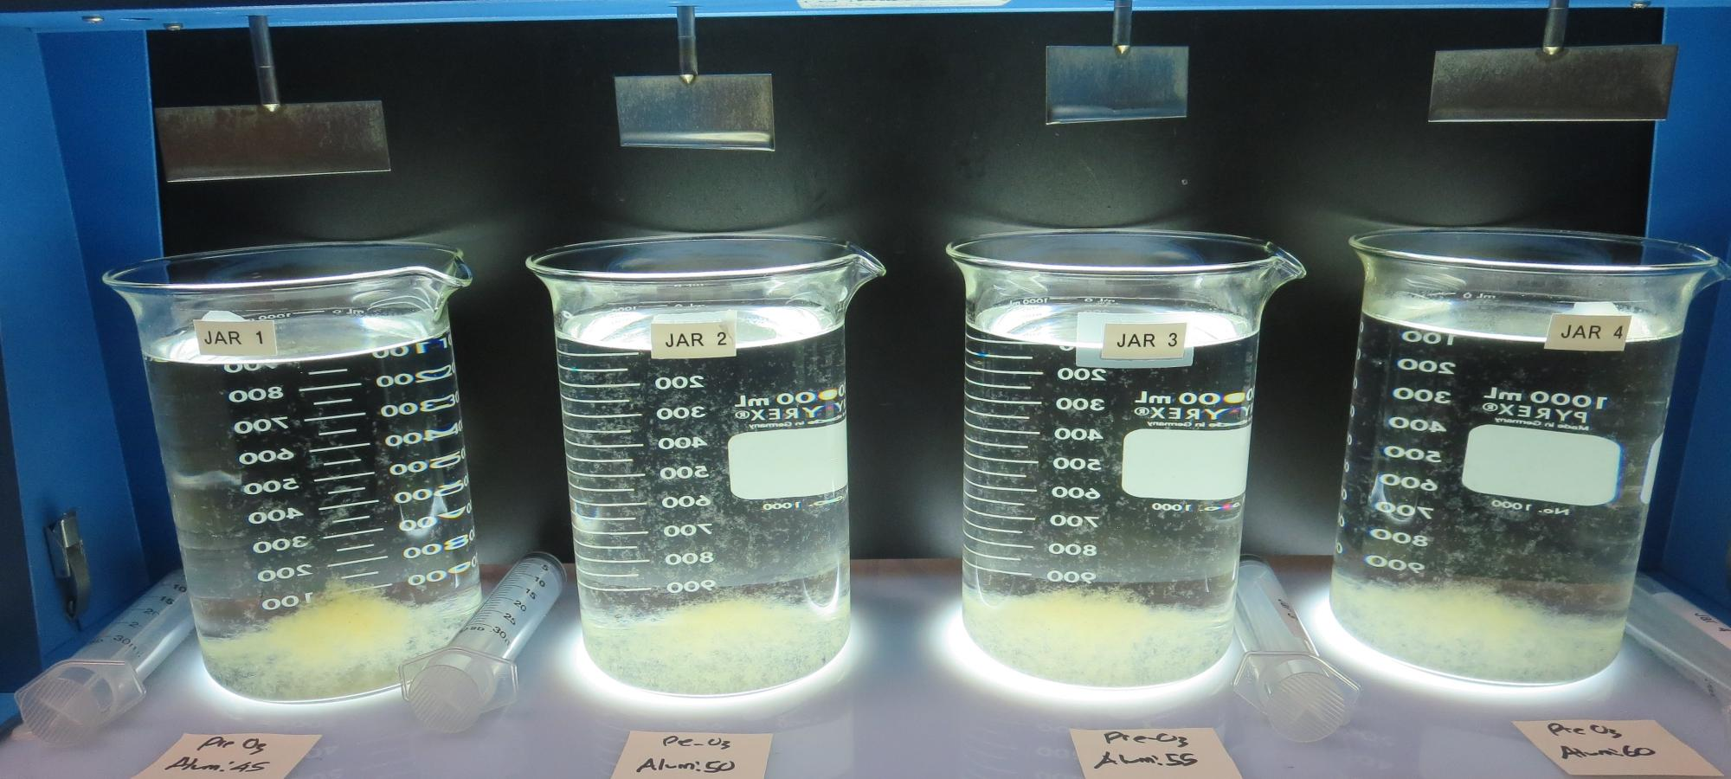
Jars 5-8: After 5 min of settling, 25 mL is syringed for filterability and %UVT/UVA

Slide 18
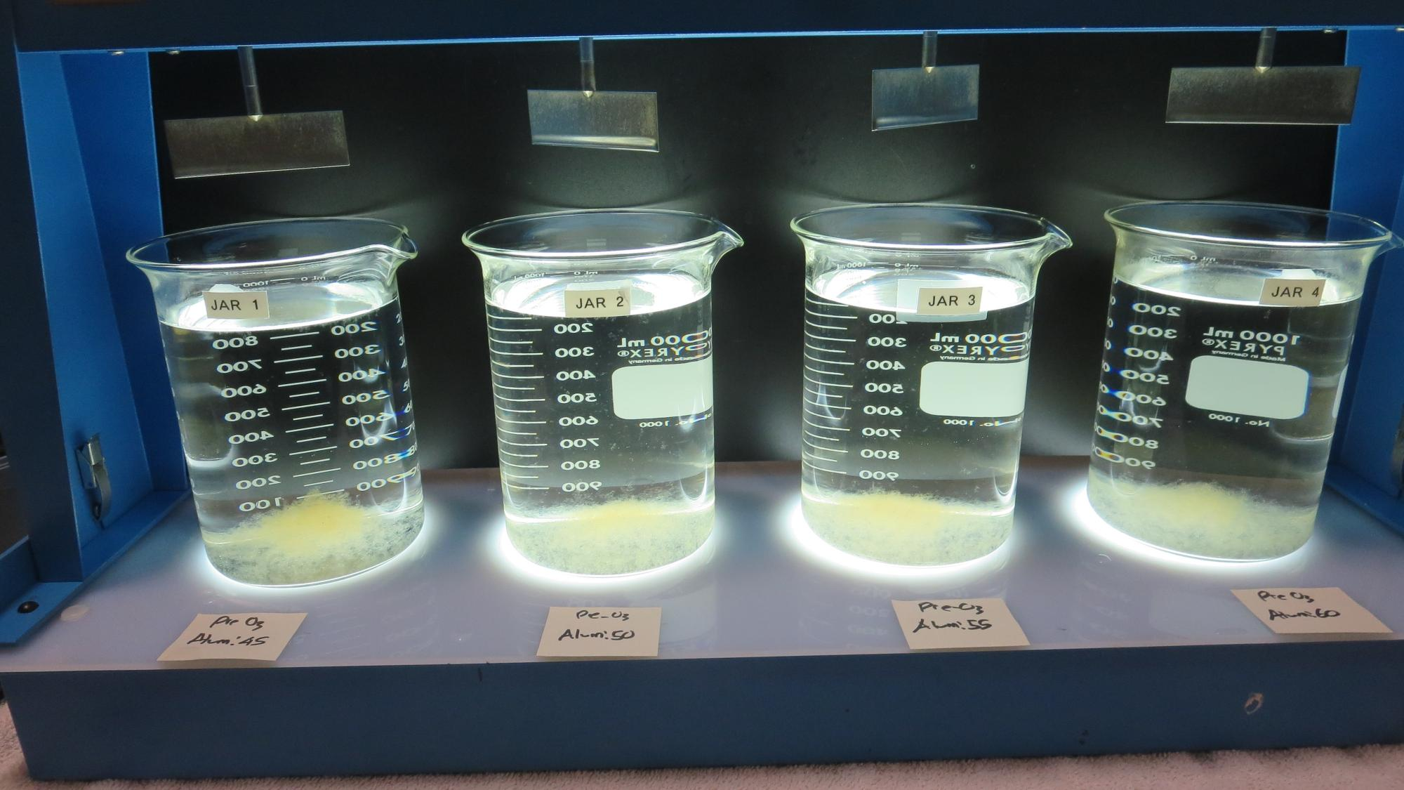
Jars 5-8: After 25-minutes of settling, settled water turbidity is taken.
Pre-O₃: 1.0 min contact time
Alum: 45 mg/L
Filtrate: 0.04 NTU
UVT: 94.11%
UVA: 0.0264/cm
UVA Reduction: 78.7%
Settled: 0.26 NTU
Pre-O₃: 1.0 min contact time
Alum: 50 mg/L
Filtrate: 0.04 NTU
UVT: 94.64%
UVA: 0.0240/cm
UVA Reduction: 80.6%
Settled: 0.48 NTU
Pre-O₃: 1.0 min contact time
Alum: 55 mg/L
Filtrate: 0.04 NTU
UVT: 94.71%
UVA: 0.0236/cm
UVA Reduction: 80.9%
Settled: 0.53 NTU
Pre-O₃: 1.0 min contact time
Alum: 60 mg/L
Filtrate: 0.04 NTU
UVT: 95.03%
UVA: 0.0221/cm
UVA Reduction: 82.1%
Settled: 0.44 NTU

Slide 19
Jars 9-12 Test Flash Mix 20 Sec (200 RPM) Floc Mix 5 min (30 RPM) Applied Coagulant Alum

Slide 20
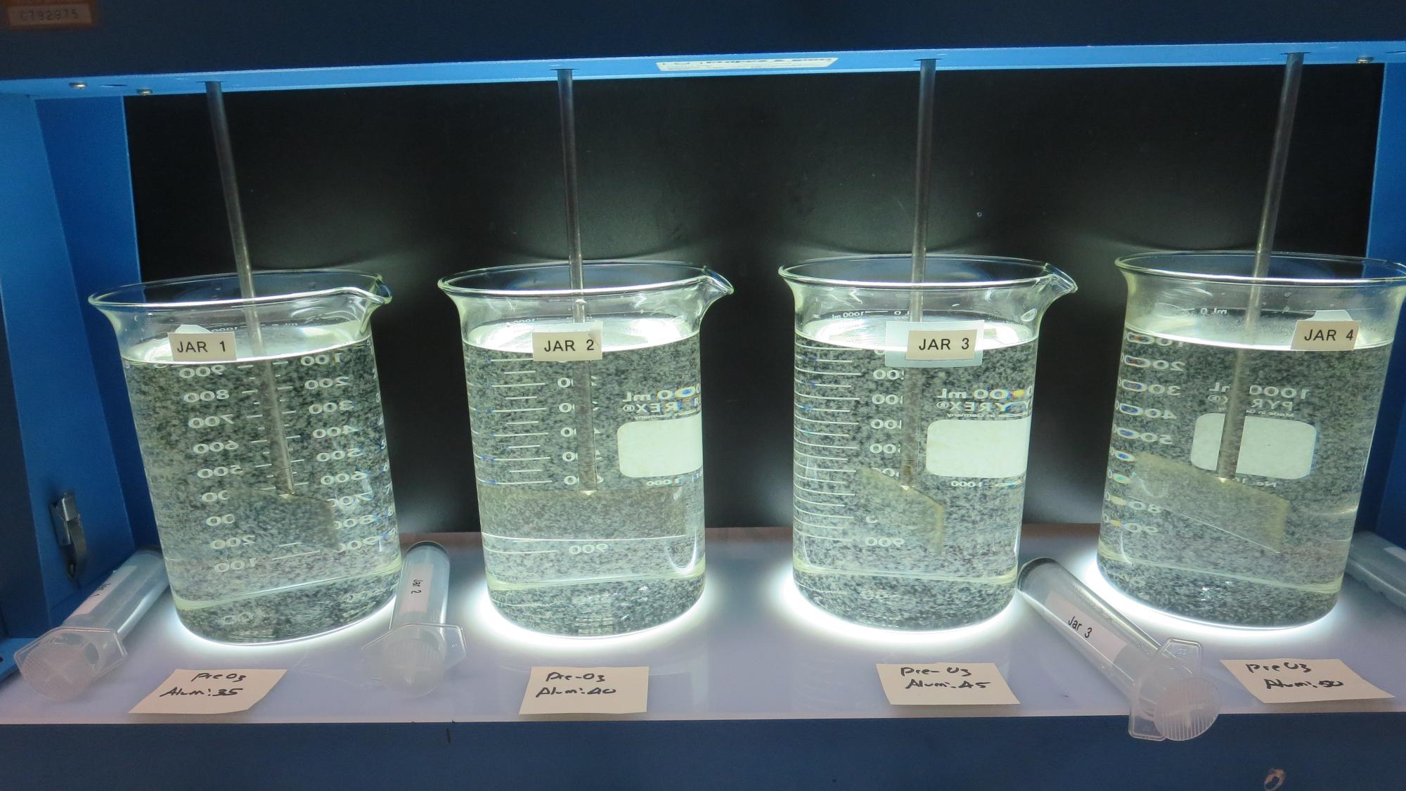
Jars 9-12: End of 5-minute flocculation (30 RPM) duration.
Pre-O₃: 0.5 min contact time
Alum: 35 mg/L
Filtrate: 0.04 NTU
UVT: 91.68%
UVA: 0.0378/cm
UVA Reduction: 69.5%
Settled: 0.33 NTU
Pre-O₃: 0.5 min contact time
Alum: 40 mg/L
Filtrate: 0.04 NTU
UVT: 91.56%
UVA: 0.0383/cm
UVA Reduction: 69.1%
Settled: 0.54 NTU
Pre-O₃: 0.5 min contact time
Alum: 45 mg/L
Filtrate: 0.04 NTU
UVT: 92.88%
UVA: 0.0321/cm
UVA Reduction: 73.4%
Settled: 0.31 NTU
Pre-O₃: 0.5 min contact time
Alum: 50 mg/L
Filtrate: 0.04 NTU
UVT: 92.96%
UVA: 0.0317/cm
UVA Reduction: 73.9%
Settled: 0.56 NTU

Slide 21
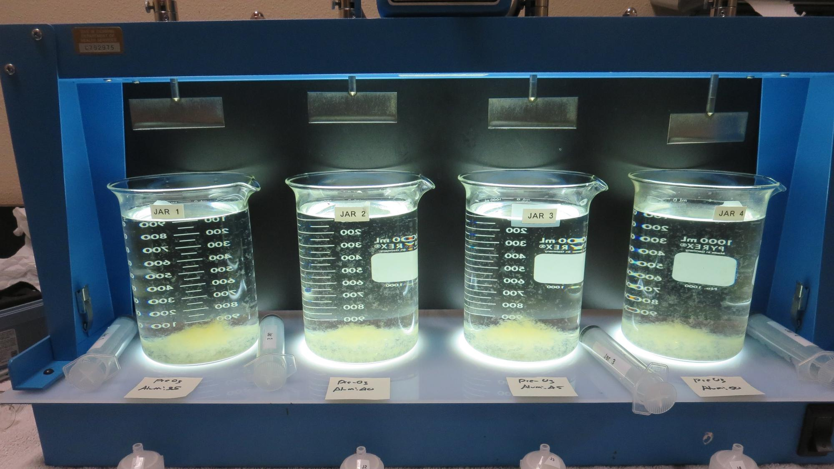
Jars 9-12: After 5 min of settling, 25 mL is syringed for filterability and %UVT/UVA

Slide 22
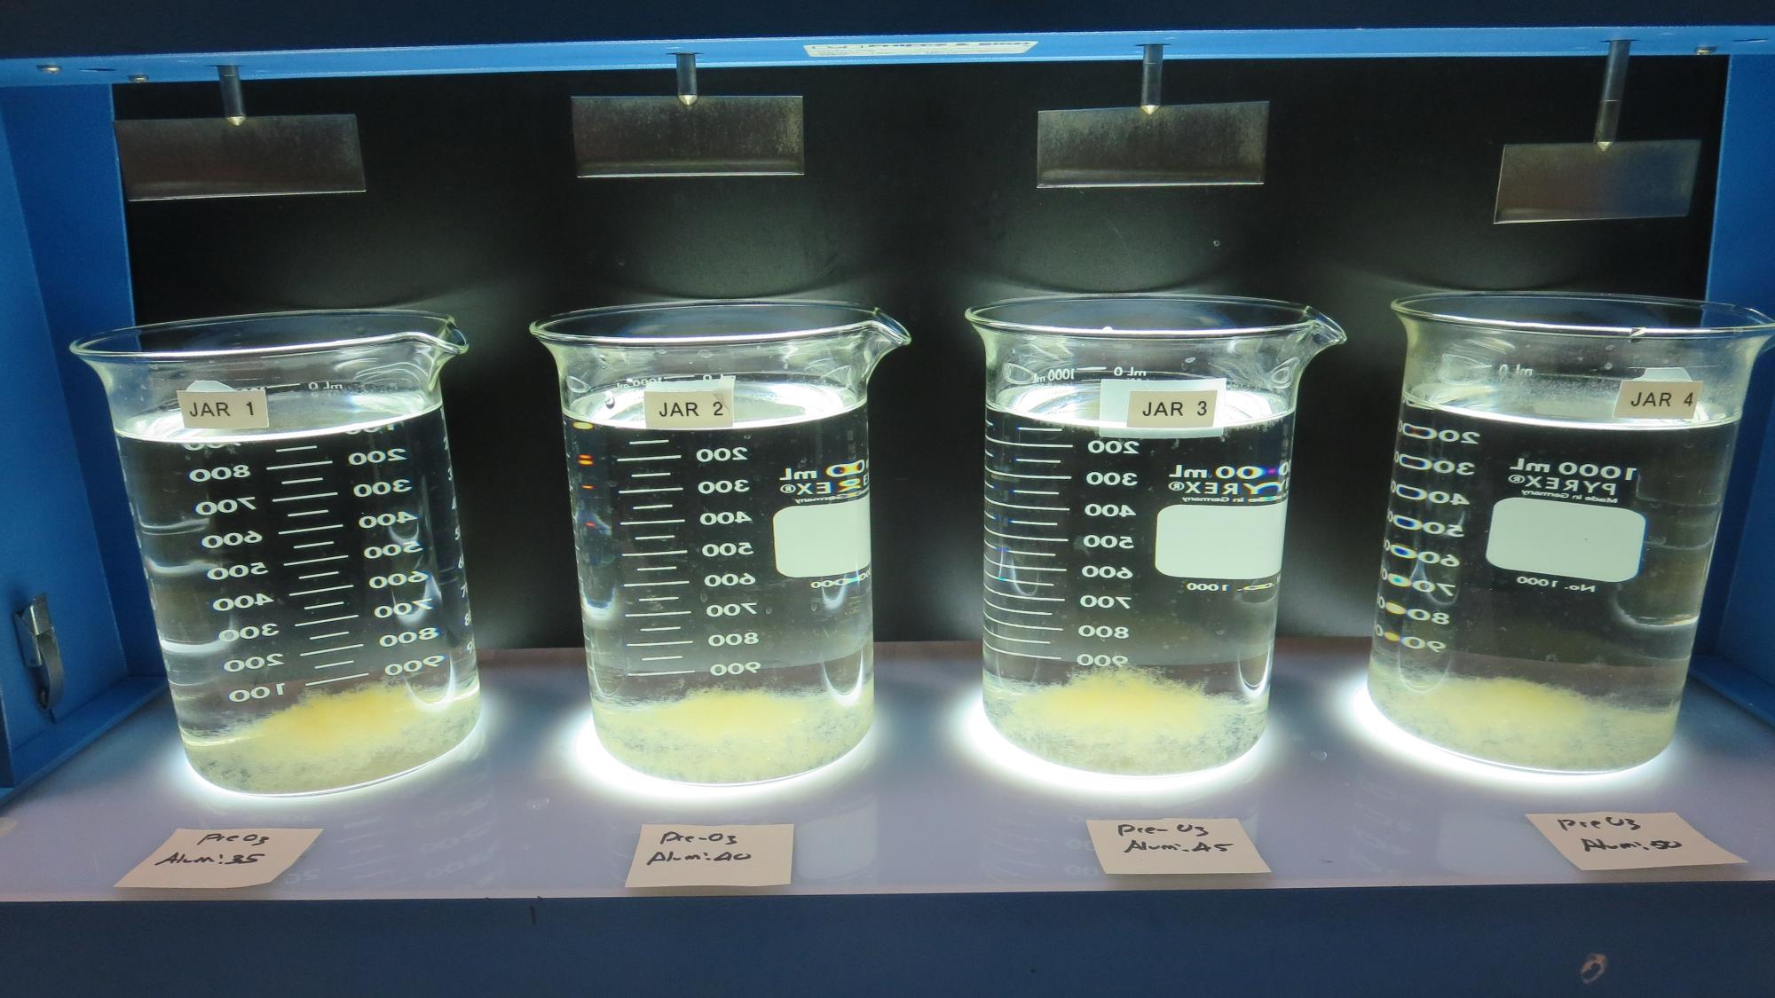
Jars 9-12: After 25-minutes of settling, settled water turbidity is taken.
Pre-O₃: 0.5 min contact time
Alum: 35 mg/L
Filtrate: 0.04 NTU
UVT: 91.68%
UVA: 0.0378/cm
UVA Reduction: 69.5%
Settled: 0.33 NTU
Pre-O₃: 0.5 min contact time
Alum: 40 mg/L
Filtrate: 0.04 NTU
UVT: 91.56%
UVA: 0.0383/cm
UVA Reduction: 69.1%
Settled: 0.54 NTU
Pre-O₃: 0.5 min contact time
Alum: 45 mg/L
Filtrate: 0.04 NTU
UVT: 92.88%
UVA: 0.0321/cm
UVA Reduction: 73.4%
Settled: 0.31 NTU
Pre-O₃: 0.5 min contact time
Alum: 50 mg/L
Filtrate: 0.04 NTU
UVT: 92.96%
UVA: 0.0317/cm
UVA Reduction: 73.9%
Settled: 0.56 NTU

Slide 23
Jars 13-16 Test Flash Mix 20 Sec (200 RPM) Floc Mix 5 min (30 RPM) Applied Coagulant Alum

Slide 24
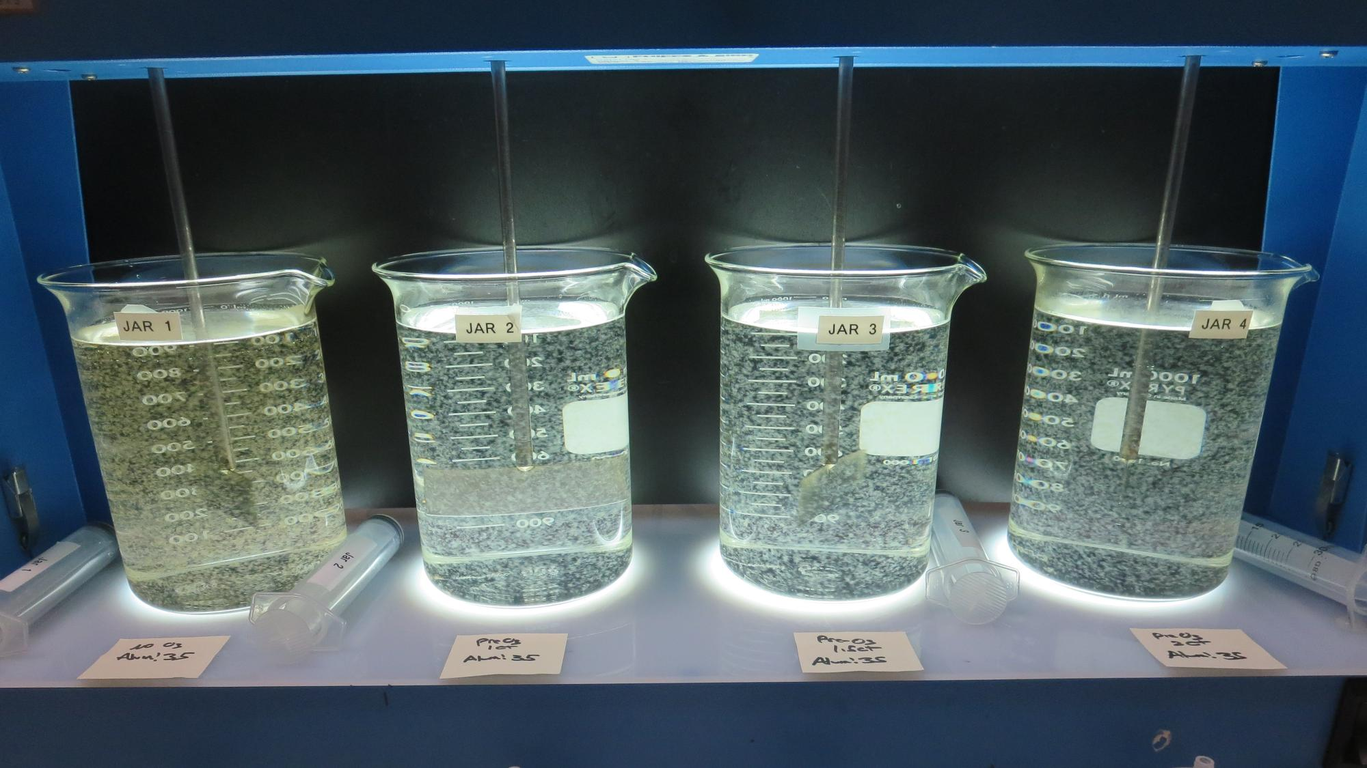
Jars 13-16: End of 5-minute flocculation (30 RPM) duration.
Pre-O₃: 0 min contact time
Alum: 35 mg/L
Filtrate: 0.07 NTU
UVT: 87.31%
UVA: 0.0590/cm
UVA Reduction: 52.3%
Settled: 0.43 NTU
Pre-O₃: 1.0 min contact time
Alum: 35 mg/L
Filtrate: 0.04 NTU
UVT: 93.34%
UVA: 0.0300/cm
UVA Reduction: 75.8%
Settled: 0.39 NTU
Pre-O₃: 1.5 min contact time
Alum: 35 mg/L
Filtrate: 0.04 NTU
UVT: 94.56%
UVA: 0.0243/cm
UVA Reduction: 80.4%
Settled: 0.39 NTU
Pre-O₃: 2.0 min contact time
Alum: 35 mg/L
Filtrate: 0.04 NTU
UVT: 95.44%
UVA: 0.0200/cm
UVA Reduction: 83.6%
Settled: 0.34 NTU

Slide 25
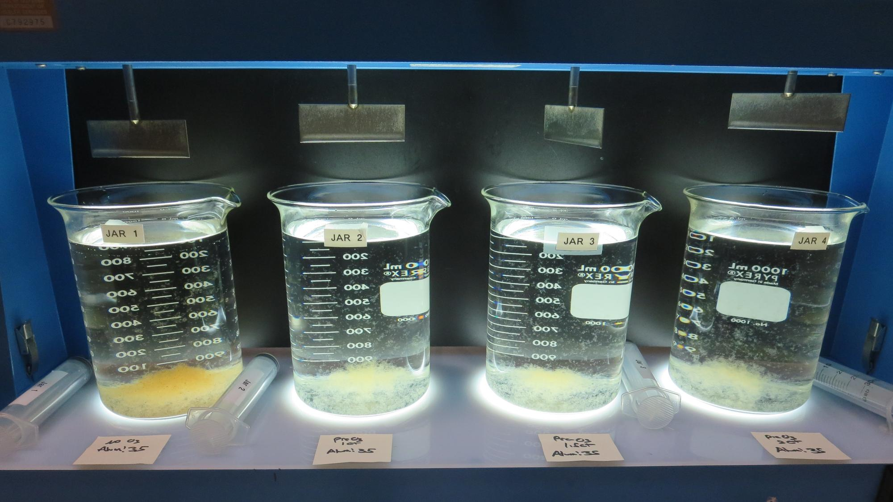
Jars 13-16: After 5 min of settling, 25 mL is syringed for filterability and %UVT/UVA

Slide 26
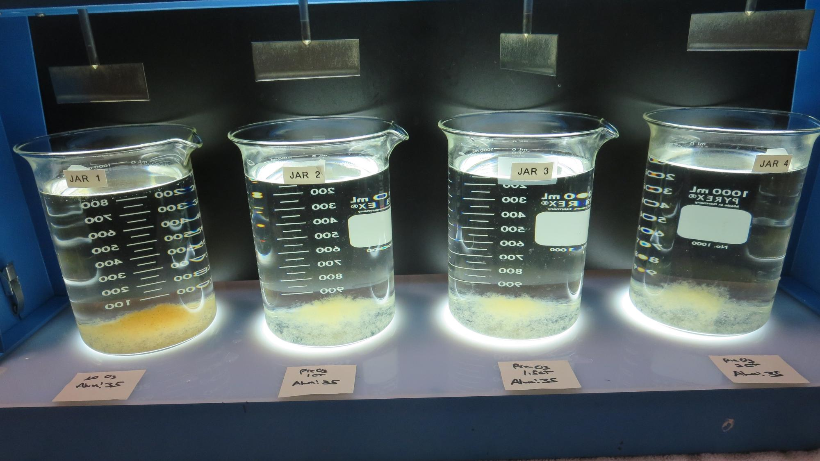
Jars 13-16: After 25-minutes of settling, settled water turbidity is taken.
Pre-O₃: 0 min contact time
Alum: 35 mg/L
Filtrate: 0.07 NTU
UVT: 87.31%
UVA: 0.0590/cm
UVA Reduction: 52.3%
Settled: 0.43 NTU
Pre-O₃: 1.0 min contact time
Alum: 35 mg/L
Filtrate: 0.04 NTU
UVT: 93.34%
UVA: 0.0300/cm
UVA Reduction: 75.8%
Settled: 0.39 NTU
Pre-O₃: 1.5 min contact time
Alum: 35 mg/L
Filtrate: 0.04 NTU
UVT: 94.56%
UVA: 0.0243/cm
UVA Reduction: 80.4%
Settled: 0.39 NTU
Pre-O₃: 2.0 min contact time
Alum: 35 mg/L
Filtrate: 0.04 NTU
UVT: 95.44%
UVA: 0.0200/cm
UVA Reduction: 83.6%
Settled: 0.34 NTU

Slide 27
Jar Testing for 1-Liter Jars: Procedures for Most Treatment Plants
Fill jars with source water prior to coagulant injection and set paddle speed at 30 rpm
Add chemicals (i.e., NaOCl, primary coagulant, coagulant aid) to each jar
Flash mix for 15-60 seconds (200 rpm)
Slow mix for 5 minutes (20-30 rpm)
Settled for 5 minutes. Syringe 25 mL from each jar taken 1-inch below surface (25 mL/12 sec rate)
Filtered through 1.2 um isopore membrane into cuvette drip rate, 15 mL/(50-90 sec)
Measure filtrate turbidity, chlorine residual and %UVT/UVA
Measure settled water turbidity after 25 minutes of total setting
Record all data

Slide 28
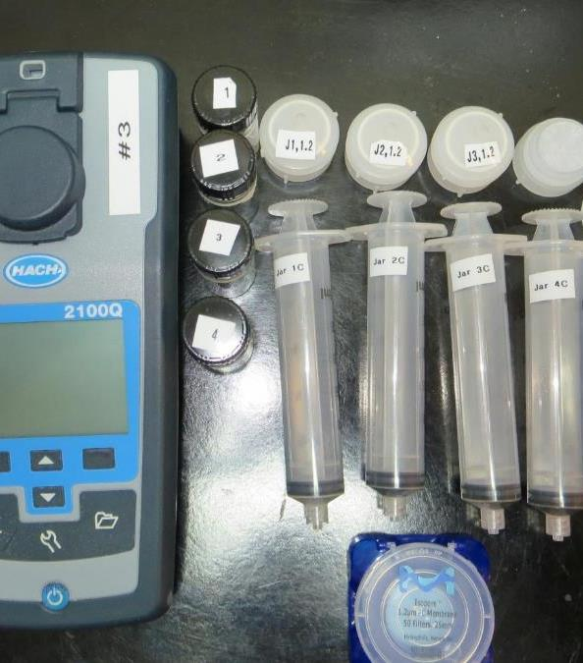
Jar Test Filterability Test Equipment
Turbidity Instrument
Syringe w/Luer-Lock Tip, 30 cc
(part#: 2225800, by Hach)
Swinnex Filter Holder, 25 mm (part#: SX0002500)
Isopore Membrane Filter, 1.2 um absolute
pore size,
Φ= 25 mm , thickness: 24 um,
hydrophilic polycarbonate membrane
(part #: RTTP02500)
Go to Sigma-Aldrich for laboratory supplies http://www.sigmaaldrich.com/united-states.html

Slide 29
Isopore Membrane Information
Categories | Information
trade name | Isopore
filter color | White
chemistry | Polycarbonate (PC)
water flow rate | Avg. 175 mL/min x cm² (typical results @ 10 psi)
media | Isopore®
wettability | Hydrophilic
porosity | 14.7%
pore size | 1.2 µm
bubble point at 23 °C | 1.0 bar, air with water
thickness | 24 µm
filter diameter (ø) | 25 mm
material size | polycarbonate, Hydrophilic, 1.2 µm, 25 mm, white, plain, 100

Slide 30
Isopore Membrane Background Information
The Isopore membrane is a polycarbonate, track-etched screen filter recommended for all analyses in which the sample is viewed on the surface of the membrane. The Isopore membrane is composed of polycarbonate film, which has a smooth, glass-like surface for clearer sample observation. The unique manufacturing process of the membrane ensures a precise pore diameter and a consistent pore size for accurate separation of samples by size. Matched-weight filters are not usually required because of low, constant tar and ash weights. Features & Benefits: Membrane structure retains particles on the surface, simplifying counting and analysis

Slide 31
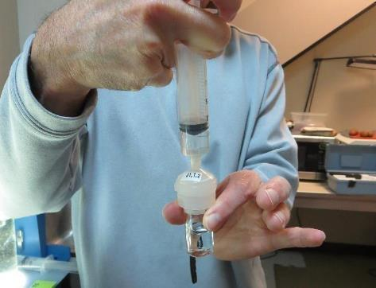
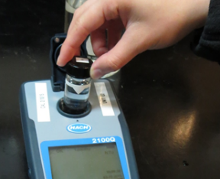
Jar Test - Filterability Test
Syringe ~ 25 mL from jar (after 5-minutes of settling)
Filter-to-waste 3-5 mL
Filter directly into clean cuvette
Measure turbidity
Note: Take several readings before recording final NTU results. Micro bubbles can adhere to glass causing false NTU readings. To remove bubbles, tilt cuvette up to 90 degrees.

Slide 32

Contact
Guy Schott, P.E.
State Water Resources Control Board
Division of Drinking Water
Santa Rosa, CA
Go to Stock Solution/Dose calculations/Jar Test Results for tools to download
www.waterboards.ca.gov/drinking_water/programs/districts/mendocino_district.html
Jar Testing Done Right training video: https://www.youtube.com/watch?v=aGByyxhelkI
Email: Guy Schott - Guy.Schott@waterboards.ca.gov
Office Number: 707-576-2732

