Slide 1
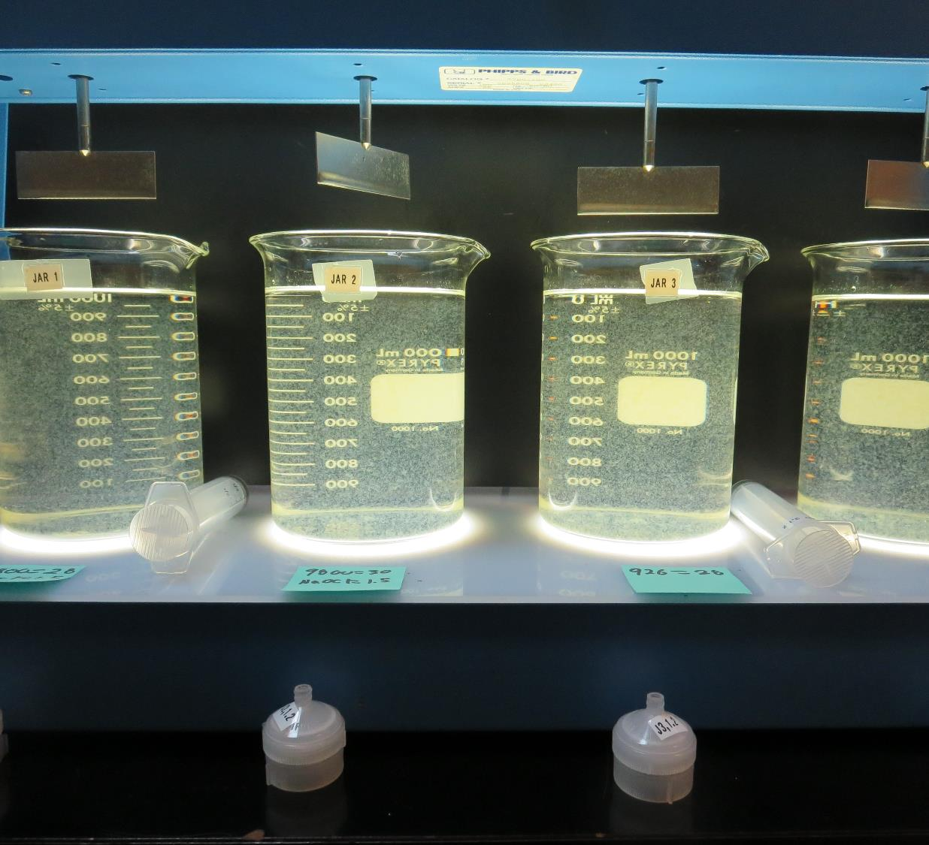
City of St. Helena
CA2810004
Napa County
Jar Test
by Guy Schott, P.E.
April 5, 2019

Slide 2
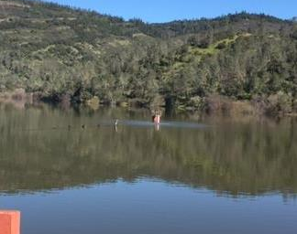
Source Water:
Bell Canyon Reservoir
Source Water Characteristics
Turbidity: 5.7 NTU
pH: 7.2
UVT: 63.2%
UVA: 0.199
0.4 um Filtered
UVT: 68.6%
UVA: 0.164

Slide 3
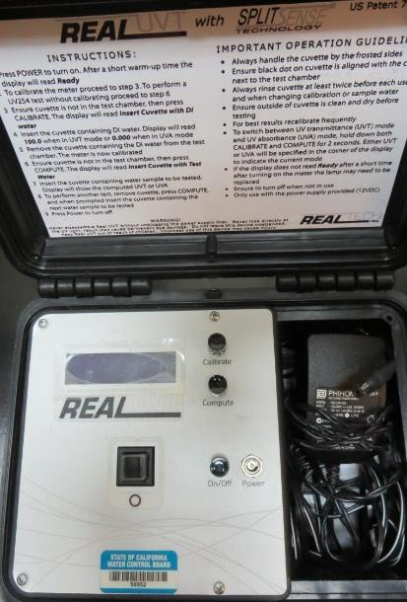
UVT/UVA, pathlength 10 mm
UV transmittance (UVT) is a measurement of the amount of ultraviolet light (commonly at 254 nm due to its germicidal effect) that passes through a water sample compared to the amount of light that passes through a pure water sample. The measurement is expressed as a percentage, % UVT.
%UVT = 10^{(-UVA)} x 100%
UV absorbance (UVA) is calculated as a relative measure of the amount of light absorbed by a water sample compared with the amount of light absorbed by a pure water sample.
UVA = -log(%UVT/100)

Slide 4
Applied Coagulants for Jar Testing (1)
Aluminum Sulfate (Product)
Al₂(SO₄)₃*14.3H₂0 (Liquid)
48% Aluminum Sulfate
52% Water
8.2% Al₂O₃
4.3% Al
0% Basicity
SG = 1.32
NSF limit: 400 mg/L (product)
As hydrated Al₂(SO₄)₃*14.3H₂0
17% Al₂O₃
NALCLEAR 8170 PULV (Nalco)
Flocculant
Dry
Polyacrylamide
NSF limit: 1 mg/L

Slide 5
Applied Coagulants for Jar Testing (2)
Pro Pac 9800 (NTU Technologies)
50% Aluminum Chlorohydrate
50% Water
23.62% Al₂O₃
12.5% Al
83% Basicity
SG = 1.25-1.34
NSF limit: 250 mg/L as Product
10 mg/L as 9800 = Reduction 1.18 mg/L as CaCO₃
Pro Pac 926 (NTU Technologies)
30-40% Aluminum Chlorohydrate
30% polyamine (80% water, 20% active polyamines)
30-40% Water
~14.17% Al₂O₃
~7.5% Al
83% Basicity
SG = 1.25-1.34
NSF limit: 83 mg/L as Product;
Product dose 16.6 mg/L = 1 mg/L polyamines active

Slide 6
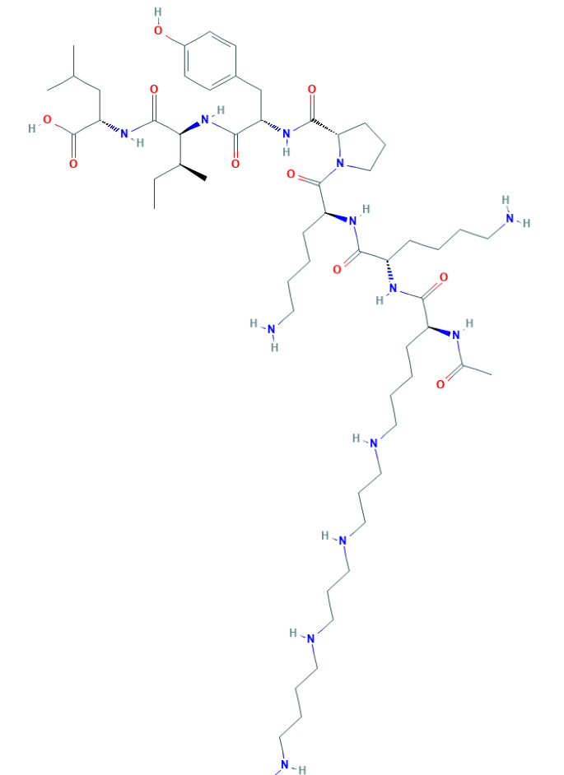
Polyamine
C₅₉H₁₀₈N₁₄O₁₀
MW: 1,173.6 g/mol

Slide 7
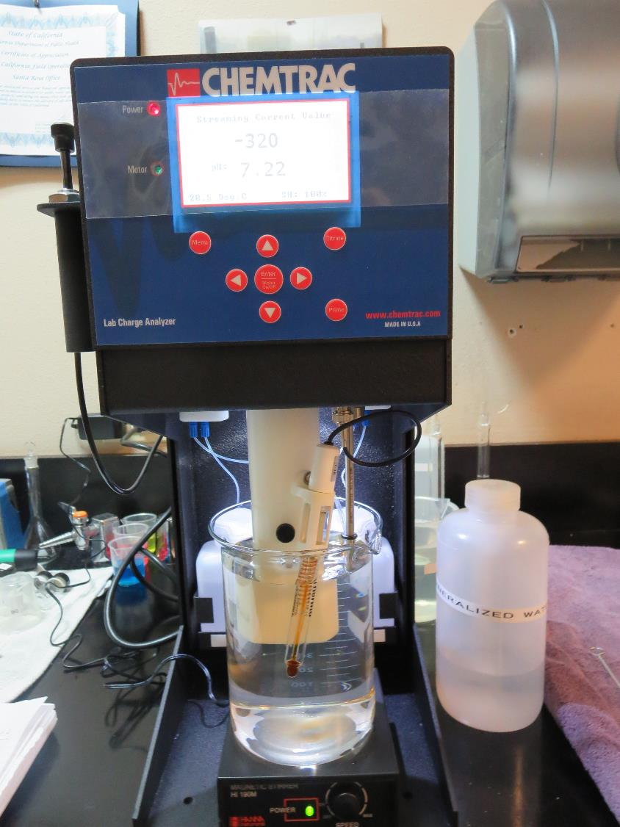
Laboratory Charge Analyzer
LCA: Used to determine coagulant demand of a source water entering the treatment plant.
Source pH: 7.2
LCA #1
9800: 24 mg/L as product
No pH adjustment.
LCA #2:
Aluminum Sulfate: 32 mg/L as Alum
No pH adjustment.

Slide 8
Coagulant Information
Unless stated otherwise, all coagulant doses are reported as Product (100% strength). Aluminum sulfate is reported as Alum.
Preparation of coagulant stock solutions are generally 1.0 and/or 0.1 percent strength using 100 and/or 200 mL volumetric flasks.
Finnpipette F2 variable volume pipette, capacity 100-1000 micro liters is used for stock solution preparation and coagulant aid jar test dosing.
Finnpipette F2 variable volume pipette, capacity 0.5-5 mL is used for primary coagulant jar test dosing.

Slide 9
City of St. Helena : Jar Test 1-8 Results
Flash Mix 200 RPM (60 sec); Floc Mix 30 RPM (10 min)
Jar # | 9800 mg/L | Filtrate NTU | Filtrate %UVT | Filtrate UVA/cm | %UVA Reduction | Settle NTU 25 min
J1 | 22 | 0.71 | 87.6 | 0.057 | 65.2 | 3.3
J2 | 24 | 0.20 | 91.0 | 0.041 | 75.0 | 2.9
J3 | 26 | 0.12 | 91.9 | 0.037 | 77.5 | 2.3
J4 | 28 | 0.10 | 92.4 | 0.034 | 79.3 | 1.9
J5 | 26 | 0.11 | 91.9 | 0.037 | 77.4 | 2.8
J6 | 28 | 0.07 | 92.8 | 0.032 | 80.4 | 2.3
J7 | 30 | 0.08 | 93.0 | 0.032 | 80.4 | 3.0
J8 | 32 | 0.08 | 93.2 | 0.031 | 81.1 | 2.8

Slide 10
Veterans Home: Jar Test 9-14 Results
Flash Mix 200 RPM (60 sec); Floc Mix 30 RPM (10 min)
Jar # | NaOCl mg/L | PAC mg/L | 9800 mg/L | Filtrate NTU | Filtrate %UVT | Filtrate UVA/cm | %UVA Reduction | Settle NTU 25 min
J9 | 0 | 20 | 26 | 0.07 | 92.8 | 0.032 | 80.5 | 7.0
J10 | 0 | 20 | 28 | 0.18 | 92.8 | 0.032 | 80.5 | 5.0
J11 | 0 | 20 | 30 | 0.07 | 93.4 | 0.030 | 81.7 | 4.4
J12 | 0 | 20 | 32 | 0.49 | 93.1 | 0.031 | 81.1 | 5.4
J13 | 1.5 | 0 | 28 | 0.73 | 89.0 | 0.051 | 68.9 | 1.8
J14 | 1.5 | 0 | 30 | 0.62 | 90.4 | 0.044 | 73.2 | 1.7

Slide 11
Veterans Home: Jar Test 15-20 Results
Flash Mix 200 RPM (60 sec); Floc Mix 30 RPM (10 min)
Jar # | 926 mg/L | Filtrate NTU | Filtrate %UVT | Filtrate UVA/cm | %UVA Reduction | Settle NTU 25 min
J15 | 28 | 0.47 | 90.1 | 0.045 | 72.6 | 1.8
J16 | 30 | 0.39 | 91.2 | 0.040 | 75.6 | 1.6
J17 | 32 | 0.07 | 93.3 | 0.030 | 81.7 | 3.4
J18 | 34 | 0.05 | 93.9 | 0.027 | 83.5 | 3.1
J19 | 36 | 0.23 | 92.8 | 0.032 | 80.5 | 6.1
J20 | 38 | 0.12 | 93.8 | 0.028 | 82.9 | 6.3

Slide 12
Veterans Home: Jar Test 21-24 Results
Flash Mix 200 RPM (60 sec); Floc Mix 30 RPM (10 min)
Jar # | Alum mg/L | 8107 mg/L | PAC mg/L | Filtrate NTU | Filtrate %UVT | Filtrate UVA/cm | %UVA Reduction | Settle NTU 25 min
J21 | 28 | 0.2 | 0 | 0.06 | 92.1 | 0.036 | 78.0 | 1.6
J22 | 30 | 0.2 | 0 | 0.06 | 92.9 | 0.032 | 80.5 | 1.6
J23 | 28 | 0.2 | 20 | 0.09 | 92.2 | 0.035 | 78.7 | 2.2
J24 | 30 | 0.2 | 20 | 0.11 | 92.6 | 0.033 | 79.9 | 1.7

Slide 13
Veterans Home: Jar Test 25-28 Results
Flash Mix 200 RPM (60 sec); Floc Mix 30 RPM (10 min)
Jar # | Alum mg/L | 8107 mg/L | Filtrate NTU | Filtrate %UVT | Filtrate UVA/cm | %UVA Reduction | Settle NTU 25 min
J25 | 28 | 0.2 | 0.19 | 92.2 | 0.035 | 78.7 | 1.8
J26 | 30 | 0.2 | 0.17 | 92.5 | 0.034 | 79.3 | 1.6
J27 | 32 | 0.2 | 0.07 | 92.4 | 0.034 | 79.3 | 1.8
J28 | 34 | 0.2 | 0.07 | 93.2 | 0.031 | 81.1 | 3.8

Slide 14
Veterans Home: Jar Test 29-36 Results
Flash Mix 200 RPM (60 sec); Floc Mix 30 RPM (10 min)
Jar # | 926 mg/L | Filtrate NTU | Filtrate %UVT | Filtrate UVA/cm | %UVA Reduction | Settle NTU 25 min
J29 | 32 | 0.43 | 90.8 | 0.042 | 74.4 | 1.8
J30 | 34 | 0.06 | 93.7 | 0.028 | 82.9 | 2.2
J31 | 36 | 0.63 | 90.5 | 0.043 | 73.8 | 3.5
J32 | 38 | 0.50 | 91.3 | 0.040 | 75.6 | 6.4
J33 | 33 | 0.11 | 93.2 | 0.031 | 81.1 | 1.9
J34 | 33 | 0.07 | 93.4 | 0.030 | 81.7 | 1.8
J35 | 34 | 0.07 | 93.2 | 0.031 | 81.1 | 2.5
J36 | 34 | 0.06 | 94.0 | 0.027 | 83.5 | 2.9

Slide 15
Jars 1-4 Test
Flash Mix 60 Sec (200 RPM)
Floc Mix 10 min (30 RPM)
Post NaMnO₄
Applied Coagulant
9800

Slide 16
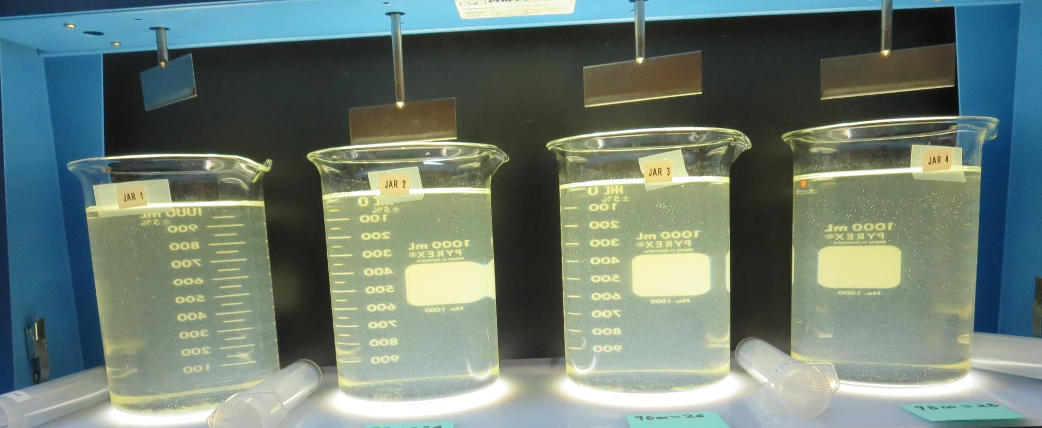
Jars 1-4: End of 10-minute flocculation (30 RPM) duration.
22mg/L 9800
Filtrate: 0.71 NTU
UVT: 87.6%
UVA: 0.057/cm
UVA Reduction: 65.2%
Settled: 3.3 NTU
24 mg/L 9800
Filtrate: 0.20 NTU
UVT: 91.0%
UVA: 0.041/cm
UVA Reduction: 75.0%
Settled: 2.9 NTU
26 mg/L 9800
Filtrate: 0.12 NTU
UVT: 91.9%
UVA: 0.037/cm
UVA Reduction: 77.5%
Settled: 2.3 NTU
28 mg/L 9800
Filtrate: 0.10 NTU
UVT: 92.4%
UVA: 0.034/cm
UVA Reduction: 77.5%
Settled: 1.9 NTU

Slide 17
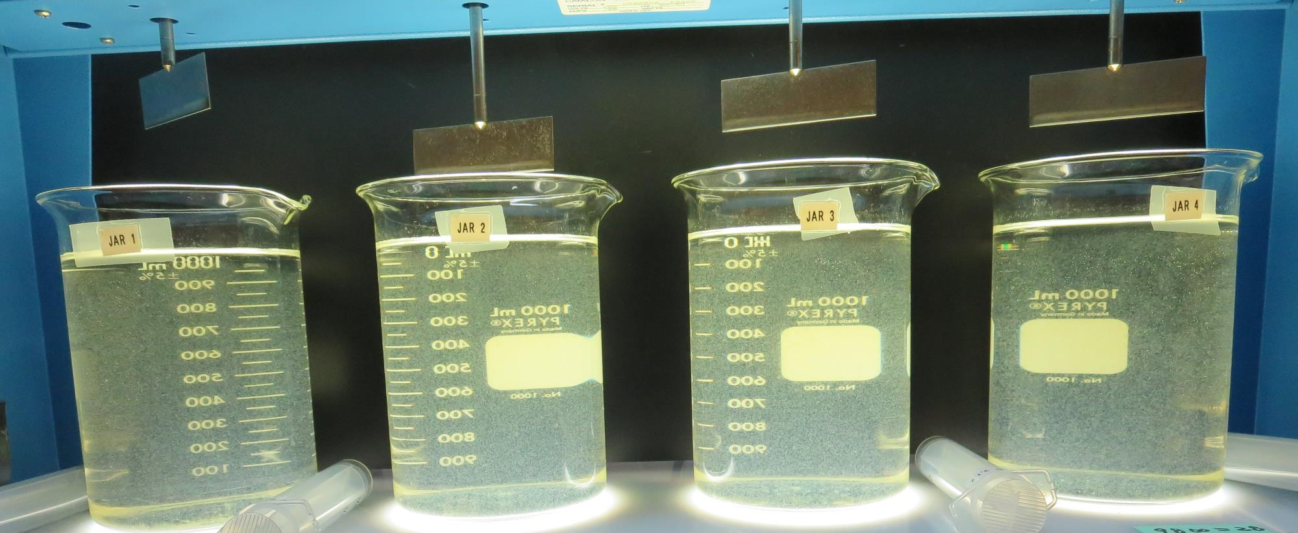
Jars 1-4: After 5 min of settling, 25 mL is syringed for filterability and %UVT/UVA

Slide 18
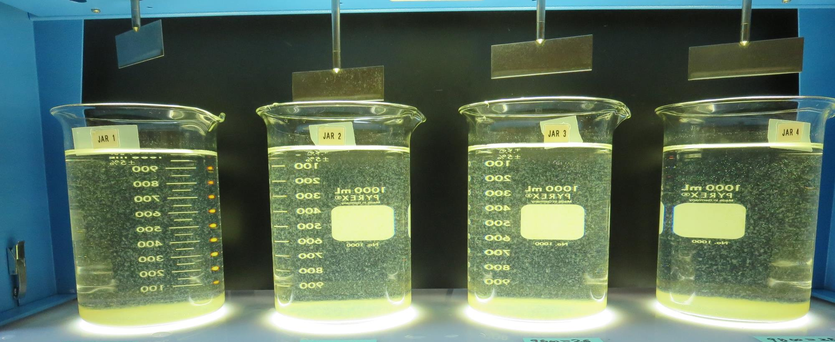
Jars 1-4: After 25-minutes of settling, settled water turbidity is taken.
22mg/L 9800
Filtrate: 0.71 NTU
UVT: 87.6%
UVA: 0.057/cm
UVA Reduction: 65.2%
Settled: 3.3 NTU
24 mg/L 9800
Filtrate: 0.20 NTU
UVT: 91.0%
UVA: 0.041/cm
UVA Reduction: 75.0%
Settled: 2.9 NTU
26 mg/L 9800
Filtrate: 0.12 NTU
UVT: 91.9%
UVA: 0.037/cm
UVA Reduction: 77.5%
Settled: 2.3 NTU
28 mg/L 9800
Filtrate: 0.10 NTU
UVT: 92.4%
UVA: 0.034/cm
UVA Reduction: 77.5%
Settled: 1.9 NTU

Slide 19
Jars 5-8 Test
Flash Mix 60 Sec (200 RPM)
Floc Mix 10 min (30 RPM)
Post NaMnO₄
Applied Coagulant
9800

Slide 20
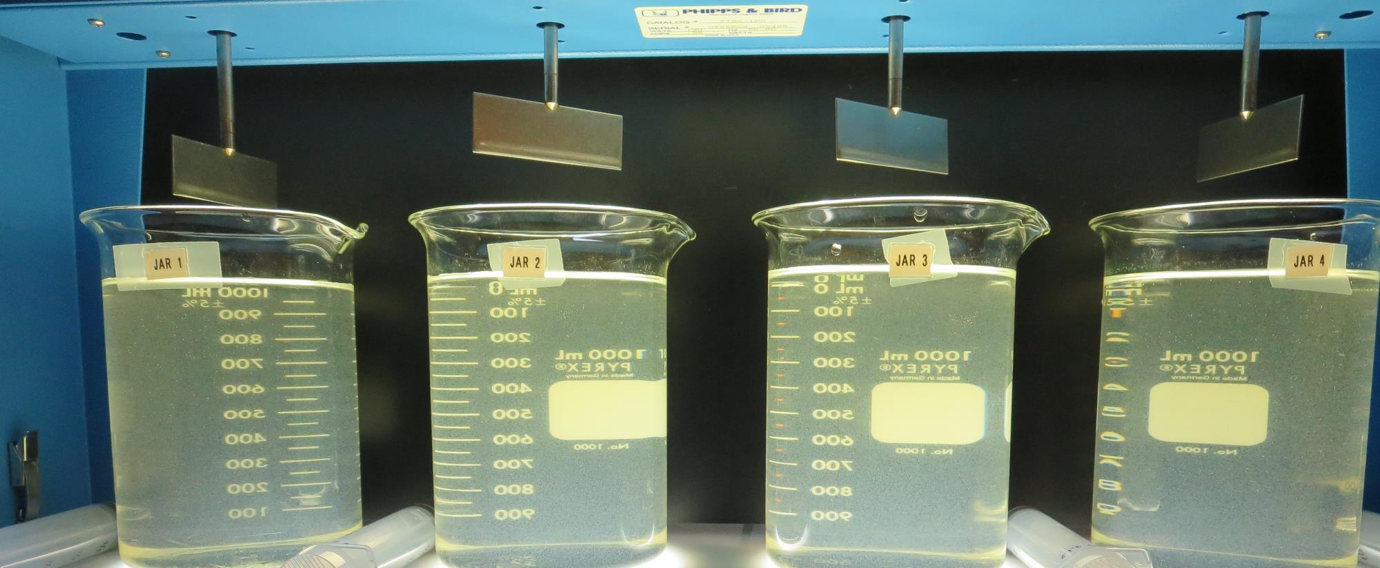
Jars 5-8: End of 10-minute flocculation (30 RPM) duration.
26 mg/L 9800
Filtrate: 0.11 NTU
UVT: 91.9%
UVA: 0.037/cm
UVA Reduction: 77.4%
Settled: 2.8 NTU
28 mg/L 9800
Filtrate: 0.07 NTU
UVT: 92.8%
UVA: 0.032/cm
UVA Reduction: 80.4%
Settled: 2.3 NTU
30 mg/L 9800
Filtrate: 0.08 NTU
UVT: 93.0%
UVA: 0.032/cm
UVA Reduction: 80.4%
Settled: 3.0 NTU
32 mg/L 9800
Filtrate: 0.08 NTU
UVT: 93.2%
UVA: 0.031/cm
UVA Reduction: 81.1%
Settled: 2.8 NTU

Slide 21
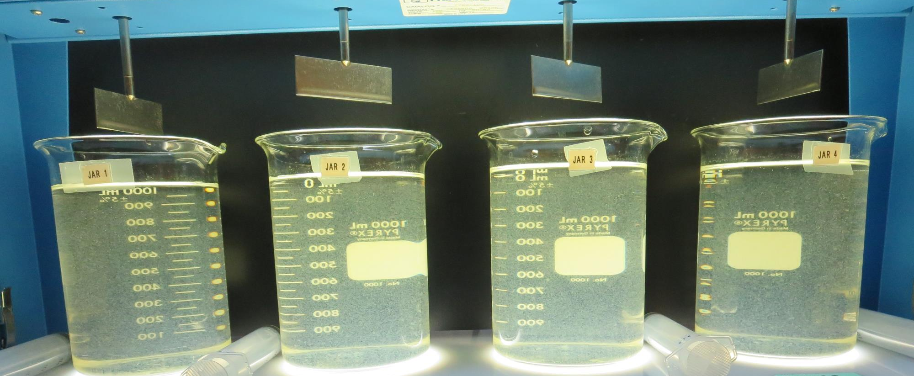
Jars 5-8: After 5 min of settling, 25 mL is syringed for filterability and %UVT/UVA

Slide 22
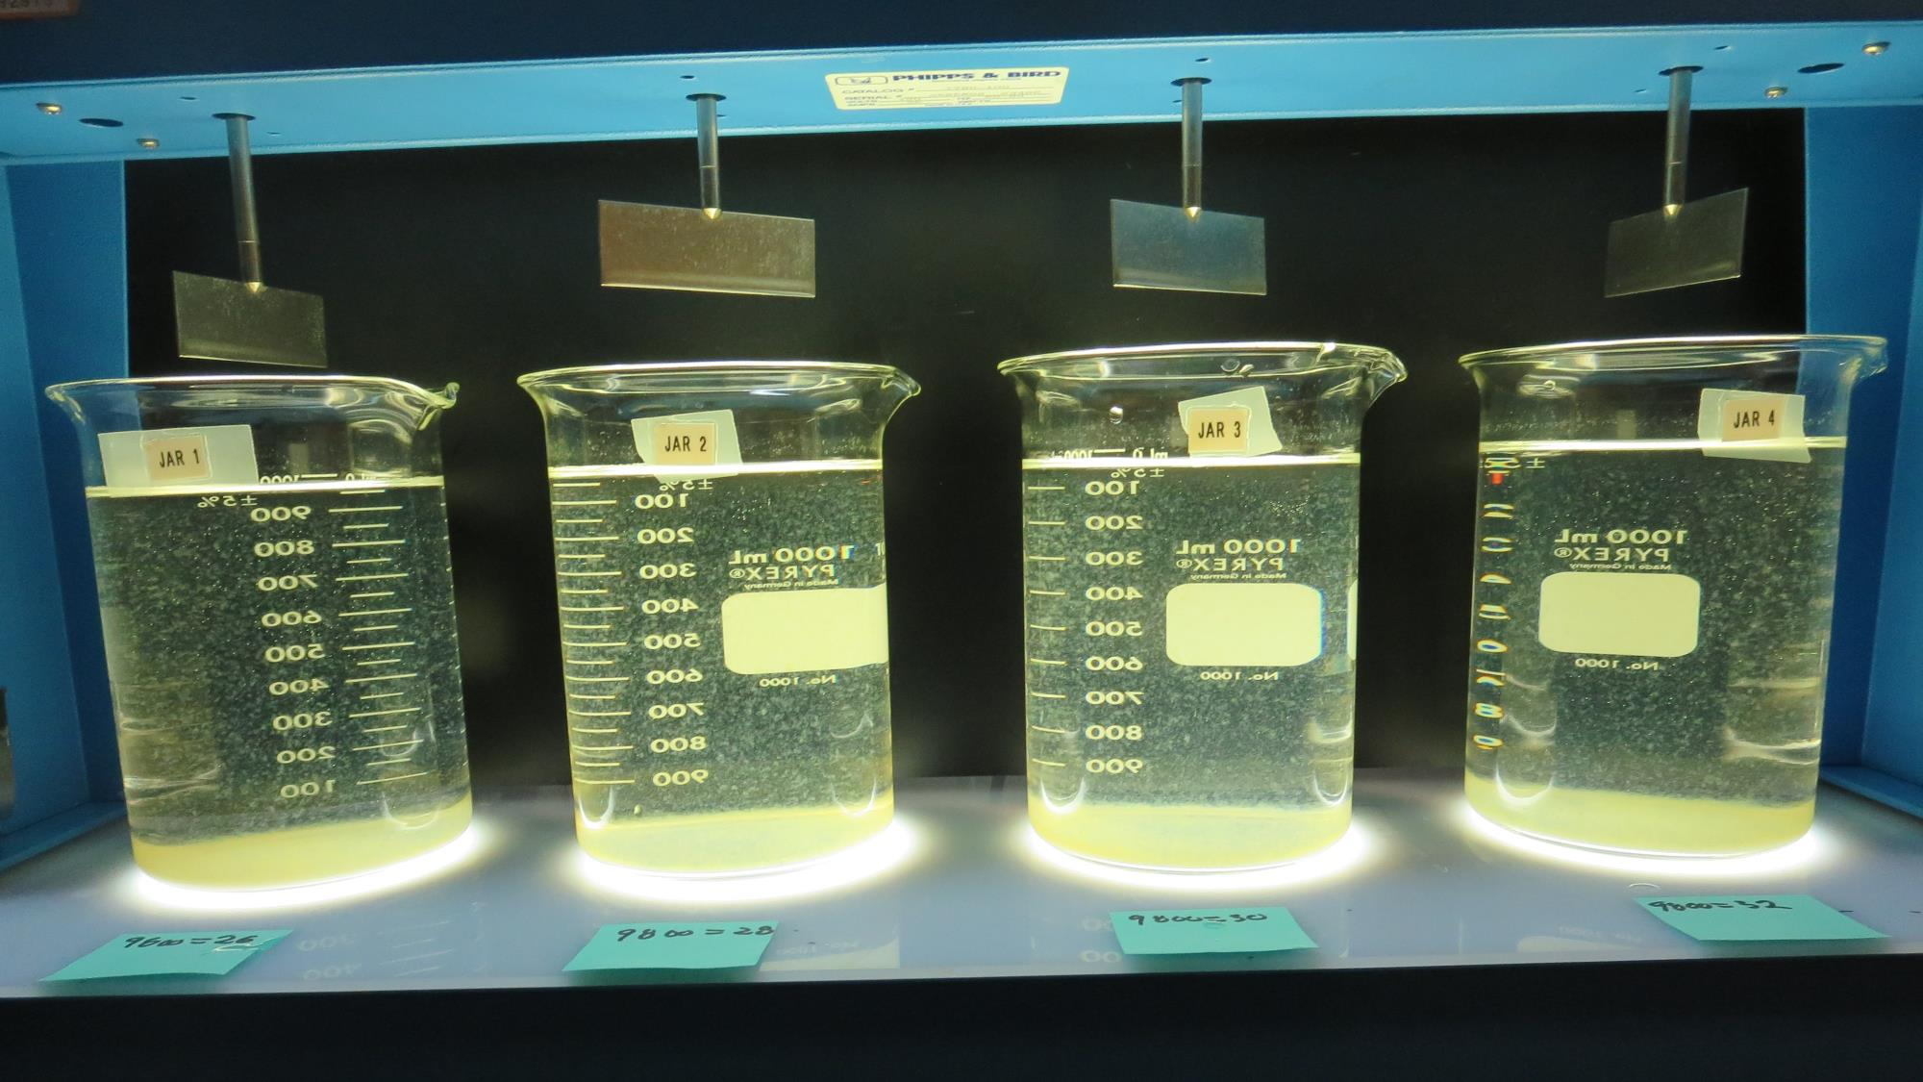
Jars 5-8: After 25-minutes of settling, settled water turbidity is taken.
26 mg/L 9800
Filtrate: 0.11 NTU
UVT: 91.9%
UVA: 0.037/cm
UVA Reduction: 77.4%
Settled: 2.8 NTU
28 mg/L 9800
Filtrate: 0.07 NTU
UVT: 92.8%
UVA: 0.032/cm
UVA Reduction: 80.4%
Settled: 2.3 NTU
30 mg/L 9800
Filtrate: 0.08 NTU
UVT: 93.0%
UVA: 0.032/cm
UVA Reduction: 80.4%
Settled: 3.0 NTU
32 mg/L 9800
Filtrate: 0.08 NTU
UVT: 93.2%
UVA: 0.031/cm
UVA Reduction: 81.1%
Settled: 2.8 NTU

Slide 23
Jars 9-12 Test
Flash Mix 60 Sec (200 RPM)
Floc Mix 10 min (30 RPM)
Post NaMnO₄
Applied Coagulant
9800 w/PAC

Slide 24
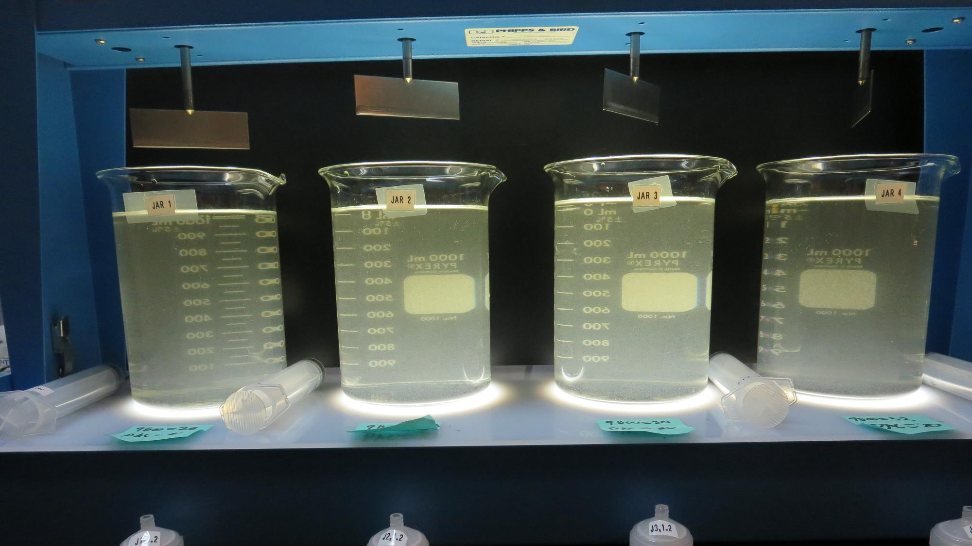
Jars 9-12: End of 10-minute flocculation (30 RPM) duration.
20 mg/L PAC
26 mg/L 9800
Filtrate: 0.07 NTU
UVT: 92.8%
UVA: 0.032/cm
UVA Reduction: 80.5%
Settled: 7.0 NTU
20 mg/L PAC
28 mg/L 9800
Filtrate: 0.18 NTU
UVT: 92.8%
UVA: 0.032/cm
UVA Reduction: 80.5%
Settled: 5.0 NTU
20 mg/L PAC
30 mg/L 9800
Filtrate: 0.07 NTU
UVT: 93.4%
UVA: 0.030/cm
UVA Reduction: 81.7%
Settled: 4.4 NTU
20 mg/L PAC
32 mg/L 9800
Filtrate: 0.49 NTU
UVT: 93.1%
UVA: 0.031/cm
UVA Reduction: 81.1%
Settled: 5.4 NTU

Slide 25
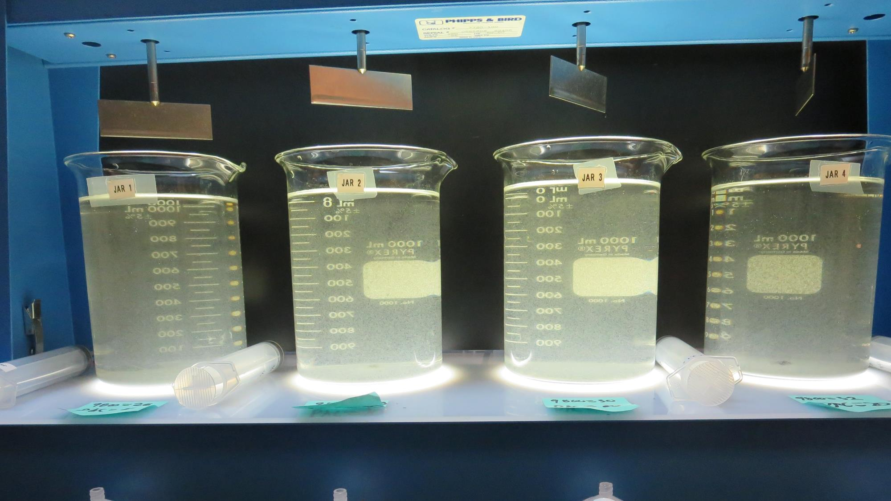
Jars 9-12: After 5 min of settling, 25 mL is syringed for filterability and %UVT/UVA

Slide 26
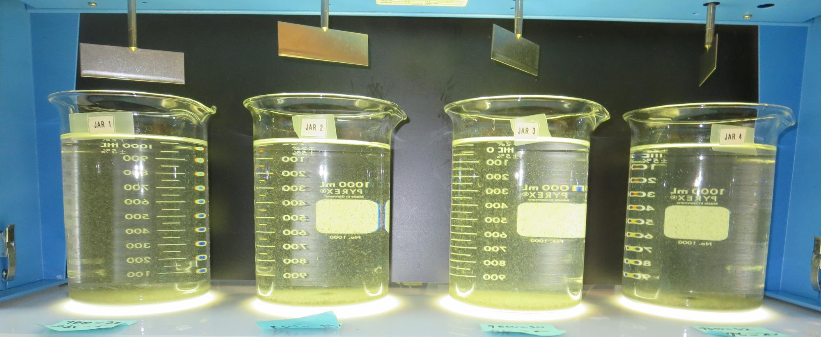
Jars 9-12: After 25-minutes of settling, settled water turbidity is taken.
20 mg/L PAC
26 mg/L 9800
Filtrate: 0.07 NTU
UVT: 92.8%
UVA: 0.032/cm
UVA Reduction: 80.5%
Settled: 7.0 NTU
20 mg/L PAC
28 mg/L 9800
Filtrate: 0.18 NTU
UVT: 92.8%
UVA: 0.032/cm
UVA Reduction: 80.5%
Settled: 5.0 NTU
20 mg/L PAC
30 mg/L 9800
Filtrate: 0.07 NTU
UVT: 93.4%
UVA: 0.030/cm
UVA Reduction: 81.7%
Settled: 4.4 NTU
20 mg/L PAC
32 mg/L 9800
Filtrate: 0.49 NTU
UVT: 93.1%
UVA: 0.031/cm
UVA Reduction: 81.1%
Settled: 5.4 NTU

Slide 27
Jars 13-16 Test
Flash Mix 60 Sec (200 RPM)
Floc Mix 10 min (30 RPM)
Post NaMnO₄
Applied Coagulants
9800/926 w/NaOCl

Slide 28
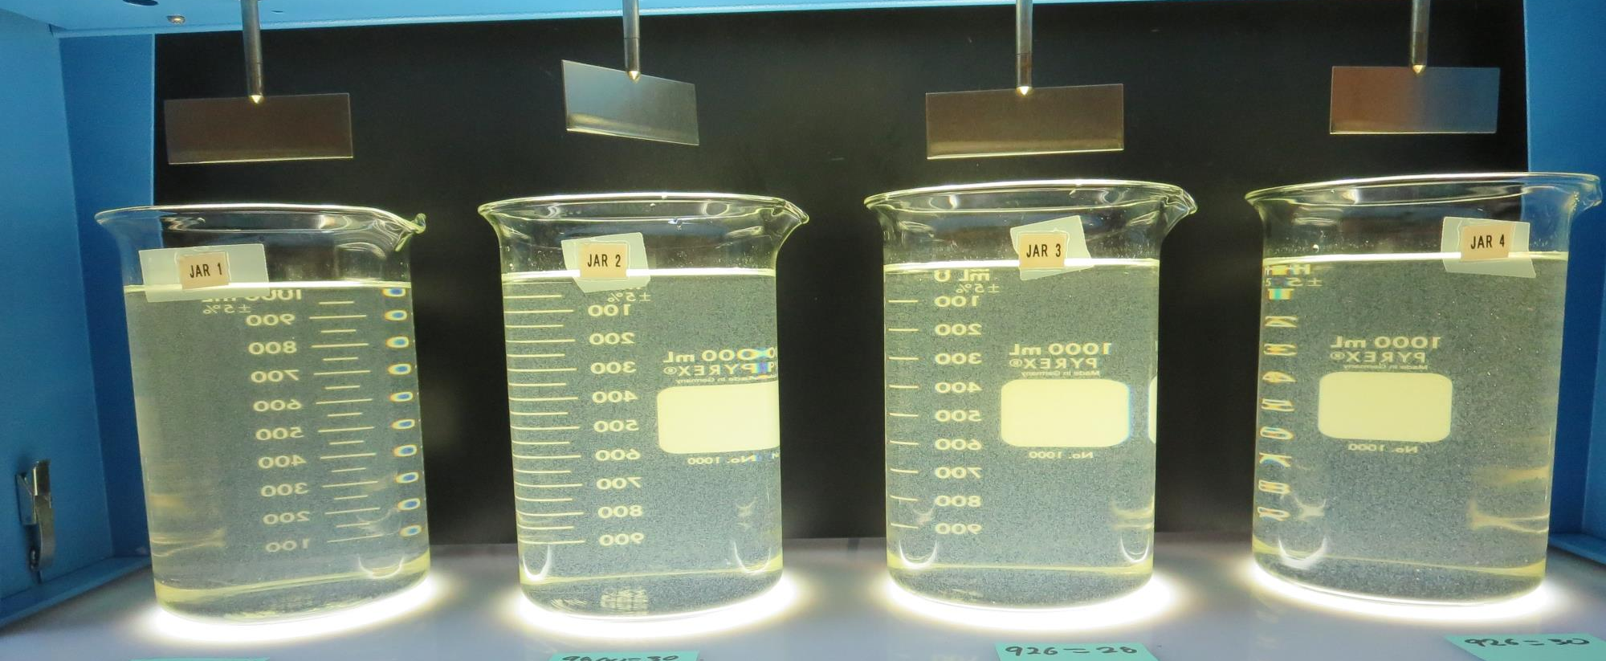
Jars 13-16: End of 10-minute flocculation (30 RPM) duration.
1.5 mg/L NaOCl
28 mg/L 9800
Filtrate: 0.73 NTU
UVT: 89.0%
UVA: 0.051/cm
UVA Reduction: 68.9%
Settled: 1.8 NTU
1.5 mg/L NaOCl
30 mg/L 9800
Filtrate: 0.62 NTU
UVT: 90.4%
UVA: 0.044/cm
UVA Reduction: 73.2%
Settled: 1.7 NTU
0 mg/L NaOCl
28 mg/L 926
Filtrate: 0.47 NTU
UVT: 90.4%
UVA: 0.045/cm
UVA Reduction: 72.6%
Settled: 1.8 NTU
0 mg/L NaOCl
30 mg/L 926
Filtrate: 0.39 NTU
UVT: 91.2%
UVA: 0.040/cm
UVA Reduction: 75.6%
Settled: 1.6 NTU

Slide 29
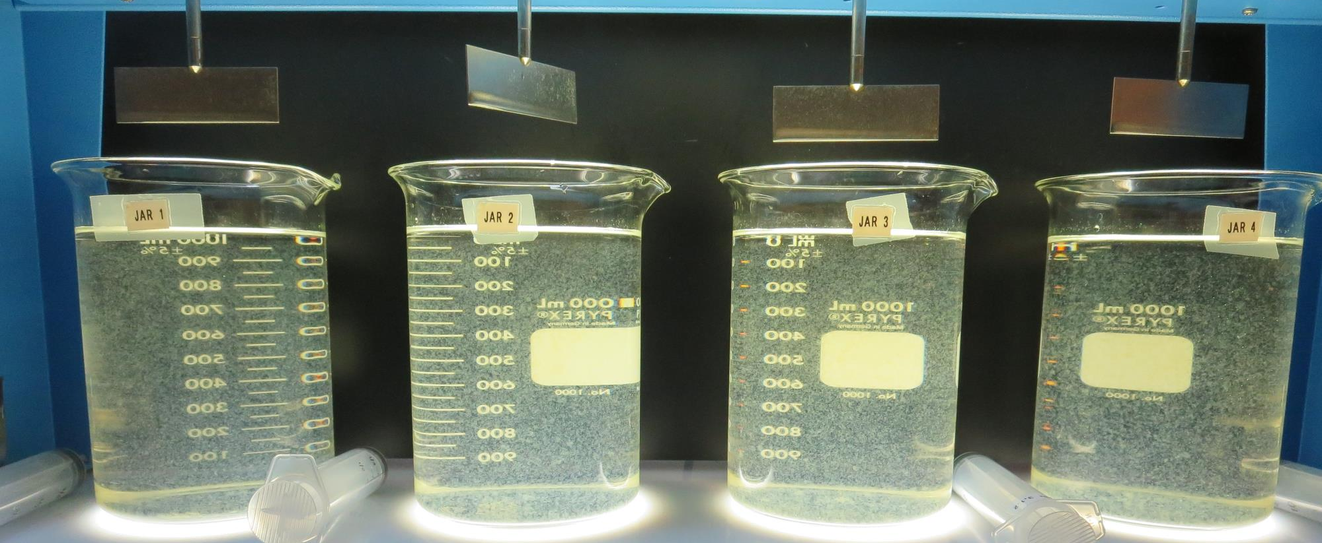
Jars 13-16: After 5 min of settling, 25 mL is syringed for filterability and %UVT/UVA

Slide 30
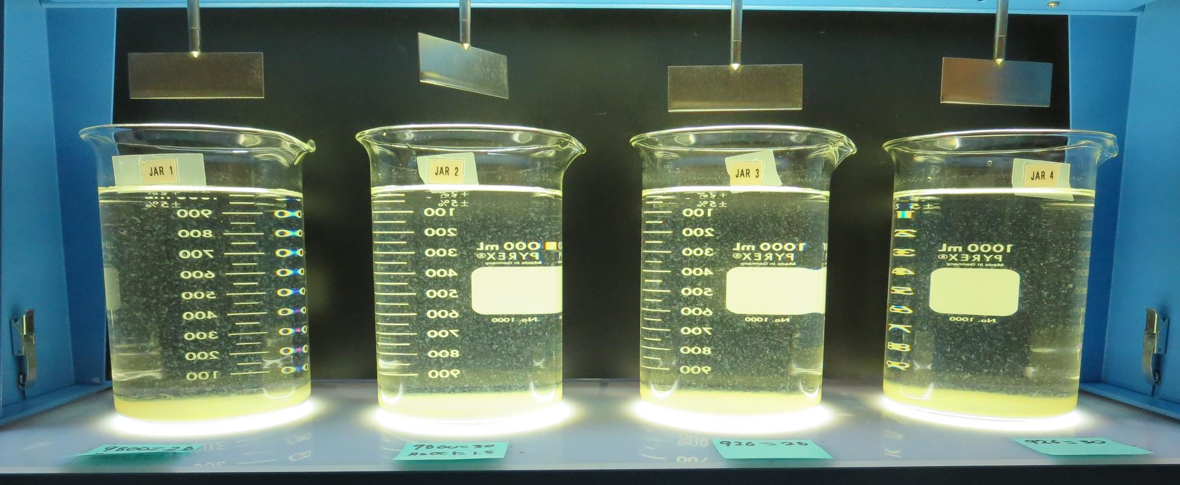
Jars 13-16: After 25-minutes of settling, settled water turbidity is taken.
1.5 mg/L NaOCl
28 mg/L 9800
Filtrate: 0.73 NTU
UVT: 89.0%
UVA: 0.051/cm
UVA Reduction: 68.9%
Settled: 1.8 NTU
1.5 mg/L NaOCl
30 mg/L 9800
Filtrate: 0.62 NTU
UVT: 90.4%
UVA: 0.044/cm
UVA Reduction: 73.2%
Settled: 1.7 NTU
0 mg/L NaOCl
28 mg/L 926
Filtrate: 0.47 NTU
UVT: 90.4%
UVA: 0.045/cm
UVA Reduction: 72.6%
Settled: 1.8 NTU
0 mg/L NaOCl
30 mg/L 926
Filtrate: 0.39 NTU
UVT: 91.2%
UVA: 0.040/cm
UVA Reduction: 75.6%
Settled: 1.6 NTU

Slide 31
Jars 17-20 Test
Flash Mix 60 Sec (200 RPM)
Floc Mix 10 min (30 RPM)
Post NaMnO₄
Applied Coagulant
926

Slide 32
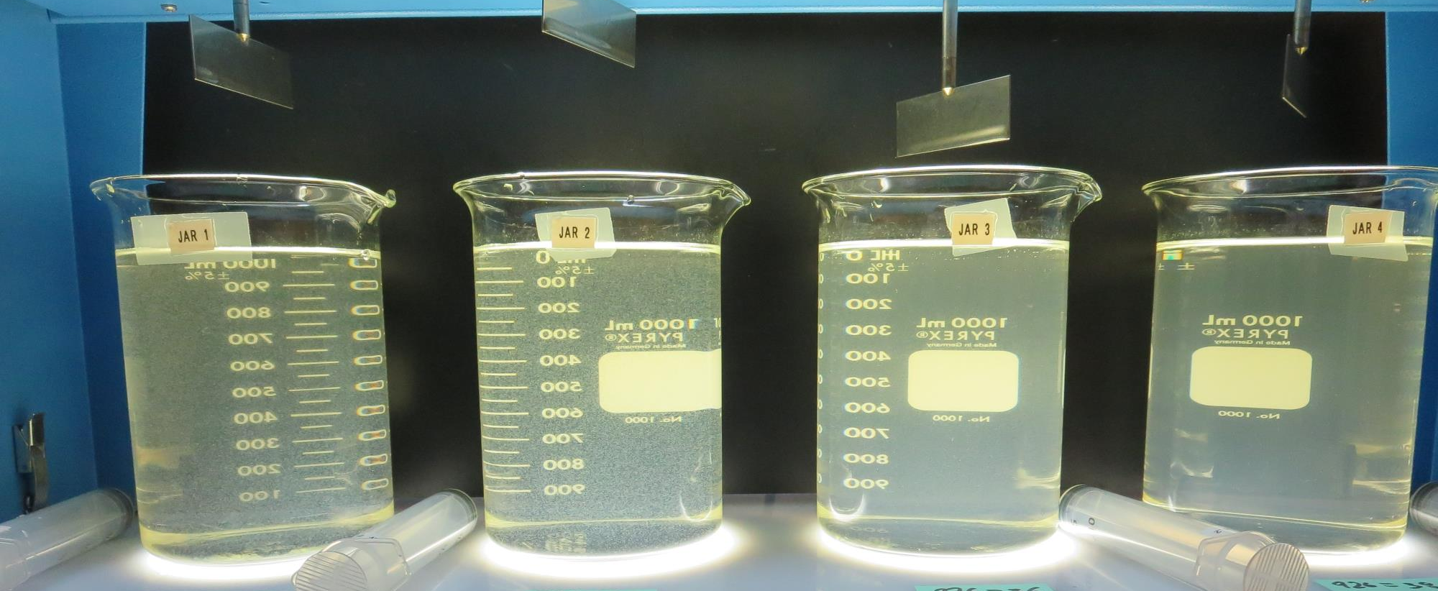
Jars 17-20: End of 10-minute flocculation (30 RPM) duration.
32 mg/L 926
Filtrate: 0.07 NTU
UVT: 93.3%
UVA: 0.030/cm
UVA Reduction: 81.7%
Settled: 3.4 NTU
34 mg/L 926
Filtrate: 0.05 NTU
UVT: 93.9%
UVA: 0.027/cm
UVA Reduction: 83.5%
Settled: 3.1 NTU
36 mg/L 926
Filtrate: 0.23 NTU
UVT: 92.8%
UVA: 0.032/cm
UVA Reduction: 80.5%
Settled: 6.1 NTU
38 mg/L 926
Filtrate: 0.12 NTU
UVT: 93.8%
UVA: 0.028/cm
UVA Reduction: 82.9%
Settled: 6.3 NTU

Slide 33
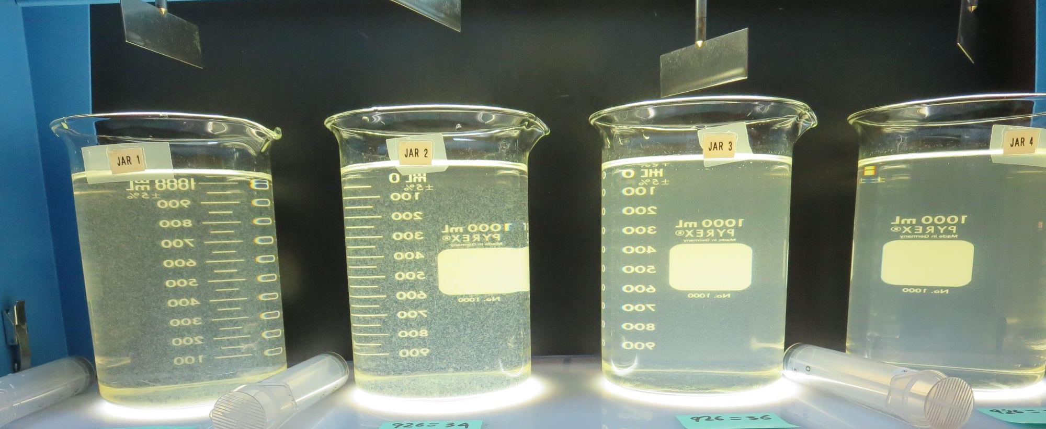
Jars 17-20: After 5 min of settling, 25 mL is syringed for filterability and %UVT/UVA

Slide 34
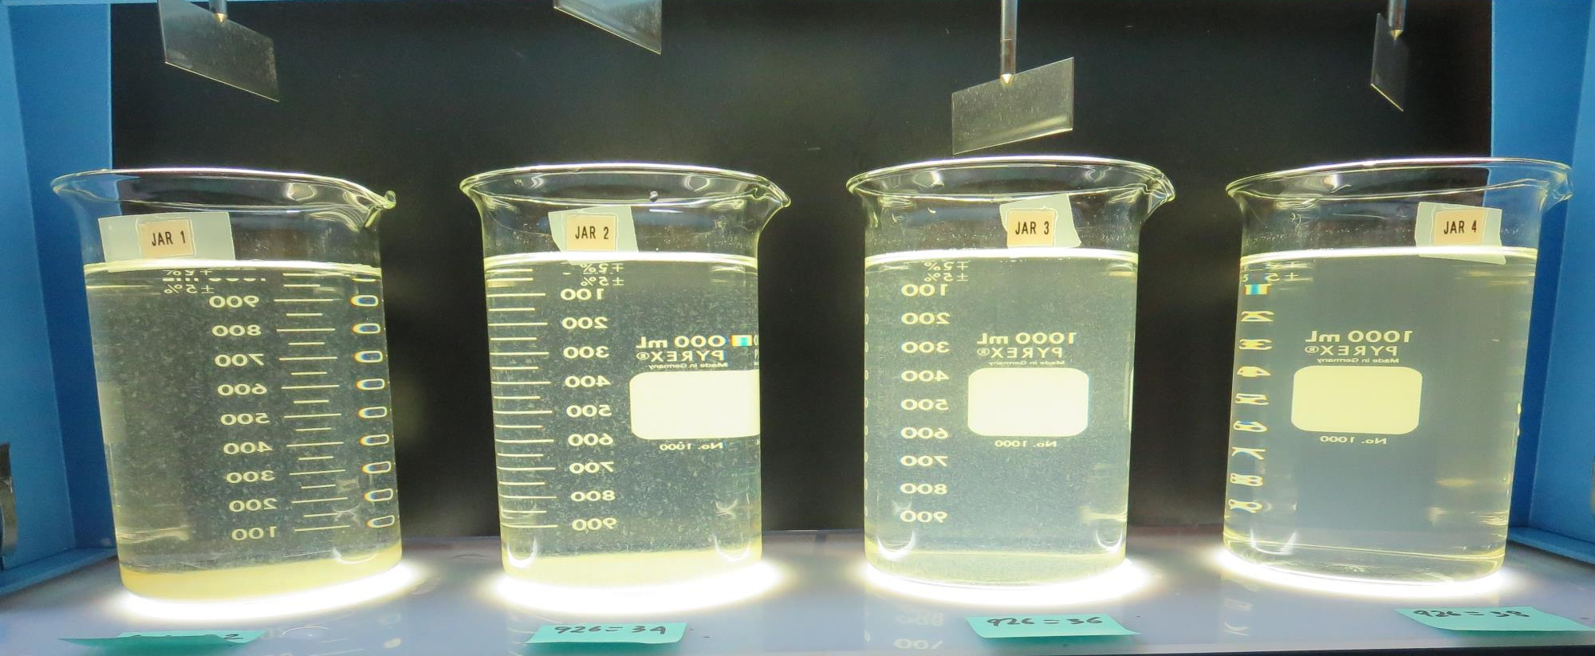
Jars 17-20: After 25-minutes of settling, settled water turbidity is taken.
32 mg/L 926
Filtrate: 0.07 NTU
UVT: 93.3%
UVA: 0.030/cm
UVA Reduction: 81.7%
Settled: 3.4 NTU
34 mg/L 926
Filtrate: 0.05 NTU
UVT: 93.9%
UVA: 0.027/cm
UVA Reduction: 83.5%
Settled: 3.1 NTU
36 mg/L 926
Filtrate: 0.23 NTU
UVT: 92.8%
UVA: 0.032/cm
UVA Reduction: 80.5%
Settled: 6.1 NTU
38 mg/L 926
Filtrate: 0.12 NTU
UVT: 93.8%
UVA: 0.028/cm
UVA Reduction: 82.9%
Settled: 6.3 NTU

Slide 35
Jars 21-24 Test
Flash Mix 60 Sec (200 RPM)
Floc Mix 10 min (30 RPM)
Post NaMnO₄
Applied Coagulants
Alum/8170

Slide 36
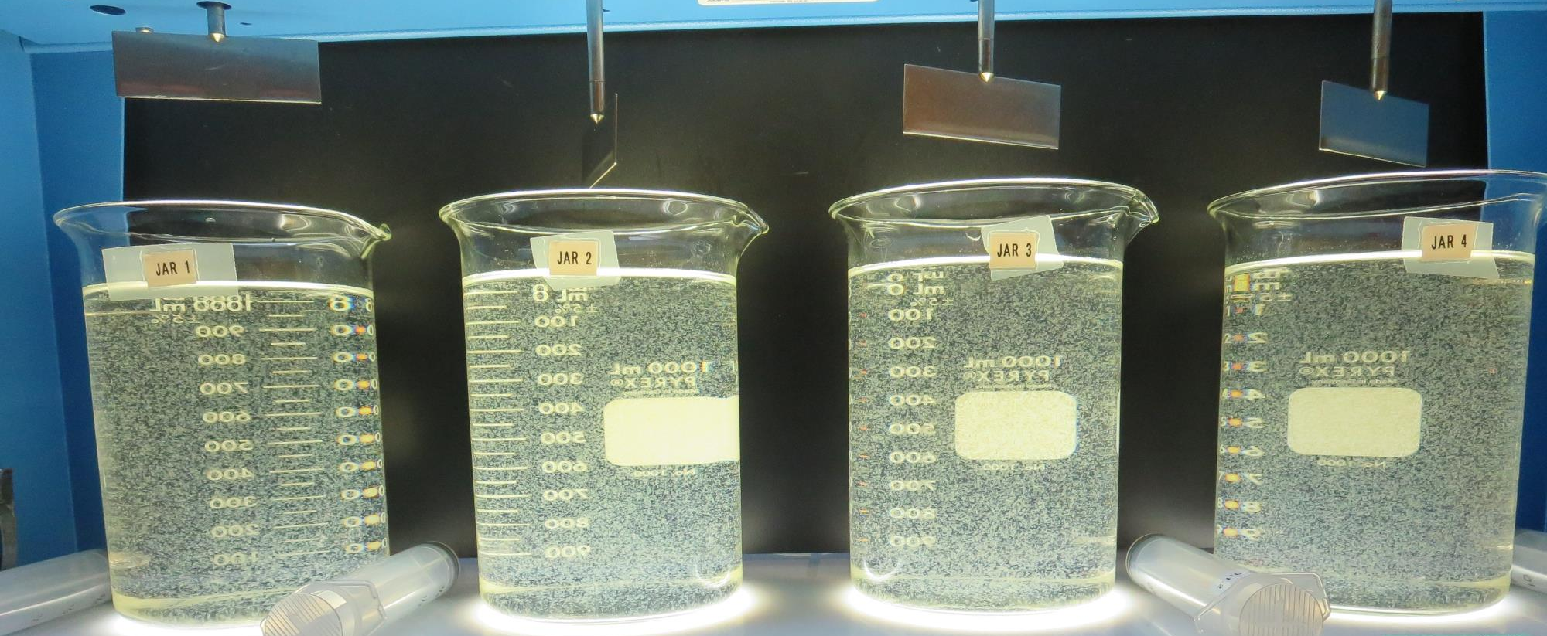
Jars 21-24: End of 10-minute flocculation (30 RPM) duration.
28 mg/L Alum
0.2 mg/L 8170
Filtrate: 0.06 NTU
0 mg/L PAC
UVT: 92.1%
UVA: 0.036/cm
UVA Reduction: 78.0%
Settled: 1.6 NTU
30 mg/L Alum
0.2 mg/L 8170
Filtrate: 0.06 NTU
0 mg/L PAC
UVT: 92.9%
UVA: 0.032/cm
UVA Reduction: 80.5%
Settled: 1.6 NTU
28 mg/L Alum
0.2 mg/L 8170
20 mg/L PAC
Filtrate: 0.09 NTU
UVT: 92.2%
UVA: 0.035/cm
UVA Reduction: 78.7%
Settled: 2.2 NTU
28 mg/L Alum
0.2 mg/L 8170
20 mg/L PAC
Filtrate: 0.11 NTU
UVT: 92.6%
UVA: 0.033/cm
UVA Reduction: 79.9%
Settled: 1.7 NTU

Slide 37
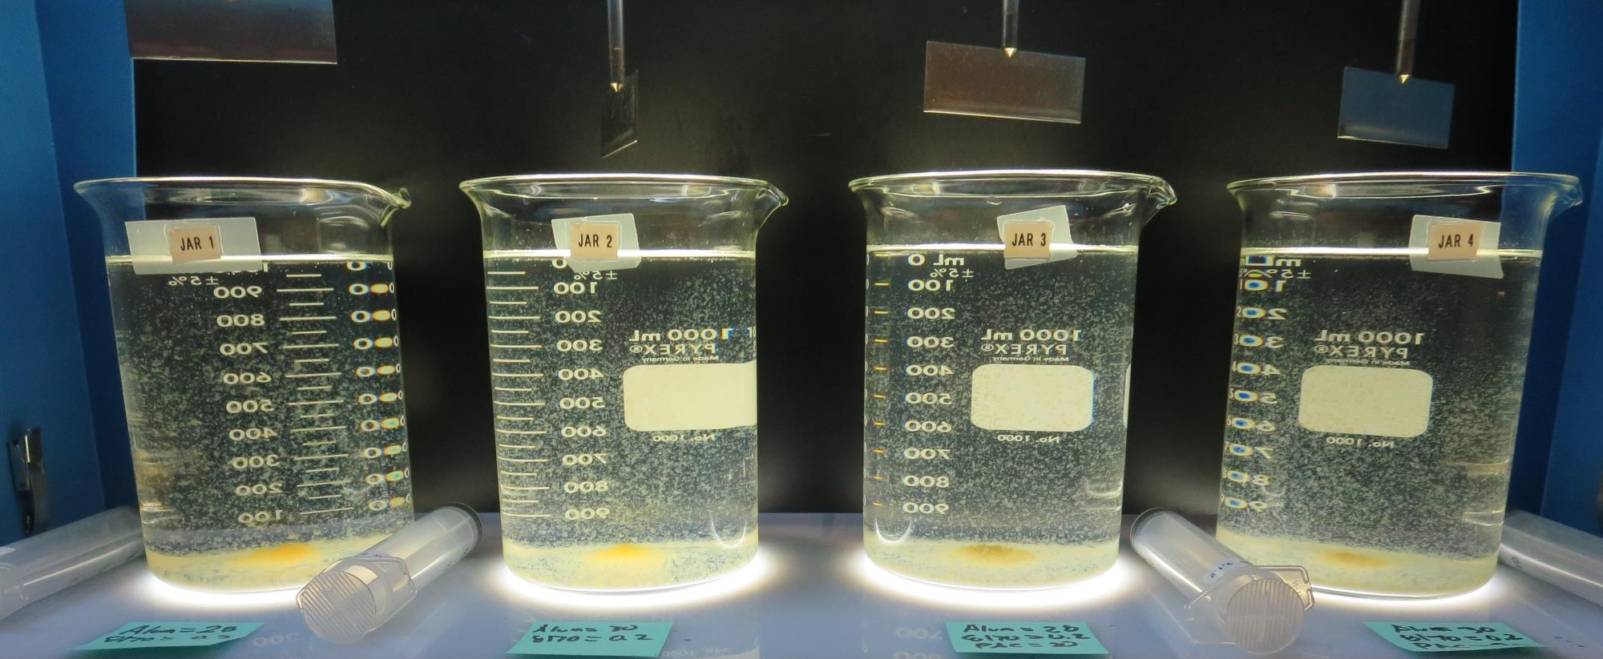
Jars 21-24: After 5 min of settling, 25 mL is syringed for filterability and %UVT/UVA

Slide 38
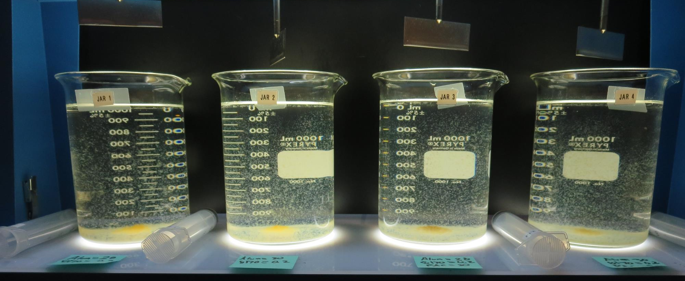
Jars 21-24: After 25-minutes of settling, settled water turbidity is taken.
28 mg/L Alum
0.2 mg/L 8170
Filtrate: 0.06 NTU
0 mg/L PAC
UVT: 92.1%
UVA: 0.036/cm
UVA Reduction: 78.0%
Settled: 1.6 NTU
30 mg/L Alum
0.2 mg/L 8170
Filtrate: 0.06 NTU
0 mg/L PAC
UVT: 92.9%
UVA: 0.032/cm
UVA Reduction: 80.5%
Settled: 1.6 NTU
28 mg/L Alum
0.2 mg/L 8170
20 mg/L PAC
Filtrate: 0.09 NTU
UVT: 92.2%
UVA: 0.035/cm
UVA Reduction: 78.7%
Settled: 2.2 NTU
28 mg/L Alum
0.2 mg/L 8170
20 mg/L PAC
Filtrate: 0.11 NTU
UVT: 92.6%
UVA: 0.033/cm
UVA Reduction: 79.9%
Settled: 1.7 NTU

Slide 39
Jars 25-28 Test
Flash Mix 60 Sec (200 RPM)
Floc Mix 10 min (30 RPM)
Pre-NaMnO₄
Applied Coagulants
Alum/8170

Slide 40
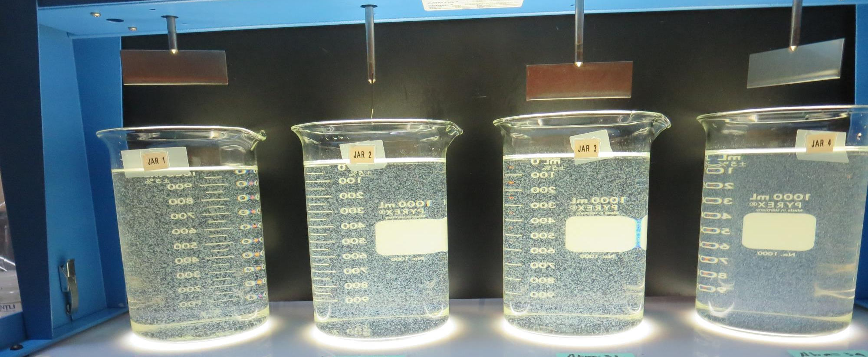
Jars 25-28: End of 10-minute flocculation (30 RPM) duration.
28 mg/L Alum
0.2 mg/L 8170
Filtrate: 0.19 NTU
UVT: 92.1%
UVA: 0.035/cm
UVA Reduction: 78.7%
Settled: 1.8 NTU
30 mg/L Alum
0.2 mg/L 8170
Filtrate: 0.17 NTU
UVT: 92.5%
UVA: 0.034/cm
UVA Reduction: 79.3%
Settled: 1.6 NTU
32 mg/L Alum
0.2 mg/L 8170
Filtrate: 0.07 NTU
UVT: 92.4%
UVA: 0.034/cm
UVA Reduction: 79.3%
Settled: 1.8 NTU
34 mg/L Alum
0.2 mg/L 8170
Filtrate: 0.07 NTU
UVT: 93.2%
UVA: 0.031/cm
UVA Reduction: 81.1%
Settled: 3.8 NTU

Slide 41
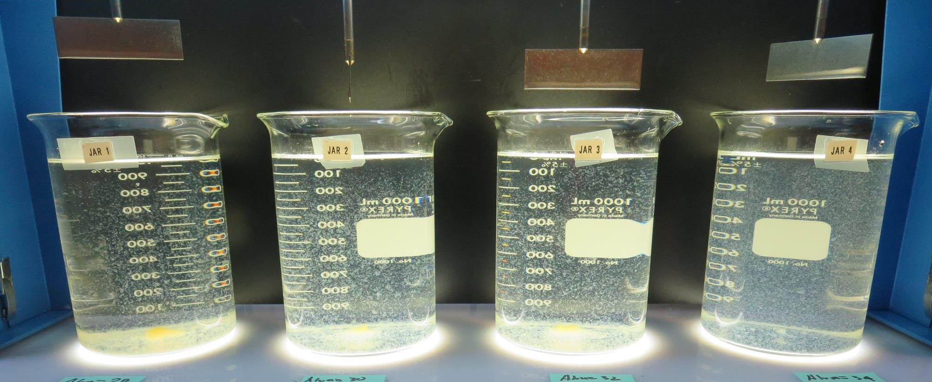
Jars 25-28: After 5 min of settling, 25 mL is syringed for filterability and %UVT/UVA

Slide 42
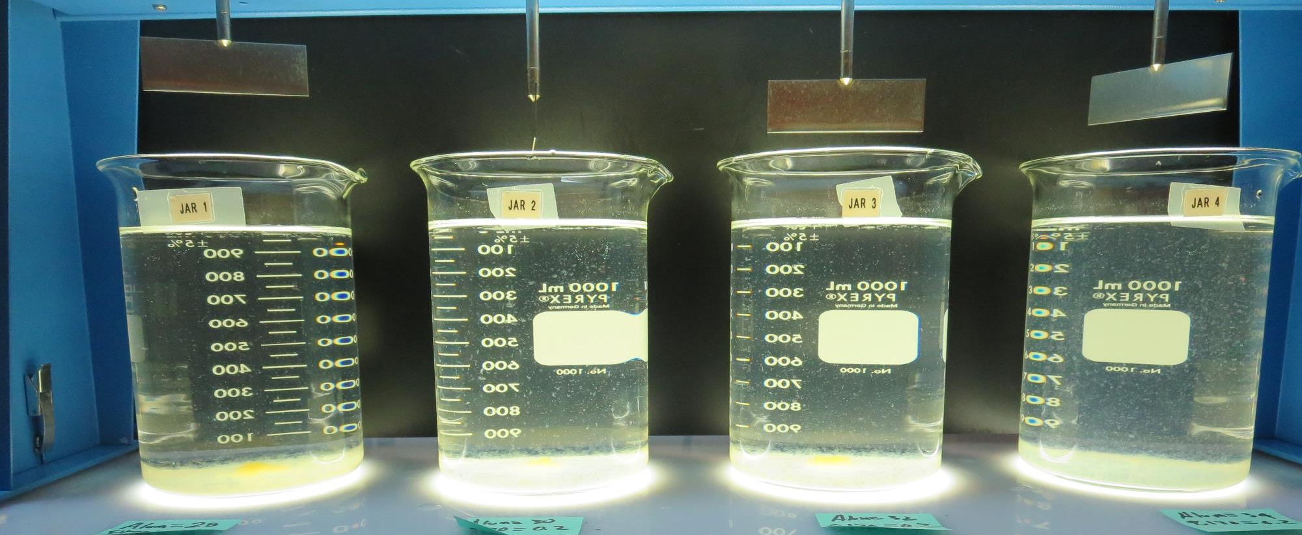
Jars 25-28: After 25-minutes of settling, settled water turbidity is taken.
28 mg/L Alum
0.2 mg/L 8170
Filtrate: 0.19 NTU
UVT: 92.1%
UVA: 0.035/cm
UVA Reduction: 78.7%
Settled: 1.8 NTU
30 mg/L Alum
0.2 mg/L 8170
Filtrate: 0.17 NTU
UVT: 92.5%
UVA: 0.034/cm
UVA Reduction: 79.3%
Settled: 1.6 NTU
32 mg/L Alum
0.2 mg/L 8170
Filtrate: 0.07 NTU
UVT: 92.4%
UVA: 0.034/cm
UVA Reduction: 79.3%
Settled: 1.8 NTU
34 mg/L Alum
0.2 mg/L 8170
Filtrate: 0.07 NTU
UVT: 93.2%
UVA: 0.031/cm
UVA Reduction: 81.1%
Settled: 3.8 NTU

Slide 43
Jars 29-32 Test
Flash Mix 60 Sec (200 RPM)
Floc Mix 10 min (30 RPM)
Pre-NaMnO₄
Applied Coagulant
926

Slide 44
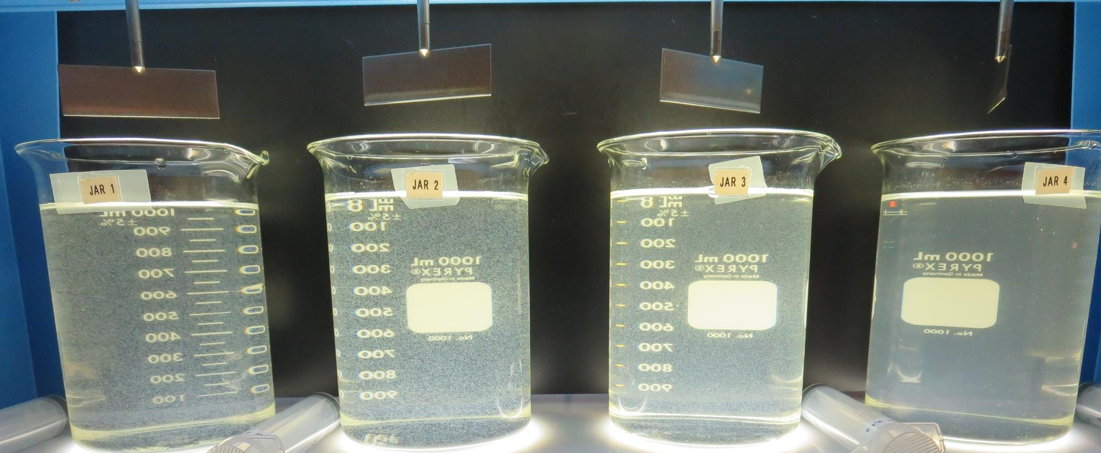
Jars 29-32: End of 10-minute flocculation (30 RPM) duration.
32 mg/L 926
Filtrate: 0.43 NTU
UVT: 90.8%
UVA: 0.042/cm
UVA Reduction: 74.4%
Settled: 1.8 NTU
34 mg/L 926
Filtrate: 0.06 NTU
UVT: 93.7%
UVA: 0.028/cm
UVA Reduction: 82.9%
Settled: 2.2 NTU
36 mg/L 926
Filtrate: 0.63 NTU
UVT: 90.5%
UVA: 0.043/cm
UVA Reduction: 73.8%
Settled: 3.5 NTU
38 mg/L 926
Filtrate: 0.50 NTU
UVT: 91.3%
UVA: 0.040/cm
UVA Reduction: 75.6%
Settled: 6.4 NTU

Slide 45
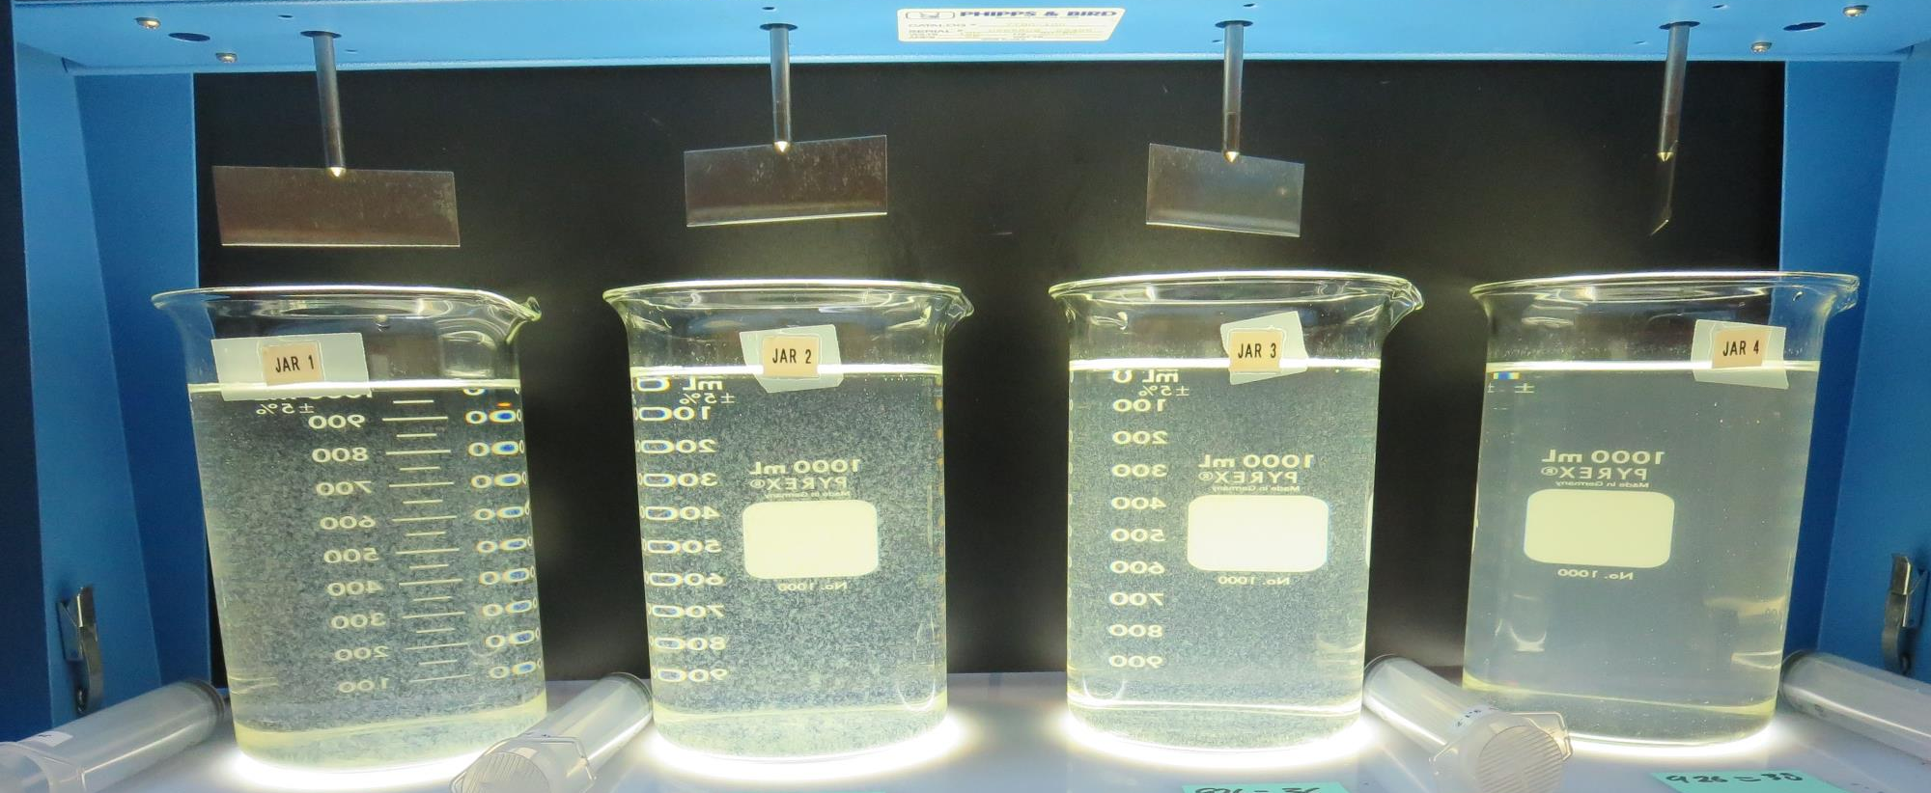
Jars 29-32: After 5 min of settling, 25 mL is syringed for filterability and %UVT/UVA

Slide 46
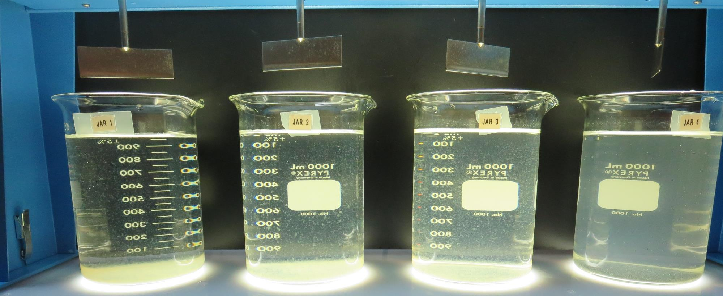
Jars 29-32: After 25-minutes of settling, settled water turbidity is taken.
32 mg/L 926
Filtrate: 0.43 NTU
UVT: 90.8%
UVA: 0.042/cm
UVA Reduction: 74.4%
Settled: 1.8 NTU
34 mg/L 926
Filtrate: 0.06 NTU
UVT: 93.7%
UVA: 0.028/cm
UVA Reduction: 82.9%
Settled: 2.2 NTU
36 mg/L 926
Filtrate: 0.63 NTU
UVT: 90.5%
UVA: 0.043/cm
UVA Reduction: 73.8%
Settled: 3.5 NTU
38 mg/L 926
Filtrate: 0.50 NTU
UVT: 91.3%
UVA: 0.040/cm
UVA Reduction: 75.6%
Settled: 6.4 NTU

Slide 47
Jars 33-36 Test
Flash Mix 60 Sec (200 RPM)
Floc Mix 10 min (30 RPM)
Pre-NaMnO₄
Applied Coagulant
926

Slide 48
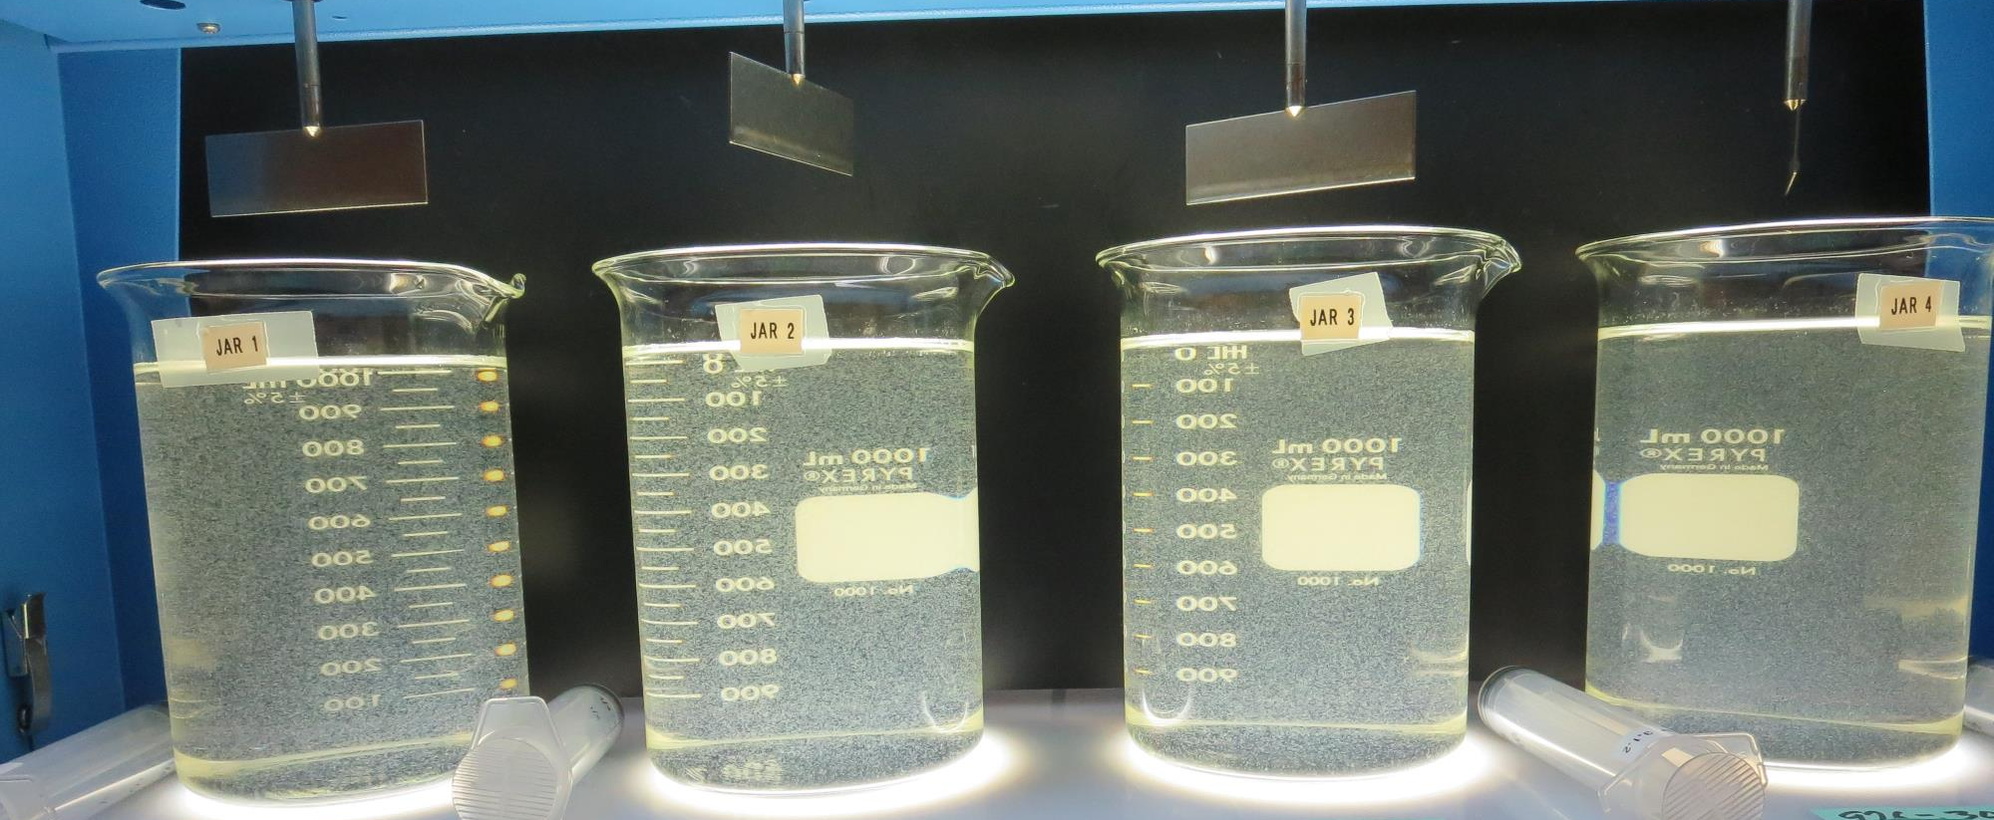
Jars 33-36: End of 10-minute flocculation (30 RPM) duration.
33 mg/L 926
Filtrate: 0.11 NTU
UVT: 93.2%
UVA: 0.031/cm
UVA Reduction: 81.1%
Settled: 1.9 NTU
33 mg/L 926
Filtrate: 0.07 NTU
UVT: 93.4%
UVA: 0.030/cm
UVA Reduction: 81.7%
Settled: 1.8 NTU
34 mg/L 926
Filtrate: 0.07 NTU
UVT: 93.2%
UVA: 0.031/cm
UVA Reduction: 81.1%
Settled: 2.5 NTU
34 mg/L 926
Filtrate: 0.06 NTU
UVT: 94.0%
UVA: 0.027/cm
UVA Reduction: 83.5%
Settled: 2.9 NTU

Slide 49
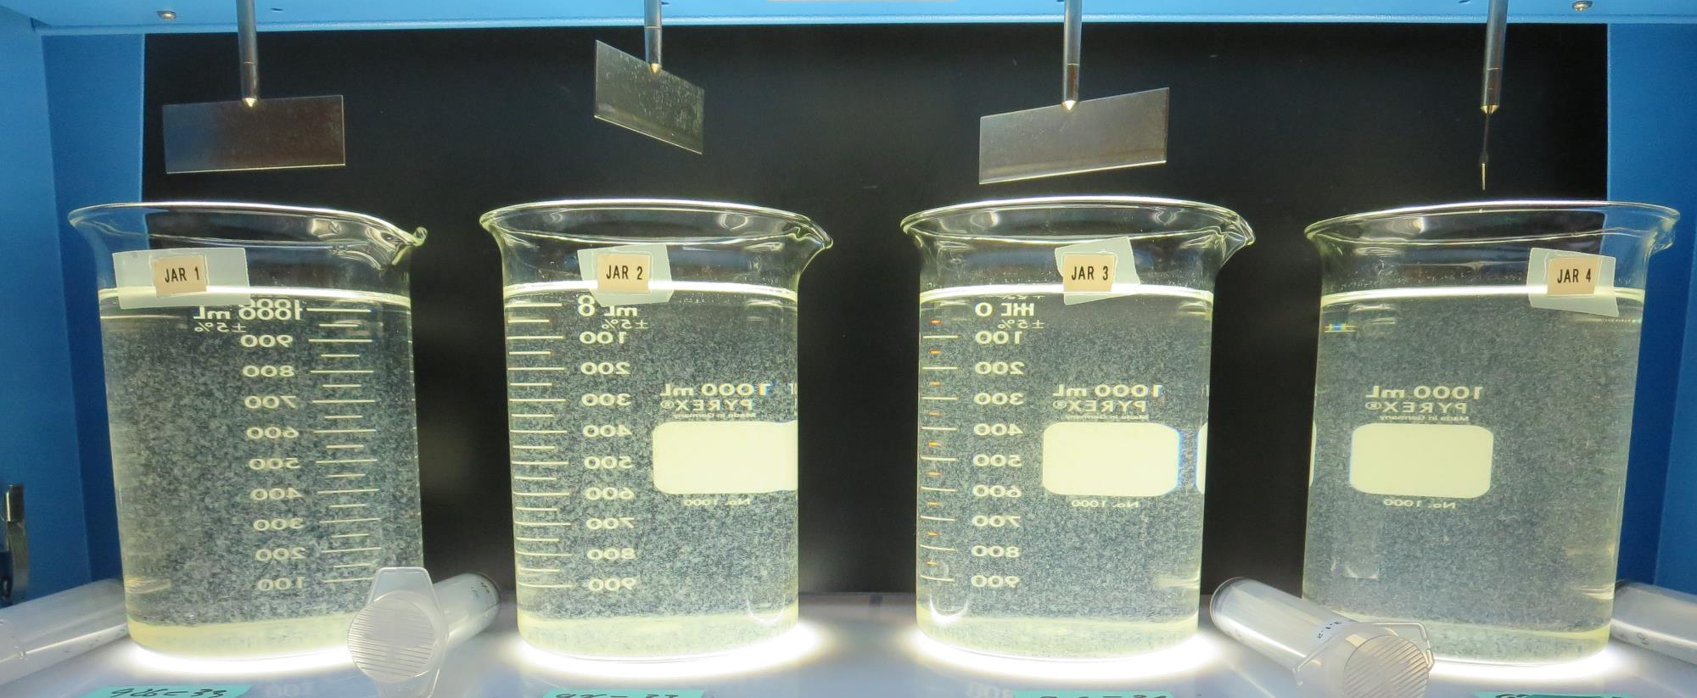
Jars 33-36: After 5 min of settling, 25 mL is syringed for filterability and %UVT/UVA

Slide 50
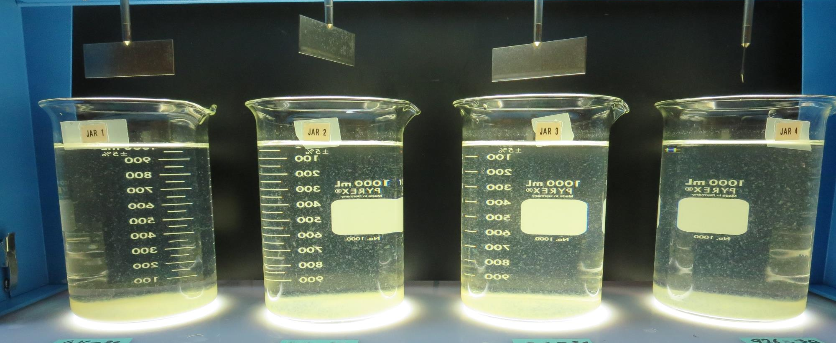
Jars 33-36: After 25-minutes of settling, settled water turbidity is taken.
33 mg/L 926
Filtrate: 0.11 NTU
UVT: 93.2%
UVA: 0.031/cm
UVA Reduction: 81.1%
Settled: 1.9 NTU
33 mg/L 926
Filtrate: 0.07 NTU
UVT: 93.4%
UVA: 0.030/cm
UVA Reduction: 81.7%
Settled: 1.8 NTU
34 mg/L 926
Filtrate: 0.07 NTU
UVT: 93.2%
UVA: 0.031/cm
UVA Reduction: 81.1%
Settled: 2.5 NTU
34 mg/L 926
Filtrate: 0.06 NTU
UVT: 94.0%
UVA: 0.027/cm
UVA Reduction: 83.5%
Settled: 2.9 NTU

Slide 51
Jar Testing for 1-Liter Jars:
Procedures for Most Treatment Plants
Fill jars with source water prior to coagulant injection and set paddle speed at 30 rpm
Add chemicals (i.e., NaOCl, primary coagulant, coagulant aid) to each jar
Flash mix for 15-60 seconds (200 rpm)
Slow mix for 5 minutes (20-30 rpm)
Settled for 5 minutes. Syringe 25 mL from each jar taken 1-inch below surface (25 mL/12 sec rate)
Filtered through 1.2 um isopore membrane into cuvette drip rate, 15 mL/(50-90 sec)
Measure filtrate turbidity, chlorine residual and %UVT/UVA
Measure settled water turbidity after 25 minutes of total setting
Record all data

Slide 52

Jar Test
Filterability Test Equipment
Turbidity Instrument
Syringe w/Luer-Lock Tip, 30 cc
(part#: 2225800, by Hach)
Swinnex Filter Holder, 25 mm (part#: SX0002500)
Isopore Membrane Filter, 1.2 um absolute
pore size,
Φ= 25 mm , thickness: 24 um,
hydrophilic polycarbonate membrane
(part #: RTTP02500)
Go to Sigma-Aldrich for laboratory supplies http://www.sigmaaldrich.com/united-states.html

Slide 53
Isopore Membrane Information
Categories | Information
trade name | Isopore
filter color | White
chemistry | Polycarbonate (PC)
water flow rate | Avg. 175 mL/min x cm² (typical results @ 10 psi)
media | Isopore®
wettability | Hydrophilic
porosity | 14.7%
pore size | 1.2 µm
bubble point at 23 °C | 1.0 bar, air with water
thickness | 24 µm
filter diameter (ø) | 25 mm
material size | polycarbonate, Hydrophilic, 1.2 µm, 25 mm, white, plain, 100

Slide 54
Isopore Membrane Background Information
The Isopore membrane is a polycarbonate, track-etched screen filter recommended for all analyses in which the sample is viewed on the surface of the membrane. The Isopore membrane is composed of polycarbonate film, which has a smooth, glass-like surface for clearer sample observation. The unique manufacturing process of the membrane ensures a precise pore diameter and a consistent pore size for accurate separation of samples by size. Matched-weight filters are not usually required because of low, constant tar and ash weights.
Features & Benefits:
Membrane structure retains particles on the surface, simplifying counting and analysis

Slide 55
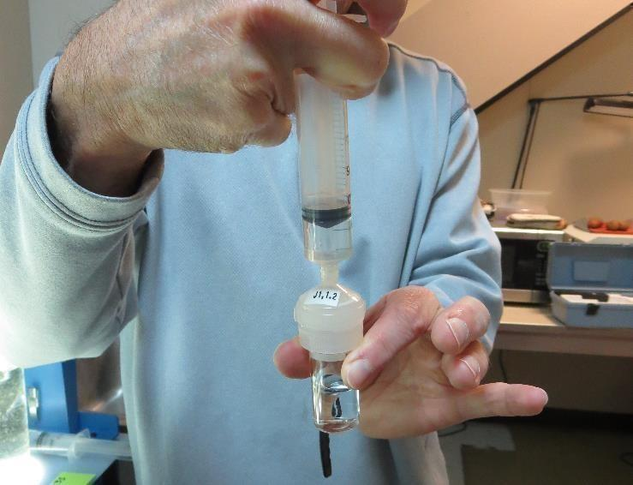

Jar Test - Filterability Test
Syringe ~ 25 mL from jar (after 5-minutes of settling)
Filter-to-waste 3-5 mL
Filter directly into clean cuvette
Measure turbidity
Note: Take several readings before recording final NTU results. Micro bubbles can adhere to glass causing false NTU readings. To remove bubbles, tilt cuvette up to 90 degrees.

Slide 56

Contact
Guy Schott, P.E.
State Water Resources Control Board
Division of Drinking Water
Santa Rosa, CA
Go to Stock Solution/Dose calculations/Jar Test Results for tools to download
www.waterboards.ca.gov/drinking_water/programs/districts/mendocino_district.html
Email: Guy Schott - Guy.Schott@waterboards.ca.gov
Office Number: 707-576-2732

