Slide 1
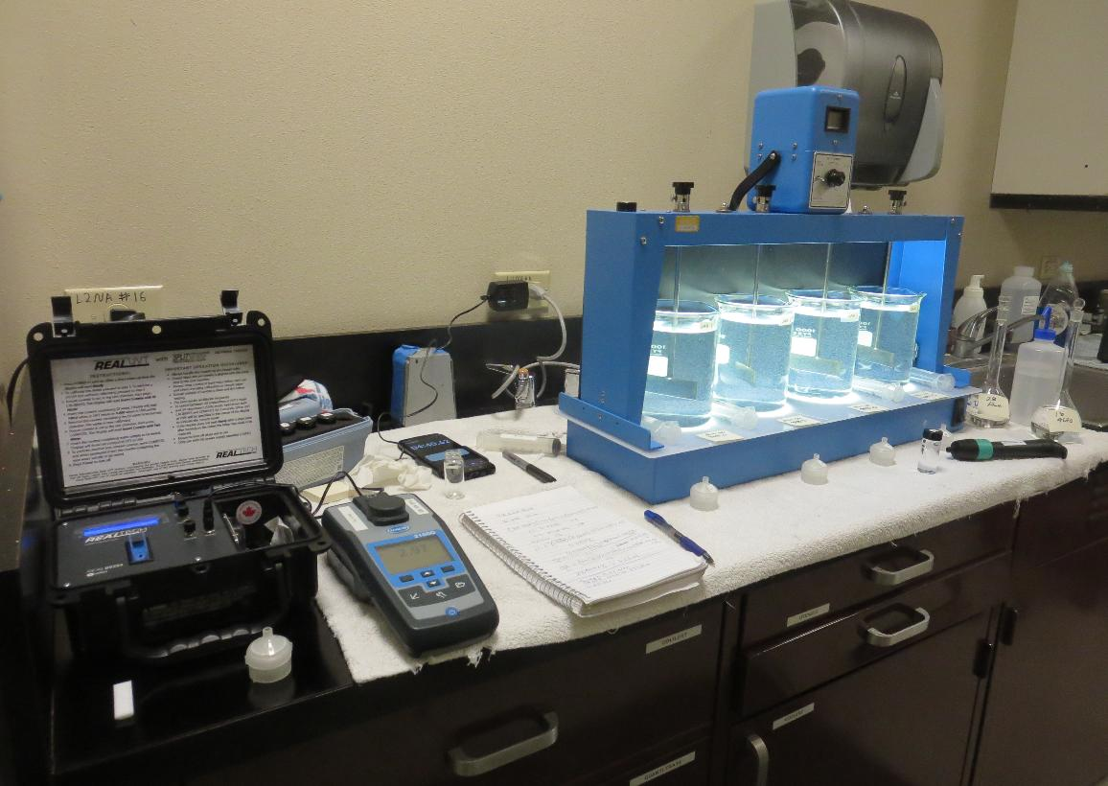
City of American Canyon CA2810005 Napa County Jar Test
by Guy Schott, P.E.
November 7, 2025

Slide 2
North Bay Aqueduct Source & Treated Water Characteristics, November 7, 2025
Source – North Bay Aqueduct
pH: 7.91
Alkalinity: 87 mg/L as CaCO₃
Turbidity: 2.97 NTU
UVT: 76.68%,
UVA: 0.1153/cm
0.4 um Filtered
Turbidity: 0.41 NTU
UVT: 79.13%,
UVA: 0.1017/cm
West Filter Water
pH: 6.94
Alkalinity: 47 mg/L as CaCO₃
0.11 NTU
UVT: 94.15%,
UVA: 0.0262/cm
%UVA Reduction: 70.6%

Slide 3
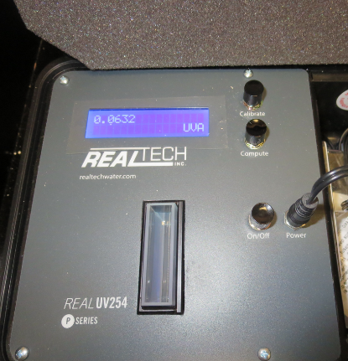
UVT/UVA, pathlength 40 mm
UV transmittance (UVT) is a measurement of the amount of ultraviolet light (commonly at 254 nm due to its germicidal effect) that passes through a water sample compared to the amount of light that passes through a pure water sample. The measurement is expressed as a percentage, % UVT.
%UVT = 10^{(-UVA)} x 100%
UV absorbance (UVA) is calculated as a relative measure of the amount of light absorbed by a water sample compared with the amount of light absorbed by a pure water sample.
UVA = -log(%UVT/100)

Slide 4
Applied Coagulants for Jar Testing (1)
Aluminum Sulfate (Product)
Al₂(SO₄)₃*14.3H₂0 (Liquid)
47.47% Aluminum Sulfate
52% Water
8.08% Al₂O₃
0% Basicity
SG = 1.325
NSF max use: 400 mg/L (product)
As hydrated Al₂(SO₄)₃*14.3H₂0
17% Al₂O₃
Pro Pac 9890, NTU Technologies
35-45% Aluminum Chlorohydrate
20% polyamine solution (50% water, 50% active polyamine)
35-45% Water
~18.9% Al₂O₃
~10.5% Al
83% Basicity
SG = 1.25-1.34
NSF Max Use: 50 mg/L as Product;
Product dose 50 mg/L = 5 mg/L polyamine active

Slide 5
Applied Coagulant for Jar Testing (2)
NTU Technologies
Pro Pac 9810
45-50% Aluminum Chlorohydrate
45-50% Water
~22.4% Al₂O₃
~11.9% Al
83% Basicity
5% polyamine (50% water, 50% active polyamines)
SG = 1.25-1.34
NSF Max Use: 200 mg/L as Product;
Product dose 40 mg/L = 1 mg/L polyamines active
NTU Technologies
Pro Pac 9800
50% Aluminum Chlorohydrate
50% Water
23.62% Al₂O₃
12.5% Al
83% Basicity
SG = 1.25-1.34
NSF limit: 250 mg/L as Product

Slide 6
Coagulant Information
Unless stated otherwise, all coagulant doses are reported as Product (100% strength). Aluminum sulfate is reported as Alum.
Preparation of coagulant stock solutions are generally 1.0 and/or 0.1 percent strength using 100 and/or 200 mL volumetric flasks.
Finnpipette F2 variable volume pipette, capacity 100-1000 micro liters is used for stock solution preparation and coagulant aid jar test dosing.
Finnpipette F2 variable volume pipette, capacity 0.5-5 mL is used for primary coagulant jar test dosing.

Slide 7
City of American Canyon : Jar Test 1-8 Results Flash Mix 200 RPM (20 sec); Floc Mix 30 RPM (5 min)
Jar # | Alum mg/L | 9890 mg/L | 9810 mg/L | Filtrate NTU | Filtrate %UVT | Filtrate UVA/cm | %UVA Reduction | Settle NTU 25 min
J1 | 60 | 0 | - | 0.05 | 91.70 | 0.0377 | 62.9 | 0.75
J2 | 60 | 5 | - | 0.04 | 92.50 | 0.0339 | 66.7 | 0.83
J3 | 60 | 10 | - | 0.04 | 93.03 | 0.0314 | 69.1 | 1.17
J4 | 60 | 15 | - | 0.05 | 93.30 | 0.0302 | 70.3 | 1.21
J5 | - | - | 35 | 0.05 | 92.79 | 0.0325 | 68.0 | 0.65
J6 | - | - | 40 | 0.04 | 92.98 | 0.0310 | 69.5 | 0.64
J7 | - | - | 45 | 0.04 | 93.34 | 0.0300 | 70.5 | 0.60
J8 | - | - | 50 | 0.05 | 93.50 | 0.0292 | 71.3 | 0.62

Slide 8
City of American Canyon : Jar Test 9-12 Results Flash Mix 200 RPM (20 sec); Floc Mix 30 RPM (5 min)
Jar # | Alum mg/L | 9800 mg/L | Filtrate NTU | Filtrate %UVT | Filtrate UVA/cm | %UVA Reduction | Settle NTU 25 min
J9 | 65 | - | 0.08 | 91.88 | 0.0368 | 63.8 | 0.79
J10 | 70 | - | 0.04 | 92.19 | 0.0354 | 65.2 | 0.75
J11 | - | 40 | 0.06 | 92.22 | 0.0352 | 65.4 | 0.63
J12 | - | 45 | 0.04 | 92.86 | 0.0322 | 68.3 | 0.46

Slide 9
City of American Canyon : Jar Test 13-17 Results Flash Mix 200 RPM (20 sec); Floc Mix 30 RPM (5 min)
Jar # | Alum mg/L | 9890 mg/L | 9810 mg/L | 9800 mg/L | Filtrate NTU | Filtrate %UVT | Filtrate UVA/cm | %UVA Reduction | Settle NTU 25 min | Alk mg/L | pH
J13 | 70 | - | - | - | 0.05 | 92.07 | 0.0359 | 64.7 | 0.66 | 45 | 6.62
J14 | - | 45 | - | - | 0.38 | 88.46 | 0.0533 | 47.6 | 4.31 | 88 | 7.46
J15 | - | - | - | 45 | 0.04 | 92.18 | 0.0354 | 65.2 | 0.62 | 86 | 7.50
J16 | - | - | 45 |  | 0.04 | 92.24 | 0.0351 | 65.5 | 1.06 | 82 | 7.53
J17 | 60 | 15 | - | - | 0.09 | 92.89 | 0.0321 | 68.4 | 2.05 | 53 | 6.68

Slide 10
Jars 1-4 Test Flash Mix 20 Sec (200 RPM) Floc Mix 5 min (30 RPM) Applied Coagulants Alum/9890

Slide 11
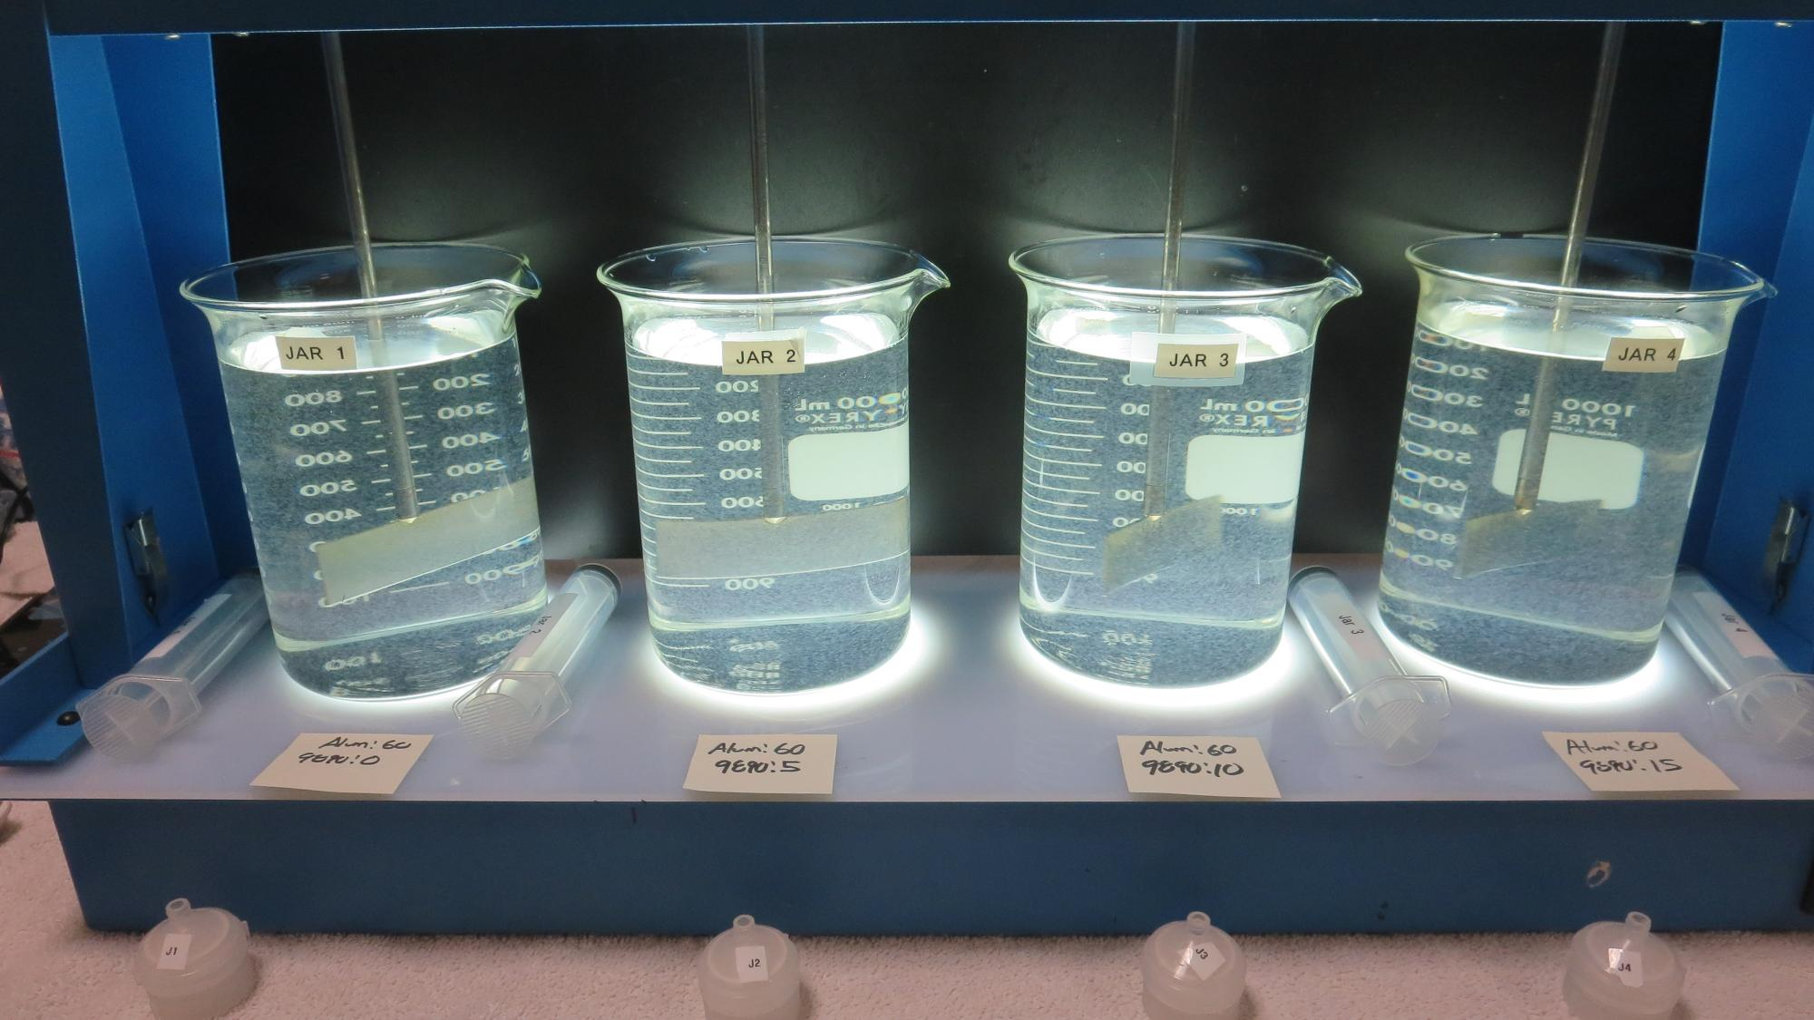
Jars 1-4: End of 5-minute flocculation (30 RPM) duration.
Alum: 60 mg/L
9890: 0 mg/L
Filtrate: 0.05 NTU
UVT: 91.70%
UVA: 0.0377/cm
UVA Reduction: 62.9%
Settled: 0.75 NTU
Alum: 60 mg/L
9890: 5 mg/L
Filtrate: 0.04 NTU
UVT: 92.50%
UVA: 0.0339/cm
UVA Reduction: 66.7%
Settled: 0.83 NTU
Alum: 60 mg/L
9890: 10 mg/L
Filtrate: 0.04 NTU
UVT: 92.50%
UVA: 0.0314/cm
UVA Reduction: 69.1%
Settled: 1.17 NTU
Alum: 60 mg/L
9890: 15 mg/L
Filtrate: 0.05 NTU
UVT: 93.30%
UVA: 0.0302/cm
UVA Reduction: 70.3%
Settled: 1.21 NTU

Slide 12
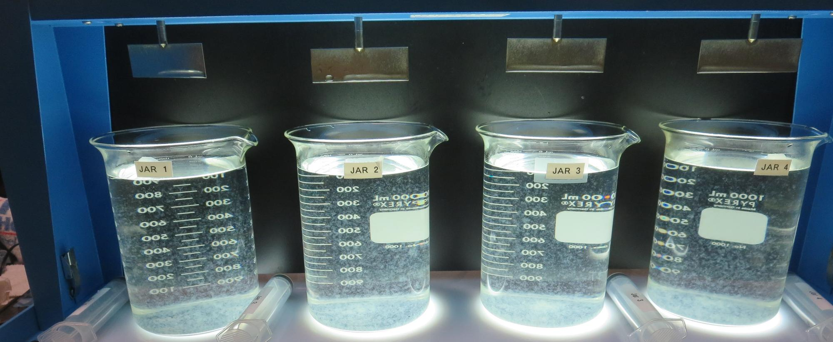
Jars 1-4: After 5 min of settling, 25 mL is syringed for filterability and %UVT/UVA

Slide 13
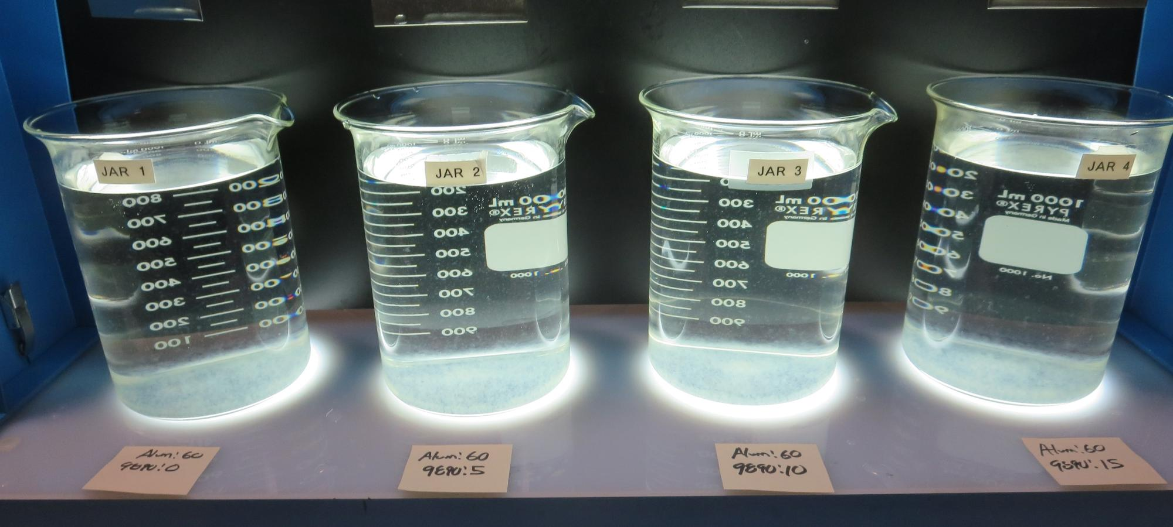
Jars 1-4: After 25-minutes of settling, settled water turbidity is taken.
Alum: 60 mg/L
9890: 0 mg/L
Filtrate: 0.05 NTU
UVT: 91.70%
UVA: 0.0377/cm
UVA Reduction: 62.9%
Settled: 0.75 NTU
Alum: 60 mg/L
9890: 5 mg/L
Filtrate: 0.04 NTU
UVT: 92.50%
UVA: 0.0339/cm
UVA Reduction: 66.7%
Settled: 0.83 NTU
Alum: 60 mg/L
9890: 10 mg/L
Filtrate: 0.04 NTU
UVT: 92.50%
UVA: 0.0314/cm
UVA Reduction: 69.1%
Settled: 1.17 NTU
Alum: 60 mg/L
9890: 15 mg/L
Filtrate: 0.05 NTU
UVT: 93.30%
UVA: 0.0302/cm
UVA Reduction: 70.3%
Settled: 1.21 NTU

Slide 14
Jars 5-8 Test Flash Mix 20 Sec (200 RPM) Floc Mix 5 min (30 RPM) Applied Coagulant 9810

Slide 15
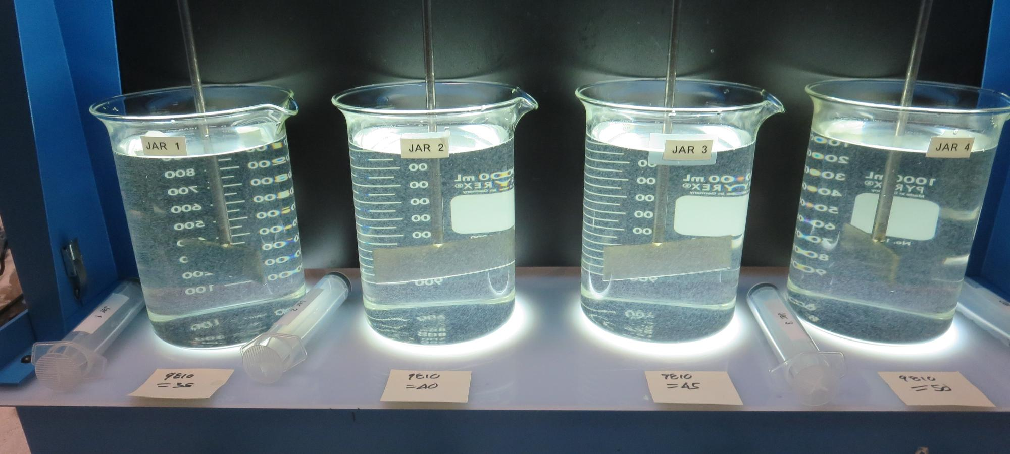
Jars 5-8: End of 5-minute flocculation (30 RPM) duration.
9810: 35 mg/L
Filtrate: 0.05 NTU
UVT: 92.79%
UVA: 0.0325/cm
UVA Reduction: 68.0%
Settled: 0.65 NTU
9810: 40 mg/L
Filtrate: 0.04 NTU
UVT: 93.11%
UVA: 0.0310/cm
UVA Reduction: 69.5%
Settled: 0.64 NTU
9810: 45 mg/L
Filtrate: 0.04 NTU
UVT: 93.34%
UVA: 0.0300/cm
UVA Reduction: 70.5%
Settled: 0.60 NTU
9810: 50 mg/L
Filtrate: 0.05 NTU
UVT: 93.50%
UVA: 0.0292/cm
UVA Reduction: 71.3%
Settled: 0.62 NTU

Slide 16
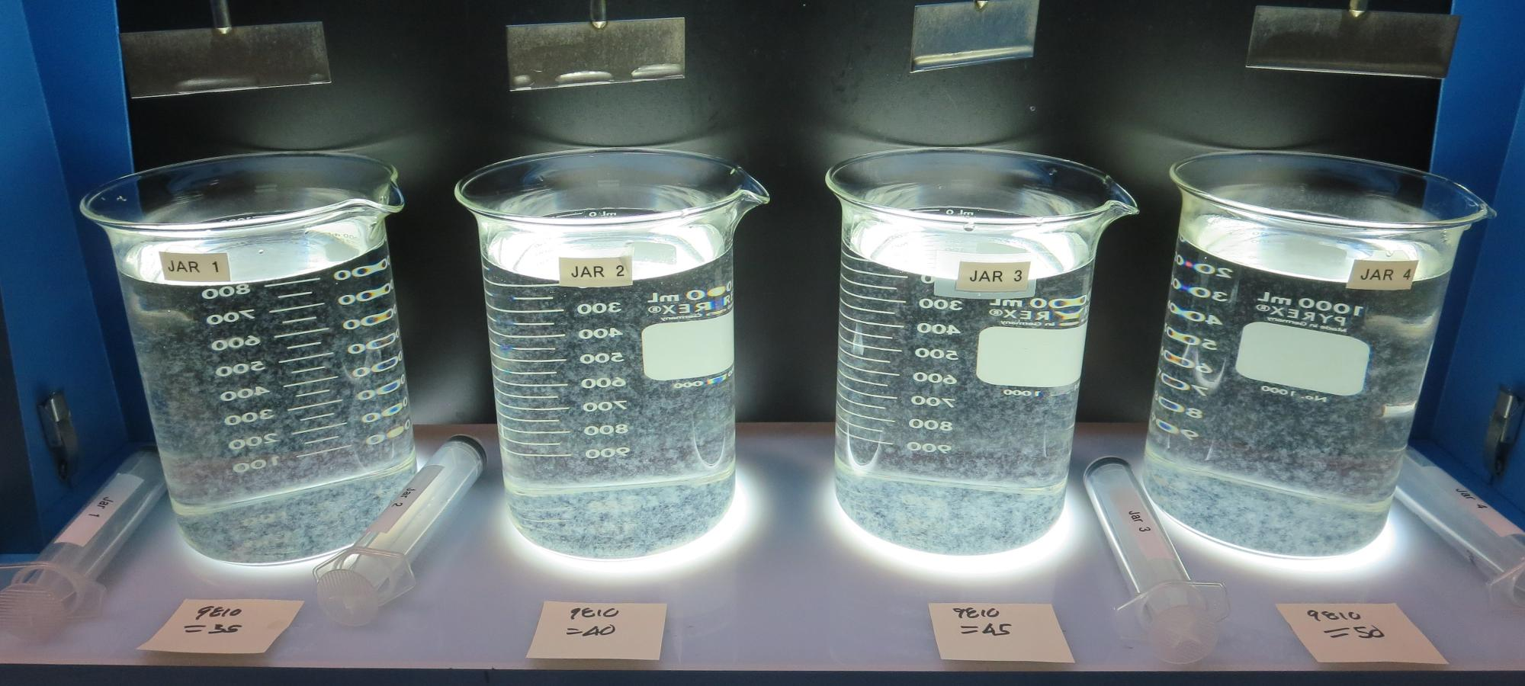
Jars 5-8: After 5 min of settling, 25 mL is syringed for filterability and %UVT/UVA

Slide 17
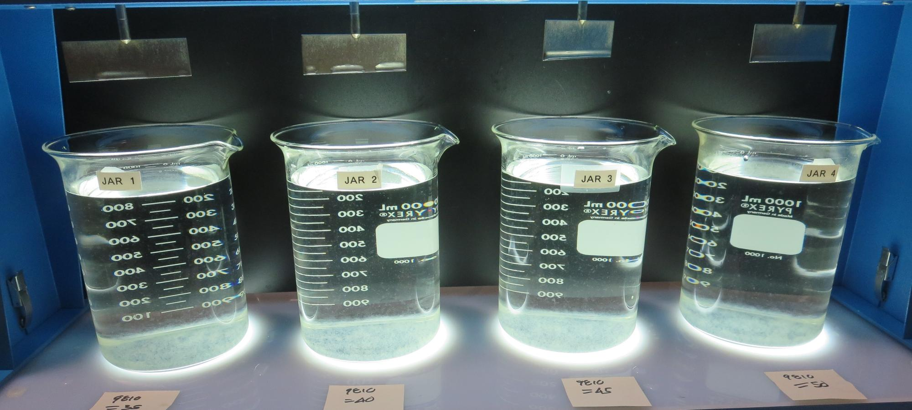
Jars 5-8: After 25-minutes of settling, settled water turbidity is taken.
9810: 35 mg/L
Filtrate: 0.05 NTU
UVT: 92.79%
UVA: 0.0325/cm
UVA Reduction: 68.0%
Settled: 0.65 NTU
9810: 40 mg/L
Filtrate: 0.04 NTU
UVT: 93.11%
UVA: 0.0310/cm
UVA Reduction: 69.5%
Settled: 0.64 NTU
9810: 45 mg/L
Filtrate: 0.04 NTU
UVT: 93.34%
UVA: 0.0300/cm
UVA Reduction: 70.5%
Settled: 0.60 NTU
9810: 50 mg/L
Filtrate: 0.05 NTU
UVT: 93.50%
UVA: 0.0292/cm
UVA Reduction: 71.3%
Settled: 0.62 NTU

Slide 18
Jars 9-12 Test Flash Mix 20 Sec (200 RPM) Floc Mix 5 min (30 RPM) Applied Coagulants Alum/9800

Slide 19
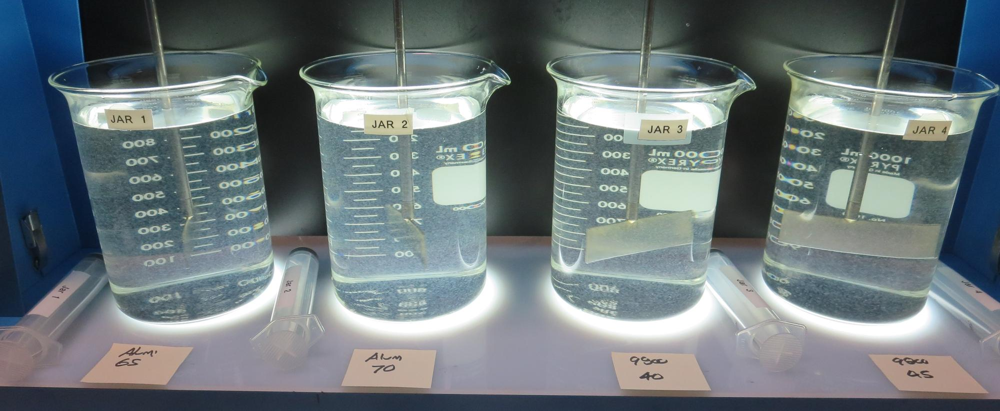
Jars 9-12: End of 5-minute flocculation (30 RPM) duration.
Alum: 65 mg/L
Filtrate: 0.08 NTU
UVT: 91.88%
UVA: 0.0368/cm
UVA Reduction: 63.8%
Settled: 0.79 NTU
Alum: 70 mg/L
Filtrate: 0.04 NTU
UVT: 92.19%
UVA: 0.0354/cm
UVA Reduction: 65.2%
Settled: 0.75 NTU
9800: 40 mg/L
Filtrate: 0.06 NTU
UVT: 92.22%
UVA: 0.0352/cm
UVA Reduction: 65.4%
Settled: 0.63 NTU
9800: 45 mg/L
Filtrate: 0.04 NTU
UVT: 92.86%
UVA: 0.0322/cm
UVA Reduction: 68.3%
Settled: 0.46 NTU

Slide 20
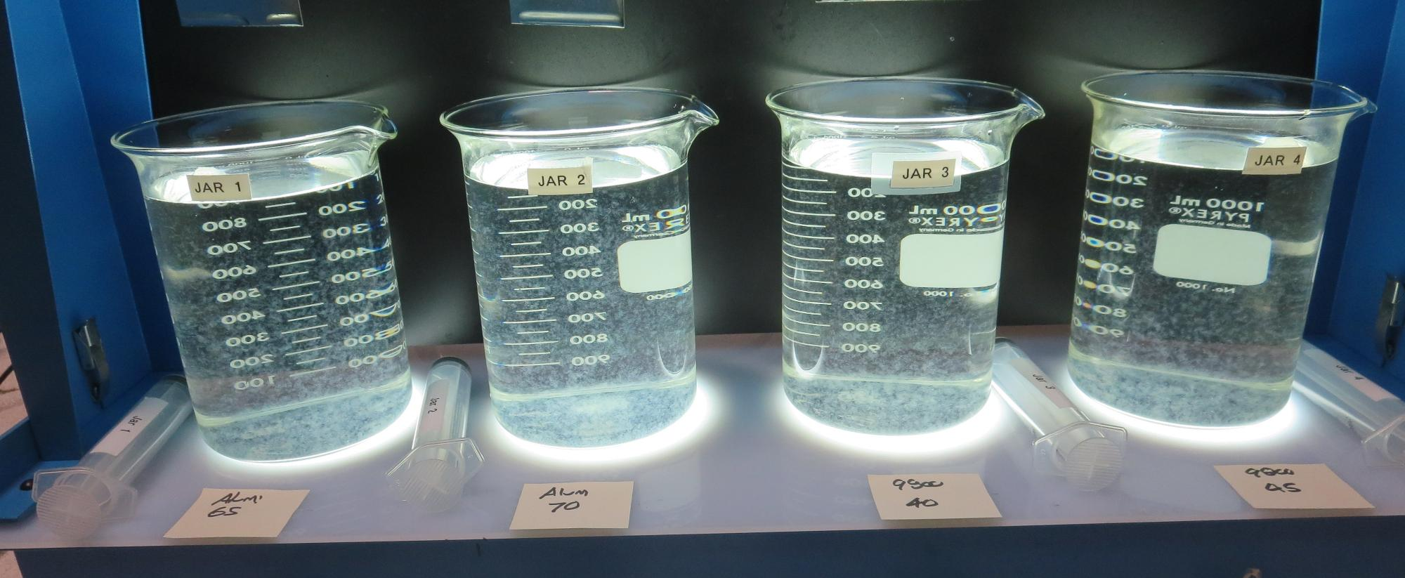
Jars 9-12: After 5 min of settling, 25 mL is syringed for filterability and %UVT/UVA

Slide 21
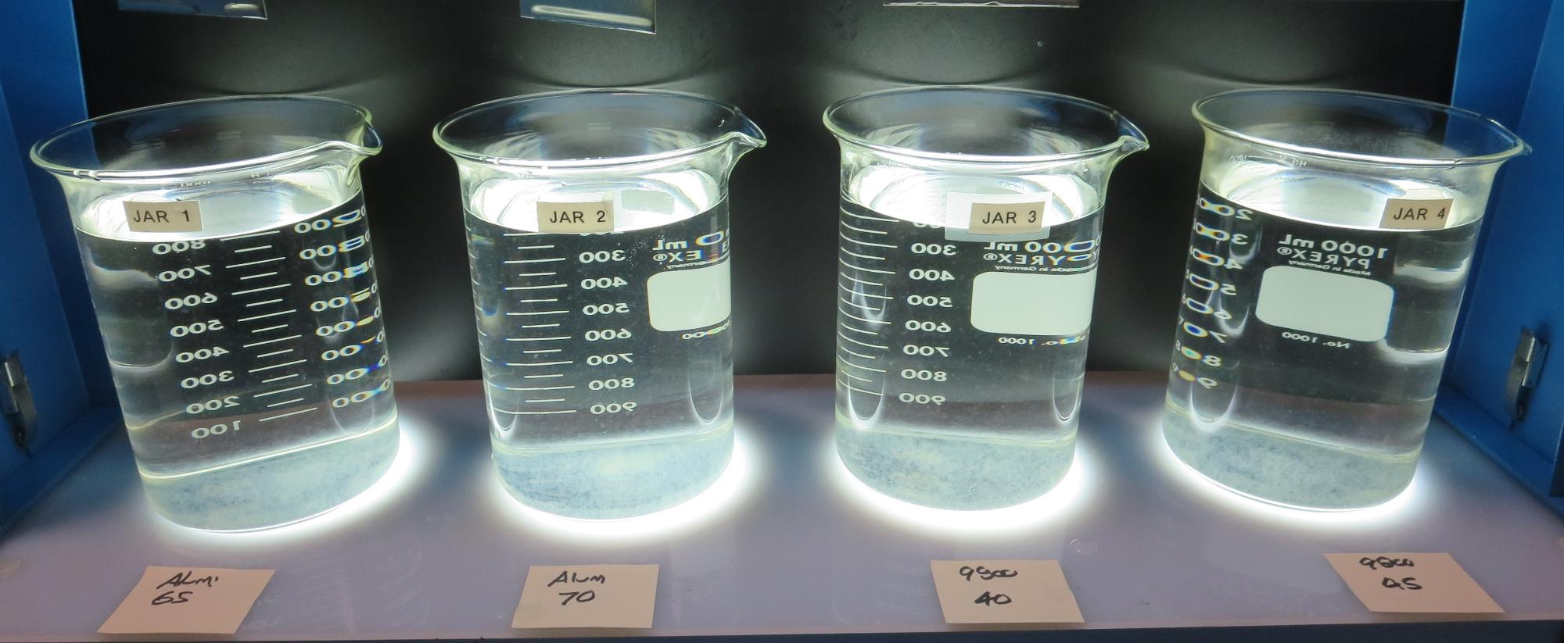
Jars 9-12: After 25-minutes of settling, settled water turbidity is taken.
Alum: 65 mg/L
Filtrate: 0.08 NTU
UVT: 91.88%
UVA: 0.0368/cm
UVA Reduction: 63.8%
Settled: 0.79 NTU
Alum: 70 mg/L
Filtrate: 0.04 NTU
UVT: 92.19%
UVA: 0.0354/cm
UVA Reduction: 65.2%
Settled: 0.75 NTU
9800: 40 mg/L
Filtrate: 0.06 NTU
UVT: 92.22%
UVA: 0.0352/cm
UVA Reduction: 65.4%
Settled: 0.63 NTU
9800: 45 mg/L
Filtrate: 0.04 NTU
UVT: 92.86%
UVA: 0.0322/cm
UVA Reduction: 68.3%
Settled: 0.46 NTU

Slide 22
Jars 13-16 Test Flash Mix 20 Sec (200 RPM) Floc Mix 5 min (30 RPM) Applied Coagulants Alum/9890 9800/9810

Slide 23
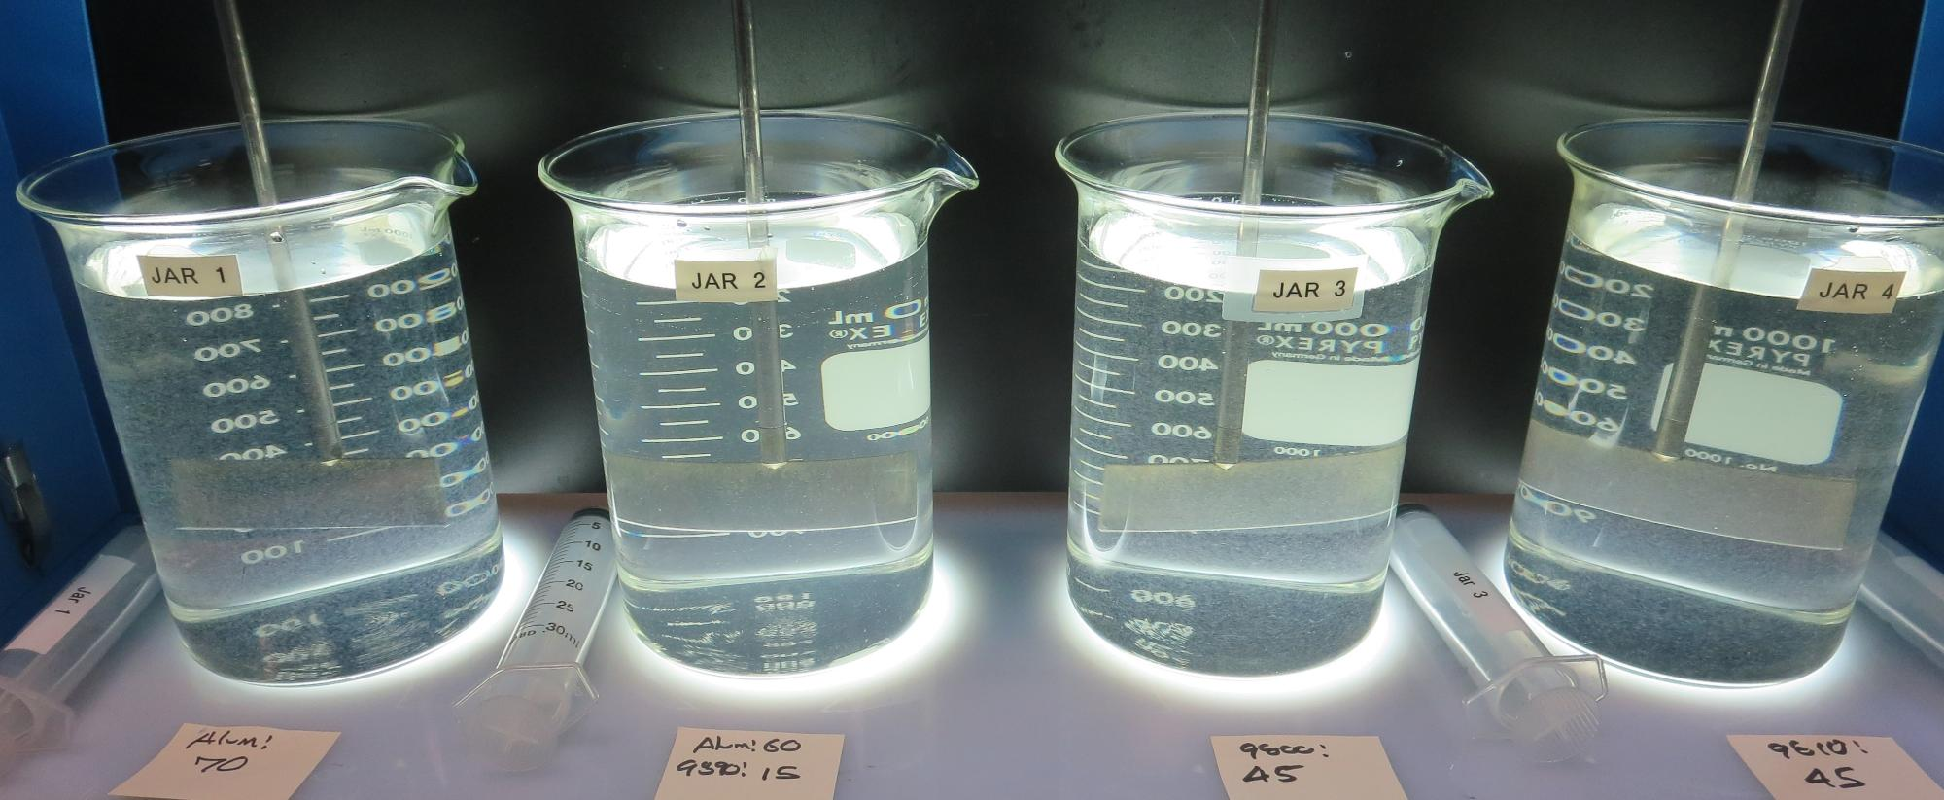
Jars 13-16: End of 5-minute flocculation (30 RPM) duration.
Alum: 70 mg/L
Filtrate: 0.05 NTU
UVT: 92.07%
UVA: 0.0359/cm
UVA Reduction: 64.7%
Settled: 0.66 NTU
pH: 6.62, Alk: 45 mg/L
9890: 45 mg/L
Filtrate: 0.38 NTU
UVT: 88.46%
UVA: 0.0533/cm
UVA Reduction: 47.6%
Settled: 4.3 NTU
pH: 7.46, Alk: 88 mg/L
9800: 45 mg/L
Filtrate: 0.04 NTU
UVT: 92.18%
UVA: 0.0354/cm
UVA Reduction: 65.2%
Settled: 0.62 NTU
pH: 7.50, Alk: 86 mg/L
9810: 45 mg/L
Filtrate: 0.04 NTU
UVT: 92.24%
UVA: 0.0351/cm
UVA Reduction: 65.5%
Settled: 1.06 NTU
pH: 7.53, Alk: 82 mg/L
9890: 45 mg/L

Slide 24
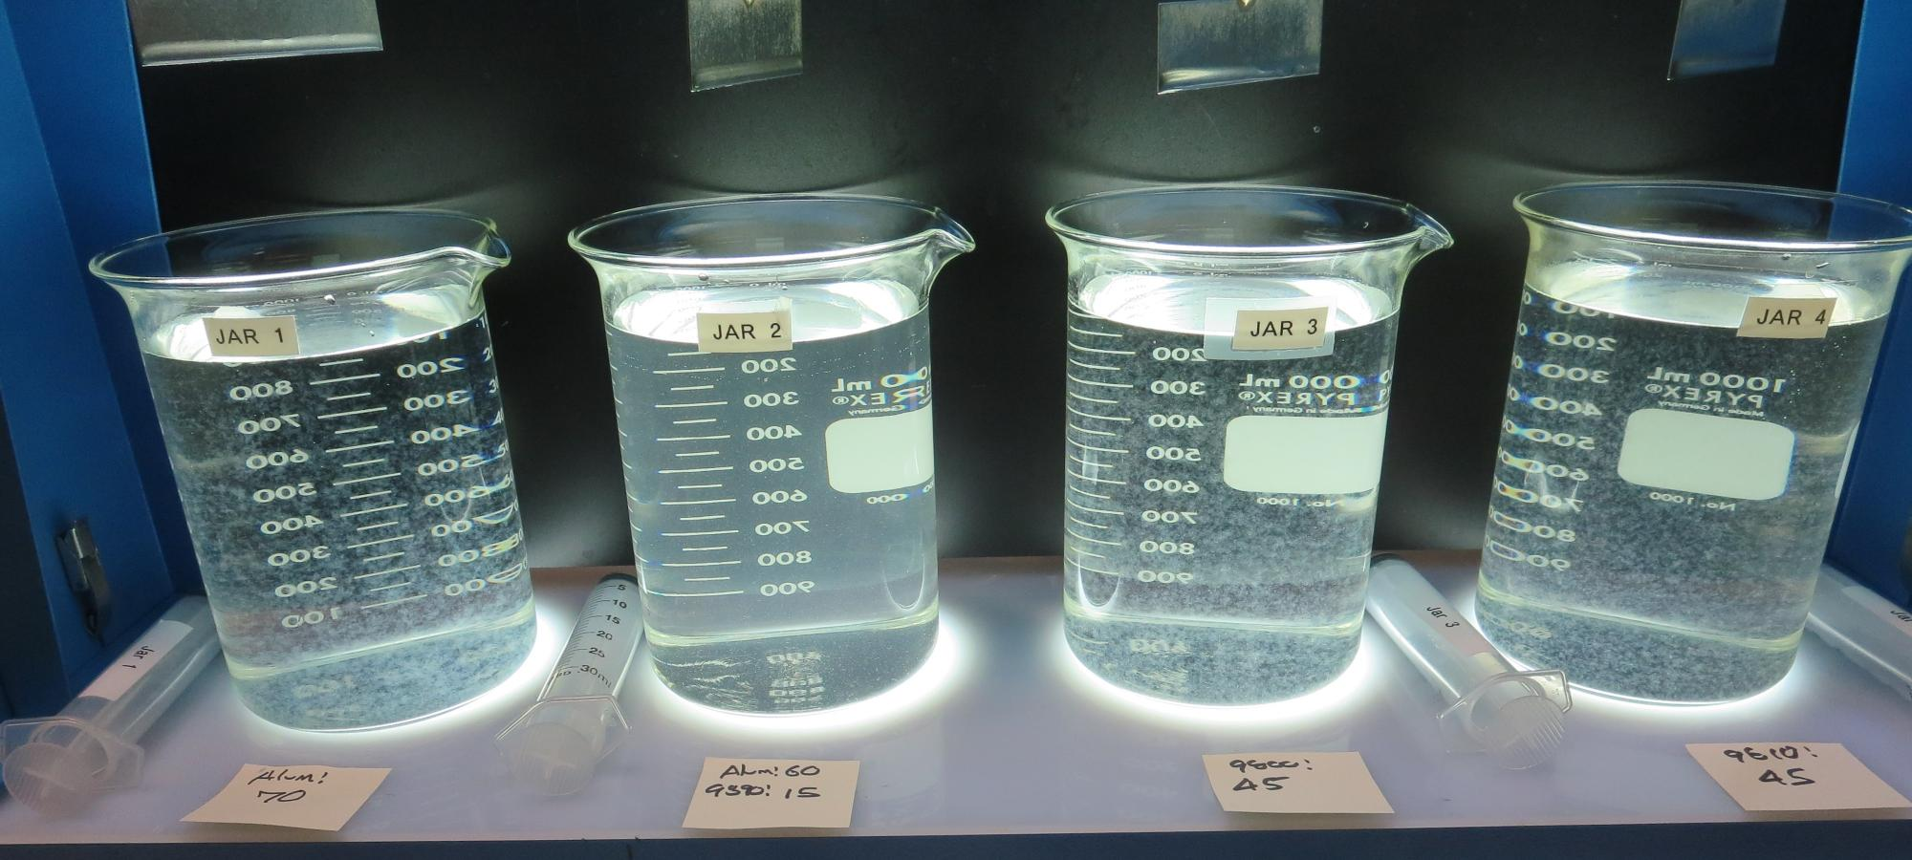
Jars 13-16: After 5 min of settling, 25 mL is syringed for filterability and %UVT/UVA
9890: 45 mg/L

Slide 25
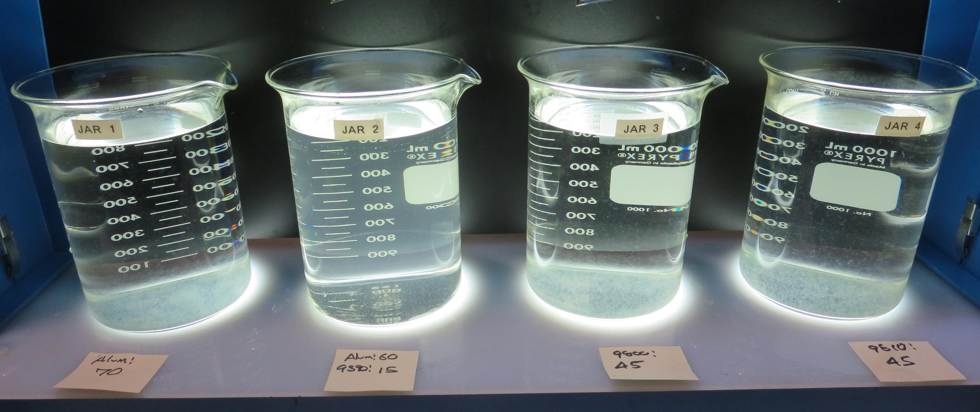
Jars 13-16: After 25-minutes of settling, settled water turbidity is taken.
Alum: 70 mg/L
Filtrate: 0.05 NTU
UVT: 92.07%
UVA: 0.0359/cm
UVA Reduction: 64.7%
Settled: 0.66 NTU
pH: 6.62, Alk: 45 mg/L
9890: 45 mg/L
Filtrate: 0.38 NTU
UVT: 88.46%
UVA: 0.0533/cm
UVA Reduction: 47.6%
Settled: 4.3 NTU
pH: 7.46, Alk: 88 mg/L
9800: 45 mg/L
Filtrate: 0.04 NTU
UVT: 92.18%
UVA: 0.0354/cm
UVA Reduction: 65.2%
Settled: 0.62 NTU
pH: 7.50, Alk: 86 mg/L
9810: 45 mg/L
Filtrate: 0.04 NTU
UVT: 92.24%
UVA: 0.0351/cm
UVA Reduction: 65.5%
Settled: 1.06 NTU
pH: 7.53, Alk: 82 mg/L
9890: 45 mg/L

Slide 26
Jar 17 Test Flash Mix 20 Sec (200 RPM) Floc Mix 5 min (30 RPM) Applied Coagulants Alum/9890

Slide 27
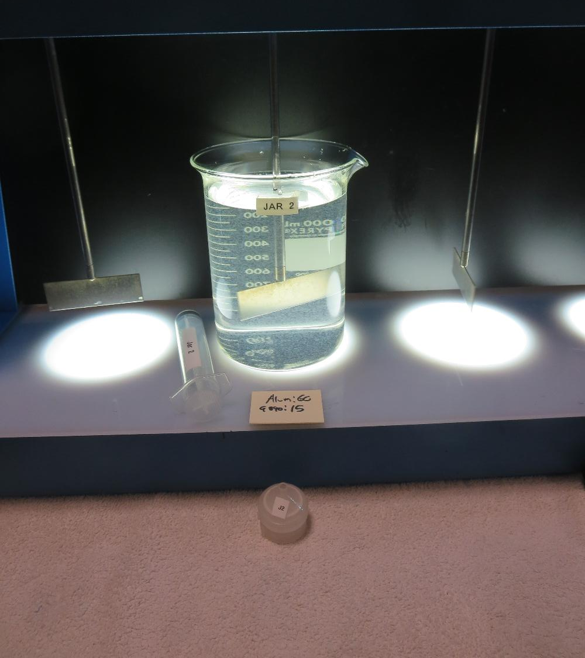
Jar 17: End of 5-minute flocculation (30 RPM) duration.
Alum: 60 mg/L
9890: 15 mg/L
Filtrate: 0.09 NTU
UVT: 92.89%
UVA: 0.0321/cm
UVA Reduction: 68.4%
Settled: 2.05 NTU

Slide 28
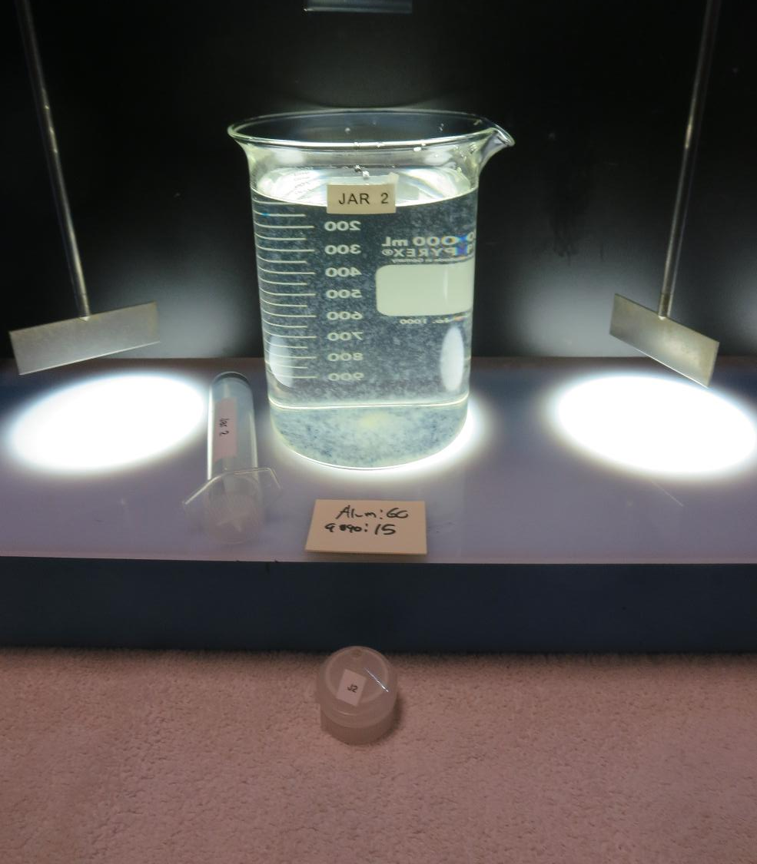
Jar 17: After 5 min of settling, 25 mL is syringed for filterability and %UVT/UVA

Slide 29
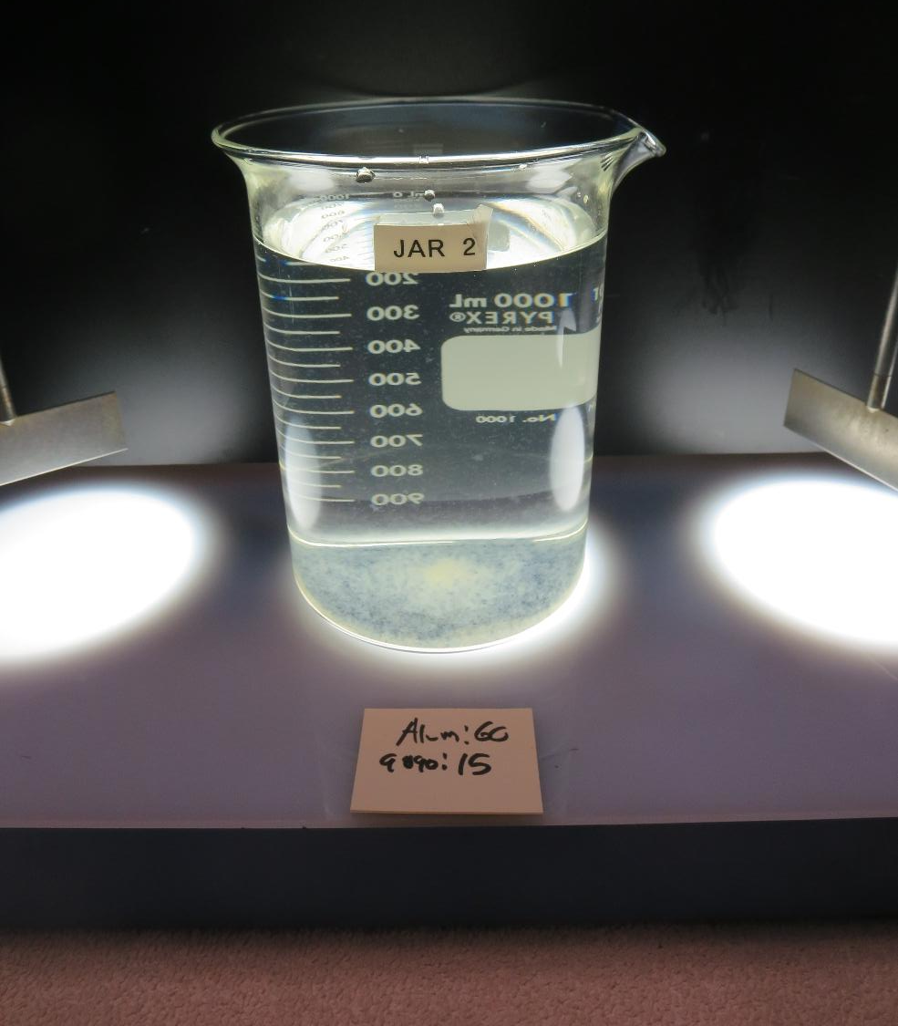
Jars 17-20: After 25-minutes of settling, settled water turbidity is taken.
Alum: 60 mg/L
9890: 15 mg/L
Filtrate: 0.09 NTU
UVT: 92.89%
UVA: 0.0321/cm
UVA Reduction: 68.4%
Settled: 2.05 NTU

Slide 30
Jar Testing for 1-Liter Jars: Procedures for Most Treatment Plants
Fill jars with source water prior to coagulant injection and set paddle speed at 30 rpm
Add chemicals (i.e., NaOCl, primary coagulant, coagulant aid) to each jar
Flash mix for 15-60 seconds (200 rpm)
Slow mix for 5 minutes (20-30 rpm)
Settled for 5 minutes. Syringe 25 mL from each jar taken 1-inch below surface (25 mL/12 sec rate)
Filtered through 1.2 um isopore membrane into cuvette drip rate, 15 mL/(50-90 sec)
Measure filtrate turbidity, chlorine residual and %UVT/UVA
Measure settled water turbidity after 25 minutes of total setting
Record all data

Slide 31
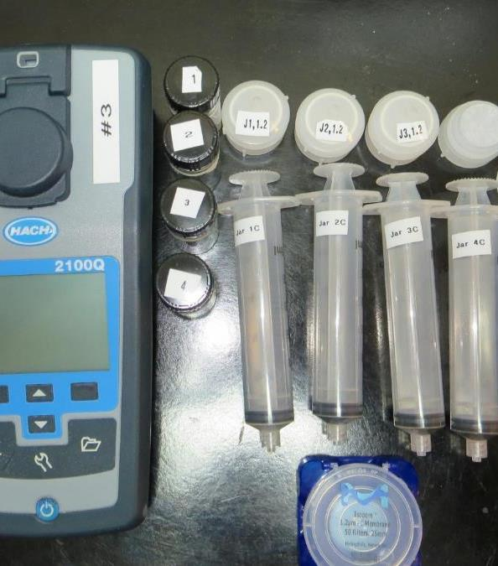
Jar Test Filterability Test Equipment
Turbidity Instrument
Syringe w/Luer-Lock Tip, 30 cc
(part#: 2225800, by Hach)
Swinnex Filter Holder, 25 mm (part#: SX0002500)
Isopore Membrane Filter, 1.2 um absolute
pore size,
Φ= 25 mm , thickness: 24 um,
hydrophilic polycarbonate membrane
(part #: RTTP02500)
Go to Sigma-Aldrich for laboratory supplies http://www.sigmaaldrich.com/united-states.html

Slide 32
Isopore Membrane Information
Categories | Information
trade name | Isopore
filter color | White
chemistry | Polycarbonate (PC)
water flow rate | Avg. 175 mL/min x cm² (typical results @ 10 psi)
media | Isopore®
wettability | Hydrophilic
porosity | 14.7%
pore size | 1.2 µm
bubble point at 23 °C | 1.0 bar, air with water
thickness | 24 µm
filter diameter (ø) | 25 mm
material size | polycarbonate, Hydrophilic, 1.2 µm, 25 mm, white, plain, 100

Slide 33
Isopore Membrane Background Information
The Isopore membrane is a polycarbonate, track-etched screen filter recommended for all analyses in which the sample is viewed on the surface of the membrane. The Isopore membrane is composed of polycarbonate film, which has a smooth, glass-like surface for clearer sample observation. The unique manufacturing process of the membrane ensures a precise pore diameter and a consistent pore size for accurate separation of samples by size. Matched-weight filters are not usually required because of low, constant tar and ash weights. Features & Benefits: Membrane structure retains particles on the surface, simplifying counting and analysis

Slide 34
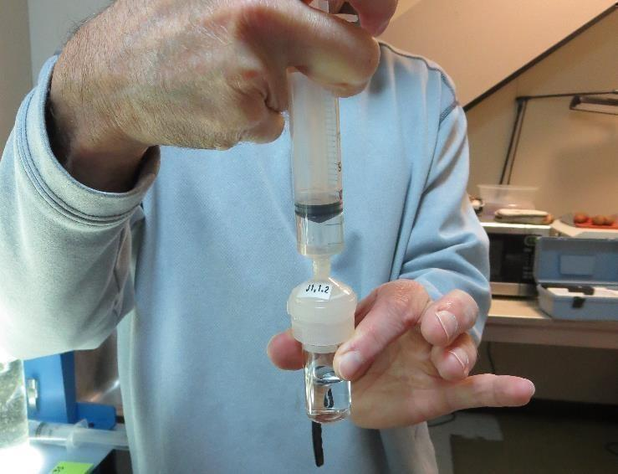
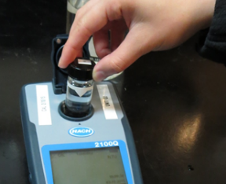
Jar Test - Filterability Test
Syringe ~ 25 mL from jar (after 5-minutes of settling)
Filter-to-waste 3-5 mL
Filter directly into clean cuvette
Measure turbidity
Note: Take several readings before recording final NTU results. Micro bubbles can adhere to glass causing false NTU readings. To remove bubbles, tilt cuvette up to 90 degrees.

Slide 35

Contact
Guy Schott, P.E.
State Water Resources Control Board
Division of Drinking Water
Santa Rosa, CA
Go to Stock Solution/Dose calculations/Jar Test Results for tools to download
www.waterboards.ca.gov/drinking_water/programs/districts/mendocino_district.html
Jar Testing Done Right training video: https://www.youtube.com/watch?v=aGByyxhelkI
Email: Guy Schott - Guy.Schott@waterboards.ca.gov
Office Number: 707-576-2732

