Slide 1
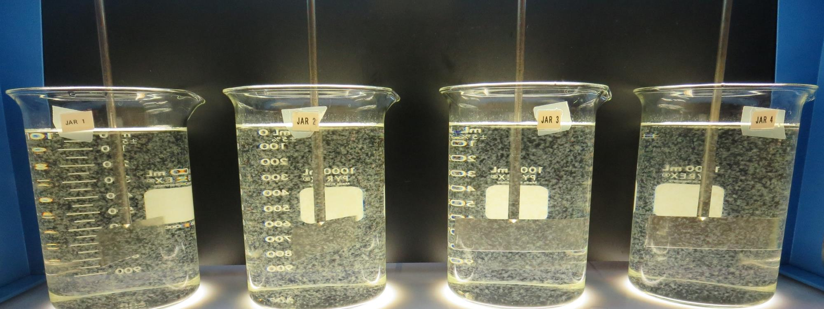
City of American Canyon
CA2810005
Napa County
Jar Test
by Guy Schott, P.E.
August 28, 2019

Slide 2
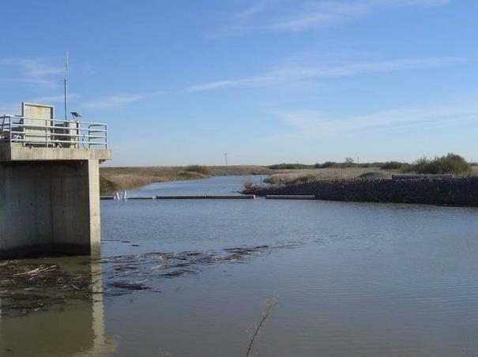
Source Water:
North Bay Aqueduct
Source Water Characteristics (August 28, 2019)
Unfiltered
Turbidity: 6 NTU
pH: 7.63
UVT: 72.8%, UVA: 0.138/cm
Filtered (0.4 um filtered)
UVT: 77.2%, UVA: 0.112/cm
Turbidity: 0.26 NTU

Slide 3
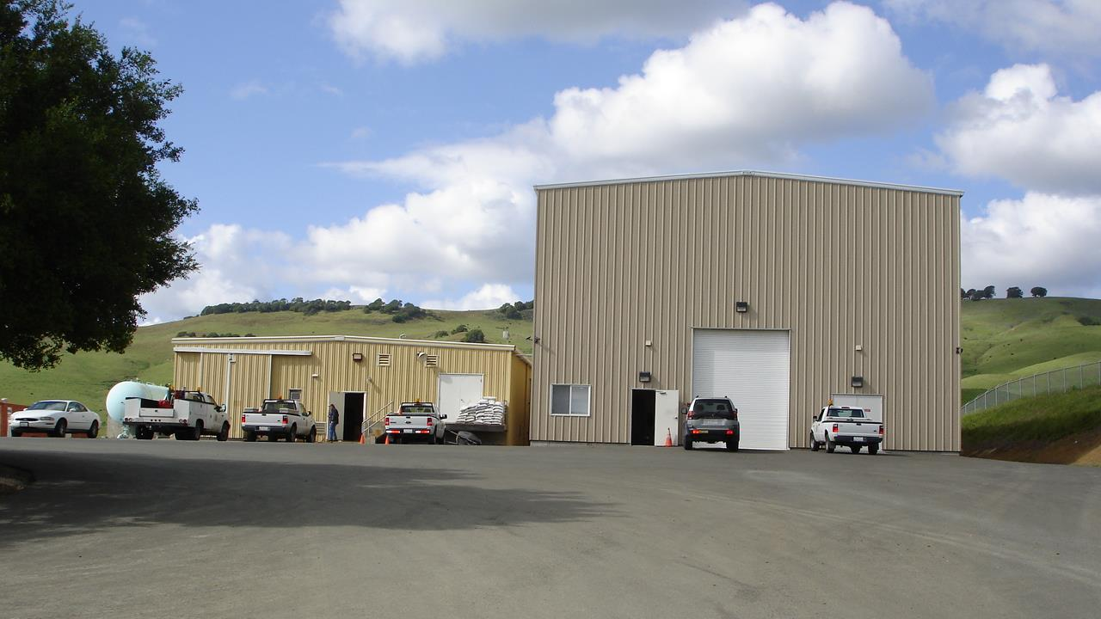
Conventional and Membrane Treatment Plants

Slide 4
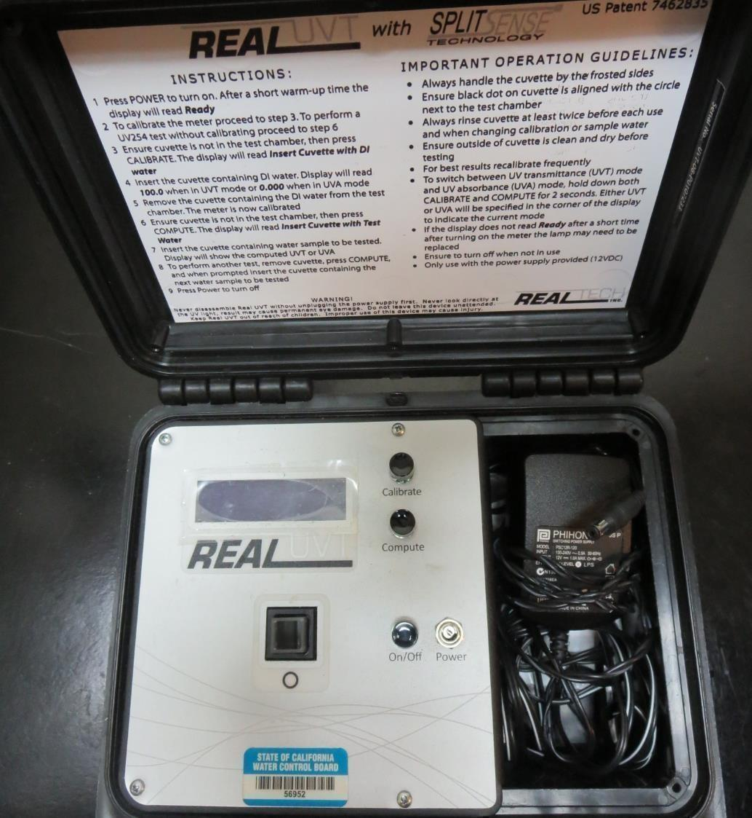
UVT/UVA
UV transmittance (UVT) is a measurement of the amount of ultraviolet light (commonly at 254 nm due to its germicidal effect) that passes through a water sample compared to the amount of light that passes through a pure water sample. The measurement is expressed as a percentage, % UVT.
%UVT = 10^{(-UVA)} x 100%
UV absorbance (UVA) is calculated as a relative measure of the amount of light absorbed by a water sample compared with the amount of light absorbed by a pure water sample.
UVA = -log(%UVT/100)

Slide 5
Coagulant Used for Jar Testing
Pro Pac 925 (NTU Technologies)
45% ACH
45% Water
5% Proprietary
SG = 1.25 - 1.34
7066 (Garratt Callahan)
10 – 30% Poly Aluminum Hydroxychloride Sulfate
SG = 1.2
Alum
36.48% Alum
7% H₂SO₄
SG = 1.3
AH-710 (Garratt Callahan)
10 – 30% Poly Aluminum Hydroxychloride Sulfate
SG = 1.2

Slide 6
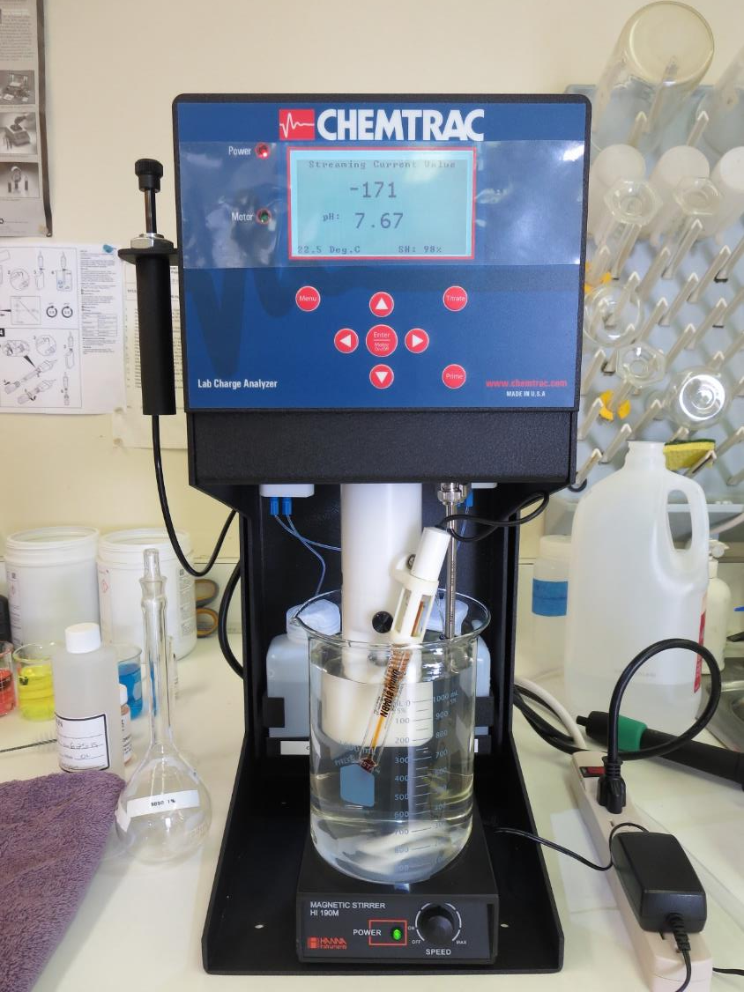
Laboratory Charge Analyzer
LCA: Used to determine coagulant demand of a source water entering the treatment plant.
Source pH: 7.67
LCA #1: 7% Acid Alum: 43.5 mg/L as Alum
pH adjusted to 6.8 w/acidic acid
LCA #2: 925: 27 mg/L as product
No pH adjustment
LCA #3: AH-710: 19.5 mg/L as product
No pH adjustment
LCA #4: 7066: 128 mg/L as product
No pH adjustment

Slide 7
Coagulant Information
Unless stated otherwise, all coagulant doses are reported as Product (100% strength). Aluminum Sulfate is reported as Alum.
Preparation of coagulant stock solutions are generally 1.0 and/or 0.1 percent strength using 100 and/or 200 mL volumetric flasks.
Finnpipette F2 variable volume pipette, capacity 100-1000 micro liters is used for stock solution preparation and coagulant aid jar test dosing.
Finnpipette F2 variable volume pipette, capacity 0.5-5 mL is used for primary coagulant jar test dosing.

Slide 8
City of American Canyon: Jar Test 1-8 Results
Jar | 200 RPM Flash Mix seconds | 30 RPM Floc Duration minutes | 925 mg/L | 7% Acid Alum mg/L | Filtrate NTU | Filtrate %UVT | Filtrate UVA/cm | Settle NTU 25 min
J1 | 60 | 5 | 24 | 0 | 0.13 | 89.9 | 0.047 | 0.58
J2 | 60 | 5 | 27 | 0 | 0.12 | 90.0 | 0.046 | 0.58
J3 | 60 | 5 | 30 | 0 | 0.12 | - | - | 0.75
J4 | 60 | 5 | 33 | 0 | 0.11 | 90.6 | 0.043 | 0.53
J5 | 60 | 5 | 0 | 35 | 0.13 | 90.0 | 0.046 | 0.79
J6 | 60 | 5 | 0 | 40 | 0.12 | 90.9 | 0.041 | 0.69
J7 | 60 | 5 | 0 | 45 | 0.08 | 91.4 | 0.039 | 0.76
J8 | 60 | 5 | 0 | 50 | 0.07 | 92.3 | 0.035 | 0.62

Slide 9
City of American Canyon: Jar Test 9-16 Results
Jar | 200 RPM Flash Mix seconds | 30 RPM Floc Duration minutes | AH-710 mg/L | 7066 mg/L | Filtrate NTU | Filtrate %UVT | Filtrate UVA/cm | Settle NTU 25 min
J9 | 60 | 5 | 18 | 0 | 0.09 | 89.2 | 0.050 | 0.84
J10 | 60 | 5 | 20 | 0 | 0.08 | 89.5 | 0.048 | 0.75
J11 | 60 | 5 | 22 | 0 | 0.11 | 89.9 | 0.046 | 0.60
J12 | 60 | 5 | 24 | 0 | 0.10 | 90.4 | 0.044 | 0.60
J13 | 60 | 5 | 0 | 120 | 0.08 | 92.4 | 0.034 | 0.17
J14 | 60 | 5 | 0 | 125 | 0.08 | 92.6 | 0.033 | 0.18
J15 | 60 | 5 | 0 | 130 | 0.06 | 92.9 | 0.032 | 0.35
J16 | 60 | 5 | 0 | 135 | 0.06 | 92.8 | 0.032 | 0.18

Slide 10
City of American Canyon: Jar Test 17-23 Results
Jar | 200 RPM Flash Mix seconds | 30 RPM Floc Duration minutes | 7% Acid Alum mg/L | Filtrate NTU | Filtrate %UVT | Filtrate UVA/cm | Settle NTU 25 min | Sludge Lbs./MG
J17 | 60 | 5 | 50 | 0.08 | 92.7 | 0.033 | 0.48 | 262
J18 | 60 | 5 | 55 | 0.07 | 92.9 | 0.032 | 0.61 | 291
J19 | 60 | 5 | 60 | 0.10 | 93.1 | 0.031 | 0.78 | 300
J20 | 60 | 5 | 65 | 0.06 | 93.5 | 0.029 | 0.53 | 319
J21 | 60 | 5 | 65 | 0.09 | 93.5 | 0.029 | 0.73 | 319
J22 | 60 | 5 | 70 | 0.10 | 93.7 | 0.028 | 0.69 | 338
J23 | 60 | 5 | 75 | 0.07 | 94.1 | 0.026 | 0.64 | 356

Slide 11
City of American Canyon: Jar Test 24-27 Results
Jars 24 & 27 were syringed at end of floc duration.
Jar | 200 RPM Flash Mix seconds | 30 RPM Floc Duration minutes | 7066 mg/L | Filtrate NTU | Filtrate %UVT | Filtrate UVA/cm | Settle NTU 25 min | Sludge Lbs./MG
J24 | 60 | 5 | 50 | 0.08 | 92.7 | 0.033 | 0.48 | 262
J25 | 60 | 5 | 55 | 0.07 | 92.9 | 0.032 | 0.61 | 291
J26 | 60 | 5 | 60 | 0.10 | 93.1 | 0.031 | 0.78 | 300
J27 | 60 | 5 | 65 | 0.06 | 93.5 | 0.029 | 0.53 | 319

Slide 12
Jars 1-4 Test
Flash Mix 60 Sec (200 RPM)
Floc Mix 5 min (30 RPM)
Applied Coagulant
925

Slide 13
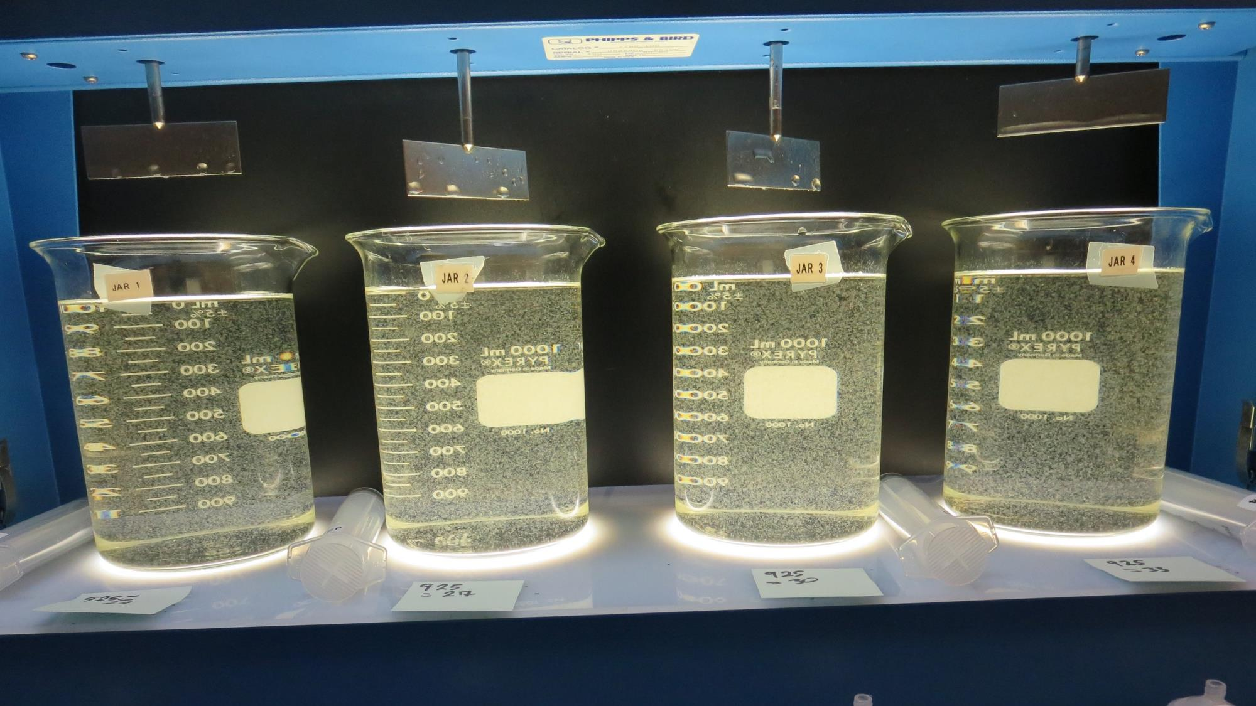
Jars 1-4: End of 5-minute flocculation (30 RPM) duration.
24 mg/L 925
Filtrate 0.13 NTU
UVT: 89.8%
UVA: 0.047/cm
Settled: 0.58 NTU
27 mg/L 925
Filtrate 0.12 NTU
UVT: 90.0%
UVA: 0.046/cm
Settled: 0.58 NTU
30 mg/L 925
Filtrate 0.12 NTU
UVT: -%
UVA: -/cm
Settled: 0.75 NTU
33 mg/L 925
Filtrate 0.11 NTU
UVT: 90.6%
UVA: 0.043/cm
Settled: 0.53 NTU

Slide 14
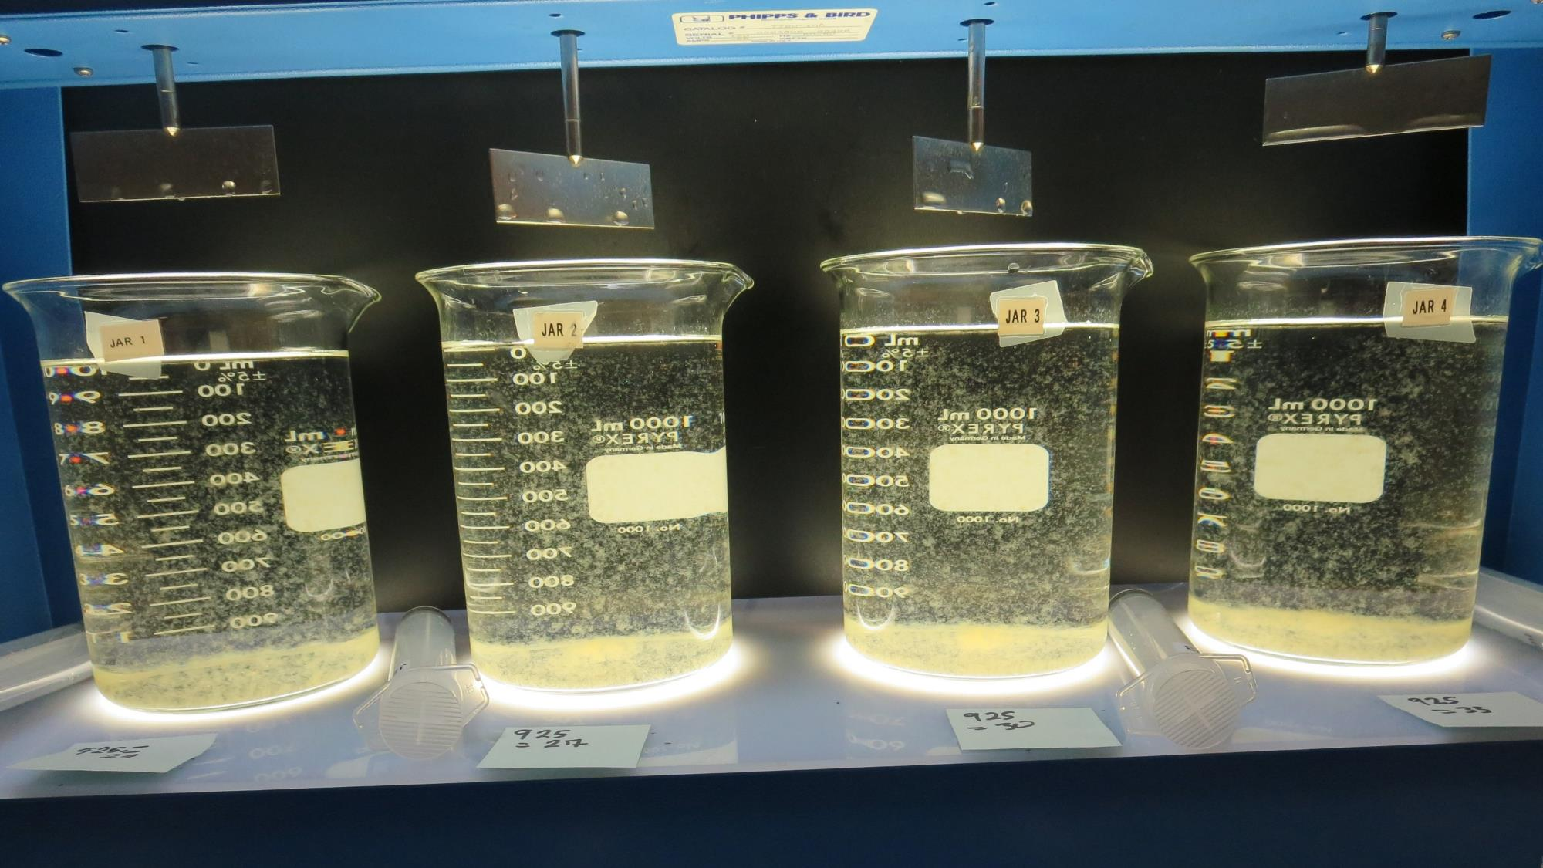
Jars 1-4: After 5 min of settling, 25 mL is syringed for filterability and %UVT/UVA.

Slide 15
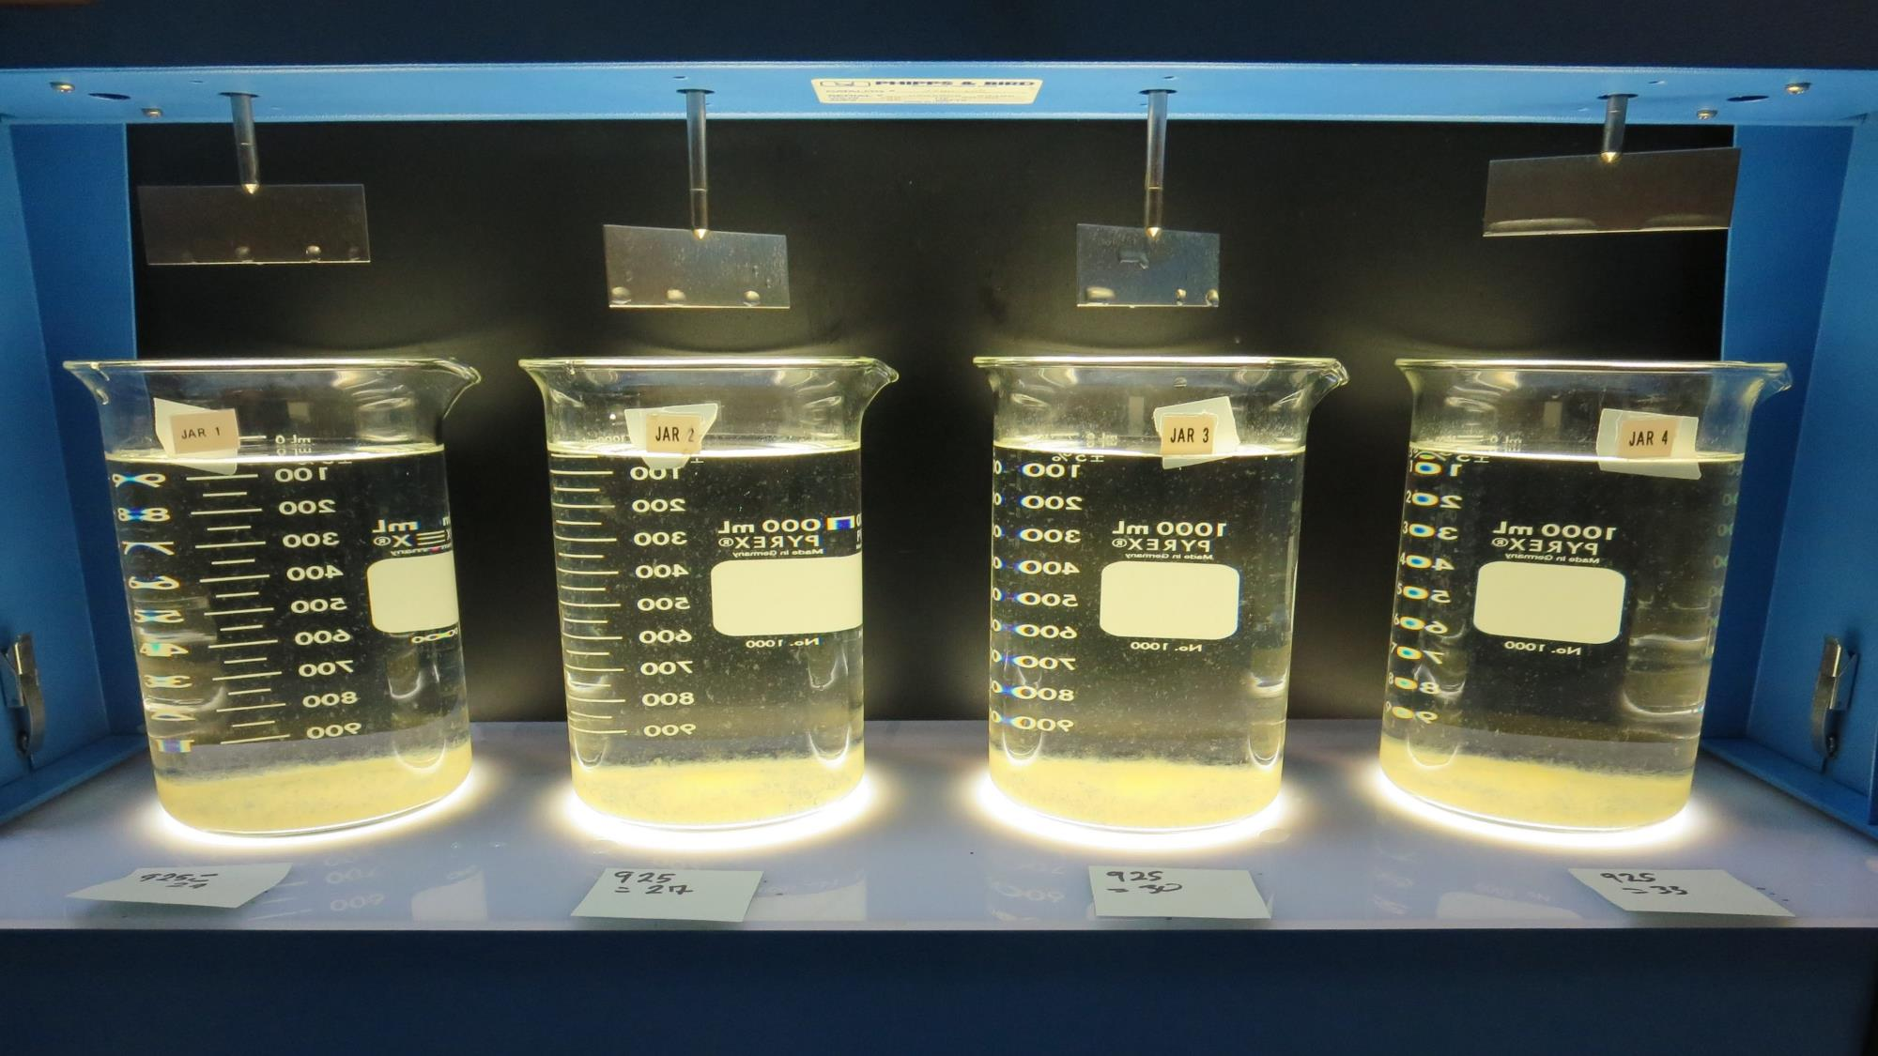
Jars 1-4: After 25-minutes of settling, settled water turbidity is taken.
24 mg/L 925
Filtrate 0.13 NTU
UVT: 89.8%
UVA: 0.047/cm
Settled: 0.58 NTU
27 mg/L 925
Filtrate 0.12 NTU
UVT: 90.0%
UVA: 0.046/cm
Settled: 0.58 NTU
30 mg/L 925
Filtrate 0.12 NTU
UVT: -%
UVA: -/cm
Settled: 0.75 NTU
33 mg/L 925
Filtrate 0.11 NTU
UVT: 90.6%
UVA: 0.043/cm
Settled: 0.53 NTU

Slide 16
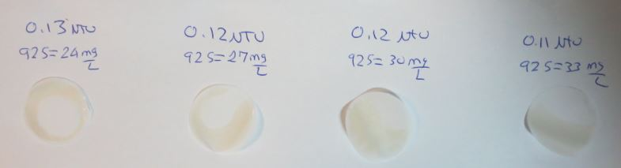
Visual of Filterability of Jars 1-4

Slide 17
Jars 5-8 Test
Flash Mix 60 Sec (200 RPM)
Floc Mix 5 min (30 RPM)
Applied Coagulant
7% Acid Alum

Slide 18
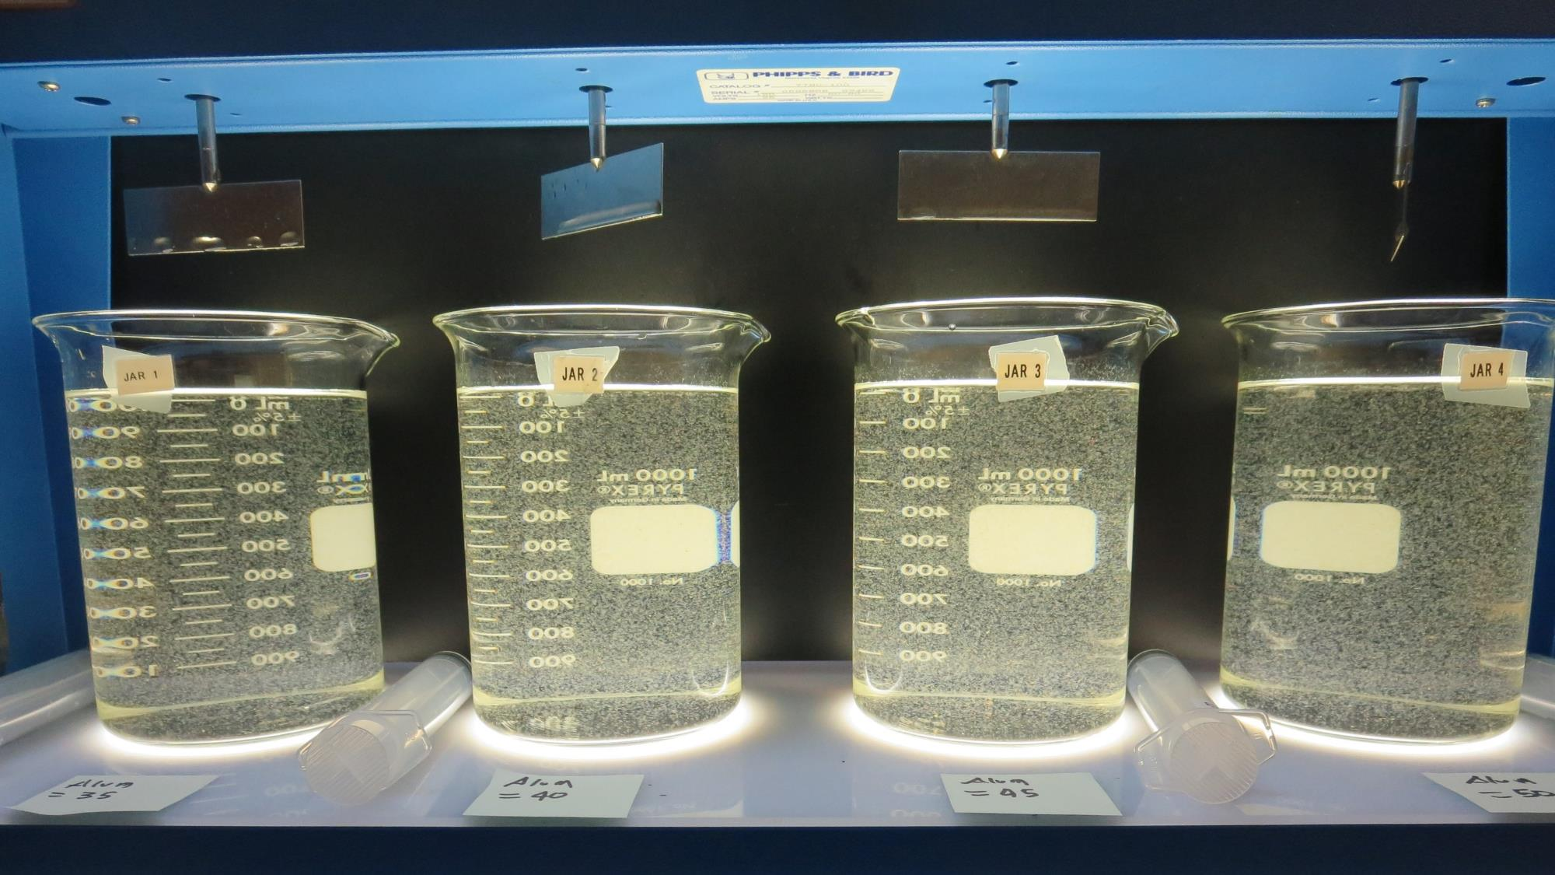
Jars 5-8: End of 5-minute flocculation (30 RPM) duration.
35 mg/L 7% Acid Alum
Filtrate 0.13 NTU
UVT: 90.0%
UVA: 0.046/cm
Settled: 0.79 NTU
40 mg/L 7% Acid Alum
Filtrate 0.12 NTU
UVT: 90.9%
UVA: 0.041/cm
Settled: 0.69 NTU
45 mg/L 7% Acid Alum
Filtrate 0.08 NTU
UVT: 91.1%
UVA: 0.039/cm
Settled: 0.76 NTU
50 mg/L 7% Acid Alum
Filtrate 0.07 NTU
UVT: 92.3%
UVA: 0.035/cm
Settled: 0.62 NTU

Slide 19
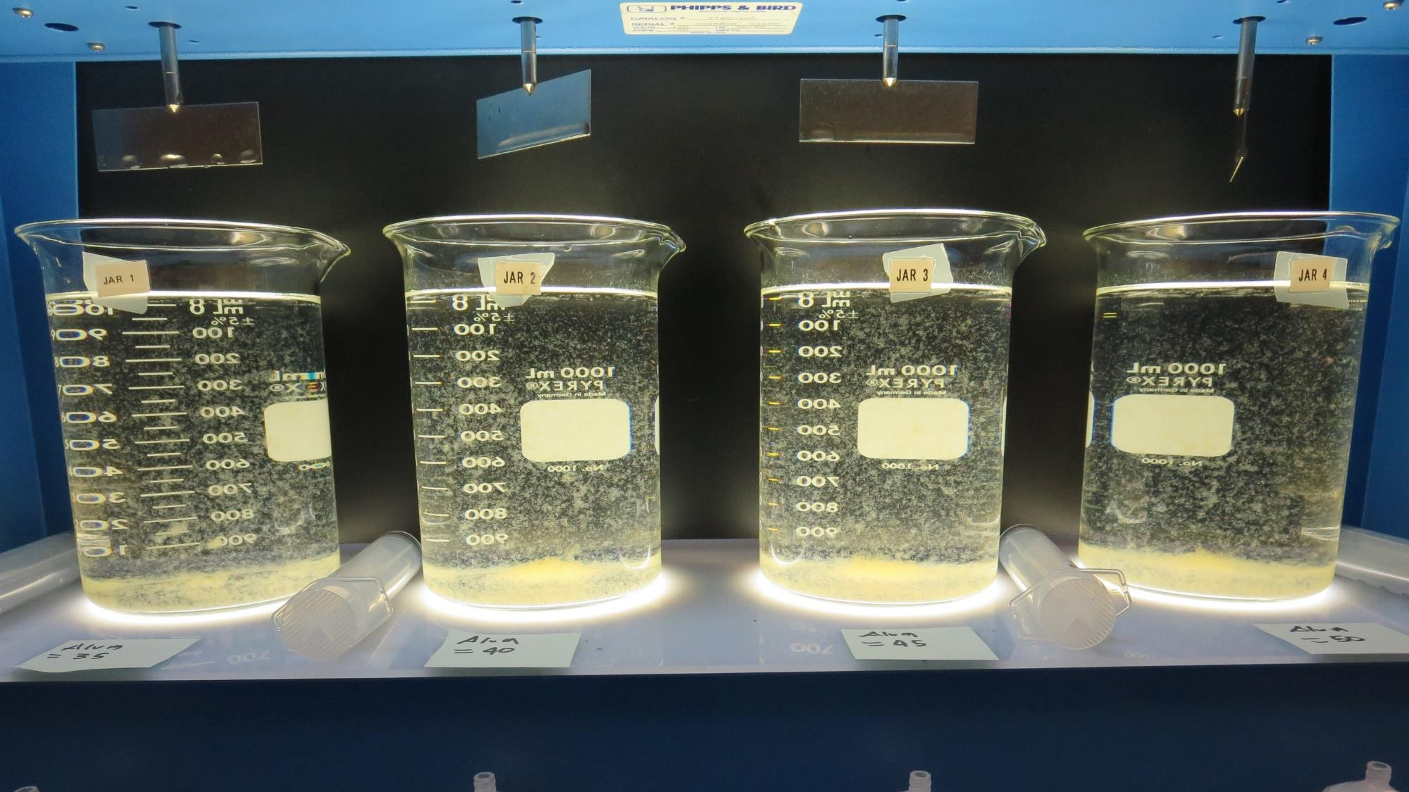
Jars 5-8: After 5 min of settling, 25 mL is syringed for filterability and %UVT/UVA.

Slide 20
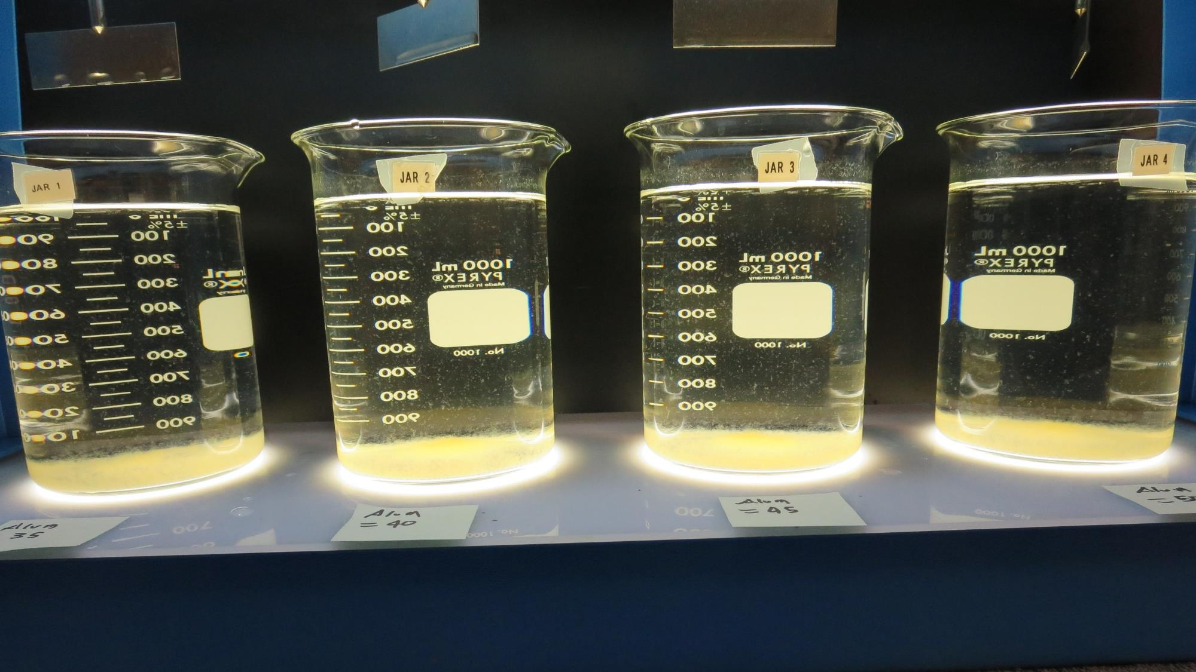
Jars 5-8: After 25-minutes of settling, settled water turbidity is taken.
35 mg/L 7% Acid Alum
Filtrate 0.13 NTU
UVT: 90.0%
UVA: 0.046/cm
Settled: 0.79 NTU
40 mg/L 7% Acid Alum
Filtrate 0.12 NTU
UVT: 90.9%
UVA: 0.041/cm
Settled: 0.69 NTU
45 mg/L 7% Acid Alum
Filtrate 0.08 NTU
UVT: 91.1%
UVA: 0.039/cm
Settled: 0.76 NTU
50 mg/L 7% Acid Alum
Filtrate 0.07 NTU
UVT: 92.3%
UVA: 0.035/cm
Settled: 0.62 NTU

Slide 21
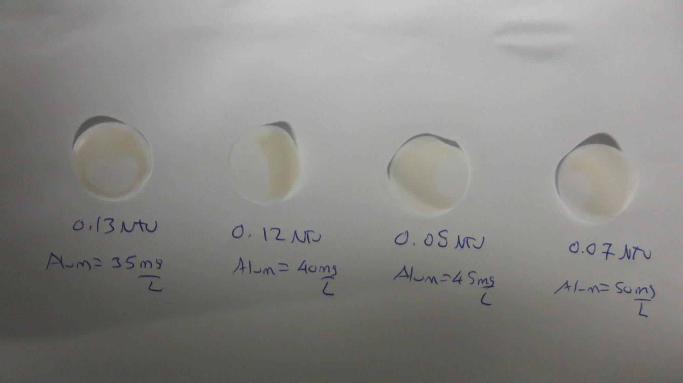
Visual of Filterability of Jars 5-8

Slide 22
Jars 9-12 Test
Flash Mix 60 Sec (200 RPM)
Floc Mix 5 min (30 RPM)
Applied Coagulant
AH-710

Slide 23
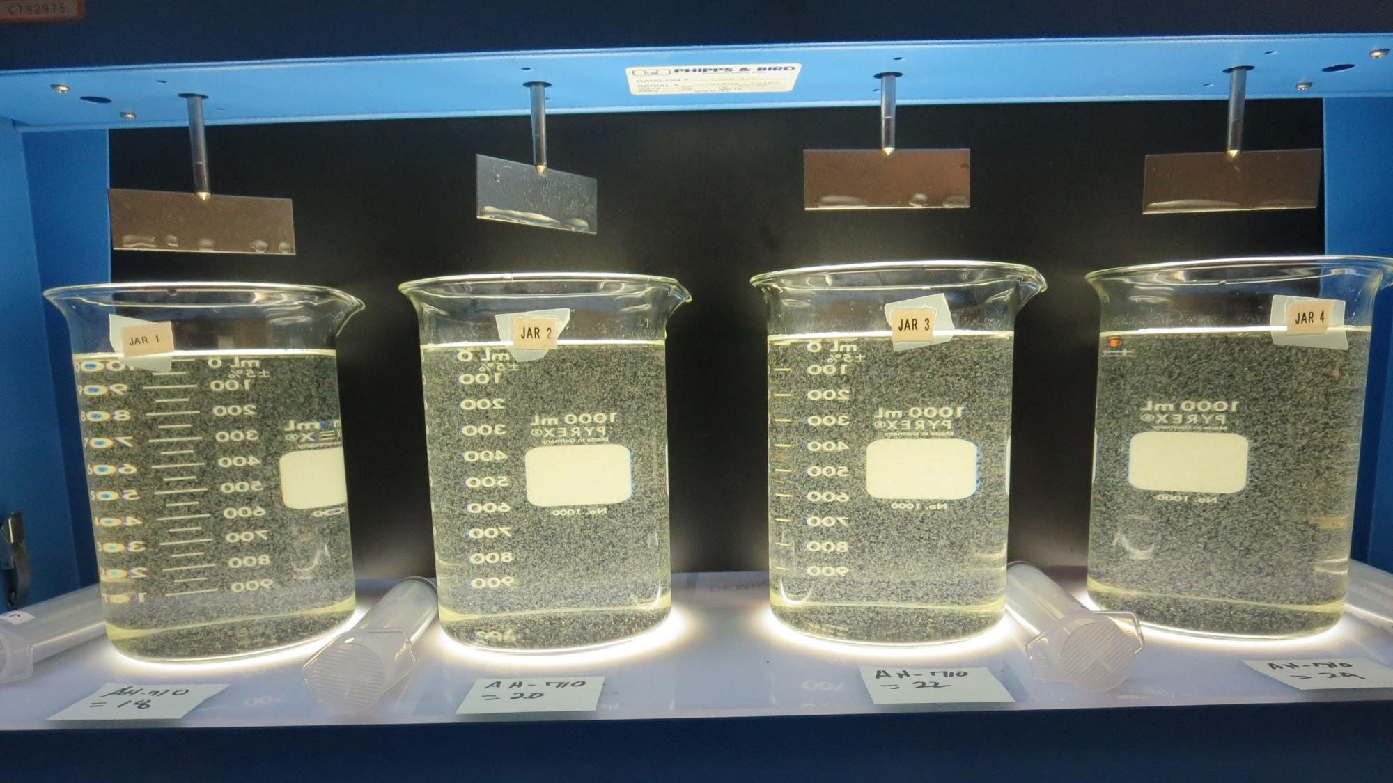
Jars 9-12: End of 5-minute flocculation (30 RPM) duration.
18 mg/L AH-710
Filtrate 0.09 NTU
UVT: 89.2%
UVA: 0.050/cm
Settled: 0.84 NTU
20 mg/L AH-710
Filtrate 0.08 NTU
UVT: 89.5%
UVA: 0.048/cm
Settled: 0.75 NTU
22 mg/L AH-710
Filtrate 0.11 NTU
UVT: 89.9%
UVA: 0.046/cm
Settled: 0.60 NTU
24 mg/L AH-710
Filtrate 0.10 NTU
UVT: 90.4%
UVA: 0.044/cm
Settled: 0.60 NTU

Slide 24
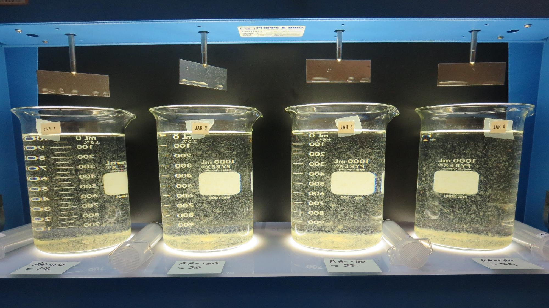
Jars 9-12: After 5 min of settling, 25 mL is syringed for filterability and %UVT/UVA.

Slide 25
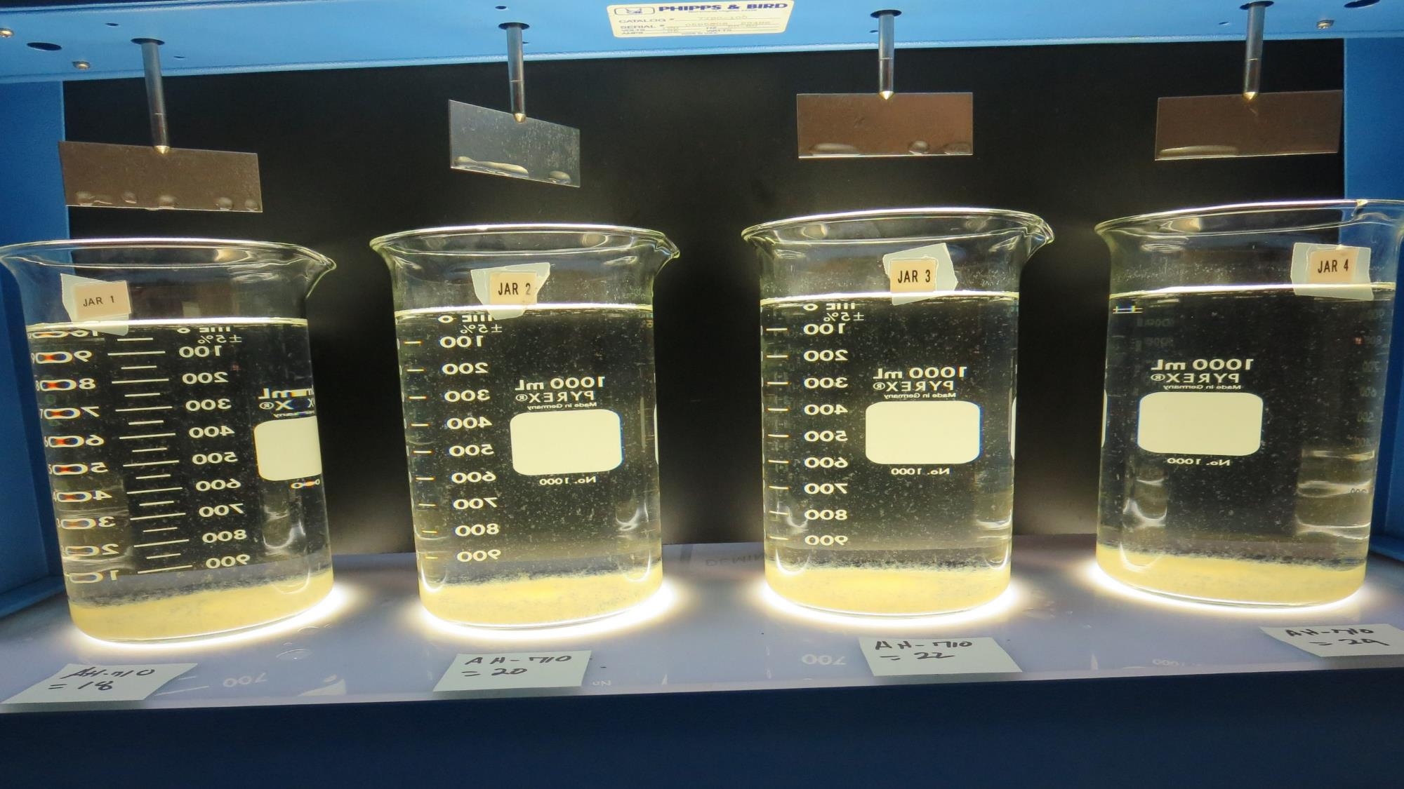
Jars 9-12: After 25-minutes of settling, settled water turbidity is taken.
18 mg/L AH-710
Filtrate 0.09 NTU
UVT: 89.2%
UVA: 0.050/cm
Settled: 0.84 NTU
20 mg/L AH-710
Filtrate 0.08 NTU
UVT: 89.5%
UVA: 0.048/cm
Settled: 0.75 NTU
22 mg/L AH-710
Filtrate 0.11 NTU
UVT: 89.9%
UVA: 0.046/cm
Settled: 0.60 NTU
24 mg/L AH-710
Filtrate 0.10 NTU
UVT: 90.4%
UVA: 0.044/cm
Settled: 0.60 NTU

Slide 26
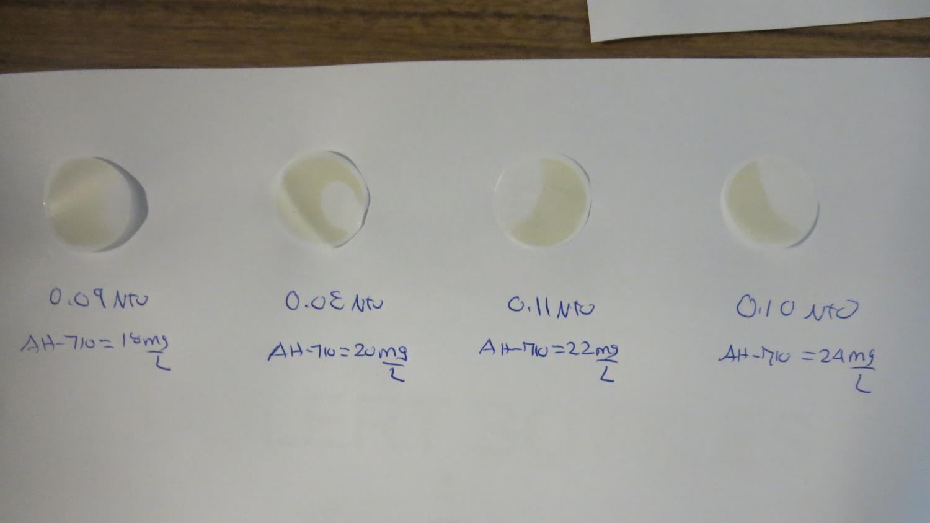
Visual of Filterability of Jars 9-12

Slide 27
Jars 13-16 Test
Flash Mix 60 Sec (200 RPM)
Floc Mix 5 min (30 RPM)
Applied Coagulant
7066

Slide 28
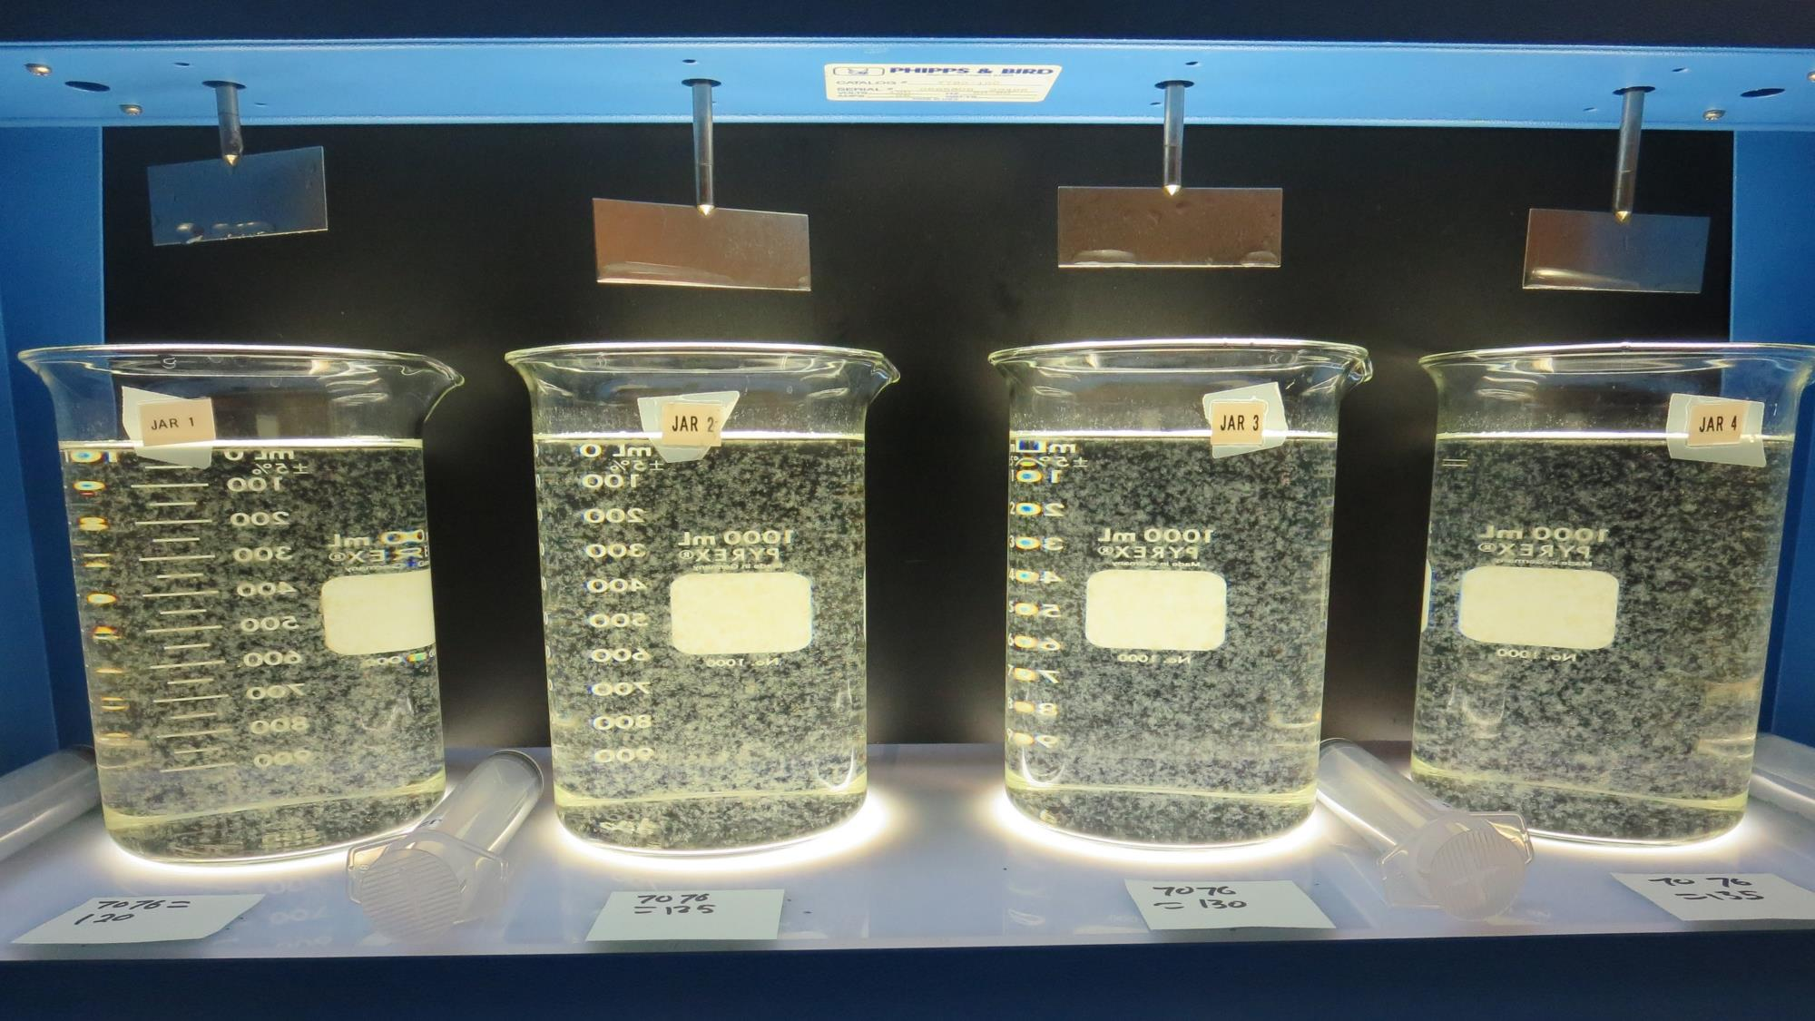
Jars 13-16: End of 5-minute flocculation (30 RPM) duration.
120 mg/L 7066
Filtrate 0.08 NTU
UVT: 92.4%
UVA: 0.034/cm
Settled: 0.17 NTU
125 mg/L 7066
Filtrate 0.08 NTU
UVT: 92.6%
UVA: 0.033/cm
Settled: 0.18 NTU
130 mg/L 7066
Filtrate 0.06 NTU
UVT: 92.9%
UVA: 0.032/cm
Settled: 0.35 NTU
135 mg/L 7066
Filtrate 0.06 NTU
UVT: 92.8%
UVA: 0.032/cm
Settled: 0.18 NTU

Slide 29
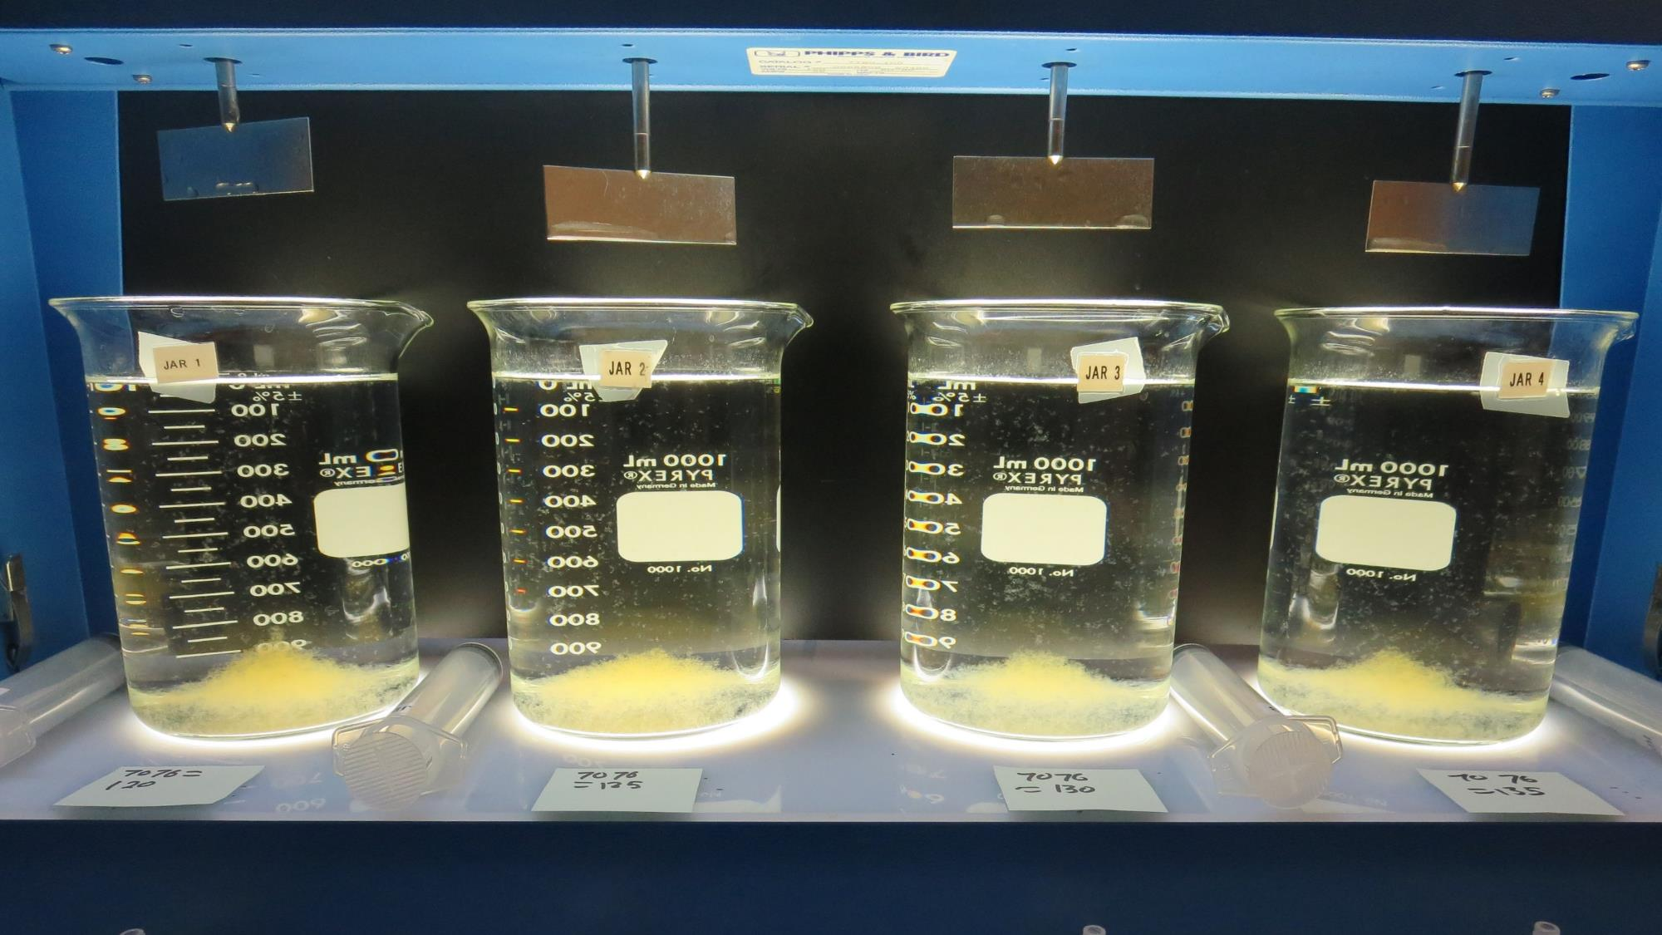
Jars 13-16: After 5 min of settling, 25 mL is syringed for filterability and %UVT/UVA.

Slide 30
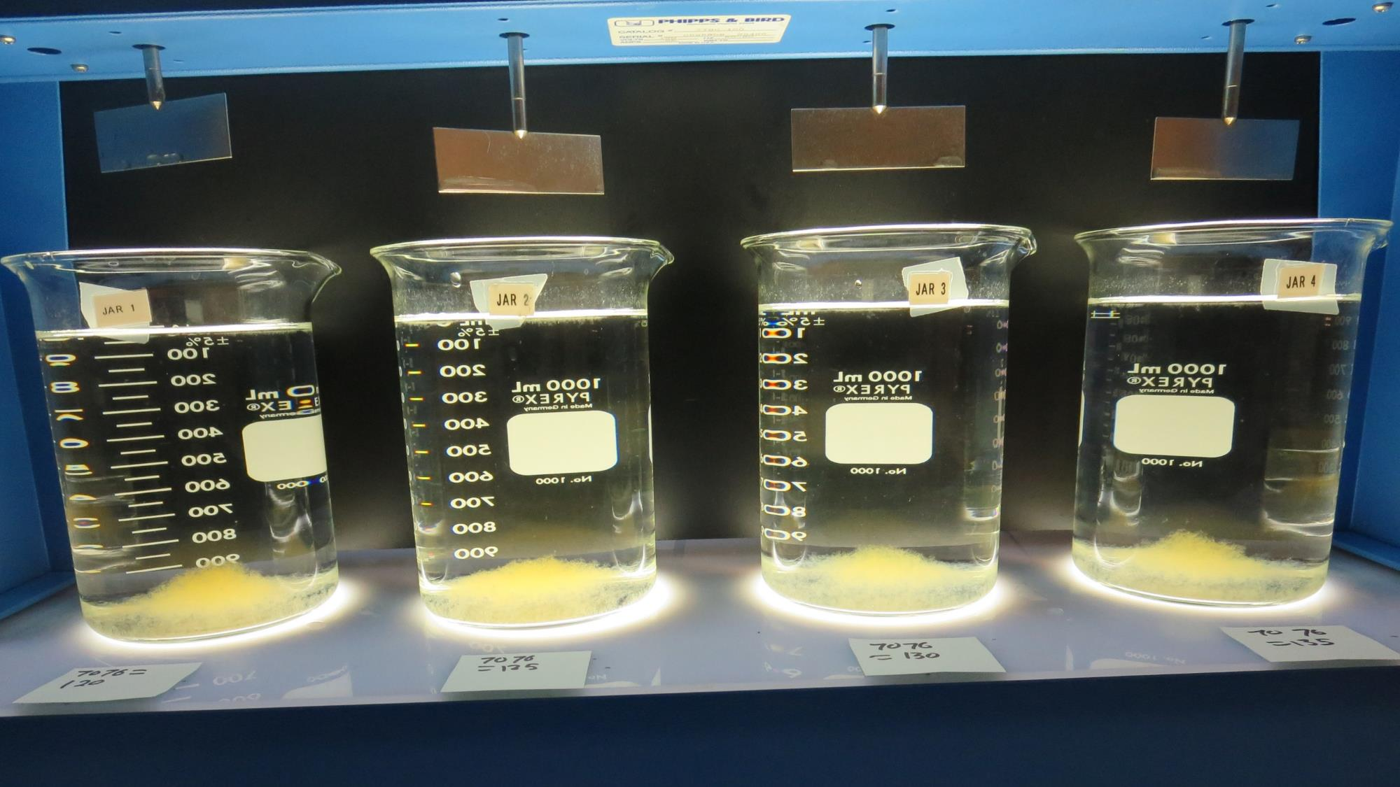
Jars 13-16: After 25-minutes of settling, settled water turbidity is taken.
120 mg/L 7066
Filtrate 0.08 NTU
UVT: 92.4%
UVA: 0.034/cm
Settled: 0.17 NTU
125 mg/L 7066
Filtrate 0.08 NTU
UVT: 92.6%
UVA: 0.033/cm
Settled: 0.18 NTU
130 mg/L 7066
Filtrate 0.06 NTU
UVT: 92.9%
UVA: 0.032/cm
Settled: 0.35 NTU
135 mg/L 7066
Filtrate 0.06 NTU
UVT: 92.8%
UVA: 0.032/cm
Settled: 0.18 NTU

Slide 31
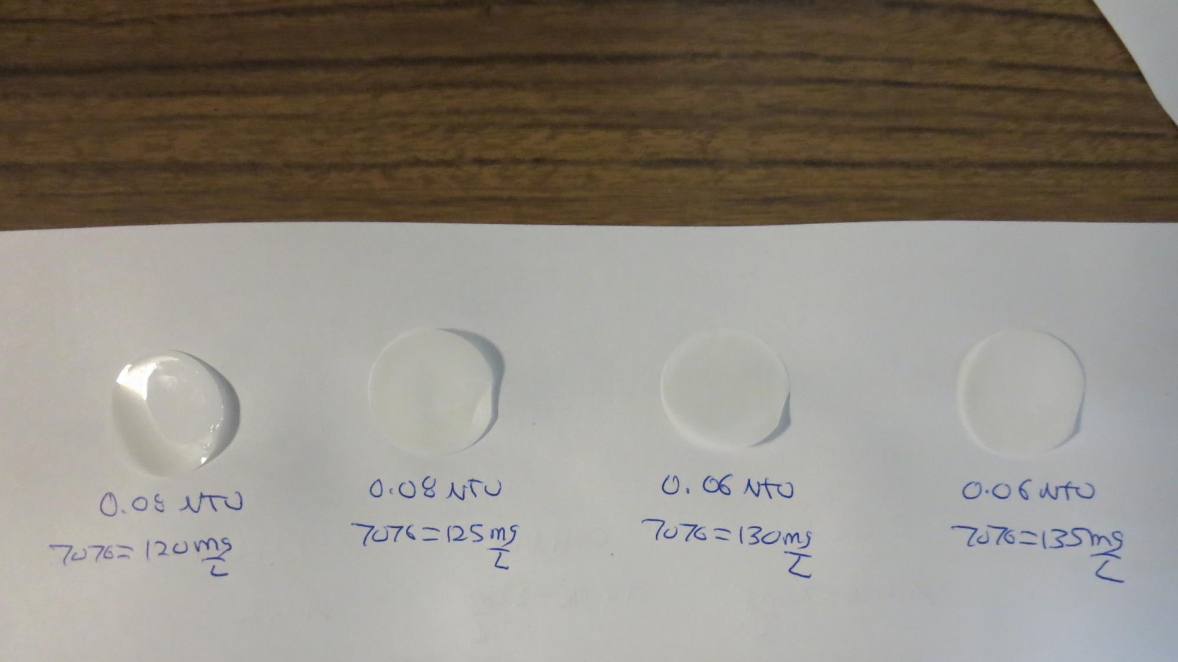
Visual of Filterability of Jars 13-16

Slide 32
Jars 17-20 Test
Flash Mix 60 Sec (200 RPM)
Floc Mix 5 min (30 RPM)
Applied Coagulant
7% Acid Alum

Slide 33
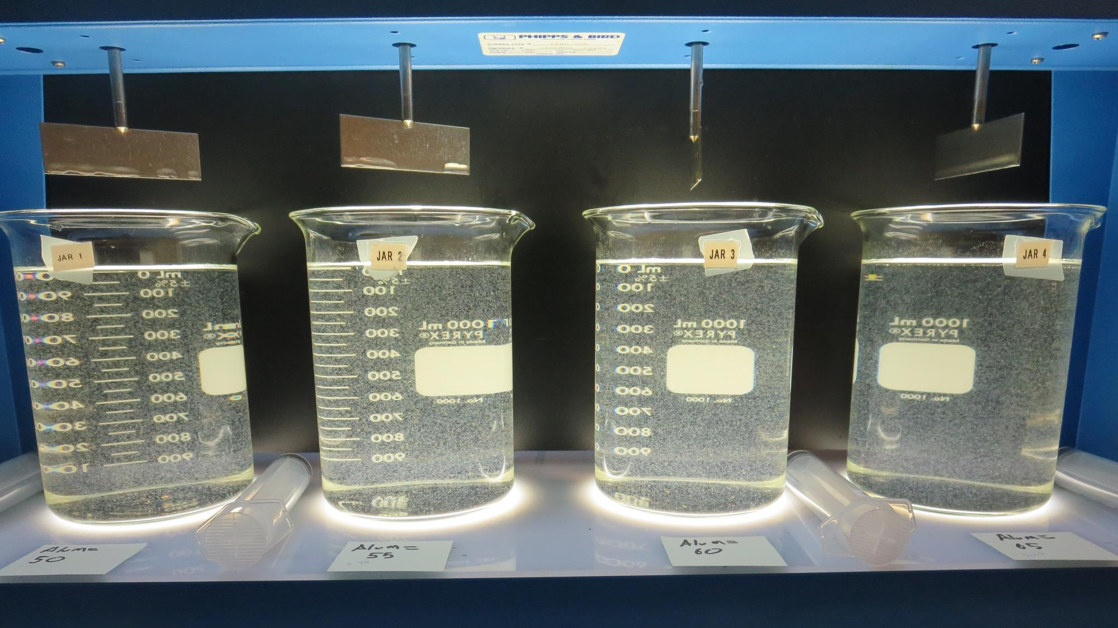
Jars 17-20: End of 5-minute flocculation (30 RPM) duration.
50 mg/L 7% Acid Alum
Filtrate 0.08 NTU
UVT: 92.7%
UVA: 0.033/cm
Settled: 0.48 NTU
55 mg/L 7% Acid Alum
Filtrate 0.07 NTU
UVT: 92.9%
UVA: 0.032/cm
Settled: 0.61 NTU
60 mg/L 7% Acid Alum
Filtrate 0.10 NTU
UVT: 93.1%
UVA: 0.031/cm
Settled: 0.78 NTU
65 mg/L 7% Acid Alum
Filtrate 0.06 NTU
UVT: 93.5%
UVA: 0.029/cm
Settled: 0.53 NTU

Slide 34
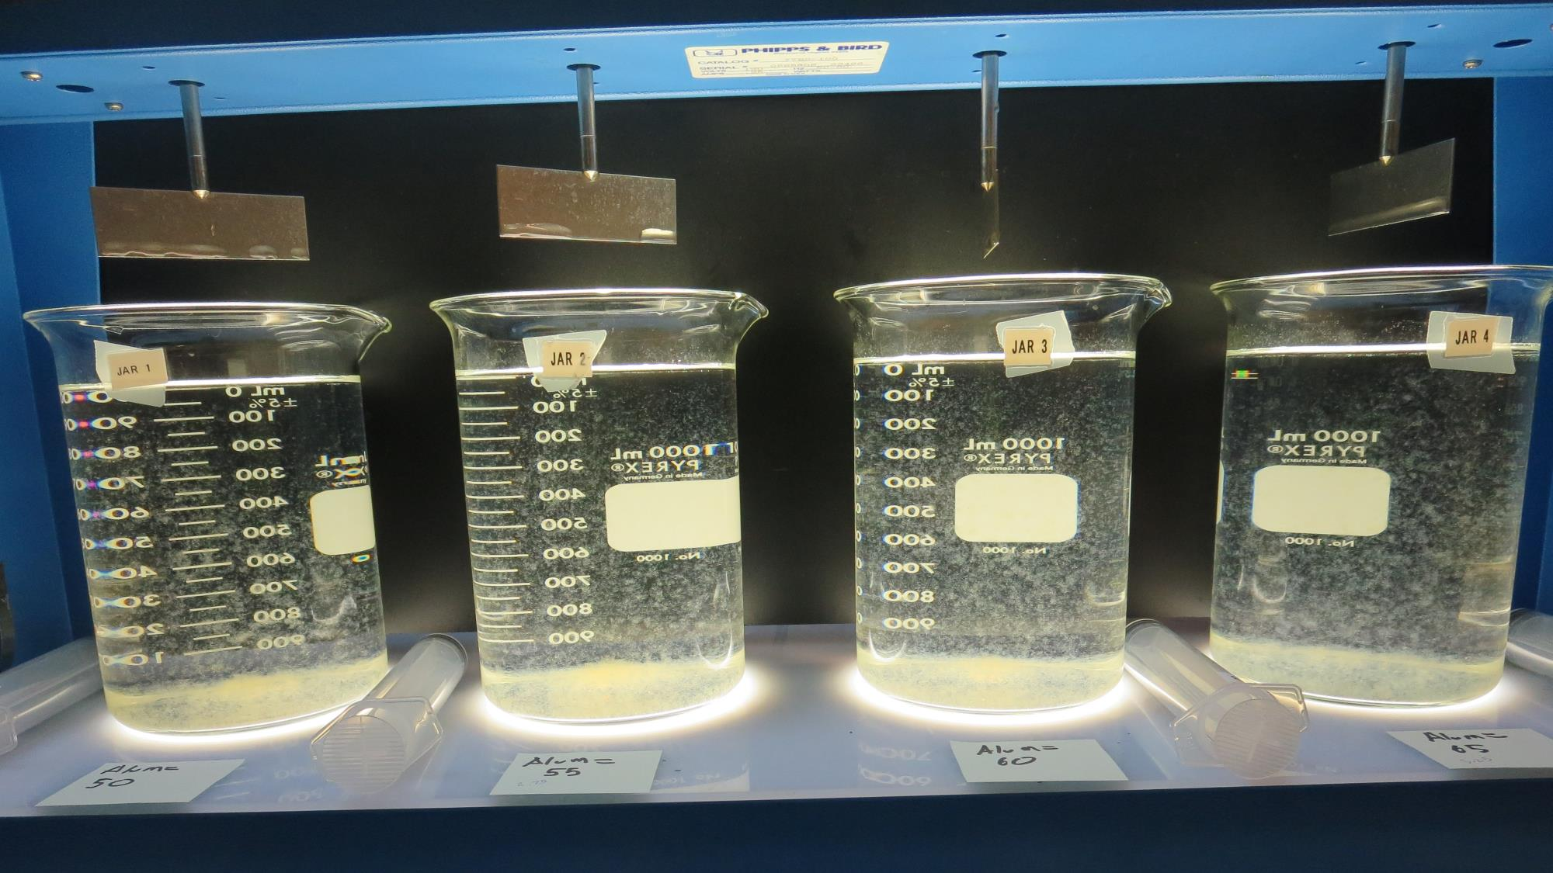
Jars 17-20: After 5 min of settling, 25 mL is syringed for filterability and %UVT/UVA.

Slide 35
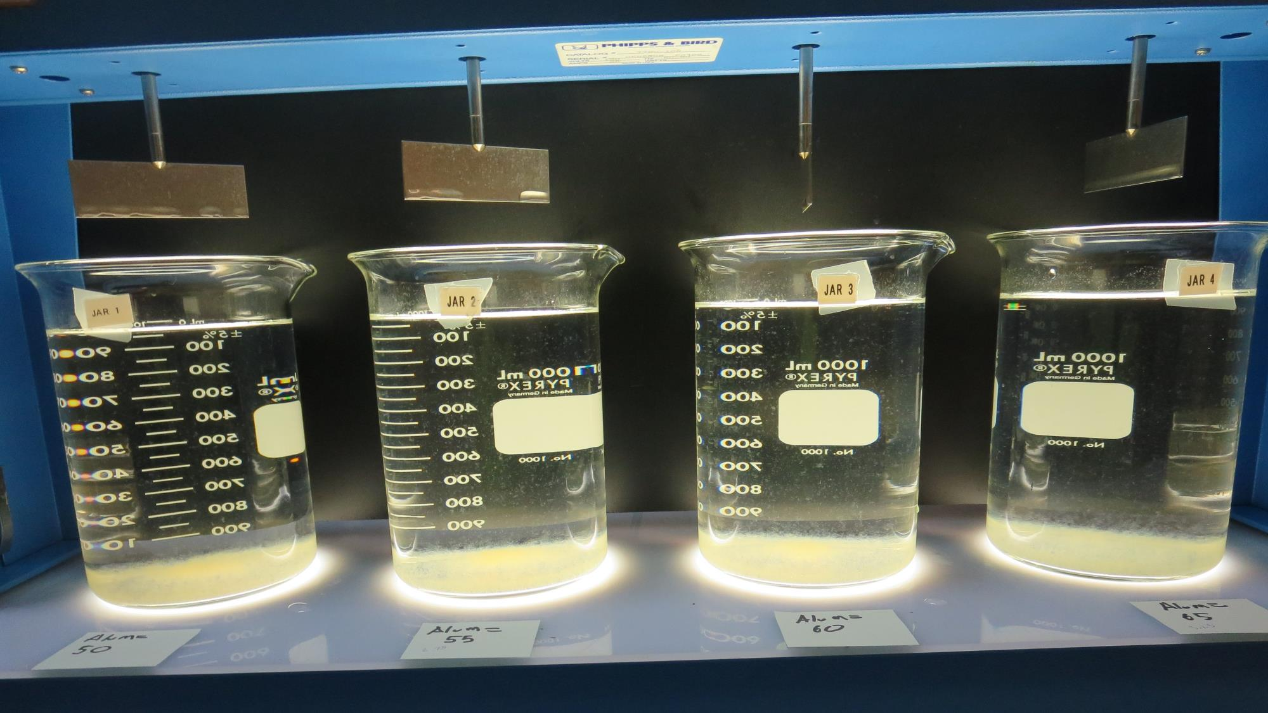
Jars 17-20: After 25-minutes of settling, settled water turbidity is taken.
50 mg/L 7% Acid Alum
Filtrate 0.08 NTU
UVT: 92.7%
UVA: 0.033/cm
Settled: 0.48 NTU
55 mg/L 7% Acid Alum
Filtrate 0.07 NTU
UVT: 92.9%
UVA: 0.032/cm
Settled: 0.61 NTU
60 mg/L 7% Acid Alum
Filtrate 0.10 NTU
UVT: 93.1%
UVA: 0.031/cm
Settled: 0.78 NTU
65 mg/L 7% Acid Alum
Filtrate 0.06 NTU
UVT: 93.5%
UVA: 0.029/cm
Settled: 0.53 NTU

Slide 36
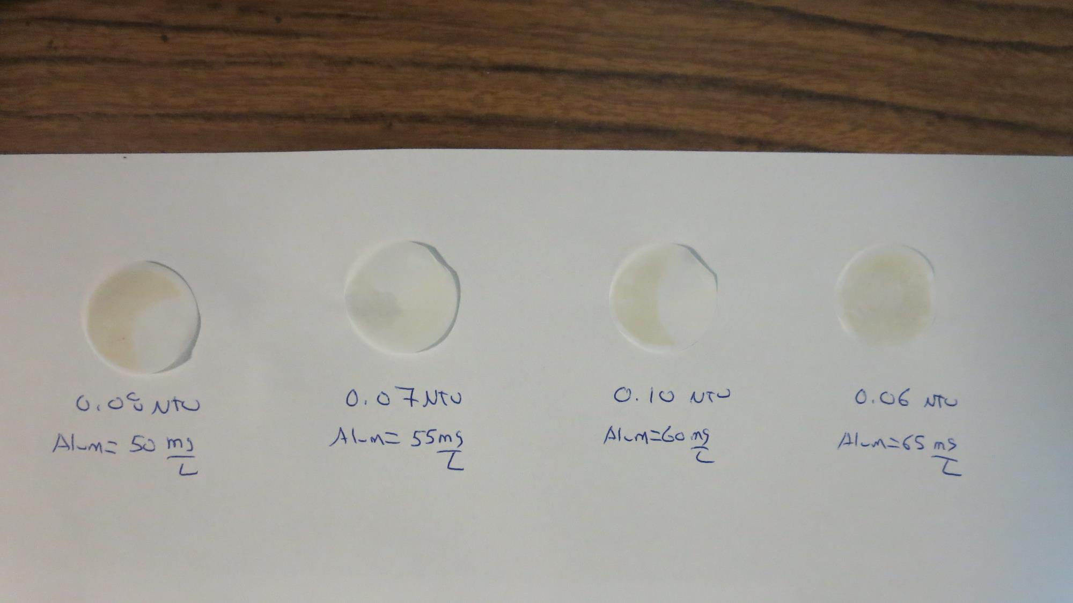
Visual of Filterability of Jars 17-20

Slide 37
Jars 21-23 Test
Flash Mix 60 Sec (200 RPM)
Floc Mix 5 min (30 RPM)
Applied Coagulant
7% Acid Alum

Slide 38
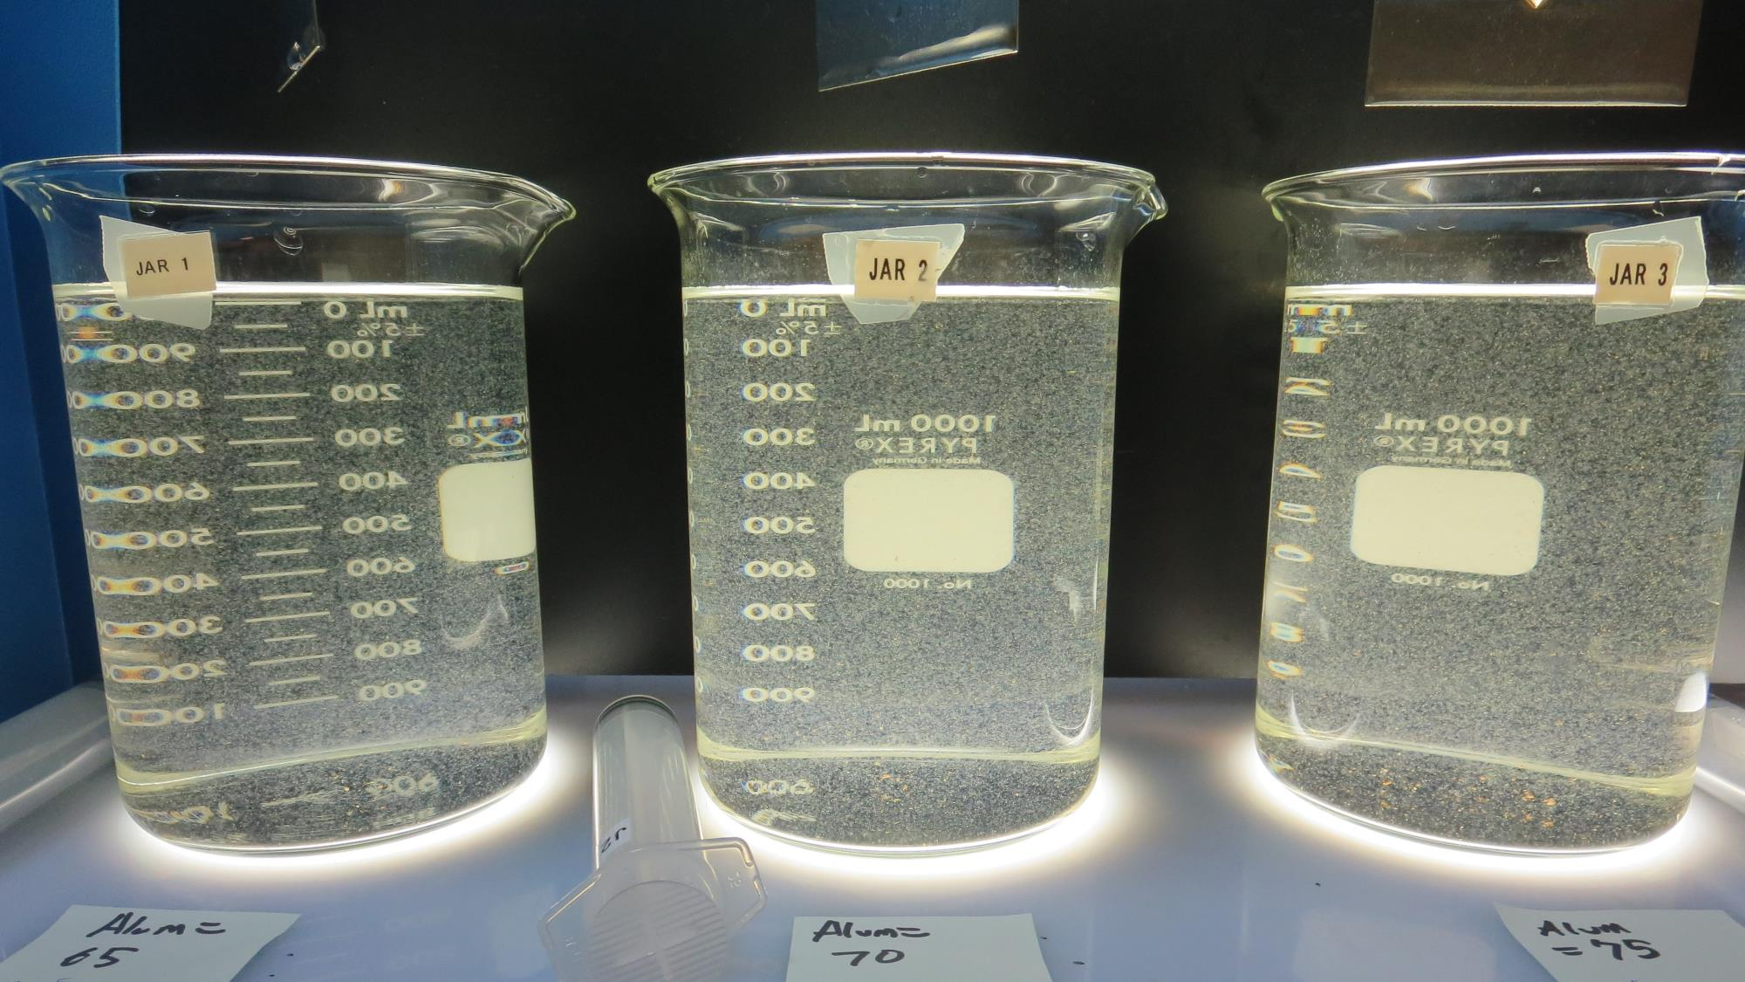
Jars 21-23: End of 5-minute flocculation (30 RPM) duration.
65 mg/L 7% Acid Alum
Filtrate 0.09 NTU
UVT: 93.5%
UVA: 0.029/cm
Settled: 0.73 NTU
70 mg/L 7% Acid Alum
Filtrate 0.10 NTU
UVT: 93.7%
UVA: 0.028/cm
Settled: 0.69 NTU
75 mg/L 7% Acid Alum
Filtrate 0.07 NTU
UVT: 94.1%
UVA: 0.026/cm
Settled: 0.64 NTU

Slide 39
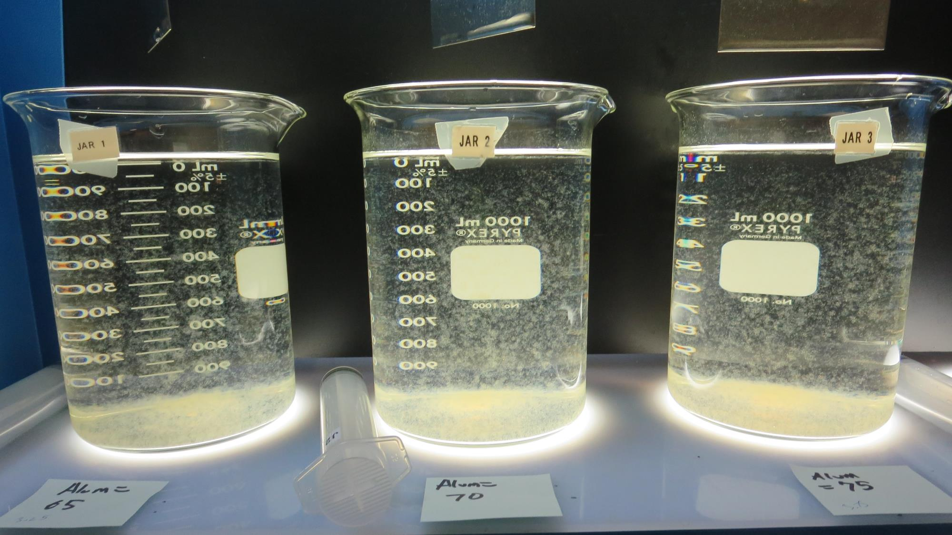
Jars 21-23: After 5 min of settling, 25 mL is syringed for filterability and %UVT/UVA.

Slide 40
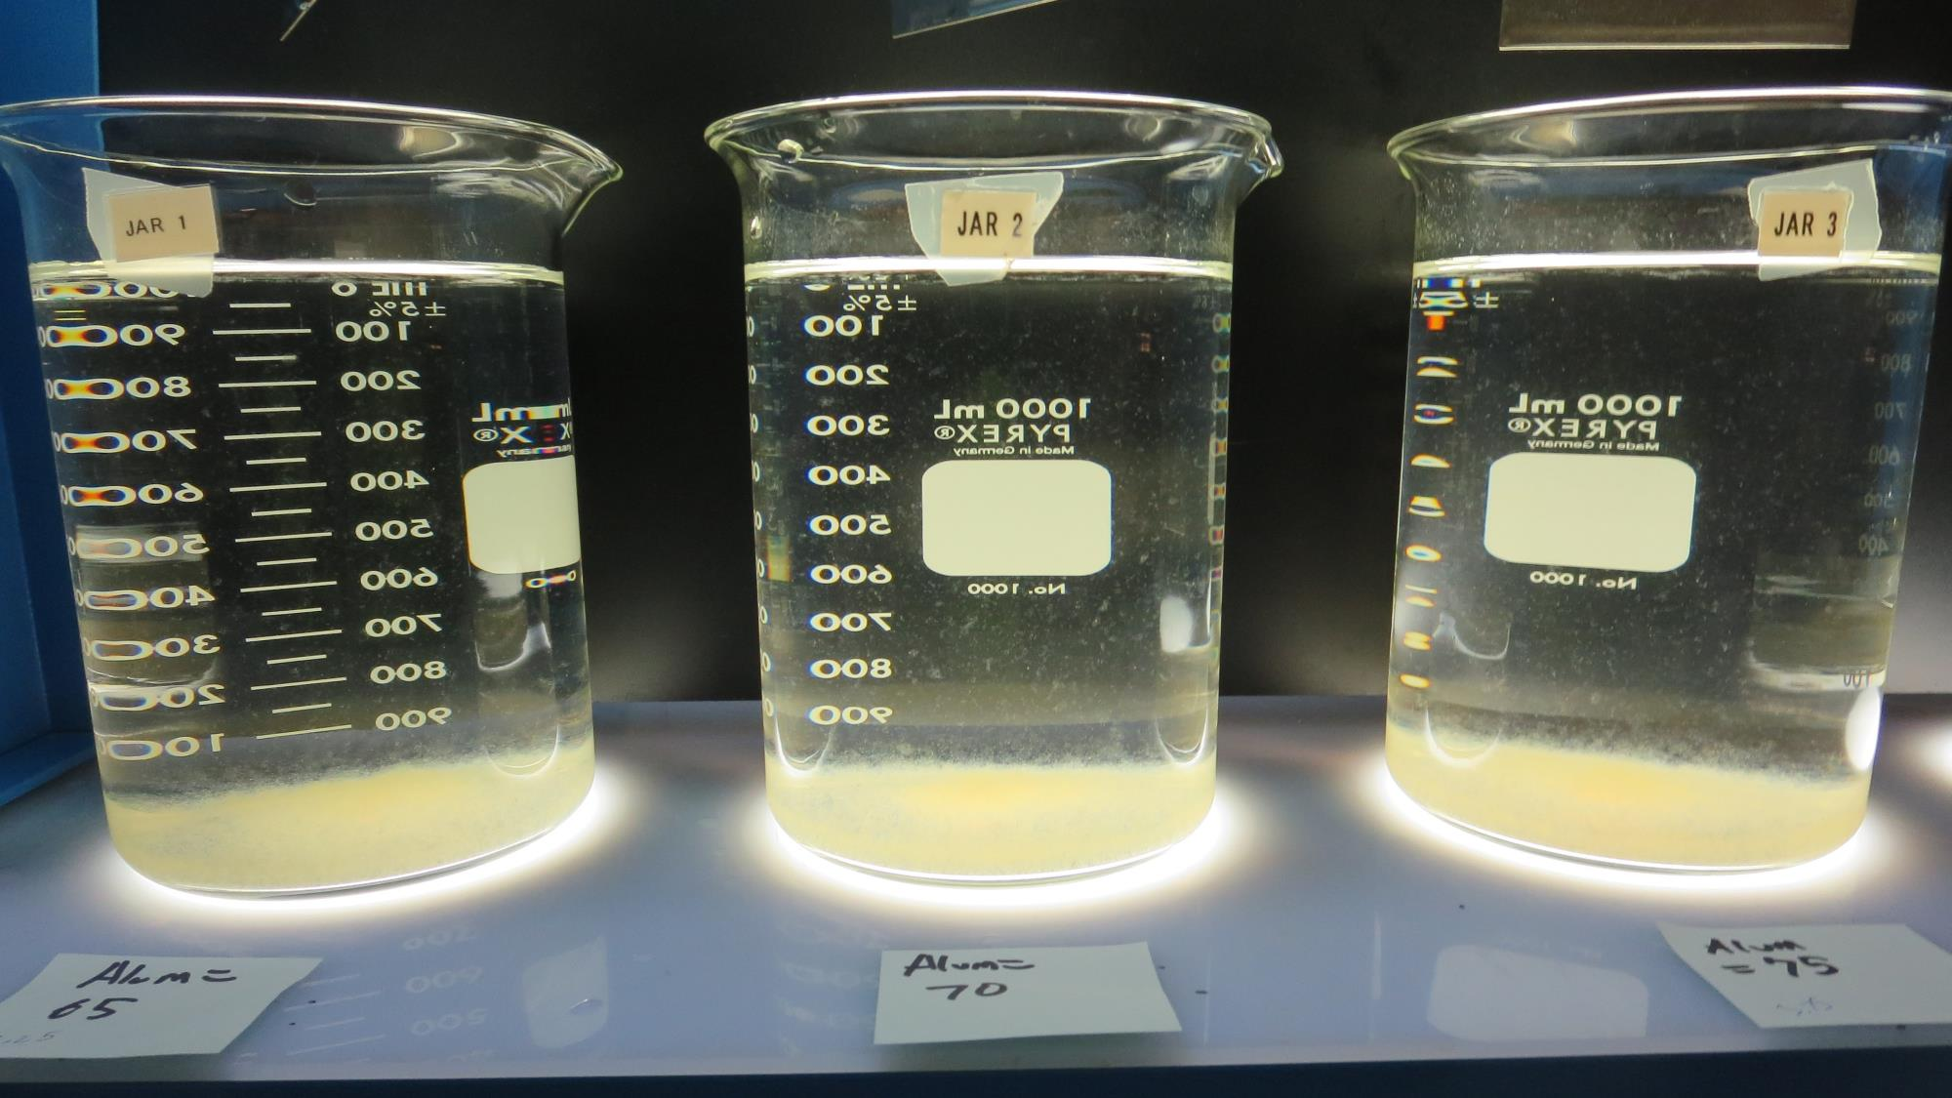
Jars 21-23: After 25-minutes of settling, settled water turbidity is taken.
65 mg/L 7% Acid Alum
Filtrate 0.09 NTU
UVT: 93.5%
UVA: 0.029/cm
Settled: 0.73 NTU
70 mg/L 7% Acid Alum
Filtrate 0.10 NTU
UVT: 93.7%
UVA: 0.028/cm
Settled: 0.69 NTU
75 mg/L 7% Acid Alum
Filtrate 0.07 NTU
UVT: 94.1%
UVA: 0.026/cm
Settled: 0.64 NTU

Slide 41
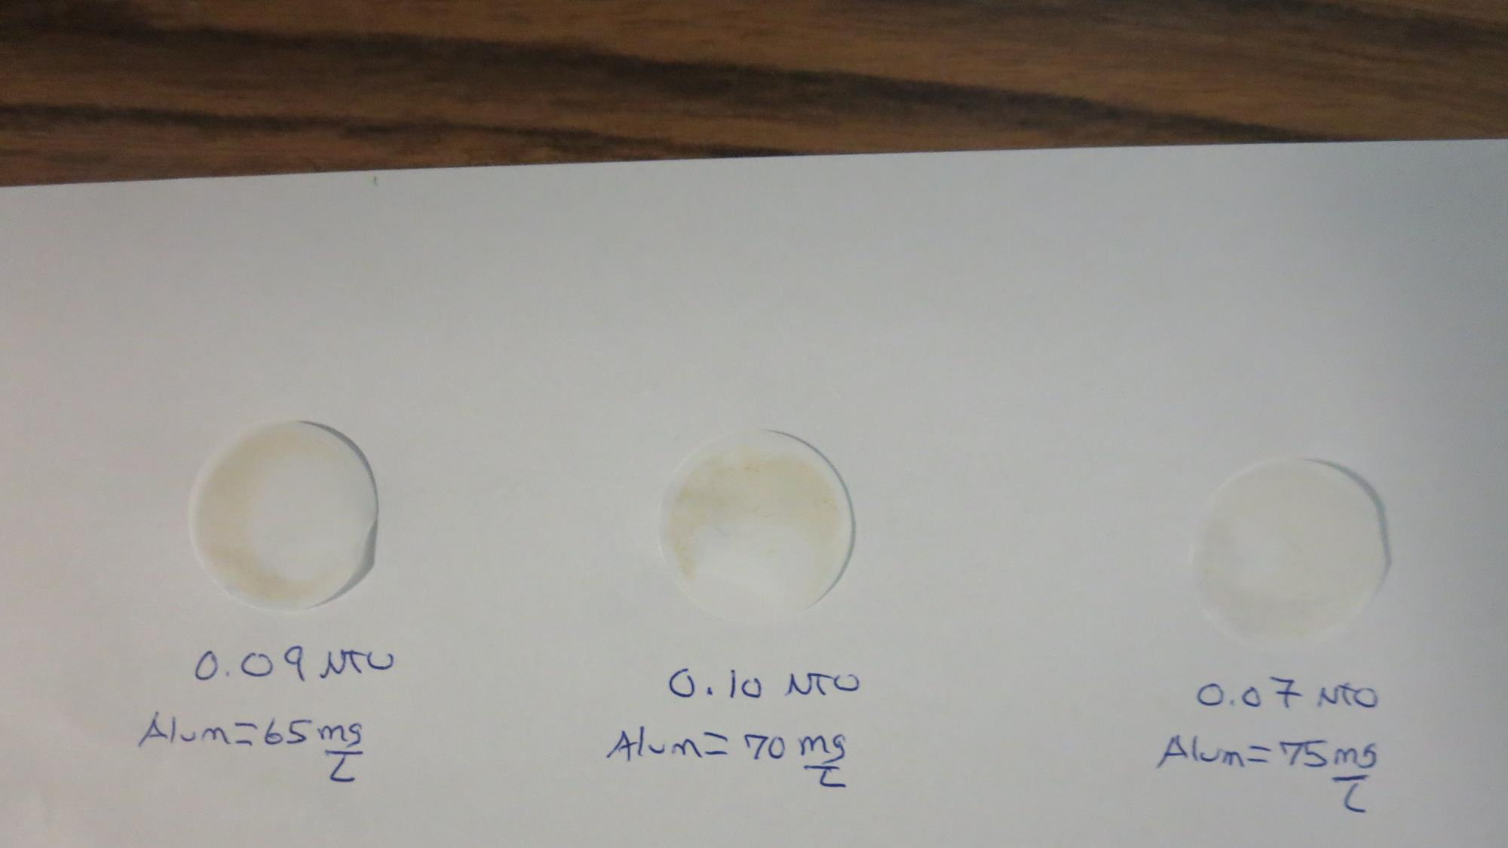
Visual of Filterability of Jars 21-23

Slide 42
Jars 24-27 Test
Flash Mix 60 Sec (200 RPM)
Floc Mix 5 min (30 RPM)
Applied Coagulant
7066

Slide 43
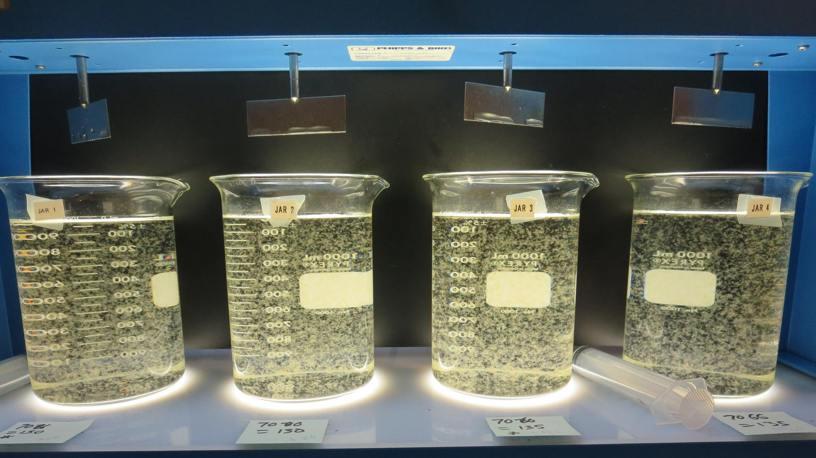
Jars 24-27: End of 5-minute flocculation (30 RPM) duration.
130 mg/L 7066
Filtrate 0.07 NTU
UVT: 92.8%
UVA: 0.032/cm
Settled: 0.19 NTU
130 mg/L 7066
Filtrate 0.07 NTU
UVT: 92.9%
UVA: 0.032/cm
Settled: 0.22 NTU
135 mg/L 7066
Filtrate 0.07 NTU
UVT: 92.9%
UVA: 0.032/cm
Settled: 0.18 NTU
135 mg/L 7066
Filtrate 0.06 NTU
UVT: 93.0%
UVA: 0.032/cm
Settled: 0.18 NTU

Slide 44
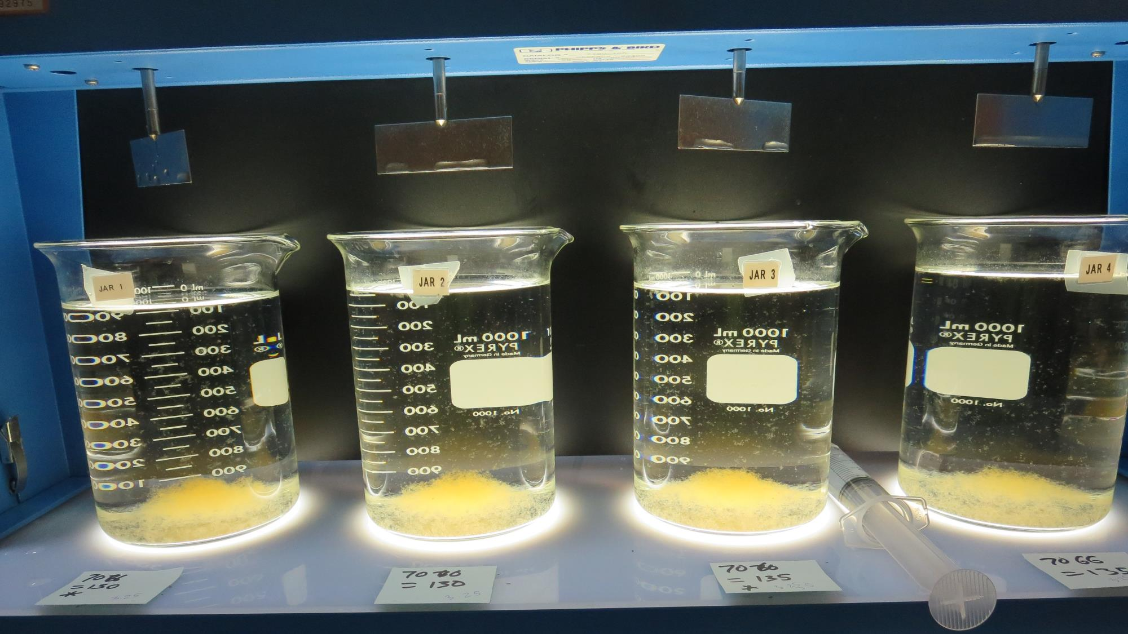
Jars 24-27: After 5 min of settling, 25 mL is syringed for filterability and %UVT/UVA.

Slide 45
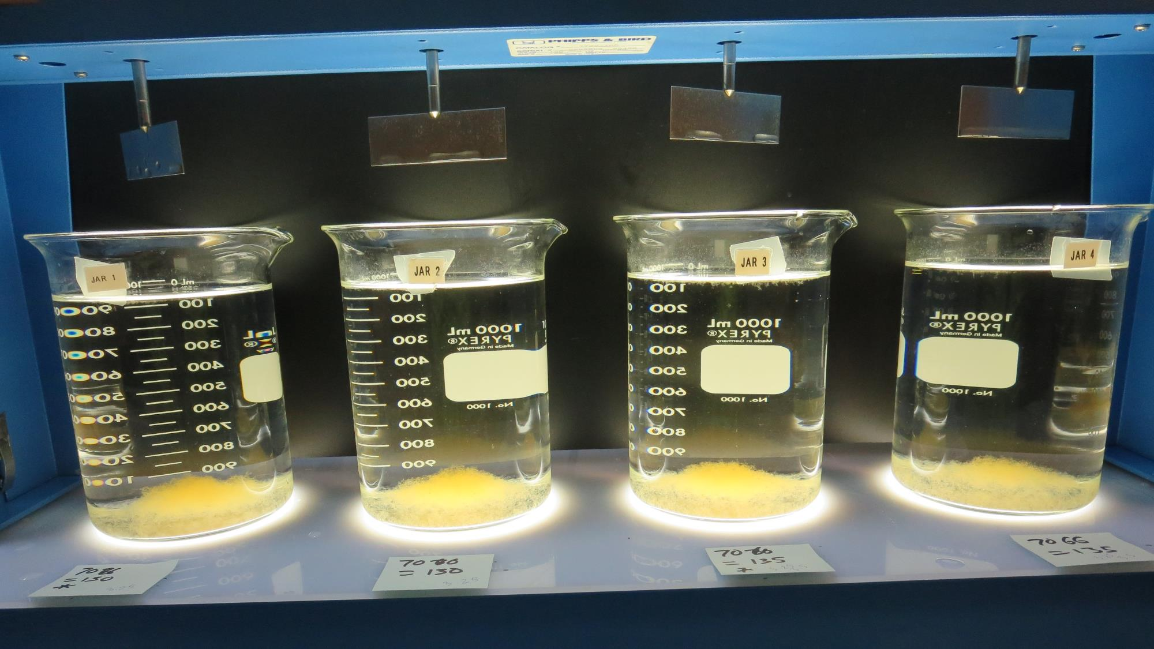
Jars 24-27: After 25-minutes of settling, settled water turbidity is taken.
130 mg/L 7066
Filtrate 0.07 NTU
UVT: 92.8%
UVA: 0.032/cm
Settled: 0.19 NTU
130 mg/L 7066
Filtrate 0.07 NTU
UVT: 92.9%
UVA: 0.032/cm
Settled: 0.22 NTU
135 mg/L 7066
Filtrate 0.07 NTU
UVT: 92.9%
UVA: 0.032/cm
Settled: 0.18 NTU
135 mg/L 7066
Filtrate 0.06 NTU
UVT: 93.0%
UVA: 0.032/cm
Settled: 0.18 NTU

Slide 46
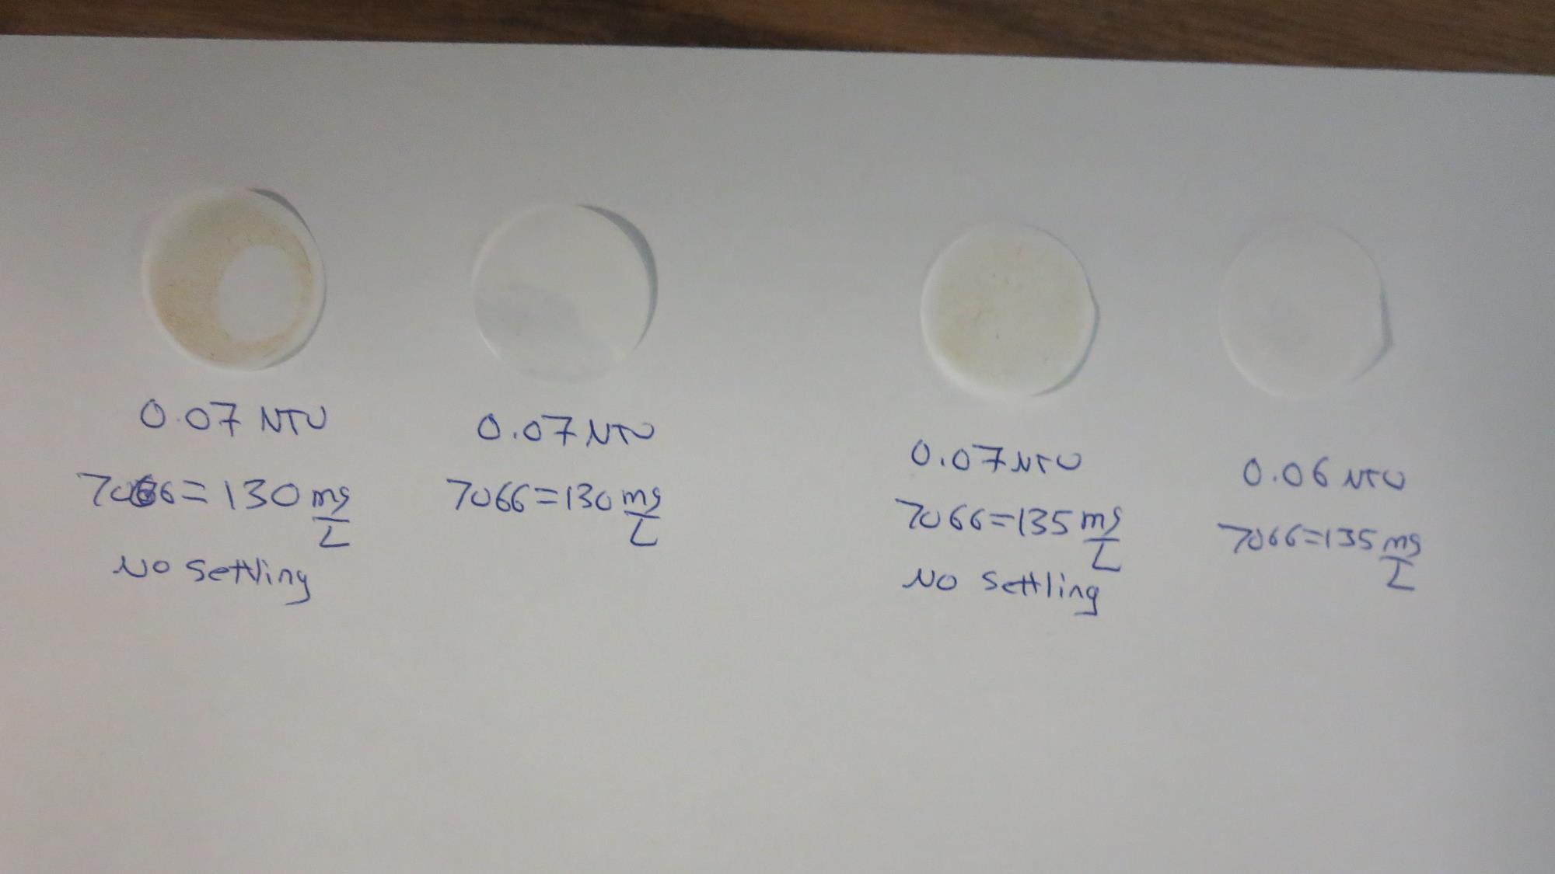
Visual of Filterability of Jars 24-27

Slide 47
Jar Testing for 1-Liter Jars:
General Procedures for Most Treatment Plants
Fill jars with source water prior to coagulant injection and set paddle speed at 30 rpm
Add chemicals (i.e., NaOCl, primary coagulant, coagulant aid) to each jar
Flash mix for 15-60 seconds (200 rpm)
Slow mix for 5 minutes (20-30 rpm)
Settled for 5 minutes. Syringe 25 mL from each jar taken 1-inch below surface (25 mL/12 sec rate)
Filtered through 1.2 um isopore membrane into cuvette drip rate, 15 mL/(50-90 sec)
Measure filtrate turbidity, chlorine residual and %UVT/UVA
Measure settled water turbidity after 25 minutes of total setting
Record all data

Slide 48

Jar Test
Filterability Test Equipment
Turbidity Instrument
Syringe w/Luer-Lock Tip, 30 cc
(part#: 2225800, by Hach)
Swinnex Filter Holder, 25 mm (part#: SX0002500)
Isopore Membrane Filter, 1.2 um absolute
pore size,
Φ= 25 mm , thickness: 24 um,
hydrophilic polycarbonate membrane
(part #: RTTP02500)
Go to Sigma-Aldrich for laboratory supplies http://www.sigmaaldrich.com/united-states.html

Slide 49
Isopore Membrane Information
Categories | Information
trade name | Isopore
filter color | White
chemistry | Polycarbonate (PC)
water flow rate | Avg. 175 mL/min x cm² (typical results @ 10 psi)
media | Isopore®
wettability | Hydrophilic
porosity | 14.7%
pore size | 1.2 µm
bubble point at 23 °C | 1.0 bar, air with water
thickness | 24 µm
filter diameter (ø) | 25 mm
material size | polycarbonate, Hydrophilic, 1.2 µm, 25 mm, white, plain, 100

Slide 50
Isopore Membrane Background Information
The Isopore membrane is a polycarbonate, track-etched screen filter recommended for all analyses in which the sample is viewed on the surface of the membrane. The Isopore membrane is composed of polycarbonate film, which has a smooth, glass-like surface for clearer sample observation. The unique manufacturing process of the membrane ensures a precise pore diameter and a consistent pore size for accurate separation of samples by size. Matched-weight filters are not usually required because of low, constant tar and ash weights.
Features & Benefits:
Membrane structure retains particles on the surface, simplifying counting and analysis

Slide 51
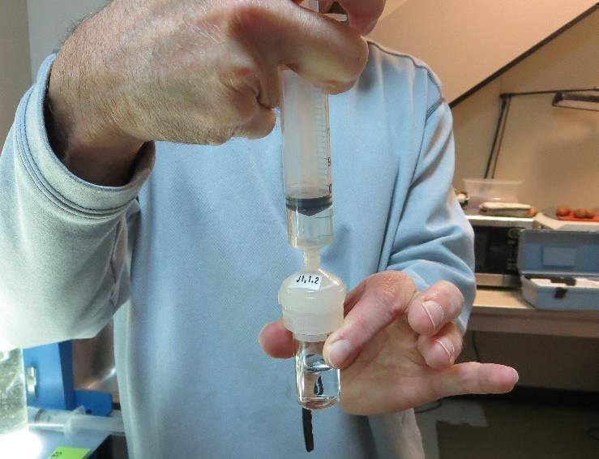

Jar Test - Filterability Test
Syringe ~ 25 mL from jar (after 5-minutes of settling)
Filter-to-waste 3-5 mL
Filter directly into clean cuvette
Measure turbidity
Note: Take several readings before recording final NTU results. Micro bubbles can adhere to glass causing false NTU readings. To remove bubbles, tilt cuvette up to 90 degrees.

Slide 52

Contact
Guy Schott, P.E.
State Water Resources Control Board
Division of Drinking Water
Santa Rosa, CA
Go to Stock Solution/Dose calculations/Jar Test Results for tools to download
www.waterboards.ca.gov/drinking_water/programs/districts/mendocino_district.html
Email: Guy Schott - Guy.Schott@waterboards.ca.gov
Office Number: 707-576-2732

