Slide 1
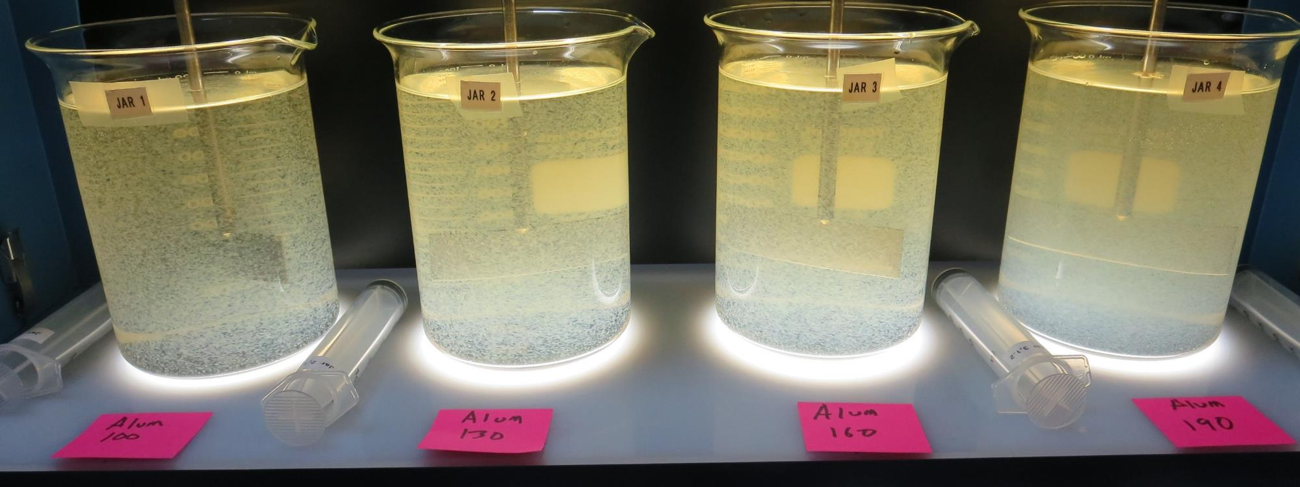
City of American Canyon
CA2810005
Napa County
Jar Test
by Guy Schott, P.E.
February 12, 2019

Slide 2
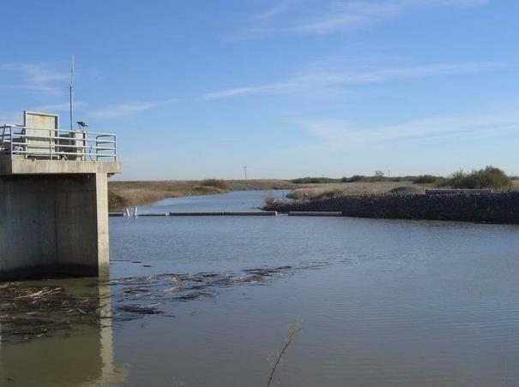
Source Water:
North Bay Aqueduct
Source Water Characteristics (August 28, 2019)
Unfiltered
Turbidity: 13 NTU
pH: 7.45
UVT: 26.8%, UVA: 0.5719/cm
Filtered (0.4 um filtered)
UVT: 33.1%, UVA: 0.4802/cm

Slide 3
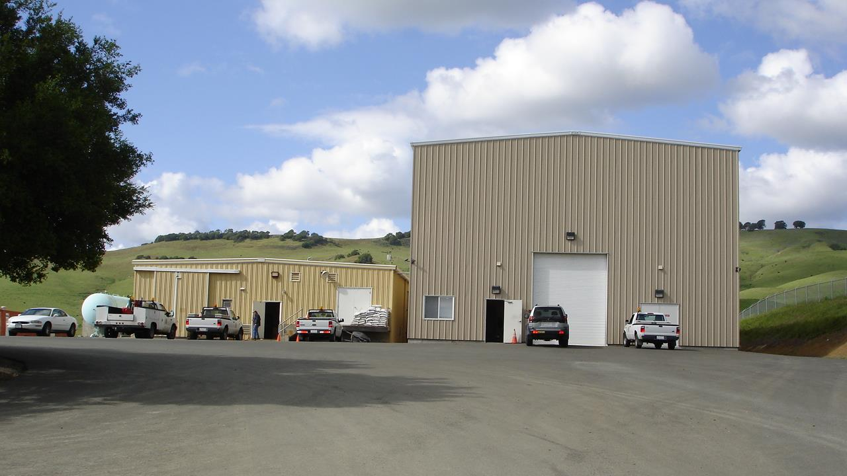
Conventional and Membrane Treatment Plants

Slide 4
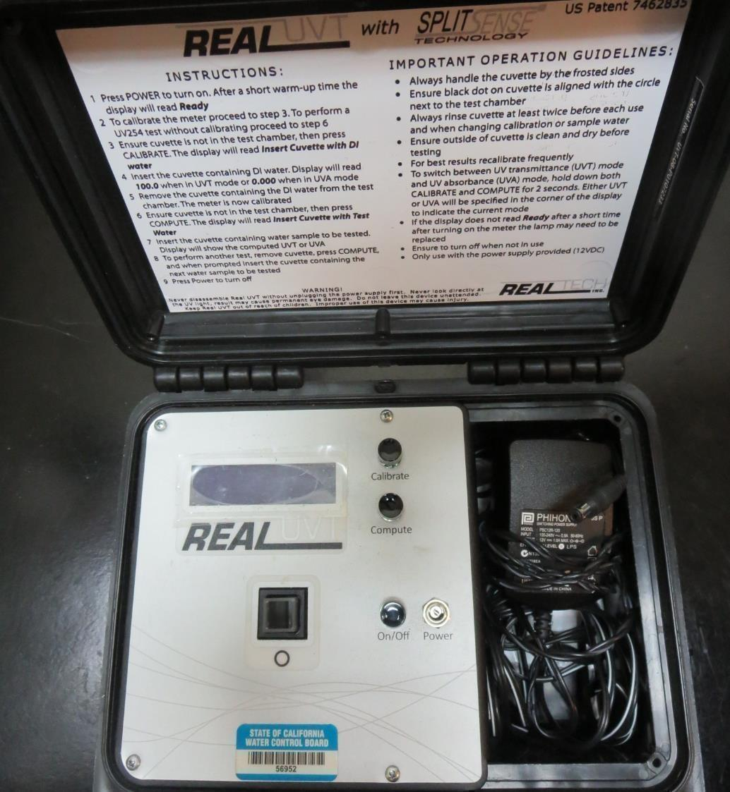
UVT/UVA
UV transmittance (UVT) is a measurement of the amount of ultraviolet light (commonly at 254 nm due to its germicidal effect) that passes through a water sample compared to the amount of light that passes through a pure water sample. The measurement is expressed as a percentage, % UVT.
%UVT = 10^{(-UVA)} x 100%
UV absorbance (UVA) is calculated as a relative measure of the amount of light absorbed by a water sample compared with the amount of light absorbed by a pure water sample.
UVA = -log(%UVT/100)

Slide 5
Coagulant Used for Jar Testing
Pro Pac 9800 (NTU Technologies)
50% ACH
50% Water
SG = 1.34
AD313P Acrylamide Polymer
(NTU Technologies)
Nonionic Polymer
Alum
35.9% Alum
6.1% Al₂O₃
7% H₂SO₄
SG = 1.28

Slide 6
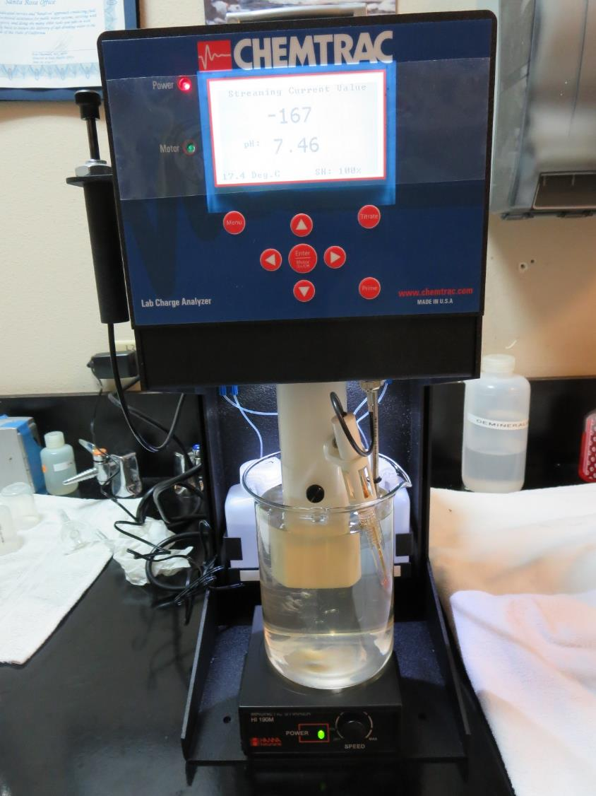
Laboratory Charge Analyzer
LCA: Used to determine coagulant demand of a source water entering the treatment plant.
Source pH: 7.46
LCA #1:
7% Acid Alum: 192 mg/L as Alum
No pH adjustment
LCA #2:
ACH (9800): 198 mg/L as product
No pH adjustment

Slide 7
Coagulant Information
Unless stated otherwise, all coagulant doses are reported as Product (100% strength). Aluminum Sulfate is reported as Alum.
Preparation of coagulant stock solutions are generally 1.0 and/or 0.1 percent strength using 100 and/or 200 mL volumetric flasks.
Finnpipette F2 variable volume pipette, capacity 100-1000 micro liters is used for stock solution preparation and coagulant aid jar test dosing.
Finnpipette F2 variable volume pipette, capacity 0.5-5 mL is used for primary coagulant jar test dosing.

Slide 8
City of American Canyon: Jar Test 1-8 Results
Jar | 200 RPM Flash Mix seconds | 30 RPM Floc Duration minutes | 7% Acid Alum mg/L | 9890 mg/L | Filtrate NTU | Filtrate %UVT | Filtrate UVA/cm | Settle NTU 25 min
J1 | 60 | 5 | 100 | 0 | 0.33 | 73.1 | 0.136 | 4.0
J2 | 60 | 5 | 130 | 0 | 0.12 | 77.5 | 0.111 | 2.5
J3 | 60 | 5 | 160 | 0 | 0.18 | 79.4 | 0.100 | 4.5
J4 | 60 | 5 | 190 | 0 | 0.12 | 81.6 | 0.088 | 5.0
J5 | 60 | 5 | 100 | 15.0 | 0.08 | 76.9 | 0.114 | 1.9
J6 | 60 | 5 | 130 | 19.5 | 0.16 | 79.2 | 0.101 | 1.2
J7 | 60 | 5 | 160 | 24.0 | 0.19 | 80.8 | 0.093 | 2.4
J8 | 60 | 5 | 190 | 28.5 | 0.19 | 82.1 | 0.086 | 2.7

Slide 9
City of American Canyon: Jar Test 9-12 Results
Jar | 200 RPM Flash Mix seconds | 30 RPM Floc Duration minutes | 9800 mg/L | 9890 mg/L | Filtrate NTU | Filtrate %UVT | Filtrate UVA/cm | Settle NTU 25 min
J9 | 60 | 5 | 100 | 15.0 | 0.08 | 73.1 | 0.136 | 1.2
J10 | 60 | 5 | 130 | 19.5 | 0.07 | 76.2 | 0.118 | 0.9
J11 | 60 | 5 | 160 | 24.0 | 0.09 | 77.3 | 0.112 | 1.2
J12 | 60 | 5 | 190 | 28.5 | 0.09 | 78.5 | 0.105 | 1.7

Slide 10
City of American Canyon: Jar Test 13-16 Results
Jar | 200 RPM Flash Mix seconds | 30 RPM Floc Duration minutes | NaOCl mg/L | 7% Acid Alum mg/L | Filtrate NTU | Filtrate %UVT | Filtrate UVA/cm | Settle NTU 25 min
J13 | 60 | 5 | 3 | 100 | 0.24 | 74.4 | 0.128 | 2.9
J14 | 60 | 5 | 3 | 130 | 0.16 | 78.0 | 0.108 | 2.4
J15 | 60 | 5 | 3 | 160 | 0.11 | 80.6 | 0.094 | 2.1
J16 | 60 | 5 | 3 | 190 | 0.14 | 82.3 | 0.085 | 2.4

Slide 11
City of American Canyon: Jar Test 17-20 Results
Flash Mix 60 seconds (200 RPM)
Jar | 30 RPM Floc Duration minutes | NaOCl mg/L | 7% Acid Alum mg/L | AD313P mg/L | Filtrate NTU | Filtrate %UVT | Filtrate UVA/cm | Settle NTU 25 min
J17 | 5 | 3 | 3 | 100 | 0.6 | 0.12 | 73.6 | 2.0
J18 | 5 | 3 | 3 | 130 | 0.6 | 0.08 | 77.9 | 1.1
J19 | 5 | 3 | 3 | 160 | 0.6 | 0.08 | 80.0 | 1.0
J20 | 5 | 3 | 3 | 190 | 0.6 | 0.18 | 81.8 | n/a

Slide 12
Jars 1-4 Test
Flash Mix 60 Sec (200 RPM)
Floc Mix 5 min (30 RPM)
Applied Coagulant
7% Acid Alum

Slide 13
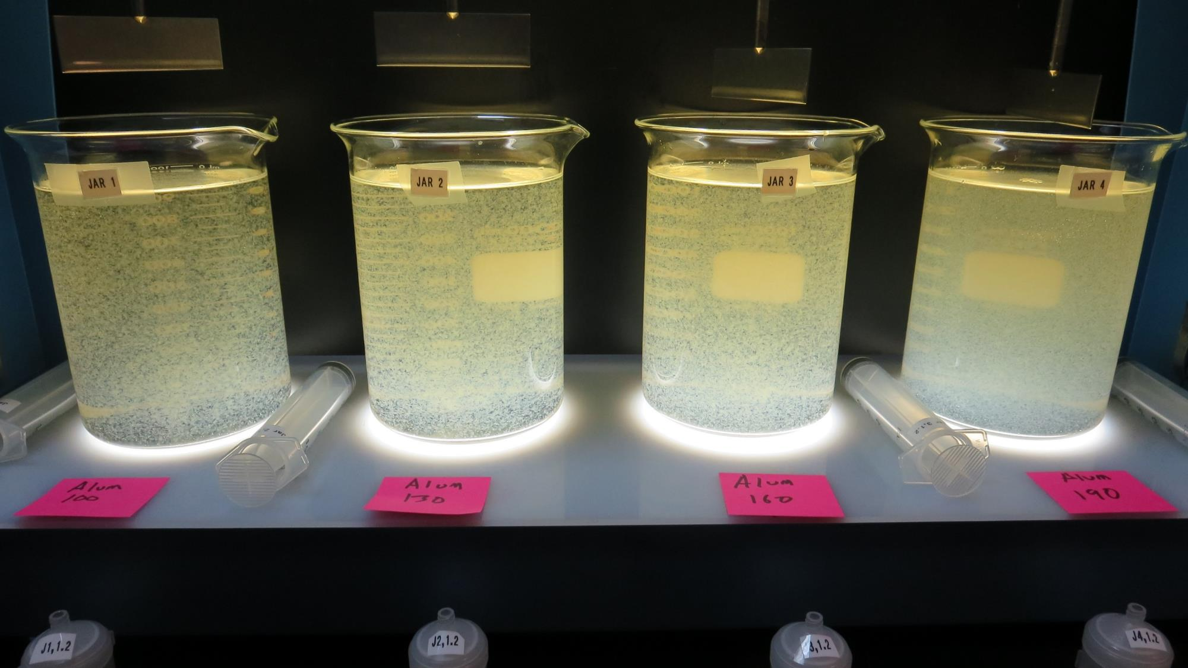
Jars 1-4: End of 5-minute flocculation (30 RPM) duration.
100 mg/L Alum
Filtrate 0.33 NTU
UVT: 73.1%
UVA: 0.136/cm
Settled: 4 NTU
130 mg/L Alum
Filtrate 0.12 NTU
UVT: 77.5%
UVA: 0.111/cm
Settled: 2.5 NTU
160 mg/L Alum
Filtrate 0.18 NTU
UVT: 79.4%
UVA: 0.100/cm
Settled: 4.5 NTU
190 mg/L Alum
Filtrate 0.12 NTU
UVT: 81.6%
UVA: 0.088/cm
Settled: 5 NTU

Slide 14
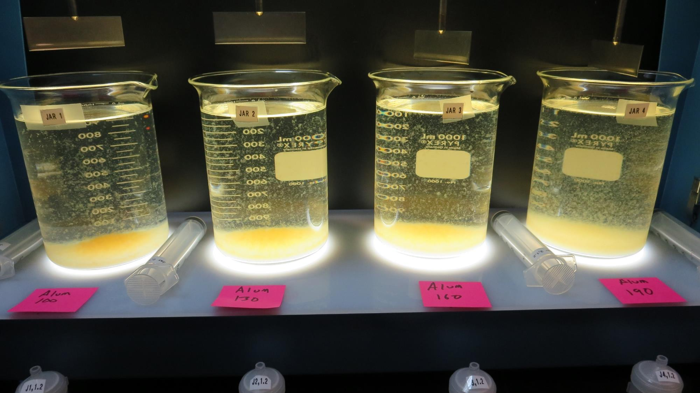
Jars 1-4: After 5 min of settling, 25 mL is syringed for filterability and %UVT/UVA.

Slide 15
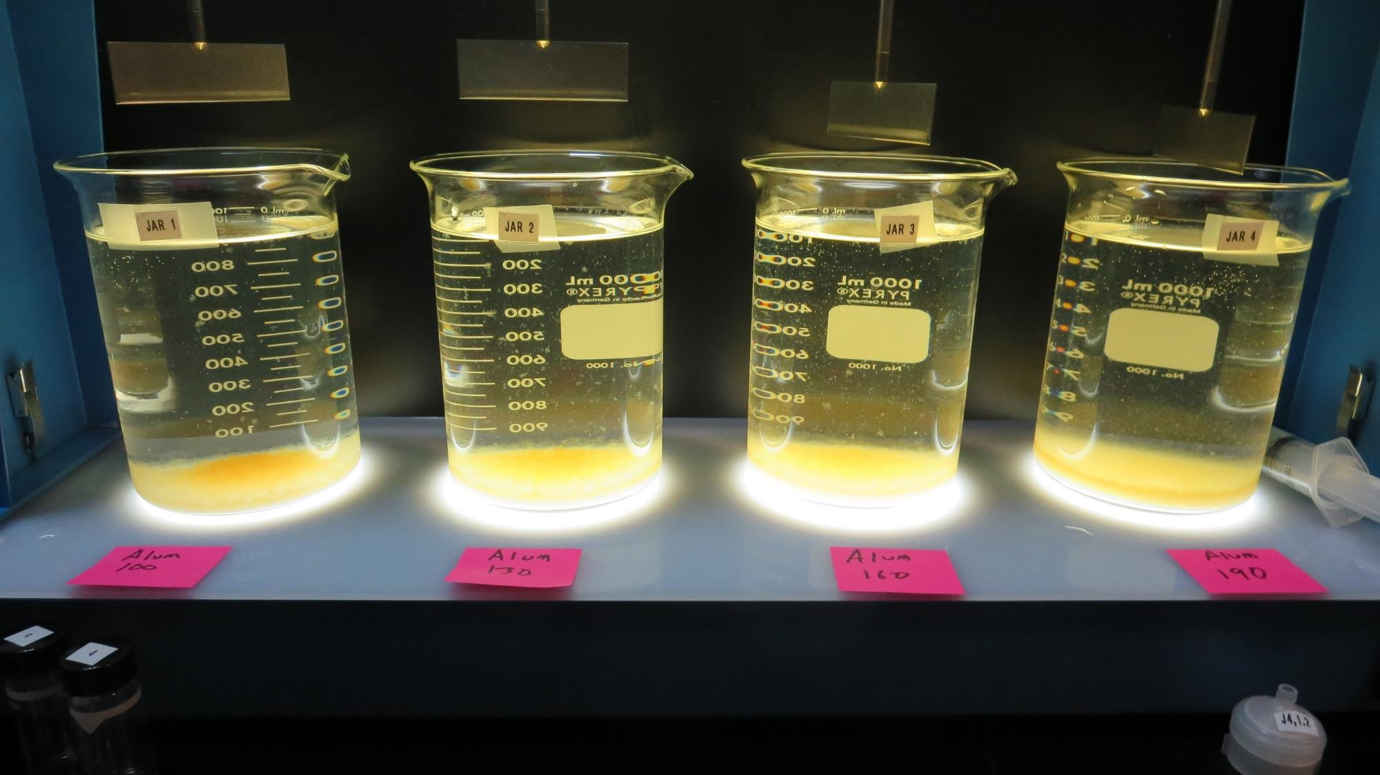
Jars 1-4: After 25-minutes of settling, settled water turbidity is taken.
100 mg/L Alum
Filtrate 0.33 NTU
UVT: 73.1%
UVA: 0.136/cm
Settled: 4 NTU
130 mg/L Alum
Filtrate 0.12 NTU
UVT: 77.5%
UVA: 0.111/cm
Settled: 2.5 NTU
160 mg/L Alum
Filtrate 0.18 NTU
UVT: 79.4%
UVA: 0.100/cm
Settled: 4.5 NTU
190 mg/L Alum
Filtrate 0.12 NTU
UVT: 81.6%
UVA: 0.088/cm
Settled: 5 NTU

Slide 16
Jars 5-8 Test
Flash Mix 60 Sec (200 RPM)
Floc Mix 5 min (30 RPM)
Applied Coagulants
7% Acid Alum
9890

Slide 17
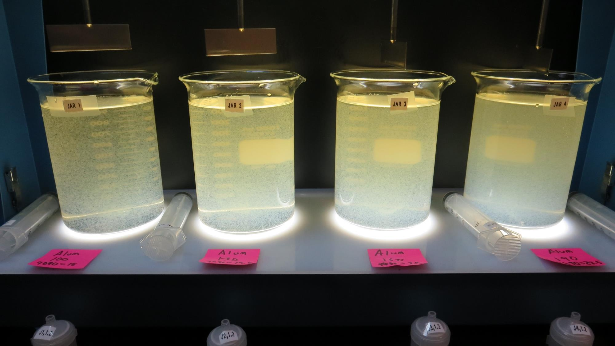
Jars 5-8: End of 5-minute flocculation (30 RPM) duration.
100 mg/L Alum
15 mg/L 9890
Filtrate 0.08 NTU
UVT: 76.9%
UVA: 0.114/cm
Settled: 1.9 NTU
130 mg/L Alum
19.5 mg/L 9890
Filtrate 0.16 NTU
UVT: 79.2%
UVA: 0.101/cm
Settled: 1.2 NTU
160 mg/L Alum
24 mg/L 9890
Filtrate 0.19 NTU
UVT: 80.8%
UVA: 0.093/cm
Settled: 2.4 NTU
190 mg/L Alum
28.5 mg/L 9890
Filtrate 0.19 NTU
UVT: 82.1%
UVA: 0.086/cm
Settled: 2.7 NTU

Slide 18
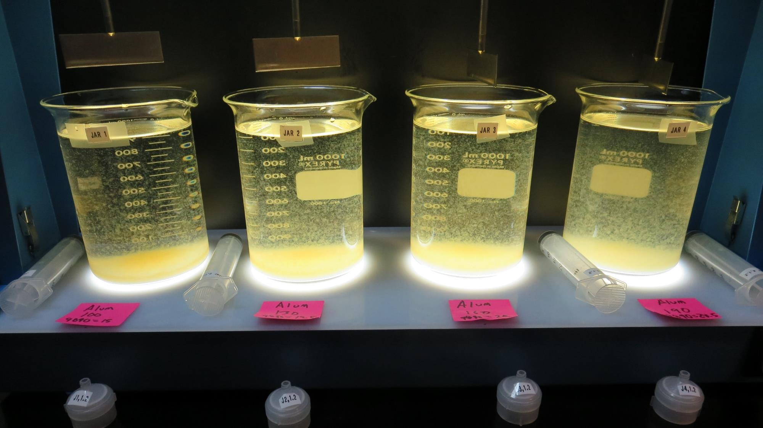
Jars 5-8: After 5 min of settling, 25 mL is syringed for filterability and %UVT/UVA.

Slide 19
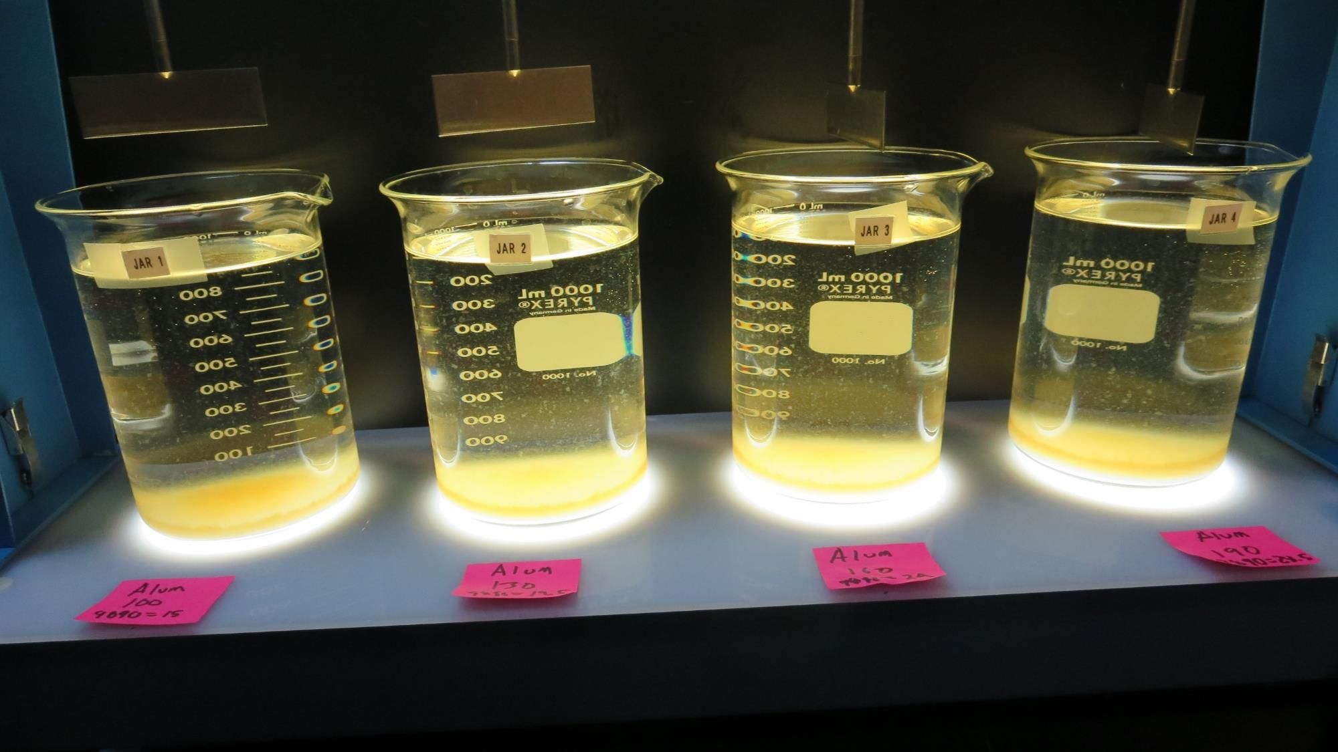
Jars 5-8: After 25-minutes of settling, settled water turbidity is taken.
100 mg/L Alum
15 mg/L 9890
Filtrate 0.08 NTU
UVT: 76.9%
UVA: 0.114/cm
Settled: 1.9 NTU
130 mg/L Alum
19.5 mg/L 9890
Filtrate 0.16 NTU
UVT: 79.2%
UVA: 0.101/cm
Settled: 1.2 NTU
160 mg/L Alum
24 mg/L 9890
Filtrate 0.19 NTU
UVT: 80.8%
UVA: 0.093/cm
Settled: 2.4 NTU
190 mg/L Alum
28.5 mg/L 9890
Filtrate 0.19 NTU
UVT: 82.1%
UVA: 0.086/cm
Settled: 2.7 NTU

Slide 20
Jars 9-12 Test
Flash Mix 60 Sec (200 RPM)
Floc Mix 5 min (30 RPM)
Applied Coagulants
9800
9890

Slide 21
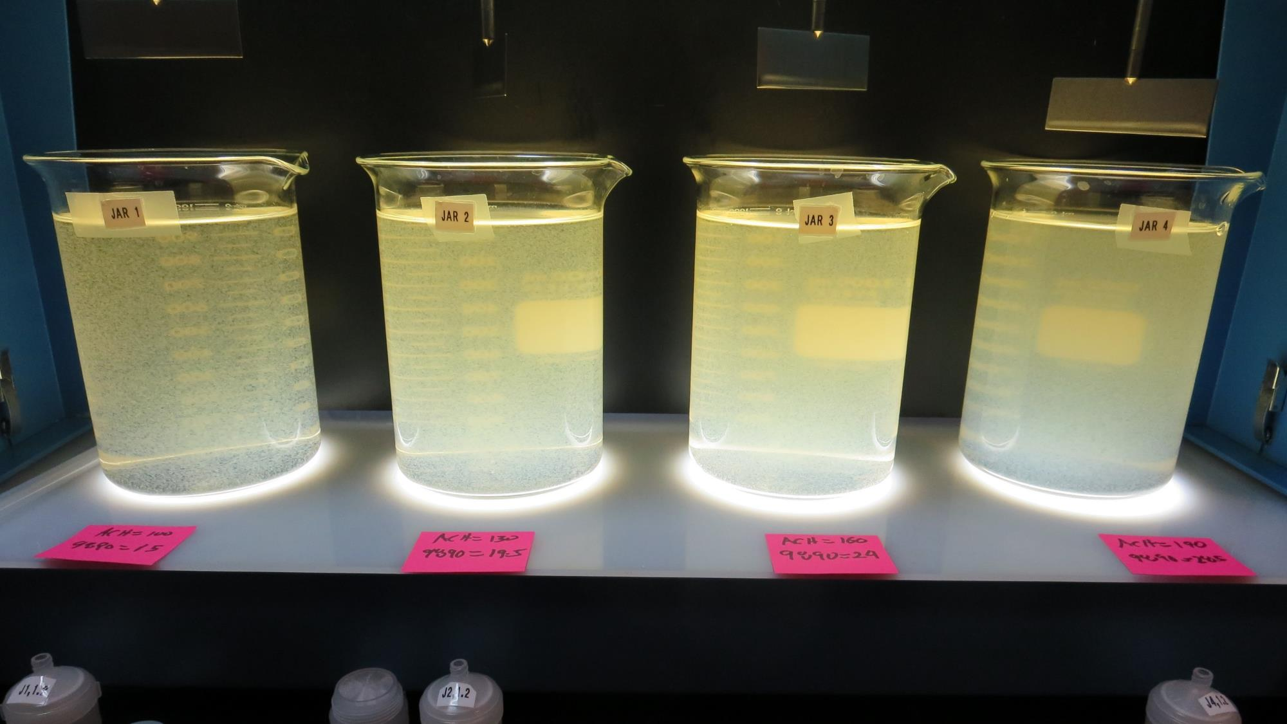
Jars 9-12: End of 5-minute flocculation (30 RPM) duration.
100 mg/L ACH
15 mg/L 9890
Filtrate 0.08 NTU
UVT: 73.1%
UVA: 0.136/cm
Settled: 1.2 NTU
130 mg/L ACH
19.5 mg/L 9890
Filtrate 0.07 NTU
UVT: 76.2%
UVA: 0.118/cm
Settled: 0.9 NTU
160 mg/L ACH
24 mg/L 9890
Filtrate 0.09 NTU
UVT: 77.3%
UVA: 0.112/cm
Settled: 1.2 NTU
190 mg/L ACH
28.5 mg/L 9890
Filtrate 0.09 NTU
UVT: 78.5%
UVA: 0.105/cm
Settled: 1.7 NTU

Slide 22
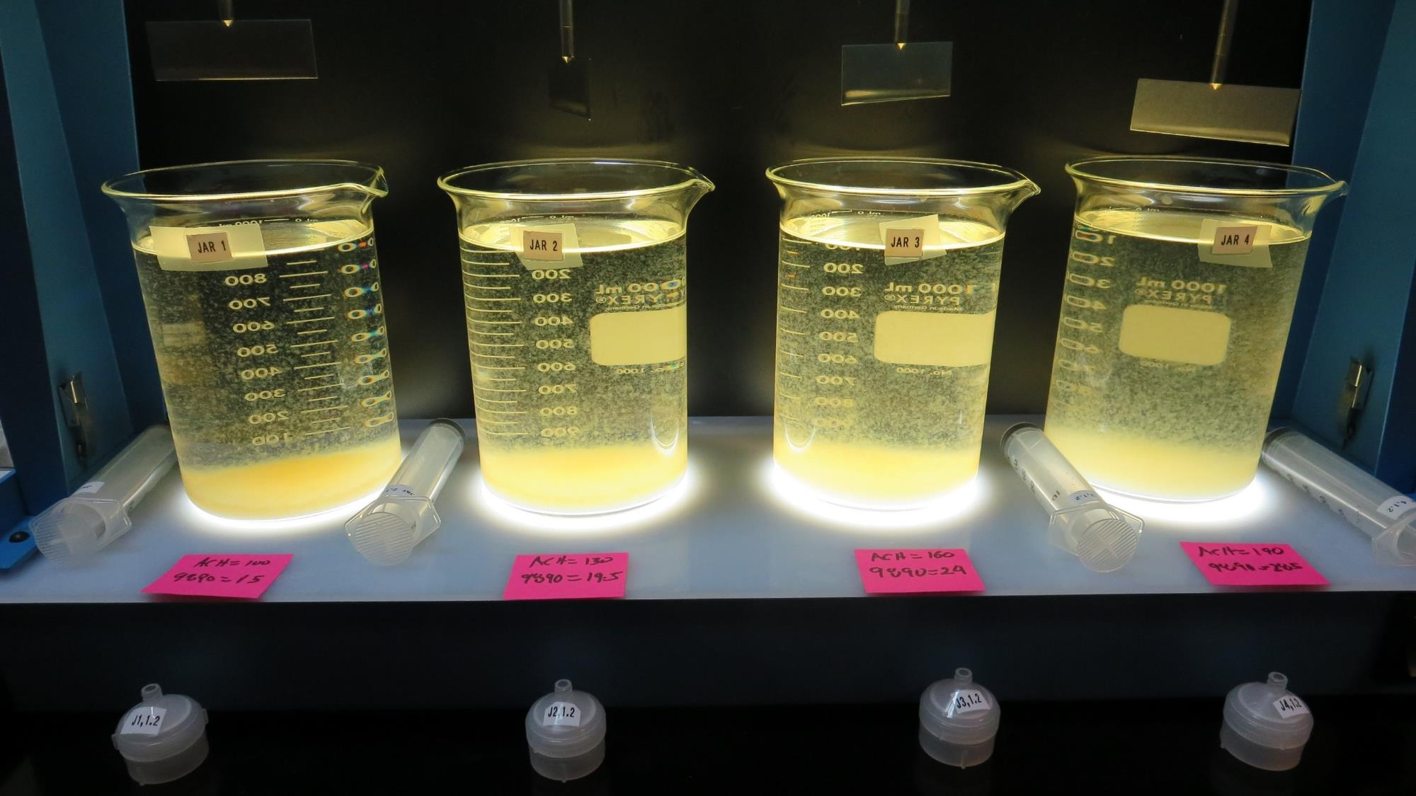
Jars 9-12: After 5 min of settling, 25 mL is syringed for filterability and %UVT/UVA.

Slide 23
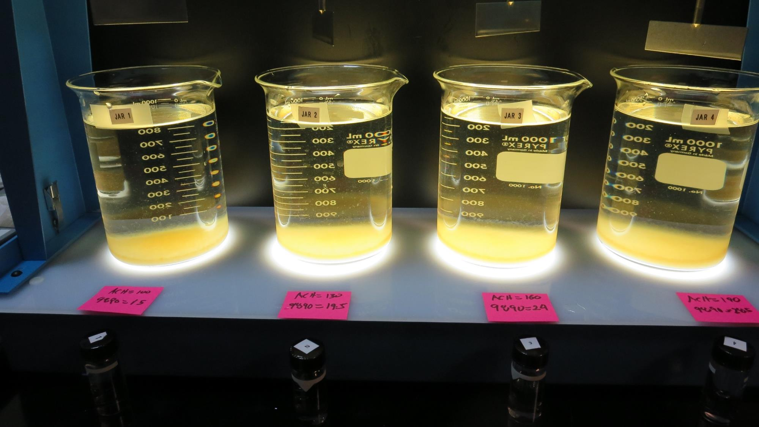
Jars 9-12: After 40-minutes of settling, settled water turbidity is taken.
100 mg/L ACH
15 mg/L 9890
Filtrate 0.08 NTU
UVT: 73.1%
UVA: 0.136/cm
Settled: 1.2 NTU
130 mg/L ACH
19.5 mg/L 9890
Filtrate 0.07 NTU
UVT: 76.2%
UVA: 0.118/cm
Settled: 0.9 NTU
160 mg/L ACH
24 mg/L 9890
Filtrate 0.09 NTU
UVT: 77.3%
UVA: 0.112/cm
Settled: 1.2 NTU
190 mg/L ACH
28.5 mg/L 9890
Filtrate 0.09 NTU
UVT: 78.5%
UVA: 0.105/cm
Settled: 1.7 NTU

Slide 24
Jars 13-16 Test
Flash Mix 60 Sec (200 RPM)
Floc Mix 5 min (30 RPM)
Applied Coagulant
7% Acid Alum w/NaOCl

Slide 25
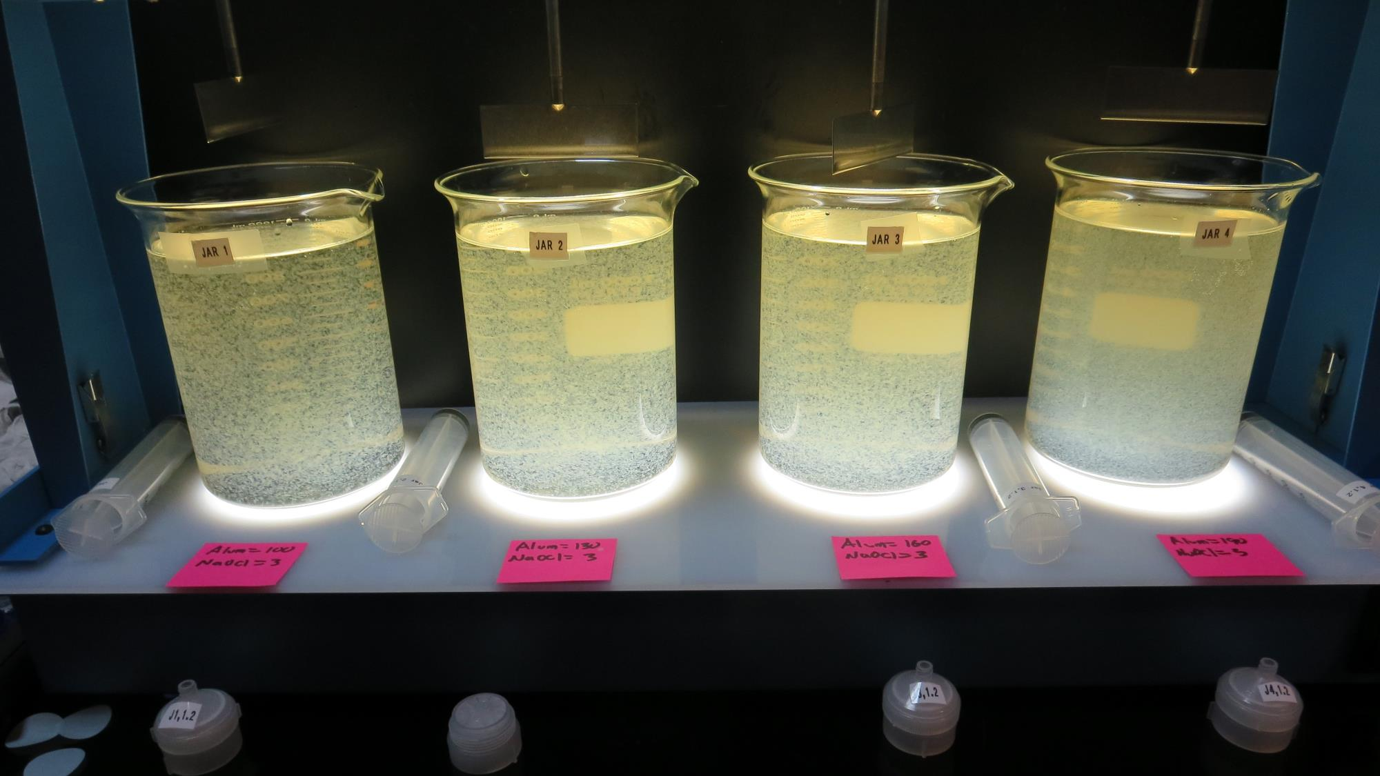
Jars 13-16: End of 5-minute flocculation (30 RPM) duration.
3 mg/L NaOCl
100 mg/L Alum
Filtrate 0.24 NTU
UVT: 74.4%
UVA: 0.128/cm
Settled: 2.9 NTU
3 mg/L NaOCl
130 mg/L Alum
Filtrate 0.16 NTU
UVT: 78.0%
UVA: 0.108/cm
Settled: 2.4 NTU
3 mg/L NaOCl
160 mg/L Alum
Filtrate 0.11 NTU
UVT: 80.6%
UVA: 0.094/cm
Settled: 2.1 NTU
3 mg/L NaOCl
190 mg/L Alum
Filtrate 0.14 NTU
UVT: 82.2%
UVA: 0.085/cm
Settled: 2.4 NTU

Slide 26
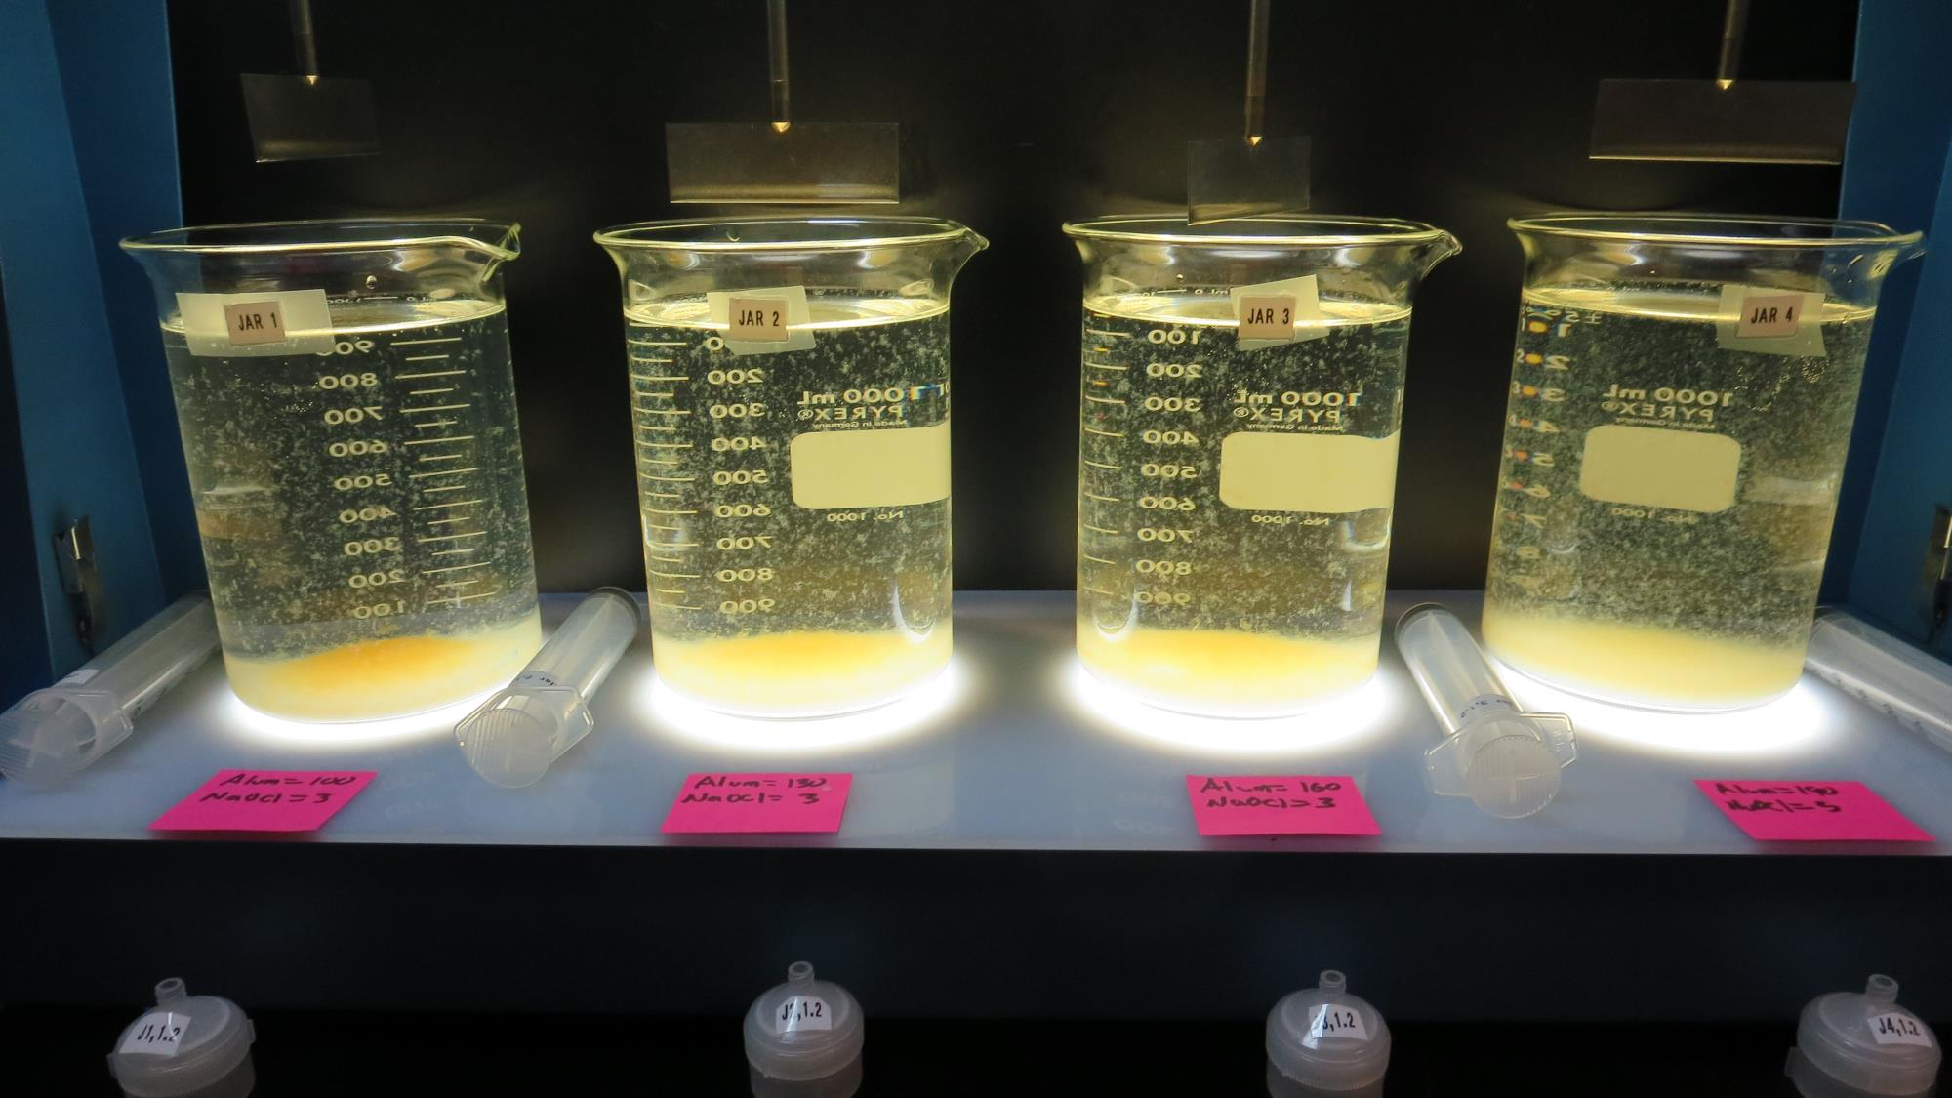
Jars 13-16: After 5 min of settling, 25 mL is syringed for filterability and %UVT/UVA.

Slide 27
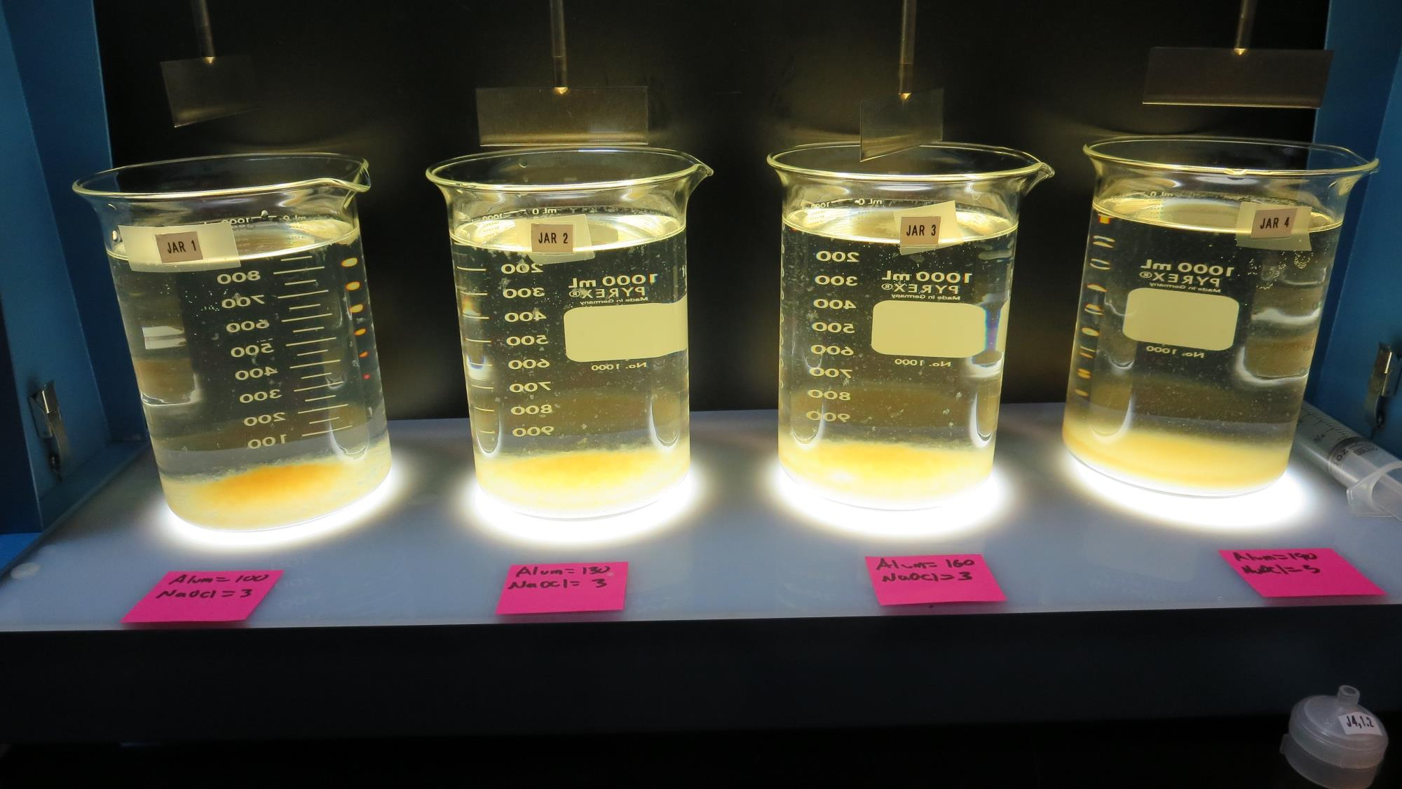
Jars 13-16: After 25-minutes of settling, settled water turbidity is taken.
3 mg/L NaOCl
100 mg/L Alum
Filtrate 0.24 NTU
UVT: 74.4%
UVA: 0.128/cm
Settled: 2.9 NTU
3 mg/L NaOCl
130 mg/L Alum
Filtrate 0.16 NTU
UVT: 78.0%
UVA: 0.108/cm
Settled: 2.4 NTU
3 mg/L NaOCl
160 mg/L Alum
Filtrate 0.11 NTU
UVT: 80.6%
UVA: 0.094/cm
Settled: 2.1 NTU
3 mg/L NaOCl
190 mg/L Alum
Filtrate 0.14 NTU
UVT: 82.2%
UVA: 0.085/cm
Settled: 2.4 NTU

Slide 28
Jars 17-20 Test
Flash Mix 60 Sec (200 RPM)
Floc Mix 5 min (30 RPM)
Applied Coagulant
7% Acid Alum
AD313P w/NaOCl

Slide 29
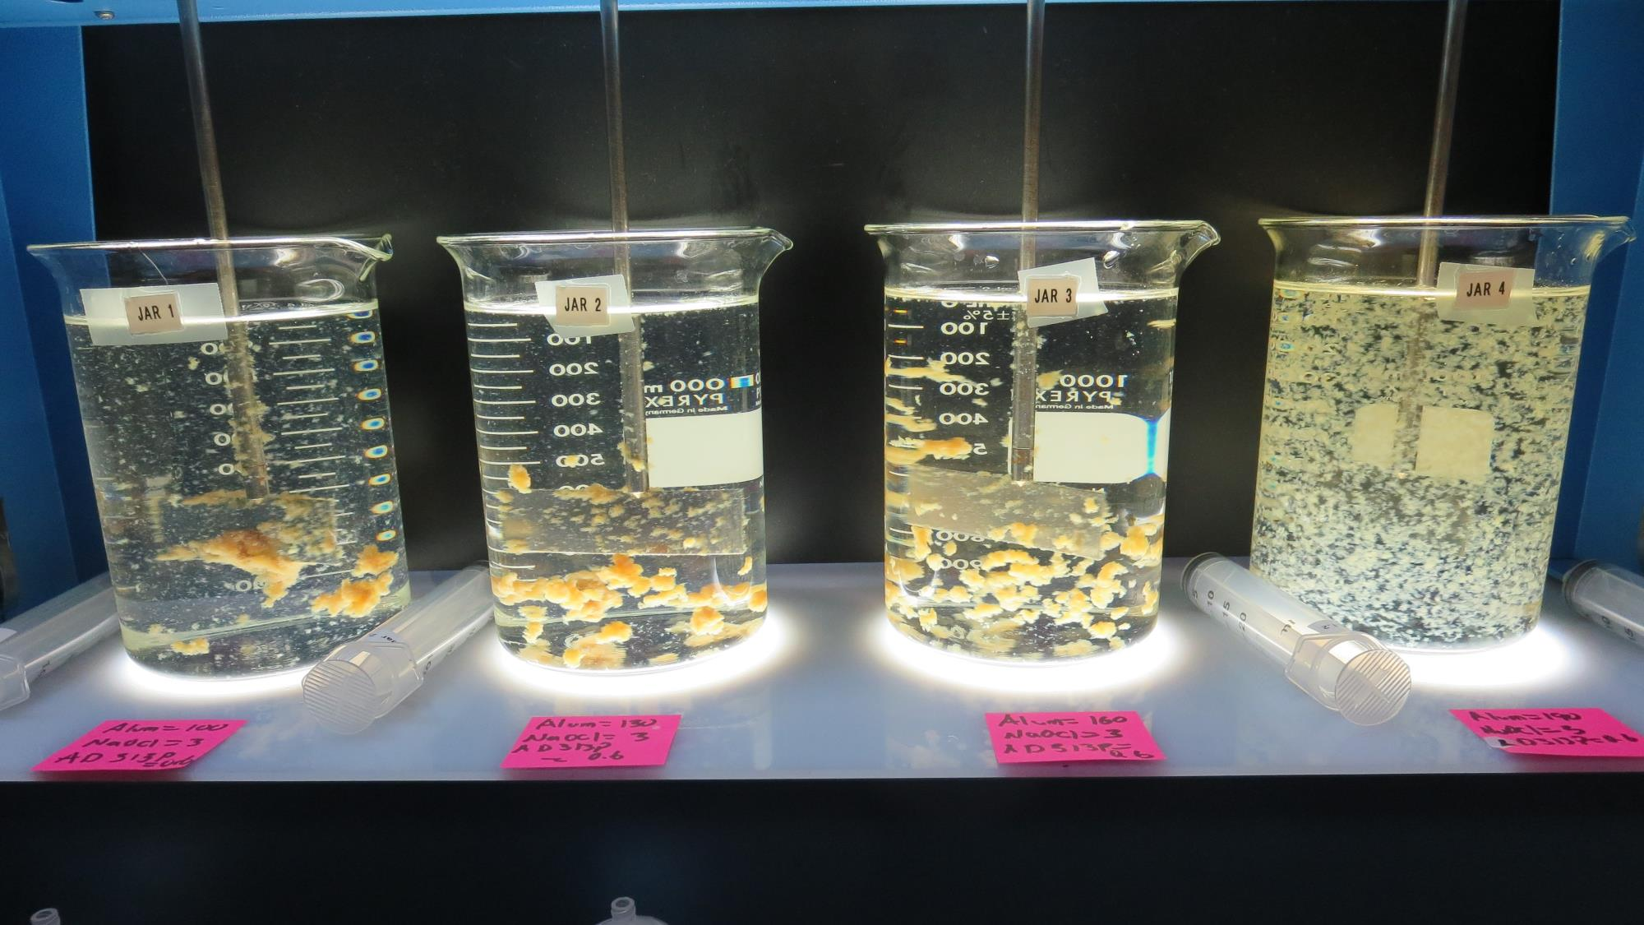
Jars 17-20: End of 5-minute flocculation (30 RPM) duration.
3 mg/L NaOCl
100 mg/L Alum
0.6 mg/L AD313P
Filtrate 0.12 NTU
UVT: 73.6%
UVA: 0.133/cm
Settled: 2.0 NTU
3 mg/L NaOCl
130 mg/L Alum
0.6 mg/L AD313P
Filtrate 0.08 NTU
UVT: 77.9%
UVA: 0.108/cm
Settled: 1.1 NTU
3 mg/L NaOCl
160 mg/L Alum
0.6 mg/L AD313P
Filtrate 0.08 NTU
UVT: 80.0%
UVA: 0.097/cm
Settled: 1.0 NTU
3 mg/L NaOCl
190 mg/L Alum
0.6 mg/L AD313P
Filtrate 0.18 NTU
UVT: 81.8%
UVA: 0.087/cm
Settled: - NTU

Slide 30
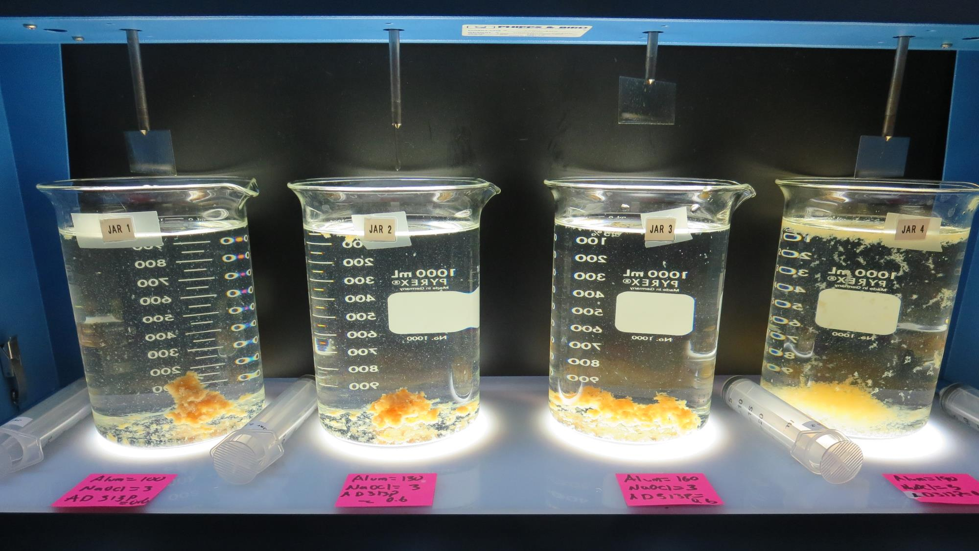
Jars 17-20: After 5 min of settling, 25 mL is syringed for filterability and %UVT/UVA.

Slide 31
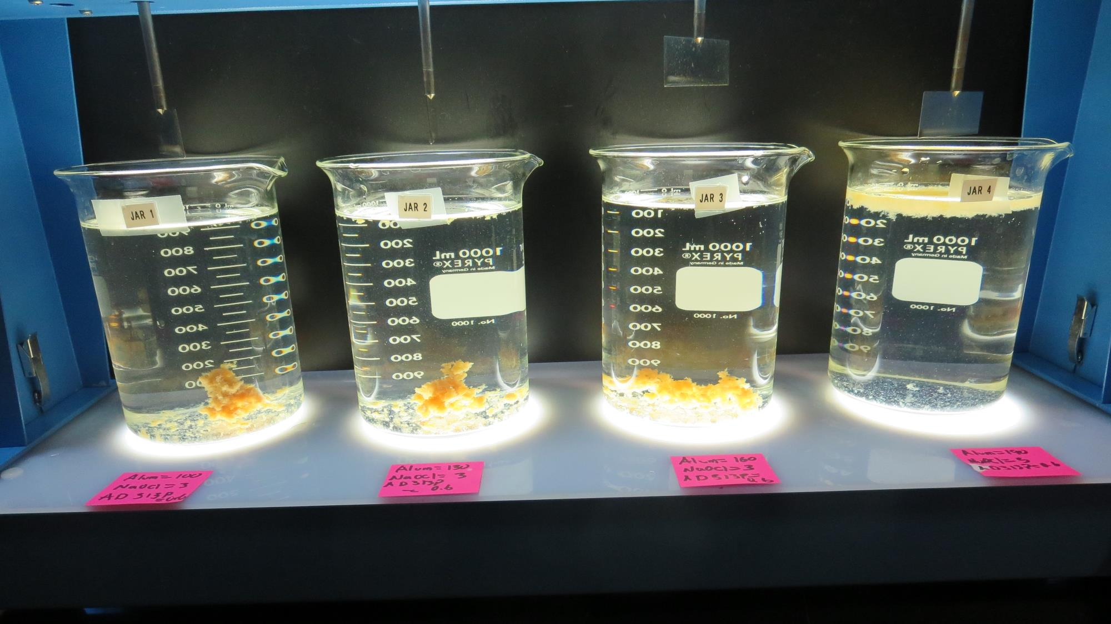
Jars 17-20: After 25-minutes of settling, settled water turbidity is taken.
3 mg/L NaOCl
100 mg/L Alum
0.6 mg/L AD313P
Filtrate 0.12 NTU
UVT: 73.6%
UVA: 0.133/cm
Settled: 2.0 NTU
3 mg/L NaOCl
130 mg/L Alum
0.6 mg/L AD313P
Filtrate 0.08 NTU
UVT: 77.9%
UVA: 0.108/cm
Settled: 1.1 NTU
3 mg/L NaOCl
160 mg/L Alum
0.6 mg/L AD313P
Filtrate 0.08 NTU
UVT: 80.0%
UVA: 0.097/cm
Settled: 1.0 NTU
3 mg/L NaOCl
190 mg/L Alum
0.6 mg/L AD313P
Filtrate 0.18 NTU
UVT: 81.8%
UVA: 0.087/cm
Settled: - NTU

Slide 32
Jar Testing for 1-Liter Jars:
General Procedures for Most Treatment Plants
Fill jars with source water prior to coagulant injection and set paddle speed at 30 rpm
Add chemicals (i.e., NaOCl, primary coagulant, coagulant aid) to each jar
Flash mix for 15-60 seconds (200 rpm)
Slow mix for 5 minutes (20-30 rpm)
Settled for 5 minutes. Syringe 25 mL from each jar taken 1-inch below surface (25 mL/12 sec rate)
Filtered through 1.2 um isopore membrane into cuvette drip rate, 15 mL/(50-90 sec)
Measure filtrate turbidity, chlorine residual and %UVT/UVA
Measure settled water turbidity after 25 minutes of total setting
Record all data

Slide 33

Jar Test
Filterability Test Equipment
Turbidity Instrument
Syringe w/Luer-Lock Tip, 30 cc
(part#: 2225800, by Hach)
Swinnex Filter Holder, 25 mm (part#: SX0002500)
Isopore Membrane Filter, 1.2 um absolute
pore size,
Φ= 25 mm , thickness: 24 um,
hydrophilic polycarbonate membrane
(part #: RTTP02500)
Go to Sigma-Aldrich for laboratory supplies http://www.sigmaaldrich.com/united-states.html

Slide 34
Isopore Membrane Information
Categories | Information
trade name | Isopore
filter color | White
chemistry | Polycarbonate (PC)
water flow rate | Avg. 175 mL/min x cm² (typical results @ 10 psi)
media | Isopore®
wettability | Hydrophilic
porosity | 14.7%
pore size | 1.2 µm
bubble point at 23 °C | 1.0 bar, air with water
thickness | 24 µm
filter diameter (ø) | 25 mm
material size | polycarbonate, Hydrophilic, 1.2 µm, 25 mm, white, plain, 100

Slide 35
Isopore Membrane Background Information
The Isopore membrane is a polycarbonate, track-etched screen filter recommended for all analyses in which the sample is viewed on the surface of the membrane. The Isopore membrane is composed of polycarbonate film, which has a smooth, glass-like surface for clearer sample observation. The unique manufacturing process of the membrane ensures a precise pore diameter and a consistent pore size for accurate separation of samples by size. Matched-weight filters are not usually required because of low, constant tar and ash weights.
Features & Benefits:
Membrane structure retains particles on the surface, simplifying counting and analysis

Slide 36
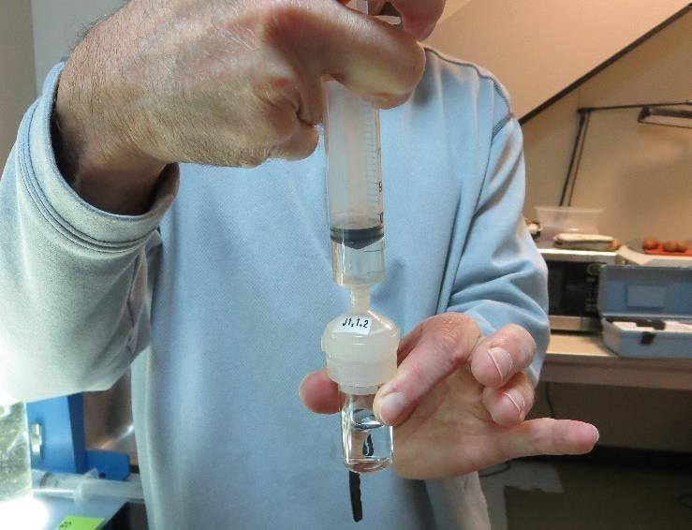

Jar Test - Filterability Test
Syringe ~ 25 mL from jar (after 5-minutes of settling)
Filter-to-waste 3-5 mL
Filter directly into clean cuvette
Measure turbidity
Note: Take several readings before recording final NTU results. Micro bubbles can adhere to glass causing false NTU readings. To remove bubbles, tilt cuvette up to 90 degrees.

Slide 37

Contact
Guy Schott, P.E.
State Water Resources Control Board
Division of Drinking Water
Santa Rosa, CA
Go to Stock Solution/Dose calculations/Jar Test Results for tools to download
www.waterboards.ca.gov/drinking_water/programs/districts/mendocino_district.html
Email: Guy Schott - Guy.Schott@waterboards.ca.gov
Office Number: 707-576-2732

