Slide 1
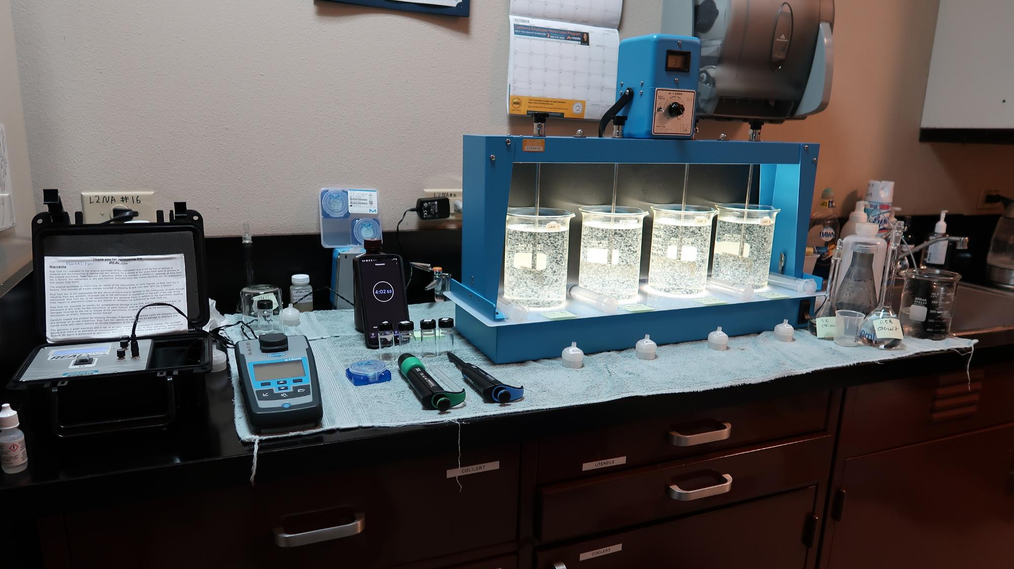
City of American Canyon CA2810005, Napa County, Jar Test
by Guy Schott, P.E. September 24, 2021

Slide 2
Conventional and Membrane Treatment Plants

Slide 3
City of American Canyon Source & Treated Water Characteristics, September 24, 2021
Source – North Bay Aqueduct
pH: 7.65 – 7.73
Alkalinity: 100 mg/L as CaCO₃
Turbidity: 11.1 NTU
UVT: 63.4%,
UVA: 0.197/cm
0.4 um Filtered
Turbidity: 0.18 NTU
UVT: 75.9%,
UVA: 0.119/cm
Plant Filtrate Water
0.15 NTU
UVT: 92.6%,
UVA: 0.033/cm

Slide 4
Applied Coagulants for Jar Testing (1)
AdvFloc-CTC-00011
Polyaluminum Hydroxy Chlorosulfate
12.55% Al₂O₃
6.64% Al
64.9% Basicity
SG = 1.299
NSF limit: 450 mg/L as Product
BWS, Inc.
Greg Nieckarz, Ph.D.
Greg.niekarz@bws.works
541-953-5112
7% Acid Alum
36.47% Alum
3.25% Al
6.2% Al₂O₃
7% H₂SO₄
SG = 1.28

Slide 5
Applied Coagulants for Jar Testing (2)
Brenntag (559-485-4150)
Solenis
Praestol 186K
SG = 1.0 – 1.2
Viscosity: 60-180 centipoise
MW: 150,00 g/moles
pDADMAC (20% active, 80% H₂O)
NSF limit: 50 mg/L (product)
Product dose 5 mg/L = 1 mg/L pDADMAC active
AdvFloc-CTC-00017
SG = 1.0 – 1.2
pDADMAC (40% active, 60% H₂O)
NSF limit: 25 mg/L (product)
Product dose 2.5 mg/L = 1 mg/L pDADMAC active
BWS, Inc.
Greg Nieckarz, Ph.D.
Greg.niekarz@bws.works
541-953-5112

Slide 6
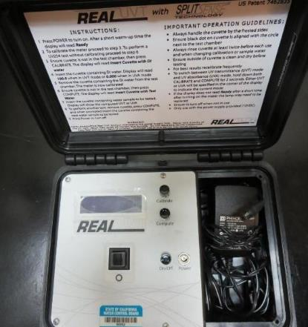
UVT/UVA, pathlength 10 mm
UV transmittance (UVT) is a measurement of the amount of ultraviolet light (254 nm) that passes through a water sample compared to the amount of light that passes through a pure water sample. The measurement is expressed as % UVT.
%UVT = 10^{(-UVA)} x 100%
UV absorbance (UVA) is calculated as a relative measure of the amount of light absorbed by a water sample compared with the amount of light absorbed by a pure water sample.
UVA = -log(%UVT/100)

Slide 7
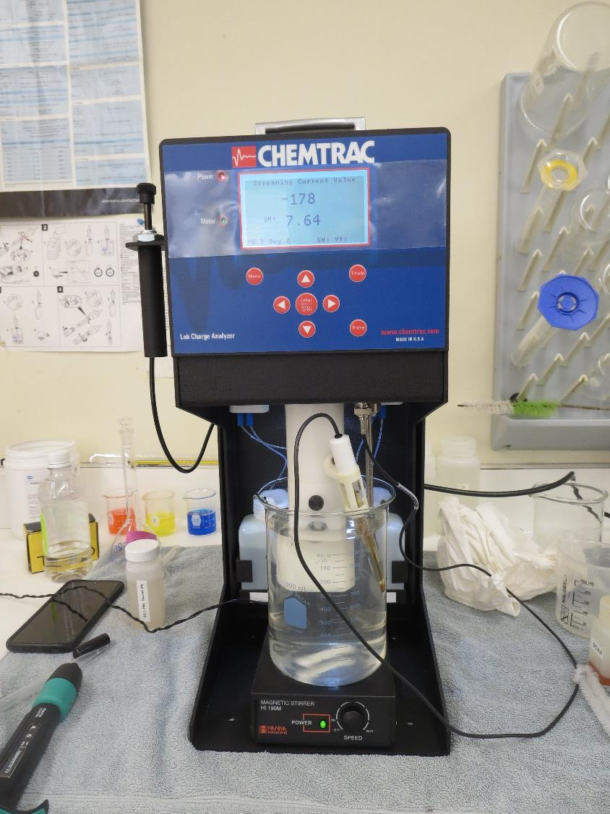
Laboratory Charge Analyzer
LCA: Used to determine coagulant demand of a source water entering the treatment plant.
No pH adjustment
Source pH: 7.65
LCA #1:
CTC-00011: 148 mg/L as product
LCA #2:
pH adjusted to 6.8 w/acidic acid
7%Acid Alum: 65 mg/L as product

Slide 8
Diallyldimethylammonium chloride or N-allyl-N,N-dimethylprop-2-en-1-aminium chloride pDADMAC C₈H₁₆ClN MW: 161.67 g/mol
CH₃
CH₂
CH₂
CH
N
+
CH
CH₂
CH₂
CH₃
Cl⁻

Slide 9
Coagulant Information
Unless stated otherwise, all coagulant doses are reported as Product (100% strength).
Aluminum Sulfate doses are reported as hydrated Al₂(SO₄)₃*14.3H₂0.
Preparation of coagulant stock solutions are generally 1.0 and/or 0.1 percent strength using 100 and/or 200 mL volumetric flasks.
Finnpipette F2 variable volume pipette, capacity 100-1000 micro liters is used for stock solution preparation and coagulant aid jar test dosing.
Finnpipette F2 variable volume pipette, capacity 0.5-5 mL is used for primary coagulant jar test dosing.

Slide 10
American Canyon: Source: North Bay Aqueduct Summary of Optimum Dose/Coagulants for Filtrate Jars
Jar# | PAC mg/L | 7% Acid Alum mg/L | CTC- 00011 mg/L | 186K pDADMAC mg/L | Filtrate NTU | Filtrate %UVT | Filtrate UVA/cm | %UVA Reduction | Settle NTU 25 min
A | 0 | 0 | 160 | 0 | 0.08 | 91.7 | 0.037 | 68.9 | 0.44
B | 0 | 0 | 160 | 0 | 0.05 | 92.0 | 0.035 | 70.6 | 0.32
C | 0 | 0 | 150 | 3 | 0.05 | 92.5 | 0.033 | 72.3 | 0.59
D | 0 | 0 | 150 | 3 | 0.05 | 91.8 | 0.037 | 68.9 | 0.78
E | 20 | 0 | 150 | 0 | 0.05 | 93.2 | 0.030 | 74.8 | 0.34
F | 20 | 0 | 150 | 3 | 0.06 | 93.2 | 0.030 | 74.8 | 0.78
G | 0 | 65 | 0 | 0 | 0.05 | 91.5 | 0.038 | 68.1 | 1.07
H | 20 | 65 | 0 | 0 | 0.05 | 92.9 | 0.031 | 73.9 | 1.17
I | 20 | 65 | 0 | 3 | 0.05 | 93.3 | 0.029 | 75.6 | 1.62

Slide 11
American Canyon; Jar Test 1 - 8 Results Flash Mix 200 RPM (20 sec); Floc Mix 30 RPM (5 min)
Jar# | CTC-00011 mg/L | 186K mg/L | Filtrate NTU | Filtrate %UVT | Filtrate UVA/cm | %UVA Reduction | Settle NTU 25 min
J1 | 140 | 0 | 0.14 | 90.4 | 0.043 | 63.9 | 0.49
J2 | 150 | 0 | 0.08 | 91.4 | 0.038 | 68.1 | 0.57
J3 | 160 | 0 | 0.08 | 91.7 | 0.037 | 68.9 | 0.44
J4 | 170 | 0 | 0.08 | 91.7 | 0.037 | 68.9 | 0.67
J5 | 150 | 0 | 0.11 | 91.7 | 0.037 | 68.9 | 0.62
J6 | 150 | 3 | 0.05 | 92.5 | 0.033 | 72.3 | 0.59
J7 | 150 | 6 | 0.12 | 92.7 | 0.032 | 73.1 | 0.80
J8 | 150 | 9 | 0.12 | 92.3 | 0.034 | 71.4 | 1.12

Slide 12
American Canyon; Jar Test 9 - 16 Results Flash Mix 200 RPM (20 sec); Floc Mix 30 RPM (5 min)
Jar# | PAC mg/L | CTC-00011 mg/L | 186K mg/L | Filtrate NTU | Filtrate %UVT | Filtrate UVA/cm | %UVA Reduction | Settle NTU 25 min
J9 | 0 | 150 | 0 | 0.08 | 91.6 | 0.037 | 68.9 | 0.63
J10 | 0 | 150 | 1 | 0.10 | 91.5 | 0.038 | 68.1 | 0.57
J11 | 0 | 150 | 2 | 0.07 | 91.9 | 0.036 | 69.7 | 0.74
J12 | 0 | 150 | 3 | 0.05 | 91.8 | 0.037 | 68.9 | 0.78
J13 | 0 | 150 | 3 | 0.06 | 92.3 | 0.034 | 71.4 | 0.64
J14 | 10 | 150 | 3 | 0.06 | 92.9 | 0.031 | 73.9 | 0.63
J15 | 15 | 150 | 3 | 0.05 | 93.3 | 0.029 | 75.6 | 0.66
J16 | 20 | 150 | 3 | 0.05 | 93.4 | 0.029 | 75.6 | 0.77

Slide 13
American Canyon; Jar Test 17 - 24 Results Flash Mix 200 RPM (20 sec); Floc Mix 30 RPM (5 min)
Jar# | PAC mg/L | CTC-00011 mg/L | 186K mg/L | Filtrate NTU | Filtrate %UVT | Filtrate UVA/cm | %UVA Reduction | Settle NTU 25 min
J17 | 0 | 150 | 0 | 0.09 | 91.7 | 0.037 | 68.9 | 0.50
J18 | 10 | 150 | 0 | 0.08 | 92.5 | 0.033 | 72.3 | 0.60
J19 | 15 | 150 | 0 | 0.07 | 92.9 | 0.032 | 73.1 | 0.50
J20 | 20 | 150 | 0 | 0.05 | 93.2 | 0.030 | 74.8 | 0.34
J21 | 0 | 150 | 0 | 0.09 | 91.7 | 0.037 | 68.9 | 0.38
J22 | 20 | 150 | 0 | 0.06 | 93.0 | 0.031 | 73.9 | 0.56
J23 | 0 | 150 | 3 | 0.05 | 92.2 | 0.035 | 70.6 | 0.70
J24 | 20 | 150 | 3 | 0.06 | 93.2 | 0.030 | 74.8 | 0.78

Slide 14
American Canyon; Jar Test 25 - 28 Results Flash Mix 200 RPM (20 sec); Floc Mix 30 RPM (10 min)
Jar# | PAC mg/L | CTC-00011 mg/L | 186K mg/L | Filtrate NTU | Filtrate %UVT | Filtrate UVA/cm | %UVA Reduction | Settle NTU 25 min
J25 | 0 | 150 | 0 | 0.07 | 91.4 | 0.038 | 68.1 | 0.44
J26 | 20 | 150 | 0 | 0.08 | 92.4 | 0.034 | 71.4 | 0.31
J27 | 0 | 150 | 3 | 0.05 | 91.8 | 0.036 | 69.7 | 0.50
J28 | 20 | 150 | 3 | 0.05 | 93.6 | 0.028 | 76.5 | 0.51

Slide 15
American Canyon; Jar Test 29 - 36 Results Flash Mix 200 RPM (20 sec); Floc Mix 30 RPM (5 min)
Jar# | PAC mg/L | 7% Acid Alum mg/L | 186K mg/L | Filtrate NTU | Filtrate %UVT | Filtrate UVA/cm | %UVA Reduction | Settle NTU 25 min
J29 | 0 | 60 | 0 | 0.11 | 91.1 | 0.040 | 66.4 | 1.03
J30 | 0 | 65 | 0 | 0.06 | 91.5 | 0.038 | 68.1 | 1.21
J31 | 0 | 70 | 0 | 0.07 | 91.7 | 0.037 | 68.9 | 1.15
J32 | 0 | 75 | 0 | 0.09 | 91.8 | 0.037 | 68.9 | 0.96
J33 | 0 | 65 | 0 | 0.05 | 91.5 | 0.038 | 68.1 | 1.07
J34 | 20 | 65 | 0 | 0.05 | 92.9 | 0.031 | 73.9 | 1.17
J35 | 0 | 65 | 3 | 0.05 | 92.0 | 0.036 | 69.7 | 1.50
J36 | 20 | 65 | 3 | 0.05 | 93.3 | 0.029 | 75.6 | 1.62

Slide 16
American Canyon; Jar Test 37 - 40 Results Flash Mix 200 RPM (20 sec); Floc Mix 20 RPM (30 min)
Jar# | KMnO₄ mg/L | 7% Acid Alum mg/L | Filtrate NTU | Filtrate %UVT | Filtrate UVA/cm | %UVA Reduction | Settle NTU 25 min
J37 | 0 | 65 | 0.08 | 91.2 | 0.039 | 67.2 | 0.46
J38 | 1.5 | 65 | 0.10 | 85.9 | 0.065 | 45.4 | 0.84
J39 | 3.0 | 65 | 0.10 | 78.2 | 0.106 | 10.9 | 0.87
J40 | 5.0 | 65 | 0.08 | 69.0 | 0.160 | - | 0.78
Note: KMnO₄ was overdosed for Jars 38-40.

Slide 17
American Canyon; Jar Test 41 - 44 Results Flash Mix 200 RPM (20 sec); Floc Mix 30 RPM (5 min)
Jar# | CTC-00011 mg/L | CTC-00017 mg/L | Filtrate NTU | Filtrate %UVT | Filtrate UVA/cm | %UVA Reduction | Settle NTU 25 min
J41 | 160 | 0 | 0.05 | 92.0 | 0.035 | 70.6 | 0.32
J42 | 160 | 1 | 0.05 | 92.2 | 0.035 | 70.6 | 0.41
J43 | 160 | 1.5 | 0.05 | 92.2 | 0.034 | 71.4 | 0.41
J44 | 160 | 2 | 0.04 | 92.4 | 0.034 | 71.4 | 0.44

Slide 18
Jars 1-4 Test Flash Mix 20 Sec (200 RPM) Floc Mix 5 min (30 RPM) Applied Coagulant CTC-00011

Slide 19
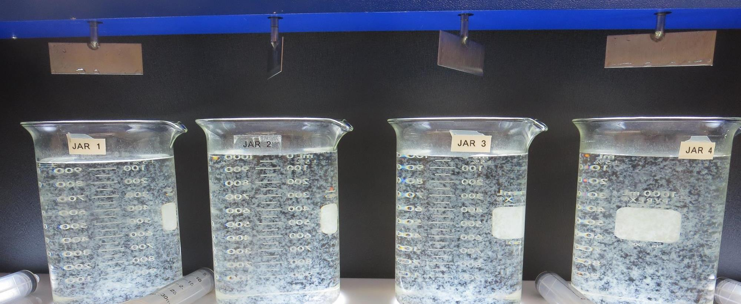
Jars 1-4: End of 5-minute flocculation (30 RPM) duration.
140 mg/L CTC-00011
Filtrate: 0.14 NTU
UVT: 90.4%
UVA: 0.043/cm
UVA Reduction: 63.9%
Settled: 0.49 NTU
150 mg/L CTC-00011
Filtrate: 0.08 NTU
UVT: 91.4%
UVA: 0.038/cm
UVA Reduction: 68.1%
Settled: 0.57 NTU
160 mg/L CTC-00011
Filtrate: 0.08 NTU
UVT: 91.7%
UVA: 0.037/cm
UVA Reduction: 68.9%
Settled: 0.44 NTU
170 mg/L CTC-00011
Filtrate: 0.08 NTU
UVT: 91.7%
UVA: 0.037/cm
UVA Reduction: 68.9%
Settled: 0.67 NTU

Slide 20
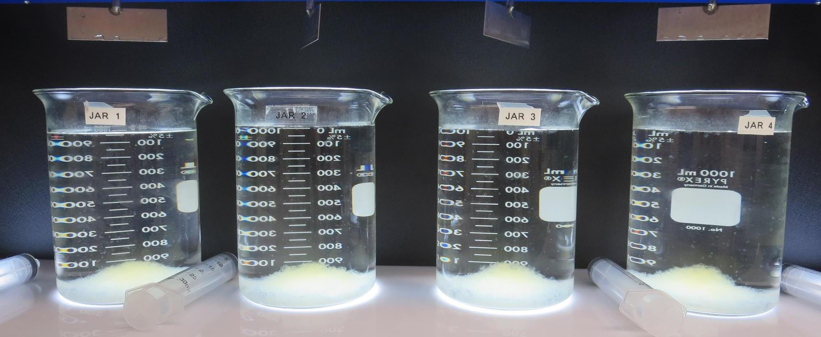
Jars 1-4: After 5 min of settling, 25 mL is syringed for filterability and %UVT/UVA.

Slide 21
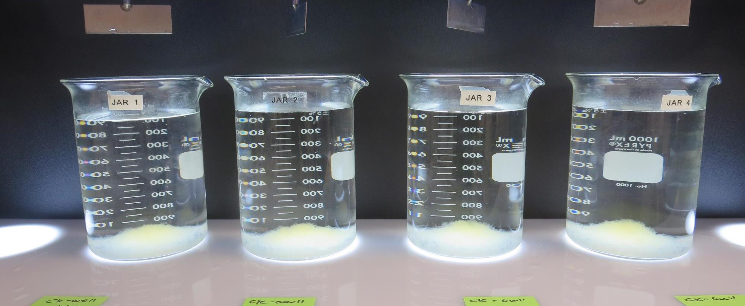
Jars 1-4: After 25-minutes of settling, settled water turbidity is taken.
140 mg/L CTC-00011
Filtrate: 0.14 NTU
UVT: 90.4%
UVA: 0.043/cm
UVA Reduction: 63.9%
Settled: 0.49 NTU
150 mg/L CTC-00011
Filtrate: 0.08 NTU
UVT: 91.4%
UVA: 0.038/cm
UVA Reduction: 68.1%
Settled: 0.57 NTU
160 mg/L CTC-00011
Filtrate: 0.08 NTU
UVT: 91.7%
UVA: 0.037/cm
UVA Reduction: 68.9%
Settled: 0.44 NTU
170 mg/L CTC-00011
Filtrate: 0.08 NTU
UVT: 91.7%
UVA: 0.037/cm
UVA Reduction: 68.9%
Settled: 0.67 NTU

Slide 22
Jars 5-8 Test Flash Mix 20 Sec (200 RPM) Floc Mix 5 min (30 RPM) Applied Coagulants CTC-00011/186K

Slide 23
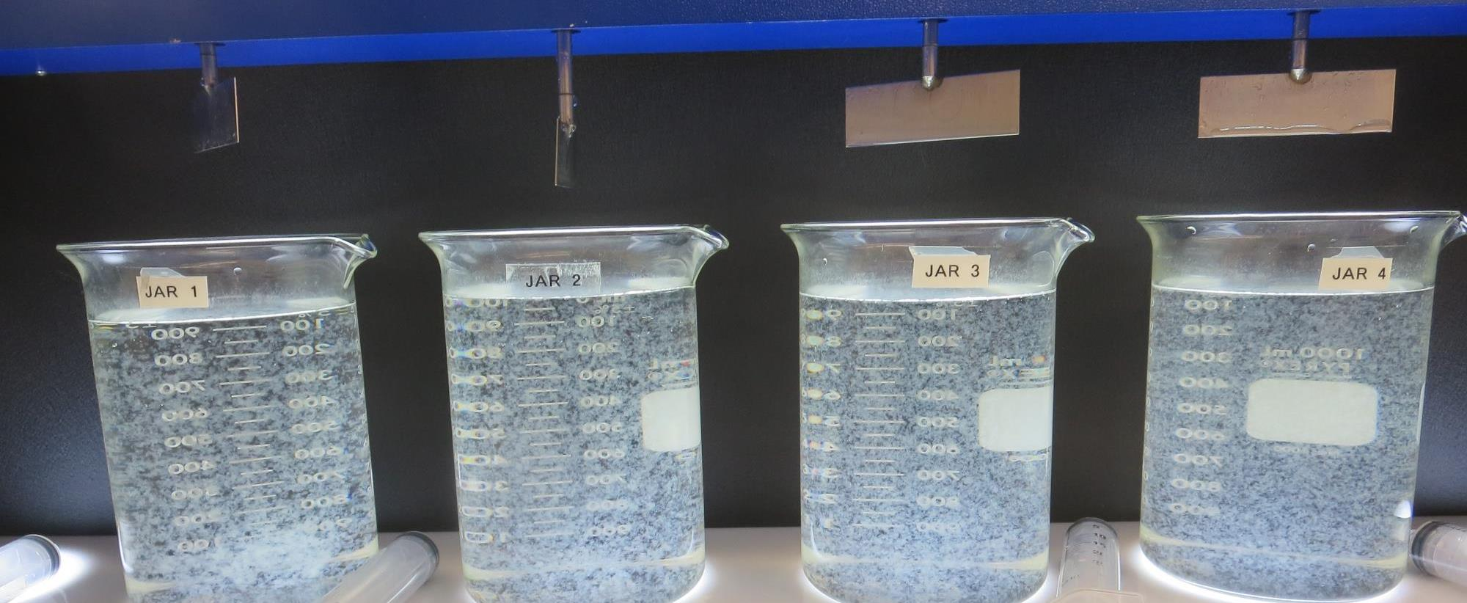
Jars 5-8: End of 5-minute flocculation (30 RPM) duration.
150 mg/L CTC-00011
0 mg/L 186K
Filtrate: 0.11 NTU
UVT: 91.7%
UVA: 0.037/cm
UVA Reduction: 68.9%
Settled: 0.62 NTU
150 mg/L CTC-00011
3 mg/L 186K
Filtrate: 0.05 NTU
UVT: 92.5%
UVA: 0.033/cm
UVA Reduction: 72.3%
Settled: 0.59 NTU
150 mg/L CTC-00011
6 mg/L 186K
Filtrate: 0.12 NTU
UVT: 92.7%
UVA: 0.032/cm
UVA Reduction: 73.1%
Settled: 0.80 NTU
150 mg/L CTC-00011
9 mg/L 186K
Filtrate: 0.12 NTU
UVT: 92.3%
UVA: 0.034/cm
UVA Reduction: 71.4%
Settled: 1.12 NTU

Slide 24
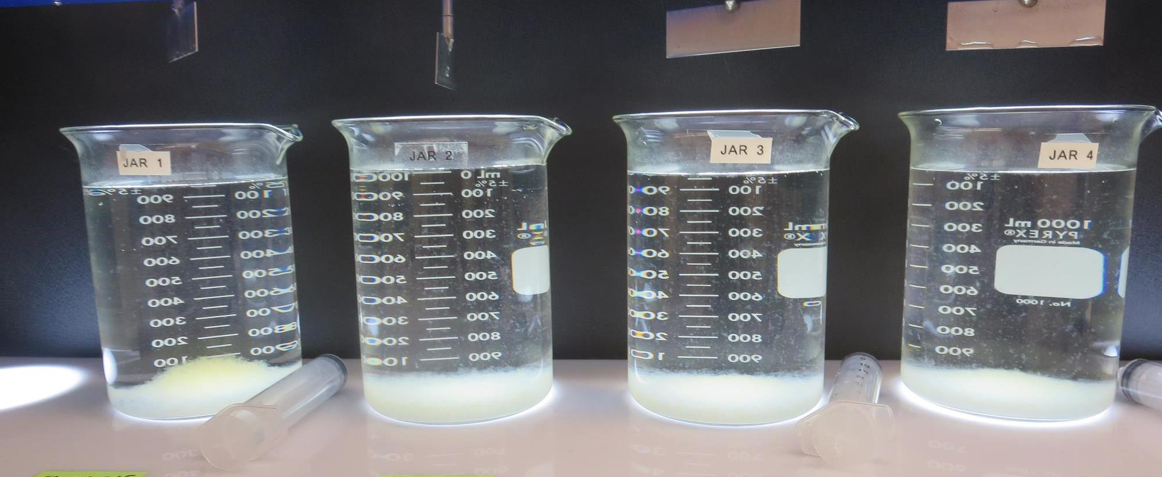
Jars 5-8: After 5 min of settling, 25 mL is syringed for filterability and %UVT/UVA.

Slide 25
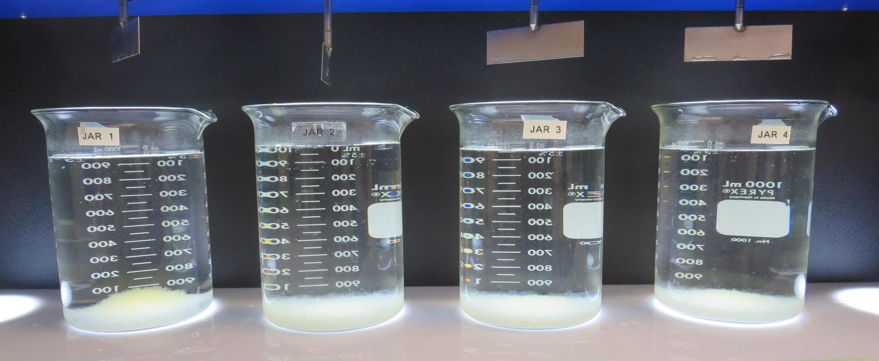
Jars 5-8: After 25-minutes of settling, settled water turbidity is taken.
150 mg/L CTC-00011
0 mg/L 186K
Filtrate: 0.11 NTU
UVT: 91.7%
UVA: 0.037/cm
UVA Reduction: 68.9%
Settled: 0.62 NTU
150 mg/L CTC-00011
3 mg/L 186K
Filtrate: 0.05 NTU
UVT: 92.5%
UVA: 0.033/cm
UVA Reduction: 72.3%
Settled: 0.59 NTU
150 mg/L CTC-00011
6 mg/L 186K
Filtrate: 0.12 NTU
UVT: 92.7%
UVA: 0.032/cm
UVA Reduction: 73.1%
Settled: 0.80 NTU
150 mg/L CTC-00011
9 mg/L 186K
Filtrate: 0.12 NTU
UVT: 92.3%
UVA: 0.034/cm
UVA Reduction: 71.4%
Settled: 1.12 NTU

Slide 26
Jars 9-12 Test Flash Mix 20 Sec (200 RPM) Floc Mix 5 min (30 RPM) Applied Coagulants CTC-00011/186K

Slide 27
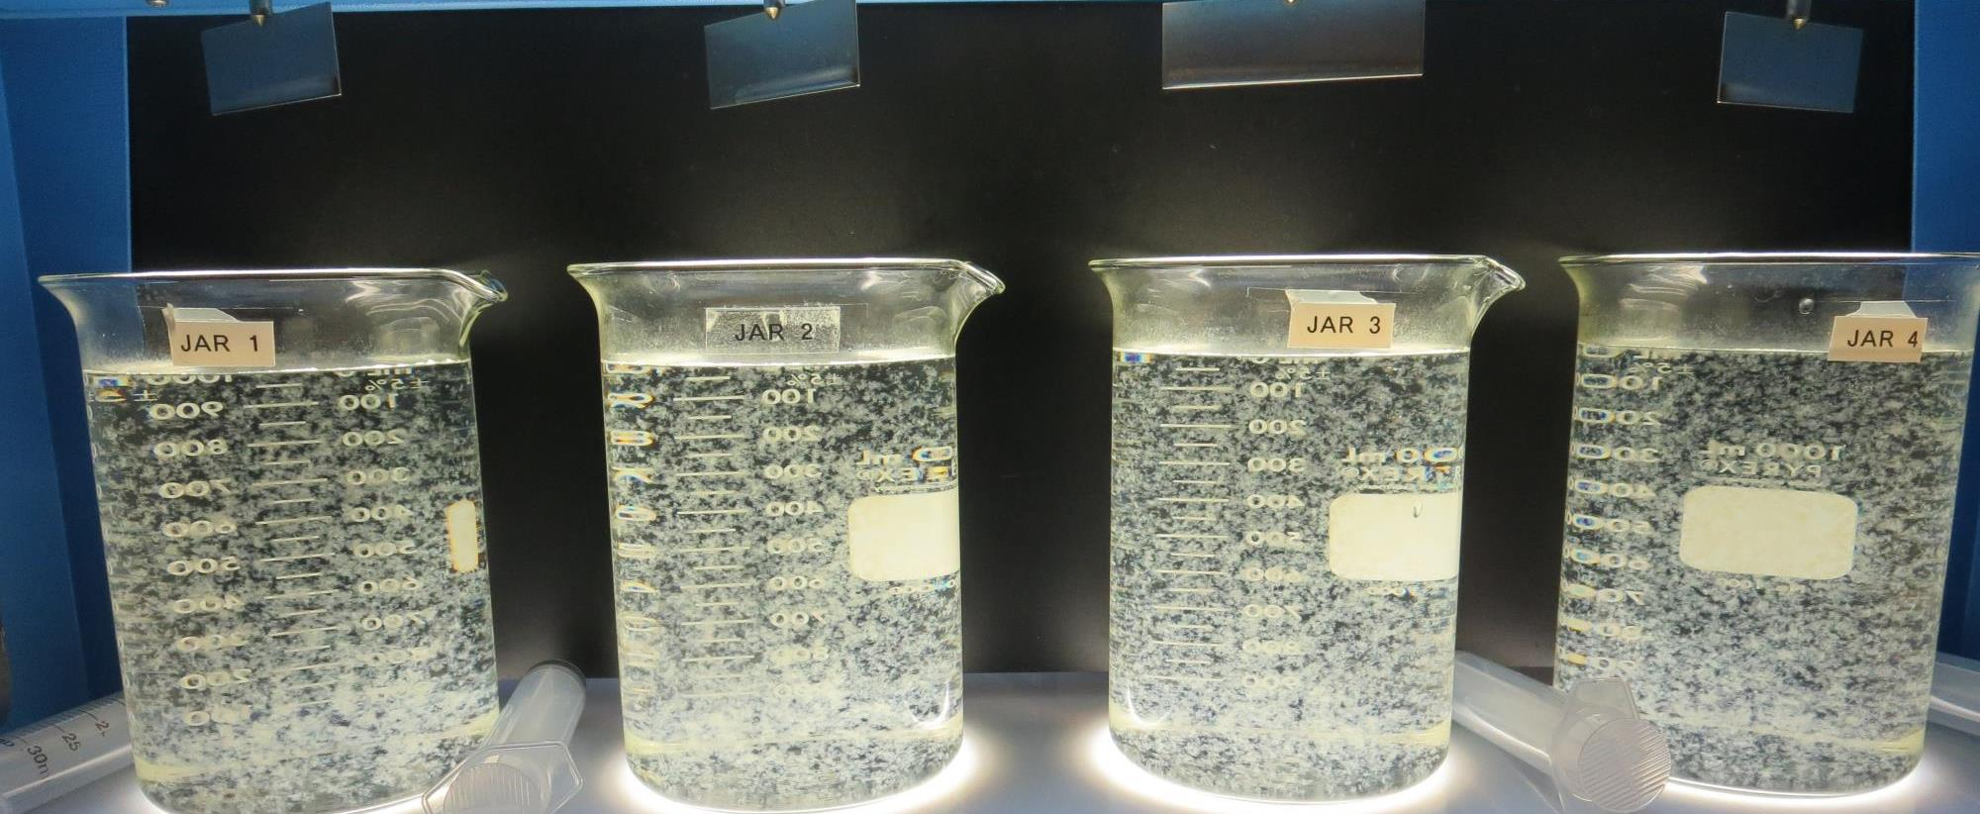
Jars 9-12: End of 5-minute flocculation (30 RPM) duration.
150 mg/L CTC-00011
0 mg/L 186K
Filtrate: 0.08 NTU
UVT: 91.6%
UVA: 0.037/cm
UVA Reduction: 68.9%
Settled: 0.63 NTU
150 mg/L CTC-00011
1 mg/L 186K
Filtrate: 0.10 NTU
UVT: 91.5%
UVA: 0.038/cm
UVA Reduction: 68.1%
Settled: 0.57 NTU
150 mg/L CTC-00011
2 mg/L 186K
Filtrate: 0.07 NTU
UVT: 91.9%
UVA: 0.036/cm
UVA Reduction: 69.7%
Settled: 0.74 NTU
150 mg/L CTC-00011
3 mg/L 186K
Filtrate: 0.05 NTU
UVT: 91.8%
UVA: 0.037/cm
UVA Reduction: 68.9%
Settled: 0.78 NTU

Slide 28
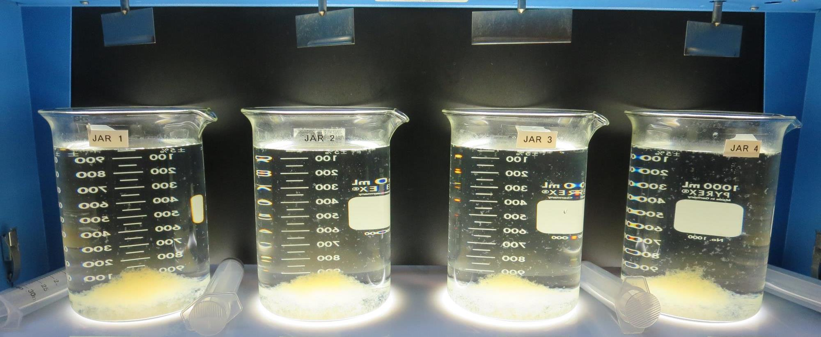
Jars 9-12: After 5 min of settling, 25 mL is syringed for filterability and %UVT/UVA.

Slide 29
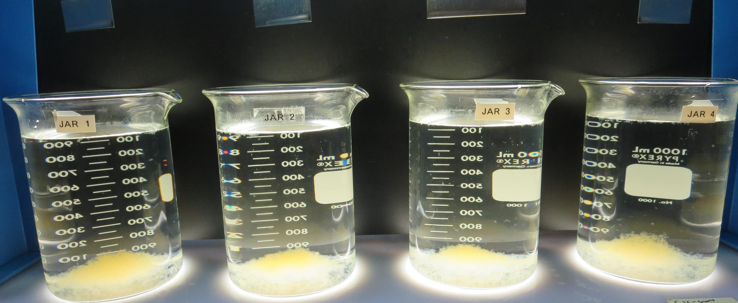
Jars 9-12: After 25-minutes of settling, settled water turbidity is taken.
150 mg/L CTC-00011
0 mg/L 186K
Filtrate: 0.08 NTU
UVT: 91.6%
UVA: 0.037/cm
UVA Reduction: 68.9%
Settled: 0.63 NTU
150 mg/L CTC-00011
1 mg/L 186K
Filtrate: 0.10 NTU
UVT: 91.5%
UVA: 0.038/cm
UVA Reduction: 68.1%
Settled: 0.57 NTU
150 mg/L CTC-00011
2 mg/L 186K
Filtrate: 0.07 NTU
UVT: 91.9%
UVA: 0.036/cm
UVA Reduction: 69.7%
Settled: 0.74 NTU
150 mg/L CTC-00011
3 mg/L 186K
Filtrate: 0.05 NTU
UVT: 91.8%
UVA: 0.037/cm
UVA Reduction: 68.9%
Settled: 0.78 NTU

Slide 30
Jars 13-16 Test Flash Mix 20 Sec (200 RPM) Floc Mix 5 min (30 RPM) PAC with Applied Coagulants CTC-00011/186K

Slide 31
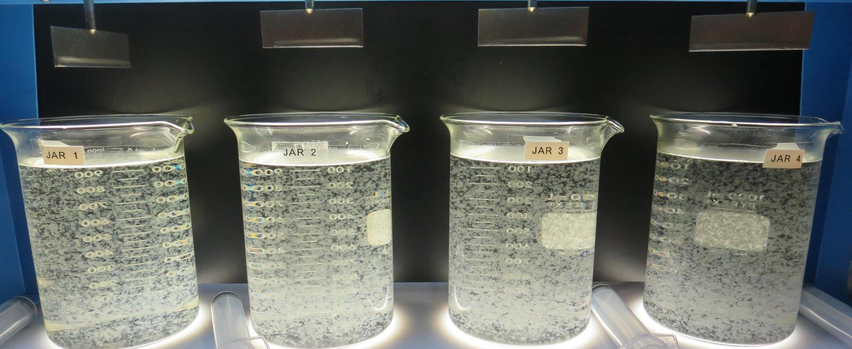
Jars 13-16: End of 5-minute flocculation (30 RPM) duration.
0 mg/L PAC
150 mg/L CTC-00011
3 mg/L 186K
Filtrate: 0.06 NTU
UVT: 92.3%
UVA: 0.034/cm
UVA Reduction: 71.4%
Settled: 0.64 NTU
10 mg/L PAC
150 mg/L CTC-00011
3 mg/L 186K
Filtrate: 0.06 NTU
UVT: 92.9%
UVA: 0.031/cm
UVA Reduction: 73.9%
Settled: 0.63 NTU
15 mg/L PAC
150 mg/L CTC-00011
3 mg/L 186K
Filtrate: 0.05 NTU
UVT: 93.3%
UVA: 0.029/cm
UVA Reduction: 75.6%
Settled: 0.66 NTU
20 mg/L PAC
150 mg/L CTC-00011
3 mg/L 186K
Filtrate: 0.05 NTU
UVT: 93.4%
UVA: 0.029/cm
UVA Reduction: 75.6%
Settled: 0.77 NTU

Slide 32
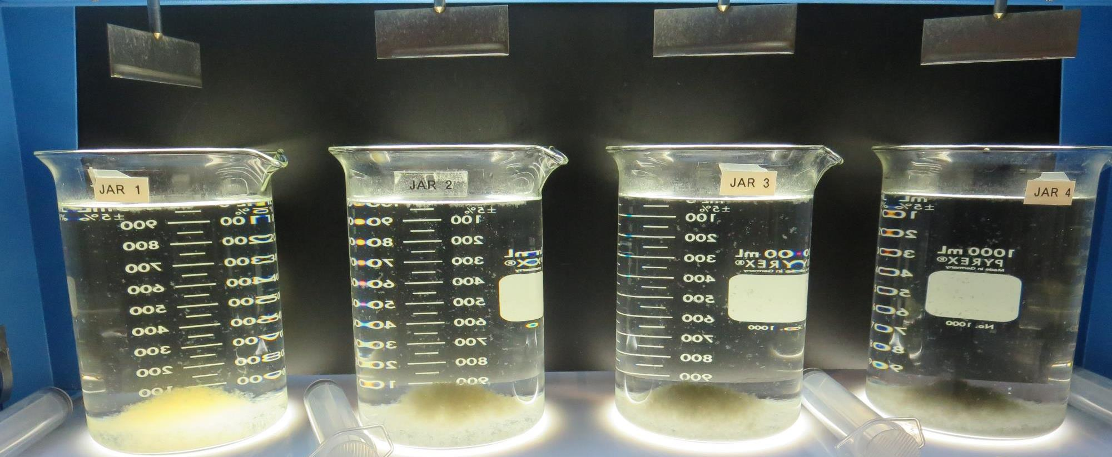
Jars 13-16: After 5 min of settling, 25 mL is syringed for filterability and %UVT/UVA.

Slide 33
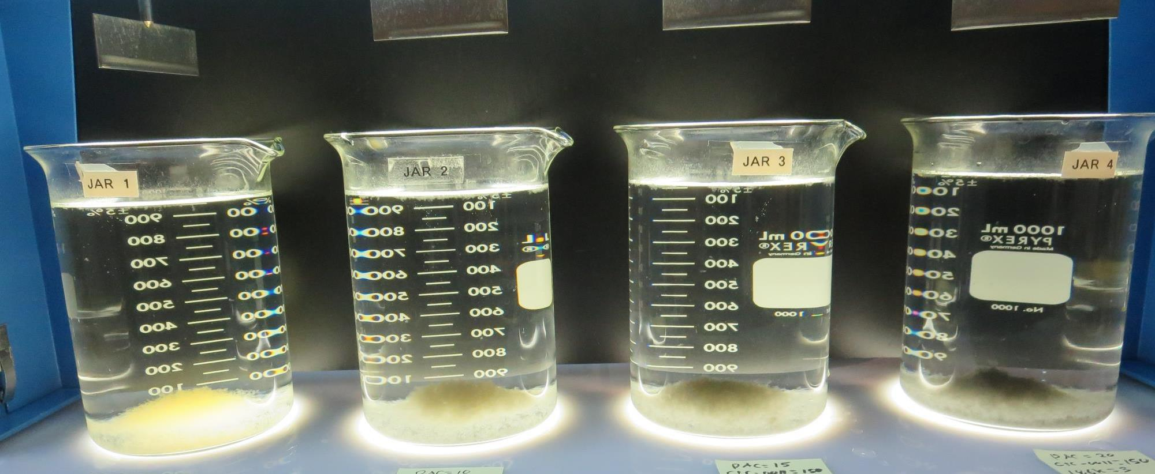
Jars 13-16: After 25-minutes of settling, settled water turbidity is taken.
0 mg/L PAC
150 mg/L CTC-00011
3 mg/L 186K
Filtrate: 0.06 NTU
UVT: 92.3%
UVA: 0.034/cm
UVA Reduction: 71.4%
Settled: 0.64 NTU
10 mg/L PAC
150 mg/L CTC-00011
3 mg/L 186K
Filtrate: 0.06 NTU
UVT: 92.9%
UVA: 0.031/cm
UVA Reduction: 73.9%
Settled: 0.63 NTU
15 mg/L PAC
150 mg/L CTC-00011
3 mg/L 186K
Filtrate: 0.05 NTU
UVT: 93.3%
UVA: 0.029/cm
UVA Reduction: 75.6%
Settled: 0.66 NTU
20 mg/L PAC
150 mg/L CTC-00011
3 mg/L 186K
Filtrate: 0.05 NTU
UVT: 93.4%
UVA: 0.029/cm
UVA Reduction: 75.6%
Settled: 0.77 NTU

Slide 34
Jars 17-20 Test Flash Mix 20 Sec (200 RPM) Floc Mix 5 min (30 RPM) PAC with Applied Coagulants CTC-00011

Slide 35
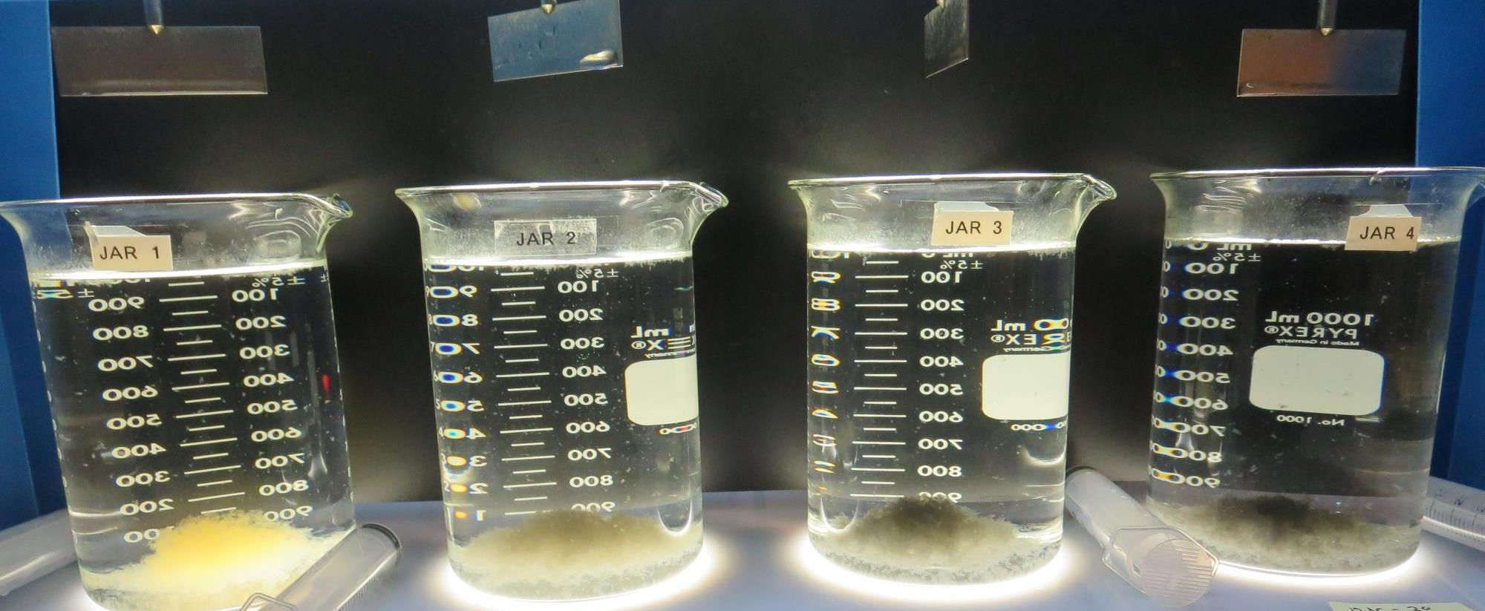
Jars 17-20: After 5 min of settling, 25 mL is syringed for filterability and %UVT/UVA.

Slide 36
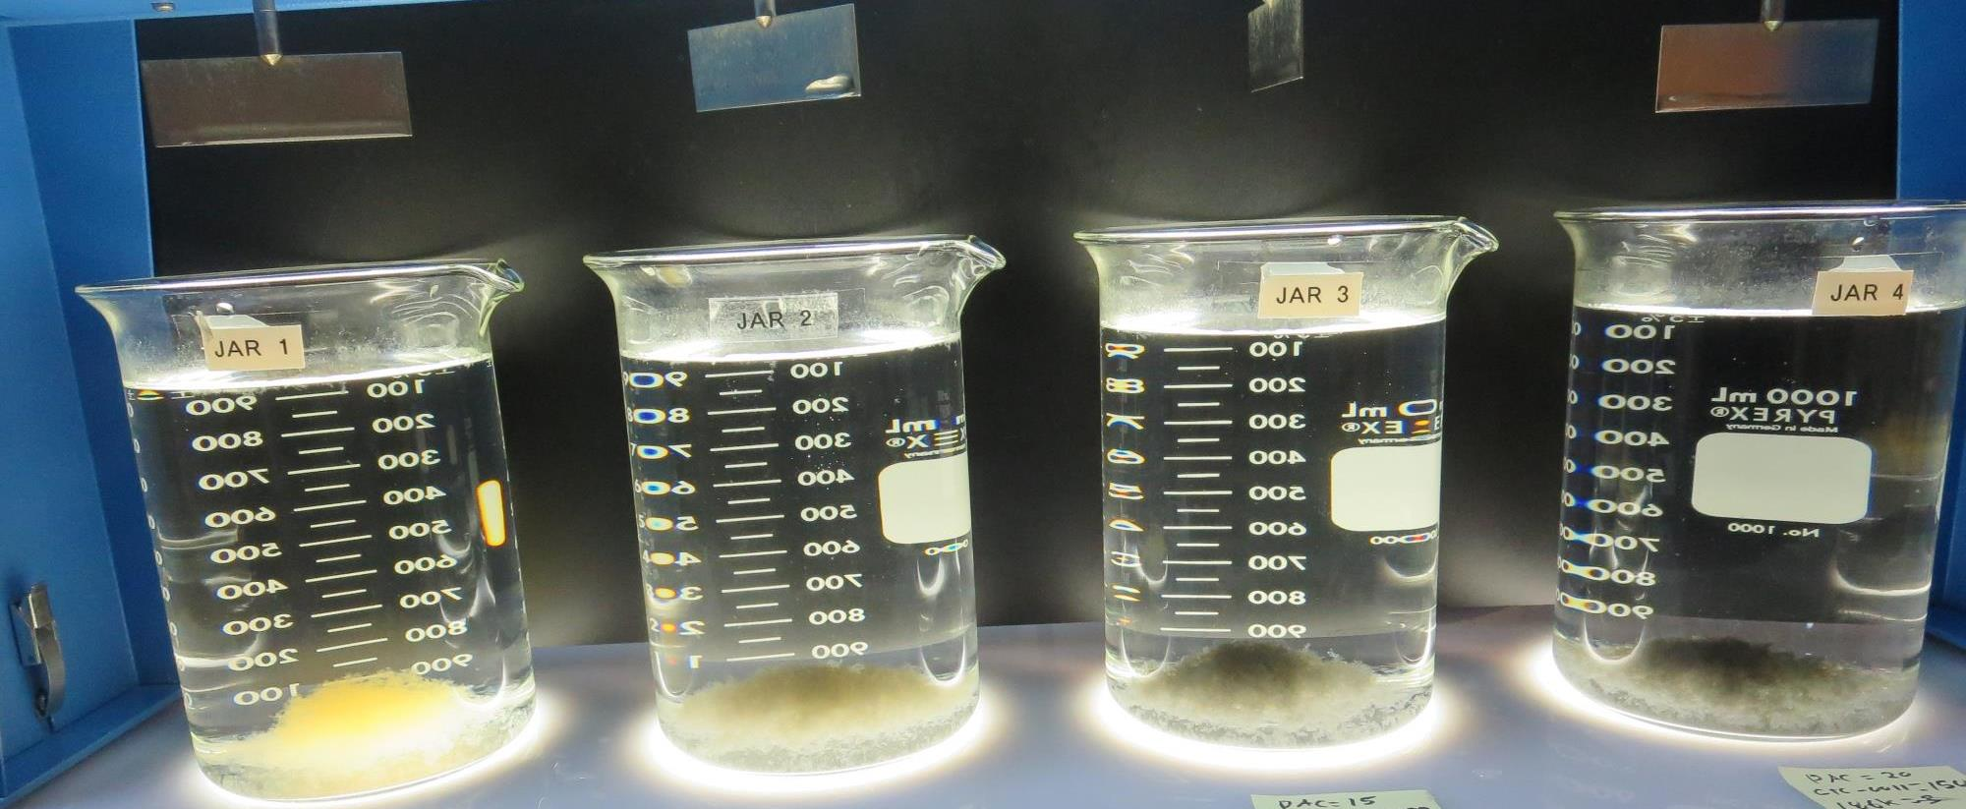
Jars 17-20: After 25-minutes of settling, settled water turbidity is taken.
0 mg/L PAC
150 mg/L CTC-00011
Filtrate: 0.09 NTU
UVT: 91.7%
UVA: 0.037/cm
UVA Reduction: 68.9%
Settled: 0.50 NTU
10 mg/L PAC
150 mg/L CTC-00011
Filtrate: 0.08 NTU
UVT: 92.5%
UVA: 0.033/cm
UVA Reduction: 72.3%
Settled: 0.60 NTU
15 mg/L PAC
150 mg/L CTC-00011
Filtrate: 0.07 NTU
UVT: 92.9%
UVA: 0.032/cm
UVA Reduction: 73.1%
Settled: 0.50 NTU
20 mg/L PAC
150 mg/L CTC-00011
Filtrate: 0.05 NTU
UVT: 93.2%
UVA: 0.030/cm
UVA Reduction: 74.8%
Settled: 0.34 NTU

Slide 37
Jars 21-24 Test Flash Mix 20 Sec (200 RPM) Floc Mix 5 min (30 RPM) PAC with Applied Coagulants CTC-00011

Slide 38
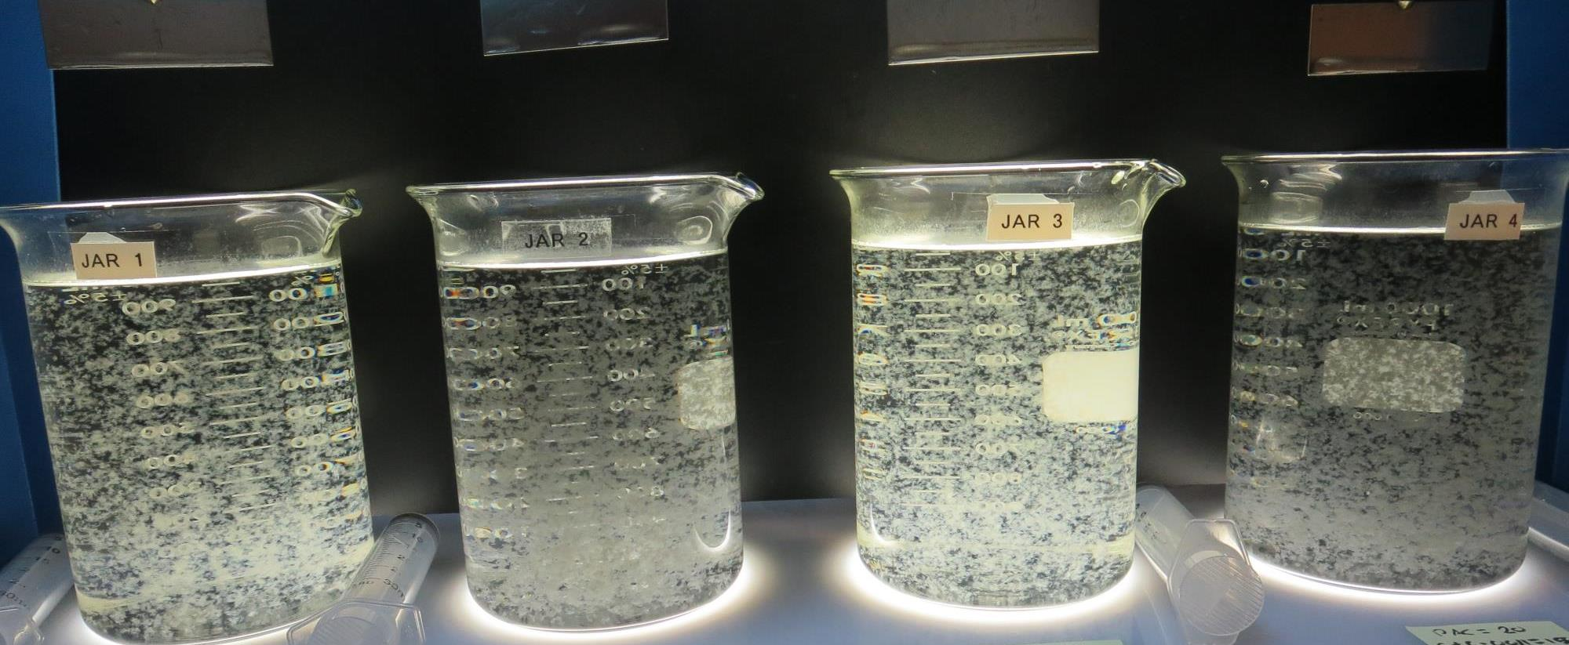
Jars 21-24: End of 5-minute flocculation (30 RPM) duration.
0 mg/L PAC
150 mg/L CTC-00011
0 mg/L 186K
Filtrate: 0.09 NTU
UVT: 91.7%
UVA: 0.037/cm
UVA Reduction: 68.9%
Settled: 0.38 NTU
20 mg/L PAC
150 mg/L CTC-00011
0 mg/L 186K
Filtrate: 0.06 NTU
UVT: 93.0%
UVA: 0.031/cm
UVA Reduction: 73.9%
Settled: 0.56 NTU
0 mg/L PAC
150 mg/L CTC-00011
3 mg/L 186K
Filtrate: 0.05 NTU
UVT: 92.2%
UVA: 0.035/cm
UVA Reduction: 70.6%
Settled: 0.70 NTU
20 mg/L PAC
150 mg/L CTC-00011
3 mg/L 186K
Filtrate: 0.06 NTU
UVT: 93.2%
UVA: 0.030/cm
UVA Reduction: 74.0%
Settled: 0.78 NTU

Slide 39
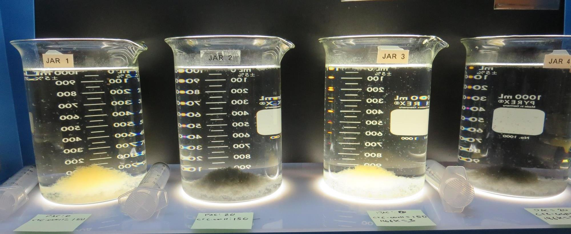
Jars 21-24: After 5 min of settling, 25 mL is syringed for filterability and %UVT/UVA.

Slide 40
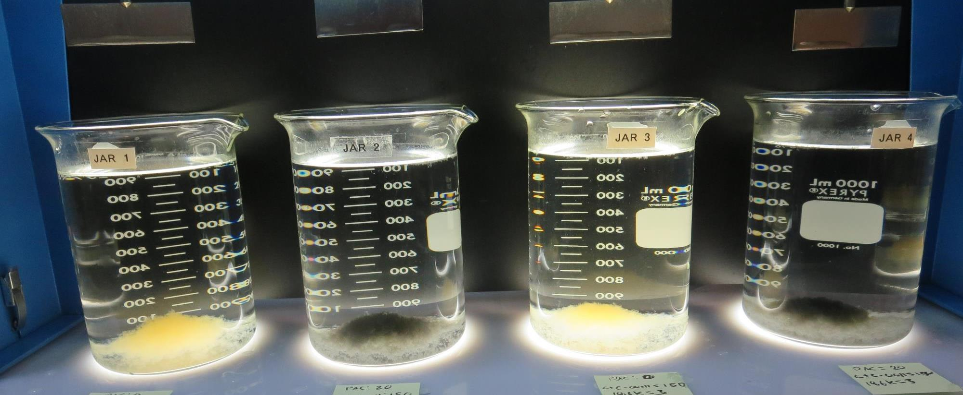
Jars 21-24: After 25-minutes of settling, settled water turbidity is taken.
0 mg/L PAC
150 mg/L CTC-00011
0 mg/L 186K
Filtrate: 0.09 NTU
UVT: 91.7%
UVA: 0.037/cm
UVA Reduction: 68.9%
Settled: 0.38 NTU
20 mg/L PAC
150 mg/L CTC-00011
0 mg/L 186K
Filtrate: 0.06 NTU
UVT: 93.0%
UVA: 0.031/cm
UVA Reduction: 73.9%
Settled: 0.56 NTU
0 mg/L PAC
150 mg/L CTC-00011
3 mg/L 186K
Filtrate: 0.05 NTU
UVT: 92.2%
UVA: 0.035/cm
UVA Reduction: 70.6%
Settled: 0.70 NTU
20 mg/L PAC
150 mg/L CTC-00011
3 mg/L 186K
Filtrate: 0.06 NTU
UVT: 93.2%
UVA: 0.030/cm
UVA Reduction: 74.0%
Settled: 0.78 NTU

Slide 41
Jars 25-28 Test Flash Mix 20 Sec (200 RPM) Floc Mix 5 min (30 RPM) PAC with Applied Coagulants CTC-00011

Slide 42
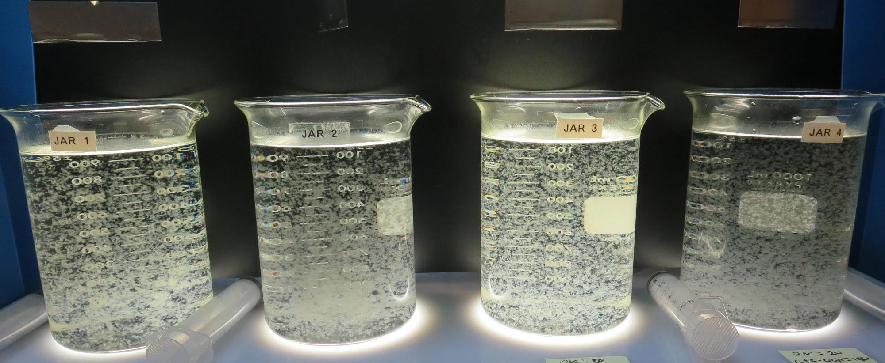
Jars 25-28: End of 5-minute flocculation (30 RPM) duration.
0 mg/L PAC
150 mg/L CTC-00011
0 mg/L 186K
Filtrate: 0.07 NTU
UVT: 91.4%
UVA: 0.038/cm
UVA Reduction: 68.1%
Settled: 0.44 NTU
20 mg/L PAC
150 mg/L CTC-00011
0 mg/L 186K
Filtrate: 0.08 NTU
UVT: 92.4%
UVA: 0.031/cm
UVA Reduction: 71.4%
Settled: 0.31 NTU
0 mg/L PAC
150 mg/L CTC-00011
3 mg/L 186K
Filtrate: 0.05 NTU
UVT: 91.8%
UVA: 0.036/cm
UVA Reduction: 69.7%
Settled: 0.50 NTU
20 mg/L PAC
150 mg/L CTC-00011
3 mg/L 186K
Filtrate: 0.05 NTU
UVT: 93.6%
UVA: 0.028/cm
UVA Reduction: 76.5%
Settled: 0.51 NTU

Slide 43
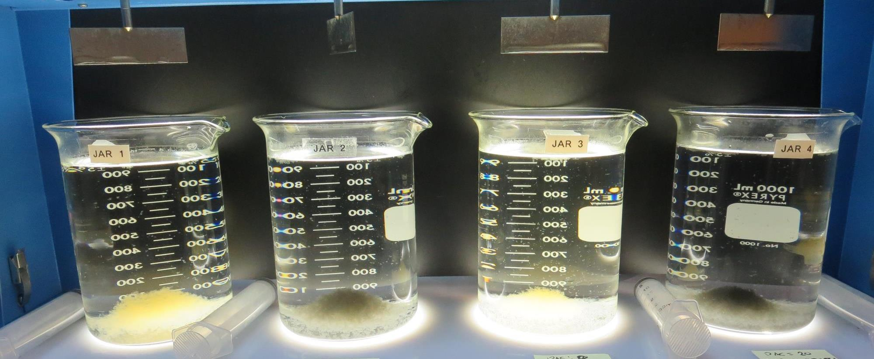
Jars 25-28: After 5 min of settling, 25 mL is syringed for filterability and %UVT/UVA.

Slide 44
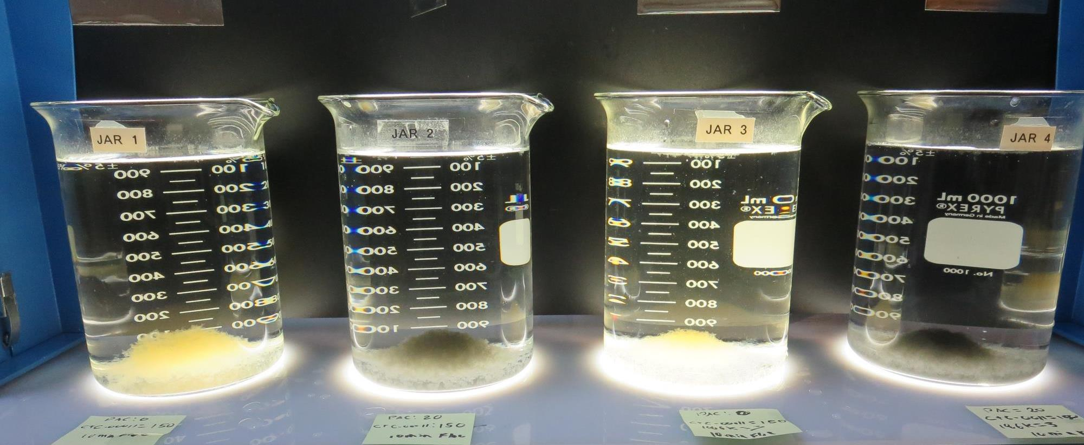
Jars 25-28: After 25-minutes of settling, settled water turbidity is taken.
0 mg/L PAC
150 mg/L CTC-00011
0 mg/L 186K
Filtrate: 0.07 NTU
UVT: 91.4%
UVA: 0.038/cm
UVA Reduction: 68.1%
Settled: 0.44 NTU
20 mg/L PAC
150 mg/L CTC-00011
0 mg/L 186K
Filtrate: 0.08 NTU
UVT: 92.4%
UVA: 0.031/cm
UVA Reduction: 71.4%
Settled: 0.31 NTU
0 mg/L PAC
150 mg/L CTC-00011
3 mg/L 186K
Filtrate: 0.05 NTU
UVT: 91.8%
UVA: 0.036/cm
UVA Reduction: 69.7%
Settled: 0.50 NTU
20 mg/L PAC
150 mg/L CTC-00011
3 mg/L 186K
Filtrate: 0.05 NTU
UVT: 93.6%
UVA: 0.028/cm
UVA Reduction: 76.5%
Settled: 0.51 NTU

Slide 45
Jars 29-32 Test Flash Mix 20 Sec (200 RPM) Floc Mix 5 min (30 RPM) Applied Coagulant 7% Acid Alum

Slide 46
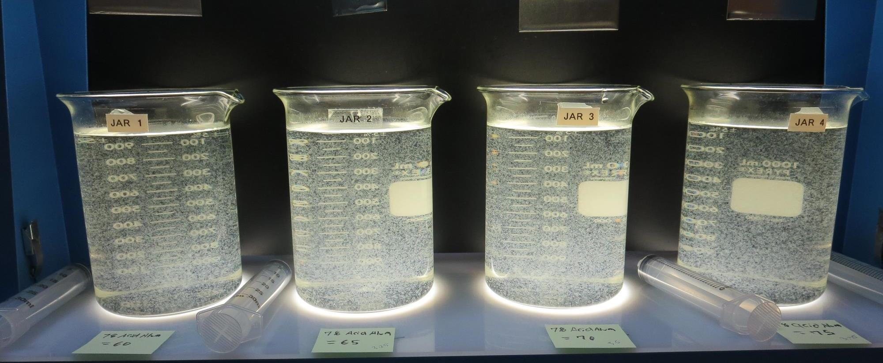
Jars 29-32: End of 5-minute flocculation (30 RPM) duration.
60 mg/L 7%Acid Alum
Filtrate: 0.11 NTU
UVT: 91.1%
UVA: 0.040/cm
UVA Reduction: 66.4%
Settled: 1.03 NTU
65 mg/L 7%Acid Alum
Filtrate: 0.06 NTU
UVT: 91.5%
UVA: 0.038/cm
UVA Reduction: 68.1%
Settled: 1.21 NTU
70 mg/L 7%Acid Alum
Filtrate: 0.07 NTU
UVT: 91.7%
UVA: 0.037/cm
UVA Reduction: 68.9%
Settled: 1.15 NTU
75 mg/L 7%Acid Alum
Filtrate: 0.09 NTU
UVT: 91.8%
UVA: 0.037/cm
UVA Reduction: 68.9%
Settled: 0.96 NTU

Slide 47
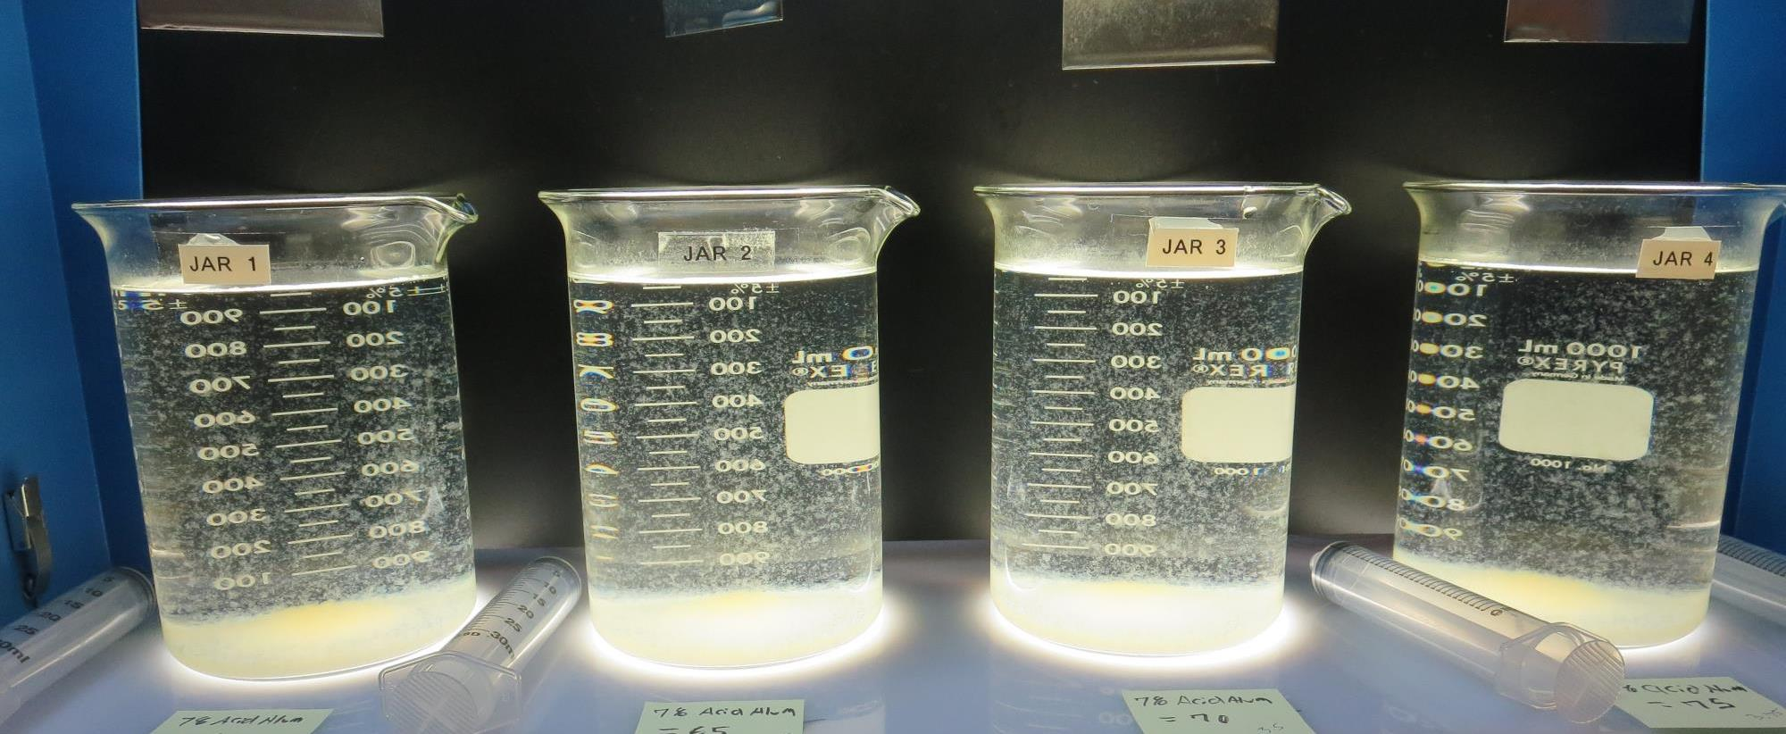
Jars 29-32: After 5 min of settling, 25 mL is syringed for filterability and %UVT/UVA.

Slide 48
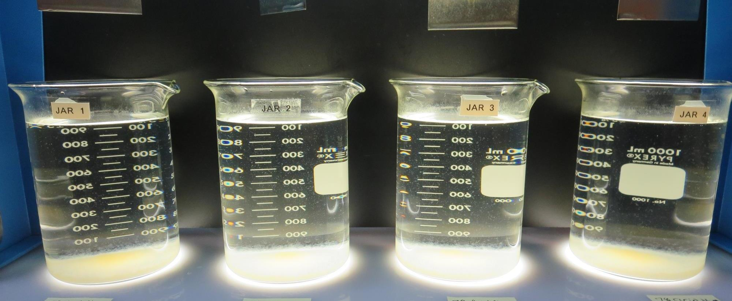
Jars 29-32: After 25-minutes of settling, settled water turbidity is taken.
60 mg/L 7%Acid Alum
Filtrate: 0.11 NTU
UVT: 91.1%
UVA: 0.040/cm
UVA Reduction: 66.4%
Settled: 1.03 NTU
65 mg/L 7%Acid Alum
Filtrate: 0.06 NTU
UVT: 91.5%
UVA: 0.038/cm
UVA Reduction: 68.1%
Settled: 1.21 NTU
70 mg/L 7%Acid Alum
Filtrate: 0.07 NTU
UVT: 91.7%
UVA: 0.037/cm
UVA Reduction: 68.9%
Settled: 1.15 NTU
75 mg/L 7%Acid Alum
Filtrate: 0.09 NTU
UVT: 91.8%
UVA: 0.037/cm
UVA Reduction: 68.9%
Settled: 0.96 NTU

Slide 49
Jars 33-36 Test Flash Mix 20 Sec (200 RPM) Floc Mix 5 min (30 RPM) PAC + Applied Coagulant 7% Acid Alum

Slide 50
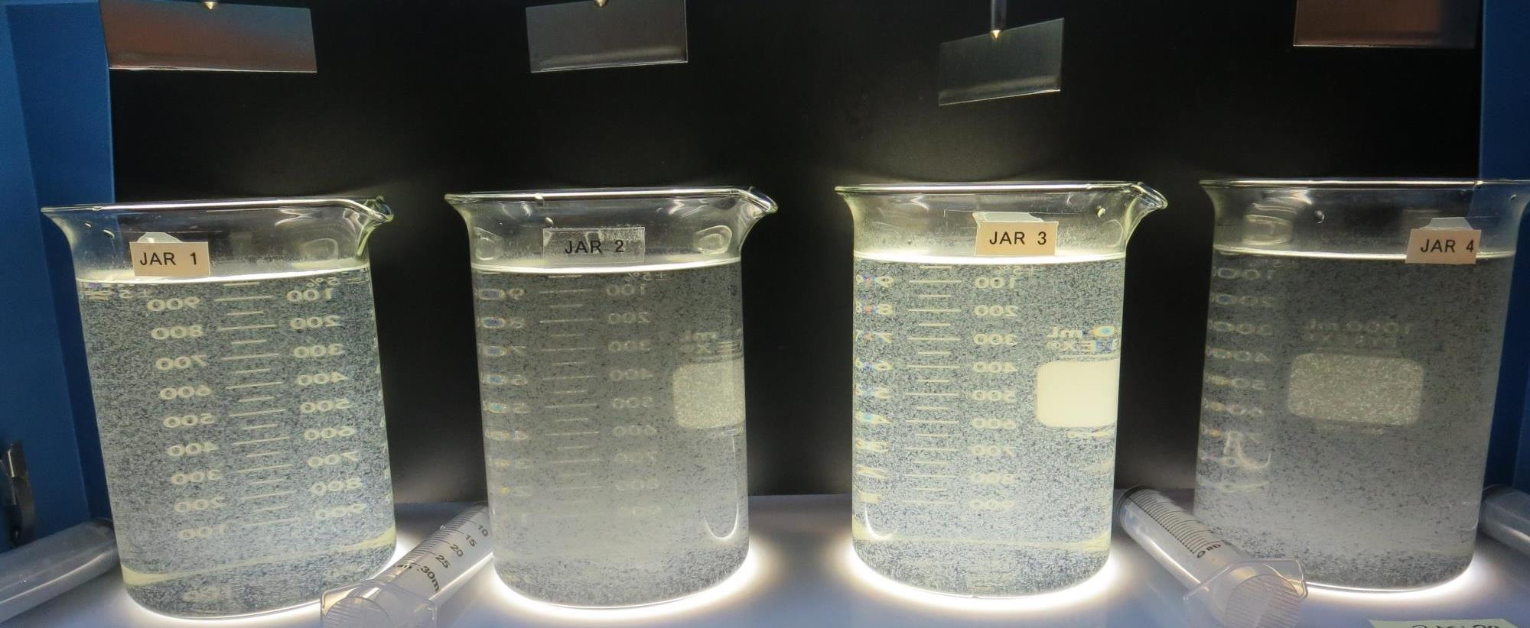
Jars 33-36: End of 5-minute flocculation (30 RPM) duration.
0 mg/L PACE
65 mg/L 7%Acid Alum
Filtrate: 0.05 NTU
UVT: 91.5%
UVA: 0.038/cm
UVA Reduction: 68.1%
Settled: 1.07 NTU
20 mg/L PACE
65 mg/L 7%Acid Alum
Filtrate: 0.05 NTU
UVT: 92.9%
UVA: 0.031/cm
UVA Reduction: 73.9%
Settled: 1.17 NTU
0 mg/L PACE
65 mg/L 7%Acid Alum
3 mg/L 186K
Filtrate: 0.05 NTU
UVT: 92.0%
UVA: 0.036/cm
UVA Reduction: 69.7%
Settled: 1.50 NTU
20 mg/L PACE
65 mg/L 7%Acid Alum
3 mg/L 186K
Filtrate: 0.04 NTU
UVT: 93.3%
UVA: 0.029/cm
UVA Reduction: 75.6%
Settled: 1.62 NTU

Slide 51
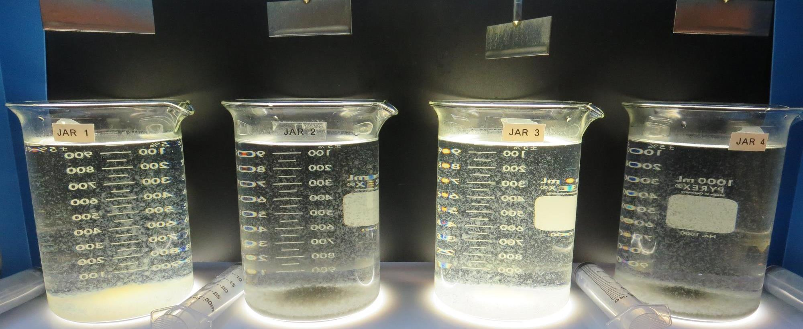
Jars 33-36: After 5 min of settling, 25 mL is syringed for filterability and %UVT/UVA.

Slide 52
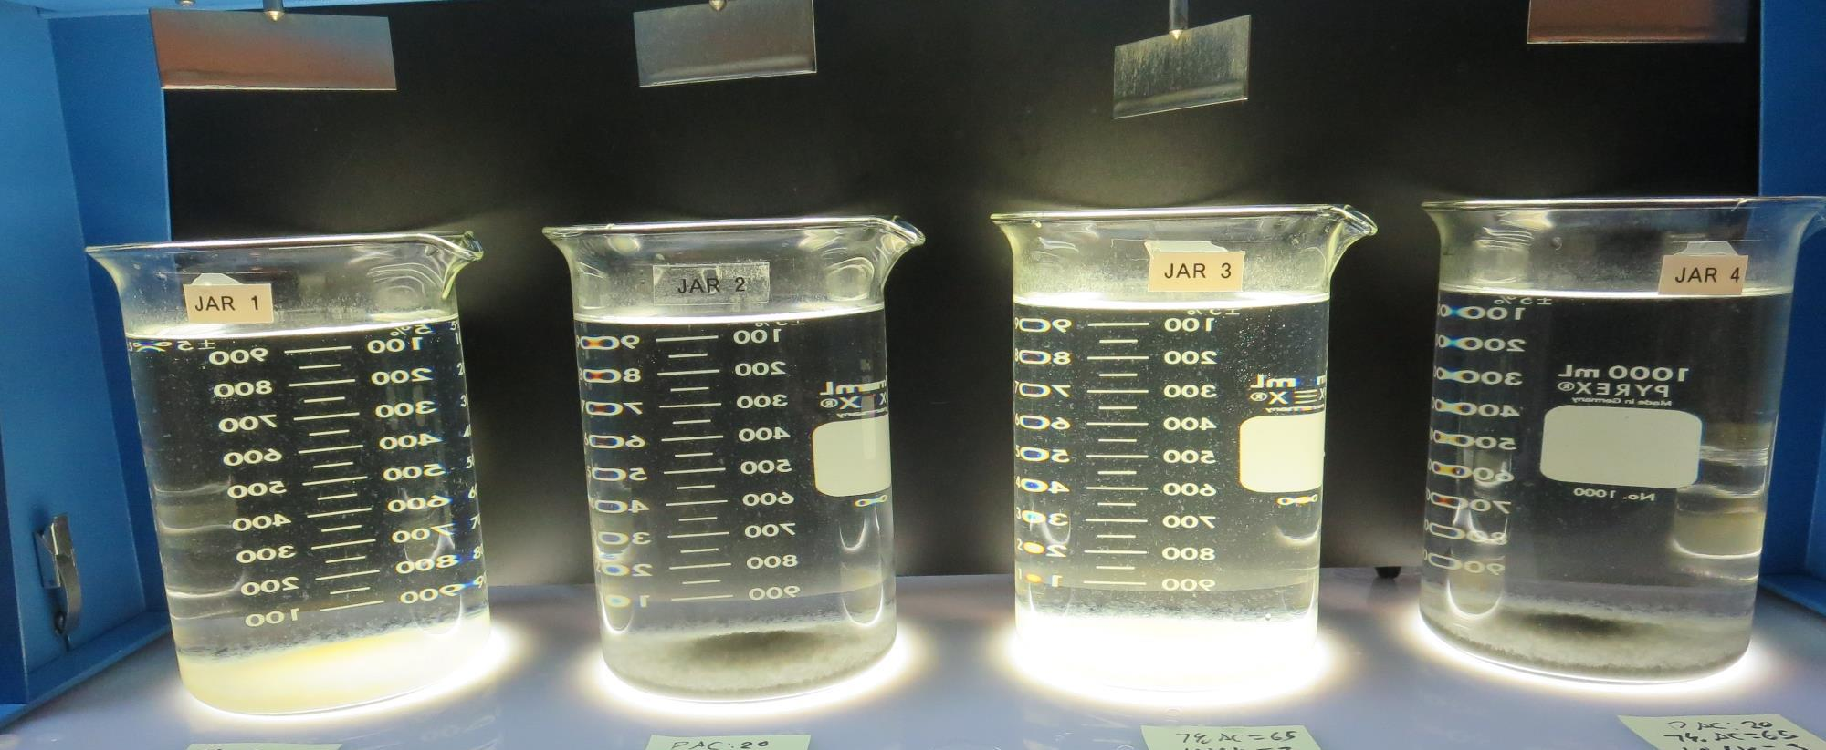
Jars 33-36: After 25-minutes of settling, settled water turbidity is taken.
0 mg/L PACE
65 mg/L 7%Acid Alum
Filtrate: 0.05 NTU
UVT: 91.5%
UVA: 0.038/cm
UVA Reduction: 68.1%
Settled: 1.07 NTU
20 mg/L PACE
65 mg/L 7%Acid Alum
Filtrate: 0.05 NTU
UVT: 92.9%
UVA: 0.031/cm
UVA Reduction: 73.9%
Settled: 1.17 NTU
0 mg/L PACE
65 mg/L 7%Acid Alum
3 mg/L 186K
Filtrate: 0.05 NTU
UVT: 92.0%
UVA: 0.036/cm
UVA Reduction: 69.7%
Settled: 1.50 NTU
20 mg/L PACE
65 mg/L 7%Acid Alum
3 mg/L 186K
Filtrate: 0.04 NTU
UVT: 93.3%
UVA: 0.029/cm
UVA Reduction: 75.6%
Settled: 1.62 NTU

Slide 53
Jars 37-40 Test Flash Mix 20 Sec (200 RPM) Floc Mix 30 min (20 RPM) KMnO₄ + Applied Coagulant 7% Acid Alum

Slide 54
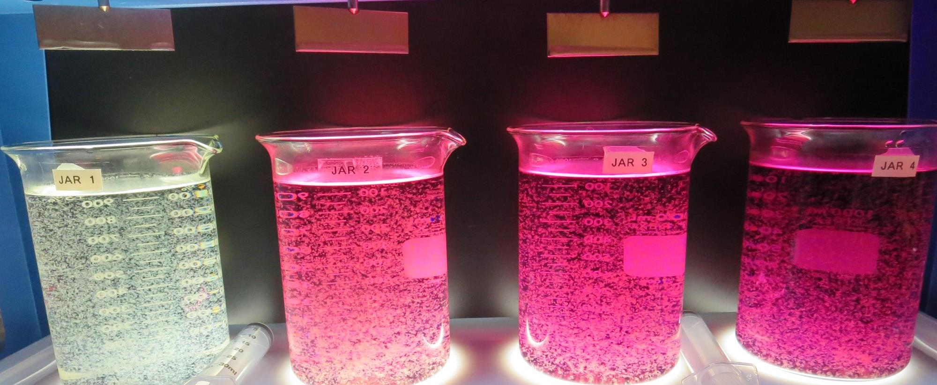
Jars 37-40: End of 30-minute flocculation (30 RPM) duration.
0 mg/L KMnO₄
65 mg/L 7%Acid Alum
Filtrate: 0.08 NTU
UVT: 91.2%
UVA: 0.039/cm
UVA Reduction: 67.2%
Settled: 0.46 NTU
1.5 mg/L KMnO₄
65 mg/L 7%Acid Alum
Filtrate: 0.10 NTU
UVT: 85.9%
UVA: 0.065/cm
UVA Reduction: 45.4%
Settled: 0.84 NTU
3.0 mg/L KMnO₄
65 mg/L 7%Acid Alum
Filtrate: 0.10 NTU
UVT: 78.2%
UVA: 0.106/cm
UVA Reduction: 10.9%
Settled: 0.87 NTU
5.0 mg/L KMnO₄
65 mg/L 7%Acid Alum
Filtrate: 0.08 NTU
UVT: 69.0%
UVA: 0.160/cm
UVA Reduction: -%
Settled: 0.78 NTU

Slide 55
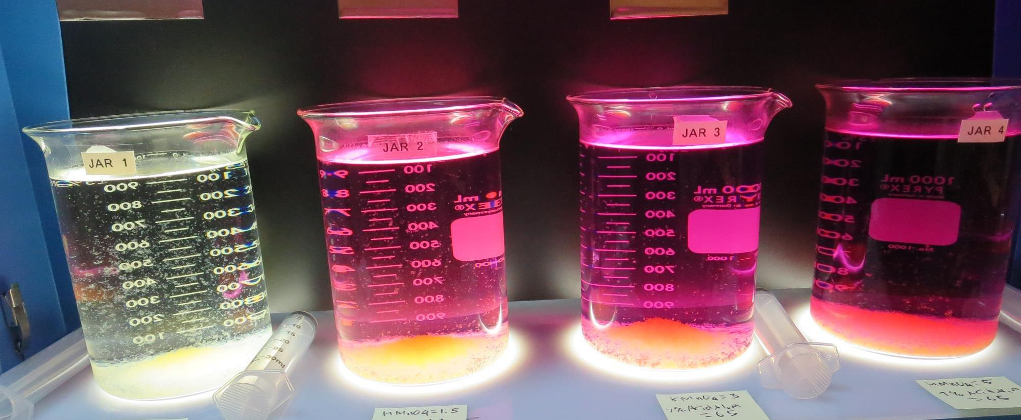
Jars 37-40: After 5 min of settling, 25 mL is syringed for filterability and %UVT/UVA.

Slide 56
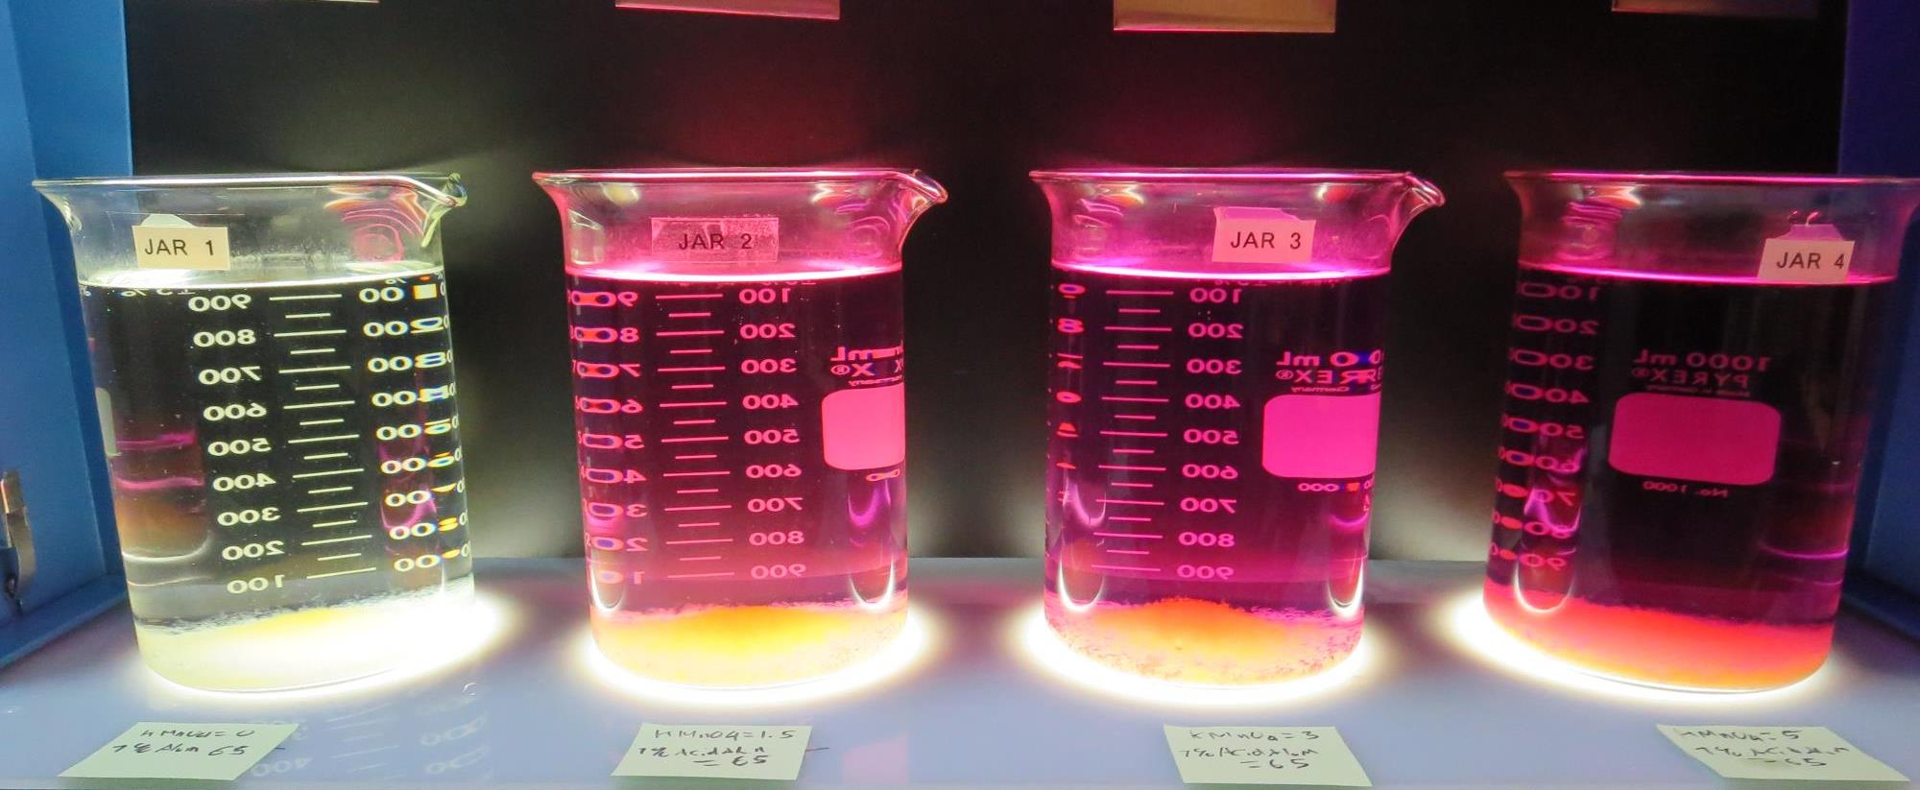
Jars 37-40: After 25-minutes of settling, settled water turbidity is taken.
0 mg/L KMnO₄
65 mg/L 7%Acid Alum
Filtrate: 0.08 NTU
UVT: 91.2%
UVA: 0.039/cm
UVA Reduction: 67.2%
Settled: 0.46 NTU
1.5 mg/L KMnO₄
65 mg/L 7%Acid Alum
Filtrate: 0.10 NTU
UVT: 85.9%
UVA: 0.065/cm
UVA Reduction: 45.4%
Settled: 0.84 NTU
3.0 mg/L KMnO₄
65 mg/L 7%Acid Alum
Filtrate: 0.10 NTU
UVT: 78.2%
UVA: 0.106/cm
UVA Reduction: 10.9%
Settled: 0.87 NTU
5.0 mg/L KMnO₄
65 mg/L 7%Acid Alum
Filtrate: 0.08 NTU
UVT: 69.0%
UVA: 0.160/cm
UVA Reduction: -%
Settled: 0.78 NTU

Slide 57
Jars 41-44 Test Flash Mix 20 Sec (200 RPM) Floc Mix 5 min (30 RPM) Applied Coagulants CTC-00011/CTC-00017

Slide 58
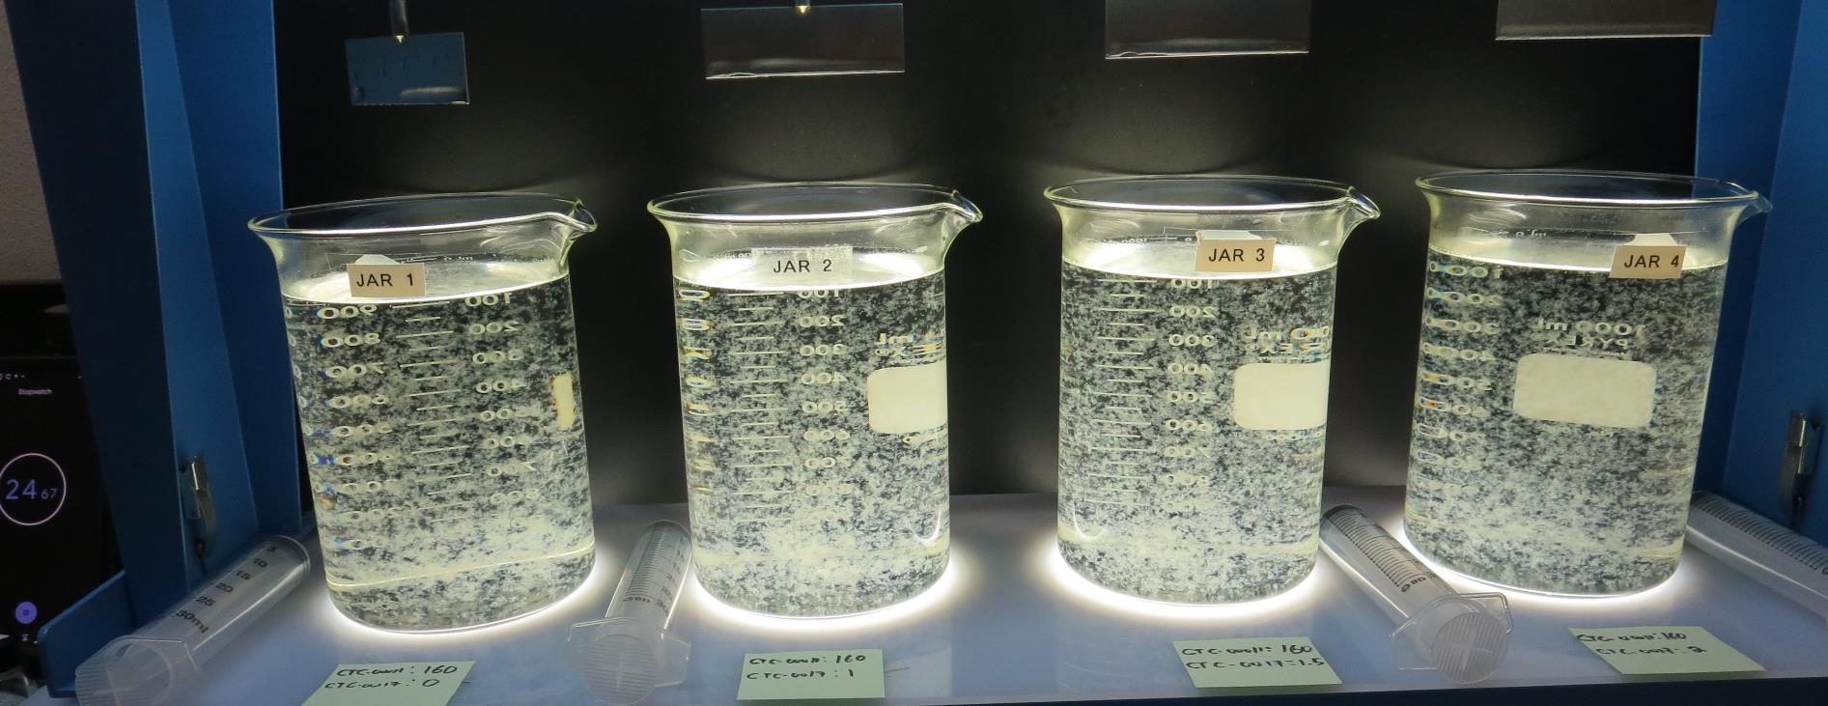
Jars 41-44: End of 5-minute flocculation (30 RPM) duration.
160 mg/L CTC-00011
0 mg/L CTC-00017
Filtrate: 0.05 NTU
UVT: 92.0%
UVA: 0.035/cm
UVA Reduction: 70.6%
Settled: 0.32 NTU
160 mg/L CTC-00011
1 mg/L CTC-00017
Filtrate: 0.05 NTU
UVT: 92.2%
UVA: 0.035/cm
UVA Reduction: 70.6%
Settled: 0.41 NTU
160 mg/L CTC-00011
1.5 mg/L CTC-00017
Filtrate: 0.05 NTU
UVT: 92.2%
UVA: 0.034/cm
UVA Reduction: 71.4%
Settled: 0.41 NTU
160 mg/L CTC-00011
2 mg/L CTC-00017
Filtrate: 0.05 NTU
UVT: 92.4%
UVA: 0.034/cm
UVA Reduction: 71.4%
Settled: 0.44 NTU

Slide 59
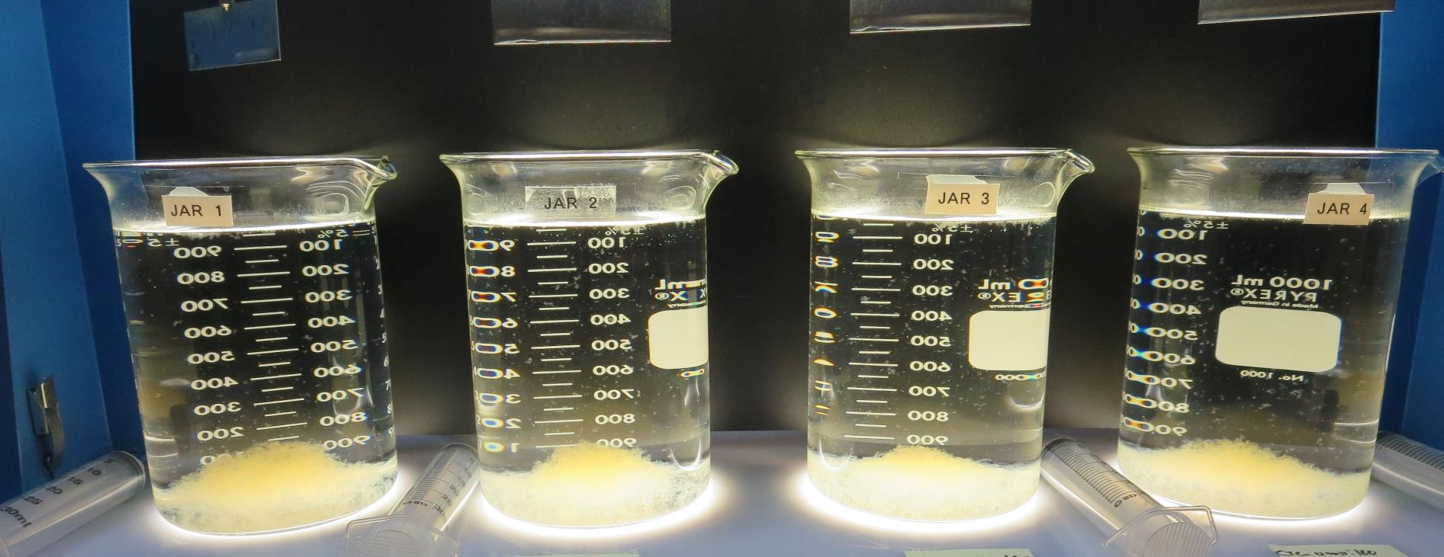
Jars 41-44: After 5 min of settling, 25 mL is syringed for filterability and %UVT/UVA.

Slide 60
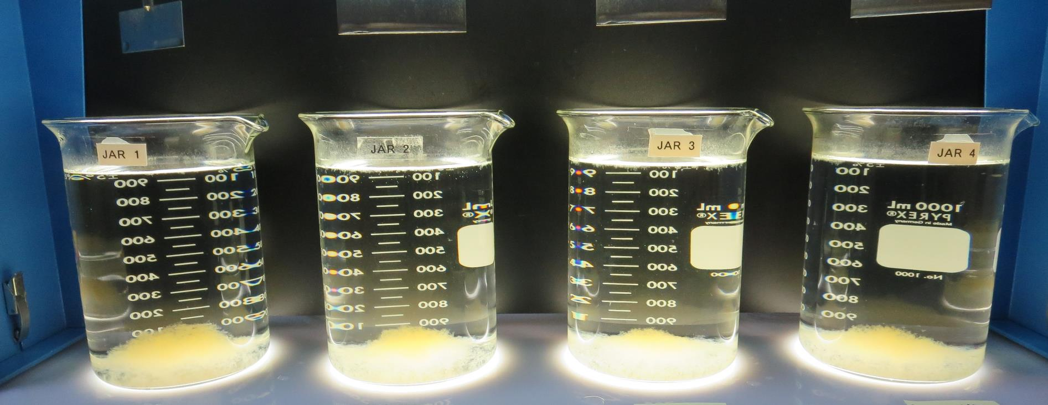
Jars 41-44: After 25-minutes of settling, settled water turbidity is taken.
160 mg/L CTC-00011
0 mg/L CTC-00017
Filtrate: 0.05 NTU
UVT: 92.0%
UVA: 0.035/cm
UVA Reduction: 70.6%
Settled: 0.32 NTU
160 mg/L CTC-00011
1 mg/L CTC-00017
Filtrate: 0.05 NTU
UVT: 92.2%
UVA: 0.035/cm
UVA Reduction: 70.6%
Settled: 0.41 NTU
160 mg/L CTC-00011
1.5 mg/L CTC-00017
Filtrate: 0.05 NTU
UVT: 92.2%
UVA: 0.034/cm
UVA Reduction: 71.4%
Settled: 0.41 NTU
160 mg/L CTC-00011
2 mg/L CTC-00017
Filtrate: 0.05 NTU
UVT: 92.4%
UVA: 0.034/cm
UVA Reduction: 71.4%
Settled: 0.44 NTU

Slide 61
Jar Testing for 1-Liter Jars: Procedures for Most Treatment Plants
Fill jars with source water prior to coagulant injection and set paddle speed at 30 rpm
Add chemicals (i.e., NaOCl, primary coagulant, coagulant aid) to each jar
Flash mix for 15-30 seconds (200 rpm)
Slow mix for 5 minutes (20-30 rpm)
Settled for 5 minutes. Syringe 25 mL from each jar taken 1-inch below surface (25 mL/12 sec rate)
Filtered through 1.2 um isopore membrane into cuvette drip rate, 15 mL/(50-90 sec)
Measure filtrate turbidity, chlorine residual and %UVT/UVA
Measure settled water turbidity after 25 minutes of total setting
Record all data

Slide 62
Jar Test Filterability Test Equipment
Turbidity Instrument
Syringe w/Luer-Lock Tip, 30 cc
(part#: 2225800, by Hach)
Swinnex Filter Holder, 25 mm (part#: SX0002500)
Isopore Membrane Filter, 1.2 um absolute
pore size,
Φ= 25 mm , thickness: 24 um,
hydrophilic polycarbonate membrane
(part #: RTTP02500)
Go to Sigma-Aldrich for laboratory supplies http://www.sigmaaldrich.com/united-states.html

Slide 63
Isopore Membrane Information
Categories | Information
trade name | Isopore
filter color | White
chemistry | Polycarbonate (PC)
water flow rate | Avg. 175 mL/min x cm² (typical results @ 10 psi)
media | Isopore®
wettability | Hydrophilic
porosity | 14.7%
pore size | 1.2 µm
bubble point at 23 °C | 1.0 bar, air with water
thickness | 24 µm
filter diameter (ø) | 25 mm
material size | polycarbonate, Hydrophilic, 1.2 µm, 25 mm, white, plain, 100

Slide 64
Isopore Membrane Background Information
The Isopore membrane is a polycarbonate, track-etched screen filter recommended for all analyses in which the sample is viewed on the surface of the membrane. The Isopore membrane is composed of polycarbonate film, which has a smooth, glass-like surface for clearer sample observation. The unique manufacturing process of the membrane ensures a precise pore diameter and a consistent pore size for accurate separation of samples by size. Matched-weight filters are not usually required because of low, constant tar and ash weights. Features & Benefits: Membrane structure retains particles on the surface, simplifying counting and analysis

Slide 65
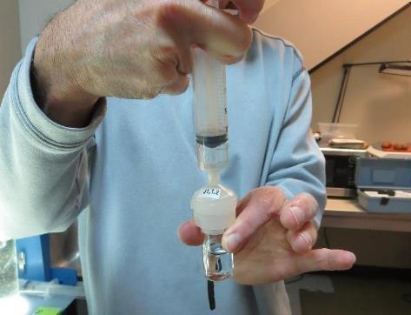
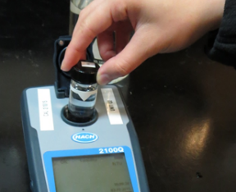
Jar Test - Filterability Test
Syringe ~ 25 mL from jar (after 5-minutes of settling)
Filter-to-waste 3-5 mL
Filter directly into clean cuvette
Measure turbidity
Note: Take several readings before recording final NTU results. Micro bubbles can adhere to glass causing false NTU readings. To remove bubbles, tilt cuvette up to 90 degrees.

Slide 66
Contact
Guy Schott, P.E.
State Water Resources Control Board
Division of Drinking Water
Santa Rosa, CA
Go to Stock Solution/Dose calculations/Jar Test Results for tools to download
www.waterboards.ca.gov/drinking_water/programs/districts/mendocino_district.html
Email: Guy Schott - Guy.Schott@waterboards.ca.gov
Office Number: 707-576-2732

