Slide 1
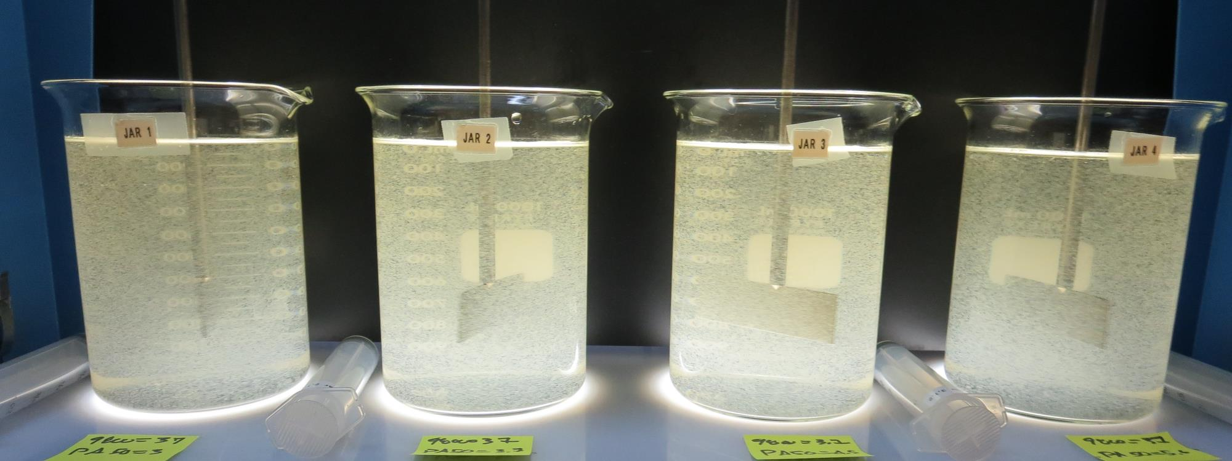
Veterans Home
Roberts Filtration Treatment Plant
CA2810008
Napa County
Jar Test
by Guy Schott, P.E.
March 6, 2019

Slide 2
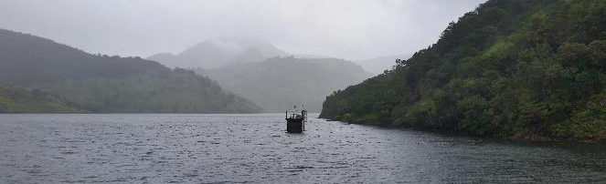
Rector Reservoir
Water Characteristics
March 6, 2019
Source
Turbidity: 15 NTU
pH: 7.24
UVT: 65.7%
UVA: 0.182/cm
0.4 um Filtered
UVT: 72.7%
UVA: 0.138/cm

Slide 3
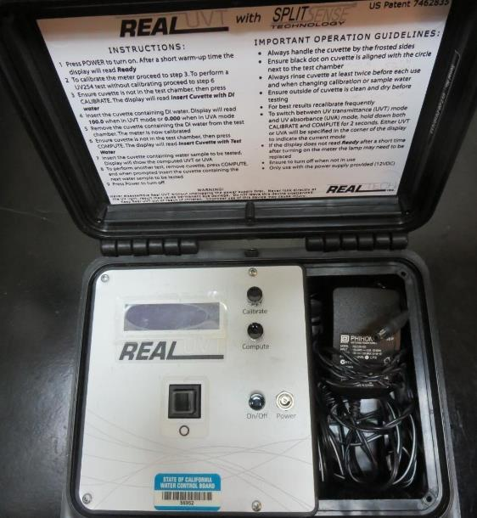
UVT/UVA
UV transmittance (UVT) is a measurement of the amount of ultraviolet light (commonly at 254 nm due to its germicidal effect) that passes through a water sample compared to the amount of light that passes through a pure water sample. The measurement is expressed as a percentage, % UVT.
%UVT = 10^{(-UVA)} x 100%
UV absorbance (UVA) is calculated as a relative measure of the amount of light absorbed by a water sample compared with the amount of light absorbed by a pure water sample.
UVA = -log(%UVT/100)

Slide 4
Applied Coagulants for Jar Testing
AH-710 (Garratt Callahan)
ACH/1,2-Ethanediamine, Polymer w/(Chloromethlyl) Oxirane & N-Methylmethanamine (Epichlorohydrin Dimethylamine Copolymer)
SG-1.31
Zeta Floc PA 40
(NTU Technologies)
Coagulant Aid, cationic organic polymer
SG = 1.1 – 1.2
Pro Pac 926 (NTU Technologies)
30-40% Aluminum Chlorohydrate (ACH)
30-40% Water
30% Trade Secret
SG = 1.2-1.34
Pro Pac 9800 (NTU Technologies)
50% Aluminum Chlorohydrate (ACH)
50% Water
SG = 1.34

Slide 5
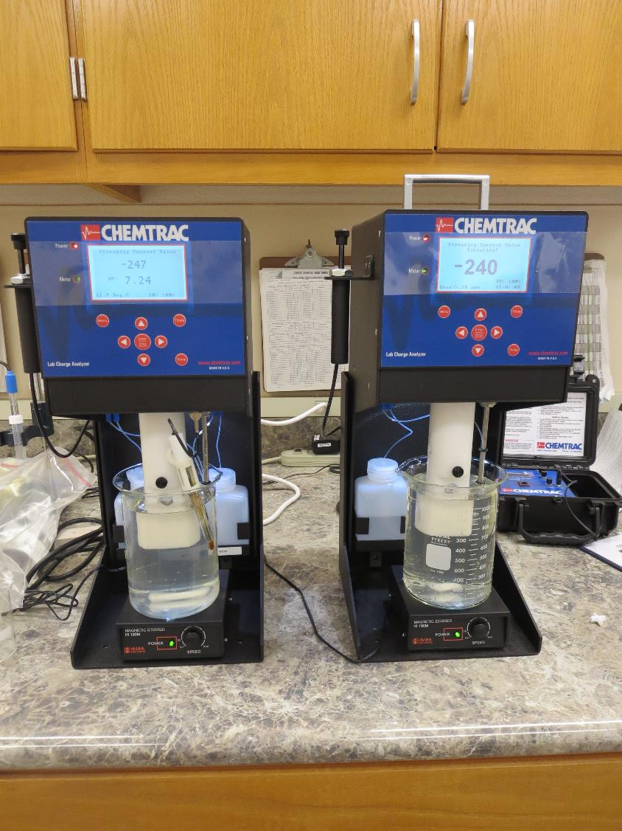
Laboratory Charge Analyzer
LCA: Used to determine coagulant demand of a source water entering the treatment plant.
Source pH: 7.24
LCA #1
926: 17 mg/L as product
No pH adjustment.
LCA #2:
AH 710: 14 mg/L as product
No pH adjustment.

Slide 6
Coagulant Information
Unless stated otherwise, all coagulant doses are reported as Product (100% strength). Aluminum sulfate is reported as Alum.
Preparation of coagulant stock solutions are generally 1.0 and/or 0.1 percent strength using 100 and/or 200 mL volumetric flasks.
Finnpipette F2 variable volume pipette, capacity 100-1000 micro liters is used for stock solution preparation and coagulant aid jar test dosing.
Finnpipette F2 variable volume pipette, capacity 0.5-5 mL is used for primary coagulant jar test dosing.

Slide 7
Veterans Home: Jar Test 1-8 Results
Jar # | 200 RPM Flash Mix seconds | 30 RPM Floc Duration minutes | 926 mg/L | AH-710 mg/L | Filtrate NTU | Filtrate %UVT | Filtrate UVA/cm | Settle NTU 25 min
J1 | 60 | 5 | 11 | 0 | 2.2 | 85.9 | 0.066 | 15.7
J2 | 60 | 5 | 16 | 0 | 0.72 | 91.0 | 0.033 | 3.9
J3 | 60 | 5 | 0 | 9 | 2.8 | 84.5 | 0.073 | 13
J4 | 60 | 5 | 0 | 14 | 0.43 | 91.3 | 0.040 | 5.7
J5 | 60 | 5 | 20 | 0 | 2.2 | 89.7 | 0.047 | n/a
J6 | 60 | 5 | 24 | 0 | 0.25 | 93.9 | 0.028 | n/a
J7 | 60 | 5 | 0 | 18 | 1.7 | 90.5 | 0.043 | n/a
J8 | 60 | 5 | 0 | 22 | 4.2 | 87.2 | 0.059 | n/a

Slide 8
Veterans Home: Jar Test 9-10 Results
Jar # | 200 RPM Flash Mix seconds | 30 RPM Floc Duration minutes | 926 mg/L | AH-710 mg/L | Filtrate NTU | Filtrate %UVT | Filtrate UVA/cm | Settle NTU 25 min
J9 | 60 | 10 | 10 | 0 | 2.7 | 85.1 | 0.070 | 14.2
J10 | 60 | 10 | 0 | 10 | 1.6 | 88.1 | 0.055 | 6.1

Slide 9
Veterans Home: Jar Test 11-14 Results
Jar # | 200 RPM Flash Mix seconds | 30 RPM Floc Duration minutes | 926 mg/L | Zeta Floc PA 40 mg/L | Filtrate NTU | Filtrate %UVT | Filtrate UVA/cm | Settle NTU 25 min
J11 | 60 | 5 | 10 | 1.0 | 3.0 | 85.1 | 0.070 | 15
J12 | 60 | 5 | 14 | 1.4 | 1.2 | 90.0 | 0.046 | 6.3
J13 | 60 | 5 | 18 | 1.8 | 0.25 | 93.1 | 0.031 | 8.7
J14 | 60 | 5 | 22 | 2.2 | 0.15 | 94.1 | 0.026 | 19

Slide 10
Veterans Home: Jar Test 15-18 Results
Jar # | 200 RPM Flash Mix seconds | 30 RPM Floc Duration minutes | 9800 mg/L | Filtrate NTU | Filtrate %UVT | Filtrate UVA/cm | Settle NTU 25 min
J15 | 60 | 5 | 15 | 1.9 | 87.8 | 0.057 | 12.2
J16 | 60 | 5 | 20 | 2.3 | 89.0 | 0.051 | 6.1
J17 | 60 | 5 | 25 | 0.56 | 93.4 | 0.030 | 8.3
J18 | 60 | 5 | 30 | 0.43 | 94.2 | 0.026 | 17.6

Slide 11
Veterans Home: Jar Test 19-23 Results
Flash Mix 60 sec (200 RPM)
Jar # | 30 RPM Floc Duration minutes | NaOCl mg/L | 926 mg/L | Zeta Floc PA 40 mg/L | Filtrate NTU | Filtrate %UVT | Filtrate UVA/cm | Settle NTU 25 min
J19 | 5 | 0 | 25 | 3.8 | 1.07 | 92.5 | 0.034 | 17.6
J20 | 5 | 0 | 30 | 4.5 | 0.19 | 94.8 | 0.023 | 18.6
J21 | 5 | 1.5 | 25 | 3.8 | 0.12 | 94.2 | 0.026 | 10.2
J22 | 5 | 1.5 | 30 | 4.5 | 0.14 | 94.7 | 0.024 | 18.3
J23 | 5 | 2.0 | 25 | 5.0 | 0.12 | 94.4 | 0.025 | 22

Slide 12
Jars 1-4 Test
Flash Mix 60 Sec (200 RPM)
Floc Mix 5 min (30 RPM)
Applied Coagulants
926
AH-710

Slide 13
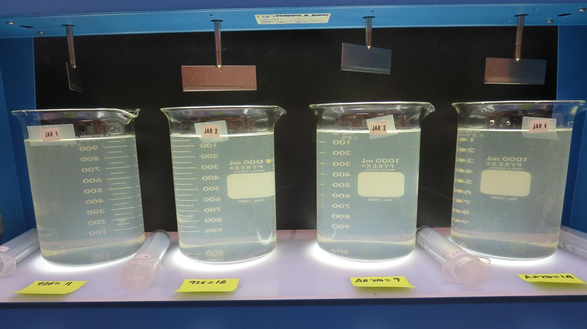
Jars 1-4: End of 5-minute flocculation (30 RPM) duration.
11 mg/L 926
Filtrate 2.2 NTU
UVT: 85.9%
UVA: 0.066/cm
Settled: 15.7 NTU
16 mg/L 926
Filtrate 0.72 NTU
UVT: 91.0%
UVA: 0.033/cm
Settled: 3.9 NTU
9 mg/L AH 710
Filtrate 2.8 NTU
UVT: 84.5%
UVA: 0.073/cm
Settled: 13 NTU
14 mg/L AH 710
Filtrate 4.3 NTU
UVT: 91.3%
UVA: 0.040/cm
Settled: 5.7 NTU

Slide 14
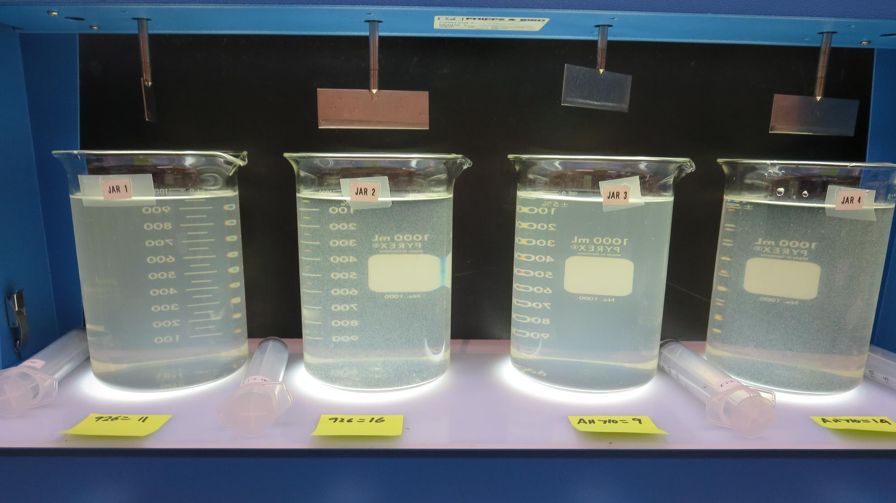
Jars 1-4: After 5 min of settling, 25 mL is syringed for filterability and %UVT/UVA

Slide 15
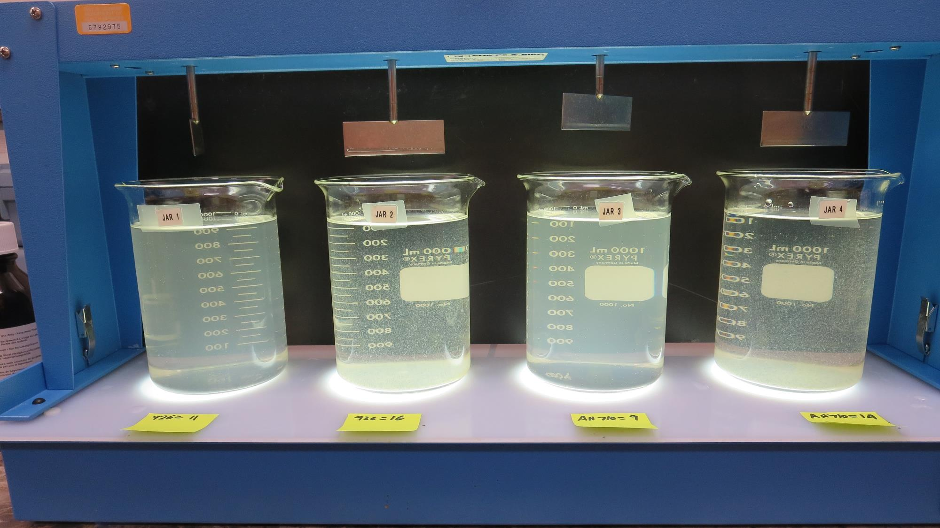
Jars 1-4: After 25-minutes of settling, settled water turbidity is taken.
11 mg/L 926
Filtrate 2.2 NTU
UVT: 85.9%
UVA: 0.066/cm
Settled: 15.7 NTU
11 mg/L 926
Filtrate 2.2 NTU
UVT: 85.9%
UVA: 0.066/cm
Settled: 15.7 NTU
9 mg/L AH 710
Filtrate 2.8 NTU
UVT: 84.5%
UVA: 0.073/cm
Settled: 13 NTU
14 mg/L AH 710
Filtrate 4.3 NTU
UVT: 91.3%
UVA: 0.040/cm
Settled: 5.7 NTU

Slide 16
Jars 5-8 Test
Flash Mix 60 Sec (200 RPM)
Floc Mix 5 min (30 RPM)
Applied Coagulants
926
AH-710

Slide 17
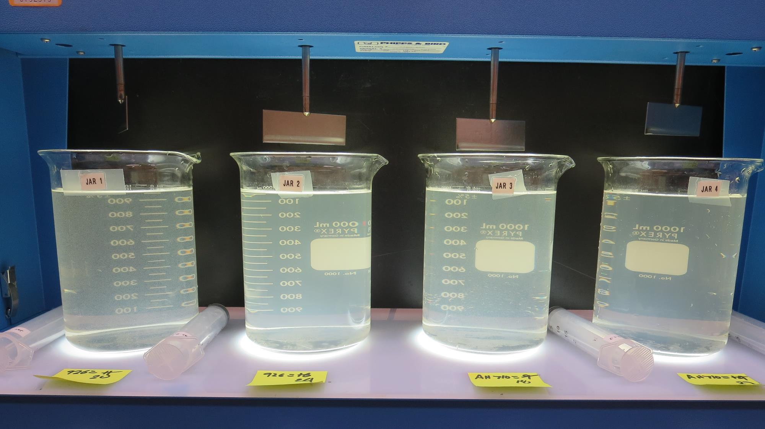
Jars 5-8: End of 5-minute flocculation (30 RPM) duration.
20 mg/L 926
Filtrate 2.2 NTU
UVT: 89.7%
UVA: 0.047/cm
24 mg/L 926
Filtrate 0.25 NTU
UVT: 93.9%
UVA: 0.028/cm
18 mg/L AH 710
Filtrate 1.7 NTU
UVT: 90.5%
UVA: 0.043/cm
22 mg/L AH 710
Filtrate 4.2 NTU
UVT: 87.2%
UVA: 0.059/cm

Slide 18
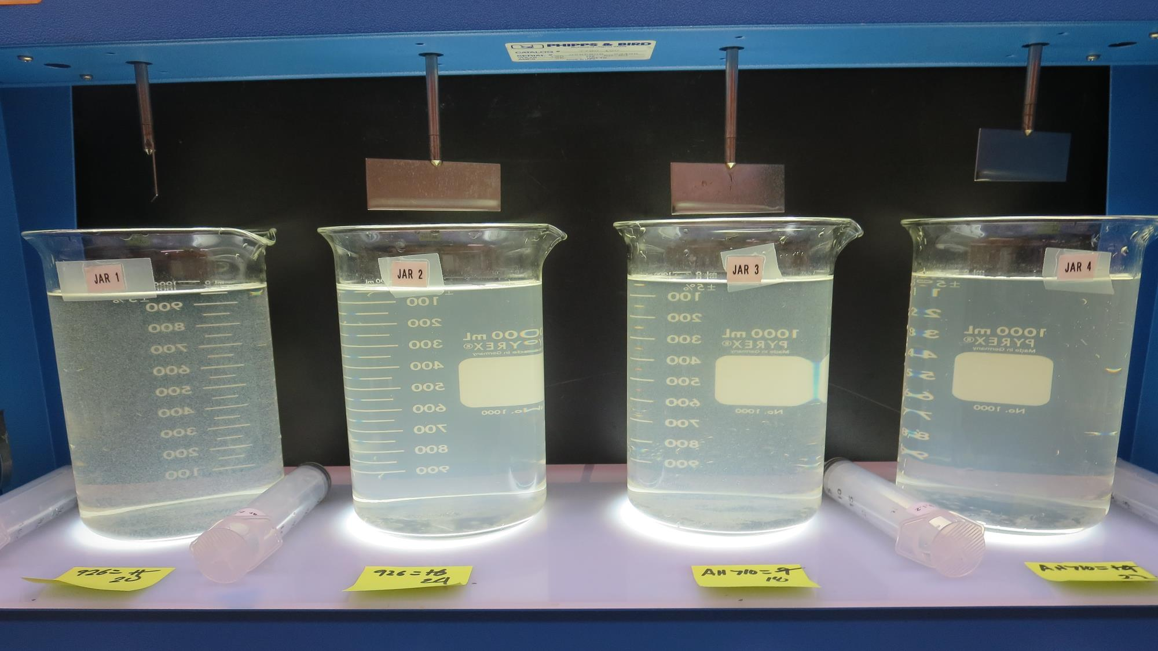
Jars 5-8: After 5 min of settling, 25 mL is syringed for filterability and %UVT/UVA

Slide 19
Jars 9-10 Test
Flash Mix 60 Sec (200 RPM)
Floc Mix 10 min (30 RPM)
Applied Coagulants
926
AH-710

Slide 20
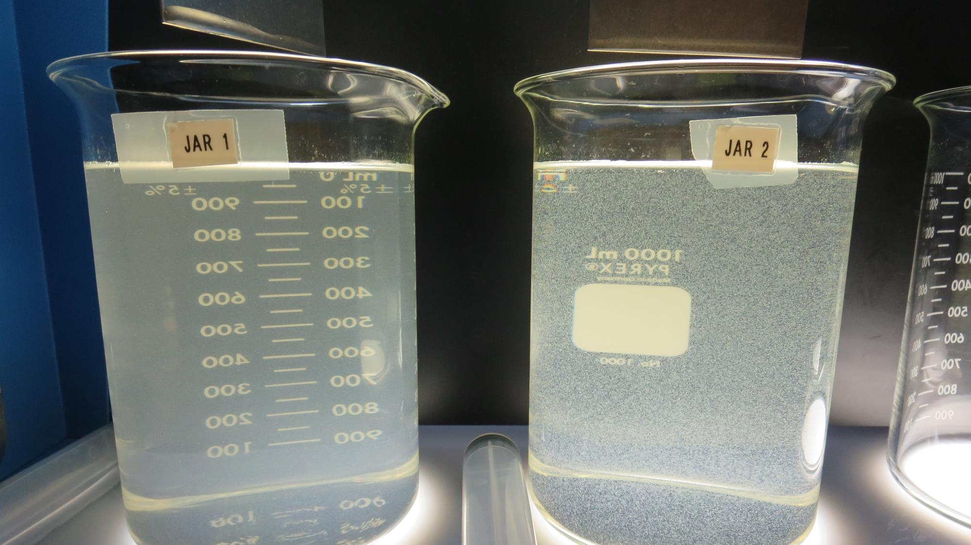
Jars 9-10: End of 5-minute flocculation (30 RPM) duration.
10 mg/L 926
Filtrate 2.7 NTU
UVT: 85.1%
UVA: 0.070/cm
Settled: 14.2 NTU
10 mg/L AH 710
Filtrate 1.6 NTU
UVT: 88.1%
UVA: 0.055/cm
Settled: 6.1 NTU

Slide 21
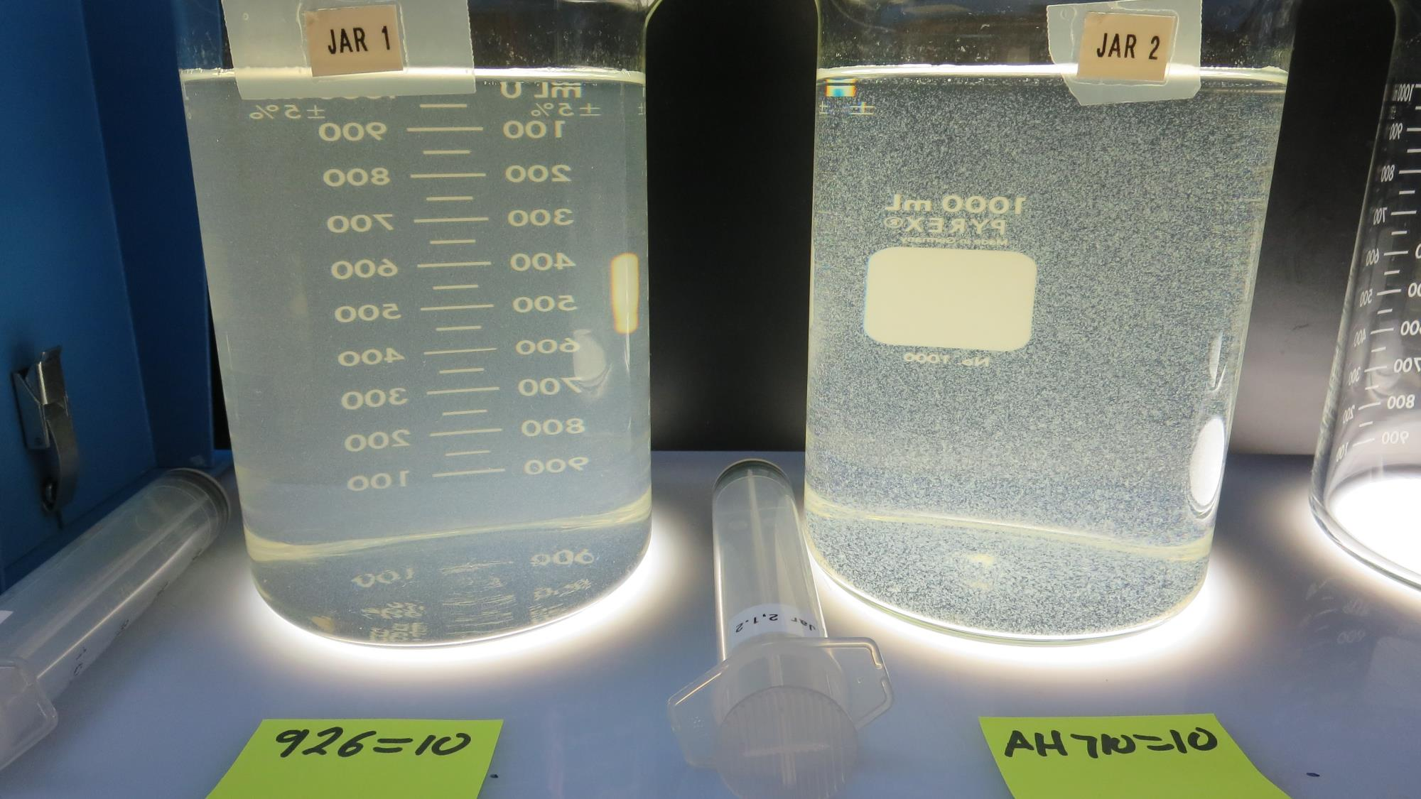
Jars 9-12: After 5 min of settling, 25 mL is syringed for filterability and %UVT/UVA

Slide 22
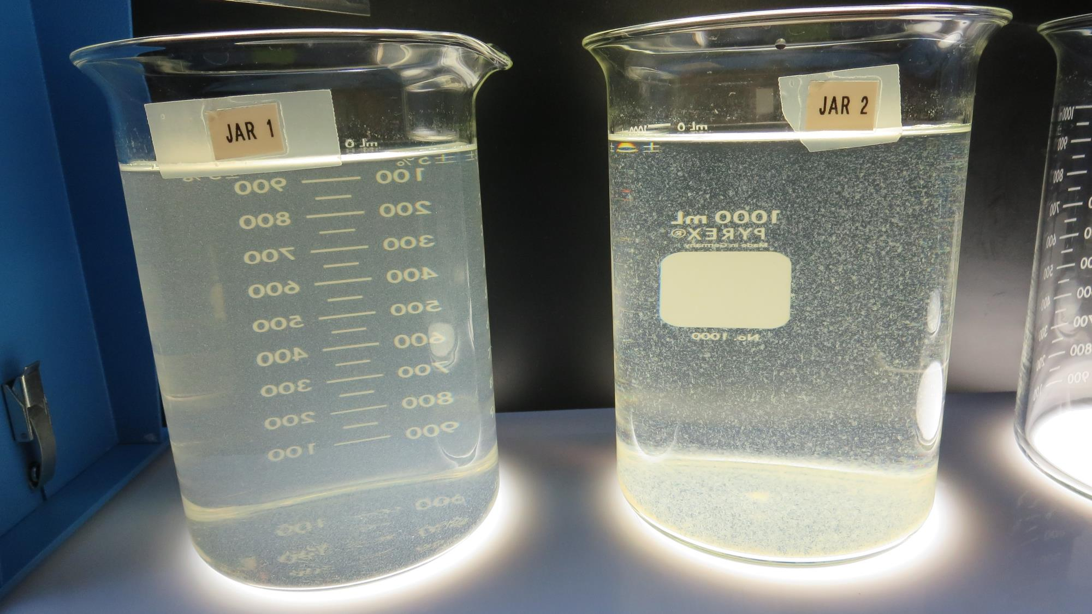
Jars 9-10: After 25-minutes of settling, settled water turbidity is taken.
10 mg/L 926
Filtrate 2.7 NTU
UVT: 85.1%
UVA: 0.070/cm
Settled: 14.2 NTU
10 mg/L AH 710
Filtrate 1.6 NTU
UVT: 88.1%
UVA: 0.055/cm
Settled: 6.1 NTU

Slide 23
Jars 11-14 Test
Flash Mix 60 Sec (200 RPM)
Floc Mix 5 min (30 RPM)
Applied Coagulants
926
PA 40

Slide 24
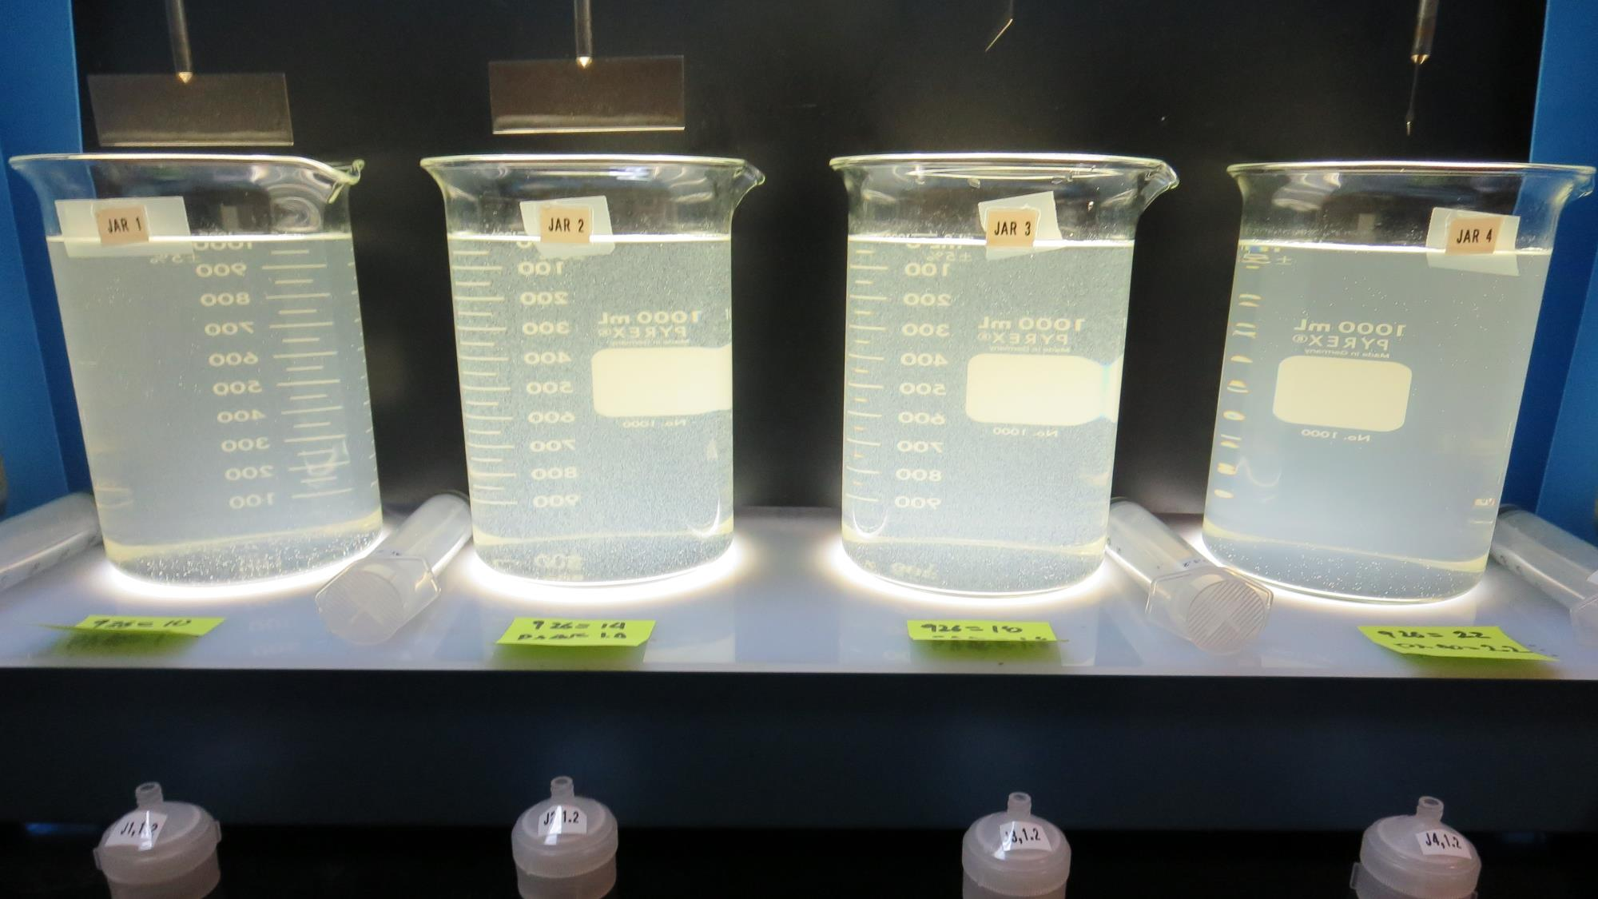
Jars 11-14: End of 5-minute flocculation (30 RPM) duration.
10 mg/L 926
1.0 mg/L PA 40
Filtrate 3.0 NTU
UVT: 85.1%
UVA: 0.070/cm
Settled: 15 NTU
14 mg/L 926
1.4 mg/L PA 40
Filtrate 1.2 NTU
UVT: 90.0%
UVA: 0.046/cm
Settled: 6.3 NTU
18 mg/L 926
1.8 mg/L PA 40
Filtrate 0.25 NTU
UVT: 93.1%
UVA: 0.031/cm
Settled: 8.7 NTU
22 mg/L 926
2.2 mg/L PA 40
Filtrate 0.15 NTU
UVT: 94.1%
UVA: 0.026/cm
Settled: 19 NTU

Slide 25
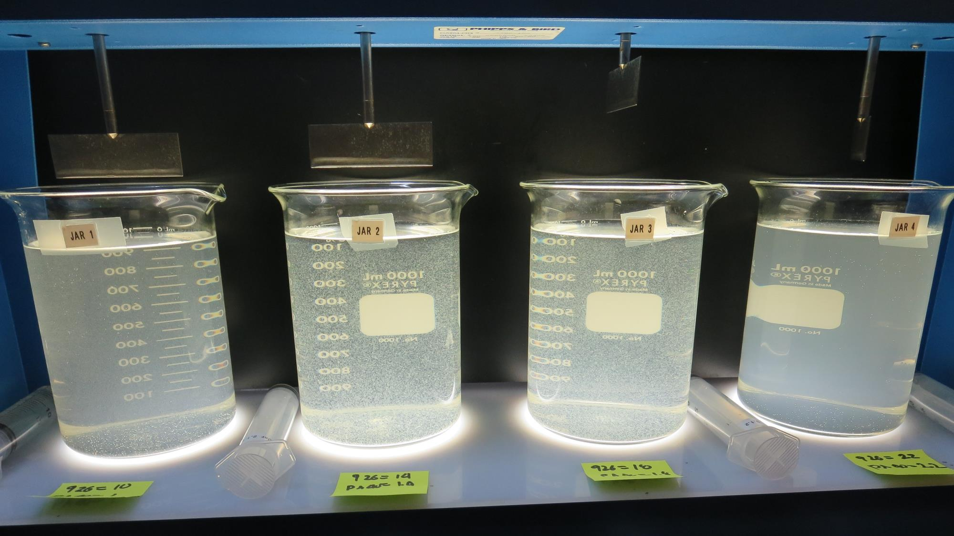
Jars 11-14: After 5 min of settling, 25 mL is syringed for filterability and %UVT/UVA

Slide 26
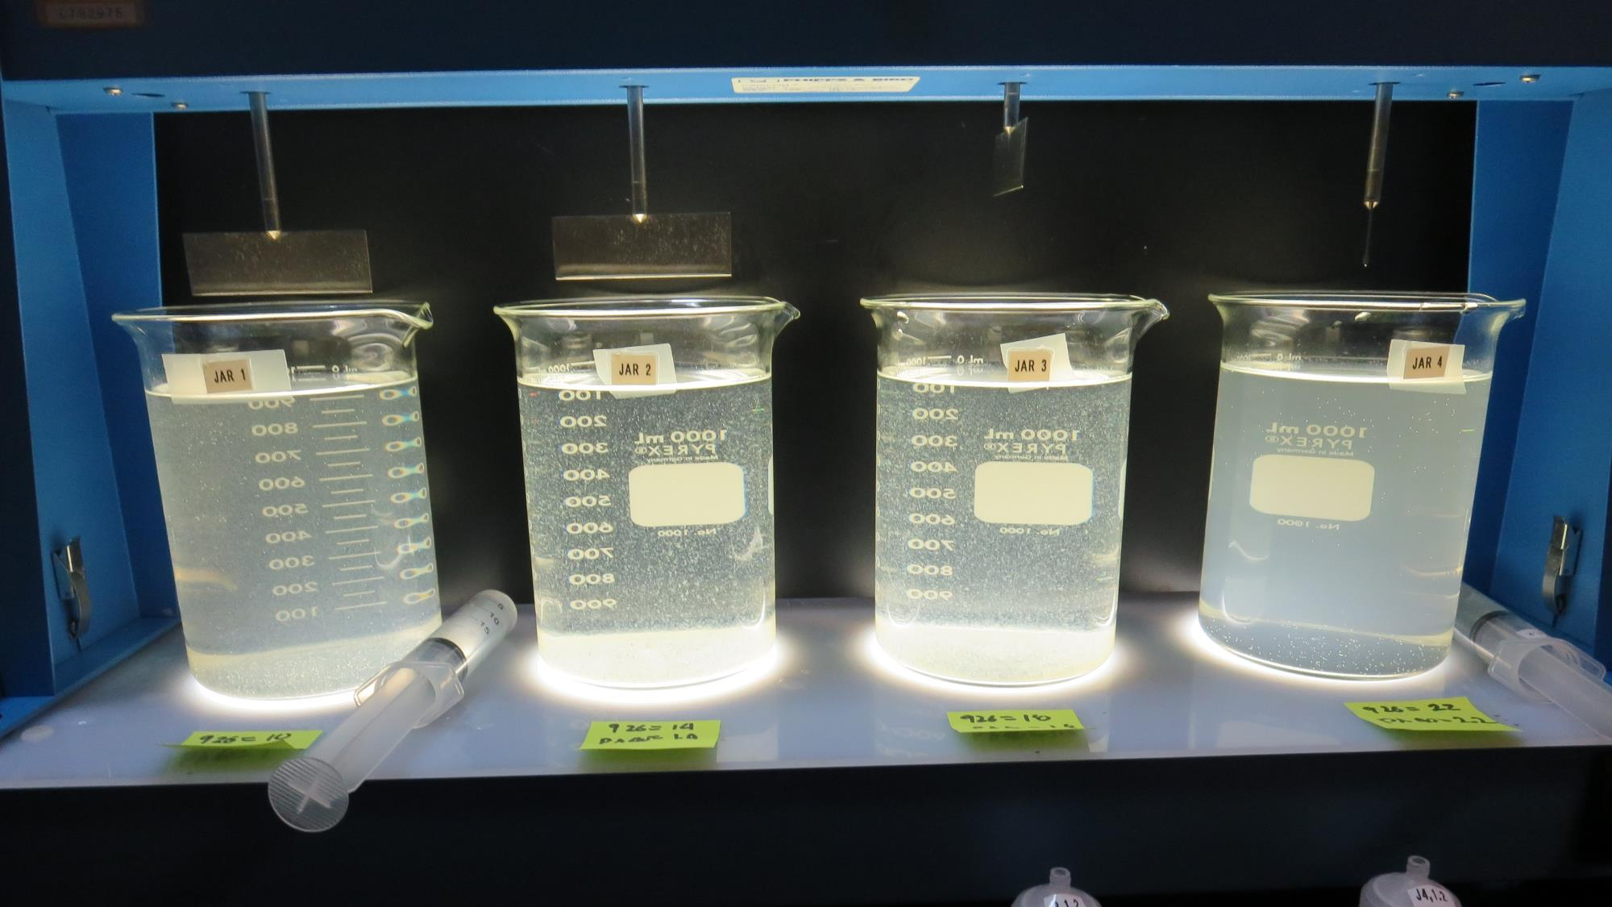
Jars 11-14: After 25-minutes of settling, settled water turbidity is taken.
10 mg/L 926
1.0 mg/L PA 40
Filtrate 3.0 NTU
UVT: 85.1%
UVA: 0.070/cm
Settled: 15 NTU
14 mg/L 926
1.4 mg/L PA 40
Filtrate 1.2 NTU
UVT: 90.0%
UVA: 0.046/cm
Settled: 6.3 NTU
18 mg/L 926
1.8 mg/L PA 40
Filtrate 0.25 NTU
UVT: 93.1%
UVA: 0.031/cm
Settled: 8.7 NTU
22 mg/L 926
2.2 mg/L PA 40
Filtrate 0.15 NTU
UVT: 94.1%
UVA: 0.026/cm
Settled: 19 NTU

Slide 27
Jars 15-18 Test
Flash Mix 60 Sec (200 RPM)
Floc Mix 5 min (30 RPM)
Applied Coagulant
9800

Slide 28
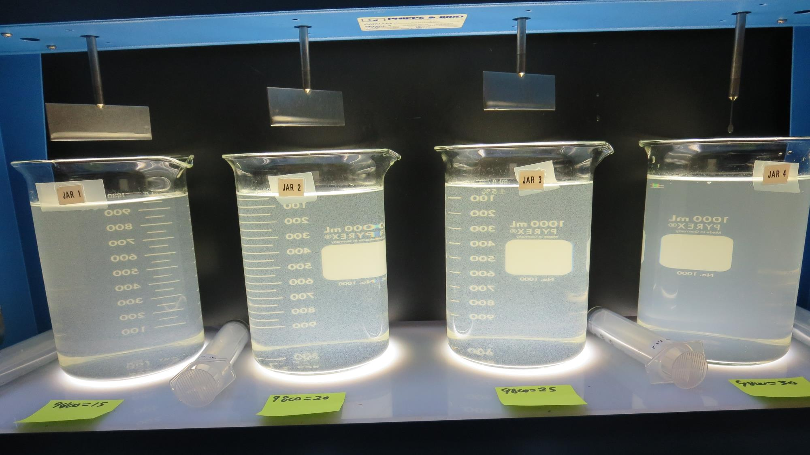
Jars 15-18: End of 5-minute flocculation (30 RPM) duration.
15 mg/L 9800
Filtrate 1.9 NTU
UVT: 87.8%
UVA: 0.057/cm
Settled: 12.2 NTU
20 mg/L 9800
Filtrate 2.3 NTU
UVT: 89.0%
UVA: 0.051/cm
Settled: 6.1 NTU
25 mg/L 9800
Filtrate 0.56 NTU
UVT: 93.4%
UVA: 0.030/cm
Settled: 8.3 NTU
30 mg/L 9800
Filtrate 0.43 NTU
UVT: 94.2%
UVA: 0.026/cm
Settled: 17.6 NTU

Slide 29
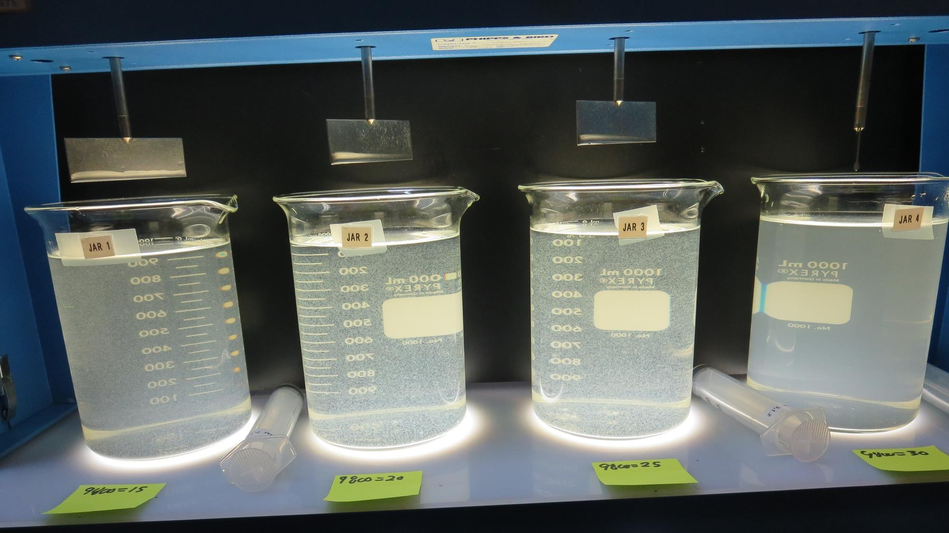
Jars 15-18: After 5 min of settling, 25 mL is syringed for filterability and %UVT/UVA

Slide 30
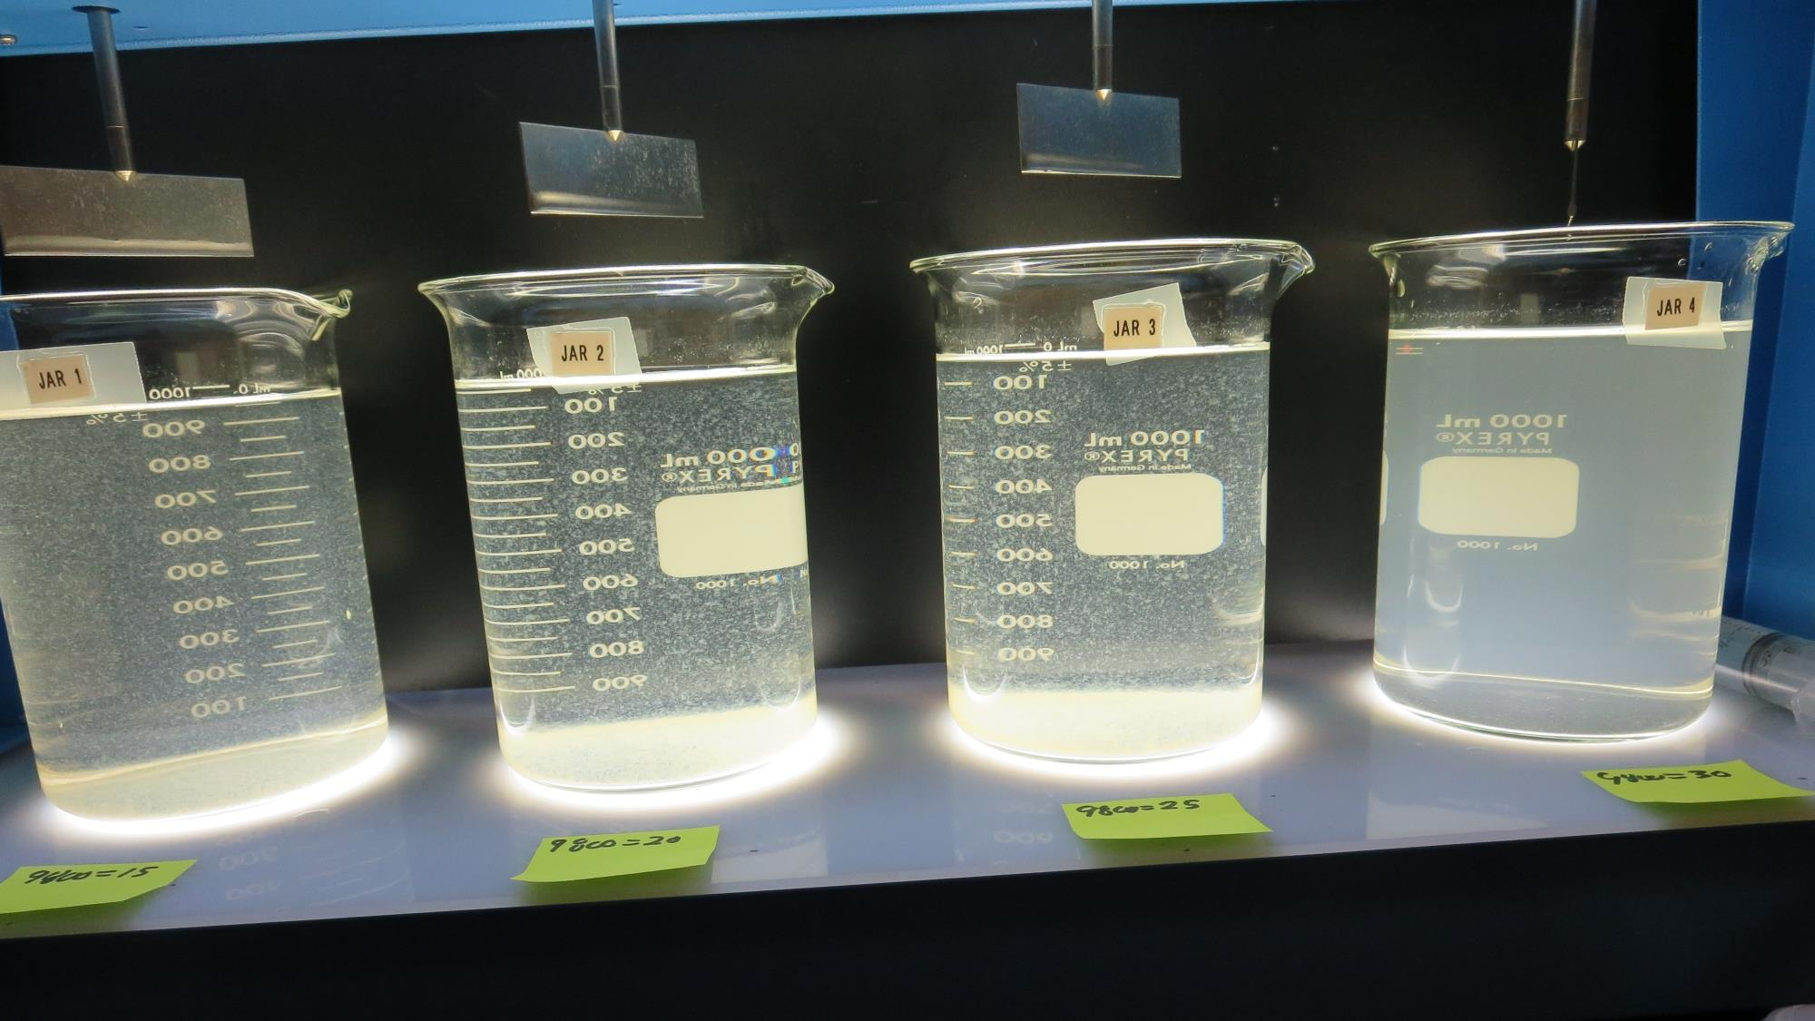
Jars 15-18: After 25-minutes of settling, settled water turbidity is taken.
15 mg/L 9800
Filtrate 1.9 NTU
UVT: 87.8%
UVA: 0.057/cm
Settled: 12.2 NTU
20 mg/L 9800
Filtrate 2.3 NTU
UVT: 89.0%
UVA: 0.051/cm
Settled: 6.1 NTU
25 mg/L 9800
Filtrate 0.56 NTU
UVT: 93.4%
UVA: 0.030/cm
Settled: 8.3 NTU
30 mg/L 9800
Filtrate 0.43 NTU
UVT: 94.2%
UVA: 0.026/cm
Settled: 17.6 NTU

Slide 31
Jars 19-22 Test
Flash Mix 60 Sec (200 RPM)
Floc Mix 5 min (30 RPM)
Applied Coagulants
9800/9890 w/NaOCl

Slide 32
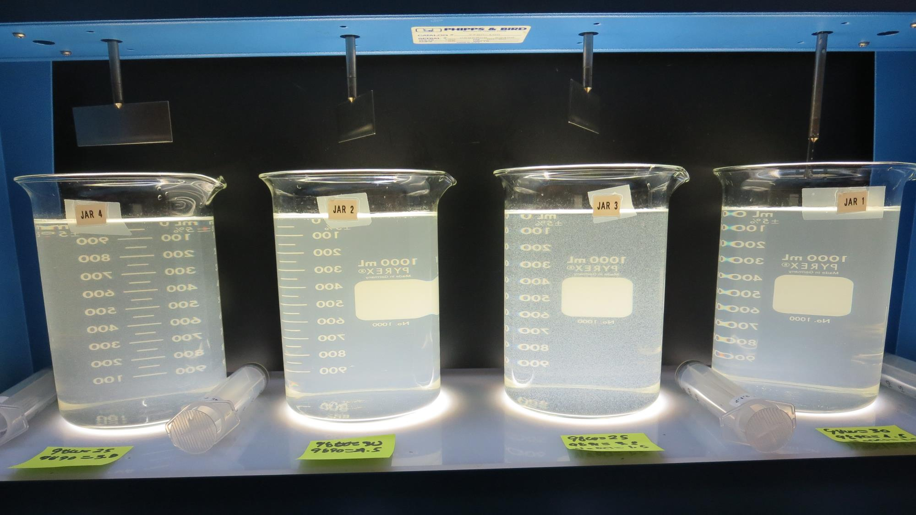
Jars 19-22: End of 5-minute flocculation (30 RPM) duration.
25 mg/L 9800
3.8 mg/L 9890
Filtrate 1.07 NTU
UVT: 92.5%
UVA: 0.034/cm
Settled: 17.6 NTU
30 mg/L 9800
4.5 mg/L 9890
Filtrate 0.19 NTU
UVT: 94.8%
UVA: 0.023/cm
Settled: 18.6 NTU
1.5 mg/L NaOCl
25 mg/L 9800
3.8 mg/L 9890
Filtrate 0.12 NTU
UVT: 94.2%
UVA: 0.026/cm
Settled: 10.2 NTU
1.5 mg/L NaOCl
30 mg/L 9800
4.5 mg/L 9890
Filtrate 0.14 NTU
UVT: 94.7%
UVA: 0.024/cm
Settled: 18.3 NTU

Slide 33
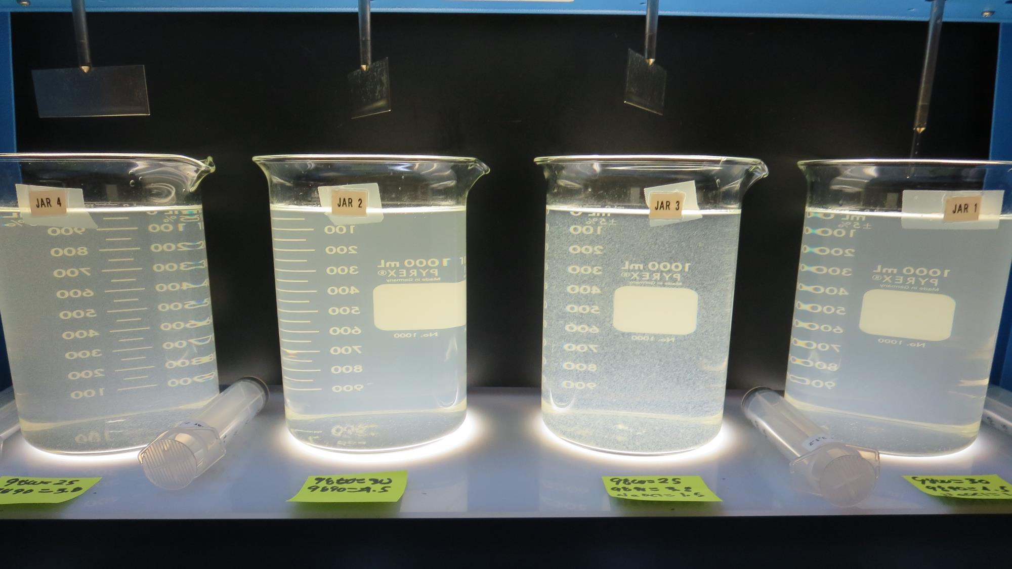
Jars 19-22: After 5 min of settling, 25 mL is syringed for filterability and %UVT/UVA

Slide 34
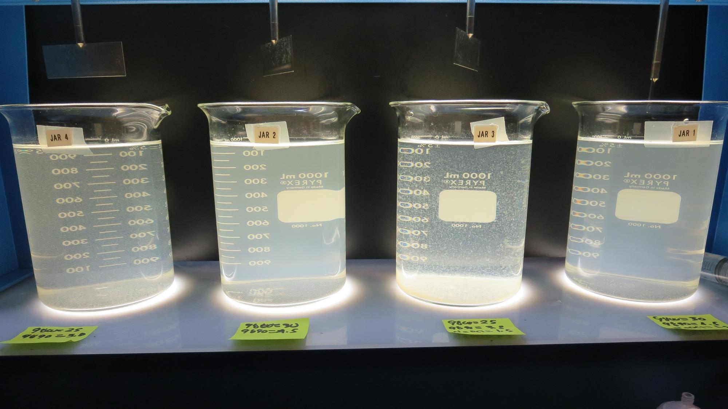
Jars 19-22: After 25-minutes of settling, settled water turbidity is taken.

Slide 35
Jar Testing for 1-Liter Jars:
Procedures for Most Treatment Plants
Fill jars with source water prior to coagulant injection and set paddle speed at 30 rpm
Add chemicals (i.e., NaOCl, primary coagulant, coagulant aid) to each jar
Flash mix for 15-60 seconds (200 rpm)
Slow mix for 5 minutes (20-30 rpm)
Settled for 5 minutes. Syringe 25 mL from each jar taken 1-inch below surface (25 mL/12 sec rate)
Filtered through 1.2 um isopore membrane into cuvette drip rate, 15 mL/(50-90 sec)
Measure filtrate turbidity, chlorine residual and %UVT/UVA
Measure settled water turbidity after 25 minutes of total setting
Record all data

Slide 36

Jar Test
Filterability Test Equipment
Turbidity Instrument
Syringe w/Luer-Lock Tip, 30 cc
(part#: 2225800, by Hach)
Swinnex Filter Holder, 25 mm (part#: SX0002500)
Isopore Membrane Filter, 1.2 um absolute
pore size,
Φ= 25 mm , thickness: 24 um,
hydrophilic polycarbonate membrane
(part #: RTTP02500)
Go to Sigma-Aldrich for laboratory supplies http://www.sigmaaldrich.com/united-states.html

Slide 37
Isopore Membrane Information
Categories | Information
trade name | Isopore
filter color | White
chemistry | Polycarbonate (PC)
water flow rate | Avg. 175 mL/min x cm² (typical results @ 10 psi)
media | Isopore®
wettability | Hydrophilic
porosity | 14.7%
pore size | 1.2 µm
bubble point at 23 °C | 1.0 bar, air with water
thickness | 24 µm
filter diameter (ø) | 25 mm
material size | polycarbonate, Hydrophilic, 1.2 µm, 25 mm, white, plain, 100

Slide 38
Isopore Membrane Background Information
The Isopore membrane is a polycarbonate, track-etched screen filter recommended for all analyses in which the sample is viewed on the surface of the membrane. The Isopore membrane is composed of polycarbonate film, which has a smooth, glass-like surface for clearer sample observation. The unique manufacturing process of the membrane ensures a precise pore diameter and a consistent pore size for accurate separation of samples by size. Matched-weight filters are not usually required because of low, constant tar and ash weights.
Features & Benefits:
Membrane structure retains particles on the surface, simplifying counting and analysis

Slide 39
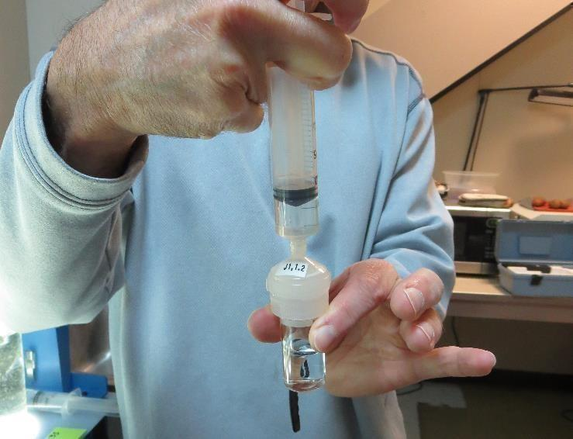

Jar Test - Filterability Test
Syringe ~ 25 mL from jar (after 5-minutes of settling)
Filter-to-waste 3-5 mL
Filter directly into clean cuvette
Measure turbidity
Note: Take several readings before recording final NTU results. Micro bubbles can adhere to glass causing false NTU readings. To remove bubbles, tilt cuvette up to 90 degrees.

Slide 40

Contact
Guy Schott, P.E.
State Water Resources Control Board
Division of Drinking Water
Santa Rosa, CA
Go to Stock Solution/Dose calculations/Jar Test Results for tools to download
www.waterboards.ca.gov/drinking_water/programs/districts/mendocino_district.html
Email: Guy Schott - Guy.Schott@waterboards.ca.gov
Office Number: 707-576-2732

