Slide 1
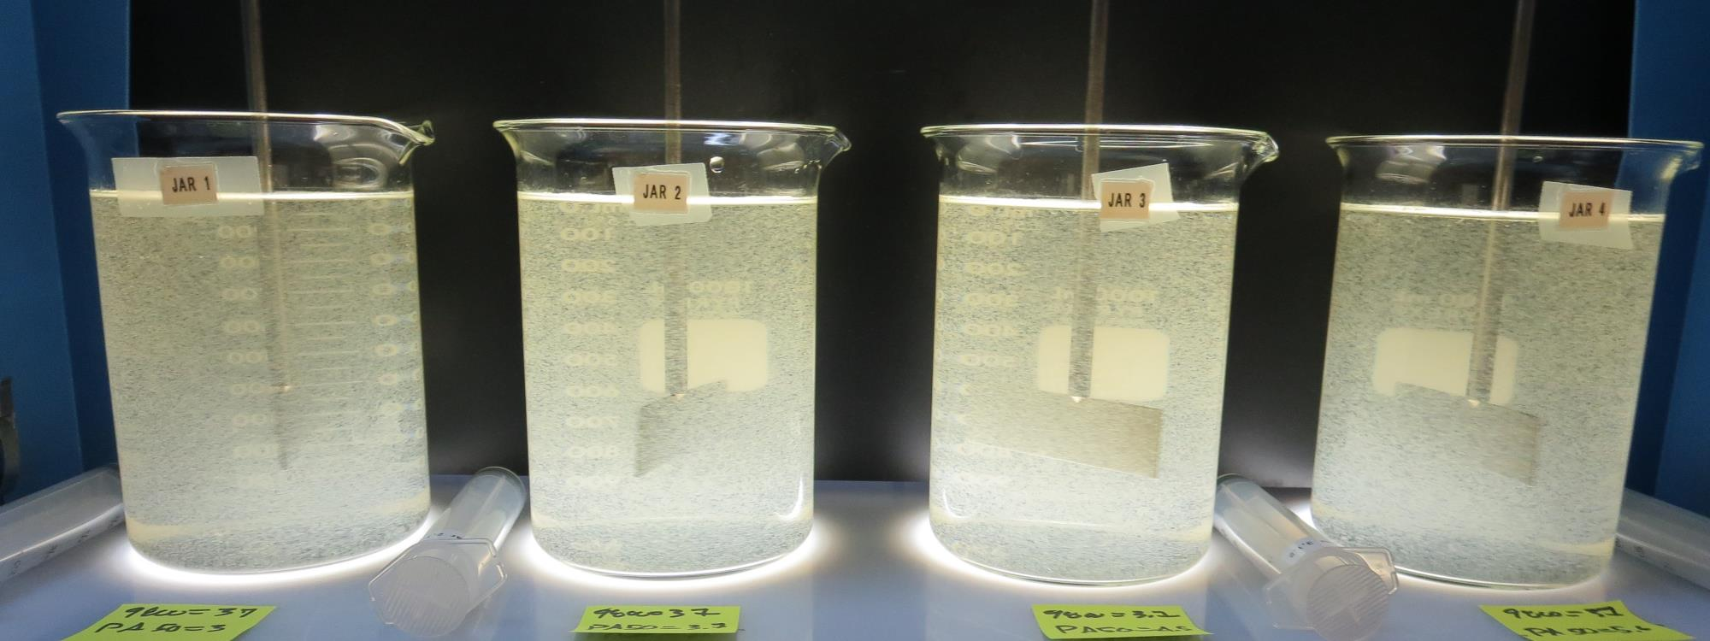
Little Potato Slough Mutual CA3910022 San Joaquin County Jar Test
by Guy Schott, P.E.
February 28, 2019

Slide 2
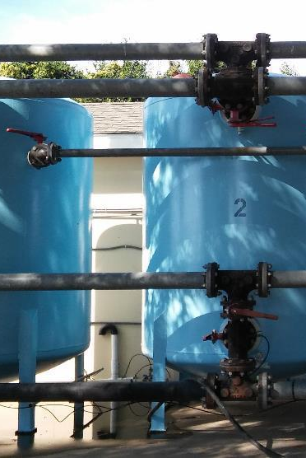
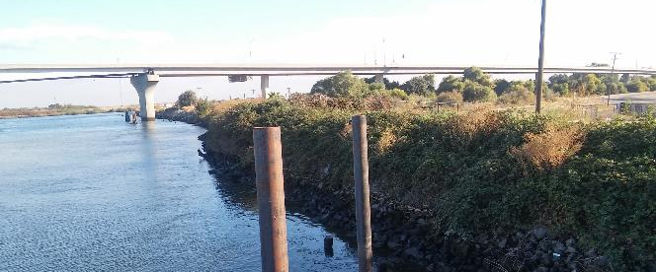
Little Potato Slough Conventional Treatment

Slide 3
Little Potato Slough, February 28, 2019 Source Water Characteristics
Source Water Charateristics
Turbidity: 31 NTU
pH: 7.61
UVT: 54.9
UVA: 0.2604/cm
0.4 um Filtered
UVT: 76.6%
UVA: 0.116/cm

Slide 4
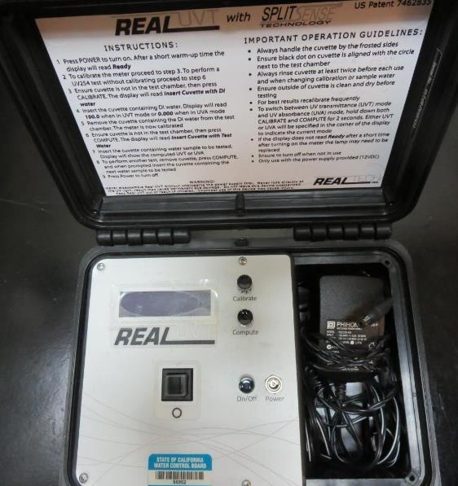
UVT/UVA, pathlength 10 mm
UV transmittance (UVT) is a measurement of the amount of ultraviolet light (254 nm) that passes through a water sample compared to the amount of light that passes through a pure water sample. The measurement is expressed as % UVT.
%UVT = 10^{(-UVA)} x 100%
UV absorbance (UVA) is calculated as a relative measure of the amount of light absorbed by a water sample compared with the amount of light absorbed by a pure water sample.
UVA = -log(%UVT/100)

Slide 5
Applied Coagulants for Jar Testing (1)
Pro Pac 9800 (NTU Technologies)
50% Aluminum Chlorohydrate
50% Water
23.62% Al₂O₃
12.5% Al
83% Basicity
SG = 1.25-1.34
NSF limit: 250 mg/L as Product
10 mg/L as 9800 = Reduction 1.18 mg/L as CaCO₃
Pro Pac 9890 (NTU Technologies)
35-45% Aluminum Chlorohydrate
20% polyamine (50% water, 50% active polyamines)
35-45% Water
~18.9% Al₂O₃
~10.5% Al
83% Basicity
SG = 1.25-1.34
NSF limit: 50 mg/L as Product;
Product dose 10 mg/L = 1 mg/L polyamines active

Slide 6
Applied Coagulants for Jar Testing (2)
Zeta Floc PA50 (NTU Technologies)
Coagulant Aid
Polyamine
SG = 1.1 – 1.2
NSF limit: 10 mg/L as Product
JC 9450 (Jenfitch, Inc.)
Disinfection/Oxidation
NSF limit: 52 mg/L as Product

Slide 7
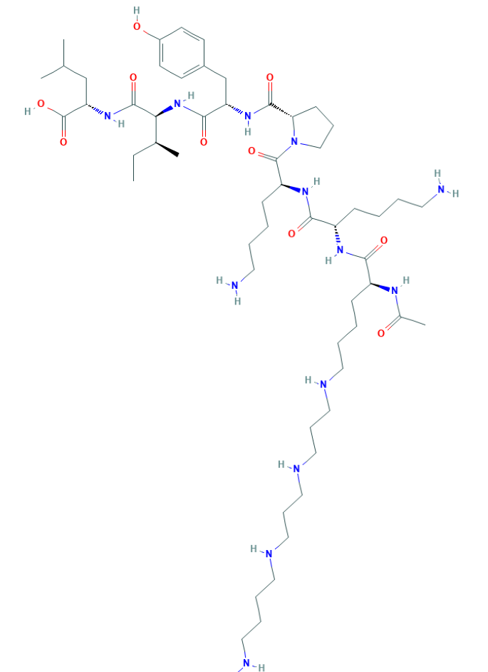
Polyamine C₅₉H₁₀₈N₁₄O₁₀ MW: 1,173.6 g/mol

Slide 8
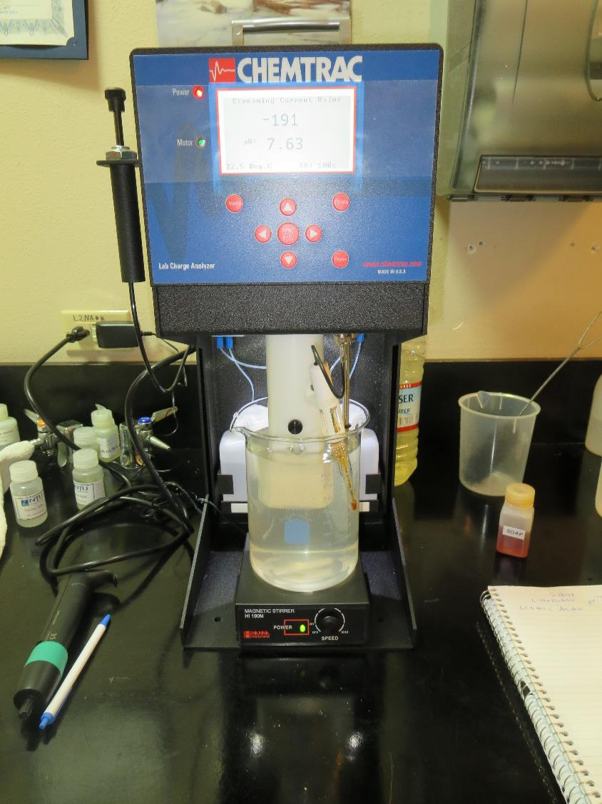
Laboratory Charge Analyzer
LCA: Used to determine coagulant demand of a source water entering the treatment plant.
Source pH: 7.63
LCA #1
ACH (9800): 29 mg/L as product
No pH adjustment.
LCA #2:
JC 9450: 5 mg/L as product (manually added)
+ ACH (9800) = 29.6 mg/L
No pH adjustment.

Slide 9
Coagulant Information
Unless stated otherwise, all coagulant doses are reported as Product (100% strength).
Preparation of coagulant stock solutions are generally 1.0 and/or 0.1 percent strength using 100 and/or 200 mL volumetric flasks.
Finnpipette F2 variable volume pipette, capacity 100-1000 micro liters is used for stock solution preparation and coagulant aid jar test dosing.
Finnpipette F2 variable volume pipette, capacity 0.5-5 mL is used for primary coagulant jar test dosing.

Slide 10
Little Potato Slough, Jar Test 1 - 8 Results Flash Mix 200 RPM (60 sec); Floc Mix 30 RPM (5 min)
Jar # | 9800 mg/L | 9890 mg/L | Filtrate NTU | Filtrate %UVT | Filtrate UVA/cm | %UVA Reduction | Settle NTU 25 min
J1 | 25 | 0 | 0.57 | 90.2 | 0.045 | 61.4 | 4.9
J2 | 29 | 0 | 0.50 | 91.3 | 0.040 | 65.9 | 4.8
J3 | 33 | 0 | 0.11 | 91.8 | 0.037 | 68.0 | 5.4
J4 | 37 | 0 | 0.35 | 92.2 | 0.035 | 69.6 | 5.1
J5 | 25 | 1.25 | 0.56 | 89.6 | 0.048 | 58.6 | 4.3
J6 | 29 | 1.45 | 0.48 | 91.4 | 0.039 | 66.4 | 4.2
J7 | 33 | 1.65 | 0.31 | 92.2 | 0.035 | 69.6 | 4.0
J8 | 37 | 1.85 | 0.11 | 92.9 | 0.032 | 72.4 | 3.5

Slide 11
Little Potato Slough, Jar Test 9 - 16 Results Flash Mix 200 RPM (60 sec); Floc Mix 30 RPM (5 min)
Jar # | 9800 mg/L | 9890 mg/L | Filtrate NTU | Filtrate %UVT | Filtrate UVA/cm | %UVA Reduction | Settle NTU 25 min
J9 | 25 | 2.5 | 0.18 | 91.8 | 0.037 | 68.0 | 4.0
J10 | 29 | 2.9 | 0.33 | 92.0 | 0.036 | 69.0 | 3.4
J11 | 33 | 3.3 | 0.32 | 92.5 | 0.034 | 70.7 | 3.4
J12 | 37 | 3.7 | 0.07 | 93.3 | 0.030 | 74.1 | 4.9
J13 | 37 | 3.7 | 0.08 | 93.0 | 0.032 | 72.4 | 2.2
J14 | 41 | 4.1 | 0.20 | 93.1 | 0.031 | 73.3 | 2.6
J15 | 37 | 5.6 | 0.06 | 93.3 | 0.030 | 74.1 | 2.8
J16 | 41 | 6.2 | 0.07 | 93.7 | 0.028 | 75.9 | 2.9

Slide 12
Little Potato Slough, Jar Test 17 - 20 Results Flash Mix 200 RPM (60 sec); Floc Mix 30 RPM (5 min)
Jar # | NaOCl mg/L | JC 9450 mg/L | 9800 mg/L | 9890 mg/L | Filtrate NTU | Filtrate %UVT | Filtrate UVA/cm | %UVA Reduction | Settle NTU 25 min
J17 | 2 | 0 | 37 | 3.7 | 0.28 | 92.6 | 0.033 | 71.6 | 3.1
J18 | 2 | 0 | 37 | 5.6 | 6.6 | 85.4 | 0.069 | 40.5 | 3.4
J19 | 0 | 5 | 37 | 3.7 | 0.28 | 92.6 | 0.033 | 71.6 | 3.1
J20 | 0 | 5 | 37 | 5.6 | 0.27 | n/a | n/a | - | 3.4

Slide 13
Little Potato Slough, Jar Test 21 - 24 Results Flash Mix 200 RPM (60 sec); Floc Mix 30 RPM (5 min)
Jar # | 9800 mg/L | Zeta Floc PA 50 mg/L | Filtrate NTU | Filtrate %UVT | Filtrate UVA/cm | %UVA Reduction | Settle NTU 25 min
J21 | 37 | 3.0 | 0.06 | 93.7 | 0.028 | 75.9 | 4.1
J22 | 37 | 3.7 | 0.05 | 93.8 | 0.028 | 75.9 | 2.6
J23 | 37 | 4.5 | 0.07 | 94.0 | 0.027 | 76.7 | 3.2
J24 | 37 | 5.6 | 0.06 | 94.1 | 0.026 | 77.6 | 3.0

Slide 14
Jars 1-4 Test Flash Mix 60 Sec (200 RPM) Floc Mix 5 min (30 RPM) Applied Coagulant 9800

Slide 15
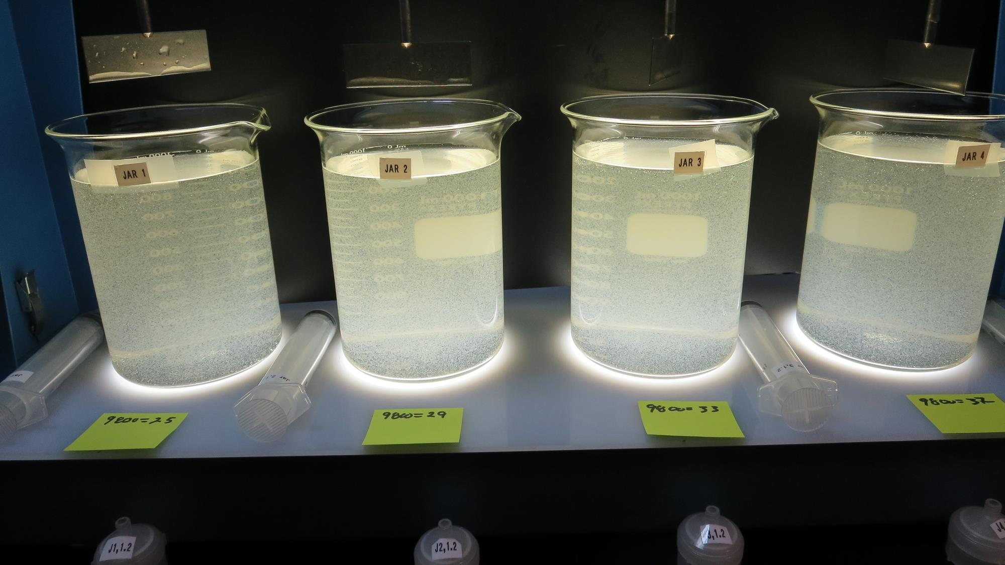
Jars 1-4: End of 5-minute flocculation (30 RPM) duration.
25 mg/L 9800
Filtrate: 0.57 NTU
UVT: 90.2%
UVA: 0.045/cm
UVA Reduction: 61.4%
Settled: 4.9 NTU
29 mg/L 9800
Filtrate: 0.50 NTU
UVT: 91.3%
UVA: 0.040/cm
UVA Reduction: 65.9%
Settled: 4.8 NTU
33 mg/L 9800
Filtrate: 0.11 NTU
UVT: 91.8%
UVA: 0.037/cm
UVA Reduction: 68.0%
Settled: 5.4 NTU
37 mg/L 9800
Filtrate: 0.35 NTU
UVT: 92.2%
UVA: 0.035/cm
UVA Reduction: 69.9%
Settled: 5.1 NTU

Slide 16
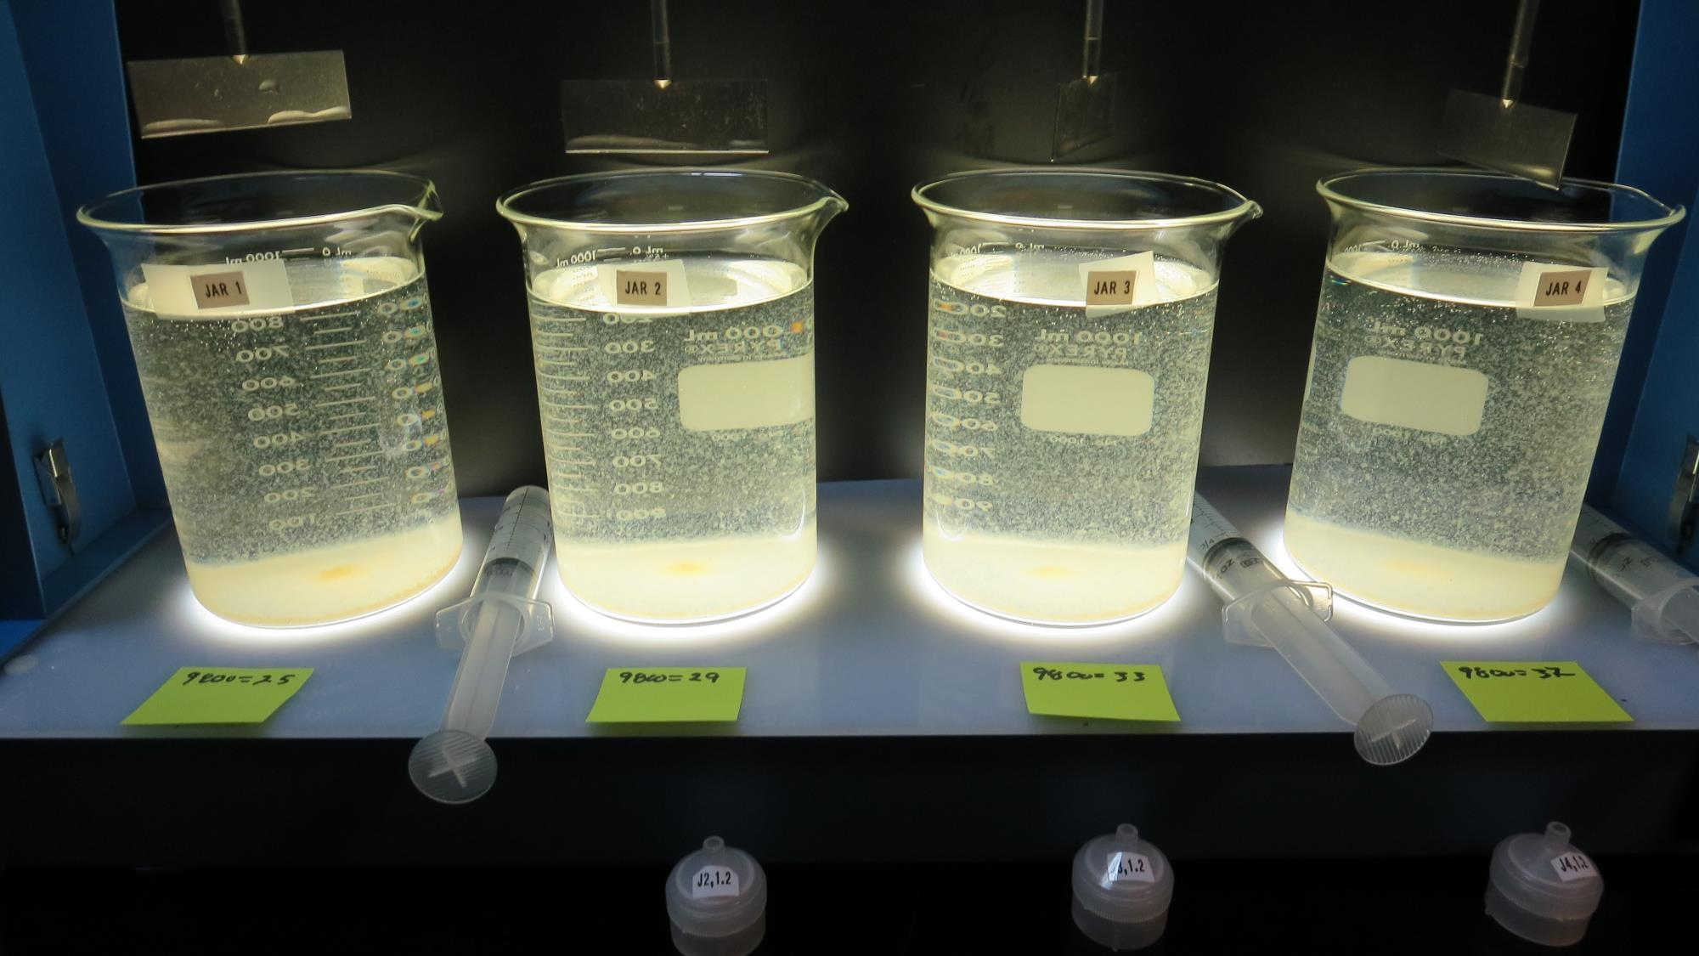
Jars 1-4: After 5 min of settling, 25 mL is decanted for filterability and %UVT/UVA.

Slide 17
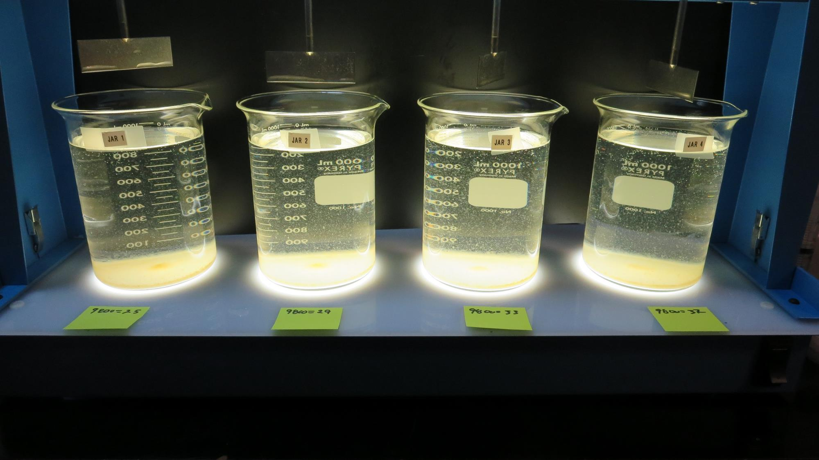
Jars 1-4: After 25-minutes of settling, settled water turbidity is taken.
25 mg/L 9800
Filtrate: 0.57 NTU
UVT: 90.2%
UVA: 0.045/cm
UVA Reduction: 61.4%
Settled: 4.9 NTU
29 mg/L 9800
Filtrate: 0.50 NTU
UVT: 91.3%
UVA: 0.040/cm
UVA Reduction: 65.9%
Settled: 4.8 NTU
33 mg/L 9800
Filtrate: 0.11 NTU
UVT: 91.8%
UVA: 0.037/cm
UVA Reduction: 68.0%
Settled: 5.4 NTU
37 mg/L 9800
Filtrate: 0.35 NTU
UVT: 92.2%
UVA: 0.035/cm
UVA Reduction: 69.9%
Settled: 5.1 NTU

Slide 18
Jars 5-8 Test Flash Mix 60 Sec (200 RPM) Floc Mix 5 min (30 RPM) Applied Coagulants 9800/9890

Slide 19
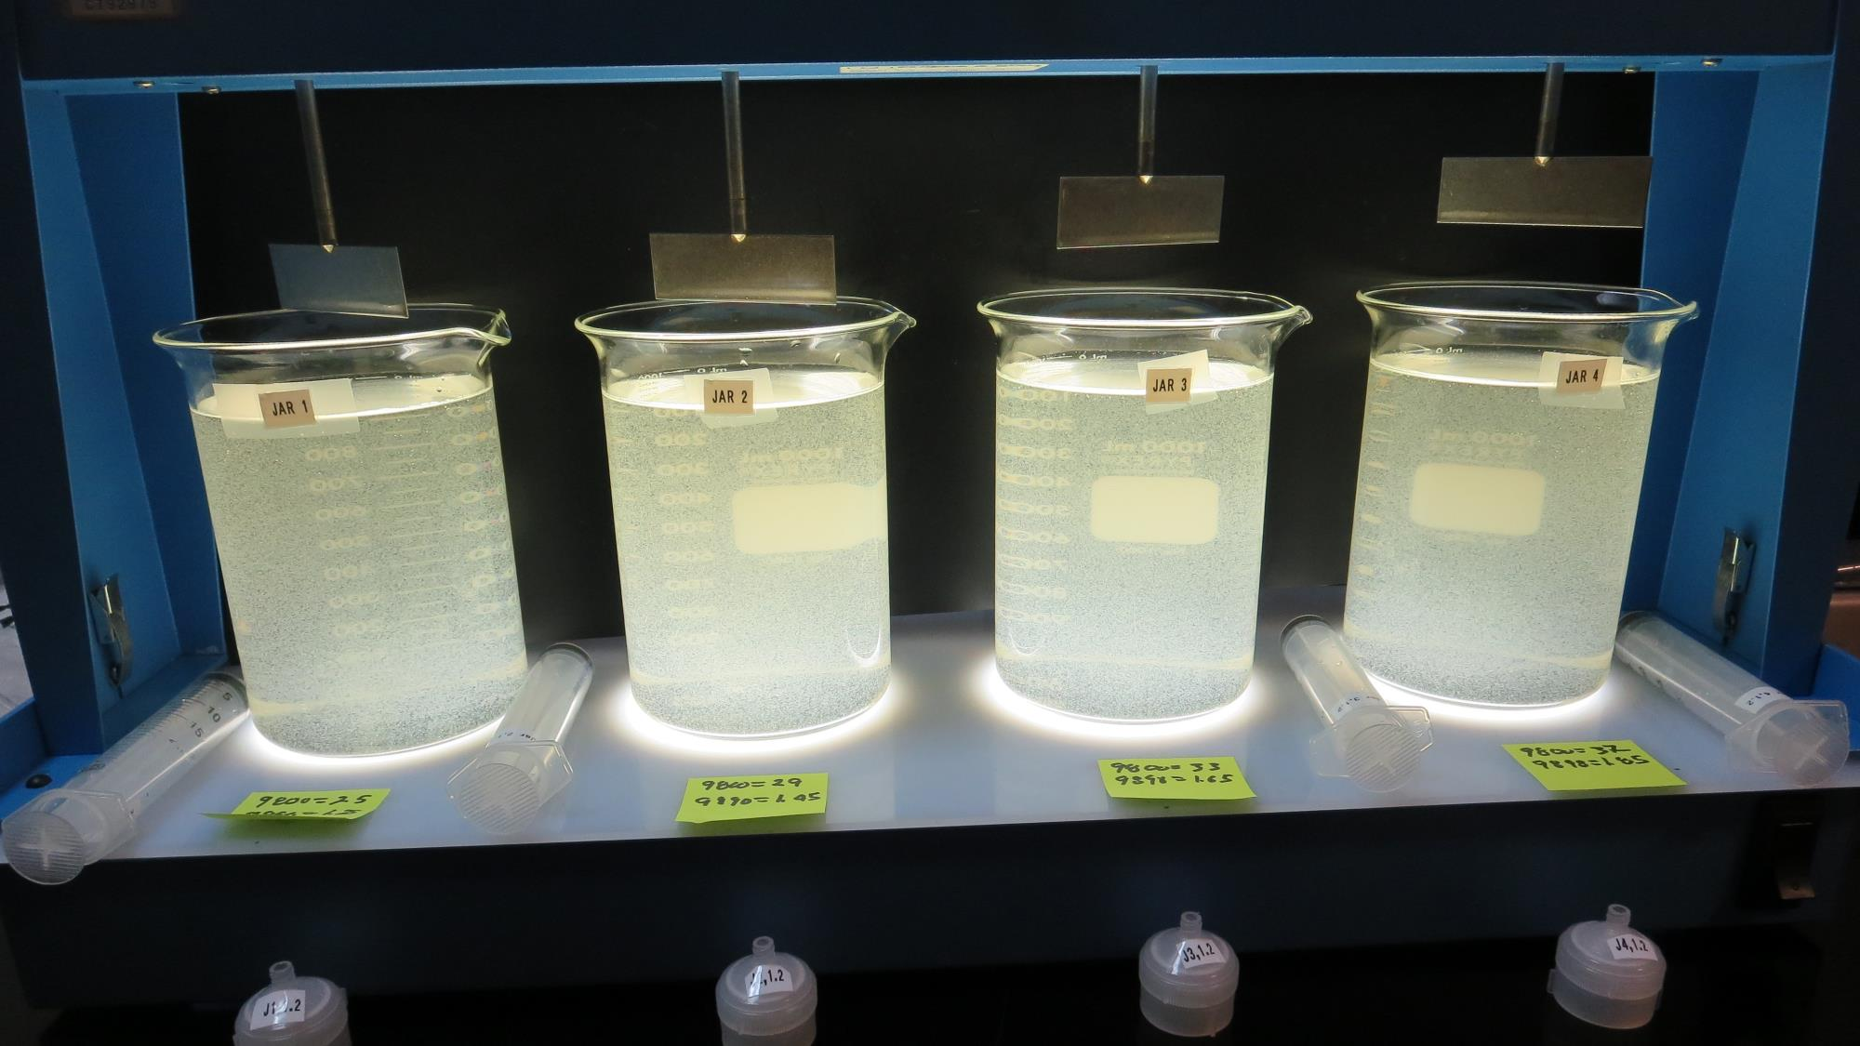
Jars 5-8: End of 5-minute flocculation (30 RPM) duration.
25 mg/L 9800
1.25 mg/L 9890
Filtrate: 0.56 NTU
UVT: 89.6%
UVA: 0.048/cm
UVA Reduction: 58.6%
Settled: 4.3 NTU
29 mg/L 9800
1.45 mg/L 9890
Filtrate: 0.48 NTU
UVT: 91.4%
UVA: 0.039/cm
UVA Reduction: 66.4%
Settled: 4.2 NTU
33 mg/L 9800
1.65 mg/L 9890
Filtrate: 0.31 NTU
UVT: 92.2%
UVA: 0.035/cm
UVA Reduction: 69.6%
Settled: 4.0 NTU
37 mg/L 9800
1.85 mg/L 9890
Filtrate: 0.11 NTU
UVT: 92.9%
UVA: 0.032/cm
UVA Reduction: 72.4%
Settled: 3.5 NTU

Slide 20
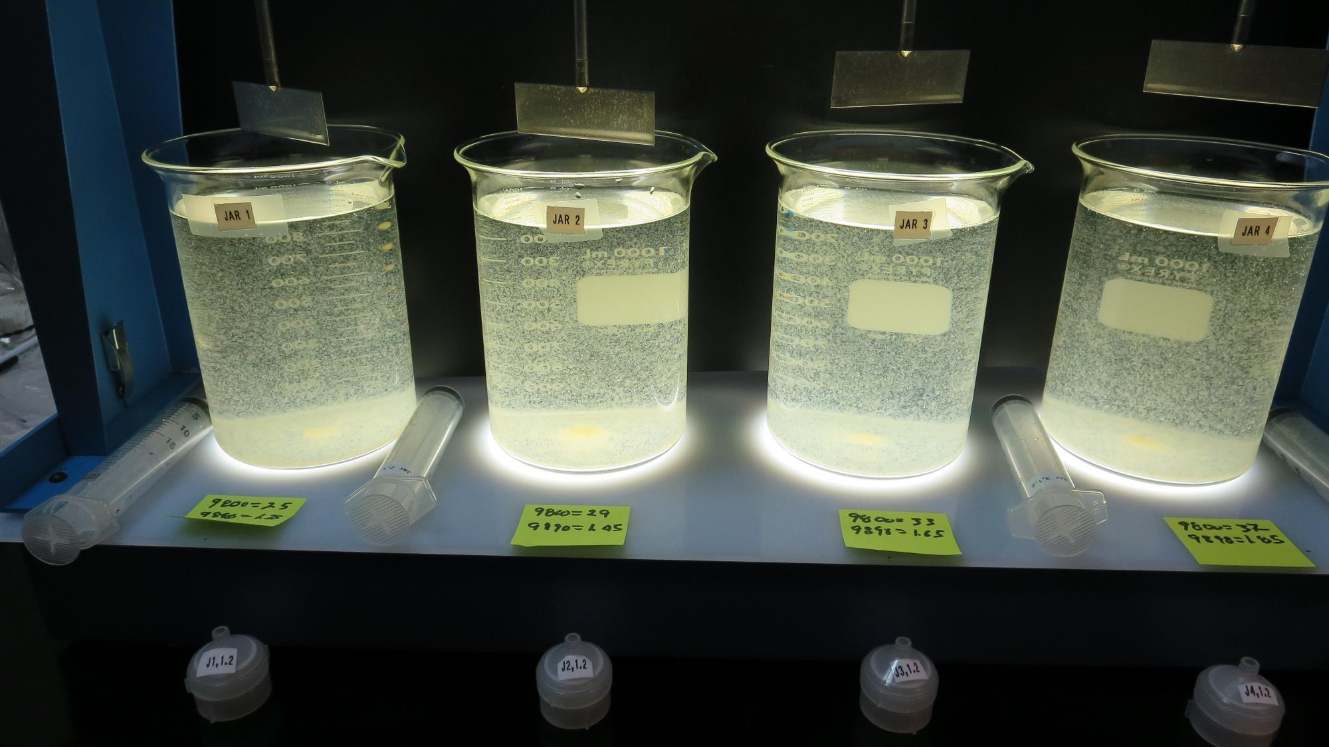
Jars 5-8: After 5 min of settling, 25 mL is decanted for filterability and %UVT/UVA.

Slide 21
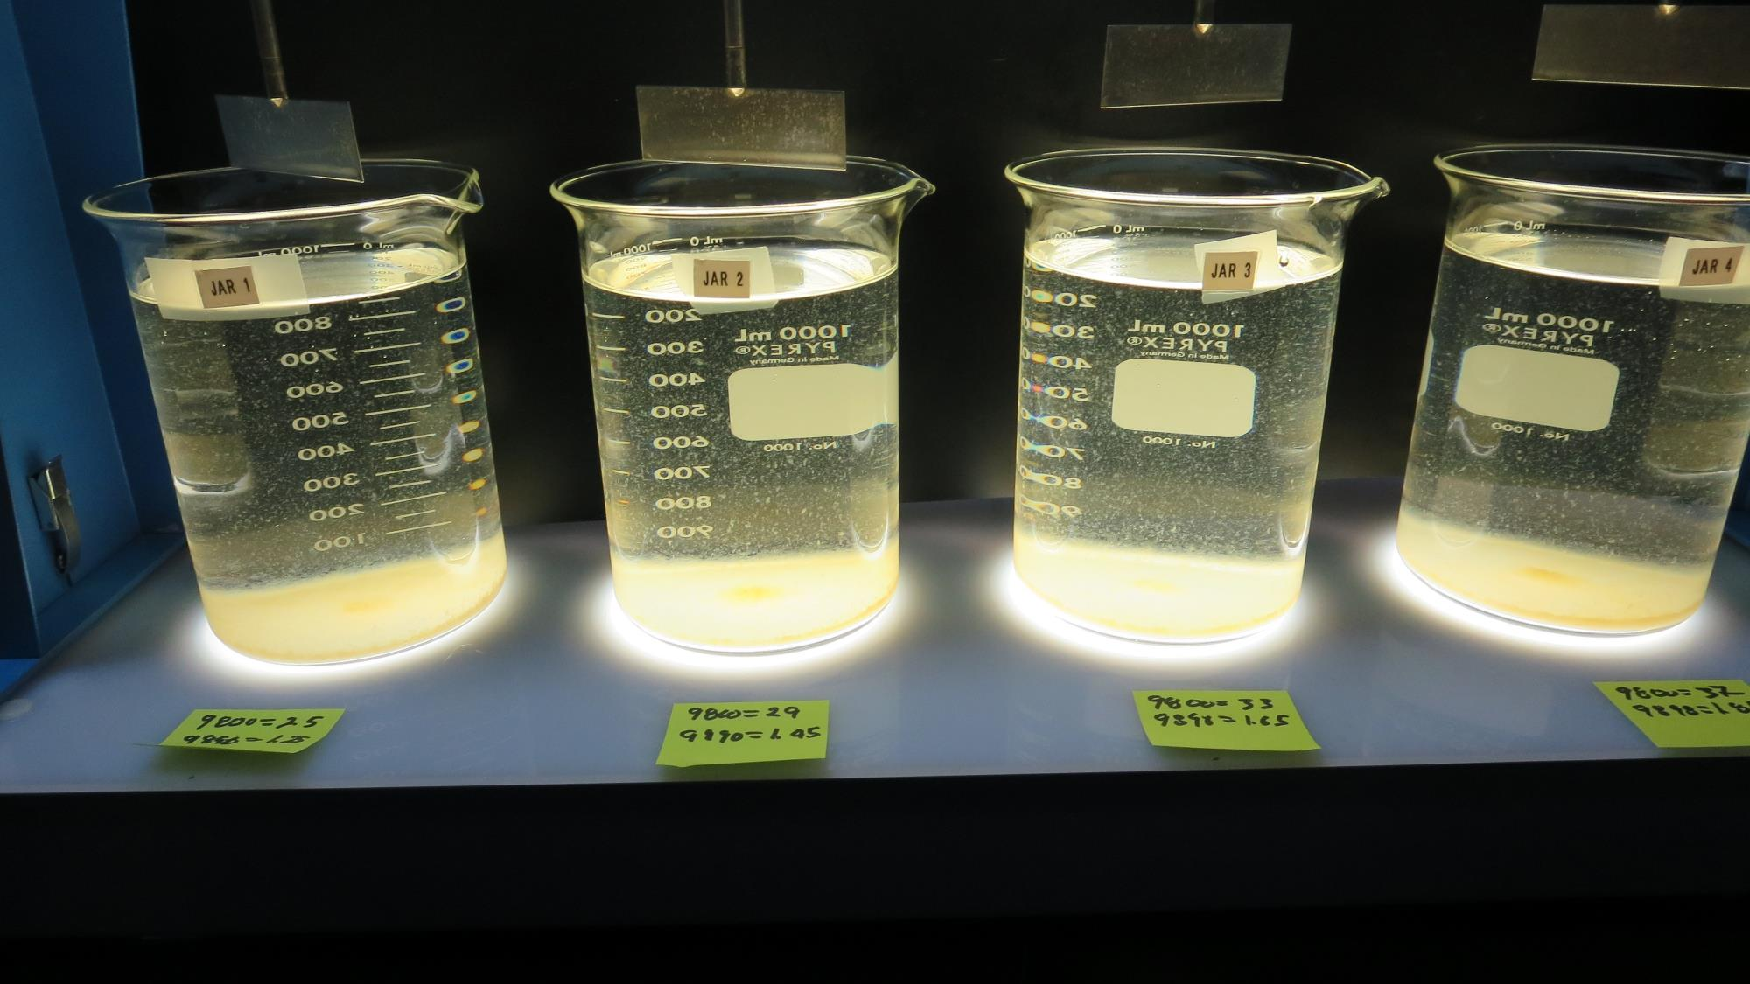
Jars 5-8: After 25-minutes of settling, settled water turbidity is taken.
25 mg/L 9800
1.25 mg/L 9890
Filtrate: 0.56 NTU
UVT: 89.6%
UVA: 0.048/cm
UVA Reduction: 58.6%
Settled: 4.3 NTU
29 mg/L 9800
1.45 mg/L 9890
Filtrate: 0.48 NTU
UVT: 91.4%
UVA: 0.039/cm
UVA Reduction: 66.4%
Settled: 4.2 NTU
33 mg/L 9800
1.65 mg/L 9890
Filtrate: 0.31 NTU
UVT: 92.2%
UVA: 0.035/cm
UVA Reduction: 69.6%
Settled: 4.0 NTU
37 mg/L 9800
1.85 mg/L 9890
Filtrate: 0.11 NTU
UVT: 92.9%
UVA: 0.032/cm
UVA Reduction: 72.4%
Settled: 3.5 NTU

Slide 22
Jars 9-12 Test Flash Mix 60 Sec (200 RPM) Floc Mix 5 min (30 RPM) Applied Coagulants 9800/9890

Slide 23
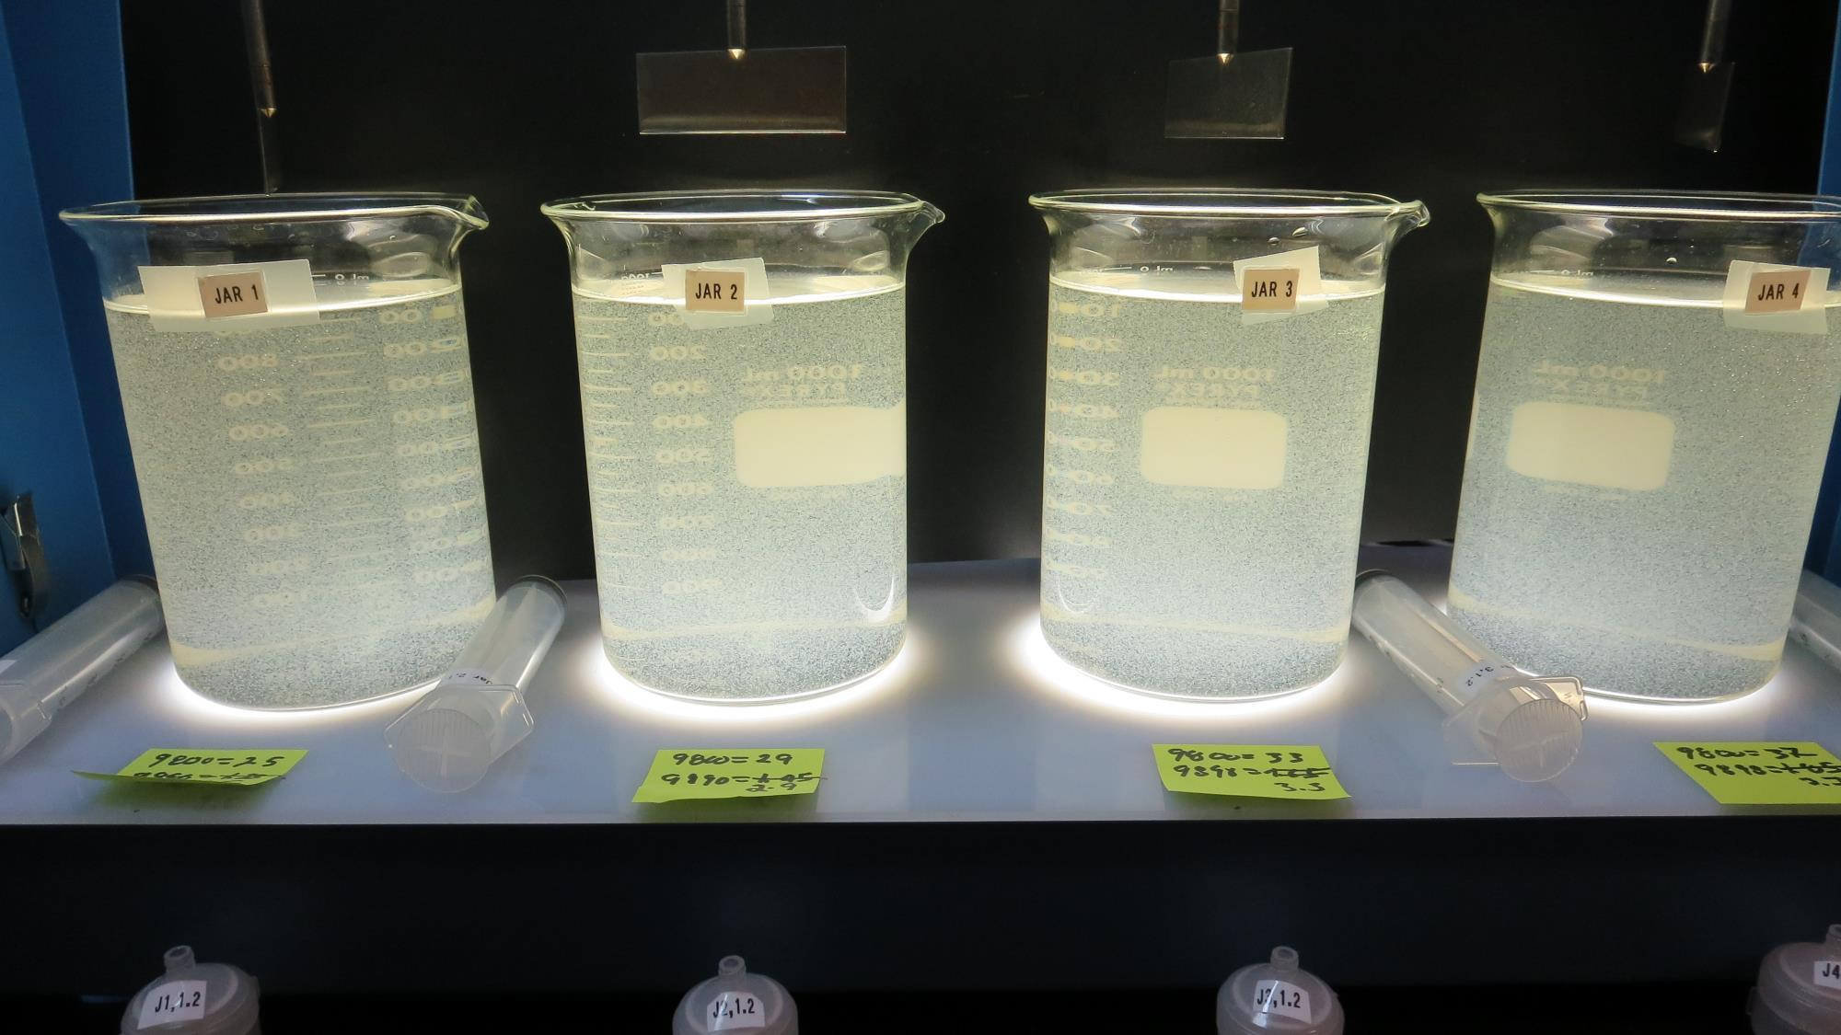
Jars 9-12: End of 5-minute flocculation (30 RPM) duration.
25 mg/L 9800
2.5 mg/L 9890
Filtrate: 0.18 NTU
UVT: 91.8%
UVA: 0.037/cm
UVA Reduction: 68.0%
Settled: 4.0 NTU
29 mg/L 9800
2.9 mg/L 9890
Filtrate: 0.33 NTU
UVT: 92.0%
UVA: 0.036/cm
UVA Reduction: 69.0%
Settled: 3.4 NTU
33 mg/L 9800
3.3 mg/L 9890
Filtrate: 0.32 NTU
UVT: 92.5%
UVA: 0.034/cm
UVA Reduction: 70.7%
Settled: 3.4 NTU
37 mg/L 9800
3.7 mg/L 9890
Filtrate: 0.07 NTU
UVT: 93.3%
UVA: 0.030/cm
UVA Reduction: 74.1%
Settled: 4.9 NTU

Slide 24
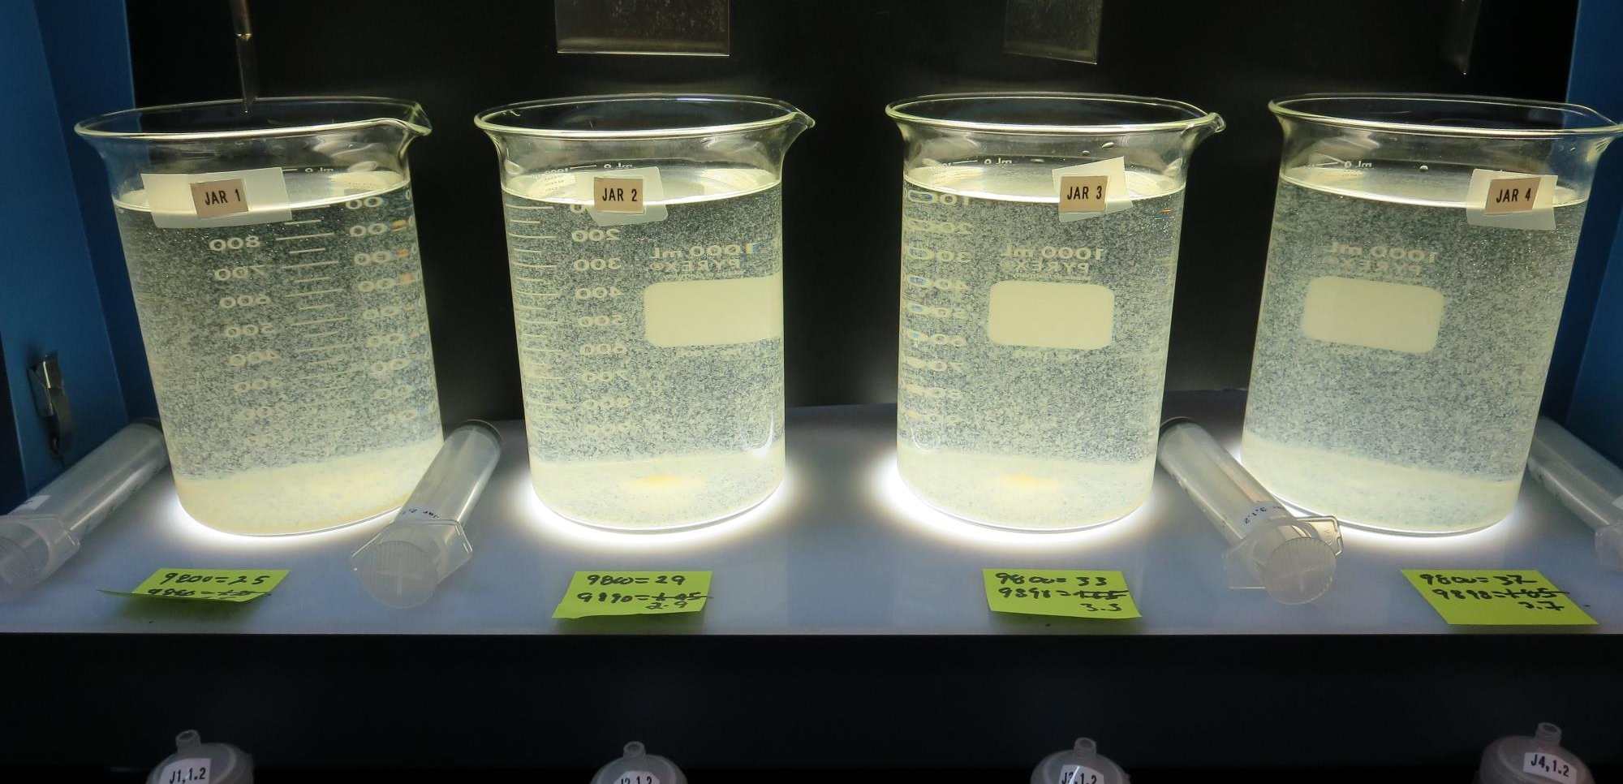
Jars 9-12: After 5 min of settling, 25 mL is decanted for filterability and %UVT/UVA.

Slide 25
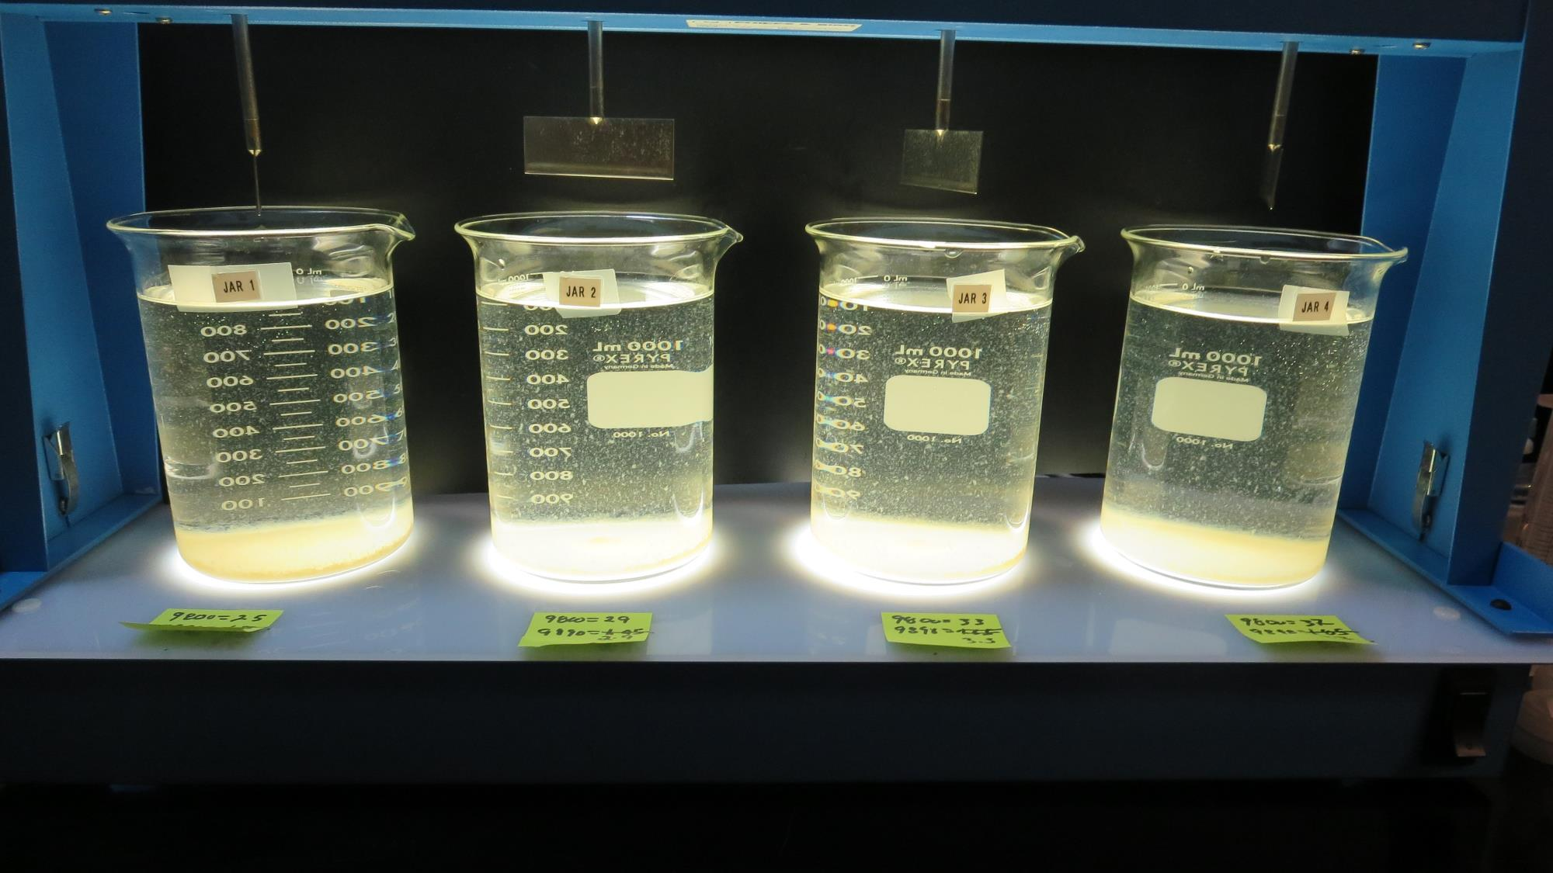
Jars 9-12: After 25-minutes of settling, settled water turbidity is taken.
25 mg/L 9800
2.5 mg/L 9890
Filtrate: 0.18 NTU
UVT: 91.8%
UVA: 0.037/cm
UVA Reduction: 68.0%
Settled: 4.0 NTU
29 mg/L 9800
2.9 mg/L 9890
Filtrate: 0.33 NTU
UVT: 92.0%
UVA: 0.036/cm
UVA Reduction: 69.0%
Settled: 3.4 NTU
33 mg/L 9800
3.3 mg/L 9890
Filtrate: 0.32 NTU
UVT: 92.5%
UVA: 0.034/cm
UVA Reduction: 70.7%
Settled: 3.4 NTU
37 mg/L 9800
3.7 mg/L 9890
Filtrate: 0.07 NTU
UVT: 93.3%
UVA: 0.030/cm
UVA Reduction: 74.1%
Settled: 4.9 NTU

Slide 26
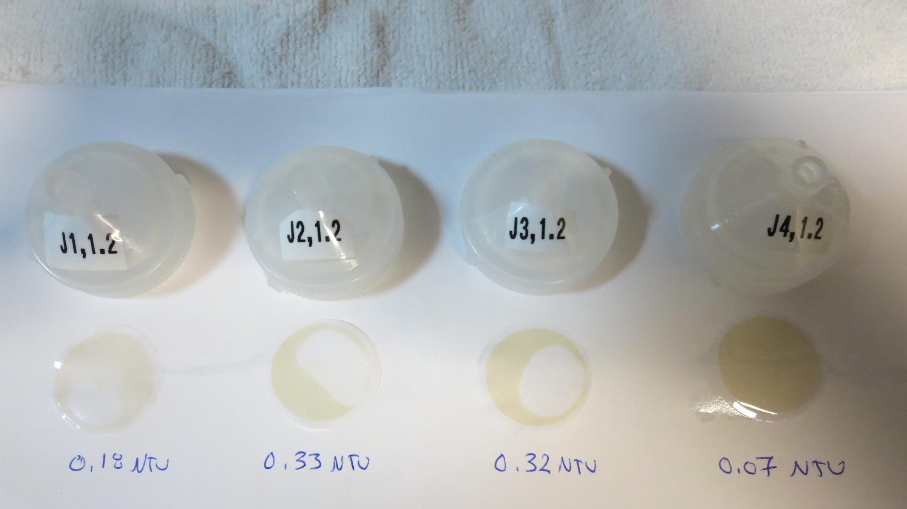
Visual of Filterability of Jars 9-12

Slide 27
Jars 13-16 Test Flash Mix 60 Sec (200 RPM) Floc Mix 5 min (30 RPM) Applied Coagulants 9800/9890

Slide 28
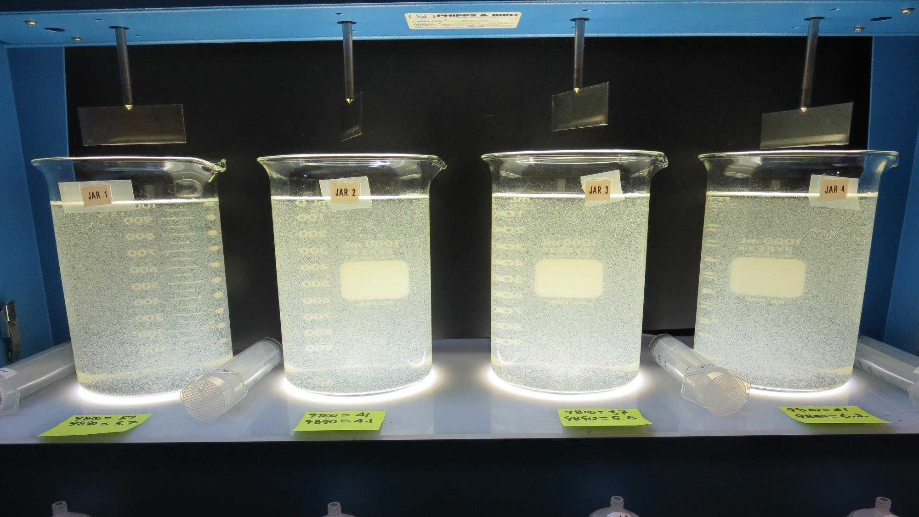
Jars 13-16: End of 5-minute flocculation (30 RPM) duration.
37 mg/L 9800
3.7 mg/L 9890
Filtrate: 0.08 NTU
UVT: 93.0%
UVA: 0.032/cm
UVA Reduction: 72.4%
Settled: 2.2 NTU
41 mg/L 9800
4.1 mg/L 9890
Filtrate: 0.20 NTU
UVT: 93.1%
UVA: 0.031/cm
UVA Reduction: 73.3%
Settled: 2.6 NTU
37 mg/L 9800
5.6 mg/L 9890
Filtrate: 0.06 NTU
UVT: 93.3%
UVA: 0.030/cm
UVA Reduction: 74.1%
Settled: 2.8 NTU
41 mg/L 9800
6.2 mg/L 9890
Filtrate: 0.07 NTU
UVT: 93.7%
UVA: 0.028/cm
UVA Reduction: 75.9%
Settled: 2.9 NTU

Slide 29
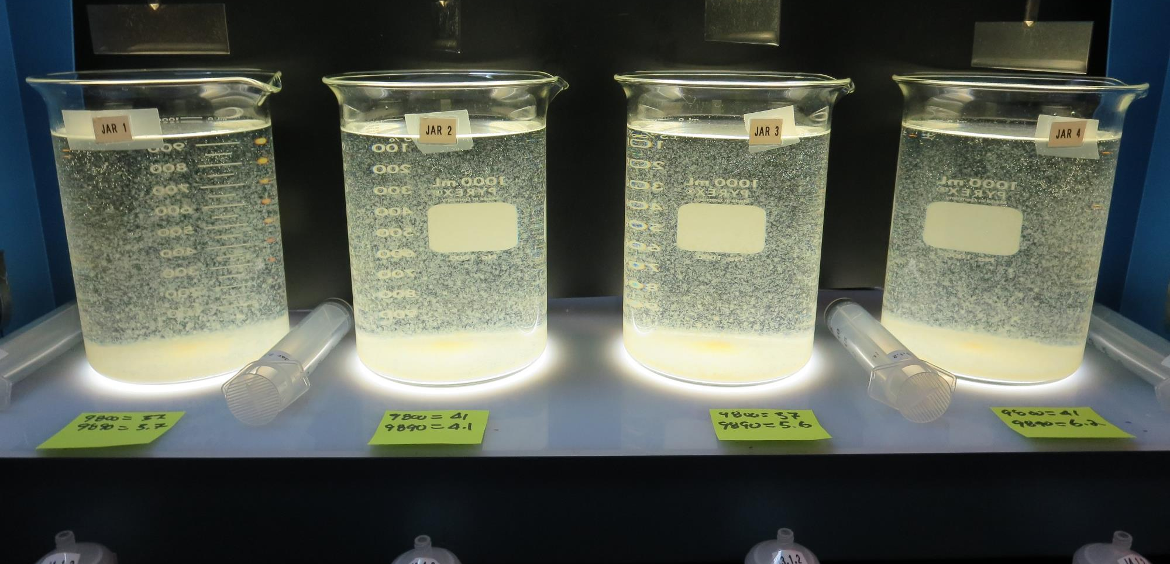
Jars 13-16: After 5 min of settling, 25 mL is decanted for filterability and %UVT/UVA.

Slide 30
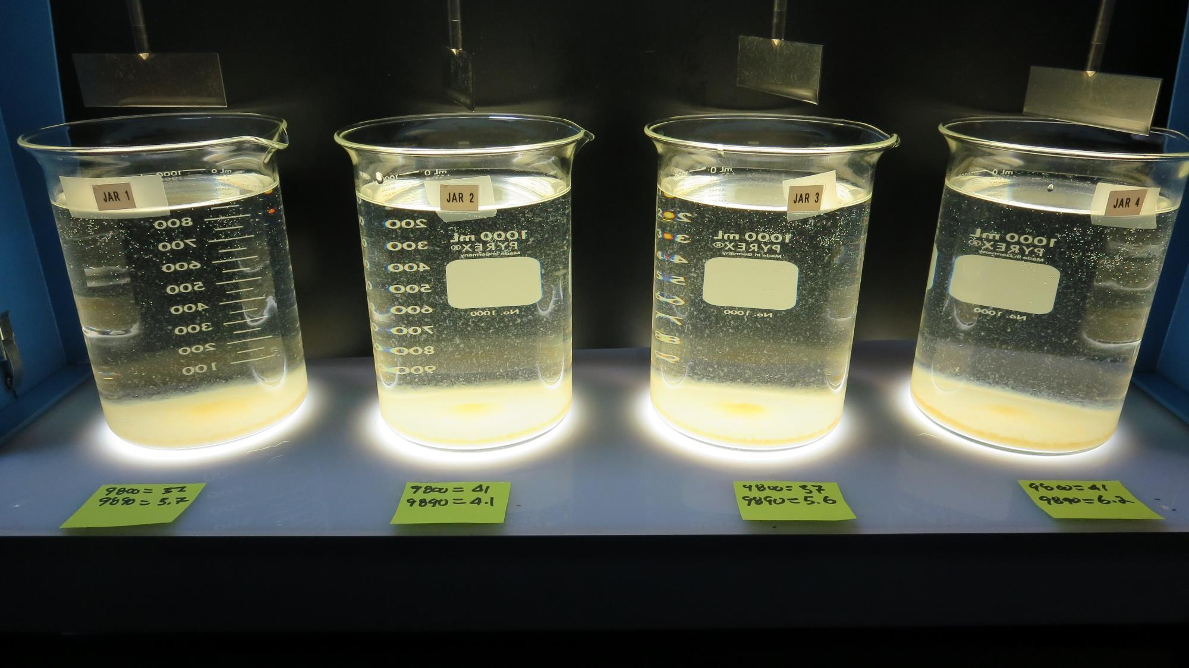
Jars 13-16: After 25-minutes of settling, settled water turbidity is taken.
37 mg/L 9800
3.7 mg/L 9890
Filtrate: 0.08 NTU
UVT: 93.0%
UVA: 0.032/cm
UVA Reduction: 72.4%
Settled: 2.2 NTU
41 mg/L 9800
4.1 mg/L 9890
Filtrate: 0.20 NTU
UVT: 93.1%
UVA: 0.031/cm
UVA Reduction: 73.3%
Settled: 2.6 NTU
37 mg/L 9800
5.6 mg/L 9890
Filtrate: 0.06 NTU
UVT: 93.3%
UVA: 0.030/cm
UVA Reduction: 74.1%
Settled: 2.8 NTU
41 mg/L 9800
6.2 mg/L 9890
Filtrate: 0.07 NTU
UVT: 93.7%
UVA: 0.028/cm
UVA Reduction: 75.9%
Settled: 2.9 NTU

Slide 31
Jars 17-20 Test Flash Mix 60 Sec (200 RPM) Floc Mix 5 min (30 RPM) Applied Coagulants 9800/9890 w/NaOCl & JC 9450

Slide 32
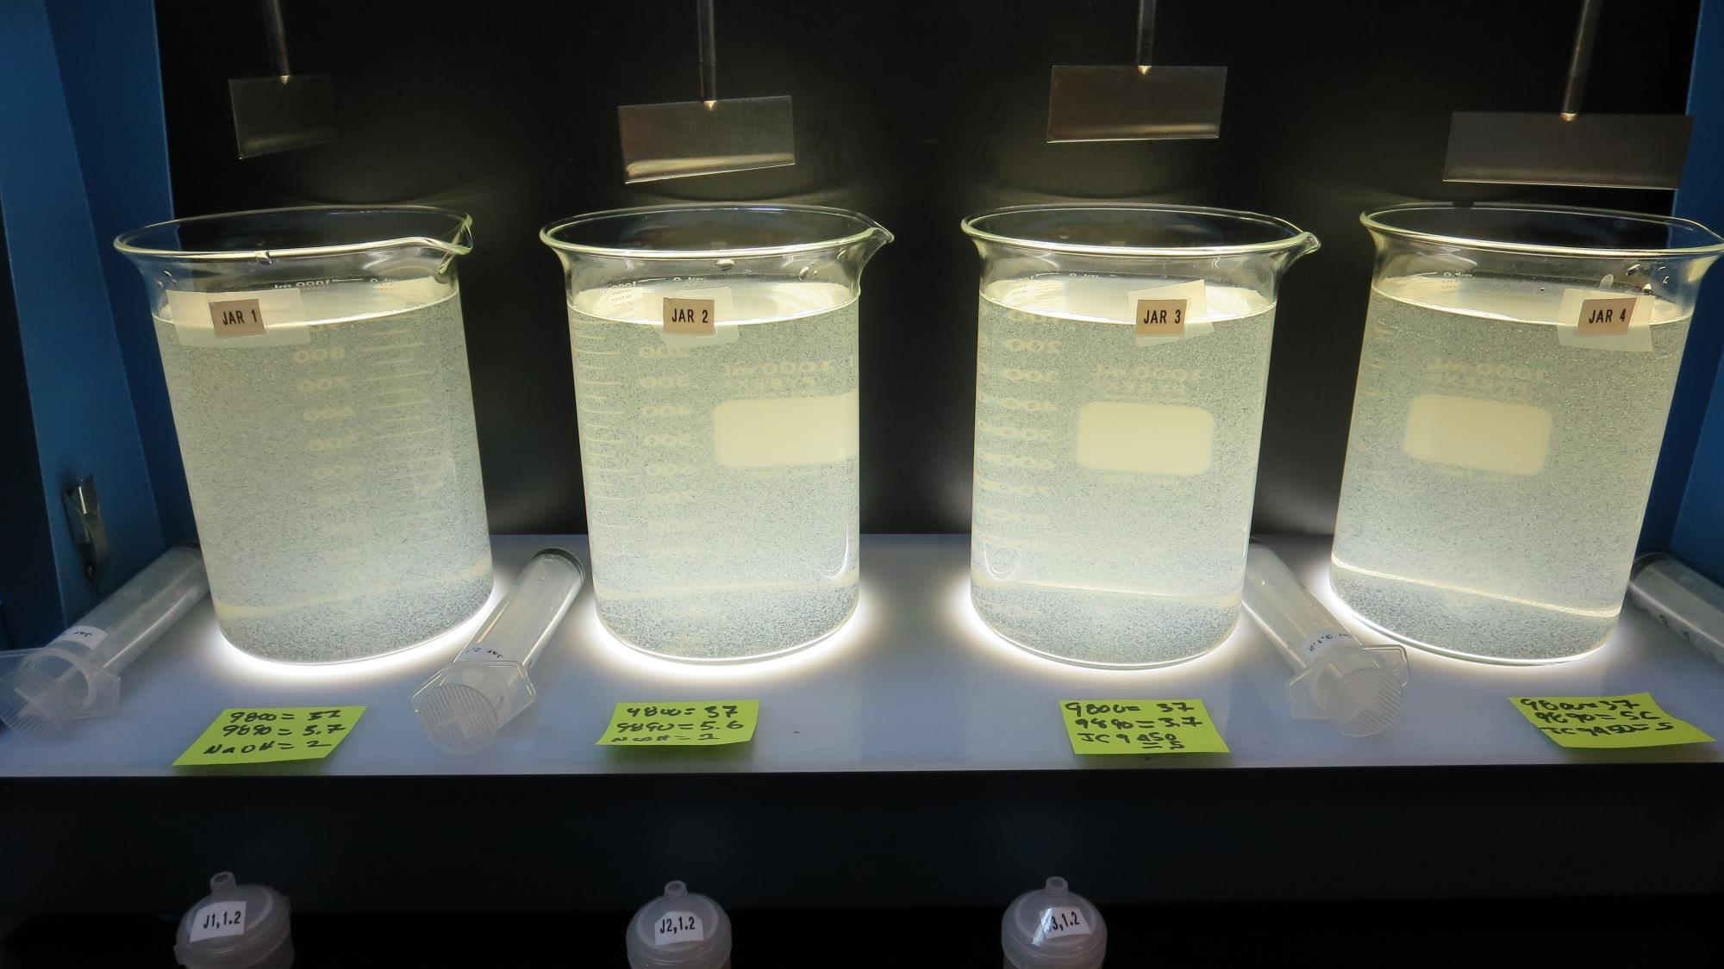
Jars 17-20: End of 5-minute flocculation (30 RPM) duration.
2 mg/L NaOCl
37 mg/L 9800
3.7 mg/L 9890
Filtrate: 0.28 NTU
UVT: 92.6%
UVA: 0.033/cm
UVA Reduction: 71.6%
Settled: 3.1 NTU
2 mg/L NaOCl
37 mg/L 9800
5.6 mg/L 9890
Filtrate: 6.6 NTU
UVT: 85.4%
UVA: 0.069/cm
UVA Reduction: 40.5%
Settled: 3.4 NTU
5 mg/L JC 9450
37 mg/L 9800
3.7 mg/L 9890
Filtrate: 0.28 NTU
UVT: 92.6%
UVA: 0.033/cm
UVA Reduction: 71.6%
Settled: 4.0 NTU
5 mg/L JC 9450
37 mg/L 9800
5.6 mg/L 9890
Filtrate: 0.27 NTU
UVT: -%
UVA: -/cm
Settled: 3.7 NTU

Slide 33
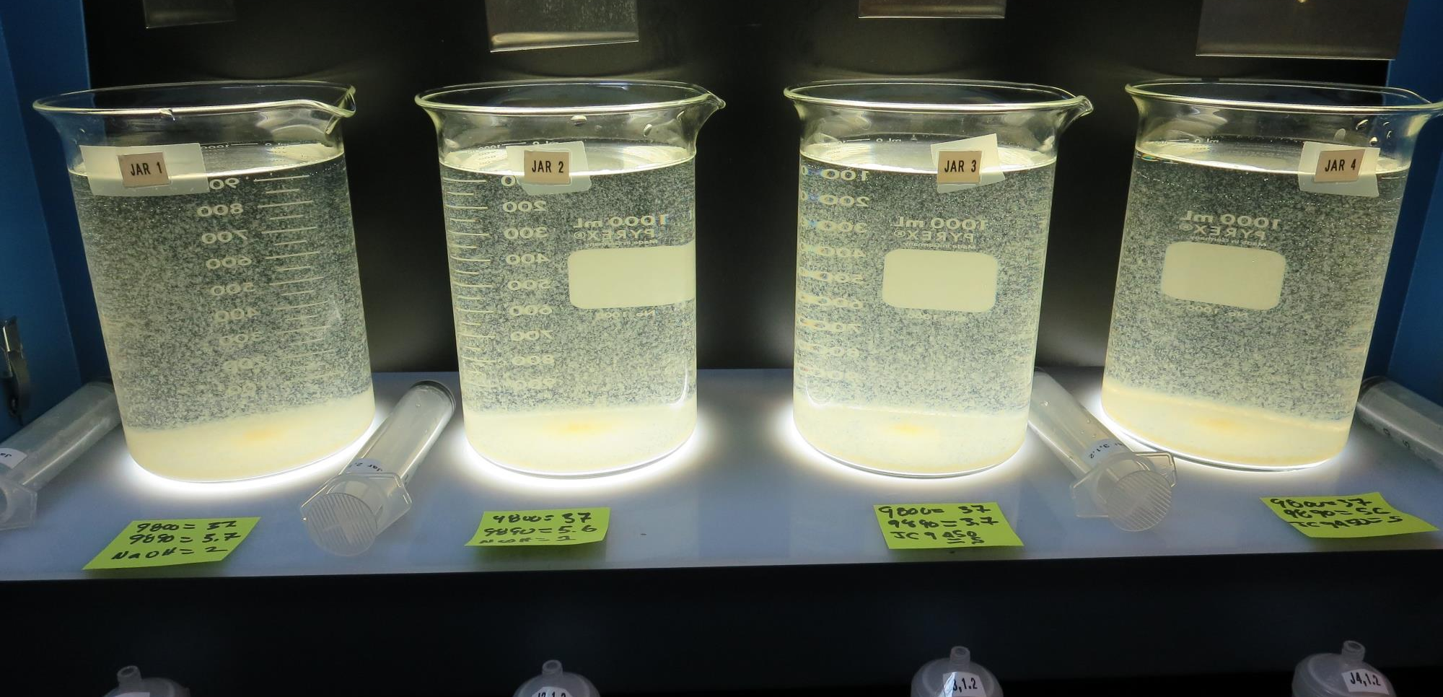
Jars 17-20: After 5 min of settling, 25 mL is decanted for filterability and %UVT/UVA.

Slide 34
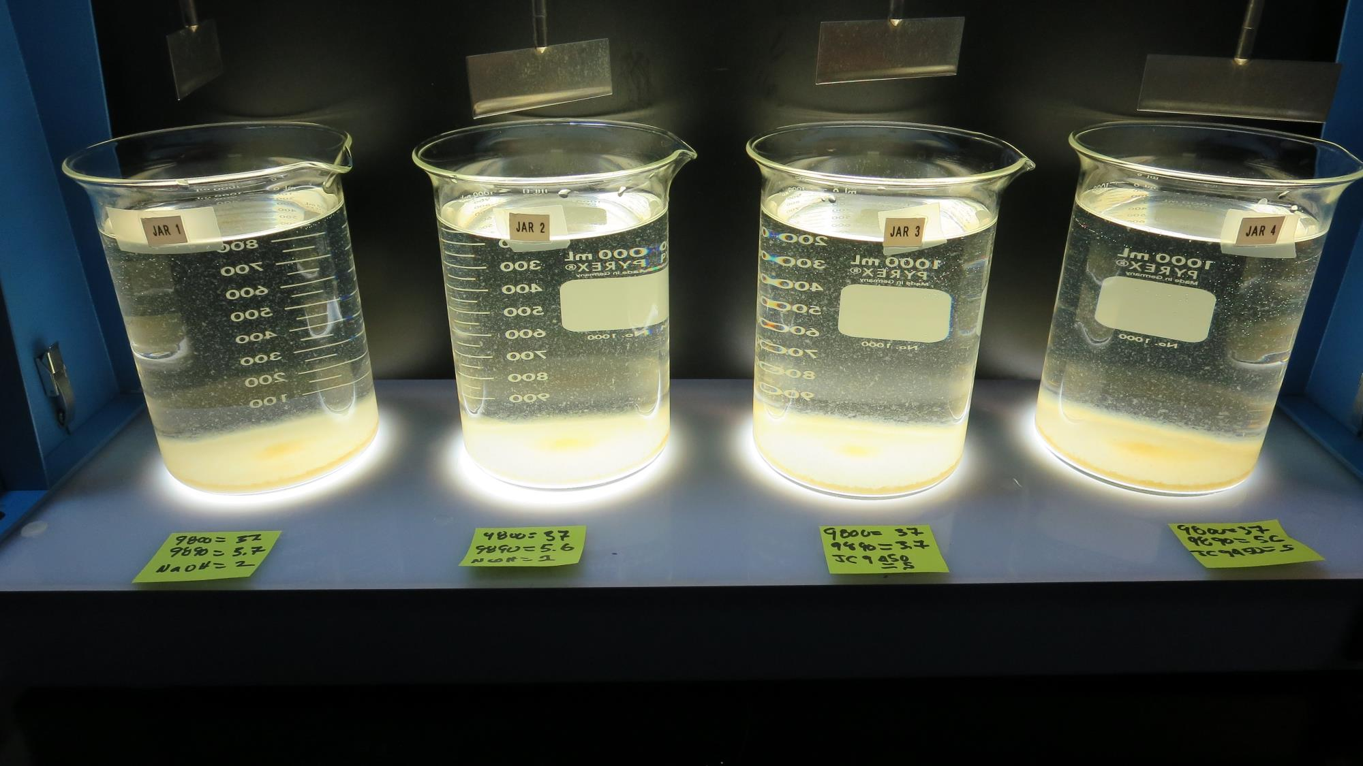
Jars 17-20: After 25-minutes of settling, settled water turbidity is taken.
2 mg/L NaOCl
37 mg/L 9800
3.7 mg/L 9890
Filtrate: 0.28 NTU
UVT: 92.6%
UVA: 0.033/cm
UVA Reduction: 71.6%
Settled: 3.1 NTU
2 mg/L NaOCl
37 mg/L 9800
5.6 mg/L 9890
Filtrate: 6.6 NTU
UVT: 85.4%
UVA: 0.069/cm
UVA Reduction: 40.5%
Settled: 3.4 NTU
5 mg/L JC 9450
37 mg/L 9800
3.7 mg/L 9890
Filtrate: 0.28 NTU
UVT: 92.6%
UVA: 0.033/cm
UVA Reduction: 71.6%
Settled: 4.0 NTU
5 mg/L JC 9450
37 mg/L 9800
5.6 mg/L 9890
Filtrate: 0.27 NTU
UVT: -%
UVA: -/cm
Settled: 3.7 NTU

Slide 35
Jars 21-24 Test Flash Mix 60 Sec (200 RPM) Floc Mix 5 min (30 RPM) Applied Coagulants 9800 Zeta Floc PA 50

Slide 36
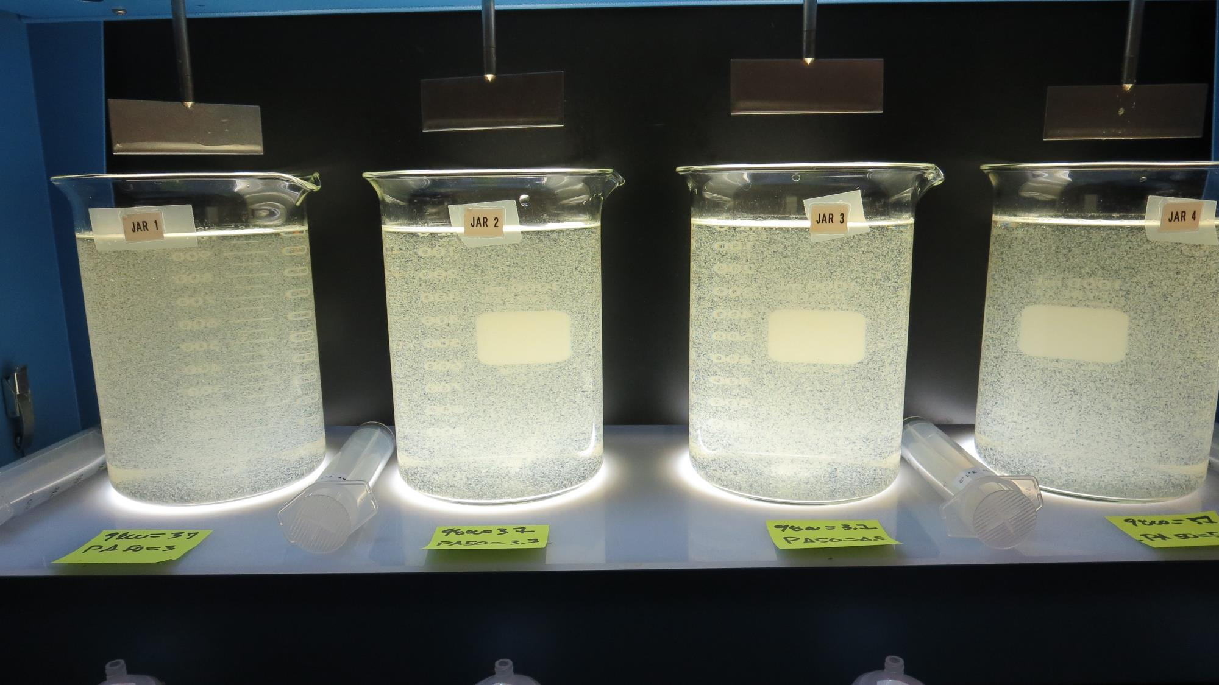
Jars 21-24: End of 5-minute flocculation (30 RPM) duration.
37 mg/L 9800
3.0 mg/L PA 50
Filtrate: 0.06 NTU
UVT: 93.7%
UVA: 0.028/cm
UVA Reduction: 75.9%
Settled: 4.1 NTU
37 mg/L 9800
3.7 mg/L PA 50
Filtrate: 0.05 NTU
UVT: 93.8%
UVA: 0.028/cm
UVA Reduction: 75.9%
Settled: 2.6 NTU
37 mg/L 9800
4.5 mg/L PA 50
Filtrate: 0.07 NTU
UVT: 94.0%
UVA: 0.027/cm
UVA Reduction: 76.7%
Settled: 3.2 NTU
37 mg/L 9800
5.6 mg/L PA 50
Filtrate: 0.06 NTU
UVT: 94.1%
UVA: 0.026/cm
UVA Reduction: 77.6%
Settled: 3.0 NTU

Slide 37
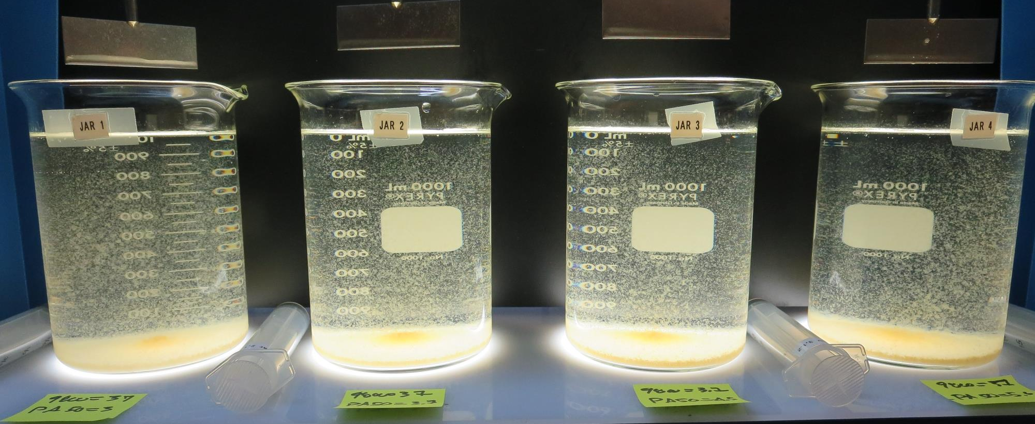
Jars 21-24: After 5 min of settling, 25 mL is decanted for filterability and %UVT/UVA.

Slide 38
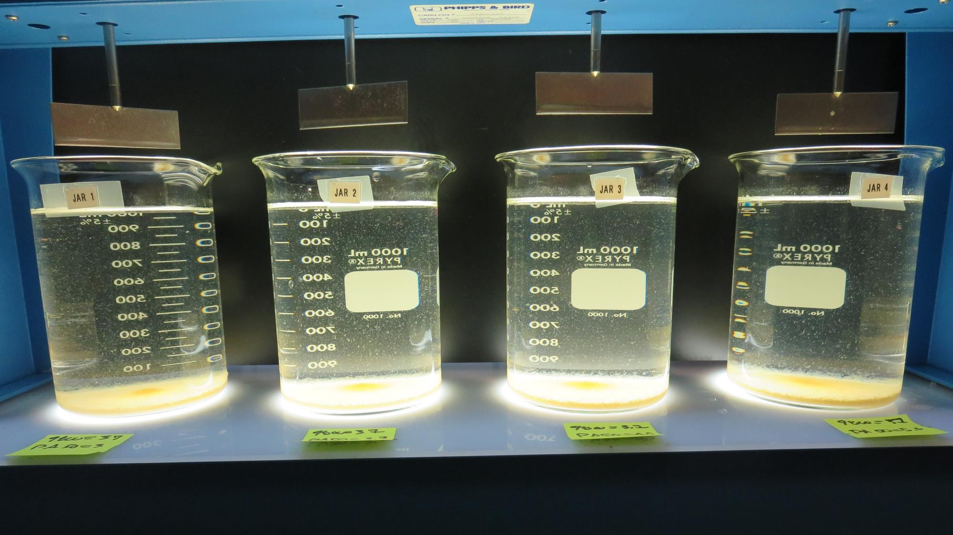
Jars 21-24: After 25-minutes of settling, settled water turbidity is taken.
37 mg/L 9800
3.0 mg/L PA 50
Filtrate: 0.06 NTU
UVT: 93.7%
UVA: 0.028/cm
UVA Reduction: 75.9%
Settled: 4.1 NTU
37 mg/L 9800
3.7 mg/L PA 50
Filtrate: 0.05 NTU
UVT: 93.8%
UVA: 0.028/cm
UVA Reduction: 75.9%
Settled: 2.6 NTU
37 mg/L 9800
4.5 mg/L PA 50
Filtrate: 0.07 NTU
UVT: 94.0%
UVA: 0.027/cm
UVA Reduction: 76.7%
Settled: 3.2 NTU
37 mg/L 9800
5.6 mg/L PA 50
Filtrate: 0.06 NTU
UVT: 94.1%
UVA: 0.026/cm
UVA Reduction: 77.6%
Settled: 3.0 NTU

Slide 39
Jar Testing for 1-Liter Jars: Procedures for Most Treatment Plants
Fill jars with source water prior to coagulant injection and set paddle speed at 30 rpm
Add chemicals (i.e., NaOCl, primary coagulant, coagulant aid) to each jar
Flash mix for 15-60 seconds (200 rpm)
Slow mix for 5 minutes (20-30 rpm)
Settled for 5 minutes. Syringe 25 mL from each jar taken 1-inch below surface (25 mL/12 sec rate)
Filtered through 1.2 um isopore membrane into cuvette drip rate, 15 mL/(50-90 sec)
Measure filtrate turbidity, chlorine residual and %UVT/UVA
Measure settled water turbidity after 25 minutes of total setting
Record all data

Slide 40
Jar Test Filterability Test Equipment
Turbidity Instrument
Syringe w/Luer-Lock Tip, 30 cc
(part#: 2225800, by Hach)
Swinnex Filter Holder, 25 mm (part#: SX0002500)
Isopore Membrane Filter, 1.2 um absolute
pore size,
Φ= 25 mm , thickness: 24 um,
hydrophilic polycarbonate membrane
(part #: RTTP02500)
Go to Sigma-Aldrich for laboratory supplies http://www.sigmaaldrich.com/united-states.html

Slide 41
Isopore Membrane Information
Categories | Information
trade name | Isopore
filter color | White
chemistry | Polycarbonate (PC)
water flow rate | Avg. 175 mL/min x cm² (typical results @ 10 psi)
media | Isopore®
wettability | Hydrophilic
porosity | 14.7%
pore size | 1.2 µm
bubble point at 23 °C | 1.0 bar, air with water
thickness | 24 µm
filter diameter (ø) | 25 mm
material size | polycarbonate, Hydrophilic, 1.2 µm, 25 mm, white, plain, 100

Slide 42
Isopore Membrane Background Information
The Isopore membrane is a polycarbonate, track-etched screen filter recommended for all analyses in which the sample is viewed on the surface of the membrane. The Isopore membrane is composed of polycarbonate film, which has a smooth, glass-like surface for clearer sample observation. The unique manufacturing process of the membrane ensures a precise pore diameter and a consistent pore size for accurate separation of samples by size. Matched-weight filters are not usually required because of low, constant tar and ash weights. Features & Benefits: Membrane structure retains particles on the surface, simplifying counting and analysis

Slide 43
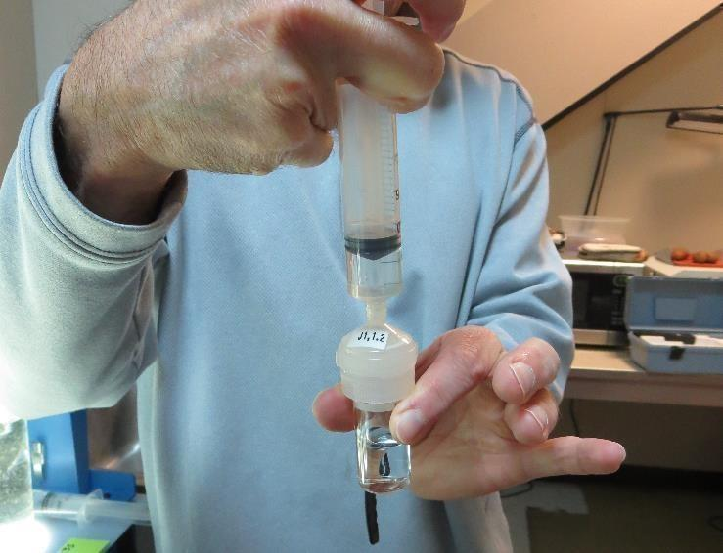
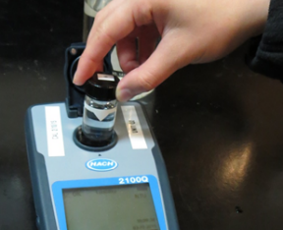
Jar Test - Filterability Test
Syringe ~ 25 mL from jar (after 5-minutes of settling)
Filter-to-waste 3-5 mL
Filter directly into clean cuvette
Measure turbidity
Note: Take several readings before recording final NTU results. Micro bubbles can adhere to glass causing false NTU readings. To remove bubbles, tilt cuvette up to 90 degrees.

Slide 44
Contact
Guy Schott, P.E.
State Water Resources Control Board
Division of Drinking Water
Santa Rosa, CA
Go to Stock Solution/Dose calculations/Jar Test Results for tools to download
www.waterboards.ca.gov/drinking_water/programs/districts/mendocino_district.html
Email: Guy Schott - Guy.Schott@waterboards.ca.gov
Office Number: 707-576-2732

