Slide 1
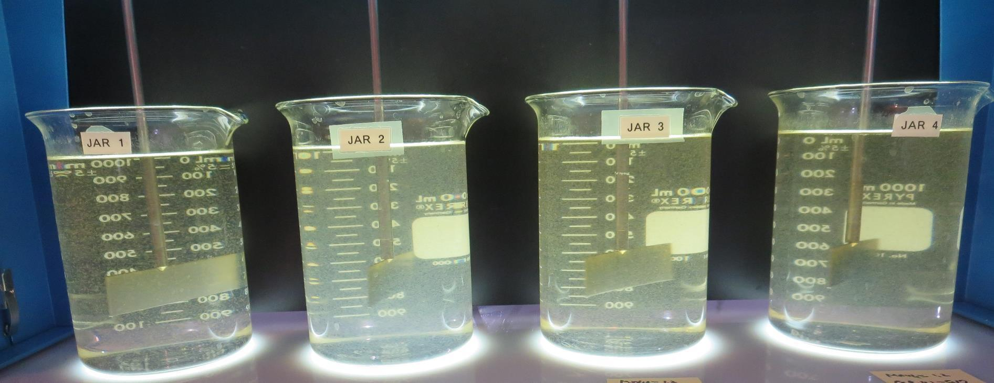
Heritage Ranch CSD
CA4010012
San Luis Obispo County
Jar Test
by Guy Schott, P.E.
September 27, 2022

Slide 2
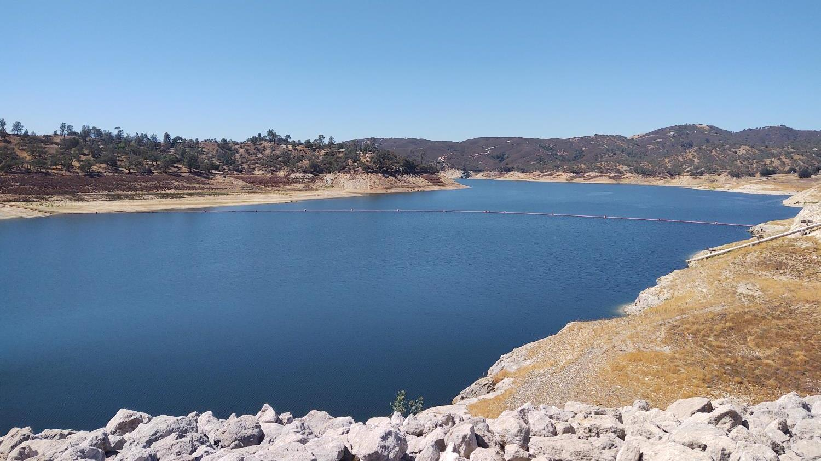
Lake Nacimiento

Slide 3
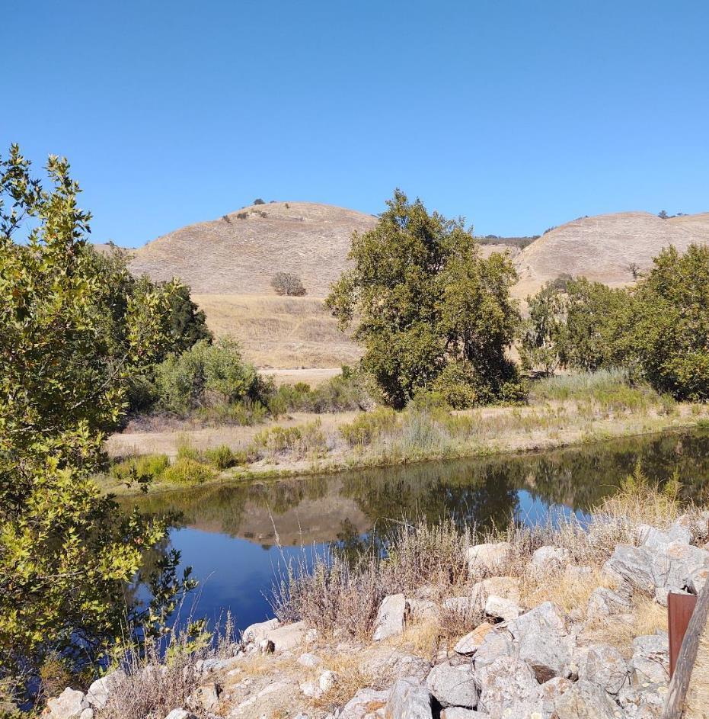
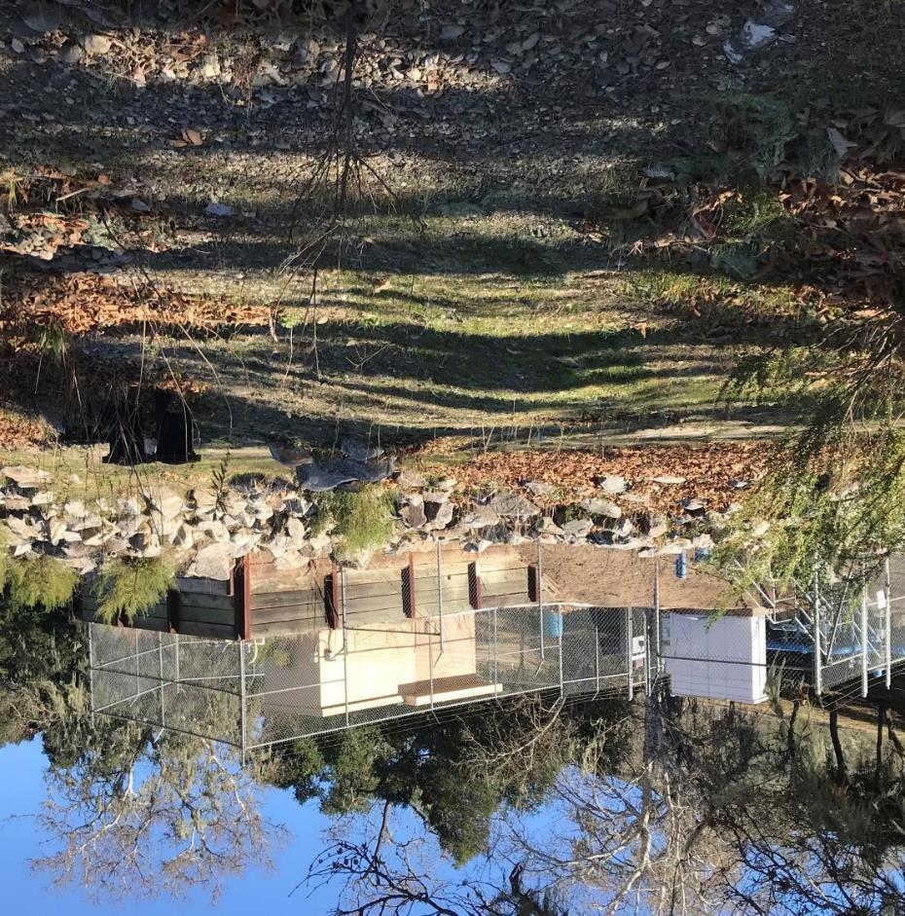
Source Water/Intake
Source Water:
Well 01 (Nacimiento River)
Pump Station
Well 01 (Nacimiento River)

Slide 4
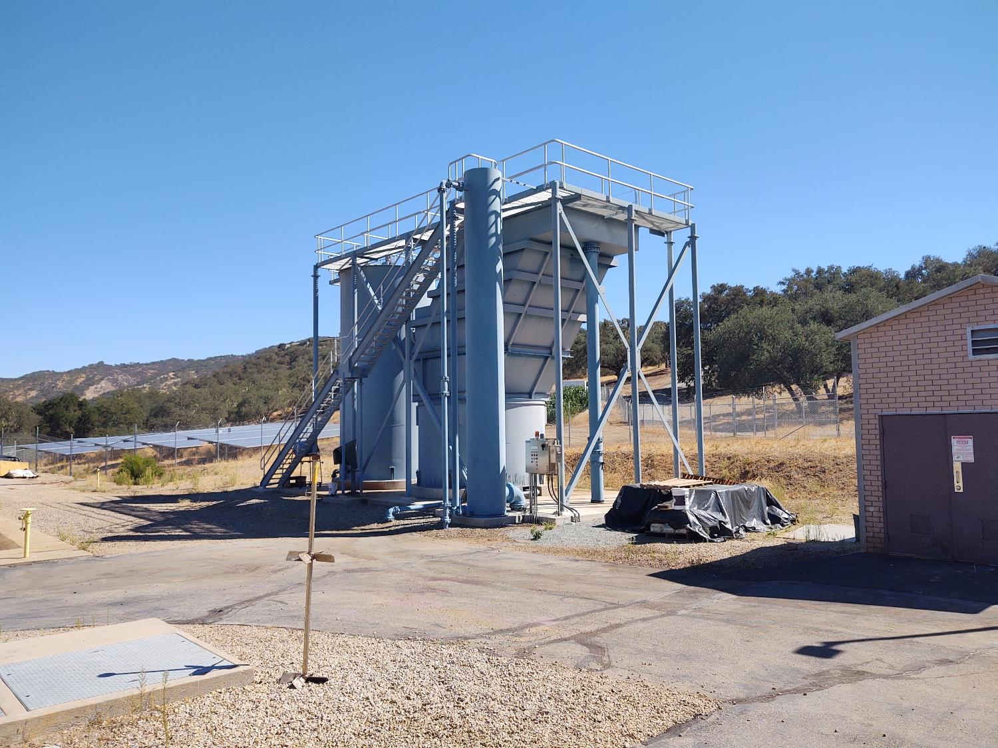
Lamella Inclined Plate Clarifier

Slide 5
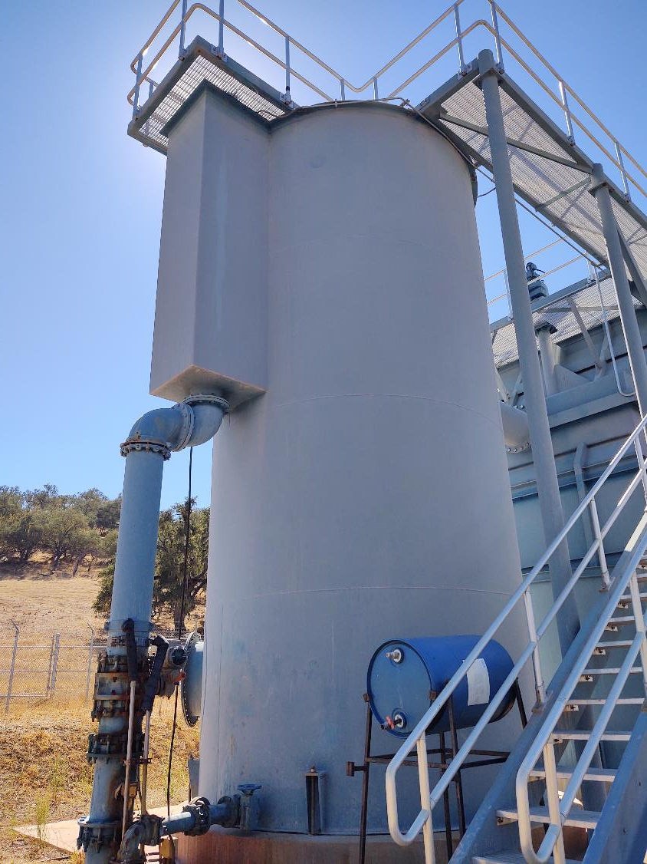
Flash/Floc Mixer
Coagulant Injection Point

Slide 6
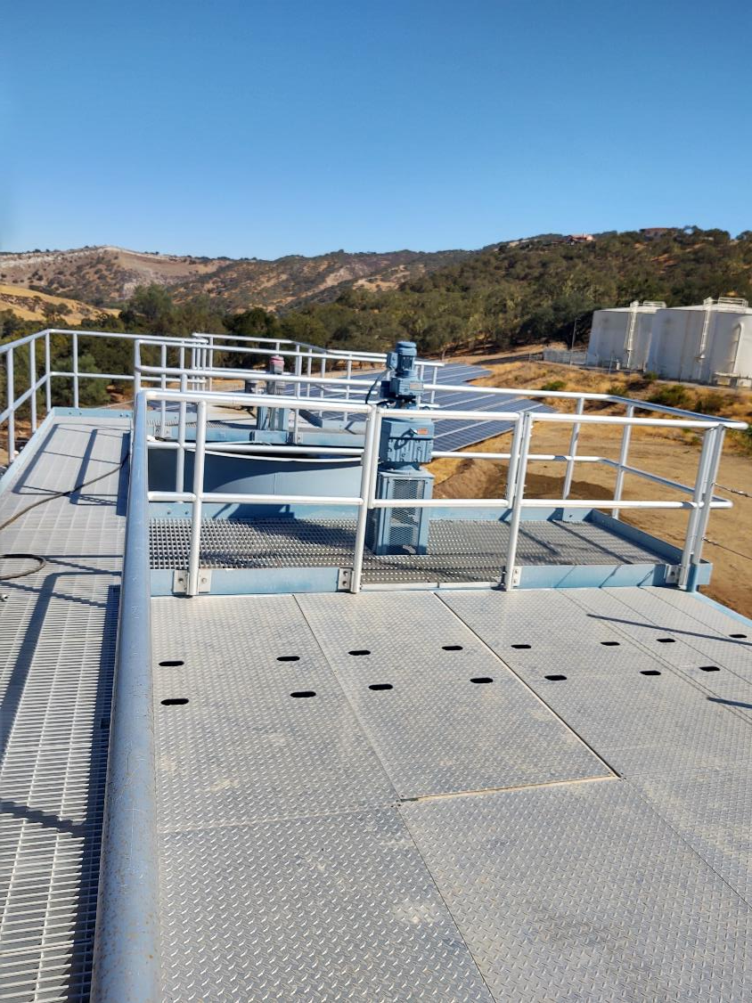
Flash/Floc Mixer and Plate Settler
Flash Mixer
Plate
Settler
Floc Mixer

Slide 7
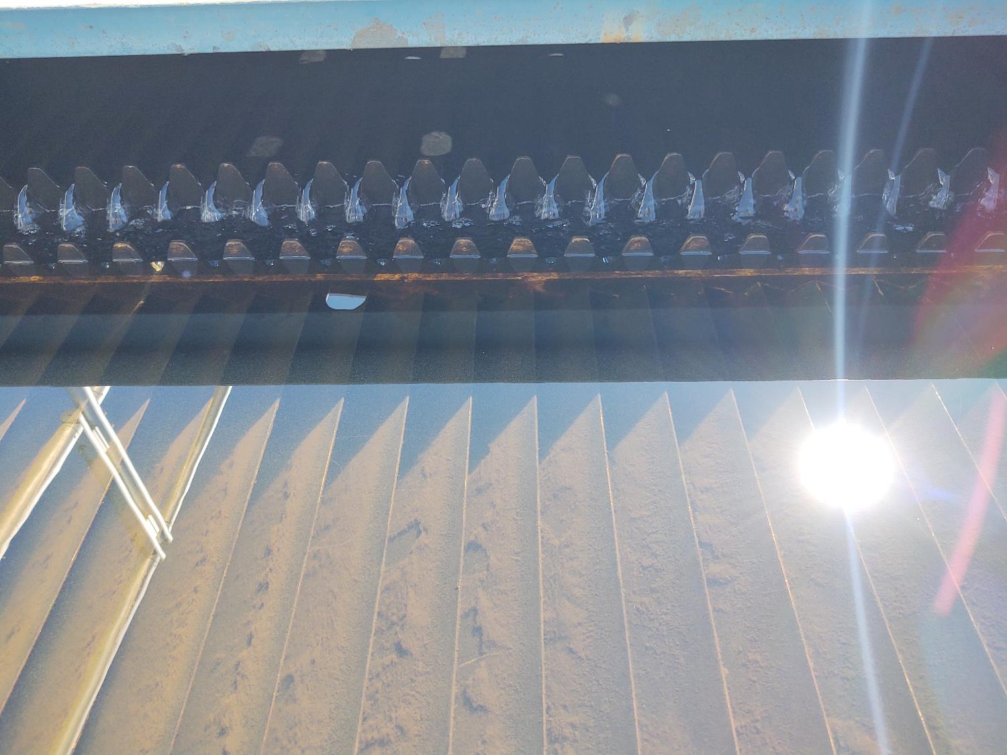
Plate Settler
Overflow weir
Plate Settler

Slide 8
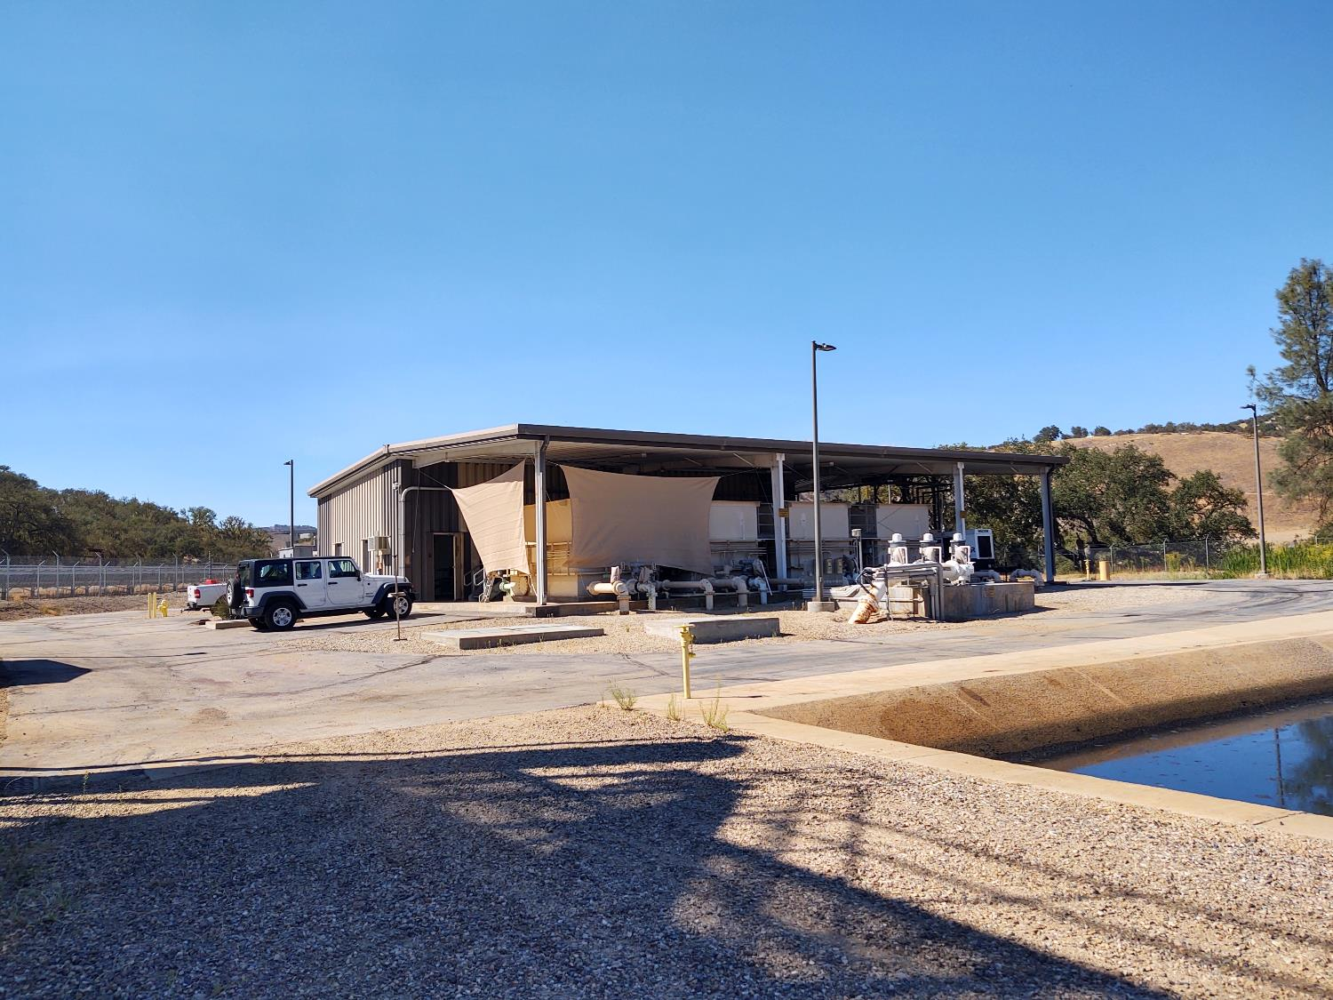
Roberts Filtration Plant
4 x Trains (350 gpm per skid)

Slide 9
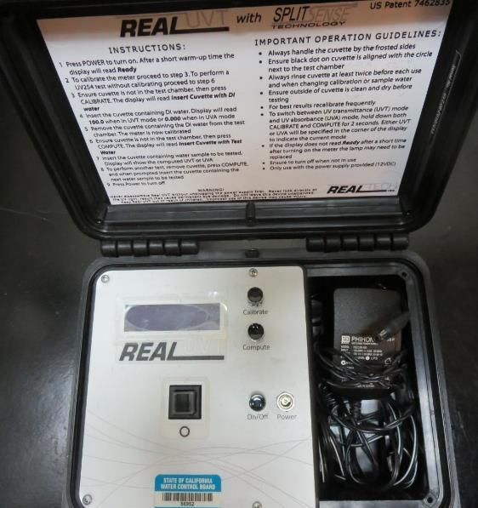
UVT/UVA, pathlength 10 mm
UV transmittance (UVT) is a measurement of the amount of ultraviolet light (254 nm) that passes through a water sample compared to the amount of light that passes through a pure water sample. The measurement is expressed as % UVT.
%UVT = 10^{(-UVA)} x 100%
UV absorbance (UVA) is calculated as a relative measure of the amount of light absorbed by a water sample compared with the amount of light absorbed by a pure water sample.
UVA = -log(%UVT/100)

Slide 10
Heritage Ranch CSD, September 27, 2022
Treatment Plant: Plate Settlers followed by Roberts Filtration
Source Water Characteristics,
Source
pH: 7.64
Alkalinity: 108 mg/L as CaCO₃
Turbidity: 4.3 NTU
UVT: 65.7%,
UVA: 0.181/cm
0.4 um Filtered
Turbidity: 0.38 NTU
UVT: 68.8%,
UVA: 0.162/cm
Post Plate Settler
3.4 - 3.6 NTU
(applied to Roberts Filtration Plant)
Plant Filtrate Water
pH: 7.41
Alkalinity: 99 mg/L as CaCO₃
Turbidity: 0.12 NTU
UVT: 83.1%,
UVA: 0.080/cm

Slide 11
Applied Coagulants for Jar Testing (1)
Aluminum Sulfate (Product)
Al₂(SO₄)₃*14.3H₂0 (Liquid)
48% Aluminum Sulfate
52% Water
8.2% Al₂O₃
4.3% Al
0% Basicity
SG = 1.32
NSF limit: 400 mg/L (product)
As hydrated Al₂(SO₄)₃*14.3H₂0
17% Al₂O₃
Brenntag (559-485-4150)
Praestol organic polymer 186K
SG = 1.1
Product Viscosity: 60-180 centipoise
Molecular Weight: 150,000 g/moles
pDADMAC (20% active, 80% H₂O)
NSF limit: 50 mg/L (product)
Product dose 5 mg/L = 1 mg/L pDADMAC active

Slide 12
Applied Coagulants for Jar Testing (2)
Pro Pac 9810 (NTU Technologies)
45-50% Aluminum Chlorohydrate
45-50% Water
~22.4% Al₂O₃
~11.9% Al
83% Basicity
5% polyamine (50% water, 50% active polyamines)
SG = 1.25-1.34
NSF limit: 200 mg/L as Product;
Product dose 40 mg/L = 1 mg/L polyamines active
Pro Pac 9890 (NTU Technologies)
45-50% Aluminum Chlorohydrate
45-50% Water
~18.9% Al₂O₃
~10% Al
83% Basicity
5% polyamine (50% water, 50% active polyamines)
SG = 1.25-1.34
NSF limit: 200 mg/L as Product;
Product dose 40 mg/L = 1 mg/L polyamines active

Slide 13
Applied Coagulants for Jar Testing (3)
Pro Pac 9800 (NTU Technologies)
50% Aluminum Chlorohydrate
50% Water
23.62% Al₂O₃
12.5% Al
83% Basicity
SG = 1.25-1.34
NSF limit: 250 mg/L as Product;

Slide 14
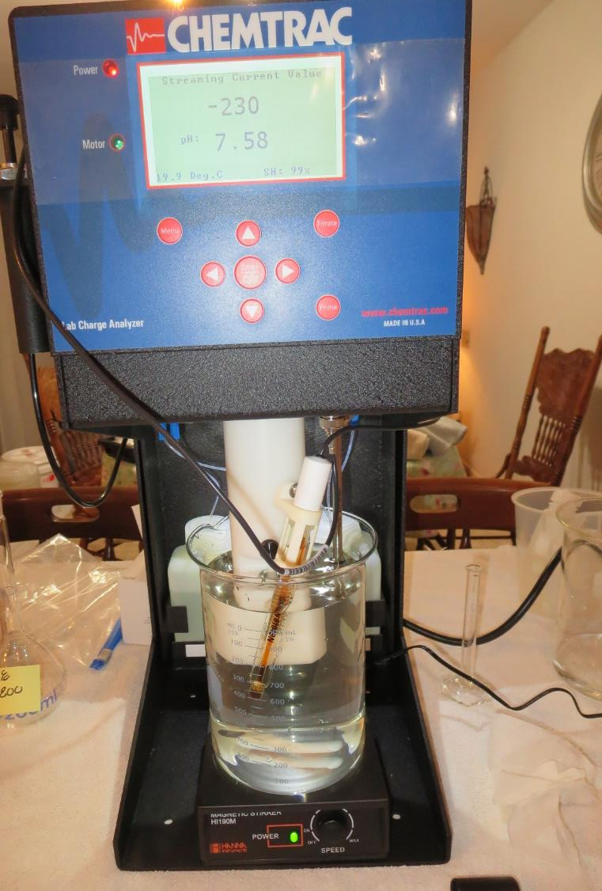
Laboratory Charge Analyzer
LCA: Used to determine coagulant demand of a source water entering the treatment plant.
Source pH: 7.64
LCA #1: Alum: 47 mg/L as hydrated
pH adjusted to 6.6 with acetic acid
LCA #2: 9800: 63 mg/L
No pH adjustment

Slide 15
Coagulant Information
Unless stated otherwise, all coagulant doses are reported as Product (100% strength).
Aluminum Sulfate doses are reported as hydrated Al₂(SO₄)₃*14.3H₂0.
Preparation of coagulant stock solutions are generally 1.0 and/or 0.1 percent strength using 100 and/or 200 mL volumetric flasks.
Finnpipette F2 variable volume pipette, capacity 100-1000 micro liters is used for stock solution preparation and coagulant aid jar test dosing.
Finnpipette F2 variable volume pipette, capacity 0.5-5 mL is used for primary coagulant jar test dosing.

Slide 16
Source Water (pH: 7.64, Alkalinity: 108 mg/L)
Coagulant | Chemical Dose, mg/L | Alkalinity Consumed mg/L as CaCO₃ | Treated Water Alkalinity mg/L as CaCO₃ | Treated Water pH
Alum | 10 | 5 | 103 | 7.40
Alum | 15 | 7.5 | 100.5 | 7.25
Alum | 40 | 20 | 88 | 6.97
Alum | 70 | 35.1 | 73 | 6.72
Alum | 100 | 50.1 | 58 | 6.54
Alum/9890 | 40/10 | 21 | 87 | 7.05
Alum/9890 | 60/10 | 31 | 77 | 6.87
Alum/9890 | 80/10 | 41 | 67 | 6.70
9810 | 70 | 7.9 | 100 | 7.42
9810 | 90 | 10.1 | 98 | 7.38

Slide 17
Heritage Ranch CSD; Source Well 01 (Nacimiento River)
Summary of Plant Coagulant/Dose Jar vs. Optimum Dose and Coagulants
Jar# | Na- MnO₄ mg/L | Alum (dry) mg/L | 186K pDADMAC mg/L | 9890 mg/L | 9800 mg/L | 9810 mg/L | Filtrate NTU | Filtrate %UVT | Filtrate UVA/cm | %UVA Re- duction | Settle NTU 25 min
65 | 1.2 | 15 | 6.0 | - | - | - | 0.09 | 82.5 | 0.083 | 48.8 | 3.6
vs.
17 | 0 | 100 | 0 | - | - | - | 0.06 | 91.1 | 0.040 | 75.3 | 1.3
66 | 1.2 | 100 | 6.0 | - | - | - | 0.07 | 91.3 | 0.039 | 75.9 | 1.5
55 | 1.2 | 60 | - | 10 | - | - | 0.06 | 89.9 | 0.045 | 72.2 | 1.3
11 | 0 | - | - | - | 80 | - | 0.05 | 90.3 | 0.044 | 72.8 | 1.2
50 | 0 | - | - | - | - | 70 | 0.05 | 90.9 | 0.041 | 74.7 | 0.80
49 | 1.2 | - | - | - | - | 70 | 0.05 | 90.1 | 0.037 | 77.2 | 0.49
16 | 0 | - | - | - | - | 90 | 0.05 | 91.4 | 0.038 | 76.5 | 0.57
52 | 1.2 | - | - |  |  | 90 | 0.06 | 92.3 | 0.034 | 79.0 | 0.45

Slide 18
Heritage Ranch CSD; Source Well 01; Jar Test 1 - 8 Results
Flash Mix 200 RPM (30 sec); Floc Mix 30 RPM (5 min)
Jar# | Alum (dry) mg/L | Filtrate NTU | Filtrate %UVT | Filtrate UVA/cm | %UVA Reduction | Settle NTU 25 min
J1 | 20 | 0.63 | 77.9 | 0.108 | 34.6 | 6.3
J2 | 30 | 0.81 | 77.1 | 0.112 | 30.9 | 6.1
J3 | 40 | 0.72 | 80.5 | 0.094 | 42.0 | 5.6
J4 | 50 | 0.12 | 86.1 | 0.064 | 60.5 | 2.5
J5 | 60 | 0.18 | 87.1 | 0.059 | 63.6 | 2.2
J6 | 70 | 0.12 | 87.7 | 0.056 | 65.4 | 2.0
J7 | 80 | 0.14 | 88.3 | 0.053 | 67.3 | 2.2
J8 | 90 | 0.14 | 89.3 | 0.049 | 69.8 | 2.2

Slide 19
Heritage Ranch CSD; Source Well 01; Jar Test 9 - 16 Results
Flash Mix 200 RPM (30 sec); Floc Mix 30 RPM (5 min)
Jar# | 9800 mg/L | 9810 mg/L | Filtrate NTU | Filtrate %UVT | Filtrate UVA/cm | %UVA Reduction | Settle NTU 25 min
J9 | 60 | - | 0.06 | 89.1 | 0.050 | 69.1 | 1.7
J10 | 70 | - | 0.05 | 89.9 | 0.046 | 71.6 | 1.2
J11 | 80 | - | 0.05 | 90.3 | 0.044 | 72.8 | 1.2
J12 | 90 | - | 0.07 | 90.5 | 0.043 | 73.5 | 1.4
J13 | - | 60 | 0.05 | 90.0 | 0.045 | 72.2 | 0.72
J14 | - | 70 | 0.12 | 90.1 | 0.045 | 72.2 | 0.46
J15 | - | 80 | 0.05 | 91.1 | 0.040 | 75.3 | 0.44
J16 | - | 90 | 0.05 | 91.4 | 0.038 | 76.5 | 0.57

Slide 20
Heritage Ranch CSD; Source Well 01; Jar Test 17 - 24 Results
Flash Mix 200 RPM (30 sec); Floc Mix 30 RPM (5 min)
Jar# | Alum (dry) mg/L | 186K pDADMAC mg/L | Filtrate NTU | Filtrate %UVT | Filtrate UVA/cm | %UVA Reduction | Settle NTU 25 min
J17 | 100 | - | 0.06 | 91.1 | 0.040 | 75.3 | 1.3
J18 | 110 | - | 0.07 | 91.0 | 0.040 | 75.3 | 1.9
J19 | 120 | - | 0.07 | 91.0 | 0.040 | 75.3 | 2.6
J20 | 130 | - | 0.07 | 91.2 | 0.039 | 75.9 | 2.1
J21 | 70 | 3.0 | 0.10 | 89.1 | 0.049 | 69.8 | 1.4
J22 | 80 | 3.0 | 0.06 | 89.5 | 0.047 | 71.0 | 1.5
J23 | 90 | 3.0 | 0.10 | 90.4 | 0.043 | 73.5 | 1.5
J24 | 90 | 3.0 | 0.10 | 90.3 | 0.044 | 72.8 | 1.6

Slide 21
Heritage Ranch CSD; Source Well 01; Jar Test 25 - 32 Results
Flash Mix 200 RPM (30 sec); Floc Mix 30 RPM (5 min)
Jar# | PAC mg/L | Alum (dry) mg/L | 186K pDADMAC mg/L | Filtrate NTU | Filtrate %UVT | Filtrate UVA/cm | %UVA Reduction | Settle NTU 25 min
J25 | 0 | 100 | - | 0.16 | 89.2 | 0.049 | 69.8 | 1.7
J26 | 5 | 100 | - | 0.43 | 88.5 | 0.052 | 67.9 | 1.6
J27 | 10 | 100 | - | 0.26 | 89.5 | 0.048 | 70.4 | 2.0
J28 | 15 | 100 | - | 0.22 | 89.7 | 0.047 | 71.0 | 1.1
J29 | 0 | 100 | 3.0 | 0.13 | 90.0 | 0.045 | 72.2 | 1.9
J30 | 5 | 100 | 3.0 | 0.09 | 90.6 | 0.042 | 74.1 | 1.7
J31 | 10 | 100 | 3.0 | 0.05 | 91.0 | 0.041 | 74.7 | 2.1
J32 | 15 | 100 | 3.0 | 0.04 | 91.3 | 0.039 | 75.9 | 1.7

Slide 22
Heritage Ranch CSD; Source Well 01; Jar Test 33 - 36 Results
Flash Mix 200 RPM (30 sec); Floc Mix 30 RPM (5 min)
Jar# | PAC mg/L | 9810 mg/L | Filtrate NTU | Filtrate %UVT | Filtrate UVA/cm | %UVA Reduction | Settle NTU 25 min
J33 | 0 | 80 | 0.13 | 89.9 | 0.046 | 71.6 | 1.1
J34 | 5 | 80 | 0.24 | 88.9 | 0.050 | 65.4 | 1.4
J35 | 10 | 80 | 0.07 | 90.4 | 0.043 | 73.5 | 1.4
J36 | 15 | 80 | 0.09 | 90.5 | 0.043 | 73.5 | 1.3

Slide 23
Heritage Ranch CSD; Source Well 01; Jar Test 37 - 40 Results
Flash Mix 200 RPM (30 sec); Floc Mix 30 RPM (5 min)
Jar# | 961 Mg/L | Filtrate NTU | Filtrate %UVT | Filtrate UVA/cm | %UVA Reduction | Settle NTU 25 min
J37 | 60 | 0.06 | 88.7 | 0.051 | 68.5 | 3.6
J38 | 70 | 0.09 | 89.0 | 0.050 | 69.1 | 6.6
J39 | 80 | 0.36 | 86.7 | 0.062 | 61.7 | 6.3
J40 | 90 | 1.23 | 80.0 | 0.097 | 40.1 | 6.2

Slide 24
Heritage Ranch CSD; Source Well 01; Jar Test 41 - 48 Results
Flash Mix 200 RPM (30 sec); Floc Mix 30 RPM (5 min)
Jar# | NaMnO₄ mg/L | Alum (dry) mg/L | 186K pDADMAC mg/L | Filtrate NTU | Filtrate %UVT | Filtrate UVA/cm | %UVA Reduction | Settle NTU 25 min
J41 | 0 | 100 | 4.0 | 0.06 | 89.8 | 0.046 | 71.6 | 1.1
J42 | 1.0 | 100 | 4.0 | 0.13 | 90.6 | 0.042 | 74.1 | 1.2
J43 | 2.0 | 100 | 4.0 | 0.07 | 90.9 | 0.041 | 74.7 | 1.4
J44 | 3.0 | 100 | 4.0 | 0.10 | 91.0 | 0.041 | 74.7 | 1.7
J45 | 0 | 80 | 4.0 | 0.15 | 89.8 | 0.046 | 71.6 | 1.3
J46 | 1.2 | 80 | 4.0 | 0.15 | 90.4 | 0.043 | 73.5 | 1.5
J47 | 0 | 100 | 4.0 | 0.20 | 90.5 | 0.043 | 73.5 | 1.7
J48 | 1.2 | 100 | 4.0 | 0.13 | 91.5 | 0.038 | 76.5 | 2.1

Slide 25
Heritage Ranch CSD; Source Well 01; Jar Test 49 - 52 Results
Flash Mix 200 RPM (30 sec); Floc Mix 30 RPM (5 min)
Jar# | NaMnO₄ mg/L | 9810 mg/L | Filtrate NTU | Filtrate %UVT | Filtrate UVA/cm | %UVA Reduction | Settle NTU 25 min
J49 | 1.2 | 70 | 0.05 | 91.8 | 0.037 | 77.2 | 0.49
J50 | 0 | 70 | 0.05 | 90.9 | 0.041 | 74.7 | 0.80
J51 | 1.2 | 90 | 0.06 | 92.3 | 0.034 | 79.0 | 0.45
J52 | 0 | 90 | 0.05 | 92.2 | 0.035 | 78.4 | 0.51

Slide 26
Heritage Ranch CSD; Source Well 01; Jar Test 53 - 60 Results
Flash Mix 200 RPM (30 sec); Floc Mix 30 RPM (5 min)
Jar# | NaMnO₄ mg/L | Alum (dry) mg/L | 9890 mg/L | 186K pDADMAC mg/L | Filtrate NTU | Filtrate %UVT | Filtrate UVA/cm | %UVA Reduction | Settle NTU 25 min
J53 | 1.2 | 10 | 10 | - | 0.08 | 83.8 | 0.076 | 53.1 | 3.5
J54 | 1.2 | 40 | 10 | - | 0.12 | 88.3 | 0.053 | 67.3 | 1.3
J55 | 1.2 | 60 | 10 | - | 0.06 | 89.9 | 0.045 | 72.2 | 1.3
J56 | 1.2 | 80 | 10 | - | 0.15 | 90.8 | 0.041 | 74.7 | 1.5
J57 | 1.2 | 15 | - | 2 | 0.78 | 78.5 | 0.105 | 35.2 | 5.6
J58 | 1.2 | 40 | - | 2 | 0.18 | 85.5 | 0.067 | 58.6 | 2.6
J59 | 1.2 | 70 | - | 2 | 0.24 | 88.9 | 0.050 | 69.1 | 1.5
J60 | 1.2 | 100 | - | 2 | 0.09 | 90.9 | 0.041 | 74.7 | 1.5

Slide 27
Heritage Ranch CSD; Source Well 01; Jar Test 61 - 68 Results
Flash Mix 200 RPM (30 sec); Floc Mix 30 RPM (5 min)
Jar# | NaMnO₄ mg/L | Alum (dry) mg/L | 186K pDADMAC mg/L | 9810 mg/L | Filtrate NTU | Filtrate %UVT | Filtrate UVA/cm | %UVA Reduction | Settle NTU 25 min
J61 | 1.2 | 15 | 6.0 | - | 0.05 | 83.0 | 0.080 | 50.6 | 4.9
J62 | 1.2 | 100 | 6.0 | - | 0.07 | 91.7 | 0.037 | 77.2 | 2.1
J63 | 1.2 | - | - | 70 | 0.06 | 90.8 | 0.041 | 74.7 | 0.83
J64 | 1.2 | - | - | 90 | 0.07 | 91.5 | 0.038 | 76.5 | 0.63
J65 | 1.2 | 15 | 6.0 | - | 0.09 | 82.5 | 0.083 | 48.8 | 3.6
J66 | 1.2 | 100 | 6.0 | - | 0.07 | 91.3 | 0.039 | 75.9 | 1.5
J67 | 1.2 | - | - | 70 | 0.05 | 90.1 | 0.045 | 72.2 | 0.41
J68 | 1.2 | - | - | 90 | 0.09 | 90.8 | 0.041 | 74.7 | 0.43

Slide 28
Jars 1-4 Test
Flash Mix 30 Sec (200 RPM)
Floc Mix 5 min (30 RPM)
Applied Chemicals
Alum

Slide 29
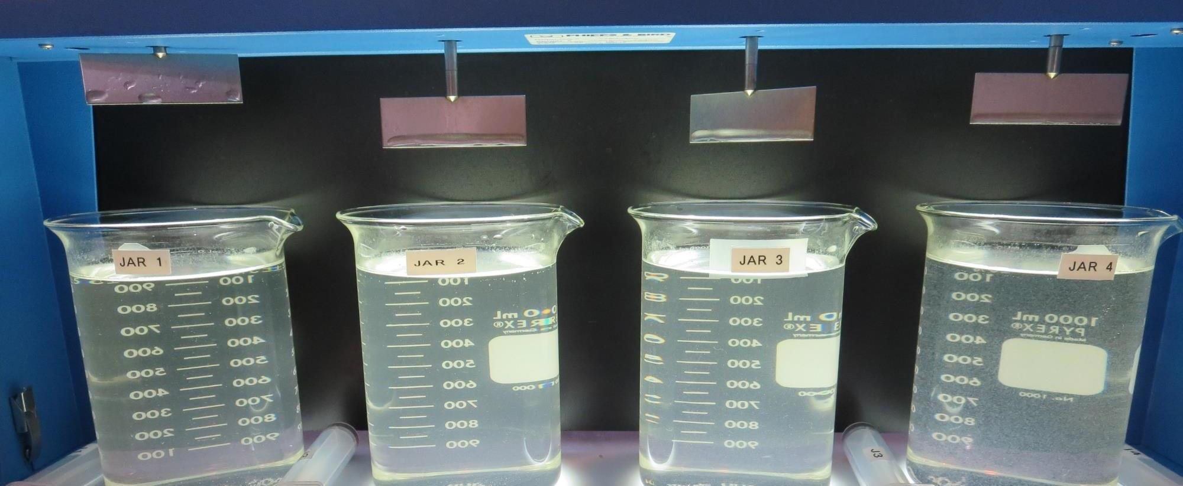
Jars 1-4: End of 5-minute flocculation (30 RPM) duration.
20 mg/L Alum
Filtrate 0.63 NTU
UVT: 77.9%
UVA: 0.108/cm
UVA Reduction 34.6%
Settled: 6.3 NTU
30 mg/L Alum
Filtrate 0.81 NTU
UVT: 77.1%
UVA: 0.112/cm
UVA Reduction 30.9%
Settled: 6.1 NTU
40 mg/L Alum
Filtrate 0.72 NTU
UVT: 80.5%
UVA: 0.094/cm
UVA Reduction 42.0%
Settled: 5.6 NTU
50 mg/L Alum
Filtrate 0.12 NTU
UVT: 86.1%
UVA: 0.064/cm
UVA Reduction 60.5%
Settled: 2.5 NTU

Slide 30
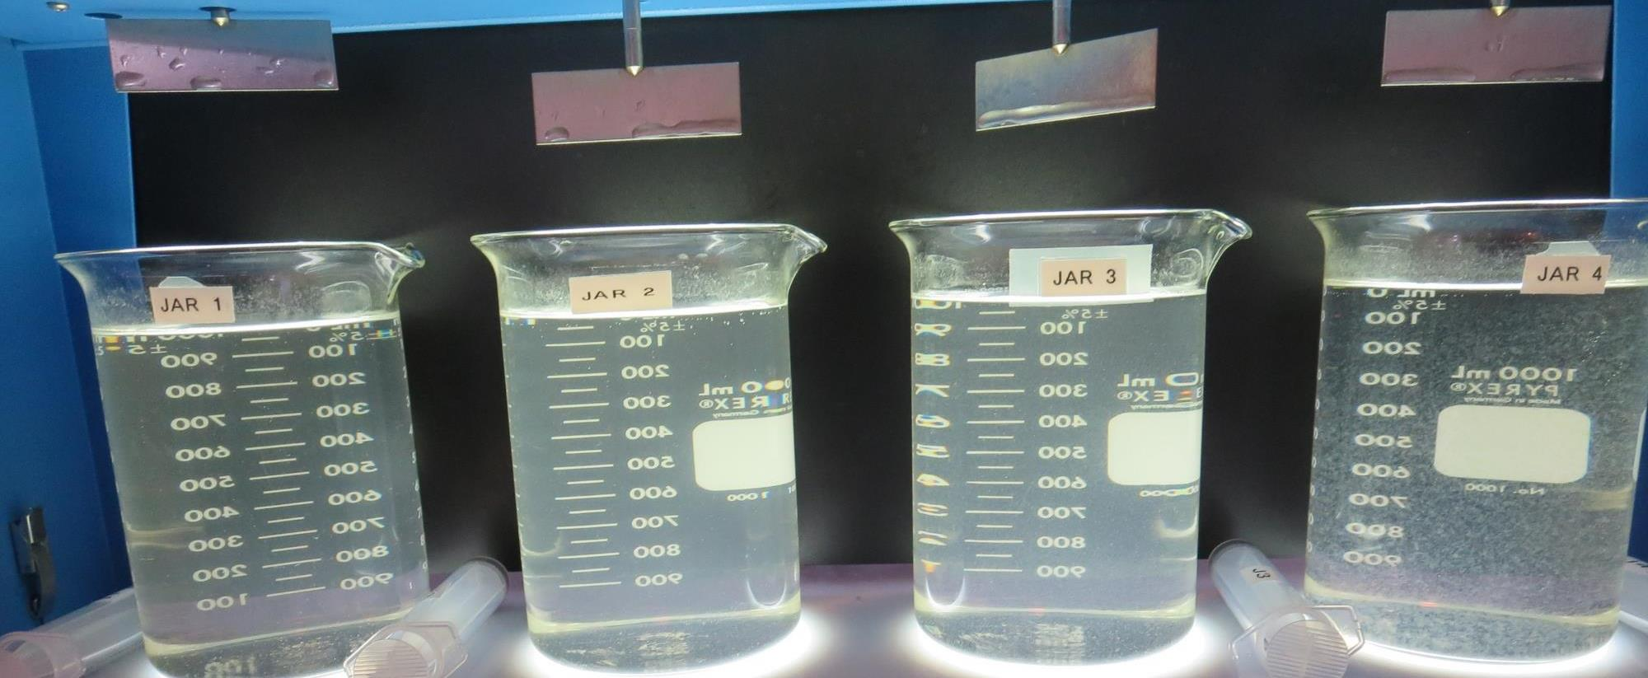
Jars 1-4: After 5 min of settling, 25 mL is syringed for filterability and %UVT/UVA.

Slide 31
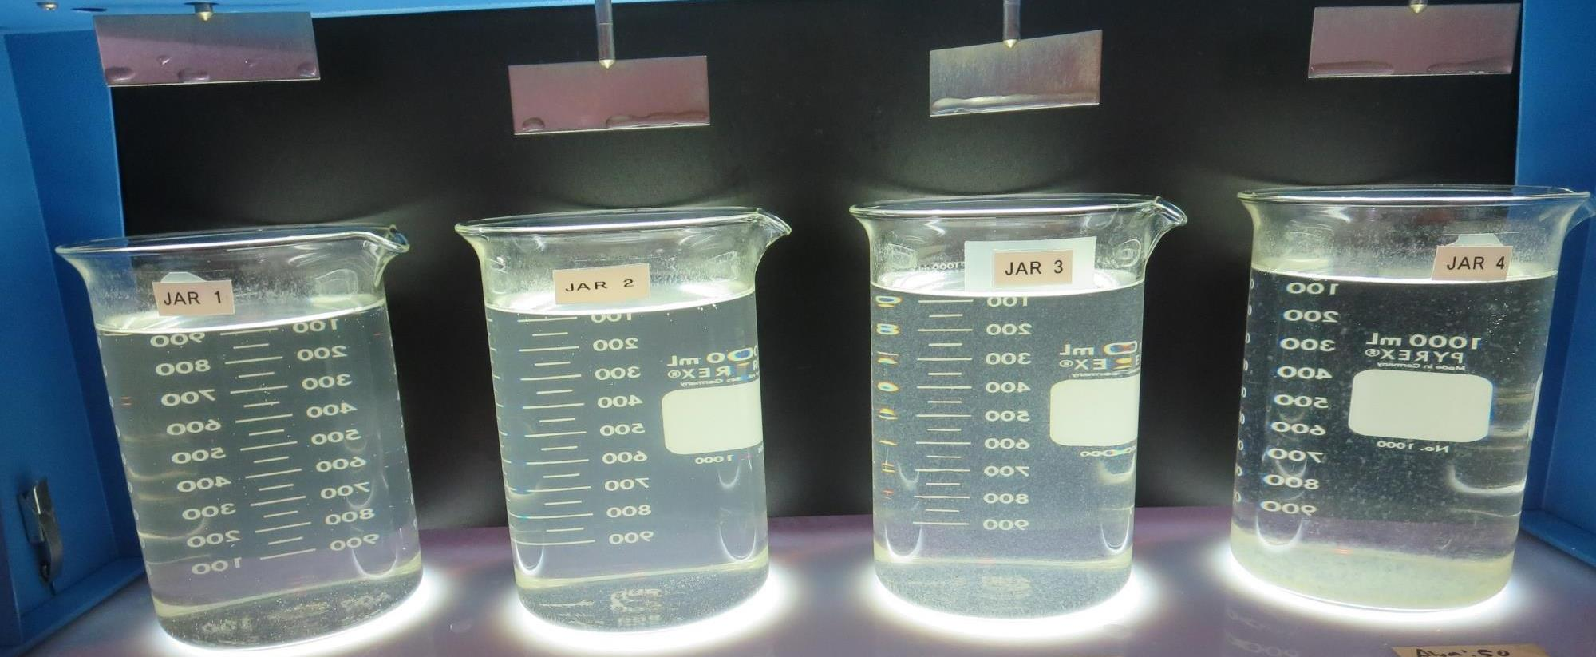
Jars 1-4: After 25-minutes of settling, settled water turbidity is taken.
20 mg/L Alum
Filtrate 0.63 NTU
UVT: 77.9%
UVA: 0.108/cm
UVA Reduction 34.6%
Settled: 6.3 NTU
30 mg/L Alum
Filtrate 0.81 NTU
UVT: 77.1%
UVA: 0.112/cm
UVA Reduction 30.9%
Settled: 6.1 NTU
40 mg/L Alum
Filtrate 0.72 NTU
UVT: 80.5%
UVA: 0.094/cm
UVA Reduction 42.0%
Settled: 5.6 NTU
50 mg/L Alum
Filtrate 0.12 NTU
UVT: 86.1%
UVA: 0.064/cm
UVA Reduction 60.5%
Settled: 2.5 NTU

Slide 32
Jars 5-8 Test
Flash Mix 30 Sec (200 RPM)
Floc Mix 5 min (30 RPM)
Applied Chemicals
Alum

Slide 33
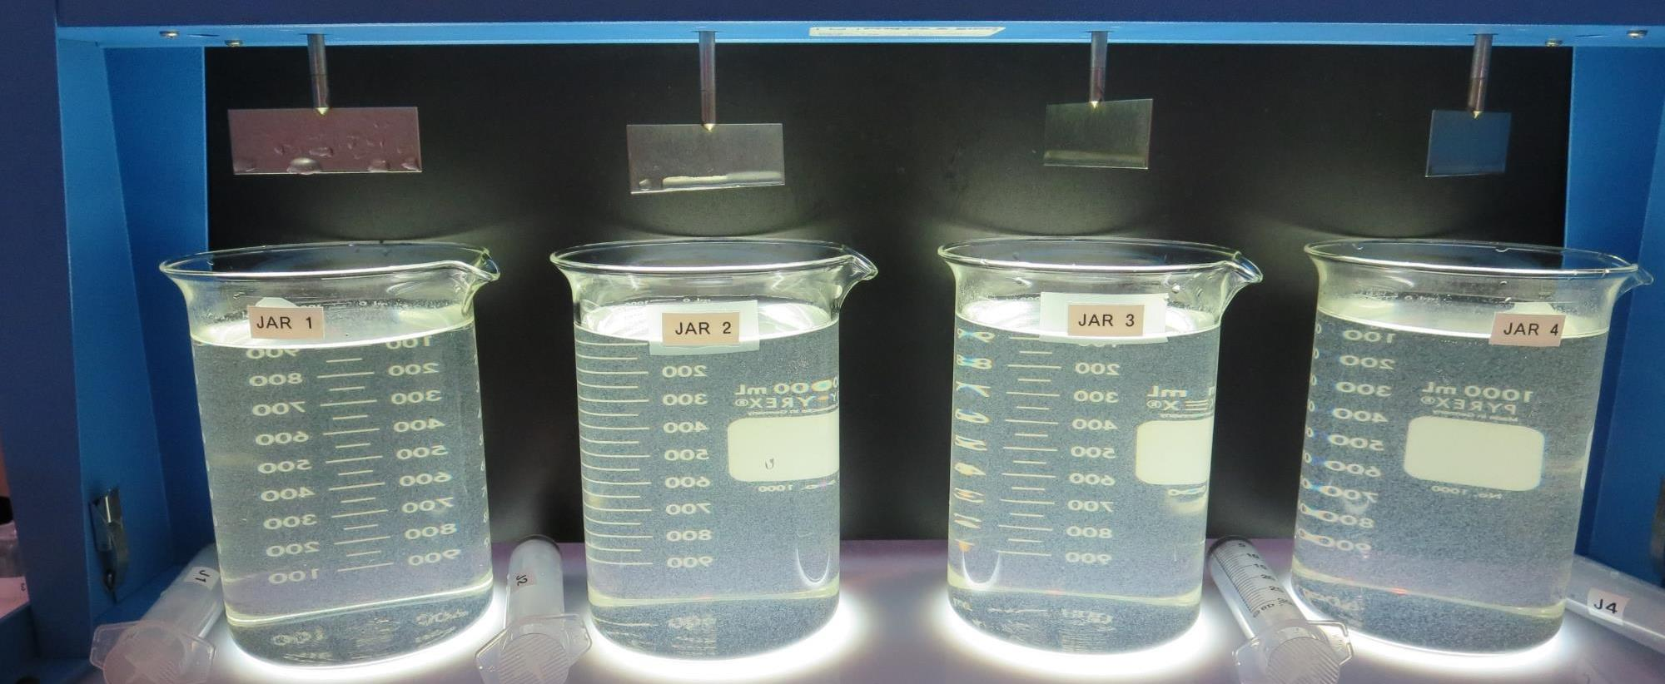
Jars 5-8: End of 5-minute flocculation (30 RPM) duration.
60 mg/L Alum
Filtrate 0.18 NTU
UVT: 87.1%
UVA: 0.058/cm
UVA Reduction 63.6%
Settled: 2.2 NTU
70 mg/L Alum
Filtrate 0.12 NTU
UVT: 87.7%
UVA: 0.053/cm
UVA Reduction 65.4%
Settled: 2.0 NTU
80 mg/L Alum
Filtrate 0.14 NTU
UVT: 88.3%
UVA: 0.052/cm
UVA Reduction 67.3%
Settled: 2.2 NTU
90 mg/L Alum
Filtrate 0.14 NTU
UVT: 89.3%
UVA: 0.046/cm
UVA Reduction 69.8%
Settled: 2.2 NTU

Slide 34
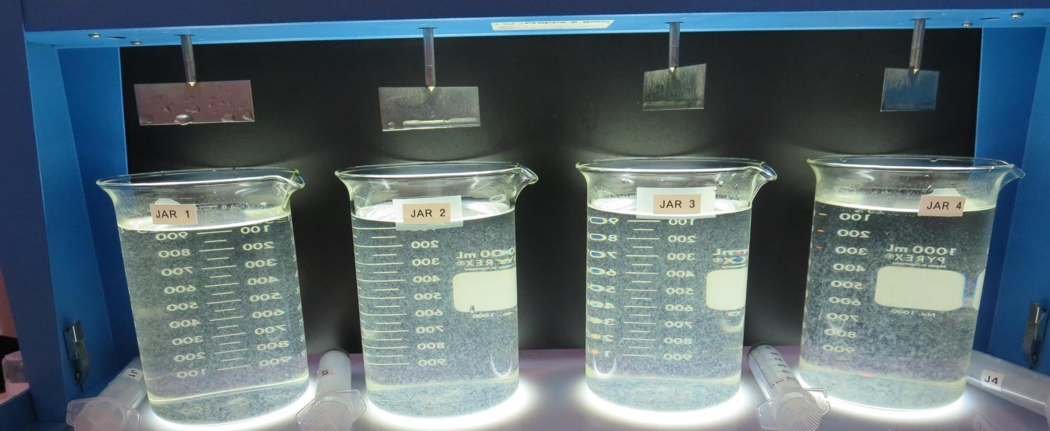
Jars 5-8: After 5 min of settling, 25 mL is syringed for filterability and %UVT/UVA.

Slide 35
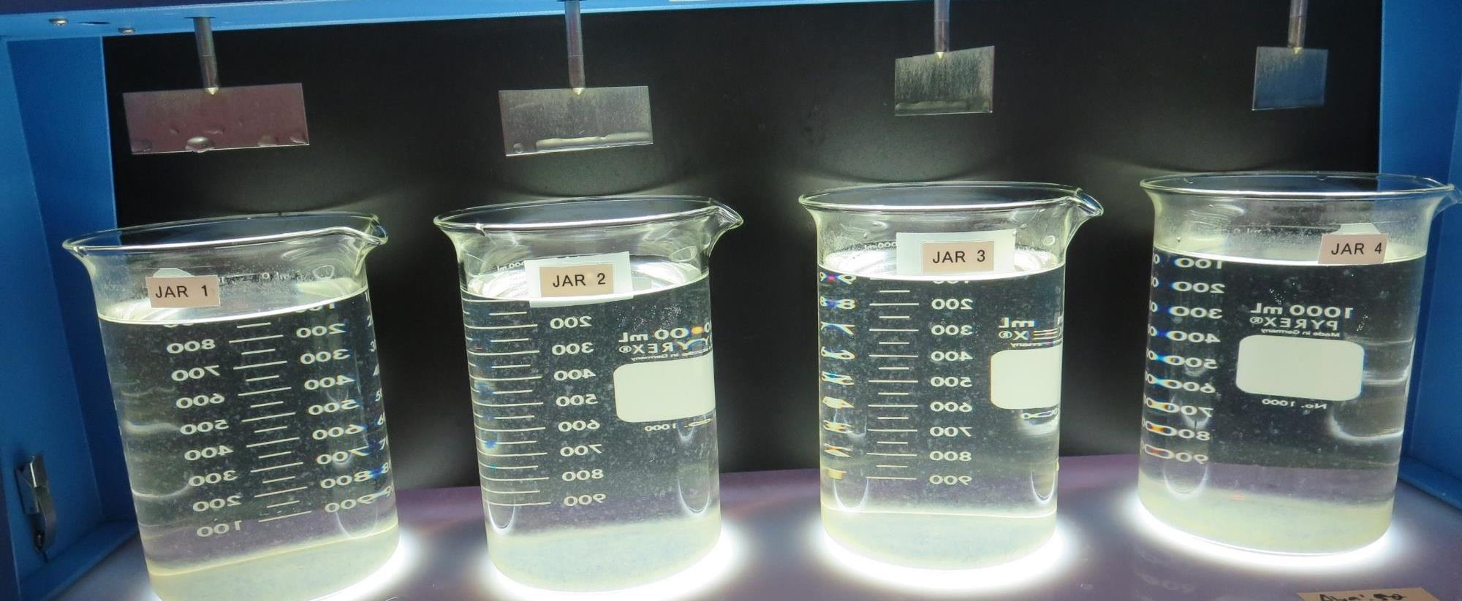
Jars 5-8: After 25-minutes of settling, settled water turbidity is taken.
60 mg/L Alum
Filtrate 0.18 NTU
UVT: 87.1%
UVA: 0.058/cm
UVA Reduction 63.6%
Settled: 2.2 NTU
70 mg/L Alum
Filtrate 0.12 NTU
UVT: 87.7%
UVA: 0.053/cm
UVA Reduction 65.4%
Settled: 2.0 NTU
80 mg/L Alum
Filtrate 0.14 NTU
UVT: 88.3%
UVA: 0.052/cm
UVA Reduction 67.3%
Settled: 2.2 NTU
90 mg/L Alum
Filtrate 0.14 NTU
UVT: 89.3%
UVA: 0.046/cm
UVA Reduction 69.8%
Settled: 2.2 NTU

Slide 36
Jars 9-12 Test
Flash Mix 30 Sec (200 RPM)
Floc Mix 5 min (30 RPM)
Applied Chemicals
ProPac 9800

Slide 37
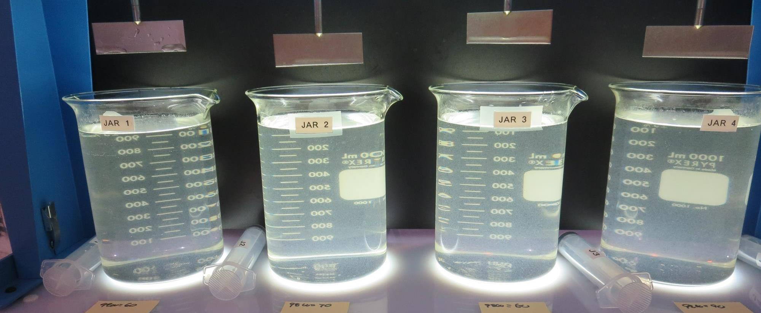
Jars 9-12: End of 5-minute flocculation (30 RPM) duration.
60 mg/L 9800
Filtrate 0.06 NTU
UVT: 89.1%
UVA: 0.050/cm
UVA Reduction 69.1%
Settled: 1.7 NTU
70 mg/L 9800
Filtrate 0.05 NTU
UVT: 89.9%
UVA: 0.046/cm
UVA Reduction 71.6%
Settled: 1.2 NTU
80 mg/L 9800
Filtrate 0.05 NTU
UVT: 90.3%
UVA: 0.044/cm
UVA Reduction 72.8%
Settled: 1.2 NTU
90 mg/L 9800
Filtrate 0.07 NTU
UVT: 90.5%
UVA: 0.043/cm
UVA Reduction 73.5%
Settled: 1.4 NTU

Slide 38
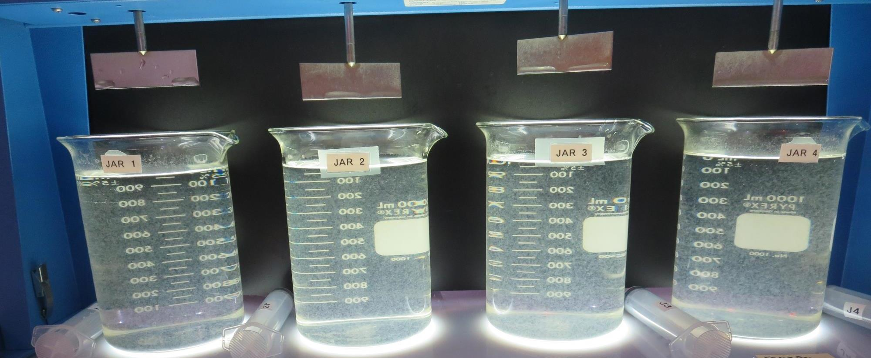
Jars 9-12: After 5 min of settling, 25 mL is syringed for filterability and %UVT/UVA.

Slide 39
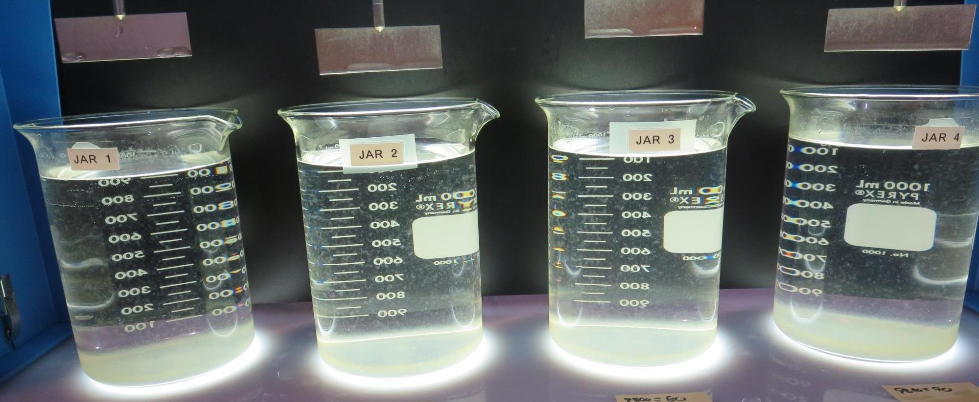
Jars 9-12: After 25-minutes of settling, settled water turbidity is taken.

Slide 40
Jars 13-16 Test
Flash Mix 30 Sec (200 RPM)
Floc Mix 5 min (30 RPM)
Applied Chemicals
ProPac 9810

Slide 41
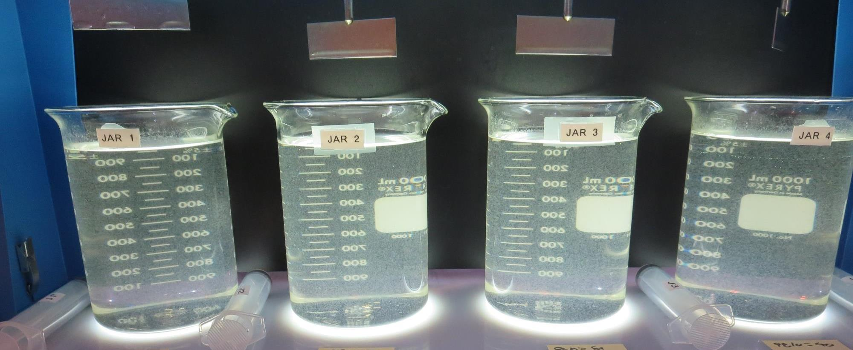
Jars 13-16: End of 5-minute flocculation (30 RPM) duration.
60 mg/L 9810
Filtrate 0.05 NTU
UVT: 90.0%
UVA: 0.045/cm
UVA Reduction 72.2%
Settled: 0.72 NTU
70 mg/L 9810
Filtrate 0.12 NTU
UVT: 90.1%
UVA: 0.045/cm
UVA Reduction 72.2%
Settled: 0.46 NTU
80 mg/L 9810
Filtrate 0.05 NTU
UVT: 91.1%
UVA: 0.040/cm
UVA Reduction 75.3%
Settled: 0.44 NTU
90 mg/L 9810
Filtrate 0.05 NTU
UVT: 91.4%
UVA: 0.038/cm
UVA Reduction 76.5%
Settled: 0.57 NTU

Slide 42
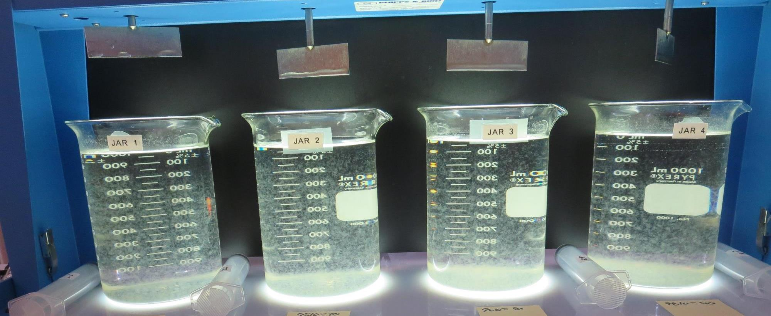
Jars 13-16: After 5 min of settling, 25 mL is syringed for filterability and %UVT/UVA.

Slide 43
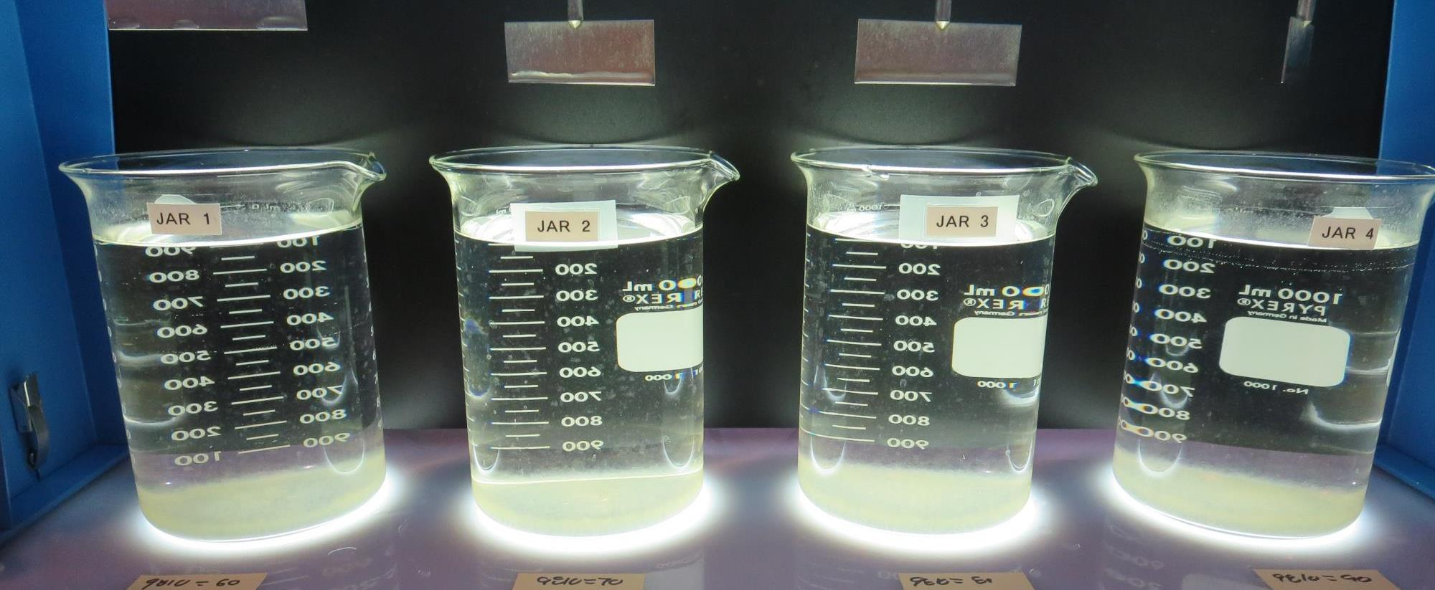
Jars 13-16: After 25-minutes of settling, settled water turbidity is taken.
60 mg/L 9810
Filtrate 0.05 NTU
UVT: 90.0%
UVA: 0.045/cm
UVA Reduction 72.2%
Settled: 0.72 NTU
70 mg/L 9810
Filtrate 0.12 NTU
UVT: 90.1%
UVA: 0.045/cm
UVA Reduction 72.2%
Settled: 0.46 NTU
80 mg/L 9810
Filtrate 0.05 NTU
UVT: 91.1%
UVA: 0.040/cm
UVA Reduction 75.3%
Settled: 0.44 NTU
90 mg/L 9810
Filtrate 0.05 NTU
UVT: 91.4%
UVA: 0.038/cm
UVA Reduction 76.5%
Settled: 0.57 NTU

Slide 44
Jars 17-20 Test
Flash Mix 30 Sec (200 RPM)
Floc Mix 5 min (30 RPM)
Applied Chemicals
Alum

Slide 45
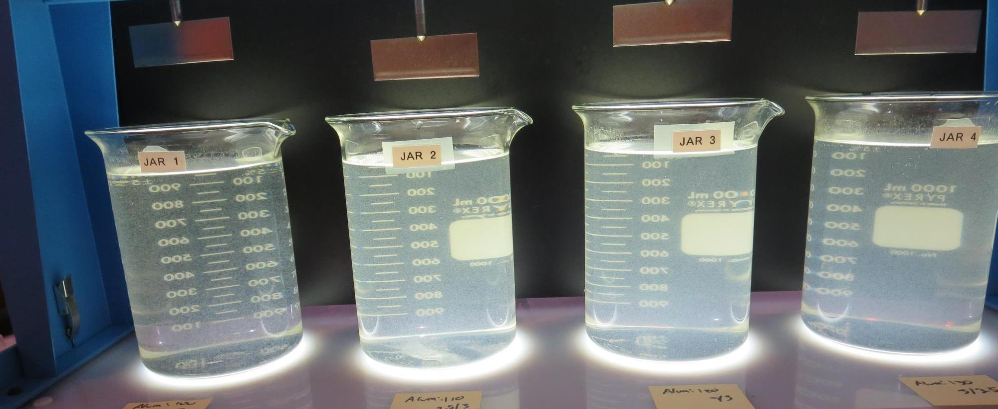
Jars 17-20: End of 5-minute flocculation (30 RPM) duration.
100 mg/L Alum
Filtrate 0.06 NTU
UVT: 91.1%
UVA: 0.040/cm
UVA Reduction 75.3%
Settled: 1.3 NTU
110 mg/L Alum
Filtrate 0.07 NTU
UVT: 91.0%
UVA: 0.040/cm
UVA Reduction 75.3%
Settled: 1.9 NTU
120 mg/L Alum
Filtrate 0.07 NTU
UVT: 91.0%
UVA: 0.040/cm
UVA Reduction 75.3%
Settled: 2.6 NTU
130 mg/L Alum
Filtrate 0.07 NTU
UVT: 91.2%
UVA: 0.039/cm
UVA Reduction 75.9%
Settled: 2.1 NTU

Slide 46
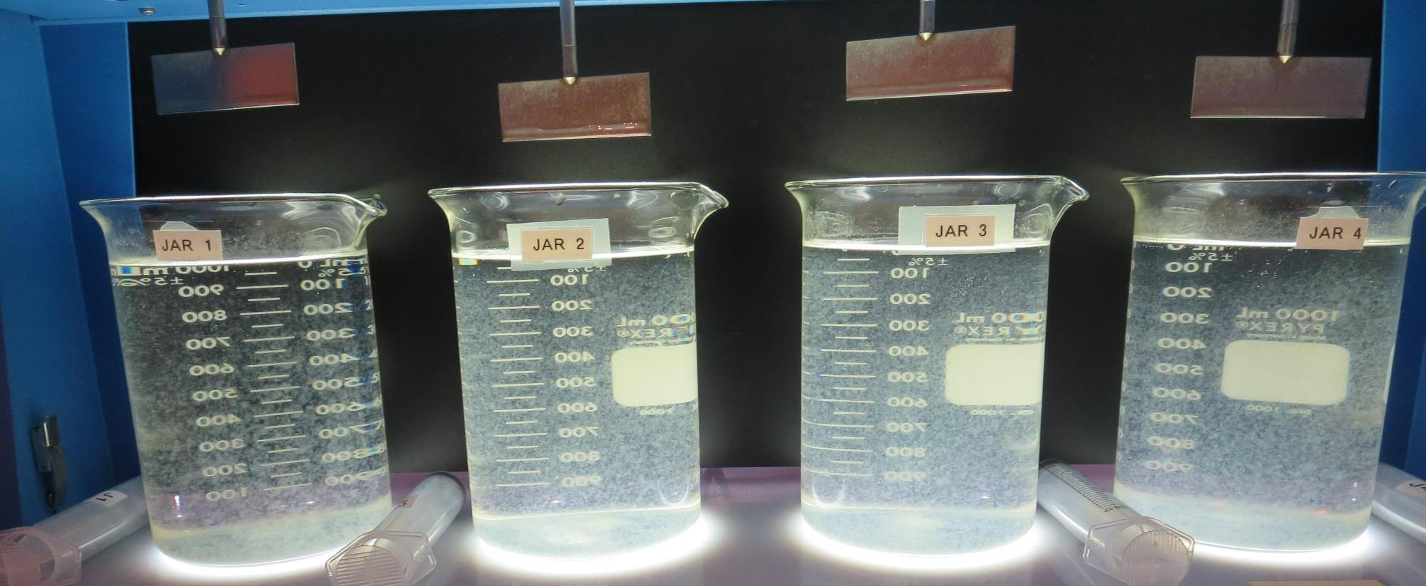
Jars 17-20: After 5 min of settling, 25 mL is syringed for filterability and %UVT/UVA.

Slide 47
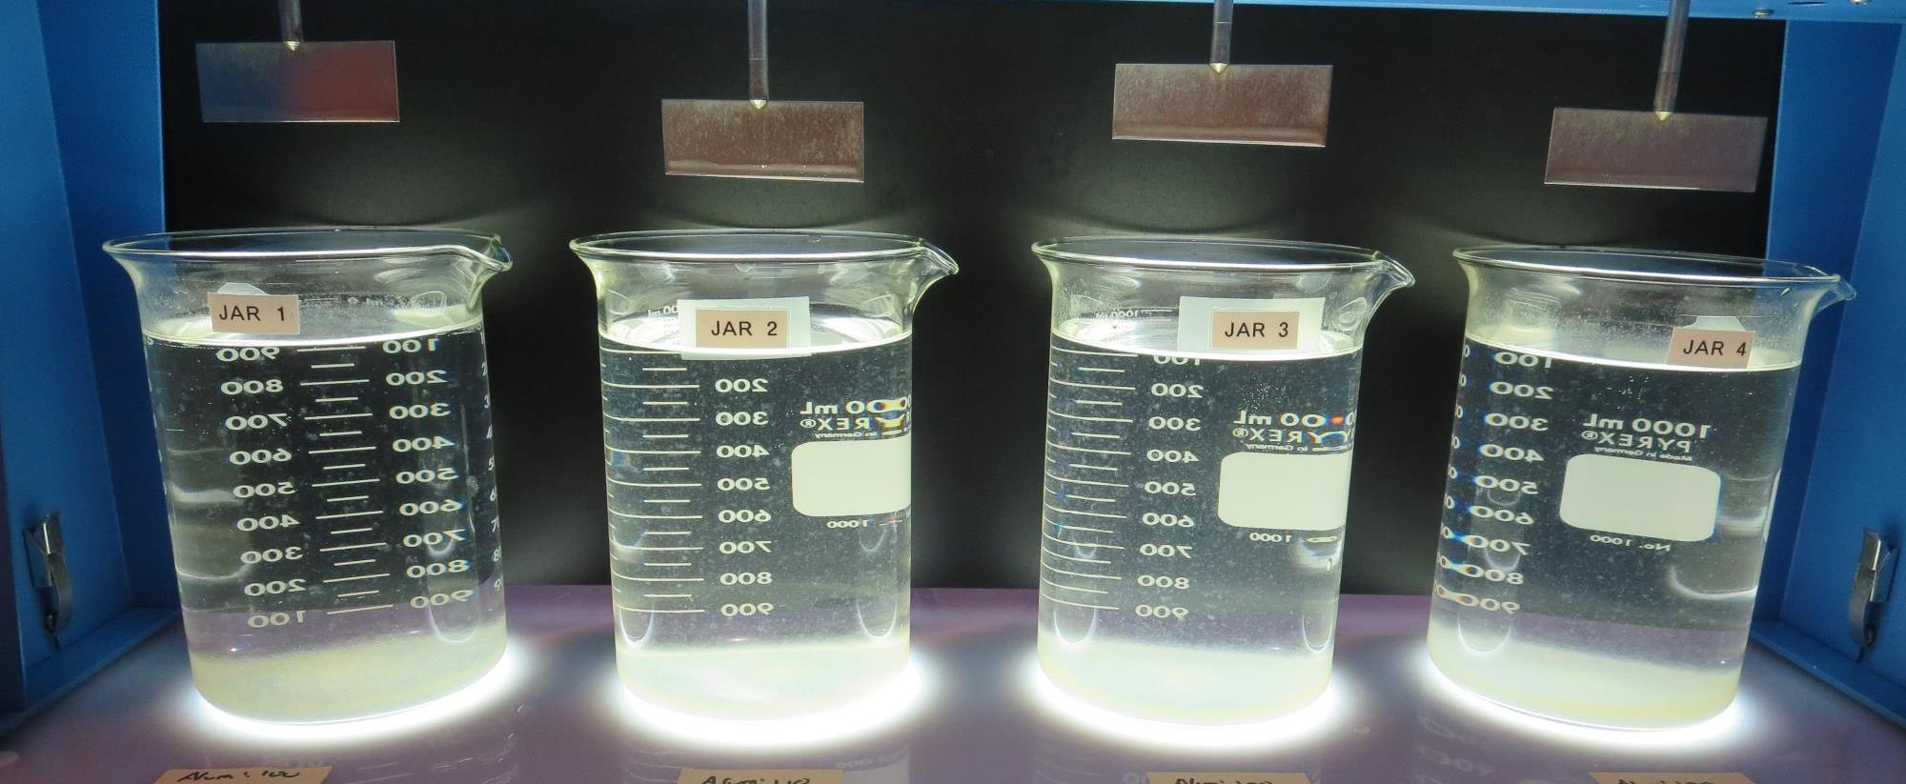
Jars 17-20: After 25-minutes of settling, settled water turbidity is taken.
100 mg/L Alum
Filtrate 0.06 NTU
UVT: 91.1%
UVA: 0.040/cm
UVA Reduction 75.3%
Settled: 1.3 NTU
110 mg/L Alum
Filtrate 0.07 NTU
UVT: 91.0%
UVA: 0.040/cm
UVA Reduction 75.3%
Settled: 1.9 NTU
120 mg/L Alum
Filtrate 0.07 NTU
UVT: 91.0%
UVA: 0.040/cm
UVA Reduction 75.3%
Settled: 2.6 NTU
130 mg/L Alum
Filtrate 0.07 NTU
UVT: 91.2%
UVA: 0.039/cm
UVA Reduction 75.9%
Settled: 2.1 NTU

Slide 48
Jars 21-24 Test
Flash Mix 30 Sec (200 RPM)
Floc Mix 5 min (30 RPM)
Applied Chemicals
Alum
186K pDADMAC

Slide 49
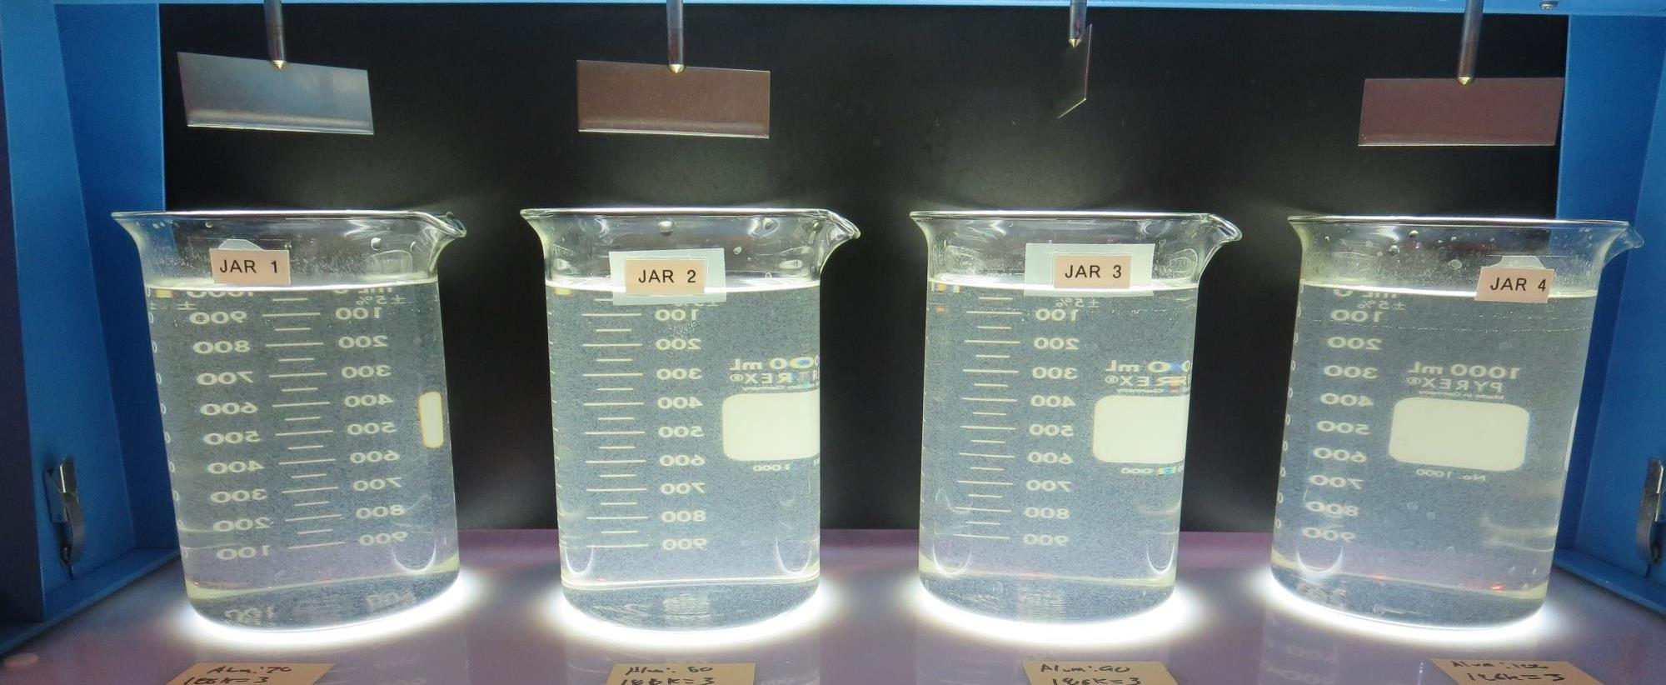
Jars 21-24: End of 5-minute flocculation (30 RPM) duration.
70 mg/L Alum
3.0 mg/L 186K pDADMAC
Filtrate 0.10 NTU
UVT: 89.1%
UVA: 0.049/cm
UVA Reduction 69.8%
Settled: 1.4 NTU
70 mg/L Alum
3.0 mg/L 186K pDADMAC
Filtrate 0.06 NTU
UVT: 89.5%
UVA: 0.047/cm
UVA Reduction 71.0%
Settled: 1.5 NTU
70 mg/L Alum
3.0 mg/L 186K pDADMAC
Filtrate 0.10 NTU
UVT: 90.4%
UVA: 0.043/cm
UVA Reduction 73.5%
Settled: 1.5 NTU
70 mg/L Alum
3.0 mg/L 186K pDADMAC
Filtrate 0.10 NTU
UVT: 90.3%
UVA: 0.044/cm
UVA Reduction 72.8%
Settled: 1.6 NTU

Slide 50
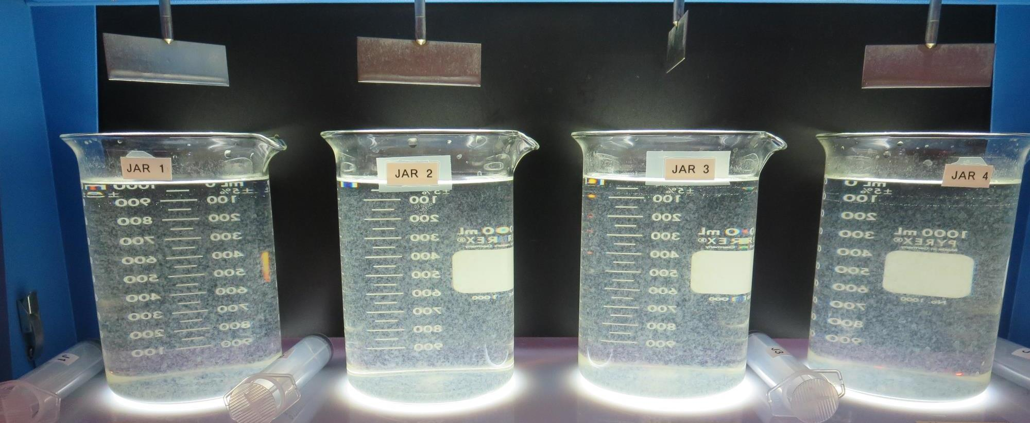
Jars 21-24: After 5 min of settling, 25 mL is syringed for filterability and %UVT/UVA.

Slide 51
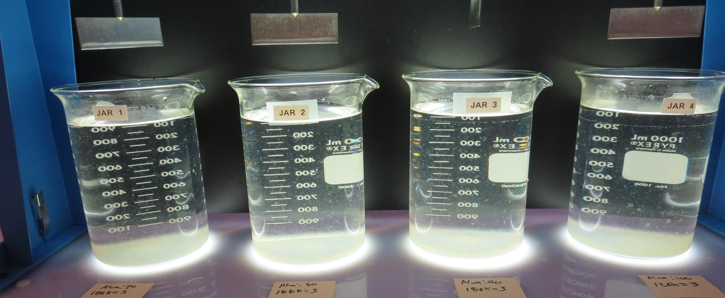
Jars 21-24: After 25-minutes of settling, settled water turbidity is taken.
70 mg/L Alum
3.0 mg/L 186K pDADMAC
Filtrate 0.10 NTU
UVT: 89.1%
UVA: 0.049/cm
UVA Reduction 69.8%
Settled: 1.4 NTU
70 mg/L Alum
3.0 mg/L 186K pDADMAC
Filtrate 0.06 NTU
UVT: 89.5%
UVA: 0.047/cm
UVA Reduction 71.0%
Settled: 1.5 NTU
70 mg/L Alum
3.0 mg/L 186K pDADMAC
Filtrate 0.10 NTU
UVT: 90.4%
UVA: 0.043/cm
UVA Reduction 73.5%
Settled: 1.5 NTU
70 mg/L Alum
3.0 mg/L 186K pDADMAC
Filtrate 0.10 NTU
UVT: 90.3%
UVA: 0.044/cm
UVA Reduction 72.8%
Settled: 1.6 NTU

Slide 52
Jars 25-28 Test
Flash Mix 30 Sec (200 RPM)
Floc Mix 5 min (30 RPM)
Applied Chemicals
Alum

Slide 53
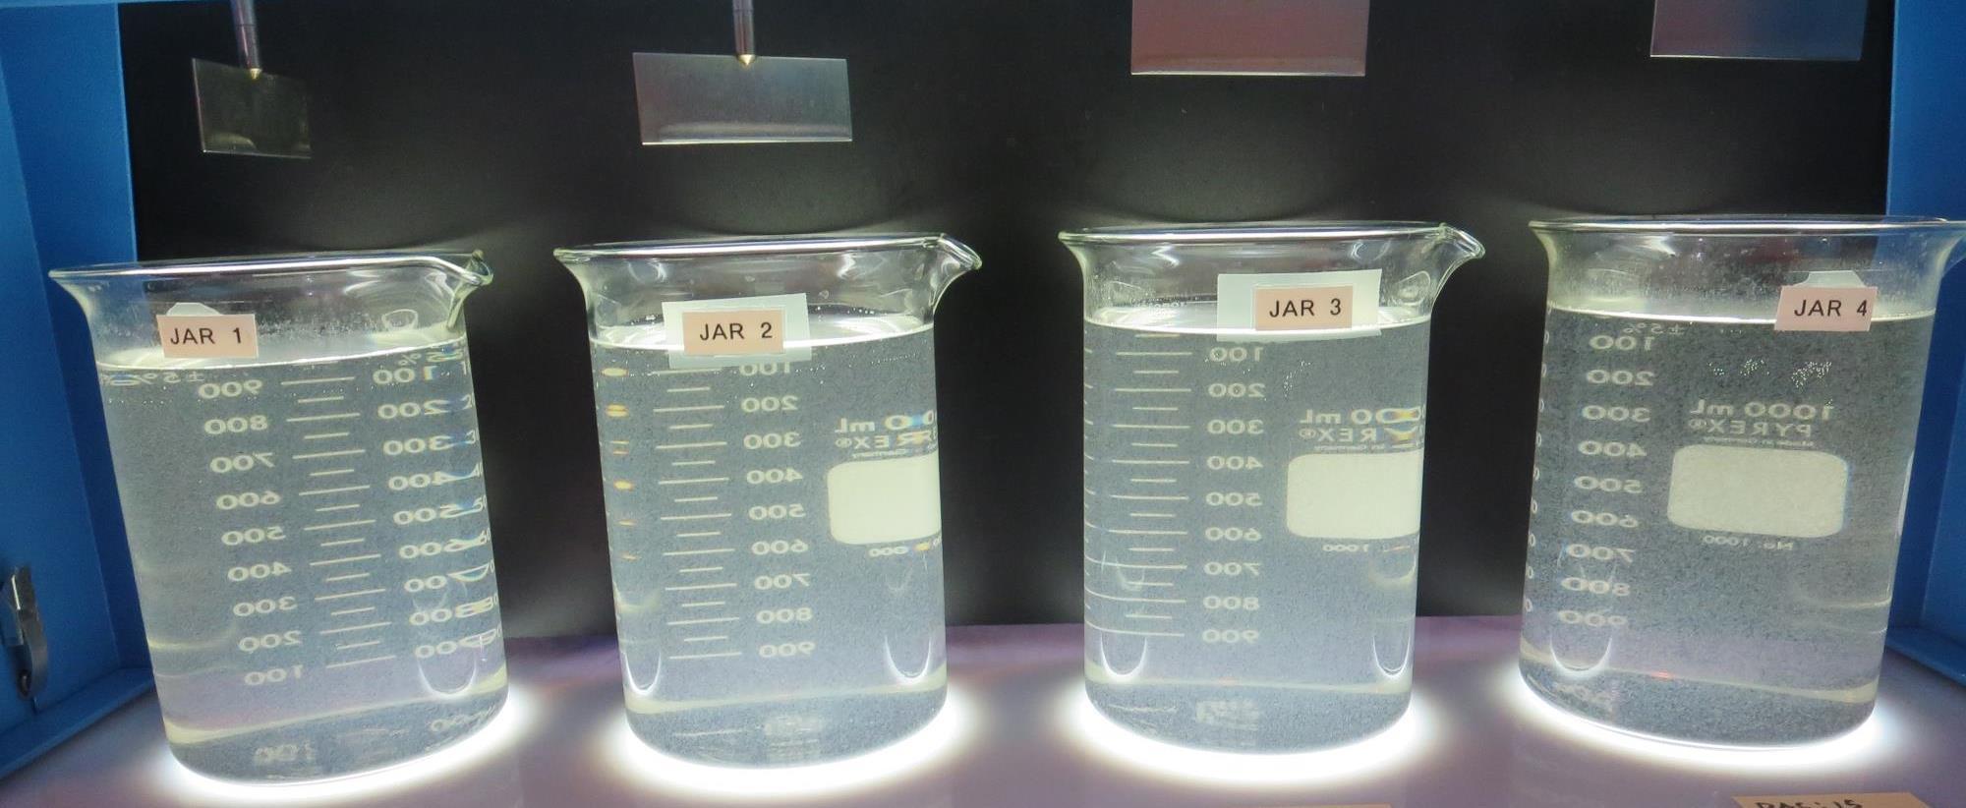
Jars 25-28: End of 5-minute flocculation (30 RPM) duration.
0 mg/L PAC
100 mg/L Alum
Filtrate 0.16 NTU
UVT: 89.2%
UVA: 0.049/cm
UVA Reduction 69.8%
Settled: 1.7 NTU
5 mg/L PAC
100 mg/L Alum
Filtrate 0.43 NTU
UVT: 88.5%
UVA: 0.052/cm
UVA Reduction 67.9%
Settled: 1.6 NTU
10 mg/L PAC
100 mg/L Alum
Filtrate 0.26 NTU
UVT: 89.5%
UVA: 0.048/cm
UVA Reduction 70.4%
Settled: 2.0 NTU
15 mg/L PAC
100 mg/L Alum
Filtrate 0.22 NTU
UVT: 89.7%
UVA: 0.047/cm
UVA Reduction 71.0%
Settled: 1.1 NTU

Slide 54
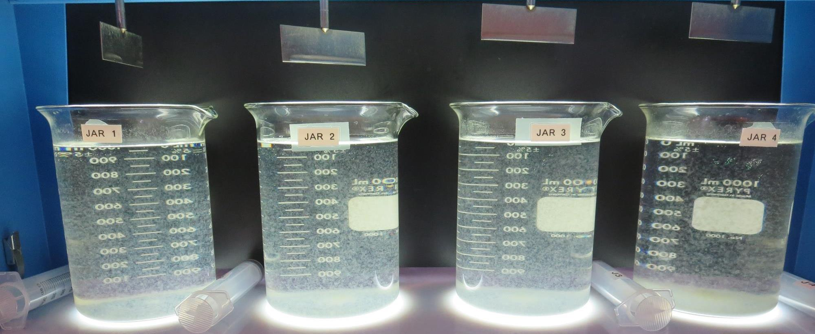
Jars 25-28: After 5 min of settling, 25 mL is syringed for filterability and %UVT/UVA.

Slide 55
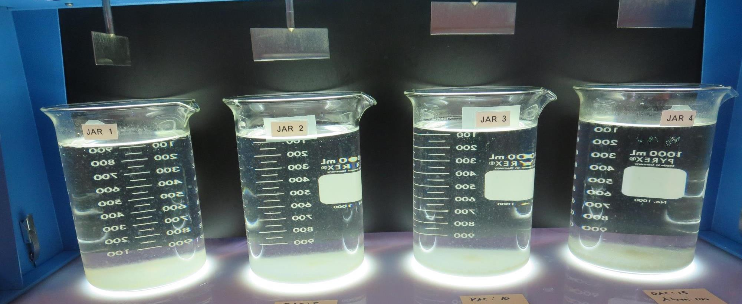
Jars 25-28: After 25-minutes of settling, settled water turbidity is taken.
0 mg/L PAC
100 mg/L Alum
Filtrate 0.16 NTU
UVT: 89.2%
UVA: 0.049/cm
UVA Reduction 69.8%
Settled: 1.7 NTU
5 mg/L PAC
100 mg/L Alum
Filtrate 0.43 NTU
UVT: 88.5%
UVA: 0.052/cm
UVA Reduction 67.9%
Settled: 1.6 NTU
10 mg/L PAC
100 mg/L Alum
Filtrate 0.26 NTU
UVT: 89.5%
UVA: 0.048/cm
UVA Reduction 70.4%
Settled: 2.0 NTU
15 mg/L PAC
100 mg/L Alum
Filtrate 0.22 NTU
UVT: 89.7%
UVA: 0.047/cm
UVA Reduction 71.0%
Settled: 1.1 NTU

Slide 56
Jars 29-32 Test
Flash Mix 30 Sec (200 RPM)
Floc Mix 5 min (30 RPM)
Applied Chemicals
PAC
Alum
186K pDADMAC

Slide 57
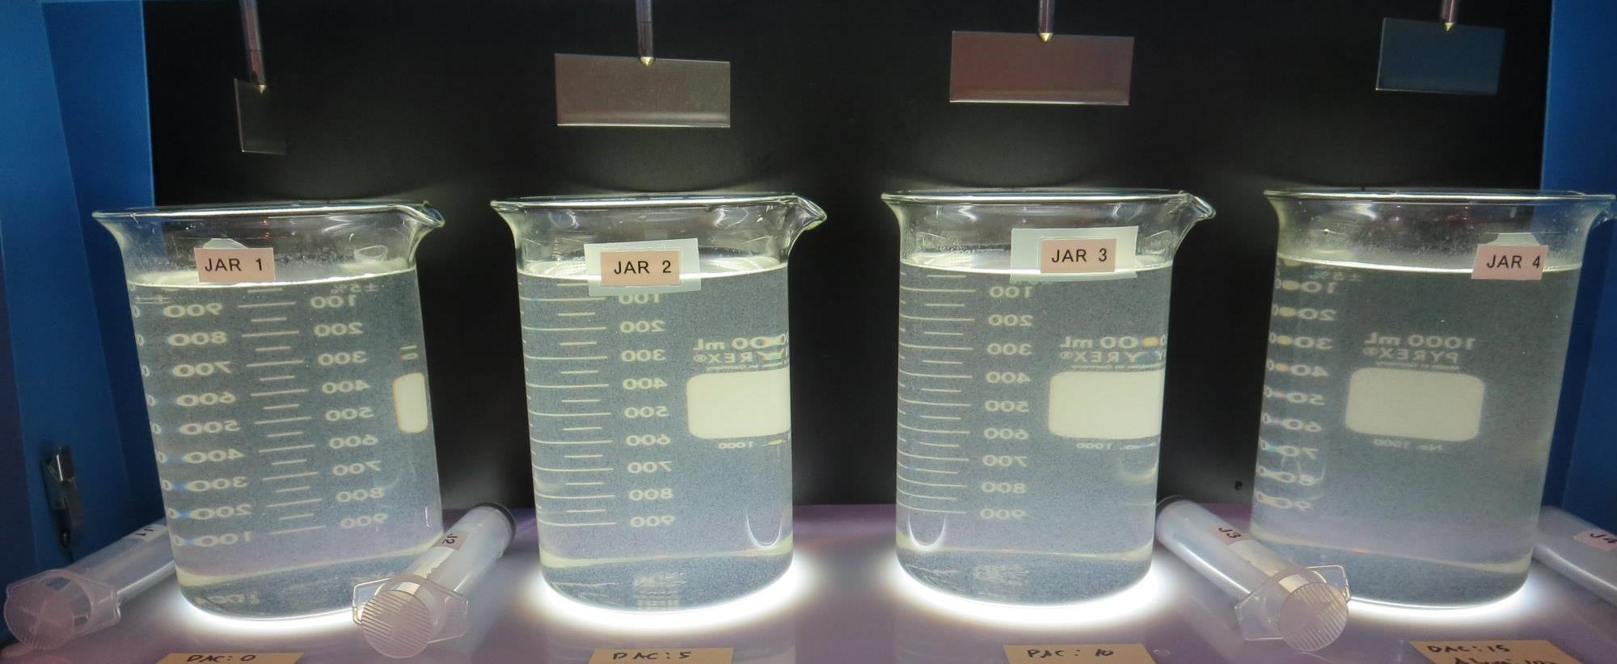
Jars 29-32: End of 5-minute flocculation (30 RPM) duration.
0 mg/L PAC
100 mg/L Alum
3.0 mg/L 186K
Filtrate 0.13 NTU
UVT: 90.0%
UVA: 0.045/cm
UVA Reduction 72.2%
Settled: 1.9 NTU
5 mg/L PAC
100 mg/L Alum
3.0 mg/L 186K
Filtrate 0.09 NTU
UVT: 90.6%
UVA: 0.042/cm
UVA Reduction 74.1%
Settled: 1.7 NTU
10 mg/L PAC
100 mg/L Alum
3.0 mg/L 186K
Filtrate 0.05 NTU
UVT: 91.0%
UVA: 0.041/cm
UVA Reduction 74.7%
Settled: 2.1 NTU
15 mg/L PAC
100 mg/L Alum
3.0 mg/L 186K
Filtrate 0.04 NTU
UVT: 91.3%
UVA: 0.039/cm
UVA Reduction 75.9%
Settled: 1.7 NTU

Slide 58
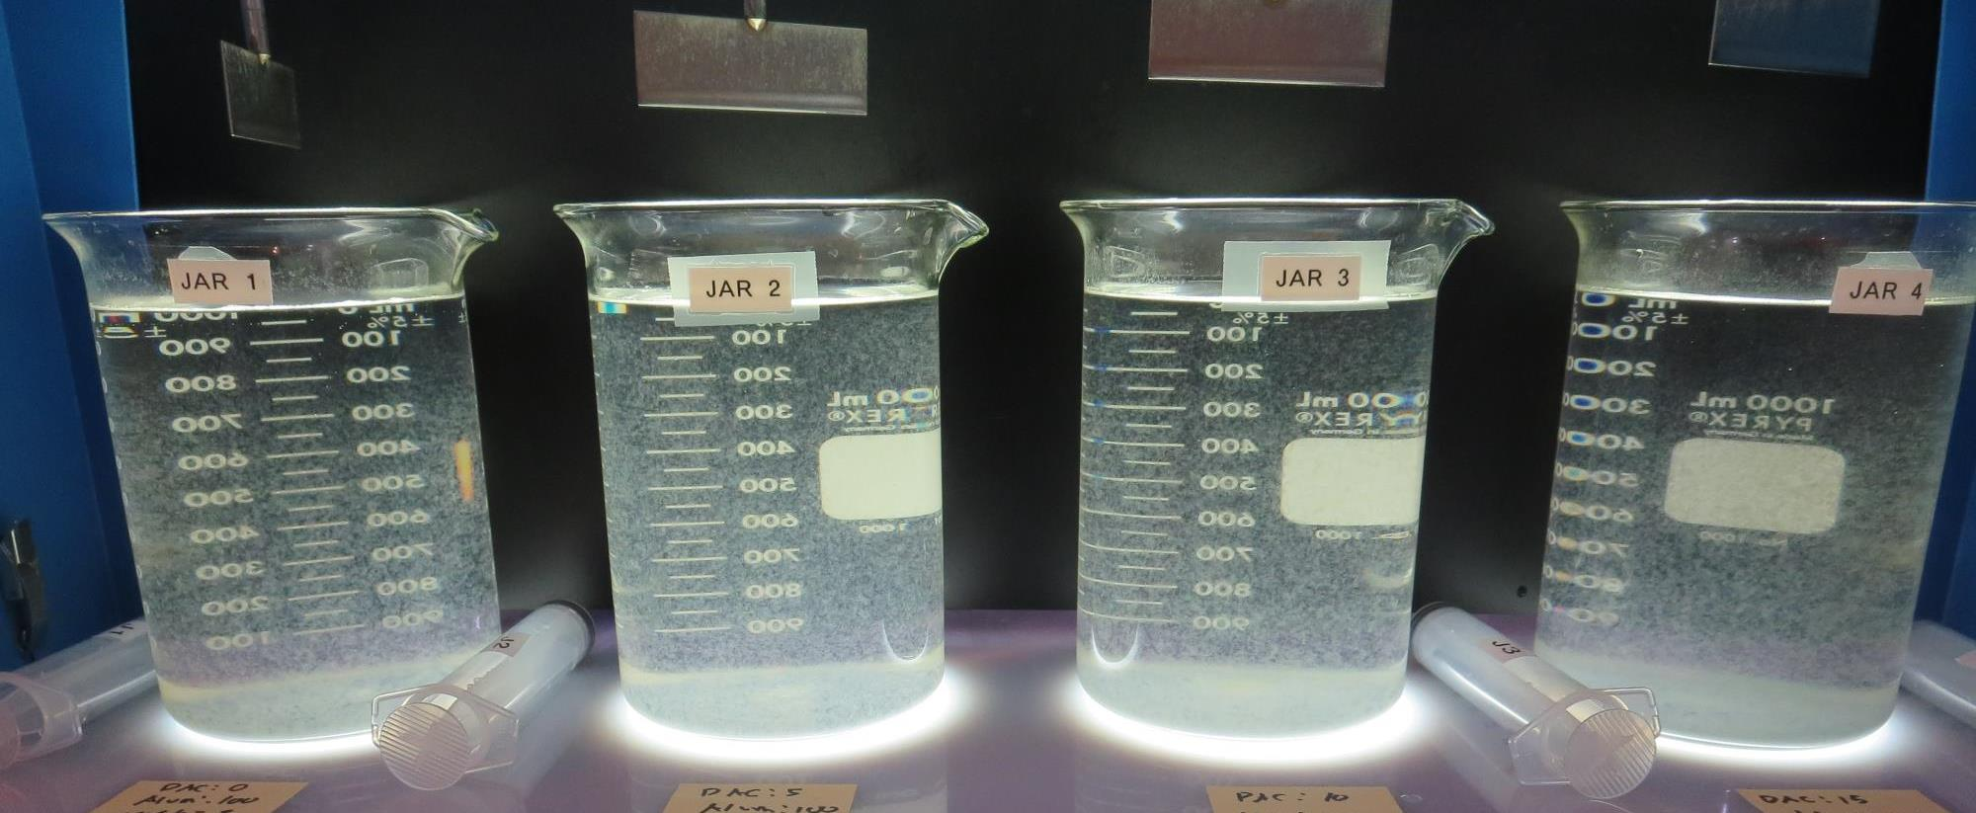
Jars 29-32: After 5 min of settling, 25 mL is syringed for filterability and %UVT/UVA.

Slide 59
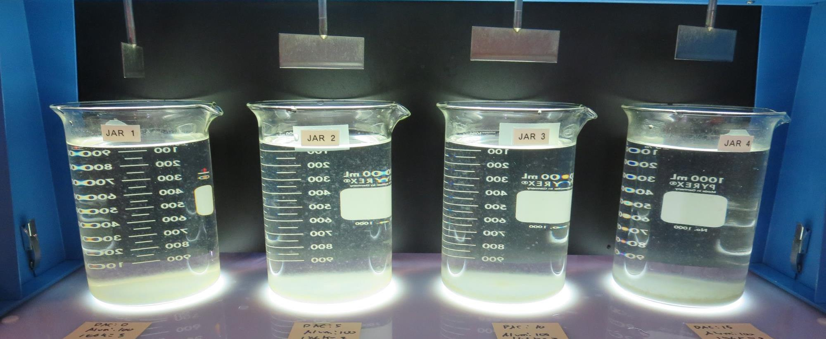
Jars 29-32: After 25-minutes of settling, settled water turbidity is taken.
0 mg/L PAC
100 mg/L Alum
3.0 mg/L 186K
Filtrate 0.13 NTU
UVT: 90.0%
UVA: 0.045/cm
UVA Reduction 72.2%
Settled: 1.9 NTU
5 mg/L PAC
100 mg/L Alum
3.0 mg/L 186K
Filtrate 0.09 NTU
UVT: 90.6%
UVA: 0.042/cm
UVA Reduction 74.1%
Settled: 1.7 NTU
10 mg/L PAC
100 mg/L Alum
3.0 mg/L 186K
Filtrate 0.05 NTU
UVT: 91.0%
UVA: 0.041/cm
UVA Reduction 74.7%
Settled: 2.1 NTU
15 mg/L PAC
100 mg/L Alum
3.0 mg/L 186K
Filtrate 0.04 NTU
UVT: 91.3%
UVA: 0.039/cm
UVA Reduction 75.9%
Settled: 1.7 NTU

Slide 60
Jars 33-36 Test
Flash Mix 30 Sec (200 RPM)
Floc Mix 5 min (30 RPM)
Applied Chemicals
PAC
ProPac 9810

Slide 61
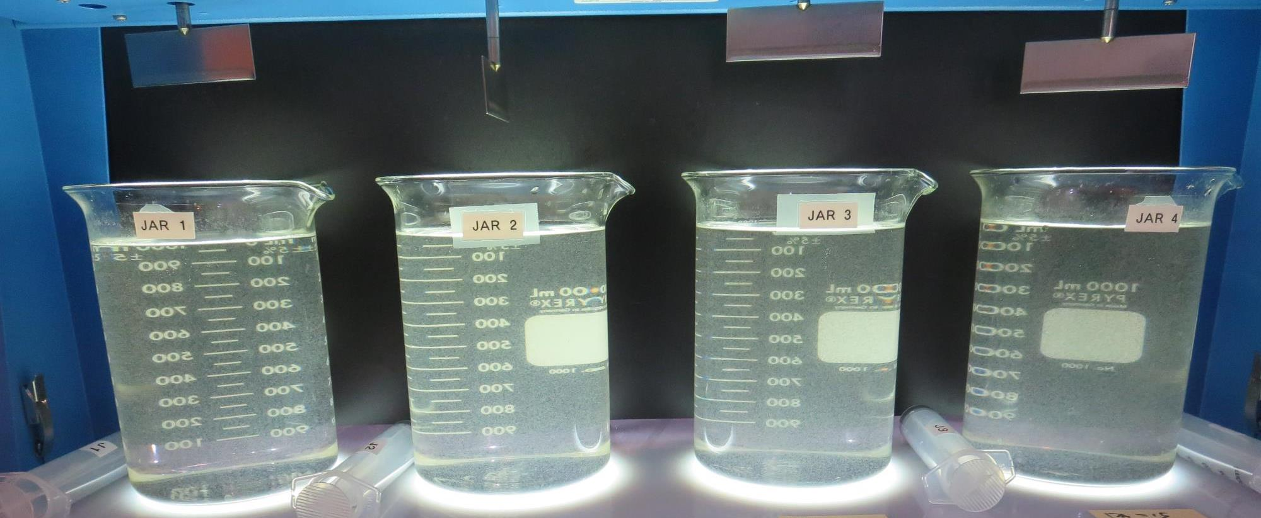
Jars 33-36: End of 5-minute flocculation (30 RPM) duration.
0 mg/L PAC
80 mg/L 9810
Filtrate 0.13 NTU
UVT: 89.9%
UVA: 0.046/cm
UVA Reduction 71.6%
Settled: 1.1 NTU
5 mg/L PAC
80 mg/L 9810
Filtrate 0.24 NTU
UVT: 88.9%
UVA: 0.056/cm
UVA Reduction 65.4%
Settled: 1.4 NTU
10 mg/L PAC
80 mg/L 9810
Filtrate 0.07 NTU
UVT: 90.4%
UVA: 0.043/cm
UVA Reduction 73.5%
Settled: 1.4 NTU
15 mg/L PAC
80 mg/L 9810
Filtrate 0.09 NTU
UVT: 90.5%
UVA: 0.043/cm
UVA Reduction 73.5%
Settled: 1.3 NTU

Slide 62
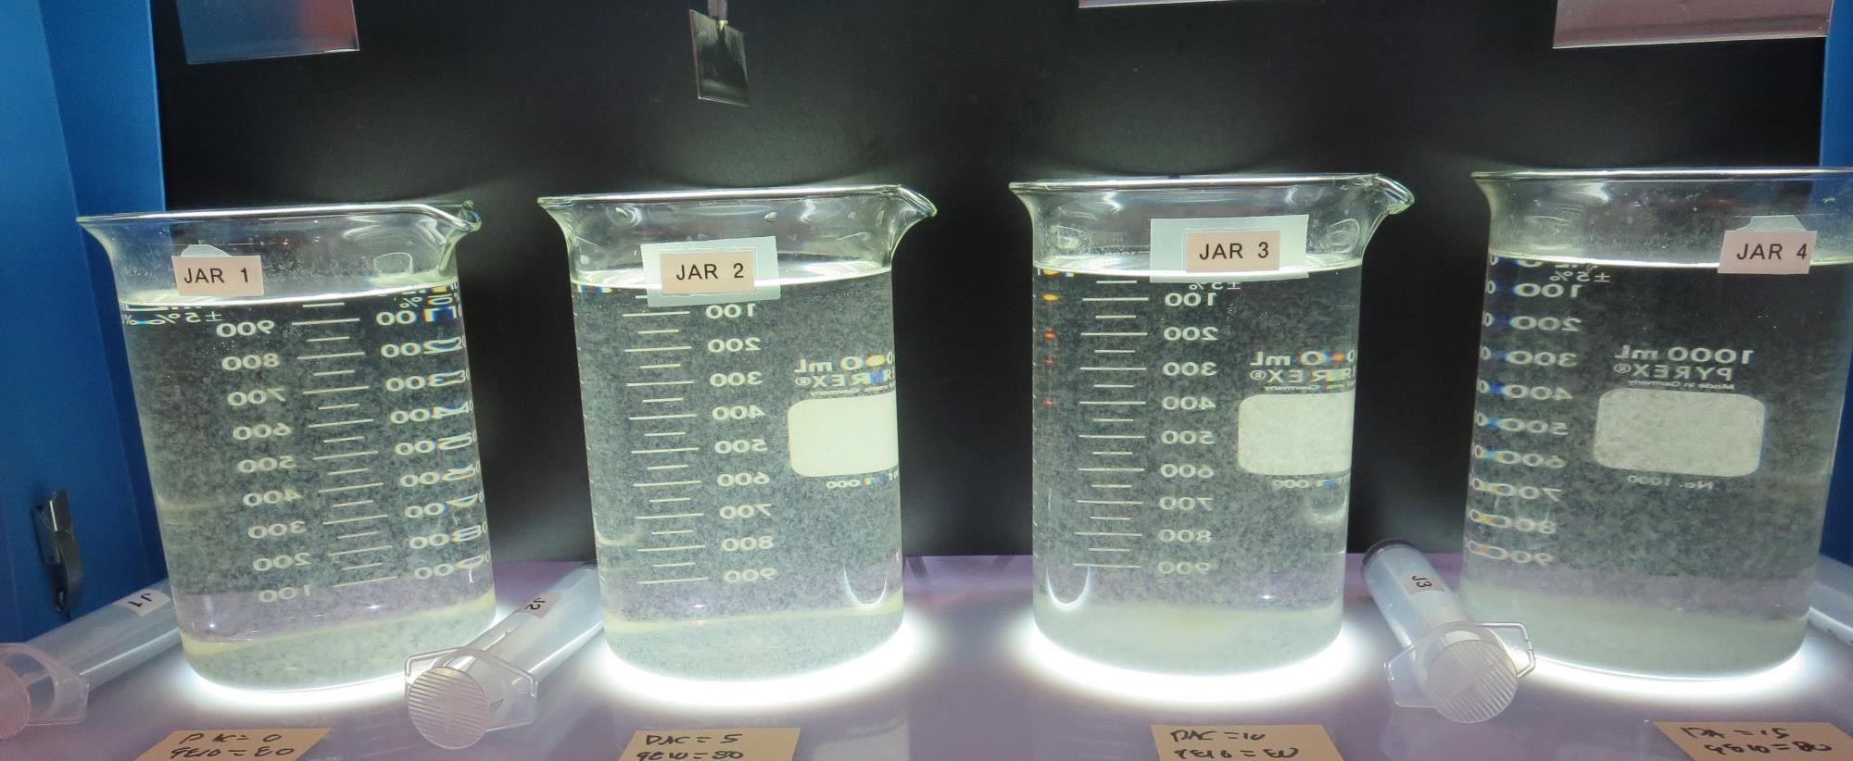
Jars 33-36: After 5 min of settling, 25 mL is syringed for filterability and %UVT/UVA.

Slide 63
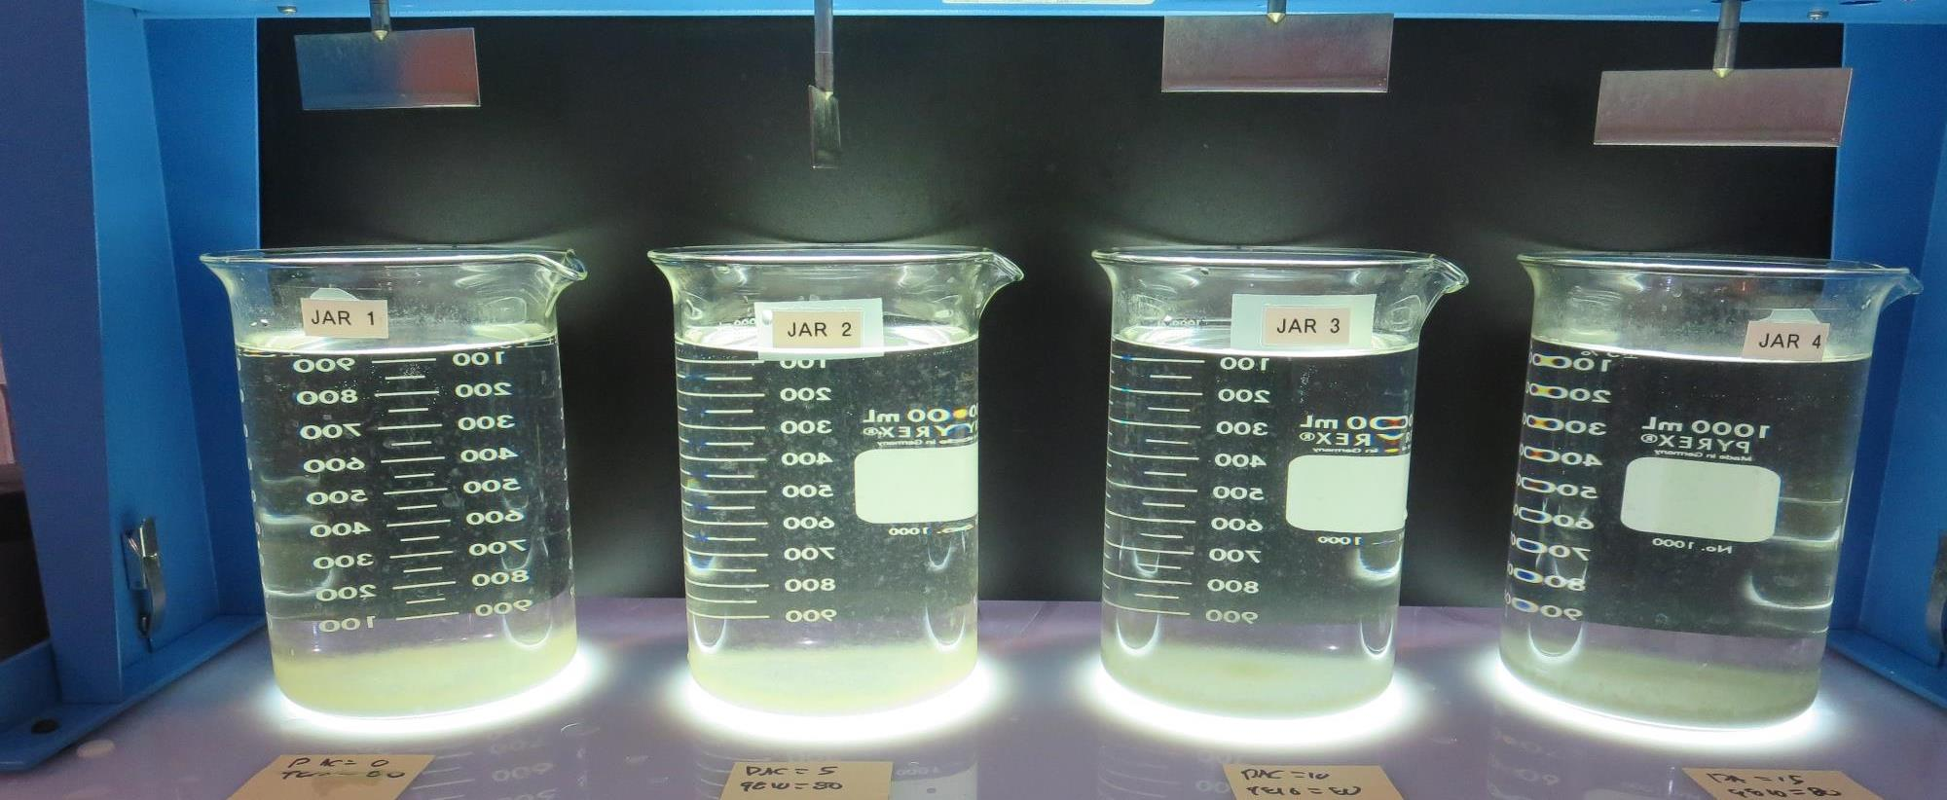
Jars 33-36: After 25-minutes of settling, settled water turbidity is taken.
0 mg/L PAC
80 mg/L 9810
Filtrate 0.13 NTU
UVT: 89.9%
UVA: 0.046/cm
UVA Reduction 71.6%
Settled: 1.1 NTU
5 mg/L PAC
80 mg/L 9810
Filtrate 0.24 NTU
UVT: 88.9%
UVA: 0.056/cm
UVA Reduction 65.4%
Settled: 1.4 NTU
10 mg/L PAC
80 mg/L 9810
Filtrate 0.07 NTU
UVT: 90.4%
UVA: 0.043/cm
UVA Reduction 73.5%
Settled: 1.4 NTU
15 mg/L PAC
80 mg/L 9810
Filtrate 0.09 NTU
UVT: 90.5%
UVA: 0.043/cm
UVA Reduction 73.5%
Settled: 1.3 NTU

Slide 64
Jars 37-40 Test
Flash Mix 30 Sec (200 RPM)
Floc Mix 5 min (30 RPM)
Applied Chemicals
961

Slide 65
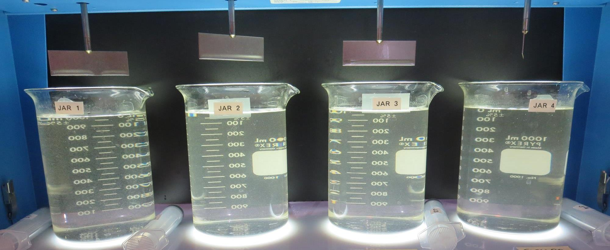
Jars 37-40: End of 5-minute flocculation (30 RPM) duration.
60 mg/L 961
Filtrate 0.06 NTU
UVT: 88.7%
UVA: 0.051/cm
UVA Reduction 88.7%
Settled: 3.6 NTU
70 mg/L 961
Filtrate 0.09 NTU
UVT: 89.0%
UVA: 0.050/cm
UVA Reduction 89.0%
Settled: 6.6 NTU
80 mg/L 961
Filtrate 0.36 NTU
UVT: 86.7%
UVA: 0.062/cm
UVA Reduction 86.7%
Settled: 6.3 NTU
90 mg/L 961
Filtrate 1.23 NTU
UVT: 80.0%
UVA: 0.097/cm
UVA Reduction 80.0%
Settled: 6.3 NTU

Slide 66
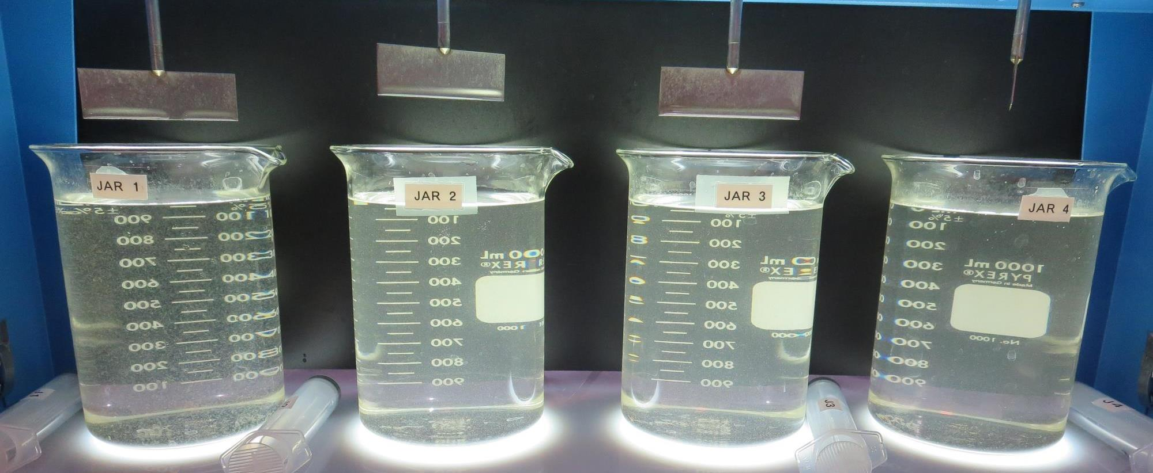
Jars 37-40: After 5 min of settling, 25 mL is syringed for filterability and %UVT/UVA.

Slide 67
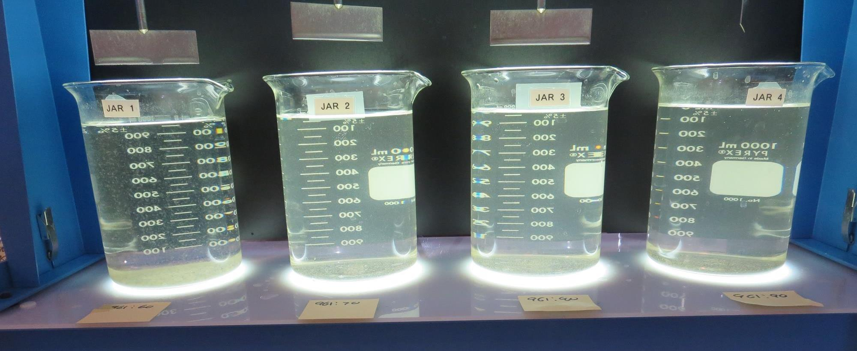
Jars 37-40: After 25-minutes of settling, settled water turbidity is taken.
60 mg/L 961
Filtrate 0.06 NTU
UVT: 88.7%
UVA: 0.051/cm
UVA Reduction 88.7%
Settled: 3.6 NTU
70 mg/L 961
Filtrate 0.09 NTU
UVT: 89.0%
UVA: 0.050/cm
UVA Reduction 89.0%
Settled: 6.6 NTU
80 mg/L 961
Filtrate 0.36 NTU
UVT: 86.7%
UVA: 0.062/cm
UVA Reduction 86.7%
Settled: 6.3 NTU
90 mg/L 961
Filtrate 1.23 NTU
UVT: 80.0%
UVA: 0.097/cm
UVA Reduction 80.0%
Settled: 6.3 NTU

Slide 68
Jars 41-44 Test
Flash Mix 30 Sec (200 RPM)
Floc Mix 5 min (30 RPM)
Applied Chemicals
NaMnO₄
Alum
186K pDADMAC

Slide 69
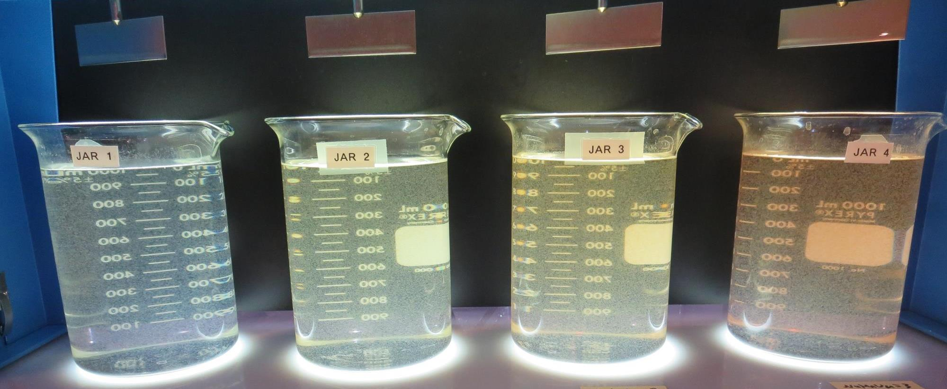
Jars 41-44: End of 5-minute flocculation (30 RPM) duration.
0 mg/L NaMnO₄
100 mg/L Alum
4.0 mg/L 186K
Filtrate 0.06 NTU
UVT: 89.8%
UVA: 0.046/cm
UVA Reduction 71.6%
Settled: 1.1 NTU
1.0 mg/L NaMnO₄
100 mg/L Alum
4.0 mg/L 186K
Filtrate 0.13 NTU
UVT: 90.6%
UVA: 0.042/cm
UVA Reduction 74.1%
Settled: 1.2 NTU
2.0 mg/L NaMnO₄
100 mg/L Alum
4.0 mg/L 186K
Filtrate 0.07 NTU
UVT: 90.9%
UVA: 0.041/cm
UVA Reduction 74.7%
Settled: 1.4 NTU
3.0 mg/L NaMnO₄
100 mg/L Alum
4.0 mg/L 186K
Filtrate 0.10 NTU
UVT: 91.0%
UVA: 0.041/cm
UVA Reduction 74.7%
Settled: 1.7 NTU

Slide 70
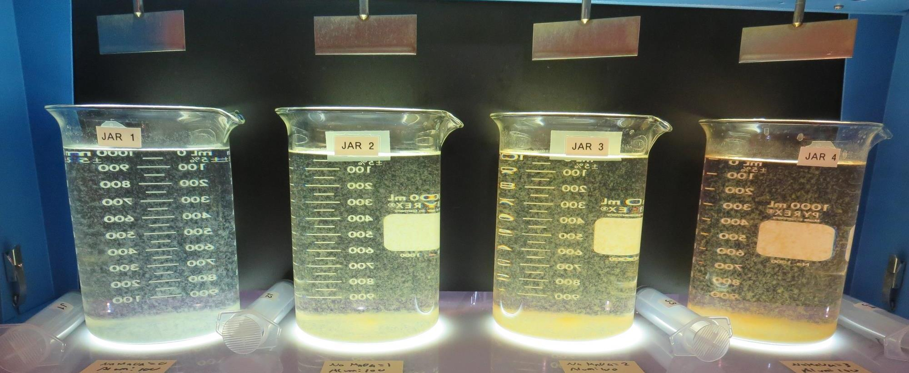
Jars 41-44: After 5 min of settling, 25 mL is syringed for filterability and %UVT/UVA.

Slide 71
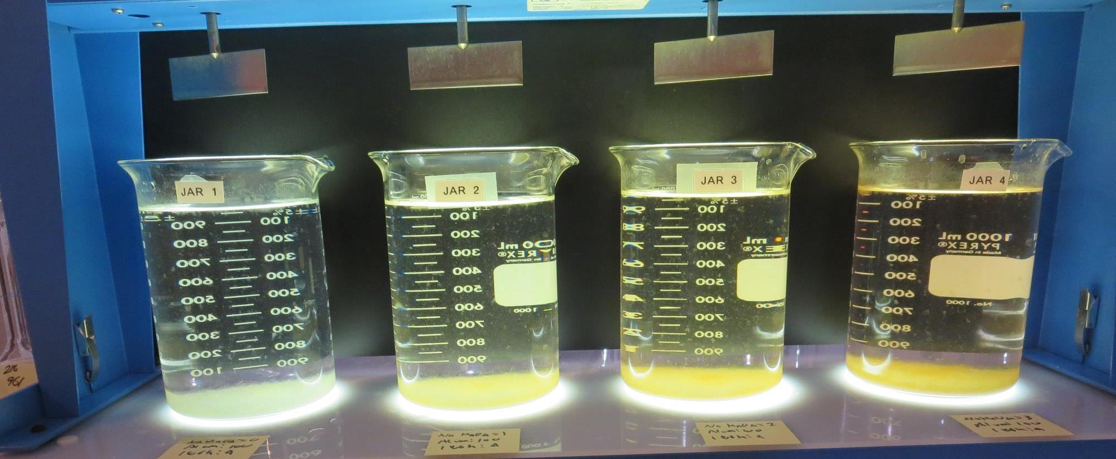
Jars 41-44: After 25-minutes of settling, settled water turbidity is taken.
0 mg/L NaMnO₄
100 mg/L Alum
4.0 mg/L 186K
Filtrate 0.06 NTU
UVT: 89.8%
UVA: 0.046/cm
UVA Reduction 71.6%
Settled: 1.1 NTU
1.0 mg/L NaMnO₄
100 mg/L Alum
4.0 mg/L 186K
Filtrate 0.13 NTU
UVT: 90.6%
UVA: 0.042/cm
UVA Reduction 74.1%
Settled: 1.2 NTU
2.0 mg/L NaMnO₄
100 mg/L Alum
4.0 mg/L 186K
Filtrate 0.07 NTU
UVT: 90.9%
UVA: 0.041/cm
UVA Reduction 74.7%
Settled: 1.4 NTU
3.0 mg/L NaMnO₄
100 mg/L Alum
4.0 mg/L 186K
Filtrate 0.10 NTU
UVT: 91.0%
UVA: 0.041/cm
UVA Reduction 74.7%
Settled: 1.7 NTU

Slide 72
Jars 45-48 Test
Flash Mix 30 Sec (200 RPM)
Floc Mix 5 min (30 RPM)
Applied Chemicals
NaMnO₄
Alum
186K pDADMAC

Slide 73
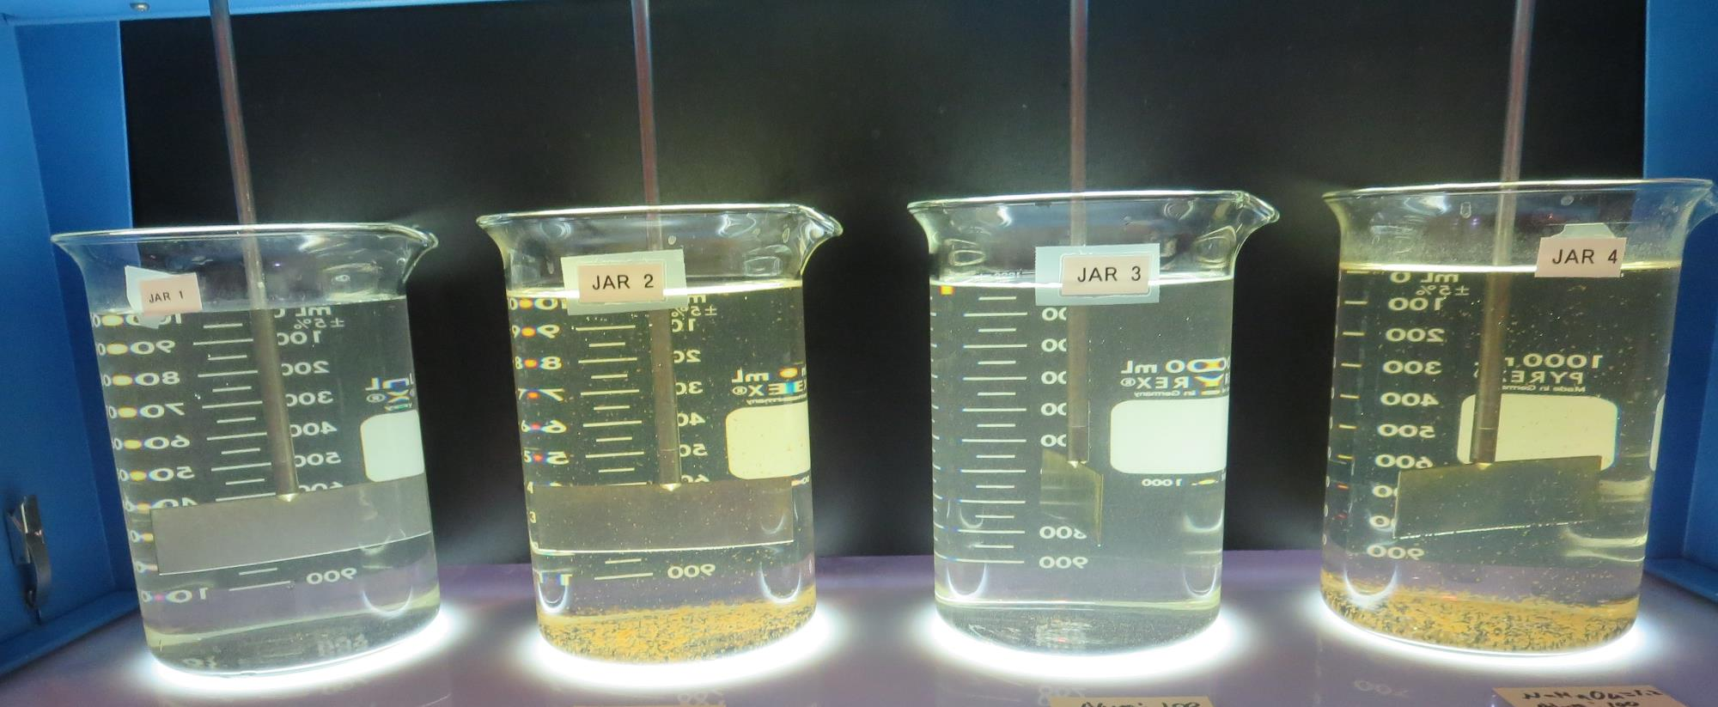
Jars 45-48: End of 5-minute flocculation (30 RPM) duration.
0 mg/L NaMnO₄
80 mg/L Alum
4.0 mg/L 186K
Filtrate 0.15 NTU
UVT: 89.8%
UVA: 0.046/cm
UVA Reduction 71.6%
Settled: 1.3 NTU
1.2 mg/L NaMnO₄
80 mg/L Alum
4.0 mg/L 186K
Filtrate 0.15 NTU
UVT: 90.4%
UVA: 0.043/cm
UVA Reduction 73.5%
Settled: 1.5 NTU
0 mg/L NaMnO₄
100 mg/L Alum
4.0 mg/L 186K
Filtrate 0.20 NTU
UVT: 90.5%
UVA: 0.043/cm
UVA Reduction 73.5%
Settled: 1.7 NTU
1.2 mg/L NaMnO₄
100 mg/L Alum
4.0 mg/L 186K
Filtrate 0.13 NTU
UVT: 91.5%
UVA: 0.038/cm
UVA Reduction 76.5%
Settled: 2.1 NTU

Slide 74
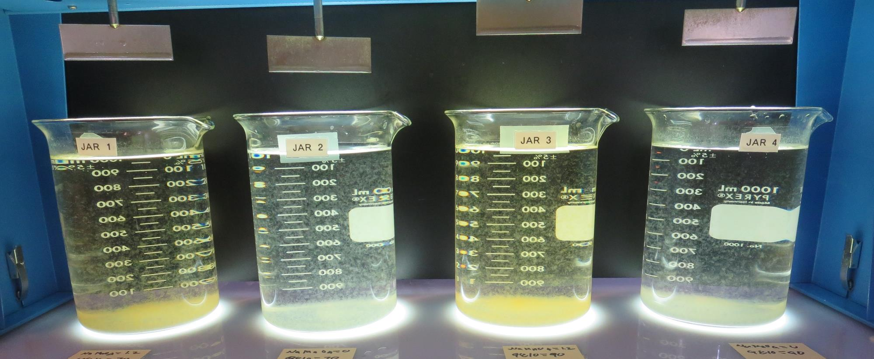
Jars 45-48: After 5 min of settling, 25 mL is syringed for filterability and %UVT/UVA.

Slide 75
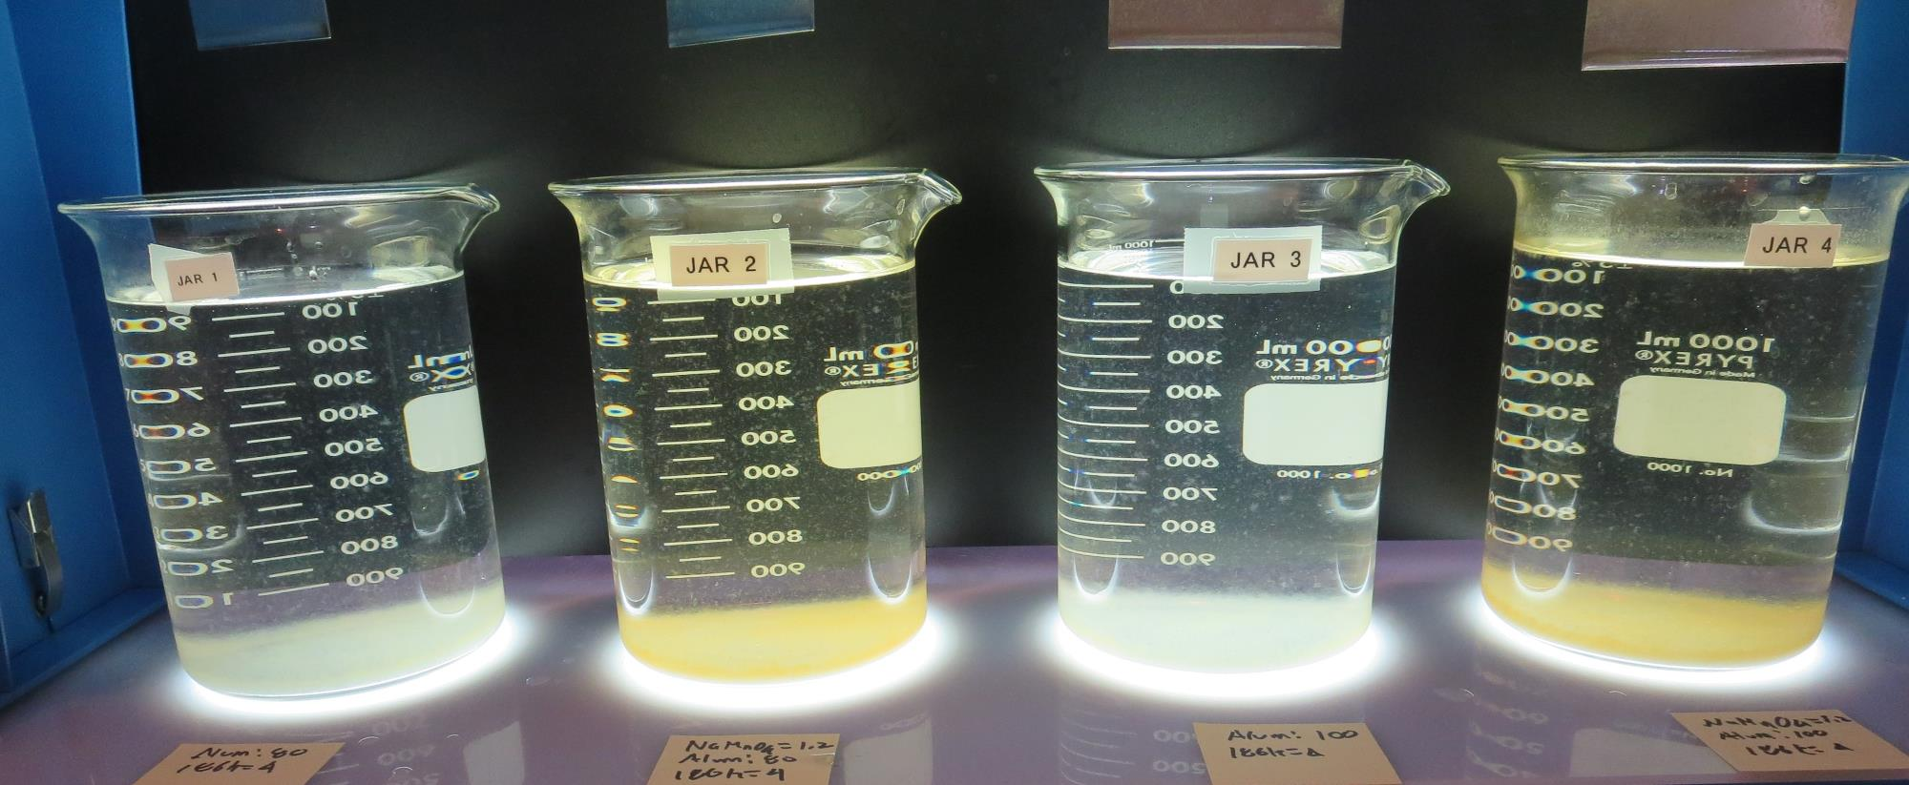
Jars 45-48: After 25-minutes of settling, settled water turbidity is taken.
0 mg/L NaMnO₄
80 mg/L Alum
4.0 mg/L 186K
Filtrate 0.15 NTU
UVT: 89.8%
UVA: 0.046/cm
UVA Reduction 71.6%
Settled: 1.3 NTU
1.2 mg/L NaMnO₄
80 mg/L Alum
4.0 mg/L 186K
Filtrate 0.15 NTU
UVT: 90.4%
UVA: 0.043/cm
UVA Reduction 73.5%
Settled: 1.5 NTU
0 mg/L NaMnO₄
100 mg/L Alum
4.0 mg/L 186K
Filtrate 0.20 NTU
UVT: 90.5%
UVA: 0.043/cm
UVA Reduction 73.5%
Settled: 1.7 NTU
1.2 mg/L NaMnO₄
100 mg/L Alum
4.0 mg/L 186K
Filtrate 0.13 NTU
UVT: 91.5%
UVA: 0.038/cm
UVA Reduction 76.5%
Settled: 2.1 NTU

Slide 76
Jars 49-52 Test
Flash Mix 30 Sec (200 RPM)
Floc Mix 5 min (30 RPM)
Applied Chemicals
NaMnO₄
ProPac 9810

Slide 77
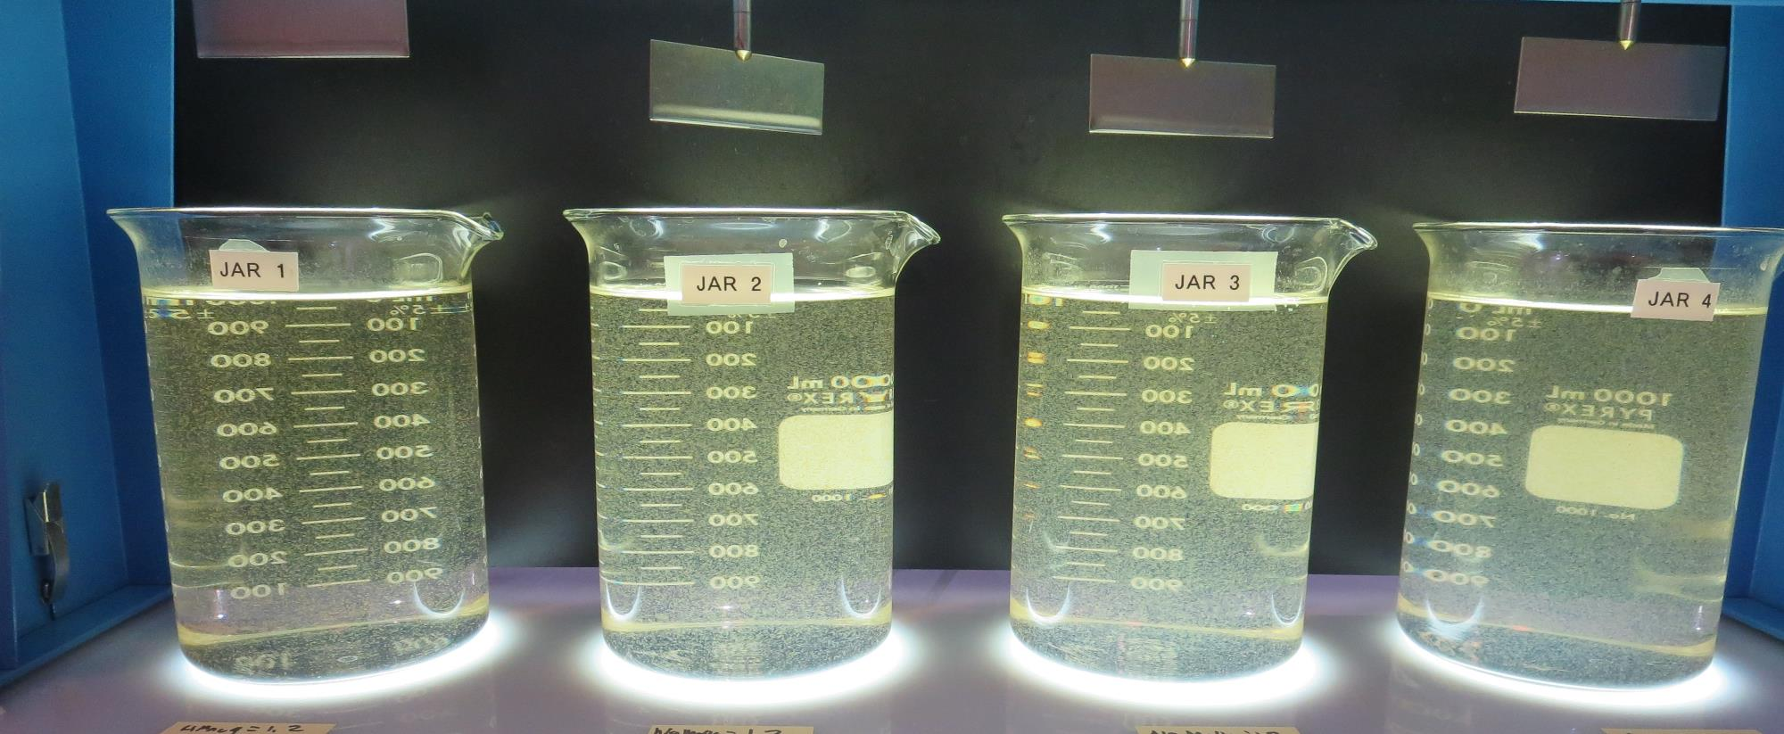
Jars 49-52: End of 5-minute flocculation (30 RPM) duration.
1.2 mg/L NaMnO₄
70 mg/L 9810
Filtrate 0.05 NTU
UVT: 91.8%
UVA: 0.037/cm
UVA Reduction 77.2%
Settled: 0.49 NTU
0 mg/L NaMnO₄
70 mg/L 9810
Filtrate 0.05 NTU
UVT: 90.9%
UVA: 0.037/cm
UVA Reduction 74.7%
Settled: 0.80 NTU
1.2 mg/L NaMnO₄
90 mg/L 9810
Filtrate 0.06 NTU
UVT: 92.3%
UVA: 0.034/cm
UVA Reduction 79.0%
Settled: 0.45 NTU
0 mg/L NaMnO₄
90 mg/L 9810
Filtrate 0.05 NTU
UVT: 92.2%
UVA: 0.035/cm
UVA Reduction 78.4%
Settled: 0.51 NTU

Slide 78
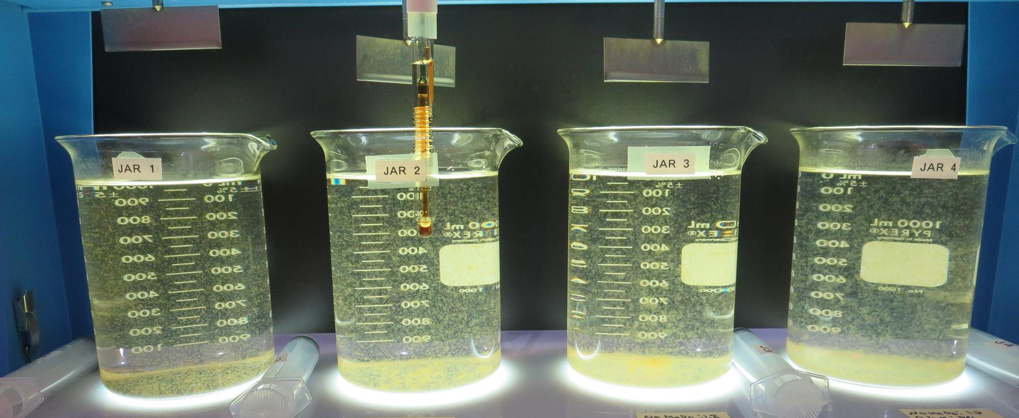
Jars 49-52: After 5 min of settling, 25 mL is syringed for filterability and %UVT/UVA.

Slide 79
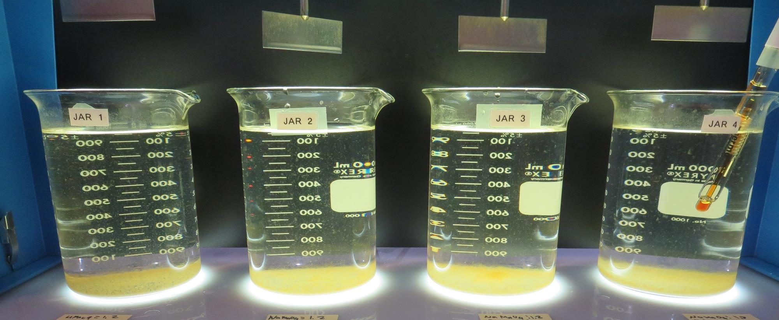
Jars 49-52: After 25-minutes of settling, settled water turbidity is taken.
1.2 mg/L NaMnO₄
70 mg/L 9810
Filtrate 0.05 NTU
UVT: 91.8%
UVA: 0.037/cm
UVA Reduction 77.2%
Settled: 0.49 NTU
0 mg/L NaMnO₄
70 mg/L 9810
Filtrate 0.05 NTU
UVT: 90.9%
UVA: 0.037/cm
UVA Reduction 74.7%
Settled: 0.80 NTU
1.2 mg/L NaMnO₄
90 mg/L 9810
Filtrate 0.06 NTU
UVT: 92.3%
UVA: 0.034/cm
UVA Reduction 79.0%
Settled: 0.45 NTU
0 mg/L NaMnO₄
90 mg/L 9810
Filtrate 0.05 NTU
UVT: 92.2%
UVA: 0.035/cm
UVA Reduction 78.4%
Settled: 0.51 NTU

Slide 80
Jars 53-56 Test
Flash Mix 30 Sec (200 RPM)
Floc Mix 5 min (30 RPM)
Applied Chemicals
NaMnO₄
Alum
ProPac 9890

Slide 81
Jars 53-56: End of 5-minute flocculation (30 RPM) duration.
1.2 mg/L NaMnO₄
10 mg/L Alum
10 mg/L 9890
Filtrate 0.08 NTU
UVT: 83.8%
UVA: 0.076/cm
UVA Reduction 53.1%
Settled: 3.5 NTU
1.2 mg/L NaMnO₄
40 mg/L Alum
10 mg/L 9890
Filtrate 0.12 NTU
UVT: 88.3%
UVA: 0.053/cm
UVA Reduction 67.3%
Settled: 1.3 NTU
1.2 mg/L NaMnO₄
60 mg/L Alum
10 mg/L 9890
Filtrate 0.06 NTU
UVT: 89.9%
UVA: 0.045/cm
UVA Reduction 72.2%
Settled: 1.3 NTU
1.2 mg/L NaMnO₄
80 mg/L Alum
10 mg/L 9890
Filtrate 0.15 NTU
UVT: 90.8%
UVA: 0.041/cm
UVA Reduction 74.7%
Settled: 1.5 NTU

Slide 82
Jars 53-56: After 5 min of settling, 25 mL is syringed for filterability and %UVT/UVA.

Slide 83
Jars 53-56: After 25-minutes of settling, settled water turbidity is taken.
1.2 mg/L NaMnO₄
10 mg/L Alum
10 mg/L 9890
Filtrate 0.08 NTU
UVT: 83.8%
UVA: 0.076/cm
UVA Reduction 53.1%
Settled: 3.5 NTU
1.2 mg/L NaMnO₄
40 mg/L Alum
10 mg/L 9890
Filtrate 0.12 NTU
UVT: 88.3%
UVA: 0.053/cm
UVA Reduction 67.3%
Settled: 1.3 NTU
1.2 mg/L NaMnO₄
60 mg/L Alum
10 mg/L 9890
Filtrate 0.06 NTU
UVT: 89.9%
UVA: 0.045/cm
UVA Reduction 72.2%
Settled: 1.3 NTU
1.2 mg/L NaMnO₄
80 mg/L Alum
10 mg/L 9890
Filtrate 0.15 NTU
UVT: 90.8%
UVA: 0.041/cm
UVA Reduction 74.7%
Settled: 1.5 NTU

Slide 84
Jars 57-60 Test
Flash Mix 30 Sec (200 RPM)
Floc Mix 5 min (30 RPM)
Applied Chemicals
NaMnO₄
Alum
186K pDADMAC

Slide 85

Jars 57-60: End of 5-minute flocculation (30 RPM) duration.
1.2 mg/L NaMnO₄
15 mg/L Alum
2.0 mg/L 186K
Filtrate 0.78 NTU
UVT: 78.5%
UVA: 0.105/cm
UVA Reduction 35.2%
Settled: 5.6 NTU
1.2 mg/L NaMnO₄
40 mg/L Alum
2.0 mg/L 186K
Filtrate 0.18 NTU
UVT: 85.5%
UVA: 0.067/cm
UVA Reduction 58.6%
Settled: 2.6 NTU
1.2 mg/L NaMnO₄
70 mg/L Alum
2.0 mg/L 186K
Filtrate 0.24 NTU
UVT: 89.9%
UVA: 0.050/cm
UVA Reduction 69.1%
Settled: 1.5 NTU
1.2 mg/L NaMnO₄
100 mg/L Alum
2.0 mg/L 186K
Filtrate 0.09 NTU
UVT: 90.9%
UVA: 0.041/cm
UVA Reduction 74.7%
Settled: 1.5 NTU

Slide 86

Jars 57-60: After 5 min of settling, 25 mL is syringed for filterability and %UVT/UVA.

Slide 87

Jars 57-60: After 25-minutes of settling, settled water turbidity is taken.
1.2 mg/L NaMnO₄
15 mg/L Alum
2.0 mg/L 186K
Filtrate 0.78 NTU
UVT: 78.5%
UVA: 0.105/cm
UVA Reduction 35.2%
Settled: 5.6 NTU
1.2 mg/L NaMnO₄
40 mg/L Alum
2.0 mg/L 186K
Filtrate 0.18 NTU
UVT: 85.5%
UVA: 0.067/cm
UVA Reduction 58.6%
Settled: 2.6 NTU
1.2 mg/L NaMnO₄
70 mg/L Alum
2.0 mg/L 186K
Filtrate 0.24 NTU
UVT: 89.9%
UVA: 0.050/cm
UVA Reduction 69.1%
Settled: 1.5 NTU
1.2 mg/L NaMnO₄
100 mg/L Alum
2.0 mg/L 186K
Filtrate 0.09 NTU
UVT: 90.9%
UVA: 0.041/cm
UVA Reduction 74.7%
Settled: 1.5 NTU

Slide 88
Jars 61-64 Test
Flash Mix 30 Sec (200 RPM)
Floc Mix 5 min (30 RPM)
Applied Chemicals
NaMnO₄
Alum
186K pDADMAC
ProPac 9810

Slide 89

Jars 61-64: End of 5-minute flocculation (30 RPM) duration.
1.2 mg/L NaMnO₄
15 mg/L Alum
6.0 mg/L 186K
Filtrate 0.05 NTU
UVT: 83.0%
UVA: 0.080/cm
UVA Reduction 50.6%
Settled: 4.9 NTU
1.2 mg/L NaMnO₄
100 mg/L Alum
6.0 mg/L 186K
Filtrate 0.07 NTU
UVT: 91.7%
UVA: 0.037/cm
UVA Reduction 77.2%
Settled: 2.1 NTU
1.2 mg/L NaMnO₄
70 mg/L 9810
Filtrate 0.06 NTU
UVT: 90.8%
UVA: 0.041/cm
UVA Reduction 74.7%
Settled: 0.83 NTU
1.2 mg/L NaMnO₄
90 mg/L 9810
Filtrate 0.07 NTU
UVT: 91.5%
UVA: 0.038/cm
UVA Reduction 76.5%
Settled: 0.63 NTU

Slide 90

Jars 61-64: After 5 min of settling, 25 mL is syringed for filterability and %UVT/UVA.

Slide 91

Jars 61-64: After 25-minutes of settling, settled water turbidity is taken.
1.2 mg/L NaMnO₄
15 mg/L Alum
6.0 mg/L 186K
Filtrate 0.05 NTU
UVT: 83.0%
UVA: 0.080/cm
UVA Reduction 50.6%
Settled: 4.9 NTU
1.2 mg/L NaMnO₄
100 mg/L Alum
2.0 mg/L 186K
Filtrate 0.07 NTU
UVT: 91.7%
UVA: 0.037/cm
UVA Reduction 77.2%
Settled: 2.1 NTU
1.2 mg/L NaMnO₄
70 mg/L 9810
Filtrate 0.06 NTU
UVT: 90.8%
UVA: 0.041/cm
UVA Reduction 74.7%
Settled: 0.83 NTU
1.2 mg/L NaMnO₄
90 mg/L 9810
Filtrate 0.07 NTU
UVT: 91.5%
UVA: 0.038/cm
UVA Reduction 76.5%
Settled: 0.63 NTU

Slide 92
Jars 65-68 Test
Flash Mix 30 Sec (200 RPM)
Floc Mix 5 min (30 RPM)
Applied Chemicals
NaMnO₄
Alum
186K pDADMAC
9810

Slide 93

Jars 65-68: End of 5-minute flocculation (30 RPM) duration.
1.2 mg/L NaMnO₄
15 mg/L Alum
6.0 mg/L 186K
Filtrate 0.09 NTU
UVT: 82.5%
UVA: 0.083/cm
UVA Reduction 48.8%
Settled: 3.6 NTU
1.2 mg/L NaMnO₄
100 mg/L Alum
6.0 mg/L 186K
Filtrate 0.07 NTU
UVT: 91.3%
UVA: 0.039/cm
UVA Reduction 75.9%
Settled: 1.5 NTU
1.2 mg/L NaMnO₄
70 mg/L 9810
Filtrate 0.05 NTU
UVT: 90.1%
UVA: 0.045/cm
UVA Reduction 72.2%
Settled: 0.41 NTU
1.2 mg/L NaMnO₄
90 mg/L 9810
Filtrate 0.09 NTU
UVT: 90.8%
UVA: 0.041/cm
UVA Reduction 74.7%
Settled: 0.43 NTU

Slide 94

Jars 65-68: After 5 min of settling, 25 mL is syringed for filterability and %UVT/UVA.

Slide 95

Jars 65-68: After 25-minutes of settling, settled water turbidity is taken.
1.2 mg/L NaMnO₄
15 mg/L Alum
6.0 mg/L 186K
Filtrate 0.09 NTU
UVT: 82.5%
UVA: 0.083/cm
UVA Reduction 48.8%
Settled: 3.6 NTU
1.2 mg/L NaMnO₄
100 mg/L Alum
6.0 mg/L 186K
Filtrate 0.07 NTU
UVT: 91.3%
UVA: 0.039/cm
UVA Reduction 75.9%
Settled: 1.5 NTU
1.2 mg/L NaMnO₄
70 mg/L 9810
Filtrate 0.05 NTU
UVT: 90.1%
UVA: 0.045/cm
UVA Reduction 72.2%
Settled: 0.41 NTU
1.2 mg/L NaMnO₄
90 mg/L 9810
Filtrate 0.09 NTU
UVT: 90.8%
UVA: 0.041/cm
UVA Reduction 74.7%
Settled: 0.43 NTU

Slide 96
Jar Testing for 1-Liter Jars:
Procedures for Most Treatment Plants
Fill jars with source water prior to coagulant injection and set paddle speed at 30 rpm
Add chemicals (i.e., NaOCl, primary coagulant, coagulant aid) to each jar
Flash mix for 15-30 seconds (200 rpm)
Slow mix for 5 minutes (20-30 rpm)
Settled for 5 minutes. Syringe 25 mL from each jar taken 1-inch below surface (25 mL/12 sec rate)
Filtered through 1.2 um isopore membrane into cuvette drip rate, 15 mL/(50-90 sec)
Measure filtrate turbidity, chlorine residual and %UVT/UVA
Measure settled water turbidity after 25 minutes of total setting
Record all data

Slide 97

Jar Test
Filterability Test Equipment
Turbidity Instrument
Syringe w/Luer-Lock Tip, 30 cc
(part#: 2225800, by Hach)
Swinnex Filter Holder, 25 mm (part#: SX0002500)
Isopore Membrane Filter, 1.2 um absolute
pore size,
Φ= 25 mm , thickness: 24 um,
hydrophilic polycarbonate membrane
(part #: RTTP02500)
Go to Sigma-Aldrich for laboratory supplies http://www.sigmaaldrich.com/united-states.html

Slide 98
Isopore Membrane Information
Categories | Information
trade name | Isopore
filter color | White
chemistry | Polycarbonate (PC)
water flow rate | Avg. 175 mL/min x cm² (typical results @ 10 psi)
media | Isopore®
wettability | Hydrophilic
porosity | 14.7%
pore size | 1.2 µm
bubble point at 23 °C | 1.0 bar, air with water
thickness | 24 µm
filter diameter (ø) | 25 mm
material size | polycarbonate, Hydrophilic, 1.2 µm, 25 mm, white, plain, 100

Slide 99
Isopore Membrane Background Information
The Isopore membrane is a polycarbonate, track-etched screen filter recommended for all analyses in which the sample is viewed on the surface of the membrane. The Isopore membrane is composed of polycarbonate film, which has a smooth, glass-like surface for clearer sample observation. The unique manufacturing process of the membrane ensures a precise pore diameter and a consistent pore size for accurate separation of samples by size. Matched-weight filters are not usually required because of low, constant tar and ash weights.
Features & Benefits:
Membrane structure retains particles on the surface, simplifying counting and analysis

Slide 100


Jar Test - Filterability Test
Syringe ~ 25 mL from jar (after 5-minutes of settling)
Filter-to-waste 3-5 mL
Filter directly into clean cuvette
Measure turbidity
Note: Take several readings before recording final NTU results. Micro bubbles can adhere to glass causing false NTU readings. To remove bubbles, tilt cuvette up to 90 degrees.

Slide 101

Contact
Guy Schott, P.E.
State Water Resources Control Board
Division of Drinking Water
Santa Rosa, CA
Go to Stock Solution/Dose calculations/Jar Test Results for tools to download
www.waterboards.ca.gov/drinking_water/programs/districts/mendocino_district.html
Email: Guy Schott - Guy.Schott@waterboards.ca.gov
Office Number: 707-576-2732

