Slide 1
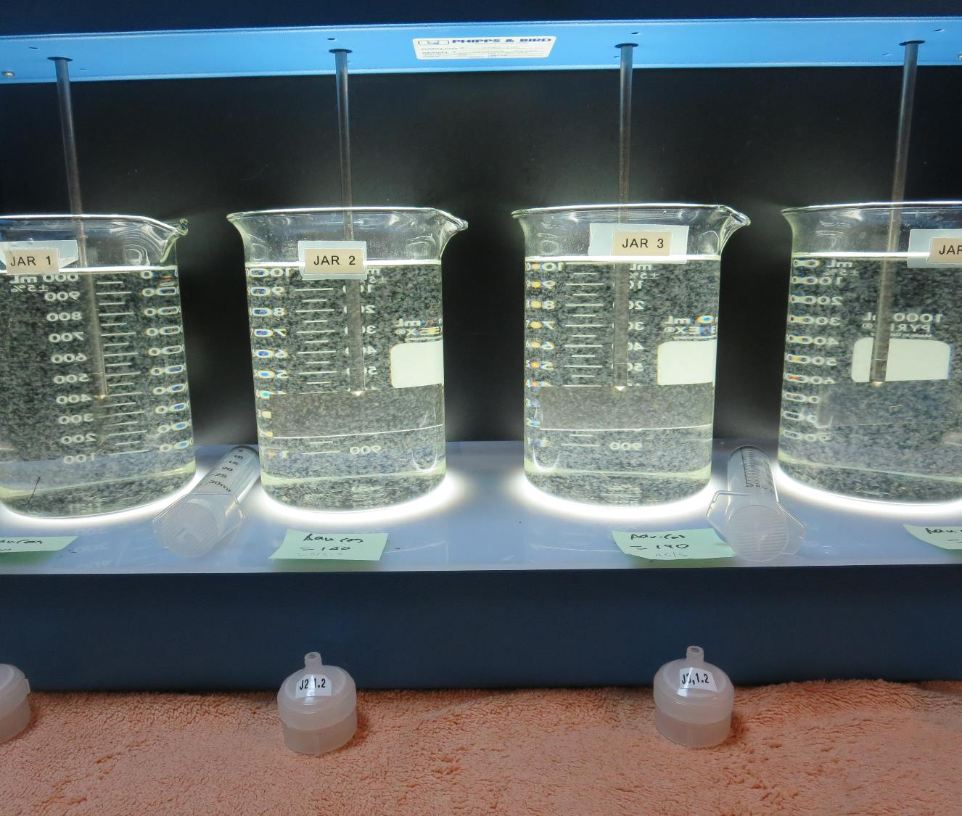
Loma Mar Mutual CA4100512 San Mateo County Jar Test
by Guy Schott, P.E.
July 8, 2020

Slide 2
Treatment Processes
Source water: Pescadero Creek
Vertical pressure roughing filter
Multi-Media Filtration (vertical pressure vessel)
Activated Carbon Filtration
Chlorine disinfection

Slide 3
Loma Mar Mutual, July 8, 2020 Source Water Characteristics
Source
pH: 7.99
Turbidity: 4.5 NTU
UVT: 81.1%
UVA: 0.090/cm
0.4 um Filtered
Turbidity: 0.14 NTU
UVT: 84.5%
UVA: 0.073/cm
Plant Filtrate
Samples not taken.

Slide 4
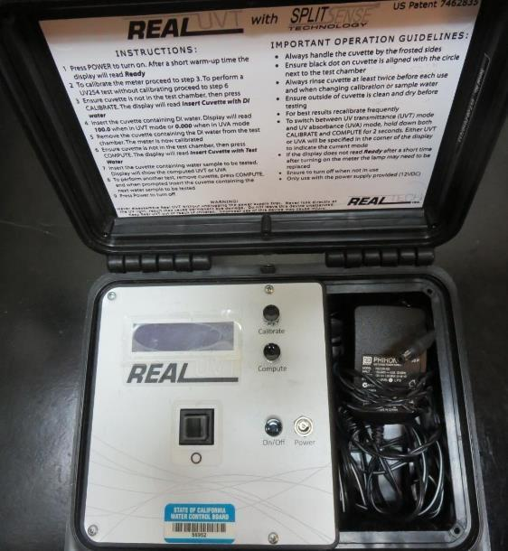
UVT/UVA, pathlength 10 mm
UV transmittance (UVT) is a measurement of the amount of ultraviolet light (commonly at 254 nm due to its germicidal effect) that passes through a water sample compared to the amount of light that passes through a pure water sample. The measurement is expressed as a percentage, % UVT.
%UVT = 10^{(-UVA)} x 100%
UV absorbance (UVA) is calculated as a relative measure of the amount of light absorbed by a water sample compared with the amount of light absorbed by a pure water sample.
UVA = -log(%UVT/100)

Slide 5
Applied Coagulant for Jar Testing
Advanced Coagulant
12.55% Al₂O₃
6.64% Al
66.4% Basicity
SG = 1.3

Slide 6
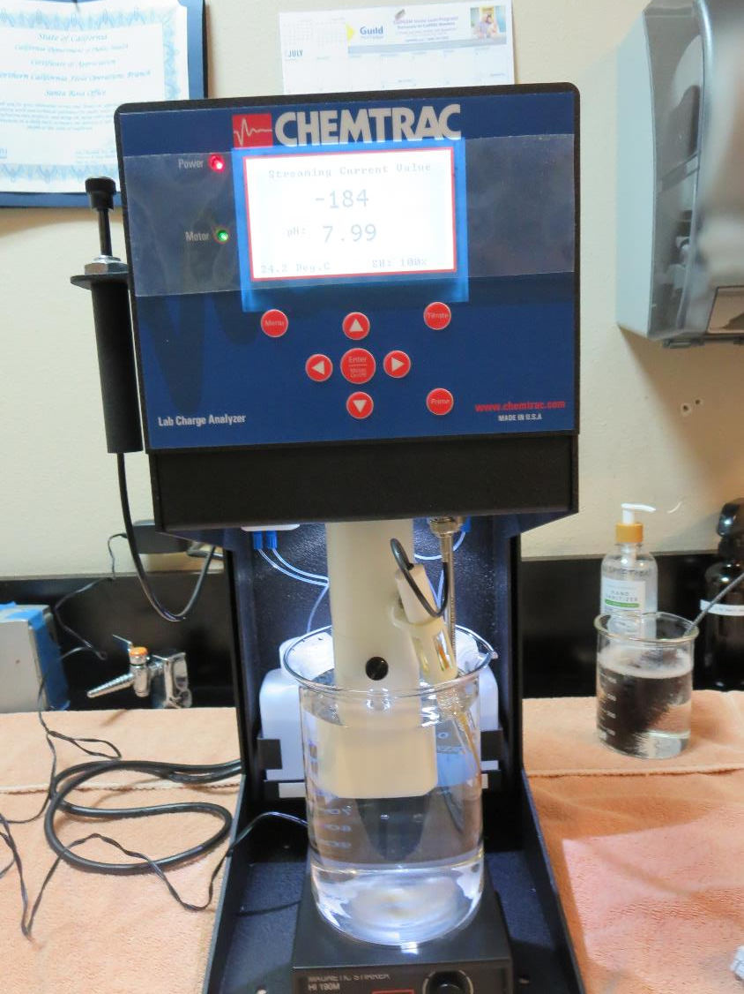
Laboratory Charge Analyzer
LCA: Used to determine coagulant demand of a source water entering the treatment plant.
Source pH: 7.99
LCA #1:
Advance Coagulant: 256 mg/L as product
pH adjusted to 7.5 w/acetic acid solution
LCA #2:
Advance Coagulant: 172 mg/L as product
pH adjusted to 7.0 w/acetic acid solution

Slide 7
Coagulant Information
Unless stated otherwise, all coagulant doses are reported as Product (100% strength).
Preparation of coagulant stock solutions are generally 1.0 and/or 0.1 percent strength using 100 and/or 200 mL volumetric flasks.
Finnpipette F2 variable volume pipette, capacity 100-1000 micro liters is used for stock solution preparation and coagulant aid jar test dosing.
Finnpipette F2 variable volume pipette, capacity 0.5-5 mL is used for primary coagulant jar test dosing.

Slide 8
Loma Mar Mutual: Jar Test 1-4 Results Pescadero Creek Source Water Flash Mix 200 RPM (30 sec)
Jar # | 30 RPM Floc Duration minutes | Adv Coag. mg/L | Filtrate NTU | Filtrate %UVT | Filtrate UVA/cm | %UVA Reduction | Settle NTU 25 min
J1 | 5 | 80 | 0.09 | 89.7 | 0.046 | 37.0 | 0.26
J2 | 5 | 100 | 0.07 | 90.5 | 0.043 | 41.1 | 0.24
J3 | 5 | 120 | 0.08 | 90.9 | 0.041 | 43.8 | 0.38
J4 | 5 | 140 | 0.08 | 91.5 | 0.038 | 47.9 | 0.25

Slide 9
Loma Mar Mutual: Jar Test 5-8 Results Pescadero Creek Source Water Flash Mix 200 RPM (30 sec)
Jar # | 30 RPM Floc Duration minutes | Adv Coag. mg/L | Filtrate NTU | Filtrate %UVT | Filtrate UVA/cm | %UVA Reduction | Settle NTU 25 min
J5 | 5 | 160 | 0.07 | 91.1 | 0.040 | 45.2 | 0.26
J6 | 5 | 170 | 0.08 | 91.5 | 0.038 | 47.9 | 0.21
J7 | 5 | 180 | 0.06 | 91.5 | 0.038 | 47.9 | 0.25
J8 | 5 | 190 | 0.07 | 92.1 | 0.035 | 52.1 | 0.35

Slide 10
Loma Mar Mutual: Jar Test 9-12 Results Pescadero Creek Source Water Flash Mix 200 RPM (30 sec)
Jar # | 30 RPM Floc Duration minutes | Adv Coag. mg/L | Filtrate NTU | Filtrate %UVT | Filtrate UVA/cm | %UVA Reduction | Settle NTU 25 min
J9 | 5 | 130 | 0.08 | 90.6 | 0.042 | 42.5 | 0.22
J10 | 5 | 140 | 0.07 | 90.9 | 0.041 | 43.8 | 0.30
J11 | 5 | 190 | 0.08 | 91.6 | 0.037 | 49.3 | 0.37
J12 | 5 | 200 | 0.06 | 92.0 | 0.035 | 52.1 | 0.23

Slide 11
Jars 1-4 Test Flash Mix 30 Sec (200 RPM) Floc Mix 5 min (30 RPM) Applied Coagulant Advanced Coagulant

Slide 12
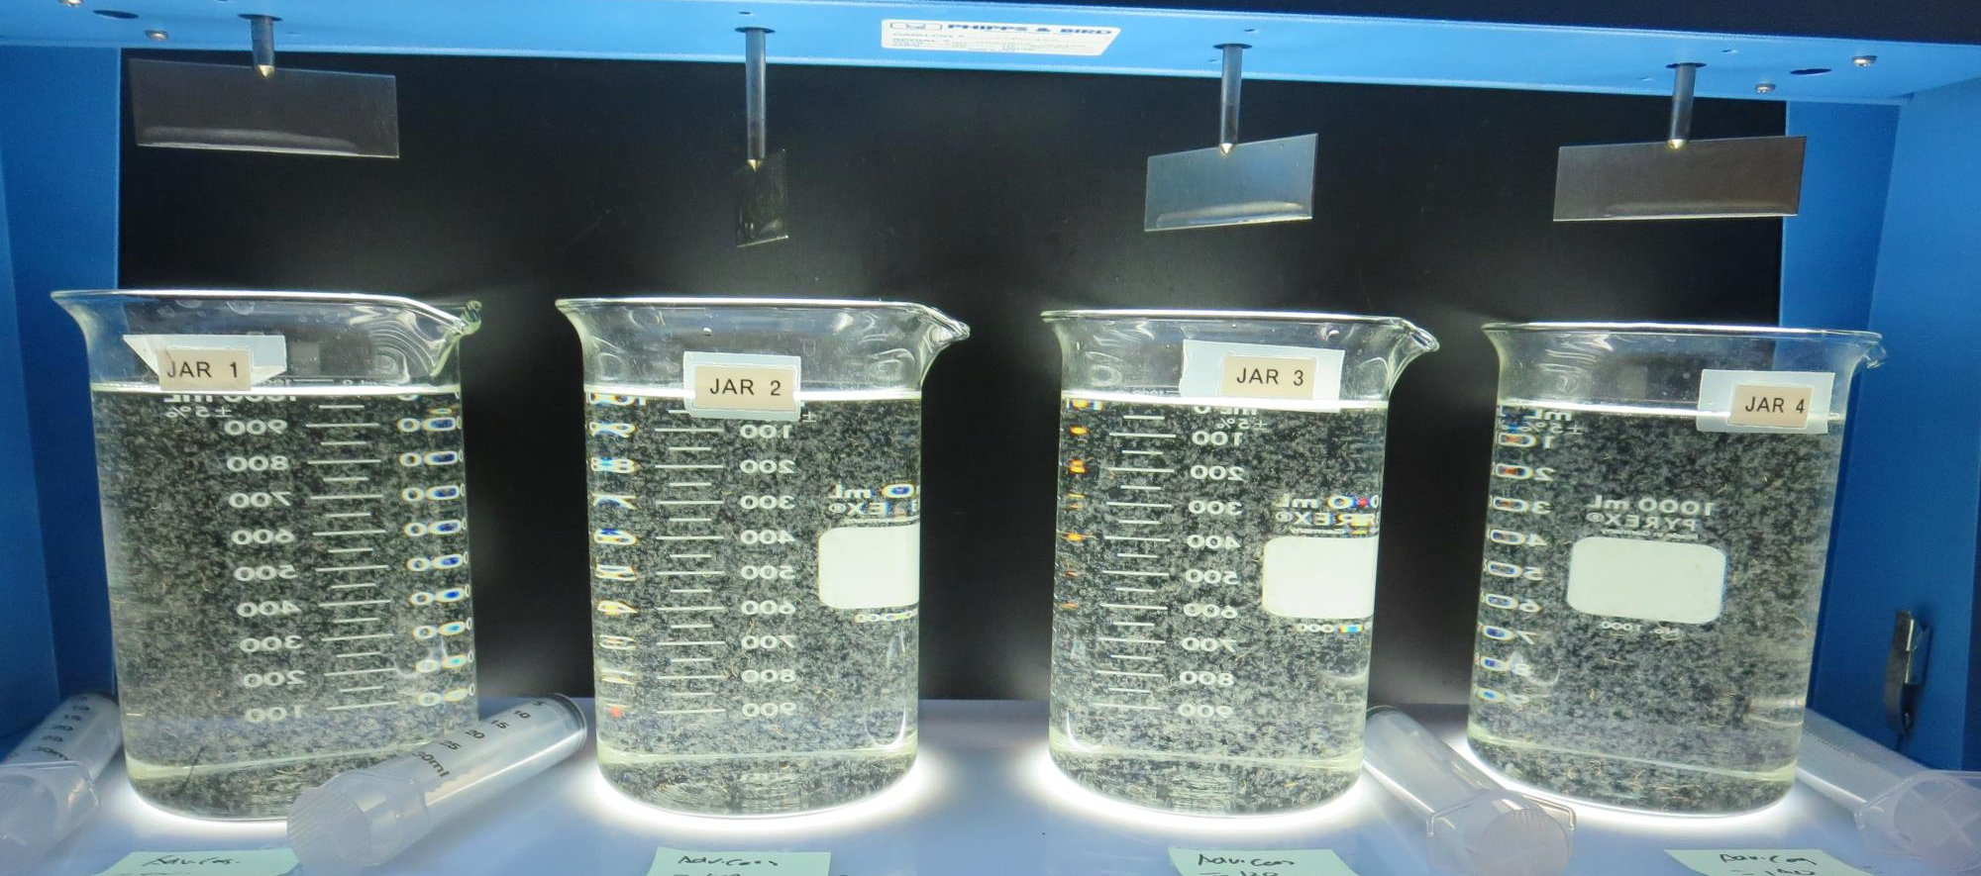
Jars 1-4: End of 5-minute flocculation (30 RPM) duration.
80 mg/L Adv Coag.
Filtrate 0.09 NTU
UVT: 89.7%
UVA: 0.046/cm
UVA Reduction 37%
Settled: 0.26 NTU
100 mg/L Adv Coag.
Filtrate 0.07 NTU
UVT: 90.5%
UVA: 0.043/cm
UVA Reduction 41.1%
Settled: 0.24 NTU
120 mg/L Adv Coag.
Filtrate 0.08 NTU
UVT: 90.9%
UVA: 0.041/cm
UVA Reduction 43.8%
Settled: 0.38 NTU
140 mg/L Adv Coag.
Filtrate 0.08 NTU
UVT: 91.5%
UVA: 0.038/cm
UVA Reduction 47.9%
Settled: 0.25 NTU

Slide 13
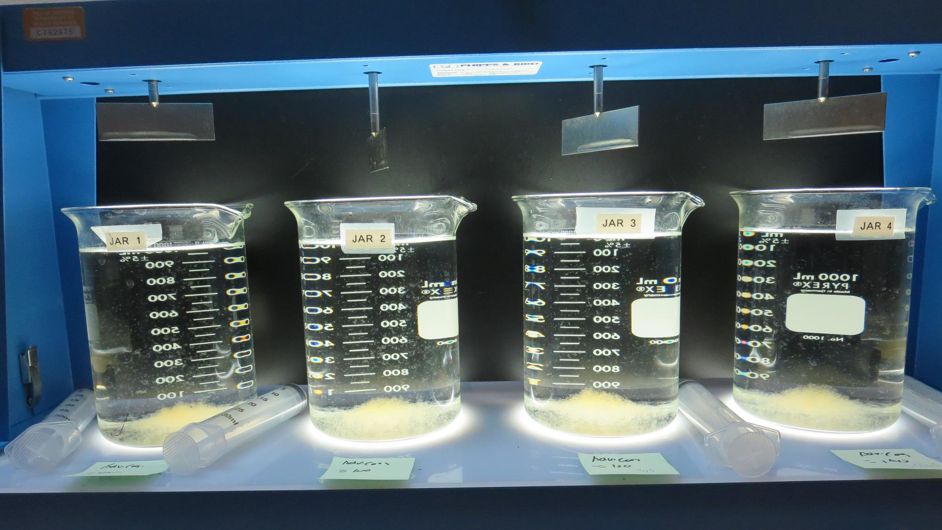
Jars 1-4: After 5 min of settling, 25 mL is syringed for filterability and %UVT/UVA.

Slide 14
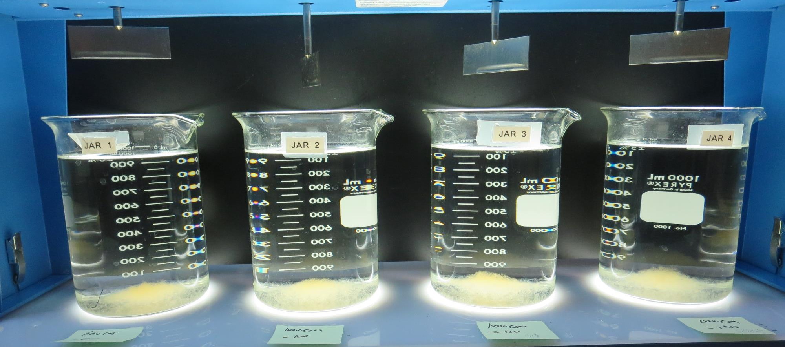
Jars 1-4: After 25-minutes of settling, settled water turbidity is taken.
80 mg/L Adv Coag.
Filtrate 0.09 NTU
UVT: 89.7%
UVA: 0.046/cm
UVA Reduction 37%
Settled: 0.26 NTU
100 mg/L Adv Coag.
Filtrate 0.07 NTU
UVT: 90.5%
UVA: 0.043/cm
UVA Reduction 41.1%
Settled: 0.24 NTU
120 mg/L Adv Coag.
Filtrate 0.08 NTU
UVT: 90.9%
UVA: 0.041/cm
UVA Reduction 43.8%
Settled: 0.38 NTU
140 mg/L Adv Coag.
Filtrate 0.08 NTU
UVT: 91.5%
UVA: 0.038/cm
UVA Reduction 47.9%
Settled: 0.25 NTU

Slide 15
Jars 5-8 Test Flash Mix 30 Sec (200 RPM) Floc Mix 5 min (30 RPM) Applied Coagulant Advanced Coagulant

Slide 16
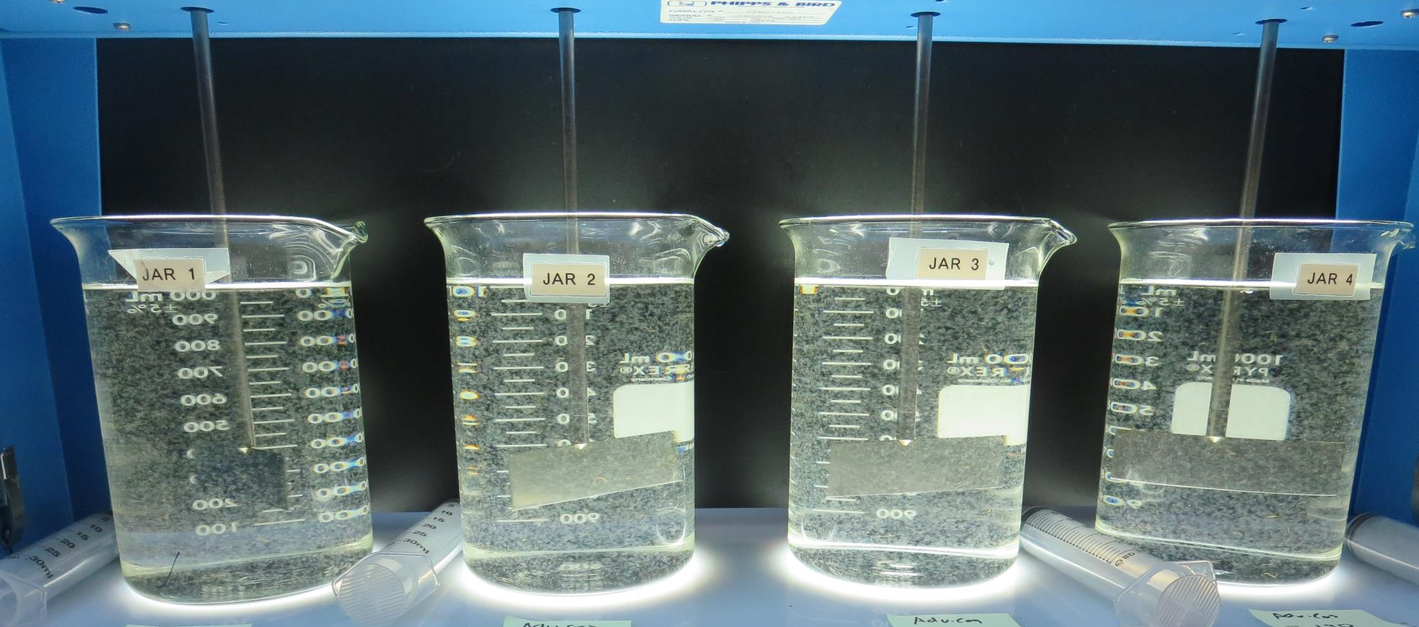
Jars 5-8: End of 5-minute flocculation (30 RPM) duration.
160 mg/L Adv Coag.
Filtrate 0.07 NTU
UVT: 91.1%
UVA: 0.040/cm
UVA Reduction 45.2%
Settled: 0.26 NTU
170 mg/L Adv Coag.
Filtrate 0.08 NTU
UVT: 91.5%
UVA: 0.038/cm
UVA Reduction 47.9%
Settled: 0.21 NTU
180 mg/L Adv Coag.
Filtrate 0.06 NTU
UVT: 91.5%
UVA: 0.038/cm
UVA Reduction 47.9%
Settled: 0.25 NTU
190 mg/L Adv Coag.
Filtrate 0.07 NTU
UVT: 92.1%
UVA: 0.035/cm
UVA Reduction 52.1%
Settled: 0.35 NTU

Slide 17
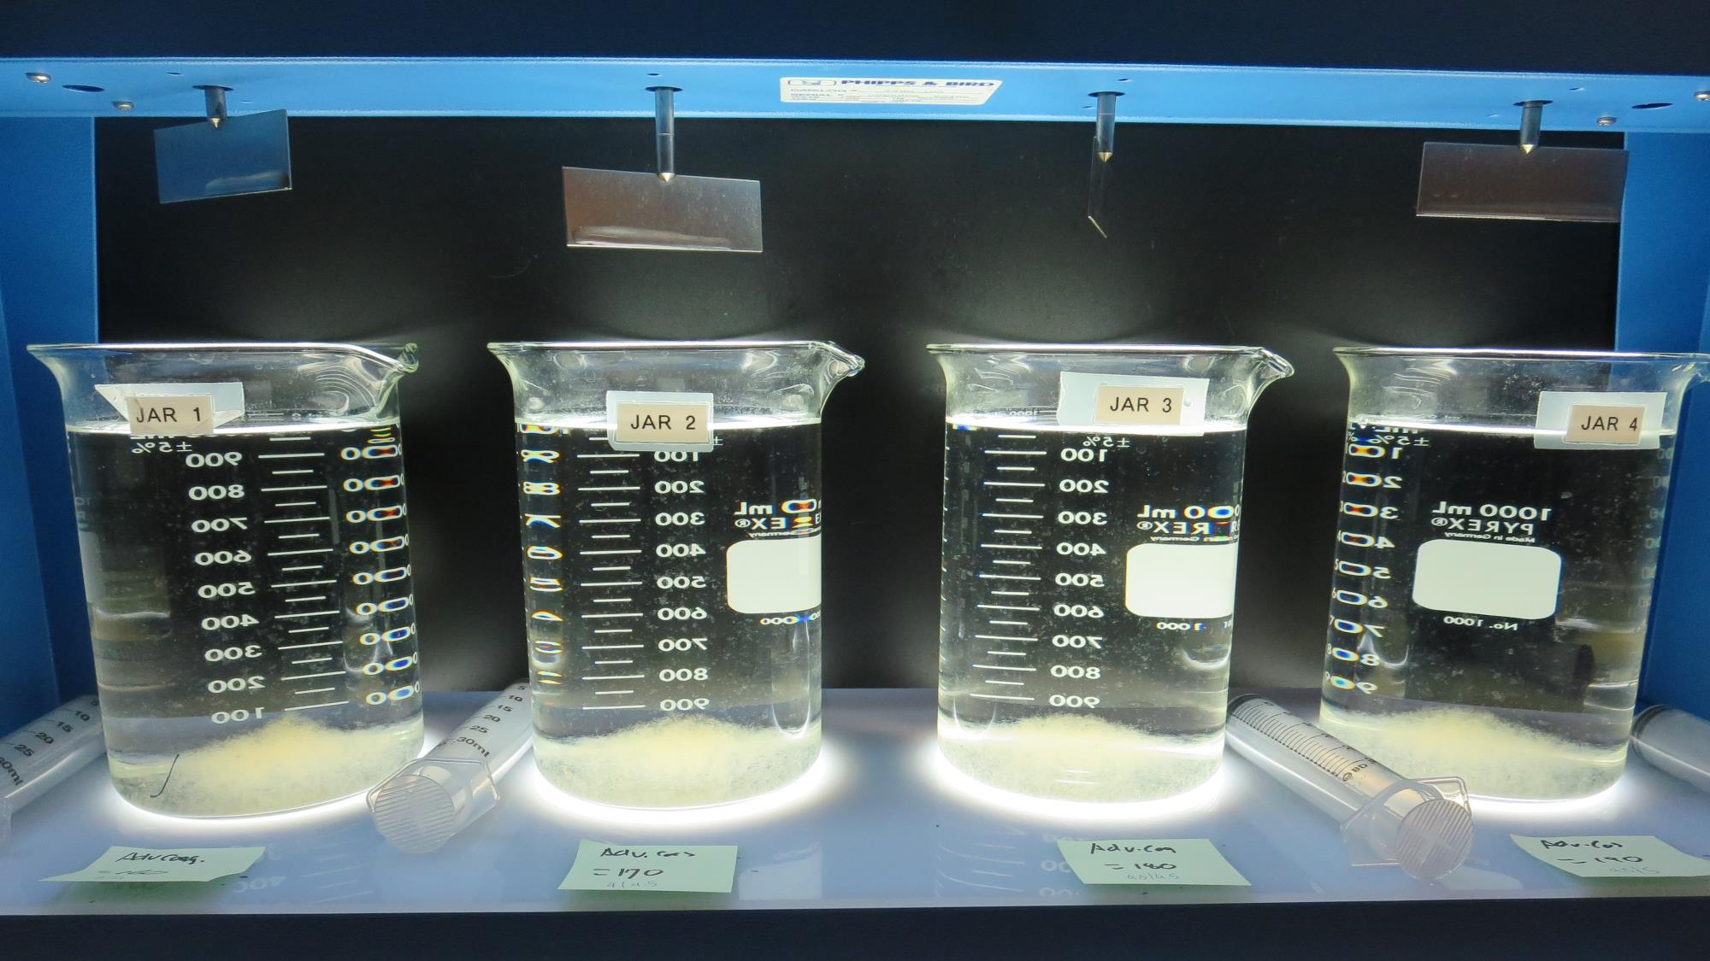
Jars 5-8: After 5 min of settling, 25 mL is syringed for filterability and %UVT/UVA.

Slide 18
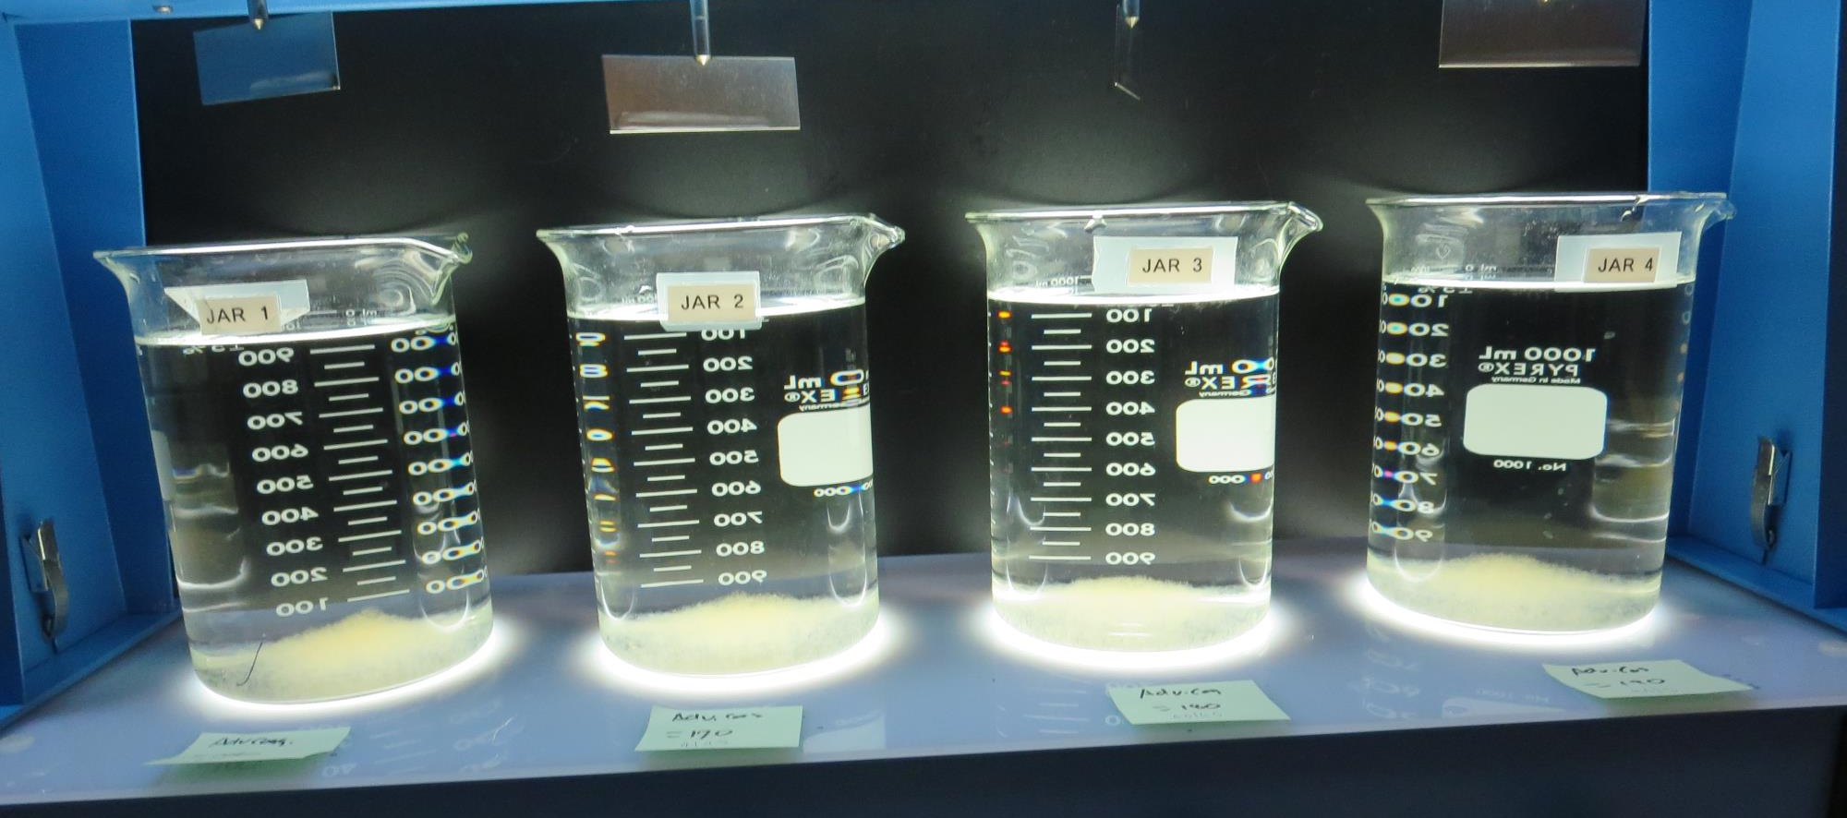
Jars 5-8: After 25-minutes of settling, settled water turbidity is taken.
160 mg/L Adv Coag.
Filtrate 0.07 NTU
UVT: 91.1%
UVA: 0.040/cm
UVA Reduction 45.2%
Settled: 0.26 NTU
170 mg/L Adv Coag.
Filtrate 0.08 NTU
UVT: 91.5%
UVA: 0.038/cm
UVA Reduction 47.9%
Settled: 0.21 NTU
180 mg/L Adv Coag.
Filtrate 0.06 NTU
UVT: 91.5%
UVA: 0.038/cm
UVA Reduction 47.9%
Settled: 0.25 NTU
190 mg/L Adv Coag.
Filtrate 0.07 NTU
UVT: 92.1%
UVA: 0.035/cm
UVA Reduction 52.1%
Settled: 0.35 NTU

Slide 19
Jars 9-12 Test Flash Mix 30 Sec (200 RPM) Floc Mix 5 min (30 RPM) Applied Coagulant Advanced Coagulant

Slide 20
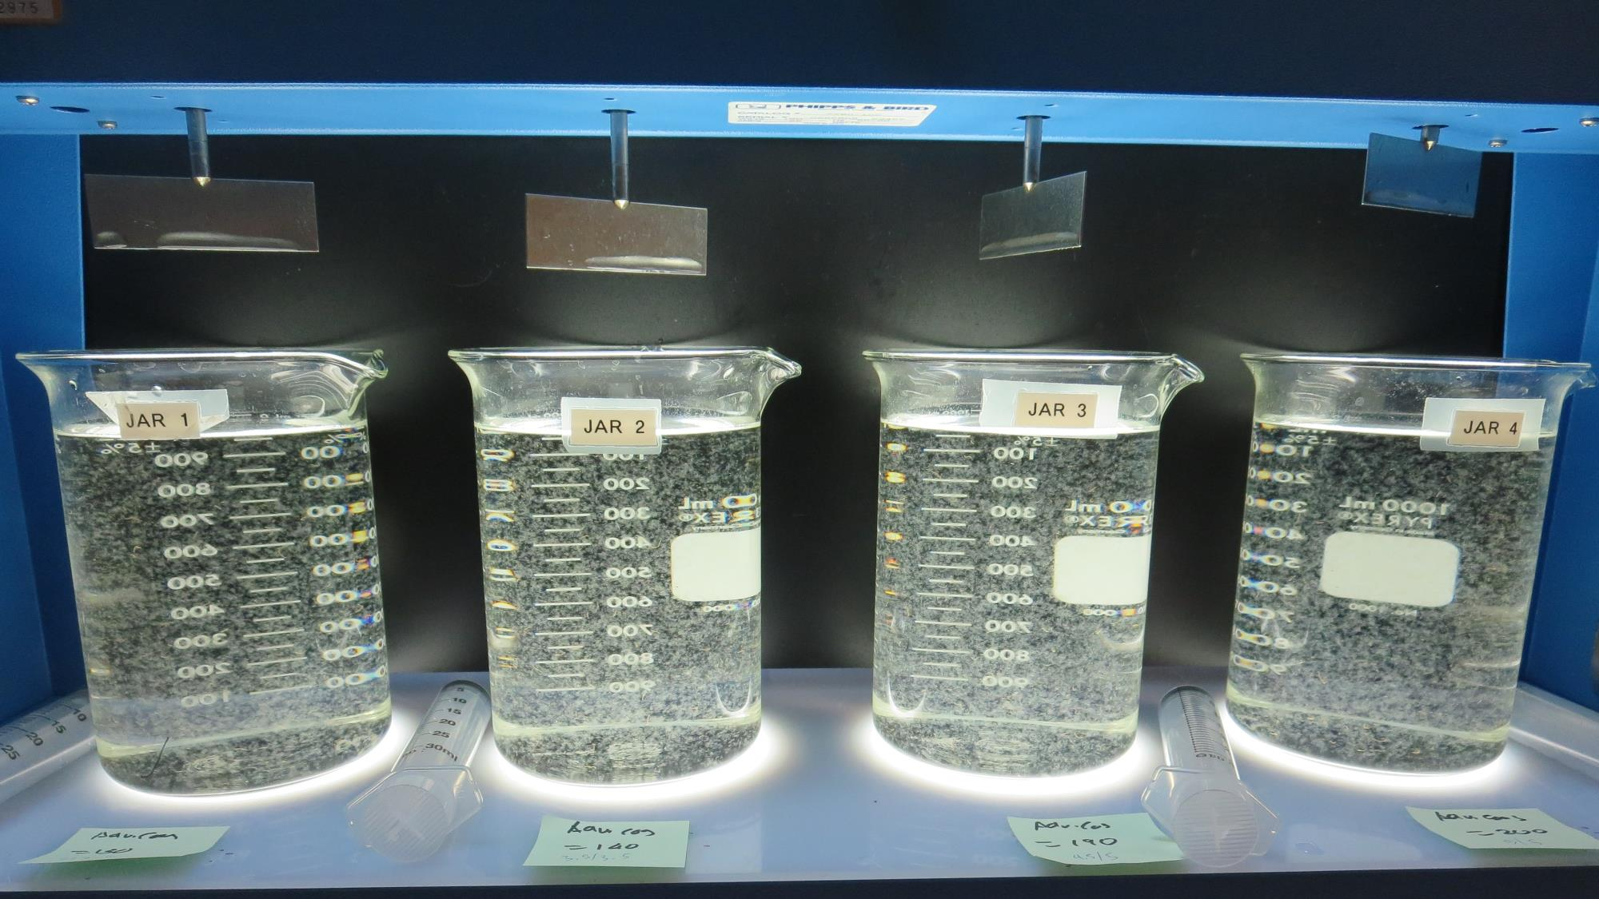
Jars 9-12: End of 5-minute flocculation (30 RPM) duration.
130 mg/L Adv Coag.
Filtrate 0.08 NTU
UVT: 90.6%
UVA: 0.042/cm
UVA Reduction 42.5%
Settled: 0.22 NTU
140 mg/L Adv Coag.
Filtrate 0.07 NTU
UVT: 90.9%
UVA: 0.041/cm
UVA Reduction 43.8%
Settled: 0.30 NTU
190 mg/L Adv Coag.
Filtrate 0.08 NTU
UVT: 91.6%
UVA: 0.037/cm
UVA Reduction 49.3%
Settled: 0.37 NTU
200 mg/L Adv Coag.
Filtrate 0.06 NTU
UVT: 92.0%
UVA: 0.035/cm
UVA Reduction 52.1%
Settled: 0.23 NTU

Slide 21
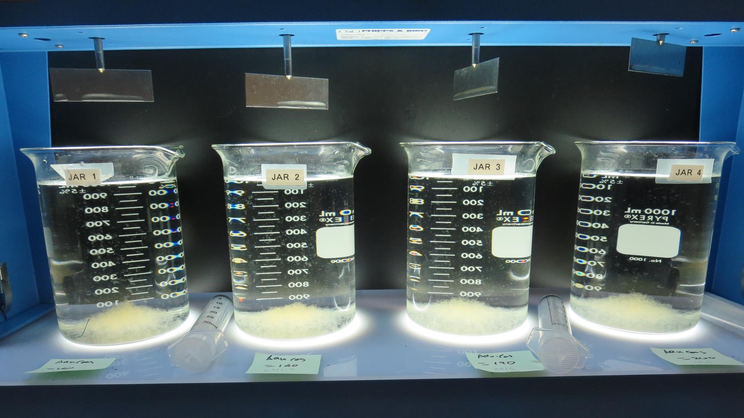
Jars 9-12: After 5 min of settling, 25 mL is syringed for filterability and %UVT/UVA.

Slide 22
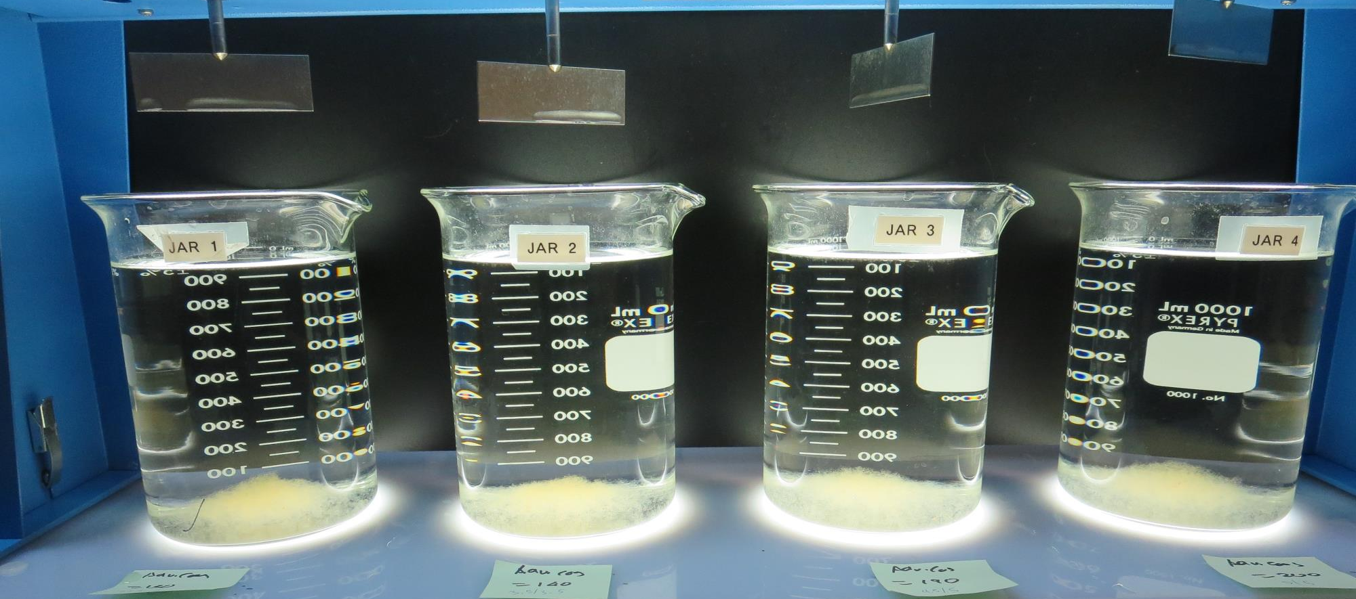
Jars 9-12: After 25-minutes of settling, settled water turbidity is taken.
130 mg/L Adv Coag.
Filtrate 0.08 NTU
UVT: 90.6%
UVA: 0.042/cm
UVA Reduction 37%
Settled: 0.22 NTU
140 mg/L Adv Coag.
Filtrate 0.07 NTU
UVT: 90.9%
UVA: 0.041/cm
UVA Reduction 37%
Settled: 0.30 NTU
190 mg/L Adv Coag.
Filtrate 0.08 NTU
UVT: 91.6%
UVA: 0.037/cm
UVA Reduction 37%
Settled: 0.37 NTU
200 mg/L Adv Coag.
Filtrate 0.06 NTU
UVT: 92.0%
UVA: 0.035/cm
UVA Reduction 37%
Settled: 0.23 NTU

Slide 23
Jar Testing for 1-Liter Jars: Procedures for Most Treatment Plants
Fill jars with source water prior to coagulant injection and set paddle speed at 30 rpm
Add chemicals (i.e., NaOCl, primary coagulant, coagulant aid) to each jar
Flash mix for 15-30 seconds (200 rpm)
Slow mix for 5 minutes (20-30 rpm)
Settled for 5 minutes. Syringe 25 mL from each jar taken 1-inch below surface (25 mL/12 sec rate).
Filtered through 1.2 um isopore membrane into cuvette drip rate, 15 mL/(50-90 sec)
Measure filtrate turbidity, chlorine residual and %UVT/UVA
Measure settled water turbidity after 25 minutes of total setting
Record all data

Slide 24
Jar Test Filterability Test Equipment
Turbidity Instrument
Syringe w/Luer-Lock Tip, 30 cc
(part#: 2225800, by Hach)
Swinnex Filter Holder, 25 mm (part#: SX0002500)
Isopore Membrane Filter, 1.2 um absolute
pore size,
Φ= 25 mm , thickness: 24 um,
hydrophilic polycarbonate membrane
(part #: RTTP02500)
Go to Sigma-Aldrich for laboratory supplies http://www.sigmaaldrich.com/united-states.html

Slide 25
Isopore Membrane Information
Categories | Information
trade name | Isopore
filter color | White
chemistry | Polycarbonate (PC)
water flow rate | Avg. 175 mL/min x cm² (typical results @ 10 psi)
media | Isopore®
wettability | Hydrophilic
porosity | 14.7%
pore size | 1.2 µm
bubble point at 23 °C | 1.0 bar, air with water
thickness | 24 µm
filter diameter (ø) | 25 mm
material size | polycarbonate, Hydrophilic, 1.2 µm, 25 mm, white, plain, 100

Slide 26
Isopore Membrane Background Information
The Isopore membrane is a polycarbonate, track-etched screen filter recommended for all analyses in which the sample is viewed on the surface of the membrane. The Isopore membrane is composed of polycarbonate film, which has a smooth, glass-like surface for clearer sample observation. The unique manufacturing process of the membrane ensures a precise pore diameter and a consistent pore size for accurate separation of samples by size. Matched-weight filters are not usually required because of low, constant tar and ash weights. Features & Benefits: Membrane structure retains particles on the surface, simplifying counting and analysis

Slide 27
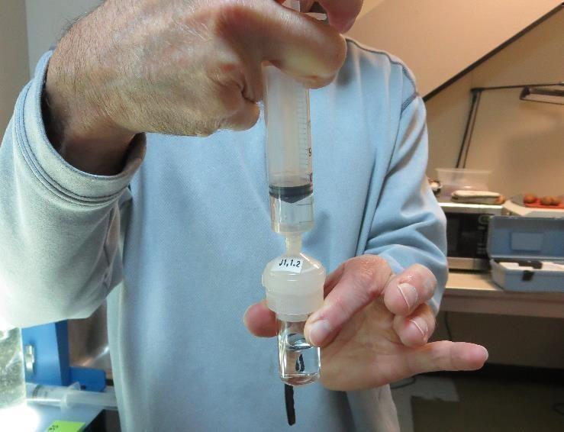
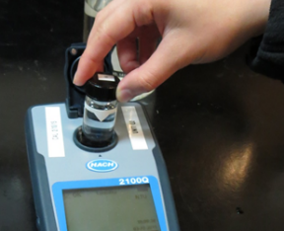
Jar Test - Filterability Test
Syringe ~ 25 mL from jar (after 5-minutes of settling)
Filter-to-waste 3-5 mL
Filter directly into clean cuvette
Measure turbidity
Note: Take several readings before recording final NTU results. Micro bubbles can adhere to glass causing false NTU readings. To remove bubbles, tilt cuvette up to 90 degrees.

Slide 28
Contact
Guy Schott, P.E.
State Water Resources Control Board
Division of Drinking Water
Santa Rosa, CA
Go to Stock Solution/Dose calculations/Jar Test Results for tools to download
www.waterboards.ca.gov/drinking_water/programs/districts/mendocino_district.html
Email: Guy Schott - Guy.Schott@waterboards.ca.gov
Office Number: 707-576-2732

