Slide 1
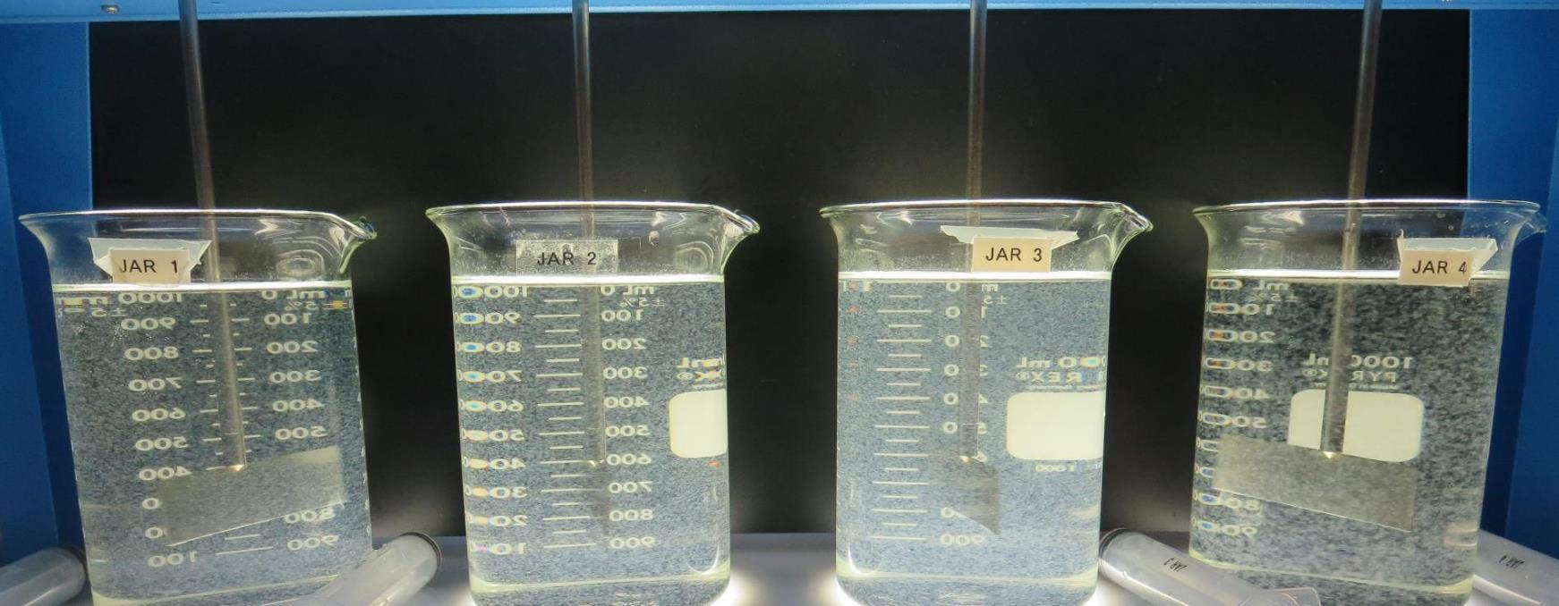
Benicia, City of CA4810001 Solano County Jar Test
by Guy Schott, P.E.
February 12, 2021

Slide 2
Source Water: North Bay Aqueduct

Slide 3
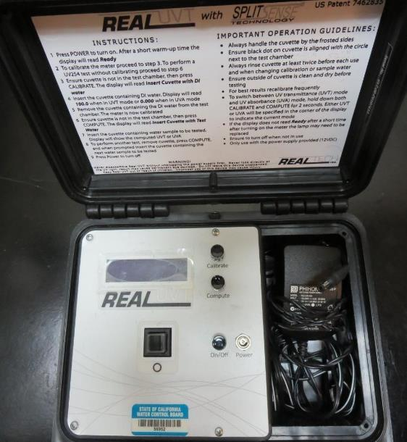
UVT/UVA, pathlength 10 mm
UV transmittance (UVT) is a measurement of the amount of ultraviolet light (254 nm) that passes through a water sample compared to the amount of light that passes through a pure water sample. The measurement is expressed as % UVT.
%UVT = 10^{(-UVA)} x 100%
UV absorbance (UVA) is calculated as a relative measure of the amount of light absorbed by a water sample compared with the amount of light absorbed by a pure water sample.
UVA = -log(%UVT/100)

Slide 4
City of Benicia WTP Water Characteristics February 12, 2021
Source
pH: 7.5-7.7
Alkalinity: 86 mg/L as CaCO₃
Turbidity: 6.06 NTU
UVT: 72.2%,
UVA: 0.141/cm
0.4 um Filtered
Turbidity: 0.37 NTU
UVT: 77.5%,
UVA: 0.110/cm
Plant Coagulant Dose:
5% Acid Alum: 46 mg/L
Clarifloc C-378: 0.5 mg/L
Filtrate Water (pre-chlorine)
Alkalinity: 56 mg/L as CaCO₃
Turbidity: 0.28 NTU
UVT: 92.3%,
UVA: 0.034/cm
Filtrate Water (post-Chlorine)
Turbidity: 0.05 NTU
UVT: 94.5%,
UVA: 0.024/cm

Slide 5
%UVA Reduction via Source Water Pre-Chlorination

Slide 6
Filtrate Water (Jar Test) Plant Coagulant Dose vs. Optimum Coagulant Dose

Slide 7
Filtrate Water (Jar Test) Plant Coagulant Dose vs. Optimum Coagulant Dose/PAC

Slide 8
Applied Coagulants for Jar Testing (1)
5% Acid Aluminum Sulfate (Product)
Al₂(SO₄)₃*14.3H₂0 (Liquid)
40% Aluminum Sulfate
5% H₂SO₄
55% Water
6.8% Al₂O₃
3.6% Al
0% Basicity
SG = 1.29
NSF limit: 400 mg/L (product)
As hydrated Al₂(SO₄)₃*14.3H₂0
17% Al₂O₃
Polydyne Incorporated
Clarifloc C-378
SG = 1.0 – 1.2
pDADMAC (20% active, 80% H₂O)
NSF limit: 50 mg/L (product)
Product dose 5 mg/L = 1 mg/L pDADMAC active

Slide 9
Applied Coagulants for Jar Testing (2)
Pro Pac 9810 (NTU Technologies)
45-50% Aluminum Chlorohydrate
45-50% Water
~22.4% Al₂O₃
~11.9% Al
83% Basicity
5% polyamine (50% water, 50% active polyamines)
SG = 1.25-1.34
NSF limit: 200 mg/L as Product;
Product dose 40 mg/L = 1 mg/L polyamines active
BWS, Inc.
AdvFloc-CTC-00011
Polyaluminum Hydroxy Chlorosulfate
12.55% Al₂O₃
6.64% Al
64.9% Basicity
SG = 1.299
NSF limit: 250 mg/L as Product

Slide 10
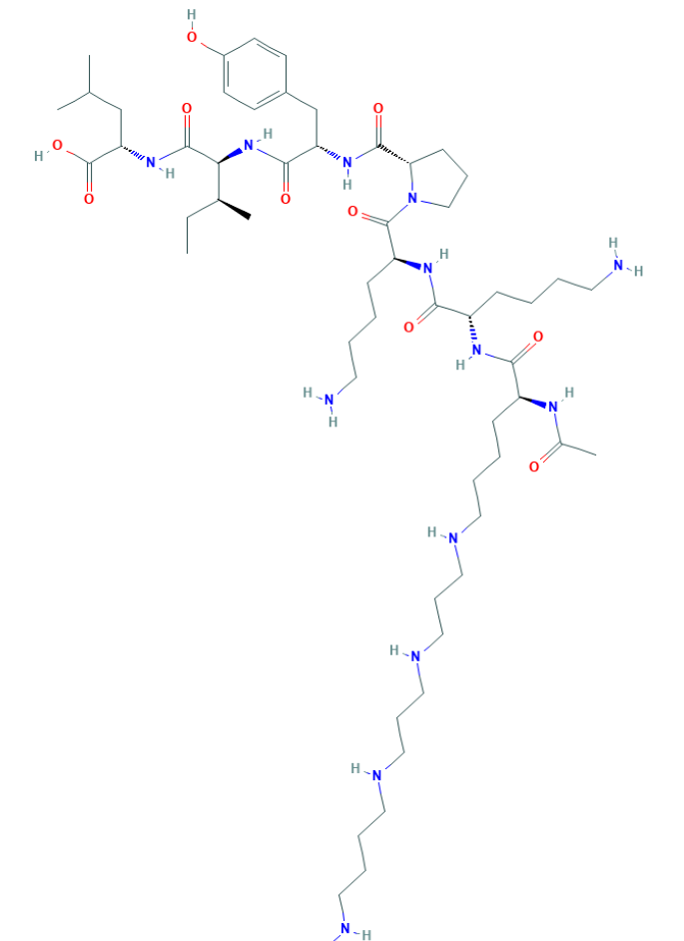
Polyamine C₅₉H₁₀₈N₁₄O₁₀ MW: 1,173.6 g/mol

Slide 11
Diallyldimethylammonium chloride or N-allyl-N,N-dimethylprop-2-en-1-aminium chloride pDADMAC C₈H₁₆ClN MW: 161.67 g/mol
CH₃
CH₂
CH₂
CH
N
+
CH
CH₂
CH₂
CH₃
Cl⁻

Slide 12
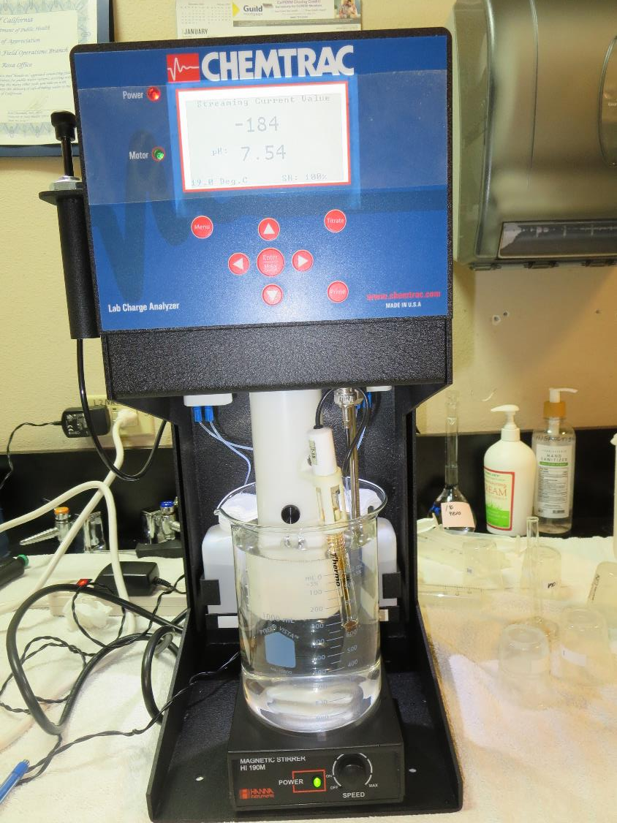
Laboratory Charge Analyzer
LCA: Used to determine coagulant demand of a source water entering the treatment plant.
Source pH: 7.72
LCA #1: 5% Acid Alum: 36.7 mg/L as hydrated
pH adjusted to 6.6 with acetic acid
LCA #2: 9810: 32.9 mg/L
pH adjusted to 7.5 with acetic acid
LCA #3: AdvFloc CTC-00011: 126 mg/L
pH adjusted to 7.5 with acetic acid

Slide 13
Coagulant Information
Unless stated otherwise, all coagulant doses are reported as Product (100% strength).
Aluminum Sulfate doses are reported as hydrated Al₂(SO₄)₃*14.3H₂0.
Preparation of coagulant stock solutions are generally 1.0 and/or 0.1 percent strength using 100 and/or 200 mL volumetric flasks.
Finnpipette F2 variable volume pipette, capacity 100-1000 micro liters is used for stock solution preparation and coagulant aid jar test dosing.
Finnpipette F2 variable volume pipette, capacity 0.5-5 mL is used for primary coagulant jar test dosing.

Slide 14
Alkalinity (mg/L as CaCO₃) Consumed based on Coagulant and Dose
Dose, mg/L | 5% Acid Alum (dry) | AdvFloc (product) | 9810 (product)
10 | 6.29 | 1.3 | 1.12
30 | 18.9 | 3.9 | 3.4
46 | 28.9 | 6.0 | 5.2
85 | 53.4 | 11 | 9.5
100 | 62.9 | 13 | 11.3
180 | 113 | 23.4 | 20.2

Slide 15
City of Benicia WTP; Source NBA; Summary of Plant Coagulant/Dose Jar vs. Best Jars
Jar# | 5% Acid Alum mg/L | AdvFloc CTC-0011 mg/L | CatFloc C-378 mg/L | 9810 mg/L | PAC mg/L | Filtrate NTU | Filtrate %UVT | Filtrate UVA/cm | %UVA Reduction | Settle NTU 25 min
A | 46 | 0 | 2.0 | 0 | 0 | 0.06 | 91.4 | 0.038 | 65.5 | 1.12
vs.
B | 85 | 0 | 3.1 | 0 | 0 | 0.04 | 93.4 | 0.029 | 73.6 | 1.84
C | 46 | 0 | 3.2 | 0 | 30 | 0.06 | 94.5 | 0.024 | 78.2 | 5.69
D | 0 | 180 | 4.0 | 0 | 0 | 0.04 | 93.6 | 0.028 | 74.5 | 0.49
E | 0 | 0 | 0 | 45 | 0 | 0.12 | 91.9 | 0.036 | 67.3 | 1.38

Slide 16
City of Benicia WTP; Source NBA; Jar Test 1 - 8 Results Flash Mix 200 RPM (30 sec); Floc Mix 30 RPM (5 min)
Jar# | 5% Acid Alum mg/L | Filtrate NTU | Filtrate %UVT | Filtrate UVA/cm | %UVA Reduction | Settle NTU 25 min
J1 | 25 | 0.18 | 87.2 | 0.059 | 46.4 | 3.93
J2 | 30 | 0.17 | 88.1 | 0.055 | 50.0 | 2.93
J3 | 35 | 0.17 | 88.9 | 0.051 | 53.6 | 2.48
J4 | 40 | 0.07 | 90.4 | 0.043 | 60.9 | 1.17
J5 | 40 | 0.15 | 89.9 | 0.046 | 58.2 | 1.40
J6 | 45 | 0.14 | 90.5 | 0.043 | 60.9 | 1.22
J7 | 50 | 0.20 | 90.4 | 0.043 | 60.9 | 1.37
J8 | 55 | 0.10 | 91.2 | 0.039 | 64.5 | 1.40

Slide 17
City of Benicia WTP; Source NBA; Jar Test 9 - 16 Results Flash Mix 200 RPM (30 sec); Floc Mix 30 RPM (5 min)
Jar# | 9810 mg/L | Filtrate NTU | Filtrate %UVT | Filtrate UVA/cm | %UVA Reduction | Settle NTU 25 min
J9 | 30 | 0.15 | 89.9 | 0.046 | 58.2 | 1.47
J10 | 33 | 0.15 | 90.0 | 0.045 | 59.1 | 1.20
J11 | 36 | 0.15 | 90.6 | 0.042 | 61.8 | 1.41
J12 | 39 | 0.15 | 90.8 | 0.041 | 62.7 | 1.64
J13 | 42 | 0.12 | 91.5 | 0.038 | 65.5 | 1.12
J14 | 45 | 0.12 | 91.9 | 0.036 | 67.3 | 1.38
J15 | 48 | 0.13 | 91.8 | 0.036 | 67.3 | 1.30
J16 | 51 | 0.17 | 91.9 | 0.036 | 67.3 | 1.45

Slide 18
City of Benicia WTP; Source NBA; Jar Test 17 - 24 Results Flash Mix 200 RPM (30 sec); Floc Mix 30 RPM (5 min)
Jar# | AdvFloc CTC-0011 mg/L | Filtrate NTU | Filtrate %UVT | Filtrate UVA/cm | %UVA Reduction | Settle NTU 25 min
J17 | 120 | 0.08 | 92.1 | 0.035 | 68.2 | N/A
J18 | 130 | 0.07 | 92.5 | 0.033 | 70.0 | N/A
J19 | 140 | 0.06 | 92.7 | 0.032 | 70.9 | N/A
J20 | 150 | 0.06 | 92.9 | 0.031 | 71.8 | N/A
J21 | 140 | 0.09 | 92.0 | 0.036 | 67.3 | 0.35
J22 | 150 | 0.06 | 92.3 | 0.034 | 69.1 | 0.35
J23 | 160 | 0.06 | 92.5 | 0.033 | 70.0 | 0.29
J24 | 170 | 0.05 | 92.5 | 0.032 | 70.9 | 0.26

Slide 19
City of Benicia WTP; Source NBA; Jar Test 25 - 32 Results Flash Mix 200 RPM (30 sec); Floc Mix 30 RPM (5 min)
Jar# | 5% Acid Alum mg/L | CatFloc C-378 mg/L | Filtrate NTU | Filtrate %UVT | Filtrate UVA/cm | %UVA Reduction | Settle NTU 25 min
J25 | 46 | 0 | 0.13 | 90.6 | 0.042 | 61.8 | 1.02
J26 | 46 | 0.5 | 0.12 | 90.7 | 0.042 | 61.8 | 1.22
J27 | 46 | 1.0 | 0.11 | 90.9 | 0.041 | 62.7 | 1.30
J28 | 46 | 1.5 | 0.08 | 91.2 | 0.039 | 64.5 | 1.30
J29 | 46 | 1.5 | 0.08 | 91.2 | 0.039 | 64.5 | 0.95
J30 | 46 | 2.0 | 0.05 | 91.2 | 0.039 | 64.5 | 1.16
J31 | 56 | 1.5 | 0.05 | 91.9 | 0.036 | 67.3 | 1.15
J32 | 56 | 2.0 | 0.05 | 92.0 | 0.035 | 68.2 | 1.30

Slide 20
City of Benicia WTP; Source NBA; Jar Test 33 - 36 Results Flash Mix 200 RPM (30 sec); Floc Mix 30 RPM (5 min)
Jar# | 5% Acid Alum mg/L | CatFloc C-378 mg/L | Filtrate NTU | Filtrate %UVT | Filtrate UVA/cm | %UVA Reduction | Settle NTU 25 min
J33 | 55 | 2.0 | 0.05 | 92.1 | 0.035 | 68.2 | 1.39
J34 | 65 | 2.4 | 0.05 | 92.7 | 0.032 | 70.9 | 1.60
J35 | 75 | 2.7 | 0.04 | 93.0 | 0.031 | 71.8 | 1.94
J36 | 85 | 3.1 | 0.04 | 93.3 | 0.029 | 73.6 | 1.62

Slide 21
City of Benicia WTP; Source NBA; Jar Test 37 - 40 Results Flash Mix 200 RPM (30 sec); Floc Mix 30 RPM (5 min)
Jar# | AdvFloc CTC-0011 mg/L | CatFloc C-378 mg/L | Filtrate NTU | Filtrate %UVT | Filtrate UVA/cm | %UVA Reduction | Settle NTU 25 min
J37 | 180 | 0.0 | 0.06 | 93.0 | 0.031 | 71.8 | 0.37
J38 | 180 | 2.0 | 0.04 | 93.4 | 0.029 | 73.6 | 0.40
J39 | 180 | 3.0 | 0.04 | 93.7 | 0.028 | 74.5 | 0.39
J40 | 180 | 4.0 | 0.04 | 93.8 | 0.027 | 75.5 | 0.48

Slide 22
City of Benicia WTP; Source NBA; Jar Test 41 - 44 Results Flash Mix 200 RPM (30 sec); Floc Mix 30 RPM (5 min)
Jar# | 5% Acid Alum mg/L | AdvFloc CTC-0011 mg/L | CatFloc C-378 mg/L | Filtrate NTU | Filtrate %UVT | Filtrate UVA/cm | %UVA Reduct | Settle NTU 25 min
J41 | 46 | 0 | 0 | 0.12 | 90.6 | 0.042 | 61.8 | 0.89
J42 | 46 | 0 | 2.0 | 0.06 | 91.4 | 0.038 | 65.5 | 1.12
J43 | 85 | 0 | 3.1 | 0.04 | 93.4 | 0.029 | 73.6 | 1.84
J44 | 0 | 180 | 4.0 | 0.04 | 93.6 | 0.028 | 74.5 | 0.49

Slide 23
City of Benicia WTP; Source NBA; Jar Test 45 - 52 Results Flash Mix 200 RPM (30 sec); Floc Mix 30 RPM (15 min)
Jar# | 5% Acid Alum mg/L | CatFloc C-378 mg/L | PAC mg/L | Filtrate NTU | Filtrate %UVT | Filtrate UVA/cm | %UVA Reduction | Settle NTU 25 min
J45 | 46 | 2.2 | 0 | 0.08 | 91.0 | 0.040 | 63.6 | 0.51
J46 | 46 | 2.2 | 20 | 0.11 | 93.2 | 0.030 | 72.7 | 3.01
J47 | 46 | 2.2 | 30 | 0.11 | 93.9 | 0.027 | 75.7 | 5.06
J48 | 46 | 2.2 | 40 | 0.16 | 93.9 | 0.027 | 75.7 | 5.74
J49 | 46 | 2.2 | 0 | 0.05 | 90.9 | 0.041 | 62.7 | 0.48
J50 | 46 | 2.2 | 30 | 0.10 | 93.7 | 0.028 | 74.5 | 4.72
J51 | 46 | 3.2 | 30 | 0.06 | 94.5 | 0.024 | 78.2 | 5.69
J52 | 46 | 4.2 | 30 | 0.05 | 93.9 | 0.027 | 75.5 | 6.10

Slide 24
Jars 1-4 Test Flash Mix 30 Sec (200 RPM) Floc Mix 5 min (30 RPM) Applied Coagulant 5% Acid Alum

Slide 25
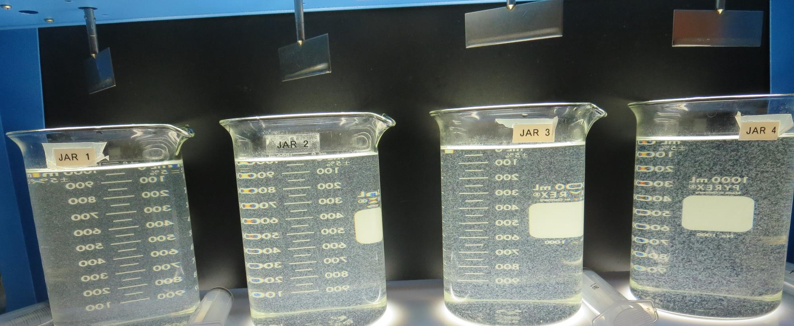
Jars 1-4: End of 5-minute flocculation (30 RPM) duration.
25 mg/L 5% Acid Alum
Filtrate 0.18 NTU
UVT: 87.2%
UVA: 0.059/cm
UVA Reduction 46.4%
Settled: 3.91 NTU
30 mg/L 5% Acid Alum
Filtrate 0.17 NTU
UVT: 88.1%
UVA: 0.055/cm
UVA Reduction 50.0%
Settled: 2.93 NTU
35 mg/L 5% Acid Alum
Filtrate 0.17 NTU
UVT: 88.9%
UVA: 0.051/cm
UVA Reduction 53.6%
Settled: 2.48 NTU
40 mg/L 5% Acid Alum
Filtrate 0.07 NTU
UVT: 90.4%
UVA: 0.043/cm
UVA Reduction 60.9%
Settled: 1.17 NTU

Slide 26
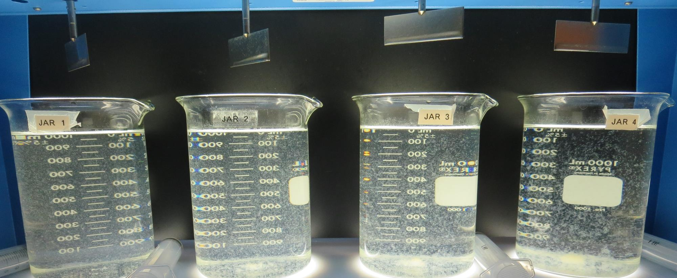
Jars 1-4: After 5 min of settling, 25 mL is syringed for filterability and %UVT/UVA.

Slide 27
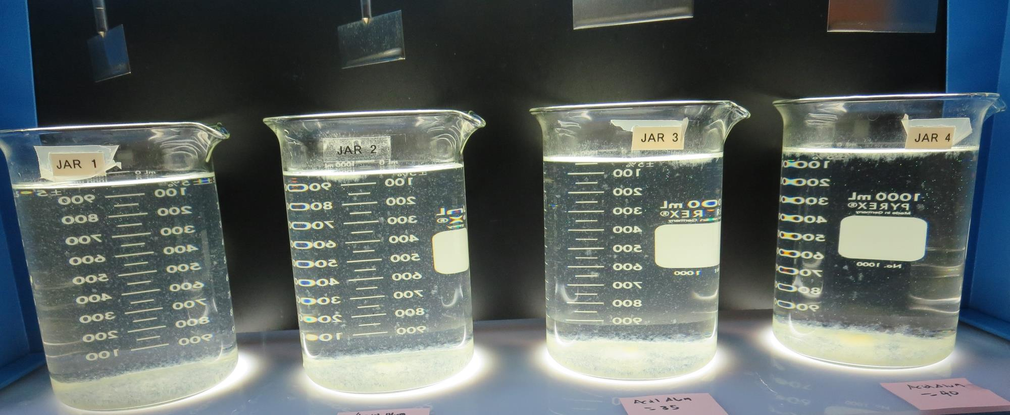
Jars 1-4: After 25-minutes of settling, settled water turbidity is taken.
25 mg/L 5% Acid Alum
Filtrate 0.18 NTU
UVT: 87.2%
UVA: 0.059/cm
UVA Reduction 46.4%
Settled: 3.91 NTU
30 mg/L 5% Acid Alum
Filtrate 0.17 NTU
UVT: 88.1%
UVA: 0.055/cm
UVA Reduction 50.0%
Settled: 2.93 NTU
35 mg/L 5% Acid Alum
Filtrate 0.17 NTU
UVT: 88.9%
UVA: 0.051/cm
UVA Reduction 53.6%
Settled: 2.48 NTU
40 mg/L 5% Acid Alum
Filtrate 0.07 NTU
UVT: 90.4%
UVA: 0.043/cm
UVA Reduction 60.9%
Settled: 1.17 NTU

Slide 28
Jars 5-8 Test Flash Mix 30 Sec (200 RPM) Floc Mix 5 min (30 RPM) Applied Coagulant 5% Acid Alum

Slide 29
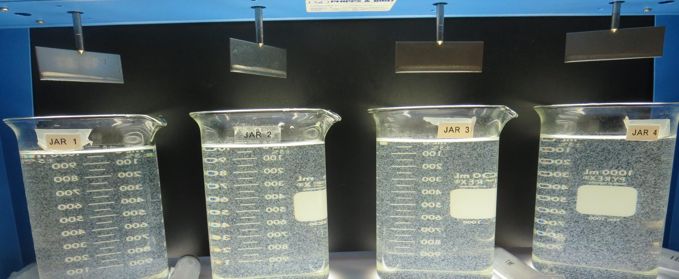
Jars 5-8: End of 5-minute flocculation (30 RPM) duration.
40 mg/L 5% Acid Alum
Filtrate 0.15 NTU
UVT: 89.9%
UVA: 0.046/cm
UVA Reduction 58.2%
Settled: 1.40 NTU
45 mg/L 5% Acid Alum
Filtrate 0.14 NTU
UVT: 90.5%
UVA: 0.043/cm
UVA Reduction 60.9%
Settled: 1.22 NTU
50 mg/L 5% Acid Alum
Filtrate 0.20 NTU
UVT: 90.4%
UVA: 0.043/cm
UVA Reduction 60.9%
Settled: 1.37 NTU
55 mg/L 5% Acid Alum
Filtrate 0.10 NTU
UVT: 91.2%
UVA: 0.039/cm
UVA Reduction 64.5%
Settled: 1.40 NTU

Slide 30
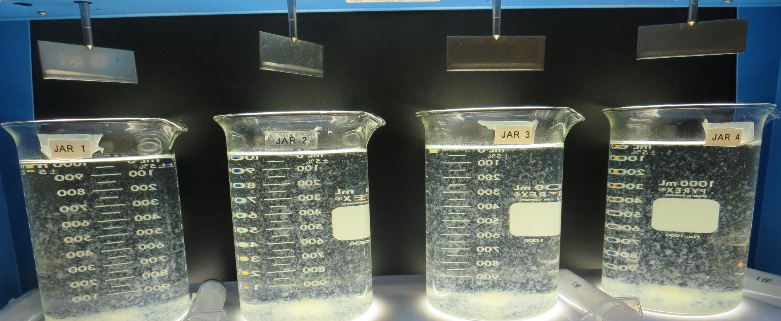
Jars 5-8: After 5 min of settling, 25 mL is syringed for filterability and %UVT/UVA.

Slide 31
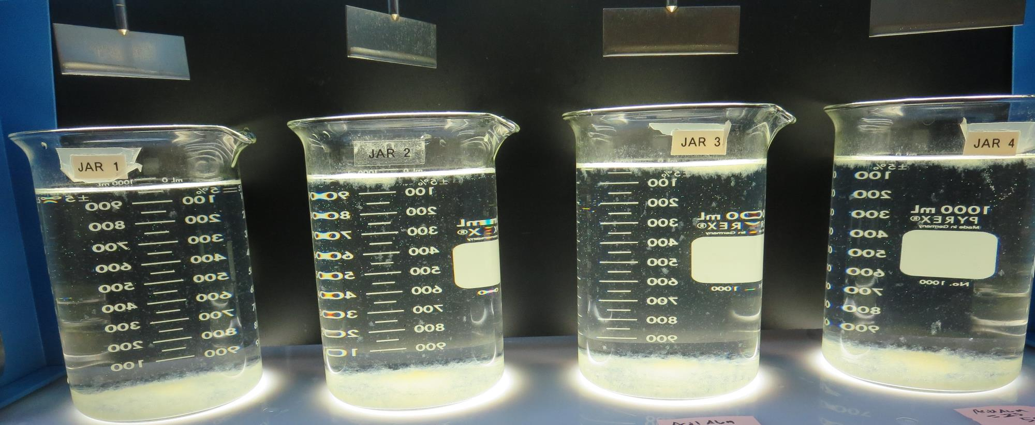
Jars 5-8: After 25-minutes of settling, settled water turbidity is taken.
40 mg/L 5% Acid Alum
Filtrate 0.15 NTU
UVT: 89.9%
UVA: 0.046/cm
UVA Reduction 58.2%
Settled: 1.40 NTU
45 mg/L 5% Acid Alum
Filtrate 0.14 NTU
UVT: 90.5%
UVA: 0.043/cm
UVA Reduction 60.9%
Settled: 1.22 NTU
50 mg/L 5% Acid Alum
Filtrate 0.20 NTU
UVT: 90.4%
UVA: 0.043/cm
UVA Reduction 60.9%
Settled: 1.37 NTU
55 mg/L 5% Acid Alum
Filtrate 0.10 NTU
UVT: 91.2%
UVA: 0.039/cm
UVA Reduction 64.5%
Settled: 1.40 NTU

Slide 32
Jars 9-12 Test Flash Mix 30 Sec (200 RPM) Floc Mix 5 min (30 RPM) Applied Coagulant 9810

Slide 33
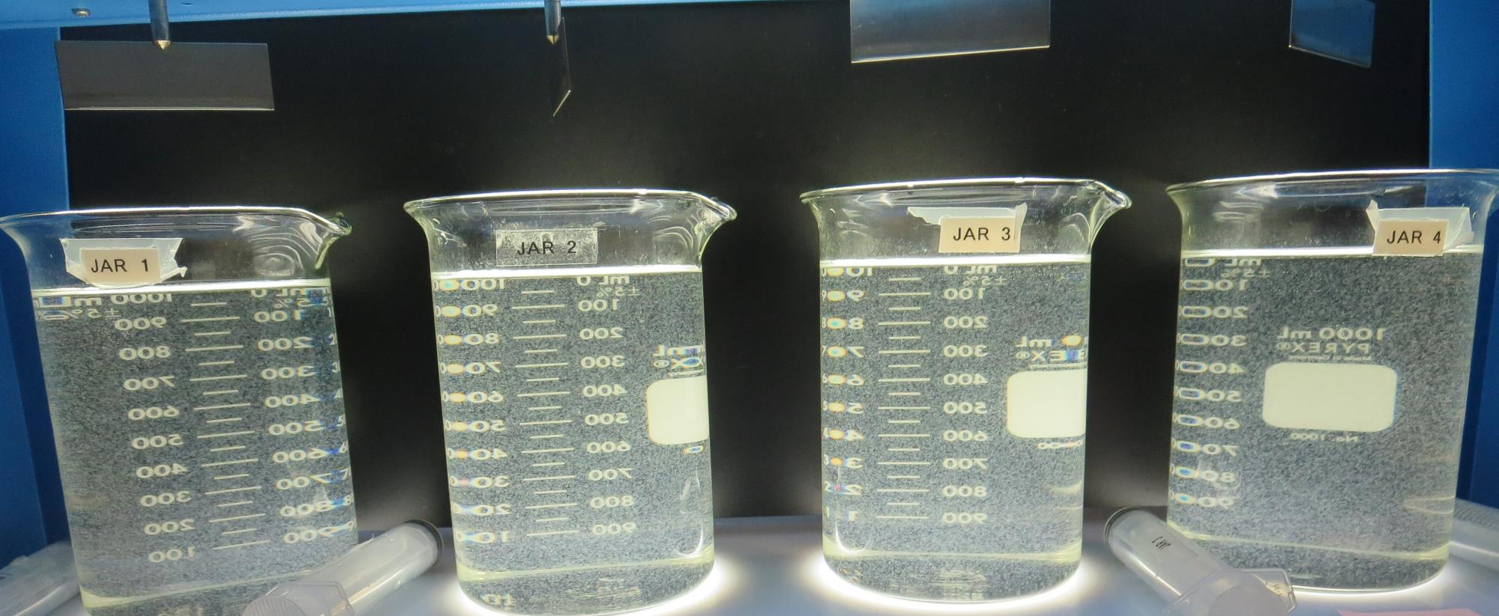
Jars 9-12: End of 5-minute flocculation (30 RPM) duration.
30 mg/L 9810
Filtrate 0.15 NTU
UVT: 89.9%
UVA: 0.046/cm
UVA Reduction 58.2%
Settled: 1.47 NTU
33 mg/L 9810
Filtrate 0.15 NTU
UVT: 90.0%
UVA: 0.045/cm
UVA Reduction 59.1%
Settled: 1.20 NTU
36 mg/L 9810
Filtrate 0.15 NTU
UVT: 90.6%
UVA: 0.042/cm
UVA Reduction 61.8%
Settled: 1.41 NTU
39 mg/L 9810
Filtrate 0.15 NTU
UVT: 90.8%
UVA: 0.041/cm
UVA Reduction 62.7%
Settled: 1.64 NTU

Slide 34
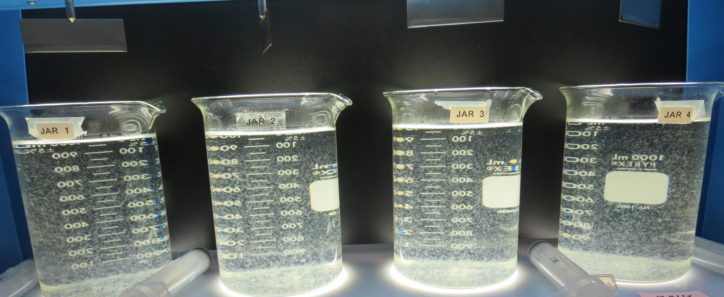
Jars 9-12: After 5 min of settling, 25 mL is syringed for filterability and %UVT/UVA.

Slide 35
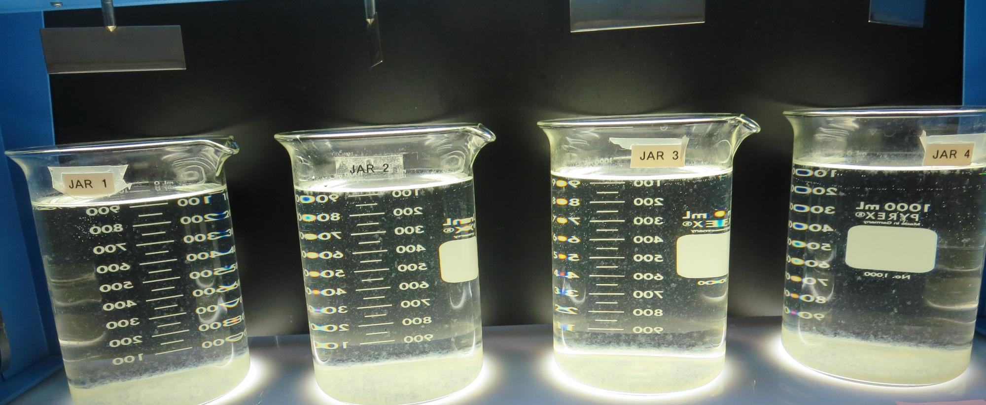
Jars 9-12: After 25-minutes of settling, settled water turbidity is taken.
30 mg/L 9810
Filtrate 0.15 NTU
UVT: 89.9%
UVA: 0.046/cm
UVA Reduction 58.2%
Settled: 1.47 NTU
33 mg/L 9810
Filtrate 0.15 NTU
UVT: 90.0%
UVA: 0.045/cm
UVA Reduction 59.1%
Settled: 1.20 NTU
36 mg/L 9810
Filtrate 0.15 NTU
UVT: 90.6%
UVA: 0.042/cm
UVA Reduction 61.8%
Settled: 1.41 NTU
39 mg/L 9810
Filtrate 0.15 NTU
UVT: 90.8%
UVA: 0.041/cm
UVA Reduction 62.7%
Settled: 1.64 NTU

Slide 36
Jars 13-16 Test Flash Mix 30 Sec (200 RPM) Floc Mix 5 min (30 RPM) Applied Coagulant 9810

Slide 37
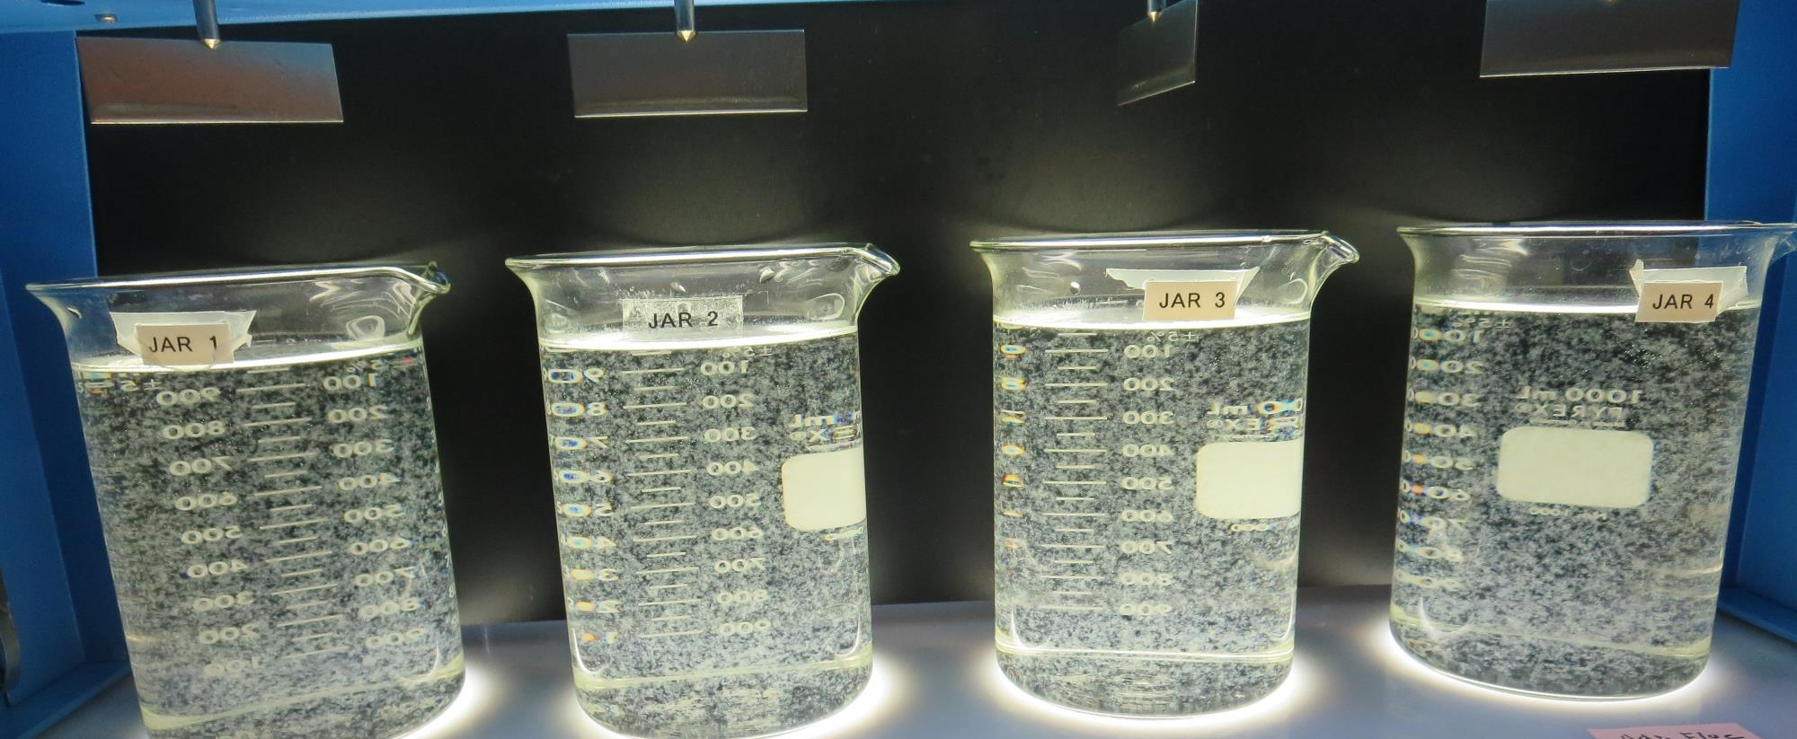
Jars 13-16: End of 5-minute flocculation (30 RPM) duration.
42 mg/L 9810
Filtrate 0.12 NTU
UVT: 91.5%
UVA: 0.038/cm
UVA Reduction 65.5%
Settled: 1.12 NTU
45 mg/L 9810
Filtrate 0.12 NTU
UVT: 91.9%
UVA: 0.036/cm
UVA Reduction 67.3%
Settled: 1.38 NTU
48 mg/L 9810
Filtrate 0.13 NTU
UVT: 91.8%
UVA: 0.036/cm
UVA Reduction 67.3%
Settled: 1.30 NTU
51 mg/L 9810
Filtrate 0.17 NTU
UVT: 91.9%
UVA: 0.036/cm
UVA Reduction 67.3%
Settled: 1.45 NTU

Slide 38
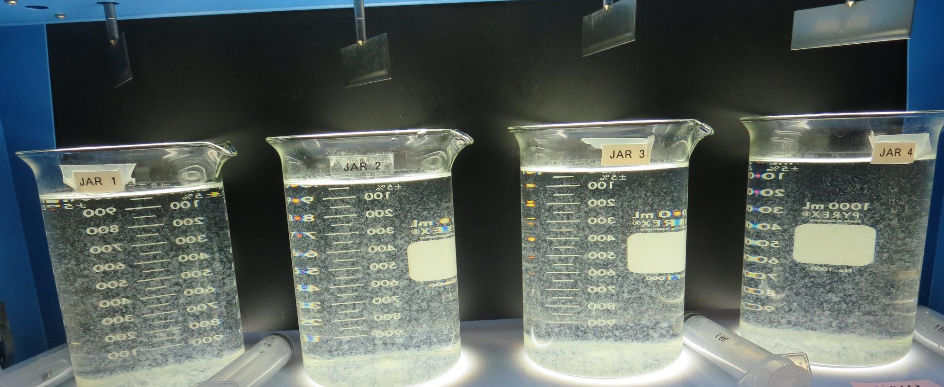
Jars 13-16: After 5 min of settling, 25 mL is syringed for filterability and %UVT/UVA.

Slide 39
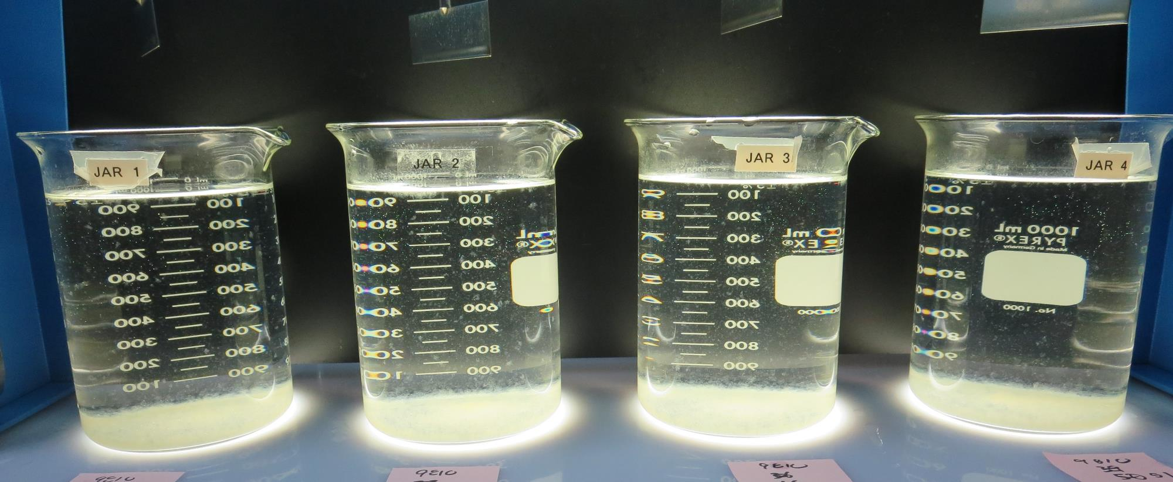
Jars 13-16: After 25-minutes of settling, settled water turbidity is taken.
42 mg/L 9810
Filtrate 0.12 NTU
UVT: 91.5%
UVA: 0.038/cm
UVA Reduction 65.5%
Settled: 1.12 NTU
45 mg/L 9810
Filtrate 0.12 NTU
UVT: 91.9%
UVA: 0.036/cm
UVA Reduction 67.3%
Settled: 1.38 NTU
48 mg/L 9810
Filtrate 0.13 NTU
UVT: 91.8%
UVA: 0.036/cm
UVA Reduction 67.3%
Settled: 1.30 NTU
51 mg/L 9810
Filtrate 0.17 NTU
UVT: 91.9%
UVA: 0.036/cm
UVA Reduction 67.3%
Settled: 1.45 NTU

Slide 40
Jars 17-20 Test Flash Mix 30 Sec (200 RPM) Floc Mix 5 min (30 RPM) Applied Coagulant AdvFloc CTC-00011

Slide 41
Jars 17-20: End of 5-minute flocculation (30 RPM) duration.
120 mg/L AdvFloc
Filtrate 0.08 NTU
UVT: 92.1%
UVA: 0.035/cm
UVA Reduction 68.2%
Settled: N/A NTU
130 mg/L AdvFloc
Filtrate 0.07 NTU
UVT: 92.5%
UVA: 0.033/cm
UVA Reduction 70.0%
Settled: N/A NTU
140 mg/L AdvFloc
Filtrate 0.06 NTU
UVT: 92.7%
UVA: 0.032/cm
UVA Reduction 7.8%
Settled: N/A NTU
150 mg/L AdvFloc
Filtrate 0.06 NTU
UVT: 92.9%
UVA: 0.031/cm
UVA Reduction 71.8%
Settled: N/A NTU

Slide 42
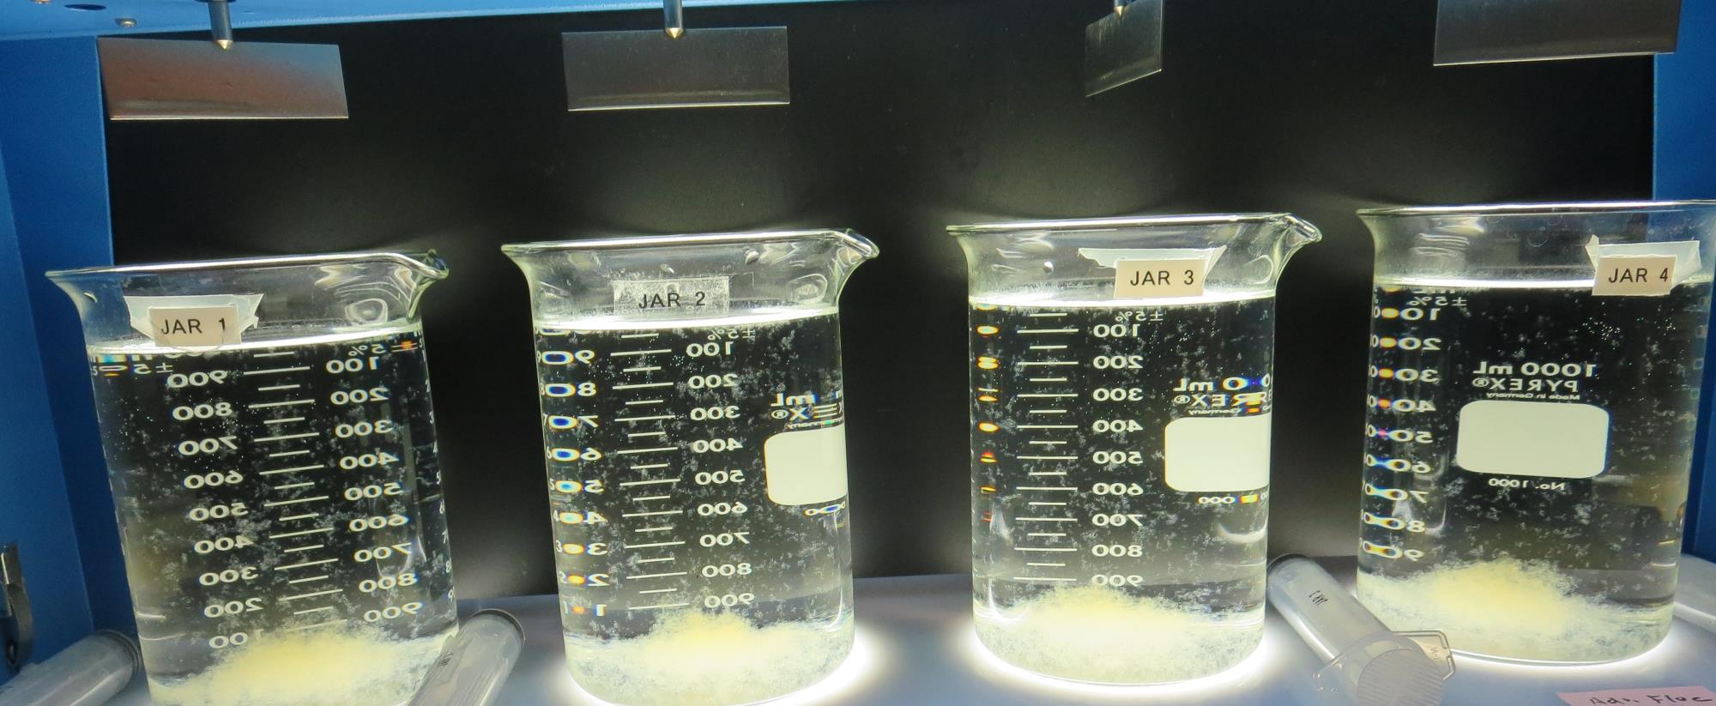
Jars 17-20: After 5 min of settling, 25 mL is syringed for filterability and %UVT/UVA.

Slide 43
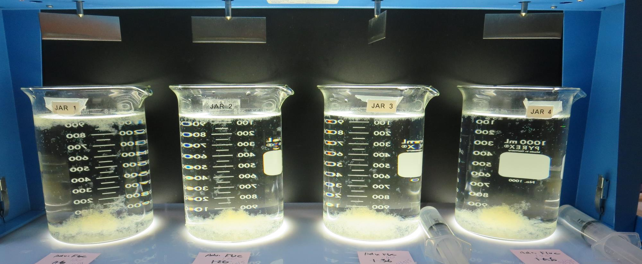
Jars 17-20: After 25-minutes of settling, settled water turbidity is taken.
120 mg/L AdvFloc
Filtrate 0.08 NTU
UVT: 92.1%
UVA: 0.035/cm
UVA Reduction 68.2%
Settled: N/A NTU
130 mg/L AdvFloc
Filtrate 0.07 NTU
UVT: 92.5%
UVA: 0.033/cm
UVA Reduction 70.0%
Settled: N/A NTU
140 mg/L AdvFloc
Filtrate 0.06 NTU
UVT: 92.7%
UVA: 0.032/cm
UVA Reduction 7.8%
Settled: N/A NTU
150 mg/L AdvFloc
Filtrate 0.06 NTU
UVT: 92.9%
UVA: 0.031/cm
UVA Reduction 71.8%
Settled: N/A NTU

Slide 44
Jars 21-24 Test Flash Mix 30 Sec (200 RPM) Floc Mix 5 min (30 RPM) Applied Coagulant AdvFloc CTC-00011

Slide 45
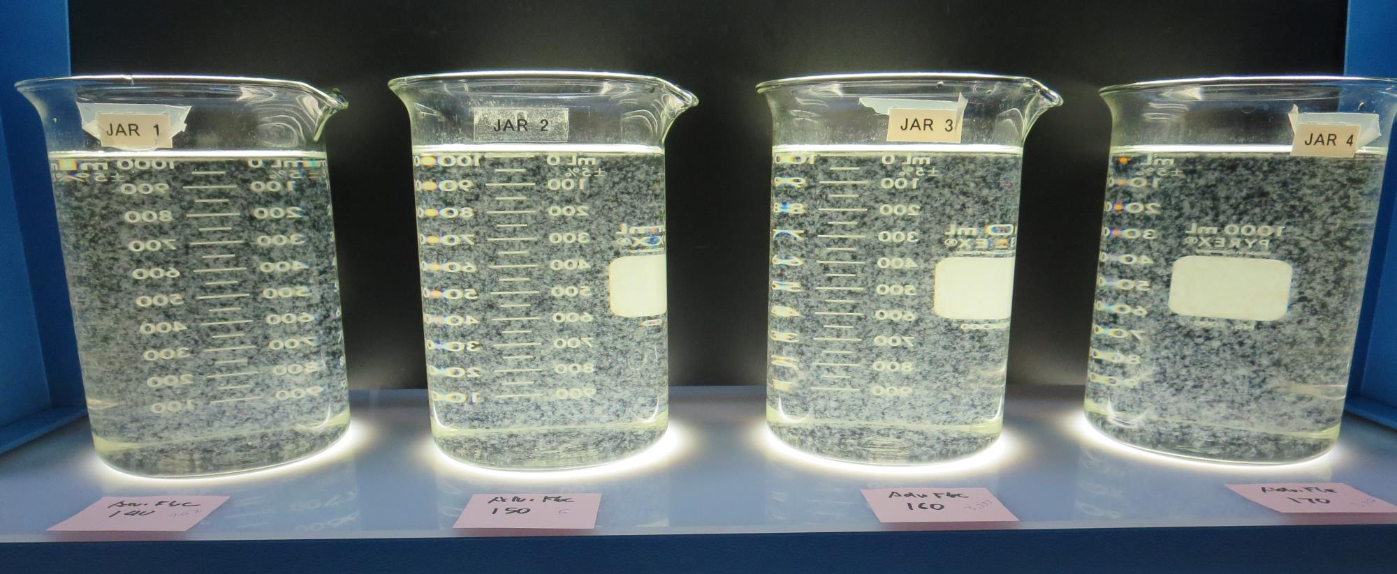
Jars 21-24: End of 5-minute flocculation (30 RPM) duration.
140 mg/L AdvFloc
Filtrate 0.09 NTU
UVT: 92.0%
UVA: 0.036/cm
UVA Reduction 67.3%
Settled: 0.35 NTU
150 mg/L AdvFloc
Filtrate 0.06 NTU
UVT: 92.3%
UVA: 0.034/cm
UVA Reduction 69.1%
Settled: 0.35 NTU
160 mg/L AdvFloc
Filtrate 0.06 NTU
UVT: 92.5%
UVA: 0.033/cm
UVA Reduction 70.0%
Settled: 0.29 NTU
170 mg/L AdvFloc
Filtrate 0.05 NTU
UVT: 92.7%
UVA: 0.032/cm
UVA Reduction 70.9%
Settled: 0.26 NTU

Slide 46
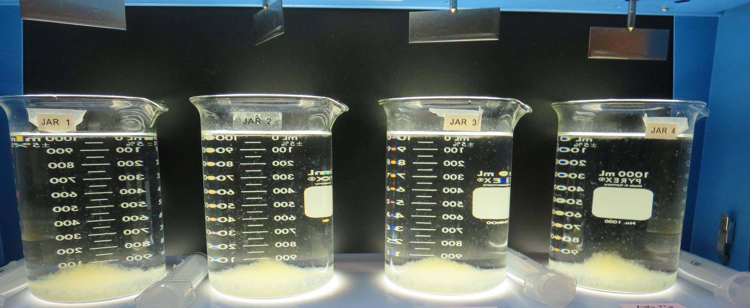
Jars 21-24: After 5 min of settling, 25 mL is syringed for filterability and %UVT/UVA.

Slide 47
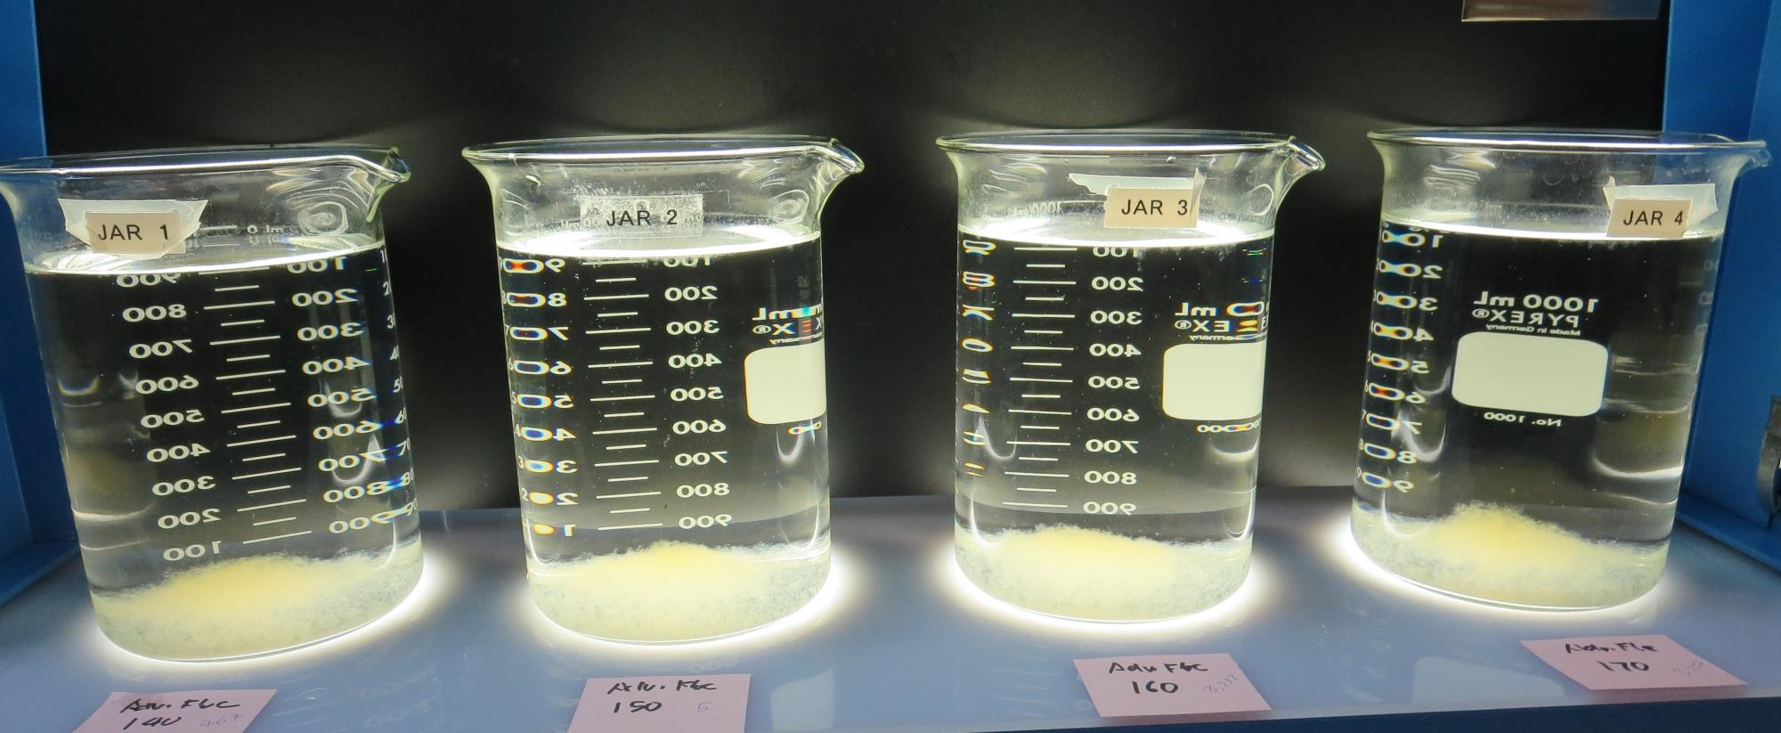
Jars 21-24: After 25-minutes of settling, settled water turbidity is taken.
140 mg/L AdvFloc
Filtrate 0.09 NTU
UVT: 92.0%
UVA: 0.036/cm
UVA Reduction 67.3%
Settled: 0.35 NTU
150 mg/L AdvFloc
Filtrate 0.06 NTU
UVT: 92.3%
UVA: 0.034/cm
UVA Reduction 69.1%
Settled: 0.35 NTU
160 mg/L AdvFloc
Filtrate 0.06 NTU
UVT: 92.5%
UVA: 0.033/cm
UVA Reduction 70.0%
Settled: 0.29 NTU
170 mg/L AdvFloc
Filtrate 0.05 NTU
UVT: 92.7%
UVA: 0.032/cm
UVA Reduction 70.9%
Settled: 0.26 NTU

Slide 48
Jars 25-28 Test Flash Mix 30 Sec (200 RPM) Floc Mix 5 min (30 RPM) Applied Coagulants 5% Acid Alum/CatFloc C-378

Slide 49
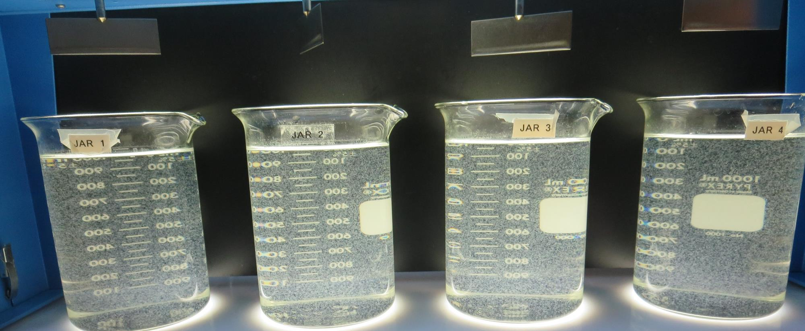
Jars 25-28: End of 5-minute flocculation (30 RPM) duration.
46 mg/L 5% Acid Alum
0 mg/L C-378
Filtrate 0.13 NTU
UVT: 90.6%
UVA: 0.042/cm
UVA Reduction 61.8%
Settled: 1.02 NTU
46 mg/L 5% Acid Alum
0.5 mg/L C-378
Filtrate 0.12 NTU
UVT: 87.2%
UVA: 0.042/cm
UVA Reduction 61.8%
Settled: 1.22 NTU
46 mg/L 5% Acid Alum
1.0 mg/L C-378
Filtrate 0.11 NTU
UVT: 90.9%
UVA: 0.041/cm
UVA Reduction 62.7%
Settled: 1.30 NTU
46 mg/L 5% Acid Alum
1.5 mg/L C-378
Filtrate 0.08 NTU
UVT: 91.2%
UVA: 0.039/cm
UVA Reduction 64.5%
Settled: 1.30 NTU

Slide 50
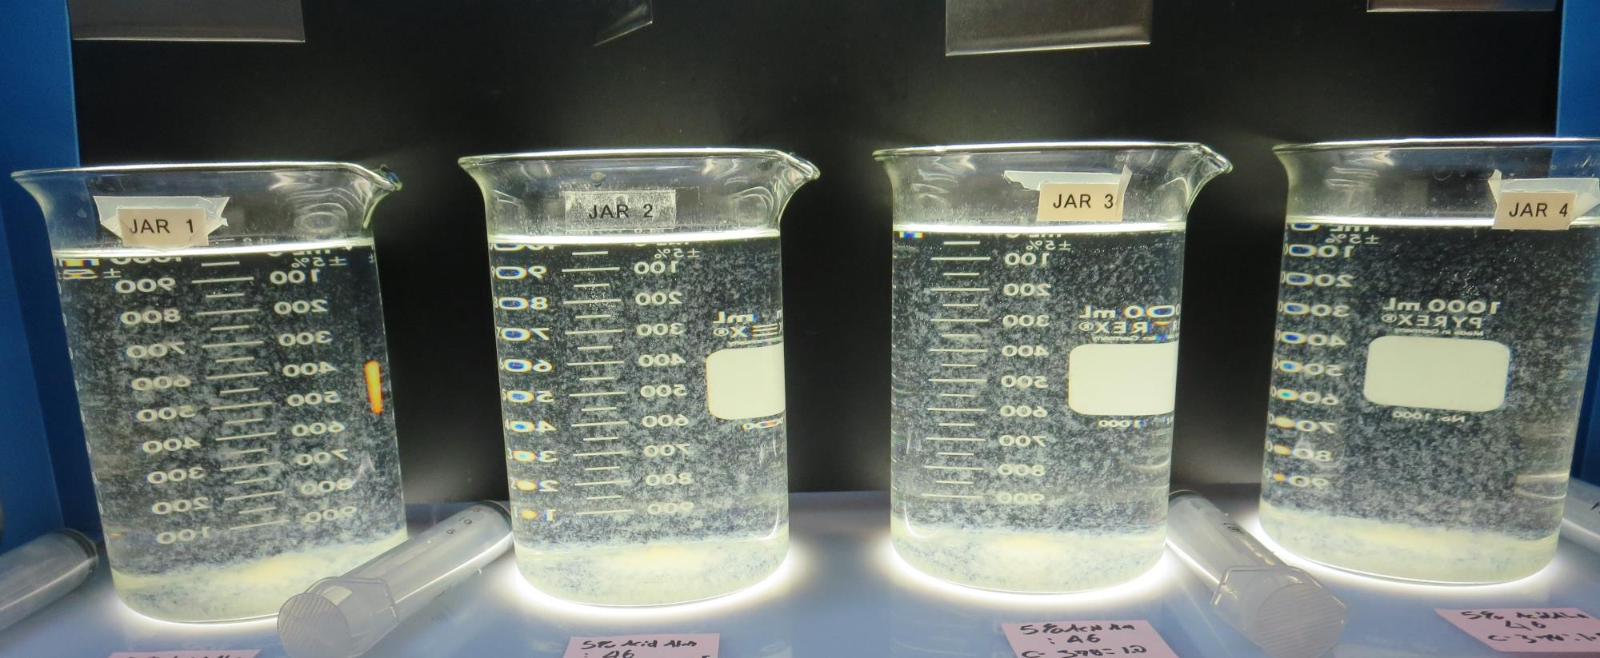
Jars 25-28: After 5 min of settling, 25 mL is syringed for filterability and %UVT/UVA.

Slide 51
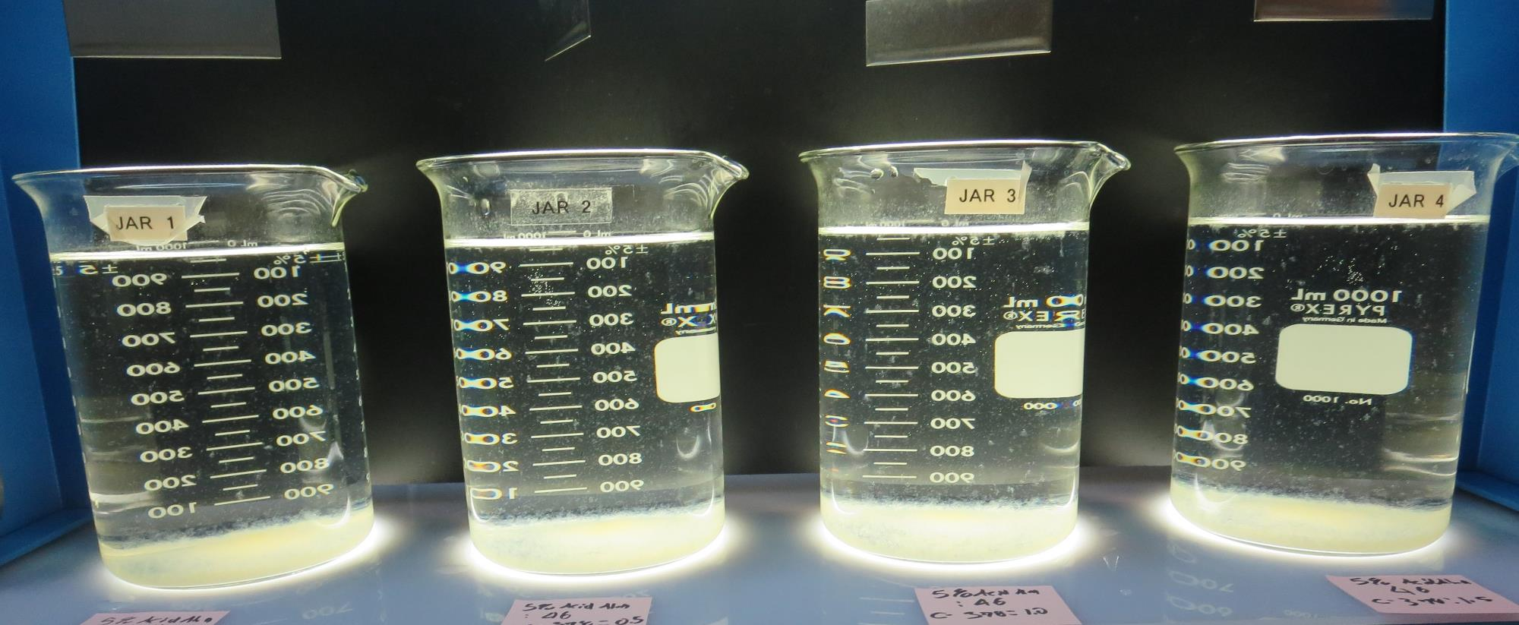
Jars 25-28: After 25-minutes of settling, settled water turbidity is taken.
46 mg/L 5% Acid Alum
0 mg/L C-378
Filtrate 0.13 NTU
UVT: 90.6%
UVA: 0.042/cm
UVA Reduction 61.8%
Settled: 1.02 NTU
46 mg/L 5% Acid Alum
0.5 mg/L C-378
Filtrate 0.12 NTU
UVT: 87.2%
UVA: 0.042/cm
UVA Reduction 61.8%
Settled: 1.22 NTU
46 mg/L 5% Acid Alum
1.0 mg/L C-378
Filtrate 0.11 NTU
UVT: 90.9%
UVA: 0.041/cm
UVA Reduction 62.7%
Settled: 1.30 NTU
46 mg/L 5% Acid Alum
1.5 mg/L C-378
Filtrate 0.08 NTU
UVT: 91.2%
UVA: 0.039/cm
UVA Reduction 64.5%
Settled: 1.30 NTU

Slide 52
Jars 29-32 Test Flash Mix 30 Sec (200 RPM) Floc Mix 5 min (30 RPM) Applied Coagulants 5% Acid Alum/CatFloc C-378

Slide 53
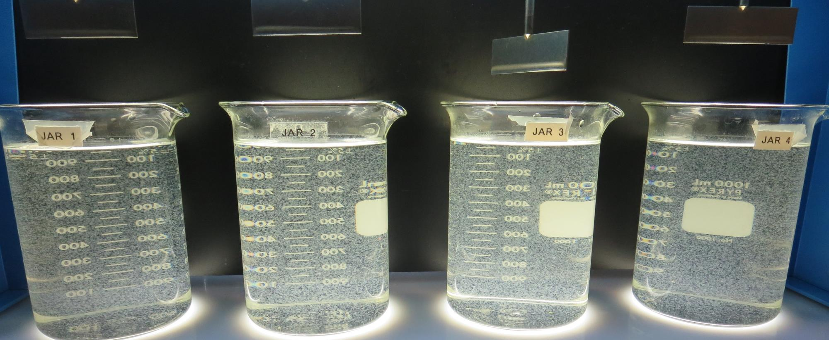
Jars 29-32: End of 5-minute flocculation (30 RPM) duration.
46 mg/L 5% Acid Alum
1.5 mg/L C-378
Filtrate 0.08 NTU
UVT: 91.2%
UVA: 0.039/cm
UVA Reduction 64.5%
Settled: 0.95 NTU
46 mg/L 5% Acid Alum
2.0 mg/L C-378
Filtrate 0.05 NTU
UVT: 91.2%
UVA: 0.039/cm
UVA Reduction 64.5%
Settled: 1.16 NTU
56 mg/L 5% Acid Alum
1.5 mg/L C-378
Filtrate 0.05 NTU
UVT: 91.9%
UVA: 0.036/cm
UVA Reduction 67.3%
Settled: 1.15 NTU
56 mg/L 5% Acid Alum
2.0 mg/L C-378
Filtrate 0.05 NTU
UVT: 92.0%
UVA: 0.035/cm
UVA Reduction 68.2%
Settled: 1.30 NTU

Slide 54
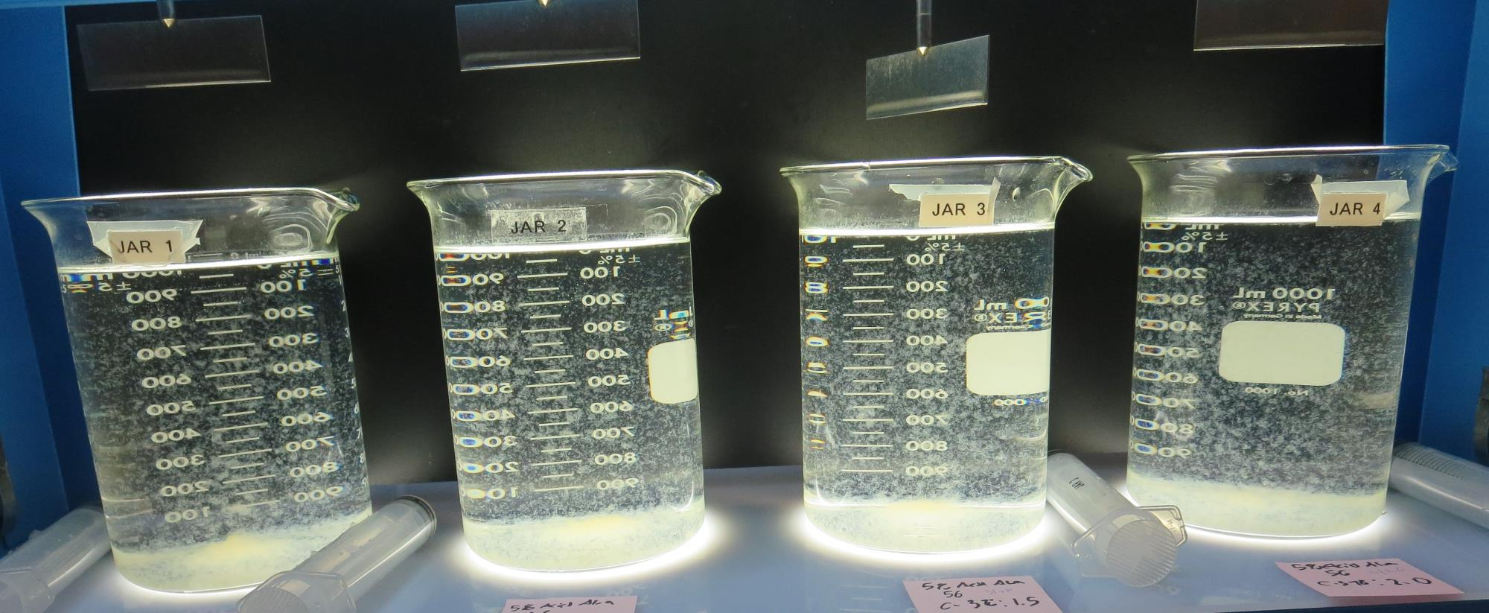
Jars 29-32: After 5 min of settling, 25 mL is syringed for filterability and %UVT/UVA.

Slide 55
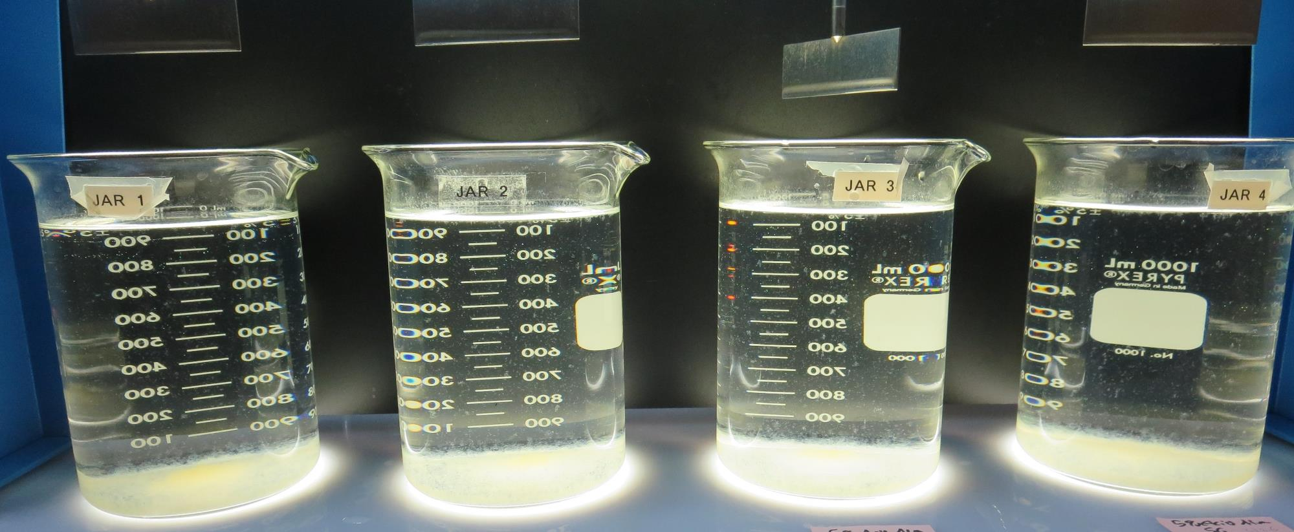
Jars 29-32: After 25-minutes of settling, settled water turbidity is taken.
46 mg/L 5% Acid Alum
1.5 mg/L C-378
Filtrate 0.08 NTU
UVT: 91.2%
UVA: 0.039/cm
UVA Reduction 64.5%
Settled: 0.95 NTU
46 mg/L 5% Acid Alum
2.0 mg/L C-378
Filtrate 0.05 NTU
UVT: 91.2%
UVA: 0.039/cm
UVA Reduction 64.5%
Settled: 1.16 NTU
56 mg/L 5% Acid Alum
1.5 mg/L C-378
Filtrate 0.05 NTU
UVT: 91.9%
UVA: 0.036/cm
UVA Reduction 67.3%
Settled: 1.15 NTU
56 mg/L 5% Acid Alum
2.0 mg/L C-378
Filtrate 0.05 NTU
UVT: 92.0%
UVA: 0.035/cm
UVA Reduction 68.2%
Settled: 1.30 NTU

Slide 56
Jars 33-36 Test Flash Mix 30 Sec (200 RPM) Floc Mix 5 min (30 RPM) Applied Coagulants 5% Acid Alum/CatFloc C-378

Slide 57
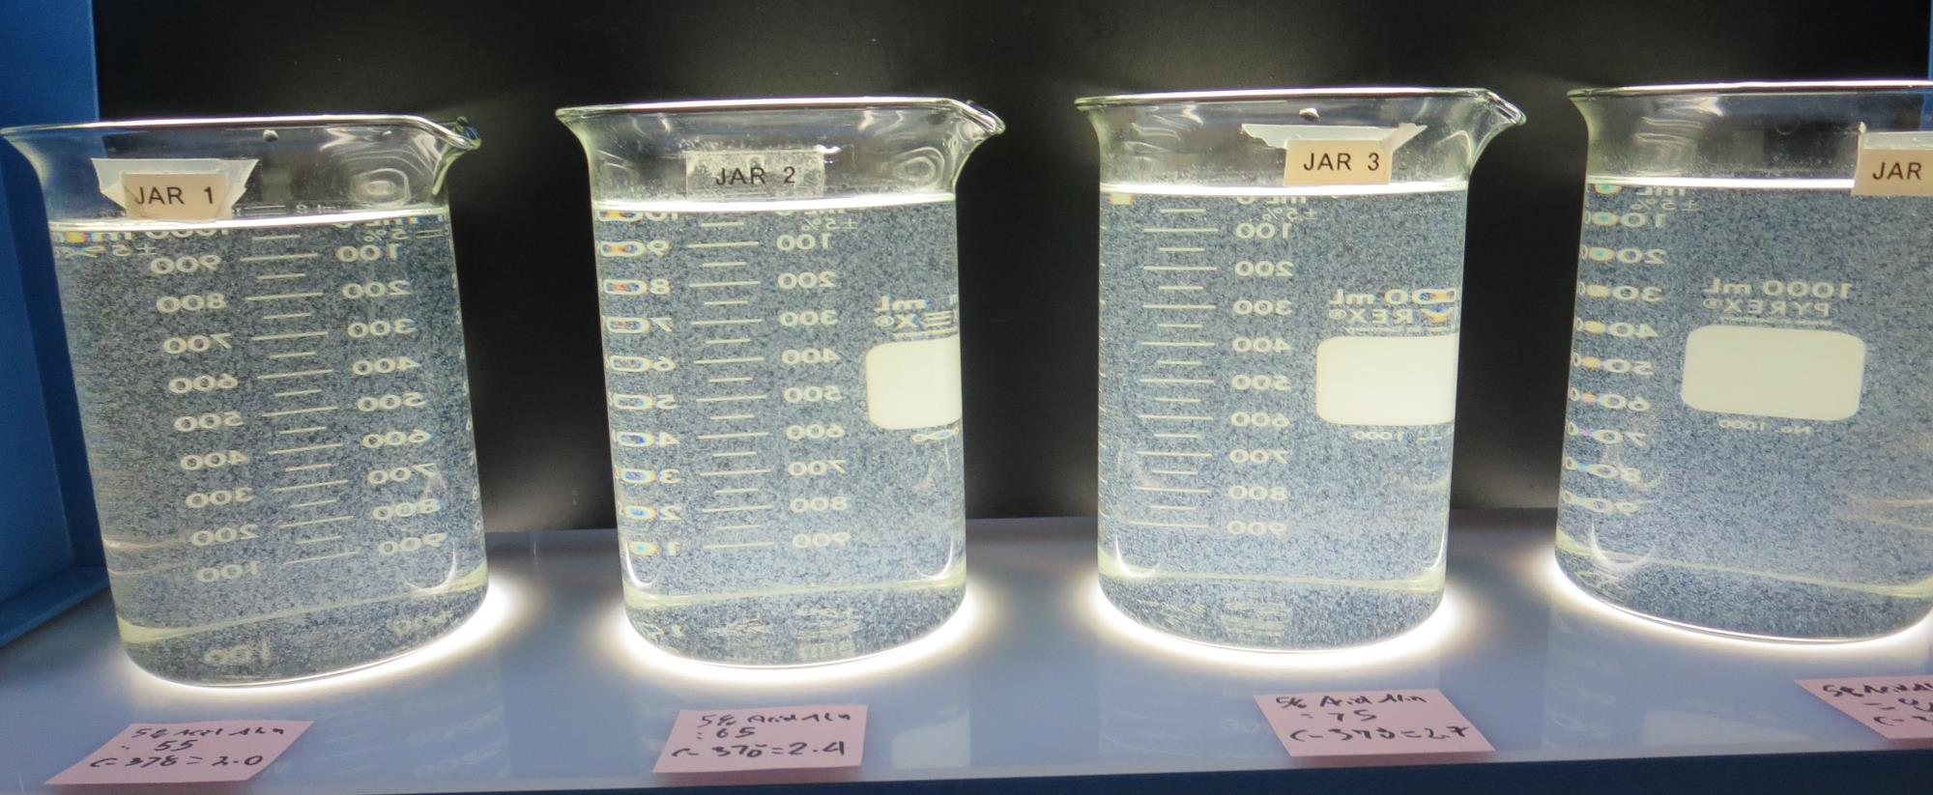
Jars 33-36: End of 5-minute flocculation (30 RPM) duration.
55 mg/L 5% Acid Alum
2.0 mg/L C-378
Filtrate 0.05 NTU
UVT: 92.1%
UVA: 0.035/cm
UVA Reduction 68.2%
Settled: 1.39 NTU
65 mg/L 5% Acid Alum
2.4 mg/L C-378
Filtrate 0.05 NTU
UVT: 92.7%
UVA: 0.032/cm
UVA Reduction 70.9%
Settled: 1.60 NTU
75 mg/L 5% Acid Alum
2.7 mg/L C-378
Filtrate 0.04 NTU
UVT: 93.0%
UVA: 0.031/cm
UVA Reduction 71.8%
Settled: 1.94 NTU
85 mg/L 5% Acid Alum
3.1 mg/L C-378
Filtrate 0.04 NTU
UVT: 93.3%
UVA: 0.029/cm
UVA Reduction 73.6%
Settled: 1.62 NTU

Slide 58
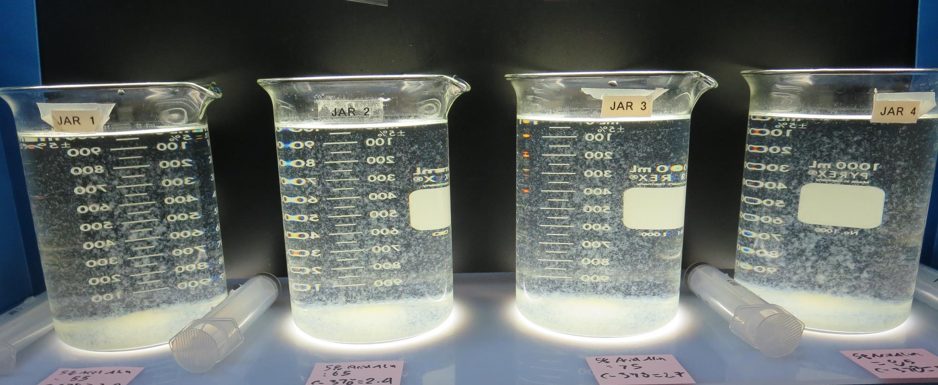
Jars 33-36: After 5 min of settling, 25 mL is syringed for filterability and %UVT/UVA.

Slide 59
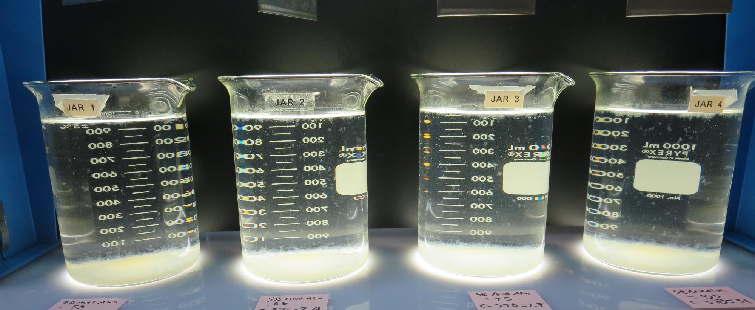
Jars 33-36: After 25-minutes of settling, settled water turbidity is taken.
55 mg/L 5% Acid Alum
2.0 mg/L C-378
Filtrate 0.05 NTU
UVT: 92.1%
UVA: 0.035/cm
UVA Reduction 68.2%
Settled: 1.39 NTU
65 mg/L 5% Acid Alum
2.4 mg/L C-378
Filtrate 0.05 NTU
UVT: 92.7%
UVA: 0.032/cm
UVA Reduction 70.9%
Settled: 1.60 NTU
75 mg/L 5% Acid Alum
2.7 mg/L C-378
Filtrate 0.04 NTU
UVT: 93.0%
UVA: 0.031/cm
UVA Reduction 71.8%
Settled: 1.94 NTU
85 mg/L 5% Acid Alum
3.1 mg/L C-378
Filtrate 0.04 NTU
UVT: 93.3%
UVA: 0.029/cm
UVA Reduction 73.6%
Settled: 1.62 NTU

Slide 60
Jars 37-40 Test Flash Mix 30 Sec (200 RPM) Floc Mix 5 min (30 RPM) Applied Coagulants AdvFloc CTC-00011 /CatFloc C-378

Slide 61
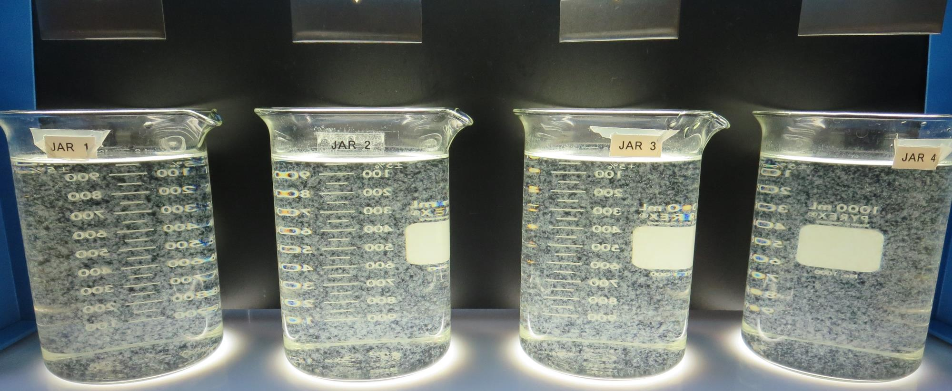
Jars 37-40: End of 5-minute flocculation (30 RPM) duration.
180 mg/L AdvFloc
0 mg/L C-378
Filtrate 0.06 NTU
UVT: 93.0%
UVA: 0.031/cm
UVA Reduction 71.8%
Settled: 0.37 NTU
180 mg/L AdvFloc
2.0 mg/L C-378
Filtrate 0.04 NTU
UVT: 93.4%
UVA: 0.029/cm
UVA Reduction 73.6%
Settled: 0.40 NTU
180 mg/L AdvFloc
3.0 mg/L C-378
Filtrate 0.04 NTU
UVT: 93.7%
UVA: 0.028/cm
UVA Reduction 74.5%
Settled: 0.39 NTU
180 mg/L AdvFloc
4.0 mg/L C-378
Filtrate 0.04 NTU
UVT: 93.8%
UVA: 0.027/cm
UVA Reduction 75.5%
Settled: 0.48 NTU

Slide 62
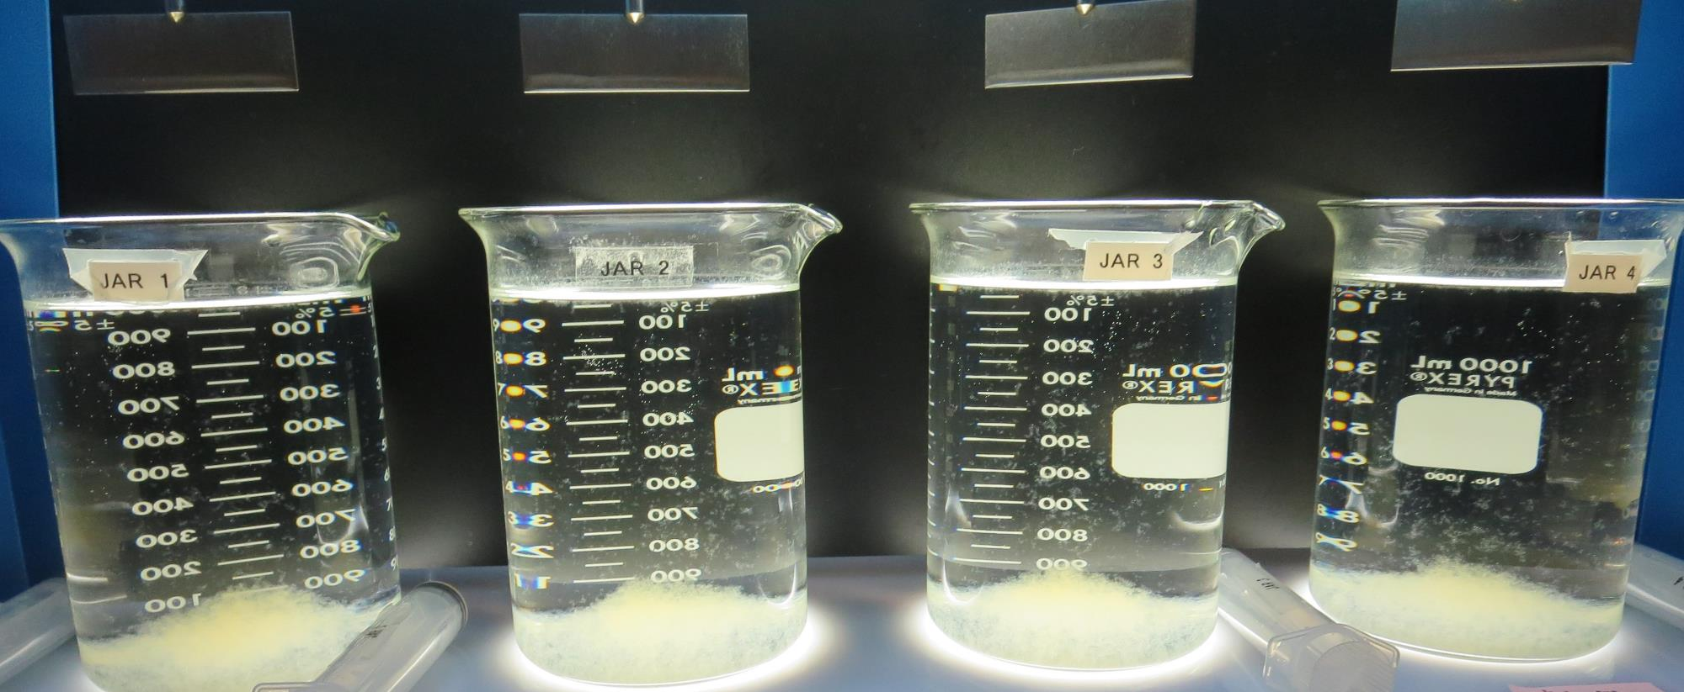
Jars 37-40: After 5 min of settling, 25 mL is syringed for filterability and %UVT/UVA.

Slide 63
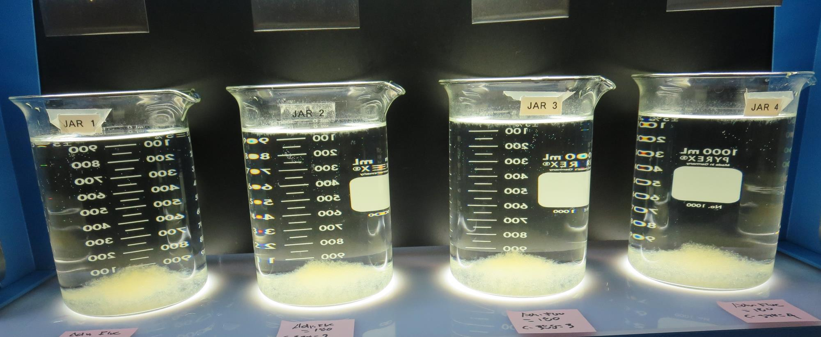
Jars 37-40: After 25-minutes of settling, settled water turbidity is taken.
180 mg/L AdvFloc
0 mg/L C-378
Filtrate 0.06 NTU
UVT: 93.0%
UVA: 0.031/cm
UVA Reduction 71.8%
Settled: 0.37 NTU
180 mg/L AdvFloc
2.0 mg/L C-378
Filtrate 0.04 NTU
UVT: 93.4%
UVA: 0.029/cm
UVA Reduction 73.6%
Settled: 0.40 NTU
180 mg/L AdvFloc
3.0 mg/L C-378
Filtrate 0.04 NTU
UVT: 93.7%
UVA: 0.028/cm
UVA Reduction 74.5%
Settled: 0.39 NTU
180 mg/L AdvFloc
4.0 mg/L C-378
Filtrate 0.04 NTU
UVT: 93.8%
UVA: 0.027/cm
UVA Reduction 75.5%
Settled: 0.48 NTU

Slide 64
Jars 41-44 Test Flash Mix 30 Sec (200 RPM) Floc Mix 5 min (30 RPM) Applied Coagulants 5% Acid Alum/ AdvFloc CTC-00011 /CatFloc C-378

Slide 65
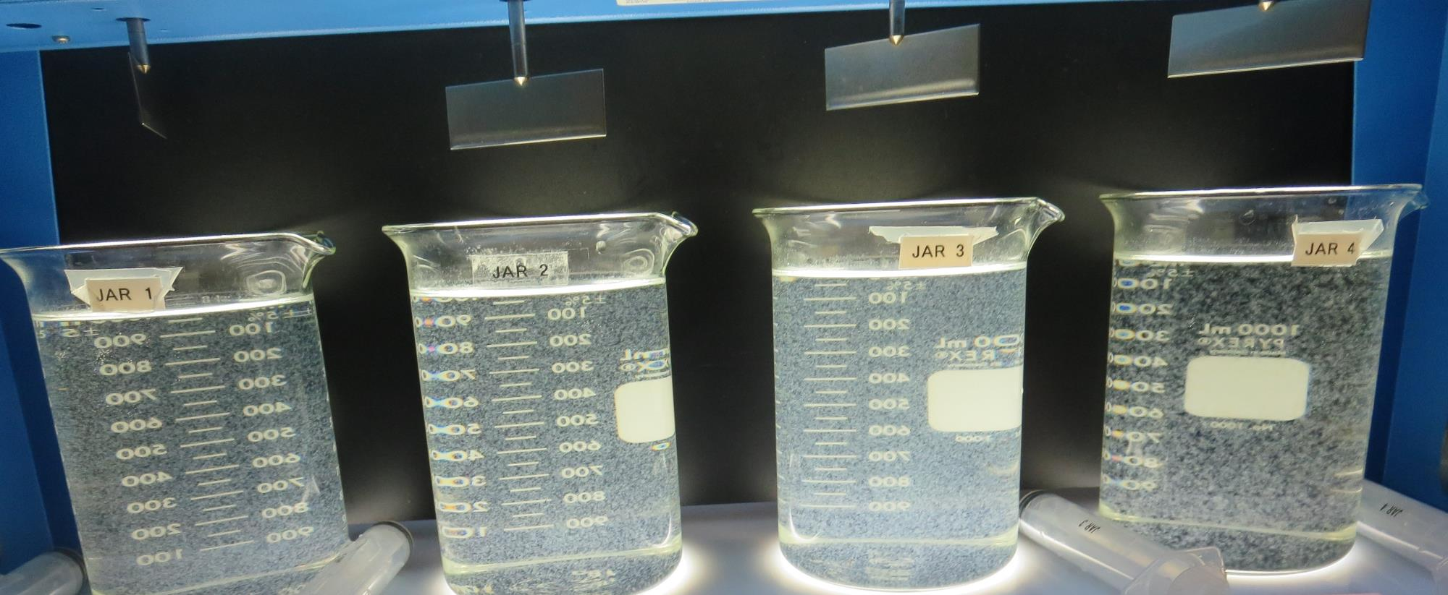
Jars 41-44: End of 5-minute flocculation (30 RPM) duration.
46 mg/L 5% Acid Alum
0 mg/L C-378
Filtrate 0.12 NTU
UVT: 90.6%
UVA: 0.042/cm
UVA Reduction 61.8%
Settled: 0.89 NTU
46 mg/L 5% Acid Alum
2.0 mg/L C-378
Filtrate 0.06 NTU
UVT: 91.4%
UVA: 0.038/cm
UVA Reduction 65.4%
Settled: 1.12 NTU
85 mg/L 5% Acid Alum
3.1 mg/L C-378
Filtrate 0.04 NTU
UVT: 93.4%
UVA: 0.029/cm
UVA Reduction 73.6%
Settled: 1.84 NTU
180 mg/L AdvFloc
4.0 mg/L C-378
Filtrate 0.04 NTU
UVT: 93.6%
UVA: 0.028/cm
UVA Reduction 74.5%
Settled: 0.49 NTU

Slide 66
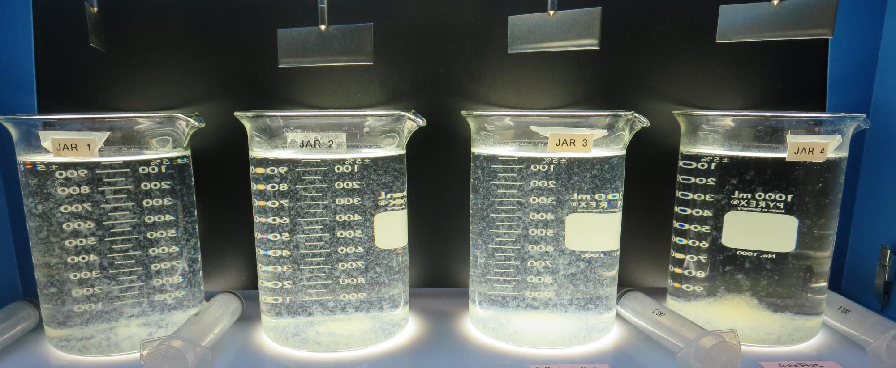
Jars 41-44: After 5 min of settling, 25 mL is syringed for filterability and %UVT/UVA.

Slide 67
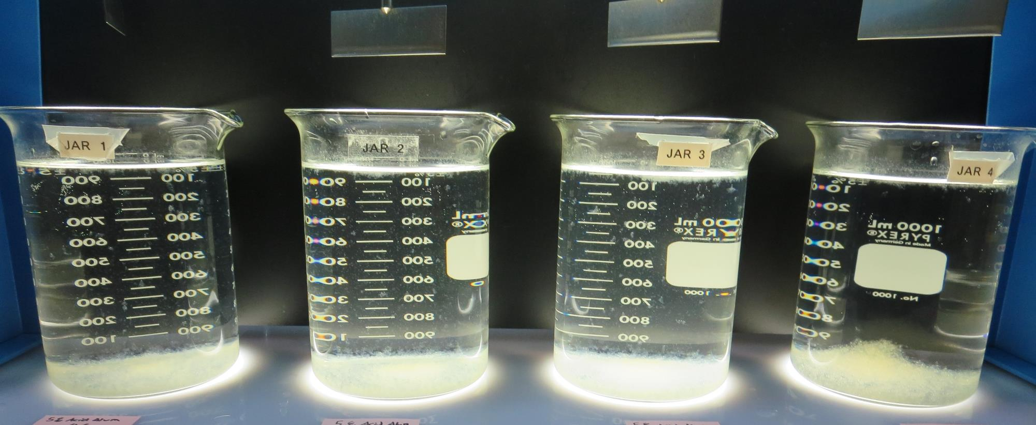
Jars 41-44: After 25-minutes of settling, settled water turbidity is taken.
46 mg/L 5% Acid Alum
0 mg/L C-378
Filtrate 0.12 NTU
UVT: 90.6%
UVA: 0.042/cm
UVA Reduction 61.8%
Settled: 0.89 NTU
46 mg/L 5% Acid Alum
2.0 mg/L C-378
Filtrate 0.06 NTU
UVT: 91.4%
UVA: 0.038/cm
UVA Reduction 65.4%
Settled: 1.12 NTU
85 mg/L 5% Acid Alum
3.1 mg/L C-378
Filtrate 0.04 NTU
UVT: 93.4%
UVA: 0.029/cm
UVA Reduction 73.6%
Settled: 1.84 NTU
180 mg/L AdvFloc
4.0 mg/L C-378
Filtrate 0.04 NTU
UVT: 93.6%
UVA: 0.028/cm
UVA Reduction 74.5%
Settled: 0.49 NTU

Slide 68
Jars 45-48 Test Flash Mix 30 Sec (200 RPM) Floc Mix 5 min (30 RPM) Applied Coagulants 5% Acid Alum/CatFloc C-378 + Powder Activated Carbon (PAC)

Slide 69
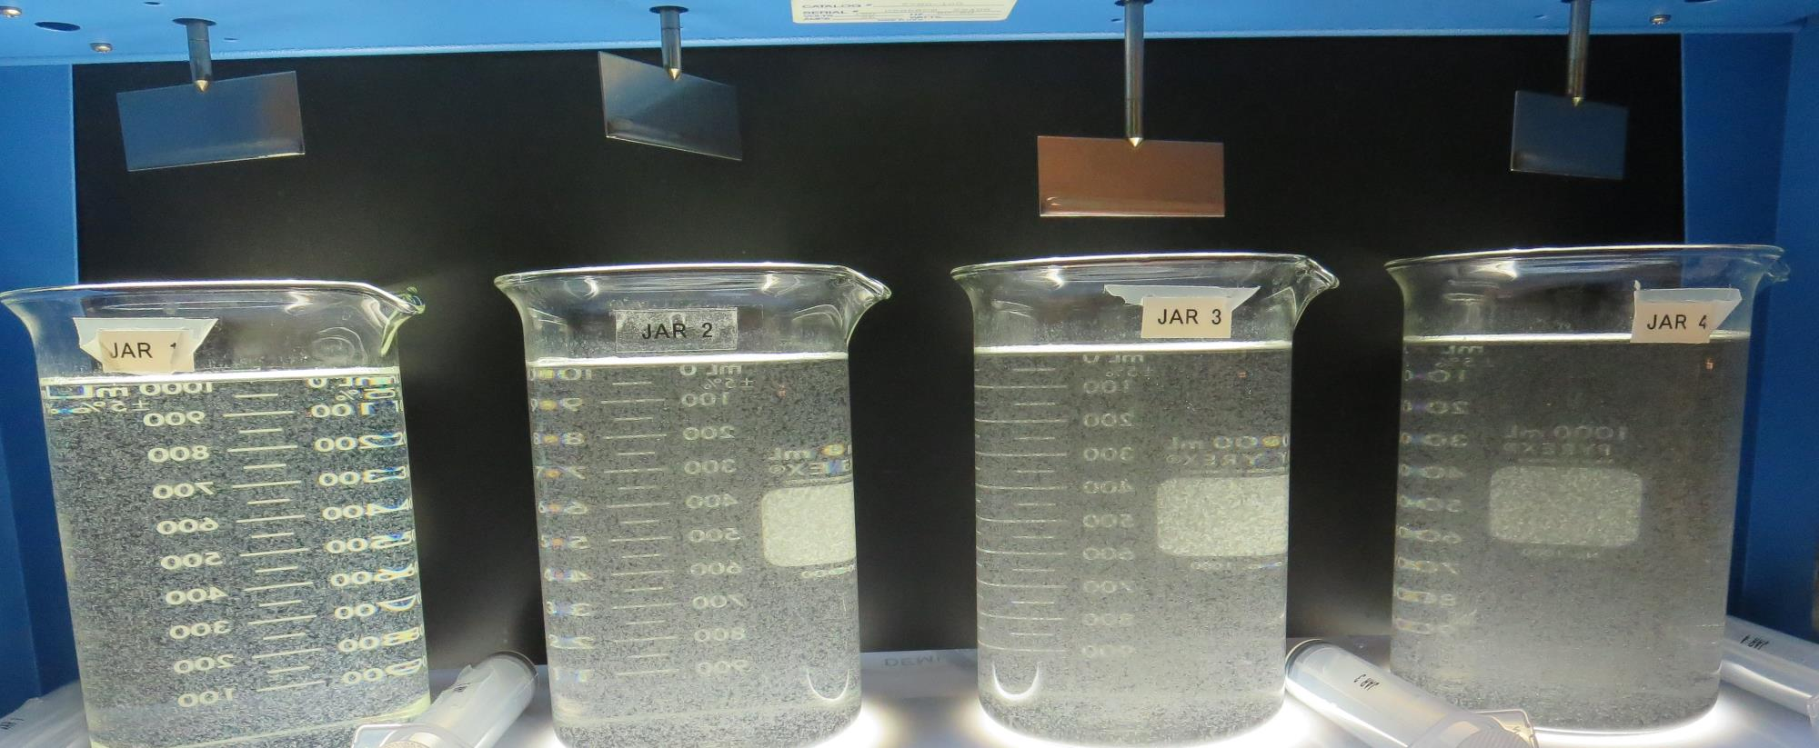
Jars 45-48: End of 5-minute flocculation (30 RPM) duration.
46 mg/L 5% Acid Alum
2.2 mg/L C-378
0 mg/L PAC
Filtrate 0.08 NTU
UVT: 91.0%
UVA: 0.040/cm
UVA Reduction 63.6%
Settled: 0.51 NTU
46 mg/L 5% Acid Alum
2.2 mg/L C-378
20 mg/L PAC
Filtrate 0.11 NTU
UVT: 93.2%
UVA: 0.030/cm
UVA Reduction 72.7%
Settled: 3.01 NTU
46 mg/L 5% Acid Alum
2.2 mg/L C-378
30 mg/L PAC
Filtrate 0.11 NTU
UVT: 93.9%
UVA: 0.027/cm
UVA Reduction 75.7%
Settled: 5.06 NTU
46 mg/L 5% Acid Alum
2.2 mg/L C-378
40 mg/L PAC
Filtrate 0.16 NTU
UVT: 93.9%
UVA: 0.027/cm
UVA Reduction 75.7%
Settled: 5.74 NTU

Slide 70
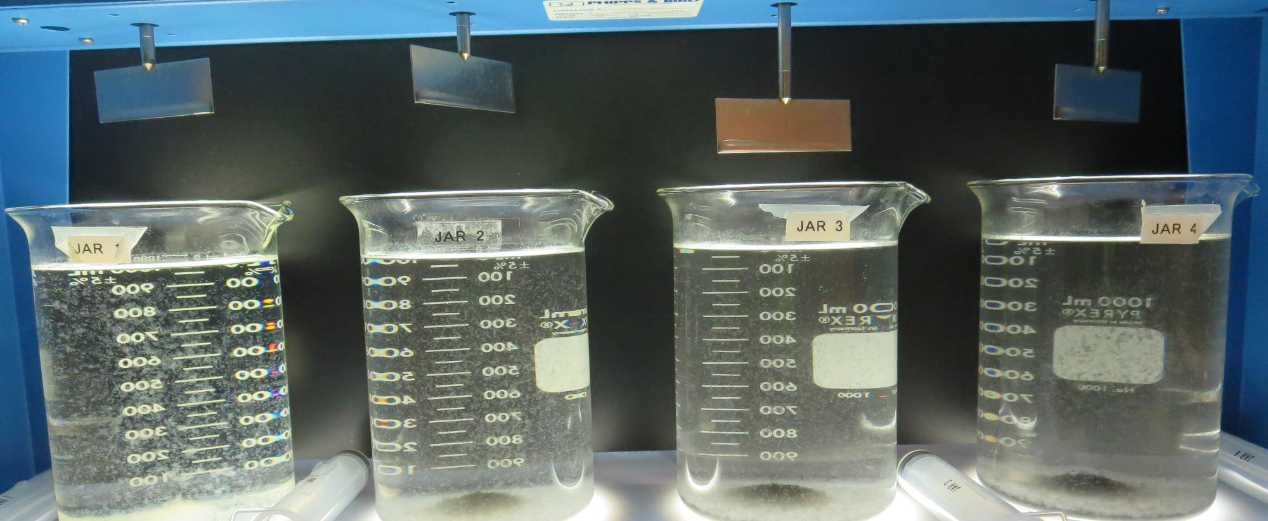
Jars 45-48: After 5 min of settling, 25 mL is syringed for filterability and %UVT/UVA.

Slide 71
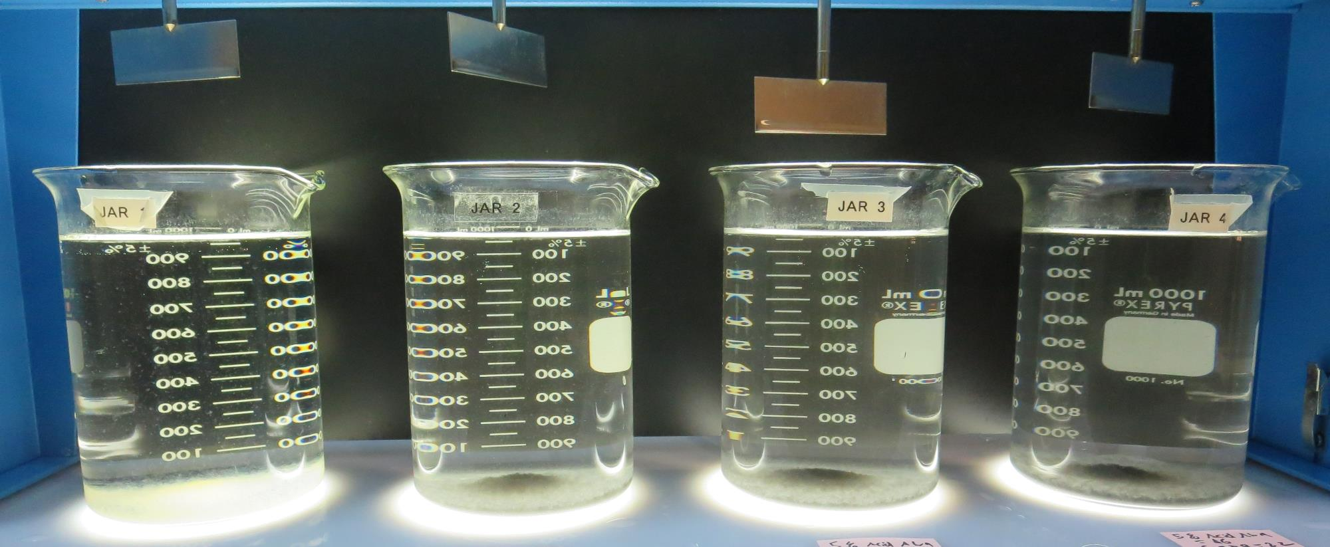
Jars 45-48: After 25-minutes of settling, settled water turbidity is taken.
46 mg/L 5% Acid Alum
2.2 mg/L C-378
0 mg/L PAC
Filtrate 0.08 NTU
UVT: 91.0%
UVA: 0.040/cm
UVA Reduction 63.6%
Settled: 0.51 NTU
46 mg/L 5% Acid Alum
2.2 mg/L C-378
20 mg/L PAC
Filtrate 0.11 NTU
UVT: 93.2%
UVA: 0.030/cm
UVA Reduction 72.7%
Settled: 3.01 NTU
46 mg/L 5% Acid Alum
2.2 mg/L C-378
30 mg/L PAC
Filtrate 0.11 NTU
UVT: 93.9%
UVA: 0.027/cm
UVA Reduction 75.7%
Settled: 5.06 NTU
46 mg/L 5% Acid Alum
2.2 mg/L C-378
40 mg/L PAC
Filtrate 0.16 NTU
UVT: 93.9%
UVA: 0.027/cm
UVA Reduction 75.7%
Settled: 5.74 NTU

Slide 72
Jars 49-52 Test Flash Mix 30 Sec (200 RPM) Floc Mix 5 min (30 RPM) Applied Coagulants 5% Acid Alum/CatFloc C-378 + Powder Activated Carbon (PAC)

Slide 73
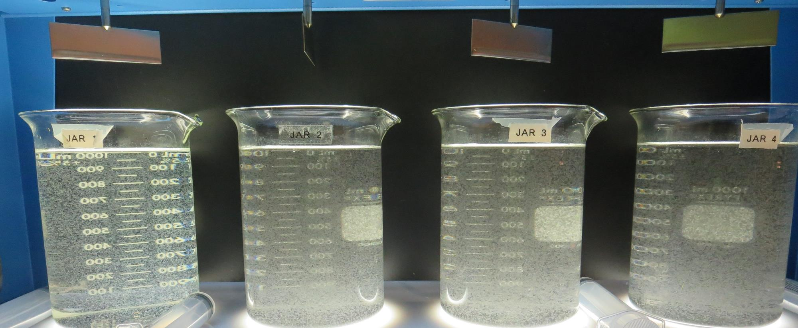
Jars 49-52: End of 5-minute flocculation (30 RPM) duration.
46 mg/L 5% Acid Alum
2.2 mg/L C-378
0 mg/L PAC
Filtrate 0.05 NTU
UVT: 91.0%
UVA: 0.041/cm
UVA Reduction 62.7%
Settled: 0.48 NTU
46 mg/L 5% Acid Alum
2.2 mg/L C-378
30 mg/L PAC
Filtrate 0.10 NTU
UVT: 93.7%
UVA: 0.028/cm
UVA Reduction 74.5%
Settled: 4.72 NTU
46 mg/L 5% Acid Alum
3.2 mg/L C-378
30 mg/L PAC
Filtrate 0.06 NTU
UVT: 94.5%
UVA: 0.024/cm
UVA Reduction 78.2%
Settled: 5.69 NTU
46 mg/L 5% Acid Alum
4.2 mg/L C-378
30 mg/L PAC
Filtrate 0.05 NTU
UVT: 93.9%
UVA: 0.027/cm
UVA Reduction 75.5%
Settled: 6.10 NTU

Slide 74
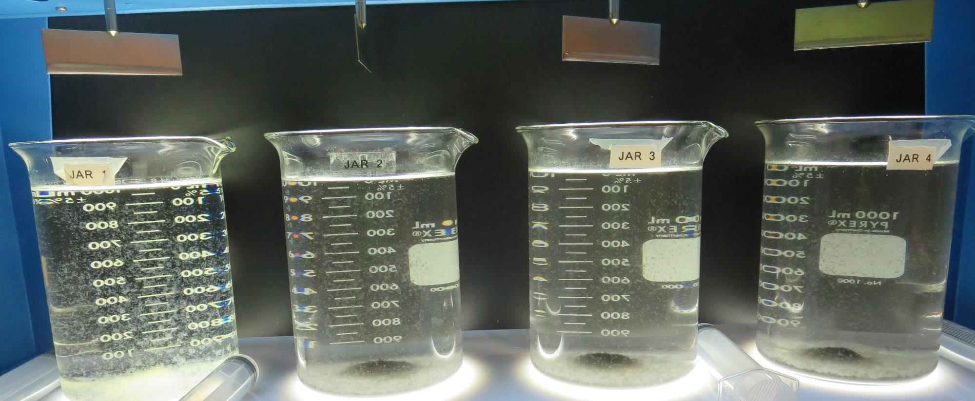
Jars 49-52: After 5 min of settling, 25 mL is syringed for filterability and %UVT/UVA.

Slide 75
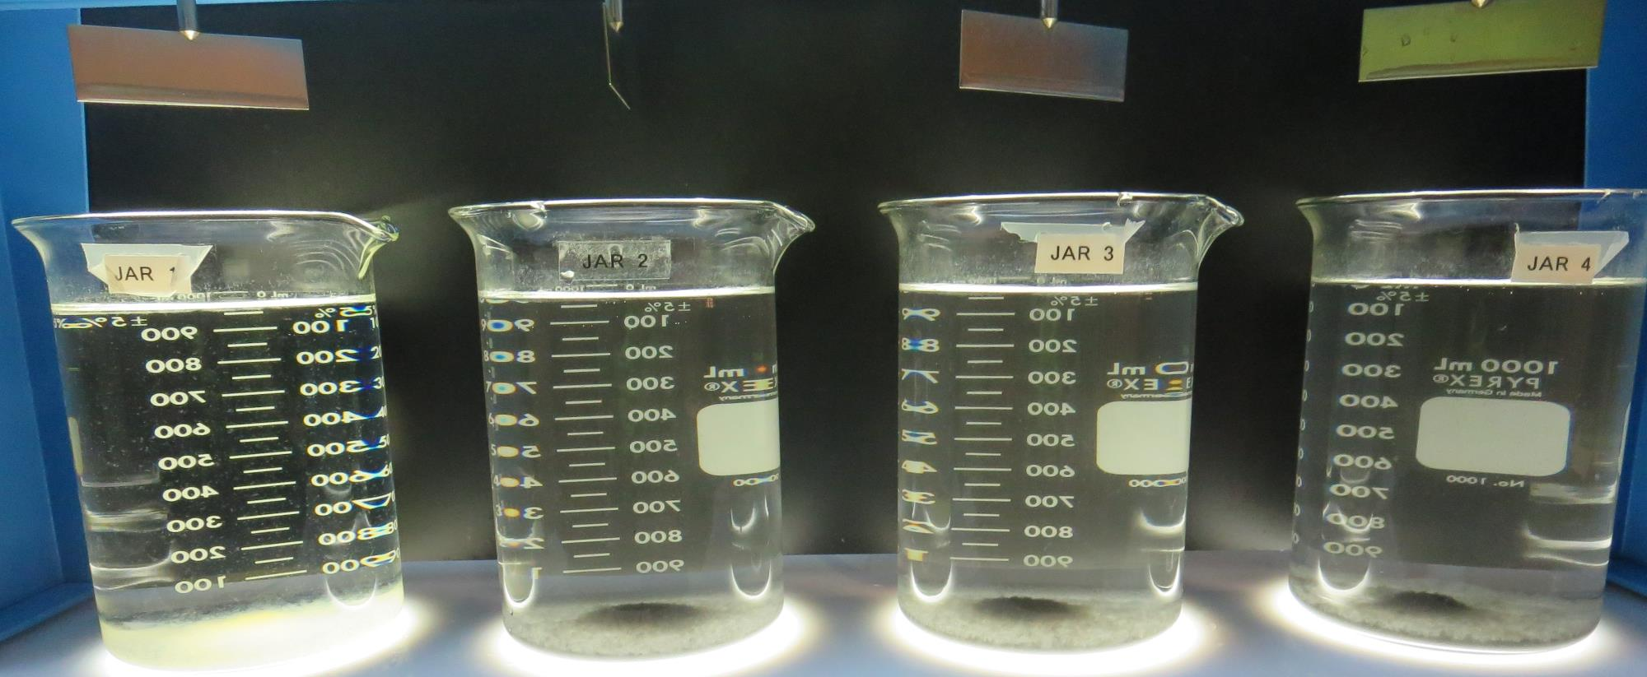
Jars 49-52: After 25-minutes of settling, settled water turbidity is taken.
46 mg/L 5% Acid Alum
2.2 mg/L C-378
0 mg/L PAC
Filtrate 0.05 NTU
UVT: 91.0%
UVA: 0.041/cm
UVA Reduction 62.7%
Settled: 0.48 NTU
46 mg/L 5% Acid Alum
2.2 mg/L C-378
30 mg/L PAC
Filtrate 0.10 NTU
UVT: 93.7%
UVA: 0.028/cm
UVA Reduction 74.5%
Settled: 4.72 NTU
46 mg/L 5% Acid Alum
3.2 mg/L C-378
30 mg/L PAC
Filtrate 0.06 NTU
UVT: 94.5%
UVA: 0.024/cm
UVA Reduction 78.2%
Settled: 5.69 NTU
46 mg/L 5% Acid Alum
4.2 mg/L C-378
30 mg/L PAC
Filtrate 0.05 NTU
UVT: 93.9%
UVA: 0.027/cm
UVA Reduction 75.5%
Settled: 6.10 NTU

Slide 76
Jar Testing for 1-Liter Jars: Procedures for Most Treatment Plants
Fill jars with source water prior to coagulant injection and set paddle speed at 30 rpm
Add chemicals (i.e., NaOCl, primary coagulant, coagulant aid) to each jar
Flash mix for 15-30 seconds (200 rpm)
Slow mix for 5 minutes (20-30 rpm)
Settled for 5 minutes. Syringe 25 mL from each jar taken 1-inch below surface (25 mL/12 sec rate)
Filtered through 1.2 um isopore membrane into cuvette drip rate, 15 mL/(50-90 sec)
Measure filtrate turbidity, chlorine residual and %UVT/UVA
Measure settled water turbidity after 25 minutes of total setting
Record all data

Slide 77
Jar Test Filterability Test Equipment
Turbidity Instrument
Syringe w/Luer-Lock Tip, 30 cc
(part#: 2225800, by Hach)
Swinnex Filter Holder, 25 mm (part#: SX0002500)
Isopore Membrane Filter, 1.2 um absolute
pore size,
Φ= 25 mm , thickness: 24 um,
hydrophilic polycarbonate membrane
(part #: RTTP02500)
Go to Sigma-Aldrich for laboratory supplies http://www.sigmaaldrich.com/united-states.html

Slide 78
Isopore Membrane Information
Categories | Information
trade name | Isopore
filter color | White
chemistry | Polycarbonate (PC)
water flow rate | Avg. 175 mL/min x cm² (typical results @ 10 psi)
media | Isopore®
wettability | Hydrophilic
porosity | 14.7%
pore size | 1.2 µm
bubble point at 23 °C | 1.0 bar, air with water
thickness | 24 µm
filter diameter (ø) | 25 mm
material size | polycarbonate, Hydrophilic, 1.2 µm, 25 mm, white, plain, 100

Slide 79
Isopore Membrane Background Information
The Isopore membrane is a polycarbonate, track-etched screen filter recommended for all analyses in which the sample is viewed on the surface of the membrane. The Isopore membrane is composed of polycarbonate film, which has a smooth, glass-like surface for clearer sample observation. The unique manufacturing process of the membrane ensures a precise pore diameter and a consistent pore size for accurate separation of samples by size. Matched-weight filters are not usually required because of low, constant tar and ash weights. Features & Benefits: Membrane structure retains particles on the surface, simplifying counting and analysis

Slide 80
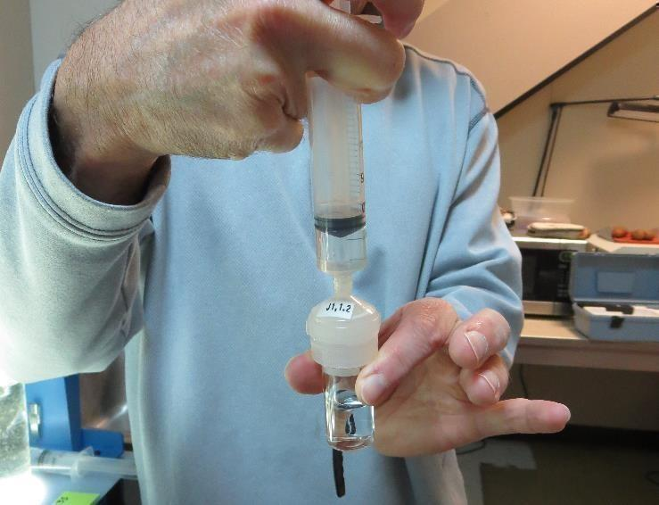
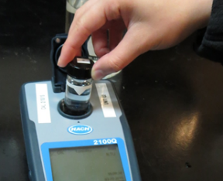
Jar Test - Filterability Test
Syringe ~ 25 mL from jar (after 5-minutes of settling)
Filter-to-waste 3-5 mL
Filter directly into clean cuvette
Measure turbidity
Note: Take several readings before recording final NTU results. Micro bubbles can adhere to glass causing false NTU readings. To remove bubbles, tilt cuvette up to 90 degrees.

Slide 81
Contact
Guy Schott, P.E.
State Water Resources Control Board
Division of Drinking Water
Santa Rosa, CA
Go to Stock Solution/Dose calculations/Jar Test Results for tools to download
www.waterboards.ca.gov/drinking_water/programs/districts/mendocino_district.html
Email: Guy Schott - Guy.Schott@waterboards.ca.gov
Office Number: 707-576-2732

