Slide 1
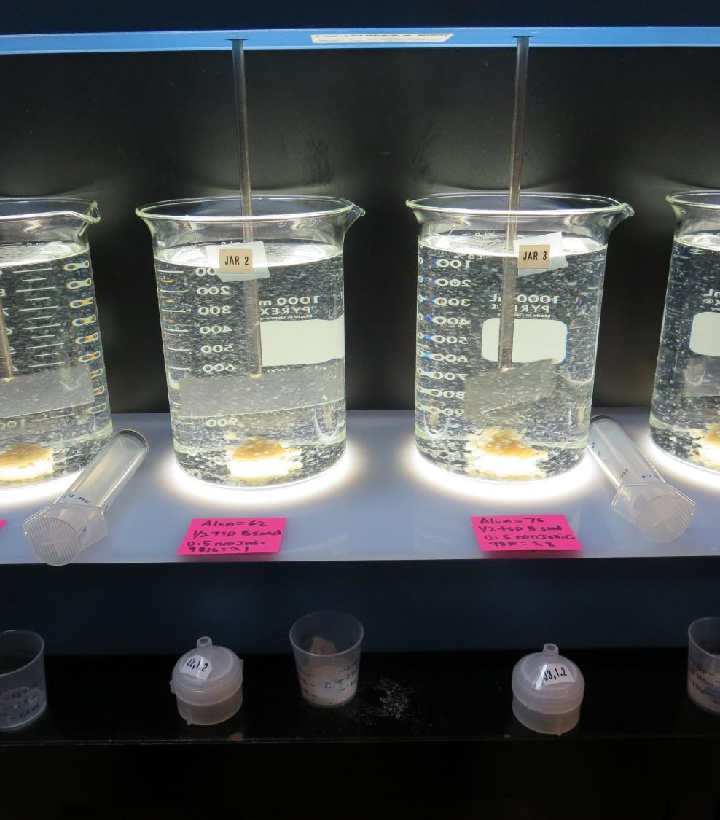
City of Fairfield
CA4810003
Solano County
Jar Test
by Guy Schott, P.E.
February 11, 2019

Slide 2
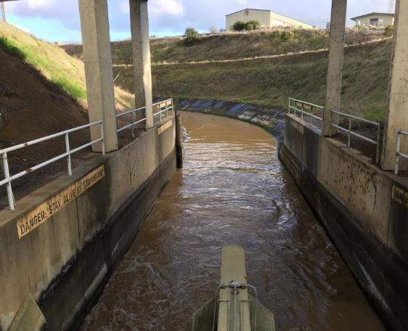
Source Water:
Putah South Canal
Source Water Characteristics
Turbidity: 2.75 NTU
pH: 8.14
UVT: 85.9%, UVA: 0.065/cm
0.4 um Filtered
Turbidity: 0.25 NTU
UVT: 88.1%, UVA: 0.054/cm

Slide 3
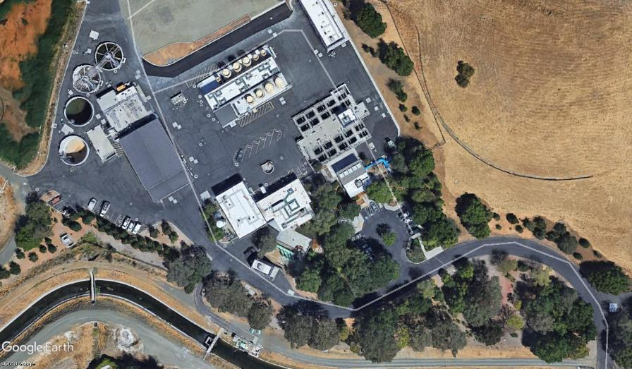
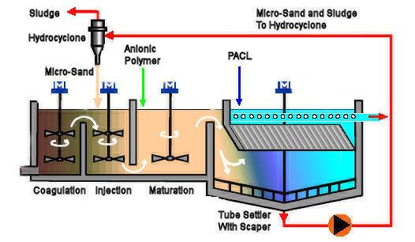
Actiflo Microsand Ballasted ClarificationTreatment

Slide 4
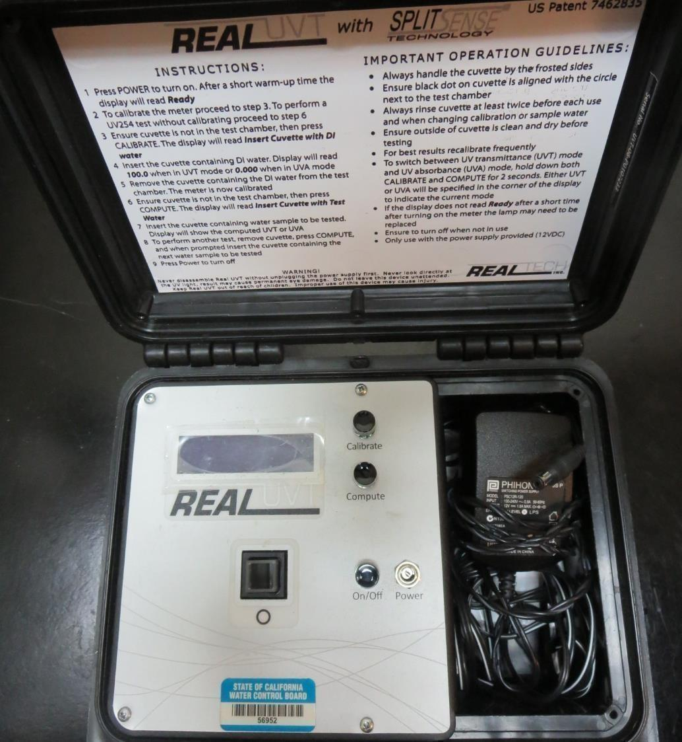
UVT/UVA
UV transmittance (UVT) is a measurement of the amount of ultraviolet light (commonly at 254 nm due to its germicidal effect) that passes through a water sample compared to the amount of light that passes through a pure water sample. The measurement is expressed as a percentage, % UVT.
%UVT = 10^{(-UVA)} x 100%
UV absorbance (UVA) is calculated as a relative measure of the amount of light absorbed by a water sample compared with the amount of light absorbed by a pure water sample.
UVA = -log(%UVT/100)

Slide 5
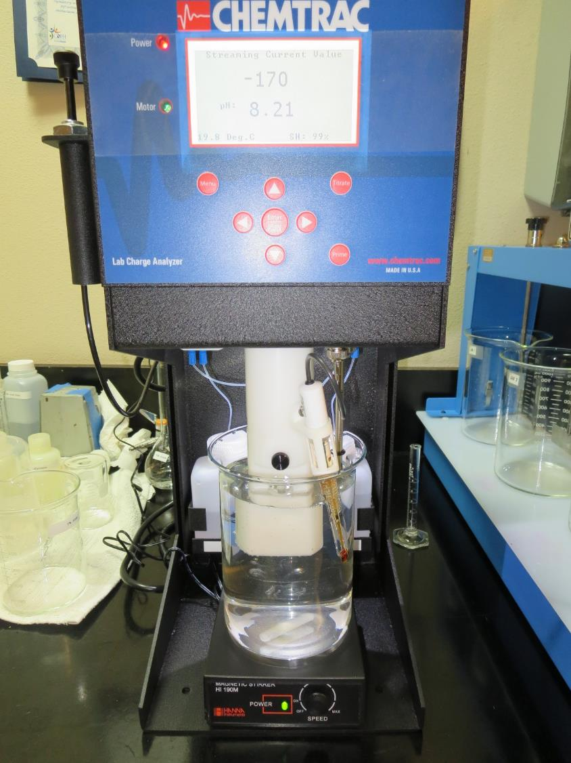
Laboratory Charge Analyzer
LCA: Used to determine coagulant demand of a source water entering the treatment plant.
Source pH: 8.2
LCA #1:
0.5 mg/L AD313P added manually
Alum: 76 mg/L as Alum
pH adjusted to 6.8 w/acetic acid
LCA #2:
0.5 mg/L AD313P added manually
ACH (9800): 56 mg/L as product
pH adjusted to 7.5 w/acetic acid

Slide 6
Coagulant Used for Jar Testing
Pro Pac 9810 (NTU Technologies)
45-50% Aluminum Chlorohydrate
45-50% Water
5% Proprietary
SG = 1.25 – 1.34
Pro Pac 9800 (NTU Technologies)
50% Aluminum Chlorohydrate
50% Water
SG = 1.25 – 1.34
Pro Pac 9890 (NTU Technologies)
35-45% Aluminum Chlorohydrate
35-45% Water
20% Proprietary
SG = 1.25 – 1.34
Aluminum Sulfate (Alum)
48.24% Aluminum Sulfate, 8.2% Al₂O₃
SG = 1.34
AD313P Acrylamide Polymer
(NTU Technologies)
Nonionic polymer

Slide 7
Coagulant Information
Unless stated otherwise, all coagulant doses are reported as Product (100% strength). Aluminum Sulfate is reported as Alum.
Preparation of coagulant stock solutions are generally 1.0 or 0.1 percent strength using 100 and/or 200 mL volumetric flasks.
Finnpipette F2 variable volume pipette, capacity 100-1000 micro liters is used for stock solution preparation and coagulant aid jar test dosing.
Finnpipette F2 variable volume pipette, capacity 0.5-5 mL is used for primary coagulant jar test dosing.

Slide 8
City of Fairfield: Jar Test 1-8 Results
Flash 1 min (200 RPM), Floc1 2 min (110 RPM), Floc2 3 min (60 RPM)
Jar # | Alum mg/L | Ballast Sand @ Floc1 | AD313P mg/L @ Floc1 | 9810 mg/L @ Floc2 | Filtrate NTU | Filtrate %UVT | Filtrate UVA/cm | Settle NTU 5 min
J1 | 49 | ½ tsp | 0.5 | 0 | 0.08 | 87.8 | 0.057 | 0.6
J2 | 62 | ½ tsp | 0.5 | 0 | 0.08 | 88.8 | 0.052 | 0.5
J3 | 76 | ½ tsp | 0.5 | 0 | 0.07 | 89.6 | 0.048 | 0.4
J4 | 90 | ½ tsp | 0.5 | 0 | 0.08 | 90.6 | 0.043 | 0.4
J5 | 49 | ½ tsp | 0.5 | 2.45 | 0.21 | 88.2 | 0.055 | 0.8
J6 | 62 | ½ tsp | 0.5 | 3.1 | 0.22 | 89.3 | 0.049 | 1.1
J7 | 76 | ½ tsp | 0.5 | 3.8 | 0.18 | 90.4 | 0.044 | 1.2
J8 | 90 | ½ tsp | 0.5 | 4.5 | 0.05 | 91.4 | 0.039 | 1.6

Slide 9
City of Fairfield: Jar Test 9-12 Results
Flash 1 min (200 RPM), Floc1 2 min (110 RPM), Floc2 3 min (60 RPM)
Jar # | Alum mg/L | 9810 mg/L | Ballast Sand @ Floc1 | AD313P mg/L @ Floc1 | Filtrate NTU | Filtrate %UVT | Filtrate UVA/cm | Settle NTU 5 min
J9 | 49 | 2.45 | ½ tsp | 0.5 | 0.08 | 88.6 | 0.053 | 0.5
J10 | 62 | 3.1 | ½ tsp | 0.5 | 0.07 | 89.6 | 0.048 | 0.5
J11 | 76 | 3.8 | ½ tsp | 0.5 | 0.07 | 90.5 | 0.043 | 0.4
J12 | 90 | 4.5 | ½ tsp | 0.5 | 0.06 | 91.4 | 0.039 | 0.4

Slide 10
City of Fairfield: Jar Test 13-16 Results
Flash 1 min (200 RPM), Floc1 2 min (110 RPM), Floc2 3 min (60 RPM)
CO2 added to target pH to 7.5.
Jar # | Alum mg/L | 9810 mg/L | Ballast Sand @ Floc1 | AD313P mg/L @ Floc1 | Filtrate NTU | Filtrate %UVT | Filtrate UVA/cm | Settle NTU 5 min
J13 | 49 | 2.45 | ½ tsp | 0.5 | 0.08 | 90.6 | 0.043 | 0.5
J14 | 62 | 3.1 | ½ tsp | 0.5 | 0.08 | 90.9 | 0.041 | 0.5
J16 | 76 | 3.8 | ½ tsp | 0.5 | 0.07 | 91.3 | 0.040 | 0.4
J16 | 90 | 4.5 | ½ tsp | 0.5 | 0.09 | 91.5 | 0.039 | 0.4

Slide 11
City of Fairfield: Jar Test 17-24 Results
Flash 1 min (200 RPM), Floc1 2 min (110 RPM), Floc2 3 min (60 RPM)
Jar # | 9800 mg/L | 9890 mg/L | Ballast Sand @ Floc1 | AD313P mg/L @ Floc1 | Filtrate NTU | Filtrate %UVT | Filtrate UVA/cm | Settle NTU 5 min
J17 | 50 | 0 | ½ tsp | 0.5 | 0.08 | 91.1 | 0.053 | 0.5
J18 | 56 | 0 | ½ tsp | 0.5 | 0.06 | 91.5 | 0.048 | 0.3
J19 | 62 | 0 | ½ tsp | 0.5 | 0.07 | 91.8 | 0.043 | 0.3
J20 | 68 | 0 | ½ tsp | 0.5 | 0.07 | 92.0 | 0.039 | 0.4
J21 | 50 | 3.5 | ½ tsp | 0.5 | 0.08 | 90.6 | 0.043 | 0.5
J22 | 56 | 2.8 | ½ tsp | 0.5 | 0.08 | 90.9 | 0.041 | 0.5
J23 | 62 | 3.1 | ½ tsp | 0.5 | 0.07 | 91.3 | 0.040 | 0.4
J24 | 68 | 3.4 | ½ tsp | 0.5 | 0.09 | 91.5 | 0.039 | 0.4

Slide 12
Jars 1-4 Test
Flash Mix 60 Sec (200 RPM)
Floc Mix 2 min (110 RPM)
Floc Mix 3 min (60 RPM)
Applied Coagulants
Alum/AD313P

Slide 13
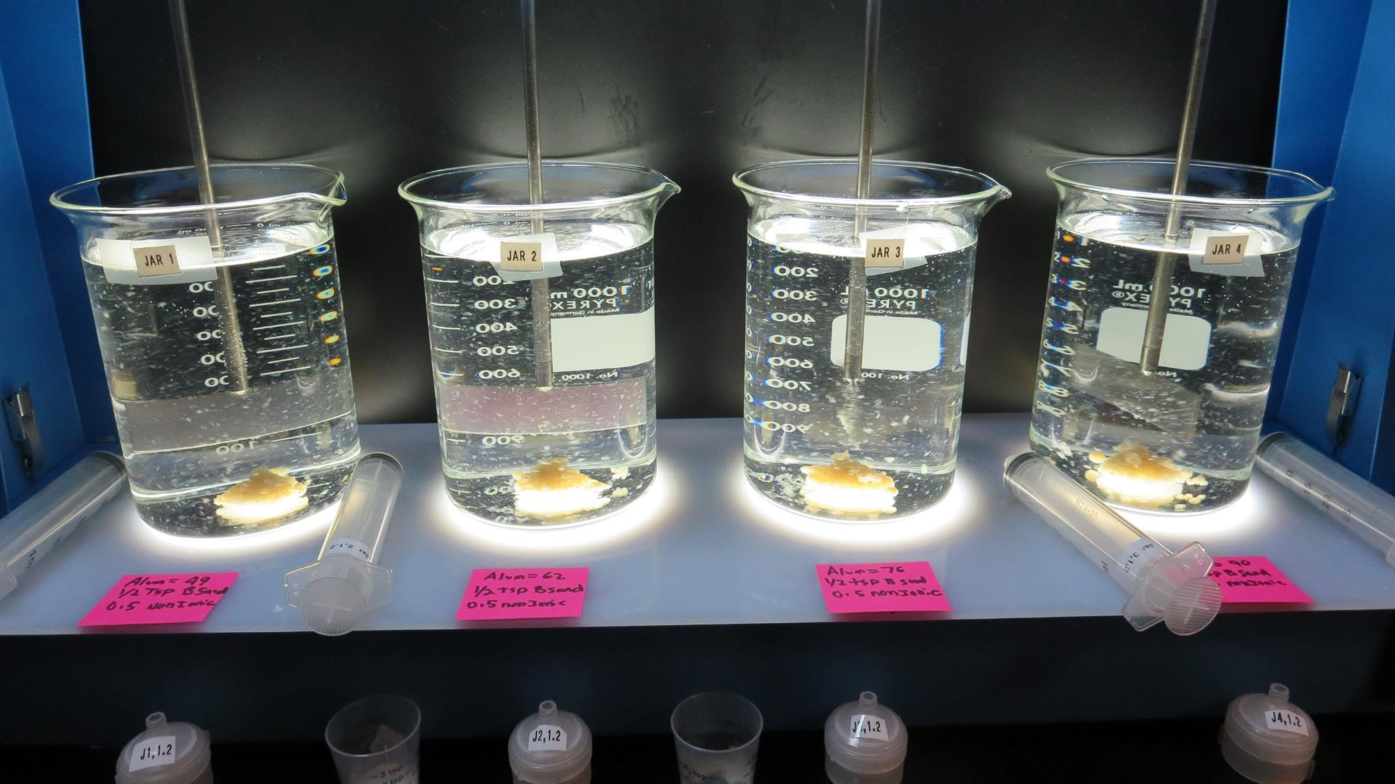
Jars 1-4: End of 5-minute flocculation duration.
After 1 min of settling, 25 mL is syringed for filterability and %UVT/UVA.
49 mg/L Alum
½ tsp Ballast Sand
0.5 mg/L AD313P
Filtrate 0.08 NTU
UVT: 87.8%
UVA: 0.057/cm
Settled: 0.6 NTU
62 mg/L Alum
½ tsp Ballast Sand
0.5 mg/L AD313P
Filtrate 0.08 NTU
UVT: 88.8%
UVA: 0.052/cm
Settled: 0.5 NTU
76 mg/L Alum
½ tsp Ballast Sand
0.5 mg/L AD313P
Filtrate 0.07 NTU
UVT: 89.6%
UVA: 0.048/cm
Settled: 0.4 NTU
90 mg/L Alum
½ tsp Ballast Sand
0.5 mg/L AD313P
Filtrate 0.08 NTU
UVT: 90.6%
UVA: 0.043/cm
Settled: 0.4 NTU

Slide 14
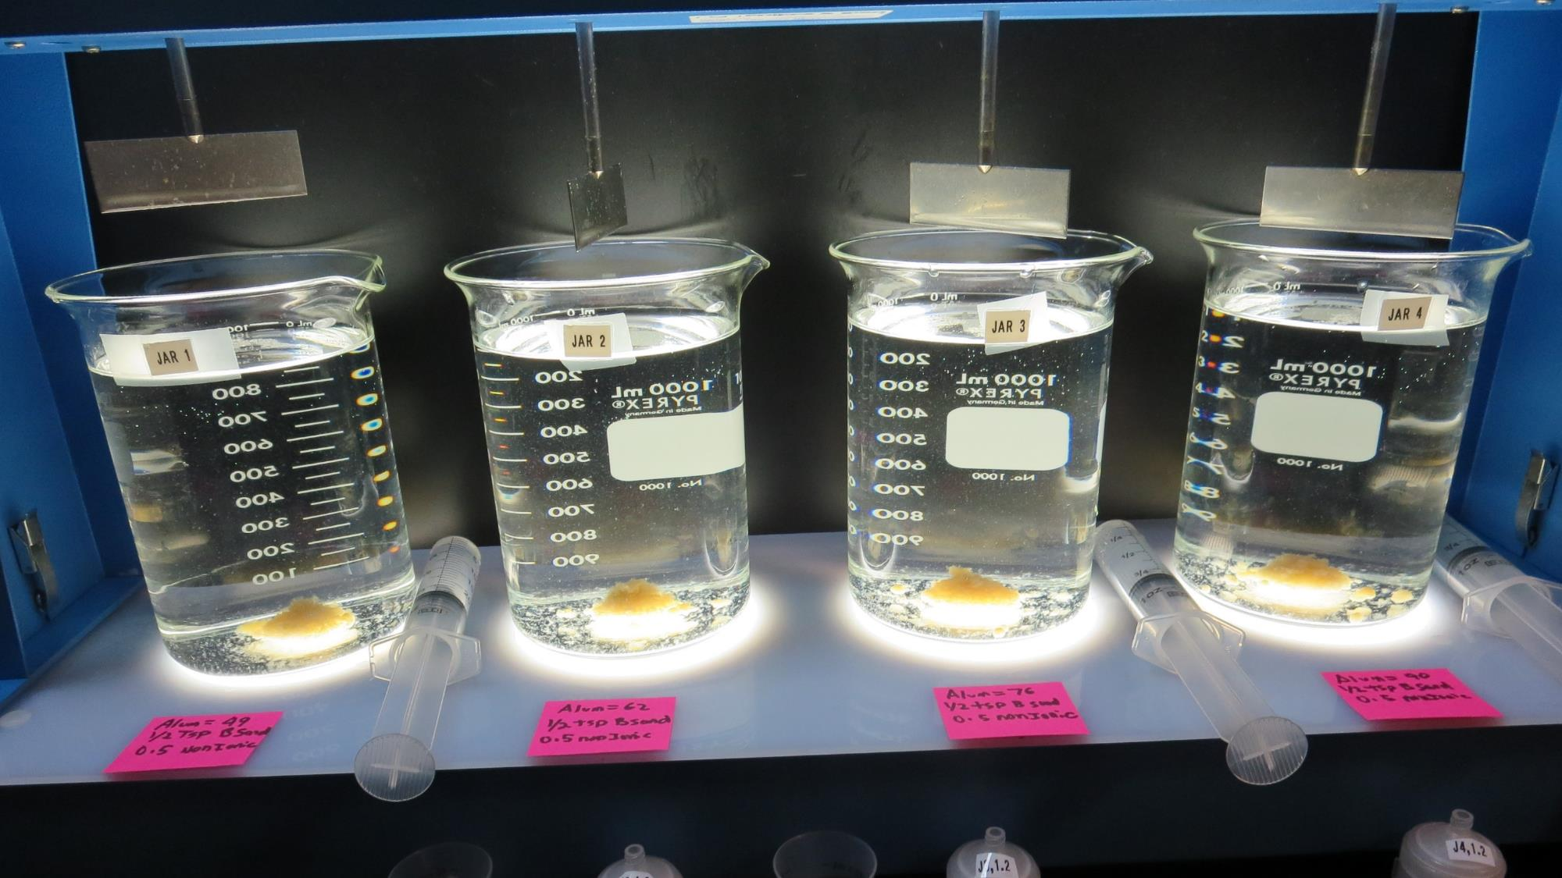
Jars 1-4: After 5-minutes of settling, settled water turbidity is taken.

Slide 15
Jars 5-8 Test
Flash Mix 60 Sec (200 RPM)
Floc Mix 2 min (110 RPM)
Floc Mix 3 min (60 RPM)
Applied Coagulants
Alum/AD313P/9810

Slide 16
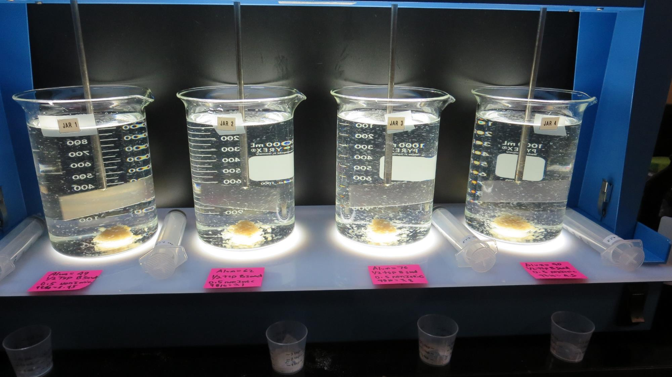
Jars 5-8: End of 5-minute flocculation duration.
After 1 min of settling, 25 mL is syringed for filterability and %UVT/UVA.
49 mg/L Alum
½ tsp Ballast Sand
0.5 mg/L AD313P
2.45 mg/L 9810
Filtrate 0.21 NTU
UVT: 88.2%
UVA: 0.055/cm
Settled: 0.8 NTU
62 mg/L Alum
½ tsp Ballast Sand
0.5 mg/L AD313P
3.1 mg/L 9810
Filtrate 0.22 NTU
UVT: 89.3%
UVA: 0.049/cm
Settled: 1.1 NTU
76 mg/L Alum
½ tsp Ballast Sand
0.5 mg/L AD313P
3.8 mg/L 9810
Filtrate 0.18 NTU
UVT: 90.4%
UVA: 0.044/cm
Settled: 1.2 NTU
90 mg/L Alum
½ tsp Ballast Sand
0.5 mg/L AD313P
4.5 mg/L 9810
Filtrate 0.05 NTU
UVT: 91.4%
UVA: 0.039/cm
Settled: 1.6 NTU

Slide 17
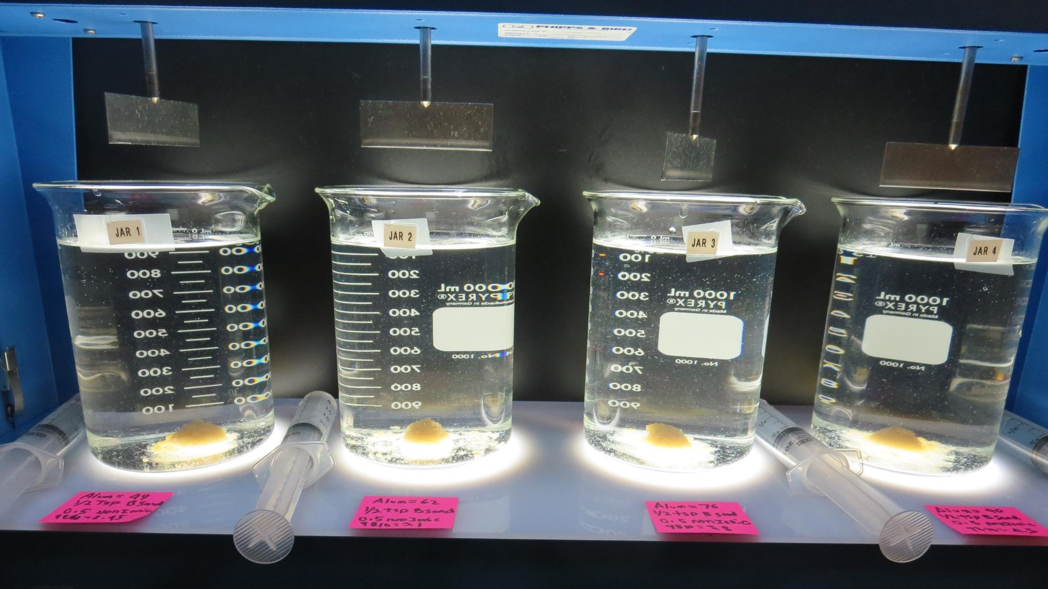
Jars 5-8: After 5-minutes of settling, settled water turbidity is taken.

Slide 18
Jars 9-12 Test
Flash Mix 60 Sec (200 RPM)
Floc Mix 2 min (110 RPM)
Floc Mix 3 min (60 RPM)
Applied Coagulants
Alum/AD313P/9810

Slide 19
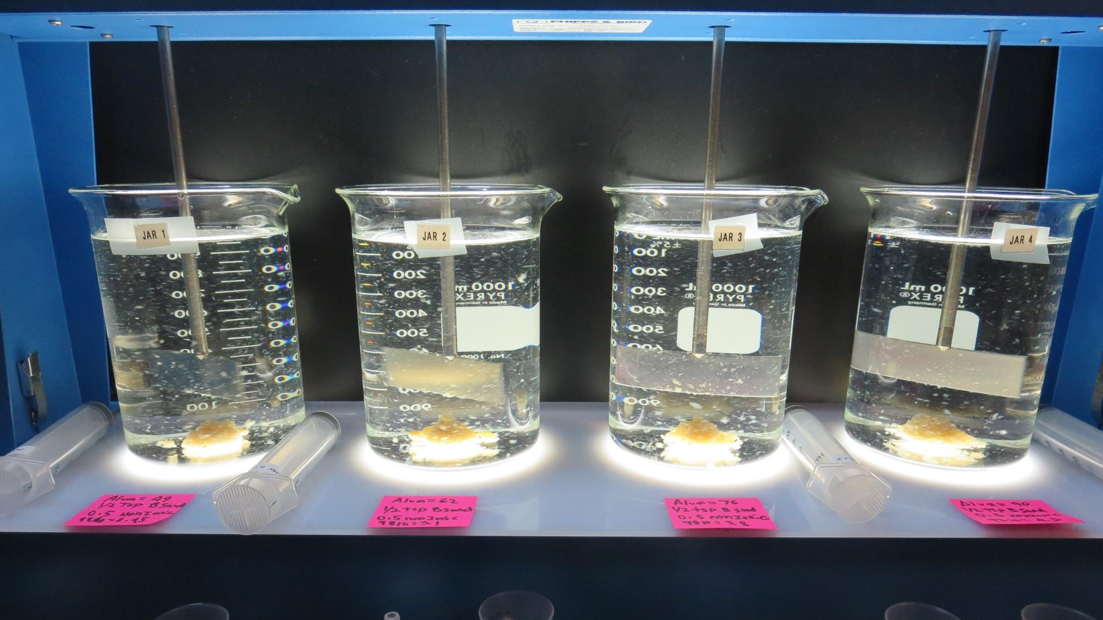
Jars 9-12: End of 5-minute flocculation duration.
After 1 min of settling, 25 mL is syringed for filterability and %UVT/UVA.
49 mg/L Alum
2.45 mg/L 9810
½ tsp Ballast Sand
0.5 mg/L AD313P
Filtrate 0.08 NTU
UVT: 88.6%
UVA: 0.053/cm
Settled: 0.5 NTU
62 mg/L Alum
3.1 mg/L 9810
½ tsp Ballast Sand
0.5 mg/L AD313P
Filtrate 0.07 NTU
UVT: 89.6%
UVA: 0.048/cm
Settled: 0.5 NTU
76 mg/L Alum
3.8 mg/L 9810
½ tsp Ballast Sand
0.5 mg/L AD313P
Filtrate 0.07 NTU
UVT: 90.5%
UVA: 0.043/cm
Settled: 0.4 NTU
90 mg/L Alum
4.5 mg/L 9810
½ tsp Ballast Sand
0.5 mg/L AD313P
Filtrate 0.06 NTU
UVT: 91.4%
UVA: 0.039/cm
Settled: 0.4 NTU

Slide 20
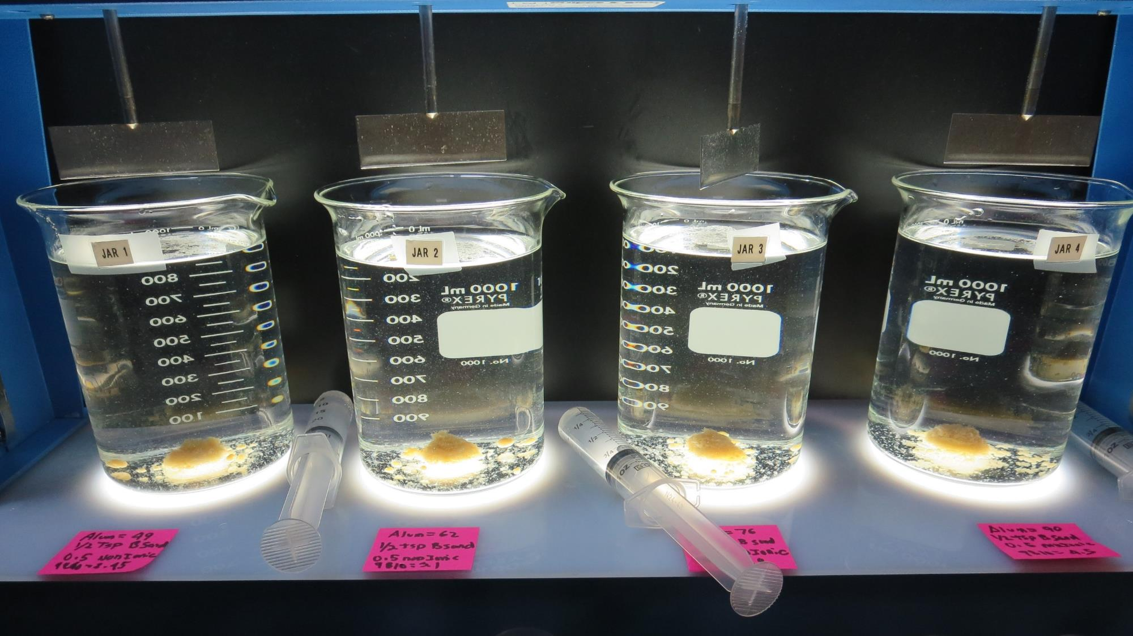
Jars 9-12: After 5-minutes of settling, settled water turbidity is taken.

Slide 21
Jars 13-16 Test
Flash Mix 60 Sec (200 RPM)
Floc Mix 2 min (110 RPM)
Floc Mix 3 min (60 RPM)
Applied Coagulants
Alum/AD313P/9810 w/CO2, target 7.5 pH

Slide 22
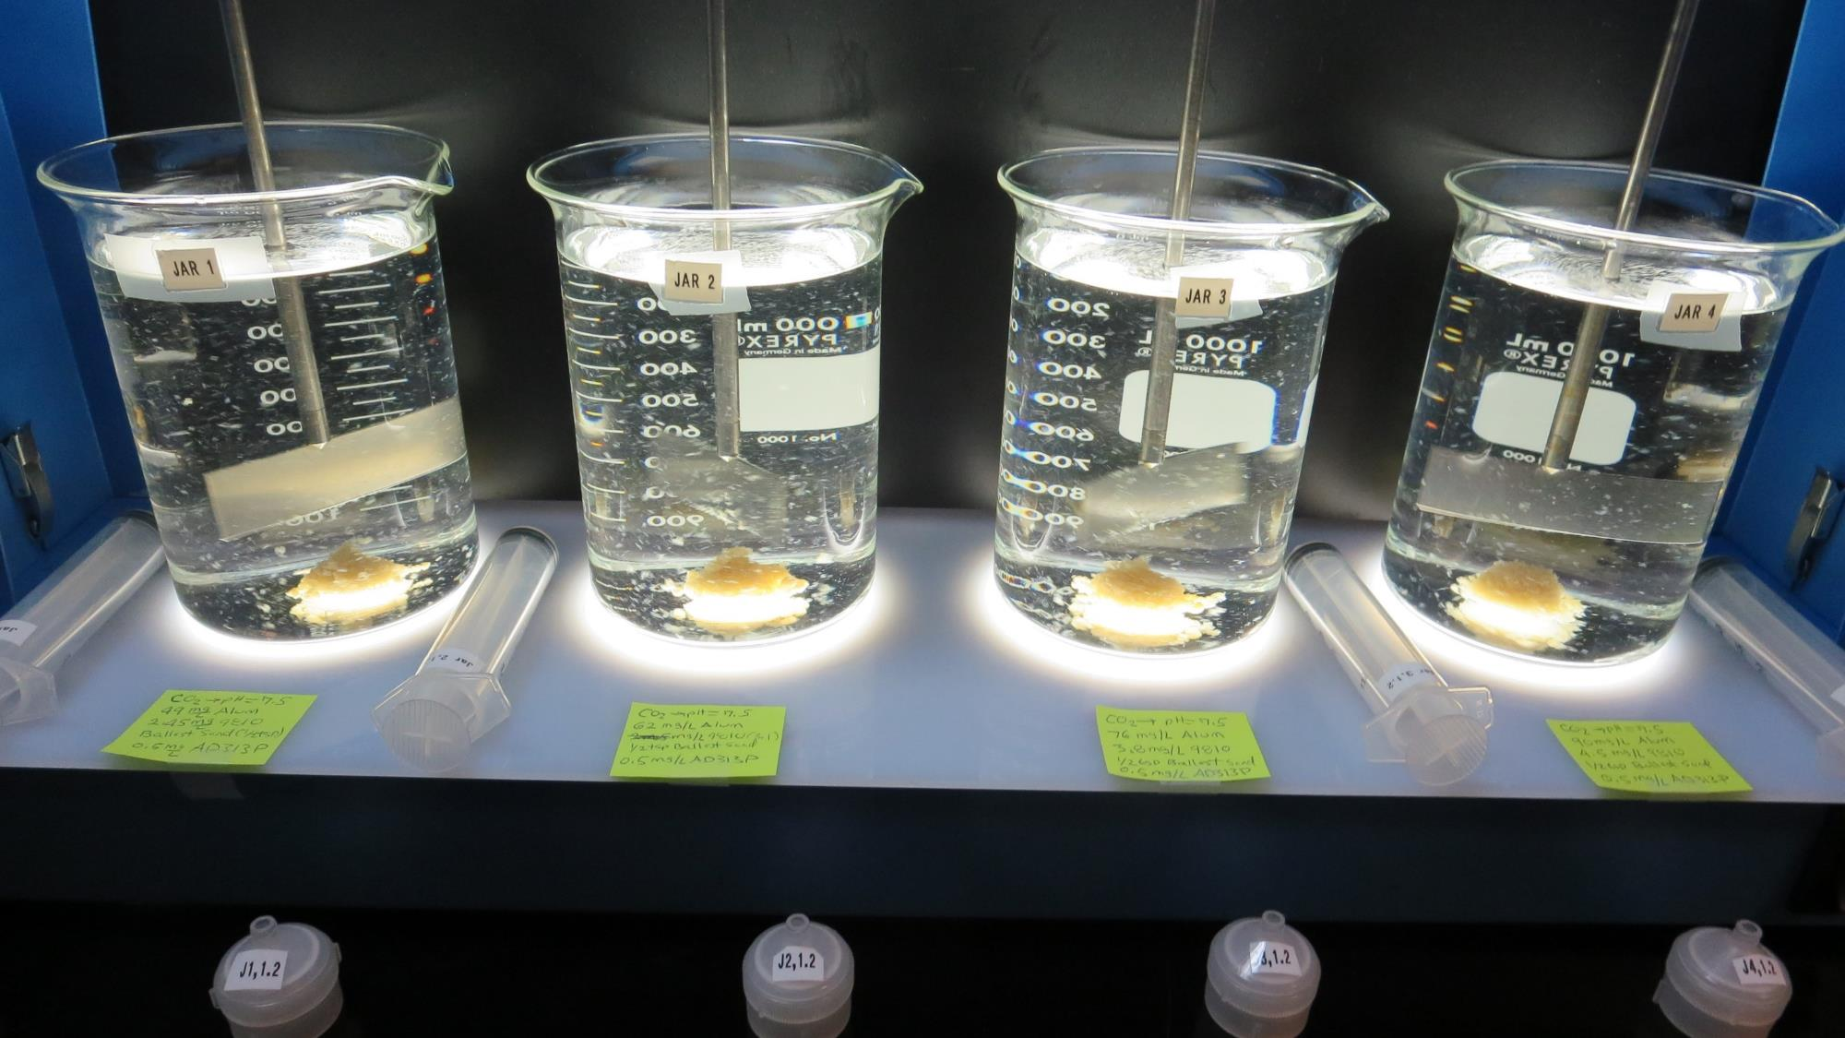
Jars 13-16: End of 5-minute flocculation duration.
After 1 min of settling, 25 mL is syringed for filterability and %UVT/UVA.
Added CO₂
49 mg/L Alum
2.45 mg/L 9810
½ tsp Ballast Sand
0.5 mg/L AD313P
Filtrate 0.07 NTU
UVT: 89.4%
UVA: 0.049/cm
Settled: 0.8 NTU
Added CO₂
62 mg/L Alum
3.1 mg/L 9810
½ tsp Ballast Sand
0.5 mg/L AD313P
Filtrate 0.07 NTU
UVT: 90.4%
UVA: 0.044/cm
Settled: 0.5 NTU
Added CO₂
76 mg/L Alum
3.8 mg/L 9810
½ tsp Ballast Sand
0.5 mg/L AD313P
Filtrate 0.06 NTU
UVT: 91.0%
UVA: 0.041/cm
Settled: 0.5 NTU
Added CO₂
90 mg/L Alum
4.5 mg/L 9810
½ tsp Ballast Sand
0.5 mg/L AD313P
Filtrate 0.07 NTU
UVT: 91.6%
UVA: 0.038/cm
Settled: 0.5 NTU

Slide 23
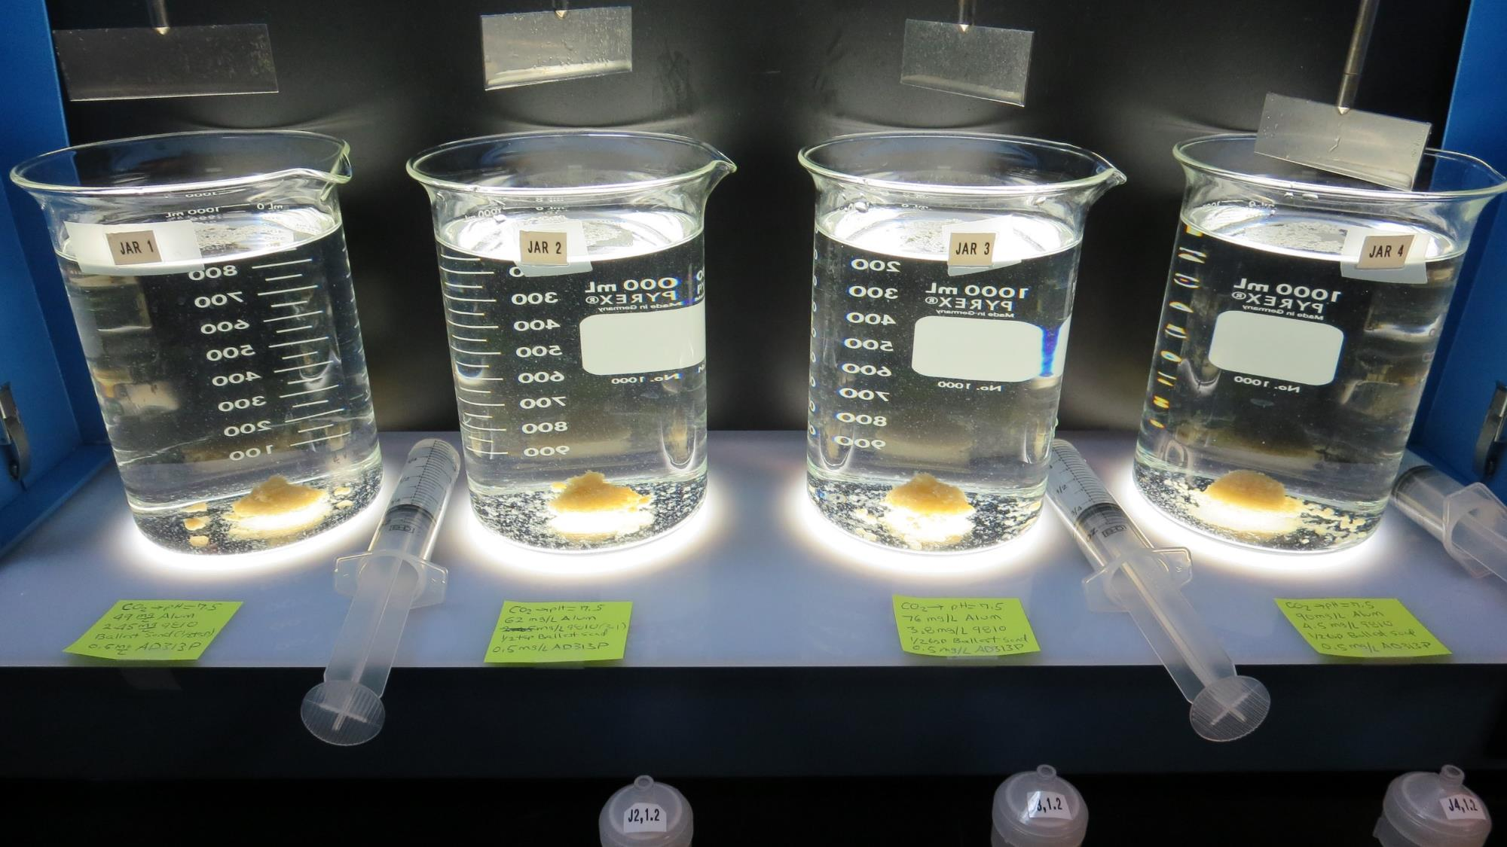
Jars 13-16: After 5-minutes of settling, settled water turbidity is taken.

Slide 24
Jars 17-20 Test
Flash Mix 60 Sec (200 RPM)
Floc Mix 2 min (110 RPM)
Floc Mix 3 min (60 RPM)
Applied Coagulants
9800/AD313P

Slide 25
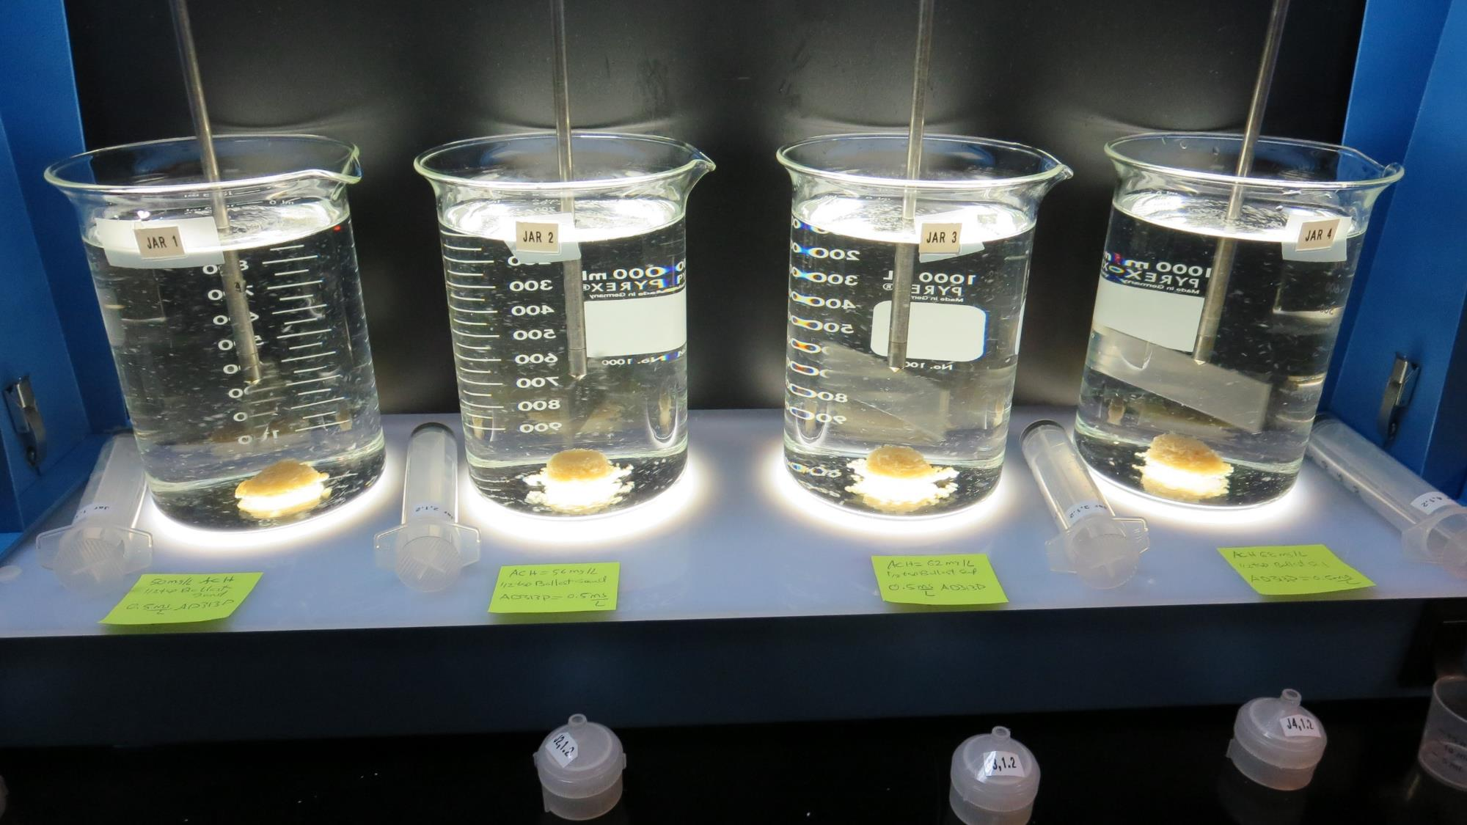
Jars 17-20: End of 5-minute flocculation duration.
After 1 min of settling, 25 mL is syringed for filterability and %UVT/UVA.
50 mg/L 9800
½ tsp Ballast Sand
0.5 mg/L AD313P
Filtrate 0.08 NTU
UVT: 91.1%
UVA: 0.040/cm
Settled: 0.5 NTU
56 mg/L 9800
½ tsp Ballast Sand
0.5 mg/L AD313P
Filtrate 0.06 NTU
UVT: 91.5%
UVA: 0.039/cm
Settled: 0.3 NTU
62 mg/L 9800
½ tsp Ballast Sand
0.5 mg/L AD313P
Filtrate 0.07 NTU
UVT: 91.8%
UVA: 0.037/cm
Settled: 0.3 NTU
68 mg/L 9800
½ tsp Ballast Sand
0.5 mg/L AD313P
Filtrate 0.07 NTU
UVT: 92.0%
UVA: 0.036/cm
Settled: 0.4 NTU

Slide 26
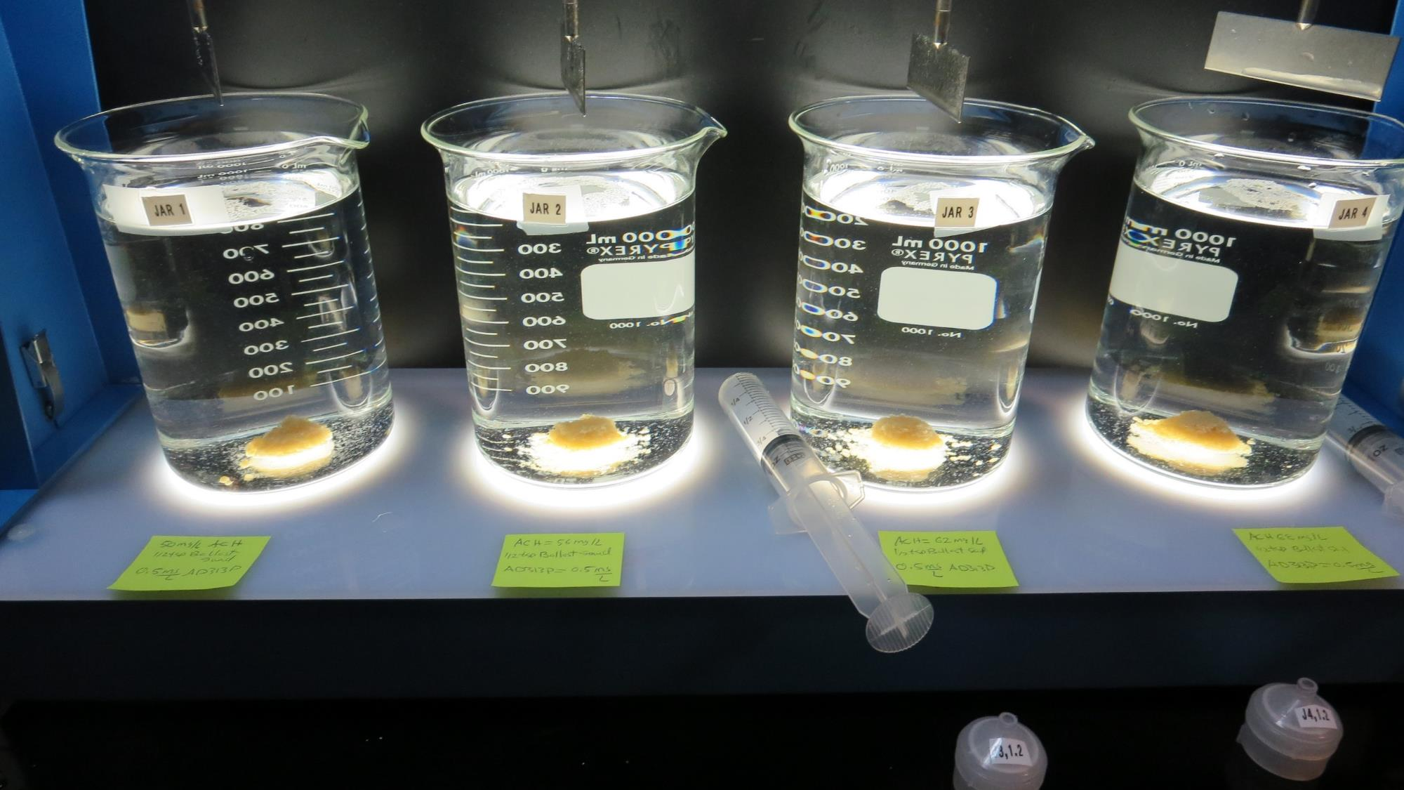
Jars 17-20: After 5-minutes of settling, settled water turbidity is taken.

Slide 27
Jars 21-24 Test
Coagulants
9800/9890/AD313P

Slide 28
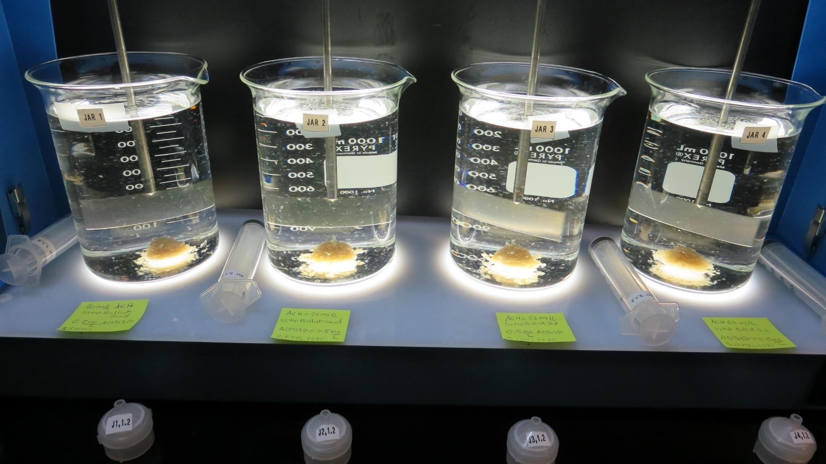
Jars 21-24: End of 5-minute flocculation duration.
After 1 min of settling, 25 mL is syringed for filterability and %UVT/UVA.
50 mg/L 9800
3.5 mg/L 9890
½ tsp Ballast Sand
0.5 mg/L AD313P
Filtrate 0.08 NTU
UVT: 90.6%
UVA: 0.043/cm
Settled: 0.5 NTU
56 mg/L 9800
2.8 mg/L 9890
½ tsp Ballast Sand
0.5 mg/L AD313P
Filtrate 0.08 NTU
UVT: 90.9%
UVA: 0.041/cm
Settled: 0.5 NTU
62 mg/L 9800
3.1 mg/L 9890
½ tsp Ballast Sand
0.5 mg/L AD313P
Filtrate 0.07 NTU
UVT: 91.3%
UVA: 0.040/cm
Settled: 0.4 NTU
68 mg/L 9800
3.4 mg/L 9890
½ tsp Ballast Sand
0.5 mg/L AD313P
Filtrate 0.09 NTU
UVT: 91.5%
UVA: 0.039/cm
Settled: 0.4 NTU

Slide 29
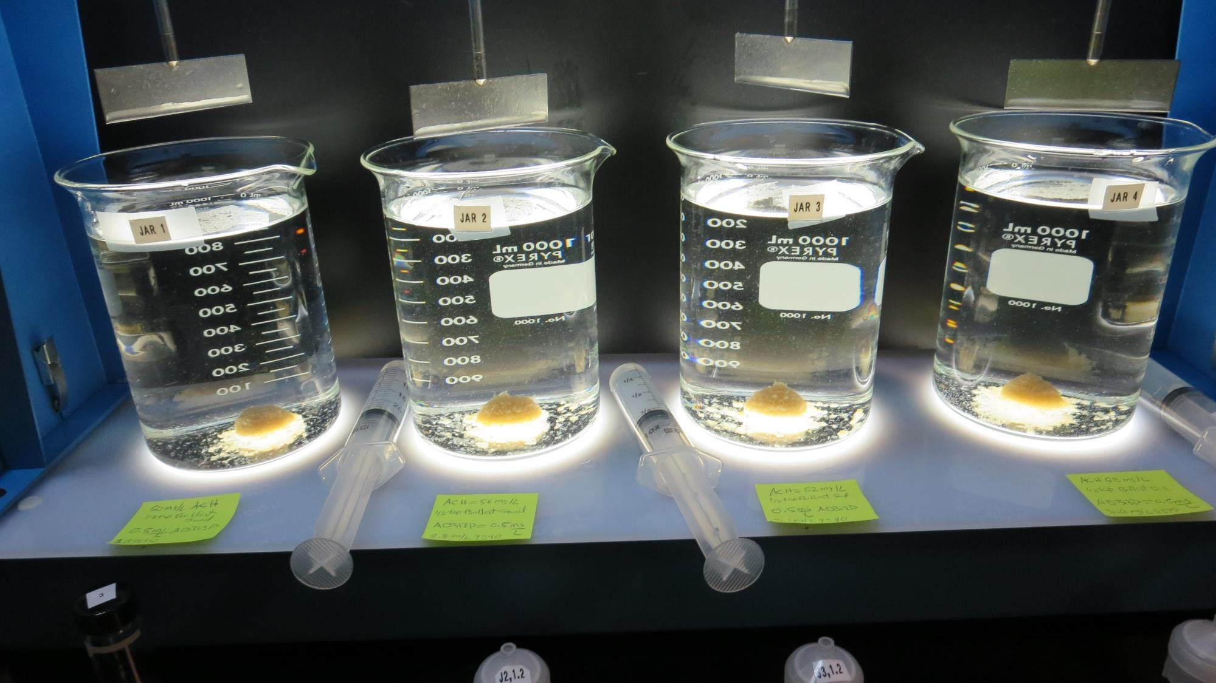
Jars 21-24: After 5-minutes of settling, settled water turbidity is taken.

Slide 30
Jar Testing – Procedures for Actiflo, 1-Liter Jars
Fill jars with source water prior to coagulant injection and set paddle speed at 30 rpm
Add chemicals (i.e., NaOCl, primary coagulant, coagulant aid) to each jar
Flash mix for 15-60 seconds (200 rpm)
Add ballast sand (1/2 tsp/liter) and nonionic polymer
Reduce paddled speed to 110 RPM for 2 minutes
Reduce paddle speed to 60 RPM for 3 minutes
Raise paddles out of water and settled for 1 minute
Syringe 25 mL from each jar taken 1-inch below surface (25 mL/12 sec rate)
Filtered through 1.2 um isopore membrane into cuvette (drip rate, 15 mL/90 sec)
Measure filtrate turbidity, chlorine residual and %UVT or UVA
Measure settled water turbidity after 5 minutes of total setting
Record all data

Slide 31

Jar Test
Filterability Test Equipment
Turbidity Instrument
Syringe w/Luer-Lock Tip, 30 cc
(part#: 2225800, by Hach)
Swinnex Filter Holder, 25 mm (part#: SX0002500)
Isopore Membrane Filter, 1.2 um absolute
pore size,
Φ= 25 mm , thickness: 24 um,
hydrophilic polycarbonate membrane
(part #: RTTP02500)
Go to Sigma-Aldrich for laboratory supplies http://www.sigmaaldrich.com/united-states.html

Slide 32
Isopore Membrane Information
Categories | Information
trade name | Isopore
filter color | White
chemistry | Polycarbonate (PC)
water flow rate | Avg. 175 mL/min x cm² (typical results @ 10 psi)
media | Isopore®
wettability | Hydrophilic
porosity | 14.7%
pore size | 1.2 µm
bubble point at 23 °C | 1.0 bar, air with water
thickness | 24 µm
filter diameter (ø) | 25 mm
material size | polycarbonate, Hydrophilic, 1.2 µm, 25 mm, white, plain, 100

Slide 33
Isopore Membrane Background Information
The Isopore membrane is a polycarbonate, track-etched screen filter recommended for all analyses in which the sample is viewed on the surface of the membrane. The Isopore membrane is composed of polycarbonate film, which has a smooth, glass-like surface for clearer sample observation. The unique manufacturing process of the membrane ensures a precise pore diameter and a consistent pore size for accurate separation of samples by size. Matched-weight filters are not usually required because of low, constant tar and ash weights.
Features & Benefits:
Membrane structure retains particles on the surface, simplifying counting and analysis

Slide 34
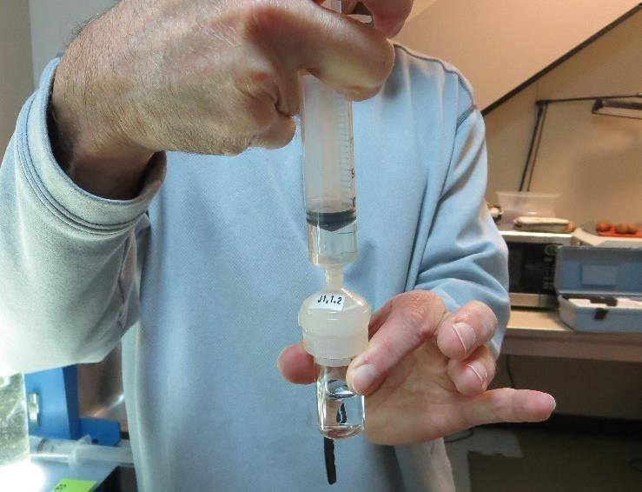

Jar Test - Filterability Test
Syringe ~ 25 mL from jar (after 5-minutes of settling)
Filter-to-waste 3-5 mL
Filter directly into clean cuvette
Measure turbidity
Note: Take several readings before recording final NTU results. Micro bubbles can adhere to glass causing false NTU readings. To remove bubbles, tilt cuvette up to 90 degrees.

Slide 35

Contact
Guy Schott, P.E.
State Water Resources Control Board
Division of Drinking Water
Santa Rosa, CA
Go to Stock Solution/Dose calculations/Jar Test Results for tools to download
www.waterboards.ca.gov/drinking_water/programs/districts/mendocino_district.html
Email: Guy Schott - Guy.Schott@waterboards.ca.gov
Office Number: 707-576-2732

