Slide 1
City of Fairfield
Public Works Waterman WTP
CA4810003
Tracer Study –
Ozone Contactor Basin 3
July 23, 2021
Tracer Study – Drinking Water
Treatment Plant Type: Actifloc
Reactor: Ozone Contactor Basin
Basin Volume: 36,420 gallons
Sample Pt. Volume: 27,500 gallons
Tracer Method: Slug-Dose
Tracer: Fluoride (liquid)
Mass Added: 232 grams
Mass Recovered: 214 grams
Percent Mass Recovered: 92%
Test Flow: 6 MGD
Baffling Factor at Sample Pt: 0.74
Performed by:
Guy Schott
Stuart Hamilton and Staff

Slide 2
Ozone Basin1

Slide 3
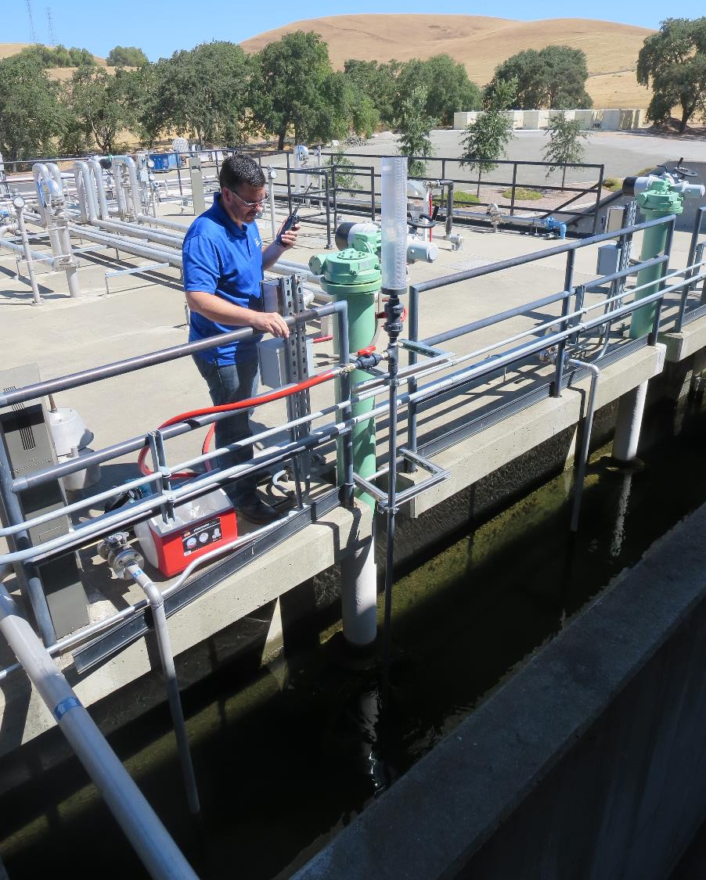
Tracer Injection –
Slug Dose
Before start of tracer test, 1,000 mL of Hydrofluosilicic acid (~232 grams F) was added to a closed valve calibrated cylinder as shown in the photo. At the start of the test, the outlet valve is manually opened that allow the fluoride to flow down the injection line into the ozone feed water. High pressure water hose is then opened to complete flushing of line.

Slide 4
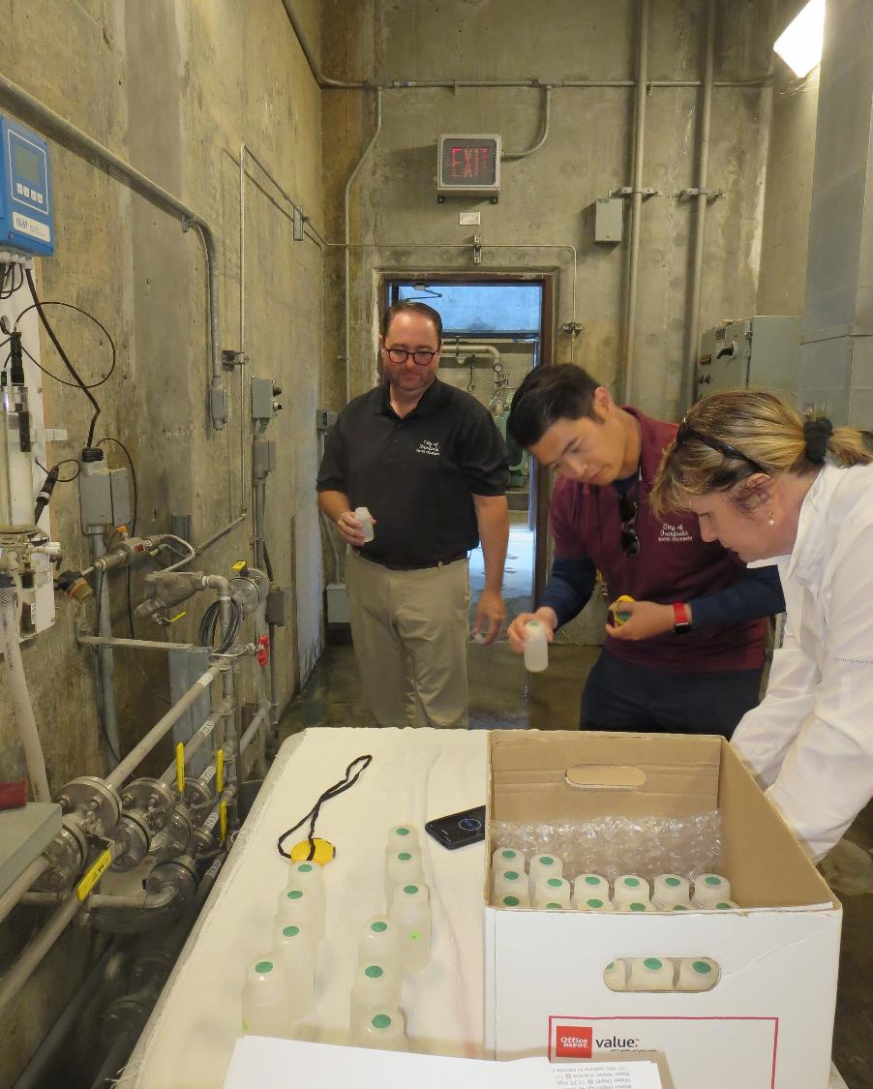
Sample Station
Bottom of Cell 4
Sample frequency ranged from 15 to 40 second intervals:
Samples 1 – 6: 20 seconds
Samples 6 – 36: 15 seconds
Samples 36 – 41: 20 seconds
Samples 41 – 46: 30 seconds
Samples 46 – 50: 40 seconds

Slide 5
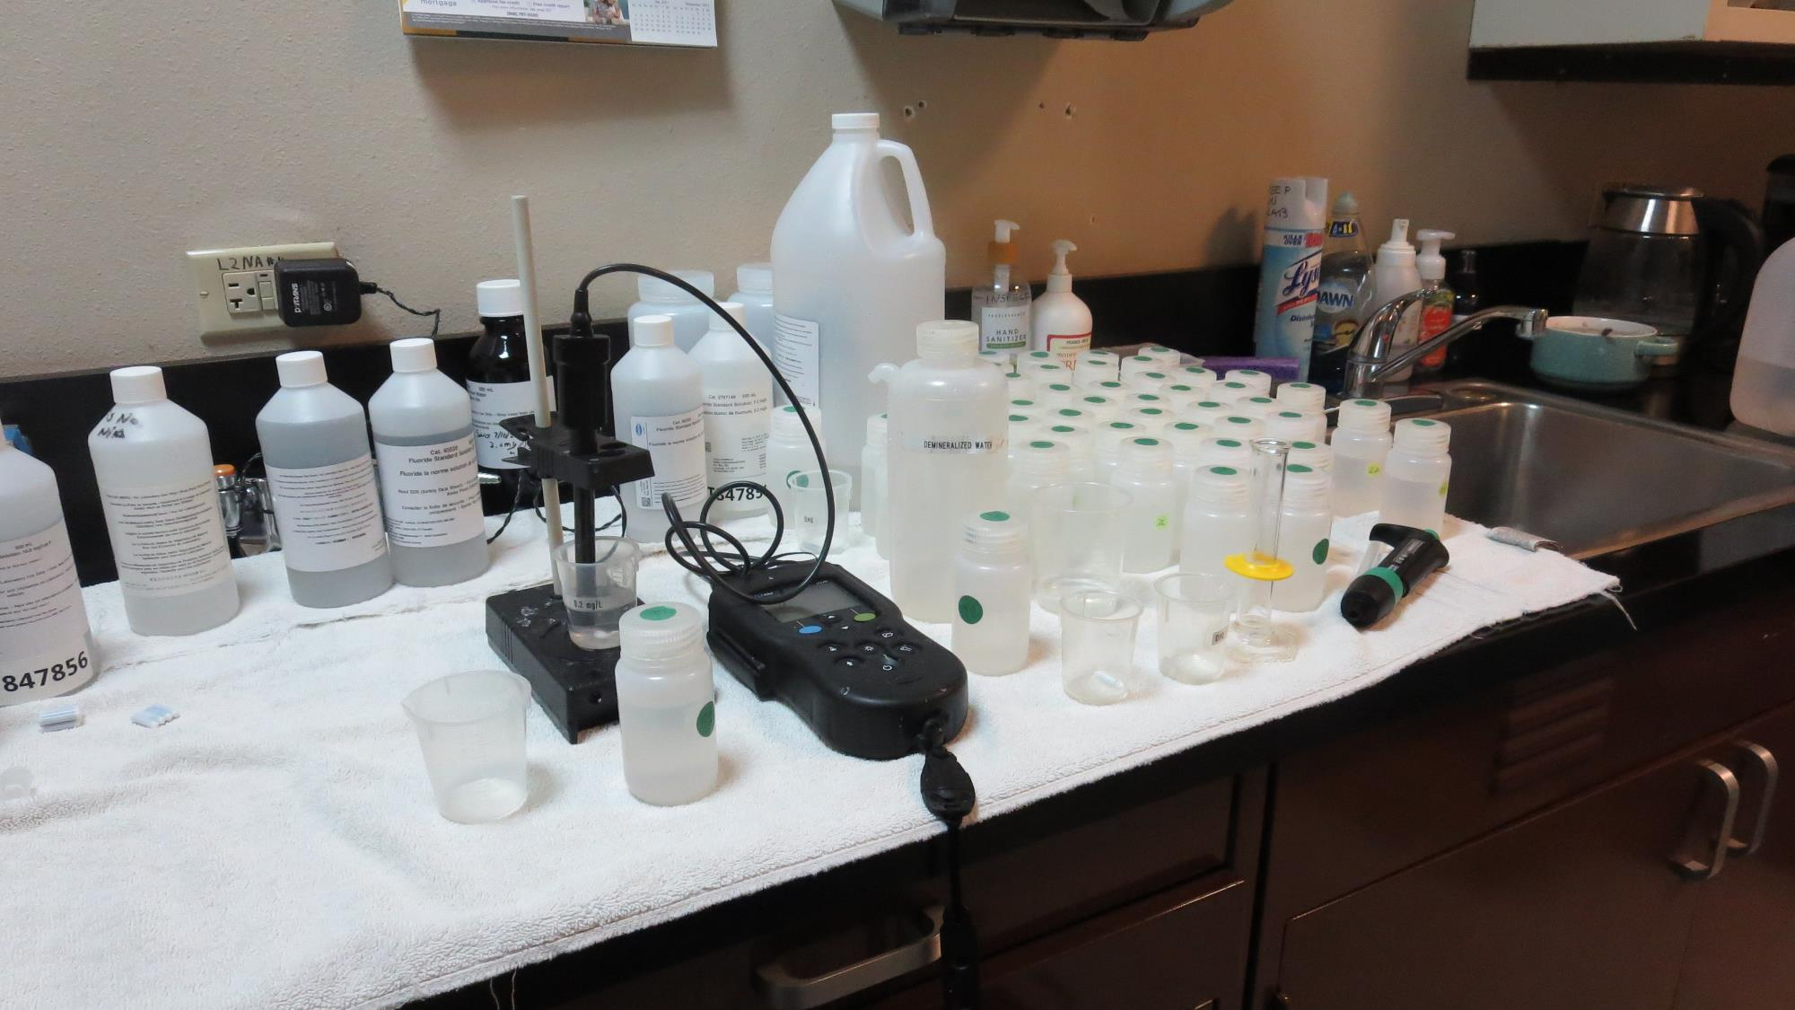
Laboratory

Slide 6
Table 1

Slide 7
Table 2

Slide 8
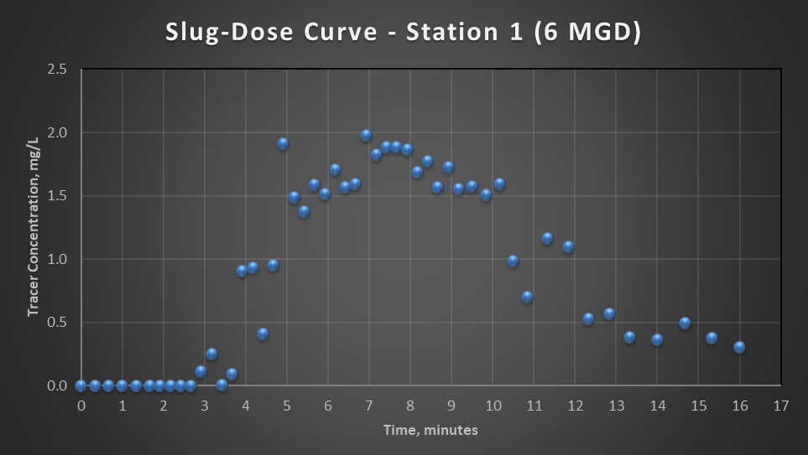
Slug Curve

Slide 9
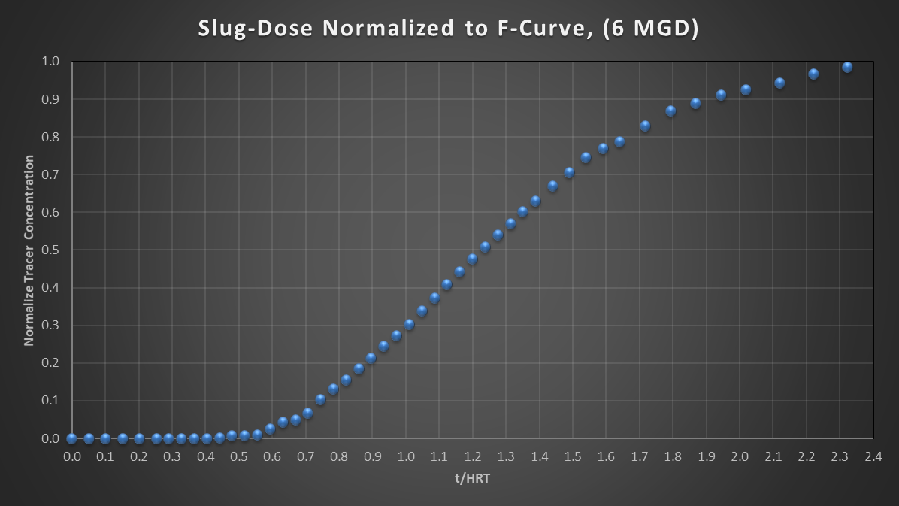
Slug Normalized
t₁₀/HRT= 0.74

Slide 10
Purpose of a Tracer Study
To determine the hydraulic efficiency or disinfectant exposure time of water through one or more reactors.
The addition of known quantities of a nonreactive chemical (tracer) is added in the form of a pulse (slug) or step-input.
The time of travel or disinfectant exposure time through the reactor is related to:
  Flow rate
  Reactor water volume
  Water Depth
  Reactor configuration

Slide 11
Disinfection Exposure Time of Fluid in Vessel for Determining Ct₁₀
“C” is the disinfectant residual (mg/L) at the point of inactivation compliance.
The disinfection exposure time of water used for Ct₁₀ calculation is the time (t₁₀) it takes for 10 percent of the water entering the reactor to exit the reactor.
To determine this, a marker (nonreactive tracer) is introduced into the water and is monitored leaving the reactor.
Example: 1,000 grams of tracer is slug-dose; t₁₀ is that time when 100 grams of tracer material (10%) has exit the reactor.

Slide 12
Ct₁₀ Value
- Log inactivation is based on the Delivered Dose, “Ct₁₀”
  “C” is the disinfectant residual (mg/L)
  “t₁₀” is the exposure or contact time (minutes)
  Multiply them:
C • t₁₀ = mg/L • min (delivered dose)
The calculated Ct₁₀ value is looked up in EPA Ct tables to determine the log inactivation based on specific monitoring parameters (pH, disinfectant residual and/or temperature).

Slide 13
Baffling Factor (BF)
Baffling factor or short-circuiting factor:
  Determined from tracer study or estimated
  BF = t₁₀/ HRT from tracer study
  HRT (hydraulic residence time) = reactor volume divided by reactor flow
Once the BF is determined, then it is applied to the operations of the reactor for determining the disinfectant exposure time.
Example:
  Ozone reactor operating volume: 27,500 gallons
  Exit flow: 5,000 gpm (7.2 MGD)
  BF: 0.74, from tracer study
  Calculated contact or disinfection exposure time:
    27,500 gal ÷ 5,000 gpm × 0.74
    = 5.5 minutes = t₁₀

Slide 14
Test Method
Slug-Dose or Pulse-Input Method
Adding the entire amount of tracer at the beginning of test. The reactor outlet tracer concentration is monitored up to 3 HRT to determine mass recovery and the time (t₁₀) it takes for 10% of the tracer mass to exit the reactor.

Slide 15
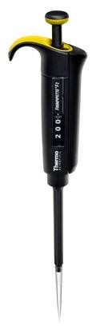
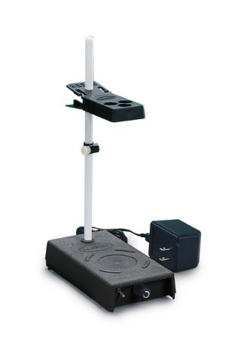
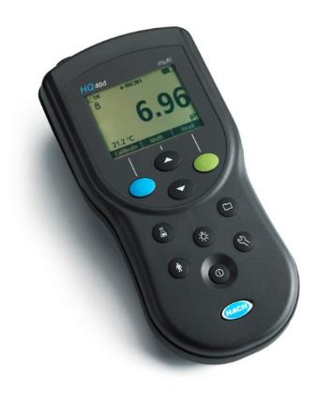
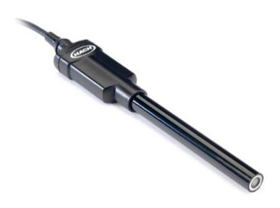
Method of Analysis and Equipment
Intellical™ ISEF121 Fluoride (F⁻) Ion Selective Electrode (ISE)
HQ40d Portable ISE Multi-Parameter Meter
Fluoride Ionic Strength Adjustor (ISA)
Fluoride Standards (0.2/2.0 & 0.5/ 5.0 mg/L)
25 mL graduated cylinder
Finnpipette F2 variable volume pipette, capacity 0.5 - 5 mL
Electrode stirrer stand
50 mL beakers
Stir Bar, Magnetic, Polygon

Slide 16

Contact
Guy Schott, P.E.
State Water Resources Control Board
Division of Drinking Water
Santa Rosa, CA
Guy.Schott@waterboards.ca.gov
707-576-2732

