Slide 1
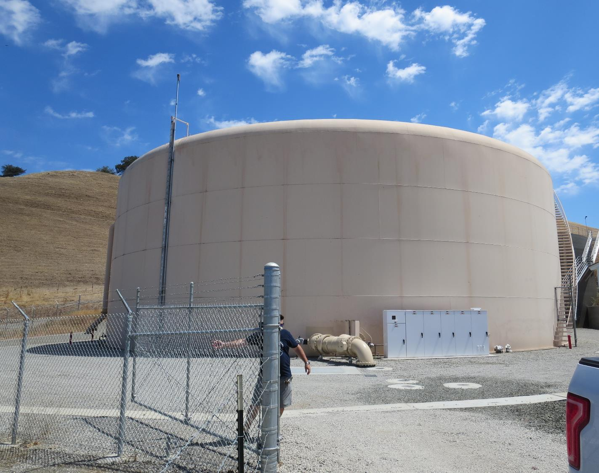
Cement Hill Water Treatment Plant
CA4810005
Tracer Study
July 30, 2020
By Guy Schott, P.E

Slide 2
Table of Contents
Clearwell Design Specifications and Tracer Sampling Points
Summary of Tracer Results and Procedures
Tracer Injection Point
Recorded Tracer Data (Tables)
Graphs: Modified Step-Dose Curves for Stations 2 and 3
Graphs: Normalized Modified Step-Dose Curve to F-Curve for Stations 2 & 3
Purpose of a Tracer Test
Disinfection Exposure Time of Fluid in Vessel for Determining Ct₁₀
Ct₁₀ Value
Baffling Factor (BF), Definition
Tracer Test Method (Modified Step-Dose)
Method of Analysis and Equipment

Slide 3
Pipeline & Tank Design Specifications

Slide 4
Summary of Tracer Procedures
Tracer study was conducted on a 3,189 linear feet, 20-in diameter transmission and two 2.0 MG storage tanks all operated in series. Liquid fluoride was used as the tracer and was injected into a 20-in pipeline downstream of filtration.
Sampling were done at three stations
  Station 1: End of 3,189 linear feet transmission line to determine fluoride dose (mg/L)
  Station 2: Outlet of 2.0 MG Steel Tank
  Station 3: Outlet of 2.0 MG Concrete Tank
Pipeline flow was 3,000 gpm (steady-state)
Tanks exit flows varied from 2,200 – 2,400 gpm

Slide 5
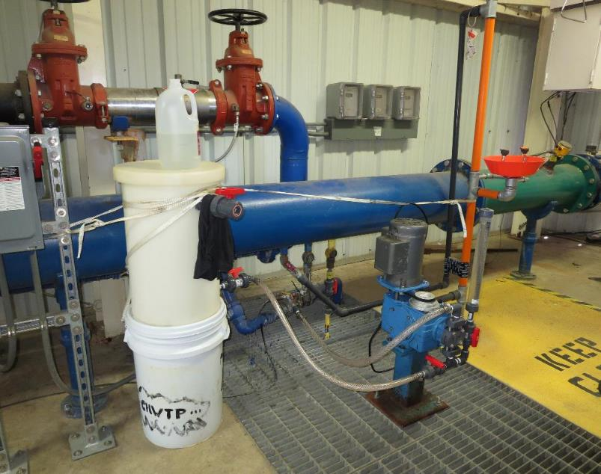
Cement Hill Water Treatment Plant
Tracer and Fluoride injection location
Tracer: H₂SiF₆, Fluoride (F)
Feed pump rate: 100 mL/min
Background: 0.081 mg/L as F
Measured dose: 2.1 mg/L as F (excluding background fluoride)
Fluoride (tracer) was injected into a 20-in diameter transmission pipe (post filtration). The transmission line is 3,189 linear feet to the CT storage tanks.

Slide 6
Tracer Test Result Summary –
Transmission Line + 2.0 MG Steel Tank
Modified Step-Dose
Test Date: 7/30/20
Transmission Line: 3,189 feet (20-in Dia)
Transmission Line Vol: 52,044 gallons
Transmission Flow: 3,000 gpm
Tank Operating Level: 21.2 - 21.6 ft
Tank Working Vol: 1,258,326 gallons (avg)
Volume of Transmission Line + Tank: 1,310,370 gallons (avg)
Steel Tank Outlet Flow: 2,390 gpm (avg)
HRT: 548 minutes (1,310,370 gal/2,390 gpm)
t₁₀: 38 minutes
Baffling Factor (t₁₀/HRT): 0.07

Slide 7
Tracer Test Result Summary –
Transmission Line + 2.0 MG Steel + 2.0 MG Concrete Tanks
Modified Step-Dose
Test Date: 7/30/20
Transmission Line: 3,189 feet (20-in Dia)
Transmission Line Vol: 52,044 gallons
Transmission Flow: 3,000 gpm
Tank Operating Level: 21.2 - 22.7 ft
Combined Tanks Working Vol: 2,583,606 gallons (avg)
Volume of Transmission Line + Tanks: 2,635,651 gallons (avg)
Concrete Tank Outlet Flow: 2,214 gpm (avg)
HRT: 1,183 minutes (2,635,651 gal/2,214 gpm)
t₁₀: 270 minutes (4.5 hours)
Baffling Factor (t₁₀/HRT): 0.23

Slide 8
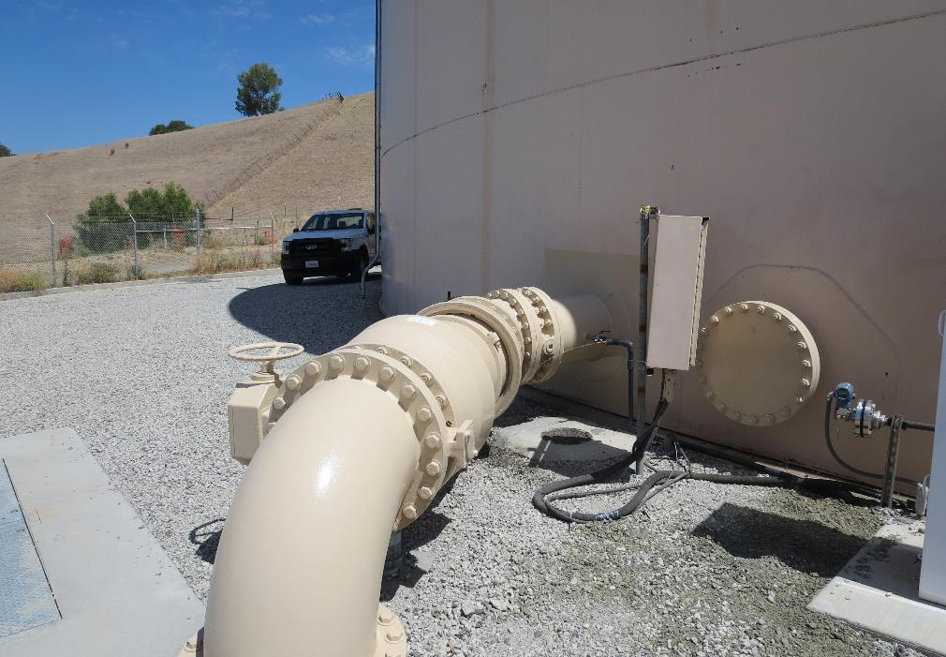
Station 1: Transmission Line to 2.0 MG Steel Tank
First segment is 3,189 linear feet of 20-inch diameter transmission line to 2 MG Steel tank. Tracer dose (Fluoride) is measured and verify as it enters the first CT storage tank.

Slide 9
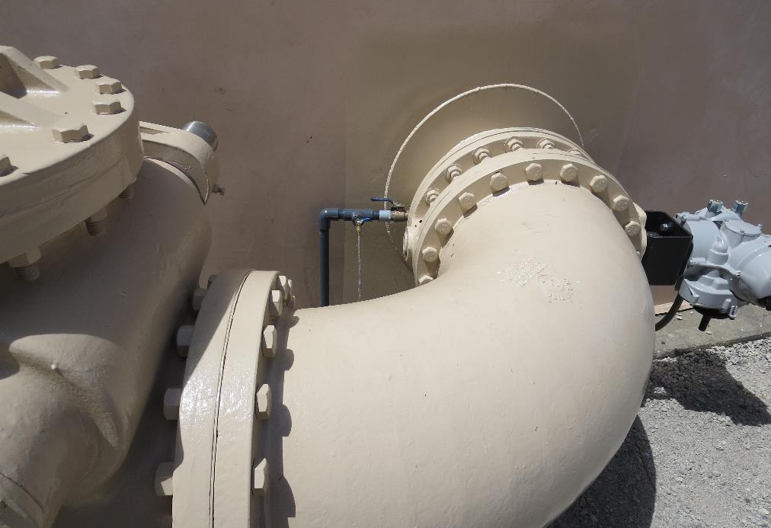
Station 2: 2.0 MG Steel Tank
Sample station on exit side of 2.0 MG Steel Tank. This water exits the tank and flows to the bottom of the 2.0 MG Concrete Tank.
Baffling Factor (t₁₀/HRT): 0.07
(Pipeline + 2.0 MG Steel Tank) operated in series

Slide 10
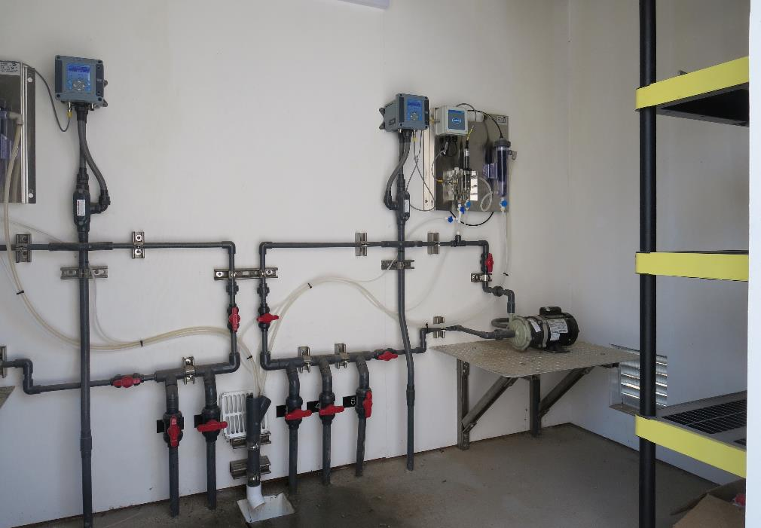
Station 3: 2.0 MG Concrete Tank
Sample station on exit side of 2.0 MG Concrete Tank.
Baffling Factor (t₁₀/HRT): 0.23
(Pipeline + 2.0 MG Steel Tank + 2.0 MG Concrete Tank) operated in series

Slide 11
Tracer Fluoride Pipeline Station 1, Table 1
Elapsed Time minutes | Tracer Fluoride mg/L | Elapsed Time minutes | Tracer Fluoride mg/L | Elapsed Time minutes | Tracer Fluoride mg/L
0 | 0.0841 | 8 | 0.0795 | 16 | 0.0795
1 | 0.0822 | 9 | 0.0800 | 17 | 0.0779
2 | 0.0824 | 10 | 0.0874 | 18 | 0.0786
3 | 0.0798 | 11 | 0.0837 | 19 | 0.0791
4 | 0.0816 | 12 | 0.0854 | 20 | 0.0928
5 | 0.0799 | 13 | 0.0786 | 21 | 1.26
6 | 0.0785 | 14 | 0.0783 | 25 | 1.98
7 | 0.0802 | 15 | 0.0784 | 30 | 2.09

Slide 12
Tracer Fluoride Pipeline Station 1, Table 2
Elapsed Time minutes | Tracer Fluoride mg/L | Elapsed Time minutes | Tracer Fluoride mg/L | Elapsed Time minutes | Tracer Fluoride mg/L
40 | 2.13 | 80 | 2.18 | 140 | 2.19
45 | 2.17 | 90 | 2.16 | 150 | 2.18
50 | 2.17 | 100 | 2.17 | 160 | 2.15
55 | 2.19 | 110 | 2.16 | 170 | 2.16
60 | 2.19 | 120 | 2.18 | 180 | 2.17
70 | 2.20 | 130 | 2.19 | 190 | 2.20

Slide 13
Tracer Dose and Background Residual
Average background fluoride concentration: 0.081 mg/L as F
Average steady-state measured fluoride concentration exiting pipeline and entering the first tank (steel): 2.179 mg/L as F
Fluoride dose: 2.179 – 0.081 = 2.10 mg/L as F
Results are based on tracer dose of 2.10 mg/L as F
10% of tracer dose is 0.210 mg/L as F

Slide 14
Tracer Fluoride Steel Tank Station 2, Table 1
Elapsed Time minutes | t/HRT | Tracer Fluoride mg/L | Elapsed Time minutes | t/HRT | Tracer Fluoride mg/L
3 | 0.005 | 0.0 | 24 | 0.044 | 0.007
6 | 0.011 | 0.0 | 27 | 0.049 | 0.1343
9 | 0.016 | 0.0 | 30 | 0.055 | 0.1783
12 | 0.022 | 0.0 | 33 | 0.060 | 0.1833
15 | 0.027 | 0.0 | 36 | 0.065 | 0.1683
18 | 0.033 | 0.0 | 39 | 0.071 | 0.2501
21 | 0.038 | 0.0 | 42 | 0.076 | 0.2313

Slide 15
Tracer Fluoride Concrete Tank Station 3, Table 1
Elapsed Time minutes | t/HRT | Tracer Fluoride mg/L | Elapsed Time minutes | t/HRT | Tracer Fluoride mg/L
10 | 0.009 | 0.000 | 110 | 0.095 | 0.041
30 | 0.026 | 0.000 | 120 | 0.104 | 0.049
50 | 0.043 | 0.008 | 126 | 0.109 | 0.052
70 | 0.061 | 0.016 | 132 | 0.114 | 0.057
80 | 0.069 | 0.020 | 138 | 0.119 | 0.065
90 | 0.078 | 0.028 | 144 | 0.124 | 0.072
100 | 0.086 | 0.033 | 150 | 0.129 | 0.073

Slide 16
Tracer Fluoride Concrete Tank Station 3, Table 2
Elapsed Time Minutes | t/HRT | Tracer Fluoride mg/L | Elapsed Time minutes | t/HRT | Tracer Fluoride mg/L
156 | 0.134 | 0.081 | 198 | 0.169 | 0.119
162 | 0.139 | 0.088 | 204 | 0.174 | 0.127
168 | 0.144 | 0.087 | 210 | 0.179 | 0.133
174 | 0.149 | 0.093 | 216 | 0.184 | 0.142
180 | 0.154 | 0.101 | 222 | 0.189 | 0.150
186 | 0.159 | 0.109 | 228 | 0.194 | 0.156

Slide 17
Tracer Fluoride Concrete Tank Station 3, Table 3
Elapsed Time Minutes | t/HRT | Tracer Fluoride mg/L | Elapsed Time minutes | t/HRT | Tracer Fluoride mg/L
240 | 0.204 | 0.170 | 276 | 0.233 | 0.216
246 | 0.209 | 0.180 | 282 | 0.238 | 0.222
252 | 0.214 | 0.188 | 288 | 0.243 | 0.231
258 | 0.219 | 0.194 | 294 | 0.248 | 0.236
264 | 0.223 | 0.200 | 300 | 0.253 | 0.244
270 | 0.228 | 0.209 | 306 | 0.257 | 0.251

Slide 18
Step-Dose Curve
20-in Dia. Transmission Line (3,189 ft)

Slide 19
Step-Dose Curve
Transmission Line + 2.0 MG Steel Tank
Dose: 2.1 mg/L
0.21 mg/L at t₁₀
t₁₀: 38 min
HRT: 548 min
t₁₀/HRT = 0.07

Slide 20
Normalized to F-Curve
Transmission Line + 2.0 MG Steel Tank
Baffling Factor (BF) = 0.07

Slide 21
Step-Dose Curve: Transmission Line +
2.0 MG Steel + 2.0 MG Concrete Tanks
Dose: 2.1 mg/L
0.21 mg/L at t₁₀
t₁₀: 270 min
HRT: 1,183 min
t₁₀/HRT = 0.23

Slide 22
Normalized to F-Curve : Transmission Line +
2.0 MG Steel + 2.0 MG Concrete Tanks
Baffling Factor (BF) = 0.23

Slide 23
Purpose of a Tracer Study
To determine the hydraulic efficiency or disinfectant exposure time of water through one or more reactors.
The addition of known quantities of a nonreactive chemical (tracer) is added in the form of a pulse (slug) or step-input.
The time of travel or disinfectant exposure time through the reactor is related to:
  Flow rate
  Reactor water volume
  Water Depth
  Reactor configuration
  Hydraulic mixing

Slide 24
Disinfection Exposure Time of Fluid in Vessel for Determining Ct₁₀
C” is the disinfectant residual (mg/L) at the point of inactivation compliance.
The disinfection exposure time of water used for Ct₁₀ calculation is the time (t₁₀) it takes for the first 10 percent of the water entering the reactor to exit the reactor.
To determine this, a marker (nonreactive tracer) is introduced into the water and is monitored leaving the reactor.
Example: 2.7 mg/L of tracer is continuously dose during testing; t₁₀ is that time when 0.27 mg/L of tracer concentration (10% of dose) has exit the reactor.

Slide 25
Ct₁₀ Value
Log inactivation is based on the Delivered Dose, “Ct₁₀”
  “C” is the disinfectant residual (mg/L)
  “t₁₀” is the exposure or contact time (minutes)
  Multiply them:
C • t₁₀ = mg/L • min (delivered dose)
The calculated Ct₁₀ value is looked up in EPA Ct tables to determine the log inactivation based on specific monitoring parameters (pH, disinfectant residual and temperature).

Slide 26
Baffling Factor (BF)
Baffling factor or short-circuiting factor:
  Determined from tracer study or estimated
  BF = t₁₀/ HRT from tracer study
  HRT (hydraulic residence time) = reactor volume divided by reactor flow
Once the BF is determined, then it is applied to the operations of the reactor for determining the disinfectant exposure time.
Example:
  Total Clearwell operating volume: 2,600,000 gallons
  Exit flow: 2,500 gpm (3.6 MGD)
  BF: 0.23, from tracer study
  Calculated contact or disinfection exposure time:
    2,600,000 gal ÷ 2,500 gpm × 0.23 = 239 minutes = t₁₀

Slide 27
Test Method
Modified Step-Dose Method
It is a continue feed of tracer at constant rate and inlet plant flow throughout the duration of the test. The “Step-Dose” test has a duration of 3-4 HRT to achieve reactor outlet steady-state tracer concentration. The time “t₁₀” is determined when 10% of the tracer dose concentration has exist the reactor. The “Modified Step-Dose” test allows the test to be completed in less than 1 HRT by physical measurements of the tracer inlet flow and/or channel basin concentration.

Slide 28
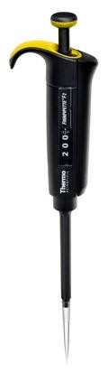
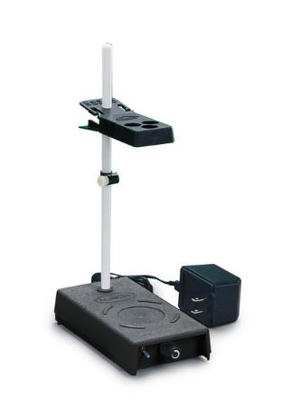
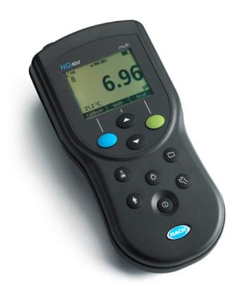
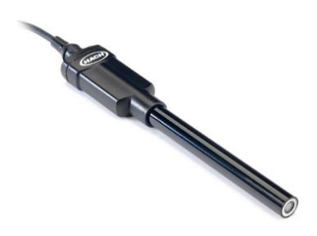
Method of Analysis and Equipment
Intellical™ ISEF121 Fluoride (F⁻) Ion Selective Electrode (ISE)
HQ40d Portable ISE Multi-Parameter Meter
Fluoride Ionic Strength Adjustor (ISA)
Fluoride Standards (0.2/2.0 & 0.5/ 5.0 mg/L)
25 mL graduated cylinder
Finnpipette F2 variable volume pipette, capacity 0.5 - 5 mL
Electrode stirrer stand
50 mL beakers
Stir Bar, Magnetic, Polygon

Slide 29

Contact
Guy Schott, P.E.
State Water Resources Control Board
Division of Drinking Water
Santa Rosa, CA
Go to Tracer Test Results for review
www.waterboards.ca.gov/drinking_water/programs/districts/mendocino_district.html
Email: Guy Schott - Guy.Schott@waterboards.ca.gov
Office Number: 707-576-2732

