Slide 1
City of Vallejo
Public Works Waterman WTP
CA4810007
Tracer Study –
Ozone Contactor West Basin
May 22 & 29, 2024
Tracer Study – Drinking Water
Treatment Plant Type: Conventional
Reactor: West Ozone Contactor Basin
Basin Volume: 177,200 gallons
Tracer Method: Slug-Dose
Tracer: Fluoride (H₂SiF₆)
Mass Added: 467 grams
Test Flows: 4, 7 & 11 MGD
Performed by:
Guy Schott, P.E.
DDW and Water Treatment Staff

Slide 2
Ozone Basin1

Slide 3
Tracer Study Overview
A tracer study was conducted on the City of Vallejo’s West Ozone Contactor (177,200 gallons).
On May 22, 2024, one test flow at 4 MGD was conducted. Samples were taken from the end of Cells 3 and 6.
On May 29, 2024, two test flows (7 and 11 MGD) were conducted. At the 7 MGD test flow, Cells 4 and 6 were sampled. At the 11 MGD test flow, Cell 6 was sampled.
The Slug-Dose test method was applied using fluoride as a non-reactive tracer.
The t₁₀ value for each sample cell was based on the minimum tracer mass recovery or tracer mass added whichever was less.

Slide 4
City of Vallejo – West Ozone Contactor
Tracer Results
Sample Cell # | Volume to Cell # Gallons | Flow MGD | Velocity Ft/min | L:W | Log (Vel x L:W) | HRT minutes | t₁₀ minutes | BF t₁₀/HRT | Tracer % Mass Recovery
3 | 91,100 | 4.0 | 2.122 | 7.68 | 1.212 | 32.8 | 14.0 | 0.43 | 100.4
4 | 119,800 | 7.0 | 3.713 | 10.08 | 1.573 | 24.9 | 10.0 | 0.40 | 104.6
6 | 177,200 | 4.0 | 2.122 | 14.84 | 1.498 | 63.8 | 33.2 | 0.52 | 96.6
6 | 177,200 | 7.0 | 3.713 | 14.84 | 1.741 | 36.8 | 19.0 | 0.52 | 100.4
6 | 177,200 | 11.0 | 5.835 | 14.84 | 1.937 | 23.2 | 12.0 | 0.52 | 98.8

Slide 5
L:W vs Velocity

Slide 6
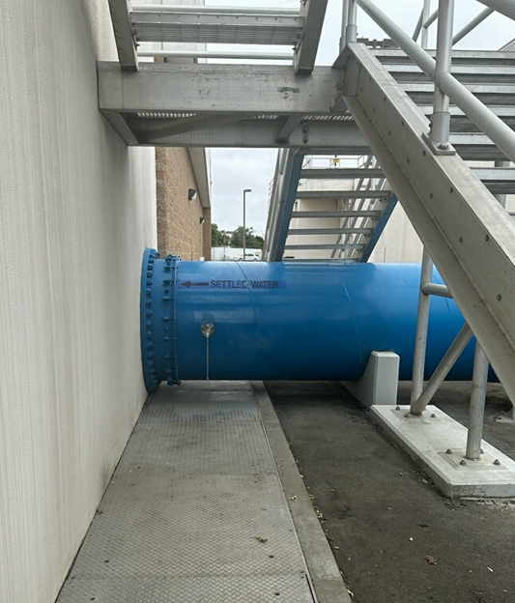
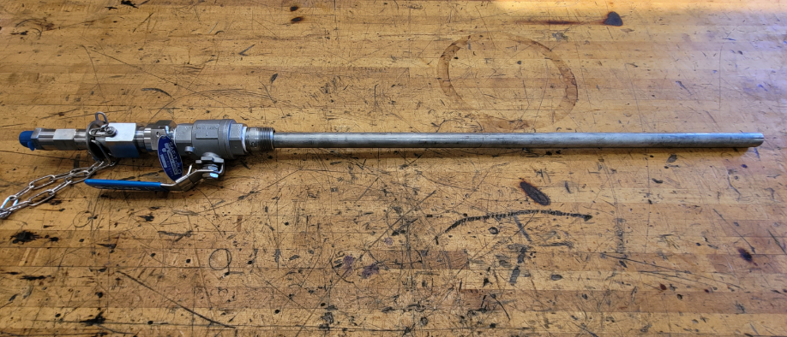
Fluoride Slug Injection Point – Post Settled
48-in Diam. Ozone Inlet Pipe
Injection Quill for Fluoride

Slide 7
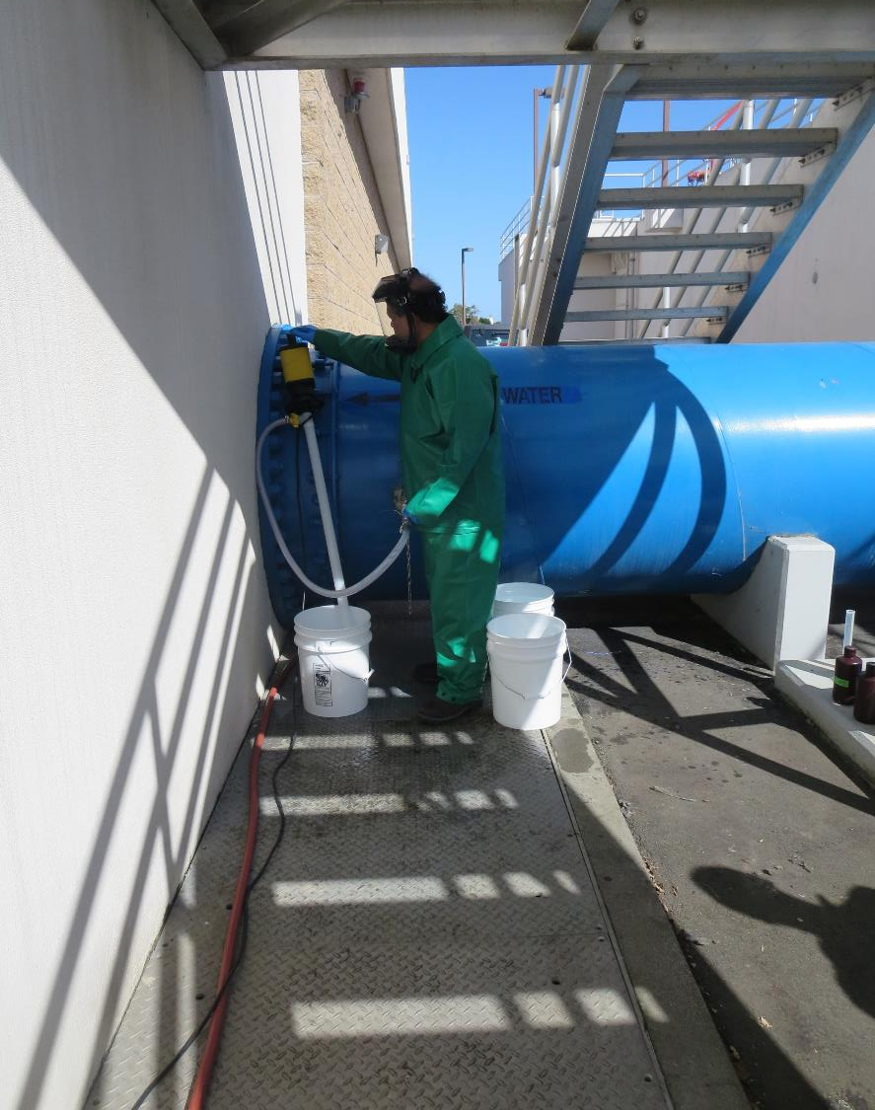
Tracer Injection –
Slug Dose
Before start of each tracer test, a solution of 3 gallons of water and 2,000 mL of Hydrofluosilicic acid (~467 grams F) was pumped into the ozone basin’s inlet line as shown in the photo. It took approximately 30 seconds to pump in solution.

Slide 8
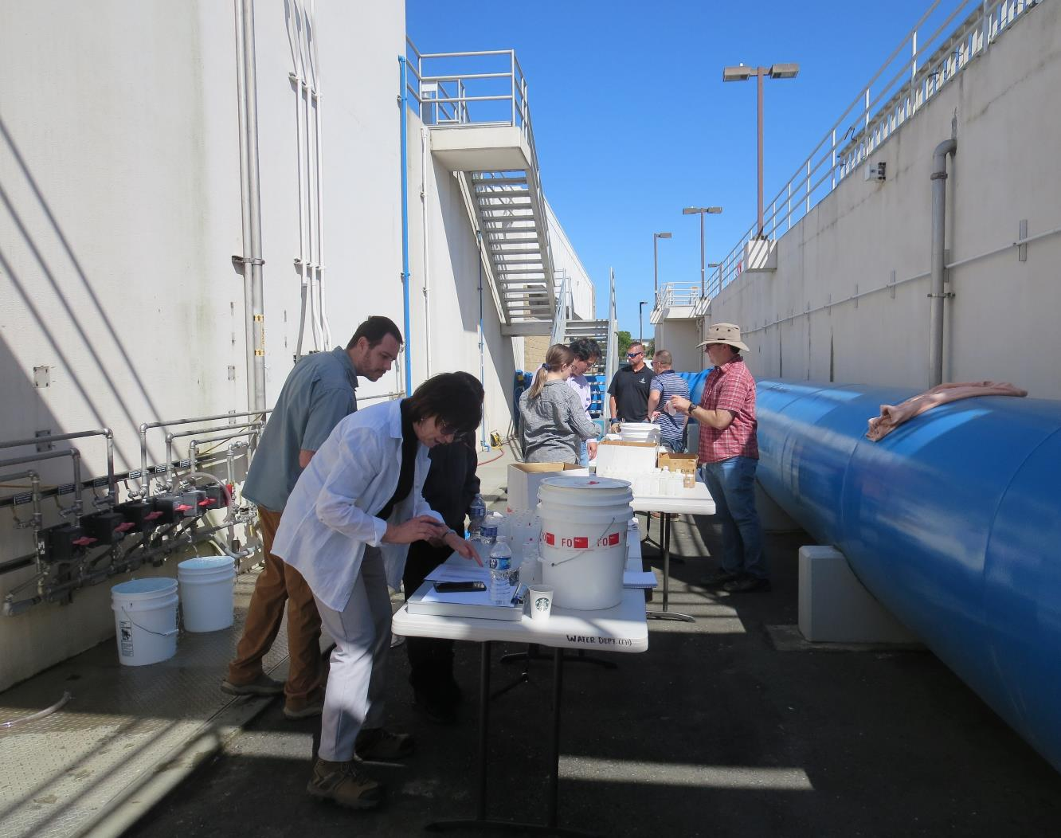
Sample Stations
Cell 3 – 4 MGD (70 samples)
Cell 4 – 7 MGD (60 samples)
Cell 6 – 4 MGD (70 samples)
Cell 6 – 7 MGD (60 samples)
Cell 6 – 11 MGD (60 samples)

Slide 9
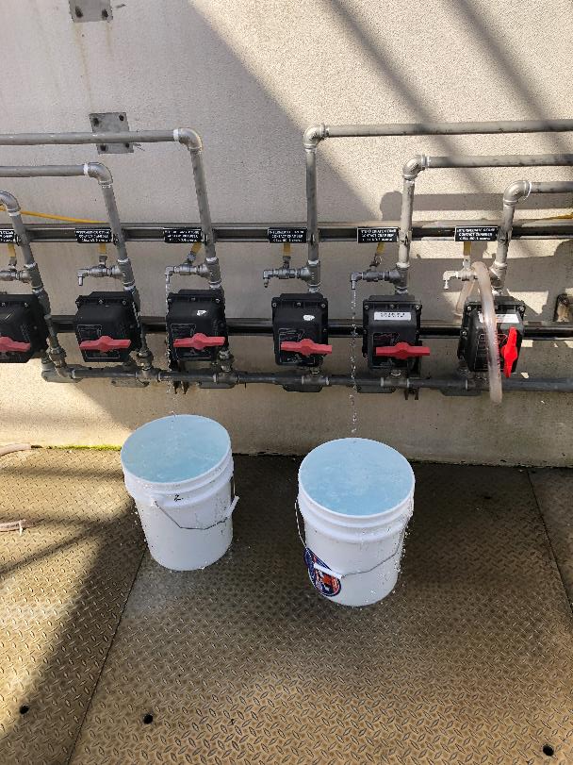
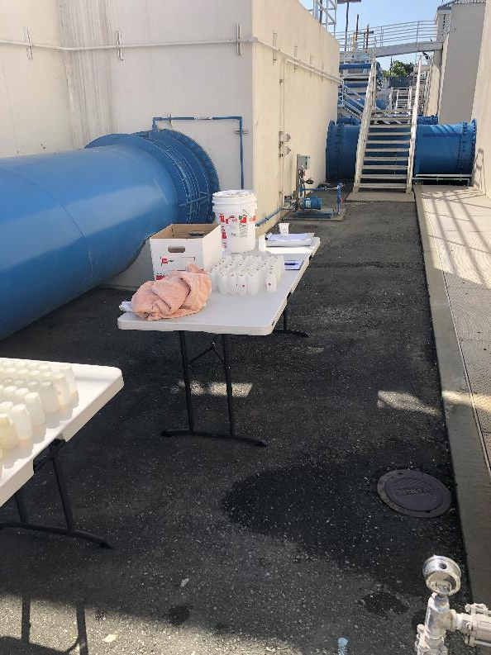
Sample Stations and Bottles

Slide 10
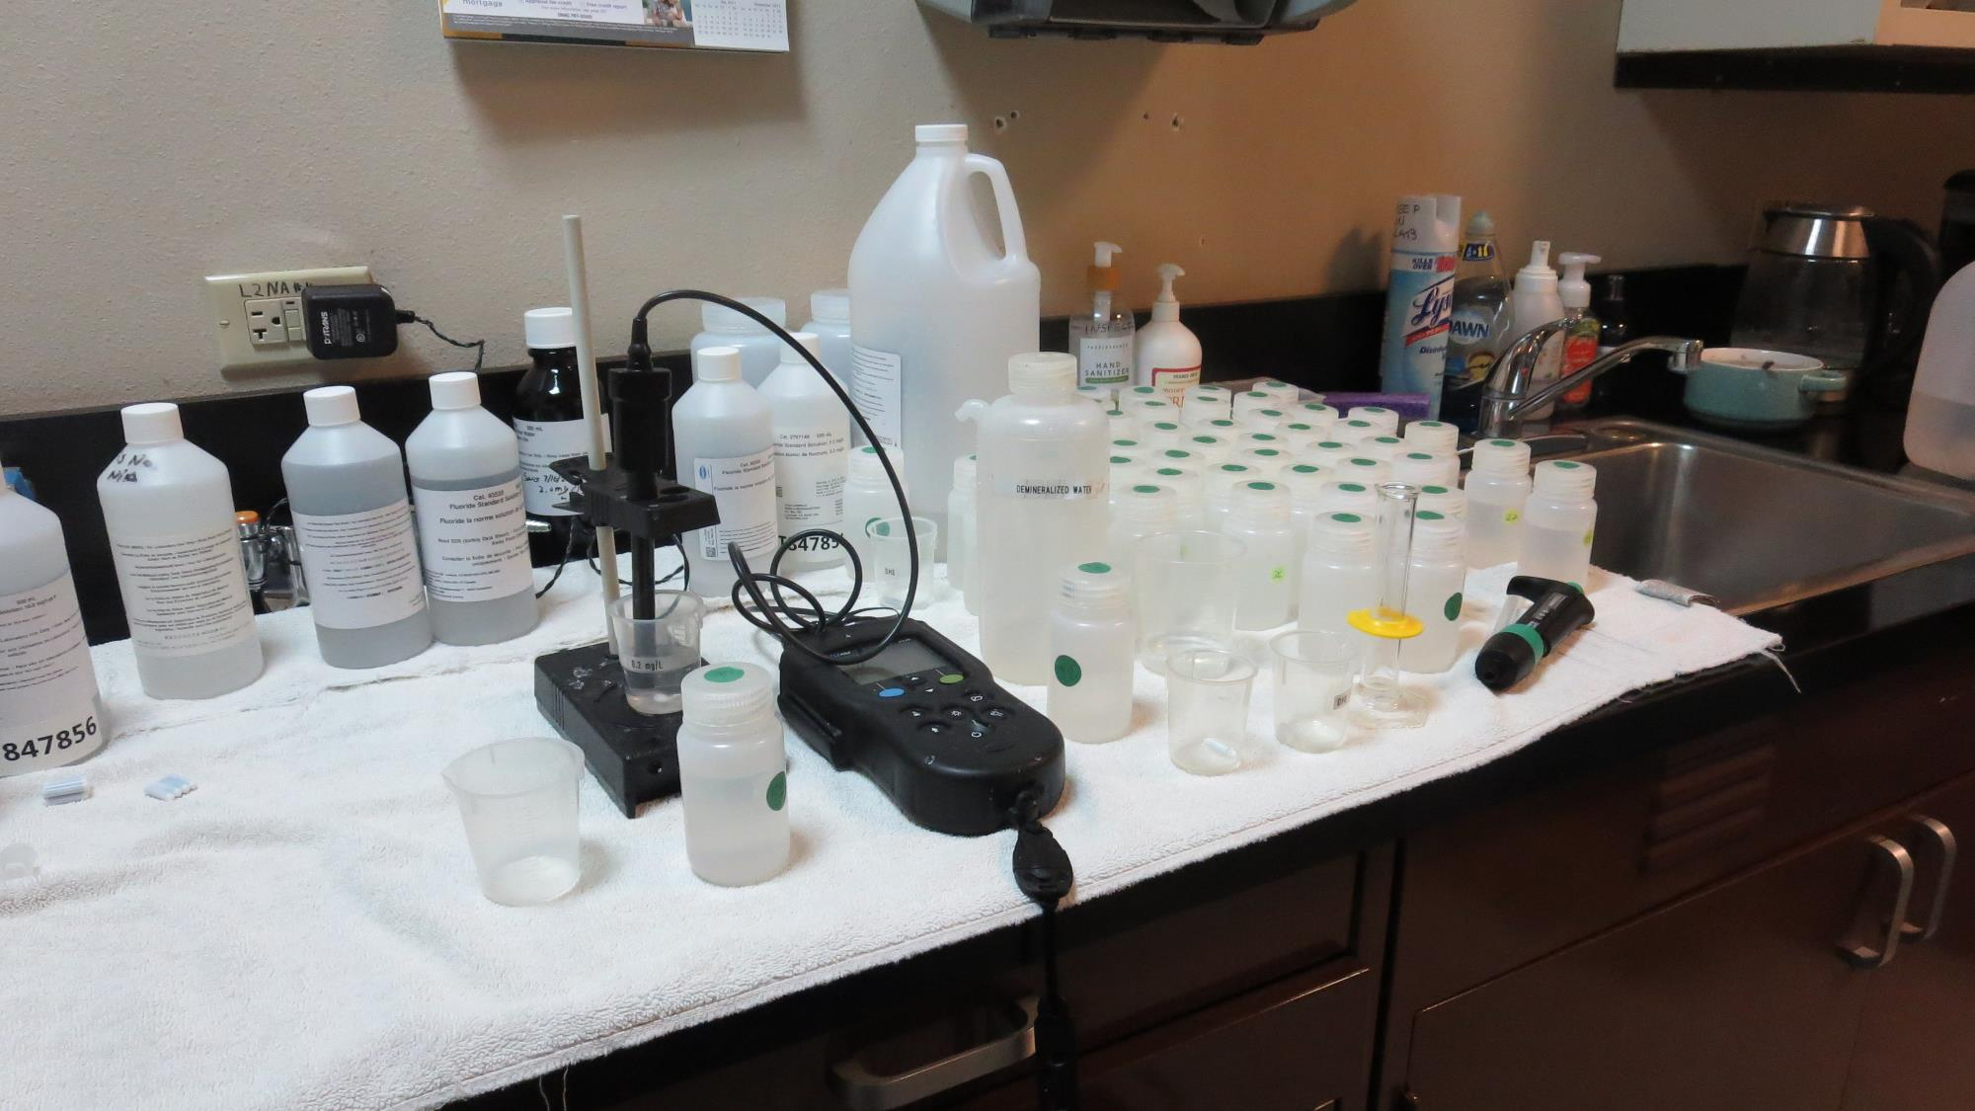
Laboratory
Fluoride Analysis

Slide 11
4 MGD Results for Cell 3
4 MGD Cell 3 Graphs
Graph 1: Slug-Dose Curve (time versus fluoride concentration)
Graph 2: Slug-Dose Curve Normalize to F-Curve (time versus normalized fluoride concentration)
Graph 3: Slug-Dose Curve Normalize to F-Curve (normalized time versus normalized fluoride concentration)
HRT: 32.8 minutes
t₁₀: 14.0 minutes
Baffling Factor: 0.43

Slide 12
1
Graph 1, 4 MGD

Slide 13
4
Graph 2, 4 MGD

Slide 14
2
Graph 3, 4 MGD

Slide 15
4 MGD Results for Cell 6
4 MGD Cell 6 Graphs
Graph 1: Slug-Dose Curve (time versus fluoride concentration)
Graph 2: Slug-Dose Curve Normalize to F-Curve (time versus normalized fluoride concentration)
Graph 3: Slug-Dose Curve Normalize to F-Curve (normalized time versus normalized fluoride concentration)
HRT: 63.8 minutes
t₁₀: 33.2 minutes
Baffling Factor: 0.52

Slide 16
3
Graph 1, 4 MGD

Slide 17
5
Graph 2, 4 MGD

Slide 18
6
Graph 3, 4 MGD

Slide 19
7 MGD Results for Cell 4
7 MGD Cell 4 Graphs
Graph 1: Slug-Dose Curve (time versus fluoride concentration)
Graph 2: Slug-Dose Curve Normalize to F-Curve (time versus normalized fluoride concentration)
Graph 3: Slug-Dose Curve Normalize to F-Curve (normalized time versus normalized fluoride concentration)
HRT: 24.9 minutes
t₁₀: 10.0 minutes
Baffling Factor: 0.40

Slide 20
7
Graph 1, 7 MGD

Slide 21
8
Graph 2, 7 MGD

Slide 22
9
Graph 3, 7 MGD

Slide 23
7 MGD Results for Cell 6
7 MGD Cell 6 Graphs
Graph 1: Slug-Dose Curve (time versus fluoride concentration)
Graph 2: Slug-Dose Curve Normalize to F-Curve (time versus normalized fluoride concentration)
Graph 3: Slug-Dose Curve Normalize to F-Curve (normalized time versus normalized fluoride concentration)
HRT: 36.8 minutes
t₁₀: 19.0 minutes
Baffling Factor: 0.52

Slide 24
10
Graph 1, 7 MGD

Slide 25
11
Graph 2, 7 MGD

Slide 26
12
Graph 3, 7 MGD

Slide 27
11 MGD Results for Cell 6
11 MGD Cell 6 Graphs
Graph 1: Slug-Dose Curve (time versus fluoride concentration)
Graph 2: Slug-Dose Curve Normalize to F-Curve (time versus normalized fluoride concentration)
Graph 3: Slug-Dose Curve Normalize to F-Curve (normalized time versus normalized fluoride concentration)
HRT: 23.2 minutes
t₁₀: 12.0 minutes
Baffling Factor: 0.52

Slide 28
13
Graph 1, 11 MGD

Slide 29
14
Graph 2, 11 MGD

Slide 30
15
Graph 3, 11 MGD

Slide 31
Purpose of a
Tracer Study
To determine the hydraulic efficiency or disinfectant exposure time of water through one or more reactors.
The addition of known quantities of a nonreactive chemical (tracer) is added in the form of a pulse (slug) or step-input.
The time of travel or disinfectant exposure time through the reactor is related to:
  Flow rate
  Reactor water volume
  Water Depth
  Reactor configuration

Slide 32
Disinfection Exposure Time of Fluid in Vessel for Determining Ct₁₀
“C” is the disinfectant residual (mg/L) at the point of inactivation compliance.
The disinfection exposure time of water used for Ct₁₀ calculation is the time (t₁₀) it takes for 10 percent of the water entering the reactor to exit the reactor.
To determine this, a marker (nonreactive tracer) is introduced into the water and is monitored leaving the reactor.
Example: 1,000 grams of tracer is slug-dose; t₁₀ is that time when 100 grams of tracer material (10%) has exited the reactor.

Slide 33
Ct₁₀ Value
- Log inactivation is based on the Delivered Dose, “Ct₁₀”
  “C” is the disinfectant residual (mg/L)
  “t₁₀” is the exposure or contact time (minutes)
  Multiply them:
C • t₁₀ = mg/L • min (delivered dose)
The calculated Ct₁₀ value is looked up in EPA Ct tables to determine the log inactivation based on specific monitoring parameters (pH, disinfectant residual and/or temperature).

Slide 34
Baffling Factor (BF)
CT &
Log Inactivation
Baffling factor or short-circuiting factor:
  Determined from tracer study or estimated
  BF = t₁₀/ HRT from tracer study
  HRT (hydraulic residence time) = reactor volume divided by reactor flow
Once the BF is determined, then it is applied to the operations of the reactor for determining the disinfectant exposure time. For ozone contactors, the BF is applied to each contact chamber where ozone monitoring is conducted. The chamber where ozone is diffused is not included as part of CT calculations.
Example:
  Each ozone reactor volume: 28,700 gallons
  Flow: 5,000 gpm (7.2 MGD)
  BF: 0.52, from tracer study
  Calculated contact or disinfection exposure time:
    28,700 gal ÷ 5,000 gpm × 0.52
    = 2.98 minutes = t₁₀
CT calc: Cell 3, O₃ = 0.3 mg/L; Cell 4, O₃ = 0.15 mg/L
Sum CT: 0.3 mg/L * 2.98 min + 0.15 mg/L * 2.98 min = 1.34 mg/L * min
Log inactivation at temperature of 15ºC:
4.1 Giardia cyst and > 5 Log Virus.

Slide 35
Tracer Test Method
Slug-Dose or Pulse-Input Method
Adding the entire amount of tracer at the beginning of test. The reactor outlet tracer concentration is monitored up to 3 HRT to determine mass recovery and the time (t₁₀) it takes for 10% of the tracer mass to exit the reactor.

Slide 36
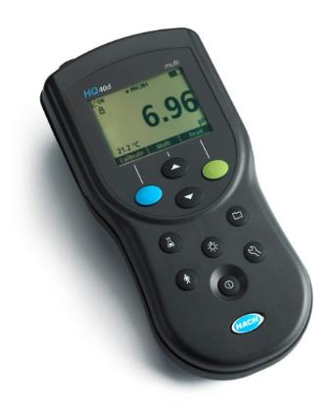
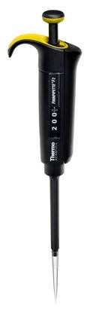
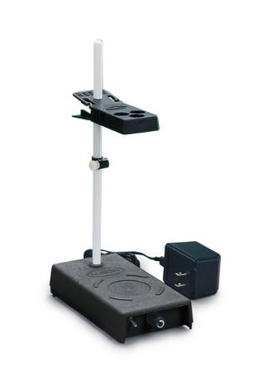
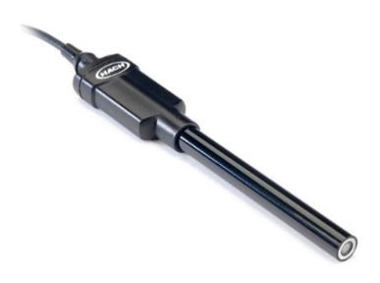
Method of Analysis and Equipment
Intellical™ ISEF121 Fluoride (F⁻) Ion Selective Electrode (ISE)
HQ40d Portable ISE Multi-Parameter Meter
Fluoride Ionic Strength Adjustor (ISA)
Fluoride Standards (0.2/2.0 & 0.5/ 5.0 mg/L)
25 mL graduated cylinder
Finnpipette F2 variable volume pipette, capacity 0.5 - 5 mL
Electrode stirrer stand
50 mL beakers
Stir Bar, Magnetic, Polygon

Slide 37

Contact
Guy Schott, P.E.
State Water Resources Control Board
Division of Drinking Water
Santa Rosa, CA
Guy.Schott@waterboards.ca.gov
707-576-2732
Drinking Water Field Operations Branch Districts - Mendocino | California State Water Resources Control Board

