Slide 1
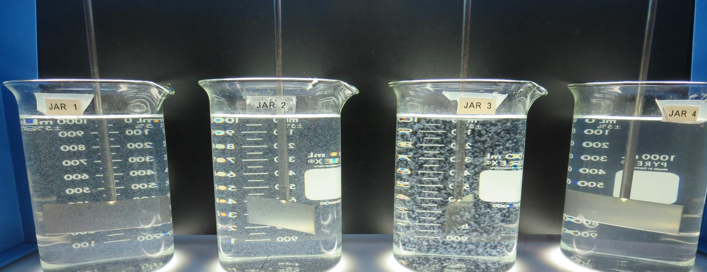
Travis AFB WTP Vallejo
CA4810015
Solano County
Jar Test
by Guy Schott, P.E.
November 18, 2020

Slide 2
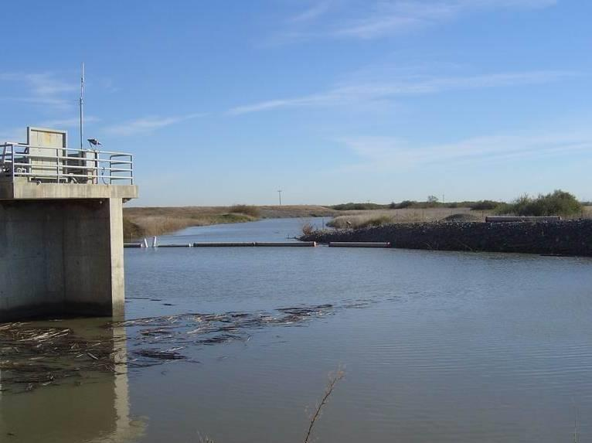
Travis AFB WTP Vallejo
North Bay Aqueduct

Slide 3
Travis AFB WTP Vallejo, Water
Characteristics
Nov 19, 2020
Source – Post Ozone
pH: 7.65 – 7.7
Alkalinity: 67 mg/L as CaCO₃
Turbidity: 4.1-4.8 NTU
UVT: 87.9%,
UVA: 0.055/cm
0.4 um Filtered
Turbidity: 0.20 NTU
UVT: 92.6%,
UVA: 0.033/cm
Plant Coagulant Dose:
Alum: 35 mg/L
CatFloc 8102 Plus: 2 mg/L
Post Filter, Pre-Chlorine:
0.08 NTU
UVT: 97.7%,
UVA: 0.011/cm
UVA Reduction: 66.7%
Clearwell:
0.10 NTU
UVT: 97.6%,
UVA: 0.009/cm
Cl₂ = 0.72 mg/L (11/21/20)

Slide 4
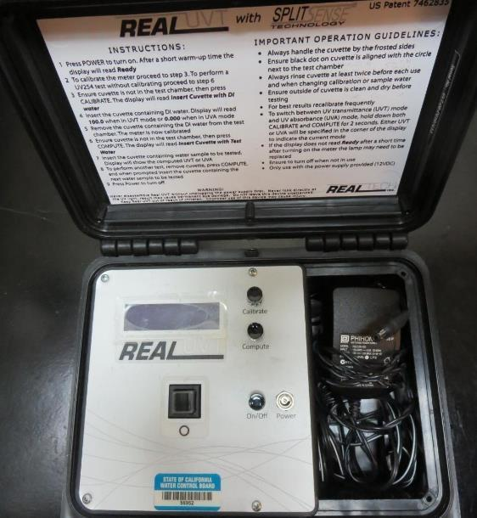
UVT/UVA, pathlength 10 mm
UV transmittance (UVT) is a measurement of the amount of ultraviolet light (commonly at 254 nm due to its germicidal effect) that passes through a water sample compared to the amount of light that passes through a pure water sample. The measurement is expressed as a percentage, % UVT.
%UVT = 10^{(-UVA)} x 100%
UV absorbance (UVA) is calculated as a relative measure of the amount of light absorbed by a water sample compared with the amount of light absorbed by a pure water sample.
UVA = -log(%UVT/100)

Slide 5
Applied Coagulants for Jar Testing (1)
Aluminum Sulfate (Product)
Al₂(SO₄)₃*14.3H₂0
48% Aluminum Sulfate
52% Water
8.2% Al₂O₃
SG = 1.32
NSF limit: 400 mg/L (product)
Nalco Company
Cat-Floc 8102 Plus
SG = 1.02 – 1.06
pDADMAC (20% active, 80% H₂O)
NSF limit: 50 mg/L (product)
Product dose 5 mg/L = 1 mg/L pDADMAC active

Slide 6
Applied Coagulants for Jar Testing (2)
BWS, Inc.
AdvFloc-CTC-00011
Polyaluminum Chloride
12.55% Al₂O₃
64.9% Basicity
SG = 1.299
NSF limit: 250 mg/L as Product
Pro Pac 9810 (NTU Technologies)
45-50% Aluminum Chlorohydrate
45-50% Water
5% polyamine (50% water, 50% active polyamines)
SG = 1.25-1.34
NSF limit: 200 mg/L as Product;
Product dose 20 mg/L = 0.5 mg/L polyamines active

Slide 7
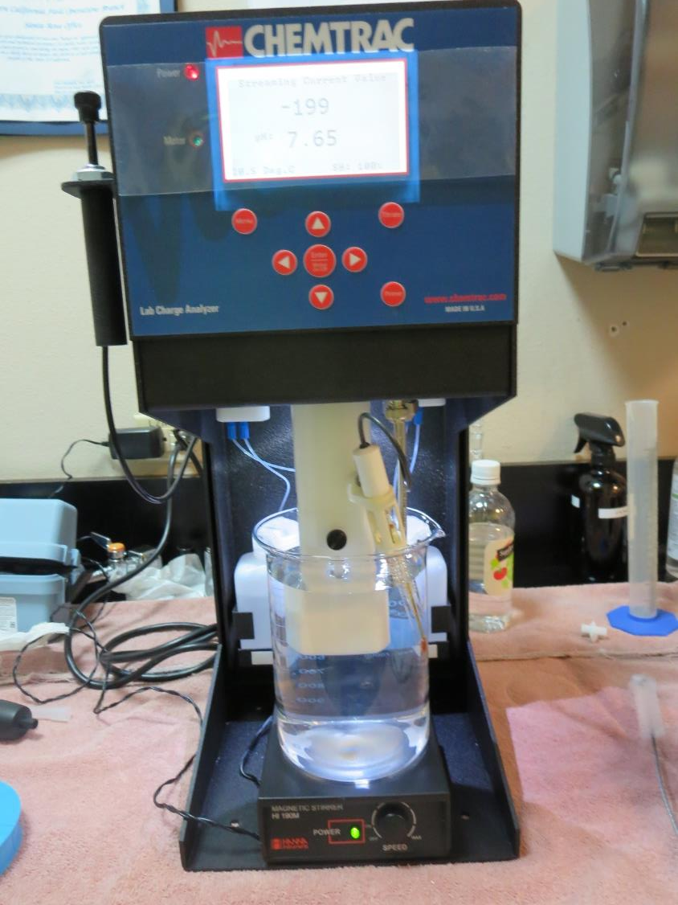
Laboratory Charge Analyzer
LCA: Used to determine coagulant demand of a source water entering the treatment plant.
Source pH: 7.65
LCA #1: Alum: 24 mg/L as product
pH adjusted to 6.5 with acetic acid
LCA #1: 9810: 14 mg/L as product
pH adjusted to 7.5 with acetic acid
LCA #3:
Advanced Coagulant: 78 mg/L
pH adjusted to 7.5 with acetic acid

Slide 8
Coagulant Information
Unless stated otherwise, all coagulant doses are reported as Product (100% strength).
Preparation of coagulant stock solutions are generally 1.0 and/or 0.1 percent strength using 100 and/or 200 mL volumetric flasks.
Finnpipette F2 variable volume pipette, capacity 100-1000 micro liters is used for stock solution preparation and coagulant aid jar test dosing.
Finnpipette F2 variable volume pipette, capacity 0.5-5 mL is used for primary coagulant jar test dosing.

Slide 9
Travis AFB WTP-Vallejo, Jar Test 1 - 8 Results
Flash Mix 200 RPM (30 sec); Floc Mix 30 RPM (5 min)
Jar# | Alum mg/L | Filtrate NTU | Filtrate %UVT | Filtrate UVA/cm | %UVA Reduction | Settle NTU 25 min
J1 | 20 | 0.13 | 95.4 | 0.020 | 39.4 | 4.39
J2 | 25 | 0.18 | 95.5 | 0.019 | 42.4 | 3.46
J3 | 30 | 0.10 | 96.0 | 0.017 | 48.5 | 2.32
J4 | 35 | 0.08 | 96.3 | 0.016 | 51.5 | 1.70
J5 | 35 | 0.17 | 95.9 | 0.017 | 48.5 | 1.28
J6 | 40 | 0.15 | 96.1 | 0.017 | 48.5 | 1.45
J7 | 50 | 0.14 | 96.2 | 0.016 | 51.5 | 1.93
J8 | 60 | 0.12 | 96.4 | 0.015 | 54.5 | 1.24

Slide 10
Travis AFB WTP-Vallejo, Jar Test 9 - 12 Results
Flash Mix 200 RPM (30 sec); Floc Mix 30 RPM (5 min)
Jar# | Alum mg/L | Cat-Floc 8102+ mg/L | Filtrate NTU | Filtrate %UVT | Filtrate UVA/cm | %UVA Reduction | Settle NTU 25 min
J9 | 30 | 2.0 | 0.08 | 96.3 | 0.016 | 51.5 | 1.39
J10 | 35 | 2.0 | 0.09 | 96.5 | 0.015 | 54.5 | 1.56
J11 | 40 | 2.0 | 0.07 | 96.6 | 0.015 | 54.5 | 1.22
J12 | 45 | 2.0 | 0.08 | 96.6 | 0.015 | 54.5 | 1.39

Slide 11
Travis AFB WTP-Vallejo, Jar Test 13 - 20 Results
Flash Mix 200 RPM (30 sec); Floc Mix 30 RPM (5 min)
Jar# | AdvFloc mg/L | Filtrate NTU | Filtrate %UVT | Filtrate UVA/cm | %UVA Reduction | Settle NTU 25 min
J13 | 70 | 0.08 | 96.8 | 0.013 | 60.6 | 0.43
J14 | 80 | 0.08 | 96.9 | 0.013 | 60.6 | 0.41
J15 | 90 | 0.08 | 97.1 | 0.012 | 63.6 | 0.40
J16 | 100 | 0.08 | 97.2 | 0.012 | 63.6 | 0.28
J17 | 50 | 0.11 | 96.6 | 0.014 | 57.6 | 0.48
J18 | 60 | 0.10 | 96.8 | 0.013 | 60.6 | 0.43
J19 | 70 | 0.08 | 97.1 | 0.012 | 63.6 | 0.39
J20 | 110 | 0.08 | 97.4 | 0.011 | 66.7 | 0.91

Slide 12
Travis AFB WTP-Vallejo, Jar Test 21 - 28 Results
Flash Mix 200 RPM (30 sec); Floc Mix 30 RPM (5 min)
Jar# | 9810 mg/L | Filtrate NTU | Filtrate %UVT | Filtrate UVA/cm | %UVA Reduction | Settle NTU 25 min
J21 | 11 | 0.10 | 96.2 | 0.016 | 51.5 | 2.0
J22 | 14 | 0.08 | 96.5 | 0.015 | 54.5 | 1.52
J23 | 17 | 0.08 | 96.8 | 0.014 | 57.6 | 1.41
J24 | 20 | 0.08 | 96.9 | 0.013 | 60.6 | 1.35
J25 | 20 | 0.07 | 97.0 | 0.013 | 60.6 | 1.03
J26 | 23 | 0.14 | 97.0 | 0.013 | 60.6 | 1.18
J27 | 26 | 0.20 | 97.0 | 0.013 | 60.6 | 1.34
J28 | 29 | 0.17 | 97.0 | 0.013 | 60.6 | 1.51

Slide 13
Travis AFB WTP-Vallejo, Jar Test 29 - 32 Results
Flash Mix 200 RPM (30 sec); Floc Mix 30 RPM (5 min)
Jar# | Alum mg/L | Adv- Floc mg/L | Cat-Floc 8102+ mg/L | Filtrate NTU | Filtrate %UVT | Filtrate UVA/cm | %UVA Reduction | Settle NTU 25 min
J29 | 35 | 0 | 0 | 0.17 | 96.1 | 0.017 | 48.5 | 0.95
J30 | 35 | 0 | 2 | 0.07 | 96.7 | 0.014 | 57.6 | 1.38
J31 | 0 | 70 | 0 | 0.08 | 96.8 | 0.014 | 57.6 | 0.43
J32 | 0 | 70 | 2 | 0.09 | 96.9 | 0.013 | 60.6 | 0.45

Slide 14
Travis AFB WTP-Vallejo, Jar Test 33 - 36 Results
Flash Mix 200 RPM (30 sec); Floc Mix 30 RPM (5 min)
Jar# | Alum mg/L | 9810 mg/L | Adv- Floc mg/L | Cat-Floc 8102+ mg/L | Filtrate NTU | Filtrate %UVT | Filtrate UVA/cm | %UVA Re- duction | Settle NTU 25 min
J33 | 35 | 0 | 0 | 2 | 0.08 | 96.8 | 0.013 | 60.6 | 1.23
J34 | 0 | 19 | 0 | 0 | 0.07 | 96.8 | 0.013 | 60.6 | 1.24
J35 | 0 | 0 | 70 | 0 | 0.10 | 96.8 | 0.013 | 60.6 | 0.39
J36 | 0 | 0 | 0 | 15 | 0.93 | 92.1 | 0.035 | 0 | 3.46

Slide 15
Jars 1-4 Test
Flash Mix 30 Sec (200 RPM)
Floc Mix 5 min (30 RPM)
Applied Coagulant
Alum

Slide 16
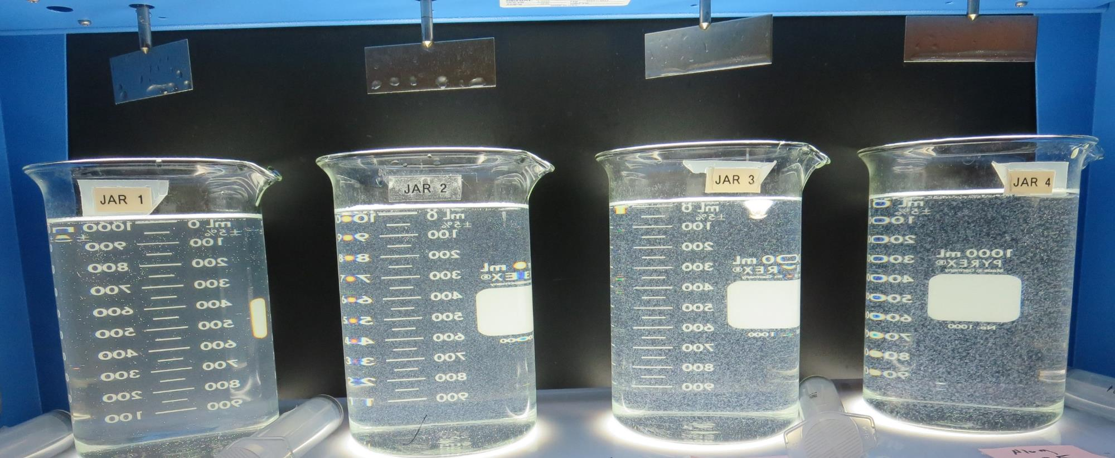
Jars 1-4: End of 5-minute flocculation (30 RPM) duration.
20 mg/L Alum
Filtrate 0.13 NTU
UVT: 95.4%
UVA: 0.020/cm
UVA Reduction 39.4%
Settled: 4.39 NTU
25 mg/L Alum
Filtrate 0.18 NTU
UVT: 95.5%
UVA: 0.019/cm
UVA Reduction 42.4%
Settled: 3.46 NTU
30 mg/L Alum
Filtrate 0.10 NTU
UVT: 96.0%
UVA: 0.017/cm
UVA Reduction 48.5%
Settled: 2.32 NTU
35 mg/L Alum
Filtrate 0.08 NTU
UVT: 96.3%
UVA: 0.016/cm
UVA Reduction 51.5%
Settled: 1.70 NTU

Slide 17
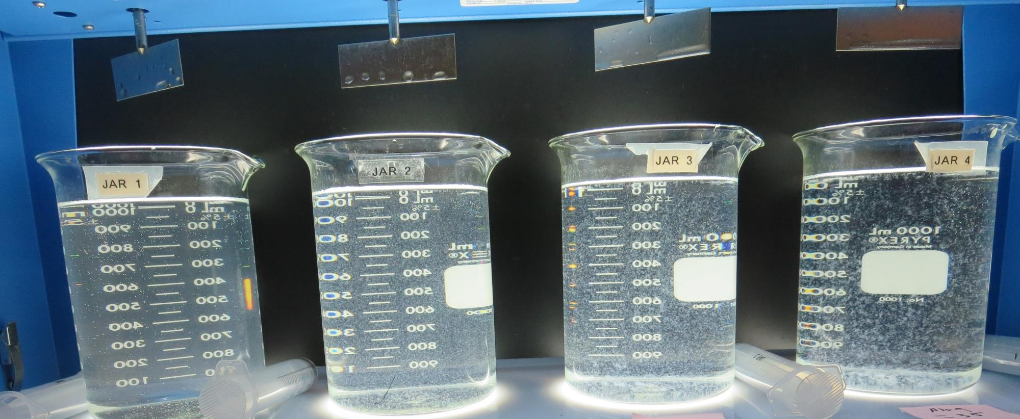
Jars 1-4: After 5 min of settling, 25 mL is syringed for filterability and %UVT/UVA.

Slide 18
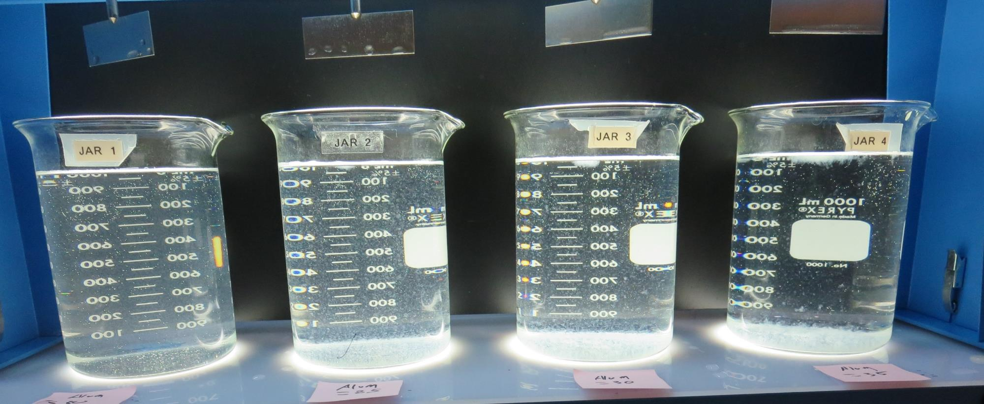
Jars 1-4: After 25-minutes of settling, settled water turbidity is taken.
20 mg/L Alum
Filtrate 0.13 NTU
UVT: 95.4%
UVA: 0.020/cm
UVA Reduction 39.4%
Settled: 4.39 NTU
25 mg/L Alum
Filtrate 0.18 NTU
UVT: 95.5%
UVA: 0.019/cm
UVA Reduction 42.4%
Settled: 3.46 NTU
30 mg/L Alum
Filtrate 0.10 NTU
UVT: 96.0%
UVA: 0.017/cm
UVA Reduction 48.5%
Settled: 2.32 NTU
35 mg/L Alum
Filtrate 0.08 NTU
UVT: 96.3%
UVA: 0.016/cm
UVA Reduction 51.5%
Settled: 1.70 NTU

Slide 19
Jars 5-8 Test
Flash Mix 30 Sec (200 RPM)
Floc Mix 5 min (30 RPM)
Applied Coagulant
Alum

Slide 20
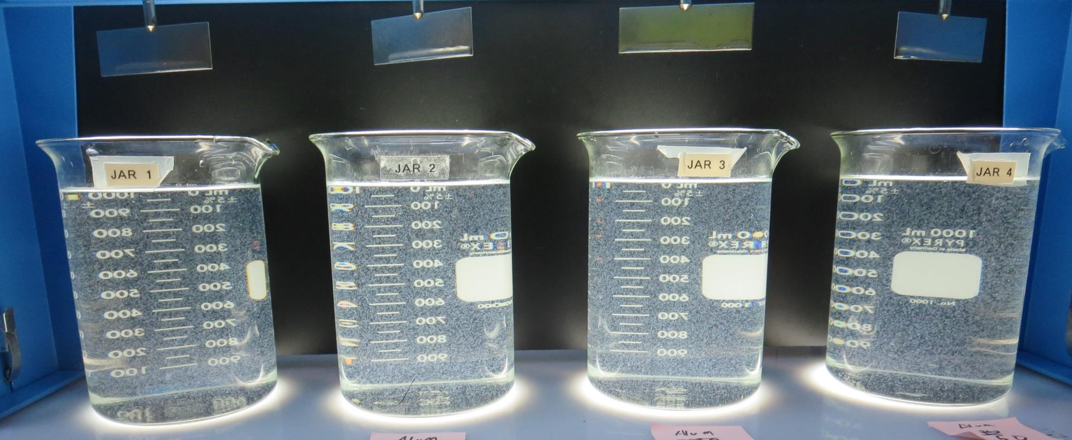
Jars 5-8: End of 5-minute flocculation (30 RPM) duration.
35 mg/L Alum
Filtrate 0.17 NTU
UVT: 95.9%
UVA: 0.017/cm
UVA Reduction 48.5%
Settled: 1.28 NTU
40 mg/L Alum
Filtrate 0.15 NTU
UVT: 96.1%
UVA: 0.017/cm
UVA Reduction 48.5%
Settled: 1.45 NTU
45 mg/L Alum
Filtrate 0.14 NTU
UVT: 96.2%
UVA: 0.016/cm
UVA Reduction 51.5%
Settled: 1.93 NTU
50 mg/L Alum
Filtrate 0.14 NTU
UVT: 96.2%
UVA: 0.016/cm
UVA Reduction 54.5%
Settled: 1.93 NTU

Slide 21
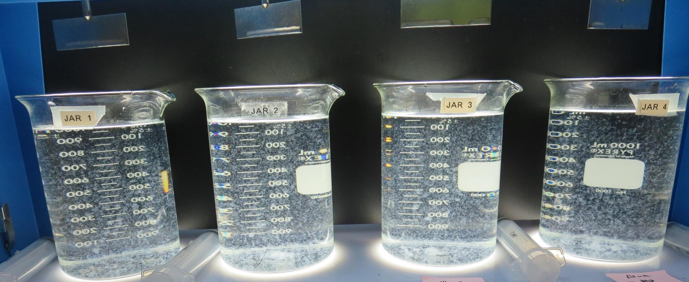
Jars 5-8: After 5 min of settling, 25 mL is syringed for filterability and %UVT/UVA.

Slide 22
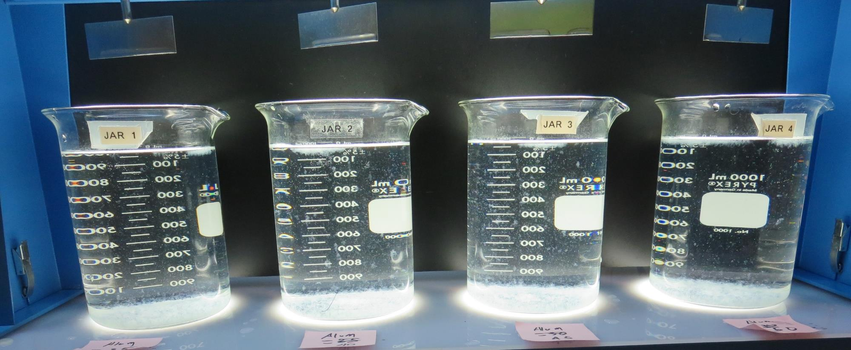
Jars 5-8: After 25-minutes of settling, settled water turbidity is taken.
35 mg/L Alum
Filtrate 0.17 NTU
UVT: 95.9%
UVA: 0.017/cm
UVA Reduction 48.5%
Settled: 1.28 NTU
40 mg/L Alum
Filtrate 0.15 NTU
UVT: 96.1%
UVA: 0.017/cm
UVA Reduction 48.5%
Settled: 1.45 NTU
45 mg/L Alum
Filtrate 0.14 NTU
UVT: 96.2%
UVA: 0.016/cm
UVA Reduction 51.5%
Settled: 1.93 NTU
50 mg/L Alum
Filtrate 0.14 NTU
UVT: 96.2%
UVA: 0.016/cm
UVA Reduction 51.5%
Settled: 1.93 NTU

Slide 23
Jars 9-12 Test
Flash Mix 30 Sec (200 RPM)
Floc Mix 5 min (30 RPM)
Applied Coagulants
Alum
Cat-Floc 8102 Plus

Slide 24
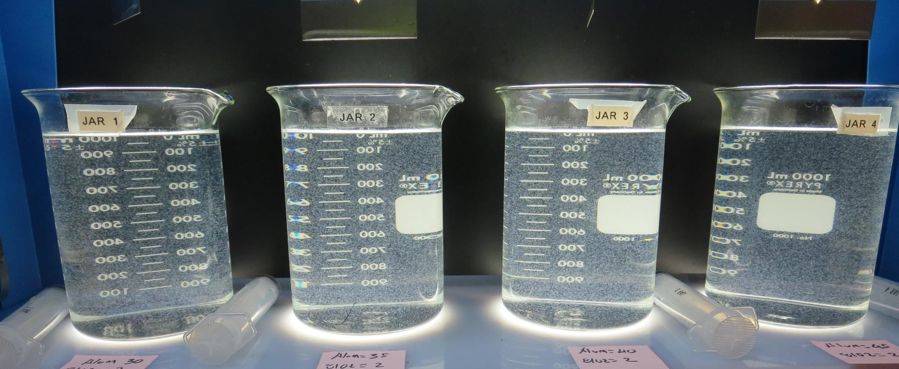
Jars 9-12: End of 5-minute flocculation (30 RPM) duration.
30 mg/L Alum
2.0 mg/L 8102+
Filtrate 0.08 NTU
UVT: 96.3%
UVA: 0.016/cm
UVA Reduction 51.5%
Settled: 1.39 NTU
35 mg/L Alum
2.0 mg/L 8102+
Filtrate 0.09 NTU
UVT: 96.5%
UVA: 0.015/cm
UVA Reduction 54.5%
Settled: 1.56 NTU
40 mg/L Alum
2.0 mg/L 8102+
Filtrate 0.07 NTU
UVT: 96.6%
UVA: 0.015/cm
UVA Reduction 54.5%
Settled: 1.22 NTU
45 mg/L Alum
2.0 mg/L 8102+
Filtrate 0.08 NTU
UVT: 96.6%
UVA: 0.015/cm
UVA Reduction 54.5%
Settled: 1.39 NTU

Slide 25
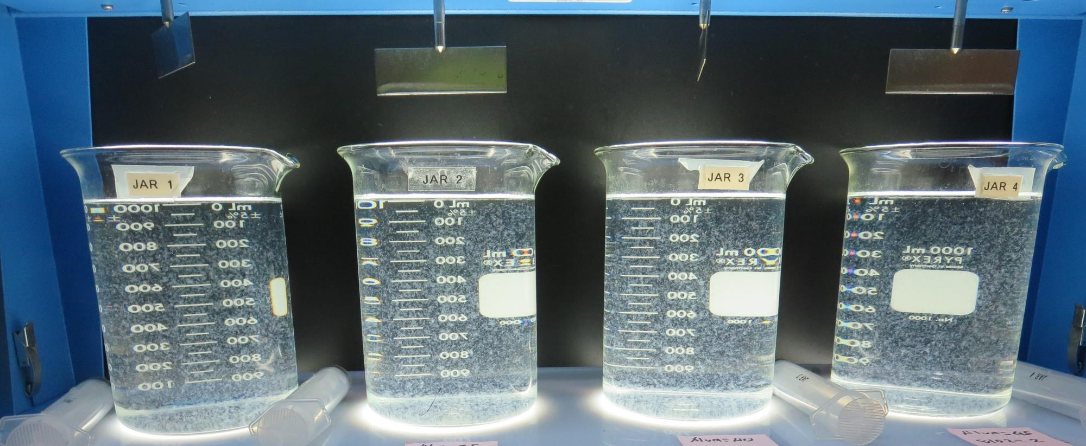
Jars 9-12: After 5 min of settling, 25 mL is syringed for filterability and %UVT/UVA.

Slide 26
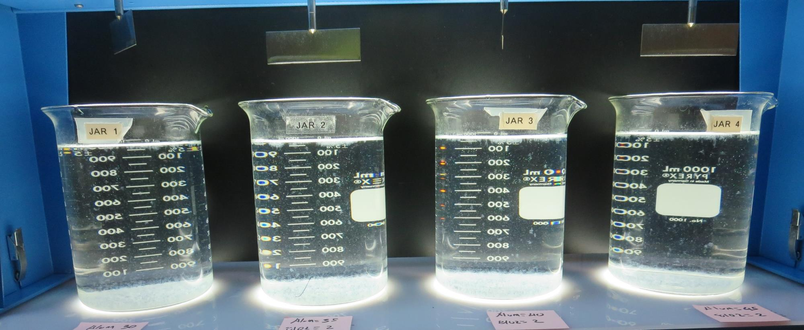
Jars 9-12: After 25-minutes of settling, settled water turbidity is taken.
30 mg/L Alum
2.0 mg/L 8102+
Filtrate 0.08 NTU
UVT: 96.3%
UVA: 0.016/cm
UVA Reduction 51.5%
Settled: 1.39 NTU
35 mg/L Alum
2.0 mg/L 8102+
Filtrate 0.09 NTU
UVT: 96.5%
UVA: 0.015/cm
UVA Reduction 54.5%
Settled: 1.56 NTU
40 mg/L Alum
2.0 mg/L 8102+
Filtrate 0.07 NTU
UVT: 96.6%
UVA: 0.015/cm
UVA Reduction 54.5%
Settled: 1.22 NTU
45 mg/L Alum
2.0 mg/L 8102+
Filtrate 0.08 NTU
UVT: 96.6%
UVA: 0.015/cm
UVA Reduction 54.5%
Settled: 1.39 NTU

Slide 27
Jars 13-28 Test
Flash Mix 30 Sec (200 RPM)
Floc Mix 5 min (30 RPM)
No Pictures are Shown

Slide 28
Jars 29-32 Test
Flash Mix 30 Sec (200 RPM)
Floc Mix 5 min (30 RPM)
Applied Coagulants
Alum/AdvFloc/8102

Slide 29
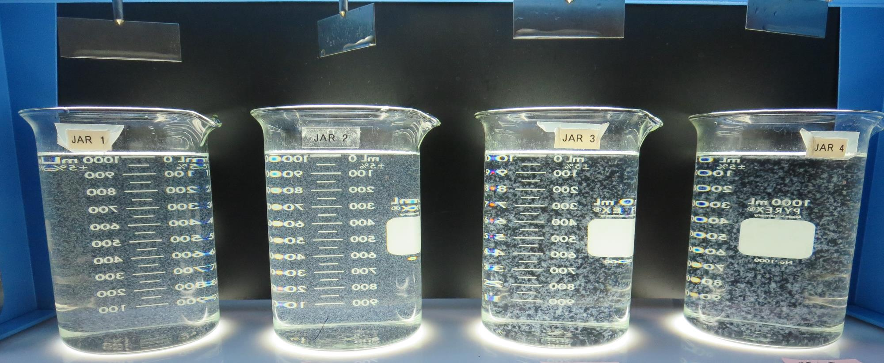
Jars 29-32: End of 5-minute flocculation (30 RPM) duration.
35 mg/L Alum
0 mg/L 8102+
Filtrate 0.17 NTU
UVT: 96.1%
UVA: 0.017/cm
UVA Reduction 46.5%
Settled: 0.95 NTU
35 mg/L Alum
2.0 mg/L 8102+
Filtrate 0.07 NTU
UVT: 96.7%
UVA: 0.014/cm
UVA Reduction 57.6%
Settled: 1.38 NTU
70 mg/L AdvFloc
0 mg/L 8102+
Filtrate 0.08 NTU
UVT: 96.8%
UVA: 0.014/cm
UVA Reduction 57.6%
Settled: 0.46 NTU
70 mg/L AdvFloc
2.0 mg/L 8102+
Filtrate 0.09 NTU
UVT: 96.9%
UVA: 0.013/cm
UVA Reduction 60.6%
Settled: 0.45 NTU

Slide 30
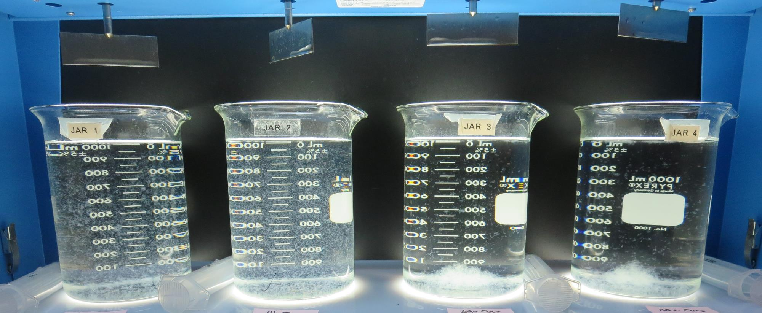
Jars 29-32: After 5 min of settling, 25 mL is syringed for filterability and %UVT/UVA.

Slide 31
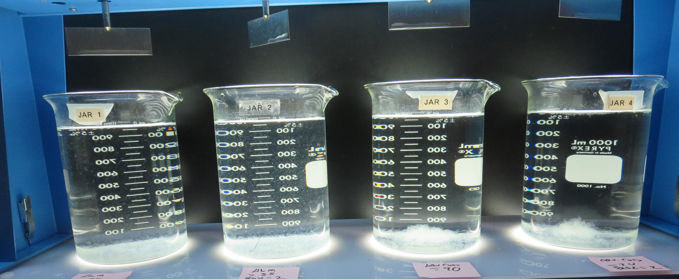
Jars 29-32: After 25-minutes of settling, settled water turbidity is taken.
35 mg/L Alum
0 mg/L 8102+
Filtrate 0.17 NTU
UVT: 96.1%
UVA: 0.017/cm
UVA Reduction 46.5%
Settled: 0.95 NTU
35 mg/L Alum
2.0 mg/L 8102+
Filtrate 0.07 NTU
UVT: 96.7%
UVA: 0.014/cm
UVA Reduction 57.6%
Settled: 1.38 NTU
70 mg/L AdvFloc
0 mg/L 8102+
Filtrate 0.08 NTU
UVT: 96.8%
UVA: 0.014/cm
UVA Reduction 57.6%
Settled: 0.46 NTU
70 mg/L AdvFloc
2.0 mg/L 8102+
Filtrate 0.09 NTU
UVT: 96.9%
UVA: 0.013/cm
UVA Reduction 60.6%
Settled: 0.45 NTU

Slide 32
Jars 33-36 Test
Flash Mix 30 Sec (200 RPM)
Floc Mix 5 min (30 RPM)
Applied Coagulants
Alum/9810/AdvFloc/8102

Slide 33
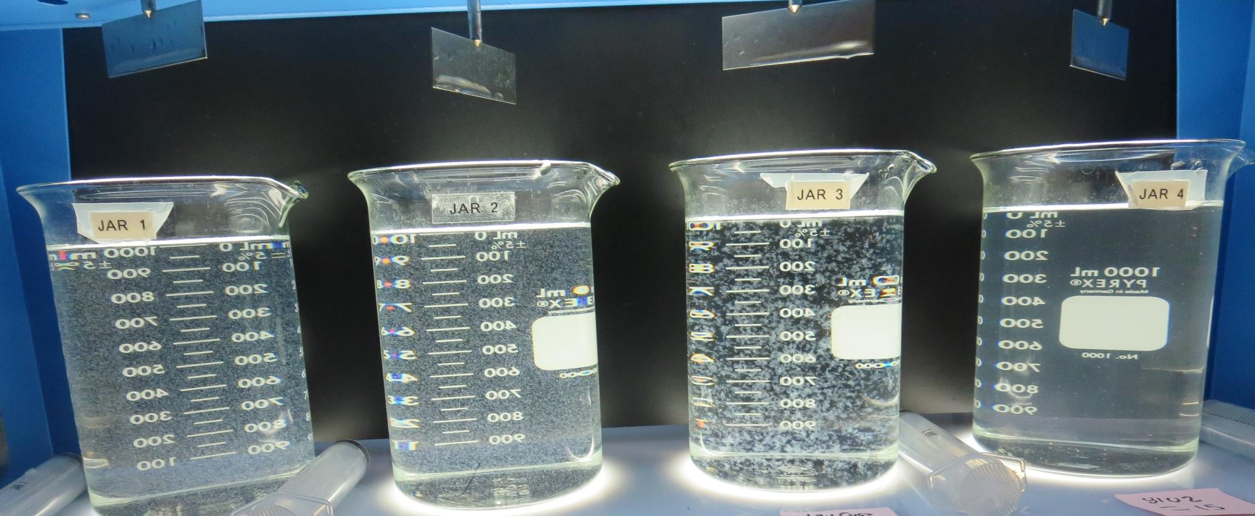
Jars 33-36: End of 5-minute flocculation (30 RPM) duration.
35 mg/L Alum
2.0 mg/L 8102+
Filtrate 0.08 NTU
UVT: 96.8%
UVA: 0.013/cm
UVA Reduction 60.6%
Settled: 1.23 NTU
19 mg/L 9810
Filtrate 0.07 NTU
UVT: 96.8%
UVA: 0.013/cm
UVA Reduction 60.6%
Settled: 1.24 NTU
70 mg/L AdvFloc
Filtrate 0.08 NTU
UVT: 96.8%
UVA: 0.013/cm
UVA Reduction 60.6%
Settled: 0.39 NTU
15 mg/L 8102+
Filtrate 0.93 NTU
UVT: 92.1%
UVA: 0.035/cm
UVA Reduction 0%
Settled: 3.46 NTU

Slide 34
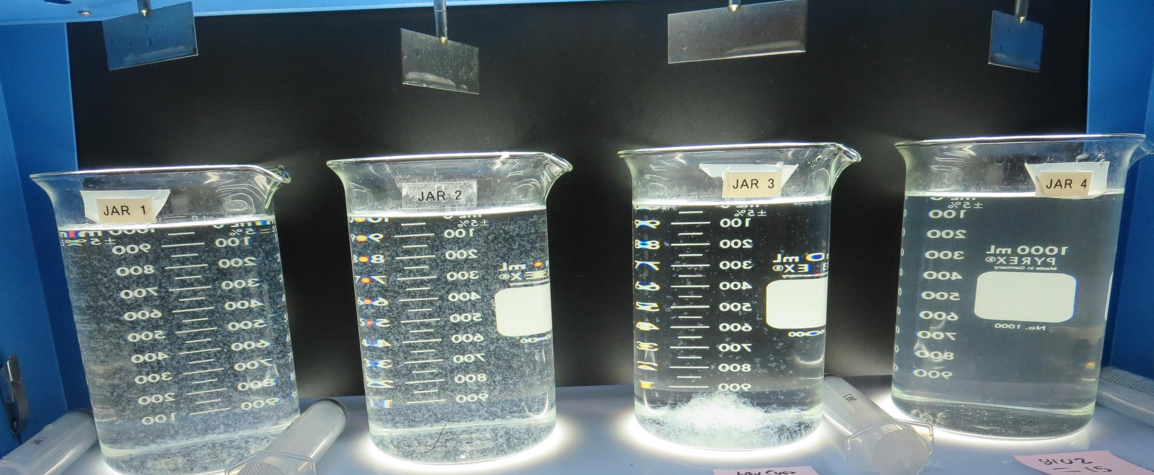
Jars 33-36: After 5 min of settling, 25 mL is syringed for filterability and %UVT/UVA.

Slide 35
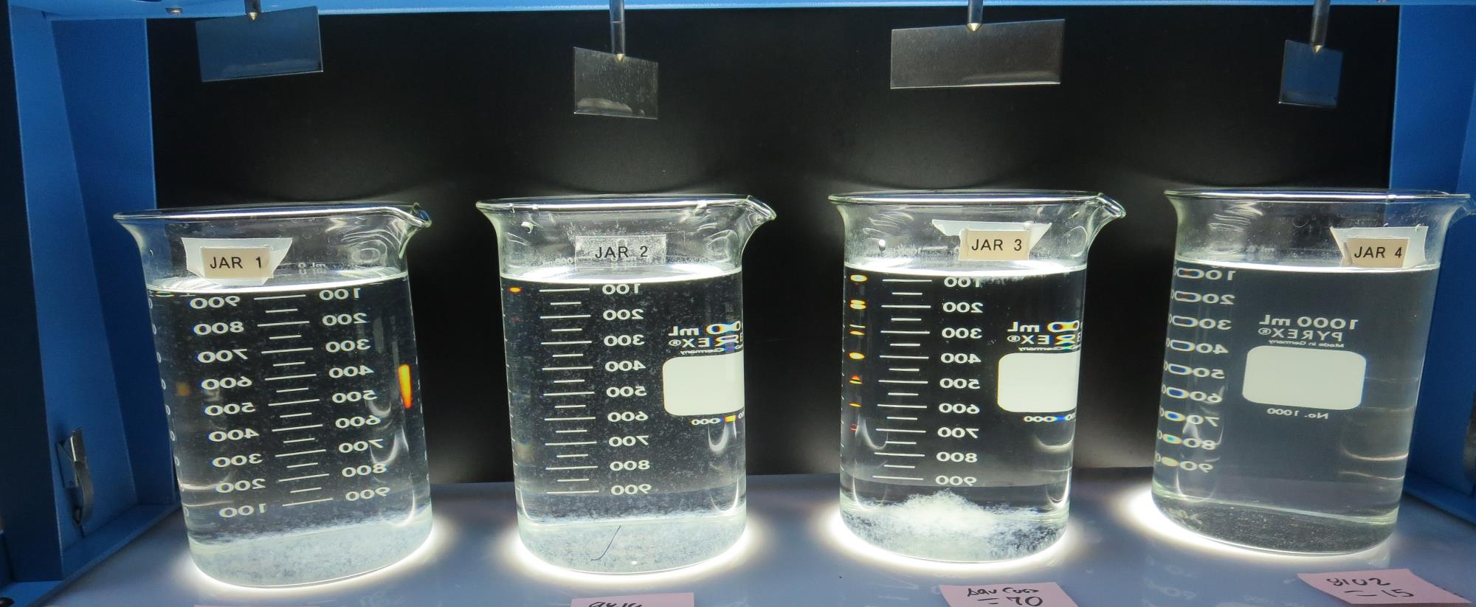
Jars 33-36: After 25-minutes of settling, settled water turbidity is taken.
35 mg/L Alum
2.0 mg/L 8102+
Filtrate 0.08 NTU
UVT: 96.8%
UVA: 0.013/cm
UVA Reduction 60.6%
Settled: 1.23 NTU
19 mg/L 9810
Filtrate 0.07 NTU
UVT: 96.8%
UVA: 0.013/cm
UVA Reduction 60.6%
Settled: 1.24 NTU
70 mg/L AdvFloc
Filtrate 0.08 NTU
UVT: 96.8%
UVA: 0.013/cm
UVA Reduction 60.6%
Settled: 0.39 NTU
15 mg/L 8102+
Filtrate 0.93 NTU
UVT: 92.1%
UVA: 0.035/cm
UVA Reduction 0%
Settled: 3.46 NTU

Slide 36
Jar Testing for 1-Liter Jars:
Procedures for Most Treatment Plants
Fill jars with source water prior to coagulant injection and set paddle speed at 30 rpm
Add chemicals (i.e., NaOCl, primary coagulant, coagulant aid) to each jar
Flash mix for 15-30 seconds (200 rpm)
Slow mix for 5 minutes (20-30 rpm)
Settled for 5 minutes. Syringe 25 mL from each jar taken 1-inch below surface (25 mL/12 sec rate)
Filtered through 1.2 um isopore membrane into cuvette drip rate, 15 mL/(50-90 sec)
Measure filtrate turbidity, chlorine residual and %UVT/UVA
Measure settled water turbidity after 25 minutes of total setting
Record all data

Slide 37

Jar Test
Filterability Test Equipment
Turbidity Instrument
Syringe w/Luer-Lock Tip, 30 cc
(part#: 2225800, by Hach)
Swinnex Filter Holder, 25 mm (part#: SX0002500)
Isopore Membrane Filter, 1.2 um absolute
pore size,
Φ= 25 mm , thickness: 24 um,
hydrophilic polycarbonate membrane
(part #: RTTP02500)
Go to Sigma-Aldrich for laboratory supplies http://www.sigmaaldrich.com/united-states.html

Slide 38
Isopore Membrane Information
Categories | Information
trade name | Isopore
filter color | White
chemistry | Polycarbonate (PC)
water flow rate | Avg. 175 mL/min x cm² (typical results @ 10 psi)
media | Isopore®
wettability | Hydrophilic
porosity | 14.7%
pore size | 1.2 µm
bubble point at 23 °C | 1.0 bar, air with water
thickness | 24 µm
filter diameter (ø) | 25 mm
material size | polycarbonate, Hydrophilic, 1.2 µm, 25 mm, white, plain, 100

Slide 39
Isopore Membrane Background Information
The Isopore membrane is a polycarbonate, track-etched screen filter recommended for all analyses in which the sample is viewed on the surface of the membrane. The Isopore membrane is composed of polycarbonate film, which has a smooth, glass-like surface for clearer sample observation. The unique manufacturing process of the membrane ensures a precise pore diameter and a consistent pore size for accurate separation of samples by size. Matched-weight filters are not usually required because of low, constant tar and ash weights.
Features & Benefits:
Membrane structure retains particles on the surface, simplifying counting and analysis

Slide 40
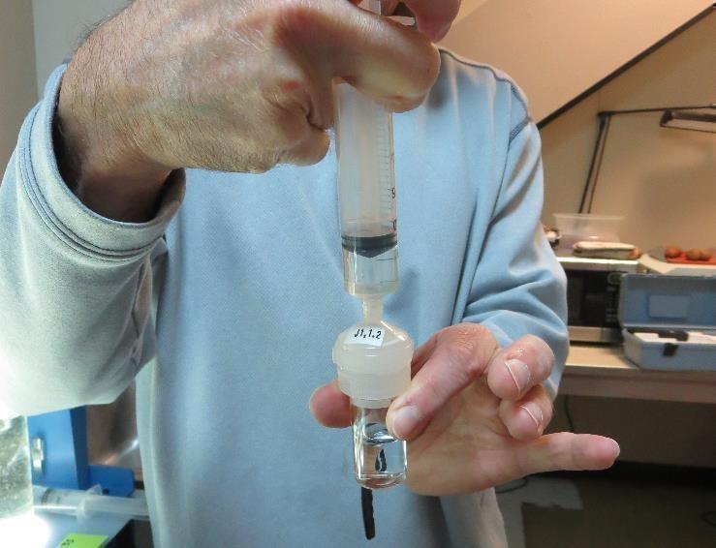

Jar Test - Filterability Test
Syringe ~ 25 mL from jar (after 5-minutes of settling)
Filter-to-waste 3-5 mL
Filter directly into clean cuvette
Measure turbidity
Note: Take several readings before recording final NTU results. Micro bubbles can adhere to glass causing false NTU readings. To remove bubbles, tilt cuvette up to 90 degrees.

Slide 41

Contact
Guy Schott, P.E.
State Water Resources Control Board
Division of Drinking Water
Santa Rosa, CA
Go to Stock Solution/Dose calculations/Jar Test Results for tools to download
www.waterboards.ca.gov/drinking_water/programs/districts/mendocino_district.html
Email: Guy Schott - Guy.Schott@waterboards.ca.gov
Office Number: 707-576-2732

