Slide 1
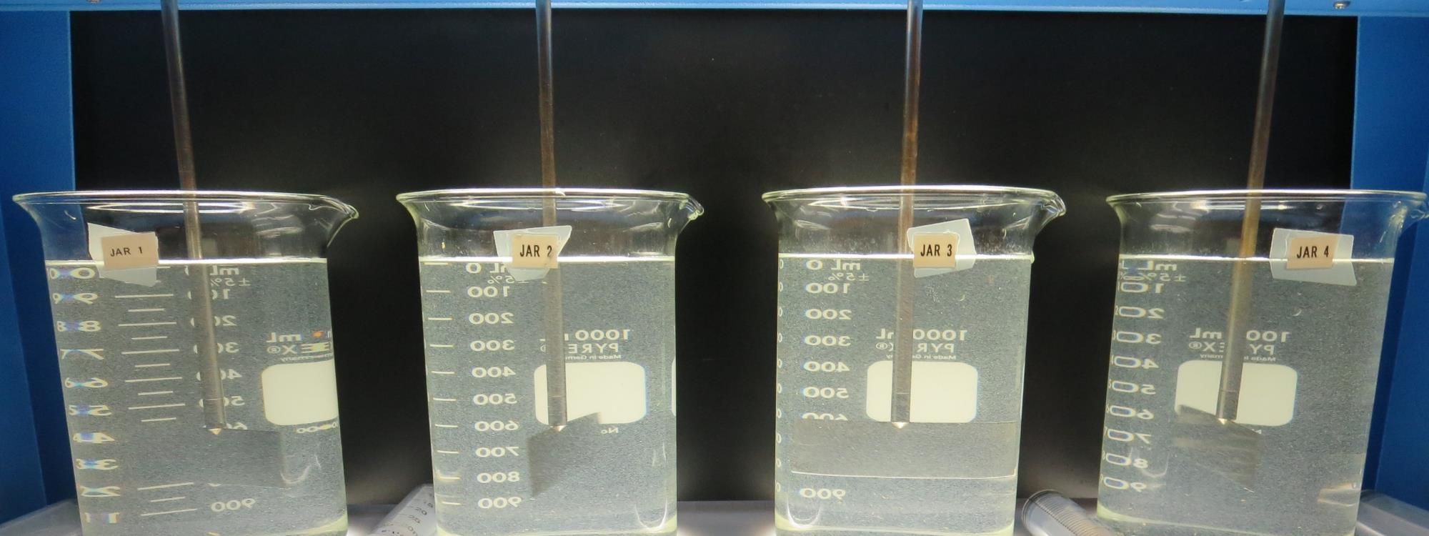
Sonoma County CSA 41 - Freestone
CA4900549
Sonoma County
Jar Test
by Guy Schott, P.E.
August 6, 2019

Slide 2
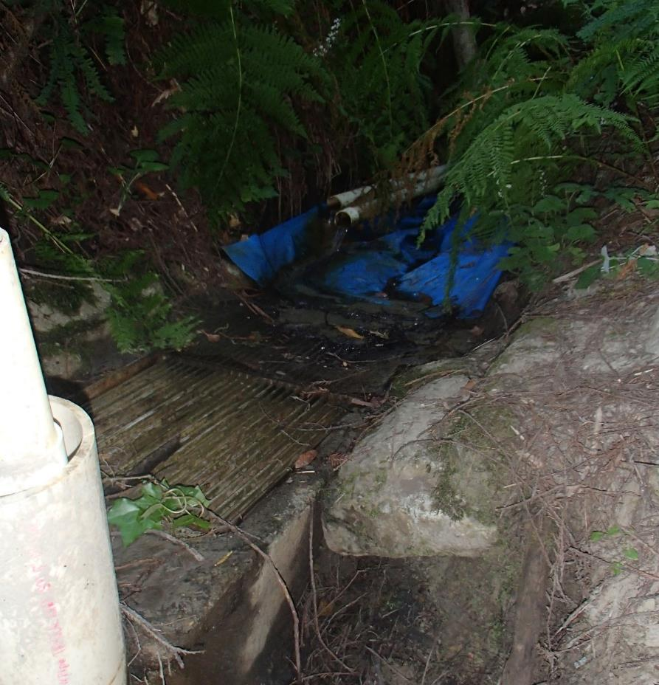
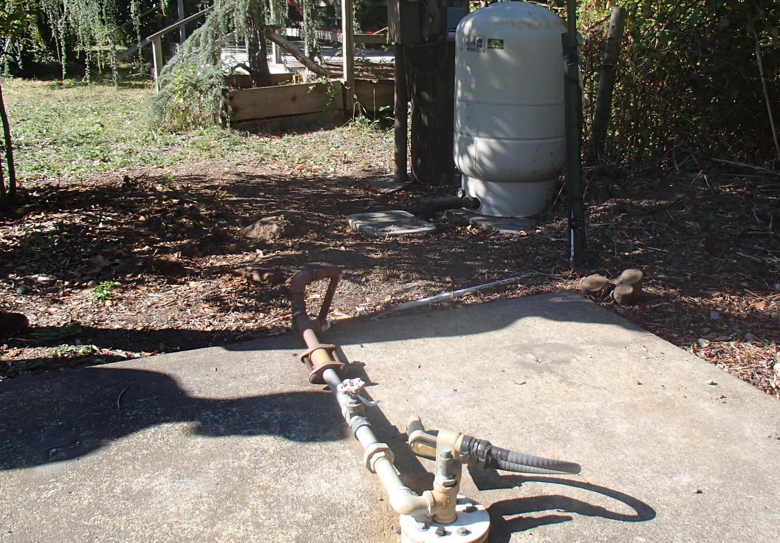
Source Water:
Wells/Spring Sources - Blended

Slide 3
Sonoma County CSA 41 - Freestone
Water Characteristics, August 6, 2019
Source
Turbidity: 8.4 NTU
pH: 7.57
Unfiltered
UVT: 87.2%
UVA/cm: 0.059
Filtered: 0.4 um absolute filter
UVT: 94.8% UVA: 0.023
Turbidity: 0.12 NTU

Slide 4
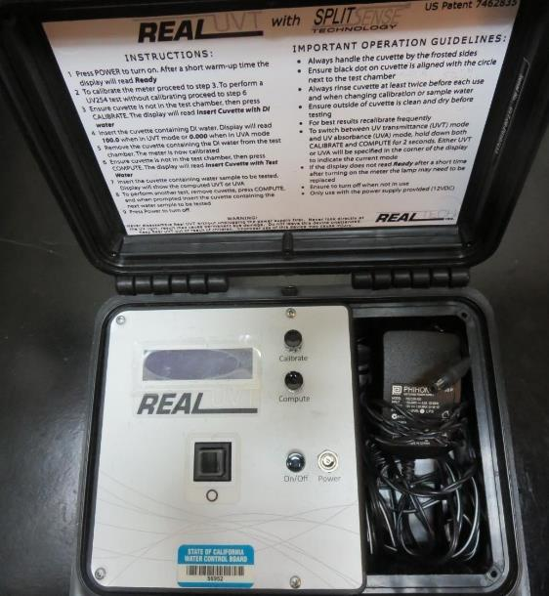
UVT/UVA
UV transmittance (UVT) is a measurement of the amount of ultraviolet light (commonly at 254 nm due to its germicidal effect) that passes through a water sample compared to the amount of light that passes through a pure water sample. The measurement is expressed as a percentage, % UVT.
%UVT = 10^{(-UVA)} x 100%
UV absorbance (UVA) is calculated as a relative measure of the amount of light absorbed by a water sample compared with the amount of light absorbed by a pure water sample.
UVA = -log(%UVT/100)

Slide 5
Applied Coagulants for Jar Testing
NTU Technologies
Pro Pac 9810
45-50% Aluminum Chlorohydrate
45-50% Water
~22.4% Al₂O₃
~11.9% Al
83% Basicity
5% polyamine (50% water, 50% active polyamines)
SG = 1.25-1.34
NSF Max Use: 200 mg/L as Product;
Product dose 40 mg/L = 1 mg/L polyamines active
Pro Pac 9890 (NTU Technologies)
35-45% Aluminum Chlorohydrate
20% polyamine (50% water, 50% active polyamines)
35-45% Water
~18.9% Al₂O₃
~10.5% Al
83% Basicity
SG = 1.25-1.34
NSF limit: 50 mg/L as Product;
Product dose 10 mg/L = 1 mg/L polyamines active

Slide 6
Applied Coagulants for Jar Testing Set 1
Pro Pac 9890 (NTU Technologies)
35-45% ACH
35-45% Water
20% Proprietary
SG = 1.25 – 1.34
Pro Pac 9810 (NTU Technologies)
45-50% Aluminum Chlorohydrate (ACH)
45-50% Water
5% Proprietary
SG = 1.25 - 1.34

Slide 7
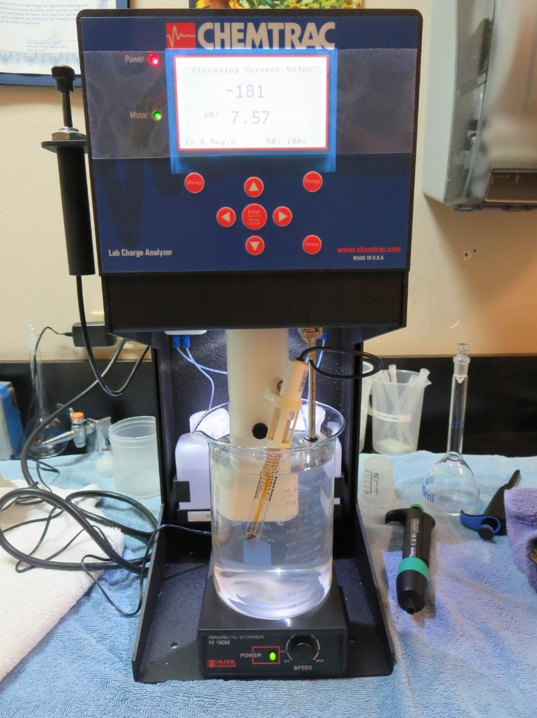
Laboratory Charge Analyzer
LCA: Used to determine coagulant demand of a source water entering the treatment plant.
Source pH: 7.57
LCA #1:
9810: 7.5 mg/L as product
(no pH adjustment)
LCA #2:
7076: >270 mg/L as product
(no pH adjustment)

Slide 8
Coagulant Information
Unless stated otherwise, all coagulant doses are reported as Product (100% strength).
Preparation of coagulant stock solutions are generally 1.0 and/or 0.1 percent strength using 100 and/or 200 mL volumetric flasks.
Finnpipette F2 variable volume pipette, capacity 100-1000 micro liters is used for stock solution preparation and coagulant aid jar test dosing.
Finnpipette F2 variable volume pipette, capacity 0.5-5 mL is used for primary coagulant jar test dosing.

Slide 9
Sonoma County CSA 41 – Freestone; Jar Test 1-4 Results
Flash Mix 200 RPM (60 sec); Floc Mix 30 RPM (5 min)
Jar | 9890 mg/L | Filtrate NTU | Filtrate %UVT | Filtrate UVA/cm | %UVA Reduction | Settle NTU 25 min
J1 | 7.0 | 0.17 | 96.5 | 0.015 | 34.8 | 6.6
J2 | 7.5 | 0.17 | 96.6 | 0.015 | 34.8 | 6.5
J3 | 8.0 | 0.18 | 96.2 | 0.017 | 26.1 | 6.7
J4 | 8.5 | 0.20 | 96.0 | 0.018 | 21.7 | 6.0

Slide 10
Sonoma County CSA 41 – Freestone; Jar Test 5-12 Results
Flash Mix 200 RPM (60 sec); Floc Mix 30 RPM (5 min)
Jar | 9890 mg/L | Filtrate NTU | Filtrate %UVT | Filtrate UVA/cm | %UVA Reduction | Settle NTU 25 min
J5 | 7.0 | 0.07 | 97.2 | 0.012 | 47.8 | 5.5
J6 | 7.5 | 0.12 | 96.5 | 0.015 | 34.8 | 5.9
J7 | 8.0 | 0.12 | 96.8 | 0.014 | 39.1 | 7.0
J8 | 8.5 | 0.10 | 96.7 | 0.015 | 34.8 | 6.2
J9 | 6.0 | 0.18 | 97.0 | 0.013 | 43.5 | 6.3
J10 | 6.5 | 0.14 | 97.1 | 0.013 | 43.5 | 6.3
J11 | 7.0 | 0.15 | 97.1 | 0.013 | 43.5 | 7.0
J12 | 7.5 | 0.18 | 96.9 | 0.014 | 39.1 | 6.7

Slide 11
Sonoma County CSA 41 – Freestone; Jar Test 13-20 Results
Flash Mix 200 RPM (60 sec); Floc Mix 30 RPM (5 min)
Jar | Pre-NaOCl | 9810 mg/L | Filtrate NTU | Filtrate %UVT | Filtrate UVA/cm | %UVA Reduction | Settle NTU 25 min
J13 | Yes | 7.0 | 0.09 | 96.8 | 0.014 | 39.1 | 4.3
J14 | Yes | 7.5 | 0.06 | 97.0 | 0.013 | 43.5 | 4.2
J15 | Yes | 8.0 | 0.10 | 96.6 | 0.015 | 34.8 | 4.8
J16 | Yes | 8.5 | 0.10 | 96.7 | 0.015 | 34.8 | 4.9
J17 | Yes | 7.0 | 0.19 | 96.6 | 0.015 | 34.8 | 6.2
J18 | Yes | 7.5 | 0.17 | 96.8 | 0.014 | 39.1 | 6.5
J19 | Yes | 8.0 | 0.13 | 96.8 | 0.014 | 39.1 | 7.0
J20 | Yes | 8.5 | 0.13 | 96.9 | 0.014 | 39.1 | 7.1

Slide 12
Sonoma County CSA 41 – Freestone; Jar Test 21-24 Results
Flash Mix 200 RPM (60 sec); Floc Mix 30 RPM (5 min)
Jar | Pre-NaOCl | 9810 mg/L | Filtrate NTU | Filtrate %UVT | Filtrate UVA/cm | %UVA Reduction | Settle NTU 25 min
J21 | Yes | 7.0 | 0.14 | 96.8 | 0.014 | 39.1 | 5.3
J22 | Yes | 7.5 | 0.19 | 96.6 | 0.015 | 34.8 | 5.7
J23 | Yes | 8.0 | 0.15 | 96.9 | 0.014 | 39.1 | 5.5
J24 | Yes | 8.5 | 0.14 | 96.9 | 0.014 | 39.1 | 5.0

Slide 13
Jars 1-4 Test
Flash Mix 60 Sec (200 RPM)
Floc Mix 5 min (30 RPM)
Applied Coagulant
9810

Slide 14
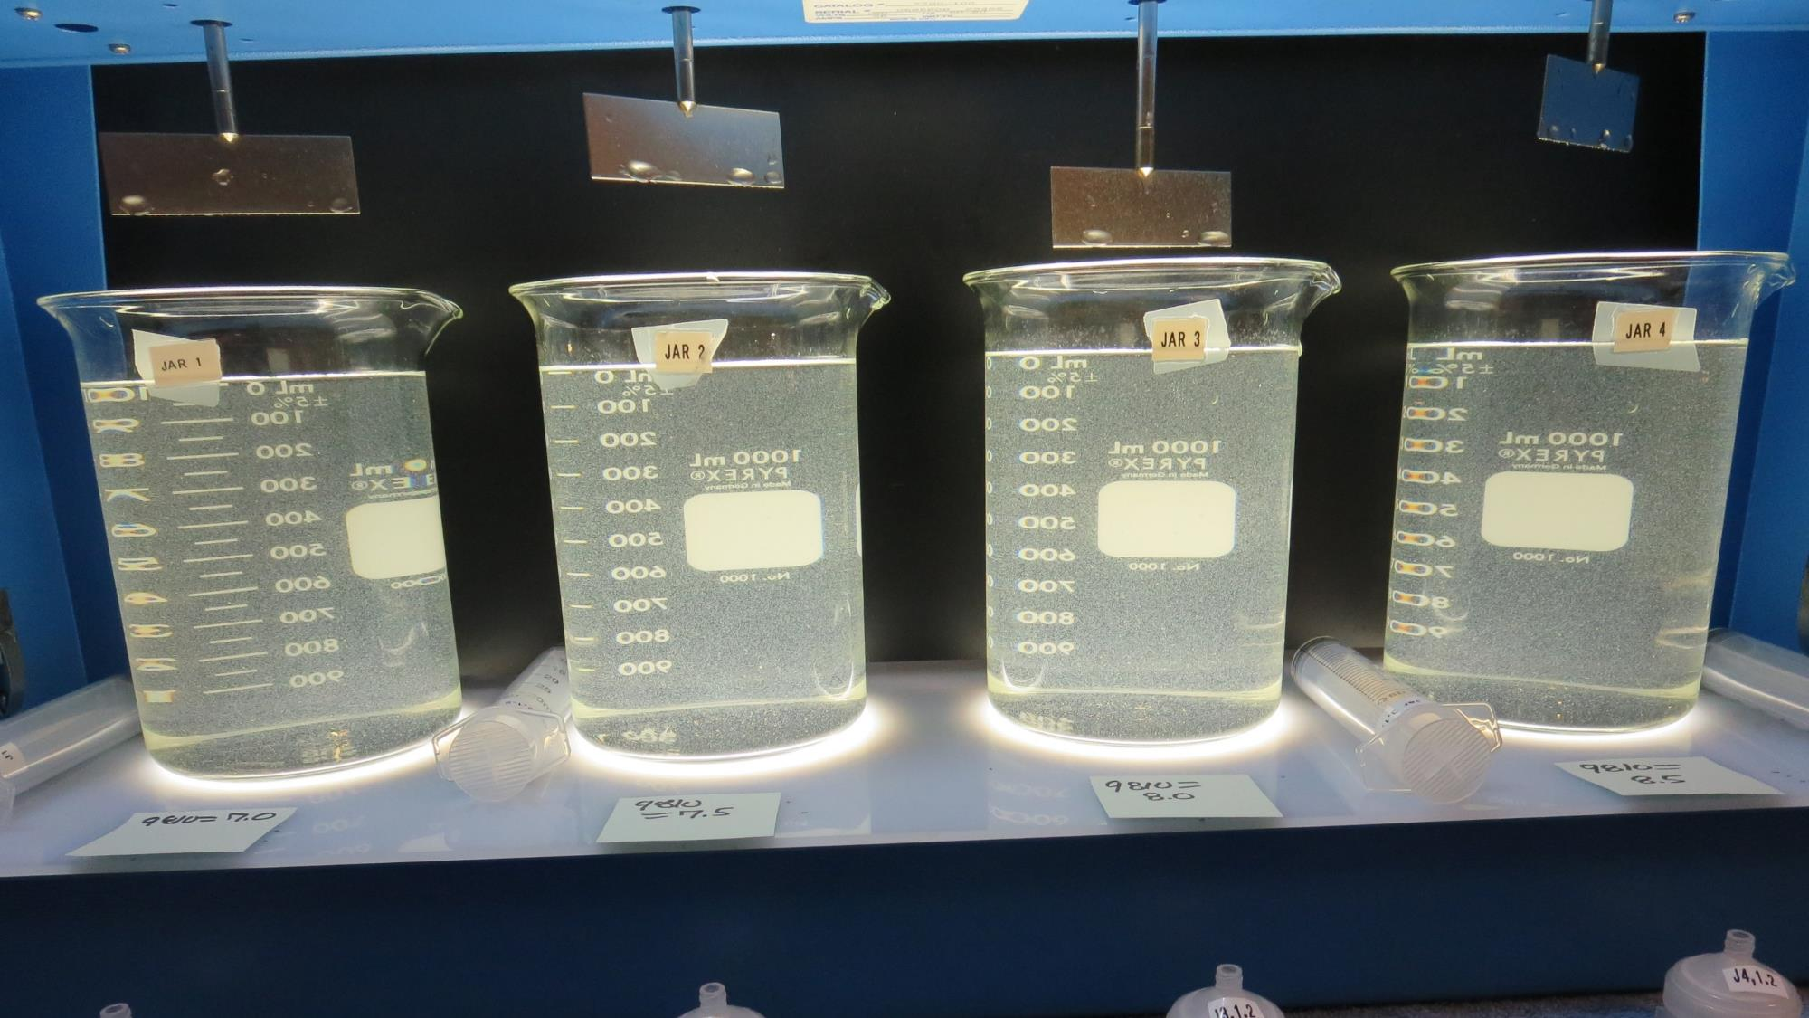
Jars 1-4: End of 5-minute flocculation (30 RPM) duration.
7.0 mg/L 9810
Filtrate 0.17 NTU
UVT: 96.5%
UVA: 0.015/cm
Settled: 6.6 NTU
7.5 mg/L 9810
Filtrate 0.17 NTU
UVT: 96.6%
UVA: 0.015/cm
Settled: 6.5 NTU
8.0 mg/L 9810
Filtrate 0.18 NTU
UVT: 96.2%
UVA: 0.017/cm
Settled: 6.7 NTU
8.5 mg/L 9810
Filtrate 0.20 NTU
UVT: 96.0%
UVA: 0.018/cm
Settled: 6.0 NTU

Slide 15
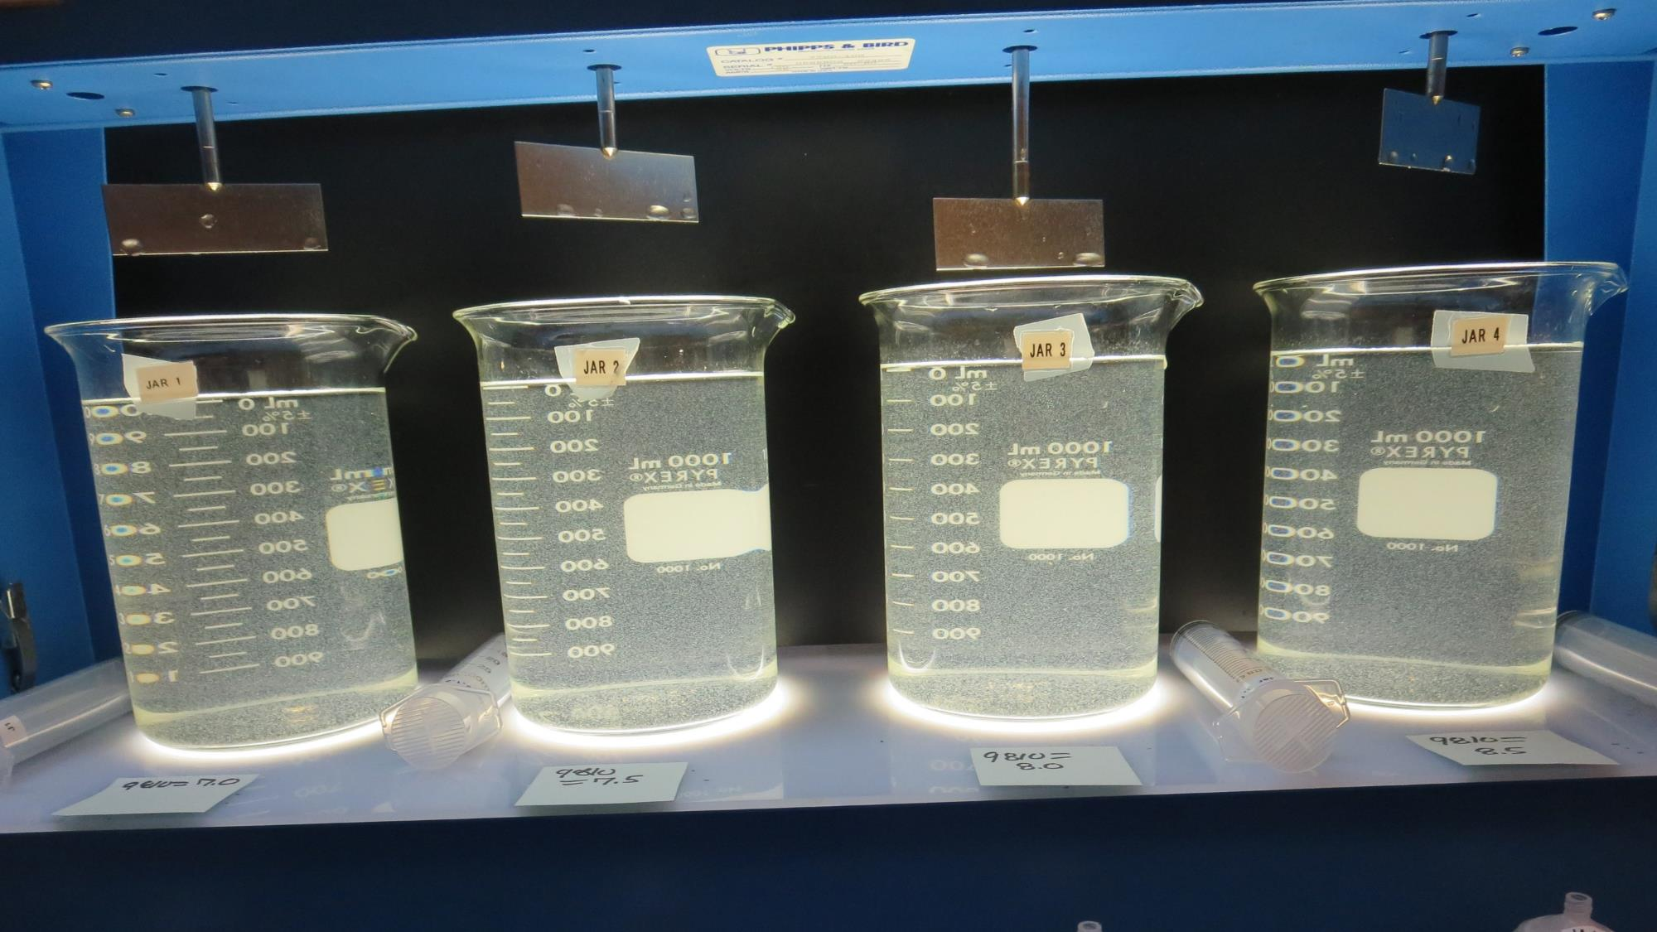
Jars 1-4: After 5 min of settling, 25 mL is syringed for filterability and %UVT/UVA.

Slide 16
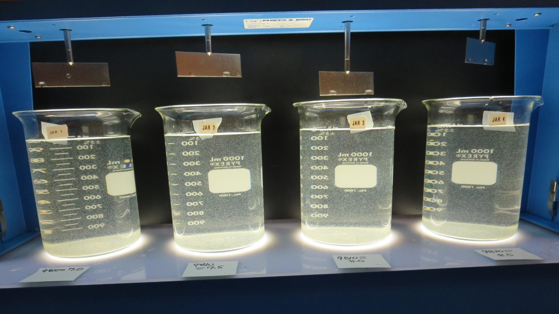
Jars 1-4: After 25-minutes of settling, settled water turbidity is taken
7.0 mg/L 9810
Filtrate 0.17 NTU
UVT: 96.5%
UVA: 0.015/cm
Settled: 6.6 NTU
7.5 mg/L 9810
Filtrate 0.17 NTU
UVT: 96.6%
UVA: 0.015/cm
Settled: 6.5 NTU
8.0 mg/L 9810
Filtrate 0.18 NTU
UVT: 96.2%
UVA: 0.017/cm
Settled: 6.7 NTU
8.5 mg/L 9810
Filtrate 0.20 NTU
UVT: 96.0%
UVA: 0.018/cm
Settled: 6.0 NTU

Slide 17
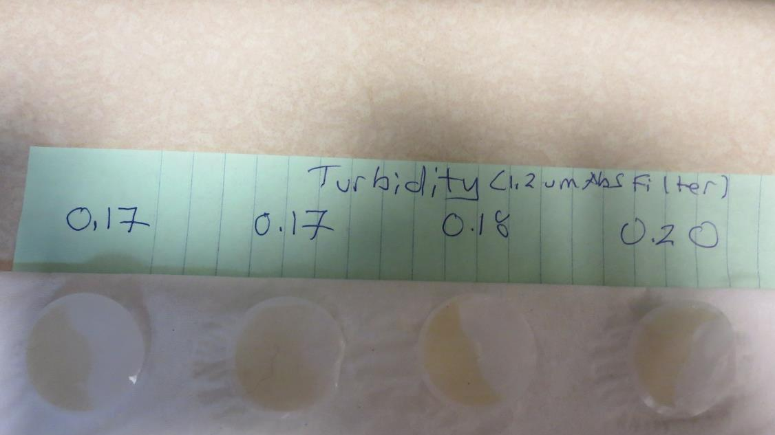
Visual of Filterability of Jars 1-4

Slide 18
Jars 5-8 Test
Flash Mix 60 Sec (200 RPM)
Floc Mix 5 min (30 RPM)
Applied Coagulant
9890

Slide 19
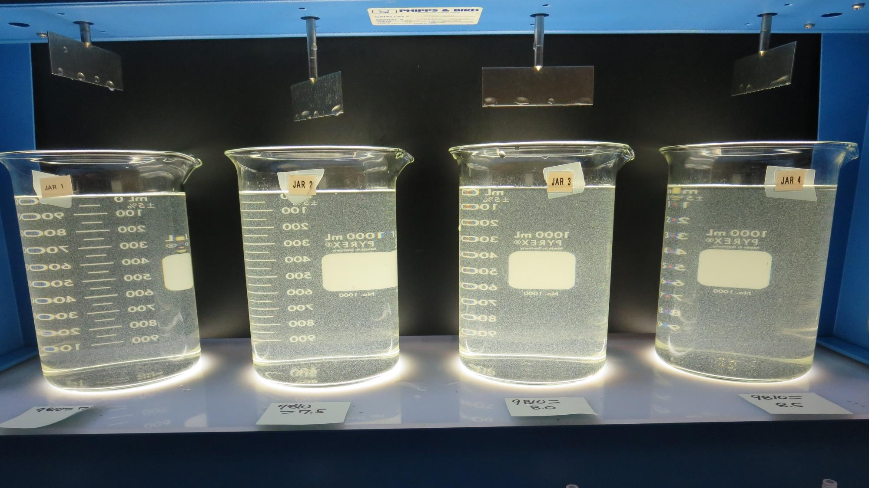
Jars 5-8: End of 5-minute flocculation (30 RPM) duration.
7.0 mg/L 9890
Filtrate 0.07 NTU
UVT: 97.2%
UVA: 0.012/cm
Settled: 5.5 NTU
7.5 mg/L 9890
Filtrate 0.12 NTU
UVT: 96.5%
UVA: 0.015/cm
Settled: 5.9 NTU
8.0 mg/L 9890
Filtrate 0.12 NTU
UVT: 96.8%
UVA: 0.014/cm
Settled: 7.0 NTU
8.5 mg/L 9890
Filtrate 0.10 NTU
UVT: 96.8%
UVA: 0.015/cm
Settled: 6.2 NTU

Slide 20
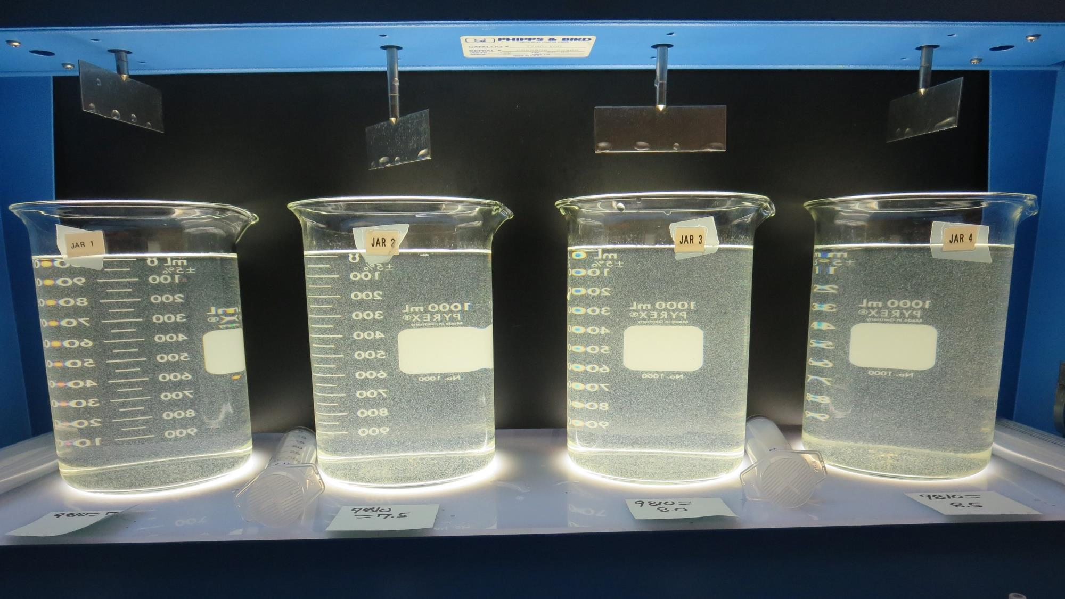
Jars 5-8: After 5 min of settling, 25 mL is syringed for filterability and %UVT/UVA.

Slide 21
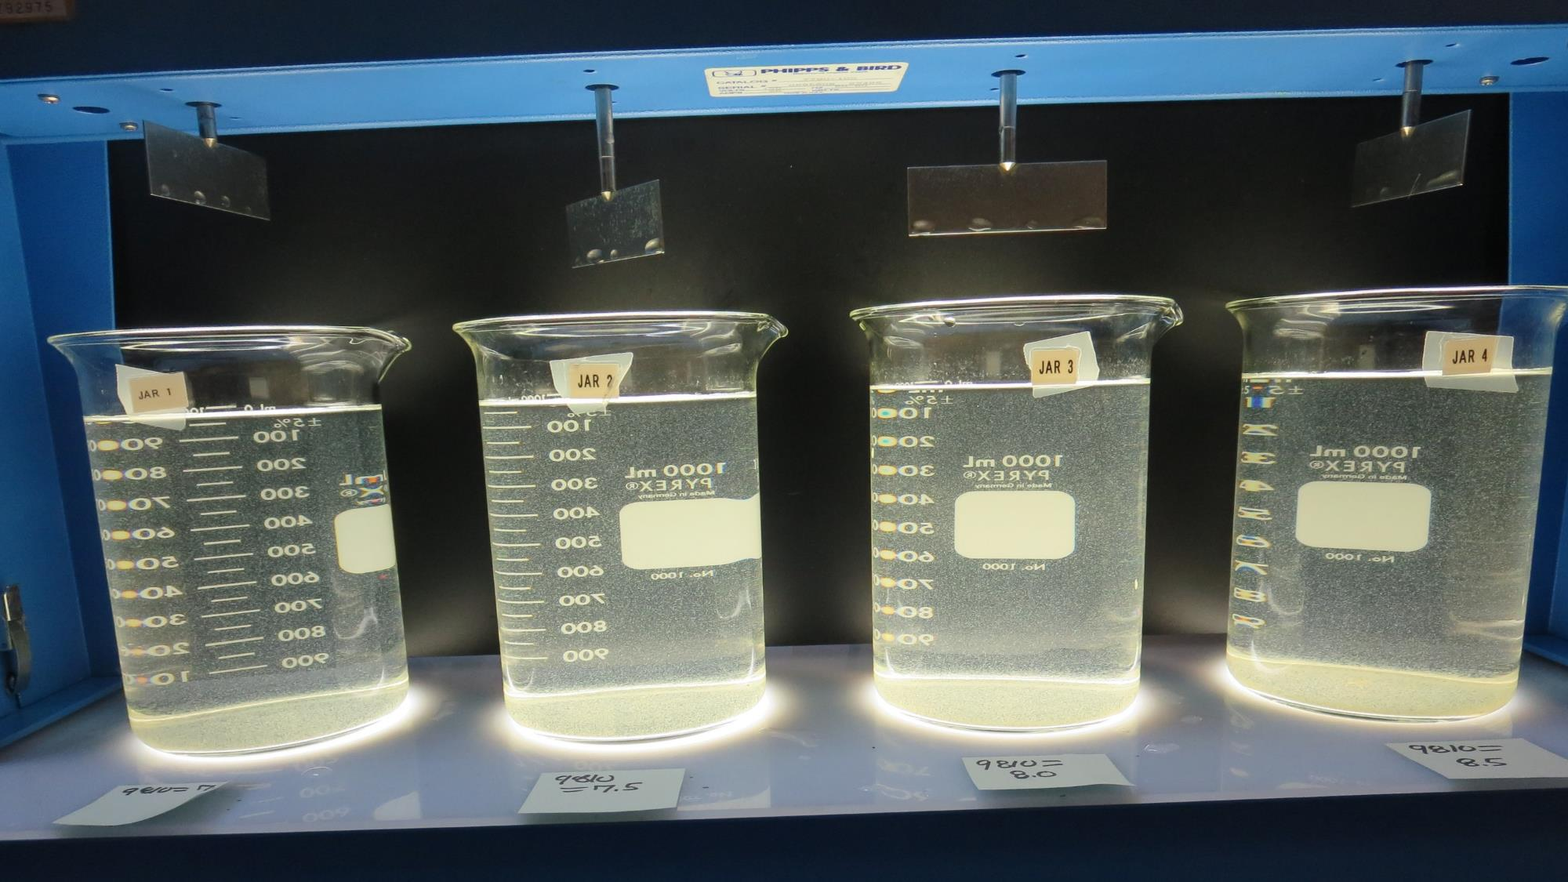
Jars 5-8: After 25-minutes of settling, settled water turbidity is taken
7.0 mg/L 9890
Filtrate 0.07 NTU
UVT: 97.2%
UVA: 0.012/cm
Settled: 5.5 NTU
7.5 mg/L 9890
Filtrate 0.12 NTU
UVT: 96.5%
UVA: 0.015/cm
Settled: 5.9 NTU
8.0 mg/L 9890
Filtrate 0.12 NTU
UVT: 96.8%
UVA: 0.014/cm
Settled: 7.0 NTU
8.5 mg/L 9890
Filtrate 0.10 NTU
UVT: 96.8%
UVA: 0.015/cm
Settled: 6.2 NTU

Slide 22
Jars 9-12 Test
Flash Mix 60 Sec (200 RPM)
Floc Mix 5 min (30 RPM)
Applied Coagulant
9890

Slide 23
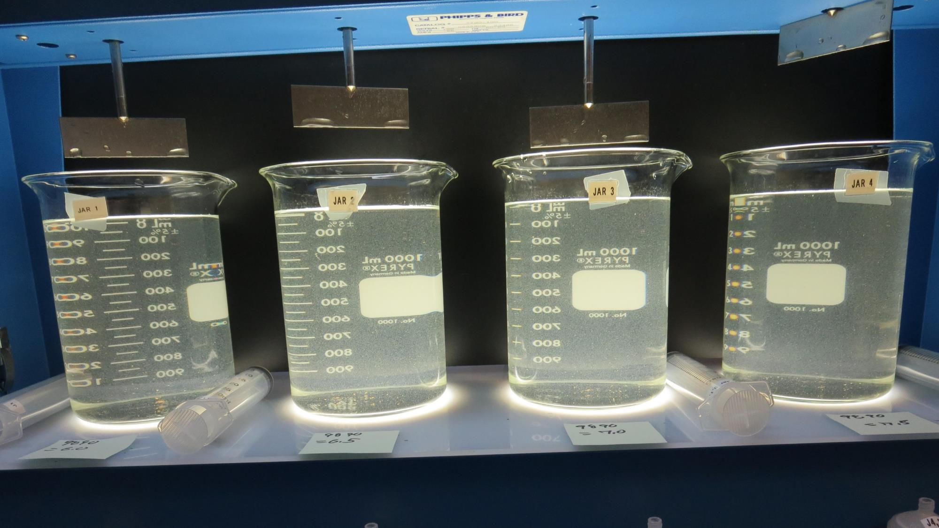
Jars 9-12: End of 5-minute flocculation (30 RPM) duration.
6.0 mg/L 9890
Filtrate 0.18 NTU
UVT: 97.0%
UVA: 0.013/cm
Settled: 6.3 NTU
6.5 mg/L 9890
Filtrate 0.14 NTU
UVT: 97.1%
UVA: 0.013/cm
Settled: 6.3 NTU
7.0 mg/L 9890
Filtrate 0.15 NTU
UVT: 97.1%
UVA: 0.013/cm
Settled: 7.0 NTU
7.5 mg/L 9890
Filtrate 0.18 NTU
UVT: 96.9%
UVA: 0.014/cm
Settled: 6.7 NTU

Slide 24
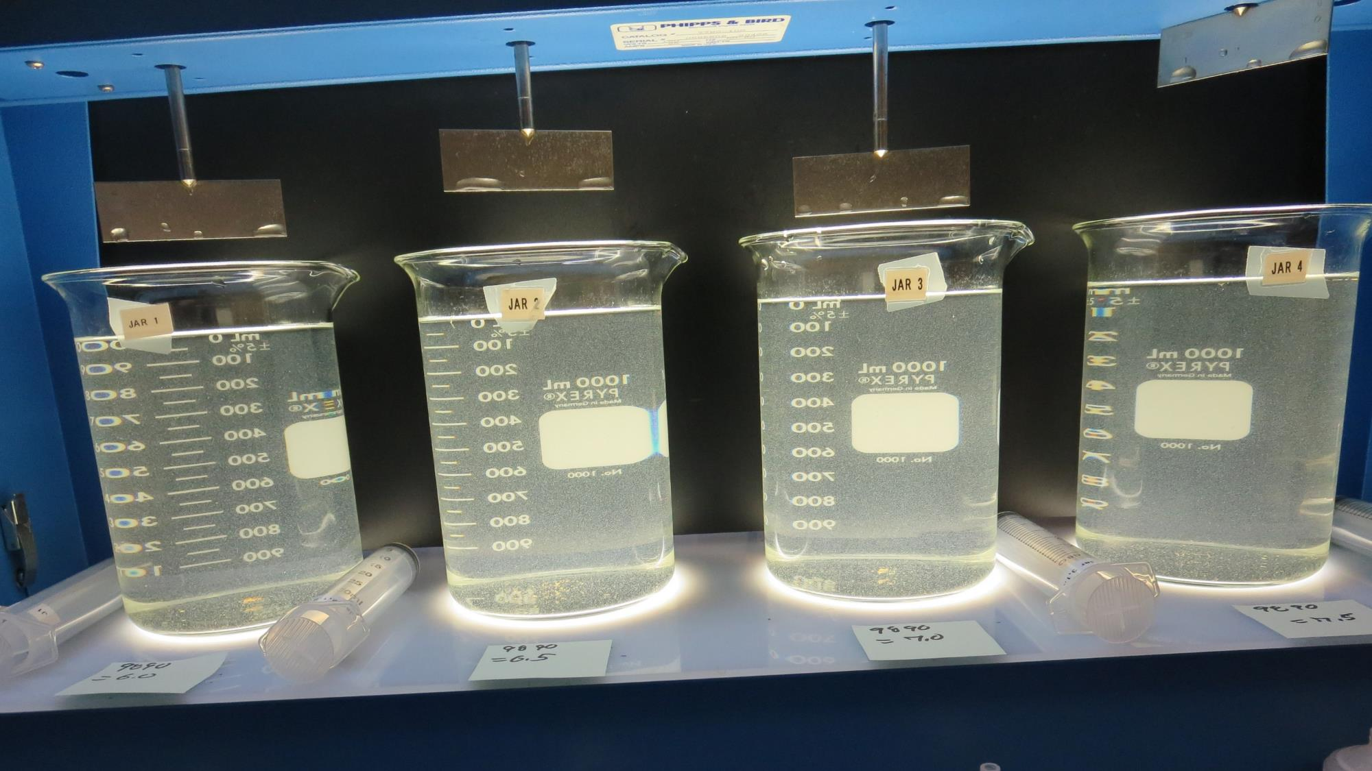
Jars 9-12: After 5 min of settling, 25 mL is syringed for filterability and %UVT/UVA.

Slide 25
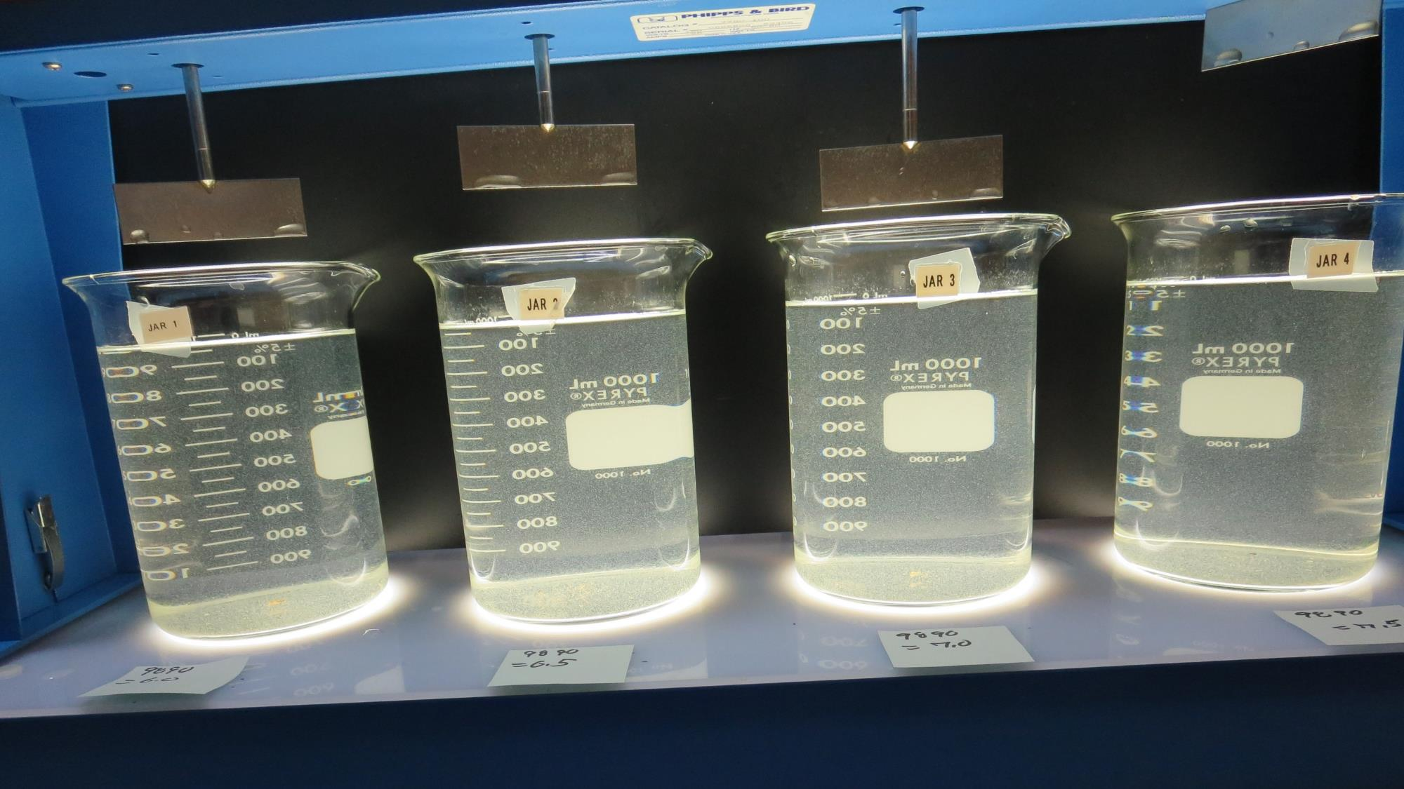
Jars 9-12: After 25-minutes of settling, settled water turbidity is taken
6.0 mg/L 9890
Filtrate 0.18 NTU
UVT: 97.0%
UVA: 0.013/cm
Settled: 6.3 NTU
6.5 mg/L 9890
Filtrate 0.14 NTU
UVT: 97.1%
UVA: 0.013/cm
Settled: 6.3 NTU
7.0 mg/L 9890
Filtrate 0.15 NTU
UVT: 97.1%
UVA: 0.013/cm
Settled: 7.0 NTU
7.5 mg/L 9890
Filtrate 0.18 NTU
UVT: 96.9%
UVA: 0.014/cm
Settled: 6.7 NTU

Slide 26
Jars 13-16 Test
Flash Mix 60 Sec (200 RPM)
Floc Mix 5 min (30 RPM)
Applied Coagulant
9810 w/NaOCl

Slide 27
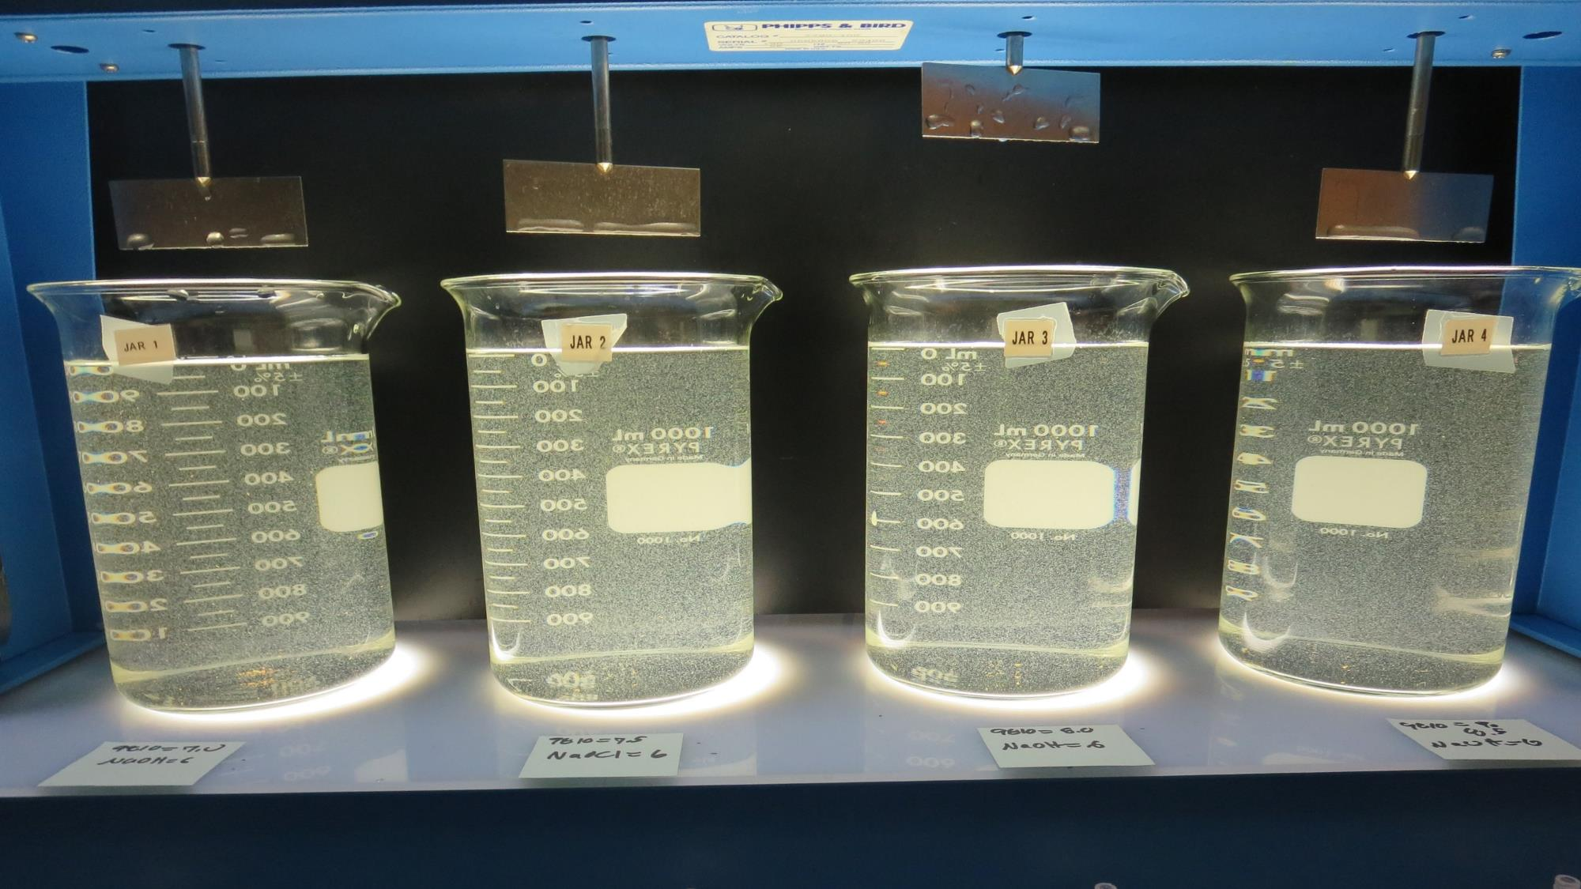
Jars 13-16: End of 5-minute flocculation (30 RPM) duration.
7.0 mg/L 9810
Filtrate 0.09 NTU
UVT: 96.8%
UVA: 0.014/cm
Settled: 4.3 NTU
7.5 mg/L 9810
Filtrate 0.06 NTU
UVT: 97.0%
UVA: 0.013/cm
Settled: 4.2 NTU
8.0 mg/L 9810
Filtrate 0.10 NTU
UVT: 96.6%
UVA: 0.015/cm
Settled: 4.8 NTU
8.5 mg/L 9810
Filtrate 0.10 NTU
UVT: 96.7%
UVA: 0.015/cm
Settled: 4.9 NTU

Slide 28
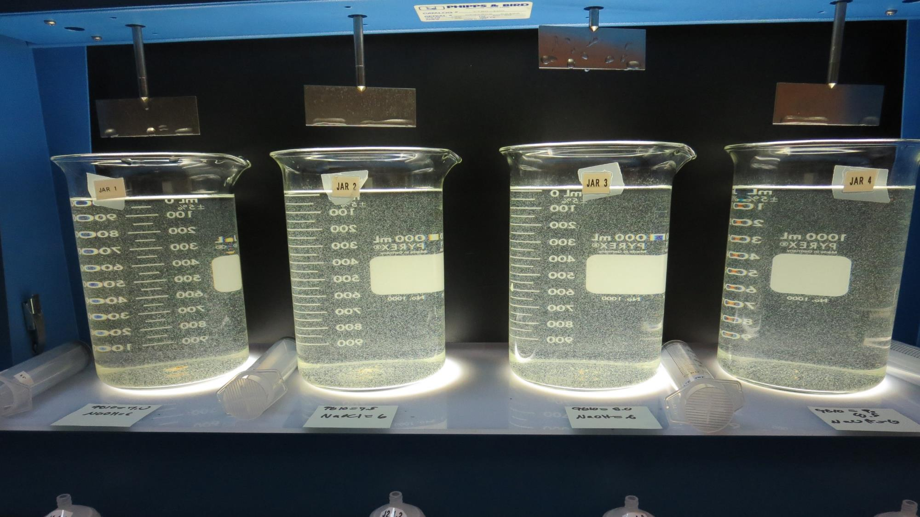
Jars 13-16: After 5 min of settling, 25 mL is syringed for filterability and %UVT/UVA.

Slide 29
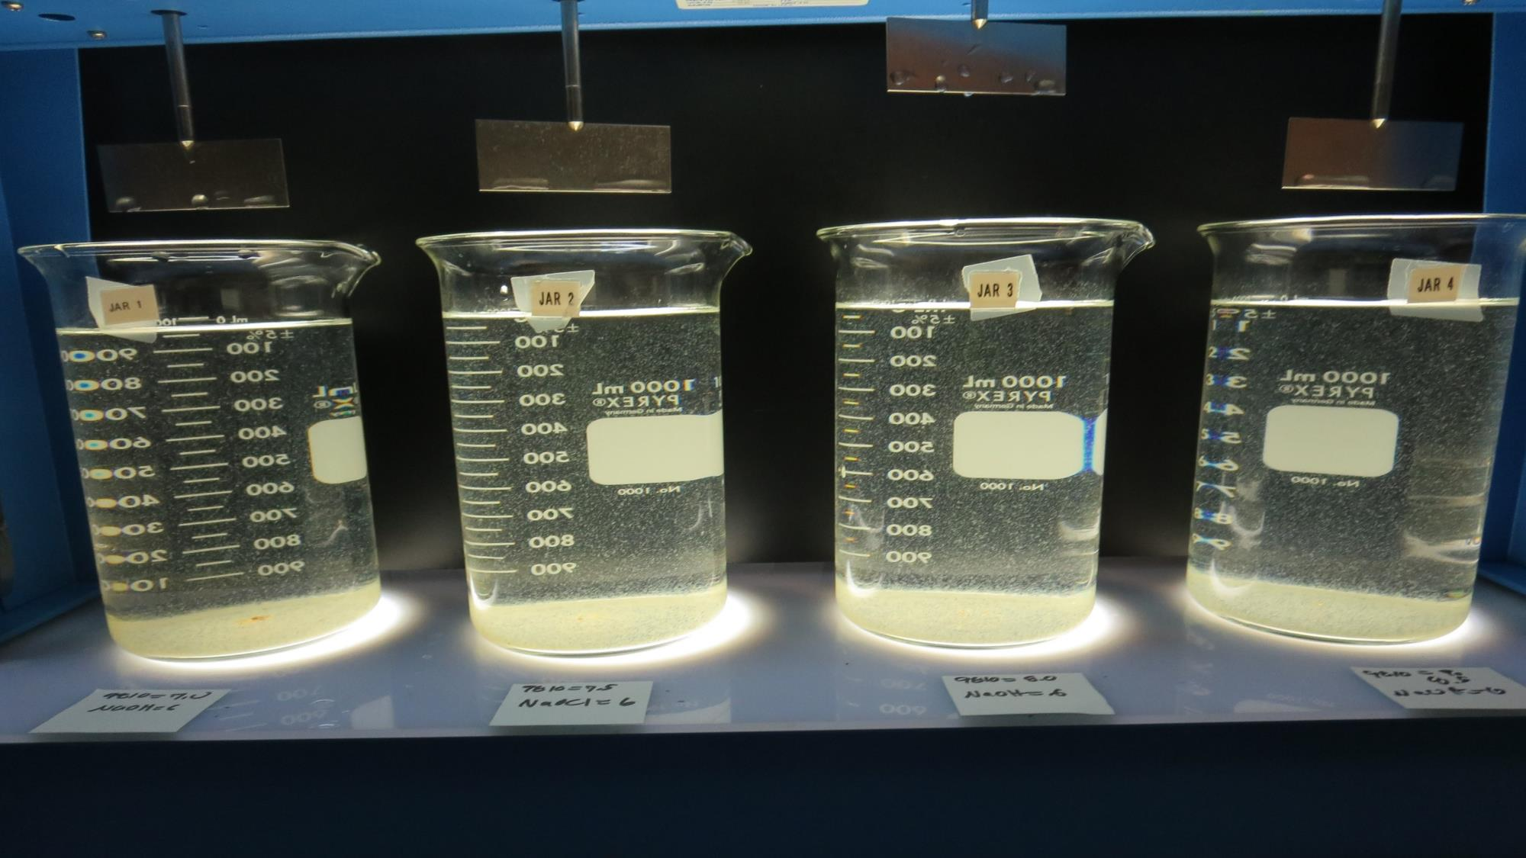
Jars 13-16: After 25-minutes of settling, settled water turbidity is taken
7.0 mg/L 9810
Filtrate 0.09 NTU
UVT: 96.8%
UVA: 0.014/cm
Settled: 4.3 NTU
7.5 mg/L 9810
Filtrate 0.06 NTU
UVT: 97.0%
UVA: 0.013/cm
Settled: 4.2 NTU
8.0 mg/L 9810
Filtrate 0.10 NTU
UVT: 96.6%
UVA: 0.015/cm
Settled: 4.8 NTU
8.5 mg/L 9810
Filtrate 0.10 NTU
UVT: 96.7%
UVA: 0.015/cm
Settled: 4.9 NTU

Slide 30
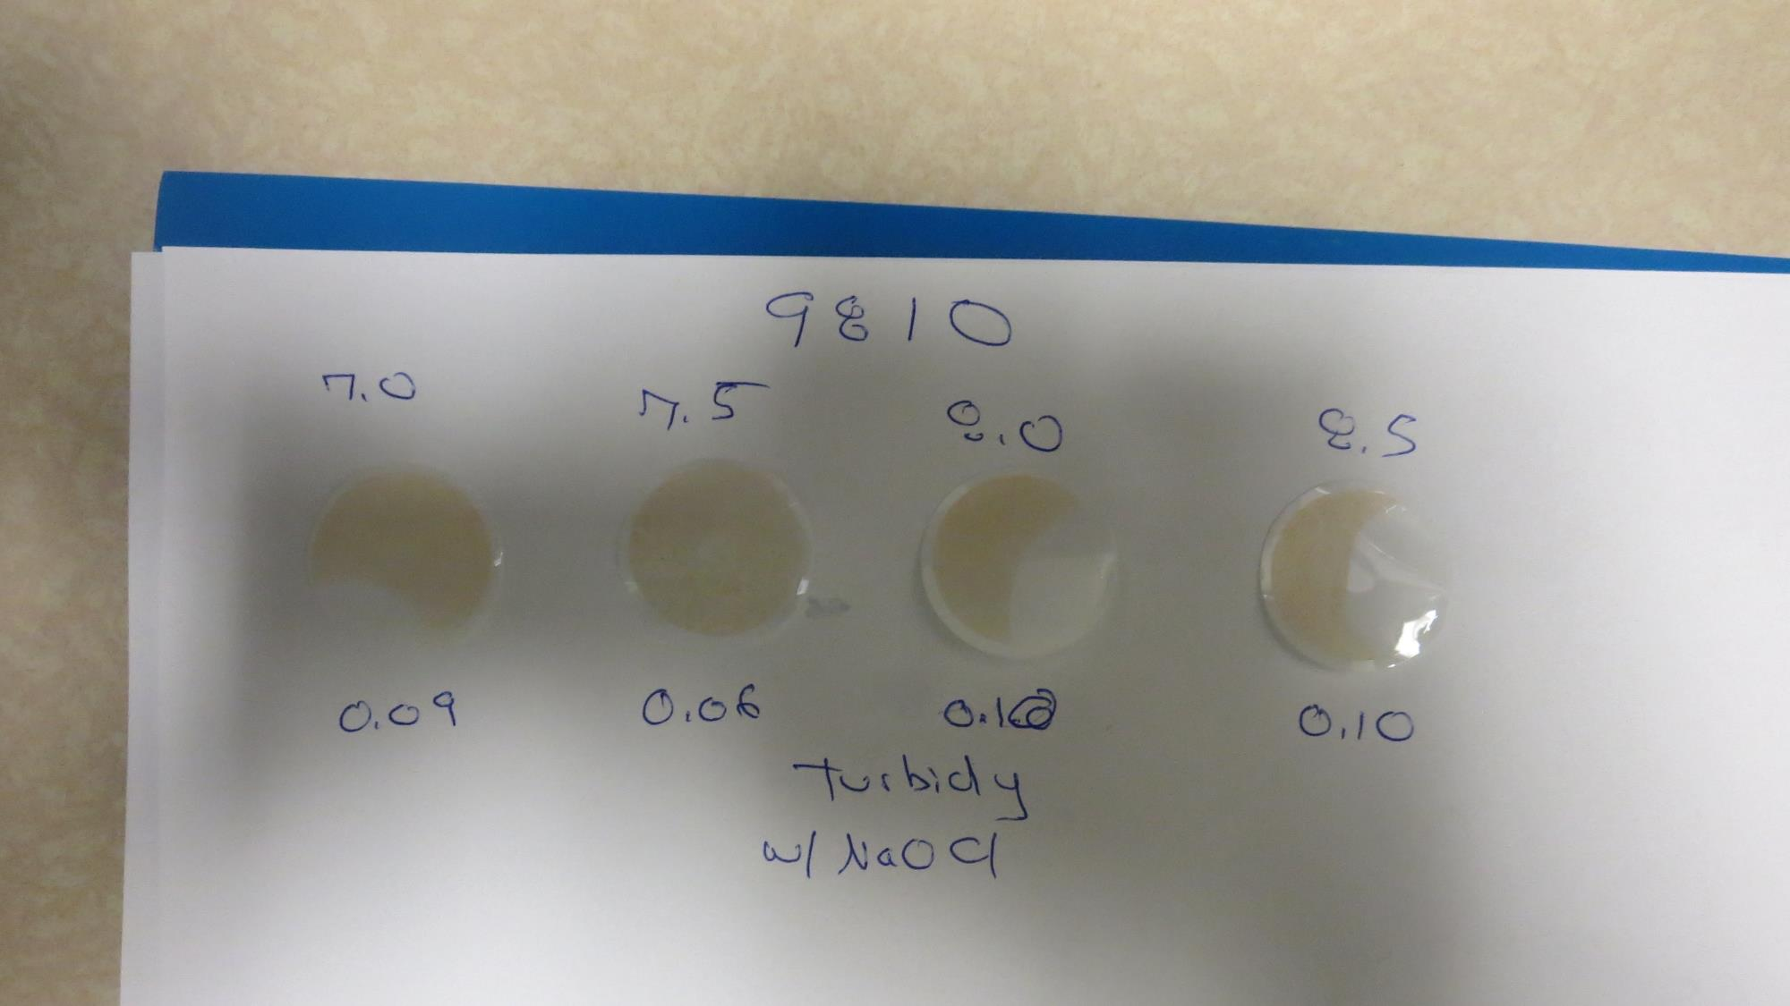
Visual of Filterability of Jars 13-16

Slide 31
Jars 17-20 Test
No Flash Mixing
Floc Mix 5 min (30 RPM)
Applied Coagulant
9810 w/NaOCl

Slide 32
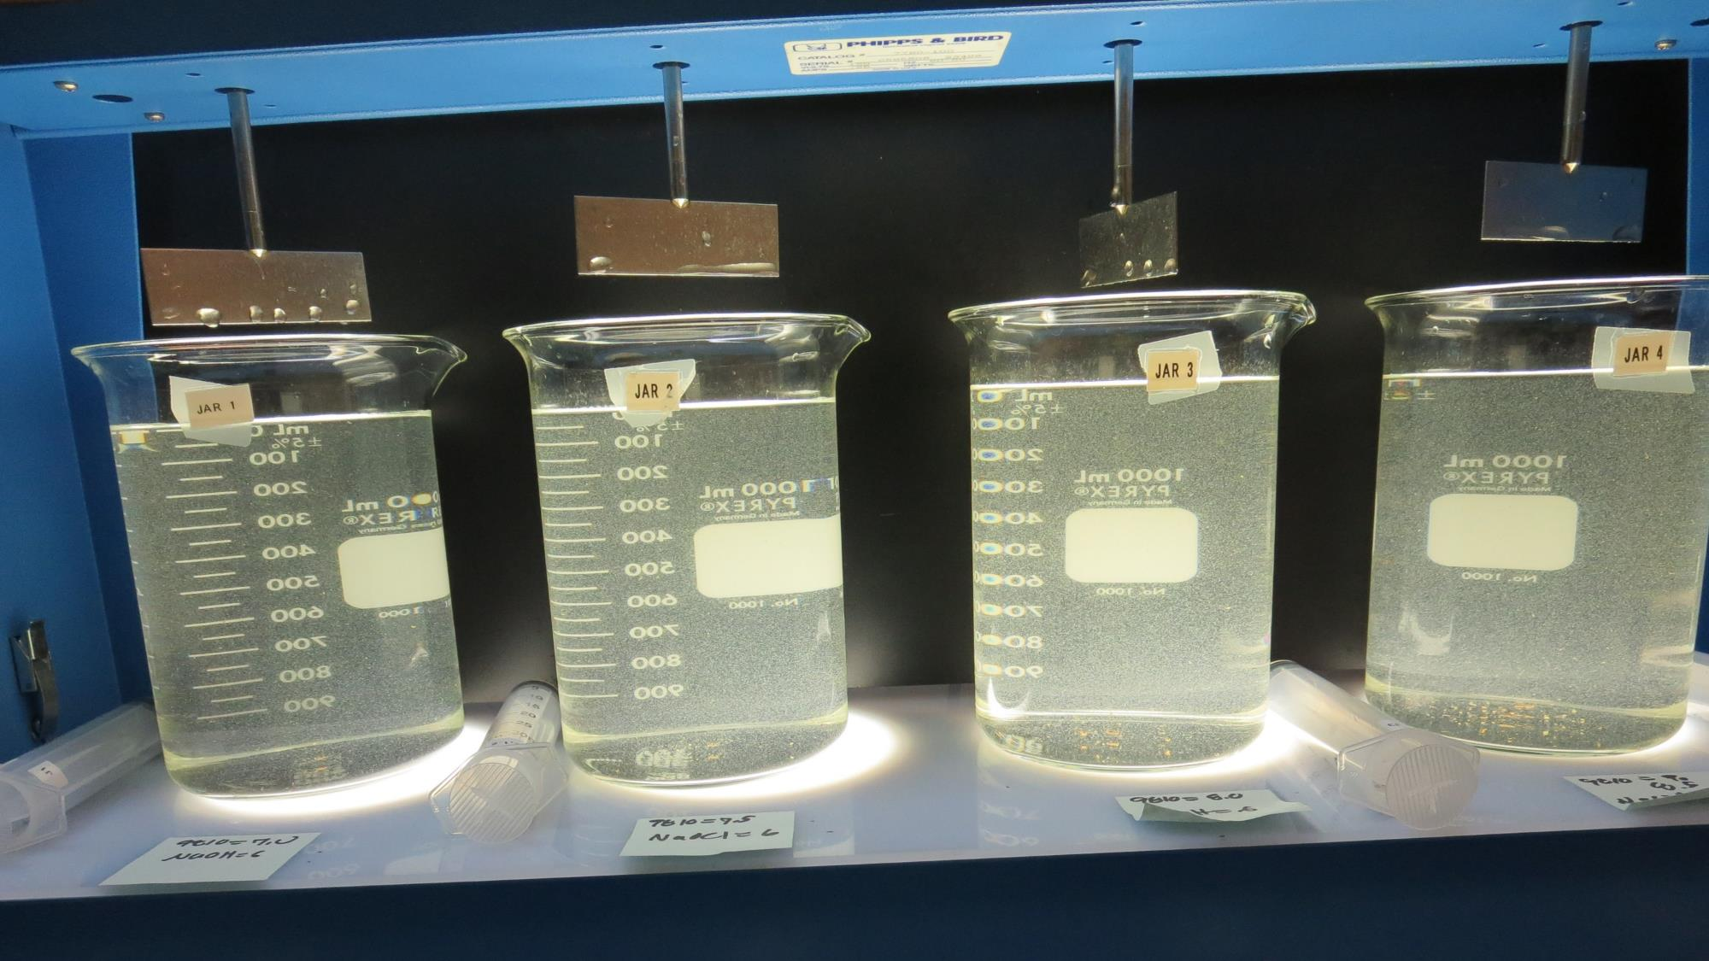
Jars 17-20: End of 5-minute flocculation (30 RPM) duration.
7.0 mg/L 9810
Filtrate 0.19 NTU
UVT: 96.6%
UVA: 0.015/cm
Settled: 6.2 NTU
7.5 mg/L 9810
Filtrate 0.17 NTU
UVT: 96.8%
UVA: 0.014/cm
Settled: 6.5 NTU
8.0 mg/L 9810
Filtrate 0.13 NTU
UVT: 96.8%
UVA: 0.014/cm
Settled: 7.0 NTU
8.5 mg/L 9810
Filtrate 0.13 NTU
UVT: 96.9%
UVA: 0.014/cm
Settled: 7.1 NTU

Slide 33
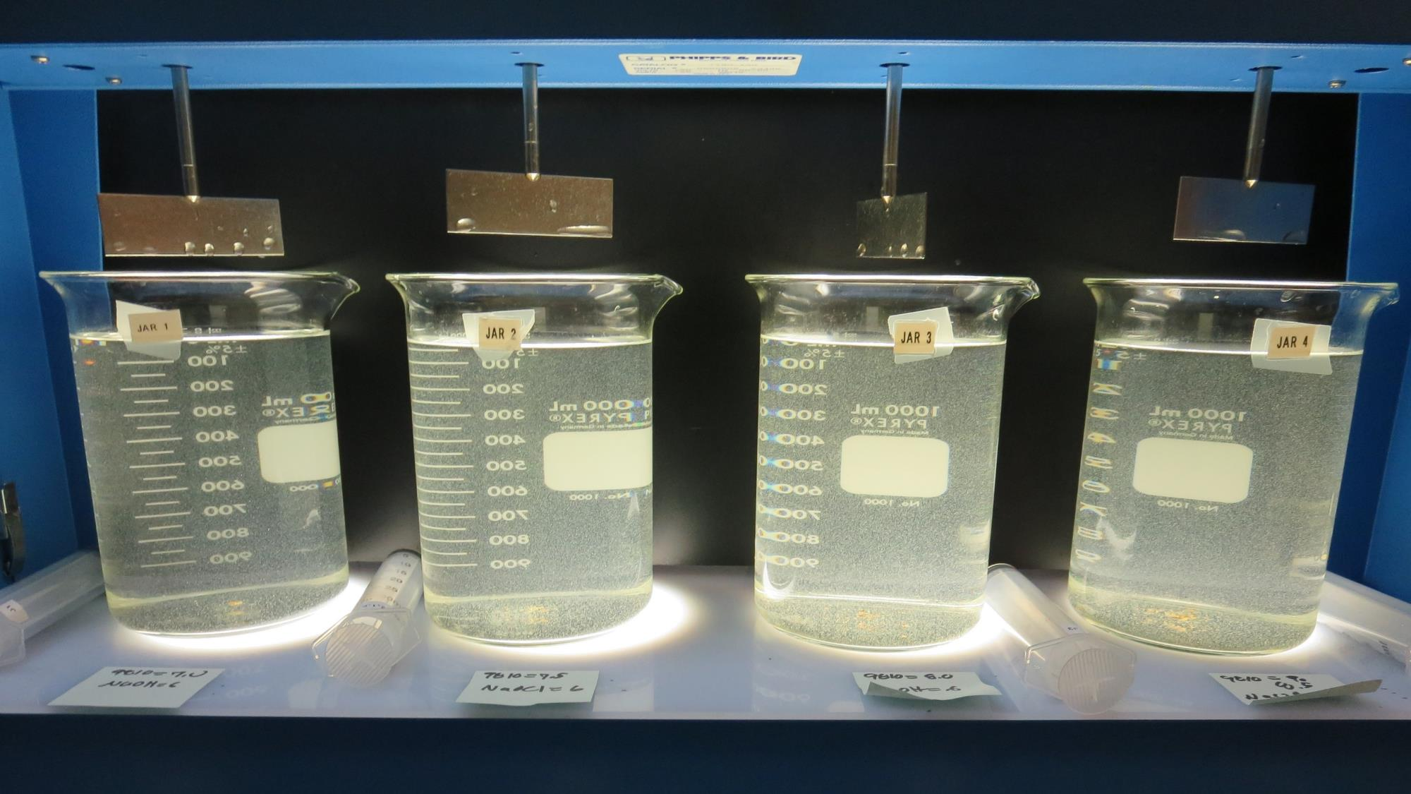
Jars 17-20: After 5 min of settling, 25 mL is syringed for filterability and %UVT/UVA.

Slide 34
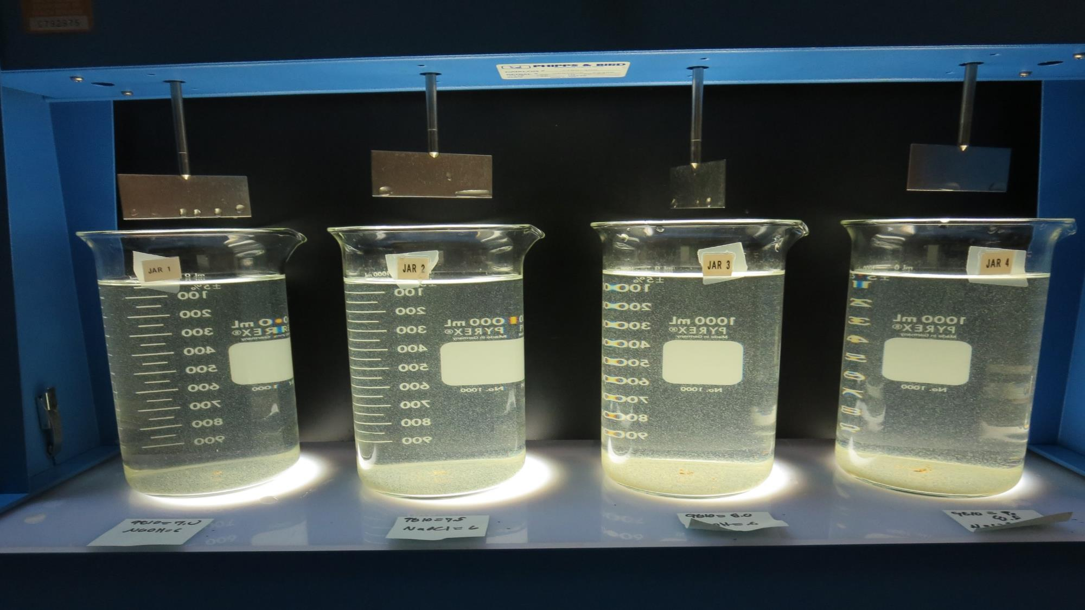
Jars 17-20: After 25-minutes of settling, settled water turbidity is taken
7.0 mg/L 9810
Filtrate 0.19 NTU
UVT: 96.6%
UVA: 0.015/cm
Settled: 6.2 NTU
7.5 mg/L 9810
Filtrate 0.17 NTU
UVT: 96.8%
UVA: 0.014/cm
Settled: 6.5 NTU
8.0 mg/L 9810
Filtrate 0.13 NTU
UVT: 96.8%
UVA: 0.014/cm
Settled: 7.0 NTU
8.5 mg/L 9810
Filtrate 0.13 NTU
UVT: 96.9%
UVA: 0.014/cm
Settled: 7.1 NTU

Slide 35
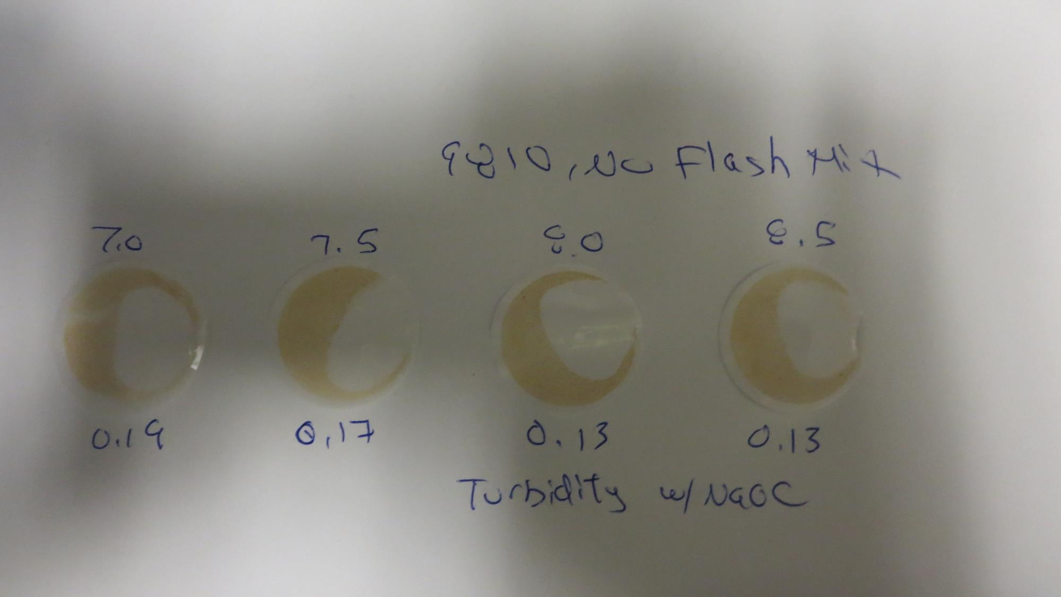
Visual of Filterability of Jars 17-20

Slide 36
Jars 21-24 Test
Flash Mix 60 Sec (200 RPM)
Floc Mix 5 min (30 RPM)
Applied Coagulant
9810 w/NaOCl

Slide 37
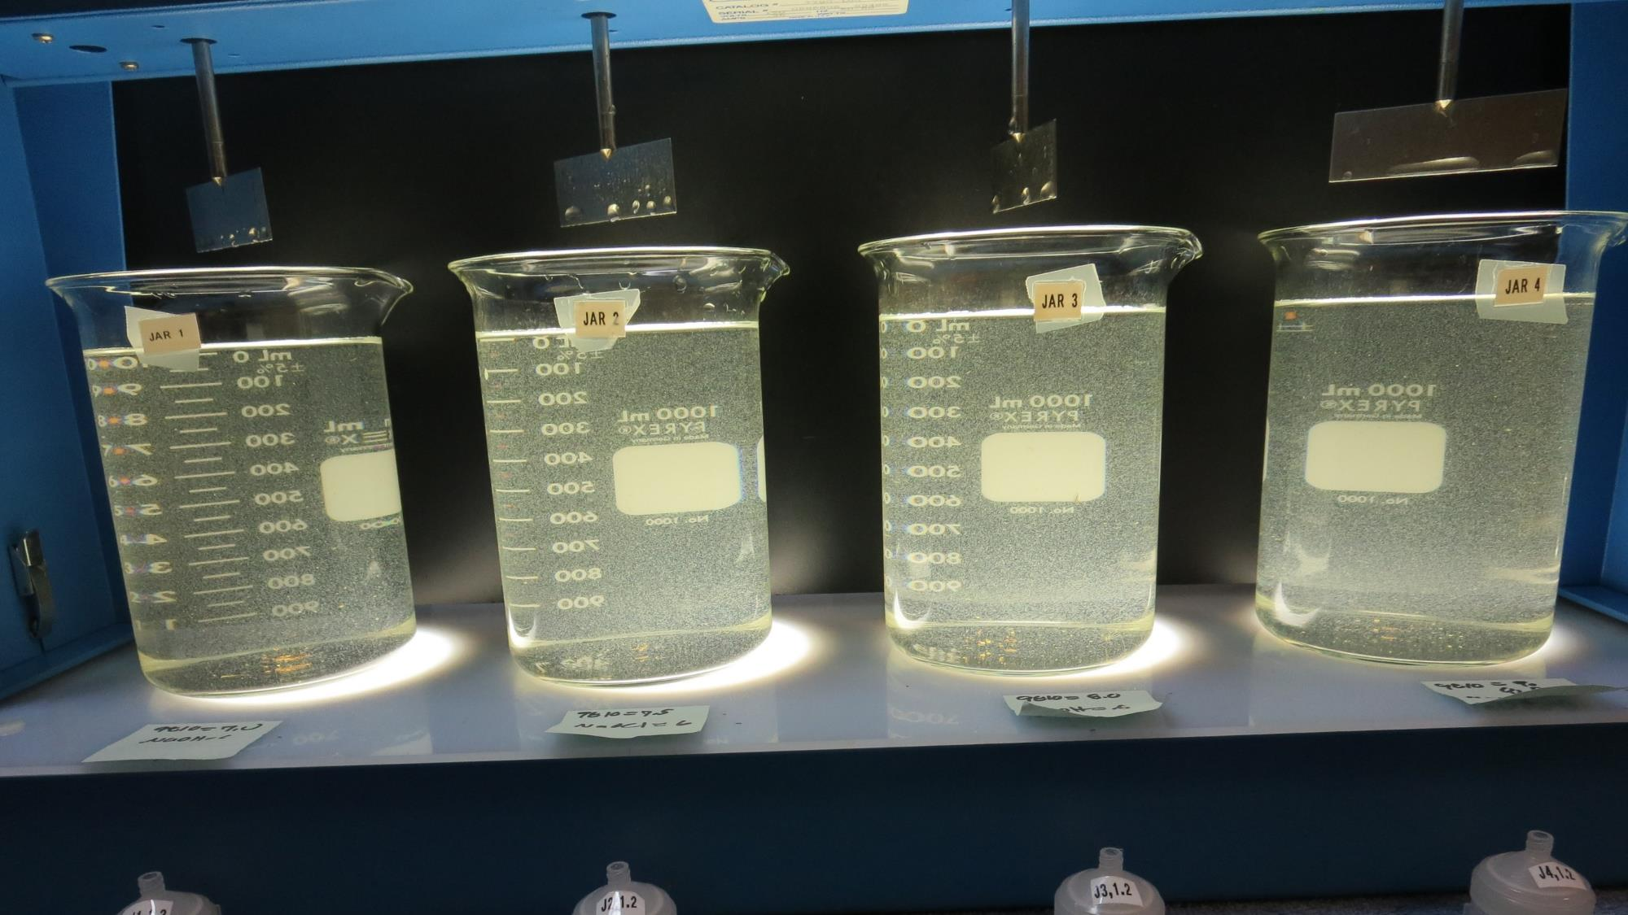
Jars 21-24: End of 5-minute flocculation (30 RPM) duration.
7.0 mg/L 9810
Filtrate 0.14 NTU
UVT: 96.8%
UVA: 0.014/cm
Settled: 5.3 NTU
7.5 mg/L 9810
Filtrate 0.19 NTU
UVT: 96.6%
UVA: 0.015/cm
Settled: 5.7 NTU
8.0 mg/L 9810
Filtrate 0.15 NTU
UVT: 96.9%
UVA: 0.014/cm
Settled: 5.5 NTU
8.5 mg/L 9810
Filtrate 0.14 NTU
UVT: 96.9%
UVA: 0.014/cm
Settled: 5.0 NTU

Slide 38
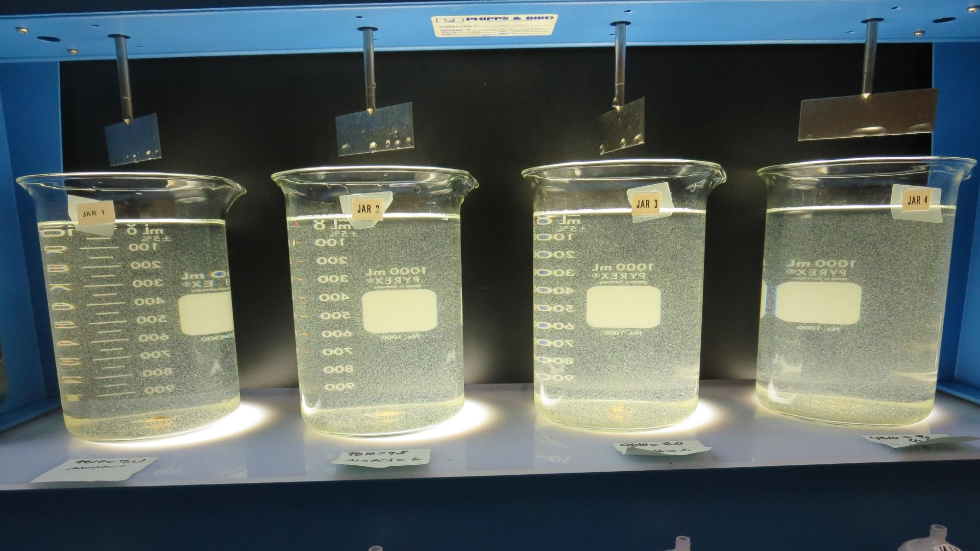
Jars 21-24: After 5 min of settling, 25 mL is syringed for filterability and %UVT/UVA.

Slide 39
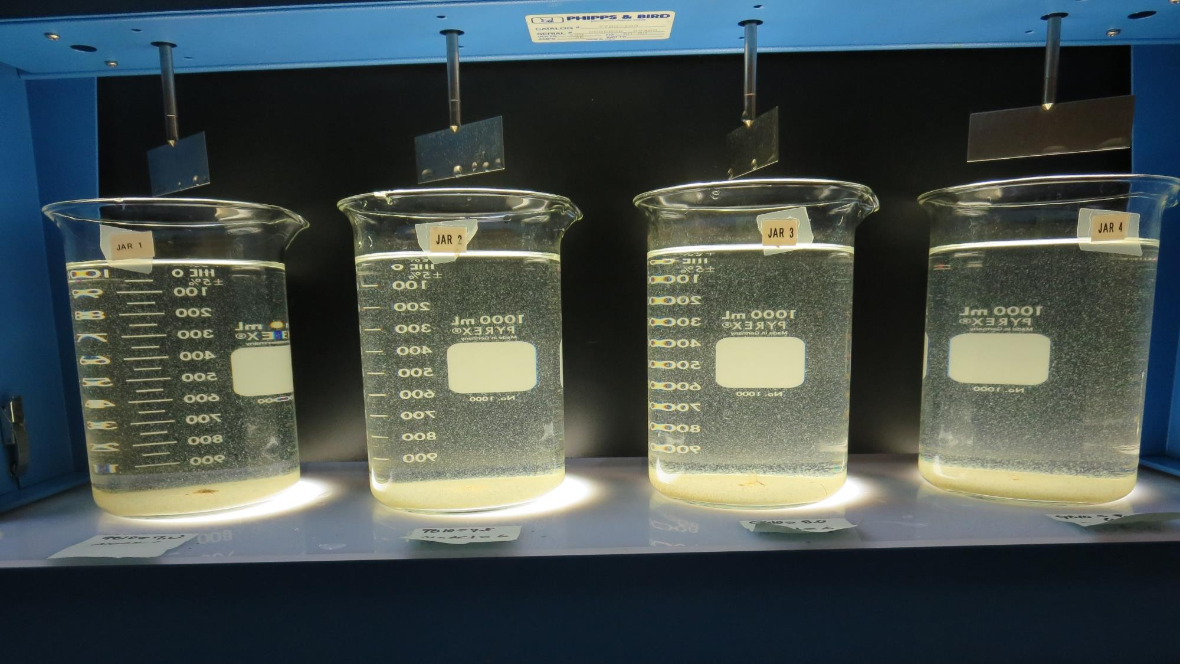
Jars 21-24: After 25-minutes of settling, settled water turbidity is taken
7.0 mg/L 9810
Filtrate 0.14 NTU
UVT: 96.8%
UVA: 0.014/cm
Settled: 5.3 NTU
7.5 mg/L 9810
Filtrate 0.19 NTU
UVT: 96.6%
UVA: 0.015/cm
Settled: 5.7 NTU
8.0 mg/L 9810
Filtrate 0.15 NTU
UVT: 96.9%
UVA: 0.014/cm
Settled: 5.5 NTU
8.5 mg/L 9810
Filtrate 0.14 NTU
UVT: 96.9%
UVA: 0.014/cm
Settled: 5.0 NTU

Slide 40
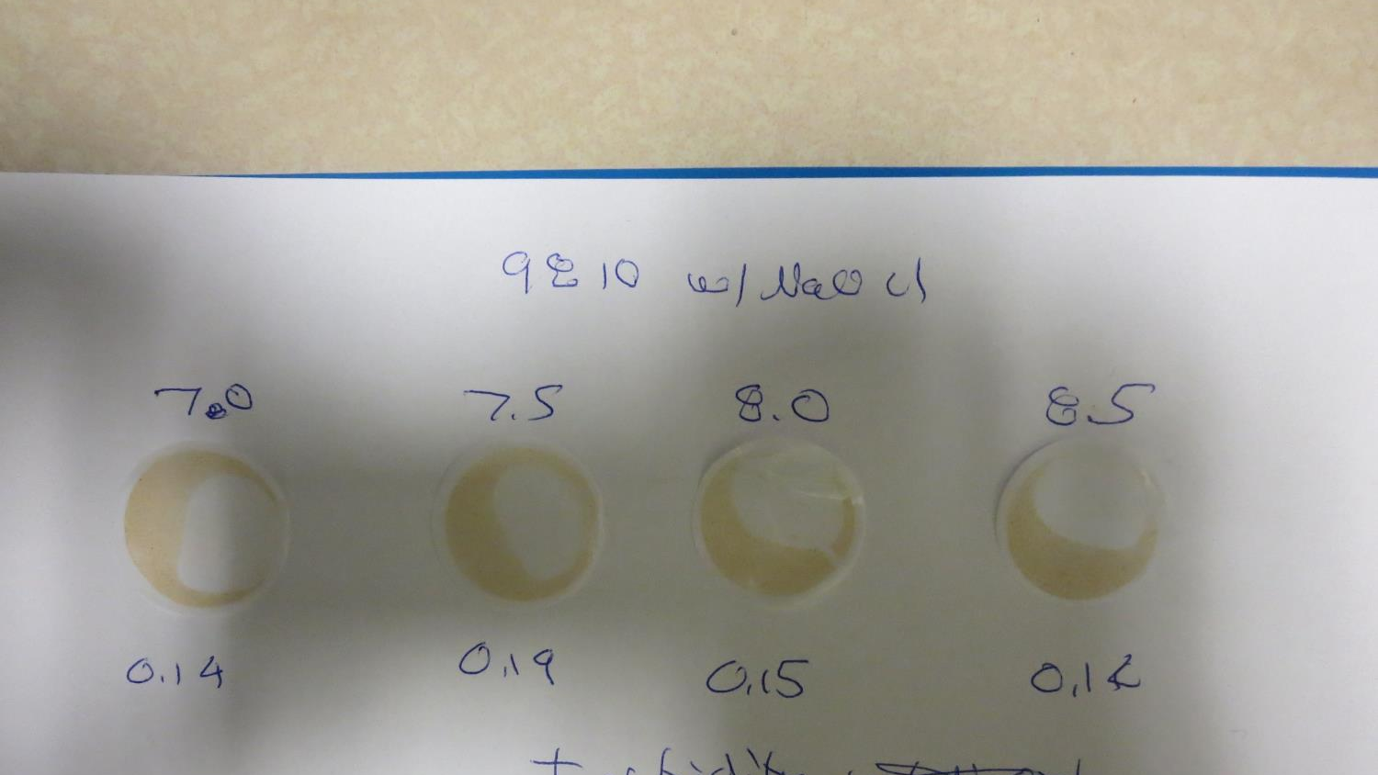
Visual of Filterability of Jars 21-24

Slide 41
Jar Testing for 1-Liter Jars:
Procedures for Most Treatment Plants
Fill jars with source water prior to coagulant injection and set paddle speed at 30 rpm
Add chemicals (i.e., NaOCl, primary coagulant, coagulant aid) to each jar
Flash mix for 15-30 seconds (200 rpm)
Slow mix for 5 minutes (20-30 rpm)
Settled for 5 minutes. Syringe 25 mL from each jar taken 1-inch below surface (25 mL/12 sec rate)
Filtered through 1.2 um isopore membrane into cuvette drip rate, 15 mL/(50-90 sec)
Measure filtrate turbidity, chlorine residual and %UVT/UVA
Measure settled water turbidity after 25 minutes of total setting
Record all data

Slide 42

Jar Test
Filterability Test Equipment
Turbidity Instrument
Syringe w/Luer-Lock Tip, 30 cc
(part#: 2225800, by Hach)
Swinnex Filter Holder, 25 mm (part#: SX0002500)
Isopore Membrane Filter, 1.2 um absolute
pore size,
Φ= 25 mm , thickness: 24 um,
hydrophilic polycarbonate membrane
(part #: RTTP02500)
Go to Sigma-Aldrich for laboratory supplies http://www.sigmaaldrich.com/united-states.html

Slide 43
Isopore Membrane Information
Categories | Information
trade name | Isopore
filter color | White
chemistry | Polycarbonate (PC)
water flow rate | Avg. 175 mL/min x cm² (typical results @ 10 psi)
media | Isopore®
wettability | Hydrophilic
porosity | 14.7%
pore size | 1.2 µm
bubble point at 23 °C | 1.0 bar, air with water
thickness | 24 µm
filter diameter (ø) | 25 mm
material size | polycarbonate, Hydrophilic, 1.2 µm, 25 mm, white, plain, 100

Slide 44
Isopore Membrane Background Information
The Isopore membrane is a polycarbonate, track-etched screen filter recommended for all analyses in which the sample is viewed on the surface of the membrane. The Isopore membrane is composed of polycarbonate film, which has a smooth, glass-like surface for clearer sample observation. The unique manufacturing process of the membrane ensures a precise pore diameter and a consistent pore size for accurate separation of samples by size. Matched-weight filters are not usually required because of low, constant tar and ash weights.
Features & Benefits:
Membrane structure retains particles on the surface, simplifying counting and analysis

Slide 45
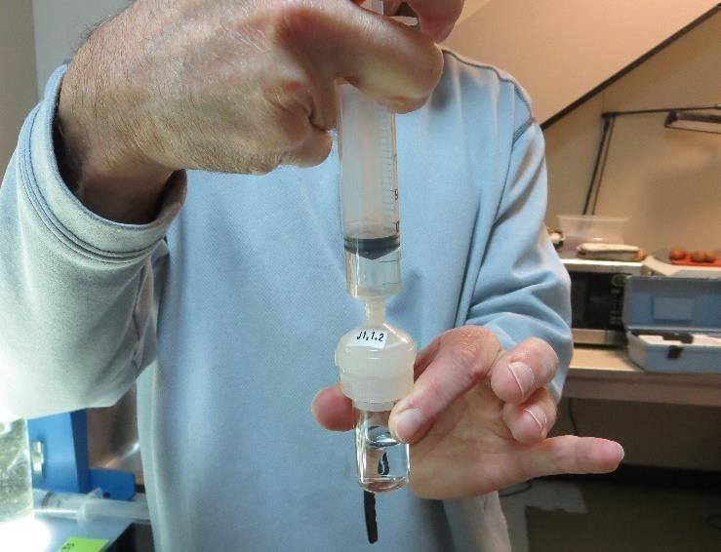

Jar Test - Filterability Test
Syringe ~ 25 mL from jar (after 5-minutes of settling)
Filter-to-waste 3-5 mL
Filter directly into clean cuvette
Measure turbidity
Note: Take several readings before recording final NTU results. Micro bubbles can adhere to glass causing false NTU readings. To remove bubbles, tilt cuvette up to 90 degrees.

Slide 46

Contact
Guy Schott, P.E.
State Water Resources Control Board
Division of Drinking Water
Santa Rosa, CA
Go to Stock Solution/Dose calculations/Jar Test Results for tools to download
www.waterboards.ca.gov/drinking_water/programs/districts/mendocino_district.html
Jar Testing Done Right training video: https://www.youtube.com/watch?v=aGByyxhelkI
Email: Guy Schott - Guy.Schott@waterboards.ca.gov
Office Number: 707-576-2732

