Slide 1
Gualala Community Services District
Wastewater Treatment Plant
Sonoma County, CA
Modal Contact Time (t_{modal})
Tracer Study #4
October 28, 2021
by Guy Schott, P.E.
Water Resources Control Board,
Division of Drinking Water
Guy.schott@waterboards.ca.gov
707-576-2732

Slide 2
Chlorine Contact - Pipeline
Pipeline volume: 21,500 gallons (4-ft Dia. x 229-feet length)
Manhole “C” + pre-piping volume: ~910 gallons
Manhole “B” volume: ~ 390 gallons
Total Contact Volume: 22,800 gallons
Pipeline L:D ratio: 57
Average treated water flows (Sea Ranch and Gualala): 95 gpm
2 x Orifice Pipelines: 1.5” PVC, 80-ft, 1/8” holes spaced 18 inches

Slide 3
Results
Test Date: October 28, 2021
Test by: Gualala Community Services District & Division of Drinking Water
Tracer Test Method: Slug-Dose using Fluoride
Total Volume (manholes and pipeline: 22,800 gallons (operating volume)
Average flow to Modal Contact Time: 95 gpm
HRT: 240 minutes (4.0 hours)
t_{modal}: 240 minutes (to peak fluoride concentration @ 95 gpm)
Modal Baffling Factor (t_{modal}/HRT): 1.0
Minimum chlorine residual to meet CT of 450 mg/L*min as 95 gpm: 1.9 mg/L Cl₂

Slide 4
Tracer Study – Overview 1
On October 28, 2021, a fourth tracer study was conducted at the Gualala CSD WWTP. This test was to evaluate the modal contact time for the underground 4-ft diameter concrete pipeline (229-ft) for a second orifice pipeline jetting system installed into Manhole B and pipeline. Each Manhole pipeline now has an 80-foot long, 1.5-in diameter PVC pipe with 1/8 orifices spaced 18-inches to promote mixing within the 21,500- gallon underground concrete pipeline.
The added jetting mixing system improved overall pipe mixing resulting in a modal contact time equal to the hydraulic residence time (HRT).

Slide 5
Tracer Study – Overview 2
Tracer Method: Slug-Dose
Injection Point of Tracer: Poured into filter overflow weir connected to 8-inch line
Sample Point: Pipeline outlet (Manhole “B”)
Tracer Analysis: Ion Selective Fluoride Probe
Sampler: Gualala CSD Operators
Analyses by: Guy Schott, Division of Drinking Water

Slide 6
Tracer Material Overview
Tracer Material: Hydrofluorosillicic Acid (H₂SiF₆)
Tracer Bulk Density: 10.3 lbs/gal
Tracer Product Strength: 24% as H₂SiF₆
Molecular Weight: 144.09 g/mole (H₂SiF₆)
Fluoride Concentration: 79.11% (144 g/mole)
H₂SiF₆ Tracer Added: ~750 mL
Fluoride mixed w/1.25 gal of water in bucket
Fluoride (F) Tracer Added: 174 g
Method of Injection: Slug-Dose (poured, < 20 sec)
Fluoride (F) mass recovered: 168.5 g (97%)

Slide 7
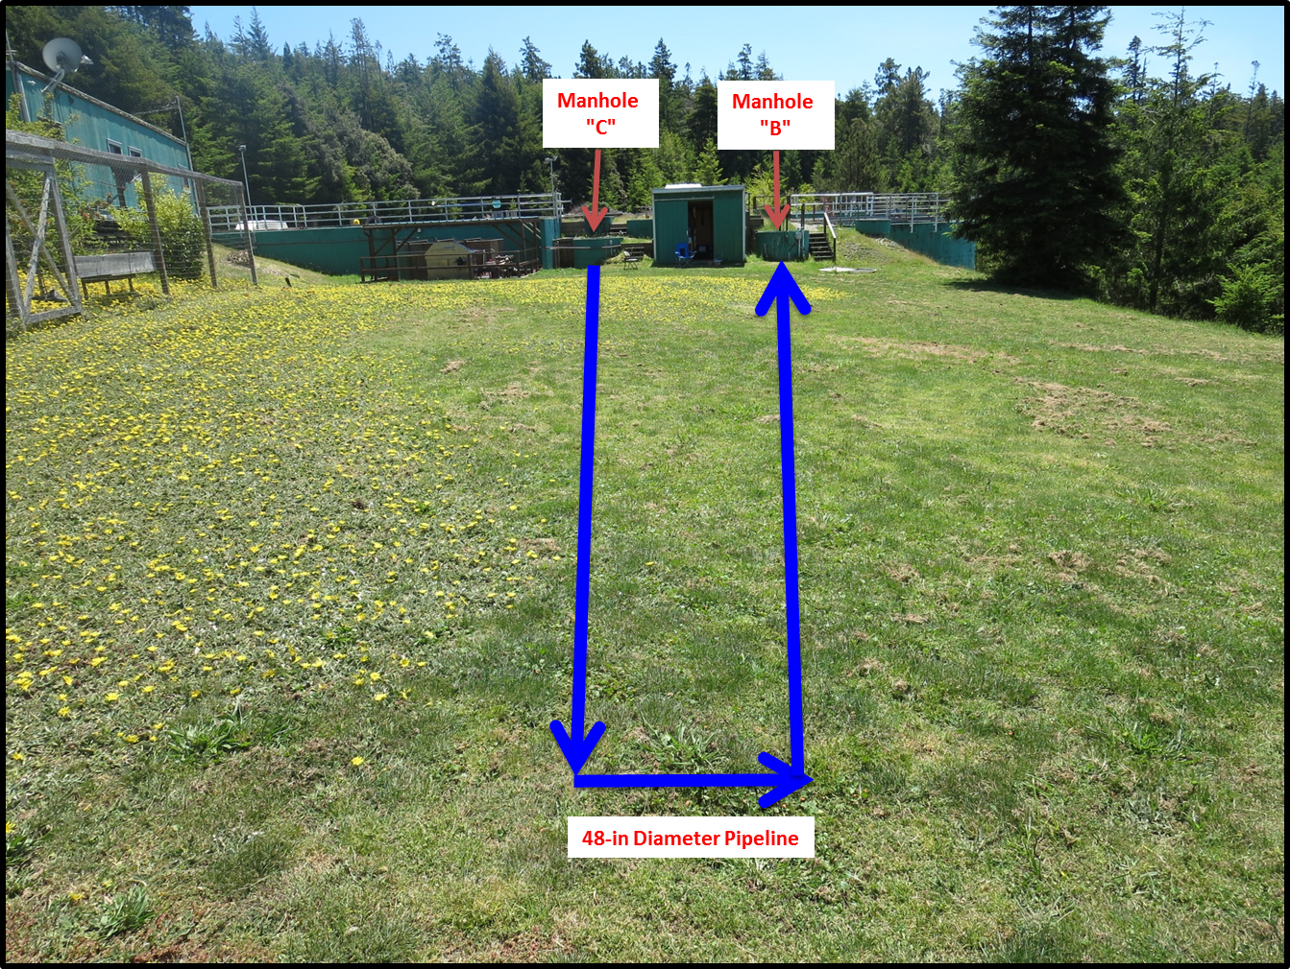
Pipeline contactor
Pipeline Contactor (21,500 gallons)
Added
Tracer
Tracer
Sampling

Slide 8
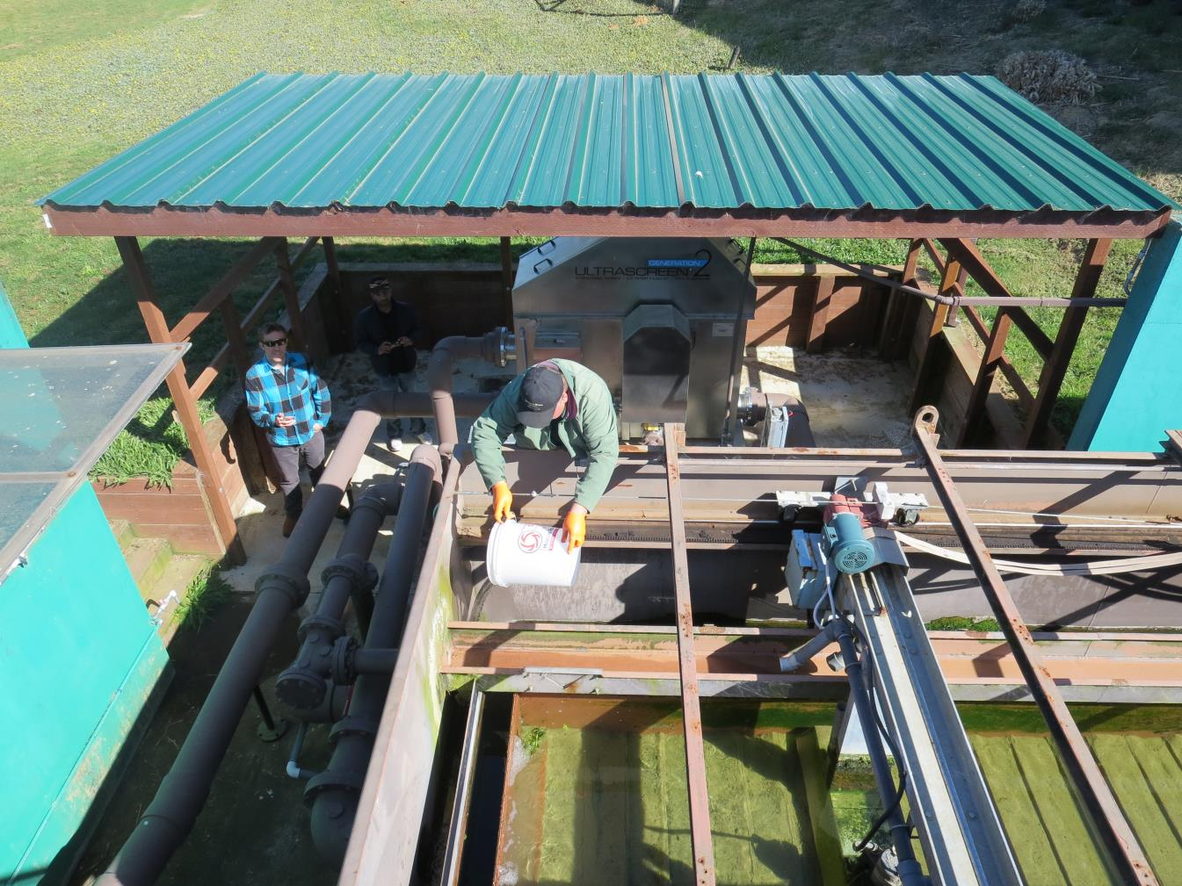
Tracer Slug Dose
Tracer Slug-Dose
Adding
Tracer

Slide 9
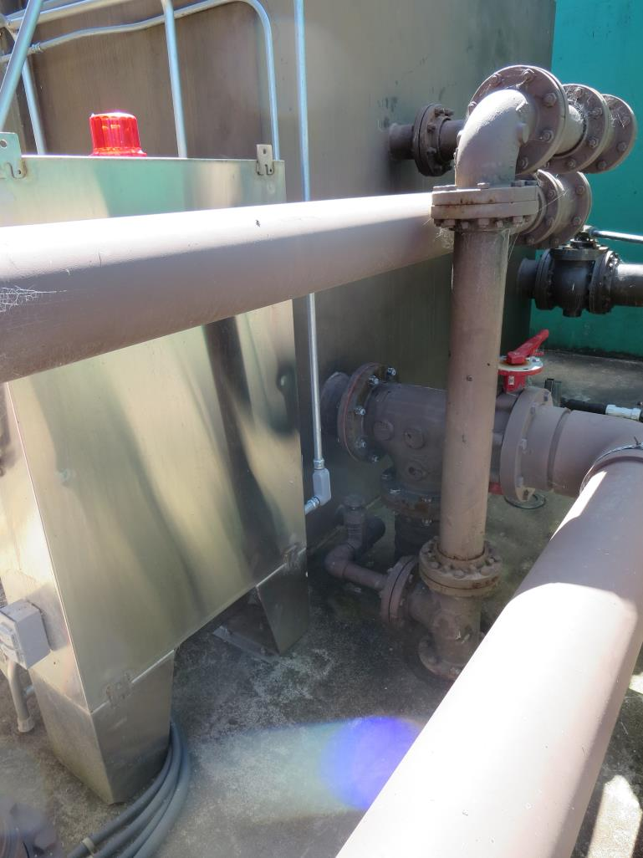
Hydraulic Mixing
Hydraulic Tracer Mixing
After tracer is poured into effluent filter trough, the mixed water flows into an 8-in line to Manhole “C”.

Slide 10
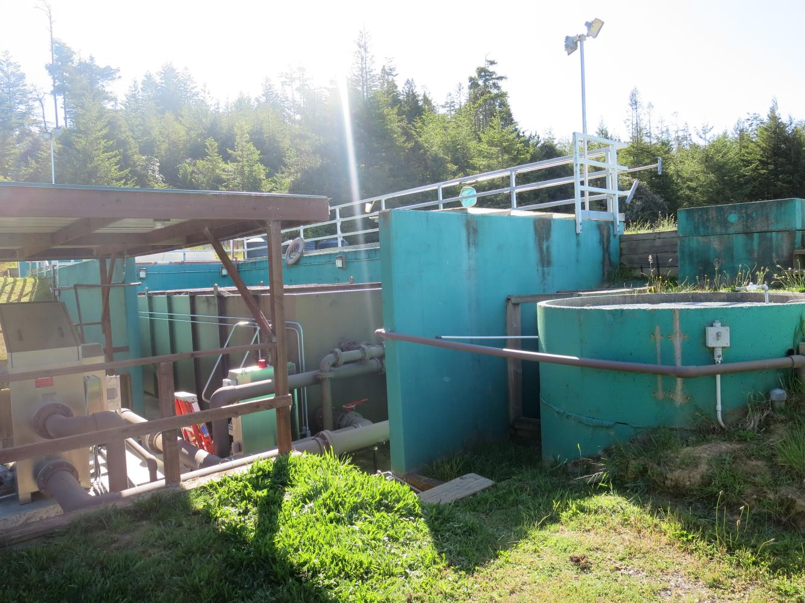
Pipeline Entry
Manhole “C” Entry to Pipeline
Manhole
“C”

Slide 11
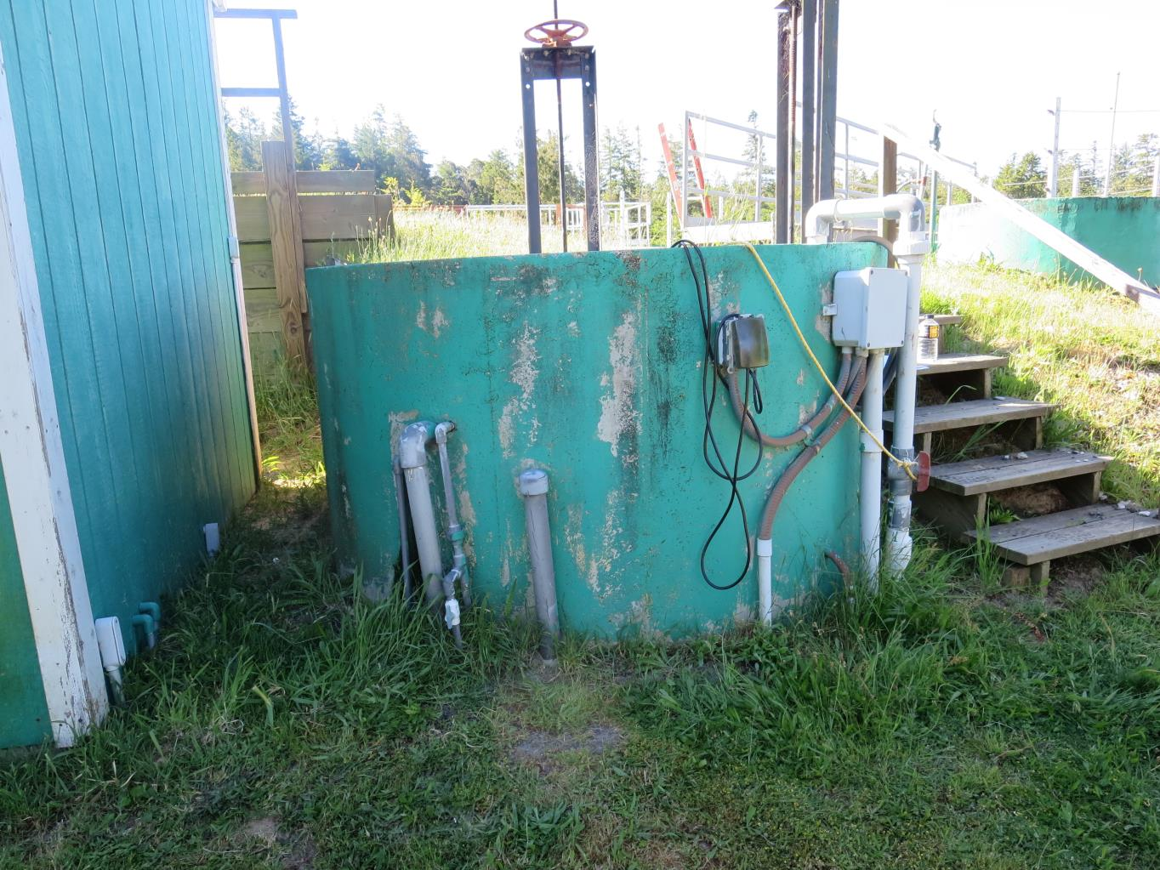
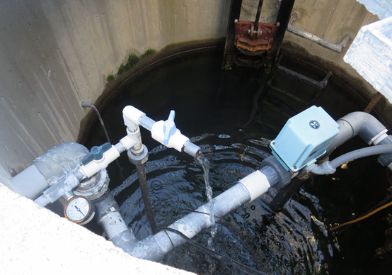
Manhole B and sample tap
Manhole “B” Pipeline Exit - Sample Station
Manhole
“B”
Sample Tap

Slide 12
Data Table

Slide 13
Slug dose curve
Modal Contact Time: 240 min; HRT: 240 min

Slide 14
F curve

Slide 15
Overall Results
1. Test Date: May 15, 2017
  No pipeline mixing
  Modal Baffling Factor: 0.24
2. Test Date: July 20, 2017
  No pipeline mixing
  Modal Baffling Factor: 0.18
3. Test Date: August 9, 2017
  Added pipeline mixing in Manhole C/pipeline
  Modal Baffling Factor: 0.62
4. Test Date: October 28, 2021
  Added second pipeline mixing in Manhole B/pipeline
  Modal Baffling Factor: 1.0

