Slide 1


Title
March 23-24, 2021

Slide 2
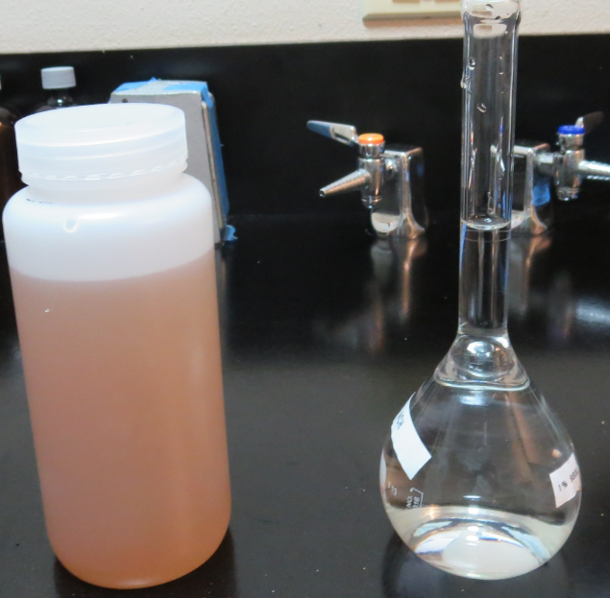
CA-NV AWWA
Operator Symposium
March 24, 2021
1. Coagulants/Identification 2. Stock Solution Prep
3. Dose Calculations
4. CT Concept
By
Guy Schott, P.E.

Slide 3
Common Inorganic Coagulants
Inorganic coagulants – Metal Salts
  [AL] Aluminum Sulfate, Al₂(SO₄)₃ * 14.3H₂O
  [AL] Aluminum Chlorohydrate (ACH), Al₂Cl(OH)₅
  [AL] Polyaluminum Chloride (PACl), Al_{n}Cl_{3n-m}(OH)_{m}
  [AL] Polyaluminum Chlorosulfate (PACS) , Al_{a}(OH)_{b}(Cl)_{c}(SO4)_{d}
  Ferric Chloride, FeCl₃
  Ferric Sulfate, Fe₂(SO₄)₃*8.8H₂0
  When inorganic coagulants hydrolyze, hydrogen ions (H⁺) are released that react with the alkalinity of the water.

Slide 4
%Basicity of a Coagulant
In the formation of PACl/PACS coagulants, some of the acid (H⁺) that would have been released is neutralized with base (OH⁻) when coagulant is manufactured. The degree to which the hydrogen ions that would be released by hydrolysis are preneutralized is known as the basicity of the product.
Example:
ACH, Al₂Cl(OH)₅; there are 5 moles of [OH] and 2 moles of [Al]
[OH]
[5]
Basicity, % =
X 100% =
X 100% = 83%
3[Al]
3[2]
This means that 83% of the formed hydrogen ions (H⁺) are pre-neutralized.

Slide 5
Alkalinity Consumption of Inorganic Coagulants
1 mg/L Aluminum base Coagulants
2.945 x [%Al₂O₃/100] x [1 - %Basicity/100] = x mg/L as CaCO₃
or
5.56 x [%Al⁺³/100] x [1 - %Basicity/100] = x mg/L as CaCO₃
1 mg/L of Coagulant | %Al₂O₃ | %Basicity | mg/L Alkalinity as CaCO₃ Reduced
Alum, Al₂(SO4)₃*14.3H₂0 | 8.2 | 0 | 2.945 x 8.2/100 x (1 - 0/100) = 0.241
Al₂(SO4)₃*14.3H₂0 (dry/hydrated) | 17 | 0 | 2.945 x 17/100 x (1 – 0/100) = 0.501
ACH, Al₂Cl(OH)₅ | 23.62 | 83 | 2.945 x 23.62/100 x (1 – 83/100) = 0.118
PACl, Al₁₀Cl₃(OH)₂₇ | 10.01 | 90 | 2.945 x 10.01/100 x (1 – 90/100) = 0.029
PACl, Al₅Cl₃(OH)₁₂ | 32.5 | 80 | 2.945 x 32.5/100 x (1 – 80/100) = 0.191
PACl, Al₁₀Cl₂₁(OH)₉ | 10.01 | 30 | 2.945 x 10.01/100 x (1 – 30/100) = 0.206
PACS, Al₂(OH)₃(Cl)(SO₄) | 10.01 | 50 | 2.945 x 10.01/100 x (1 – 50/100) = 0.147
Notes:
1 mg Al⁺³/26.9815 * 3 *100/2 = 5.56 as CaCO₃

Slide 6
Common Organic Coagulants
Organic coagulants are long-chained, medium to high-molecular-weight polymers (sticky) used for bridging floc, improve settleability, filterability, filter-run-time and organic reduction.
  [PY] Polyamine (max dose 5 mg/L as active PY)
  [pDADMAC] Polydialyldimethylammonium chloride (max dose 10 mg/L as active pDADMAC)
  [PC] Polyacrylamide, dry or emulsion (max dose 1 mg/L as active PC)
    Shelf-life 6-9 month as an emulsion; once mixed with water, use within 2-3 days.
    Shelf-life years for dry; once mixed with water, use within 7 days.

Slide 7
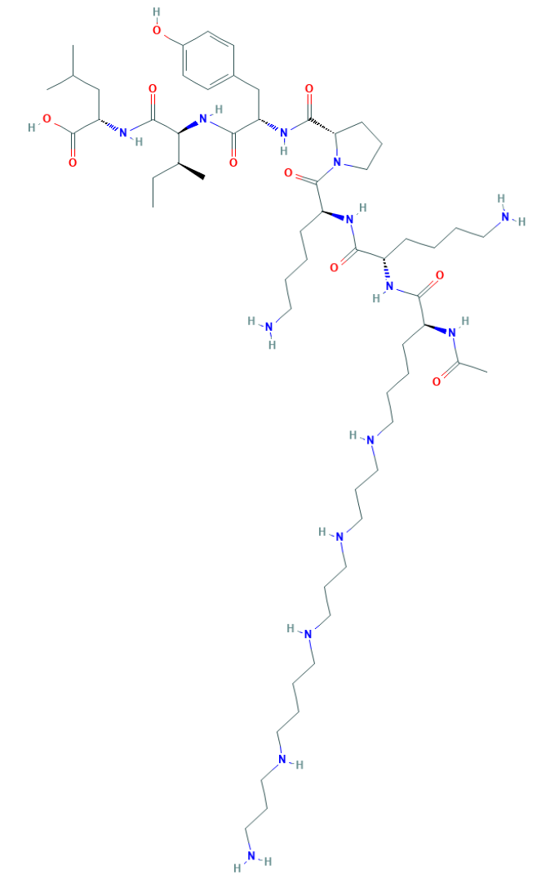
Polyamine
C₅₉H₁₀₈N₁₄O₁₀
MW: 1,173.6 g/mol

Slide 8
Diallyldimethylammonium chloride or
N-allyl-N,N-dimethylprop-2-en-1-aminium chloride pDADMAC
C₈H₁₆ClN
MW: 161.67 g/mol
Low to high viscosity
(LV, HV, VHV)
CH₃
CH₂
CH₂
CH
N
+
CH
CH₂
CH₂
CH₃
Cl⁻

Slide 9
Polyacrylamide
(C₃H₅NO)_{n}
Acrylamide
C₃H₅NO or
CH₂=CH-CONH₂
MW: 71.08 g/mol
Cationic to Anionic Charge
Acrylamide subunit (monomer) of Polyacrylamide
H
CH
N
CH₂
C
H
O
It increases the viscosity of water and facilitates the flocculation of particles present in water

Slide 10
Information on your Coagulant (C-102xyz)
Safety Data Sheet | Certificate of Analysis/Company | NSF Listing (Product #/ Name)
% Strength of Inorganic Coagulant (range) or no information | Manufacture of Chemical and Location | Name of Company, Manufacture of Chemical and Location
% Water (range) | %Al₂O₃, %Al, %Fe %H₂SO₄ (Acid Alum/Fe) | Inorganic & Organic Coagulants
% Trade Secret or Proprietary Compound | %Basicity? (ask vendor) Specific Gravity | Blended Coagulants
Specific Gravity (range) | Shipping Date/Lot# | Product Max Dose (mg/L)

Slide 11
NSF Certified Drinking Water Treatment Chemicals
Go to NSF Certified Drinking Water Treatment Chemicals website to determine coagulant type for selected chemical products.
  http://info.nsf.org/Certified/PwsChemicals/
Example headings listed in NSF for different products:
  [AL] Aluminum base coagulants; (inorganic)
  [PY] Polyamines; (organic)
  [Al] [PY] Blends; (inorganic/organic blends)
  Poly (Diallyldimethylammonium Chloride) (pDADMAC); (organic)
[AL, PY, pDADMAC, PC] NSF symbols for type of coagulants

Slide 12
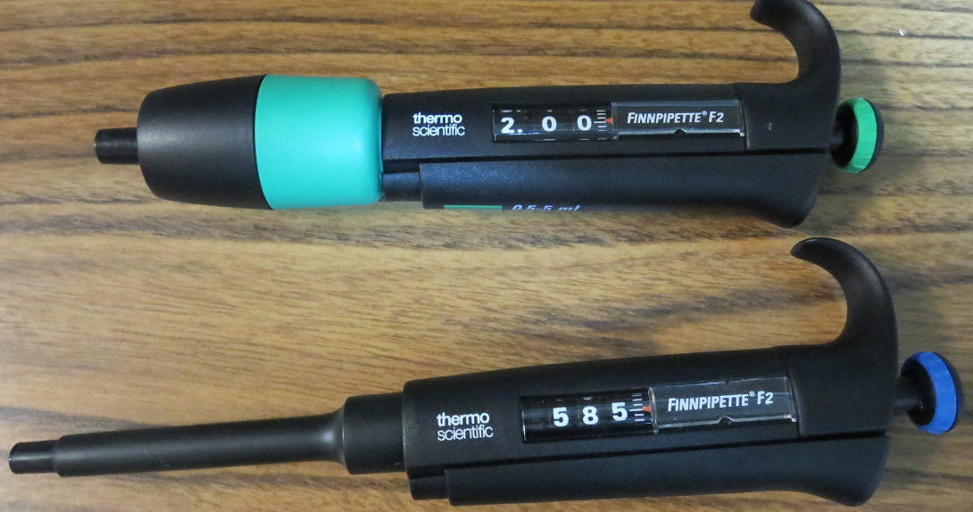
Stock Solution Preparation for Jar Testing
(V_{p}, mL) x (Product % Strength) x (SG_{p}) = (V_{s}, mL) x (Stock % Strength) x (SG_{s})
Pipettes (0.5 - 5 mL &
100 – 1000 uL)
Chemical
Product
Volumetric
Flask
Don’t use syringes

Slide 13
Stock Solution: % Strength for Jar Testing
1-Liter Jars | 2-Liters Jars
1% Solution by Weight: 1.0 mL = 10. mg chemical Injection into 1-liter jar 1.0 mL = 10. mg/L dose 0.1% Solution by Weight: 1.0 mL = 1.0 mg Injection into 1-liter jar 1.0 mL = 1.0 mg/L dose | 2% Solution by Weight: 1.0 mL = 20. mg chemical Injection into 2-liter jar 1.0 mL = 10. mg/L dose 0.2% Solution by Weight: 1.0 mL = 2.0 mg Injection into 2-liter jar 1.0 mL = 1.0 mg/L dose
1% solution strength = 1,000 g/1,000 mL x 0.01 = 10 g/1000 mL = 10,000 mg/1,000 mL
= 10 mg/mL; 1 mL = 10 mg

Slide 14
Stock Solution Preparation/Calculation
(V_{p}, mL) x (Product % Strength) x (SG_{p}) = (V_{s}, mL) x (Stock % Strength) x (SG_{s})
Solve
(v_{p}, mL) x (100% strength) x (1.34) = (200 mL) x (1.0% strength) x (1.0)
(Assume SG ~ 1.0 for <3% strengths)
Pipettes
V_{p} (mL) = (200 mL)(1.0%)(1) = 1.5 mL
(100%)(1.34)
100%
Product
SG: 1.34
1.0% Sol.
200 mL
SG: 1.

Slide 15
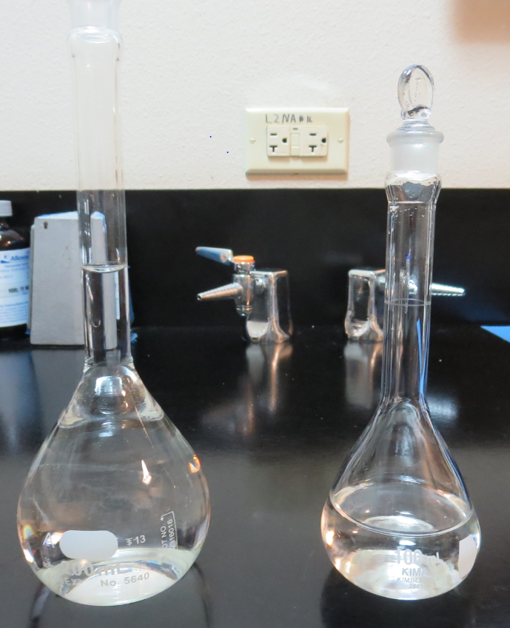
Further Dilution/Calculation (1.0% to 0.1%)
(V₁, mL) x (Stock1 % Strength) x (SG₁) = (V₂, mL) x (Stock2 % Strength) x (SG₂)
Solve
(v₁, mL) x (1.0% strength) x (1.0) = (100 mL) x (0.10% strength) x (1)
1.0% Sol.
200 mL
SG: 1.
0.10% Sol.
100 mL
SG: 1.
Pipettes (0.5 - 5 mL &
100 – 1000 uL)
V₂ (mL) = (100 mL)(0.10%)(1) = 10. mL
(1.0%)(1)
Don’t use syringes

Slide 16
Chemical Dose Setup/Calculations
Chemical Dose (mg/L) = =
20 mg
x-Vol (x mass)
1-liter
H₂O
1-liter
H₂O
or
mass
20 mg
vol
L
vol
Convert “vol” to mass chemical
L

Slide 17
Chemical Dose Setup/Calculation
Chemical Feed Rate (vol/time = mass/time)
Chemical Dose (mg/L) = =
Chemical feed rate: mL/min, L/min, L/day, gal/hr, gal/day, lbs/day
Flow rate: gallons per min (gpm), million gallons per day (MGD), L/min
Plant Flow
(vol/time)
mass
Chemical Feed Rate (vol/time or mass/time )
vol
Flow Rate (vol/time)

Slide 18
Dimensional Analysis – For Solving Dose Problems
Dimensional Analysis – a method used to convert one unit to a different unit by using conversion factors.
1 Gallon = 3.785 Liters
1 Liter = 1,000 mL
1 Day = 1,440 minutes
1 gram = 1,000 mg
1 lb = 454 grams (g) = 454,000 mg
1 mL (water) = 1 g = 1,000 mg
1 gallon (water) = 8.337 lbs
Specific gravity (SG): Relative density, which is the ratio of the density of a chemical product to that of a standard substance (water).

Slide 19
Chemical Dose Setup/Calculation – Ex1
Chemical Feed Rate 56.5 mL/min, injected as neat.
SG = 1.34, 100% strength wt/wt as product (CC-9805)
Chemical Dose (mg/L) = =
=
Chemical Dose (mg/L) = 40 mg/L as product, CC-9805
Note: Dose reported as Product: Accounts for 100% (water, inorganic, organic coagulants).
Plant Flow
500 gpm
56.5 mL/min x 1000 mg/mL x 1.34 x 1
Chemical Feed Rate
500 gal/min x 3.785 L/gal
Flow Rate
56.5 mL x 1340 mg/mL
1892.5 L

Slide 20
Chemical Dose Setup/Calculation – Ex2
Chemical Feed Rate 56.5 mL/min,
SG = 1.34, 48.5% strength wt/wt as active (Alum)
Chemical Dose (mg/L) = =
Chemical Dose (mg/L) = 19.4 mg/L as Alum (dry)
Note: Dose reported as Active: Only accounts for the designated active substance within the product (i.e., hydrated Alum and FeCl₃).
Plant Flow
500 gpm
56.5 mL/min x 1000 mg/mL x 1.34 x 0.485
56.5 mL x 649.9 mg/mL
500 gal/min x 3.785 L/gal
1892.5 L

Slide 21
Chemical Dose Setup/Calculation – Ex3
Chemical Feed Rate 56.5 mL/min,
SG = 1.34, 48.5% strength wt/wt as active (Alum)
Chemical Dose (mg/L) =
Chemical Dose (mg/L) = =
Chemical Dose (mg/L) = 19.4 mg/L as Alum (dry)
Plant Flow
0.72 MGD (MG/day)
56.5 mL/min x 1000 mg/mL x 1.34 x 0.485
0.72 MG/day x 1 day/1440 min x 1,000,000 gal/MG x 3.785 L/gal
56.5 mL/min x 1000 mg/mL x 1.34 x 0.485
56.5 mL x 649.9 mg/mL
500 gal/min x 3.785 L/gal
1892.5 L

Slide 22
Chemical Dose Setup/Calculation – Ex4
Chemical Feed Rate 21.5 gal/day,
SG = 1.34, 48.5% strength wt/wt as active (Alum)
Chemical Dose (mg/L) =
Chemical Dose (mg/L) = =
Chemical Dose (mg/L) = 19.4 mg/L as Alum (dry)
Plant Flow
500 gpm
21.5 gal/day x 1 day/1440 min x 3.785 L/gal x 1000 mL/L x 1000 mg/mL x 1.34 x 0.485
500 gal/min x 3.785 L/gal
56.5 mL/min x 1000 mg/mL x 1.34 x 0.485
56.5 mL x 649.9 mg/mL
500 gal/min x 3.785 L/gal
1892.5 L

Slide 23
Chemical Dose Setup/Calculation – Ex5
Chemical Feed Rate
10 lbs./day, Chlorine (gas)
Chemical Dose (mg/L) =
Chemical Dose (mg/L) =
Chemical Dose (mg/L) = 1.67 mg/L as Cl₂
Plant Flow
500 gpm
10 lbs./day x 1 day/1,440 min x 454,000 mg/lb.
500 gal/min x 3.785 L/gal
3,153 mg
1,892.5 L

Slide 24
Chemical Dose Setup/Calculation – Ex6
Chemical Feed Rate – injected as diluted
30 mL/min, SG = 1.13, 8% strength NaOCl
Chemical Dose (mg/L) =
Chemical Dose (mg/L) = 1.52 mg/L as NaOCl
Chemical Dose (mg/L) = 1.52 mg/L as NaOCl x 0.95 Cl₂/NaOCl = 1.44 mg/L as Cl₂
Plant Flow
500 gpm
30 mL/min x 1000 mg/mL x 1.13 x 0.08
500 gal/min x 3.785 L/gal

Slide 25
Chemical Feed Rate Setup/Calculation – Ex7
Based on jar testing, the plant dose is to be set at 50 mg/L. What is the chemical feed rate setting (mL/min)?
Plant flow is 600 gpm.
Chemical characteristics: SG = 1.34, 48% strength wt/wt as Alum
50 mg/L = ; Solve for mL/min (algebra)
mL/min = = =
Chemical Feed Rate (mL/min) = 177 mL/min as Alum
Plant Flow
600 gpm
? mL/min x 1000 mg/mL x 1.34 x 0.48
600 gal/min x 3.785 L/gal
50 mg/L x 600 gal/min x 3.785 L/gal
113,550 mg/min
113,550 mL/min
1000 mg/mL x 1.34 x 0.48
643 mg/mL
643

Slide 26
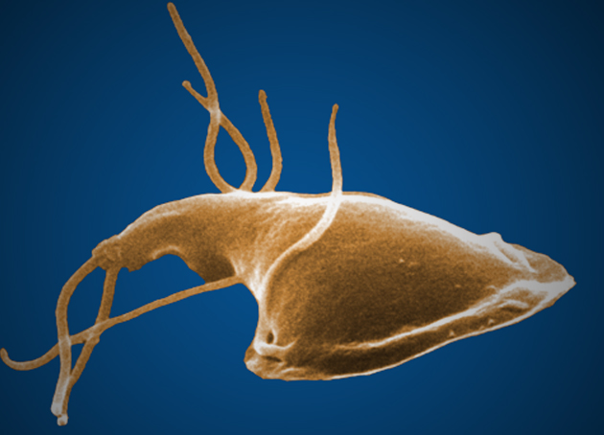
CT – Concept
It’s the delivered disinfection dose to pathogens
  Pathogens: Giardia cyst, viruses, Cryptosporidium
  CT
  “C” is the disinfection residual (mg/L)
  “T” is the disinfection exposure or contact time (minutes)
  C x T = mg/L * min, delivered dose to pathogen
Duty of Operator/Engineer: To ensure the disinfection process provides adequate CT (delivered dose) for pathogen inactivation.
CT values are lookup in EPA CT tables (temperature, pH, residual) to determine log inactivation of selected pathogen.

Slide 27
CT – Delivered Disinfection Dose
The disinfection residual “C” is measured before the first water customer via grab sampling or online monitoring.
More complicated parameter to quantify is the disinfection exposure time “T”.

Slide 28
Water Age Distribution – Leaving Clearwell

Slide 29
Age of Water in a Clearwell (Reactor)
The volume of water entering the vessel can be broken down into fluid elements.
Each of those fluid elements can have different flow paths through the reactor.
Depending on the reactor design, water temperature and mixing energy, some fluid elements can take the shortest flow path from the inlet to outlet while other elements take longer routes.

Slide 30
What Percent of Water Age is Used?
Environmental Protection Agency (EPA) decided that the time it takes for the first 10% of the total fluid elements entering the vessel to exit the vessel will be used as the disinfection compliant exposure time.
This value is called the T₁₀ value that has units of minutes.
The rest of water elements (90%) will have a water age greater than T₁₀.

Slide 31
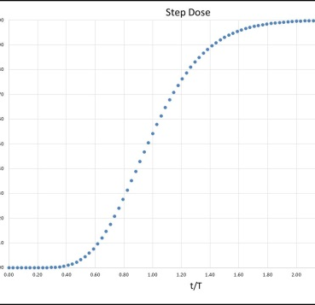
T₁₀ is Determined via Tracer Study
The disinfectant exposure time at T₁₀ is determined by conducting a tracer study.
A non-reactive tracer is added to the water in the same vicinity where the disinfectant is applied.
You may think of each fluid element tagged with a measurable non-decaying tracer marker.
As the fluid elements exits the reactor vessel, the markers are measured.

Slide 32
Baffling Factor (BF)
Determined from Tracer Study or Estimated
Baffling factor or short-circuiting factor:
  BF = T₁₀/ HRT
    where HRT: Operating Volume divided by Flow leaving reactor
Once BF is determined, it’s applied to the operations of the reactor for determining the disinfectant exposure time (T₁₀).
Example:
  Clearwell operating volume: 100,000 gallons
  Exit flow: 600 gpm
  HRT: 100,000 gal/600 gpm = 167 minutes
  BF: 0.3 (from tracer study or assigned by State)
  Calculated disinfection exposure time:
  T₁₀ = HRT x BF = 167 minutes × 0.3 = 50 minutes

Slide 33
Log Inactivation from CT
Once T₁₀ value is determined from a tracer study, “baffling factor (BF)” is calculated and applied to the daily operations of the disinfection CT reactor tank.
Daily CT values are looked up into EPA CT tables to determine log inactivation for selected pathogen.
If Clearwell chlorine residual is 1.2 mg/L and T₁₀ is 50 minutes
CT₁₀: 1.2 mg/L x 50 min = 60 mg/L * min (lookup in EPA CT tables)

Slide 34

Contact and Links
Guy Schott, P.E.
State Water Resources Control Board
Division of Drinking Water
Santa Rosa, CA
Go to Jar Test Results/Chemical Dosages/Stock Solution for tools to download
www.waterboards.ca.gov/drinking_water/programs/districts/mendocino_district.html
Email: Guy Schott - Guy.Schott@waterboards.ca.gov
Office Number: 707-576-2732

