Slide 1
City of Fairfield
Solano County, CA
Contact Time (t₁₀)
Tracer Study
May 8, 2017
by Guy Schott, P.E.
Amy Little, P.E.
Water Resources Control Board,
Division of Drinking Water
Guy.schott@waterboards.ca.gov
707-576-2732

Slide 2
Chlorine Contact Basin - Clearwell
Pipeline volume: 9,400 gallons (100-ft linear, 4-Diam.)
Influent weir & channel volume: 8,528 gallons
Clearwell basin volume/ft: 10,800 gal/ft
Total working volume during tracer study: 206,960 gallons

Slide 3
Final Results
Test Date: May 8, 2017
Test by: Water Resources Control Board, Division of Drinking Water
Tracer Test Method: Step-Dose using Fluoride
Clearwell Flow (inlet/outlet): 11 MGD (7,639 gpm)
Clearwell Operating Water Level: 17.5 feet
Operating Volume (Pipe, Weir, Clearwell): 206,960 gallons
HRT: 27.1 minutes
t₁₀: 8.6 minutes
Baffling Factor: 0.32 (t₁₀/HRT)

Slide 4
Tracer Study – Overview 1
A tracer study was conducted at the City of Fairfield, Public Works Waterman WTP to determine the “t₁₀” disinfection contact time and baffling factor for the combined pipeline, influent weir and concrete-squared clearwell. The “t₁₀” is the time is takes for 10% of the added tracer mass to exit the reactor. The baffling factor is t₁₀/HRT where HRT is the hydraulic residence time of the clearwell during the time of the tracer study.

Slide 5
Tracer Study – Overview 2
Tracer Method: Step-Dose
Injection Point: Combined Filter Effluent (CFE) 4-ft Dia. pipeline to weir channel
Sample Points: Influence weir channel and discharge side of clearwell from 4-ft Dia. pipeline
Tracer Analysis: Ion Selective Fluoride Probe
Sampler: Amy Little
Analysis by: Guy Schott

Slide 6
Tracer Material Overview
Tracer Material: Hydrofluorosillicic Acid (H₂SiF₆)
Tracer Bulk Density: 10.13 lbs/gal
Tracer Product Strength: 24.07% as H₂SiF₆
Molecular Weight: 144.09 g/mole (H₂SiF₆)
Fluoride Concentration: 79.11% (144 g/mole)
H₂SiF₆ Tracer Feed Rate: ~425 mL/min
Flow: 11 MGD (7,639 gpm)
Tracer Dose: 4.03 mg/L as F
Method of Injection: Steady-State.

Slide 7
Tracer Field Results
Flow – 11 MGD (7,639 gpm); 210,000 gallon Clearwell
HRT: 27.1 minutes
Tracer Dose– 4.03 mg/L as F
t₁₀: 8.6 minutes
Total working volume: 206,960 gallons @ 17.5 ft operating level
Calculated baffling factor: 0.32 t₁₀/HRT

Slide 8
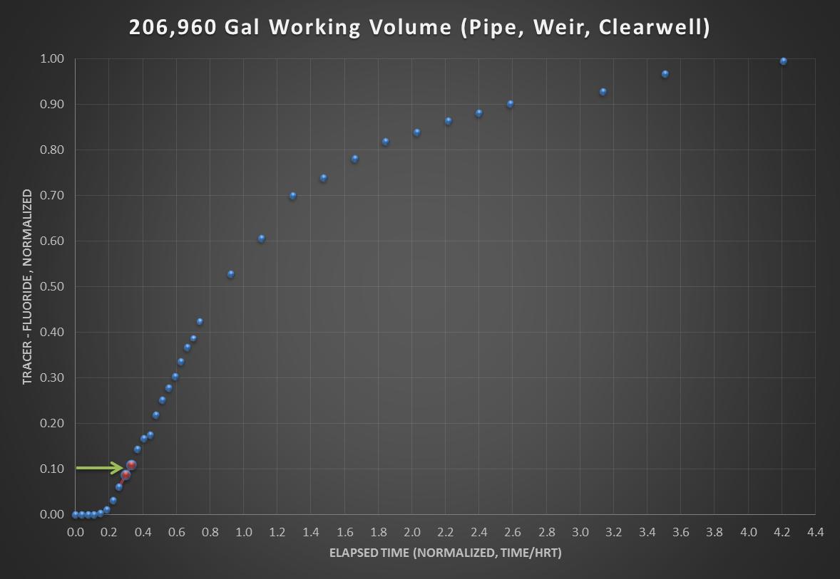
Working Volume: 206,960 gallons
Average Flow: 11 MGD (7,639 gpm)
Clearwell Water Level: 17.5 ft
HRT: 27.1 minutes
t₁₀: 8.6 minutes
Baffling factor 0.32 (t₁₀/HRT)

Slide 9
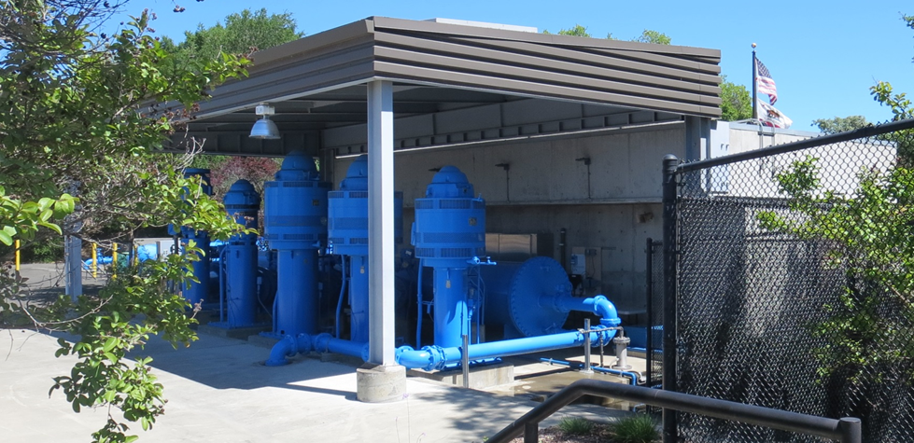
Clearwell and Effluent Pumps
270,000 gallon (max) clearwell - underground

Slide 10
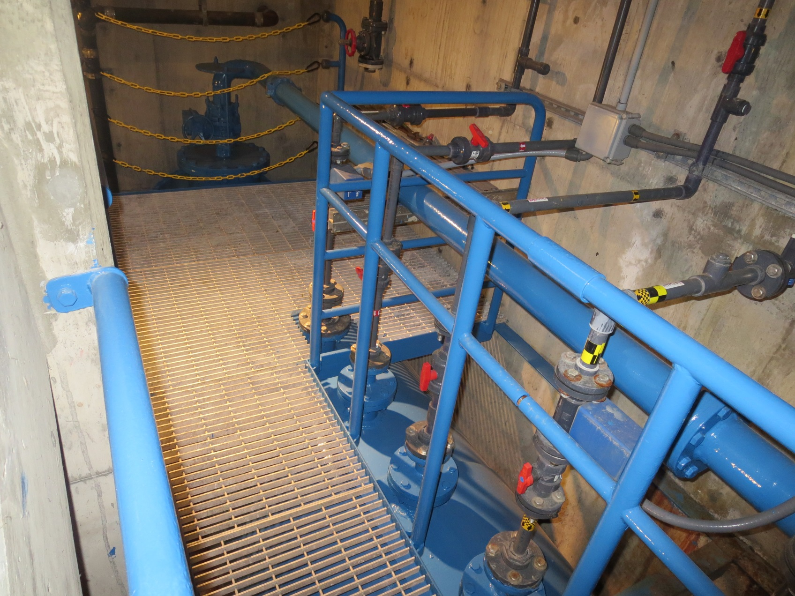
Injection Points before Clearwell
Fluoride
Caustic
NaOCl

