Slide 1
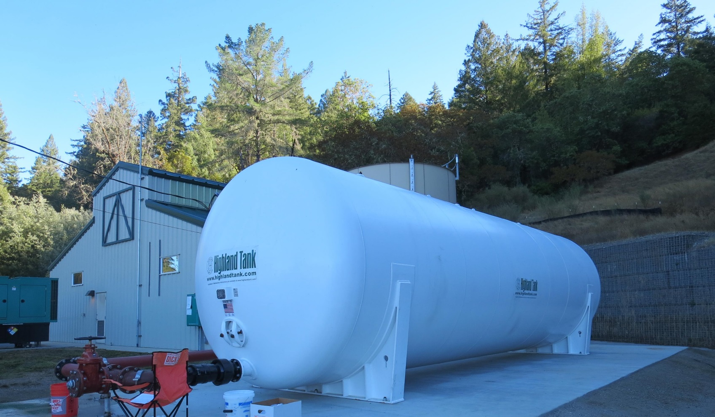
Garberville Sanitary District
CA1210008
Tracer Study
October 30-31, 2018
Tracer Study:
Reactor: Pressure Vessel
Volume: 20,000 Gallons
Diameter: 10 ft
Length: 36 ft
Baffled Tank (over/under)
Inlet/Outlet Full Perforated Baffles
Performed by:
Guy Schott, P.E.
CA Division of Drinking Water

Slide 2
Table of Content
Summary of Tracer Results
Reactor Design
Tracer Sample Locations
Graph 1: Slug-Dose Curve
Graph 2: Normalized Slug-Dose Curve to F-Curve
Graph 3: Modified Step-Dose Curve
Graph 4: Normalized Modified Step-Dose Curve to F-Curve
Purpose of a Tracer Test
Disinfection Exposure Time of Fluid in Vessel for Determining Ct₁₀
Ct₁₀ Value
Baffling Factor (BF)
Tracer Test Methods
Method of Analysis and Equipment

Slide 3
Garberville SD
Tracer Test Results
Slug-Dose Method
Test Date: 9/30/18
*Baffling Factor (t₁₀/HRT): 0.45
Modal Baffling Factor (t_{mod}/HRT): 0.67
t₅₀/HRT: 0.84
Morril Index, t₉₀/t₁₀: 3.37
Average Flow: 210 gpm
HRT: 95 minutes
t₁₀: 43 minutes
t₅₀: 80 minutes
t₉₀: 145 minutes
Tracer Added: Fluoride (126.5 grams)
Tracer Recovered: Fluoride (120.3 grams)
Sample Frequency Outlet:
  0 – 10 min (5 min)
  10 – 130 min (2 min)
  130 – 160 min (3 min)
  160 – 210 min (5 min)
  210 – 330 min (10 min)
Modified Step-Dose
Test Date: 9/31/18
Baffling Factor (t₁₀/HRT): 0.49
Average Flow: 213 gpm
HRT: 94 minutes
t₁₀: 46.5 minutes
Tracer: Fluoride (2.72 mg/L)
Sample Frequency Inlet:
  5 gallon bucket (fill duration 3-5 min)
  8 samples (10 – 59 min range)
Sample Frequency Outlet:
  0 – 10 min (5 min)
  10 – 6 min (2 min)
  36 – 52 min (1 min)
*Note: Calculations are based on tracer mass recovery.
HRT: Hydraulic Residence Time (reactor volume/flow)

Slide 4
Horizontal Pressure Clearwell Design

Slide 5
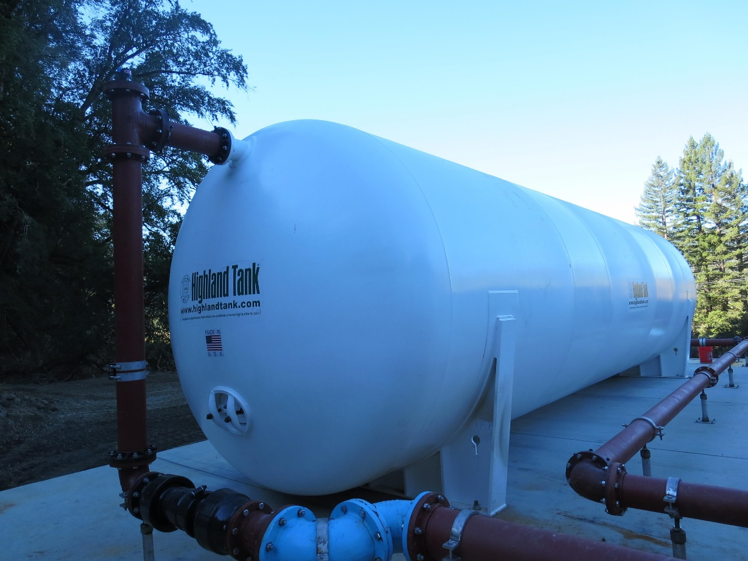
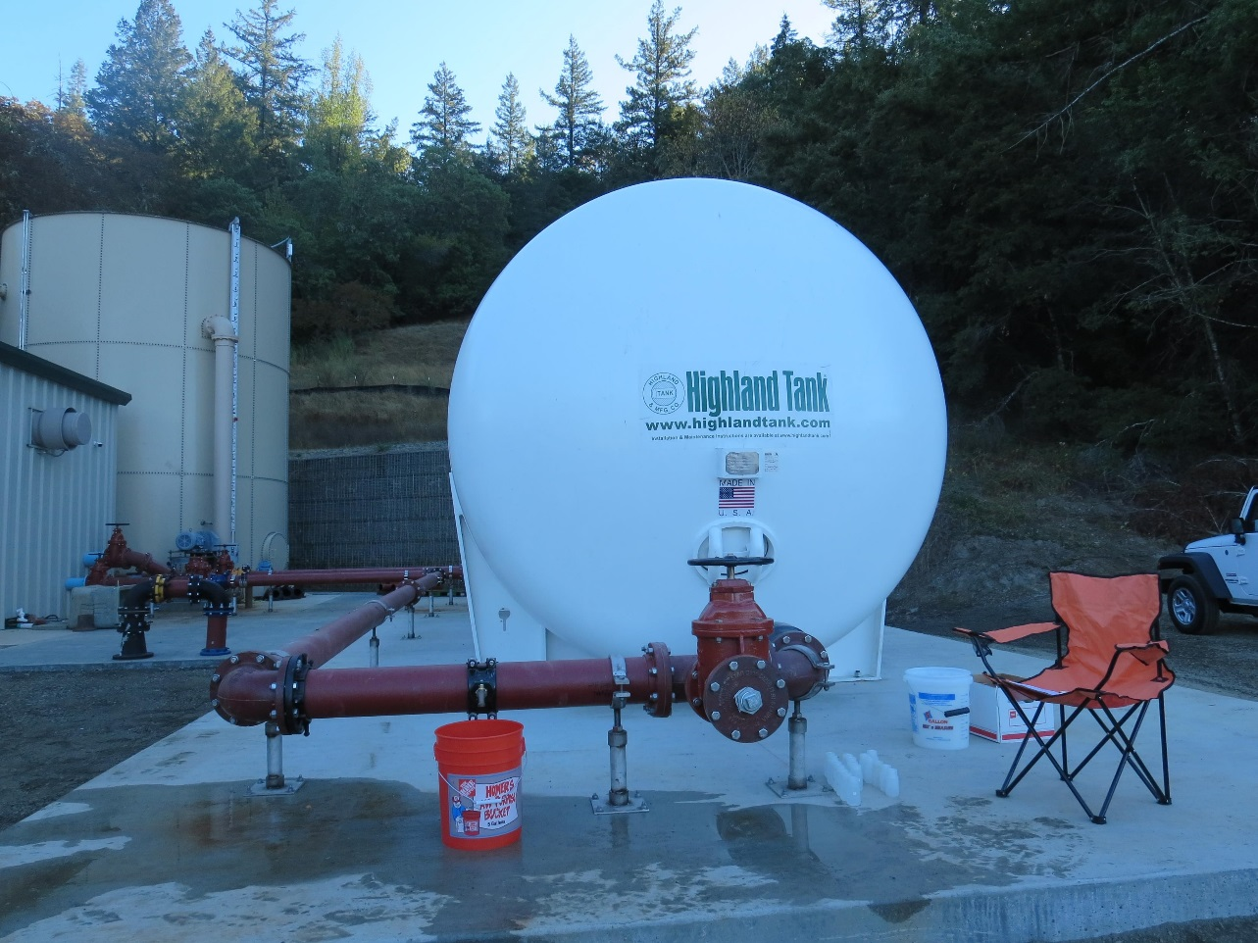
Tracer Sample Locations
Inlet
Outlet

Slide 6
Garberville SD – Slug-Dose Curve
t₁₀: 43 min
Baffling Factor = 0.45
HRT: 95 min

Slide 7
Garberville SD – Slug-Dose Curve
Normalized to F-Curve
Baffling Factor = 0.45

Slide 8
Garberville SD – Modified Step-Dose Curve
Dosage: 2.72 mg/L
0.27 mg/L at t₁₀
t₁₀: 46.5 min
HRT: 94 min
t₁₀/HRT = 0.49

Slide 9
Garberville SD – Modified Step-Dose Curve Normalized to F-Curve
Baffling Factor = 0.49

Slide 10
Purpose a Tracer Study?
To determine the hydraulic efficiency or disinfectant exposure time of water through one or more reactors.
The addition of known quantities of a nonreactive chemical (tracer) is added in the form of a pulse (slug) or step-input.
The time of travel or disinfectant exposure time through the reactor is related to:
  Flow rate
  Reactor water volume
  Water Depth
  Reactor configuration

Slide 11
Disinfection Exposure Time of Fluid in Vessel for Determining Ct₁₀
“C” is the disinfectant residual (mg/L) at the point of inactivation compliance.
The disinfection exposure time of water used for Ct₁₀ calculation is the time (t₁₀) it takes for 10 percent of the water entering the reactor to exit the reactor.
To determine this, a marker (nonreactive tracer) is introduced into the water and is monitored leaving the reactor.
Example: 1.0 Kg of tracer is slug-dose; t₁₀ is that time when 0.1 Kg of tracer material (10%) has exit the reactor.

Slide 12
Ct₁₀ Value
- Log inactivation is based on the Delivered Dose, “Ct₁₀”
  “C” is the disinfectant residual (mg/L)
  “t₁₀” is the exposure or contact time (minutes)
  Multiply them:
C • t₁₀ = mg/L • min (delivered dose)
The calculated Ct₁₀ value is looked up in EPA Ct tables to determine the log inactivation based on specific monitoring parameters (pH, disinfectant residual and/or temperature).

Slide 13
Baffling Factor (BF)
Baffling factor or short-circuiting factor:
  Determined from tracer study or estimated
  BF = t₁₀/ HRT from tracer study
  HRT (hydraulic residence time) = reactor volume divided by reactor flow
Once the BF is determined, then it is applied to the operations of the reactor for determining the disinfectant exposure time.
Example:
  Clearwell operating volume: 20,000 gallons
  Exit flow: 200 gpm
  BF: 0.44, from tracer study
  Calculated contact or disinfection exposure time:
    20,000 gal ÷ 200 gpm × 0.44 = 44 minutes = t₁₀

Slide 14
Test Methods
Slug-Dose or Pulse-Input Method
Adding the entire amount of tracer at the beginning of test. The reactor outlet tracer concentration is monitored for 3-4 HRT to determine mass recovery and the time (t₁₀) it takes for 10% of the tracer mass to exit the reactor.
Modified Step-Dose Method
It is a continue feed of tracer at constant rate and plant flow throughout the duration of the test. The “Step-Dose” test is run to 3-4 HRT to achieve reactor outlet steady-state tracer concentration. The time “t₁₀” is determined when 10% of the tracer dose concentration has exist the reactor. The “Modified Step-Dose” test allows the test to be completed in less than 1 HRT by physical measurements of the tracer inlet flow concentration to verify dosage.

Slide 15
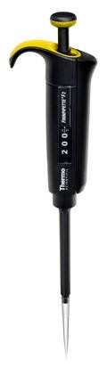
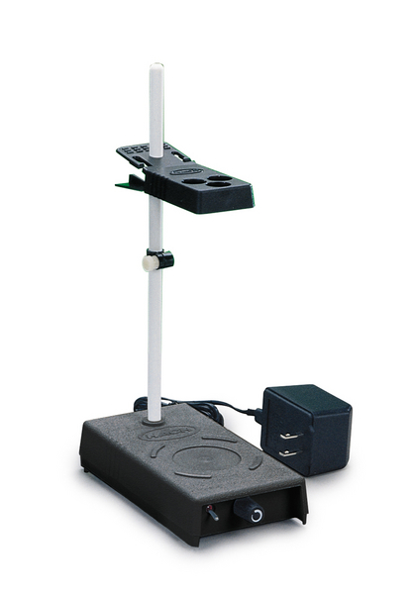
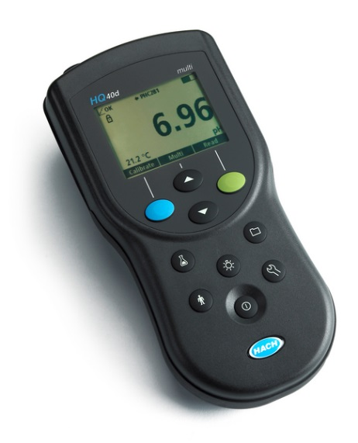
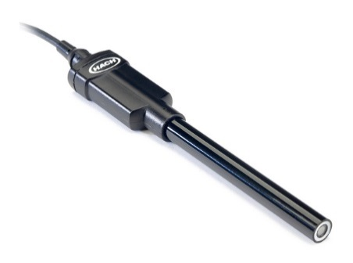
Method of Analysis and Equipment
Intellical™ ISEF121 Fluoride (F⁻) Ion Selective Electrode (ISE)
HQ40d Portable ISE Multi-Parameter Meter
Fluoride Ionic Strength Adjustor (ISA)
Fluoride Standards (0.2/2.0 & 0.5/ 5.0 mg/L)
50 mL graduated cylinder
Finnpipette F2 variable volume pipette, capacity 0.5 - 5 mL
Electrode stirrer stand
50 mL beakers
Stir Bar, Magnetic, Polygon

Slide 16

Contact
Guy Schott, P.E.
State Water Resources Control Board
Division of Drinking Water
Santa Rosa, CA
Guy.Schott@waterboards.ca.gov
707-576-2732

