Slide 1
Gibson Canyon WTP
Solano Irrigation District
Vacaville County, CA
Contact Time (t₁₀)
Tracer Study
May 8, 2017
by Guy Schott, P.E.
Amy Little, P.E.
Water Resources Control Board,
Division of Drinking Water
Guy.schott@waterboards.ca.gov
707-576-2732

Slide 2
Chlorine Contact Tank - Clearwell
Clearwell volume/ft: 2,844 gal/ft
Working volume during tracer study: 34,000 gallons
Inlet 2.8-ft off bottom angled 30º up
Outlet 2-in off bottom
L:W ratio: 11
Has spray aeration for TTHM reduction pumped from outlet pipe back into tank top in last channel.

Slide 3
Final Results
Test Date: May 8, 2017
Test by: Water Resources Control Board, Division of Drinking Water
Tracer Test Method: Modified Step-Dose using Fluoride
Clearwell Diameter: 22-ft
Clearwell Volume/Ft: 2,844 gal/ft
Number of Baffles: 2
Clearwell Flow (inlet/outlet): 400 gpm
Clearwell Operating Water Level: 12 feet
Clearwell Operating Volume: 34,000 gallons
HRT: 85 minutes
t₁₀: 31.3 minutes
L:W Ratio: 11
Baffling Factor: 0.37 (t₁₀/HRT)

Slide 4
Tracer Study – Overview 1
A tracer study was conducted at the Gibson Canyon WTP to determine the “t₁₀” disinfection contact time and baffling factor for the 40,000 gallon max capacity clearwell with two baffles. The “t₁₀” value is the time is takes for 10% of the added tracer mass to exit the reactor. The baffling factor is t₁₀/HRT where HRT is the hydraulic residence time of the clearwell during the time of the tracer study.

Slide 5
Tracer Study – Overview 2
Tracer Method: Modified Step-Dose
Injection Point: Pipeline inlet to Clearwell
Sample Points: Inlet/outlet of Clearwell
Tracer Analysis: Ion Selective Fluoride Probe
Sampler: Amy Little
Analysis by: Guy Schott

Slide 6
Tracer Material Overview
Tracer Material: Hydrofluorosillicic Acid (H₂SiF₆)
Tracer Bulk Density: 10.3 lbs/gal
Tracer Product Strength: 28% as H₂SiF₆
Molecular Weight: 144.09 g/mole (H₂SiF₆)
Fluoride Concentration: 79.11% (144 g/mole)
H₂SiF₆ Tracer Feed Rate: ~21 mL/min
Flow: 400 gpm
Tracer Dose: 3.9 mg/L as F
Method of Injection: Steady-State

Slide 7
Tracer Field Results
Flow: 400 gpm; 40,000 gallon baffled Clearwell
HRT: 85 minutes
Tracer Dose– 3.9 mg/L as F
t₁₀: 31.3 minutes
Working volume: 32,000 gallons @ 12 ft operating level
Calculated baffling factor: 0.37 t₁₀/HRT
L:W ratio: 11

Slide 8
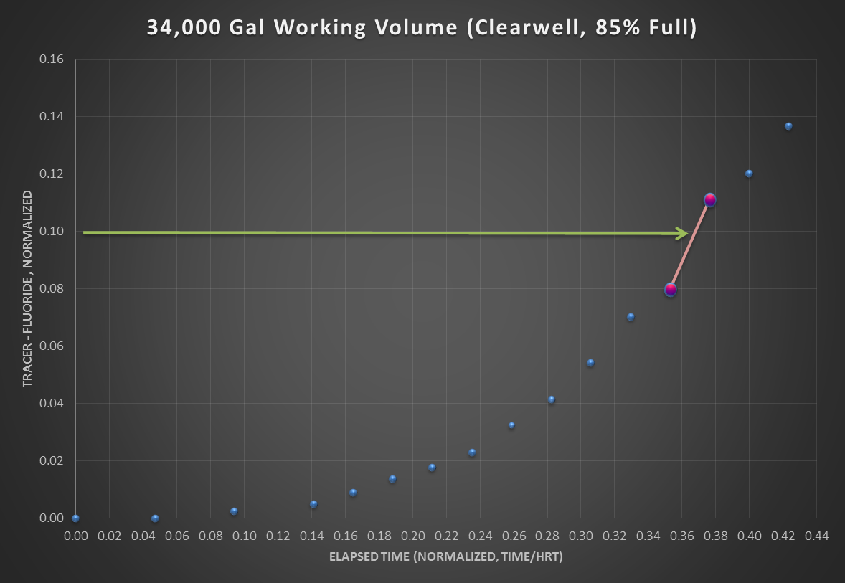
Working Volume: 34,000 gallons
Average Flow: 400 gpm
Clearwell Water Level: 12 ft
Total Baffles: 2
HRT: 85 minutes
t₁₀: 31.3 minutes
Baffling factor 0.37 (t₁₀/HRT)

Slide 9
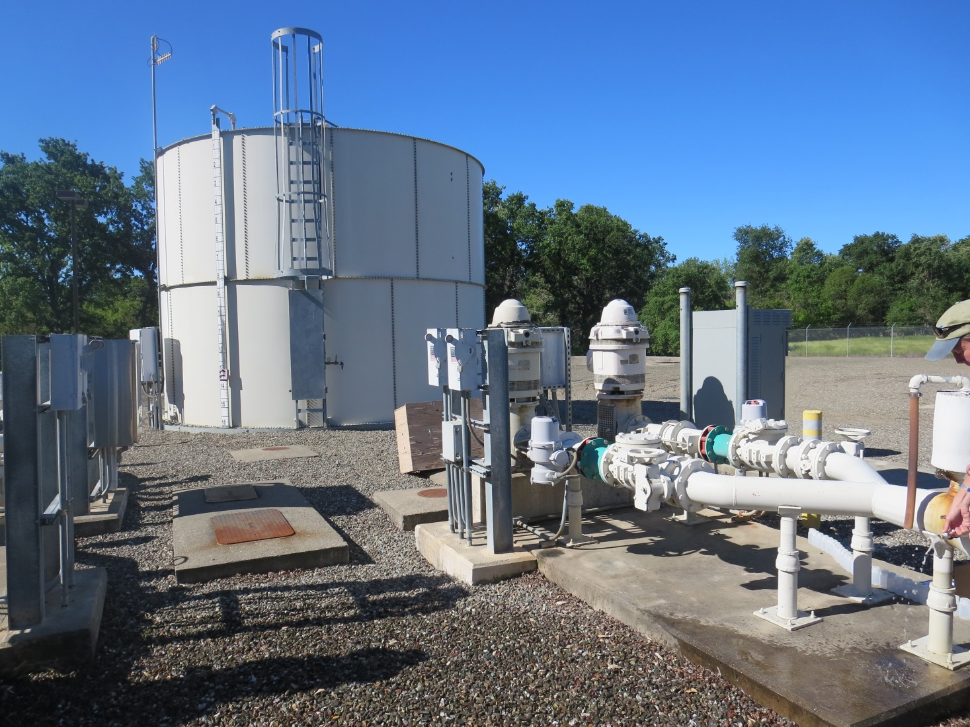
Clearwell and Effluent Pumps
Tracer Sample Point (discharge side of effluent pumps)

Slide 10
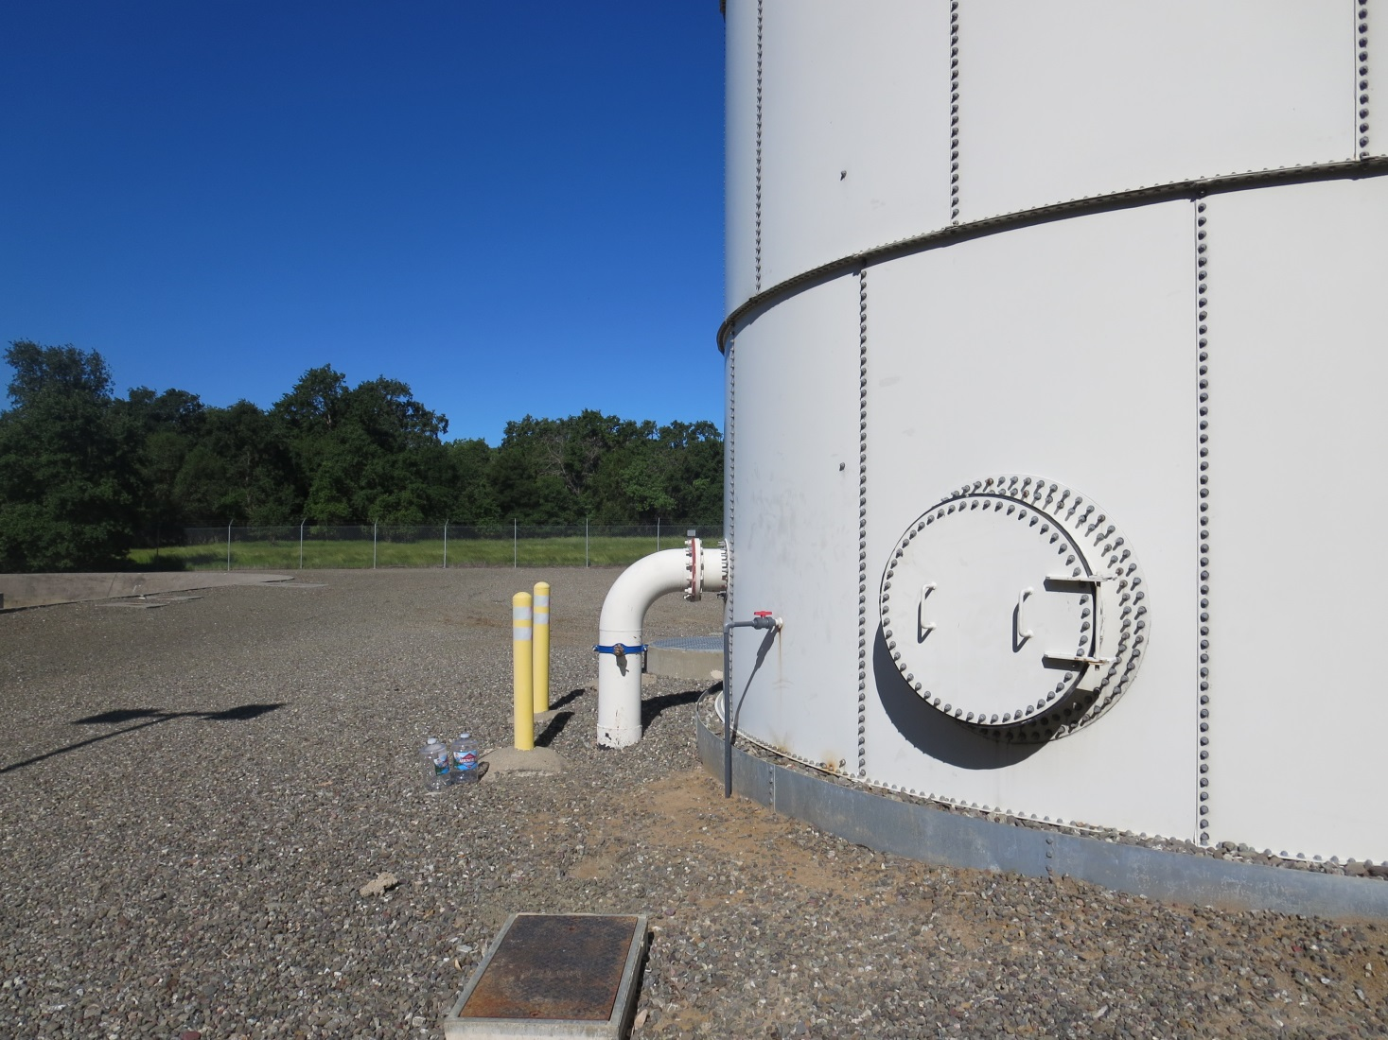
Inlet Sample Point before Clearwell
To Verify Tracer Dosage

