Slide 1
Graton Community Services District
SN 4990011
Wastewater Treatment Plant
Sonoma County, CA
Modal Contact Time (T_{mod})
Tracer Study #1
May 30, 2018
by Guy Schott, P.E.
Water Resources Control Board,
Division of Drinking Water
Guy.schott@waterboards.ca.gov
707-576-2732
Revised on July 30, 2018; basin volume.

Slide 2
Chlorine Contact Reactors in Series
Graton Community Services District
250 Ross Ln, Sebastopol, CA 95472
707-823-1542
Revised Contact Rectangular Basin from 10,800 to 12,000 gallons

Slide 3
Final Results
Test Date: May 30, 2018
Test by: GCSD & WRCB, Division of Drinking Water
Tracer Test Method: Slug-Dose using Fluoride
Reactors Tested: Purge Tank, pipeline & Serpentine Contact Basin (in series)
Total Operating Volume: 15,080 gallons
Operational Flow: 120 gpm (steady-state)
HRT: 126 minutes (hydraulic residence time)
T_{mod}: 112 minutes (Modal Contact Time)
Modal Baffling Factor: 0.89 (T_{mod}/HRT)

Slide 4
Operating Parameters
Based on Tracer Test

Slide 5
Tracer Study – Overview 1
On May 30, 2018 a single tracer study was conducted at the Graton CSD WWTP. This test was to evaluate the modal contact time for the 3,000 gallon purge tank and 12,000 gallon serpentine concrete basin operated in series including pipe volume between the two reactors. The modal contact value (T_{mod}) is that time at which the slug-dose curve is at its peak concentration.
The modal contact time was 112 minutes.
The HRT was 126 minutes.

Slide 6
Tracer Study – Overview 2
Tracer Method: Slug-Dose
Injection Point of Tracer: Pipeline to Purge Tank
Sample Point: Overflow weir at end of serpentine contact basin.
Tracer Analysis: Ion Selective Fluoride Probe
Sampler: Graton CSD Operators
Analyses by: Guy Schott, Division of Drinking Water

Slide 7
Tracer Material Overview
Tracer Material: Hydrofluorosillicic Acid (H₂SiF₆)
Tracer Bulk Density: 10.3 lbs/gal
Tracer Product Strength: 24% as H₂SiF₆
Molecular Weight: 144.09 g/mole (H₂SiF₆)
Fluoride Concentration: 79.11% (144 g/mole)
H₂SiF₆ Tracer Added: 406 mL (neat)
Fluoride (F) Tracer Added: 94 grams
Method of Injection: Slug-Dose (< 20 sec)

Slide 8
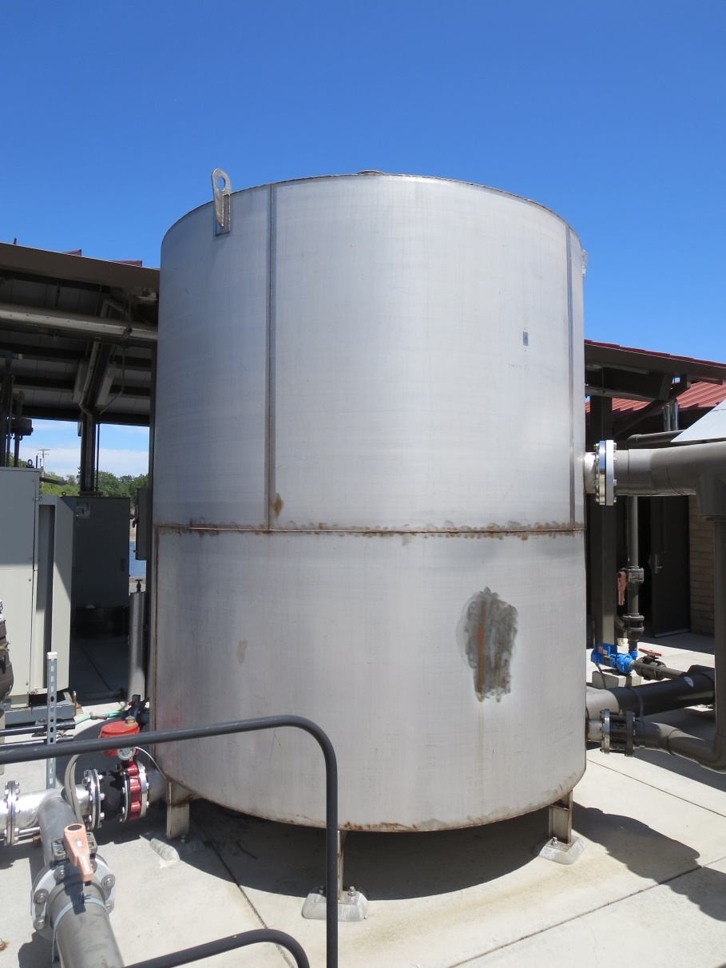
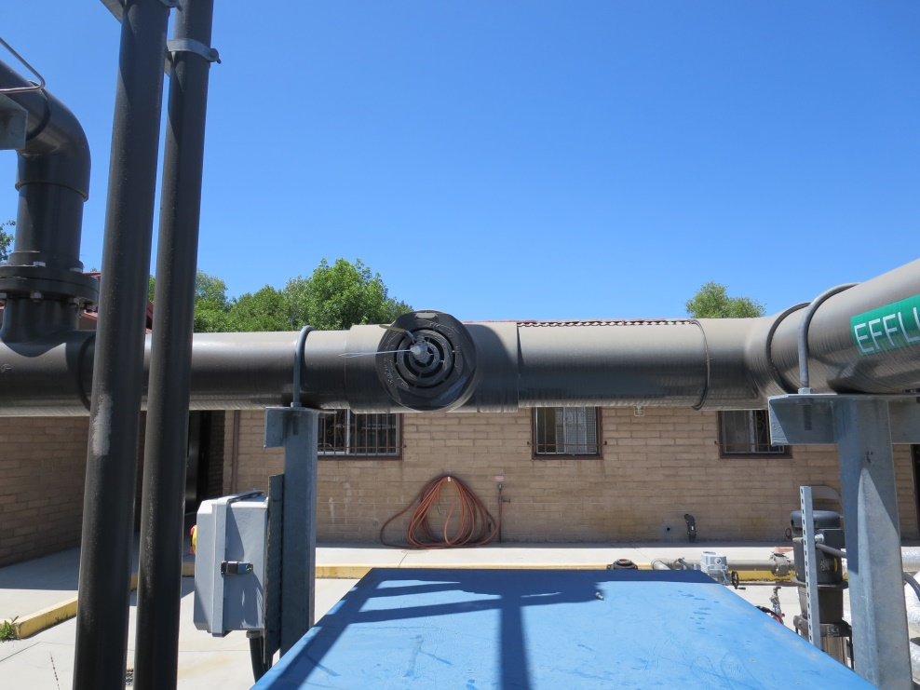
3,000 Gal Purge Tank
Inlet
Inlet
Tracer
Tracer Injection Point
Outlet
to 12,000 gallon chlorine contact basin

Slide 9
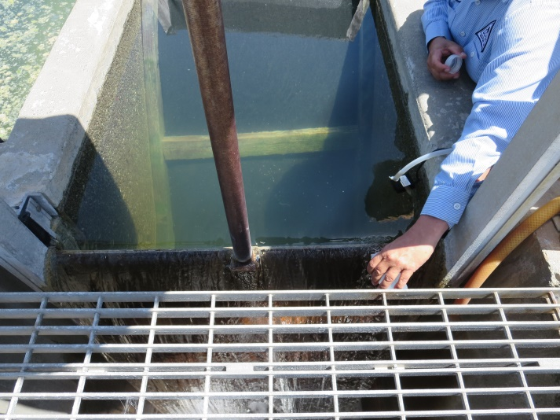
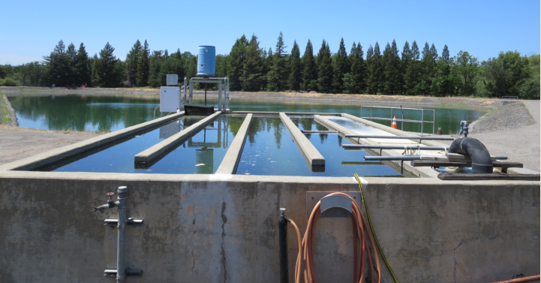
12,000 Gal
Contact Basin
Sample

Slide 10
Tracer Field Results

