Slide 1
Gualala Community Services District
Wastewater Treatment Plant
Sonoma County, CA
Modal Contact Time (t_{modal})
Tracer Study #2
July 20, 2017
by Guy Schott, P.E.
Water Resources Control Board,
Division of Drinking Water
Guy.schott@waterboards.ca.gov
707-576-2732

Slide 2
Chlorine Contact - Pipeline
Pipeline volume: 21,500 gallons
Pipeline diameter: 48-inches (4 feet)
Pipeline length: 229 feet
Material: concrete (buried)
L:D ratio: 57
Treated water flows from: Sea Ranch and Gualala

Slide 3
Final Results
Test Date: July 20, 2017
Test by: GCSD & WRCB, Division of Drinking Water
Tracer Test Method: Slug-Dose using Fluoride
Reactor Tested: Concrete Pipeline (underground)
Pipeline Length & Diameter (D): 229 ft & 48 inches (4-ft)
L:D Ratio: 57
Pipeline Volume (Vol_{Pipe}): 21,500 gallons (operating volume)
Flows to Modal Contact Time: 20-100 gpm (43 gpm weighted avg)
Weighted Avg Test Flow: 56 gpm (based on total test duration)
HRT: 380 minutes (6.3 hours, based on total test duration)
t_{modal}: 90 minutes (to peak fluoride concentration @ 43 gpm)
Cumulative Volume (Vol_{cum}) to t_{modal}: 3,900 gallons (treated)
Modal Baffling Factor: 0.18 (Vol_{cum}/Vol_{pipe})
Calculated Field Modal Time:
Ct_{modal-cal}: Cl₂ x t_{modal-cal}

Slide 4
Tracer Study – Overview 1
On July 20, 2017 a second tracer study was conducted at the Gualala CSD WWTP to verify the modal disinfection contact time for the 21,500 gallon underground concrete pipeline. The modal contact value (t_{modal}) is that time at which the slug-dose curve is at its peak concentration.
The modal contact time for Tests 1 and 2 was 90 minutes.

Slide 5
Tracer Study – Overview 2
Tracer Method: Slug-Dose
Injection Point of Tracer: Poured into filter overflow weir connected to 8-inch line
Sample Point: Pipeline outlet (Manhole “B”)
Tracer Analysis: Ion Selective Fluoride Probe
Sampler: Gualala CSD Operators
Analyses by: Guy Schott, Division of Drinking Water

Slide 6
Tracer Material Overview
Tracer Material: Hydrofluorosillicic Acid (H₂SiF₆)
Tracer Bulk Density: 10.3 lbs/gal
Tracer Product Strength: 24% as H₂SiF₆
Molecular Weight: 144.09 g/mole (H₂SiF₆)
Fluoride Concentration: 79.11% (144 g/mole)
H₂SiF₆ Tracer Added: ~4.1 lbs. (1,500 mL)
Fluoride mixed w/2.5 gal of water in bucket
Fluoride (F) Tracer Added: 0.775 lbs. (352 g)
Method of Injection: Slug-Dose (poured, < 20 sec)

Slide 7
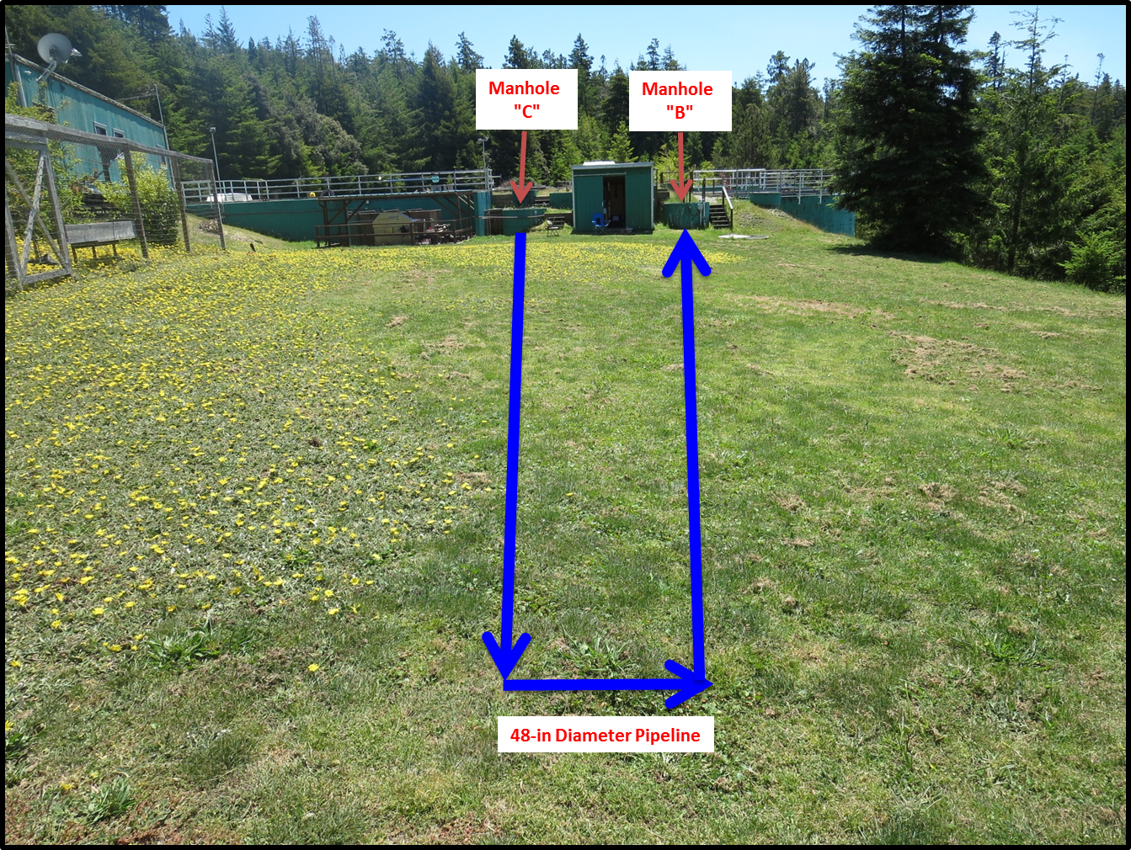
Pipeline Contactor (21,500 gallons)
Added
Tracer
Tracer
Sampling

Slide 8
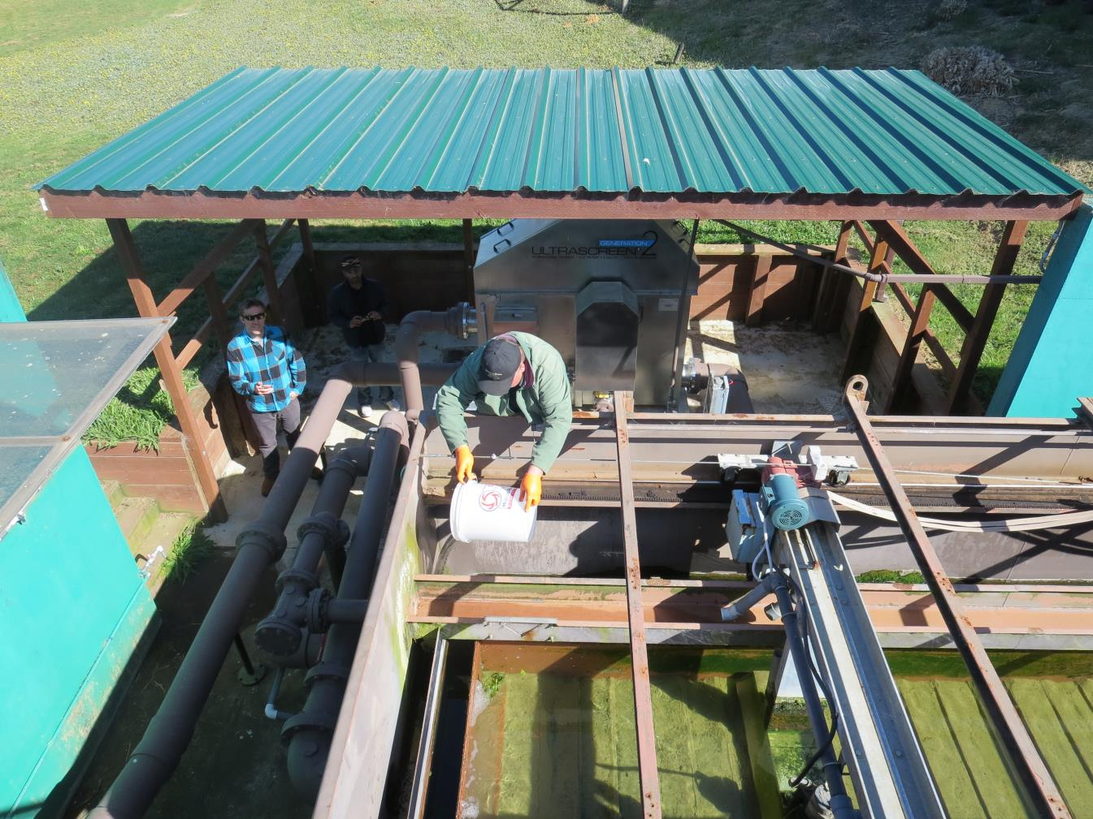
Tracer Slug-Dose
Adding
Tracer

Slide 9
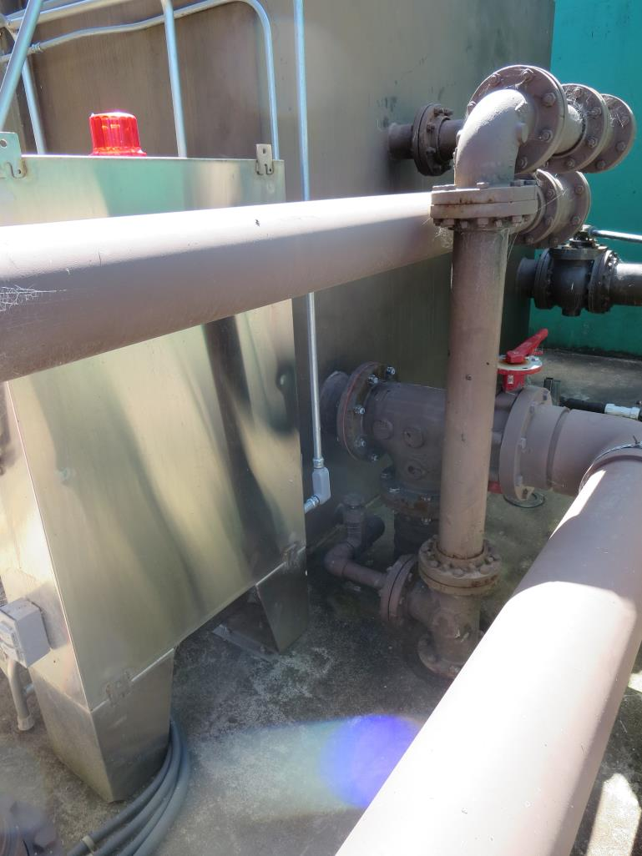
Hydraulic Tracer Mixing
After tracer is poured into effluent filter trough, the mixed water flows into an 8-in line to Manhole “C”.

Slide 10
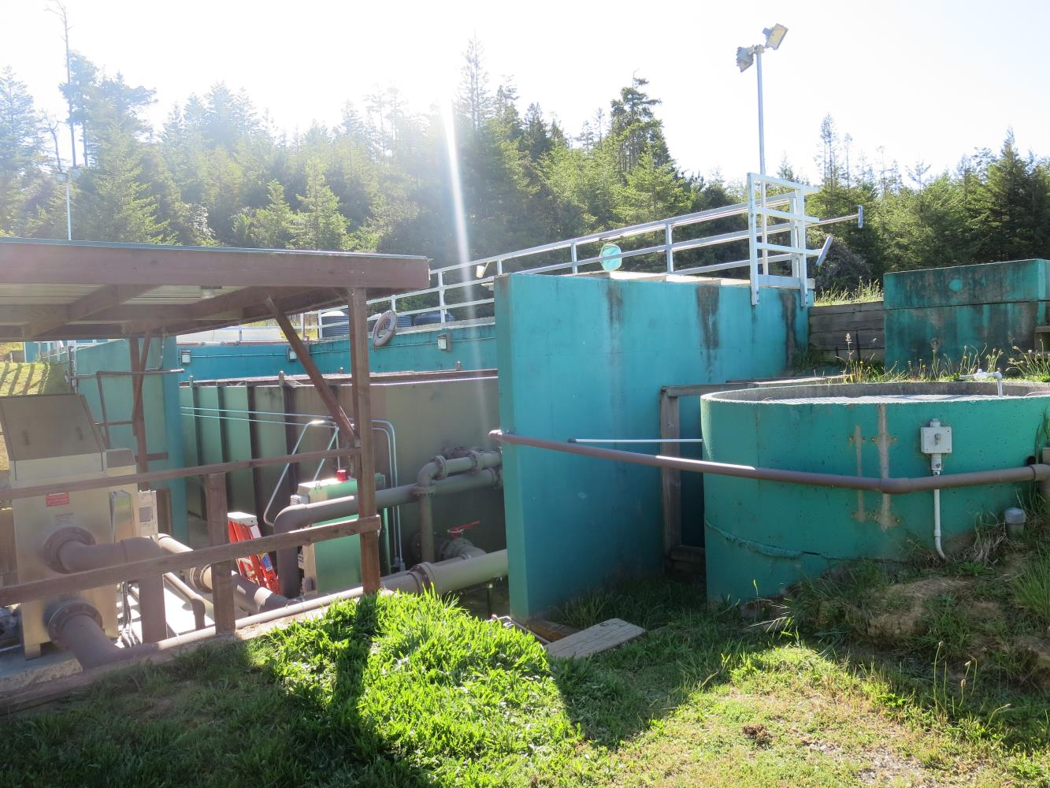
Manhole “C” Entry to Pipeline
Manhole
“C”

Slide 11
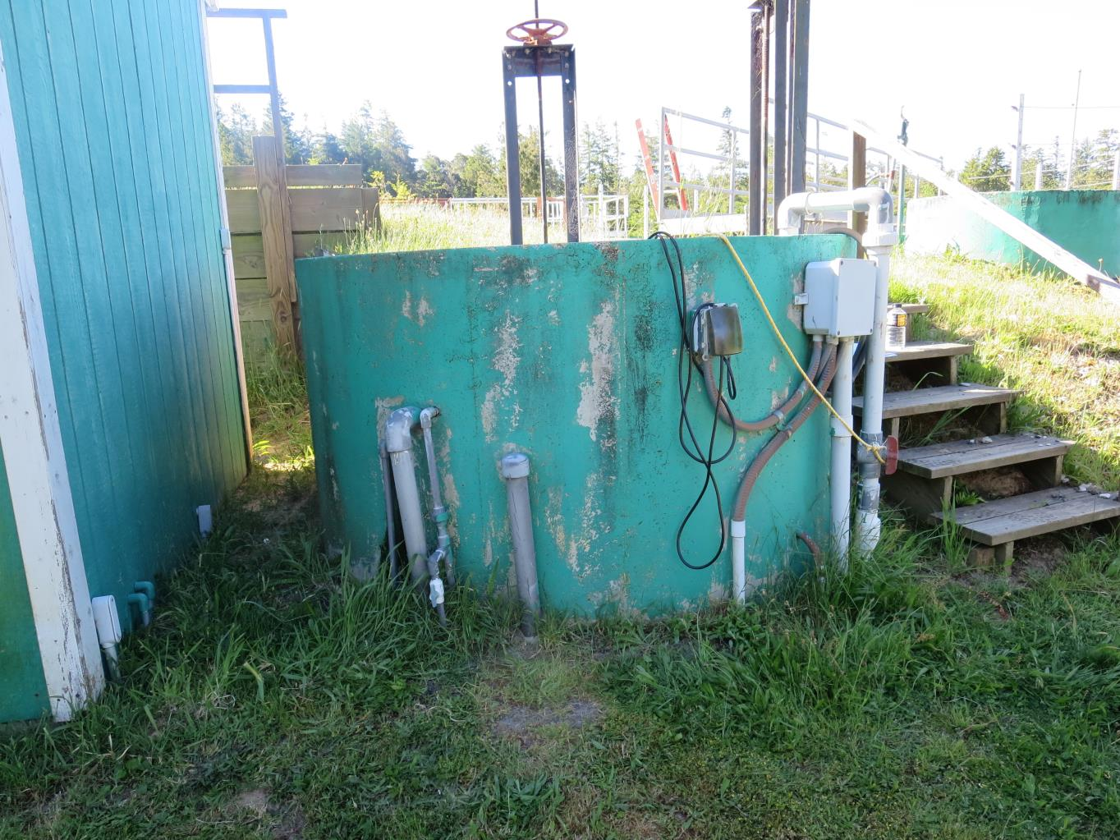
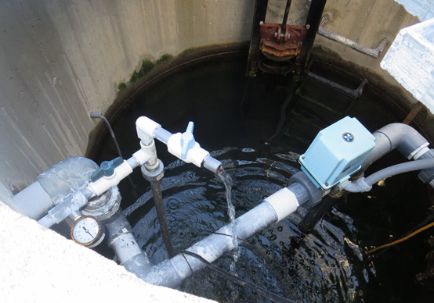
Manhole “B” Pipeline Exit - Sample Station
Manhole
“B”
Sample Tap

Slide 12
Tracer Field Results

Slide 13
Average Flow Test Duration: 56 gpm
HRT: 380 minutes
t_{modal}: 90 minutes
Average flow up to t_{modal}: 43 gpm

Slide 14
Tracer Study – Conclusion – 1 of 2
The modal contact time was 90 minutes compared to the HRT of 380 minutes (average flow over test duration). It was expected that the modal contact time would be approximately 6 hours.
This test confirms the first test conducted on May 15, 2017 that stratification is occurring inside the pipeline due to temperature gradient and flow being laminar which results in lack of mixing energy inside the pipeline. These conditions result in channeling of the incoming treated water.
To eliminate flow channeling, mixing inside the length of the pipeline would need to be applied.

Slide 15
Channeling
Manhole
“C”
Manhole
“B”
18ºC
Tracer diffusion
18ºC
<18ºC
Flow magnitude
48-in Pipeline

