Slide 1
Gualala Community Services District
Wastewater Treatment Plant
Sonoma County, CA
Modal Contact Time (t_{modal})
Tracer Study
May 15, 2017
by Guy Schott, P.E.
Aaron Kent
Water Resources Control Board,
Division of Drinking Water
Guy.schott@waterboards.ca.gov
707-576-2732

Slide 2
Chlorine Contact - Pipeline
Pipeline volume: 21,500 gallons
Pipeline diameter: 48-inches (4 feet)
Pipeline length: 229 feet
Material: concrete (buried)
L:D ratio: 57
Treated water flows from: Sea Ranch and Gualala

Slide 3
Final Results
Test Date: May 15, 2017
Test by: WRCB, Division of Drinking Water
Tracer Test Method: Slug-Dose using Fluoride
Reactor Tested: Concrete Pipeline (underground)
Pipeline Diameter (D): 48 inches (4-ft)
Pipeline Length (L): 229
L:D Ratio: 57
Pipeline Volume (Vol_{Pipe}): 21,500 gallons (operating volume)
Flows to Modal Contact Time: 20-140 gpm (58 gpm weighted avg)
HRT: 370 minutes (6.2 hours)
t_{modal}: 90 minutes (to peak fluoride concentration @ 58 gpm)
Cumulative Volume (Vol_{cum}) to t_{modal}: 5,200 gallons (treated)
Modal Baffling Factor: 0.24 (t_{modal}/HRT = Vol_{cum}/Vol_{pipe})
Calculated Field Modal Time:
Ct_{modal-cal}: Cl₂ x t_{modal-cal}

Slide 4
Tracer Study – Overview 1
On May 15, 2017 a tracer study was conducted at the Gualala CSD WWTP to determine the modal disinfection contact time for the 21,500 gallon underground concrete pipeline. The modal contact value (t_{modal}) is that time at which the slug-dose curve is at its peak concentration. The modal baffling factor is t_{modal}/HRT where HRT is the hydraulic residence time of the pipeline during the time of the tracer study.

Slide 5
Tracer Study – Overview 2
Tracer Method: Slug-Dose
Injection Point of Tracer: Poured into filter overflow weir connected to 8-inch line
Sample Point: Pipeline outlet (Manhole “B”)
Tracer Analysis: Ion Selective Fluoride Probe
Sampler: Arron Kent
Analyses by: Guy Schott

Slide 6
Tracer Material Overview
Tracer Material: Hydrofluorosillicic Acid (H₂SiF₆)
Tracer Bulk Density: 10.3 lbs/gal
Tracer Product Strength: 24% as H₂SiF₆
Molecular Weight: 144.09 g/mole (H₂SiF₆)
Fluoride Concentration: 79.11% (144 g/mole)
H₂SiF₆ Tracer Added: ~22.6 lbs. (2.2 gal)
Fluoride (F) Tracer Added: 4.3 lbs. (1,954 g)
Method of Injection: Slug-Dose (poured, < 5 sec)

Slide 7
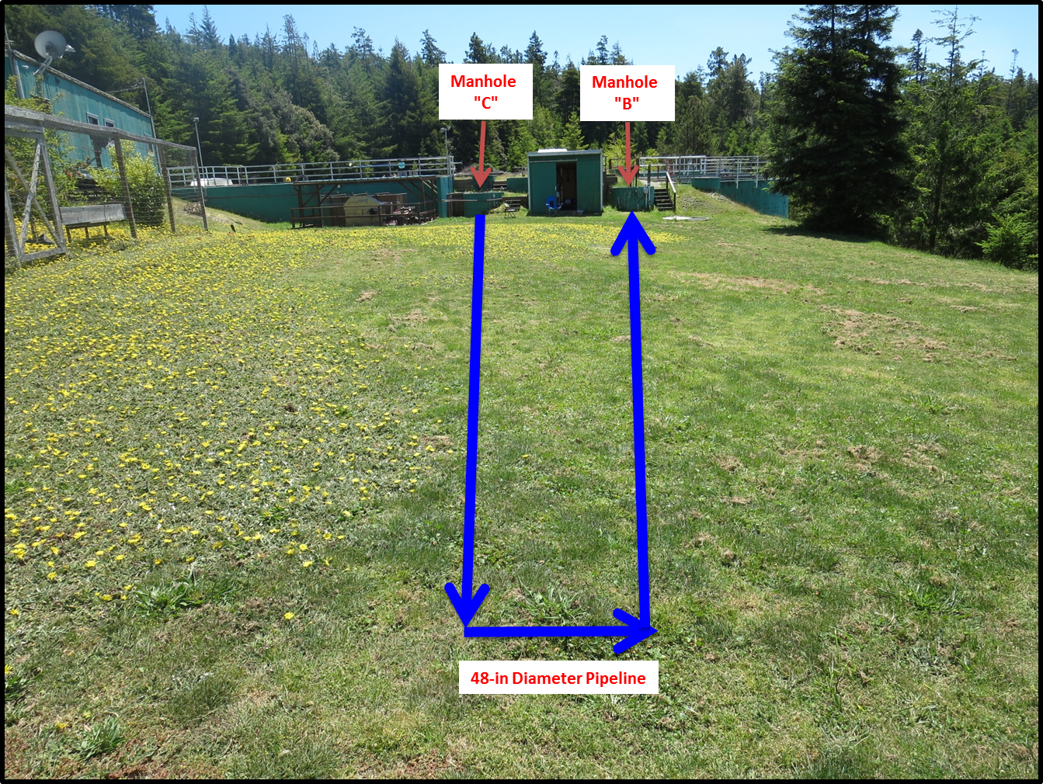
Pipeline Contactor (21,500 gallons)
Added
Tracer
Tracer
Sampling

Slide 8
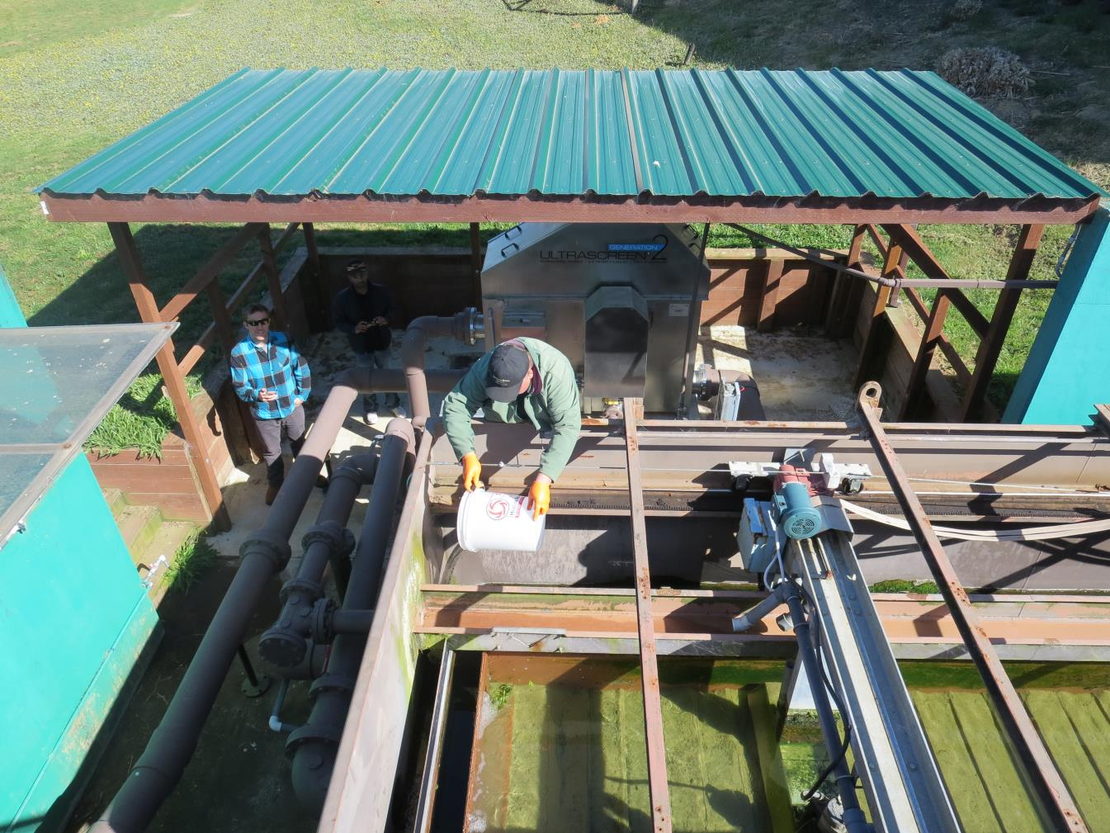
Tracer Slug-Dose
Adding
Tracer

Slide 9
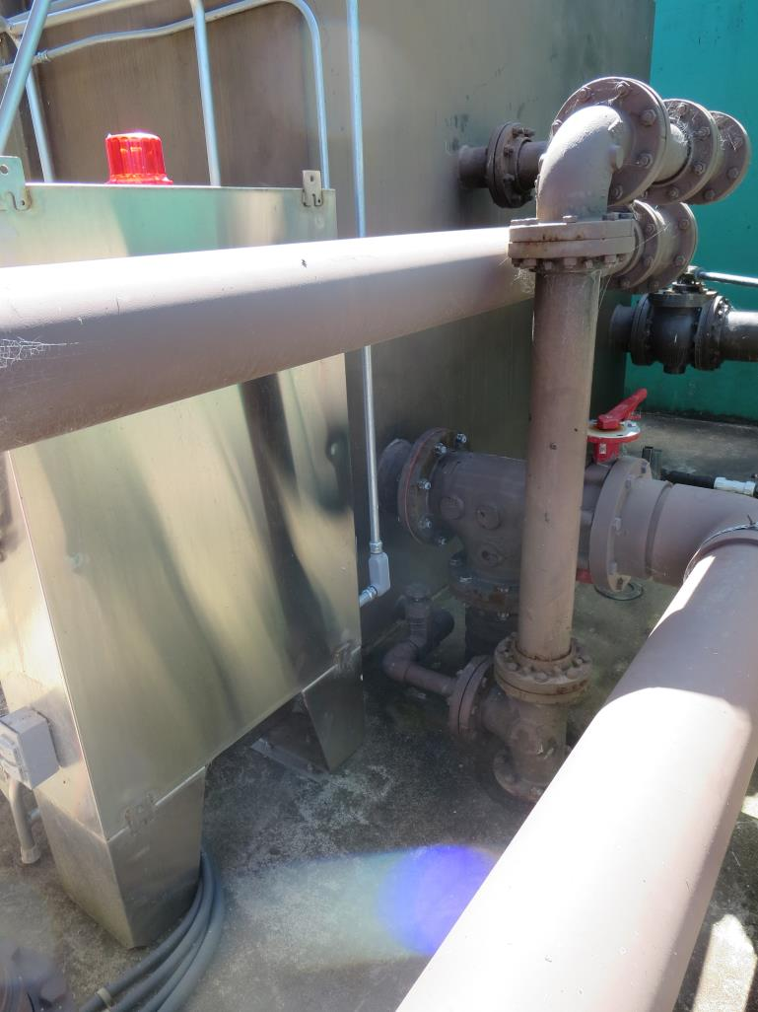
Hydraulic Tracer Mixing
After tracer is poured into effluent filter trough, the mixed water flows into an 8-in line to Manhole “C”.

Slide 10
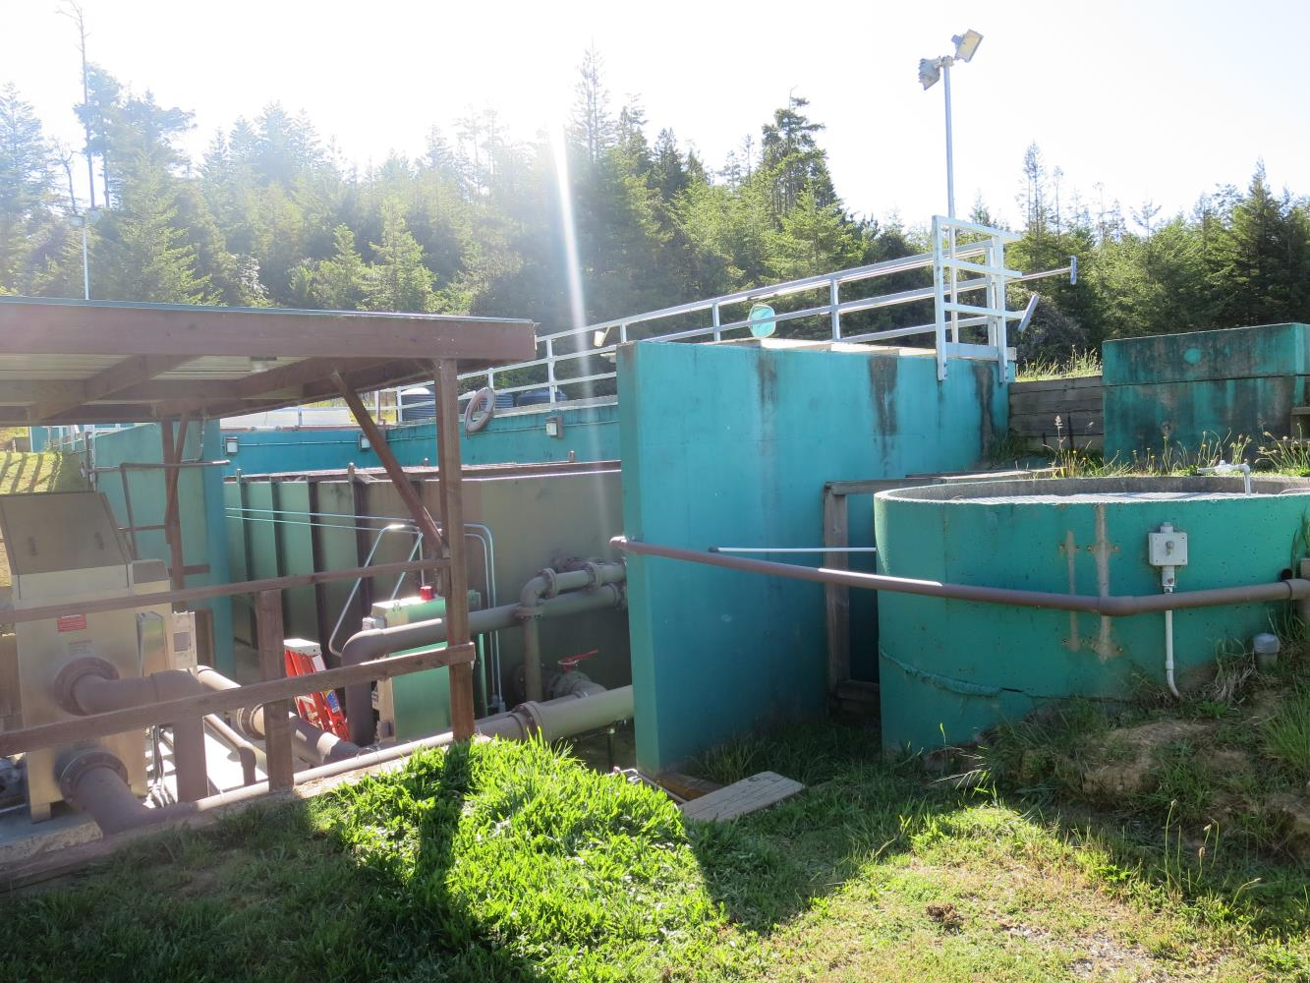
Manhole “C” Entry to Pipeline
Manhole
“C”

Slide 11
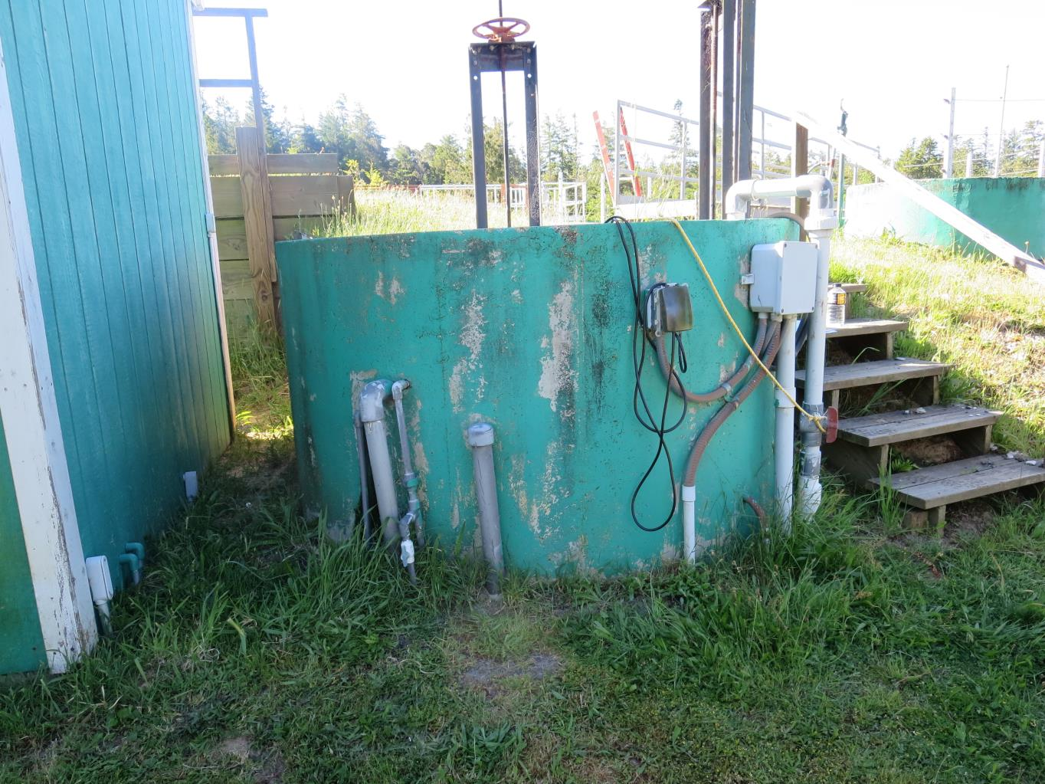
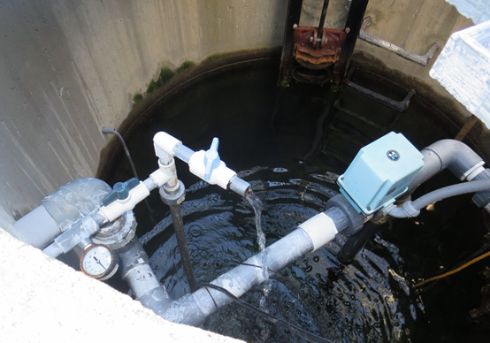
Manhole “B” Pipeline Exit - Sample Station
Manhole
“B”
Sample Tap

Slide 12
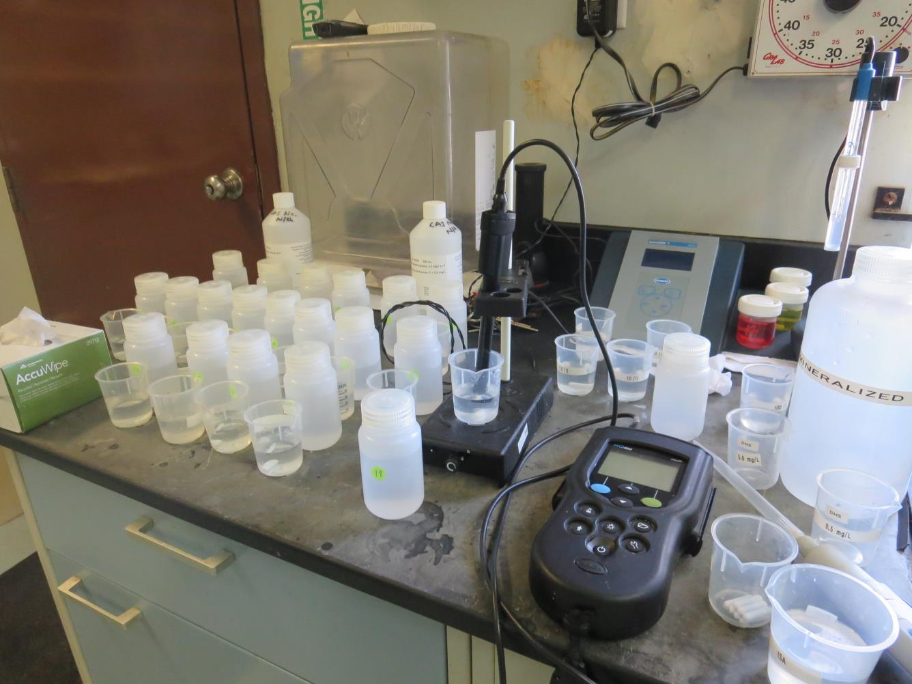
Fluoride Analysis

Slide 13
Tracer Field Results

Slide 14
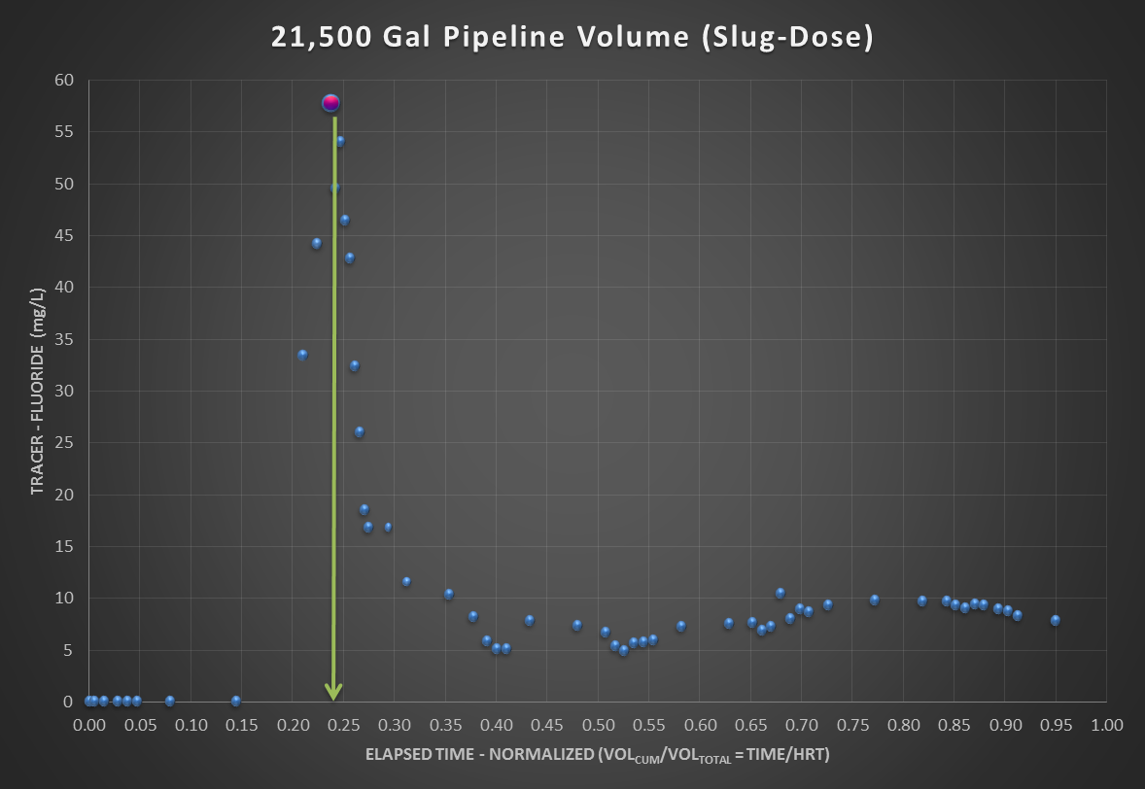
Average Flow: 58 gpm
HRT: 370 minutes
t_{modal}: 90 minutes
Modal Baffling factor 0.24 (t_{modal}/HRT)

Slide 15
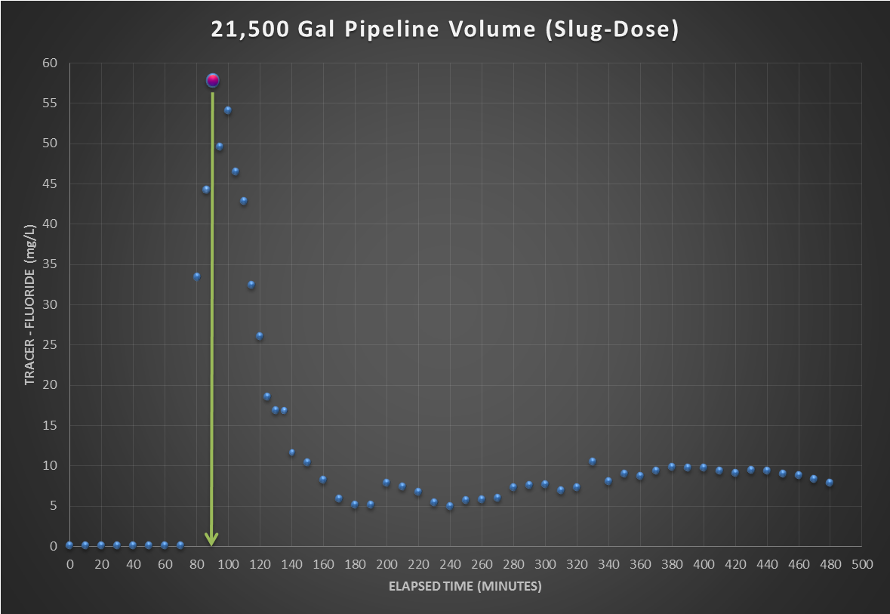
Average Flow: 58 gpm
HRT: 370 minutes
t_{modal}: 90 minutes
Modal Baffling factor 0.24 (t_{modal}/HRT)

Slide 16
Tracer Study – Conclusion – 1 of 2
The modal contact time was 90 minutes compared to the HRT of 360 minutes. It was expected the modal contact time would be 5-6 hours. The results show two issues that need to be resolved:
There could be a significant temperature gradient inside the pipeline that is causing channeling of the incoming warmer water that may explain the early departure of tracer. Two weeks later it was confirm that there was a temperature gradient throughout the pipeline with the warmer water near the top to the pipeline.
There was a constant long “bleed” of tracer long after the peak that suggest
  Diffusion due to gradient in concentration that may be due to warm and cold water stratus inside the pipeline.

Slide 17
Tracer Study – Conclusion – 2 of 2
To eliminate the possibility of channeling due to temperature gradient, it is recommended another tracer test be conducted.
A temperature profile of the water inside the pipeline would provide valuable information if channeling is a possibility. (this was conducted)

Slide 18
Channeling
Manhole
“C”
Manhole
“B”
18ºC
18ºC
<18ºC
48-in Pipeline

