Slide 1
Howell Mountain Mutual Water
Napa County, CA
PAX Clearwell Mixer
Tracer Studies, July, Sept, Oct 2015
by Guy Schott, P.E.
Guy.schott@waterboards.ca.gov
707-576-2732

Slide 2
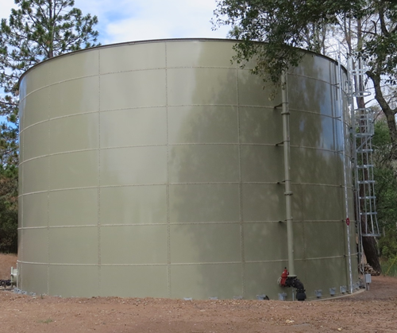
Clearwell – 488,000 Gal Max Capacity
Figure 1:
Test 1 – 4 (July 2015)
PAX location 1

Slide 3
Clearwell – 488,000 Gal Max Capacity
PAX location 2
Figure 2:
Test 5 – 6 (Sept-Oct 2015)

Slide 4
Tracer Test Overview for
488,000 Gal Max Capacity Clearwell
PAX Mixer ON |  | PAX Mixer ON
Figure 1 PAX Location |  | Figure 2 PAX Location
Inlet Configuration | Baffling Factor | Inlet Configuration | Baffling Factor
Bottom to Bottom | 0.033 | Bottom to Bottom | 0.058
Top to Bottom | 0.063 | Top to Bottom | 0.084
PAX Mixer Off |  | PAX Mixer Off
Inlet Configuration | Baffling Factor | Inlet Configuration | Baffling Factor
Bottom to Bottom | 0.049 | Top to Bottom | 0.091
Clearwell: No baffles
Inlet flow: 250-280 gpm
Outlet flow varied: 114-142 gpm
Clearwell Level: 19 – 23.2 ft
Clearwell Operating Volume: 325,500 – 397,500 gal
Tracer Test Type: Modified Step-Dose/Volume₁₀ (V₁₀) combination methods

Slide 5
Test 1 & 2
Figure 1 for PAX location in Clearwell
PAX Mixer ON |  | PAX Mixer Off
Test 1: Bottom to Bottom (inlet/outlet) July 7, 2015 |  | Test 2: Bottom to Bottom (inlet/outlet) July 14, 2015
Baffling factor (t₁₀/T) | 0.033 | Baffling factor (t₁₀/T) | 0.049
Avg tank level | 22.2 ft | Avg tank level | 23.2 ft
Avg tank volume | 379,000 gal | Avg tank volume | 401,000 gal
Inlet Flow | 255 gpm | Inlet Flow | 250 gpm
Avg outlet flow | 139 gpm | Avg outlet flow | 114 gpm
Hydraulic Retention Time | 2,727 min | Hydraulic Retention Time | 3,518 min
*Accumulated exit volume | 12,500 gal | *Accumulated exit volume | 19,500 gal
*Accumulated exit volume is the total volume that exit the Clearwell when 10% of tracer mass has exited the Clearwell.
Clearwell: 17,132 Gal/ft (Diameter: 54-ft)

Slide 6
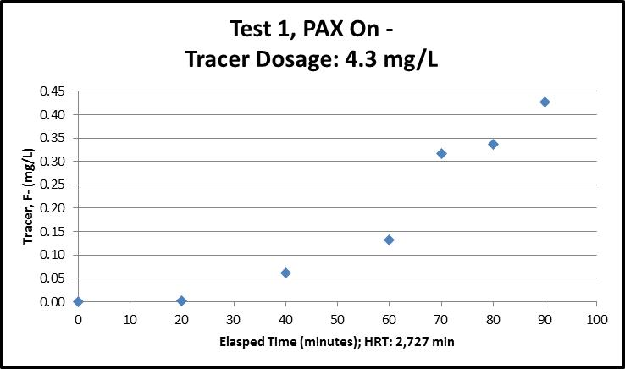
Inlet/Outlet Configuration: Bottom to Bottom
Baffling factor: 0.033 t₁₀/T
Accumulated exit volume: 12,500 gallons at 10% of tracer mass
Average operating volume: 379,000 gallons

Slide 7
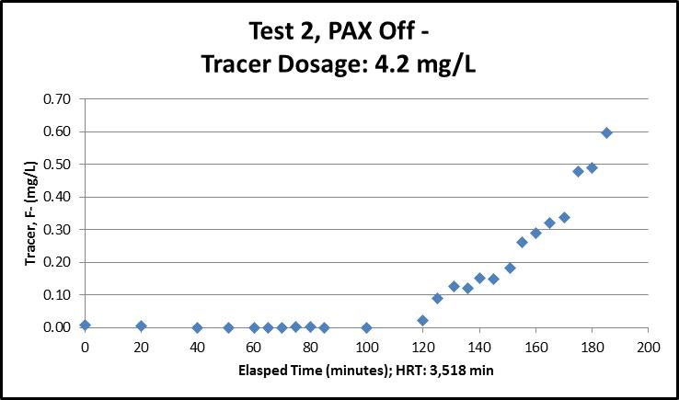
Inlet/Outlet Configuration: Bottom to Bottom
Baffling factor: 0.049 t₁₀/T
Accumulated exit volume: 19,500 gallons at 10% of tracer mass
Average operating volume: 401,000 gallons

Slide 8
Test 3 & 4
Figure 1 for PAX location in Clearwell
PAX Mixer ON |  | PAX Mixer Off
Test 3: Top to Bottom (inlet/outlet) July 23, 2015 |  | Test 4: Top to Bottom (inlet/outlet) July 28, 2015
Baffling factor (t₁₀/T) | 0.063 | Baffling factor (t₁₀/T) | 0.091
Avg tank level | 19.0 ft | Avg tank level | 21.6 ft
Avg tank volume | 321,000 gal | Avg tank volume | 370,500 gal
Inlet Flow | 255 gpm | Inlet Flow | 260 gpm
Avg outlet flow | 131 gpm | Avg outlet flow | 142 gpm
Hydraulic Retention Time | 2,360 min | Hydraulic Retention Time | 2,609 min
*Accumulated exit volume | 20,200 gal | *Accumulated exit volume | 33,800 gal
*Accumulated exit volume is the total volume that exit the Clearwell when 10% of tracer mass has exited the Clearwell.
Clearwell: 17,132 Gal/ft (Diameter: 54-ft)

Slide 9
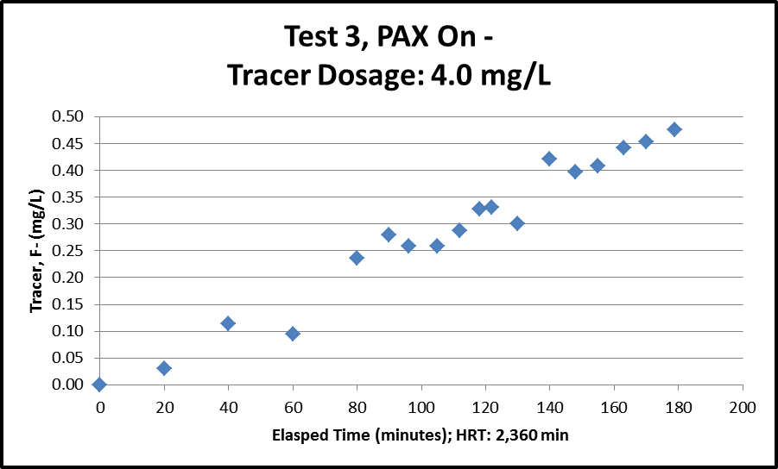
Inlet/Outlet Configuration: Top to Bottom
Baffling factor: 0.063 t₁₀/T
Accumulated exit volume: 20,200 gallons at 10% of tracer mass
Average operating volume: 321,000 gallons

Slide 10
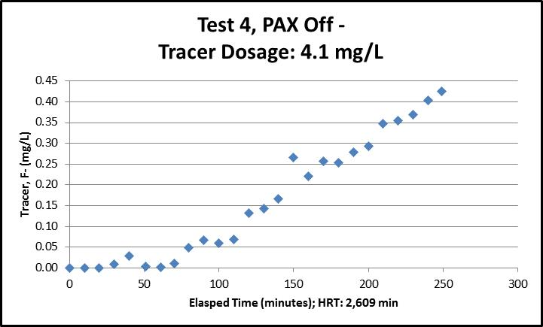
Inlet/Outlet Configuration: Top to Bottom
Baffling factor: 0.091 t₁₀/T
Accumulated exit volume: 33,800 gallons at 10% of tracer mass
Average operating volume: 370,500 gallons

Slide 11
Test 5 & 6
Figure 2 for PAX location in Clearwell
PAX Mixer ON |  | PAX Mixer ON
Test 5: Top to Bottom (inlet/outlet) September 29, 2015 |  | Test 6: Bottom to Bottom (inlet/outlet) October 13, 2015
Baffling factor (t₁₀/T) | 0.084 | Baffling factor (t₁₀/T) | 0.058
Avg tank level | 21.0 ft | Avg tank level | 23.1 ft
Avg tank volume | 360,700 gal | Avg tank volume | 395,600 gal
Inlet Flow | 259 gpm | Inlet Flow | 280 gpm
Avg outlet flow | 138 gpm | Avg outlet flow | 115 gpm
Hydraulic Retention Time | 2,610 min | Hydraulic Retention Time | 3,440 min
*Accumulated exit volume | 30,230 gal | *Accumulated exit volume | 23,000 gal
*Accumulated exit volume is the total volume that exit the Clearwell when 10% of tracer mass has exited the Clearwell.
Clearwell: 17,132 Gal/ft (Diameter: 54-ft)

Slide 12
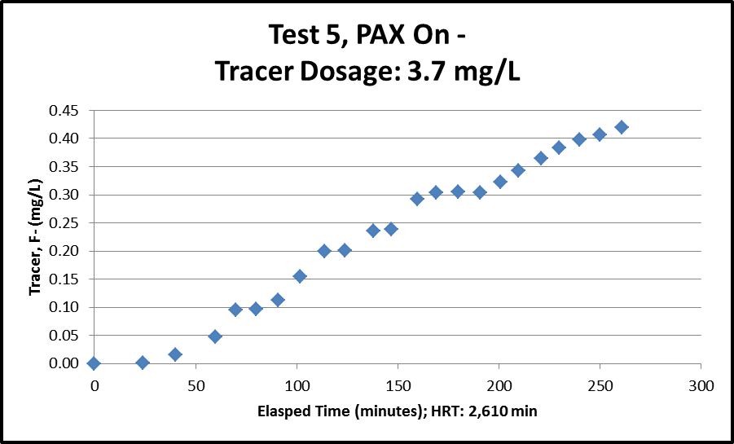
Inlet/Outlet Configuration: Top to Bottom
Baffling factor: 0.084 t₁₀/T
Accumulated exit volume: 30,230 gallons at 10% of tracer mass
Average operating volume: 360,700 gallons

Slide 13
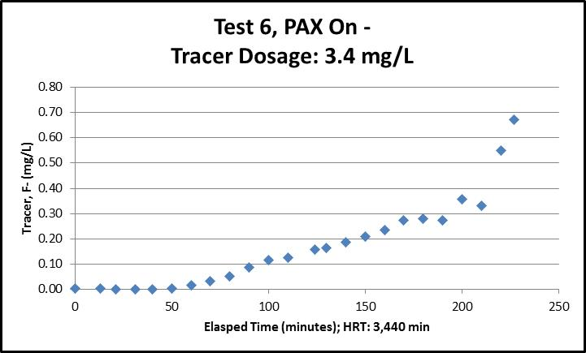
Inlet/Outlet Configuration: Bottom to Bottom
Baffling factor: 0.058 t₁₀/T
Accumulated exit volume: 23,000 gallons at 10% of tracer mass
Average operating volume: 395,600 gallons

Slide 14
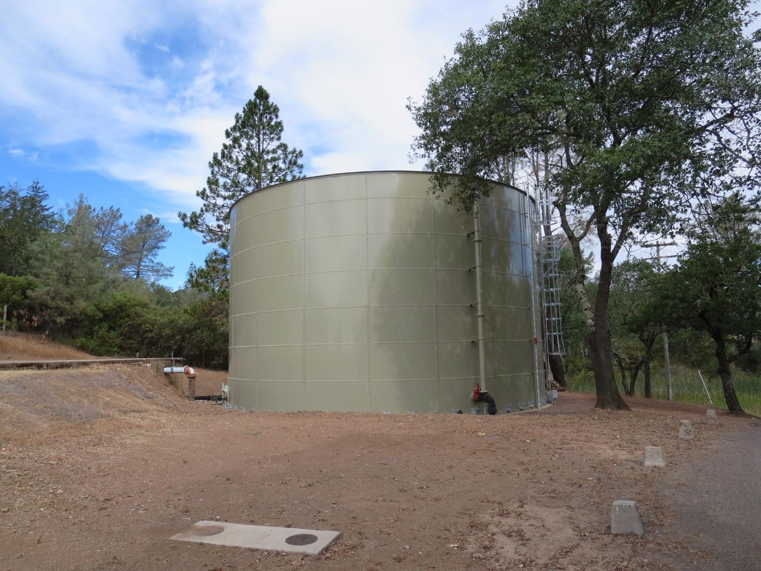
488,000 Gal Clearwell
Inlet (bottom or Top)
Outlet (bottom)

Slide 15
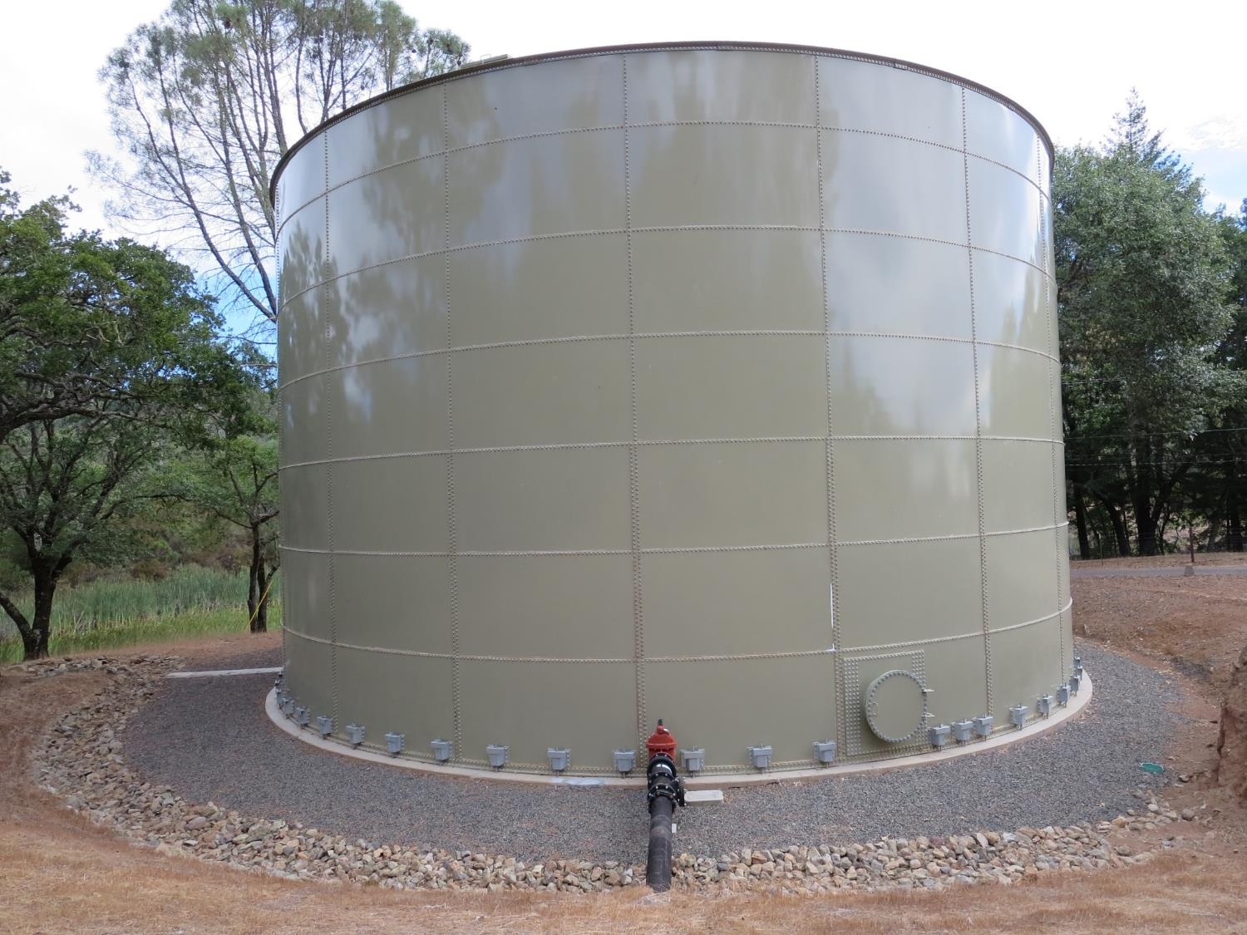
Outlet (bottom)

Slide 16
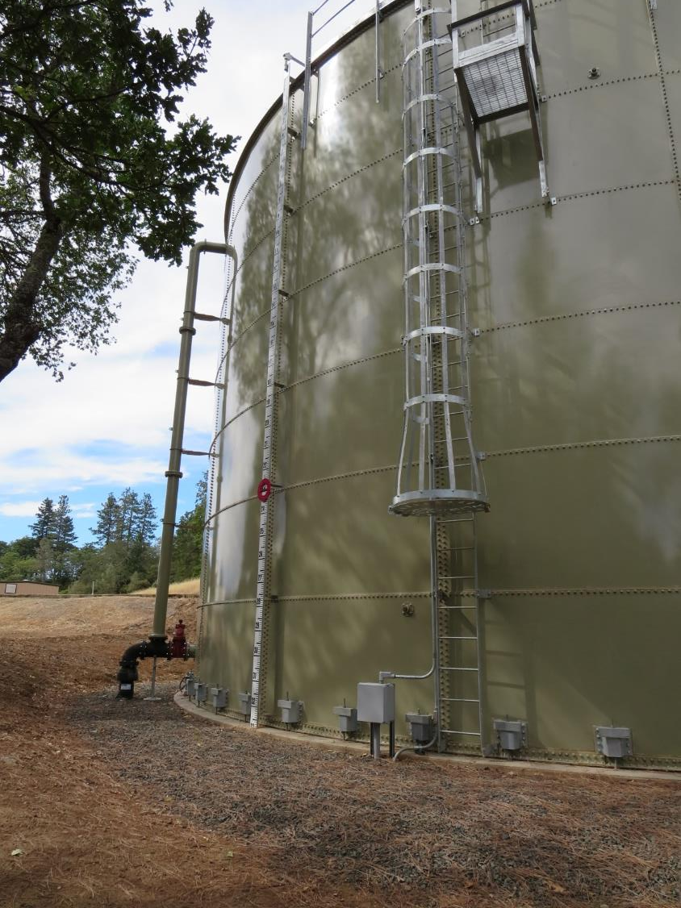
Inlet (bottom or top)

Slide 17
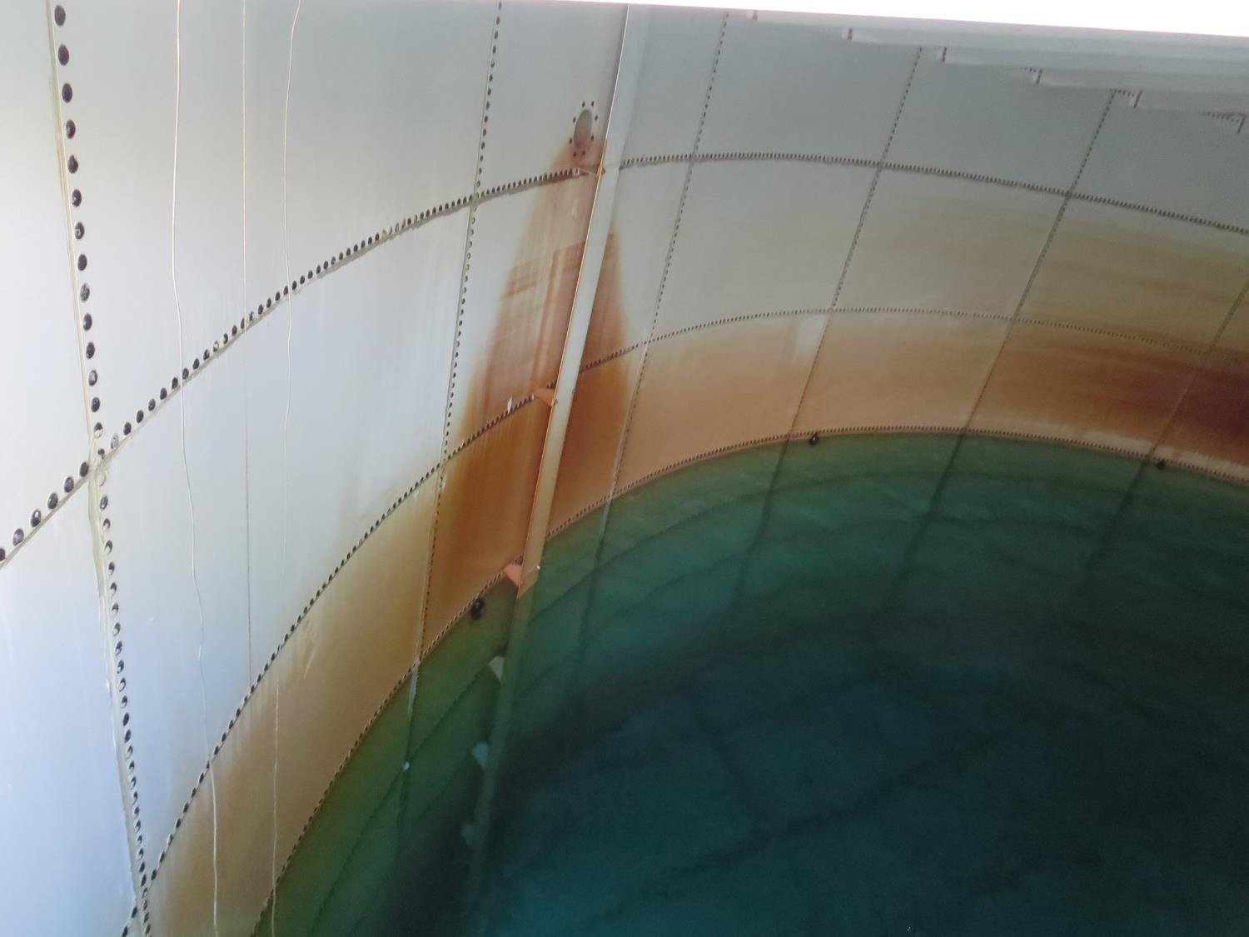
Inlet (Top)
Deflector Plate

Slide 18
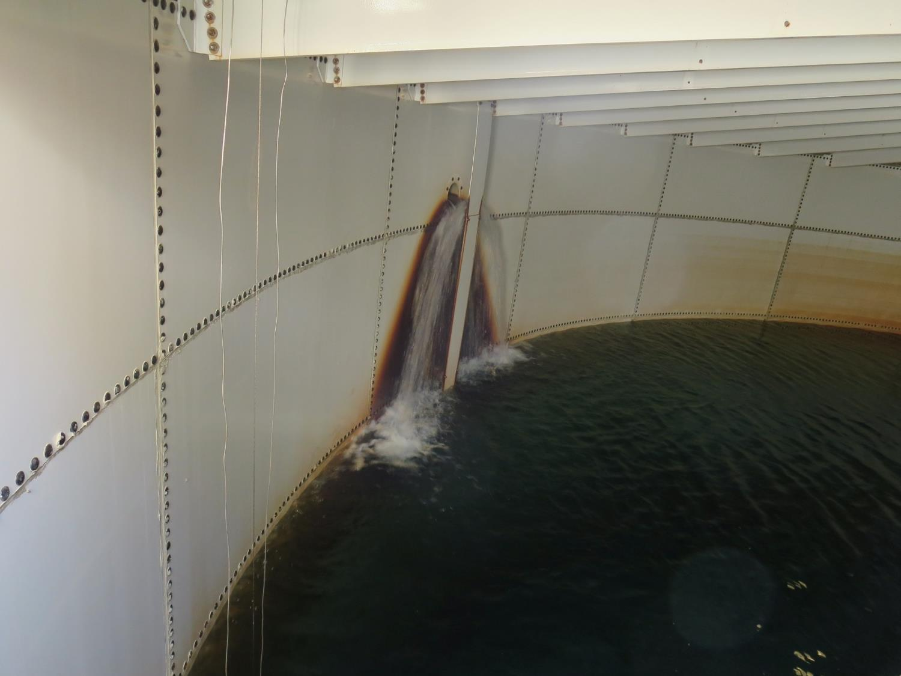
Inlet (Top)

Slide 19
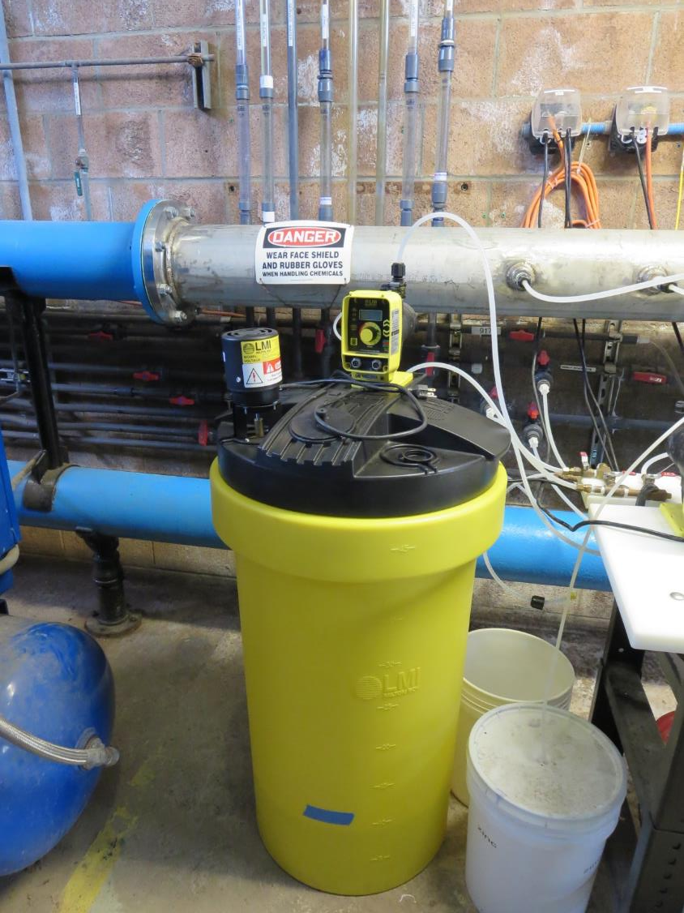
Fluoride Injection System

Slide 20
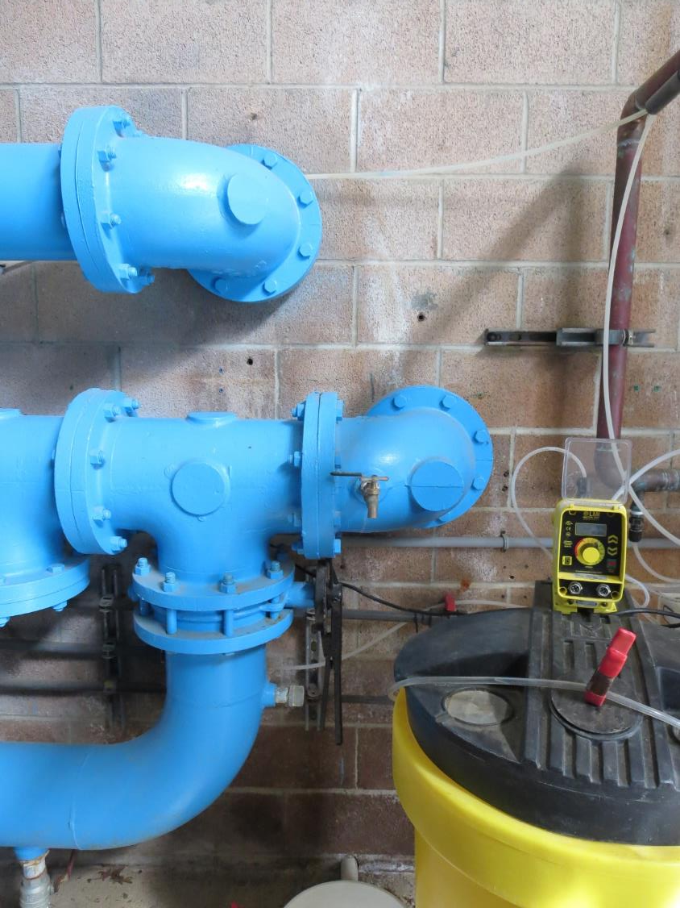
Fluoride Dosage Sampling Point

Slide 21
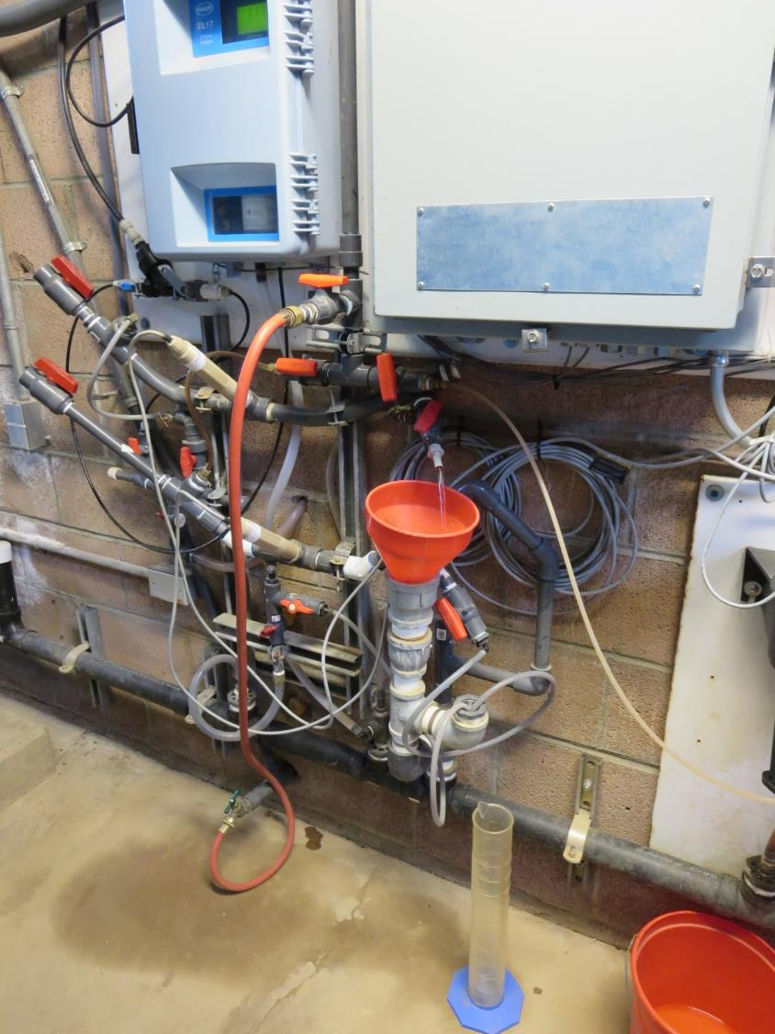
Fluoride sampling point
(after clearwell)

Slide 22
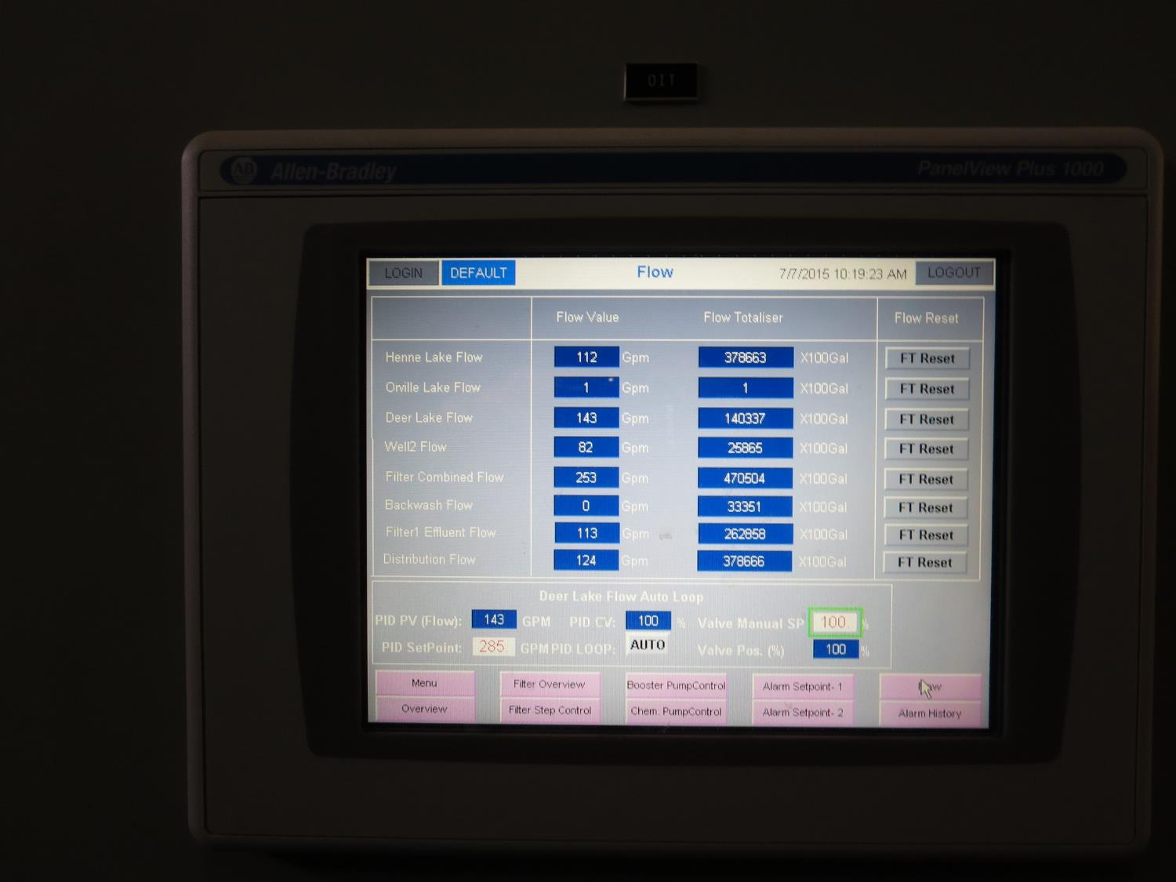
SCADA Info on Plant and Distribution Flows

Slide 23
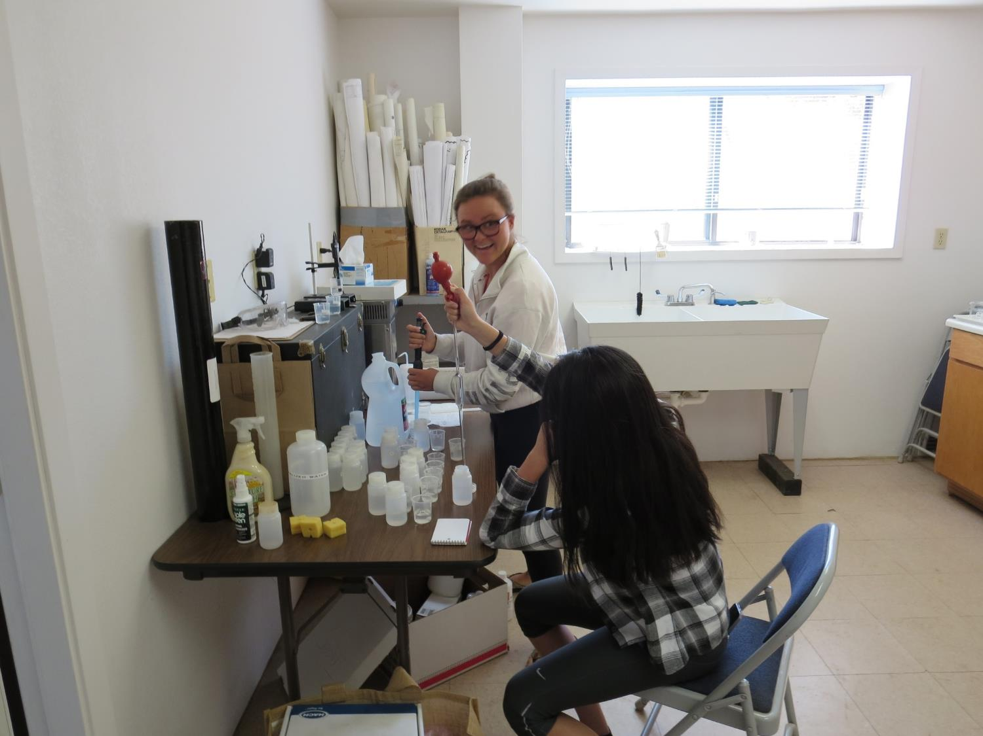
Fluoride Analysis

Slide 24
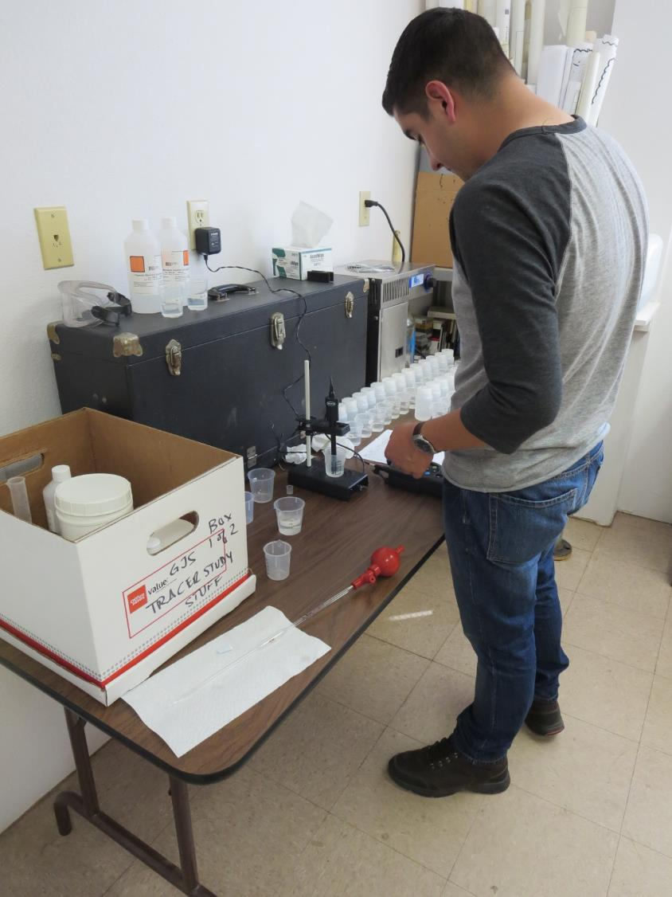
Fluoride Analysis

Slide 25
Modified
Step-Dose Method
Similar to Step-Dose Test
Differences:
  Shorter test duration: tracer is discontinued when >10% of mass has exit reactor (< Theoretical Detention Time)
  Allows for higher dosage (i.e., 4 to 10 mg/L of F⁻)
  Ion selective probes response better and faster at higher salt concentration (i.e. 10% of dosage)
Test Application – suitable for long test duration or when operating conditions up to 3Ƭ is impractical.
Presented at the CA-NV AWWA Oct 25, 2007

Slide 26
Volume₁₀ (V₁₀)
Method
For non-steady-state flows
V₁₀: Is the recorded total volume of water that has exited the reactor from t_{o} to t₁₀ when 10% of the tracer mass has exited the reactor.

