Slide 1
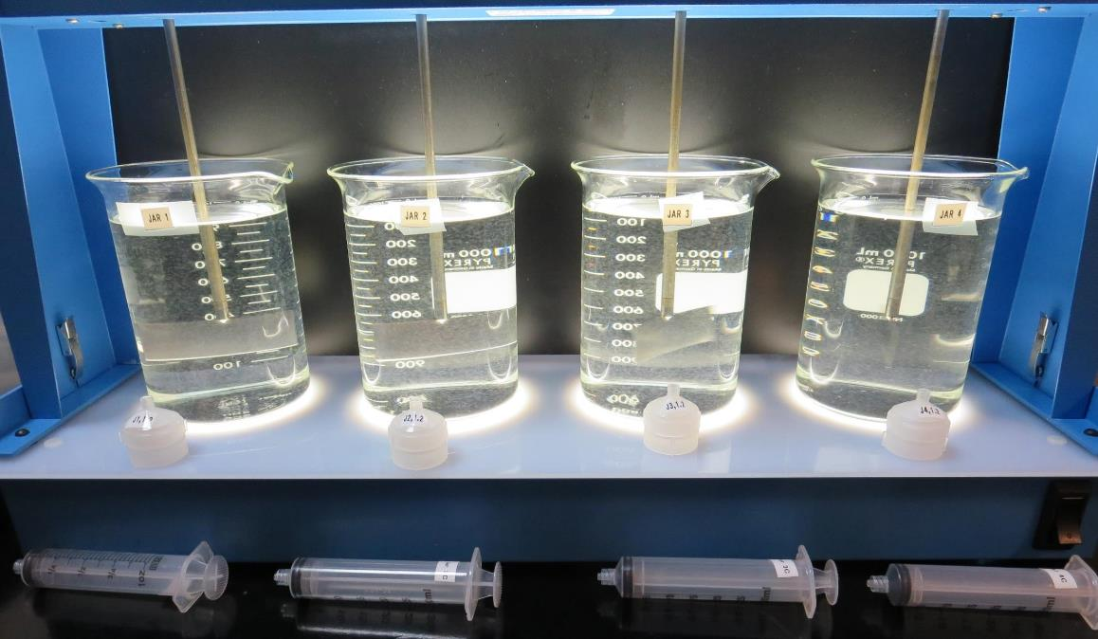
Jar Testing Made Easy CA-NV AWWA, March 26, 2019 by Guy Schott, P.E.
Filterability
Floc Strength
UVA/%UVT
Settleability
Dosages
Coagulants
Sludge Production
Jar Test Procedures
Keep it simple

Slide 2
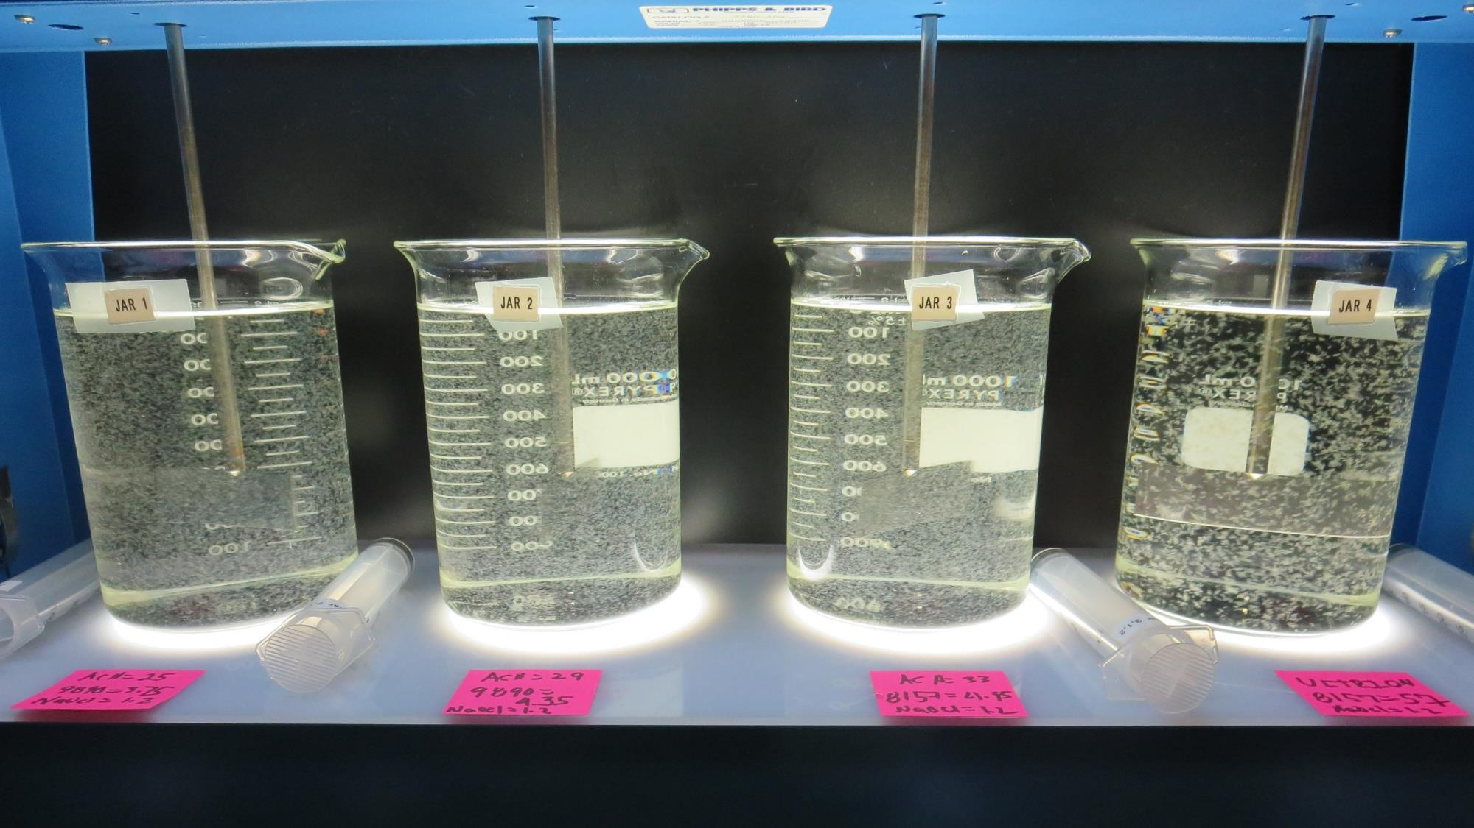
End of flocculation

Slide 3
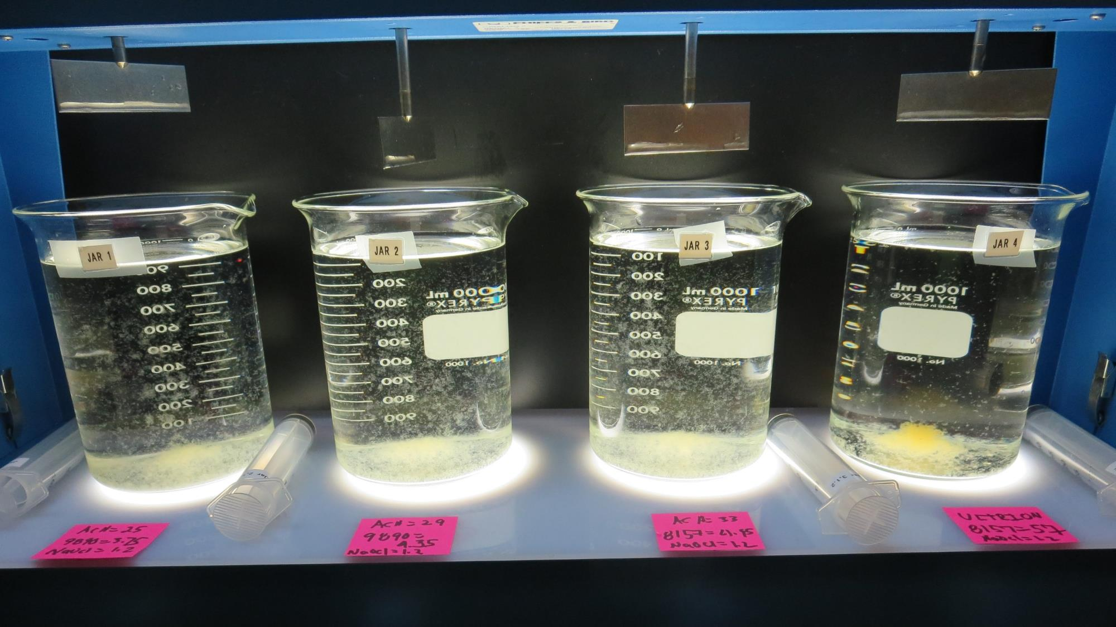
After 5 minutes of settling.

Slide 4
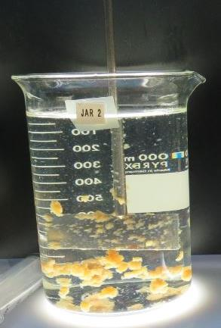
Visibility of Floc Formation/Size
Not necessary a good indicator of settleability and/or filterability.
Physical measurements are needed for proper assessment.

Slide 5
Jar Test Applications
Evaluated 18 drinking water treatment plants in 7 counties over 6 months
Humboldt
Lake
Mendocino
Napa
Shasta
Solano
Stanislaus
Sources
Burton Creek
Clear Creek
Clear Lake (8 Treatment Plants)
Dark Gulch Creek
Eel Creek
Jack Peter’s Creek
Little Potato Slough
Modesto Reservoir
North Bay Aqueduct
Putah South Canal
Rector Reservoir

Slide 6
Jar Test Application – Treatment Plants
Conventional Treatment with Media Filtration
Conventional Treatment with Membrane Filtration
Direct Filtration with Media Filtration
Direct Filtration with Membrane Filtration
Actiflo (ballast sand)
Dissolved Air Flotation (DAF)
Roberts Filtration
Alternative Technologies (Roughing media filter/Multimedia Filtration)

Slide 7
Objectives
Streamline jar testing procedures
Demonstrate the value of jar testing
Onsite training
Encourage operators to conduct own jar testing
Improve filter performance
Reduce disinfection by-products
Optimize chemical application and reduce cost

Slide 8
Tools of Measurement to Assist with Jar Testing
Turbidity Instrument
Portable UV254 Analyzer
Surrogate measurement for TOC/DOC
https://chemtrac.com/portable-uv254-monitor-uvp/
https://realtechwater.com/products/p-series/
Laboratory Charge Analyzer (LCA)
Coagulation optimization tool
Https://chemtrac.com/laboratory-charge-analyzer/
Laboratory DOC Analyzer

Slide 9
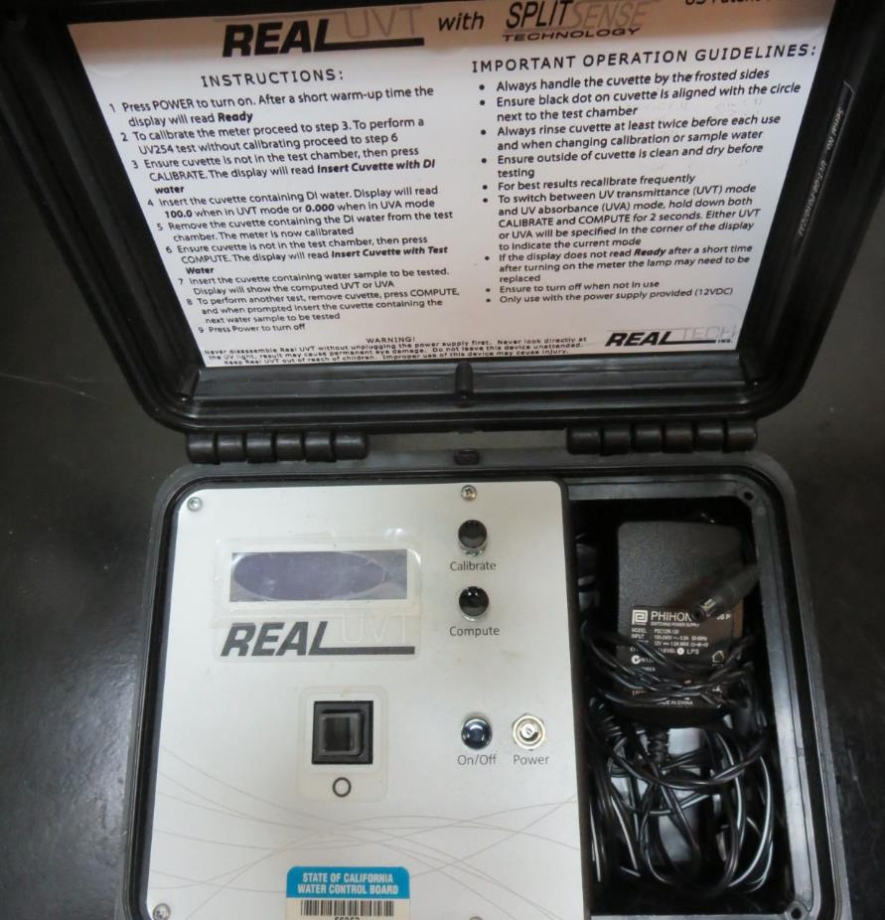
UVT/UVA
UV transmittance or UVT is a measurement of the amount of ultraviolet light (commonly at 254 nm due to its germicidal effect) that passes through a water sample compared to the amount of light that passes through a pure water sample. The measurement is expressed as a percentage, % UVT.
UVA – UV absorbance is calculated as a relative measure of the amount of light absorbed by a water sample compared with the amount of light absorbed by a pure water sample.
UVA = -log(%UVT/100)

Slide 10
Laboratory Charge Analyzer (LCA)
Used to determine coagulant demand of a source water entering the treatment plant.
1 Liter of source water
Automatic titrates coagulant to charge neutralization (~5 minutes)

Slide 11
Jar Testing Available Tools
UVT/UVA Analyzer
Turbidity
Pipette
Laboratory Charge Analyzer
pH probe
Coagulant Stock Solution
Jar Test Equipment
Syringe (filterability test)
Filter Holder
Filters

Slide 12
Jar Test Cases
Coagulant Overdosing
Coagulant Optimization
Pre-Oxidation
Pre-cursor Reduction Optimization
Selection between two Coagulants

Slide 13
1. Coagulant Overdosing
Storm event
High Turbidity (126 NTU)
50% of plant off-line for filter media change out
Filter backwashing once per hour
Backwash storage full
Filtrate turbidity > 0.2 NTU
Settled water turbidity > 11 NTU
Operator overwhelm/not enough sleep
Operator doubles coagulant dosage

Slide 14
Jar Test Results vs Plant (overdosing)
Jar | Coagulant mg/L | Filtrate NTU | Filtrate %UVT | Filtrate UVA/cm | Settled NTU | Filter Run Time, hr | Sludge Lbs./MG
1 | 45 | 0.50 | 89.3 | 0.049 | 2.2 | - | 1,595
2 | 55 | 0.35 | 90.7 | 0.042 | 1.9 |  | 1,621
3 | 65 | 0.18 | 91.6 | 0.038 | 2.4 | - | 1,647
4 | 75 | 0.05 | 91.7 | 0.039 | 2.8 | 6 | 1,673
5 | 85 | 0.14 | 91.4 | 0.039 | 3.2 | - | 1,700
6 | 110 | 0.20 | 92.6 | 0.033 | 7.0 | 1 | 1,763
Plant dosage: 110 mg/L coagulant
Settled: 11 NTU
Filtrate: 0.27 NTU
Source: 126 NTU

Slide 15
2. Coagulant Optimization
Two coagulant dosages that provide good jar test filterability results.
How do you determine which dose to applied?
Evaluate DOC reduction (indirectly) using %UVT or UVA
Evaluate settled water turbidity
Sludge production

Slide 16
Jar Test Results – Chemical Optimization
Jar | Coagulant mg/L | Filtrate NTU | Filtrate %UVT | Filtrate UVA/cm | Settled NTU | Sludge Lbs./MG
1 | 18 | 0.11 | 92.5 | 0.034 | 0.8 | 281
2 | 23 | 0.07 | 92.4 | 0.034 | 0.6 | 294
3 | 28 | 0.05 | 93.2 | 0.031 | 0.8 | 307
3 | 28 | 0.06 | 92.5 | 0.034 | 1.5 | 307
4 | 33 | 0.09 | 93.1 | 0.031 | 1.0 | 320
5 | 63 | 0.04 | 93.7 | 0.028 | 1.4 | 397
Plant dosage: 63 mg/L coagulant
Settled: 0.8 NTU
Filtrate: 0.04 NTU
Source: 20 NTU

Slide 17
3. Pre-Oxidation
Pre-oxidation w/Ozone and/or Chlorine
Improve coagulation process
Improve settleability
Improve filtrate turbidity
Increase %UVT or lower UVA
Reduce chemical dose/Al sludge production

Slide 18
Pre-Oxidation – with/without chlorine
Jar | NaOCl | Coag mg/L | Aid mg/L | Filtrate NTU | Filtrate %UVT | Filtrate UVA/cm | Settled NTU
1 | - | 19 | 4 | 0.06 | 88.4 | 0.054 | 0.39
2 | 2.0 | 19 | 4 | 0.04 | 89.6 | 0.048 | 0.24
3 | - | 23 | 4 | 0.05 | 88.7 | 0.052 | 0.50
4 | 2.0 | 23 | 4 | 0.04 | 89.9 | 0.046 | 0.23
5 | - | 31 | - | 0.06 | 88.8 | 0.052 | 0.24
6 | 2.0 | 31 | - | 0.05 | 90.3 | 0.044 | 0.14
7 | - | 35 | - | 0.05 | 89.3 | 0.049 | 0.30
8 | 2.0 | 35 | - | 0.04 | 90.2 | 0.045 | 0.18

Slide 19
Pre-Oxidation – with & without Ozone
Jar | Ozone added | Coag mg/L | Filtrate NTU | Filtrate %UVT | Filtrate UVA/cm | Settled NTU
1 | No | 35 | 0.12 | 87.4 | 0.058 | 0.7
2 | No | 40 | 0.08 | 88.2 | 0.055 | 0.65
3 | No | 45 | 0.09 | 88.6 | 0.053 | 1.0
4 | No | 50 | 0.09 | 88.7 | 0.052 | 1.2
5 | Yes | 18 | 0.11 | 92.5 | 0.034 | 0.85
6 | Yes | 23 | 0.07 | 92.4 | 0.034 | 0.65
7 | Yes | 28 | 0.05 | 93.2 | 0.031 | 0.80
8 | Yes | 33 | 0.09 | 93.1 | 0.031 | 1.0

Slide 20
4. Out of Compliance with TTHMs/HAA5
Plant Evaluate
Filtrate Turbidities
Coagulants
Pre-oxidation
%UVT/UVA
Conduct Jar Test

Slide 21
4. Out of Compliance with TTHM/HAA5
Jar | Coag mg/L | Coag Aid mg/L | Filtrate NTU | %UVT | UVA/cm
1 | 22 | 6 | 0.05 | 97.5 | 0.011
2 | 32 | - | 0.07 | 97.5 | 0.011
3 | 27 | 4.05 | 0.06 | 97.4 | 0.011
4 | 27 | 4.05 | 0.04 | 97.2 | 0.012
5 | 27 | 4.05 | 0.05 | 96.9 | 0.014
6 | 22 | 3.3 | 0.07 | 96.6 | 0.015
Plant Filtrate
Turbidity: 0.05 NTU
%UVT: 88.9%
UVA: 0.051/cm
Evaluate other coagulants via jar testing.

Slide 22
5. Comparing Coagulant Products
Jar | pH Adj CO₂ | Alum mg/L | ACH mg/L | Filtrate NTU | Filtrate %UVT | Filtrate UVA/cm | Settle NTU | Sludge Lbs./MG
1 | No | - | 28 | 0.06 | 91.5 | 0.048 | 0.3 | 248
2 | Yes | 62 |  | 0.07 | 90.4 | 0.044 | 0.5 | 357
3 | No | 62 |  | 0.07 | 89.6 | 0.048 | 0.5 | 357
4 | No | 76 |  | 0.07 | 90.5 | 0.043 | 0.4 | 414
Source water: 8.4 NTU
Selection may come down to chemical cost and sludge handling.

Slide 23
Jar Testing
Lots of literature on methods/procedures
Hydraulic mixing energies (velocity gradient, G)
Mixing times (1, 5, 15 etc.)
Plant Modeling (flash mixing, flocculation, sedimentation)
Filter indexing
Stock solution preparation
Information can be overwhelming and made more complicated then necessary

Slide 24
Jar Testing Made Easy
A procedure that is easy and straight forward
Completed in a timely matter
Provides useful information
To determine optimum coagulant dosage for optimum filterability/%UVT/cost

Slide 25
Jar Testing (fast & slow mixing settings) 3-Step Equipment Procedures
Flash mix for
1 minute (coagulation)
1
Slow mix (flocculation) for 5 minutes
(10 min for delay floc formation)
2
Settled for
5 & 25 minutes
for measurements
3

Slide 26
Jar Test Results (5 vs 10 min slow mix)
Jar | Floc mix minutes | Chem A mg/L | Chem B mg/L | Filtrate NTU | Filtrate %UVT | Filtrate UVA/cm | Settled NTU
1 | 5 | 8 | - | 0.06 | 97.2 | 0.012 | 5.4
2 | 5 | 8 | - | 0.06 | 97.4 | 0.011 | 5.8
3 | 5 | 9 | - | 0.05 | 97.4 | 0.011 | 7.7
4 | 10 | 8 | - | 0.06 | 97.2 | 0.012 | 2.8
5 | 10 | 8 | - | 0.06 | 97.1 | 0.013 | 3.6
6 | 10 | 9 | - | 0.06 | 97.4 | 0.011 | 3.7
7 | 5 | - | 8.5 | 0.09 | 97.1 | 0.013 | 5.2
8 | 5 | - | 9.5 | 0.07 | 97.4 | 0.011 | 5.3
9 | 10 | - | 8.5 | 0.05 | 97.2 | 0.012 | 4.2
10 | 10 | - | 8.5 | 0.07 | 97.3 | 0.012 | 3.2
11 | 10 | - | 9.5 | 0.06 | 97.2 | 0.012 | 4.0
Increase slow mix time from 5 to 10 minutes when there is a delay in floc formation and poor settleability.
No significant differences in filterability results between 5 and 10 minutes of flocculation.

Slide 27
Floc up to 10 Minutes when Needed
End of 5 minutes of slow mixing
End of 10 minutes of slow mixing
Note: Most waters tested only needed 5 minutes of slow mixing for good settleability.

Slide 28
Jar Testing - Measurements
Filterability (turbidity)/Floc Strength
%UVT/UVA (source and filtrate)
Filtrate chlorine residual
Settleability (turbidity)
Others
DOC

Slide 29
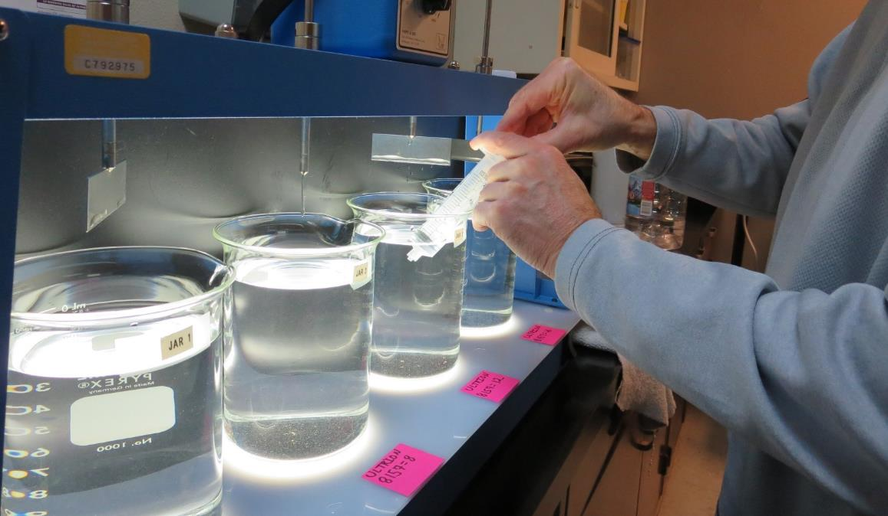
Syringe – for Filterability/Floc Strength Test
After 5 minutes of settling: Place syringe ~1/2-in below surface and pull in 25 mL of water over a time period of 12 seconds (25 mL/12 sec).

Slide 30
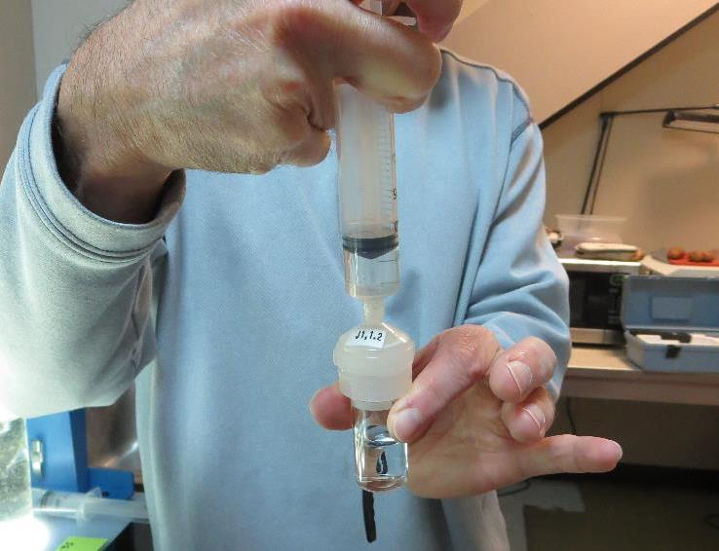
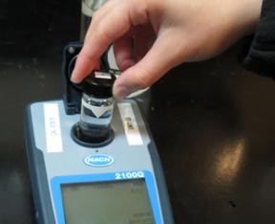
Jar Test - Filterability Test
Syringe ~ 25 mL from jar (after 5 minutes of settling)
Attached filter holder housing 1.2 um membrane filter to syringe
Filter-to-waste 3-5 mL (drip rate)
Filter directly into clean cuvette (drip rate, 15 mL/50-90 sec)
Measure turbidity
Note: Take several readings before recording final NTU results. Micro bubbles can adhered to glass causing false NTU readings. To remove bubbles, tilt cuvette up to 90 degrees.

Slide 31
Filterability and Floc Strength
Filterability is relative to how much solids are removed through a 1.2 um membrane filter.
Floc strength is relative to uniform solids removal through a 1.2 um membrane filter.

Slide 32
Filterability and Floc Strength

Slide 33
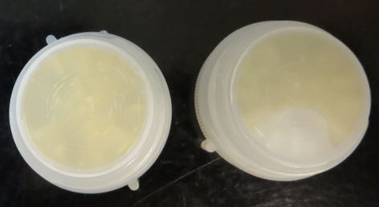
Filterability/Floc Strength Test
Jar | Coag mg/L | Coag Aid mg/L | Filtrate NTU | Filtrate %UVT | Filtrate UVA/cm | Settle NTU
1 | 25 | - | 1.5 | 73.0 | 0.137 | 7.4
2 | 30 | - | 2.8 | 67.5 | 0.171 | 2.3
3 | 35 | - | 1.0 | 82.1 | 0.086 | 1.2
4 | 40 | - | 2.0 | 77.3 | 0.112 | 4.4
5 | 30 | 4.5 | 0.22 | 88.6 | 0.053 | 2.2
6 | 35 | 5.0 | 0.10 | 91.2 | 0.040 | 0.9
7 | 40 | 6.0 | 0.08 | 92.4 | 0.034 | 1.5
8 | 50 | 7.5 | 1.37 | 86.8 | 0.061 | 1.4

Slide 34
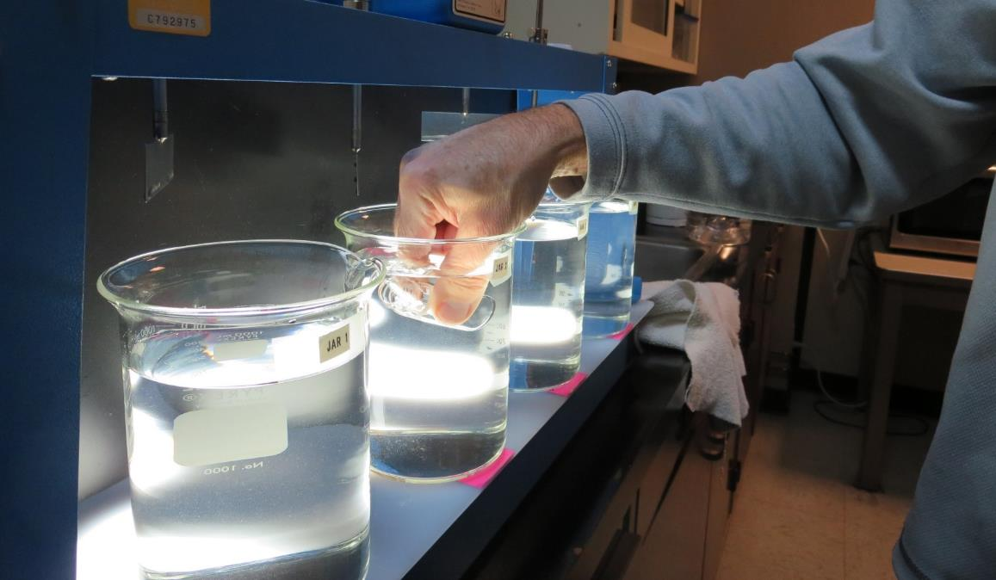
Settleability Test
Assign a designated cuvette for each jar. After 25 minutes of settling, quickly dip cuvette below surface to fill. Do this for each jar and measure settled water turbidity.

Slide 35
Jar Testing – Coagulant and Pre-oxidation
Compare different coagulant dosages
1
Compare #1 with pre-oxidations
2
Compare #1 & #2 with coagulant aid
3
Compare #1-3 with other potential coagulants
4

Slide 36
Jar Testing – Procedures for Most Treatment Plants
Fill jars with source water prior to coagulant injection and set paddle speed at 30 rpm
Add chemicals (i.e., NaOCl, primary coagulant, coagulant aid) to each jar
Flash mix for 1 minute (200 rpm for 1 liter jars; up to 300 rpm for 2 liter jars)
Slow mix for 5 minutes (30 rpm for 1 liter jars, up to 40 rpm for 2 liter jars), (10 minutes for delay floc formation)
Settled for 5 minutes Syringe 25 mL from each jar taken ½-inch below surface (25 mL/12 sec rate)
Filtered through 1.2 um isopore membrane into cuvette drip rate, 15 mL/(50-90 sec)
Measure filtrate turbidity, chlorine residual and %UVT or UVA
Measure settled water turbidity after 25 minutes of total setting
Record all data

Slide 37
Jar Test Filterability Test Equipment
Turbidity Instrument
Syringe w/Luer-Lock Tip, 30 cc
(part#: 2225800, by Hach)
Swinnex Filter Holder, 25 mm (part#: SX0002500)
Isopore Membrane Filter, 1.2 um, 25 mm
(part #: RTTP02500)
http://www.sigmaaldrich.com/

Slide 38
Jar Testing Made Easy – Recap
Keep it Simple
Don’t obsess in trying to model jar testing with plant mixing energies and contact times
Goal is to mix the chemical and form a floc (fast/slow mixing)
Measurements
Filtrate NTU
Filtrate %UVT Settled NTU
Don’t rely on visual floc formation and settleability as optimum dosage
Evaluate
Evaluate results and determine next coarse of action
Repeat
Once optimum dosage is found, repeat test for confirmation.

Slide 39
Practice – Practice - Practice
If you have the will to practice, you will learn. You will gain the experience, insight and confidence to confront the water quality issues that will surely arise.

Slide 40
Contact
Guy Schott, P.E.
State Water Resources Control Board
Division of Drinking Water
Santa Rosa, CA
For Stock Solution/Dosage calculations go to:
https://www.waterboards.ca.gov/drinking_water/programs/districts/mendocino_district.html
Guy.Schott@waterboards.ca.gov
707-576-2732

