Slide 1


Title
March 23-24, 2021

Slide 2
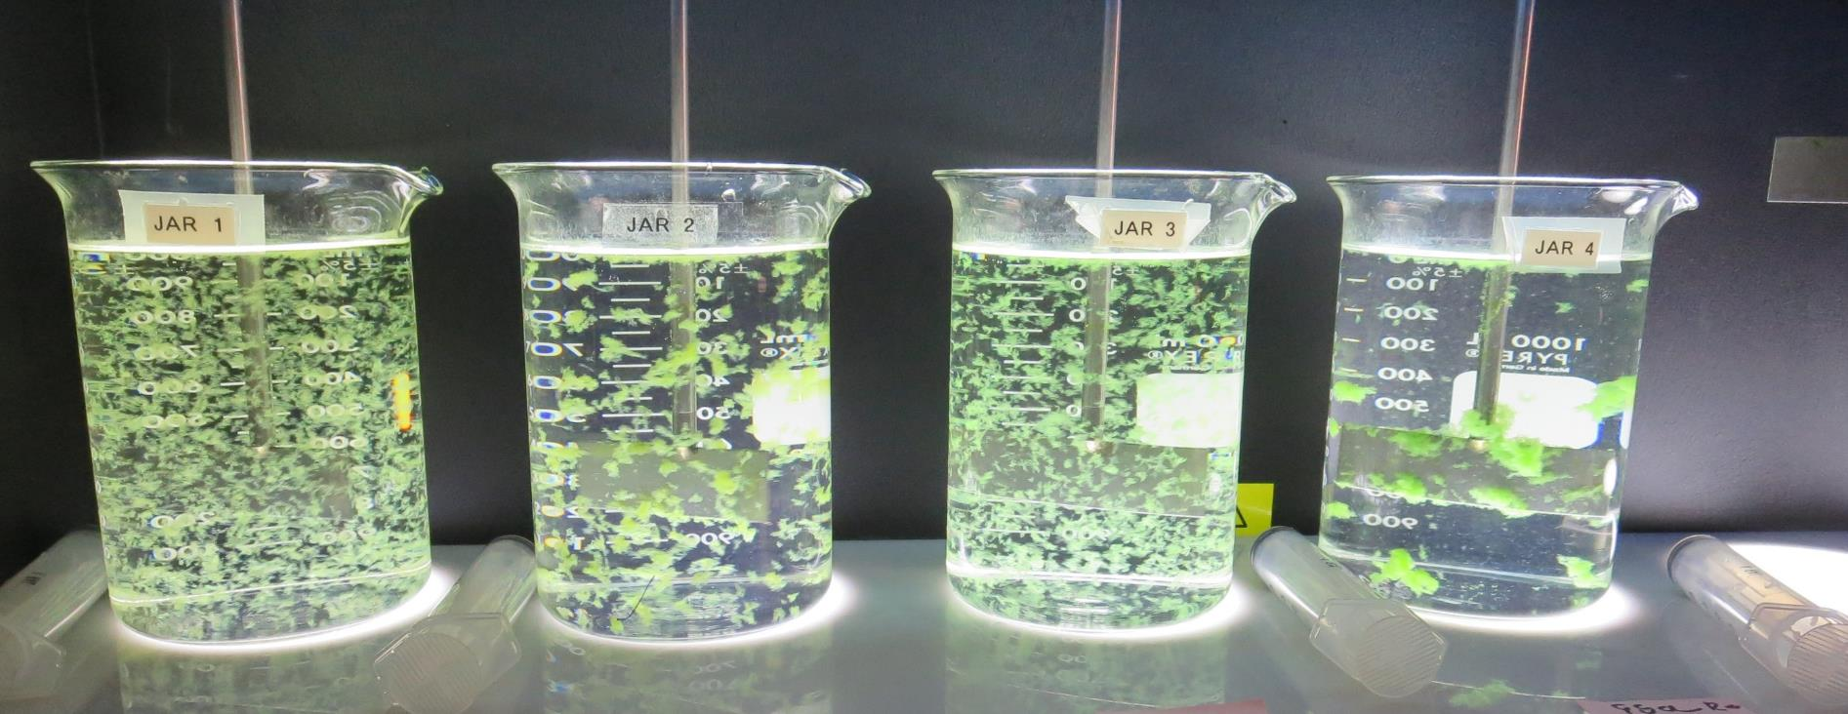
JAR TESTING MADE EASY
CA-NV AWWA OPERATOR SYMPOSIUM
by Guy Schott, P.E.
March 24, 2021

Slide 3
Presentation Overview
Topics
Jar Testing – Application, Research & Assistance
Jar Testing Equipment/Tools
Filterability, UVT/UVA & Settleability Analysis
Jar Test Protocol
Laboratory Charged Analyzer (LCA)
Case Studies
Coagulant Overdosing
Coagulant Under Dosing
Performance with/without Acid
With/without Pre-Oxidation (Ozone/NaOCl/KMnO₄)
Pre-cursor Reduction Optimization (TTHM/HAA5)
Filtrate Chlorine Decay Rate

Slide 4
Settleability - don’t use as the sole source of data to determine optimum coagulant/dose
Why?
No supporting data on floc strength and filterability
No supporting data on indirect DOC reduction (UVA surrogate)
Not all treatment plants have settling
Likely Outcome - underdosing coagulant and DBP issues
Settleability only provides data on floc size and settling performance as it relates to flocculation duration

Slide 5
Jar Testing – What’s Important
Timely, Efficient & Straightforward - (don’t make is complicated)
Completed within 1 hour (prep, testing and analysis)
One set of procedures, methods and analysis that can be applied to most treatment plants
Results that clearly depict which Coagulant(s) and dose that provides optimum
Filterability (NTU, floc strength)
Indirect dissolved organic carbon reduction (UVT/UVA suragate)
Settleability (NTU)
Confidence in your jar testing data that is transferable to plant operations

Slide 6
New Jar Testing Procedures & Analysis Application/Research/Assistance (2018-2021)
16 Counties (California)
45 Public Surface Water Treatment Plants
Plant Size from 30 gpm – 50 MGD
>2,000 Jars
Training

Slide 7
Applied Jar Test Procedures, Methods & Analysis for Various Treatment Plants
(22) Conventional Treatment Plants
with
Media Filtration &
Membrane Filtration
(3) Direct Filtration Plants
with
Media Filtration &
Membrane Filtration
(2) Dissolved Air Flotation (DAF) with
Media Filtration &
Membrane Filtration
(8) Trident & Roberts
Absorption/Contact
Media Filtration
(2) Actiflo
(ballast sand)
with
Media Filtration
(8) Alternative Technologies Roughing Contact Clarifier/Media Filtration &
Inline Filtration

Slide 8
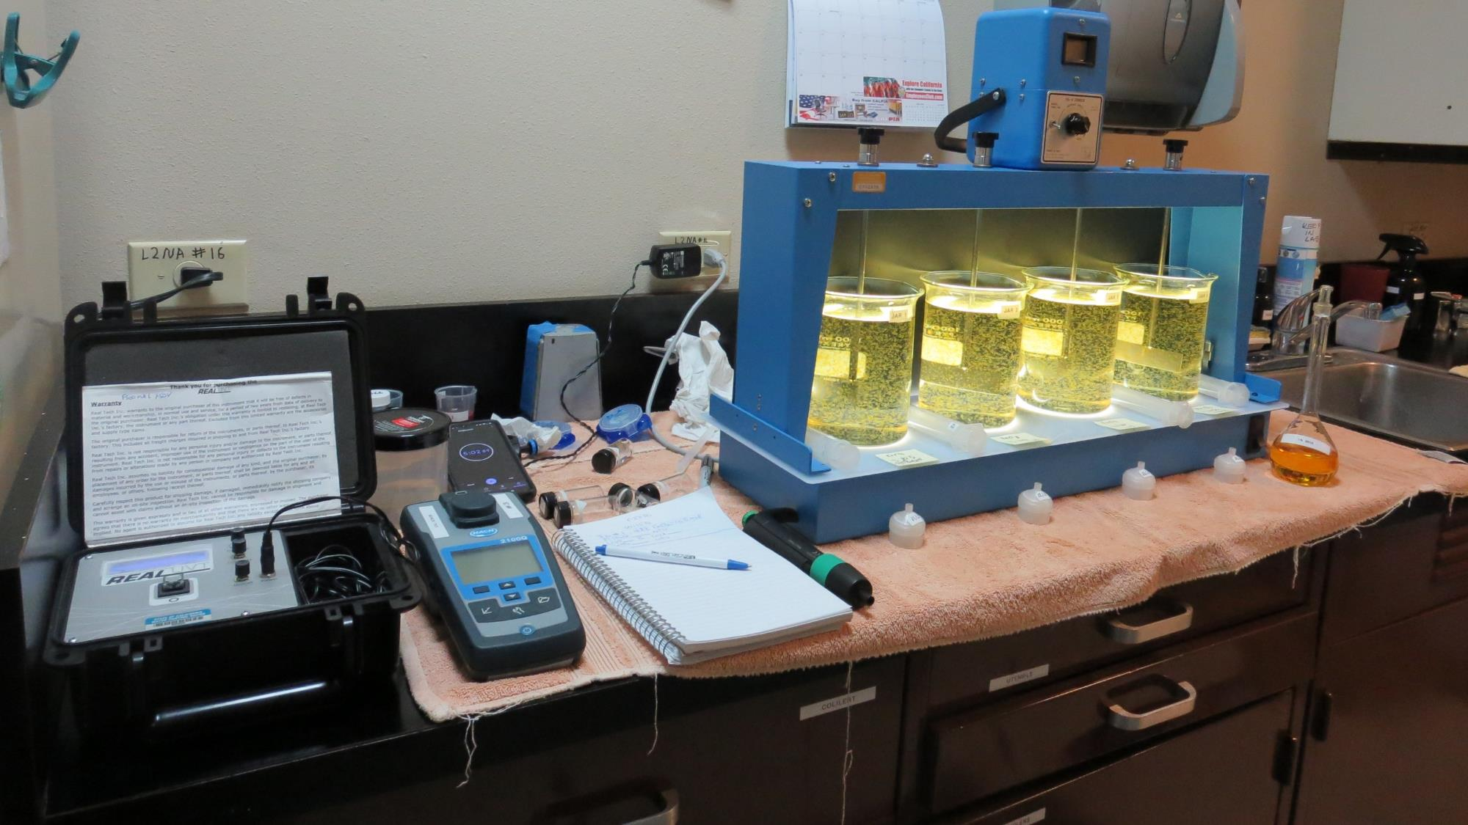
Lab

Slide 9

Filterability Analysis - New
Developed technique and analysis for predicting full-scale media filtration
Material Requires:
  30 mL Syringe w/Luer-Lock Tip
  Filter holder
  1.2 um absolute Isopore membrane filter
Samples collected at end of flocculation period to assess floc strength
Filtration and Analysis: 4 minutes per Jar to complete and record

Slide 10
Filterability Sensitivity Performance –
Plant ID: COB (4 min/Jar)
Jar# | Primary Coagulant mg/L | CatFloc mg/L | Filtrate NTU | Floc Strength
J1 | 46 | 0 | 0.13 | Fair
J2 | 46 | 0 | 0.12 | Fair
J3 | 46 | 0.5 | 0.12 | Fair
J4 | 46 | 1.0 | 0.11 | Fair
J5 | 46 | 1.5 | 0.08 | Good
J6 | 46 | 1.5 | 0.08 | Good
J7 | 46 | 2.0 | 0.06 | Strong
J8 | 46 | 2.0 | 0.05 | Strong

Slide 11
Filterability Sensitivity Performance –
Plant ID: HRCSD (4 min/Jar)
Jar# | Primary Coagulant mg/L | CatFloc mg/L | Filtrate NTU | Floc Strength
J1 | 35 | 0 | 1.06 | Very Weak
J2 | 45 | 0 | 0.66 | Very Weak
J3 | 50 | 0 | 0.28 | Weak
J4 | 55 | 0 | 0.27 | Weak
J5 | 35 | 6.0 | 0.08 | Good
J6 | 45 | 6.0 | 0.05 | Strong
J7 | 50 | 6.0 | 0.04 | Strong
J8 | 55 | 6.0 | 0.05 | Strong

Slide 12
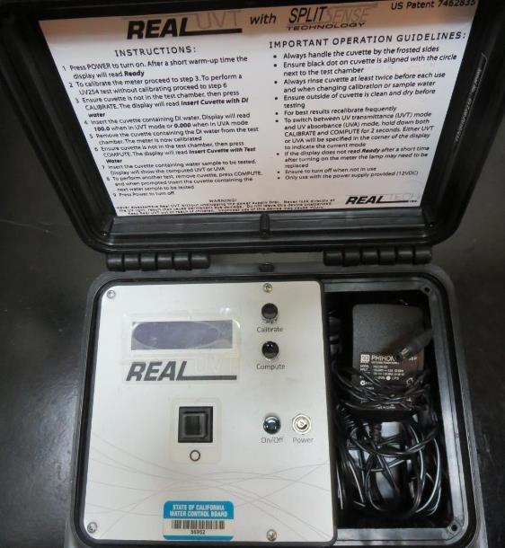
UVT/UVA Instrument, pathlength 10 or 40 mm
UV transmittance (UVT) is a measurement of the amount of ultraviolet light (254 nm) that passes through a water sample compared to the amount of light that passes through a pure water sample. The measurement is expressed as % UVT.
%UVT = 10^{(-UVA)} x 100%
UV absorbance (UVA) is calculated as a relative measure of the amount of light absorbed by a water sample compared with the amount of light absorbed by a pure water sample.
UVA = -log(%UVT/100)

Slide 13
UV-Absorption Analysis
Surrogate for predicting indirect DOC reduction
Compares different jar testing coagulants and doses for best indirect DOC reduction
Systems with DPB issues, UVA measures are critical for determining optimum coagulant and dose
UVA measurements:
  Source (0.4 um Isopore filter)
  Filtrate water from each tested jar (1.2 um Isopore filter)
UVA Analysis: 1 minutes per Jar to complete and record

Slide 14
Chart – Indirect DOC Reduction

Slide 15
Settleability Analysis
Analysis conducted for plants with settling
Relative performance measurements between each jar based on coagulant type, dose and flocculation duration
Samples collected 25 minutes from the end of the flocculation period
Settleability Analysis: 1 minutes per Jar to sample, complete and record

Slide 16
Jar Testing Procedures and Analysis
1. Flash Mix 200 RPM (20-30 sec) | 2. Flocculation 20-30 RPM (5 min) | 3. Filterability & Filtrate %UVT/UVA Analysis | 4. Settleability Analysis
Pipette coagulant into each jar. | Floc for 5 minutes. Lift paddles and lock. | Sample at end of flocculation period for plants without settling. Wait 5 minutes for plants with settling. | After 25 minutes of settling, measure settled water turbidity.

Slide 17
Jar Testing for a Four-Jar Mixer
35 minutes to complete jar testing and analysis
5 ½ minutes of jar testing (20-30 sec, 200 RPM; 5 min, 20-30 RPM)
5-minute wait before 25 mL of water is drawn from each jar
20 minutes Analysis:
  Filtrate Turbidity
  Filtrate %UVT/UVA
  %UVA Reduction (source to treated, calc.)
4 minutes: Settled Water sampled from each jar and turbidity measurements

Slide 18
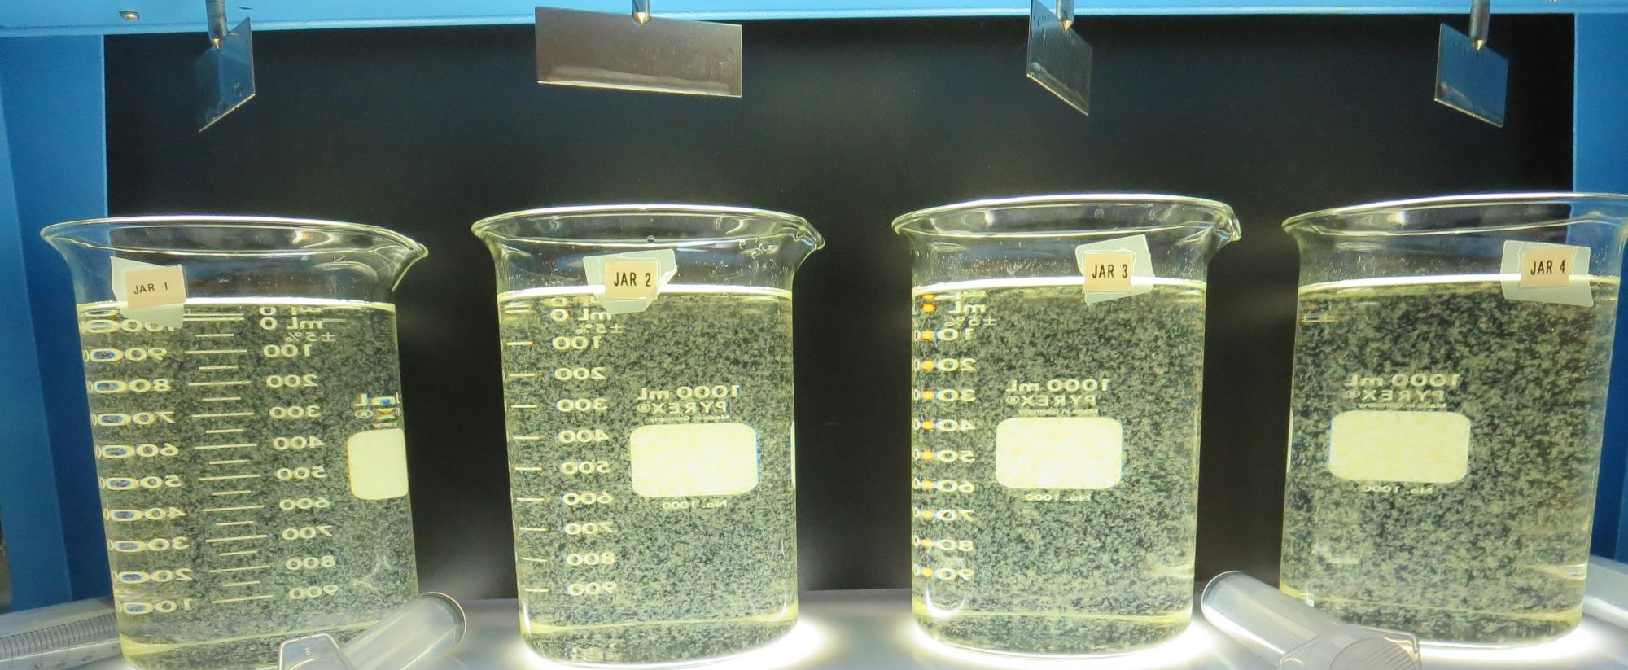
Jars 1-4: End of 5-minute flocculation (30 RPM) duration

Slide 19
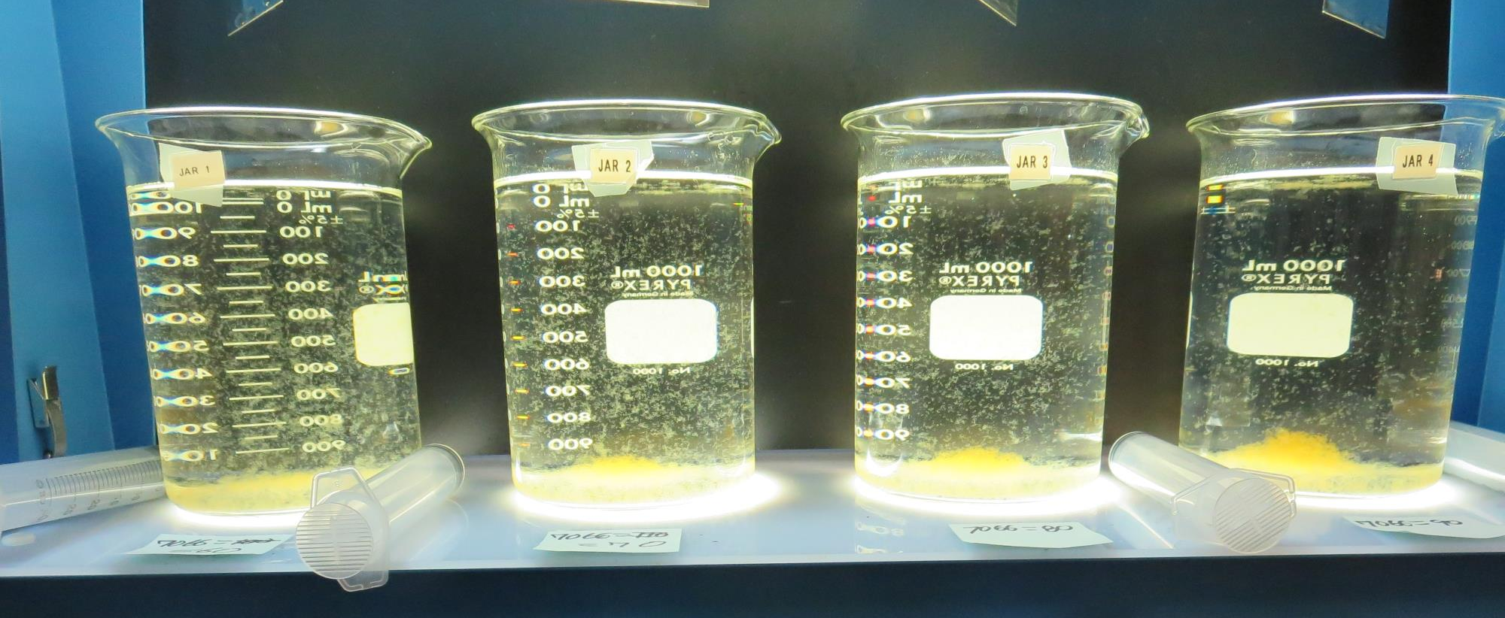
Jars 1-4: After 5 min of settling, 25 mL is syringed for filterability and %UVT/UVA.

Slide 20
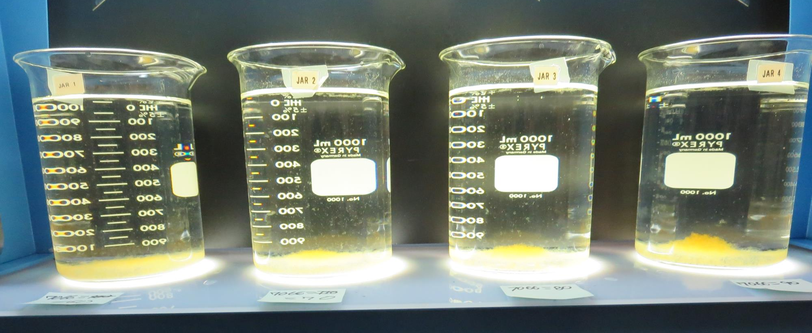
Jars 1-4: After 25-minutes of settling, settled water turbidity is taken.
60 mg/L coagulant
Filtrate 0.18 NTU
UVT: 91.4%
UVA: 0.039/cm
UVA Reduction: 75.9%
Settled: 0.84 NTU
70 mg/L coagulant
Filtrate 0.14 NTU
UVT: 92.9%
UVA: 0.032/cm
UVA Reduction: 80.2%
Settled: 0.42 NTU
80 mg/L coagulant
Filtrate 0.07 NTU
UVT: 94.1%
UVA: 0.026/cm
UVA Reduction: 84.0%
Settled: 0.32 NTU
90 mg/L coagulant
Filtrate 0.06 NTU
UVT: 94.7%
UVA: 0.024/cm
UVA Reduction: 87.7%
Settled: 0.37 NTU

Slide 21
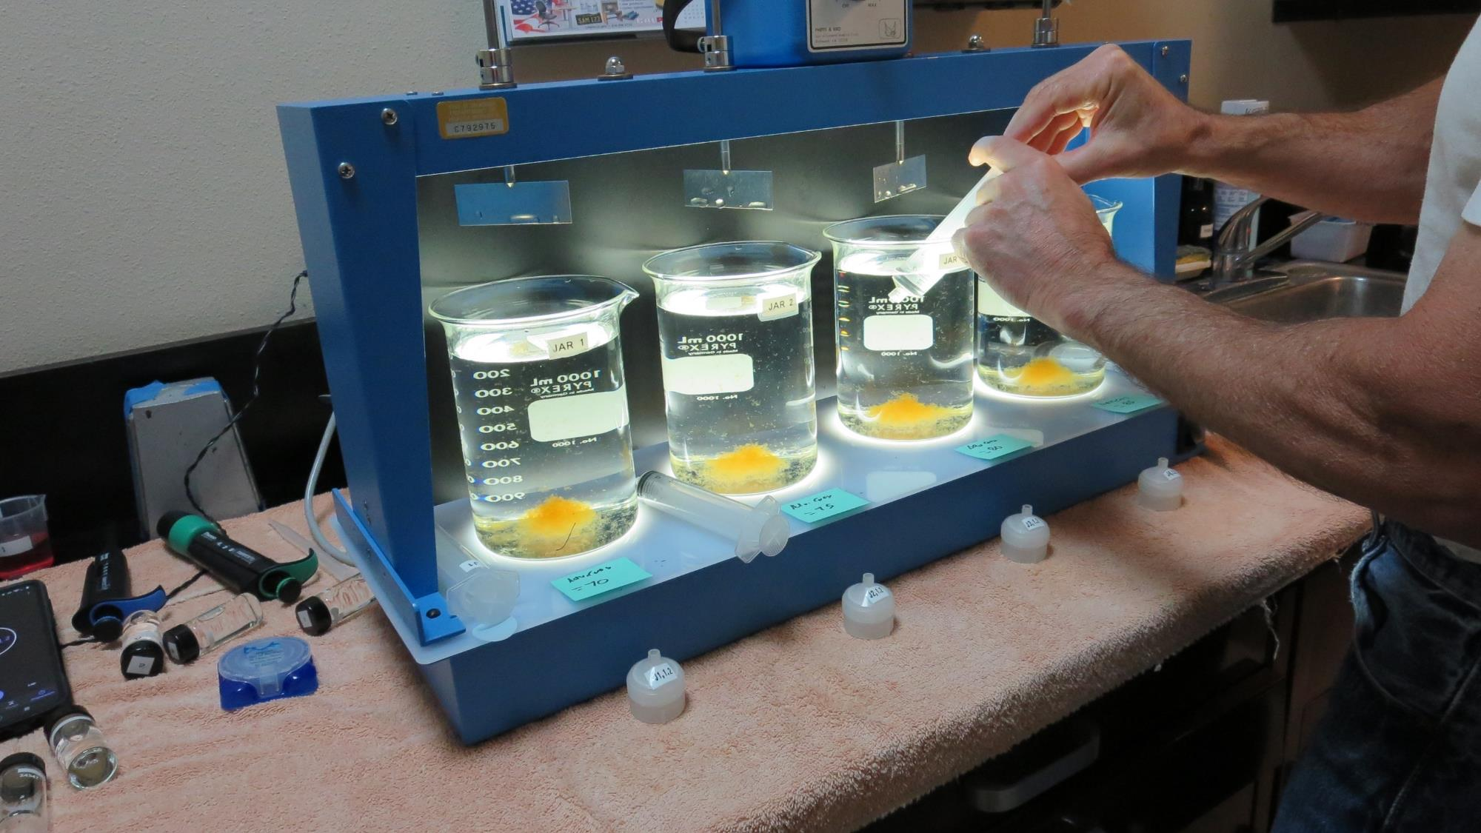
Filterability (25 mL syringed)

Slide 22
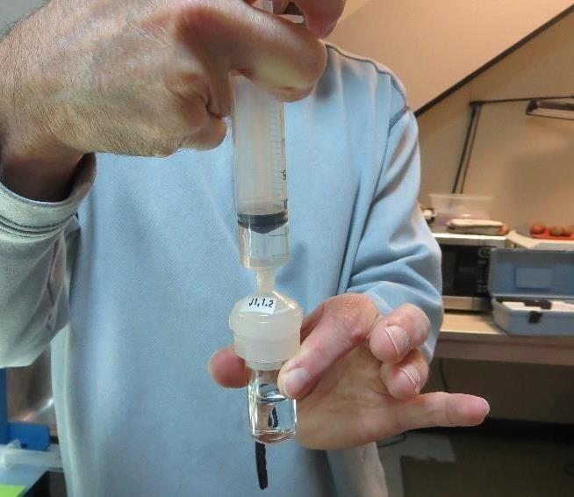
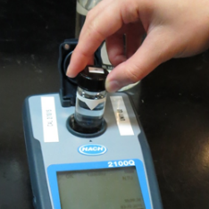
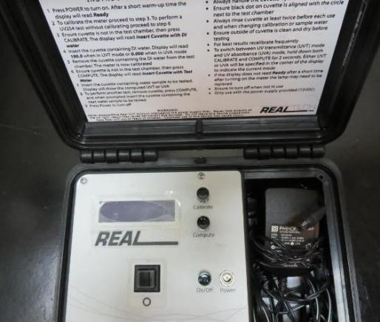
Filterability and UVT/UVA Analysis
Flocculated water is pushed through a 1.2 um absolute Isopore membrane (drip-rate) and measured for turbidity.
Water from cuvette is transferred to UVT/UVA cuvette for measurements.

Slide 23
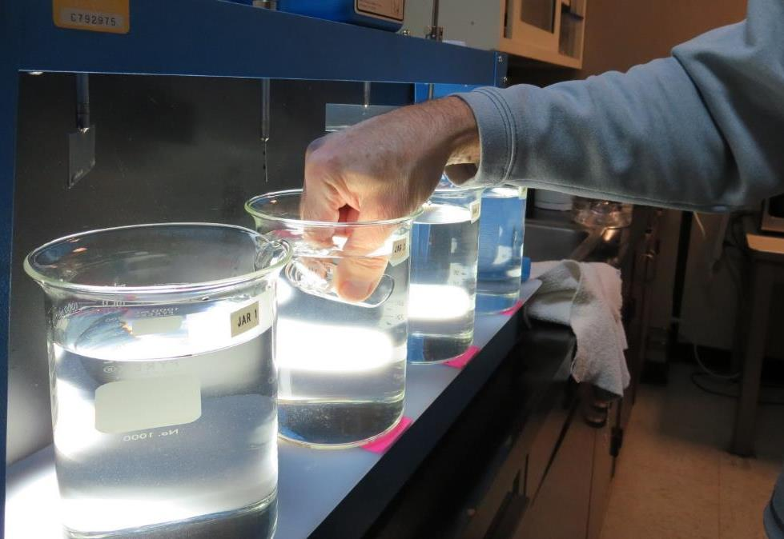
Settleability Test

Slide 24
Jar Test - Flash and Flocculation RPM & Durations
20-30 sec
Flash Mix
(200 RPM)
5 minutes
Floc Mix
(20-30 RPM)

Slide 25
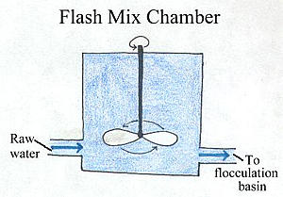
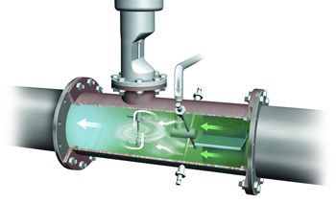
Impact of Flash Mixing – Jar Testing
Inadequate flash mixing can
  negatively impact settleability performance
  May affect filterability in some cases (site specific)
  No affect on indirect DOC reduction
Jar testing: 20-30 seconds (200 RPM) is adequate for dispersing coagulant

Slide 26
Flash Mix Duration (0 – 60 seconds)
Plant ID | 200 RPM Flash, sec | 30 RPM Floc mix min | Coag mg/L | Filtrate NTU | Filtrate %UVT | Filtrate UVA/cm | Settled NTU 25 min
SW | 0 | 5 | 54 | 0.09 | 95.4 | 0.020 | 0.90
SW | 30 | 5 | 54 | 0.08 | 95.8 | 0.019 | 0.53
CW | 0 | 5 | 18 | 0.06 | 89.4 | 0.049 | 0.28
CW | 15 | 5 | 18 | 0.06 | 89.2 | 0.050 | 0.34
CW | 30 | 5 | 18 | 0.07 | 89.3 | 0.049 | 0.36
CW | 60 | 5 | 18 | 0.07 | 89.2 | 0.050 | 0.26
GTD | 0 | 5 | 1.5 | 0.11 | 97.8 | 0.010 | 1.8
GTD | 60 | 5 | 1.5 | 0.08 | 97.2 | 0.012 | 1.4
SC41 | 0 | 5 | 8.0 | 0.13 | 96.8 | 0.014 | 7.0
SC41 | 60 | 5 | 8.0 | 0.10 | 96.6 | 0.015 | 4.8

Slide 27
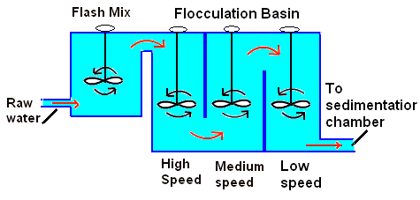
Impact of Flocculation Duration
Flocculation duration only impacts settleability performance
Filterability and Indirect DOC reduction are not affected by flocculation duration
Jar testing: 5 minutes (20 - 30 RPM) is adequate for floc formation

Slide 28
Variable Flocculation Duration (3 – 40 minutes)
Plant ID | 200 RPM Flash, sec | RPM Floc Speed | Floc Mix min | Coag/ Aid mg/L | Filtrate NTU | Filtrate %UVT | Filtrate UVA/cm | Settled NTU 25 min
COC | 30 | 30 | 3 | 38/37 | 0.06 | 94.5 | 0.024 | 1.87
COC | 30 | 30 | 5 | 38/37 | 0.07 | 94.3 | 0.025 | 1.07
COC | 30 | 30 | 10 | 38/37 | 0.06 | 94.4 | 0.024 | 0.82
COC | 30 | 30 | 15 | 38/37 | 0.09 | 94.3 | 0.025 | 0.39
GS | 30 | 30 | 5 | 29/2.9 | 0.08 | 91.7 | 0.038 | 0.38
GS | 30 | 30 | 10 | 29/2.9 | 0.09 | 91.8 | 0.037 | 0.22
GS | 30 | 30 | 20 | 29/2.9 | 0.08 | 91.8 | 0.037 | 0.30
CLO | 60 | 30 | 5 | 23 | 0.08 | 94.8 | 0.023 | 0.48
CLO | 60 | 30 | 10 | 23 | 0.07 | 94.5 | 0.025 | 0.39
CLO | 60 | 30 | 20 | 23 | 0.07 | 94.9 | 0.023 | 0.30
CLO | 60 | 30 | 40 | 23 | 0.07 | 94.9 | 0.023 | 0.36

Slide 29
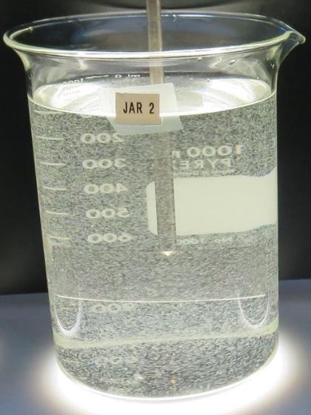
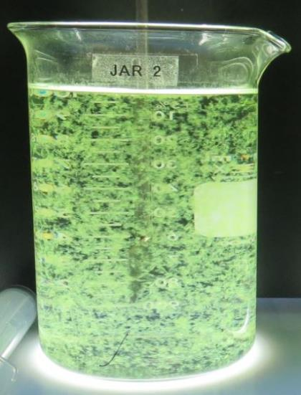
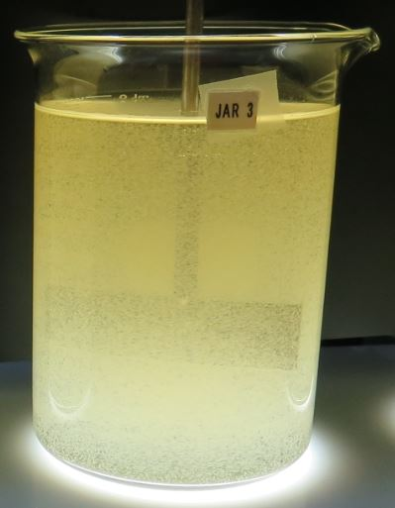
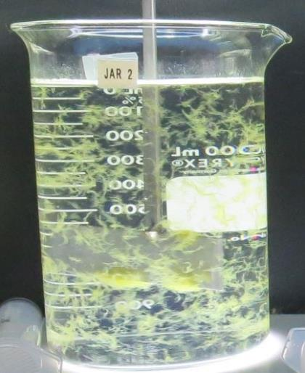
Seasonal Shift in Primary Source Water
Uneventful
Algal Bloom
(Microcystin)
Rain
Event
Algal Bloom (Lyngbya)

Slide 30
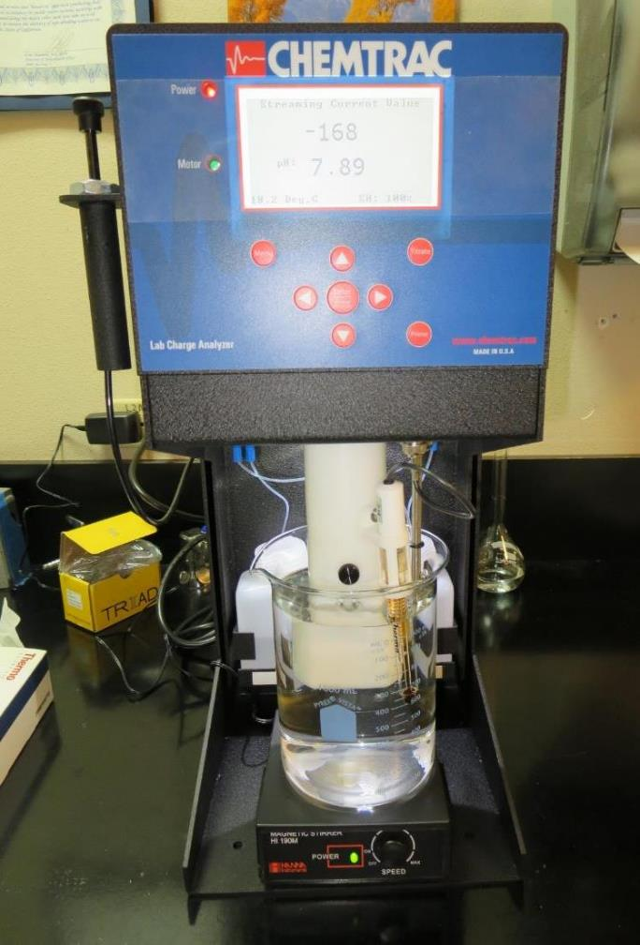
Laboratory Charge Analyzer
Used to determine coagulant demand of a source water entering the treatment plant.
1 Liter of source water
Automatic titrates coagulant to charge neutralization
Tool used for determining starting coagulant dose range for jar testing

Slide 31
Table of LCA coagulant vs. Jar Test Coagulant
Plant ID | LCA Coagulant mg/L | Best Jar Coagulant mg/L | Plant ID | LCA Coagulants mg/L | Best Jar Coagulants mg/L
MK | 27 | 35 | LP | 90 | 90
BHP | 31 | 32.5 | SW | 54 | 54
KCW | 38 | 38 | NMW | 31.8 | 30
HMW | 23.2 | 28 | GS | 28 | 26/2.6
CLO | 31.9 | 35 | CW | 19 | 23
VH | 15 | 16 | CF | 76/5 | 76/5
HV | 29 | 29 | LP | 90 | 90
CW | 19 | 23 | RV | 14 | 14
KC | 35 | 35 | HM | 18.8 | 23
GSD | 12.3 | 12 | SFG | 38.4/4 | 40/4
GTD | 1.6 | 1.5 | PV | 25 | 30
FSP | 8.7 | 9.0 | KsC | 14.5 | 14.5
HH | 101 | 105 | SH | 32 | 34
COC | 36 | 36 | AC | 192 | 190
MID | 9.45 | 9.5 | SC41 | 7.5 | 8.0

Slide 32
Jar Test Cases
Coagulant Overdosing
Coagulant Under Dosing
With/without Pre-Oxidation (NaOCl/Ozone/KMnO₄)
With/without Acid
Pre-cursor Reduction Optimization (TTHM/HAA5)
Filtrate Chlorine Decay Rate

Slide 33
Case 1. Coagulant Overdosing – Storm Event
Source turbidity: 126 NTU, storm event
50% of plant off-line for filter media change out
Plant settled water turbidity > 11 NTU
Filter backwashing once per hour
Plant filtrate turbidity: 0.27 NTU
Operator overwhelmed/not enough sleep
Operator doubles coagulant dose: 110 mg/L

Slide 34
Case 1. Jar Test Results vs Plant
(coagulant overdosing, 110 mg/L)
Jar # | Coagulant mg/L | Filtrate NTU | Filtrate %UVT | Filtrate UVA/cm | Settled NTU
J1 | 45 | 0.50 | 89.3 | 0.049 | 2.2
J2 | 55 | 0.35 | 90.7 | 0.042 | 1.9
J3 | 65 | 0.18 | 91.6 | 0.038 | 2.4
J4 | 75 | 0.05 | 91.7 | 0.039 | 2.8
J5 | 85 | 0.14 | 91.4 | 0.039 | 3.2
J6 | 110 | 0.20 | 92.6 | 0.033 | 7.0

Slide 35
Case 1. Jar Test Results versus
Adjusted Plant Coagulant Dose
Jar Test Results
Coagulant Dose: 75 mg/L
Filtrate: 0.05 NTU
Settled: 2.8 NTU
Plant Results
Coagulant Dose: 75 mg/L
Filtrate: 0.05 NTU
Settled: 2.0 NTU
Filter Run time (increased from 1 to 6 hrs.)

Slide 36
Case 2. Coagulant Under dosing
Source turbidity: 7.8 NTU
Plant settled water turbidity ~ 1 NTU
Plant filtrate turbidity: 0.09 NTU
Has aeration for TTHMs reduction
%TOC Reduction not being met
Plant dose (Coag 1 = 3.4 mg/L, Coag 2 = 3.0 mg/L)

Slide 37
Case 2. Jar Test Results versus Plant
(coagulant under dosing, 3.4/3 mg/L)
Jar # | Coag 1 mg/L | Coag 2 mg/L | Filtrate NTU | Filtrate %UVT | Filtrate UVA/cm | %UVA Reduction | Settle NTU 25 min
J1 | 3.4 | 3.0 | 0.23 | 89.1 | 0.050 | 15.3 | 1.06
J2 | 24 | 0 | 0.10 | 92.6 | 0.033 | 44.1 | 0.33
J3 | 23 | 1.0 | 0.10 | 92.6 | 0.033 | 44.1 | 0.31
J4 | 22 | 2.0 | 0.12 | 92.5 | 0.033 | 44.1 | 0.33
J5 | 21 | 3.0 | 0.07 | 92.8 | 0.032 | 45.8 | 0.33

Slide 38
Case 3. Pre-Oxidation
Ozone – Chlorine – KMnO₄
Improve coagulation process
Improve settleability
Improve filtrate turbidity
Improve indirect DOC reduction
Longer filter runs
Reduce sludge production

Slide 39
Case 3.1. Pre-Oxidation – with & without Ozone
Jar # | Ozone added | Coag mg/L | Filtrate NTU | Filtrate %UVT | Filtrate UVA/cm | %UVA Reduction | Settled NTU
1 | No | 35 | 0.12 | 87.4 | 0.058 | 36.2 | 0.7
2 | No | 40 | 0.08 | 88.2 | 0.055 | 39.6 | 0.65
3 | No | 45 | 0.09 | 88.6 | 0.053 | 41.8 | 1.0
4 | No | 50 | 0.09 | 88.7 | 0.052 | 42.9 | 1.2
5 | Yes | 18 | 0.11 | 92.5 | 0.034 | 62.6 | 0.85
6 | Yes | 23 | 0.07 | 92.4 | 0.034 | 62.6 | 0.65
7 | Yes | 28 | 0.05 | 93.2 | 0.031 | 65.9 | 0.80
8 | Yes | 33 | 0.09 | 93.1 | 0.031 | 65.9 | 1.0

Slide 40
Case 3.2. Pre-Oxidation – with & without KMnO₄
Same Source – Constant dose/compares two coagulants
Jar # | KMnO₄ Added | Coag #1 mg/L | Coag #2 mg/L | CatFloc mg/L | Filtrate NTU | Filtrate %UVT | Filtrate UVA/cm | Settle NTU 25 min
J1 | No | 70 | 0 | 6.0 | 0.08 | 87.0 | 0.060 | 6.45
J2 | Yes | 70 | 0 | 6.0 | 0.05 | 90.7 | 0.042 | 3.14
J3 | No | 0 | 160 | 6.0 | 0.10 | 90.8 | 0.041 | 3.69
J4 | Yes | 0 | 160 | 6.0 | 0.05 | 92.1 | 0.035 | 0.93

Slide 41
Note on Chlorine Pre-Oxidation
Generally:
For a given coagulant dose, there will be an increase in %UVT or decrease in UVA when chlorine is added. It is believed that some of the DOC is converted to disinfection by-products giving a false indication of improved DOC reduction via coagulation.

Slide 42
%UVA Reduction via
Source Water Pre-Chlorination

Slide 43
Case 4: Conventional Treatment with Pressure Driven Membrane Filtration
Goals:
Optimize indirect DOC reduction (UVA surrogate)
Optimize solids loading to membrane filters (settleability)
pH adjustment via acid addition to optimize the coagulation process.

Slide 44
Case 4. Performance – with/without Acid
Source pH: 8.92, Alk: 158 mg/L CaCO3
Jar # | H₂SO₄ mg/L | Coag. mg/L | pH Unit | Filtrate %UVT | Filtrate UVA/cm | %UVA Reduction | Settle NTU 25 min
J1 | 0 | 40 | 8.6 | 89.5 | 0.047 | 40.5 | 0.40
J3 | 0 | 60 | 8.4 | 90.1 | 0.045 | 43.0 | 0.40
J2 | 30 | 40 | 7.0 | 91.1 | 0.040 | 49.4 | 0.47
J4 | 30 | 60 | 6.95 | 92.0 | 0.036 | 54.4 | 0.38

Slide 45
Case 5. Out of Compliance with TTHMs/HAA5s
Jar tested source water over a 12-month period (12 coagulants)
Compare coagulants/doses to filterability and %UVT/UVA
Selected best performing coagulant
Conducted side-by-side study (Treatment Trains 1 & 2)
Compare Filtrate turbidity and %UVT/UVA
Spike filtrate samples with 2.0 mg/L NaOCl
Held for 7-days
Tested TTHMs/HAA5s

Slide 46
Case 5. Trains 1 and 2, On-site Study –
*Results 1-liter filtrate samples were taken from each treatment train and spiked with 2.0 mg/L NaOCl and held for 7-days, TTHMs/HAA5s analyzed.
Train # | Coagulant | Filtrate NTU | %UVT | UVA/cm | %UVA Reduction | *TTHMs ug/L | *HAA5s ug/L
1 | New Coagulant | 0.06 | 97.2 | 0.012 | 91.1 | 43 | 9.9
2 | Original Coagulant | 0.07 | 90.8 | 0.042 | 68.9 | 110 | 49

Slide 47
Case: 6 Jar Test – Filtrate Water Spiked with 2.2 mg/L NaOCl
Plant Coagulant Dose vs. Optimum Dose and Coagulant

Slide 48
Jar Testing Made Easy – Recap
Keep it Simple
Don’t obsess in trying to model jar testing with plant mixing energies and contact times
Goal is to mix the chemical and form a floc (fast/slow mixing)
Measurements
Filtrate NTU
Filtrate %UVT/UVA Settled NTU
Don’t rely on visual floc formation and settleability as optimum dose
Evaluate
Evaluate results and determine next course of action
Repeat
Once optimum dose is found, repeat test for confirmation.

Slide 49
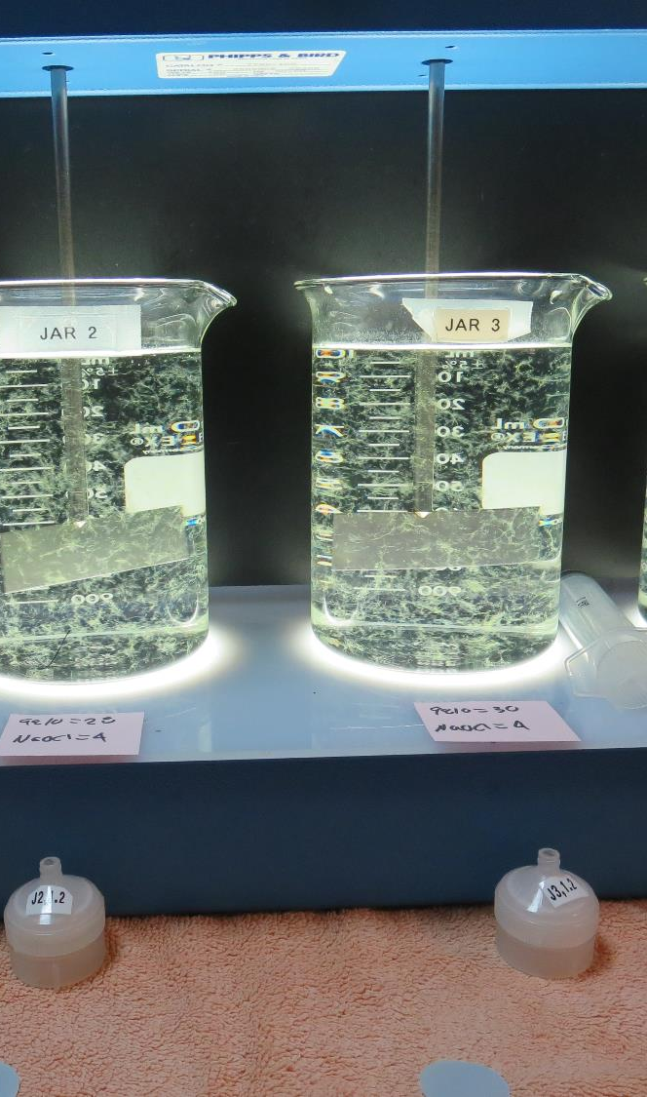
Practice – Practice – Practice
(minimum of 100 hours of practice)
Jar testing should be performed regularly during non-water quality events to develop and maintain the necessary skills and confidence to be able to confront real water quality changes.
Initial skill and confidence building will require several hours (~100 hours) of jar testing and practice.

Slide 50

Thank you for attending!
Contact and Links
Guy Schott, P.E.
State Water Resources Control Board
Division of Drinking Water
Santa Rosa, CA
Go to Jar Test Results/Procedures for tools to download
www.waterboards.ca.gov/drinking_water/programs/districts/mendocino_district.html
Email: Guy Schott - Guy.Schott@waterboards.ca.gov
Office Number: 707-576-2732

