Slide 1


Annual Fall Conference 2020
October 26-29, 2020

Slide 2
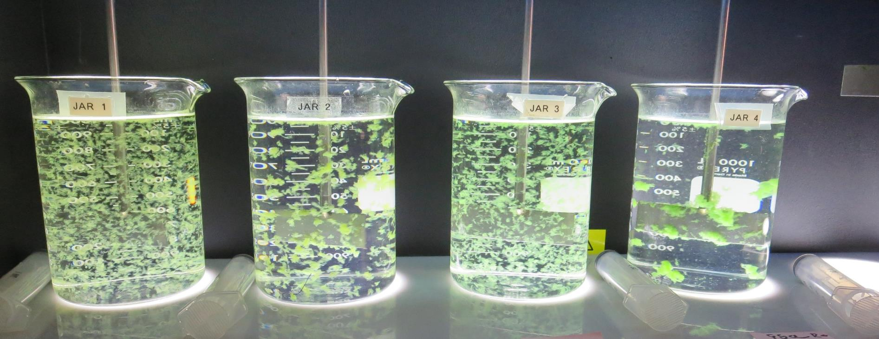
JAR TESTING MADE EASY
CA-NV AWWA FALL CONFERENCE
by Guy Schott, P.E.
October 29, 2020

Slide 3
Presentation Overview
Topics
Jar Testing – Application, Research & Assistance
Equipment/Tools
Jar Test Protocol
Filterability & UVT/UVA analysis
Case Studies
Coagulant Overdosing
Coagulant Under Dosing
Coagulant Optimization (point of diminishing return)
With/without Acid
With/without Pre-Oxidation (Ozone/NaOCl/KMnO₄)
Pre-cursor Reduction Optimization (TTHM/HAA5)

Slide 4
Jar Testing – What’s Important
Timely & Efficient - completed within 1 hour (prep, testing and analysis)
One set of procedures, methods and analysis
Procedures: The order of steps to be completed
Method: The technique for each procedural step
Analysis: Turbidity and UVT/UVA
Coagulant(s) and dose that provides optimum
Filterability (NTU, floc strength)
Indirect dissolved organic carbon reduction (UVT/UVA)
Settleability (NTU)
Confidence in your jar testing data that is transferable to plant operations

Slide 5
Jar Test Application/Research/Assistance (2018-2020)
14 Counties (California)
40 Public Surface Water Treatment Plants
11 of those Plants Visited Multiple Times
Plant Size from 30 gpm – 50 MGD
>1,800 Jars
Training

Slide 6
Applied Jar Test Procedures, Methods & Analysis for Various Treatment Plants
(20) Conventional Treatment Plants
with
Media Filtration &
Membrane Filtration
(3) Direct Filtration Plants
with
Media Filtration &
Membrane Filtration
(2) Dissolved Air Flotation (DAF) with
Media Filtration &
Membrane Filtration
(5) Trident & Roberts
Absorption/Contact
Media Filtration
(2) Actiflo
(ballast sand)
with
Media Filtration
(8) Alternative Technologies Roughing Contact Clarifier/Media Filtration &
Inline Filtration

Slide 7
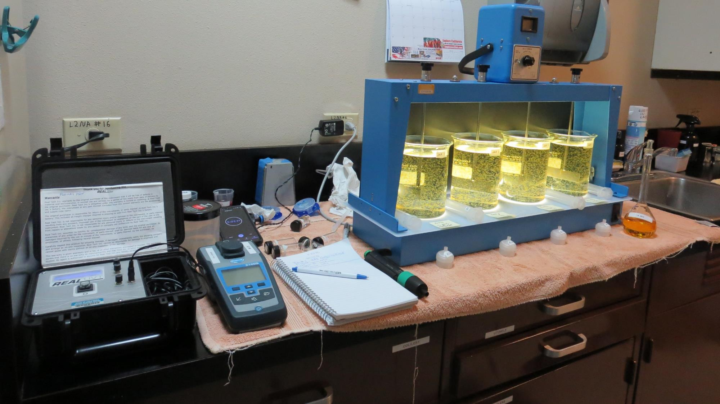
Lab

Slide 8

Jar Test
Filterability Test Equipment
Turbidity Instrument
Syringe w/Luer-Lock Tip, 30 cc
(part#: 2225800, by Hach)
Swinnex Filter Holder, 25 mm (part#: SX0002500)
Isopore Membrane Filter, 1.2 um absolute
pore size,
Φ= 25 mm , thickness: 24 um,
hydrophilic polycarbonate membrane
(part #: RTTP02500)
Go to Sigma-Aldrich for laboratory supplies http://www.sigmaaldrich.com/united-states.html

Slide 9
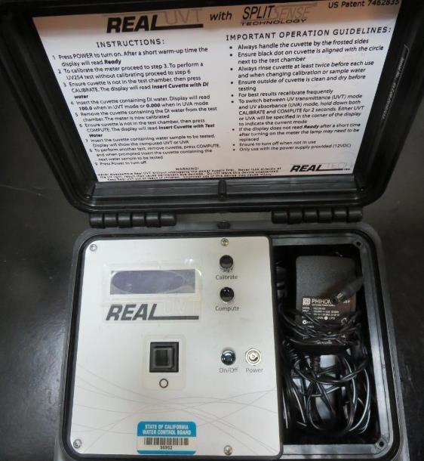
UVT/UVA
UV transmittance (UVT) is a measurement of the amount of ultraviolet light (commonly at 254 nm due to its germicidal effect) that passes through a water sample compared to the amount of light that passes through a pure water sample. The measurement is expressed as a percentage, % UVT.
%UVT = 10^{(-UVA)} x 100%
UV absorbance (UVA) is calculated as a relative measure of the amount of light absorbed by a water sample compared with the amount of light absorbed by a pure water sample.
UVA = -log(%UVT/100)

Slide 10
Chart – Indirect DOC Reduction

Slide 11
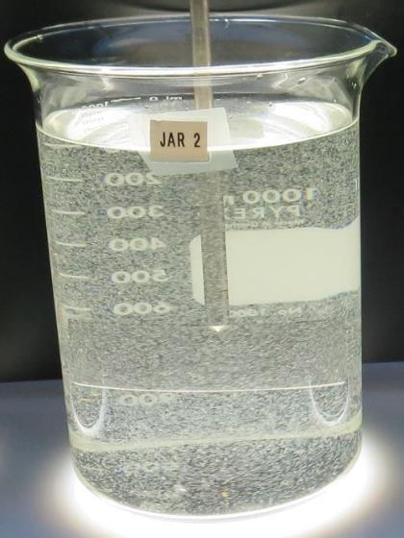
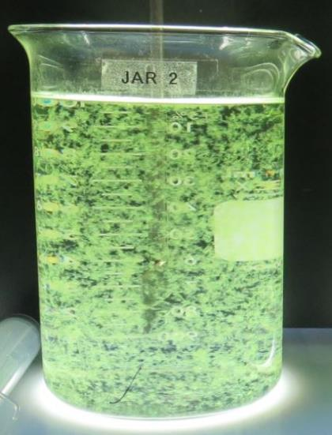
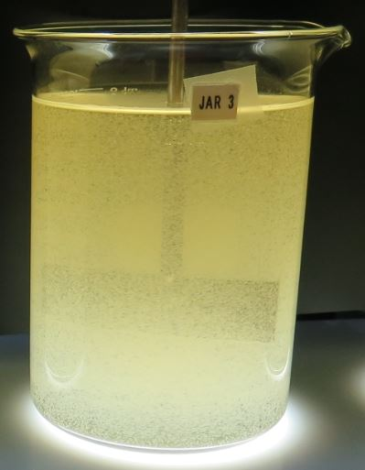
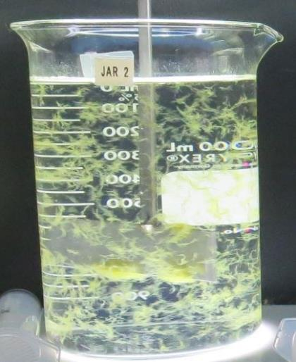
Seasonal Shift in Primary Source Water
Uneventful
Algal Bloom
(Microcystin)
Rain
Event
Algal Bloom (Lyngbya)

Slide 12
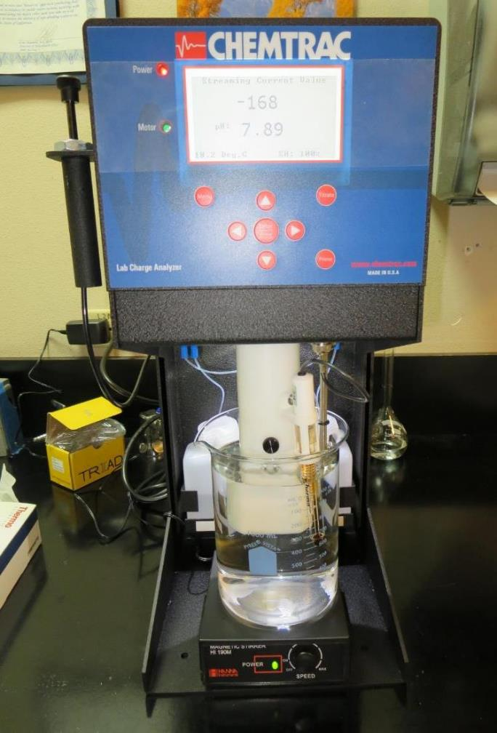
Laboratory Charge Analyzer
Used to determine coagulant demand of a source water entering the treatment plant.
1 Liter of source water
Automatic titrates coagulant to charge neutralization
Tool used to narrow down optimum coagulant dose range for jar testing

Slide 13
Table of LCA coagulant vs. Jar Test Coagulant
Plant ID | LCA Coagulant mg/L | Best Jar Coagulant mg/L | Plant ID | LCA Coagulants mg/L | Best Jar Coagulants mg/L
MK | 27 | 35 | LP | 90 | 90
BHP | 31 | 32.5 | SW | 54 | 54
KCW | 38 | 38 | NMW | 31.8 | 30
HMW | 23.2 | 28 | GS | 28 | 26/2.6
CLO | 31.9 | 35 | CW | 19 | 23
VH | 15 | 16 | CF | 76/5 | 76/5
HV | 29 | 29 | LP | 90 | 90
CW | 19 | 23 | RV | 14 | 14
KC | 35 | 35 | HM | 18.8 | 23
GSD | 12.3 | 12 | SFG | 38.4/4 | 40/4
GTD | 1.6 | 1.5 | PV | 25 | 30
FSP | 8.7 | 9.0 | KsC | 14.5 | 14.5
HH | 101 | 105 | SH | 32 | 34
COC | 36 | 36 | AC | 192 | 190
MID | 9.45 | 9.5 | SC41 | 7.5 | 8.0

Slide 14
Instruments used to
Assist with Jar Testing
Turbidity Instrument
Portable UV254 Analyzer
  Surrogate measurement for TOC/DOC
  https://chemtrac.com/portable-uv254-monitor-uvp/
  https://realtechwater.com/products/p-series/
Laboratory Charge Analyzer (LCA)
  Coagulation optimization tool
  Https://chemtrac.com/laboratory-charge-analyzer/

Slide 15
Jar Testing Procedures, 1-Liters Round Jars
1. Flash Mix 200 RPM (20-30 sec) | 2. Flocculation 20-30 RPM (5 min) | 3. Filterability & Filtrate %UVT/UVA Analysis | 4. Settleability Analysis
Pipette coagulant into each jar. | Floc for 5 minutes. Lift paddles and lock. | Sample at end of flocculation period for plants without settling. Wait 5 minutes for plants with settling. | After 25 minutes of settling, measure settled water turbidity.

Slide 16
Jar Testing for a Four-Jar Mixer
35 minutes to complete jar testing and analysis
5 ½ minutes of jar testing (20-30 sec, 200 RPM; 5 min, 20-30 RPM)
5-minute wait before 25 mL of water is drawn from each jar
20 minutes Analysis:
  Filtrate Turbidity
  Filtrate %UVT/UVA
  %UVA Reduction (source to treated, calc.)
4 minutes: Settled Water pulled from each jar and turbidity measurements

Slide 17
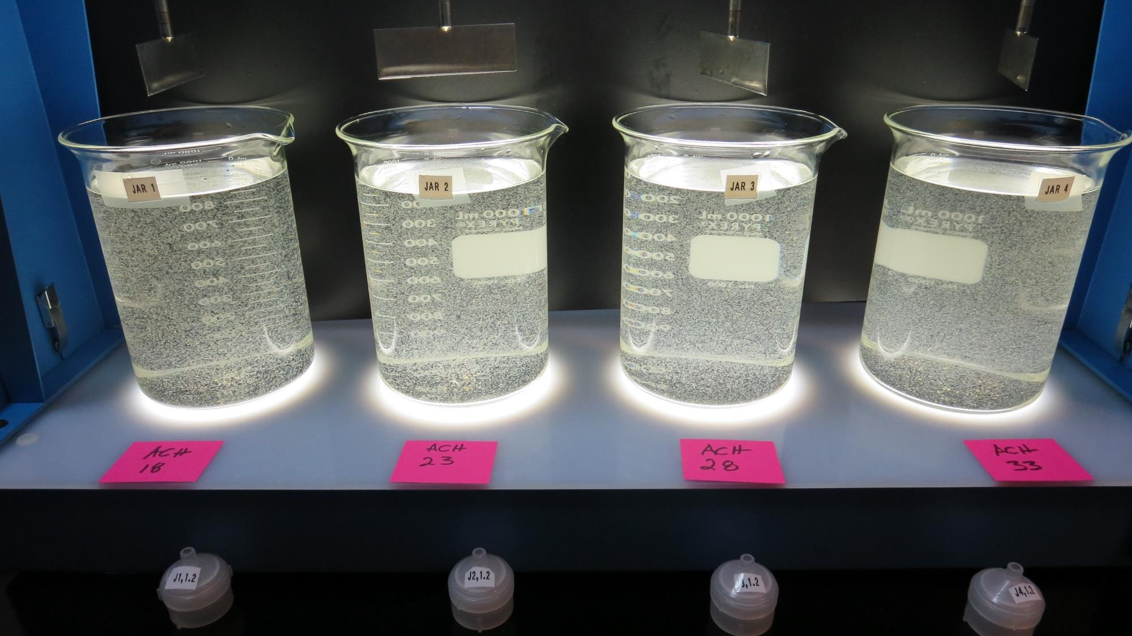
Jars 1-4: End of 5-minute flocculation (30 RPM) duration (Source 1).

Slide 18
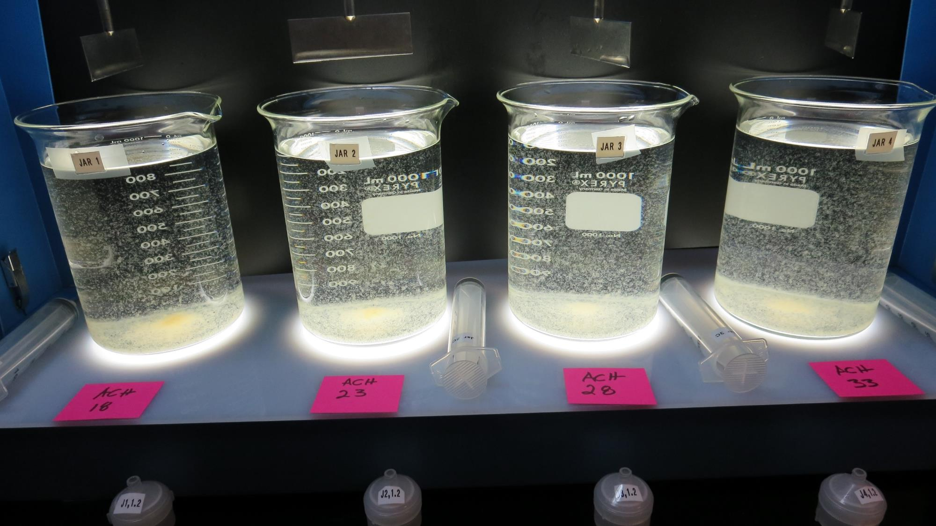
Jars 1-4: After 5 min of settling, 25 mL is syringed for filterability and %UVT/UVA.

Slide 19
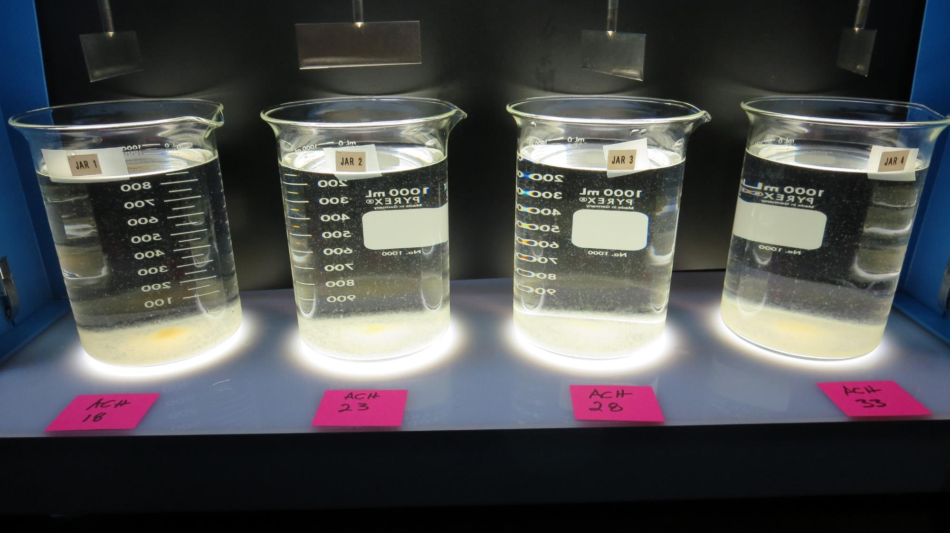
Jars 1-4: After 25-minutes of settling, settled water turbidity is taken (Source 1).
18 mg/L coagulant
Filtrate 0.11 NTU
UVT: 92.5%
UVA: 0.034/cm
UVA Reduction 57.5%
Settled: 0.85 NTU
23 mg/L coagulant
Filtrate 0.07 NTU
UVT: 92.4%
UVA: 0.034/cm
UVA Reduction 57.5%
Settled: 0.65 NTU
28 mg/L coagulant
Filtrate 0.05 NTU
UVT: 93.2%
UVA: 0.031/cm
UVA Reduction 61.3%
Settled: 0.8 NTU
33 mg/L coagulant
Filtrate 0.09 NTU
UVT: 93.1%
UVA: 0.031/cm
UVA Reduction 61.3%
Settled: 1.0 NTU

Slide 20
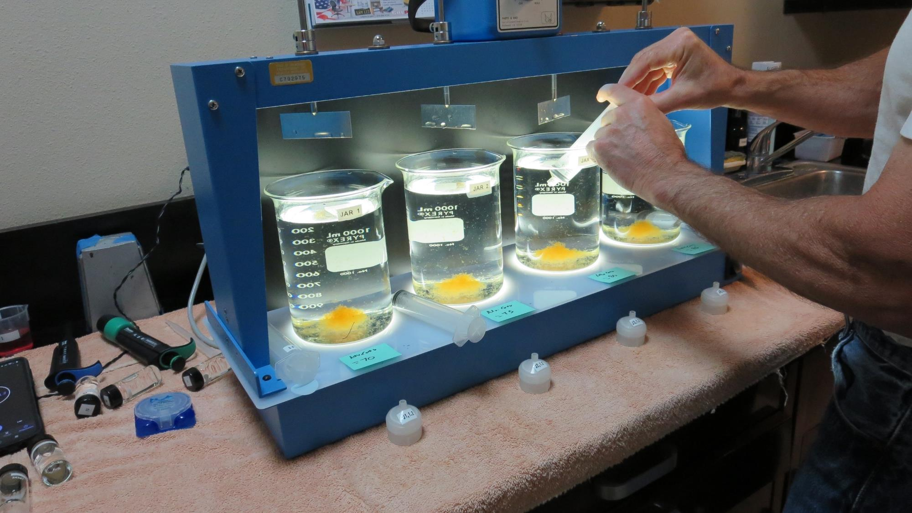
Filterability (25 mL syringed)

Slide 21
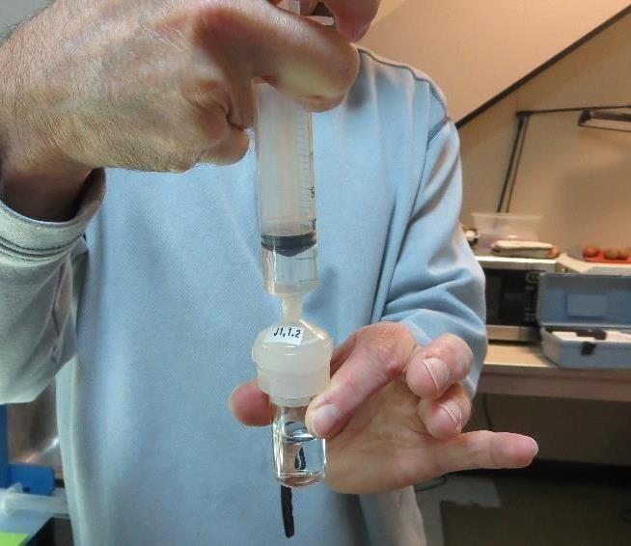
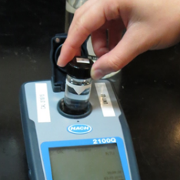
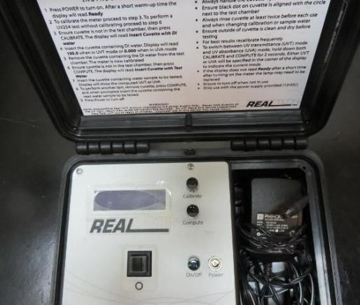
Filterability and UVT/UVA Analysis
Flocculated water is pushed through a 1.2 um absolute Isopore membrane (drip-rate) and measured for turbidity.
Water from cuvette is transferred to UVT/UVA cuvette for measurements.

Slide 22
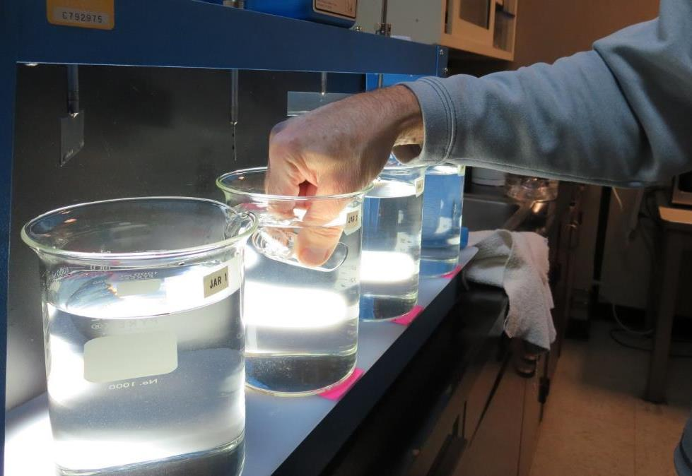
Settleability Test

Slide 23
Jar Test - Flash and Flocculation RPM & Durations
Why 20-30 sec
Flash Mix
(200 RPM)
Why 5 minutes
Floc Mix
(20-30 RPM)

Slide 24
Flash Mix Duration (0 – 60 seconds)
Plant ID | 200 RPM Flash, sec | 30 RPM Floc mix min | Coag mg/L | Filtrate NTU | Filtrate %UVT | Filtrate UVA/cm | Settled NTU 25 min
SW | 0 | 5 | 54 | 0.09 | 95.4 | 0.020 | 0.90
SW | 30 | 5 | 54 | 0.08 | 95.8 | 0.019 | 0.53
CW | 0 | 5 | 18 | 0.06 | 89.4 | 0.049 | 0.28
CW | 15 | 5 | 18 | 0.06 | 89.2 | 0.050 | 0.34
CW | 30 | 5 | 18 | 0.07 | 89.3 | 0.049 | 0.36
CW | 60 | 5 | 18 | 0.07 | 89.2 | 0.050 | 0.26
GTD | 0 | 5 | 1.5 | 0.11 | 97.8 | 0.010 | 1.8
GTD | 60 | 5 | 1.5 | 0.08 | 97.2 | 0.012 | 1.4
SC41 | 0 | 5 | 8.0 | 0.13 | 96.8 | 0.014 | 7.0
SC41 | 60 | 5 | 8.0 | 0.10 | 96.6 | 0.015 | 4.8

Slide 25
Flash vs. No Flash Mixing, variable Floc Duration (1)
Jar # | 200 RPM Flash sec | 30 RPM Floc mix min | Chem E mg/L | Chem F mg/L | Filtrate NTU | Filtrate %UVT | Filtrate UVA/cm | Settle NTU 25 min
1 | 30 | 3 | 37.7 | 36.6 | 0.06 | 94.5 | 0.024 | 1.87
2 | 30 | 5 | 37.7 | 36.6 | 0.07 | 94.3 | 0.025 | 1.07
3 | 30 | 10 | 37.7 | 36.6 | 0.06 | 94.4 | 0.024 | 0.82
4 | 30 | 15 | 37.7 | 36.6 | 0.09 | 94.3 | 0.025 | 0.39
5 | 0 | 3 | 37.7 | 36.6 | 0.07 | 94.3 | 0.025 | 2.51
6 | 0 | 5 | 37.7 | 36.6 | 0.12 | 94.0 | 0.026 | 1.53
7 | 0 | 10 | 37.7 | 36.6 | 0.15 | 93.9 | 0.027 | 0.75
8 | 0 | 15 | 37.7 | 36.6 | 0.10 | 94.0 | 0.026 | 0.43

Slide 26
Flash vs. No Flash Mixing, variable Floc Duration
Jar # | 200 RPM Flash sec | 30 RPM Floc mix min | Chem C mg/L | Chem D mg/L | Filtrate NTU | Filtrate %UVT | Filtrate UVA/cm | Settle NTU 25 min
1 | 60 | 5 | 23 | 1.15 | 0.08 | 94.8 | 0.023 | 0.48
2 | 60 | 10 | 23 | 1.15 | 0.07 | 94.5 | 0.025 | 0.39
3 | 60 | 20 | 23 | 1.15 | 0.07 | 94.9 | 0.023 | 0.30
4 | 60 | 40 | 23 | 1.15 | 0.07 | 94.9 | 0.023 | 0.36
5 | 0 | 5 | 23 | 1.15 | 0.07 | 94.4 | 0.025 | 0.43
6 | 0 | 10 | 23 | 1.15 | 0.07 | 94.6 | 0.024 | 0.30
7 | 0 | 20 | 23 | 1.15 | 0.08 | 94.6 | 0.024 | 0.22
8 | 0 | 40 | 23 | 1.15 | 0.06 | 94.7 | 0.024 | 0.15

Slide 27
Variable Flocculation Duration (3 – 40 minutes)
Plant ID | 200 RPM Flash, sec | RPM Floc Speed | Floc Mix min | Coag/ Aid mg/L | Filtrate NTU | Filtrate %UVT | Filtrate UVA/cm | Settled NTU 25 min
COC | 30 | 30 | 3 | 38/37 | 0.06 | 94.5 | 0.024 | 1.87
COC | 30 | 30 | 5 | 38/37 | 0.07 | 94.3 | 0.025 | 1.07
COC | 30 | 30 | 10 | 38/37 | 0.06 | 94.4 | 0.024 | 0.82
COC | 30 | 30 | 15 | 38/37 | 0.09 | 94.3 | 0.025 | 0.39
GS | 30 | 30 | 5 | 29/2.9 | 0.08 | 91.7 | 0.038 | 0.38
GS | 30 | 30 | 10 | 29/2.9 | 0.09 | 91.8 | 0.037 | 0.22
GS | 30 | 30 | 20 | 29/2.9 | 0.08 | 91.8 | 0.037 | 0.30
CLO | 60 | 30 | 5 | 23 | 0.08 | 94.8 | 0.023 | 0.48
CLO | 60 | 30 | 10 | 23 | 0.07 | 94.5 | 0.025 | 0.39
CLO | 60 | 30 | 20 | 23 | 0.07 | 94.9 | 0.023 | 0.30
CLO | 60 | 30 | 40 | 23 | 0.07 | 94.9 | 0.023 | 0.36

Slide 28
Filterability (25 mL, syringed); Dose 30 mg/L;
Jars 1-4, sampled at end of Floc period vs.
Jars 5-8, sampled 5 minutes from end of Floc period
Jar # | 200 RPM Flash sec | Floc 20 RPM min | Filtrate NTU | Filtrate %UVT | Filtrate UVA/cm | %UVA Reduction | Settle NTU 10 min | Settle NTU 25 min
1 | 20 | 5 | 0.09 | 91.4 | 0.039 | 48.7 | 0.50 | 0.36
2 | 20 | 15 | 0.08 | 91.1 | 0.040 | 47.4 | 0.29 | 0.32
3 | 20 | 30 | 0.07 | 91.3 | 0.039 | 48.7 | 0.31 | 0.27
4 | 20 | 45 | 0.08 | 91.4 | 0.038 | 50.0 | 0.23 | 0.25
5 | 20 | 5 | 0.08 | 90.8 | 0.041 | 46.1 | 0.74 | 0.35
6 | 20 | 15 | 0.09 | 90.9 | 0.041 | 46.1 | 0.37 | 0.30
7 | 20 | 30 | 0.08 | 91.6 | 0.038 | 50.0 | 0.27 | 0.29
8 | 20 | 45 | 0.07 | 91.1 | 0.040 | 47.4 | 0.16 | 0.20

Slide 29
Jar Test Cases
Coagulant Overdosing
Coagulant Under Dosing
Coagulant Optimization – Point of Diminishing Returns
With/without Acid
With/without Pre-Oxidation (NaOCl/Ozone/KMnO₄)
Pre-cursor Reduction Optimization (TTHM/HAA5)

Slide 30
Case 1. Coagulant Overdosing – Storm Event
Source turbidity: 126 NTU, storm event
50% of plant off-line for filter media change out
Plant settled water turbidity > 11 NTU
Filter backwashing once per hour
Plant filtrate turbidity: 0.27 NTU
Operator overwhelmed/not enough sleep
Operator doubles coagulant dose: 110 mg/L

Slide 31
Case 1. Jar Test Results vs Plant
(coagulant overdosing, 110 mg/L)
Jar # | Coagulant mg/L | Filtrate NTU | Filtrate %UVT | Filtrate UVA/cm | Settled NTU
J1 | 45 | 0.50 | 89.3 | 0.049 | 2.2
J2 | 55 | 0.35 | 90.7 | 0.042 | 1.9
J3 | 65 | 0.18 | 91.6 | 0.038 | 2.4
J4 | 75 | 0.05 | 91.7 | 0.039 | 2.8
J5 | 85 | 0.14 | 91.4 | 0.039 | 3.2
J6 | 110 | 0.20 | 92.6 | 0.033 | 7.0

Slide 32
Case 1. Jar Test Results versus
Adjusted Plant Coagulant Dose
Jar Test Results
Plant Results
Coagulant Dose: 75 mg/L
Filtrate: 0.05 NTU
Settled: 2.8 NTU
Coagulant Dose: 75 mg/L
Filtrate: 0.05 NTU
Settled: 2.0 NTU
Filter Run time (increased from 1 to 6 hrs.)

Slide 33
Case 2. Coagulant Under dosing
Source turbidity: 7.8 NTU
Plant settled water turbidity ~ 1 NTU
Plant filtrate turbidity: 0.09 NTU
Has aeration for TTHMs reduction
%TOC Reduction not being met
Plant dose (Coag 1 = 3.4 mg/L, Coag 2 = 3.0 mg/L)

Slide 34
Case 2. Jar Test Results versus Plant
(coagulant under dosing, 3.4/3 mg/L)
Jar # | Coag 1 mg/L | Coag 2 mg/L | Filtrate NTU | Filtrate %UVT | Filtrate UVA/cm | %UVA Reduction | Settle NTU 25 min
J1 | 3.4 | 3.0 | 0.23 | 89.1 | 0.050 | 15.3 | 1.06
J2 | 24 | 0 | 0.10 | 92.6 | 0.033 | 44.1 | 0.33
J3 | 23 | 1.0 | 0.10 | 92.6 | 0.033 | 44.1 | 0.31
J4 | 22 | 2.0 | 0.12 | 92.5 | 0.033 | 44.1 | 0.33
J5 | 21 | 3.0 | 0.07 | 92.8 | 0.032 | 45.8 | 0.33

Slide 35
Case 3. Jar Test Results - Coagulant Optimization
Point of Diminishing Returns
Jar | Coagulant mg/L | Filtrate NTU | Filtrate %UVT | Filtrate UVA/cm | %UVA Reduction | Settled NTU
J1 | 18 | 0.11 | 91.9 | 0.036 | 32.1 | 0.48
J2 | 20 | 0.08 | 91.9 | 0.036 | 32.1 | 0.50
J3 | 22 | 0.07 | 92.0 | 0.036 | 32.1 | 0.44
J4 | 24 | 0.08 | 92.3 | 0.034 | 35.8 | 0.38
J5 | 26 | 0.08 | 92.8 | 0.032 | 39.6 | 0.40
J6 | 28 | 0.07 | 92.9 | 0.031 | 41.5 | 0.34
J7 | 32 | 0.07 | 92.9 | 0.031 | 41.5 | 0.34
J8 | 75 | 0.07 | 93.5 | 0.029 | 45.3 | 0.33

Slide 36
Case 4. Pre-Oxidation
Ozone – Chlorine – KMnO₄
Improve coagulation process
Improve settleability
Improve filtrate turbidity
Increase %UVT or lower UVA (positive/negative effects)
Longer filter runs
Reduce sludge production

Slide 37
Case 4.1. Pre-Oxidation – with & without Ozone
Jar # | Ozone added | Coag mg/L | Filtrate NTU | Filtrate %UVT | Filtrate UVA/cm | %UVA Reduction | Settled NTU
1 | No | 35 | 0.12 | 87.4 | 0.058 | 36.2 | 0.7
2 | No | 40 | 0.08 | 88.2 | 0.055 | 39.6 | 0.65
3 | No | 45 | 0.09 | 88.6 | 0.053 | 41.8 | 1.0
4 | No | 50 | 0.09 | 88.7 | 0.052 | 42.9 | 1.2
5 | Yes | 18 | 0.11 | 92.5 | 0.034 | 62.6 | 0.85
6 | Yes | 23 | 0.07 | 92.4 | 0.034 | 62.6 | 0.65
7 | Yes | 28 | 0.05 | 93.2 | 0.031 | 65.9 | 0.80
8 | Yes | 33 | 0.09 | 93.1 | 0.031 | 65.9 | 1.0

Slide 38
Case 5. Performance – with/without Acid
Source Water pH and Alkalinity Changes
Constituents | pH | Alkalinity as CaCO₃, mg/L
Source pH | 8.92 - 9.0 | 158
H₂SO₄ = 20 mg/L | 7.8 | 138
H₂SO₄ = 30 mg/L | 7.4 | 127
Coag = 40 mg/L | 8.73 | 153
Coag= 60 mg/L | 8.62 | 151

Slide 39
Case 5. Performance – with/without Acid
Jar # | H₂SO₄ mg/L | Coag. mg/L | Filtrate NTU | Filtrate %UVT | Filtrate UVA/cm | %UVA Reduction | Settle NTU 25 min
J1 | 0 | 40 | 0.14 | 89.5 | 0.047 | 40.5 | 0.40
J3 | 0 | 60 | 0.11 | 90.1 | 0.045 | 43.0 | 0.40
J2 | 30 | 40 | 0.12 | 91.1 | 0.040 | 49.4 | 0.47
J4 | 30 | 60 | 0.08 | 92.0 | 0.036 | 54.4 | 0.38

Slide 40
Case 6. Out of Compliance with TTHMs/HAA5s
Jar tested source water over a 12-month period
Tested 12 coagulants
Compare coagulants/doses to filterability and %UVT/UVA
Selected best performing coagulant
Conducted side-by-side study (Treatment Trains 1 & 2)
Compare Filtrate turbidity and %UVT/UVA
Spike filtrate samples with 2.0 mg/L NaOCl
Held for 7-days
Tested TTHMs/HAA5s

Slide 41
Case 6. Trains 1 and 2, On-site Study –
*Results 1-liter filtrate samples were taken from each treatment train and spiked with 2.0 mg/L NaOCl and held for 7-days, TTHMs/HAA5s analyzed.
Train # | Coagulant | Filtrate NTU | %UVT | UVA/cm | %UVA Reduction | *TTHMs ug/L | *HAA5s ug/L
1 | New Coagulant | 0.06 | 97.2 | 0.012 | 91.1 | 43 | 9.9
2 | Original Coagulant | 0.07 | 90.8 | 0.042 | 68.9 | 110 | 49

Slide 42
Jar Testing Made Easy – Recap
Keep it Simple
Don’t obsess in trying to model jar testing with plant mixing energies and contact times
Goal is to mix the chemical and form a floc (fast/slow mixing)
Measurements
Filtrate NTU
Filtrate %UVT/UVA Settled NTU
Don’t rely on visual floc formation and settleability as optimum dosage
Evaluate
Evaluate results and determine next course of action
Repeat
Once optimum dose is found, repeat test for confirmation.

Slide 43
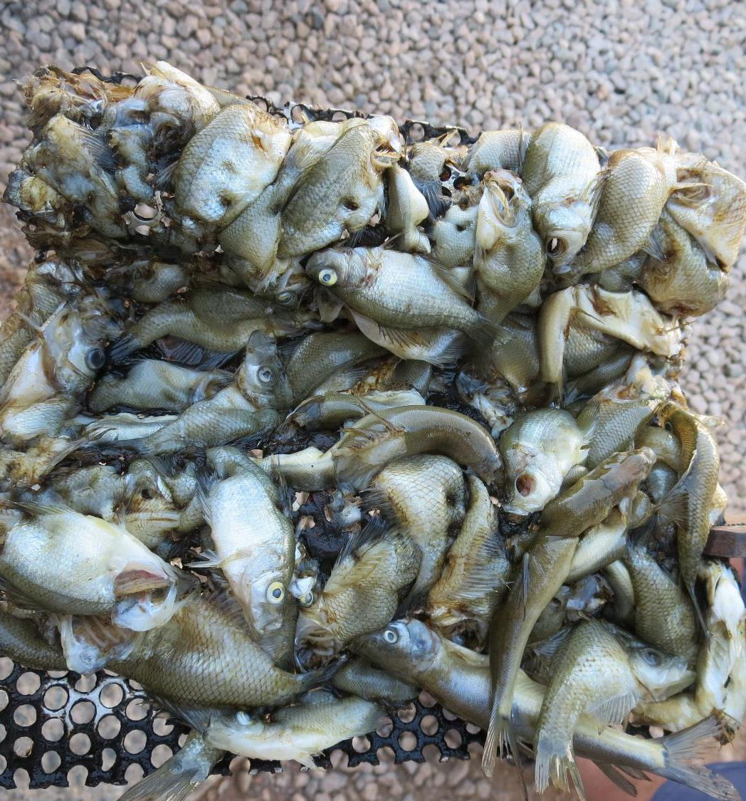
Practice – Practice – Practice
“Don’t end-up sleeping with the fishes.
Jar testing should be performed regularly during non-water quality events to develop and maintain the necessary skills and confidence to be able to confront real water quality changes.
Initial skill and confidence building will require several hours (~100 hours) of jar testing and practice.

Slide 44

Contact and Links
Guy Schott, P.E.
State Water Resources Control Board
Division of Drinking Water
Santa Rosa, CA
Go to Jar Test Results/Procedures for tools to download
www.waterboards.ca.gov/drinking_water/programs/districts/mendocino_district.html
Email: Guy Schott - Guy.Schott@waterboards.ca.gov
Office Number: 707-576-2732

Slide 45
Case 4.2. Pre-Oxidation – with/without chlorine
Jar # | NaOCl mg/L | Coag mg/L | Aid mg/L | Filtrate NTU | Filtrate %UVT | Filtrate UVA/cm | %UVA Reduction | Settled NTU 25 min
J1 | 0 | 19 | 4 | 0.06 | 88.4 | 0.054 | 34.1 | 0.39
J2 | 2.0 | 19 | 4 | 0.04 | 89.6 | 0.048 | 41.5 | 0.24
J3 | 0 | 23 | 4 | 0.05 | 88.7 | 0.052 | 36.6 | 0.50
J4 | 2.0 | 23 | 4 | 0.04 | 89.9 | 0.046 | 43.9 | 0.23
J5 | 0 | 31 | 0 | 0.06 | 88.8 | 0.052 | 36.6 | 0.24
J6 | 2.0 | 31 | 0 | 0.05 | 90.3 | 0.044 | 46.3 | 0.14
J7 | 0 | 35 | 0 | 0.05 | 89.3 | 0.049 | 40.2 | 0.30
J8 | 2.0 | 35 | 0 | 0.04 | 90.2 | 0.045 | 45.1 | 0.18

Slide 46
NaOCl Pre-Oxidation
Generally:
For a given coagulant dose, there will be an increase in %UVT or decrease in UVA when NaOCl is added. It is believed that some of the DOC is converted to disinfection by-products giving a false indication of improved DOC reduction via coagulation.

Slide 47
Case 4.3. Pre-Oxidation – with & without KMnO₄
Jar # | KMnO₄ Added | Coag mg/L | Filtrate NTU | Filtrate %UVT | Filtrate UVA/cm | %UVA Reduction | Settled NTU
1 | No | 24/2.4 | 0.10 | 90.5 | 0.043 | 37.7 | 0.31
2 | No | 26/2.6 | 0.08 | 90.6 | 0.043 | 37.7 | 0.41
3 | No | 28/2.8 | 0.08 | 90.6 | 0.043 | 37.7 | 0.32
4 | No | 30/3.0 | 0.07 | 90.8 | 0.042 | 39.1 | 0.37
5 | Yes | 23/2.3 | 0.12 | 91.1 | 0.040 | 42.0 | 0.48
6 | Yes | 25/2.5 | 0.10 | 91.5 | 0.039 | 43.5 | 0.40
7 | Yes | 27/2.7 | 0.09 | 91.5 | 0.039 | 43.5 | 0.39
8 | Yes | 29/2.8 | 0.08 | 91.7 | 0.038 | 44.9 | 0.38

Slide 48
Jar Testing for 1-Liter Jars:
General Procedures for Most Treatment Plants
Fill jars with source water prior to coagulant injection and set paddle speed at 30 rpm
Add chemicals (i.e., NaOCl, primary coagulant, coagulant aid) to each jar
Flash mix for 15-30 seconds (200 rpm)
Slow mix for 5 minutes (20-30 rpm)
Settled for 5 minutes. Syringe 25 mL from each jar taken 1-inch below surface (25 mL/12 sec rate)
Filtered through 1.2 um isopore membrane into cuvette drip rate, 15 mL/(50-90 sec)
Measure filtrate turbidity, chlorine residual and %UVT/UVA
Measure settled water turbidity after 25 minutes of total setting
Record all data

