Slide 1
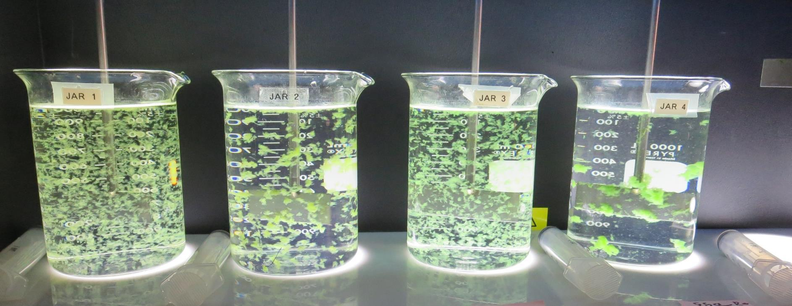
JAR TESTING MADE EASY STATE WATER RESOURCES CONTROL BOARD, DIVISION OF DRINKING WATER
by Guy Schott, P.E.
October 14, 2021

Slide 2
Presentation Overview
Jar Testing – Application, Research & Assistance
Jar Tester/Lab Equipment/Materials
Coagulants (inorganic/organic)
Jar Testing Analysis (Filterability, UVT/UVA & Settleability)
Jar Test Protocol
Laboratory Charged Analyzer (LCA)
Case Studies

Slide 3
New Jar Testing Procedures & Analysis Application/Research/Assistance (2018-2021)
51 Public Surface Water Treatment Plants
19 Counties (California)
Plant Size from 5 gpm – 50 MGD
>2,500 Jars
Training

Slide 4
Applied Jar Test Procedures, Methods & Analysis for Various Treatment Plants
(24) Conventional Treatment Plants
with
Media Filtration &
Membrane Filtration
(3) Direct Filtration Plants
with
Media Filtration &
Membrane Filtration
(2) Dissolved Air Flotation (DAF) with
Media Filtration &
Membrane Filtration
(10) Trident & Roberts
Absorption/Contact
Media Filtration
(2) Actifloc
(ballast sand)
with
Media Filtration
(10) Alternative Technologies Roughing Contact Clarifier/Media Filtration &
Inline Filtration

Slide 5
Jar Testing – Who’s Doing Them
Less than 10% of the utility's visited conduct jar testing.
Many plants don’t have jar testing equipment.
Plants with jar testers don’t have the laboratory equipment, materials and training to properly conduct jar testing and analysis.
Plants that perform limited jar testing have little supporting data on coagulant selection and dose for plant optimization (filterability and indirect DOC reduction).

Slide 6
Operator Training and Applied Jar Testing
Improved plant filterability (turbidity) performance
Less violations in meeting turbidity performance standards
Improved DOC reduction (disinfection precursors)
Less violations of disinfection by-products (TTHMs/HAA5s)
Improved treated water quality
Build customer confidence

Slide 7
Jar Testing Procedures/Methods/Analysis – What’s Important and End Goals
Timely, Efficient & Straightforward that is completed within 1 hour (prep, testing and analysis) - Don’t make is complicated
One set of procedures, methods and analysis that can be applied to most treatment plants
Results that clearly depict which pre-oxidant, coagulant(s) and dose that provides optimum (End Goals)
Filterability (floc strength, turbidity, and perceived head loss)
Dissolved organic carbon reduction (UVA surrogate)
Settleability (turbidity)
Confidence in your jar testing data that is transferable to plant operations

Slide 8
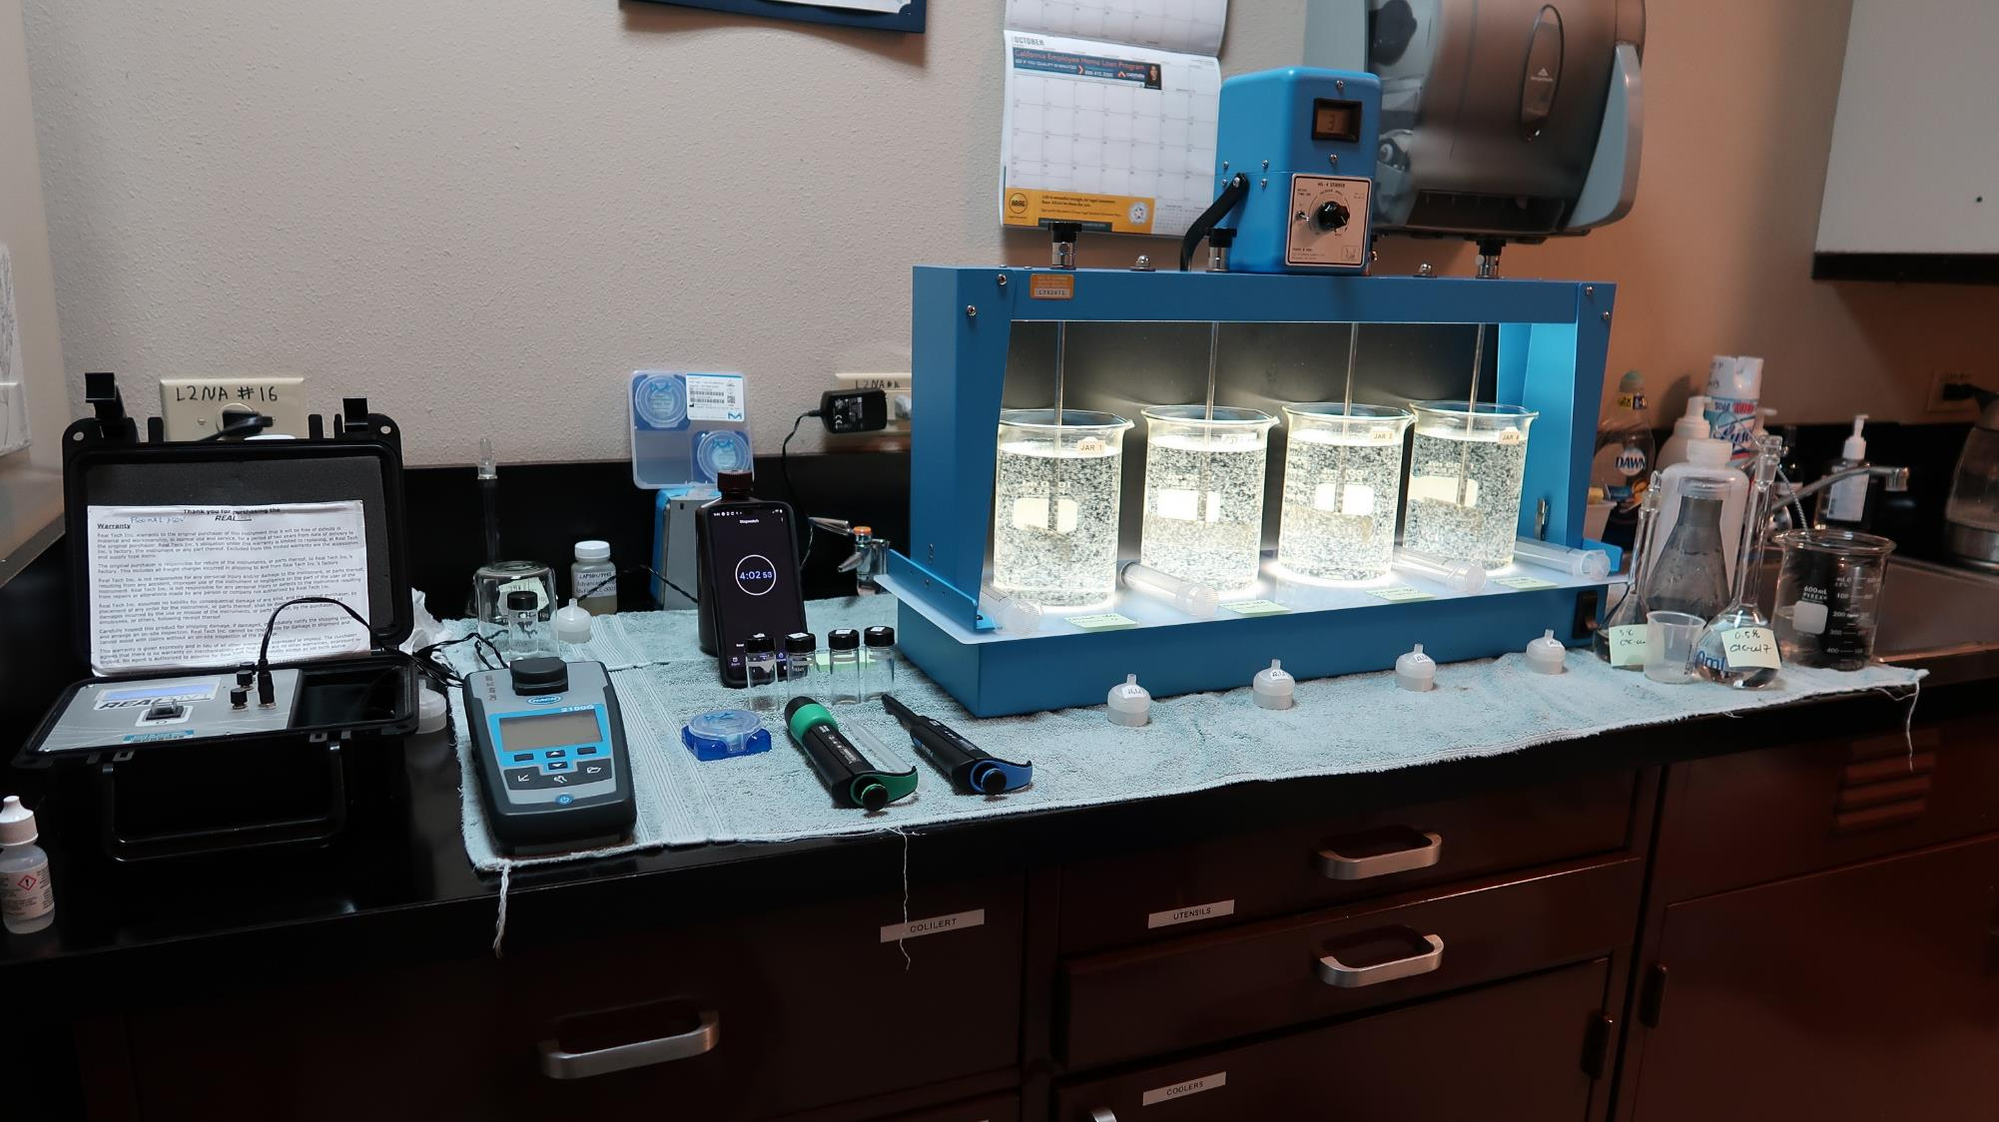
Lab
4-Jar Tester
Cuvettes
UVA/%UVT
Syringes
Stock
Solutions
Filters
Pipettes
Turbidity

Slide 9
Common Inorganic Coagulants
Inorganic coagulants are positively charged metal salts
[AL] Aluminum Sulfate, Al₂(SO₄)₃ * 14.3H₂O
[AL] Aluminum Chlorohydrate (ACH), Al₂Cl(OH)₅
[AL] Polyaluminum Chloride (PACl), Al_{n}Cl_{3n-m}(OH)_{m}
[AL] Polyaluminum Chlorosulfate (PACS) , Al_{a}(OH)_{b}(Cl)_{c}(SO4)_{d}
Ferric Chloride, FeCl₃
Ferric Sulfate, Fe₂(SO₄)₃*8.8H₂0
When inorganic coagulants hydrolyze, hydrogen ions (H⁺) are released that react with the alkalinity of the water and depresses the pH.

Slide 10
%Basicity of a Coagulant
In the formation of PACl/PACS coagulants, some of the acid (H⁺) that would have been released is neutralized with base (OH⁻) when coagulant is manufactured. The degree to which the hydrogen ions that would be released by hydrolysis are preneutralized is known as the basicity of the product.
Example:
ACH, Al₂Cl(OH)₅; there are 5 moles of [OH] and 2 moles of [Al]
[OH]
[5]
Basicity, % =
X 100% =
X 100% = 83%
3[Al]
3[2]
This means that 83% of the formed hydrogen ions (H⁺) are pre-neutralized.

Slide 11
Common Organic Coagulants
Organic coagulants are long-chained, medium to high-molecular-weight polymers (sticky) used for bridging floc, improve settleability, filterability, filter-run-time and organic reduction.
[PY] Polyamine (max dose 5 mg/L as active PY)
[pDADMAC] Polydialyldimethylammonium chloride (max dose 10 mg/L as active pDADMAC)
[PC] Polyacrylamide, dry or emulsion (max dose 1 mg/L as active PC)
Shelf-life 6-9 month as an emulsion; once mixed with water, use within 2-3 days.
Shelf-life years for dry; once mixed with water, use within 7 days.

Slide 12
NSF Certified Drinking Water Treatment Chemicals
Go to NSF Certified Drinking Water Treatment Chemicals website to determine coagulant type for selected chemical products.
http://info.nsf.org/Certified/PwsChemicals/
Example headings listed in NSF for different products:
[AL] Aluminum base coagulants; (inorganic)
[PY] Polyamines; (organic)
[AL] [PY] Blends; (inorganic/organic blends)
Poly (Diallyldimethylammonium Chloride) (pDADMAC); (organic)
[AL, PY, pDADMAC, PC] NSF symbols for type of coagulants

Slide 13
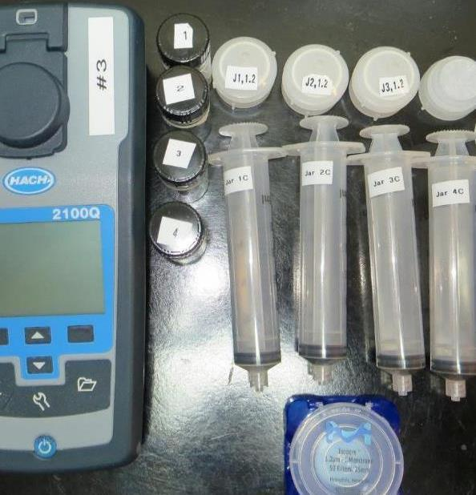
1. Filterability Analysis - New
Developed technique and analysis for predicting full-scale media filtration
Materials:
30 mL Syringe w/Luer-Lock Tip
Filter holder
1.2 um absolute Isopore membrane filter
Samples collected at end of flocculation period (0-5 minutes) to assess floc strength
Filtration and Analysis: 4 minutes per Jar to complete and record

Slide 14
Filterability Sensitivity Performance Analysis – Plant ID: COB (4 min/Jar)
Jar# | Alum (dry) mg/L | pDADMAC Solution mg/L | Filtrate NTU | Floc Strength
J1 | 46 | 0 | 0.13 | Fair
J2 | 46 | 0 | 0.12 | Fair
J3 | 46 | 0.5 | 0.12 | Fair
J4 | 46 | 1.0 | 0.11 | Fair
J5 | 46 | 1.5 | 0.08 | Good
J6 | 46 | 1.5 | 0.08 | Good
J7 | 46 | 2.0 | 0.06 | Strong
J8 | 46 | 2.0 | 0.05 | Strong

Slide 15
Filterability Sensitivity Performance Analysis – Plant ID: HRCSD (4 min/Jar)
Jar# | Alum (dry) mg/L | pDADMAC Solution mg/L | Filtrate NTU | Floc Strength
J1 | 35 | 0 | 1.06 | Very Weak
J2 | 45 | 0 | 0.66 | Very Weak
J3 | 50 | 0 | 0.28 | Weak
J4 | 55 | 0 | 0.27 | Weak
J5 | 35 | 6.0 | 0.08 | Good
J6 | 45 | 6.0 | 0.05 | Strong
J7 | 50 | 6.0 | 0.04 | Strong
J8 | 55 | 6.0 | 0.05 | Strong

Slide 16
2. UV-Absorption Analysis
Surrogate for predicting indirect DOC reduction
Compares different jar testing coagulants and doses for best indirect DOC (UVA) reduction
Systems with DPB issues, UVA measurements are critical for determining optimum coagulant and dose
UVA measurements:
Source (0.4 um Isopore filter)
Filtrate water from each tested jar (1.2 um Isopore filter)
UVA Analysis: 1 minute per Jar to complete and record

Slide 17
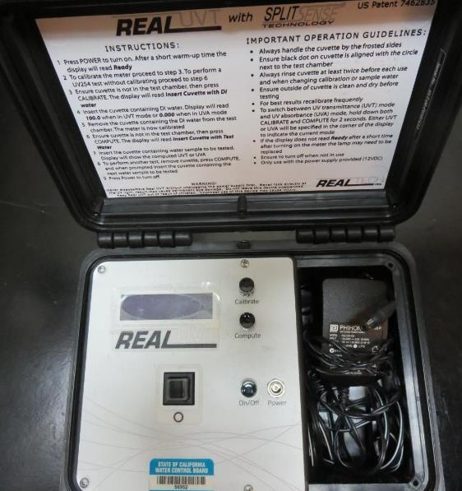
UVT/UVA Instrument, pathlength 10 or 40 mm
UV transmittance (UVT) is a measurement of the amount of ultraviolet light (254 nm) that passes through a water sample compared to the amount of light that passes through a pure water sample. The measurement is expressed as % UVT.
%UVT = 10^{(-UVA)} x 100%
UV absorbance (UVA) is calculated as a relative measure of the amount of light absorbed by a water sample compared with the amount of light absorbed by a pure water sample.
UVA = -log(%UVT/100)

Slide 18
Chart – Indirect DOC Reduction
Plant Operating Performance
Optimized
Performance based on Jar testing

Slide 19
3. Settleability Analysis
Analysis conducted for plants with settling
Relative performance measurement between jars based on coagulant type, dose and flocculation duration
Samples collected 25 minutes from the end of the flocculation period
Settleability Analysis: 1 minutes per Jar to sample, complete and record

Slide 20
Settleability – shouldn’t be used as the sole source of data to determine optimum coagulant/dose
Why?
No supporting data on floc strength and filterability
No supporting data on indirect DOC reduction (UVA surrogate)
Not all treatment plants have settling
Settleability only provides relative data on settling performance as it relates to pre-oxidation, coagulants and doses, and flocculation duration

Slide 21
Jar Testing Procedures and Analysis
1. Flash Mix 200 RPM (20-30 sec) | 2. Flocculation 20-30 RPM (5 min) | 3. Filterability & Filtrate %UVT/UVA Analysis | 4. Settleability Analysis
20-30 RPM; Pipette coagulant into each jar then start Flash Mix. | Floc for 5 minutes. Lift paddles and lock. | Sample at end of flocculation period for plants without settling. Wait 5 minutes for plants with settling. | After 25 minutes of settling, sample and measure settled water turbidity.

Slide 22
Jar Testing for a 4-Jar Mixer
35 minutes to complete jar testing and analysis;
Or 26 minutes for plants without settling
5 ½ minutes jar testing
5-minute wait before sampling (only for plants w/settling)
20 minutes Analysis:
Filtrate Turbidity
Filtrate %UVT/UVA
Settled water turbidity

Slide 23
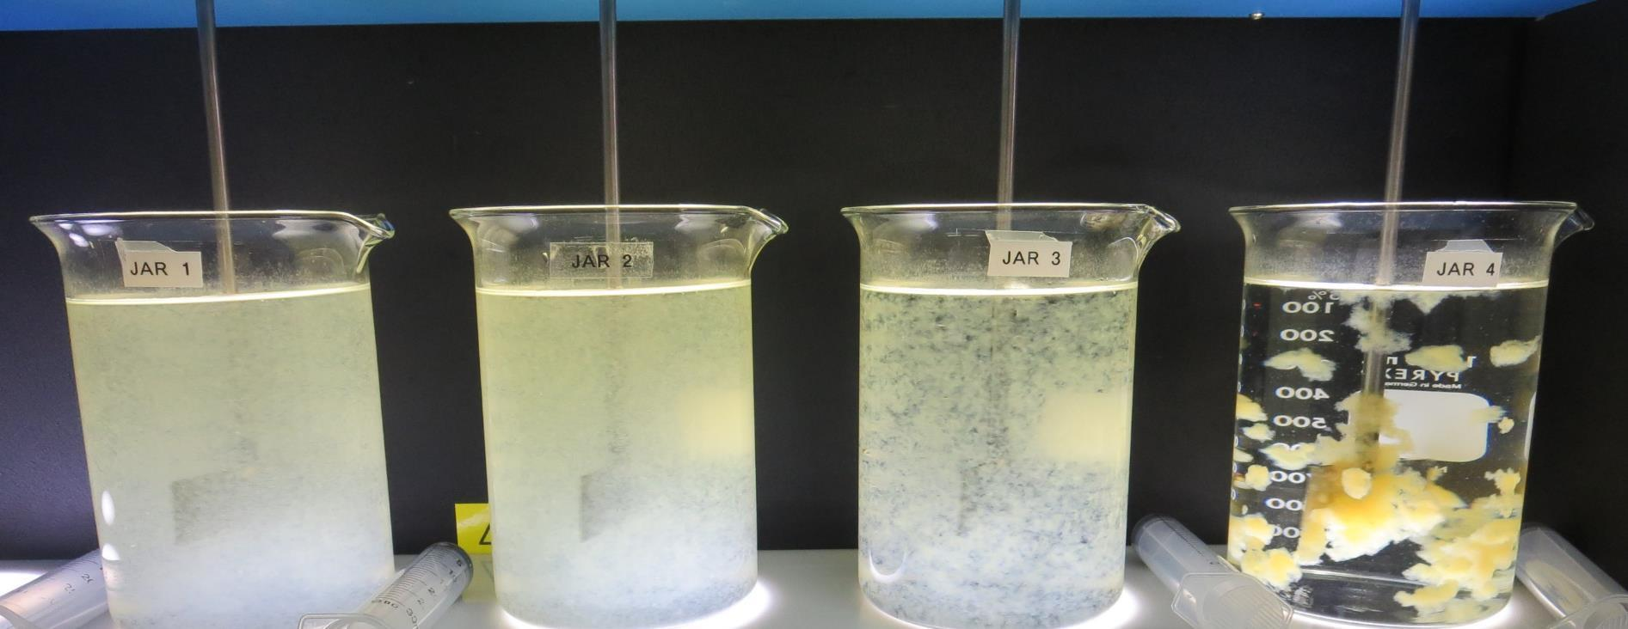
Jars 1-4: End of 5-minute flocculation (30 RPM) duration.

Slide 24
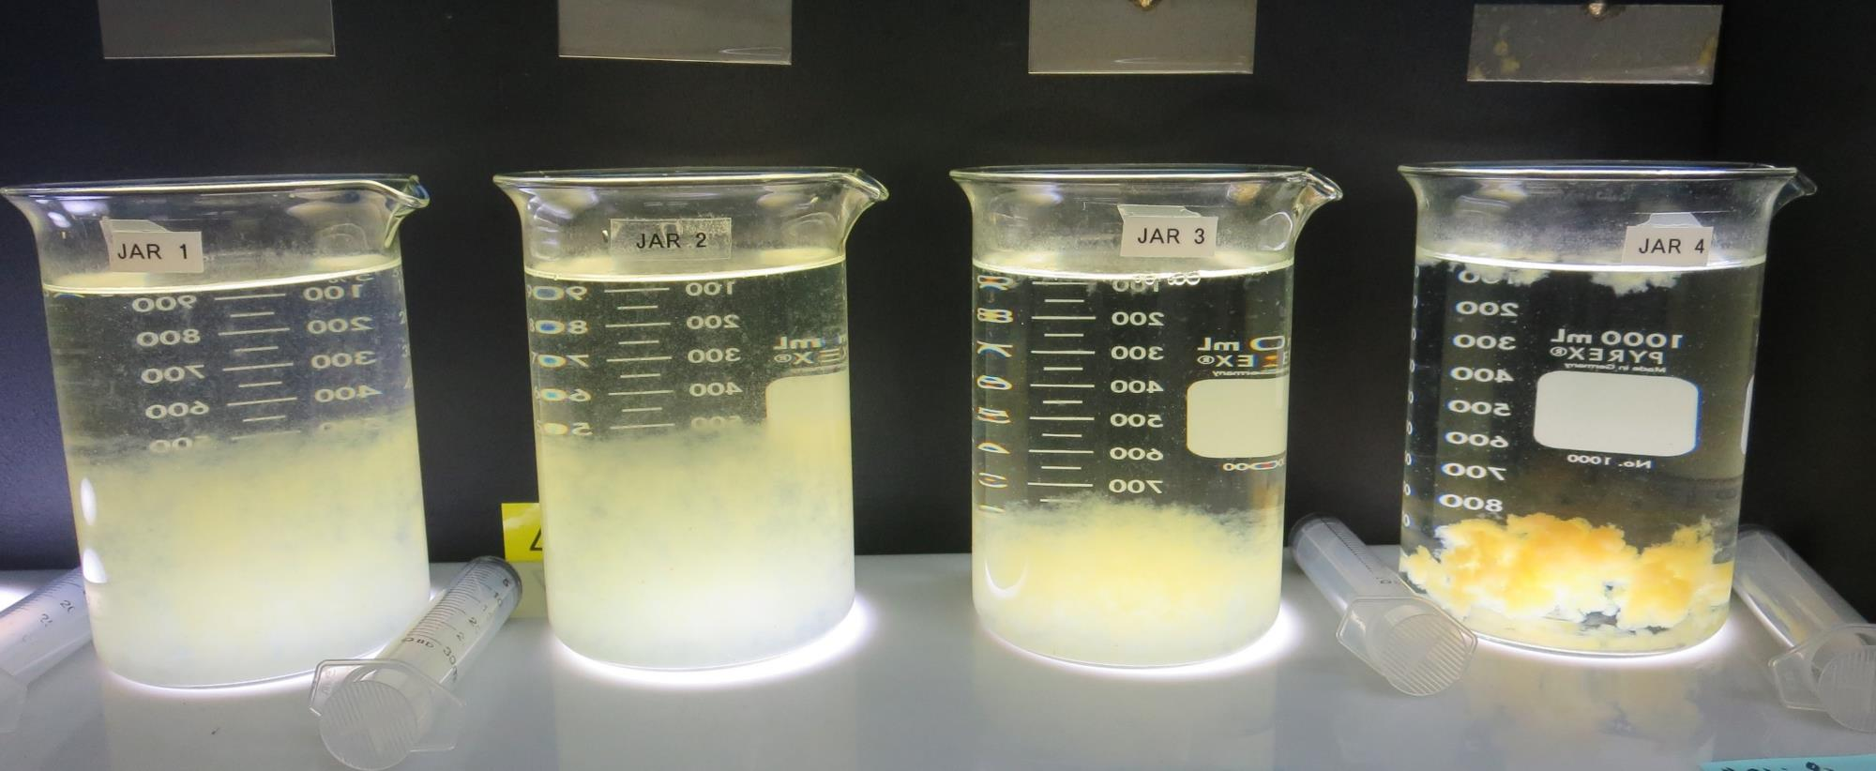
Jars 1-4: After 5 min of settling, 20 mL is syringed for filterability and %UVT/UVA.

Slide 25
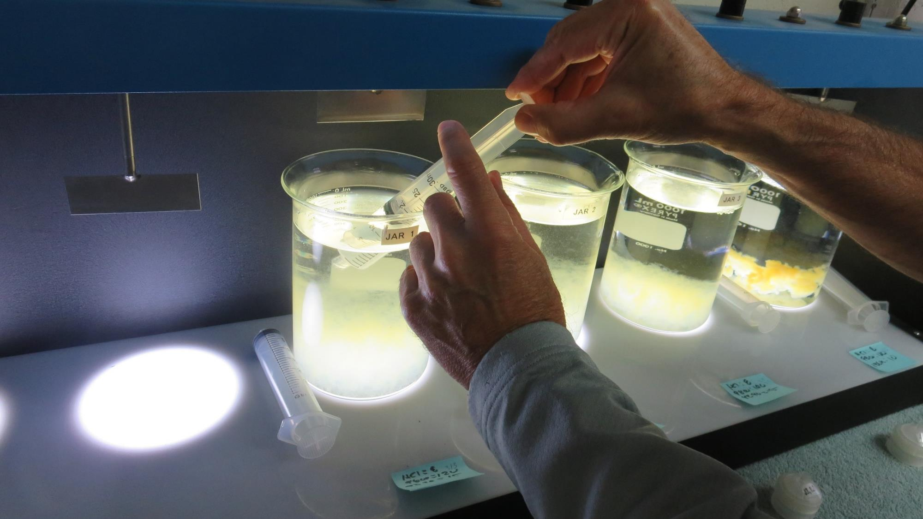
Syringing
Filterability (20-25 mL syringed)

Slide 26
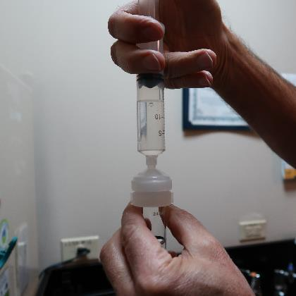
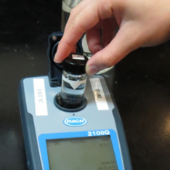
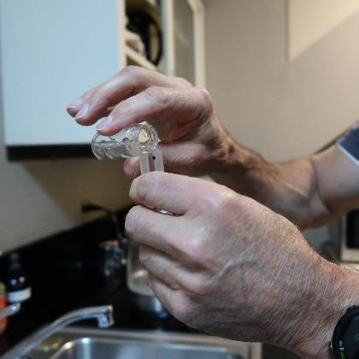
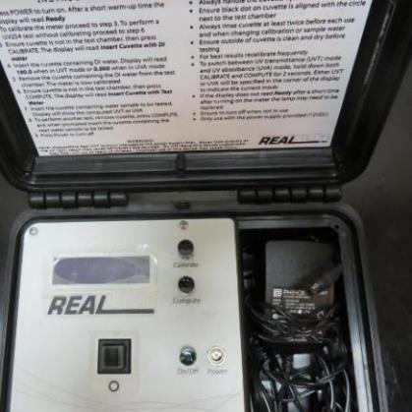
Filterability and UVT/UVA Analysis (5 min/Jar)
1.
2.
3.
4.
Flocculated water is pushed through a 1.2 um absolute Isopore membrane (drip-rate) into cuvette
Measured filtrate turbidity and record
Transfer water from cuvette to UVT/UVA cuvette
Measure UVT/UVA and record

Slide 27
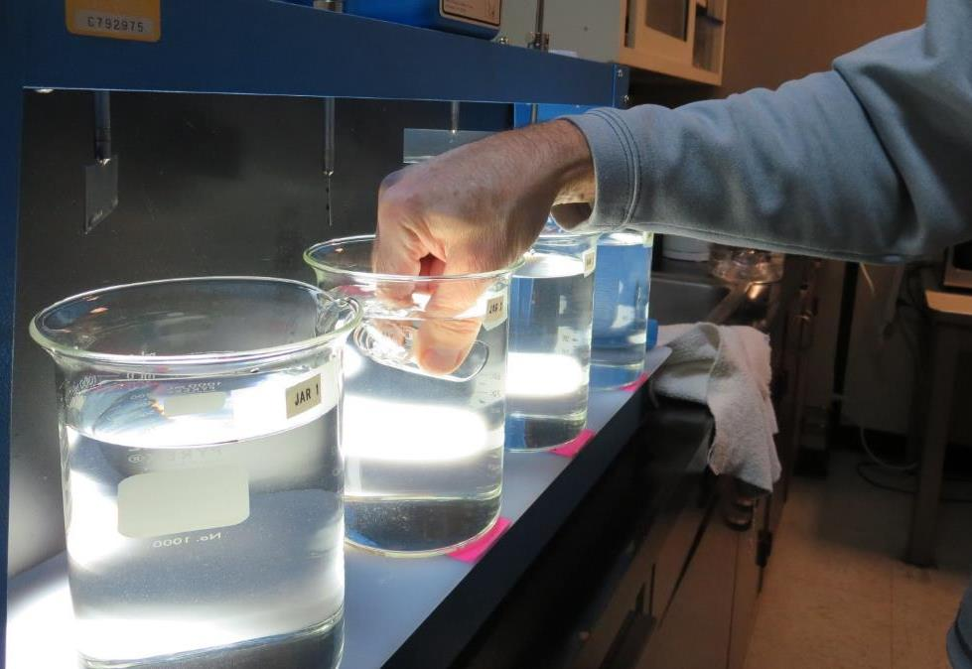
Settleability Sampling

Slide 28
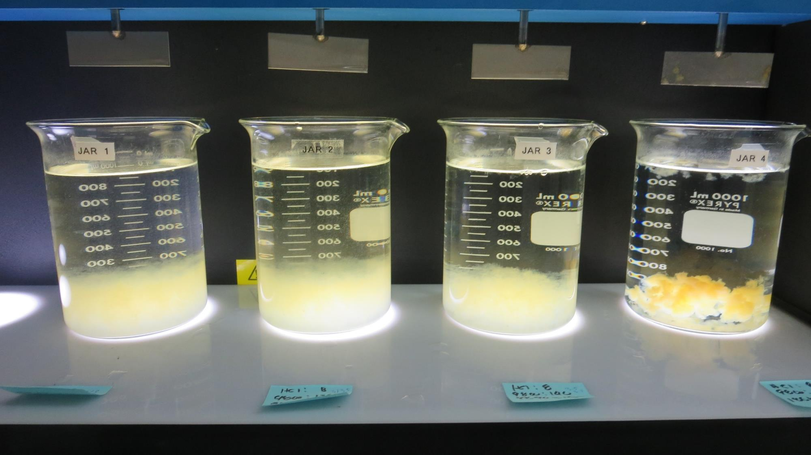
Jars 5-8: After 25-minutes of settling, settled water turbidity is taken.
8 mg/L HCl
120 mg/L ACH Product
15 mg/L ACH/PY
Filtrate 0.29 NTU
UVT: 85.8%
UVA: 0.066/cm
UVA Reduction: 57.0%
Settled: 1.3 NTU
8 mg/L HCl
130 mg/L ACH Product
15 mg/L ACH/PY
Filtrate 0.19 NTU
UVT: 86.0%
UVA: 0.065/cm
UVA Reduction: 57.6%
Settled: 1.3 NTU
8 mg/L HCl
140 mg/L ACH Product
15 mg/L ACH/PY
Filtrate 0.08 NTU
UVT: 86.8%
UVA: 0.062/cm
UVA Reduction: 60.0%
Settled: 1.1 NTU
8 mg/L HCl
120 mg/L ACH Product
10 mg/L pDADMAC
Filtrate 0.06 NTU
UVT: 86.0%
UVA: 0.066/cm
UVA Reduction: 57.5%
Settled: 0.47NTU

Slide 29
Jar Testing Impact of Flash and Flocculation Durations
20-30 sec
Flash Mix
(200 RPM)
5 minutes
Floc Mix
(20-30 RPM)

Slide 30
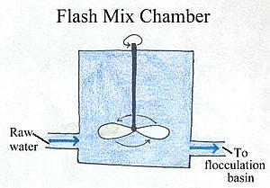
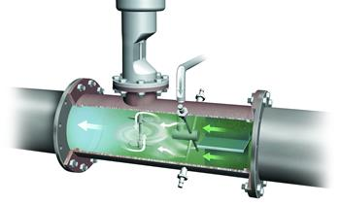
Impact of Flash Mixing – Jar Testing
Inadequate flash mixing can
negatively impact settleability performance
May affect filterability in some cases (site specific)
No impact on indirect DOC reduction
Jar testing: Flash mix 20-30 seconds (200 RPM) is adequate for dispersing coagulant

Slide 31
Flash Mix Duration (0 – 60 seconds)
Plant ID | 200 RPM Flash, seconds | 30 RPM Floc Duration minutes | Coag mg/L | Filtrate NTU | Filtrate %UVT | Filtrate UVA/cm | Settled NTU 25 min
SW | 0 | 5 | 54 | 0.09 | 95.4 | 0.020 | 0.90
SW | 30 | 5 | 54 | 0.08 | 95.8 | 0.019 | 0.53
CW | 0 | 5 | 18 | 0.06 | 89.4 | 0.049 | 0.28
CW | 15 | 5 | 18 | 0.06 | 89.2 | 0.050 | 0.34
CW | 30 | 5 | 18 | 0.07 | 89.3 | 0.049 | 0.36
CW | 60 | 5 | 18 | 0.07 | 89.2 | 0.050 | 0.26
GTD | 0 | 5 | 1.5 | 0.11 | 97.8 | 0.010 | 1.8
GTD | 60 | 5 | 1.5 | 0.08 | 97.2 | 0.012 | 1.4
SC41 | 0 | 5 | 8.0 | 0.13 | 96.8 | 0.014 | 7.0
SC41 | 60 | 5 | 8.0 | 0.10 | 96.6 | 0.015 | 4.8

Slide 32
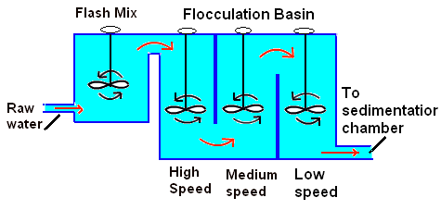
Impact of Flocculation Duration in Jar Testing
Flocculation duration only impacts settleability performance
Filterability and Indirect DOC reduction are not affected by flocculation duration
Jar testing: 5 minutes (20 - 30 RPM) is adequate for floc formation

Slide 33
Variable Flocculation Duration (3 – 40 minutes)
Plant ID | 200 RPM Flash, seconds | 30 RPM Floc Duration minutes | Coag/ Aid mg/L | Filtrate NTU | Filtrate %UVT | Filtrate UVA/cm | Settled NTU 25 min
COC | 30 | 3 | 38/37 | 0.06 | 94.5 | 0.024 | 1.87
COC | 30 | 5 | 38/37 | 0.07 | 94.3 | 0.025 | 1.07
COC | 30 | 10 | 38/37 | 0.06 | 94.4 | 0.024 | 0.82
COC | 30 | 15 | 38/37 | 0.09 | 94.3 | 0.025 | 0.39
GS | 30 | 5 | 29/2.9 | 0.08 | 91.7 | 0.038 | 0.38
GS | 30 | 10 | 29/2.9 | 0.09 | 91.8 | 0.037 | 0.22
GS | 30 | 20 | 29/2.9 | 0.08 | 91.8 | 0.037 | 0.30
CLO | 60 | 5 | 23 | 0.08 | 94.8 | 0.023 | 0.48
CLO | 60 | 10 | 23 | 0.07 | 94.5 | 0.025 | 0.39
CLO | 60 | 20 | 23 | 0.07 | 94.9 | 0.023 | 0.30
CLO | 60 | 40 | 23 | 0.07 | 94.9 | 0.023 | 0.36

Slide 34
When Shorter or Longer Flocculation is Required
Inline Filtration – floc for 1 minute (10-20 RPMs)
KMnO₄ or NaMnO₄
Duration mix (HRT) for transmission line
If added with coagulant, then floc for at least 15 minutes
Powder Activated Carbon (PAC)
If added with coagulant, floc for at least 5-10 minutes
Evaluate PAC injection before and after coagulant to assess settleability and UVA reduction performances

Slide 35
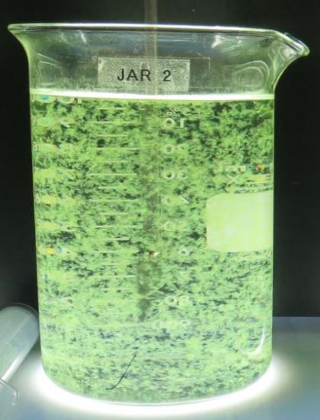
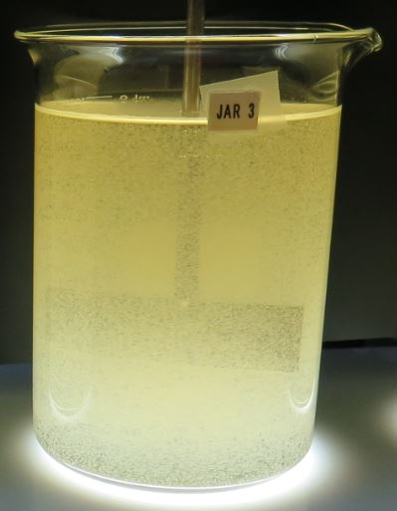
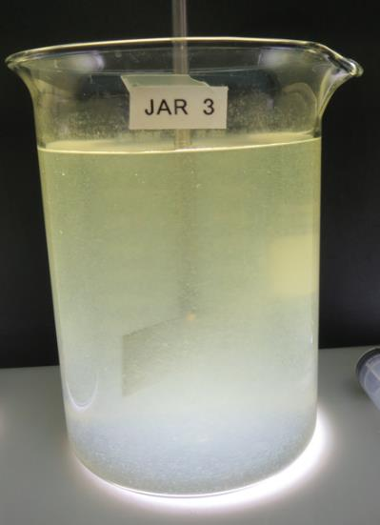
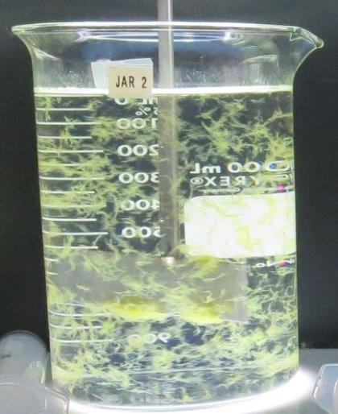
Seasonal Shift in Primary Source Water
Drought
Algal Bloom
(Microcystin)
Rain
Event
Algal Bloom (Lyngbya)

Slide 36
Laboratory Charge Analyzer
Used to determine coagulant demand of a source water entering the treatment plant.
1 Liter of source water
Automatic titrates coagulant to charge neutralization
Tool used for determining starting coagulant dose range for jar testing
Piston on streaming current moves particles that causes a charge.

Slide 37
Table of LCA coagulant vs. Jar Test Coagulant
Plant ID | LCA Coagulants mg/L | Best Jar Coagulants mg/L | Plant ID | LCA Coagulants mg/L | Best Jar Coagulants mg/L
MK | 27 | 35 | LP | 90 | 90
BHP | 31 | 32.5 | SW | 54 | 54
KCW | 38 | 38 | NMW | 31.8 | 30
HMW | 23.2 | 28 | GS | 28 | 26/2.6
CLO | 31.9 | 35 | CW | 19 | 23
VH | 15 | 16 | CF | 76/5 | 76/5
HV | 29 | 29 | LP | 90 | 90
CW | 19 | 23 | RV | 14 | 14
KC | 35 | 35 | HM | 18.8 | 23
GSD | 12.3 | 12 | SFG | 38.4/4 | 40/4
GTD | 1.6 | 1.5 | PV | 25 | 30
FSP | 8.7 | 9.0 | KsC | 14.5 | 14.5
HH | 101 | 105 | SH | 32 | 34
COC | 36 | 36 | AC | 64.8 | 65
MID | 9.45 | 9.5 | SC41 | 7.5 | 8.0

Slide 38
Case Studies
Coagulant overdosing (Filtrate NTU issues)
Coagulant underdosing (Filtrate NTU/DBP issues)
Inline to proposed membrane filtration (DBP issues?)
Performance evaluation with/without Acid and PAC
Performance evaluation with/without Pre-Oxidation (Ozone/NaOCl/KMnO₄)
Pre-cursor Reduction Optimization (TTHM/HAA5)

Slide 39
Case 1. Coagulant Overdosing – Storm Event
Source turbidity: 126 NTU, storm event
50% of plant off-line for filter media change out
Plant settled water turbidity > 11 NTU
Filter backwashing once per hour
Plant filtrate turbidity: 0.27 NTU
Operator overwhelmed/not enough sleep
Operator doubles coagulant dose: 110 mg/L

Slide 40
Case 1. Jar Test Results vs Plant (coagulant overdosing, 110 mg/L)
Jar # | ACH Product mg/L | Filtrate NTU | Settled NTU
J1 | 45 | 0.50 | 2.2
J2 | 55 | 0.35 | 1.9
J3 | 65 | 0.18 | 2.4
J4 | 75 | 0.05 | 2.8
J5 | 85 | 0.14 | 3.2
J6 | 110 | 0.20 | 7.0

Slide 41
Case 1. Jar Test Results versus Adjusted Plant Coagulant Dose
Jar Test Results
Coagulant Dose: 75 mg/L
Filtrate: 0.05 NTU
Settled: 2.8 NTU
Plant Results
Coagulant Dose: 75 mg/L
Filtrate: 0.05 NTU
Settled: 2.0 NTU
Filter Run time (increased from 1 to 6 hrs.)

Slide 42
Case 2. Coagulant under Dosing (TTHMs/Filtrate NTU)
Source
pH: 8.77
Turbidity: 2.4 NTU
UVT: 84.7%,
UVA: 0.071/cm
Plant
Alum Dose: 22 mg/L
Filtrate: 0.17 – 0.22 NTU
Settled: 2.5 NTU
UVT: 87.5%
UVA: 0.057/cm
%UVA Reduction: 19.7%
Distribution:
TTHMs RAA: 182 ug/L

Slide 43
Case 2. Coagulant Under dosing (TTHMs/NTU) (Note: LCA: 42 mg/L as Alum)
Jar# | Alum (dry) mg/L | pDADMAC Product mg/L | Filtrate NTU | Filtrate %UVT | Filtrate UVA/cm | %UVA Reduction | Settle NTU 25 min
J1 | 22 | 0 | 0.17 | 86.7 | 0.061 | 14.1 | 1.38
J2 | 35 | 0 | 0.13 | 89.3 | 0.049 | 31.0 | 0.87
J3 | 40 | 0 | 0.15 | 90.0 | 0.045 | 36.6 | 0.80
J4 | 40 | 0 | 0.16 | 90.2 | 0.044 | 38.0 | 0.77
J5 | 47 | 0 | 0.13 | 91.5 | 0.038 | 46.5 | 0.65
J6 | 40 | 2.0 | 0.08 | 91.1 | 0.040 | 43.7 | 0.37
J7 | 40 | 4.0 | 0.06 | 91.6 | 0.037 | 47.9 | 0.42
J8 | 48 | 4.0 | 0.05 | 93.0 | 0.031 | 56.3 | 0.39

Slide 44
Case 3. Replacement of inline filtration with membrane filtration
Current Plant: Inline filtration
Coagulant injection, 1 minute reaction time, filtration.
No issues with DBPs.
Proposed Replacement Plant: Membrane Filtration
No pre-coagulant treatment.
Assess if DBPs may be an issue without pre-coagulant treatment via jar testing.

Slide 45
Case 3. Jar Test and TTHMs/HAA5s Laboratory Results NaOCl dose after filtration: 2.0 mg/L (Hold Time 4.2 days)
Jar # | [AL] ClSO4 mg/L | Polyamine Product mg/L | Filtrate NTU | Filtrate %UVT | Filtrate UVA/cm | %UVA Reduction | TTHM ug/L | HAA5 ug/L
A: Membrane Filtration | 0 | 0 | 0.05 | 90.8 | 0.041 | 10.9 | 80 | 73
B: Inline Filtration | 7.5 | 1.5 | 0.04 | 95.6 | 0.019 | 58.7 | 45 | 34
Note: Jar A –water filtered through a 0.2 um absolute Isopore membrane. Jar B was filtered through 1.2 um absolute Isopore membranes used for the filterability and UVT/UVA analysis.
End of 4.2 days:
Jar #1: UVT: 93.7%, UVA: 0.027/cm; (additional UVA reduction: 41.3%)
Jar #2: UVT: 97.2%, UVA: 0.012/cm; (additional UVA reduction: 15.2%)

Slide 46
Case 3. Jar Test – Filtrate Water Spiked with 2.0 mg/L NaOCl Membrane Filtrate Water vs. Filtrate Optimum Coagulant/Dose
TTHM: 45 ug/L,
HAA5: 34 ug/L
TTHM: 80 ug/L,
HAA5: 73 ug/L

Slide 47
Case 4: Performance Evaluation w/Acid and PAC addition
Conventional Treatment with Pressure Driven Membrane Filtration
Goals:
Optimize DOC reduction (UVA surrogate)
Optimize solids loading reduction to membrane filters (settleability)
pH adjustment via acid addition to optimize the coagulation process. Also evaluate PAC addition.

Slide 48
Case 4. Performance – with/without Acid and PAC Source pH: 9.10, Alkalinity: 181 mg/L CaCO₃
Jar# | H₂SO₄ mg/L | PAC mg/L | ACH Product mg/L | Filtrate NTU | Filtrate %UVT | Filtrate UVA/cm | %UVA Reduction | Settle NTU 25 min
1 | 0 | 0 | 80 | 0.09 | 89.5 | 0.047 | 30.9 | 0.34
2 | 25 | 0 | 80 | 0.06 | 91.6 | 0.037 | 45.6 | 0.32
3 | 0 | 20 | 80 | 0.06 | 91.7 | 0.037 | 45.6 | 0.22
4 | 25 | 20 | 80 | 0.06 | 93.2 | 0.030 | 55.9 | 0.39

Slide 49
Case 5. Pre-Oxidation Performance
Ozone – KMnO₄ – Chlorine
Improve coagulation process
Improve settleability
Improve filtrate turbidity
Improve indirect DOC reduction
Longer filter runs
Reduce sludge production

Slide 50
Case 5. Pre-Oxidation – with & without Ozone
Jar # | Ozone added | Coag mg/L | Filtrate NTU | Filtrate %UVT | Filtrate UVA/cm | %UVA Reduction | Settled NTU
1 | No | 35 | 0.12 | 87.4 | 0.058 | 36.2 | 0.7
2 | No | 40 | 0.08 | 88.2 | 0.055 | 39.6 | 0.65
3 | No | 45 | 0.09 | 88.6 | 0.053 | 41.8 | 1.0
4 | No | 50 | 0.09 | 88.7 | 0.052 | 42.9 | 1.2
5 | Yes | 18 | 0.11 | 92.5 | 0.034 | 62.6 | 0.85
6 | Yes | 23 | 0.07 | 92.4 | 0.034 | 62.6 | 0.65
7 | Yes | 28 | 0.05 | 93.2 | 0.031 | 65.9 | 0.80
8 | Yes | 33 | 0.09 | 93.1 | 0.031 | 65.9 | 1.0

Slide 51
Case 5. Pre-Oxidation – with & without KMnO₄ Same Source – Constant dose/compares two coagulants
Jar # | KMnO₄ Added | Alum mg/L | [AL] ClSO4 mg/L | pDADMAC Product mg/L | Filtrate NTU | Filtrate %UVT | Filtrate UVA/cm | %UVA Reduction | Settle NTU 25 min
J1 | No | 70 | 0 | 6.0 | 0.08 | 89.2 | 0.049 | 75.4 | 6.45
J2 | Yes | 70 | 0 | 6.0 | 0.05 | 90.7 | 0.042 | 78.9 | 3.14
J3 | No | 0 | 160 | 6.0 | 0.10 | 90.8 | 0.041 | 79.4 | 3.69
J4 | Yes | 0 | 160 | 6.0 | 0.05 | 92.1 | 0.035 | 82.4 | 0.93

Slide 52
Note on Chlorine Pre-Oxidation
Generally:
For a given coagulant dose, there will be an increase in %UVT or decrease in UVA when chlorine is added. It is believed that some of the DOC is converted to disinfection by-products giving a false indication of improved DOC reduction via coagulation.

Slide 53
%UVA Reduction via Source Water Pre-Chlorination

Slide 54
Case 6. Jar Testing to Improve the reduction of Disinfection Precursors
Compare plant coagulant(s)/dose with optimize coagulant(s)/dose
Measurements of
UVA
Chlorine decay
TTHMs/HAA5

Slide 55
Case 6: Study #1: TTHMs/HAA5s Laboratory Results NaOCl dose after filtration: 2.2 mg/L (Hold Time 6 days)
Jar # | [AL] ClSO4 mg/L | Blend ACH/PY mg/L | Filtrate NTU | Filtrate %UVT | Filtrate UVA/cm | %UVA Reduction | TTHM ug/L | HAA5 ug/L | Cl2 Residual mg/L
1 | 0 | 1.8 | 0.09 | 92.7 | 0.032 | 30.4 | 71 | 41 | 0.31
vs.
2 | 15 | 2.8 | 0.04 | 95.9 | 0.017 | 63.0 | 44 | 29 | 0.82
End of 6 days:
Jar #1: UVT: 95.3%, UVA: 0.020/cm (26.1% UVA additional reduction)
Jar #2: UVT: 97.0%, UVA: 0.013/cm (8.7% UVA additional reduction)

Slide 56
Jar Test – Filtrate Water Spiked with 2.2 mg/L NaOCl Plant Coagulant Dose vs. Optimum Dose and Coagulant.
Case 6: Study #1
TTHM: 44 ug/L,
HAA5: 29 ug/L
TTHM: 71 ug/L,
HAA5: 41 ug/L

Slide 57
Case 6: Study #2: TTHMs/HAA5s Laboratory Results NaOCl dose after filtration: 2.4 mg/L (72 hrs hold time, 3 days); Second NaOCl dose 1 mg/L (at 72 hrs), (48 hrs hold time, 2 days); DBPs measurements (5 days total hold time)
Coagulant (Dose, mg/L) | Filtrate NTU | Filtrate %UVT | Filtrate UVA/cm | %UVA Reduction | Settled NTU 25 min | TTHM ug/L | HAA5 ug/L | Cl2 Residual mg/L
Alum (dry) (35) pDADMAC (6.0) | 0.04 | 89.9 | 0.046 | 65.9 | 2.01 | 90 | 63 | 0.47
versus
Alum (dry) (80) pDADMAC (6.0) | 0.04 | 93.2 | 0.030 | 77.8 | 2.01 | 59 | 40 | 0.77
[AL] ClSO4 (200) pDADMAC (6.0) | 0.04 | 93.5 | 0.029 | 78.5 | 0.42 | 61 | 41 | 0.79
Note: The existing treatment plant dose (Alum: 35 mg/L, pDADMAC: 6 mg/L) is compared to optimum dose (Alum: 80 mg/L,
pDADMAC: 6 mg/L) and to a different coagulant/dose ([AL] ClSO4: 200 mg/L, pDADMAC: 6 mg/L).

Slide 58
Jar Test – Filtrate Water Spiked with 2.2 mg/L NaOCl Plant Coagulant Dose vs. Optimum Dose and Coagulant
Case 6: Study #2

Slide 59
Jar Testing Made Easy – Recap
Keep it Simple
Don’t obsess in trying to model jar testing with plant mixing energies and contact times
Goal is to mix the chemical and form a floc (fast/slow mixing)
Measurements
Filtrate: NTU
and %UVT/UVA, Settled NTU
Don’t rely on visual floc formation and settleability as optimum dose
Evaluate
Evaluate results and determine next course of action
Repeat
Once optimum coagulant and dose are found, repeat test for confirmation.

Slide 60
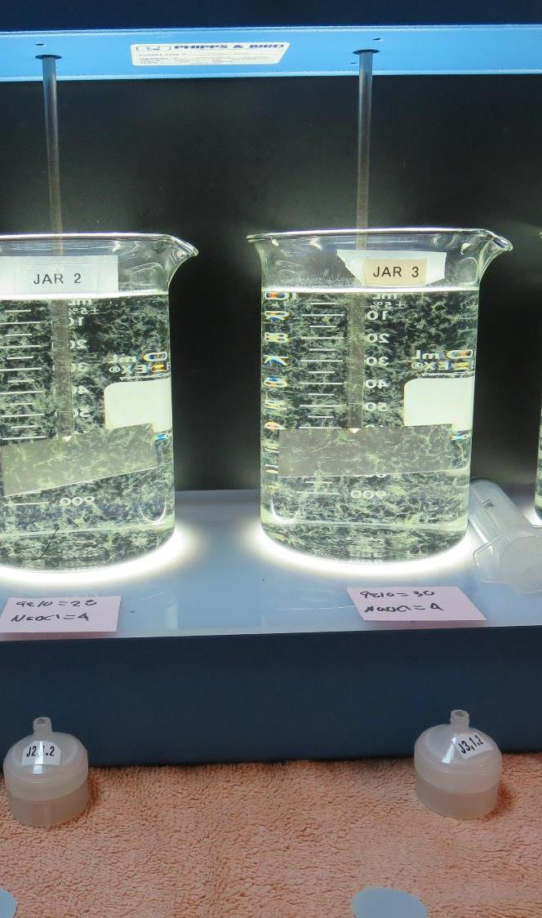
Practice – Practice – Practice (minimum of 100 hours of practice)
Jar testing should be performed regularly during non-water quality events to develop and maintain the necessary skills and confidence to be able to confront real water quality changes.
Initial skill and confidence building will require several hours (~100 hours) of jar testing and practice.

Slide 61
Thank you for attending! Contact and Links
Guy Schott, P.E.
State Water Resources Control Board
Division of Drinking Water
Santa Rosa, CA
Go to Jar Test Results/Procedures for tools to download
www.waterboards.ca.gov/drinking_water/programs/districts/mendocino_district.html
Email: Guy Schott - Guy.Schott@waterboards.ca.gov
Office Number: 707-576-2732

