Slide 1
Lake County CSA 2 – Spring Valley
Clearlake Oaks, CA
GridBee TTHM Aeration
Tracer Studies, August 2015
by Guy Schott, P.E.
Guy.schott@waterboards.ca.gov
707-576-2732

Slide 2
Tracer Test Overview for
384,9000 Gal Max Capacity Clearwell
Tank configuration – inlet at top; outlet at bottom 180 degrees from inlet. No baffles.
Tracer Test 1: GridBee spray aeration on (229 gpm).
Tracer Test 2: GridBee spray aeration off (0 gpm).
Inlet constant flow of 123 gpm
Outlet constant flow 270 gpm
Tracer Test Type: Modified Step-Dose

Slide 3
Clearwell – 384,900 Gal Max Capacity

Slide 4
Tracer Study – Clearwell
12,432 Gal/ft (Diam – 46-ft)
Test 1:
GridBee On – August 13, 2015
Test 2:
GridBee Off – August 25, 2015
Baffling factor: 0.30 (t₁₀/T)*
Avg tank level: 26.2
Avg tank vol: 325,700 gal
Aeration flow: 229 gpm
Inlet flow: 123 gpm
Outlet flow: 269 gpm
*Note: Test 1 was cut short; the predicted Baffling factor was 0.37 (t₁₀/T) based on tracer trending.
Baffling factor: 0.28 (t₁₀/T)*
Avg tank level: 23.8
Avg tank vol: 295,880 gal
Aeration flow: 0 gpm
Inlet flow: 123 gpm
Outlet flow: 271 gpm
*Note: Tracer mass for Test 2 was seen much earlier than Test 1. There was a comparable difference in tracer trending between both tests.

Slide 5
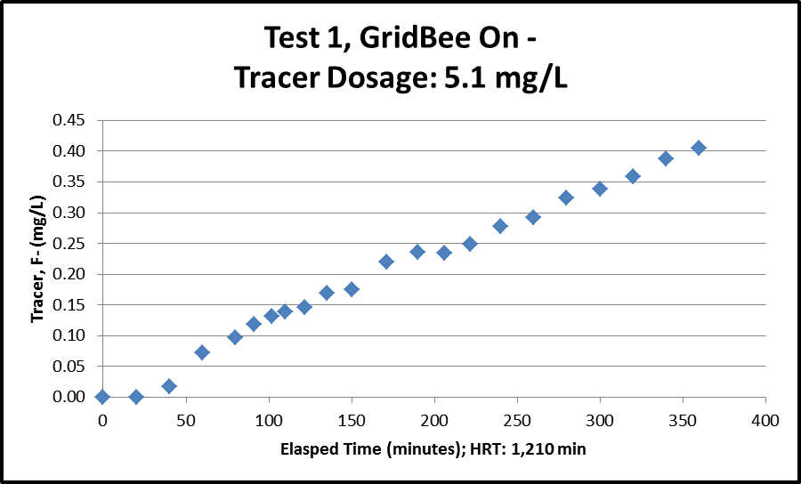
Minimum baffling factor: 0.30 t₁₀/T
Predicted baffling factor: 0.37 t₁₀/T

Slide 6
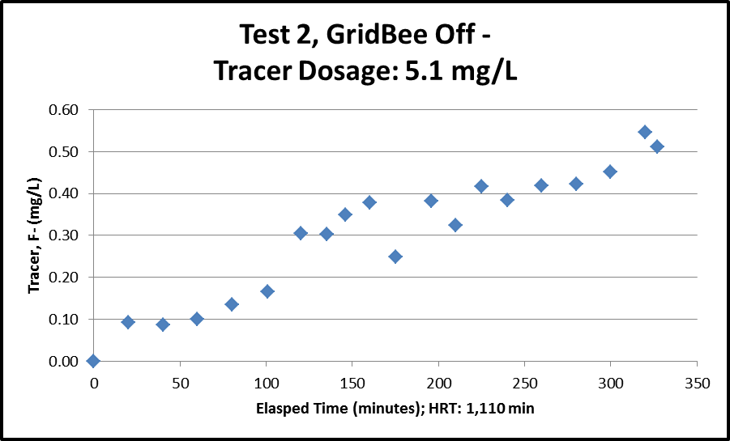
Baffling factor: 0.28 t₁₀/T

Slide 7
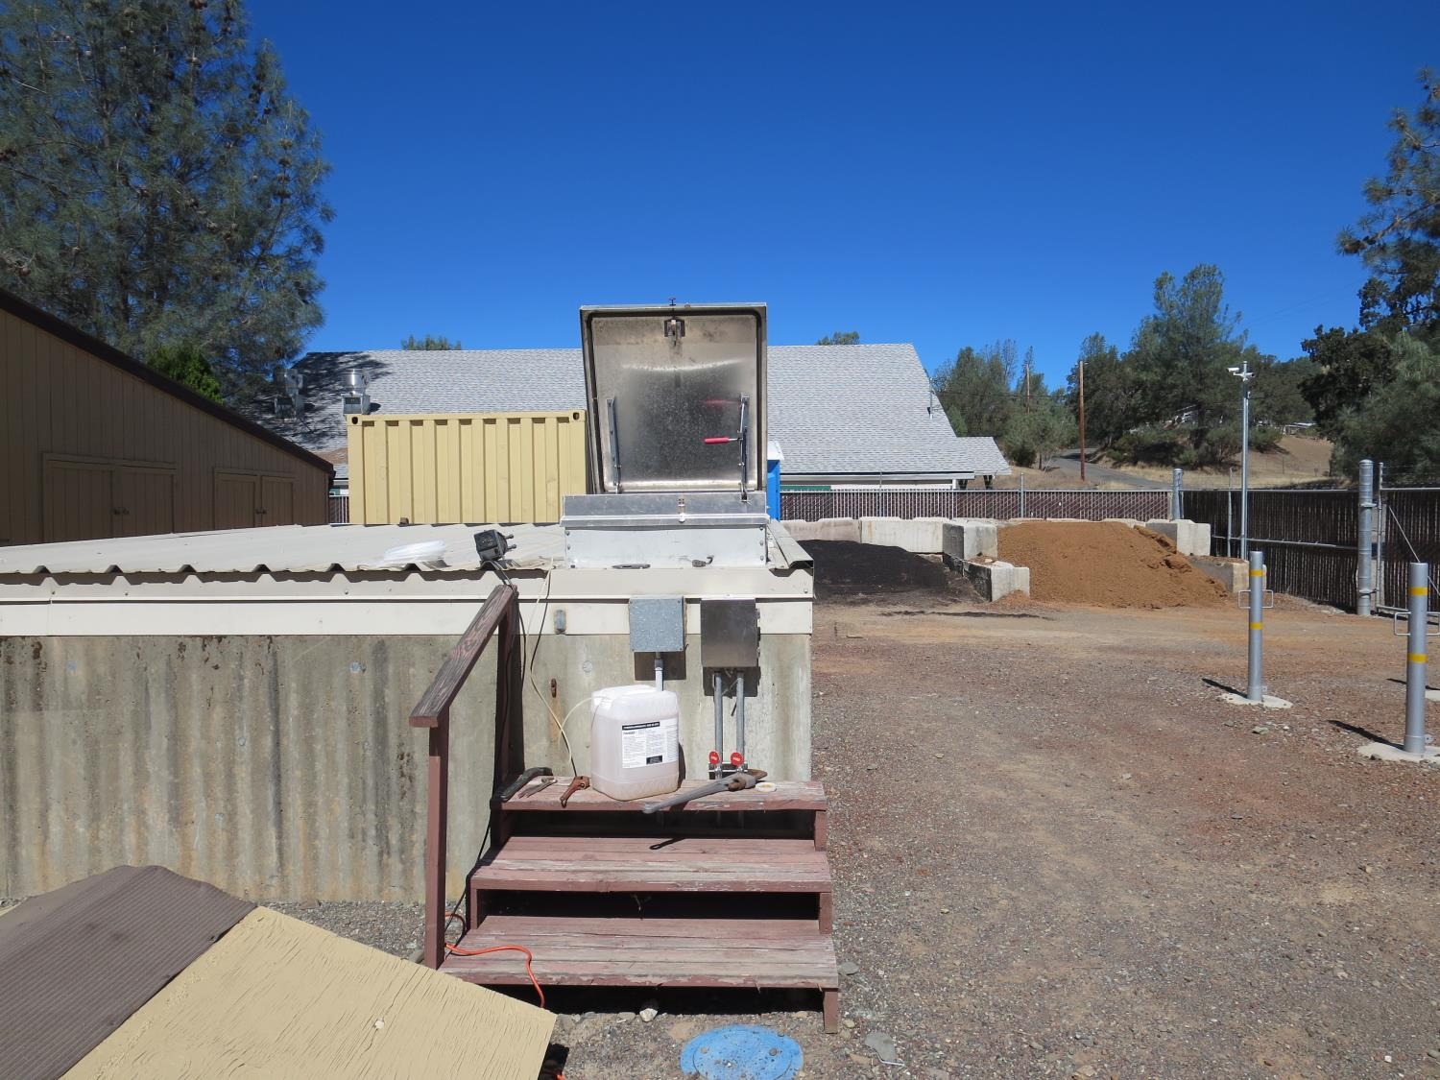
Tracer Injection Point
Transfer pump vault
(123 gpm)

Slide 8
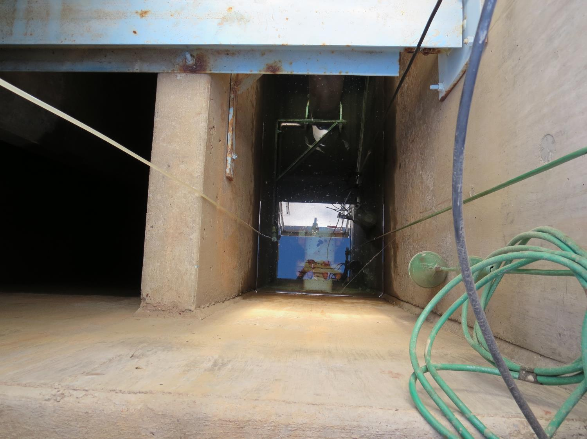
Tracer Injection Point
Suction Pipe to
transfer pumps

Slide 9
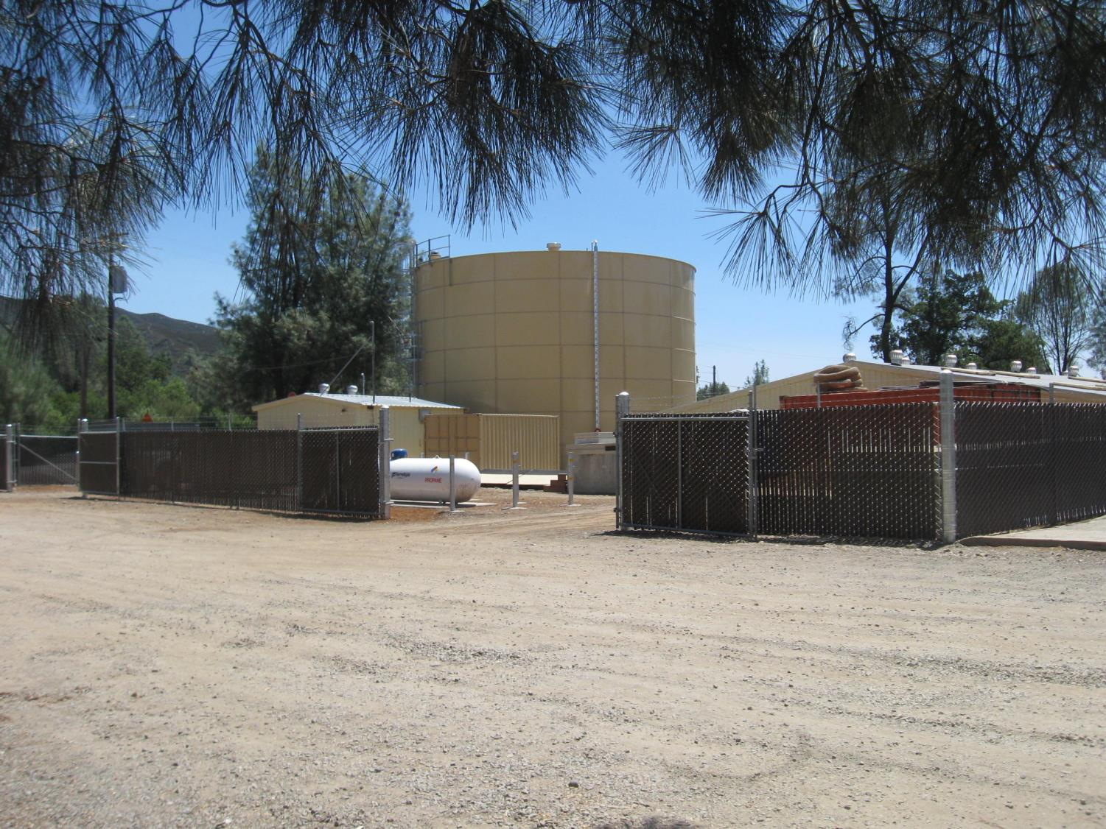
384,900 Gal Clearwell

Slide 10
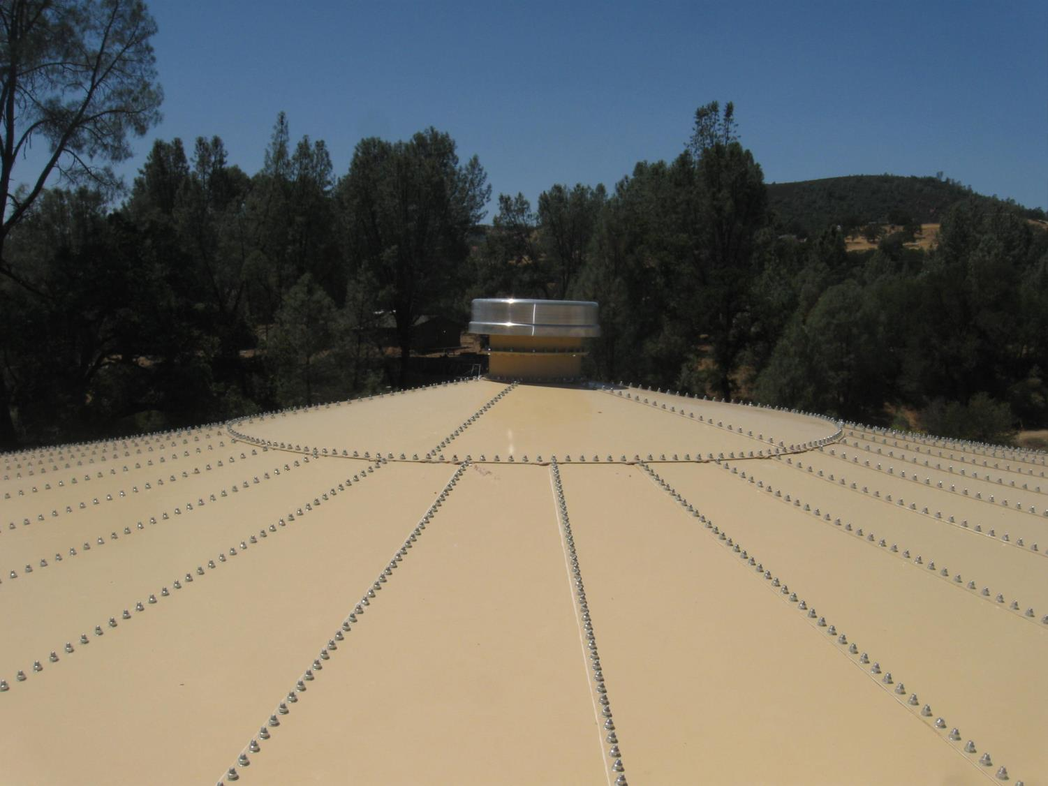
Top of Clearwell

Slide 11
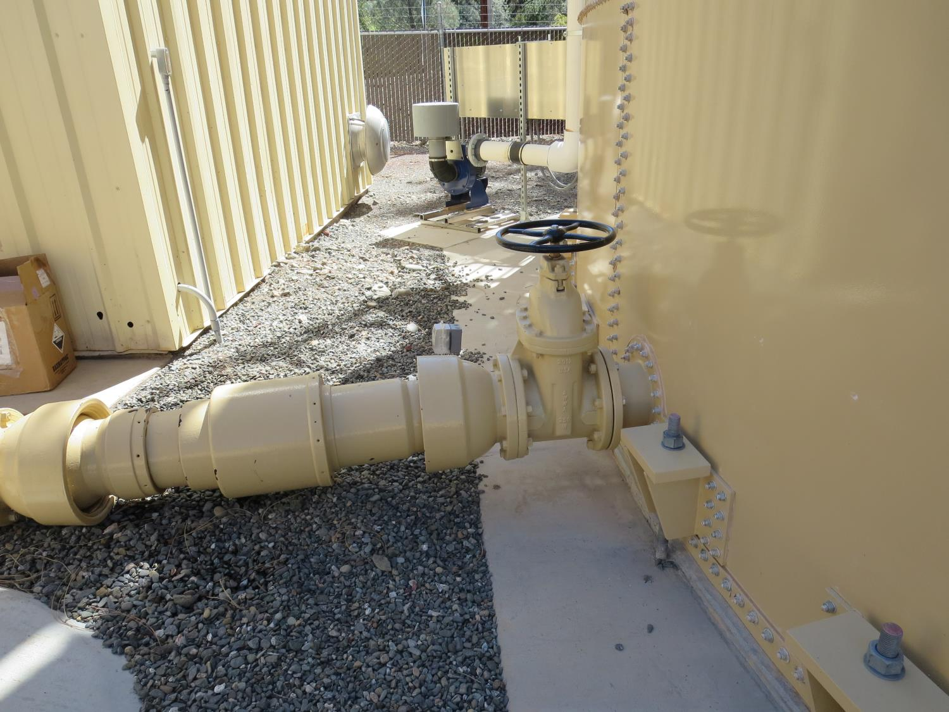
8-inch outlet pipe
on Clearwell

Slide 12
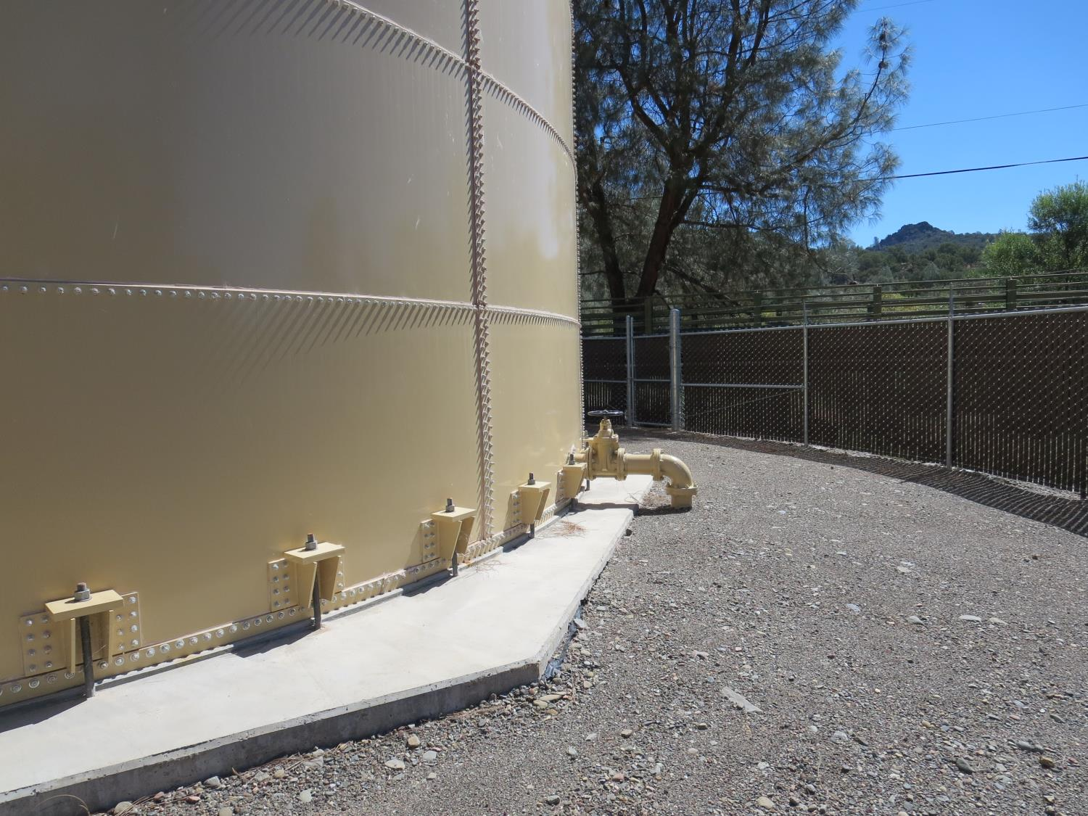
6-inch inlet pipe
on Clearwell –
goes to top of tank

Slide 13
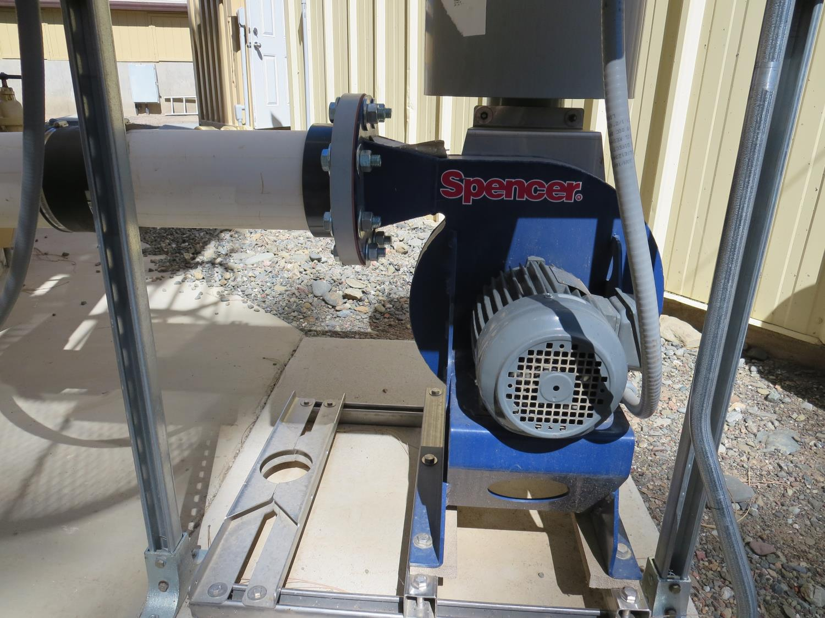
Blower Pump
2 HP (750 CFM)

Slide 14
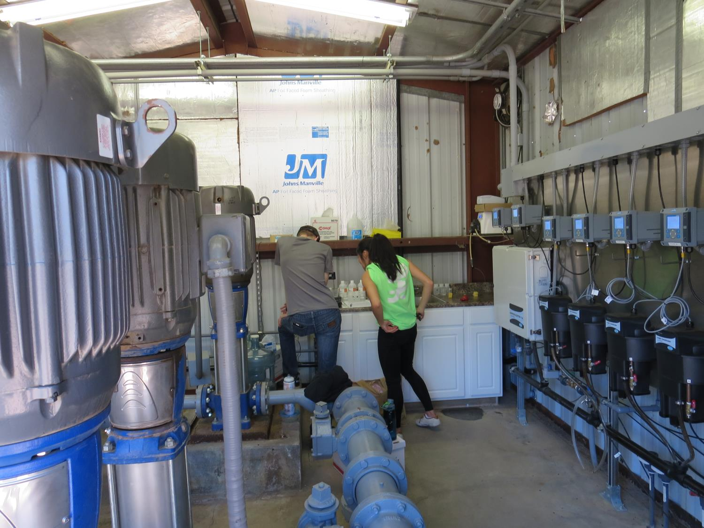
Distribution
Pumps (270 gpm)
Fluoride Analysis

Slide 15
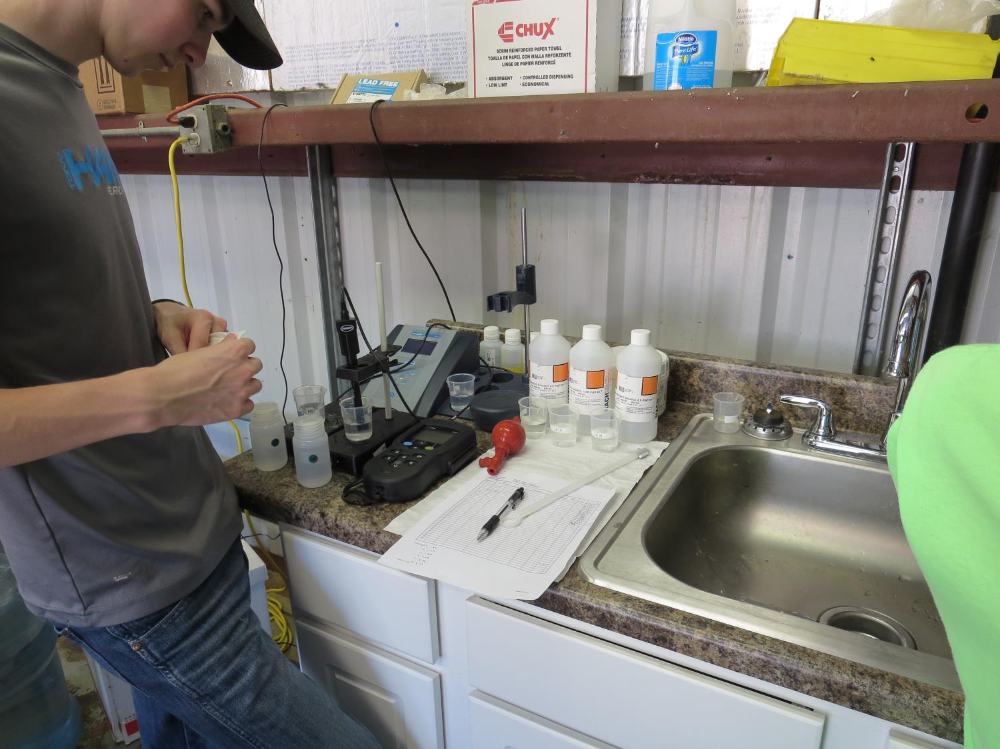
Fluoride Analysis

Slide 16
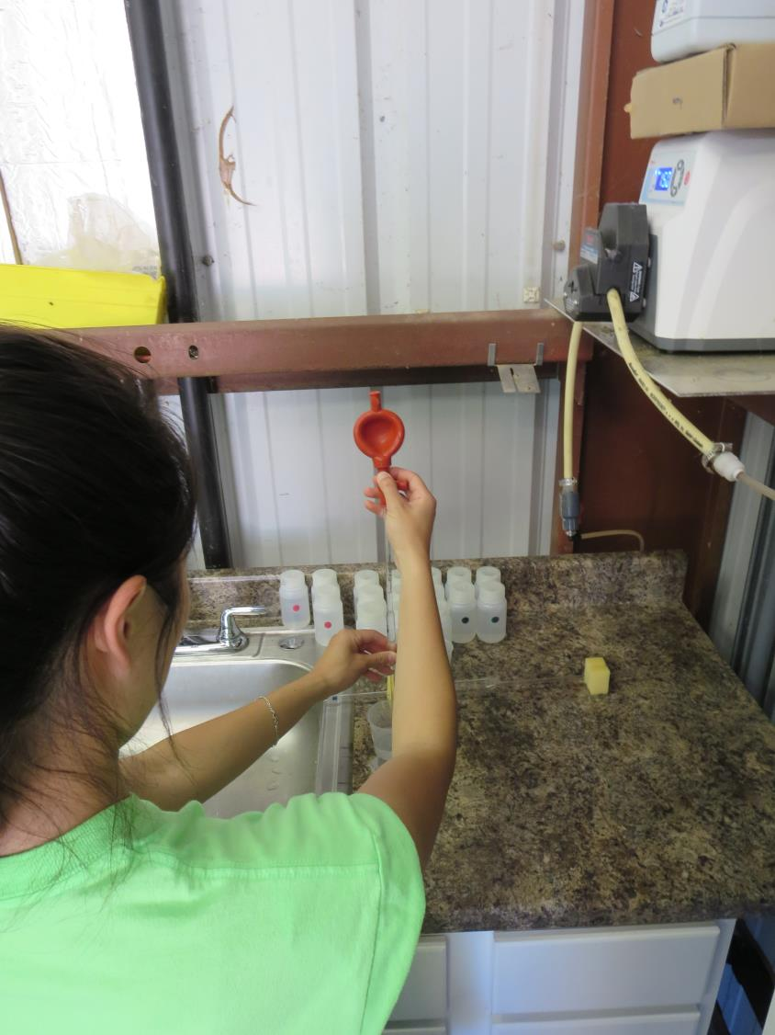
Fluoride Analysis

Slide 17
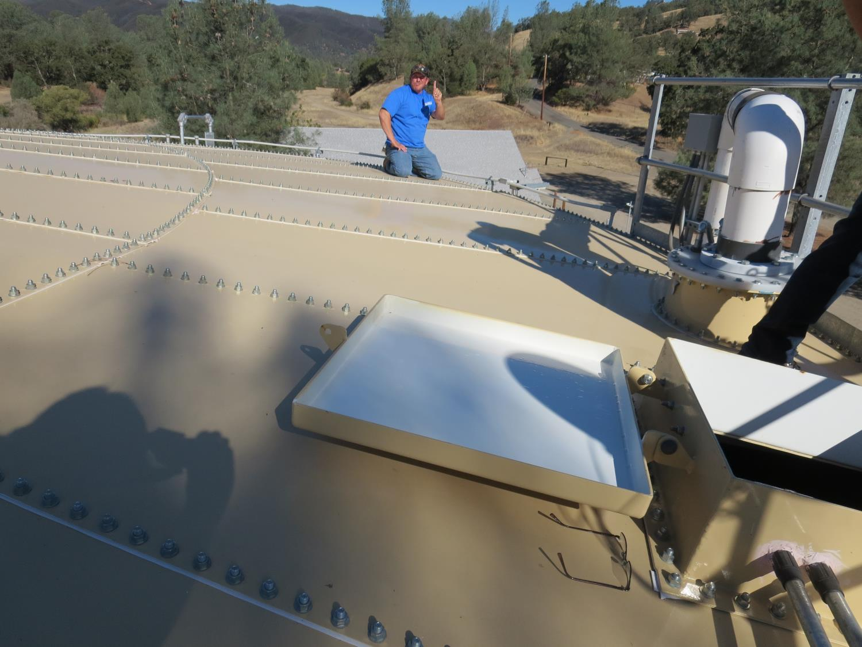
Blower Intake

Slide 18
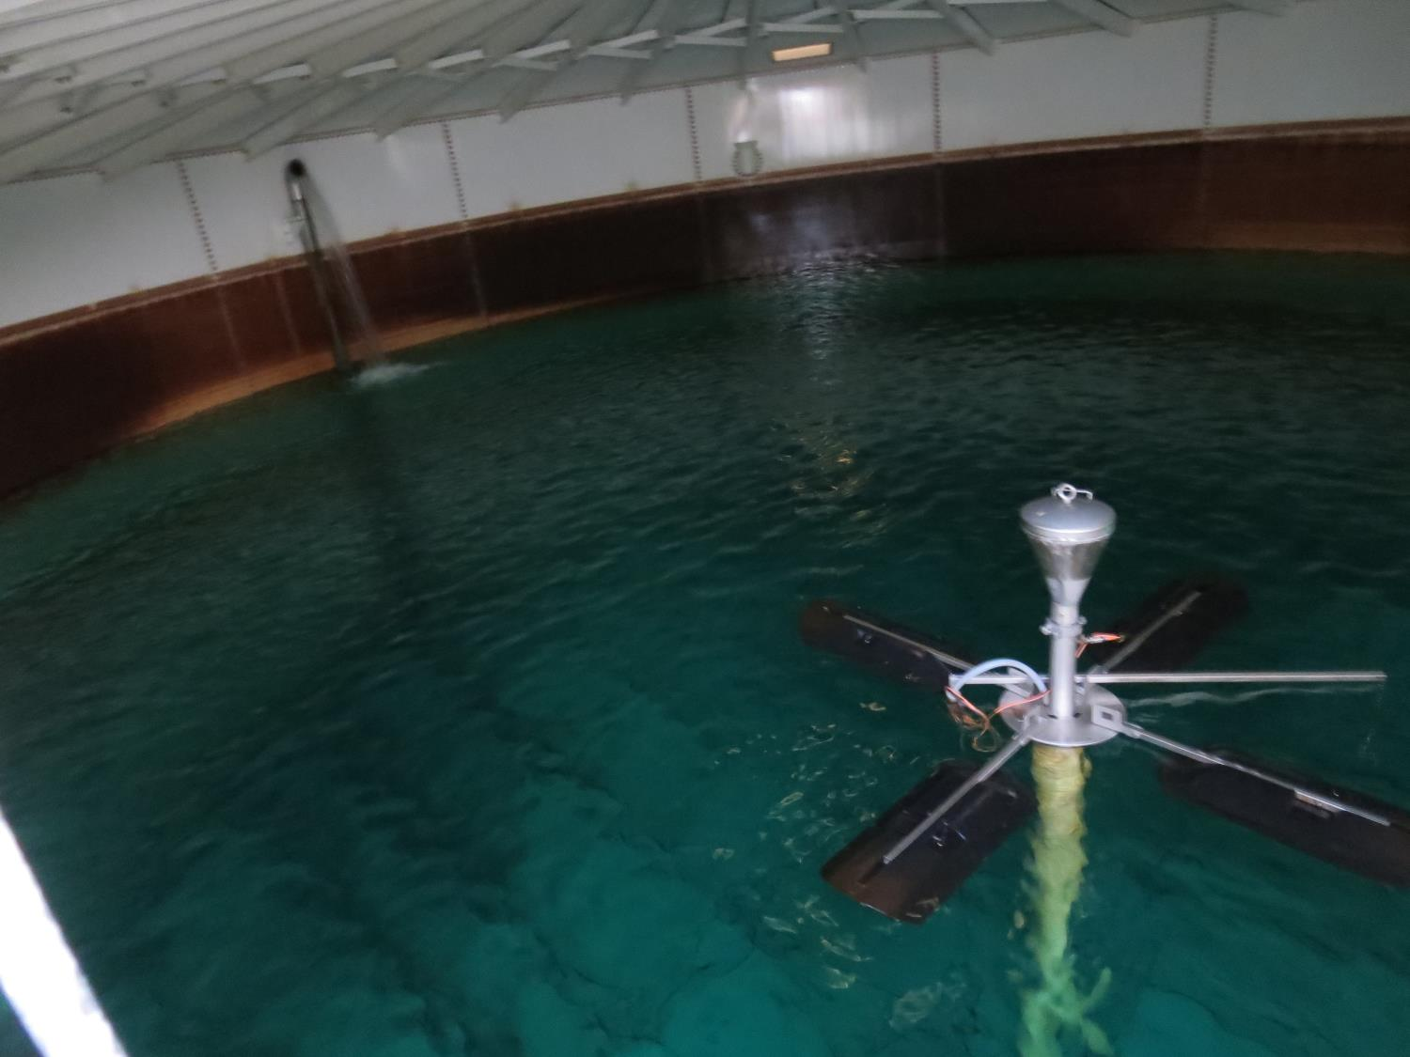
Inlet Flow – 123 gpm
GridBee - off

Slide 19
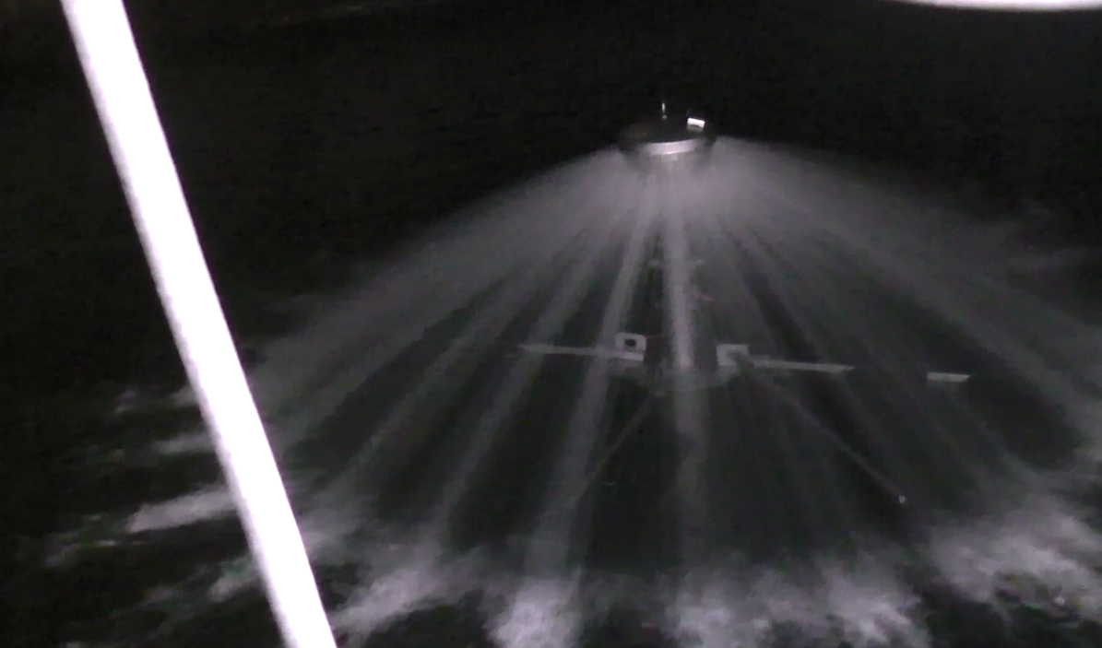
GridBee – On – 229 gpm (5HP)

