Slide 1
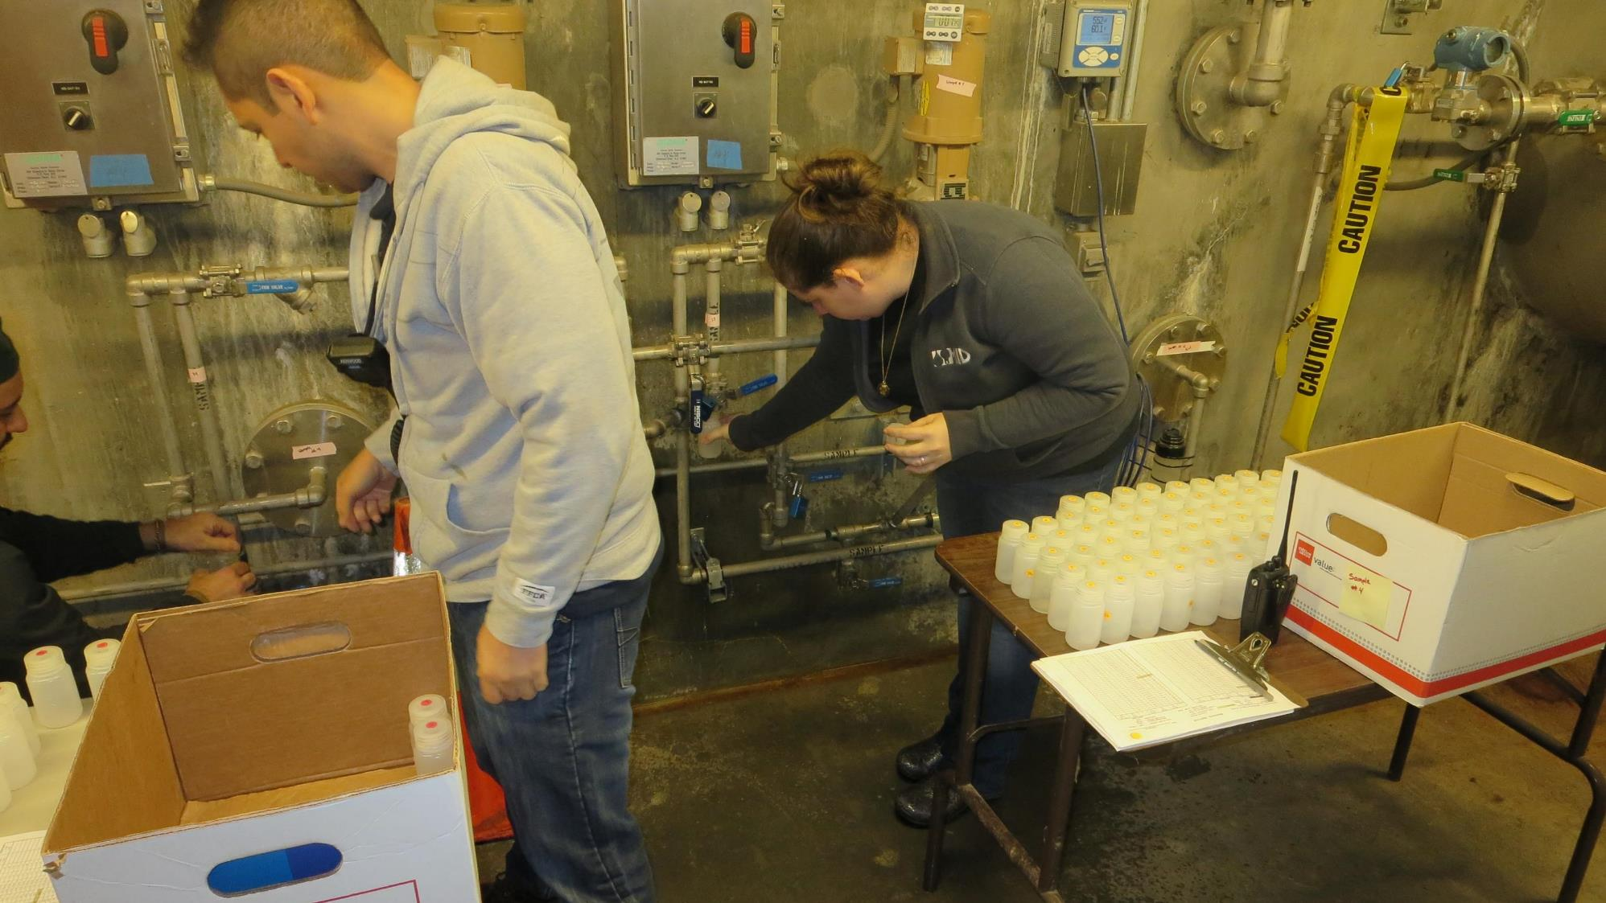
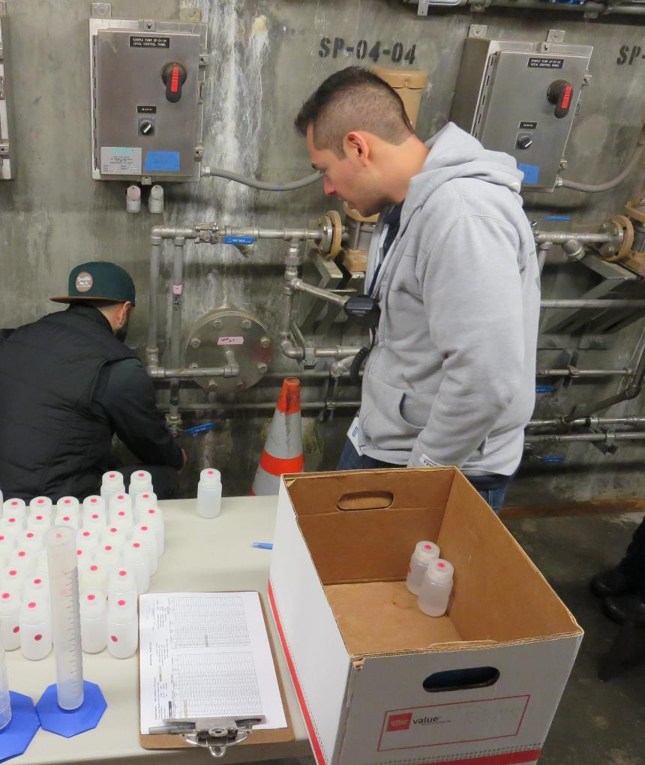
Modesto Irrigation District Ozone Contactor
Tracer Study
February 26-27, 2019

Slide 2
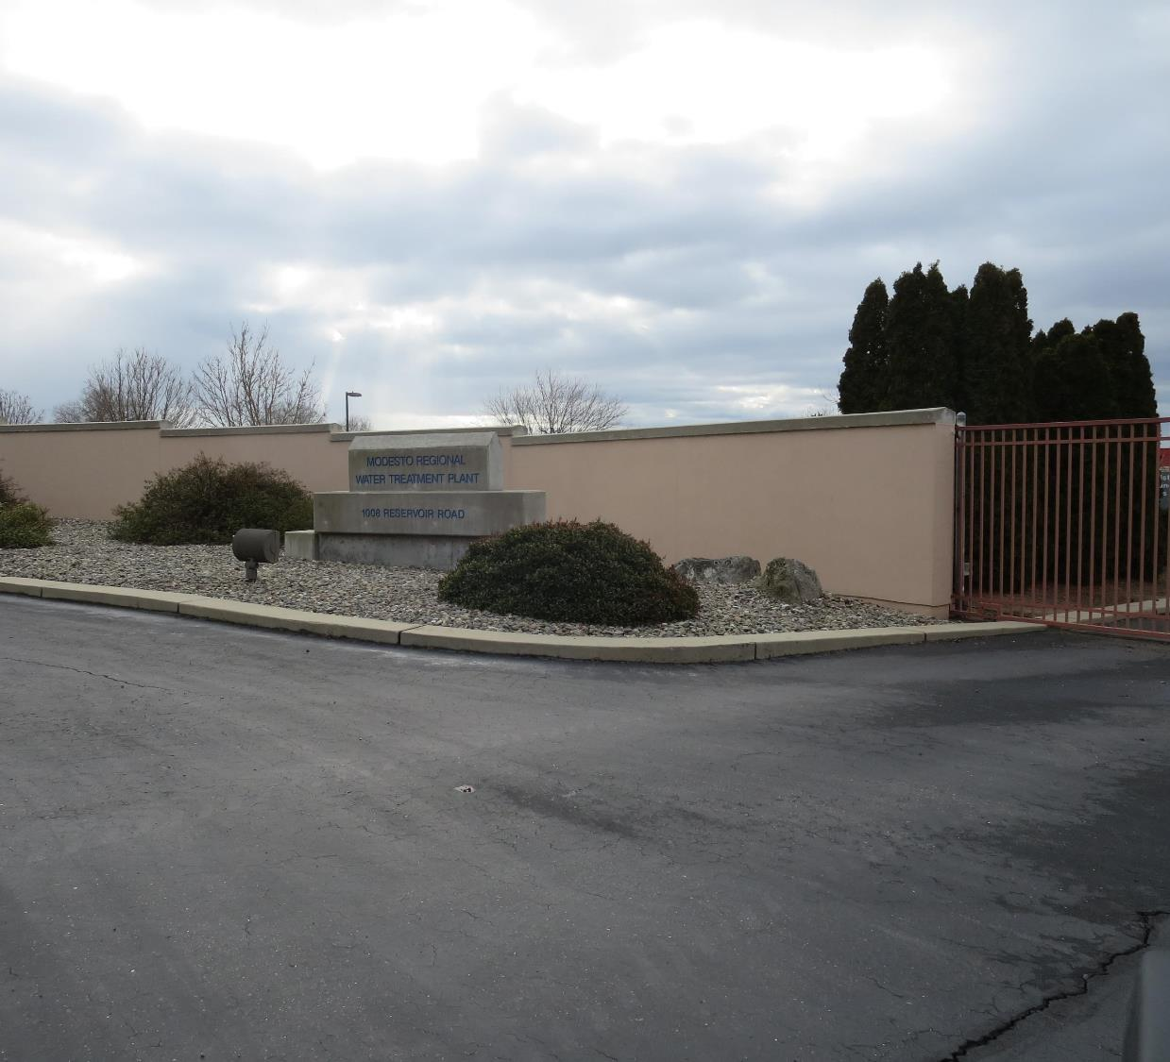
Modesto Irrigation District
CA5010038
Tracer Study –
Ozone Contactor
February 26-27, 2019
Tracer Study:
Treatment Plant: Membrane Plant
Reactor: Ozone Contactor
Serpentine: 4 Channels
Volume: 183,000 gallons
Tracer Method: Slug-Dose
Tracer: Fluoride (liquid)
Fluoride Mass Added: ~1,400 grams
Test Flows: 10.2 & 19.9 MGD
Performed by:
Guy Schott, P.E.
CA Division of Drinking Water

Slide 3
Table of Contents
Summary of Tracer Results
Ozone Reactor Design
Tracer Injection Location
Graphs 1-5: Stations 3-5, 10.2 & 19.9 MGD, Slug-Dose Curves
Purpose of a Tracer Test
Disinfection Exposure Time of Fluid in Vessel for Determining Ct₁₀
Ct₁₀ Value
Baffling Factor (BF)
Tracer Test Method (Slug-Dose)
Method of Analysis and Equipment

Slide 4
Modesto Irrigation District - Tracer Results #1
Station # | HRT 10.1 MGD | HRT 19.9 MGD | Baffling Factor (BF) t₁₀/HRT 10.2 MGD | Baffling Factor (BF) t₁₀/HRT 19.9 MGD | Tracer % Mass Recovery 10.2 MGD | Tracer % Mass Recovery 19.9 MGD
3 | 12.9 min | - | 0.66 | - | 98 | -
4 | 19.4 min | *9.9 min | 0.77 | *0.58 | 102 | *86
5 | 25.8 min | 13.2 min | 0.76 | 0.72 | 97 | 101
*Recommend to discard this data due to short HRT that may have resulted in inadequate mixing.

Slide 5
Modesto Irrigation District - Tracer Results #2
Station # | t₁₀ 10.2 MGD | t₁₀ 19.9 MGD | t₅₀/HRT 10.2 MGD | t₅₀/HRT 19.9 MGD | Morrill Index t₉₀/t₁₀ 10.2 MGD | Morrill Index t₉₀/t₁₀ 19.9 MGD
3 | 8.5 min | - | 1.38 | - | 1.38 | -
4 | 14.9 min | 7.6 min | 1.26 | 1.17 | 1.26 | 1.17
5 | 19.6 min | 10.0 min | 1.24 | 1.16 | 1.24 | 1.16
Working ozone contactor volume: 138,000 gallons.

Slide 6
MID Ozone Contactor

Slide 7
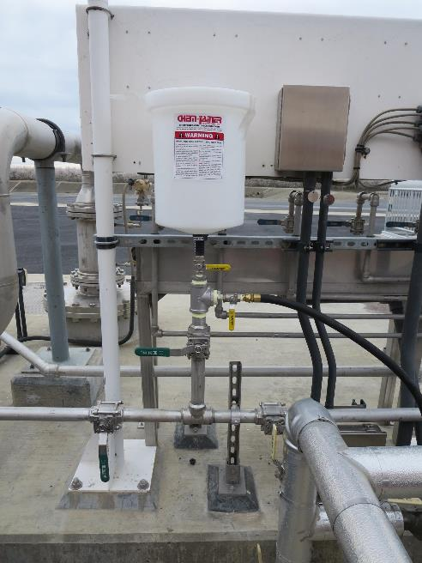
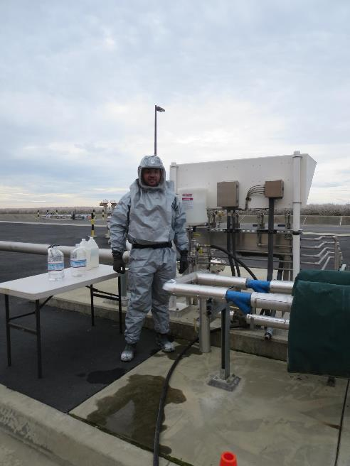
Injection – Slug Dose

Slide 8
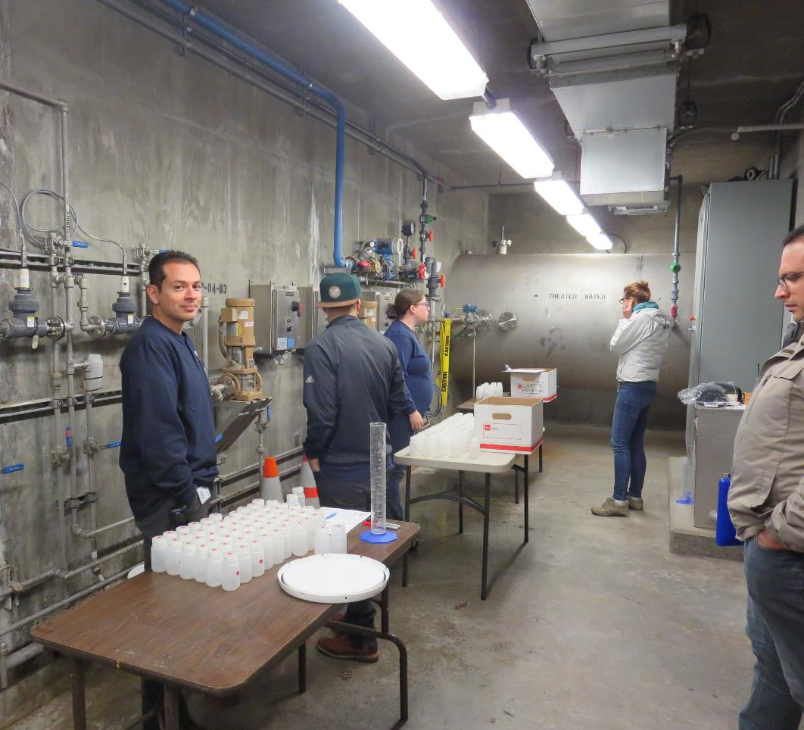
Sample Stations
Station #5
Three samples stations
(#3, 4 & 5).
Sample frequency were
at 0.5, 1, & 2 minutes.
Station #4
Station #3

Slide 14
Purpose of a Tracer Study
To determine the hydraulic efficiency or disinfectant exposure time of water through one or more reactors.
The addition of known quantities of a nonreactive chemical (tracer) is added in the form of a pulse (slug) or step-input.
The time of travel or disinfectant exposure time through the reactor is related to:
  Flow rate
  Reactor water volume
  Water Depth
  Reactor configuration

Slide 15
Disinfection Exposure Time of Fluid in Vessel for Determining Ct₁₀
“C” is the disinfectant residual (mg/L) at the point of inactivation compliance.
The disinfection exposure time of water used for Ct₁₀ calculation is the time (t₁₀) it takes for 10 percent of the water entering the reactor to exit the reactor.
To determine this, a marker (nonreactive tracer) is introduced into the water and is monitored leaving the reactor.
Example: 1,000 grams of tracer is slug-dose; t₁₀ is that time when 100 grams of tracer material (10%) has exit the reactor.

Slide 16
Ct₁₀ Value
- Log inactivation is based on the Delivered Dose, “Ct₁₀”
  “C” is the disinfectant residual (mg/L)
  “t₁₀” is the exposure or contact time (minutes)
  Multiply them:
C • t₁₀ = mg/L • min (delivered dose)
The calculated Ct₁₀ value is looked up in EPA Ct tables to determine the log inactivation based on specific monitoring parameters (pH, disinfectant residual and/or temperature).

Slide 17
Baffling Factor (BF)
Baffling factor or short-circuiting factor:
  Determined from tracer study or estimated
  BF = t₁₀/ HRT from tracer study
  HRT (hydraulic residence time) = reactor volume divided by reactor flow
Once the BF is determined, then it is applied to the operations of the reactor for determining the disinfectant exposure time.
Example:
  Ozone reactor operating volume: 183,000 gallons
  Exit flow: 7,000 gpm
  BF: 0.70, from tracer study
  Calculated contact or disinfection exposure time:
    183,000 gal ÷ 7,000 gpm × 0.70
    = 18.3 minutes = t₁₀

Slide 18
Test Method
Slug-Dose or Pulse-Input Method
Adding the entire amount of tracer at the beginning of test. The reactor outlet tracer concentration is monitored for 3-4 HRT to determine mass recovery and the time (t₁₀) it takes for 10% of the tracer mass to exit the reactor.

Slide 19
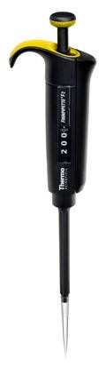
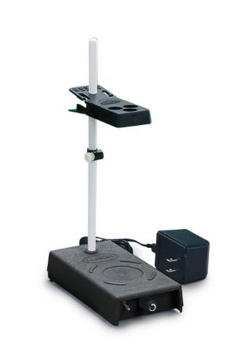
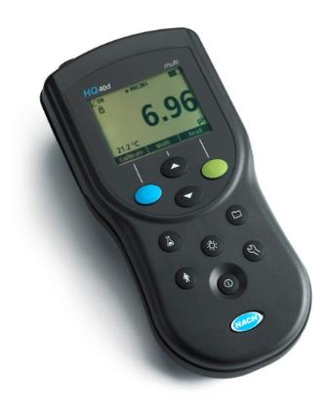
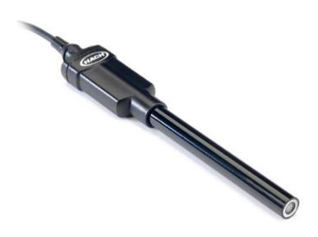
Method of Analysis and Equipment
Intellical™ ISEF121 Fluoride (F⁻) Ion Selective Electrode (ISE)
HQ40d Portable ISE Multi-Parameter Meter
Fluoride Ionic Strength Adjustor (ISA)
Fluoride Standards (0.2/2.0 & 0.5/ 5.0 mg/L)
50 mL graduated cylinder
Finnpipette F2 variable volume pipette, capacity 0.5 - 5 mL
Electrode stirrer stand
50 mL beakers
Stir Bar, Magnetic, Polygon

Slide 20

Contact
Guy Schott, P.E.
State Water Resources Control Board
Division of Drinking Water
Santa Rosa, CA
Guy.Schott@waterboards.ca.gov
707-576-2732

