Slide 1
City of Napa - Hennessey WTP
Intake Structure/Contact Chamber/Bay Tanks
Napa County, CA
Contact Time (t₁₀)
Tracer Study
July 17, 2018
by Guy Schott, P.E.
Water Resources Control Board,
Division of Drinking Water
Guy.schott@waterboards.ca.gov
707-576-2732

Slide 2
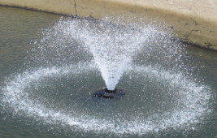
Intake Structure/Contact Chamber/Bay Tanks
Tracer Grab
Sampling #1
1.9 mg/L F
Steady-State
Tracer Injection
(Fluoride, continuous)
Tracer Grab
Sampling #2
Fountain
Aeration
(TTHM reduction)

Slide 3
Intake Structure/Contact Chamber/Bay Tanks
Intake Structure
Type: Two rectangle chambers separated by overflow weir
Dimensions (first chamber): 16 ft deep, 6 ft long, 24 ft wide
Dimensions (second chamber): 16 ft deep, 5 ft long, 24 ft wide
Volume: 31,598 gal
Contact Chamber
Type: long rectangular basin - serpentine
Dimensions: 16.8 ft deep, 272 ft long, 7.5 ft wide (dual units)
Volume: 256,372 gal
Bay Contact Tanks
Type: (two) rectangular, sloping bottom, no baffles, corner feed
Dimensions: 24 ft deep, 136 ft long, 116 ft wide (each)
Water depth during test: 20.2 ft average
Volume (operating during test): 3,886,739 gallons
Average flow rate exiting bay tanks: 14 MGD (9,723 gpm)
Bay Tank Volume, MG = 2*((Level-8)*0.1177 MG/ft+0.507MG)

Slide 4
Final Results
Test Date: July 17, 2018
Test by: Water Resources Control Board, Division of Drinking Water
Tracer Test Method: Modified Step-Dose using Fluoride
Intake Structure/Contact Chamber/Bay Tanks Operating Volume: 4,173,850 gallons
Steady-State Flow: 14 MGD (9,723 gpm)
HRT: 429 minutes (6.82 hours)
t₁₀: 72 minutes
Baffling Factor: 0.17 (t₁₀/HRT)

Slide 5
Tracer Study – Overview 1
A tracer study was conducted at the Hennessey WTP to determine the “t₁₀” disinfection contact time and baffling factor for the Intake Structure/Contact Chamber and Bay Tanks operated in series. The “t₁₀” value is the time is takes for 10% of the added tracer mass to exit the reactor. The baffling factor is t₁₀/HRT where HRT is the hydraulic residence time of the clearwell during the time of the tracer study.

Slide 6
Tracer Study – Overview 2
The purpose of the tracer study was to determine if the baffling factor had changed due to fountain spray aeration (2016) installed in each bay tank for reducing TTHMs. A previous tracer study was conducted in 1999 using the slug-dose method. Results of the 1999 test showed a baffling factor of 0.16. Baffling factor result for the 2018 test is 0.17.

Slide 7
Tracer Study – Overview 3
Tracer Method: Modified Step-Dose
Injection Point: Inlet to intake structure
Sample Points: Outlet of contact chambers and outlet of combined Bay Tanks
Tracer Analysis: Ion Selective Fluoride Probe
Samplers: Luu Nguyen and Amy Little
Analysis by: Guy Schott

Slide 8
Tracer - Dosage
Tracer dosage was based on steady-state concentration monitored after the contact chamber before the Bay Tanks. The HRT for the combined intake structure and contact chamber was 29.6 minutes (0.49 hr). Dosing and monitoring duration was 126 minutes (2.1 hr) or 4.25 HRT to ensure exit steady-state concentration.
Steady-State Tracer: 1.9 mg/L as F exiting contact chambers.

Slide 9
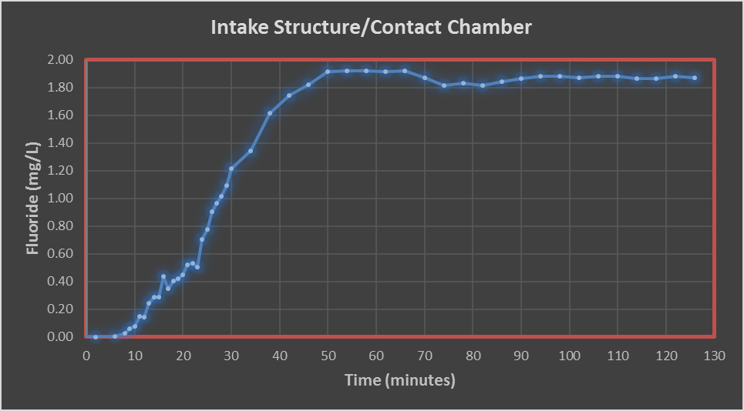
Dosage Determination
Steady-State Concentration: 1.9 mg/L as F, exiting contact chamber before Bay Tanks.

Slide 10
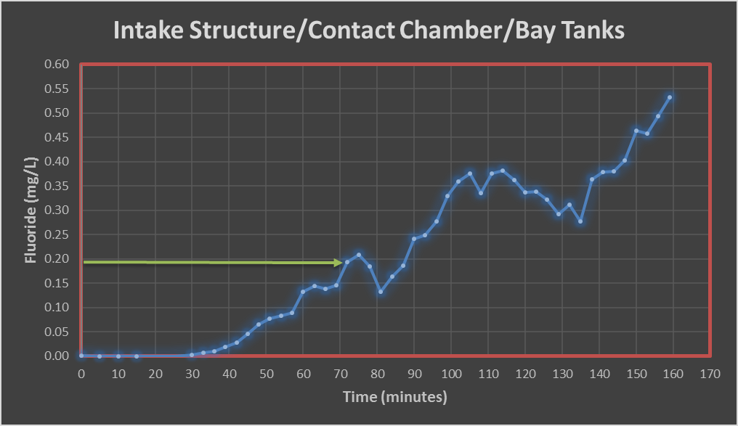
t₁₀ Determination
HRT = 429 minutes
10% of 1.9 mg/L
10% of 1.9 mg/L as F = 0.19 mg/L as F;
t₁₀ ≈ 72 minutes, exiting Bay Tanks; Baffled Factor = 72/HRT = 72/429 = 0.17

Slide 11
Baffled Factor, normalized graph
10% of trace mass
At 0.10 F normalize, t/HRT (baffled factor) ≈ 0.17

Slide 12
Tracer Field Results

Slide 13
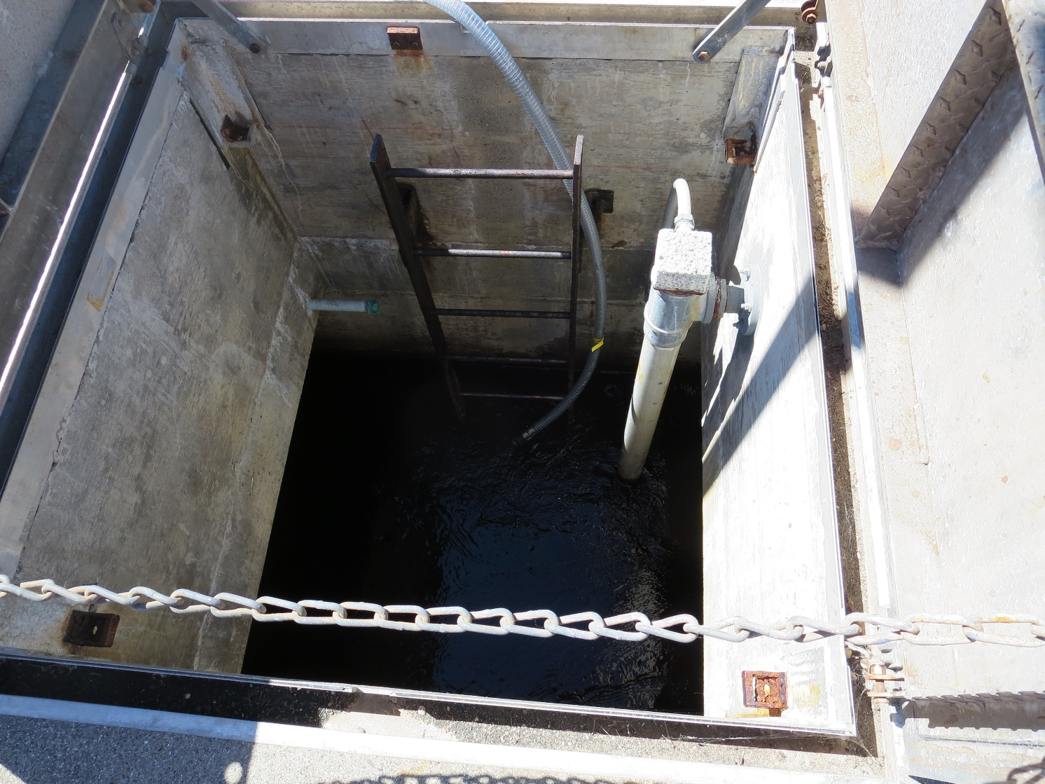
Tracer Injection
Intake Structure

Slide 14
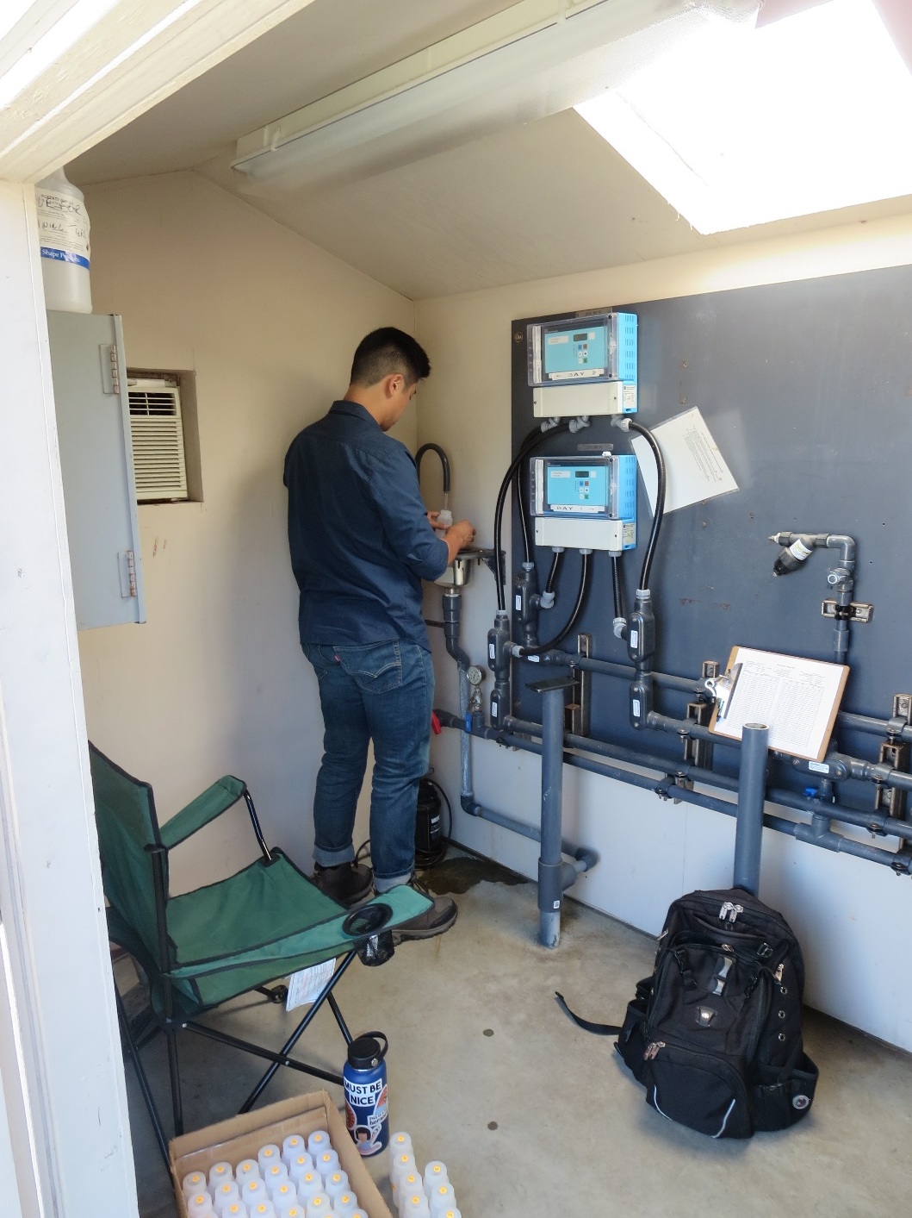
Sample Station #1 (outlet of contact chamber before Bay Tanks)

Slide 15
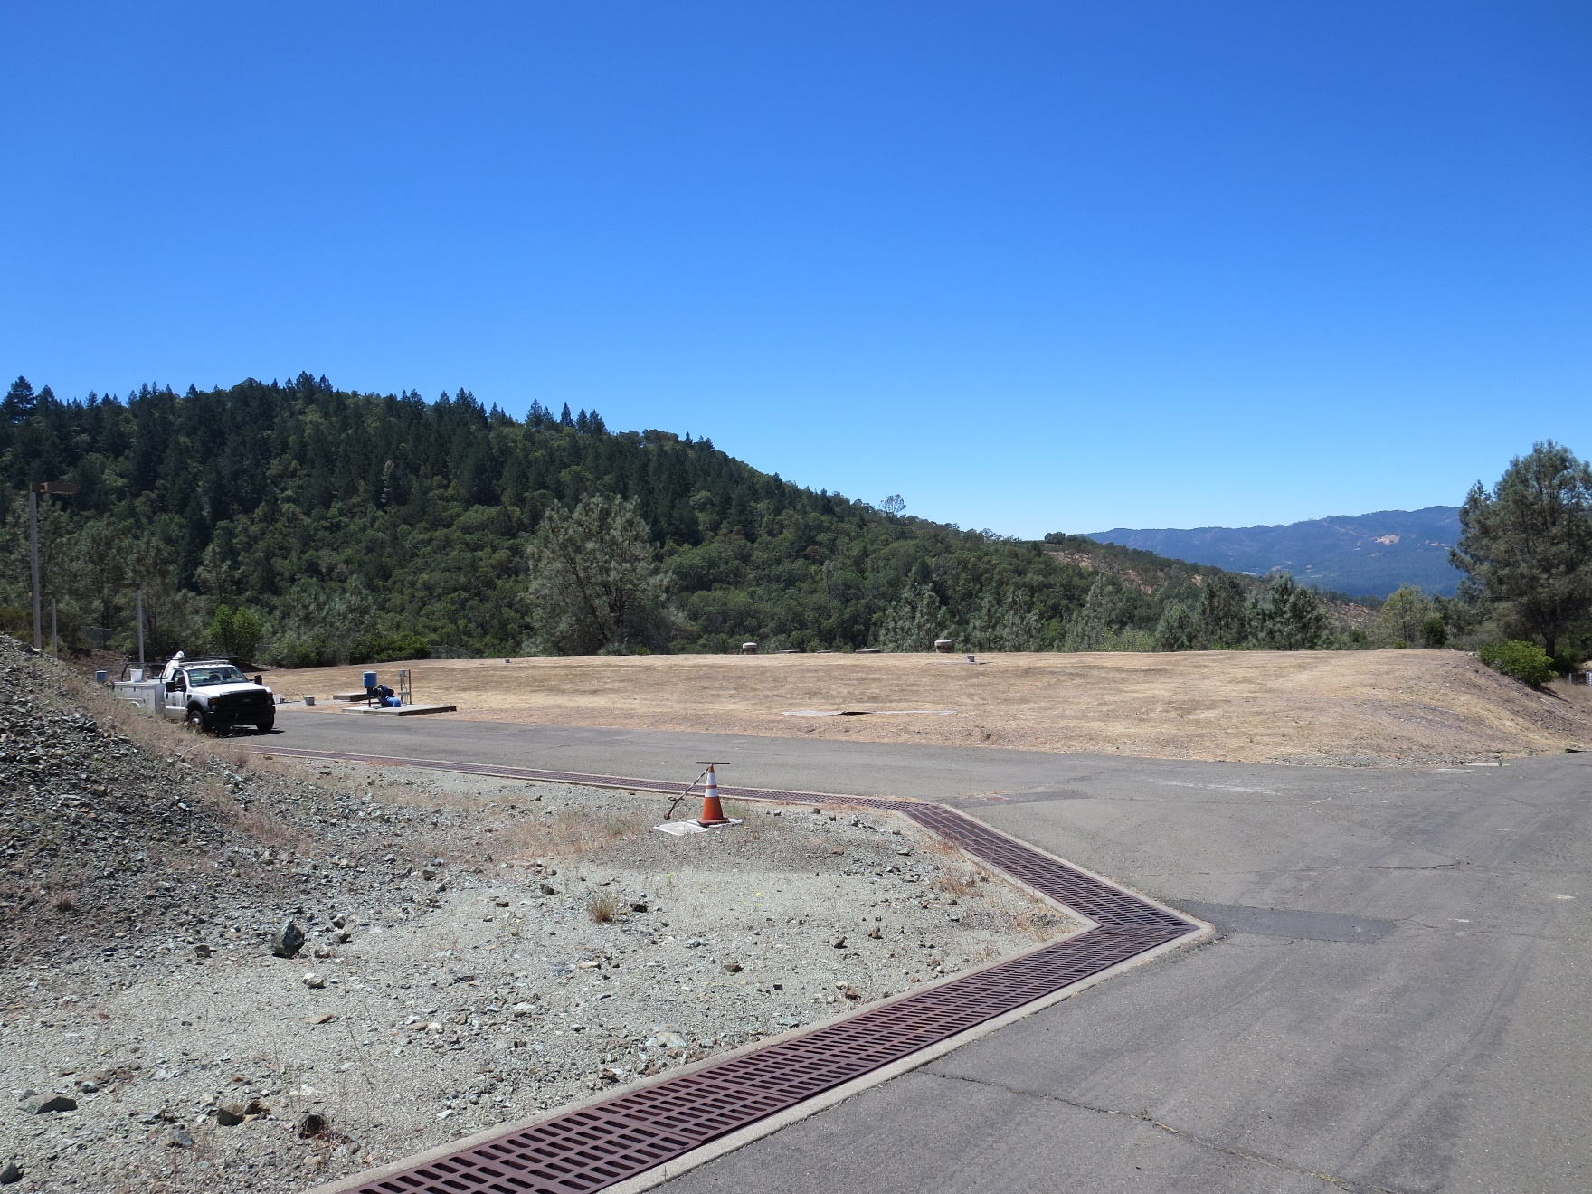
Underground Bay Tanks

Slide 16
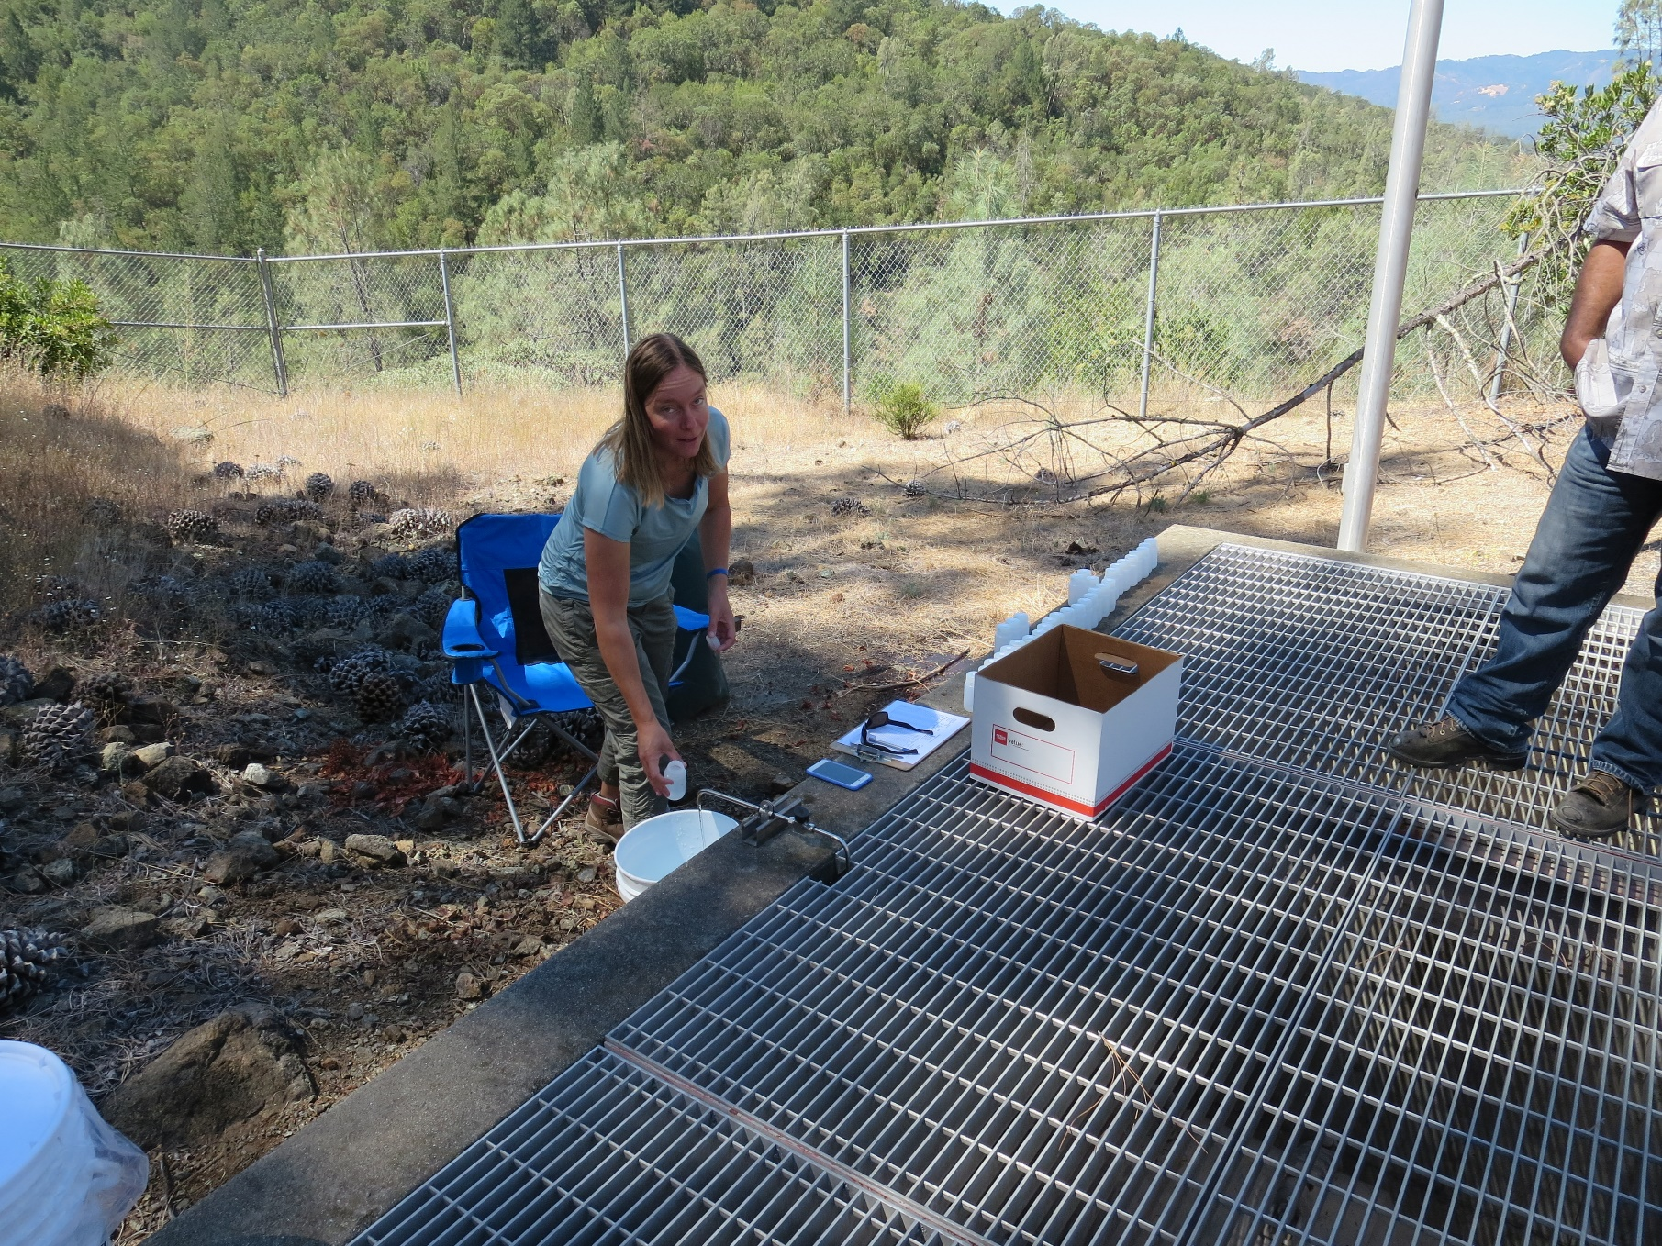
Sample Station #2, Bay Tanks

