Slide 1
Stage 2 DBP Plan Workshop
May 2013
Janice Thomas, CDPH
Sonoma District, Drinking Water Field Operations Branch

Slide 2
Stage 2 Schedule Classification
If your water system is one of these: | Schedule | Comply with Stage 2 DBP Rule by:
C or NTNC, or part of large CDS which serves 100,000 or more people | 1 | April 1, 2012
C or NTNC, or part of large CDS which serves 50,000 to 99,999 people | 2 | October 1, 2012
C or NTNC, or part of large CDS which serves 10,000 to 49,999 people | 3 | October 1, 2013
C or NTNC serving less than 10,000 people and not connect to a larger system | 4 | October 1, 2013

Slide 3
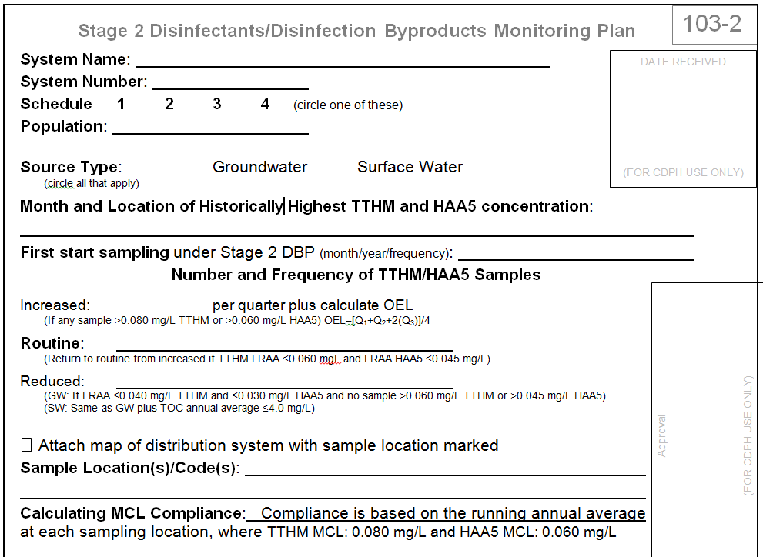
Why redo the Plan?
New monitoring frequencies
Reminders
OEL
LRAA

Slide 4
ACRONYMS
C | Community (Water System)
CDS | Combined Distribution System
CCR | Consumer Confidence Report
DBP | Disinfection Byproducts
DDBPR | Disinfectants/Disinfection Byproduct Rule
GWUDI | Groundwater Under the Direct Influence (of Surface Water)
HAA5 | Haloacetic Acids – Five
IDSE | Initial Distribution System Evaluation
LRAA | Locational Running Annual Average
MCLs | Maximum Contaminant Levels
MRDL | Maximum Residual Disinfectant Level
NTNC | Nontransient-noncommunity (Water System)
OEL | Operational Evaluation Level
RAA | Running Annual Average
TOC | Total Organic Carbon
TTHM | Total Trihalomethanes
SW | Surface Water

Slide 5

What is the purpose of the DDBPR?
Disinfectants are used to kill disease-causing microorganisms in drinking water
In excessive levels, disinfectants can cause negative health effects
Disinfectants react with natural organic matter (NOM) in water, creating by-products
Disinfection byproducts have been shown to cause cancer and adverse reproductive or developmental effects

Slide 6
To which systems does DBP apply?
Community and Nontransient water systems
Disinfects or delivers disinfected water
Transient systems that use chlorine dioxide

Slide 7
What Carries over from Stage 1 DBP?
MCLs
MRDLs
Total Organic Carbon (TOC) monitoring (surface water systems)
Disinfection Byproducts | MCL (mg/L)
TTHM | 0.080
HAA5 | 0.060
Bromate | 0.010
Chlorite | 1.0
Disinfectants | MRDL (mg/L)
Chlorine | 4.0
Chloramines | 4.0
Chlorine Dioxide | 0.8

Slide 8
What’s new in Stage 2
Monitoring – Population
Compliance based on - LRAA
Compliance Schedule – Combined Distribution System (CDS) and Schedule 1, 2, 3, & 4
IDSE
Monitoring Frequency – Routine, Reduced, Increased
Operational Evaluation Level (OEL)
Bromate reduced monitoring requirement
Consumer Confidence Report

Slide 9





Locational Running Annual Average (LRAA)
Stage 1
Total Average
= RAA
4
Average
Average
Average
Average
Total
4
= LRAA_{Purple}
Total
4
= LRAA_{Green}
Stage 2

Slide 10
What does it mean?
2 Duals
2 Duals or 1 Dual
OR
TTHM
HAA5
TTHM
HAA5
TTHM
HAA5
TTHM
HAA5
TTHM
HAA5
2 Samples
2 Samples or 1 Dual
OR
TTHM
HAA5
TTHM
HAA5
TTHM
HAA5

Slide 11
Stage 2 – Routine Sampling
 | Population | Sample # | Frequency
SW/GWUDI | 50,000 - 249,999 | 8 Duals | Quarter
 | 10,000 - 49,999 | 4 Duals | Quarter
 | 3,301 - 9,999 | 2 Duals | Quarter
 | 500 - 3,300 | 2 Samples | Quarter
 | < 500 | 2 Samples or 1 Dual | Year
GW | 100,000 - 499,999 | 6 Duals | Quarter
 | 10,000 - 99,999 | 4 Duals | Quarter
 | 500 - 9,999 | 2 Duals | Year
 | < 500 | 2 Samples or 1 Dual | Year
Return to routine from increased if TTHM LRAA ≤0.060 mg/L and LRAA HAA5 ≤0.045 mg/L.

Slide 12
Stage 2 – Reduced Sampling
 | Population | Sample # | Frequency
SW/GWUDI | 50,000 - 249,999 | 4 Duals | Quarter
 | 10,000 - 49,999 | 2 Duals | Quarter
 | 3,301 - 9,999 | 2 Duals | Year
 | 500 - 3,300 | 2 Samples or 1 Dual | Year
 | < 500 | 2 Samples or 1 Dual | Year
GW | 100,000 - 499,999 | 2 Duals | Quarter
 | 10,000 - 99,999 | 2 Duals | Year
 | 500 - 9,999 | 2 Samples or 1 Dual | Year
 | < 500 | 2 Samples or 1 Dual | Three Year
(GW: If LRAA ≤0.040 mg/L TTHM and ≤0.030 mg/L HAA5 and no sample >0.060 mg/L TTHM or >0.045 mg/L HAA5)
(SW: Same as GW plus TOC annual average ≤4.0 mg/L)

Slide 13
Stage 2 – Increased Sampling
 | Population | Sample # | Frequency
SW/GWUDI | 50,000 - 249,999 | 8 Duals | Quarter
 | 10,000 - 49,999 | 4 Duals | Quarter
 | 3,301 - 9,999 | 2 Duals | Quarter
 | 500 - 3,300 | 2 Duals | Quarter
 | < 500 | 2 Duals or 1 Dual | Quarter
GW | 100,000 - 499,999 | 6 Duals | Quarter
 | 10,000 - 99,999 | 4 Duals | Quarter
 | 500 - 9,999 | 2 Duals or 1 Dual | Quarter
 | < 500 | 2 Duals or 1 Dual | Quarter
If any sample > 0.080 mg/L TTHM or >0.060 mg/L HAA5

Slide 14
Can I stay on reduced?
≤ 0.040 mg/L TTHM LRAA
AND
≤ 0.030 mg/L HAA5 LRAA
Source water ≤ 4.0 mg/L TOC for SW/GWUDI
Sampling sites do not change

Slide 15
Picking Sites
Dual
Equal number
Fewer (Alternate between high TTHM and high HAA5 sites)
More

Slide 16
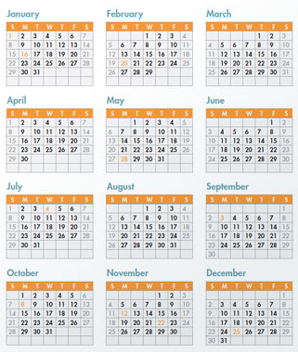
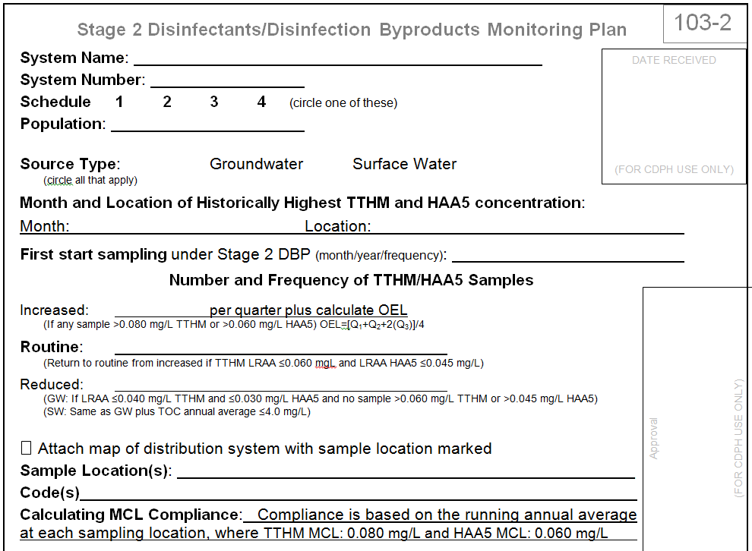
When to sample
Historical high month: “Month and Location…”

Slide 17
When to start
  Quarterly start first quarter (Oct, Nov, or Dec 2013)
  Annual and Triennial Have 12 months to begin
  “First start sampling…”
  Enter Month, Year, and Frequency
  Should capture Historical High Month

Slide 18
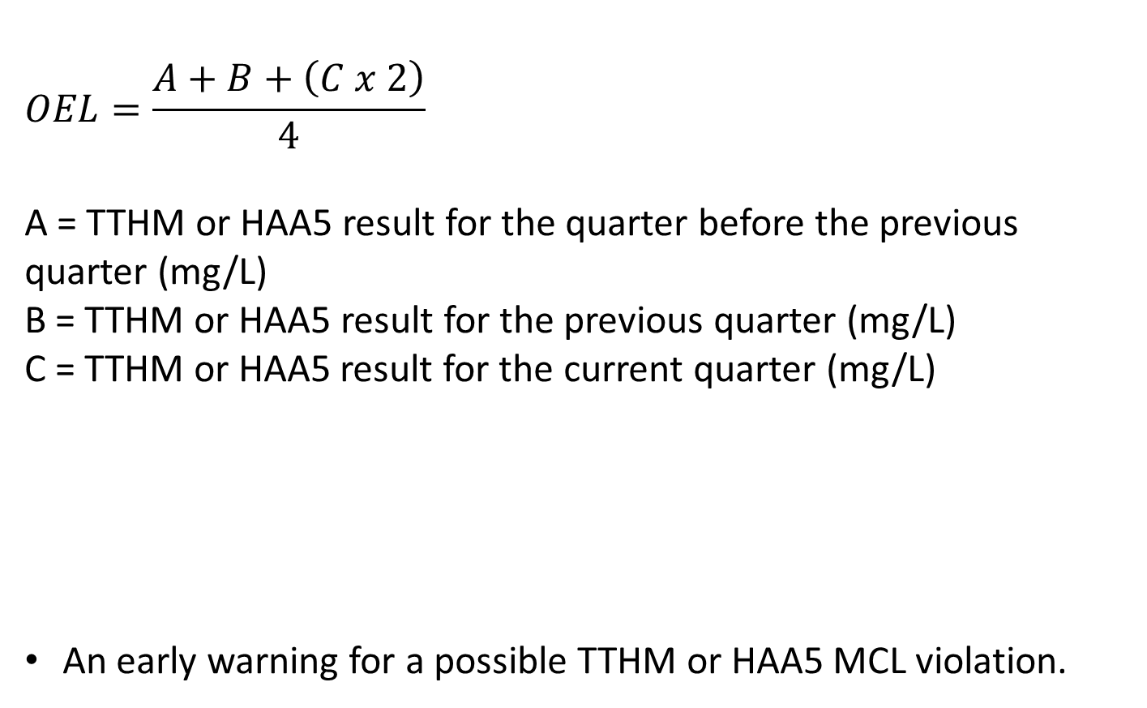

Operational Evaluation Level (OEL)
Only applies if on quarterly AND routine or increased
> 0.080 mg/L TTHM
> 0.060 mg/L HAA5

Slide 19
Operational Evaluation Level (OEL) (continued)
An early warning for a possible TTHM or HAA5 MCL violation
Triggers a comprehensive review of system operations

Slide 20
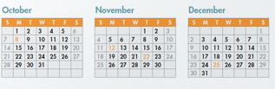


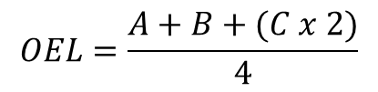
x2
A
B
C
2012
2013
2013
4

Slide 21
Some Examples of OEL Exceedances
TTHM Data
Stage 2 DBP Monitoring location | October | January | April | Operational Evaluation Value
Location #1 | 0.070 mg/L | 0.078 mg/L | 0.082 mg/L | 0.078 mg/L
Location #2 | 0.072 mg/L | 0.080 mg/L | 0.086 mg/L | 0.081 mg/L
HAA5 Data
Stage 2 DBP Monitoring location | October | January | April | Operational Evaluation Value
Location #1 | 0.056 mg/L | 0.060 mg/L | 0.062 mg/L | 0.060 mg/L
Location #2 | 0.054 mg/L | 0.062 mg/L | 0.064 mg/L | 0.061 mg/L

Slide 22

Operational Evaluation Level (OEL) (continued)
If OEL exceedance occurs…
Need to conduct Operational Evaluation, including distribution, treatment, and source evaluations.
If the cause(s) is known, request to limit your scope.
90 days to submit
WCWWA.org for forms

Slide 23
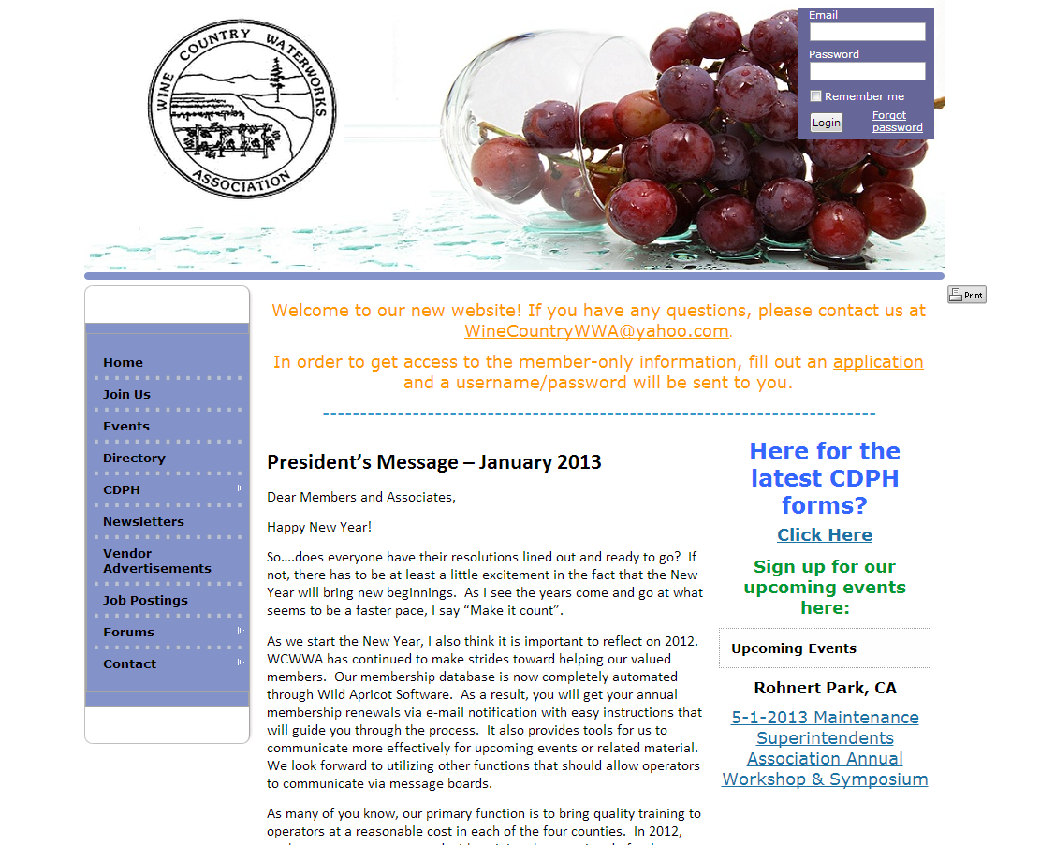

Slide 24
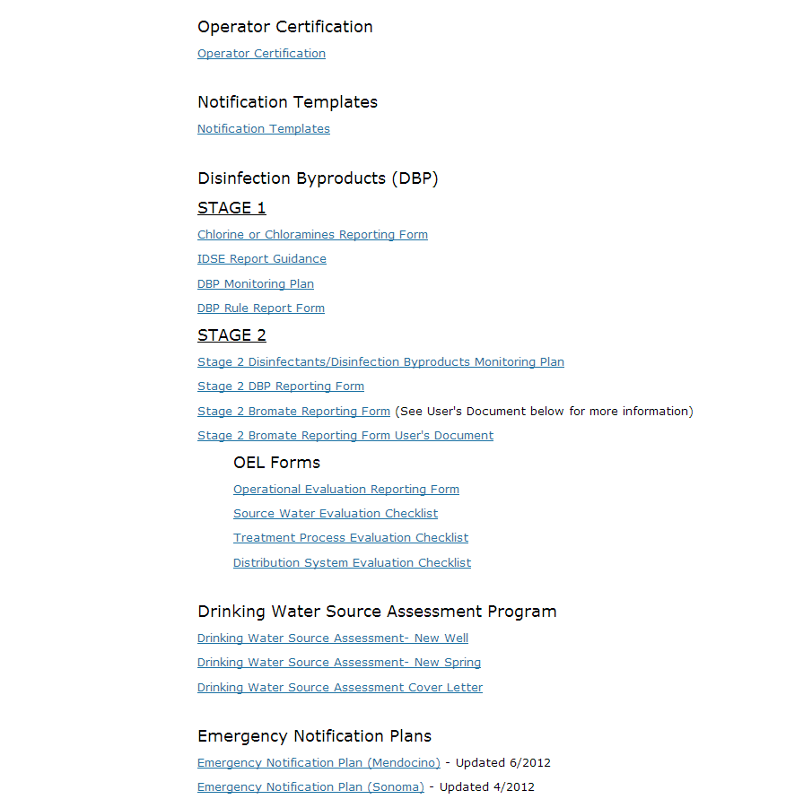

Slide 25
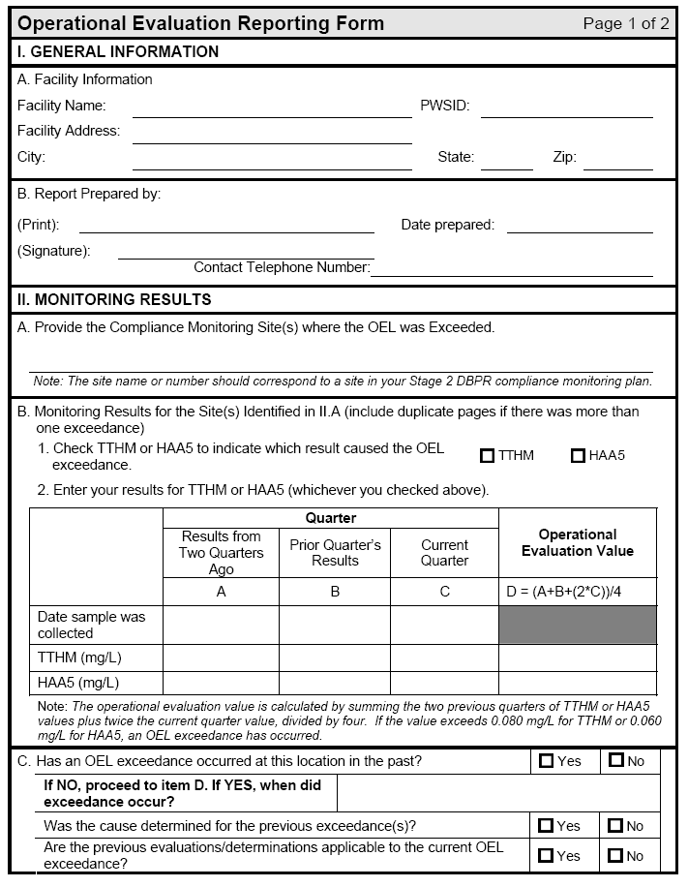
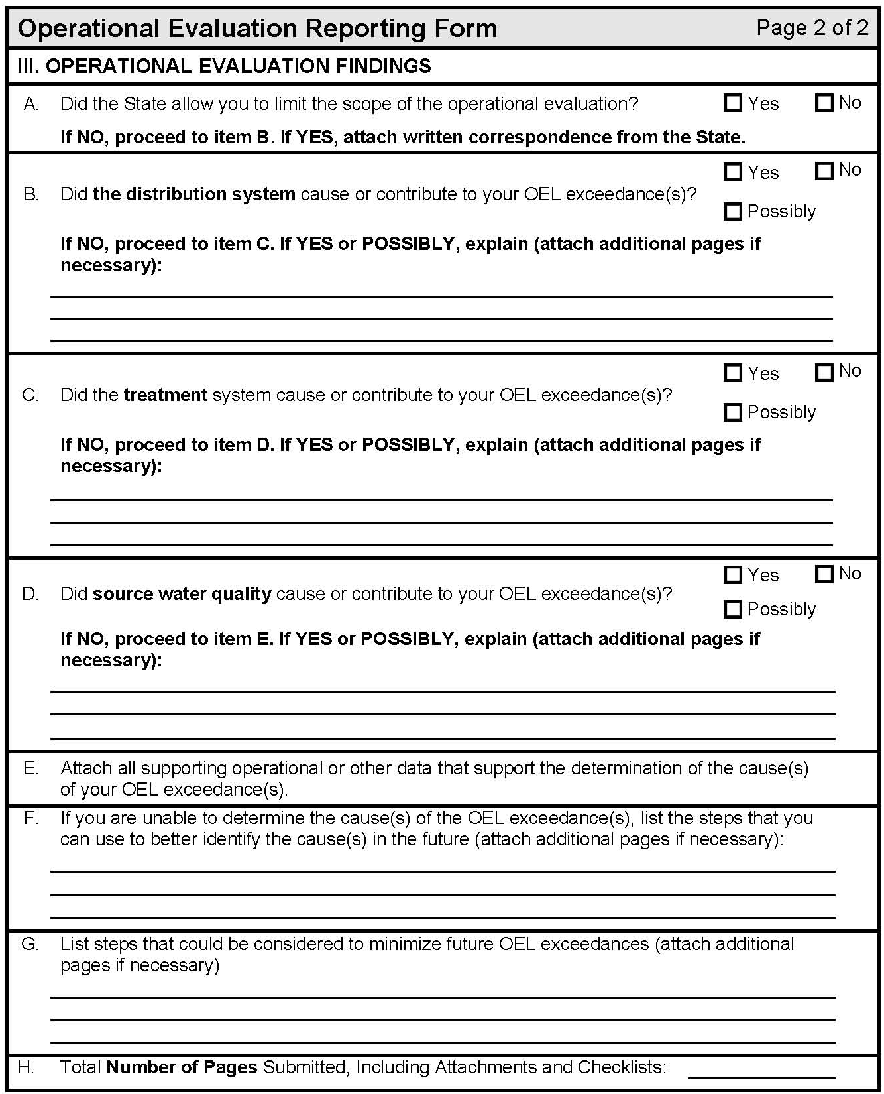

Slide 26
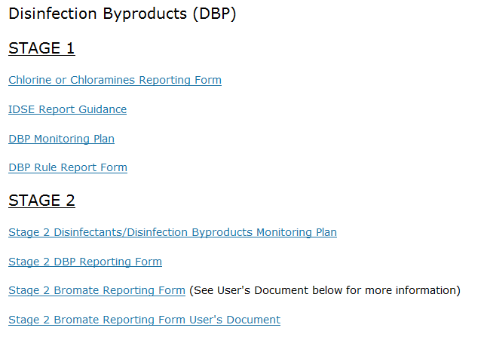
How to Report Results
Stage 2 DBP Reporting Form at WCWWA.org

Slide 27
More information at:
WCWWA website
http://wcwwa.memberlodge.com/CDPH
Consumer Confidence Reports (CCRs)
http://www.cdph.ca.gov/certlic/drinkingwater/Pages/CCR.aspx
CDPH – Recently Adopted Drinking Water Regulations – Stage 2 DBP Rule http://www.cdph.ca.gov/certlic/drinkingwater/Pages/Regulations.aspx
U.S. EPA Complying with the Stage 2 DBP Rule: Small Entity
Compliance Guide
http://www.epa.gov/ogwdw/disinfection/stage2/pdfs/guide_st2_stepguide_smallentitycomplianceguide.pdf
U.S. EPA Stage 2 DBP Rule – Operational Evaluation Guidance Manual
http://www.epa.gov/ogwdw/disinfection/stage2/pdfs/draft_guide_stage2_operationalevaluation.pdf

Slide 28

To complete your plan you will need:
  Form
  TTHM/HAA5 Data

Slide 29
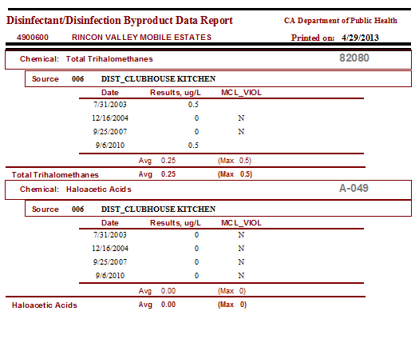
4905555 ABC Mobile Home Park

Slide 30
ABC Mobile Home Park
4905555
# From Annual Reports

Slide 31
September
Clubhouse Kitchen
September 2014/Reduced

Slide 32
1 Dual
1 Dual per year
1 Dual every three years

Slide 33
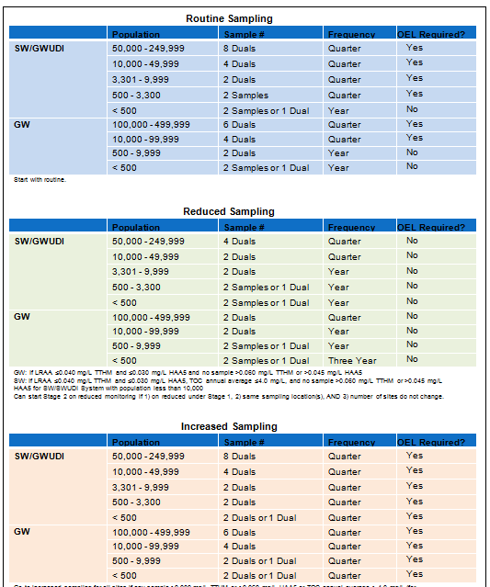

Slide 34
DIST_CLUBHOUSE KITCHEN
4905555-006

Slide 35
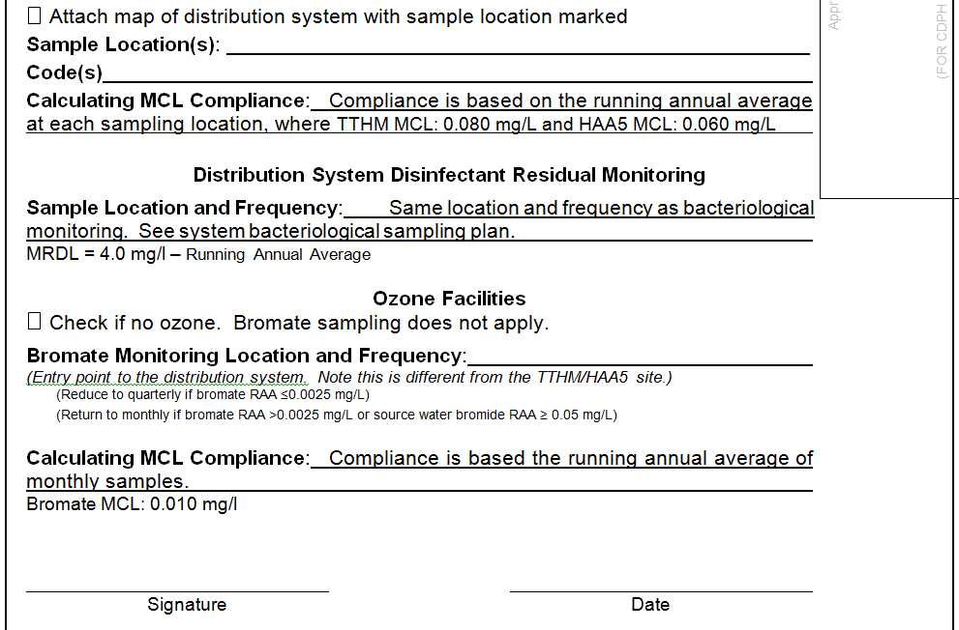

Slide 36

California Department of Public Heath
50 D Street, Room 200
Santa Rosa, CA 95404
(707) 576-2145
Thank you!!

