Slide 1
SAFER Community Workshop
June 15, 2021, 6:00-7:30 pm
Taller Comunitario SAFER
15 de junio de 2021, 6:00-7:30 pm
JUNTA ESTATAL DEL AGUA PROGRAMA SAFER

Slide 2
Recording
This event is being recorded. By entering this meeting, you agree to be recorded.
Grabación
Este evento se está grabando. Al ingresar a la reunión, usted otorga su consentimiento para que lo graben.

Slide 3
We’ll Begin Soon! For technical assistance, email: SAFER@waterboards.ca.gov
¡Pronto comenzaremos! Si necesita ayuda técnica, envíe un mensaje a: SAFER@waterboards.ca.gov
JUNTA ESTATAL DEL AGUA PROGRAMA SAFER

Slide 4
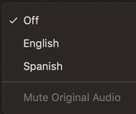
Language Interpretation through Zoom
Interpretación de idiomas en Zoom
Click Interpretation icon in your Meeting/Webinar controls
Navigate to Language Channels
Select Spanish
Mute Original Audio
For technical assistance, email: SAFER@waterboards.ca.gov
Seleccione el icono de interpretación desde los controles de la pantalla
En el menú de opciones, seleccione el idioma español (Spanish)
Seleccione la opción para silenciar el audio original (Mute Original Audio)
Si necesista ayuda técnica, envíe un mensaje electrónico a: SAFER@waterboards.ca.gov
CALIFORNIA WATER BOARDS SAFER PROGRAM

Slide 5
Stay Involved:
SAFER Summer Series!​
Este verano, ¡siga participando en la serie de eventos SAFER!
17 de junio – Taller de agua potable tribal: Norte de California
22 de junio - Taller de agua potable tribal: Sur de California
4 de agosto – Taller de solicitud a candidatura para el Grupo Asesor SAFER
Otros - fechas por determinar
June 17 - Tribal Drinking Water Workshop: Nor Cal
June 22 - Tribal Drinking Water Workshop: So Cal
August 4 - Advisory Group Application Workshop
Others - TBD
JUNTA ESTATAL DEL AGUA PROGRAMA SAFER

Slide 6
Water Boards Mission Statement​
Enunciado de la misión de la Junta del Agua
CALIFORNIA WATER BOARDS SAFER PROGRAM

Slide 7
To Participate – Para participar
To Participate | Para participar
Technical or Language Assistance:
Use the Chat or Email safer@waterboards.ca.gov
Phone Commands
*9 to raise hand
*6 to mute/unmute
Asistencia técnica o de idiomas:
Use la función de chat o correo electrónico safer@waterboards.ca.gov
Controles del teclado del teléfono
*9 para pedir la palabra
*6 para activar/desactivar el micrófono
JUNTA ESTATAL DEL AGUA PROGRAMA SAFER

Slide 8
PollEV.com/safer2019
Text-in Option |Opción por texto : SAFER2019 to|a 22333
JUNTA ESTATAL DEL AGUA PROGRAMA SAFER
Notes:
See comment in previous slide

Slide 9
Drinking Water in California
El agua potable en California
CALIFORNIA WATER BOARDS SAFER PROGRAM
Notes:
Delete?

Slide 10
7,000
public water systems sistemas públicos de agua
domestic wells pozos domésticos
state smalls sistemas pequeños estatales
tribal water systems sistemas tribales de agua
350,000
1,350
128
JUNTA ESTATAL DEL AGUA PROGRAMA SAFER
Notes:
Adriana in RTOC presentation used a slightly different map, with red dots, stars, and triangles as well as gray dots (see pic on side of slide). I assume this is the best map to use because it is the HR2W map, which shows failing public water systems

Slide 11
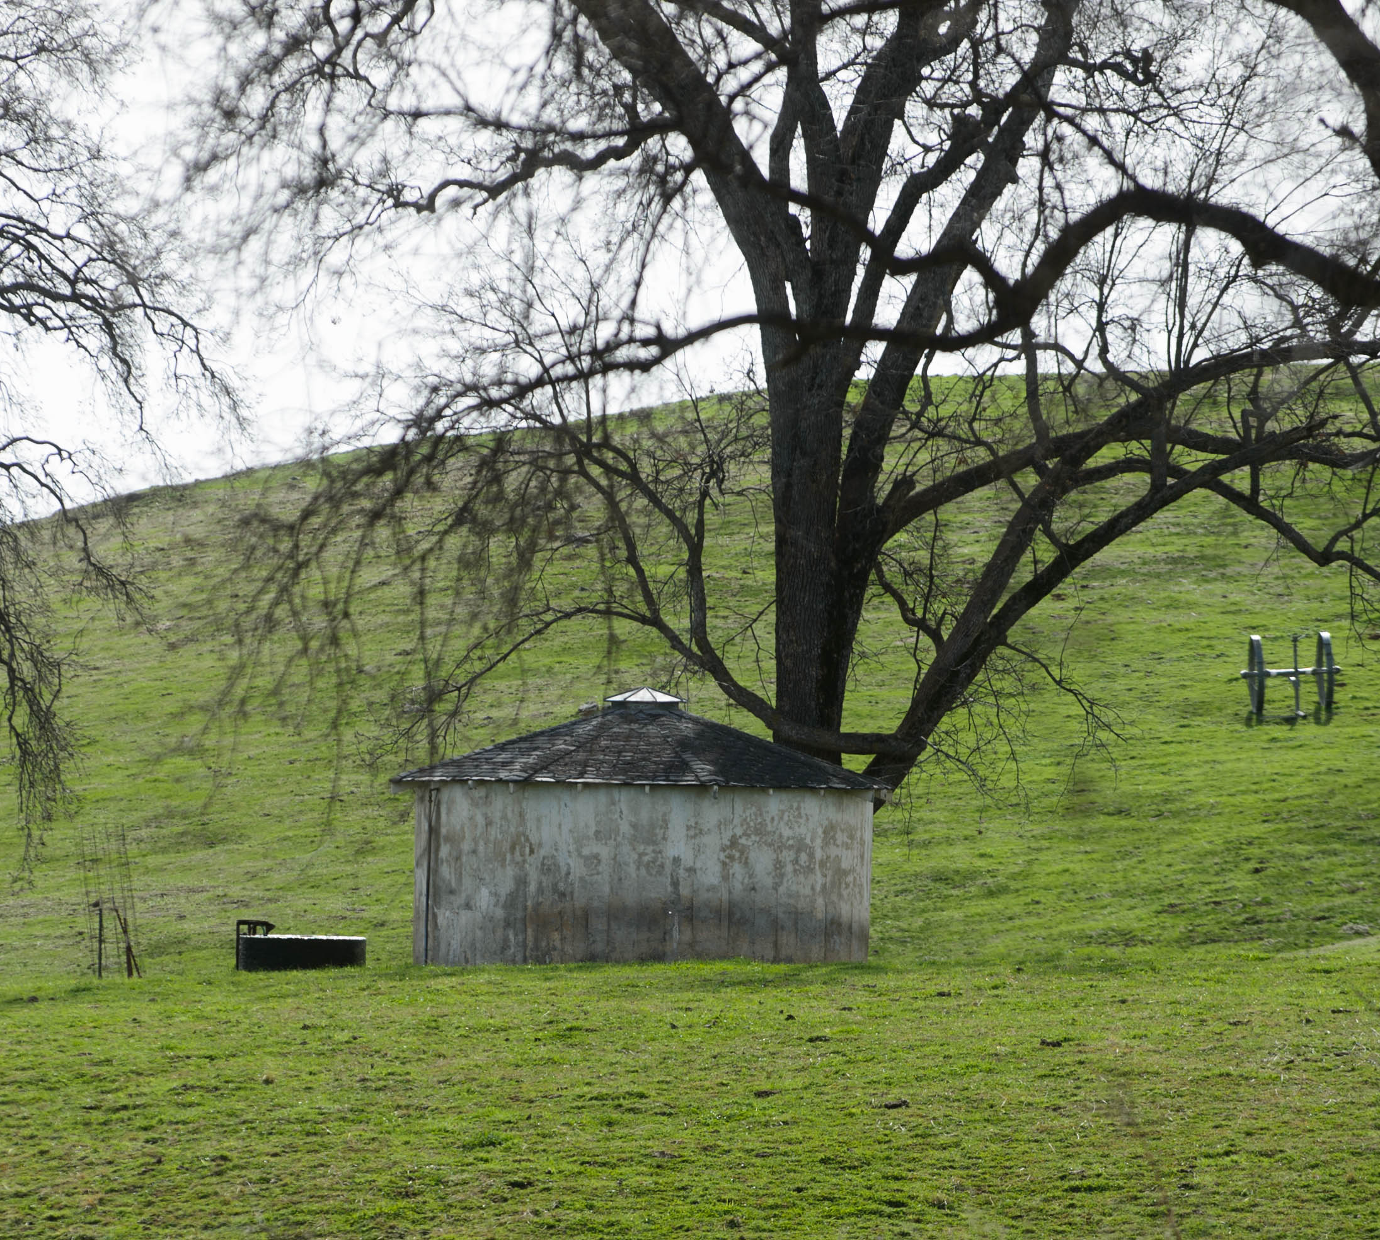
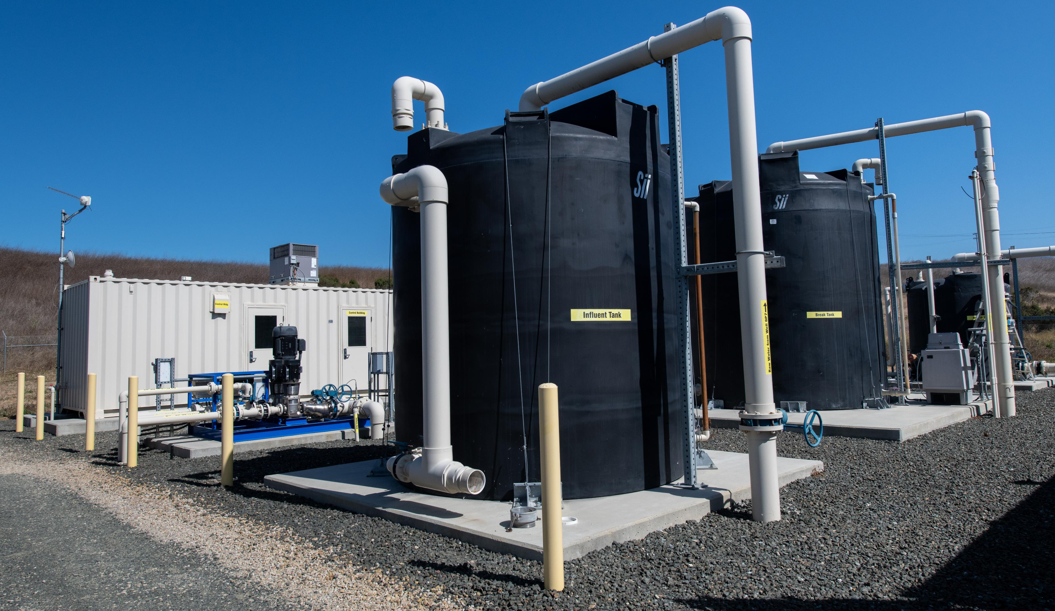
Photo Credit: DWR
CALIFORNIA WATER BOARDS SAFER PROGRAM
Notes:
Well picture:
KMG_rural_groundwater_0398.jpg
An example of a property in an area which is known for using domestic well systems that tap into groundwater. (Penn Valley, Calif. February 17th, 2014)
Kelly M. Grow/ California Department of Water Resources
Pump picture: from DWR– FL_Cambria-6402_08_29_2019.jpg
The Cambria Sustainable Water Facility makes Cambria one of the first communities in California to recycle sewage wastewater into an eventual drinking-water source. Photo taken August 29, 2019.
Flags – from DWR. Native American day

Slide 12
Agua potable SAFER
Fondos para el acceso al agua potable segura y asequible con equidad y resiliencia

Slide 13
Annual drinking water needs assessment
Comprehensive water system support
Community outreach and engagement
Funding sources
Regulatory authorities
SAFER
Advisory Group
Informe anual: Diagnóstico de necesidades de agua potable
Apoyo integral para los sistemas de agua
Extensión y participación comunitaria
Fuentes de financiamiento
Autoridades reguladoras
Grupo Asesor SAFER
JUNTA ESTATAL DEL AGUA PROGRAMA SAFER
Notes:
Human Right to Water law declares that “every human being has the right to safe, clean, affordable, and accessible water adequate for human consumption, cooking, and sanitary purposes.”
Purpose: the SAFER program supports permanent and sustainable drinking water solutions that ensure all Californians have access to safe, affordable, and reliable drinking water.
SAFER program tools:
Annual drinking water needs assessment
Funding sources
Regulatory authorities
Community outreach and engagement
Advisory Group

Slide 14
Quiz! ¡Prueba!
CALIFORNIA WATER BOARDS SAFER PROGRAM
Notes:
OPP Slide

Slide 15
What does this map show?
¿Qué indica este mapa?
JUNTA ESTATAL DEL AGUA PROGRAMA SAFER
Notes:
The map on the screen is a screenshot from the Human Right to Water Portal
7,000 water systems in California
300 water systems do not meet drinking water health standards
Approximately 350,000 domestic wells and 1,350 state smalls

Slide 16
Can you name one tool the SAFER program uses?
¿Puede nombrar uno de los recursos del programa SAFER?
CALIFORNIA WATER BOARDS SAFER PROGRAM
Notes:
Human Right to Water law declares that “every human being has the right to safe, clean, affordable, and accessible water adequate for human consumption, cooking, and sanitary purposes.”
Purpose: the SAFER program supports permanent and sustainable drinking water solutions that ensure all Californians have access to safe, affordable, and reliable drinking water.
SAFER program tools:
Annual drinking water needs assessment
Funding sources
Regulatory authorities
Community outreach and engagement
Advisory Group

Slide 17
Which is NOT regulated by the State? ¿Cuál de estos sistemas NO está regulado por el estado?
7,000
public water systems/sistemas públicos de agua
domestic wells/pozos domésticos
state smalls/sistemas pequeños estatales
federally regulated tribal water systems/ sistemas tribales de agua regulados por el gobiernos federal
350,000
1,350
128
JUNTA ESTATAL DEL AGUA PROGRAMA SAFER
Notes:
The map on the screen is a screenshot from the Human Right to Water Portal
7,000 water systems in California
300 water systems do not meet drinking water health standards
Approximately 350,000 domestic wells and 1,350 state smalls

Slide 18
Question and Answer
Preguntas y respuestas
Technical or Language Assistance:
Use the Chat or Email safer@waterboards.ca.gov
Phone Commands
*9 to raise hand
*6 to mute/unmute
Asistencia técnica o de idiomas:
Use la función de chat o por correo electrónico: safer@waterboards.ca.gov
Controles del teclado
del teléfono
*9 para pedir la palabra
*6 para activar/desactivar el micrófono
CALIFORNIA WATER BOARDS SAFER PROGRAM

Slide 19
Key SAFER Parts
Componentes claves de SAFER
JUNTA ESTATAL DEL AGUA PROGRAMA SAFER

Slide 20
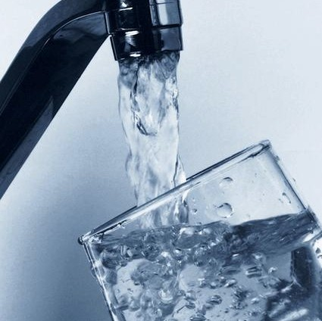
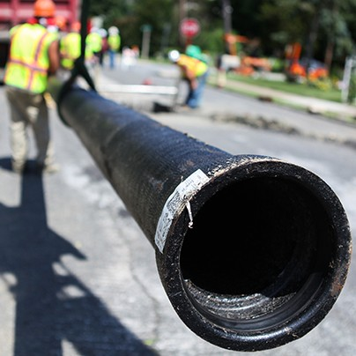
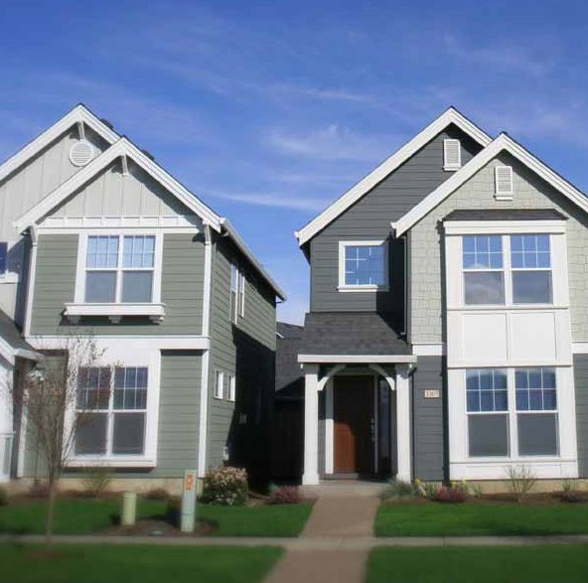
Needs Assessment - Diagnóstico de Necesidades
14
Risk
Assessment
Evaluación de riesgos
Cost
Assessment
Estudio de costos
Affordability Assessment
Evaluación de asequibilidad

Slide 21
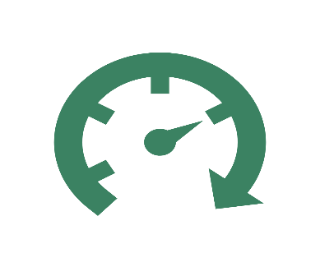
2020-21 Fund Expenditure Plan Priorities Prioridades del Plan de Desembolsos del Fondo
Emergency or urgent funding
Financiamiento urgente
Out of compliance water systems
Sistemas de agua que no cumplen con las normas establecidas
Accelerate consolidations
La aceleración de consolidaciones
Interim and long-term solutions
Soluciones provisorias y de largo plazo
JUNTA ESTATAL DEL AGUA PROGRAMA SAFER

Slide 22
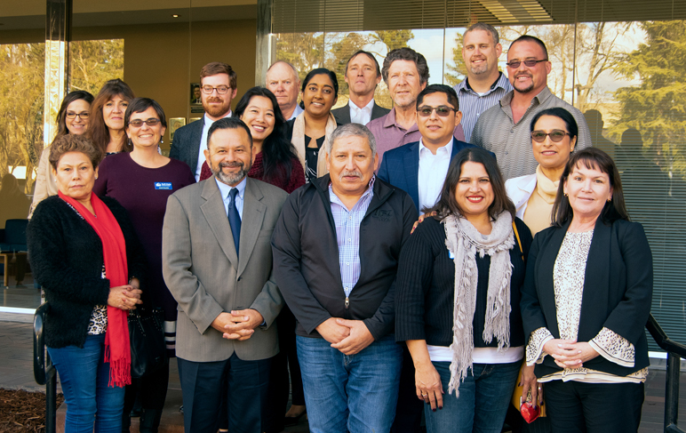
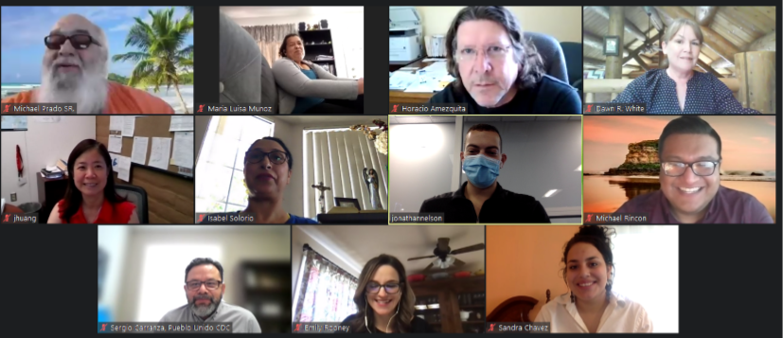
Advisory Group – Grupo Asesor
CALIFORNIA WATER BOARDS SAFER PROGRAM

Slide 23
Connect with SAFER
Conéctese con SAFER
CALIFORNIA WATER BOARDS SAFER PROGRAM

Slide 24
Connect with SAFER
Conéctese con SAFER
faast.waterboards.ca.gov
waterboards.ca.gov/safer
Exceedance/Compliance Status of Public Water Systems Map
Safer@waterboards.ca.gov ; 916-445-5615
tribal-liaison@waterboards.ca.gov
JUNTA ESTATAL DEL AGUA PROGRAMA SAFER

Slide 25
Question and Answer
Preguntas y respuestas
Technical or Language Assistance:
Use the Chat or Email safer@waterboards.ca.gov
Phone Commands
*9 to raise hand
*6 to mute/unmute
Asistencia técnica o de idiomas:
Use la función de chat o por correo electrónico: safer@waterboards.ca.gov
Controles del teclado
del teléfono
*9 para pedir la palabra
*6 para activar/desactivar el micrófono
CALIFORNIA WATER BOARDS SAFER PROGRAM

Slide 26
Community Speaker: Mike Bailey
Presentador comunitario: Mike Bailey
CALIFORNIA WATER BOARDS SAFER PROGRAM
Notes:
Prep Qs for Q&A in case don’t have questions. Jb can share questions

Slide 27
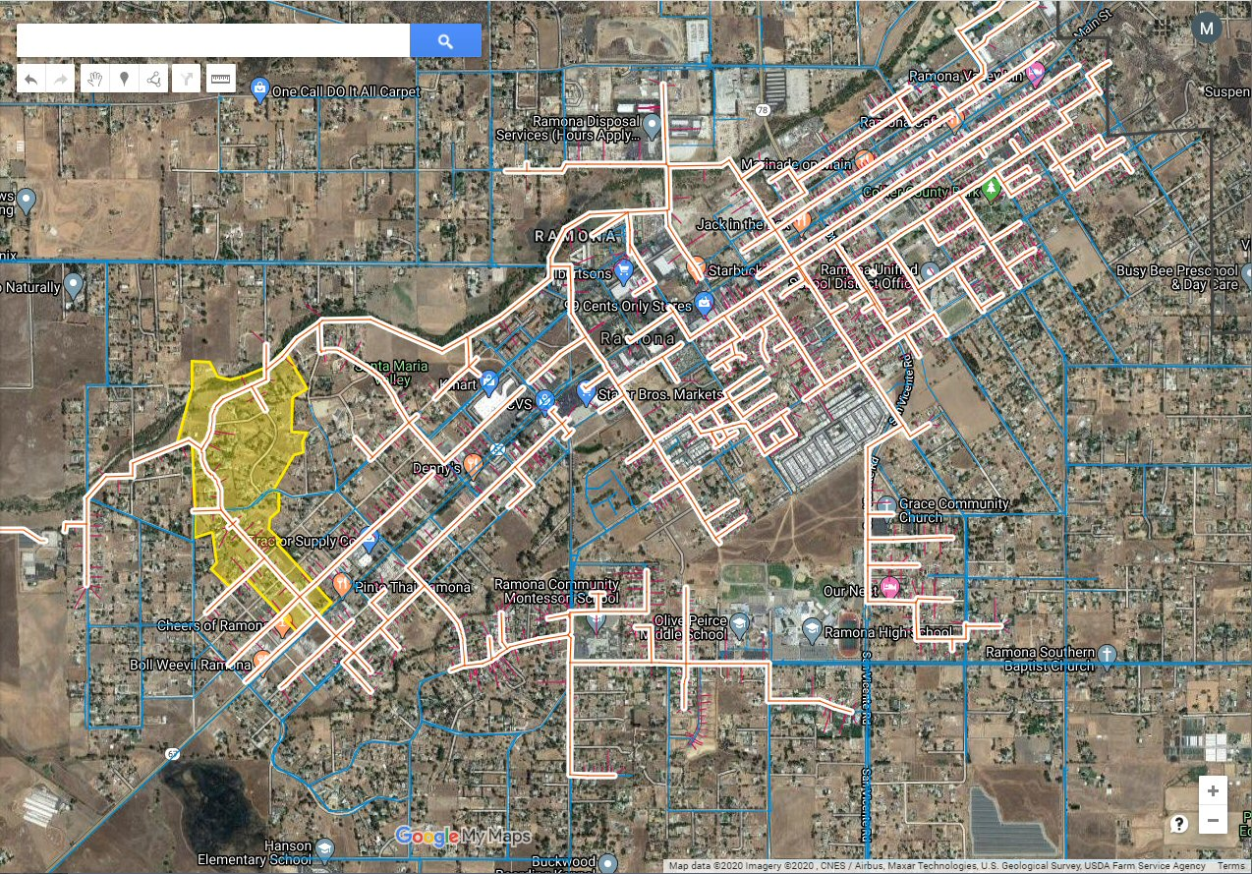

Slide 28
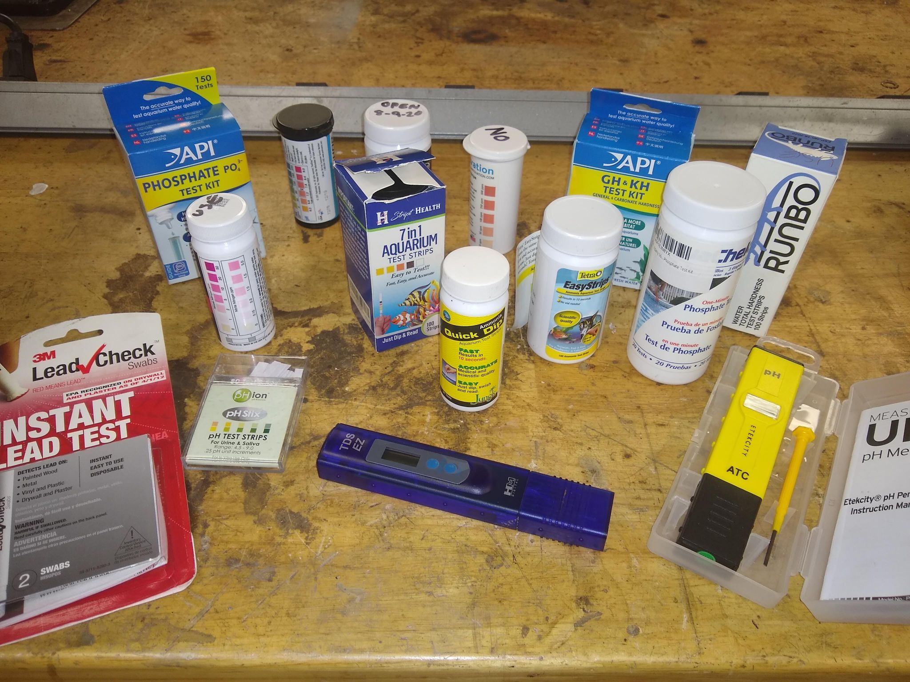

Slide 29
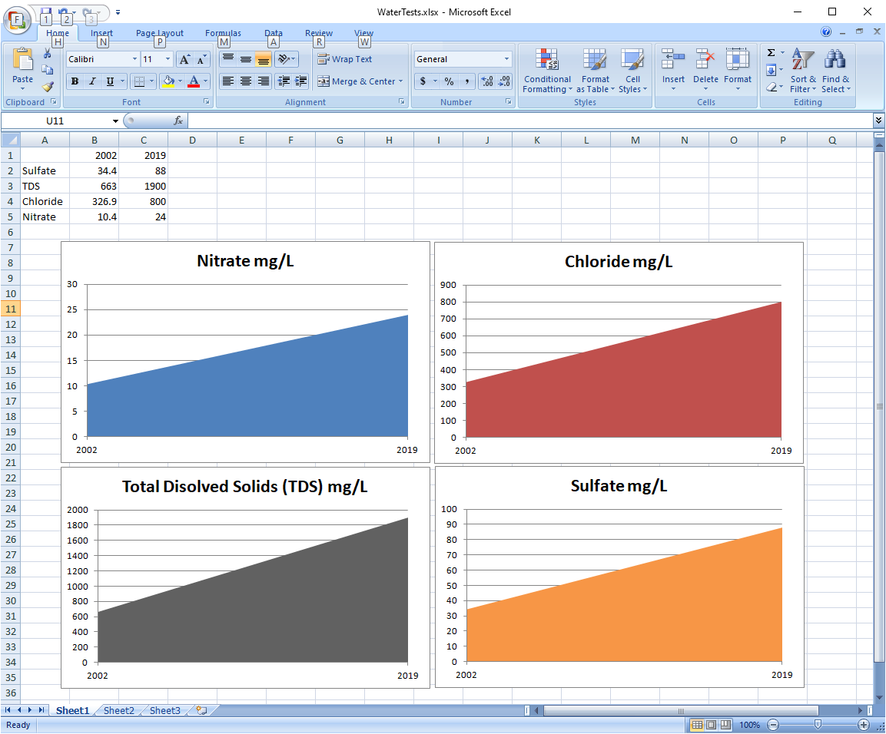

Slide 30
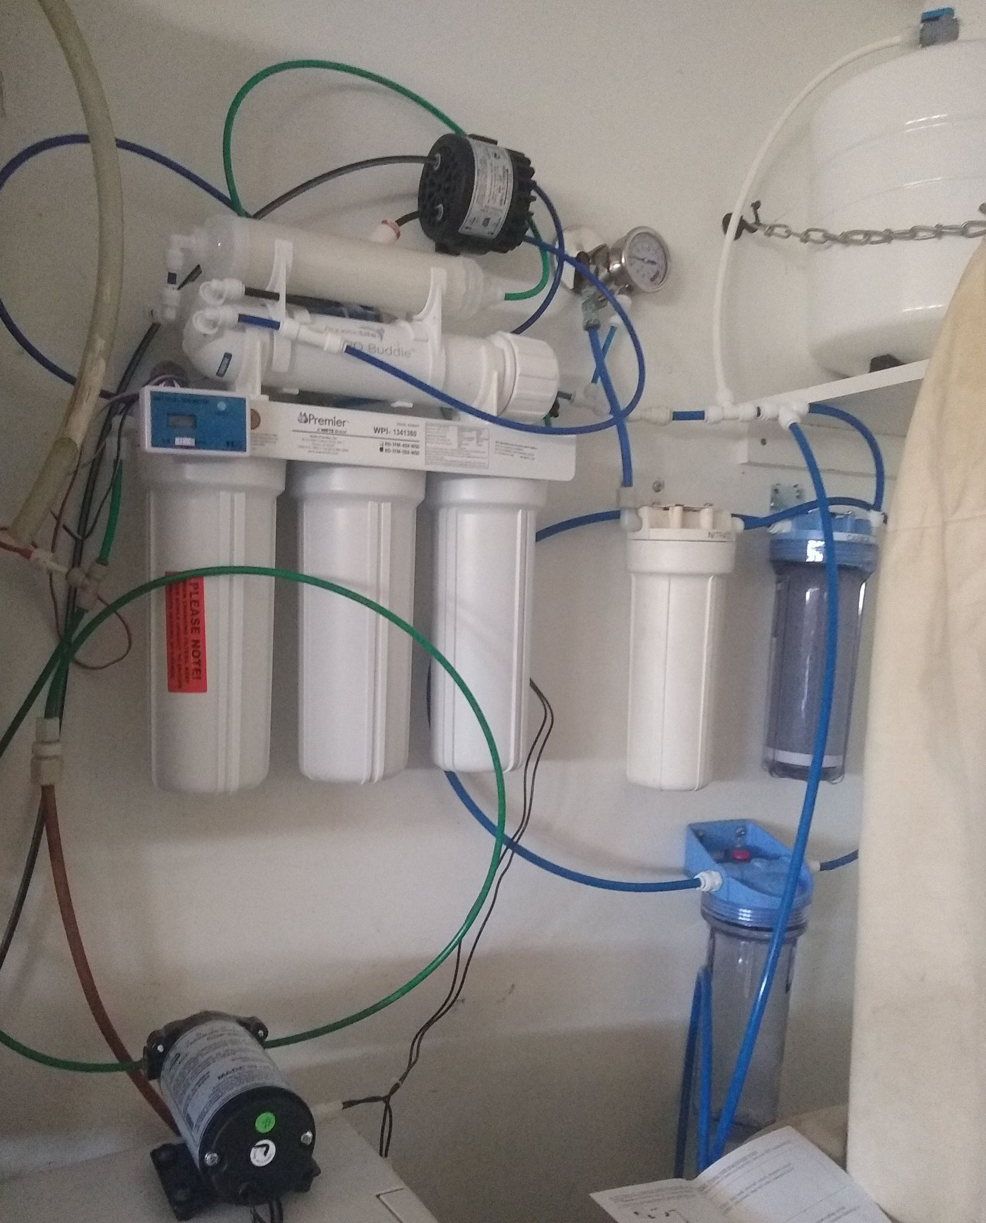

Slide 31
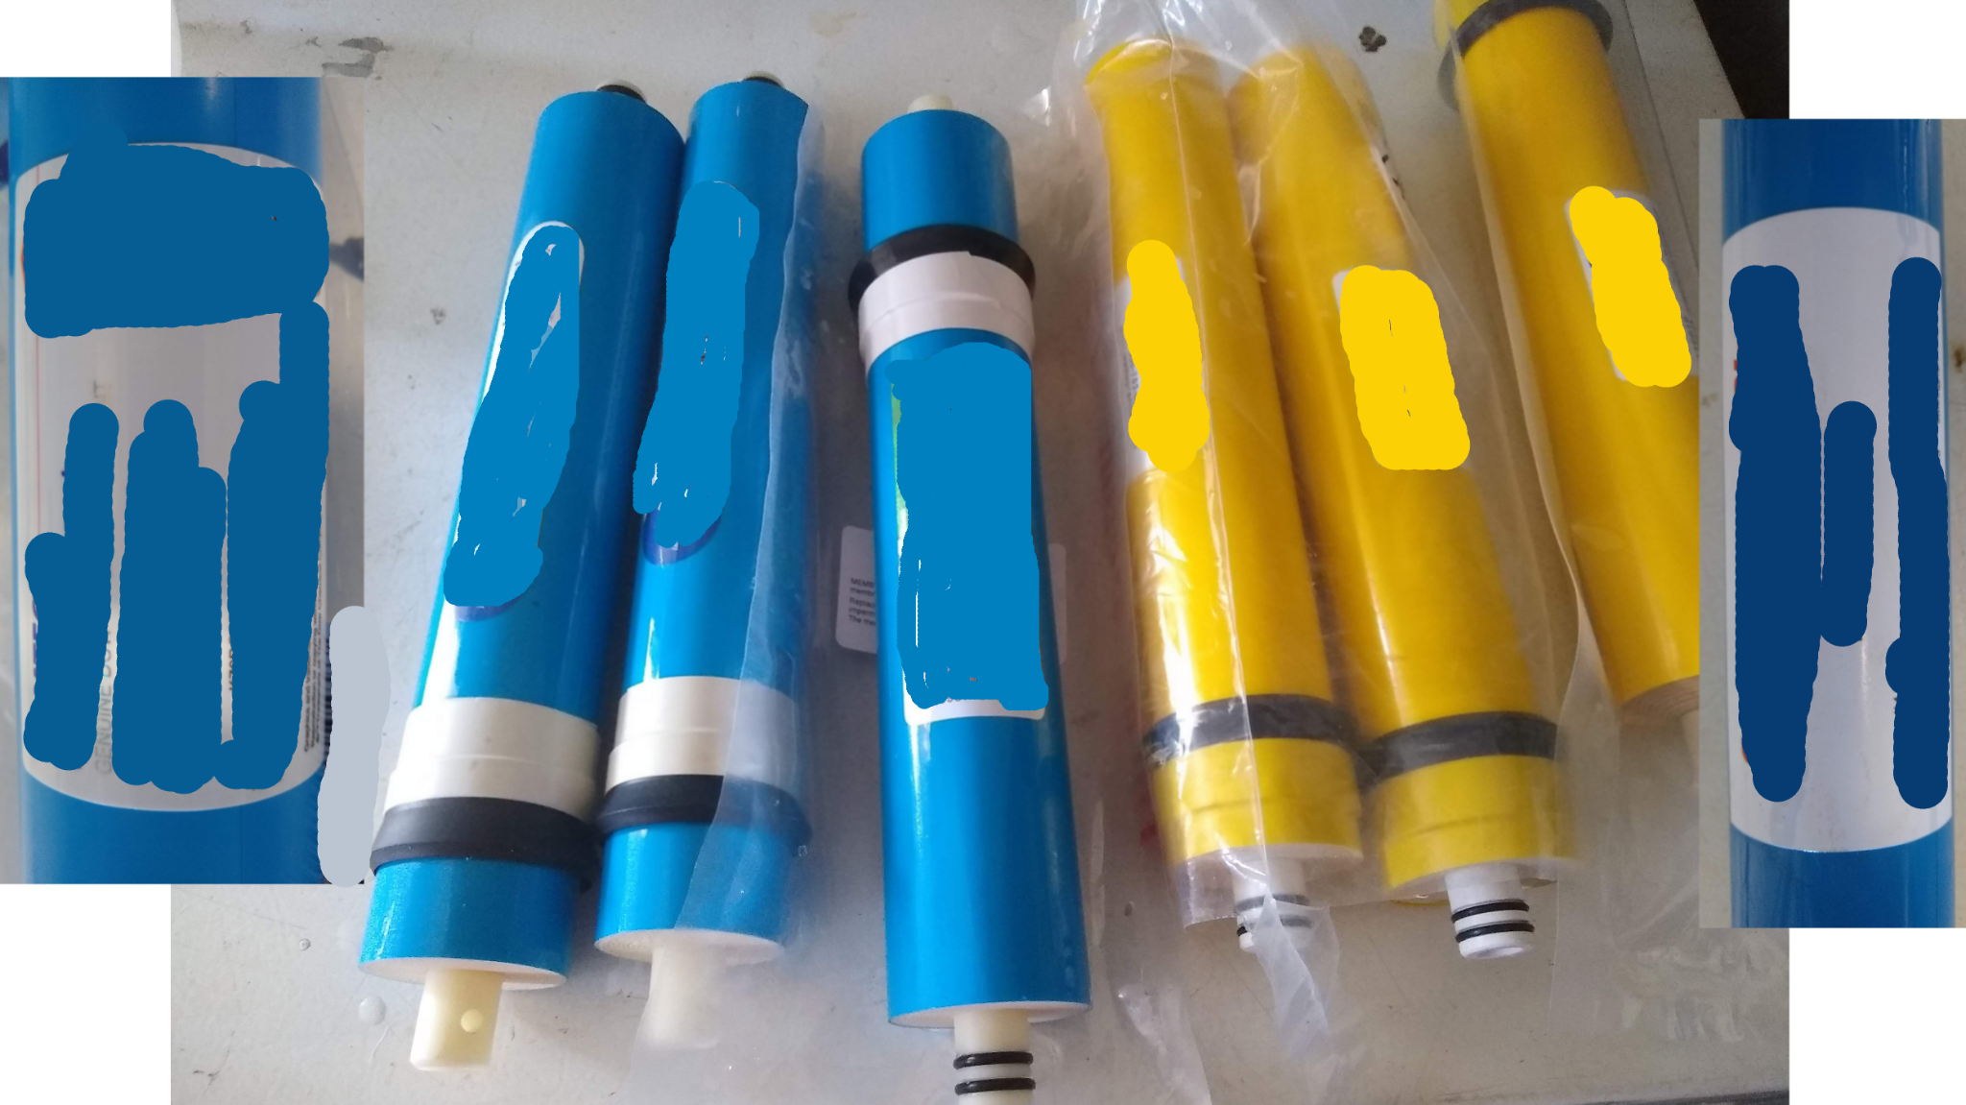

Slide 32
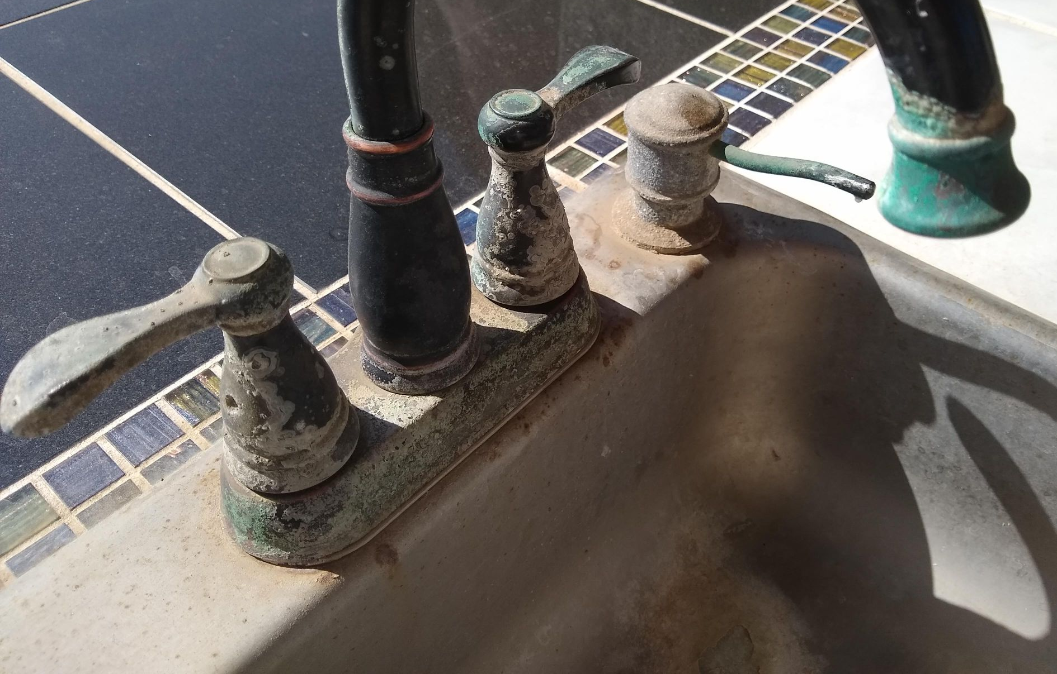

Slide 33
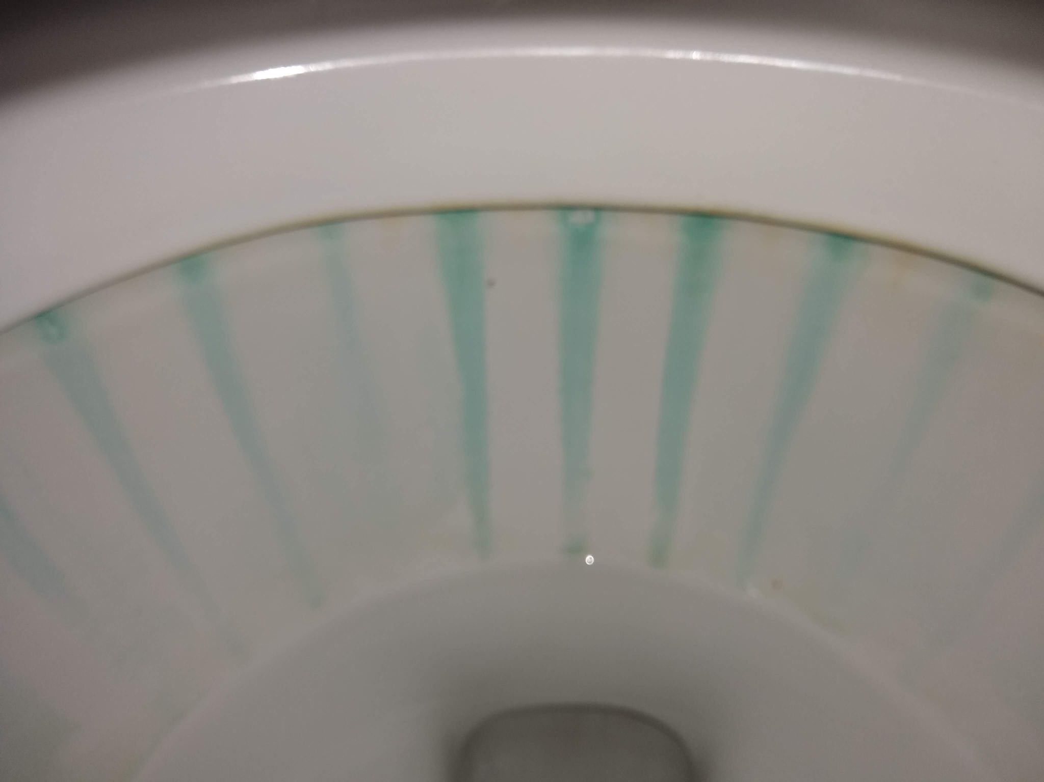

Slide 34
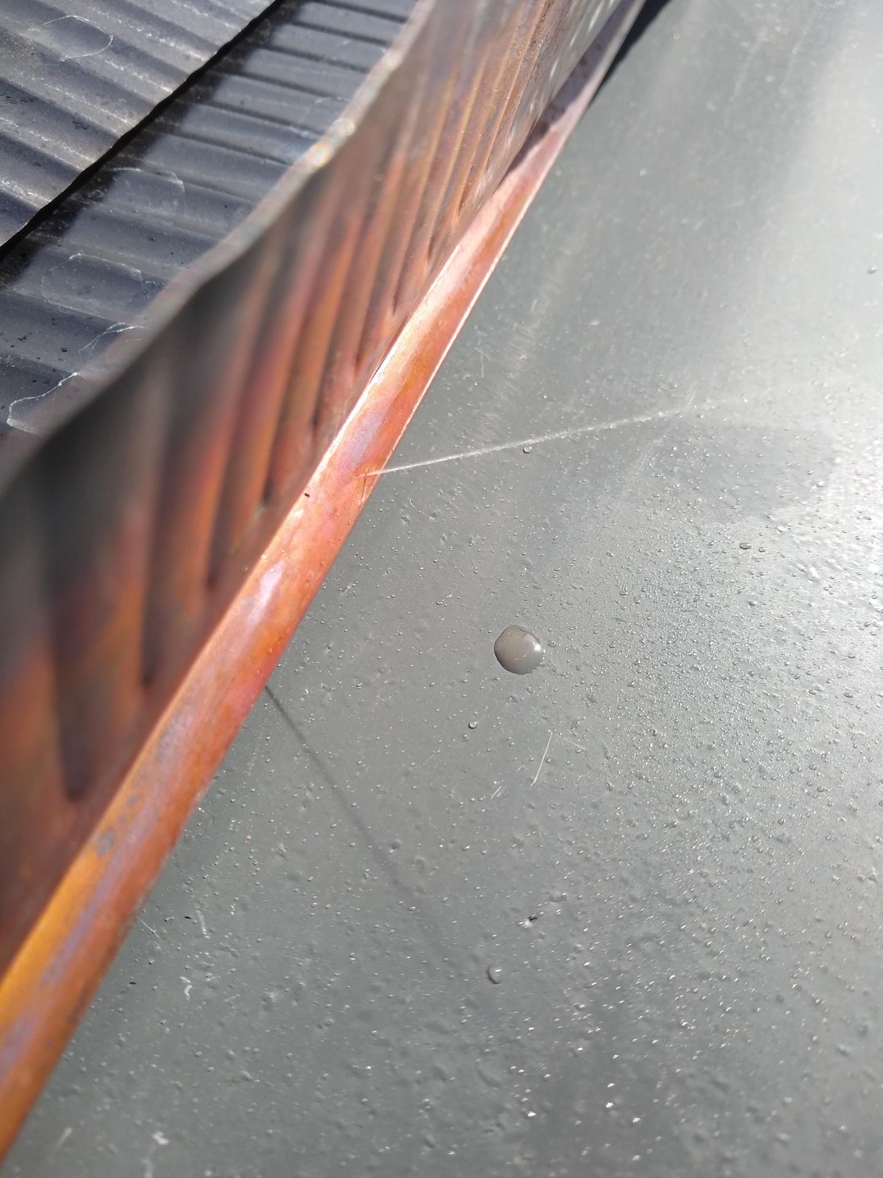

Slide 35
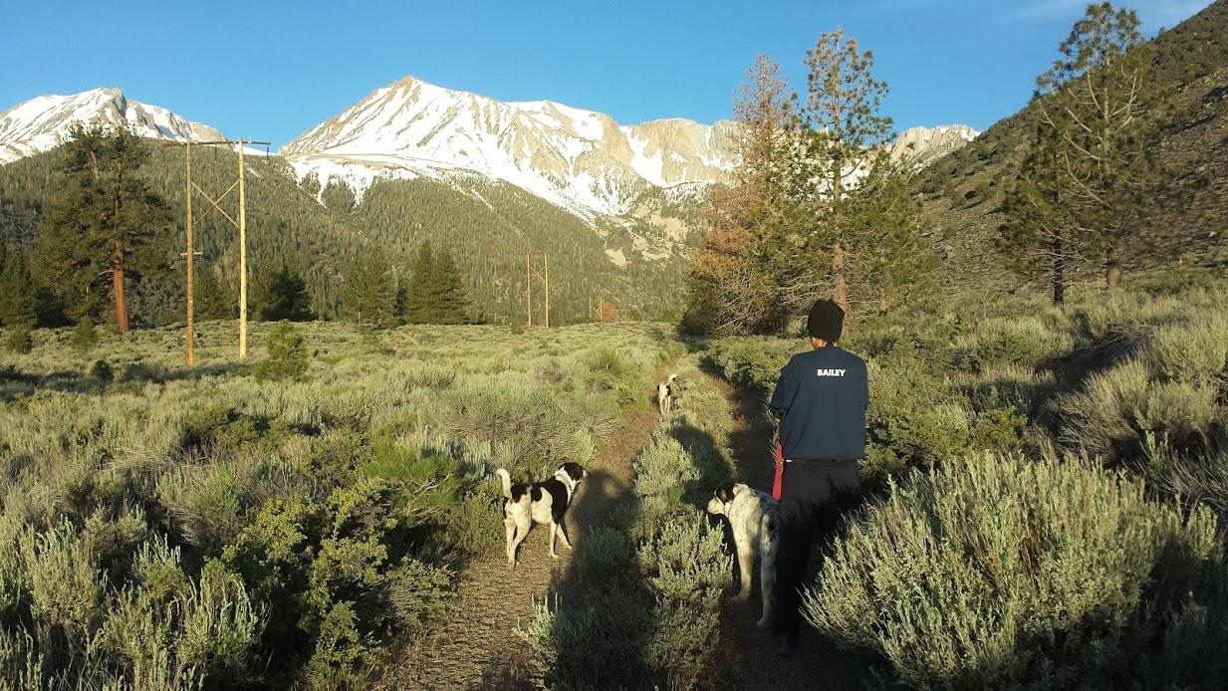

Slide 36
www.waterboards.ca.gov

Slide 37
Project area - ~50 homes
Well Testing - 9 of 10 wells unsafe
Project Manager - RCAC
Basic Community Outreach
Design Funding $
Design, Engineering and Outreach
Construction Funding $
Construction - New pipelines
Clean Water
Phase 2
✔
✔
✔
✔
✔
CALIFORNIA WATER BOARDS SAFER PROGRAM

Slide 38
Questions? ¿Preguntas?
Technical or Language Assistance:
Use the Chat or Email safer@waterboards.ca.gov
Phone Commands
*9 to raise hand
*6 to mute/unmute
Asistencia técnica o de idiomas:
Use la función de chat o por correo electrónico: safer@waterboards.ca.gov
Controles del teclado
del teléfono
*9 para pedir la palabra
*6 para activar/desactivar el micrófono
CALIFORNIA WATER BOARDS SAFER PROGRAM

Slide 39
Next Steps
Próximos pasos
Events: waterboards.ca.gov/safer/calendar
Contact us:
safer@waterboards.ca.gov
916-445-5615
Comment on FEP
Join Advisory Group
Apply for jobs! Jobs.ca.gov
Eventos: waterboards.ca.gov/safer/calendar
Comuníquese con nosotros:
safer@waterboards.ca.gov
916-445-5615
Comente sobre el Plan de Desembolsos del Fondo
Forme parte del Grupo Asesor
¡Solicite empleo! Jobs.ca.gov
JUNTA ESTATAL DEL AGUA PROGRAMA SAFER

Slide 40
Thank you!
¡Gracias!
waterboards.ca.gov/safer
SAFER@waterboards.ca.gov
916-445-5615
CALIFORNIA WATER BOARDS SAFER PROGRAM

